Slide 2
All central dogma polymerizations
(replication, transcription, translation)
Have at least three distinct steps:
initiation
elongation
termination

Slide 3
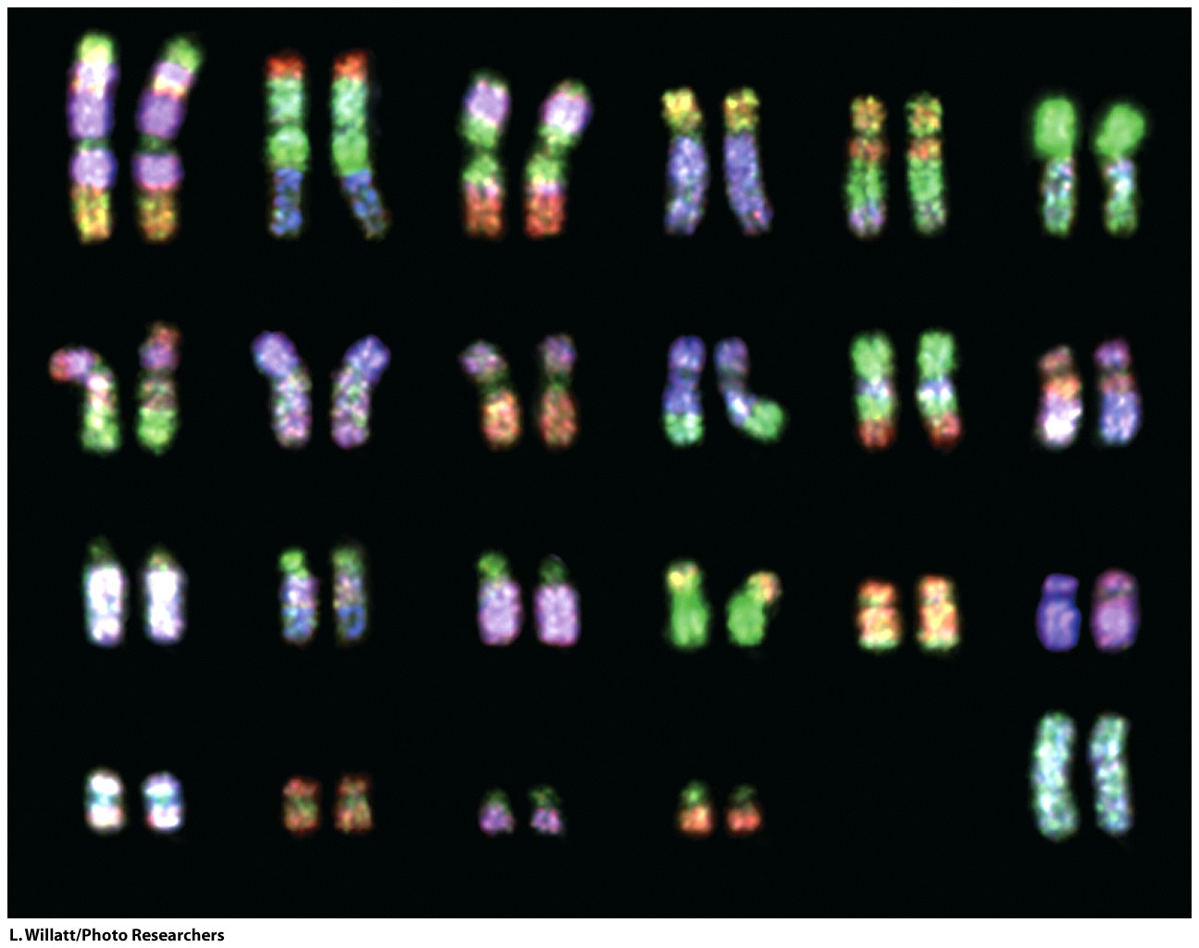
DNA replication starts with a double-stranded DNA duplex [two strands, paired to each other] and produces two daughter duplexes that are identical to each other and to the parent duplex. Each strand of the parent duplex is a template for production of the opposing complementary strand.

Slide 4
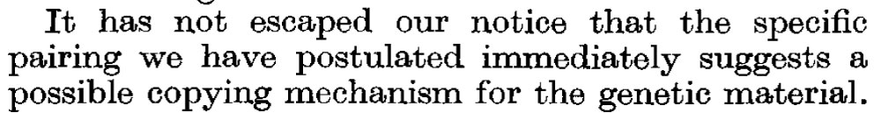

Slide 5
Matthew Meselson and Franklin Stahl's experiments on the replication of DNA, published in PNAS in 1958 helped cement the concept of the double helix. Meselson was a graduate student, and Stahl was a postdoc.
DNA Replication is Semiconservative
Meselson and Stahl (1958)
"The most beautiful (old) experiment in biology.”
Distinguish between three models
1) Semiconservative Model: Each daughter duplex contains one strand from the parent duplex and one newly synthesized strand.
2) The conservative model: an entire DNA duplex acts as a template for synthesis of an entirely new duplex.
3) The dispersive model: DNA is synthesized in short pieces that alternate from one strand to the other.

Slide 6
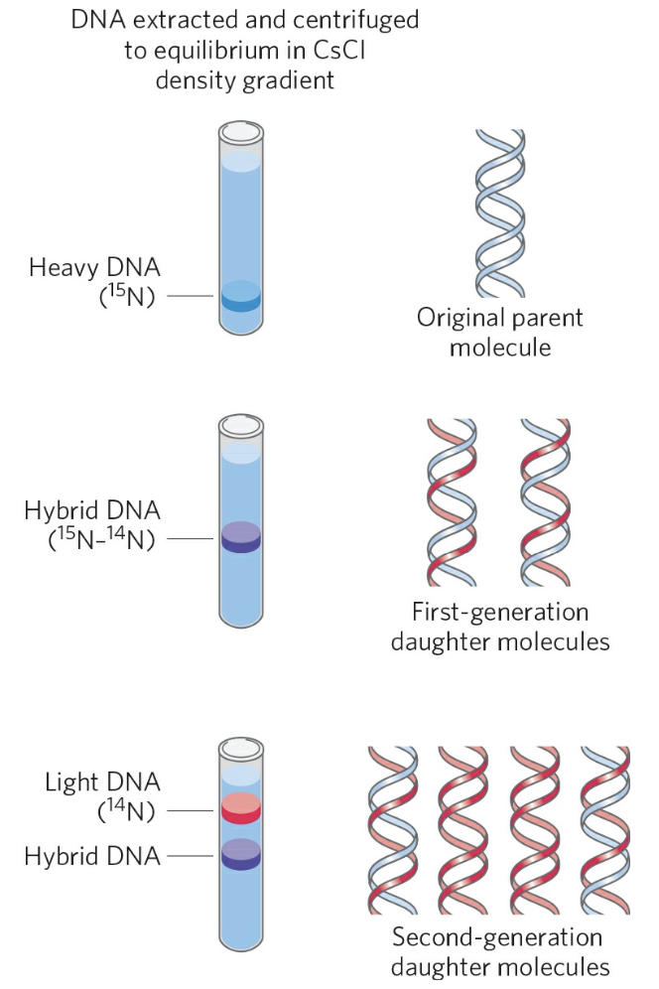
DNA Replication is Semiconservative
Meselson and Stahl (1958)
"The most beautiful experiment in biology.”
1) Semiconservative Model: Each daughter duplex contains one strand from the parent duplex and one newly synthesized strand.
Cells were grown for many generations in a medium containing only heavy nitrogen, 15N, so that all the nitrogen in their DNA was 15N, as shown by a single band (blue) when centrifuged in a CsCl density gradient.
Once the cells had been transferred to a medium containing only light nitrogen, 14N, cellular DNA isolated after one generation equilibrated at a higher position in the density gradient (purple band).
A second cycle of replication yielded a hybrid DNA band (purple) and another band (red),containing only [14N]DNA, confirming semiconservative replication.

Slide 7
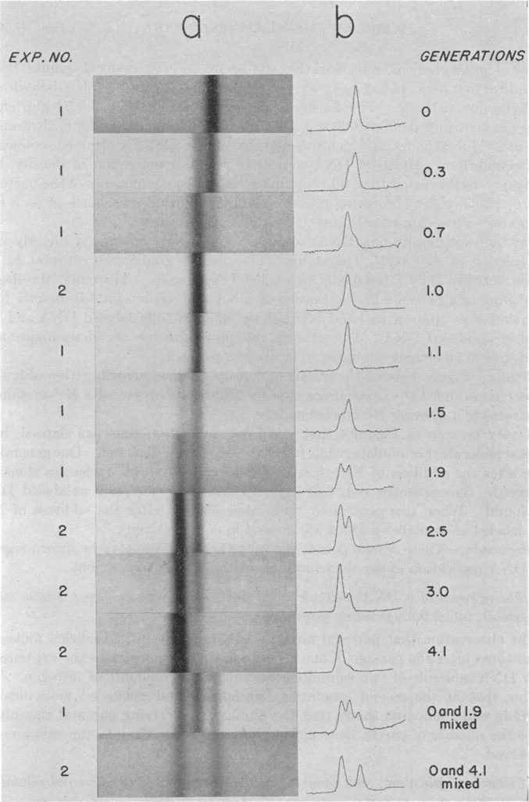
a: Ultraviolet absorption photographs showing DNA bands resulting from density-gradient centrifugation of lysates of bacteria sampled at various times after the addition of an excess of N¹⁴ substrates to a growing N¹⁵-labeled culture. Each photograph was taken after 20 hours of centrifugation at 44,770 rpm under the conditions described in the text. The density of the CsCl solution increases to the right. Regions of equal density occupy the same horizontal position on each photograph. The time of sampling is measured from the time of the addition of N¹⁴ in units of the generation time. The generation times for Experiments 1 and 2 were estimated from the measurements of bacterial growth presented in Fig. 3. b:

Slide 8
DNA replication initiates at a specific location in a genome or plasmid, called an origin of replication. The DNA unwinds at the origin and the paired strands separate to allow initiation of replication. A replication origin is a DNA sequence that is recognized by replication initiator proteins. Initiator proteins recruit other proteins to separate the two strands and form a replication fork. The branch point, where single-strands meet the double strand, is called the replication fork. The replication fork moves.

Slide 9
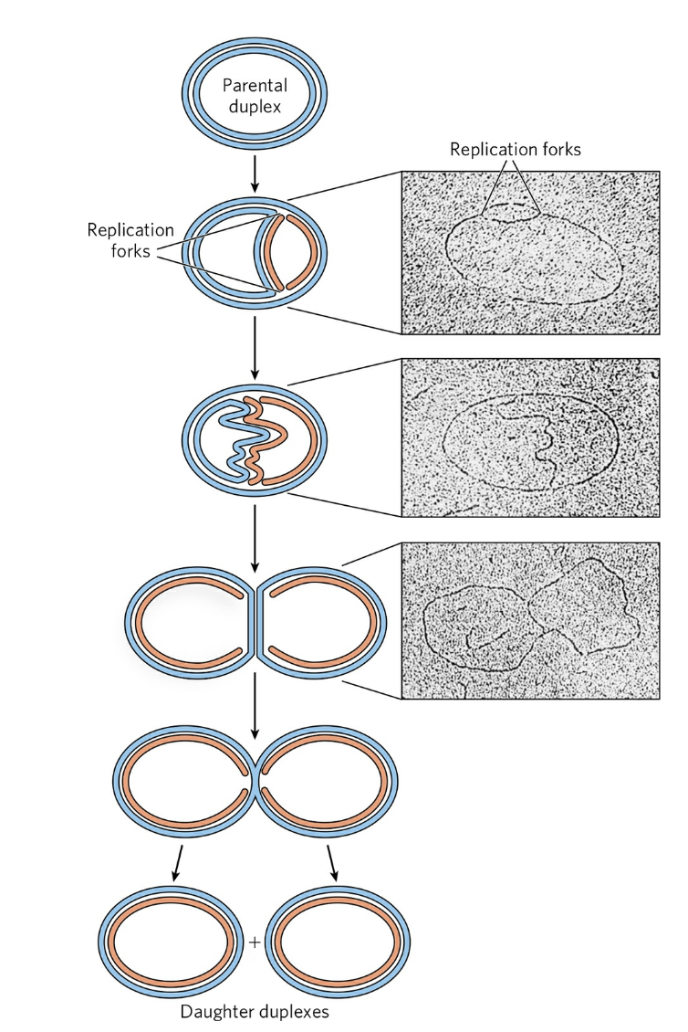
Replication Begins at an Origin of Replication and Usually Proceeds
Bidirectionally
Visualization of DNA replication. Stages in the replication of circular DNA molecules have been visualized by electron microscopy. Replication of a circular chromosome produces a structure resembling the Greek letter theta, θ, as both strands are replicated simultaneously (new strands shown in light red). The electron micrographs show images of plasmid DNA being replicated from a single replication origin.

Slide 10
There are five different Bacterial DNA polymerases:
(we are interested in DNA Pol III for this class)
DNA Pol I: for DNA repair; has (a) 5’ -> 3' polymerase activity, (b) 3’ -> 5' exonuclease activity (for proofreading), and (c) 5’ -> 3' exonuclease activity (for RNA primer removal). This enzyme performs ‘nick translation’.
DNA Pol II: for DNA repair (SOS); has (a) 5’ -> 3' polymerase activity, and (b) 3 '-> 5' exonuclease activity.
DNA Pol III: the main polymerase (responsible for replication); (a) 5’ to 3' polymerase activity and (b) 3'->5' exonuclease activity.

Slide 11
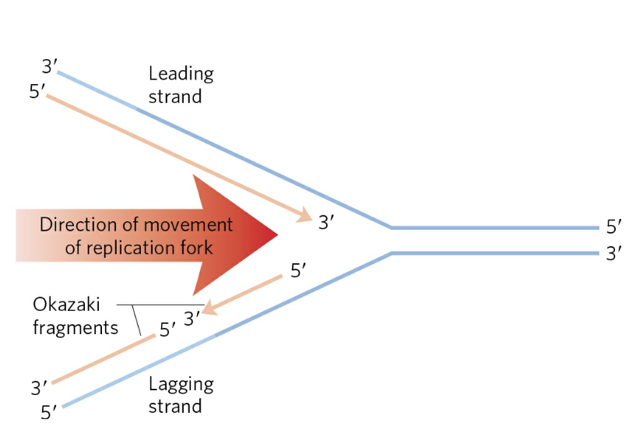
A replication fork. A new DNA strand (light red) is always synthesized in the 5′→3′ direction. The template is read in the opposite direction, 3′→5′. The leading strand is continuously synthesized in the direction taken by the replication fork. The other strand, the lagging strand, is synthesized discontinuously in short pieces (Okazaki fragments) in a direction opposite to that in which the replication fork moves. The Okazaki fragments are spliced together by DNA ligase. In bacteria, Okazaki fragments are ~1,000 to 2,000 nucleotides long. In eukaryotic cells, they are 150 to 200 nucleotides long.

Slide 12
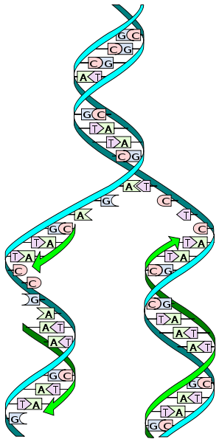
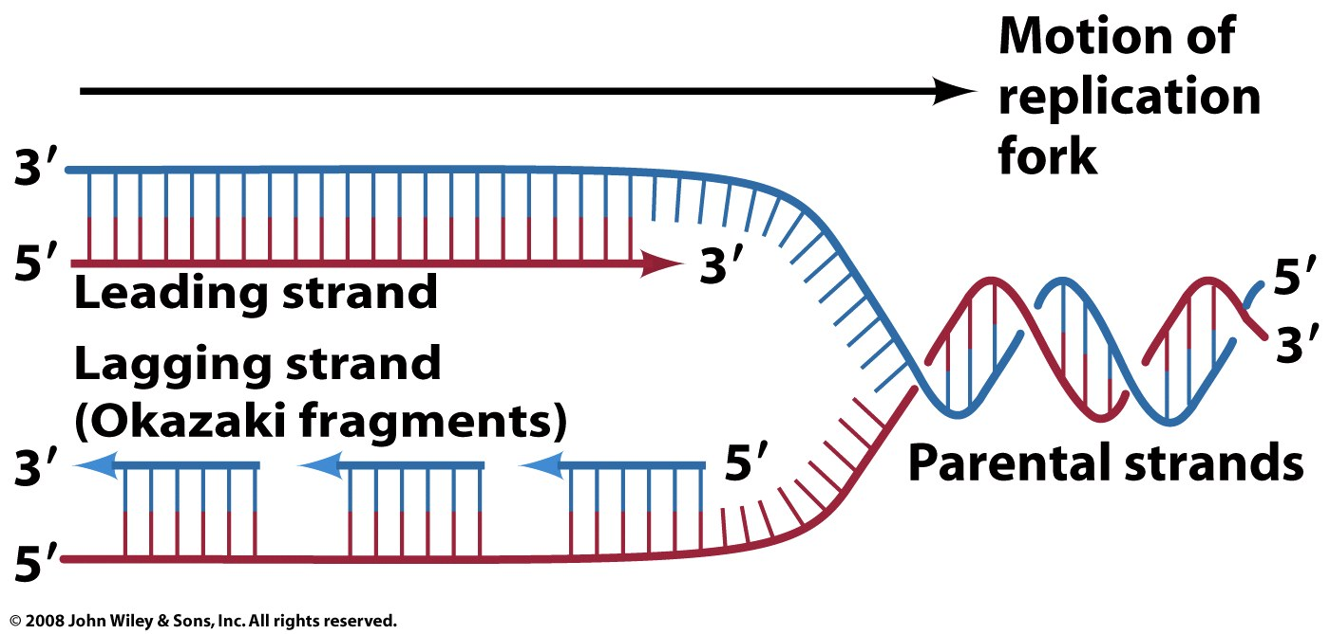
All DNA polymerases extend only in the 5’ to 3’ direction.
The Leading Strand: is extended in the 5’ to 3’ direction by continuous replication
The Lagging Strand: is effectively extended in the 3’ to 5 direction (net) by discontinuous replication (always in the 5’ to 3’ direction).

Slide 13
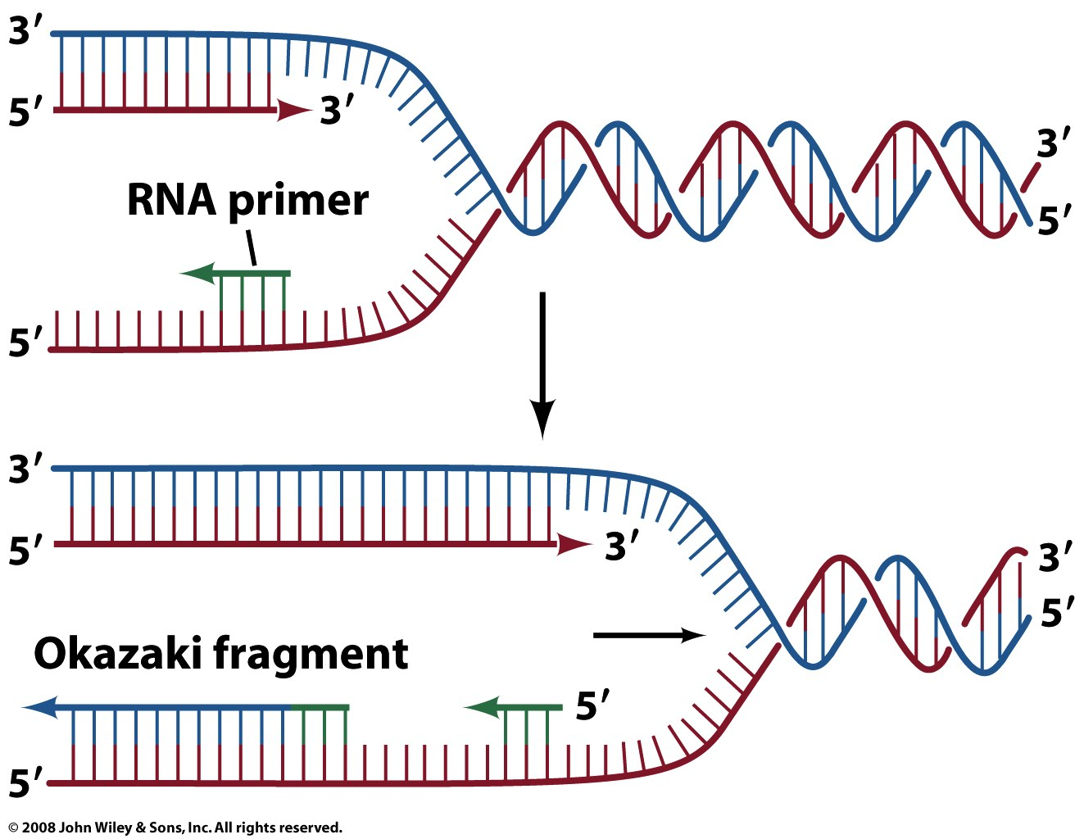
Figure 25-6

Slide 14
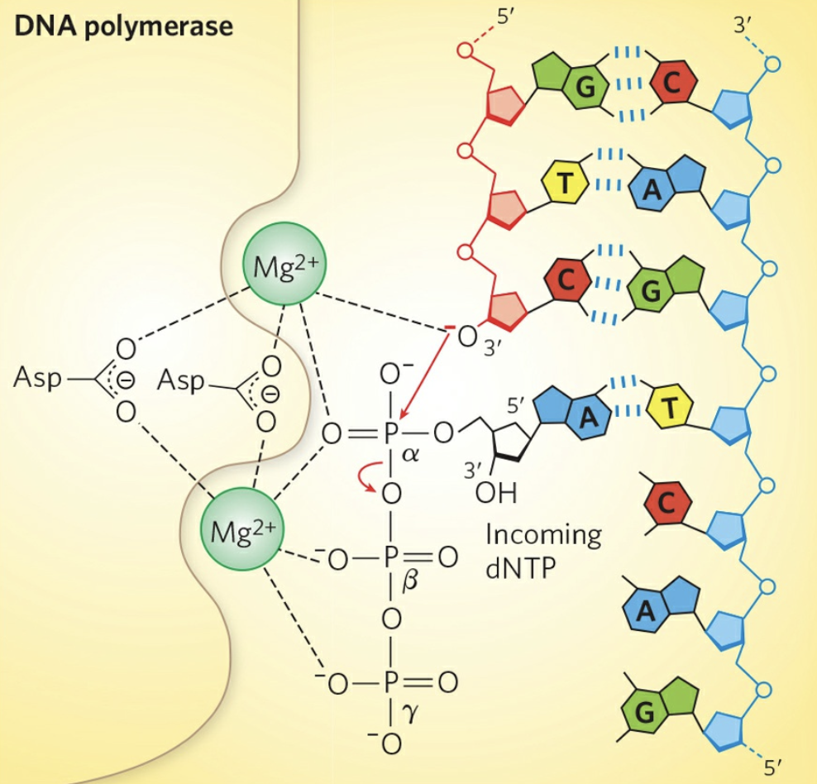
DNA is polymerized only in 5’ to 3’ direction

Slide 15
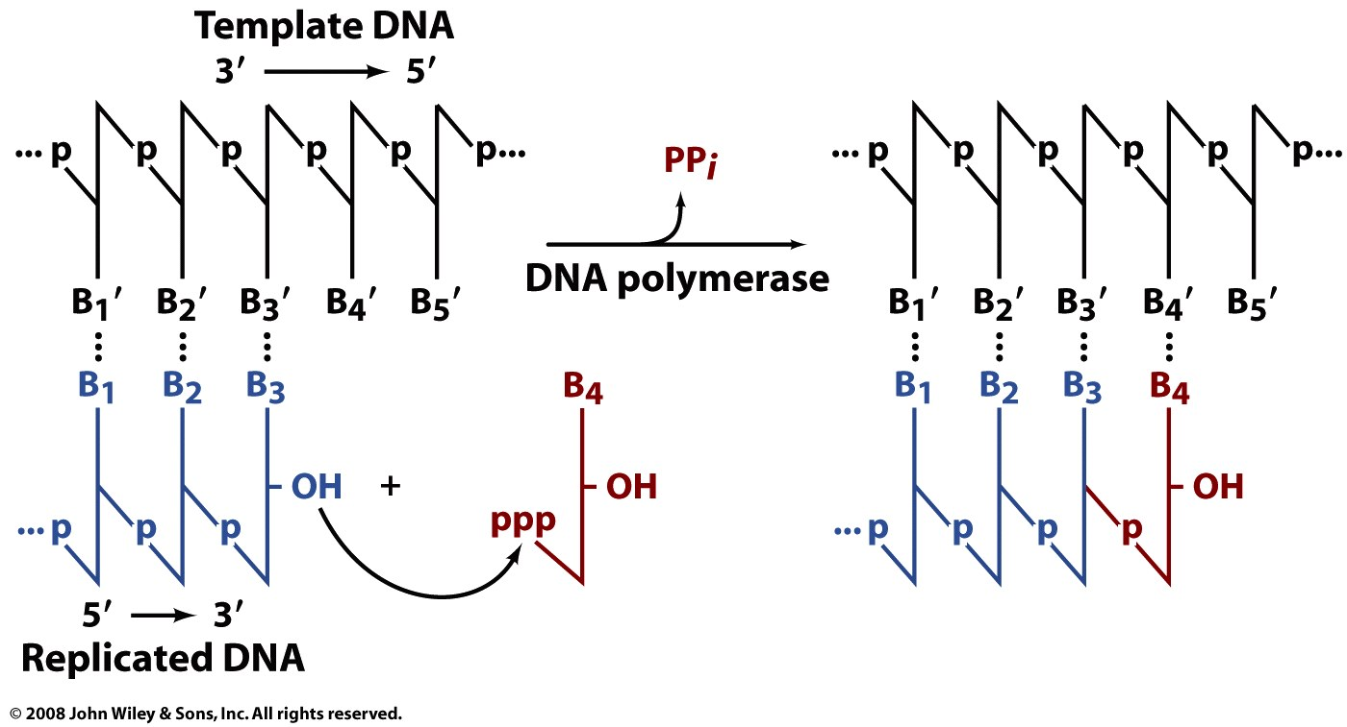
DNA is polymerized only in 5’ to 3’ direction

Slide 16
DNA replication (directionality)
(only in 5’ to 3’ direction)
lagging
leading
A DNA polymerase can extend, but cannot initiate de novo synthesis. DNA polymerase requires a primer. Leading strand synthesis (right) and lagging strand synthesis (left) cannot work in the same way. Lagging stand synthesis has to keep priming.

Slide 17
DNA replication
required chemical components
DNA replication requires:
a template
a free 3’ hydroxyl group (requires a primer to start),
four 5’ dNTPs (triphosphate on the 5’ oxygen)
(the 3’oxygen is a nucleophile that attacks the 5’ P of the dNTP.
Magnesium (any reaction that uses any dNTP requires Mg²⁺).
DNA polymerase (lots of auxillary proteins in vivo)

Slide 18
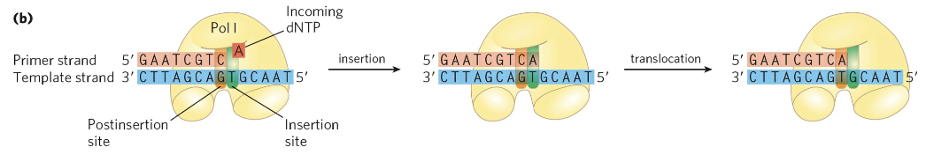
DNA polymerase requires a single unpaired strand to act as template and a primer strand to provide the free hydroxyl group at the 3′ end to which the new nucleotide unit is added. Each incoming nucleotide is selected in part by base-pairing to the appropriate nucleotide in the template strand. The reaction product has a new free 3′ hydroxyl, allowing the addition of another nucleotide. The newly formed base pair translocates to make the active site available to the next pair to be formed.

Slide 19
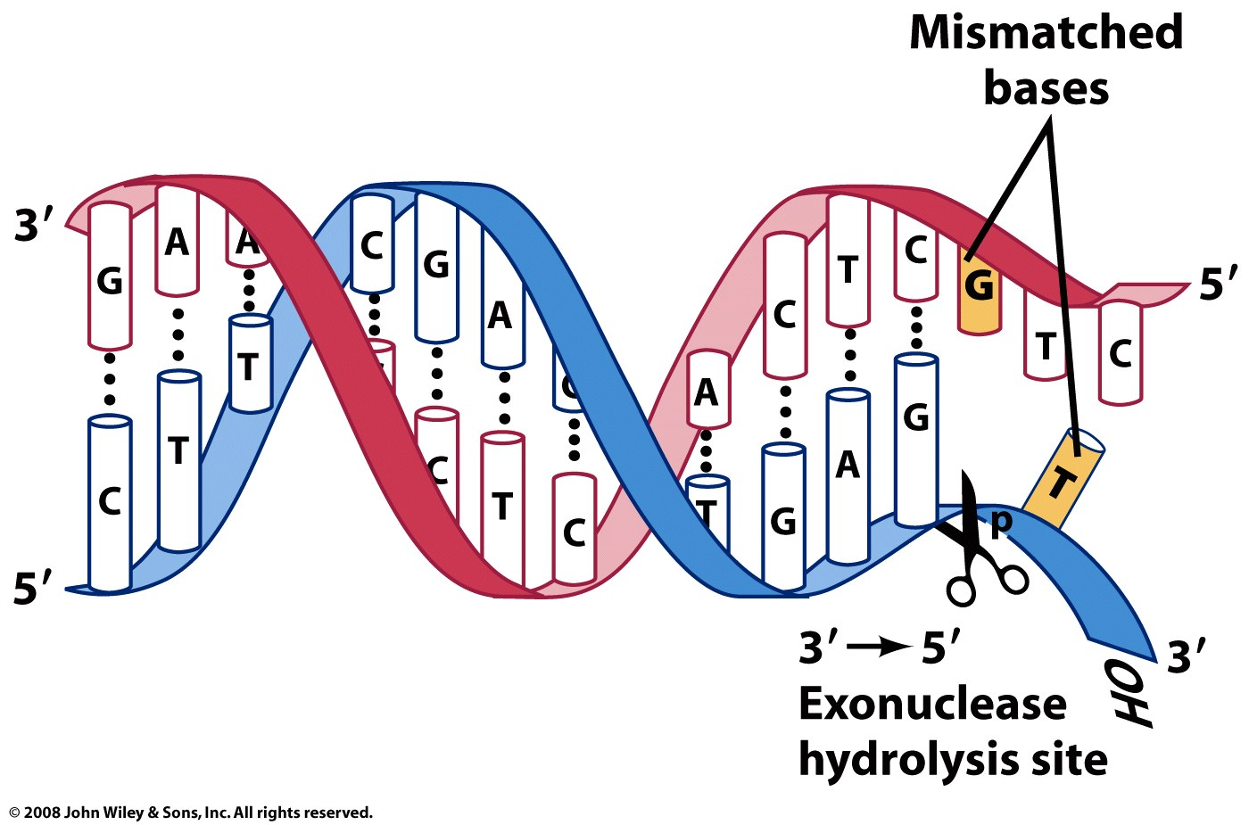
Proof reading
Figure 25-7

Slide 20
DNA replication (primers)
A DNA polymerase cannot form a strand de novo, from dNTPs alone. A DNA polymerase can only extend a strand; i.e., DNA polymerase requires a primer. Primers in vivo are generally RNA, which are later excised and replaced by DNA.

Slide 21
Fidelity or - How to replicate billions and billions of base pairs without making too many mistakes.
The problem:
The difference in free energy predicts an error rate of about 1/4000.

Slide 22
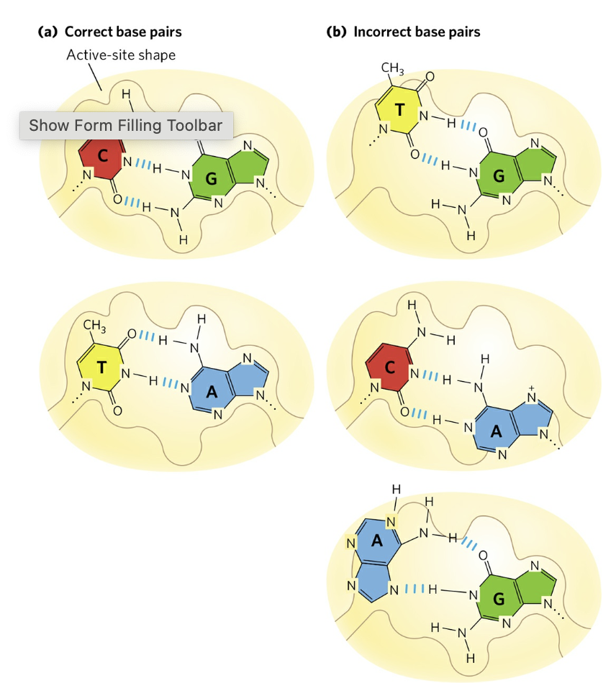
Base-pair geometry contributes to fidelity of DNA replication. (a) The standard A=T and G≡C base pairs have very similar geometries, and an active site sized to fit one will generally accommodate the other. (b) The geometry of incorrectly paired bases can exclude them from the active site, as occurs on DNA polymerase.

Slide 23
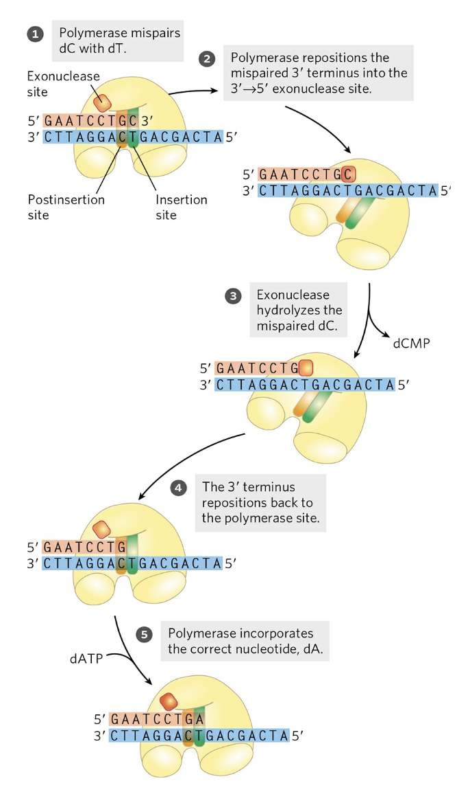
Fidelity or - How to replicate billions and billions of base pairs without making too many mistakes.
Proofreading activity
1/4000 error rate in the incorporation step.
1/1000 error rate in the proof reading step.
1/4000 x 1/1000 = 1/4,000,000
That is one mistake in 4 million base pairs
Now add in mismatch repair.

Slide 24
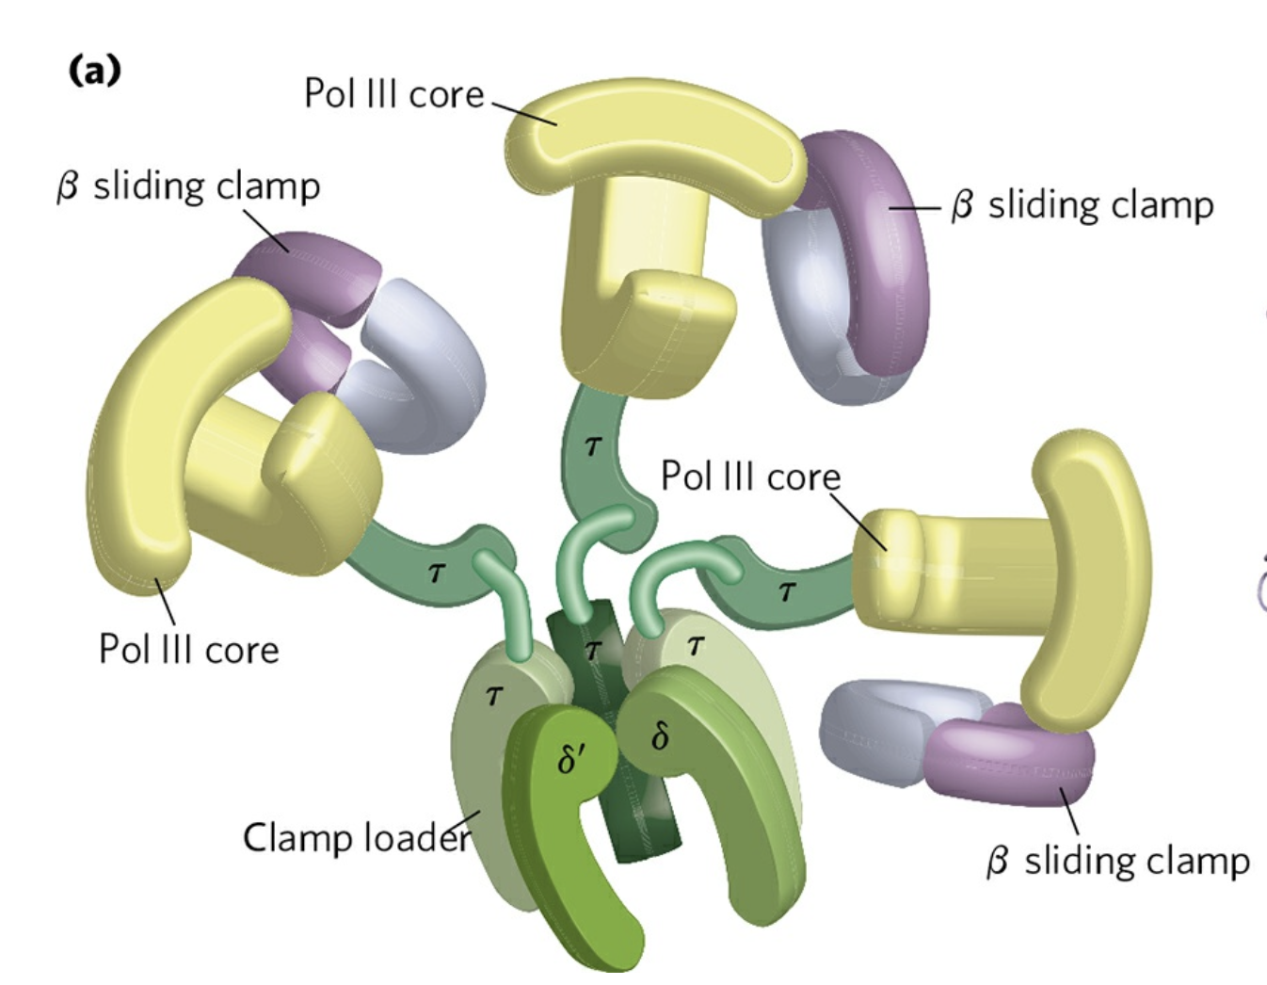

Slide 25
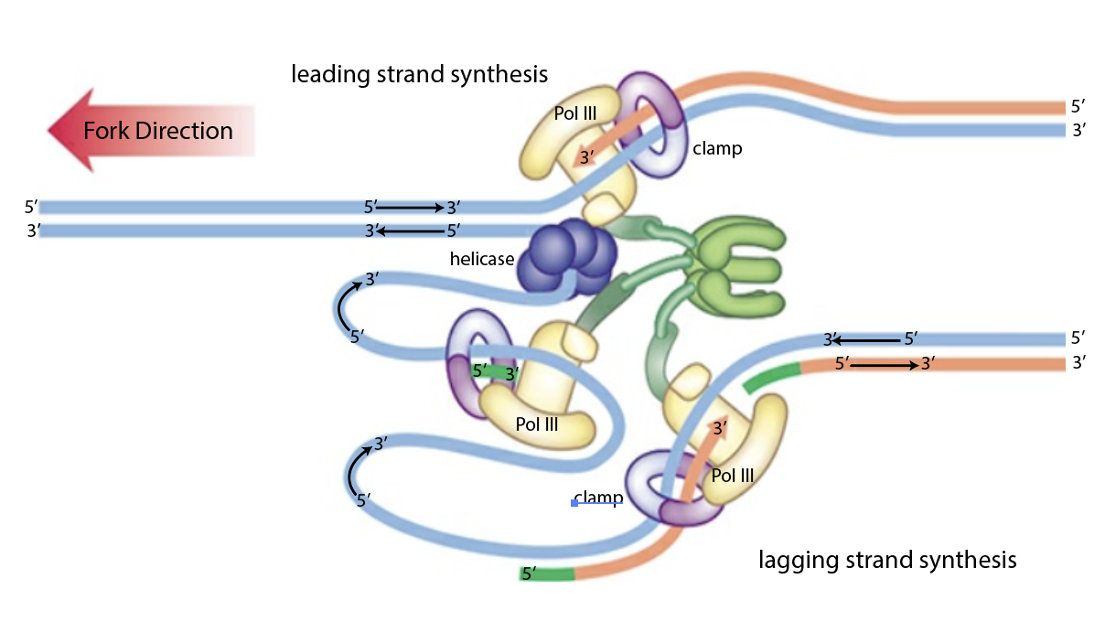

Slide 26
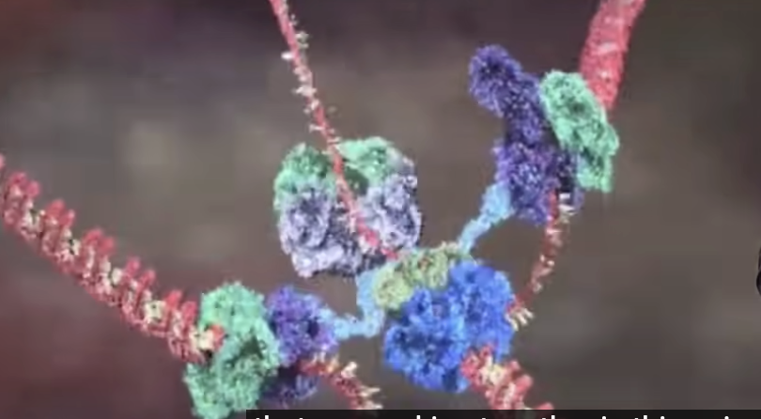

Slide 27
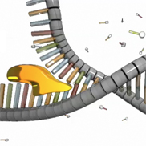
DNA replication (helicases)
dnaB is a helicase. It is a motor protein moves along a DNA duplex, separating the strands. A helicase uses energy derived from ATP hydrolysis. Single stranded binding proteins (SSBs) stabilize and protect the ss DNA between the helicase and the polymerase.

Slide 28
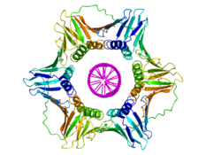
DNA replication (sliding clamp)
A DNA clamp associates with the polymerase + DNA, promoting processivity. Once the clamp assembles and is locked onto the template DNA, it cannot dissociate from the DNA without dissociating into monomers. The polymerase is not allowed to fall off the DNA.

Slide 29
The primosome
The primosome synthesizes a fragment of 1-10 RNA nucleotides that aneal to the single stranded DNA template. This RNA is used as a primer to initiate DNA polymerase. The primosome is utilized once on the leading strand of DNA and repeatedly, initiating each Okazaki fragment on the lagging DNA strand.

Slide 30
DNA Damage & Repair
damaging agents:
uv light
other ionizing radiation (x-rays, etc)
alkylating agents [nitrosamines (tobacco) mustards]
oxidants (ROS: reactive oxygen species)
radicals
results:
chemical modification of DNA bases, sugars..)
single-strand breaks
double strand breaks
=>point mutations, insertions, deletions

Slide 31
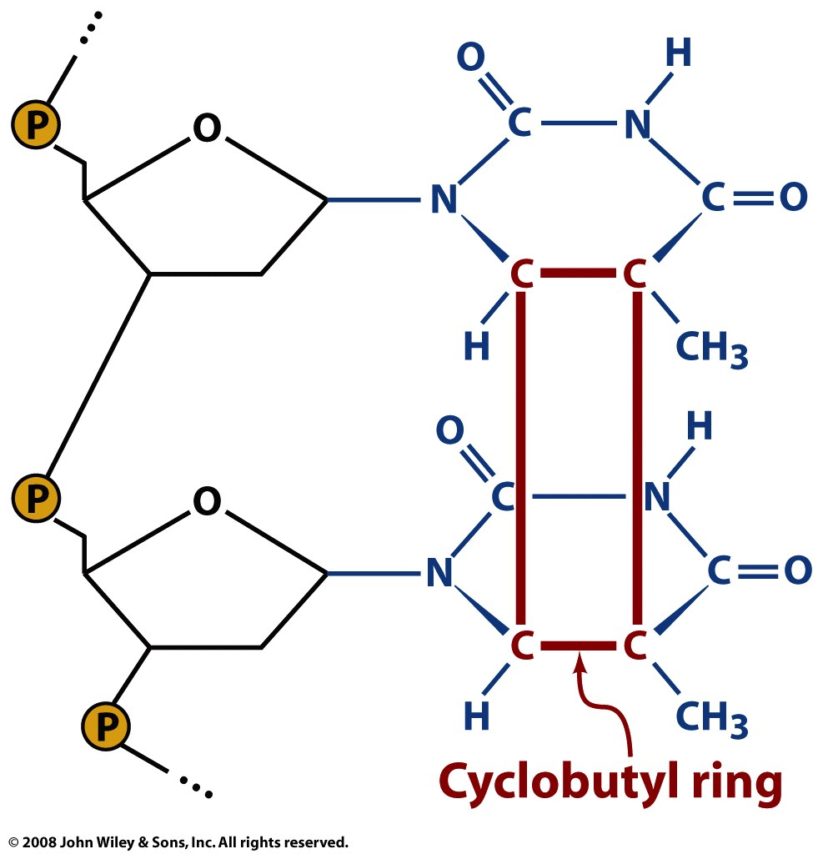
Figure 25-26

Slide 32
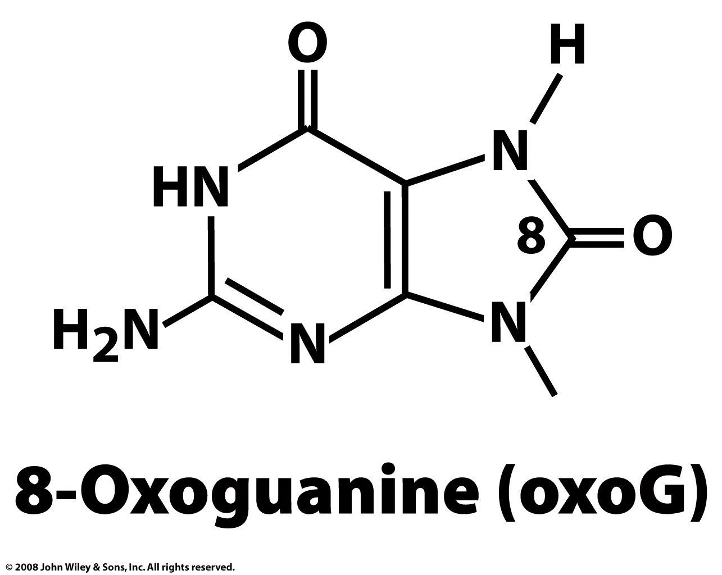
oxidized guanine
Page 917

Slide 33
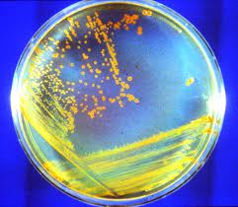
Conan the Bacterium
D. radiodurans can withstand an acute dose of 5,000 Gy (500,000 rad) of ionizing radiation with almost no loss of viability, and an dose of 15,000 Gy with 37% viability. 5,000 Gy will introduce several hundred double-strand breaks (DSBs) into an organism's DNA.
1 mGy: A chest X-ray or Apollo mission 5 Gy can kill a human,
200-800 Gy will kill E. coli,
4,000 Gy will kill a tardigrade.

Slide 35
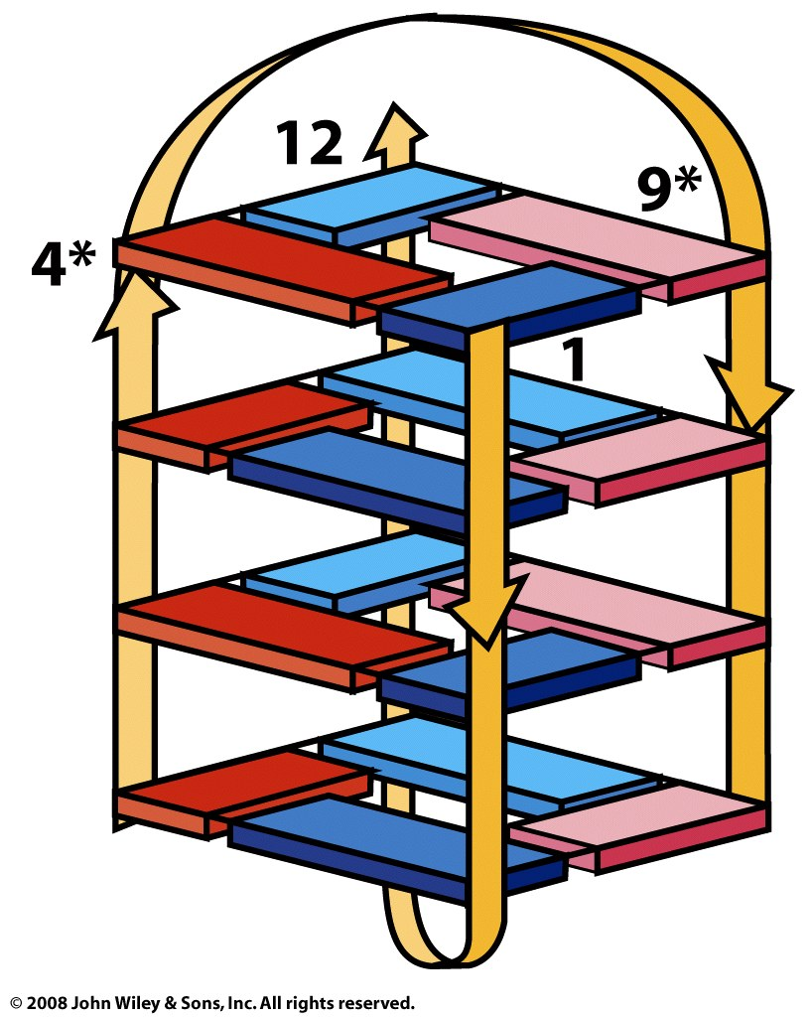
Figure 25-25b

