Slide 1
Large, multicellular animals require proteins to transport and store oxygen.
Oxygen (O₂) is not very soluble in aqueous media and cannot be carried to tissues or within cells in sufficient quantity if it is simply dissolved in blood serum or cytosol.

Slide 2
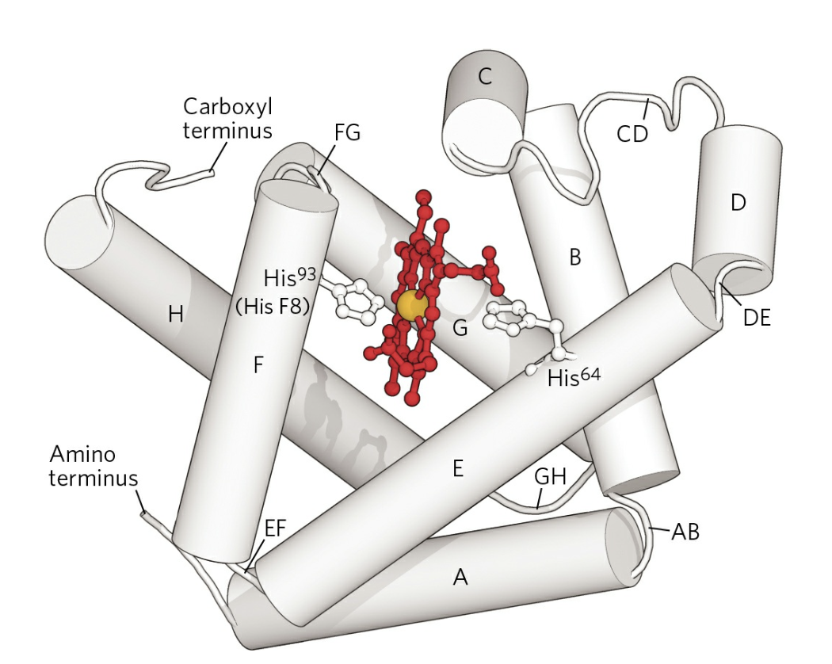
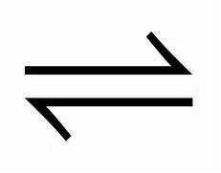
Myoglobin (Mb)
Mb contains one Fe atom that binds reversibly to O₂
Mb + O₂ MbO₂

Slide 3
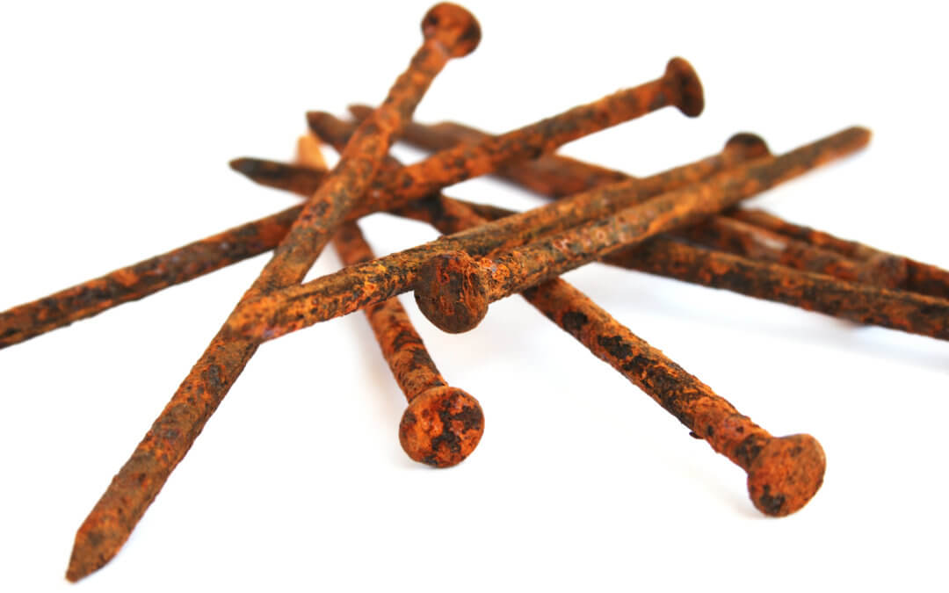
Fe usually binds irreversibly to O₂
Fe(II) + O₂ Fe(III)(OH)₃ (not balanced)
Mb(Fe(II)) + O₂ Mb (Fe(II)) O₂

Slide 4
Myoglobin (Mb)
153 amino acids
16.7 KD (16,700 Daltons)
Mb was the first protein to have its three-dimensional structure determined by x-ray diffraction
ΜΒ is 80% α-helical
(a globin fold: 8 helices: A-H)
Muscle cells use Mb to mediate O₂ transport in the cytosol, from the cell membrane to the mitochondria. Mb acts as a localized O₂ reserve. It is very abundant in marine mammals. Not found in blood.

Slide 5
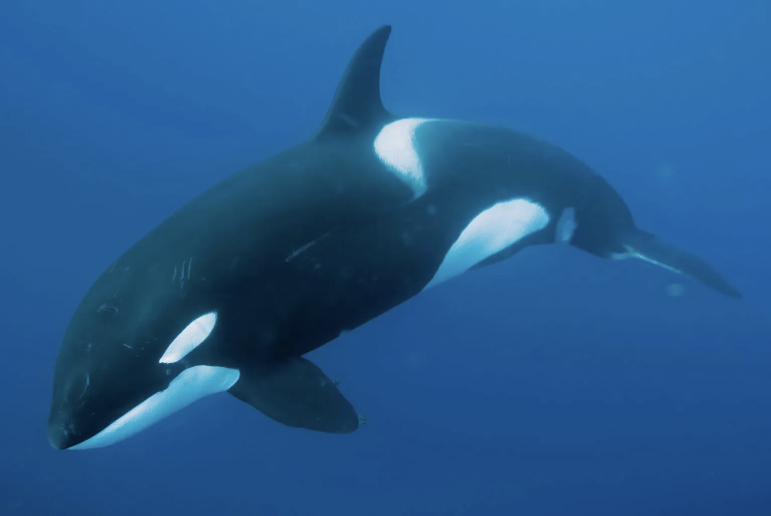
lots of myoglobin

Slide 6
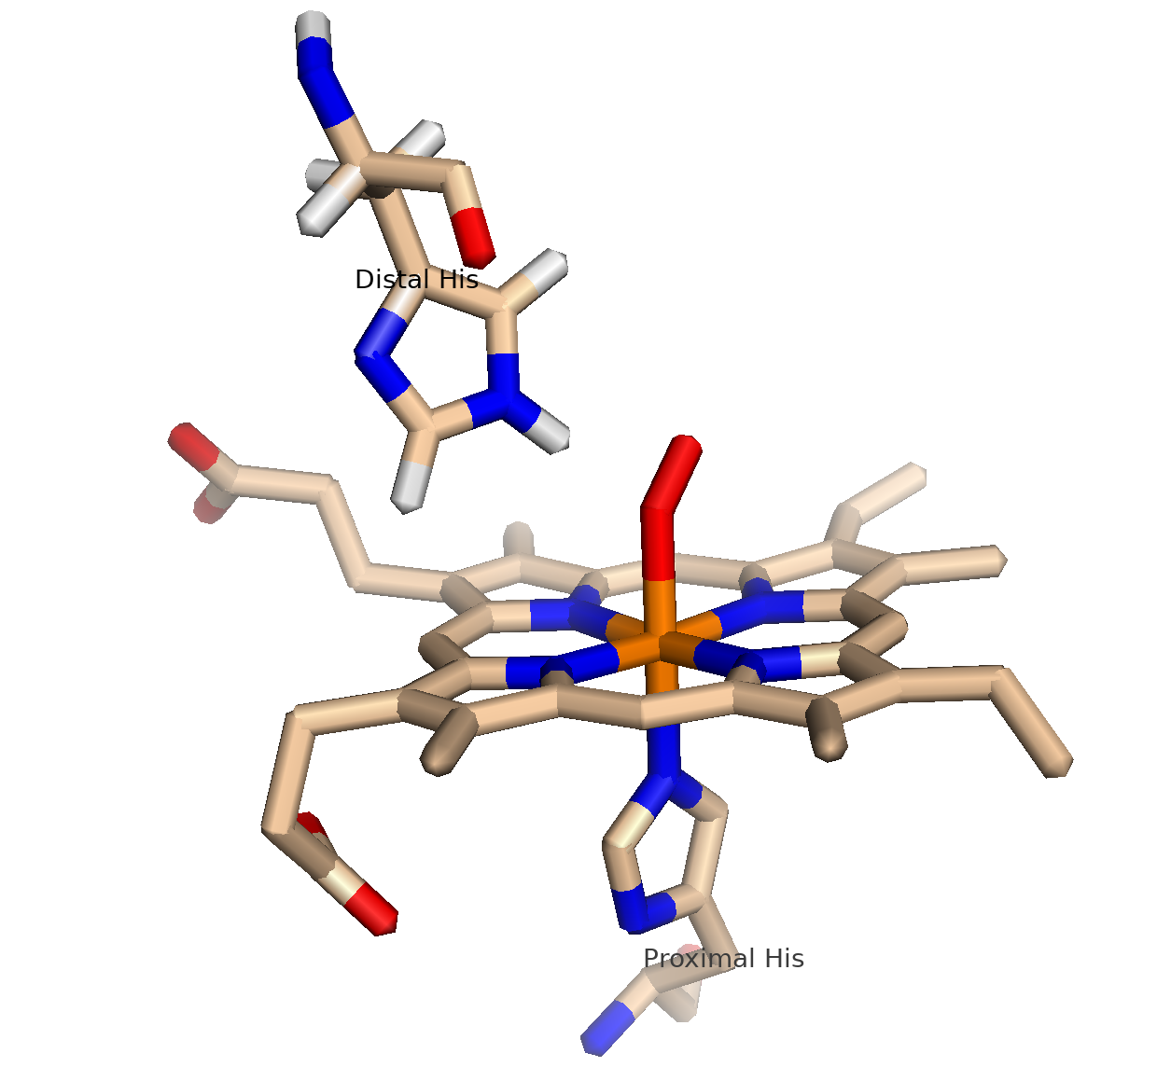
Myoglobin (Mb)
.
Contains a heme with an Fe(II)
(a prosthetic group)
Fe is 6 coordinate
(with 6 coordination bonds)
4 porphyrin N atoms
1 His N atom
O₂ (or water) forms the 6th coordination bond
Mb binds reversibly to O₂
(O₂ is a ligand)
Fe(II) in Mb does not oxidize to Fe(III)
CO, NO and H₂S also bind to MYO

Slide 7
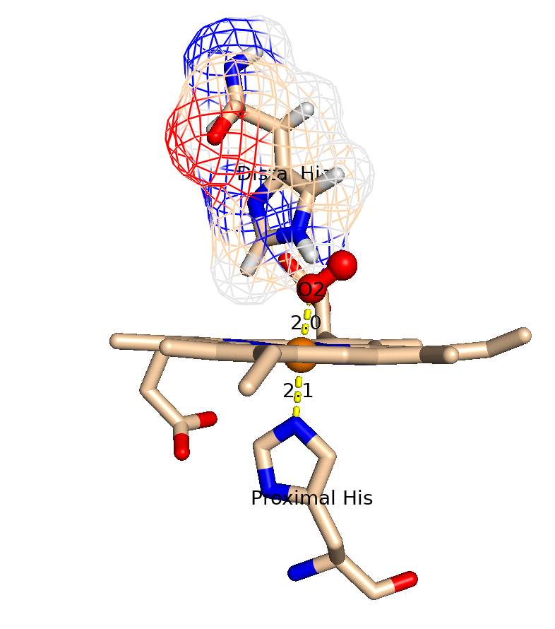
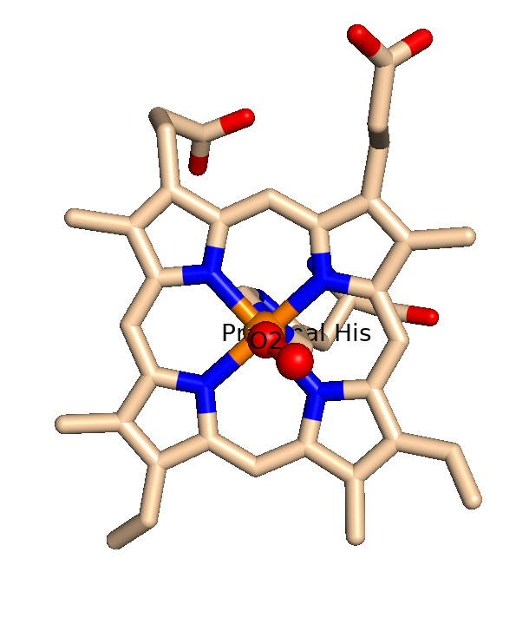

Slide 8
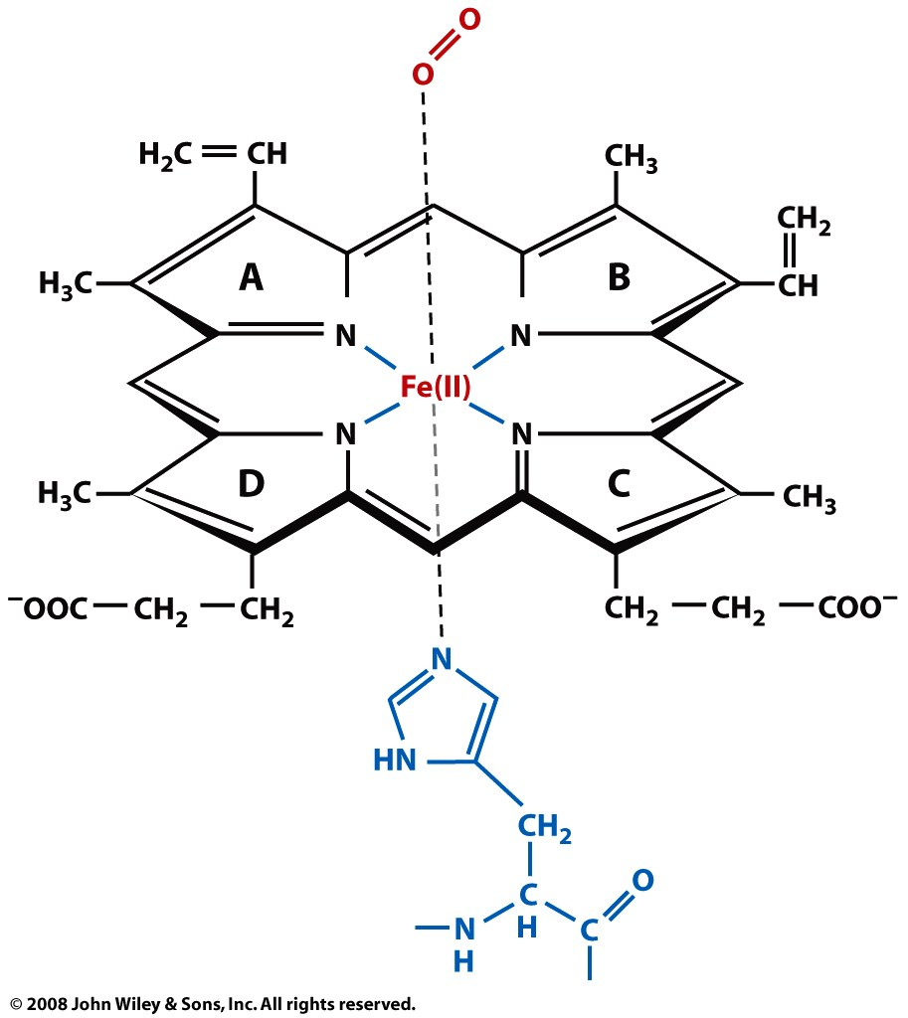

Slide 9
A heme: an iron [(Fe(II)] in a porphyrin ring.
The iron is the site of oxygen binding.
The iron is coordinated by four nitrogen atoms of the porphyrin.
The iron is also bound by the imidazole ring of the F8 histidine residue (also known as the proximal histidine, which is in the F helix).
The sixth position around the Fe can reversibly bind to oxygen.
Oxygen binds in an "end-on bent" geometry where one oxygen atom binds Fe and the other at an angle.
The iron is not oxidized (it does not rust). The binding is reversible.

Slide 10
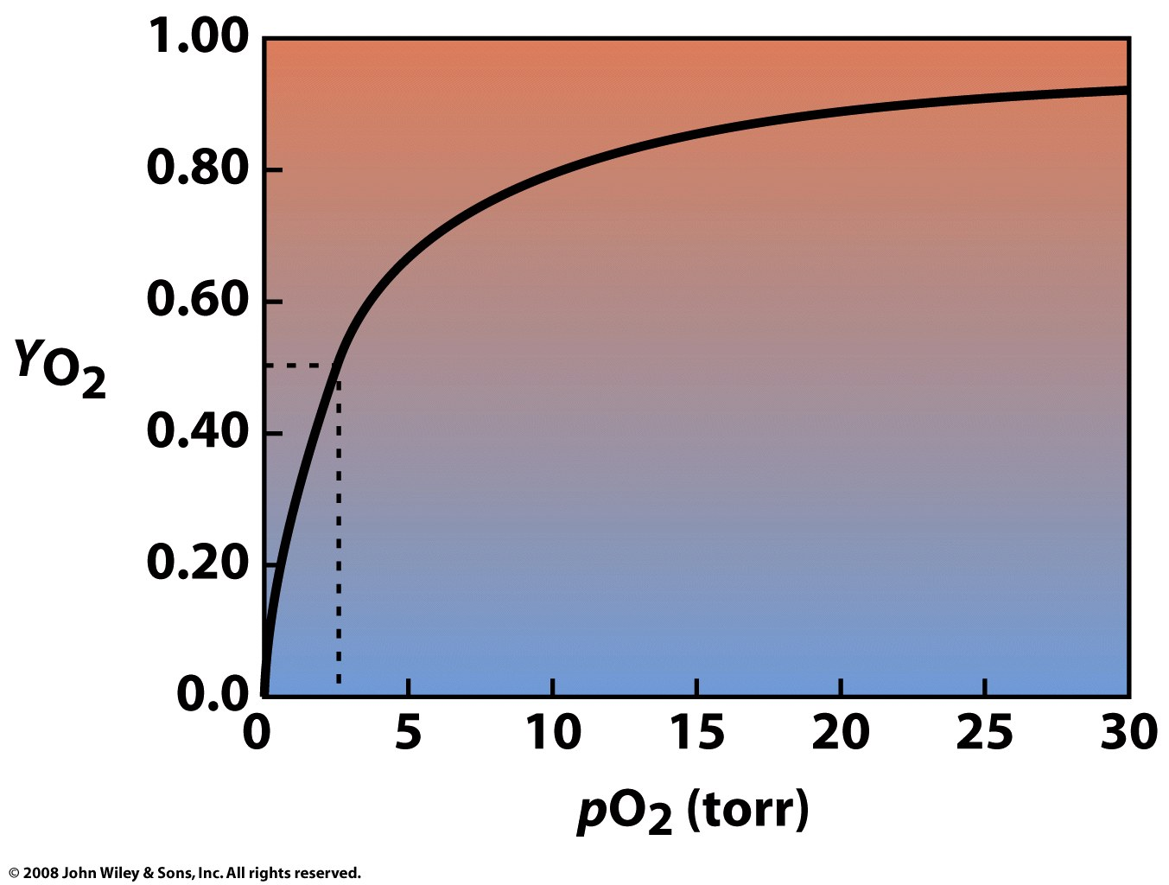
Mb + O₂ = MbO₂
K_{d} = ([Mb] [O₂]) / [MbO₂]
pO₂ = 2.8 torr
when Y=0.5
(50% Mb is occupied)
Y (fraction saturation) rises sharply with pO₂ then levels off as it reaches a maximum. MB is a monomer. It binds to O₂ non-cooperatively. The binding curve is a simple hyperbola.

Slide 11
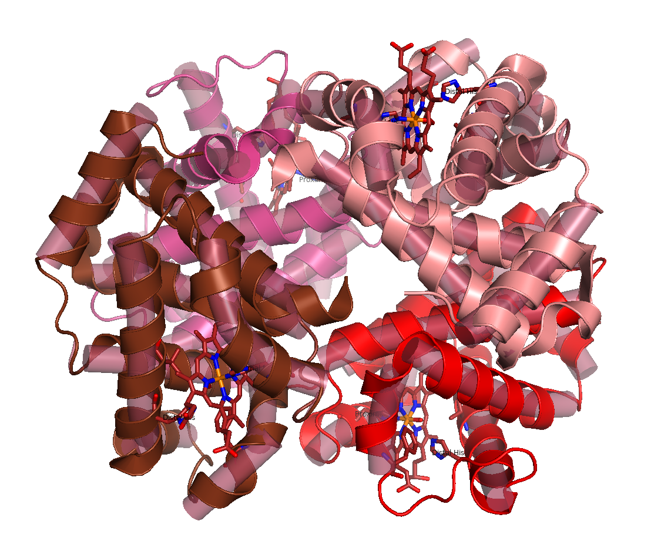
Hemoglobin (Hb)
Hb is a tetramer, with cooperative O₂ binding:
Four O₂ binding sites are ‘linked’. O₂ binding at one site influences O₂ binding at the other three binding sites.

Slide 12
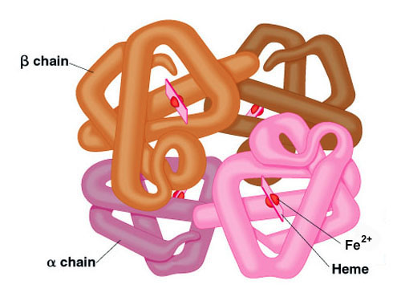
Hemoglobin
Hb binds cooperatively to O₂
Hb has four subunits (four O₂ binding sites)
O₂ binding to one subunit increases O₂ affinity of other subunits.

Slide 13
Hemoglobin (Hb)
the iron-containing oxygen-transport metalloprotein in the red blood cells of vertebrates
binds O₂ in the respiratory organs (lungs or gills) releases O₂ in tissues
binds CO₂ in tissues and releases it in lungs/gills
is a tetramer of four subunits (each a polypeptide chain)
with two α subunits (141 aa's) and two β subunits (146 aa's)
α2β2 (here α & β do not refer to α-helices and β-sheets)
α and β subunits both resemble myoglobin
α and β subunits are similar in sequence
both form α-helical globin folds
human infants, 2 α chains and 2 γ chains.

Slide 14
Myoglobin v Hemoglobin

Slide 15
Cooperative Binding:
Binding sites are ‘linked’. Events at one binding site influence other binding sites.
Three-ring binder analogy suggested by Tech student Scott Thourson, Biochem 6501, fall 2013

Slide 16
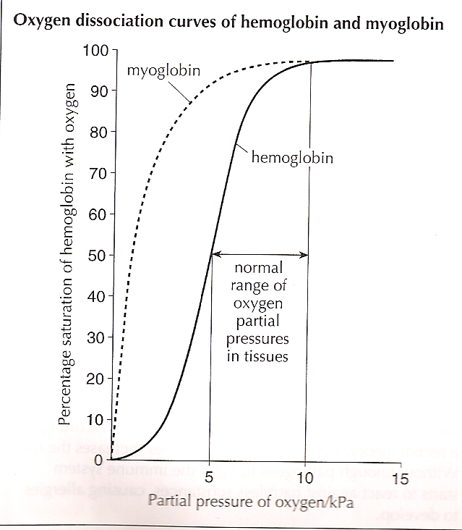
Myoglobin v Hemoglobin

Slide 17
Hemoglobin
The oxygen affinity of (O₂)₃-hemoglobin is ~300 times greater than that of deoxy-hemoglobin [(O₂)₀-hemoglobin].
two states: tense (blue, deoxygenated) (T) and relaxed (red, oxygenated) (R).
R has greater O₂ affinity, favored by
O₂ binding, high pH, low CO₂, or low 2,3 BPG
T has lower O₂ affinity, favored by
low pH, high CO₂ and high 2,3 BPG favor T state (release of O₂),
regulated by binding effector molecules at sites other than the active site (2,3 BPG).

Slide 18
Hemoglobin
Each subunit contains one Fe-heme
no bound O₂ => hemoglobin is in the T state (Tense State)
binding of one O₂ to one iron shifts the position of that Fe into the plane of the porphryn ring,
that shifts the proximal His, on the other side of the Fe, (His F8],
that shifts the position of helix F,
that changes the interfaces between the subunits
that changes the other O₂ binding sites (increases their O₂ affinity)
the O₂ affinity at the other three hemes increases
Linkage between the Fe the proximal His causes tertiary changes that transmit effects to other subunits.

Slide 19
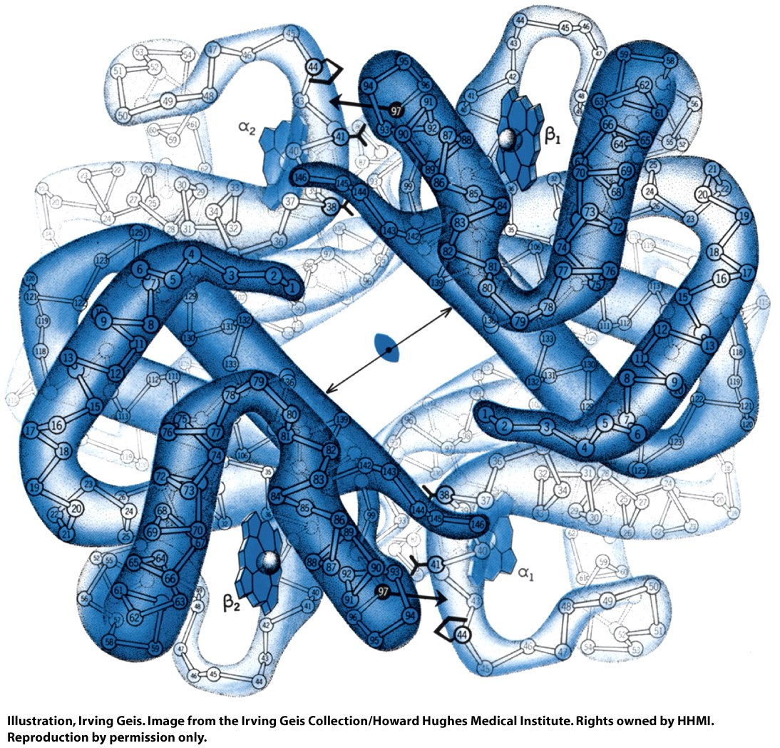
T-state,
Low O₂
affinity
Figure 7-5 part 1

Slide 20
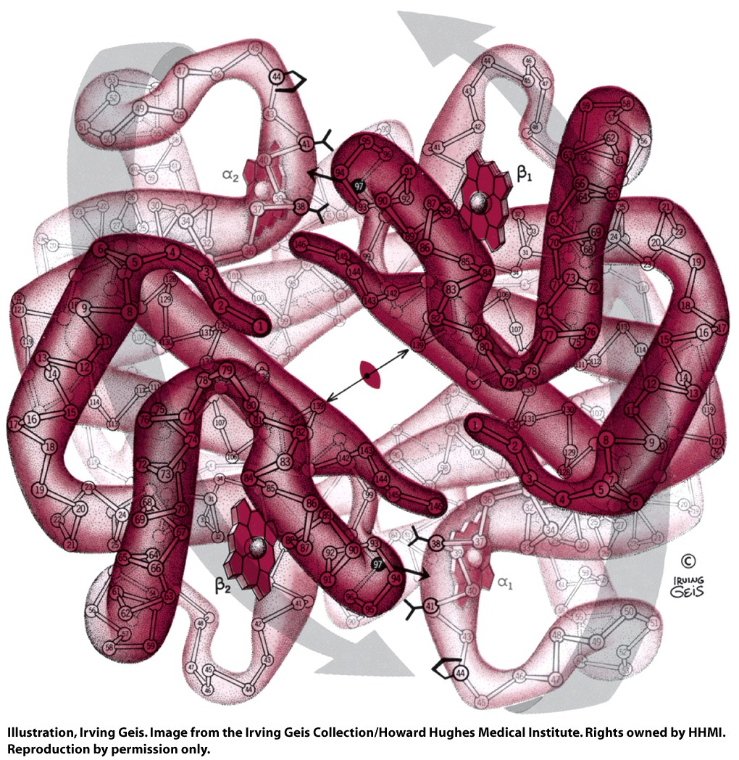
R-state,
High O₂
affinity
Figure 7-5 part 2

Slide 21
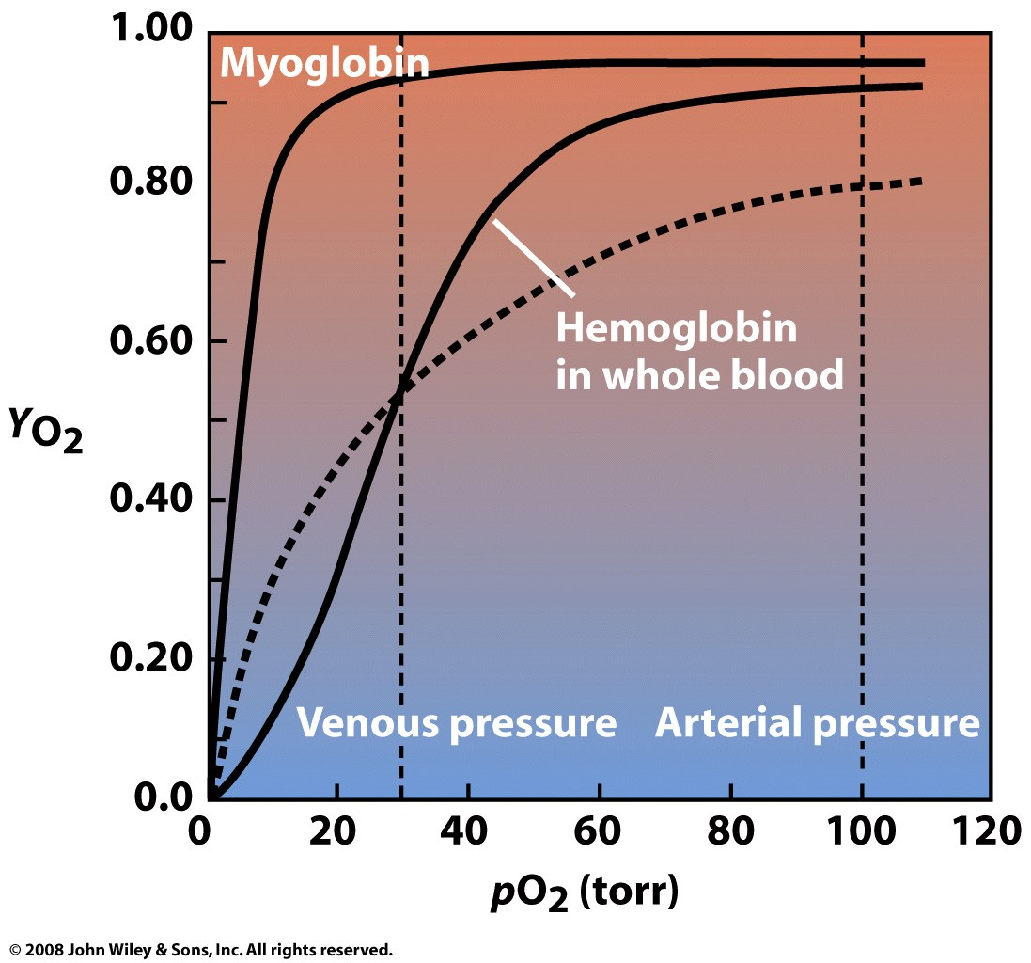

Slide 22
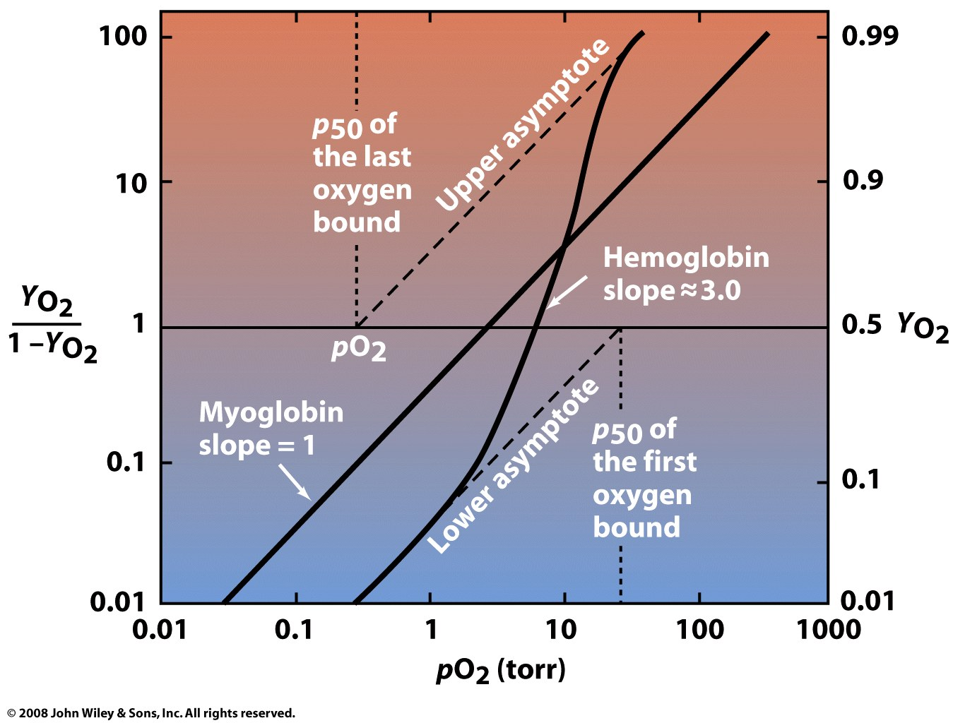
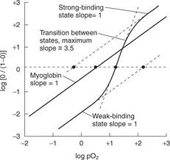
Figure 7-7

Slide 23
Cooperativity: The Hill coefficient
describes cooperativity of ligand binding to proteins (or other macromolecules). The Hill coefficient is around 3 for hemoglobin.
n>1 - Positively cooperativity: Once one ligand molecule is bound to the protein, the affinity for other ligands increases.
n<1 - Negatively cooperativity: Once one ligand molecule is bound to the protein, the affinity for other ligands decreases.
n=1 - Noncooperative cooperativity: The affinity of the protein for a ligand molecule is independent on whether or not other ligands are already bound.

Slide 24
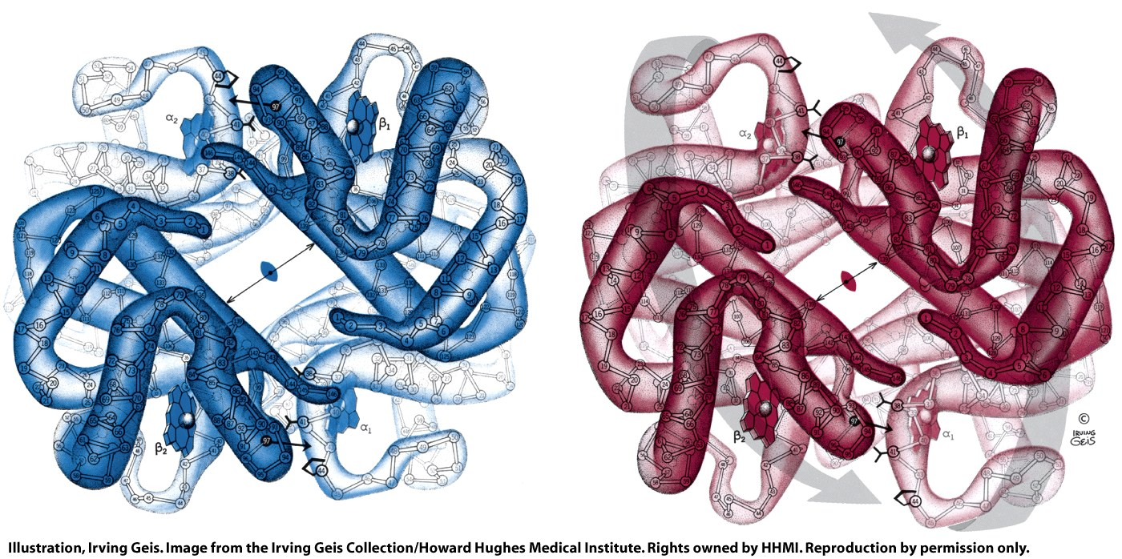
When oxygen binds to hemogolobin, atoms move, subunits move.
The iron atom that binds to O₂ moves into the plane of the porphyrin (0.6 Å).
The proximal histidine shifts with the iron toward the porphyrin ring.
Helix F8 moves with the proximal histidine
The porphyrin ring shifts sideways toward the outside of the tetramer.
These motions are transmitted to other three monomers in the tetramer.
The orientations and interactions between the subunits change.
The conformational changes activate the empty sites for binding of oxygen.
Therefore: O₂ binding is 'cooperative’.
The first O₂ bound increases the affinities of the empty sites.
Hb releases 0.6 protons per O₂ bound (lower pH means lower O2 affinity)
The oxygen binding curve of hemoglobin is sigmoidal, or S-shaped, as opposed to the hyperbolic curve of myoglobin

Slide 25
Cooperativity
requires protein oligomers (Hb is a tetramer, with 4 subunits)
(or multiple binding sites on a single subunit)
requires multiple conformations (T, R and intermediates between T and R)
subunit conformation is linked to ligand affinity (ligand binds better to R state)
subunit conformations are linked to each other
(T-state binds better to T-state
R-state binds better to R-state)
binding of a ligand to one subunit stabilizes the R-state in other subunits
Figure 7-16

Slide 26
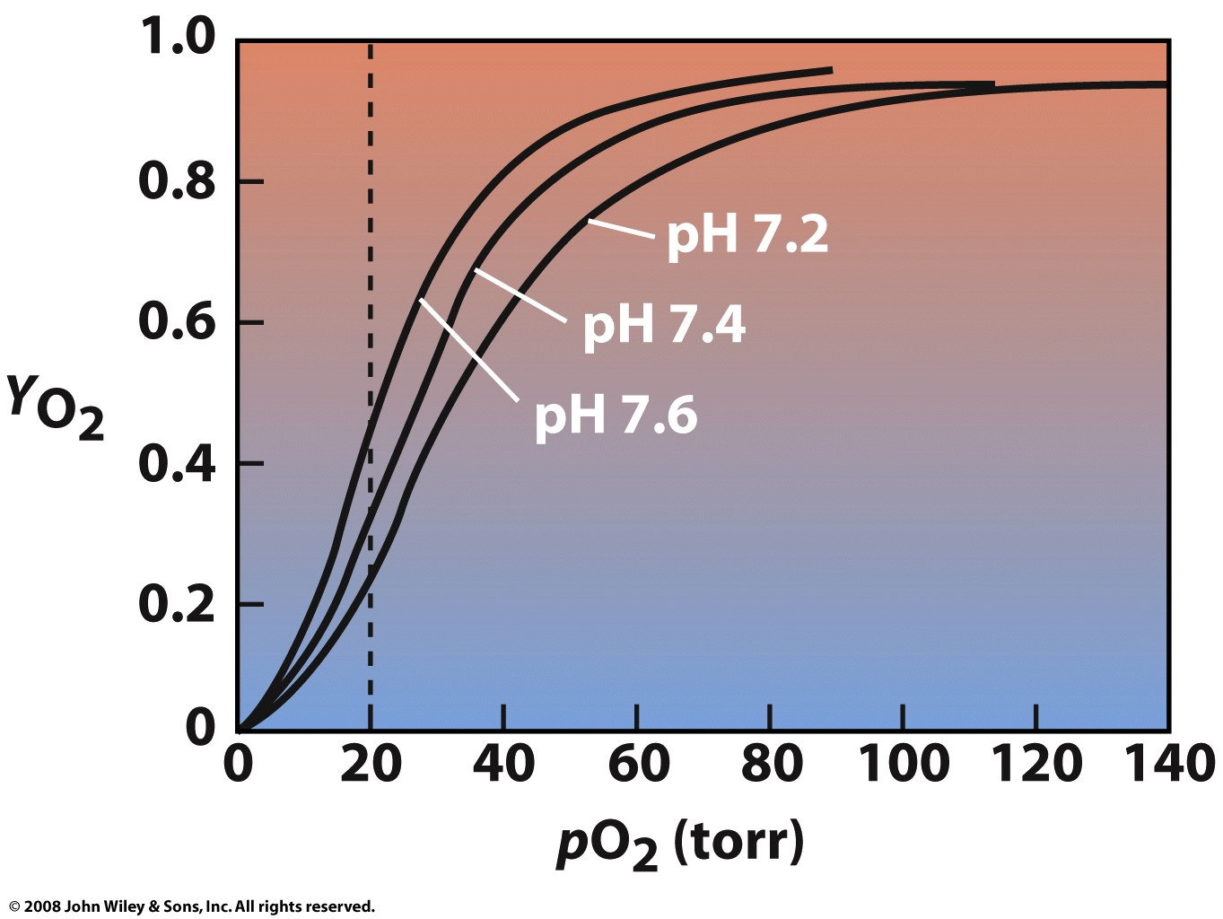
Bohr effect:
Hb releases H⁺ upon binding of O₂,
Therefore lowering the pH (increasing H⁺) decreases the affinity (LeChatlier’s principle).
CO₂ decreases the pH
Active muscles get more O₂
Figure 7-11

Slide 27
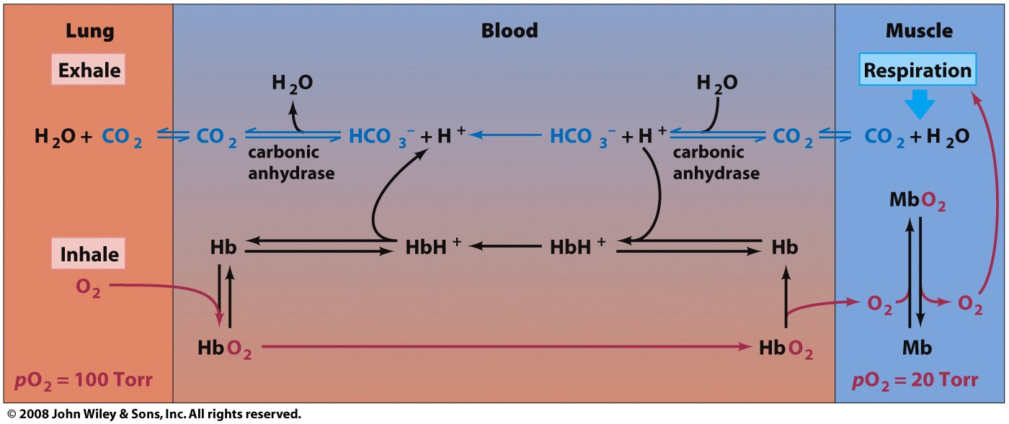
CO₂ => carbonic acid => low blood pH
hemoglobin releases H⁺ when O₂ binds
low pH (high [H⁺]) => O₂ release from hemoglobin
Confusing schematic from book
high pH
low pH
Figure 7-12

Slide 28
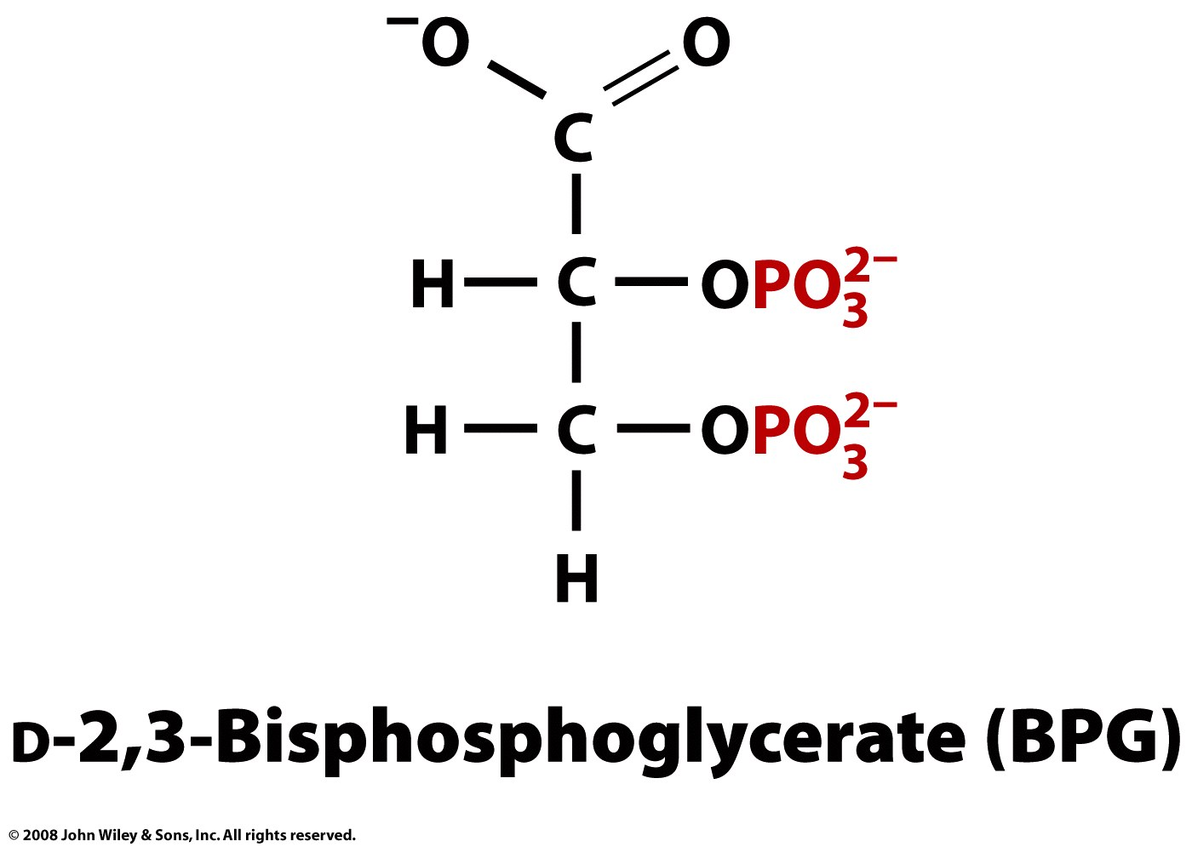
BPG lowers O₂ affinity of hemoglobin.
BPG binds to the T state (deoxy) not R state (oxy).
BPG is an allosteric effector (effects function by binding to a site other than the protein's active site).
BPG is involved in high altitude acclimatization
Page 191

Slide 29
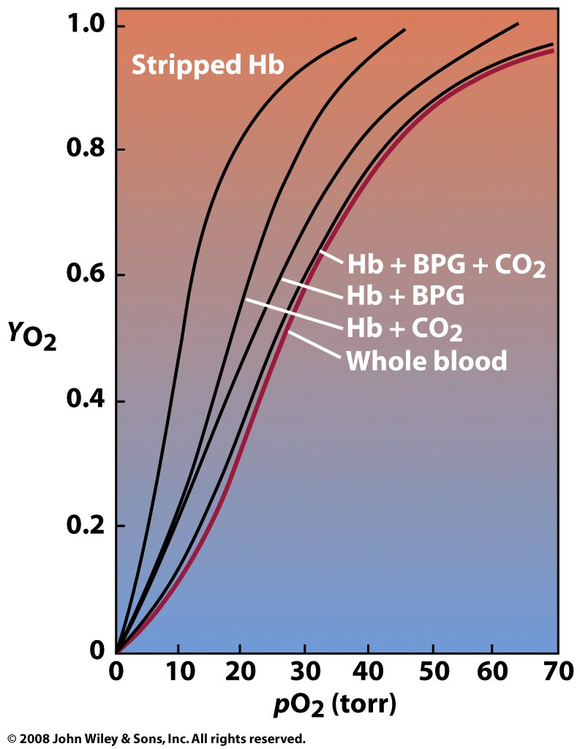
Figure 7-13

Slide 30
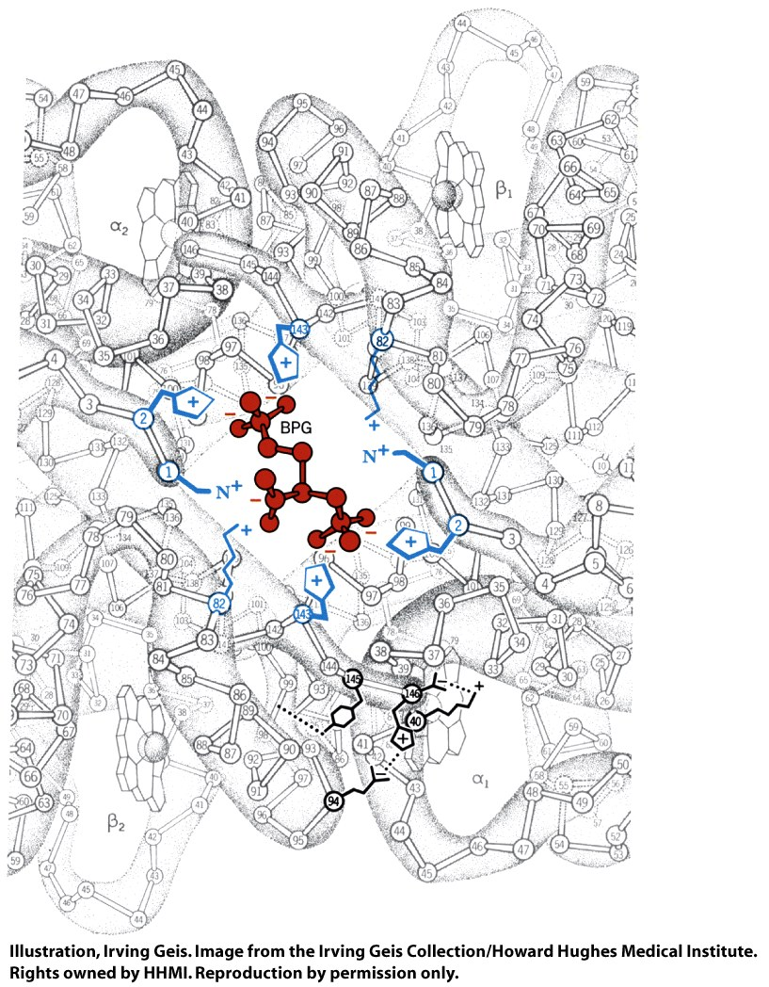
Figure 7-14

Slide 31
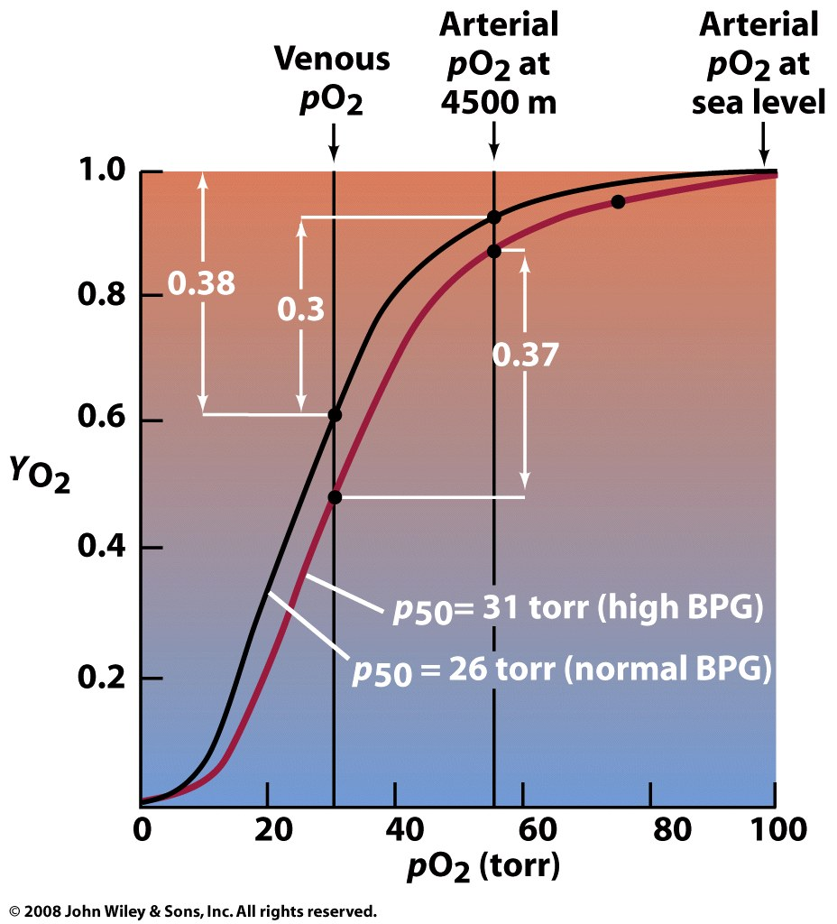
Box 7-3

Slide 32
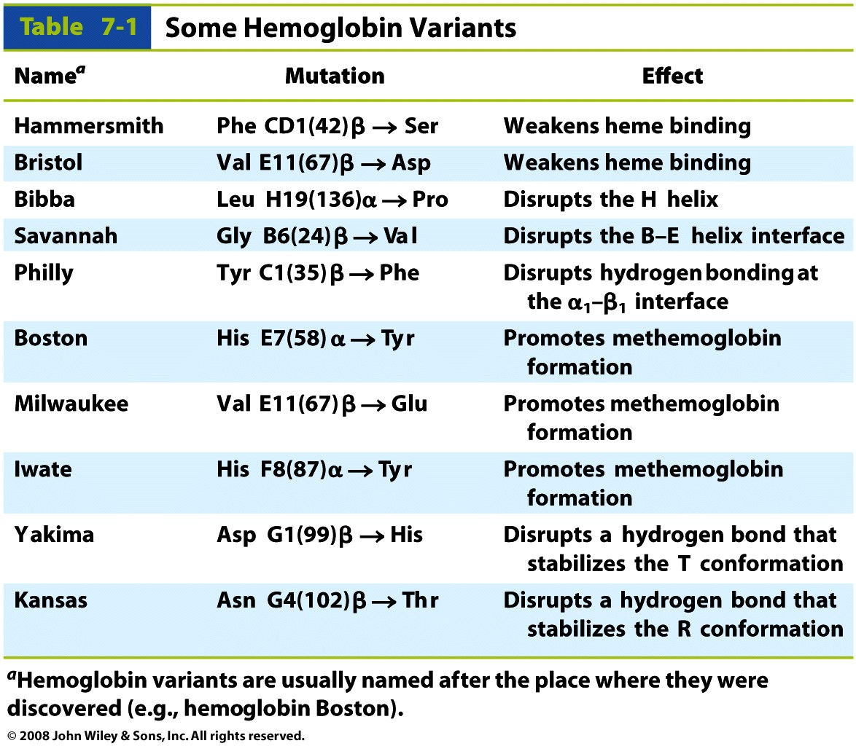
Hemoglobin mutations: nearly 950 hemoglobin variants.
Table 7-1

Slide 33
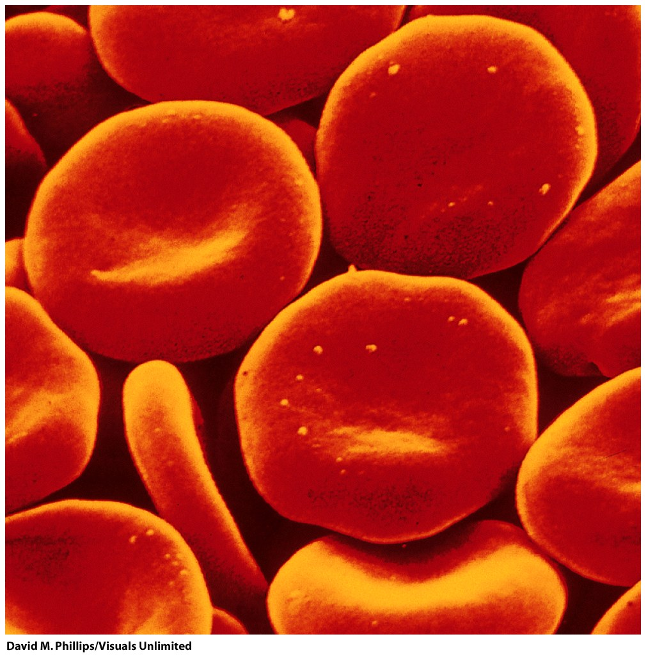
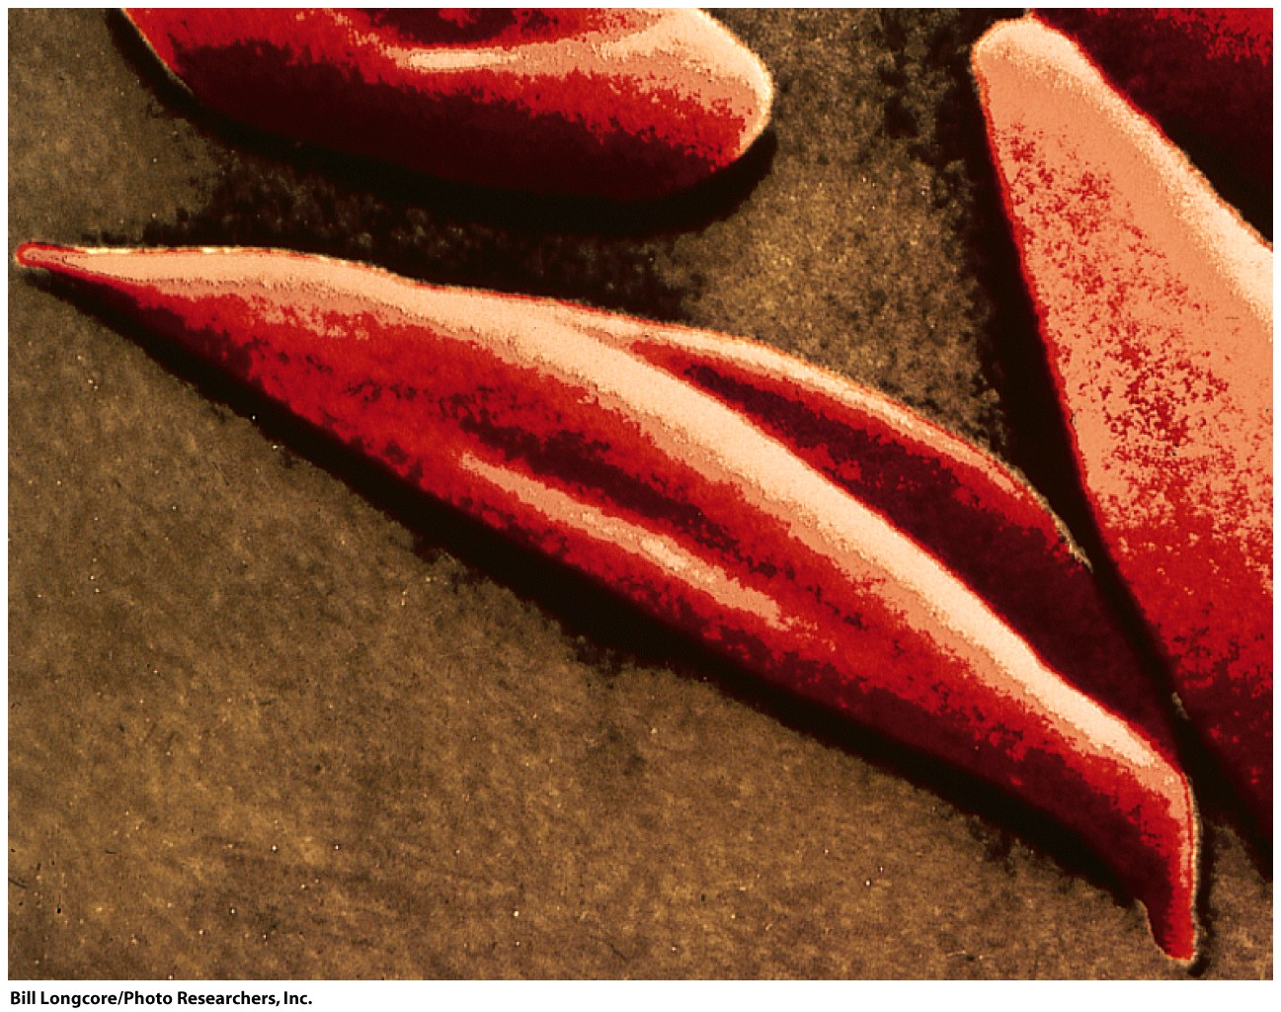
Sickle Cell: Glu(6) to Val in the β chain (Hemoglobin S, Vernon Ingram)
The mutation changes the packing between tetramers.
Causes long linear aggregates of tetramers in the T state (deoxy)
Heterozygous Hb S protects against malaria

Slide 34
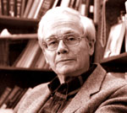
Vernon Ingram (died 2006): "The father of Molecular Medicine."
Ingram showed that the change in hemoglobin in sickle cell disease is a substitution of the glutamic acid by valine in position 6 of the β-chain. This was first demonstration that an amino acid change in a protein could cause a disease.

Slide 35
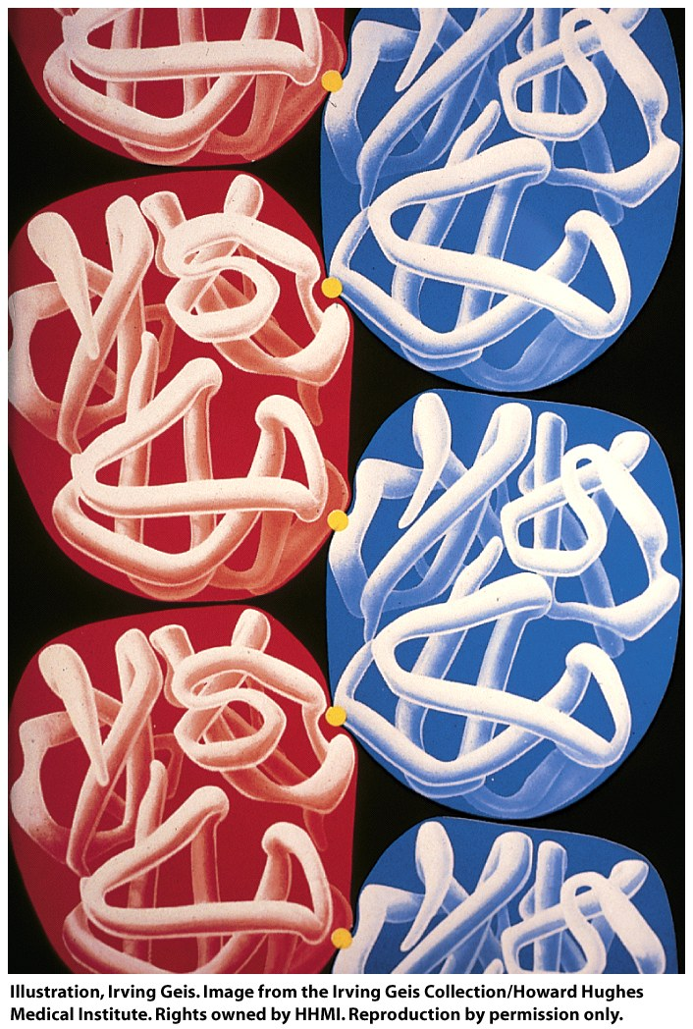
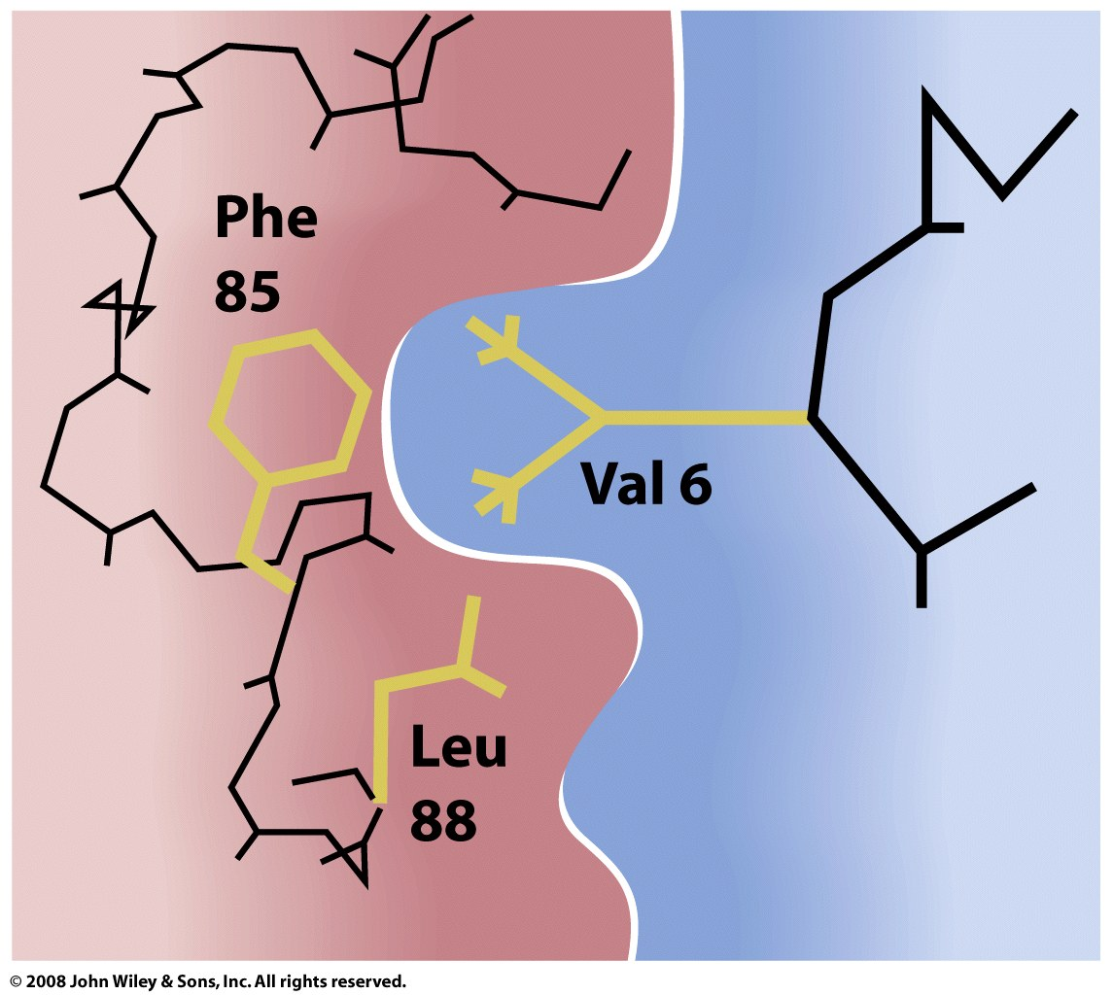
Figure 7-18a

Slide 36
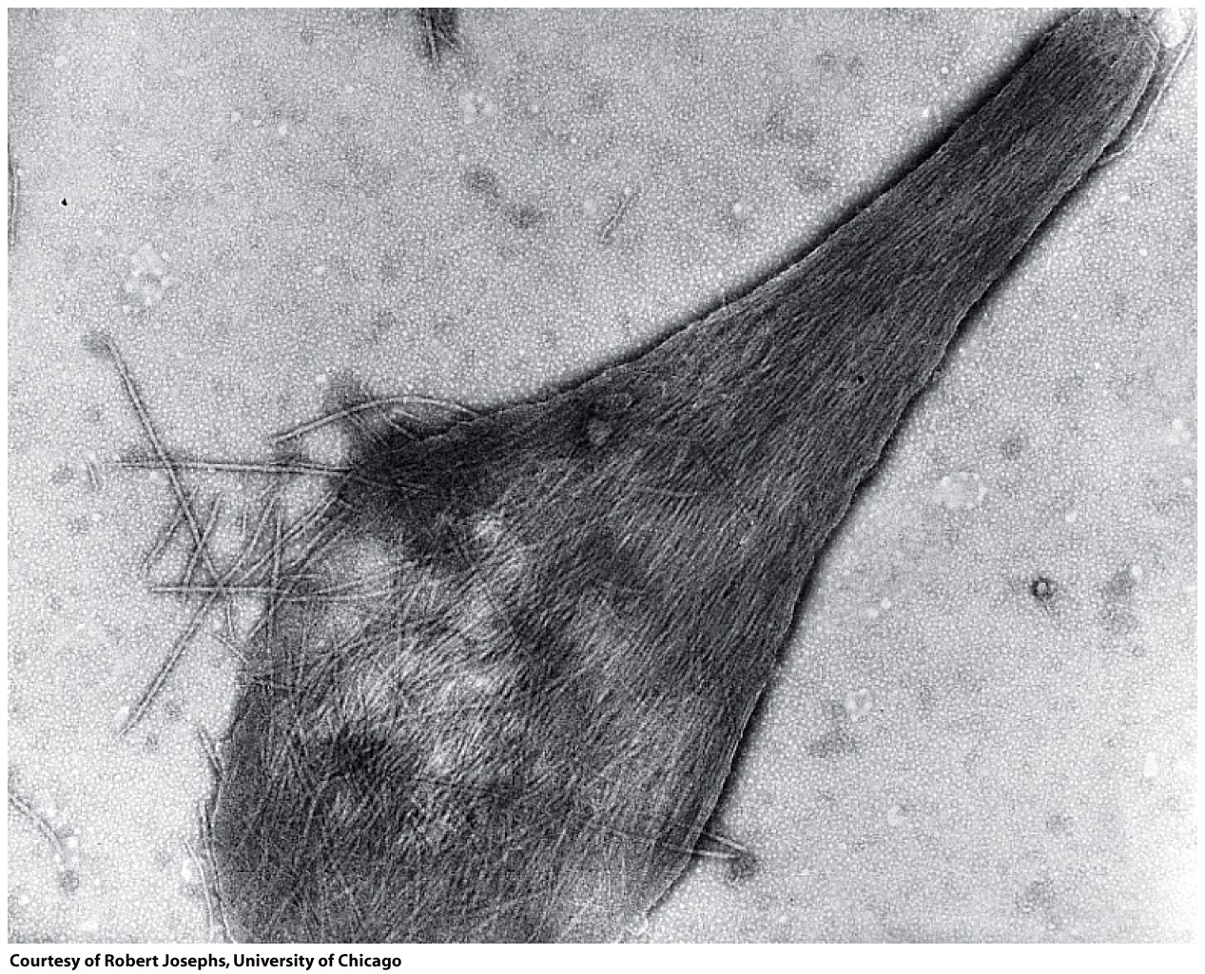
damaged sickled erythrocyte

Slide 37
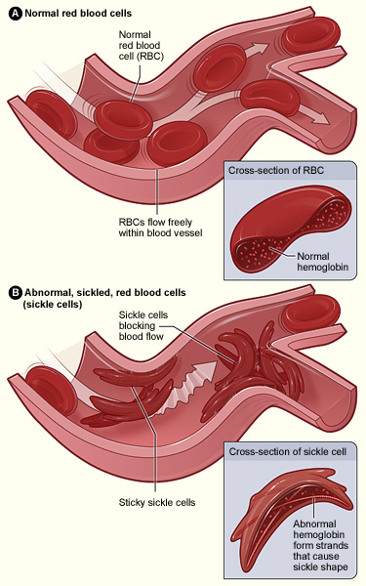

Slide 38
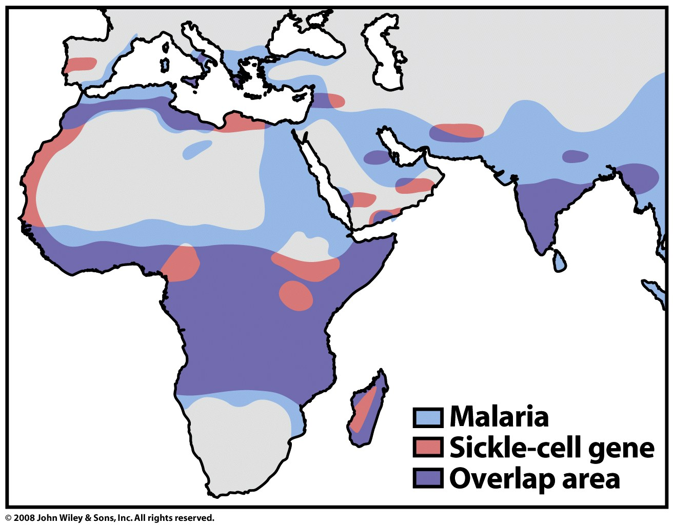
Figure 7-20

