Slide 1
Lipids:
Molecules that are hydrophobic or amphiphilic
fatty acids,
Trigycerides (fatty acids + glycerol),
phospholipids,
sphingolipids,
saccharolipids,
polyketides,
sterols,
prenols,
peptides (sometimes).
For the quiz: draw phospholipids like phosphatidylcholine or phosphatidylserine (slide 32) or sphingomyelin (slide 39).

Slide 2
Amphiphiles
An amphiphile is schizophrenic molecule with both hydrophilic (water soluble) and hydrophobic (lipophilic) character.
amphiphiles have distinct molecular regions.
One or more hydrophobic tail(s) - generally hydrocarbon (non-polar, cannot form hydrogen bonds).
A hydrophilic head group - polar (alcohol) and/or charged (ammonium, carboxylate, phosphate, sulfate, and sulfonates).
Surfactants are Amphiphiles.
Surfactants form aggregates in water with a hydrophobic core (tails) and a hydrophilic surface (head groups), which is in contact with surrounding water.
Examples of surfactants
soap [Na⁺ or K⁺ salt of a fatty acid (carboxylic acid with aliphatic tail)]
detergent (Na⁺ or K⁺ salt of a sulfonate with aliphatic tail)
phospholipid
lipoprotein

Slide 3
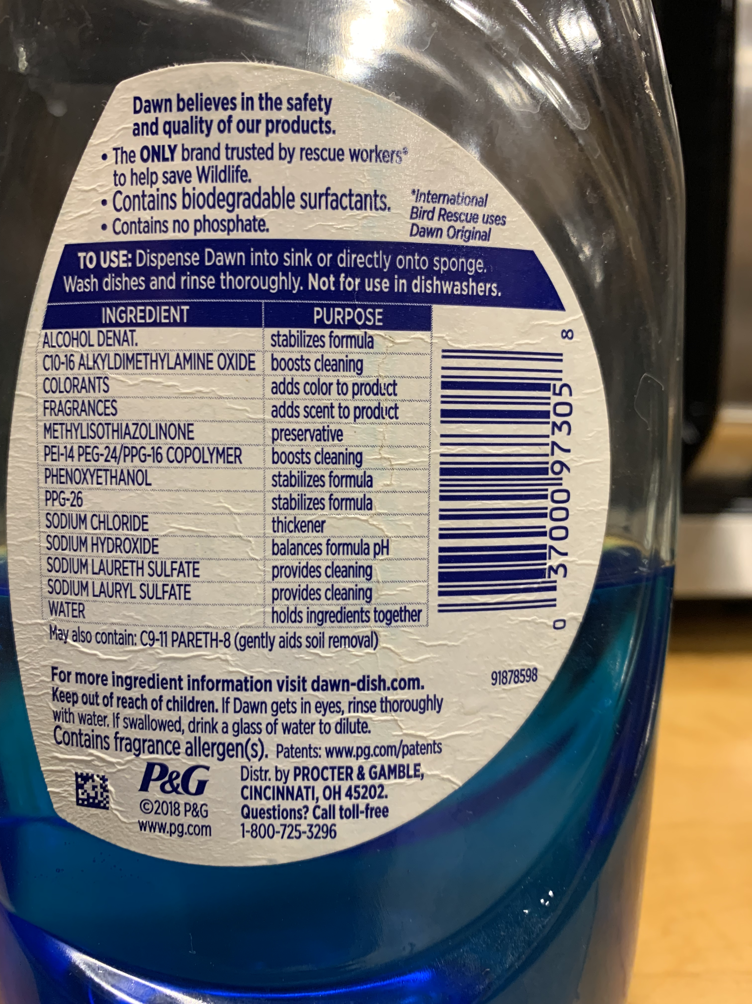
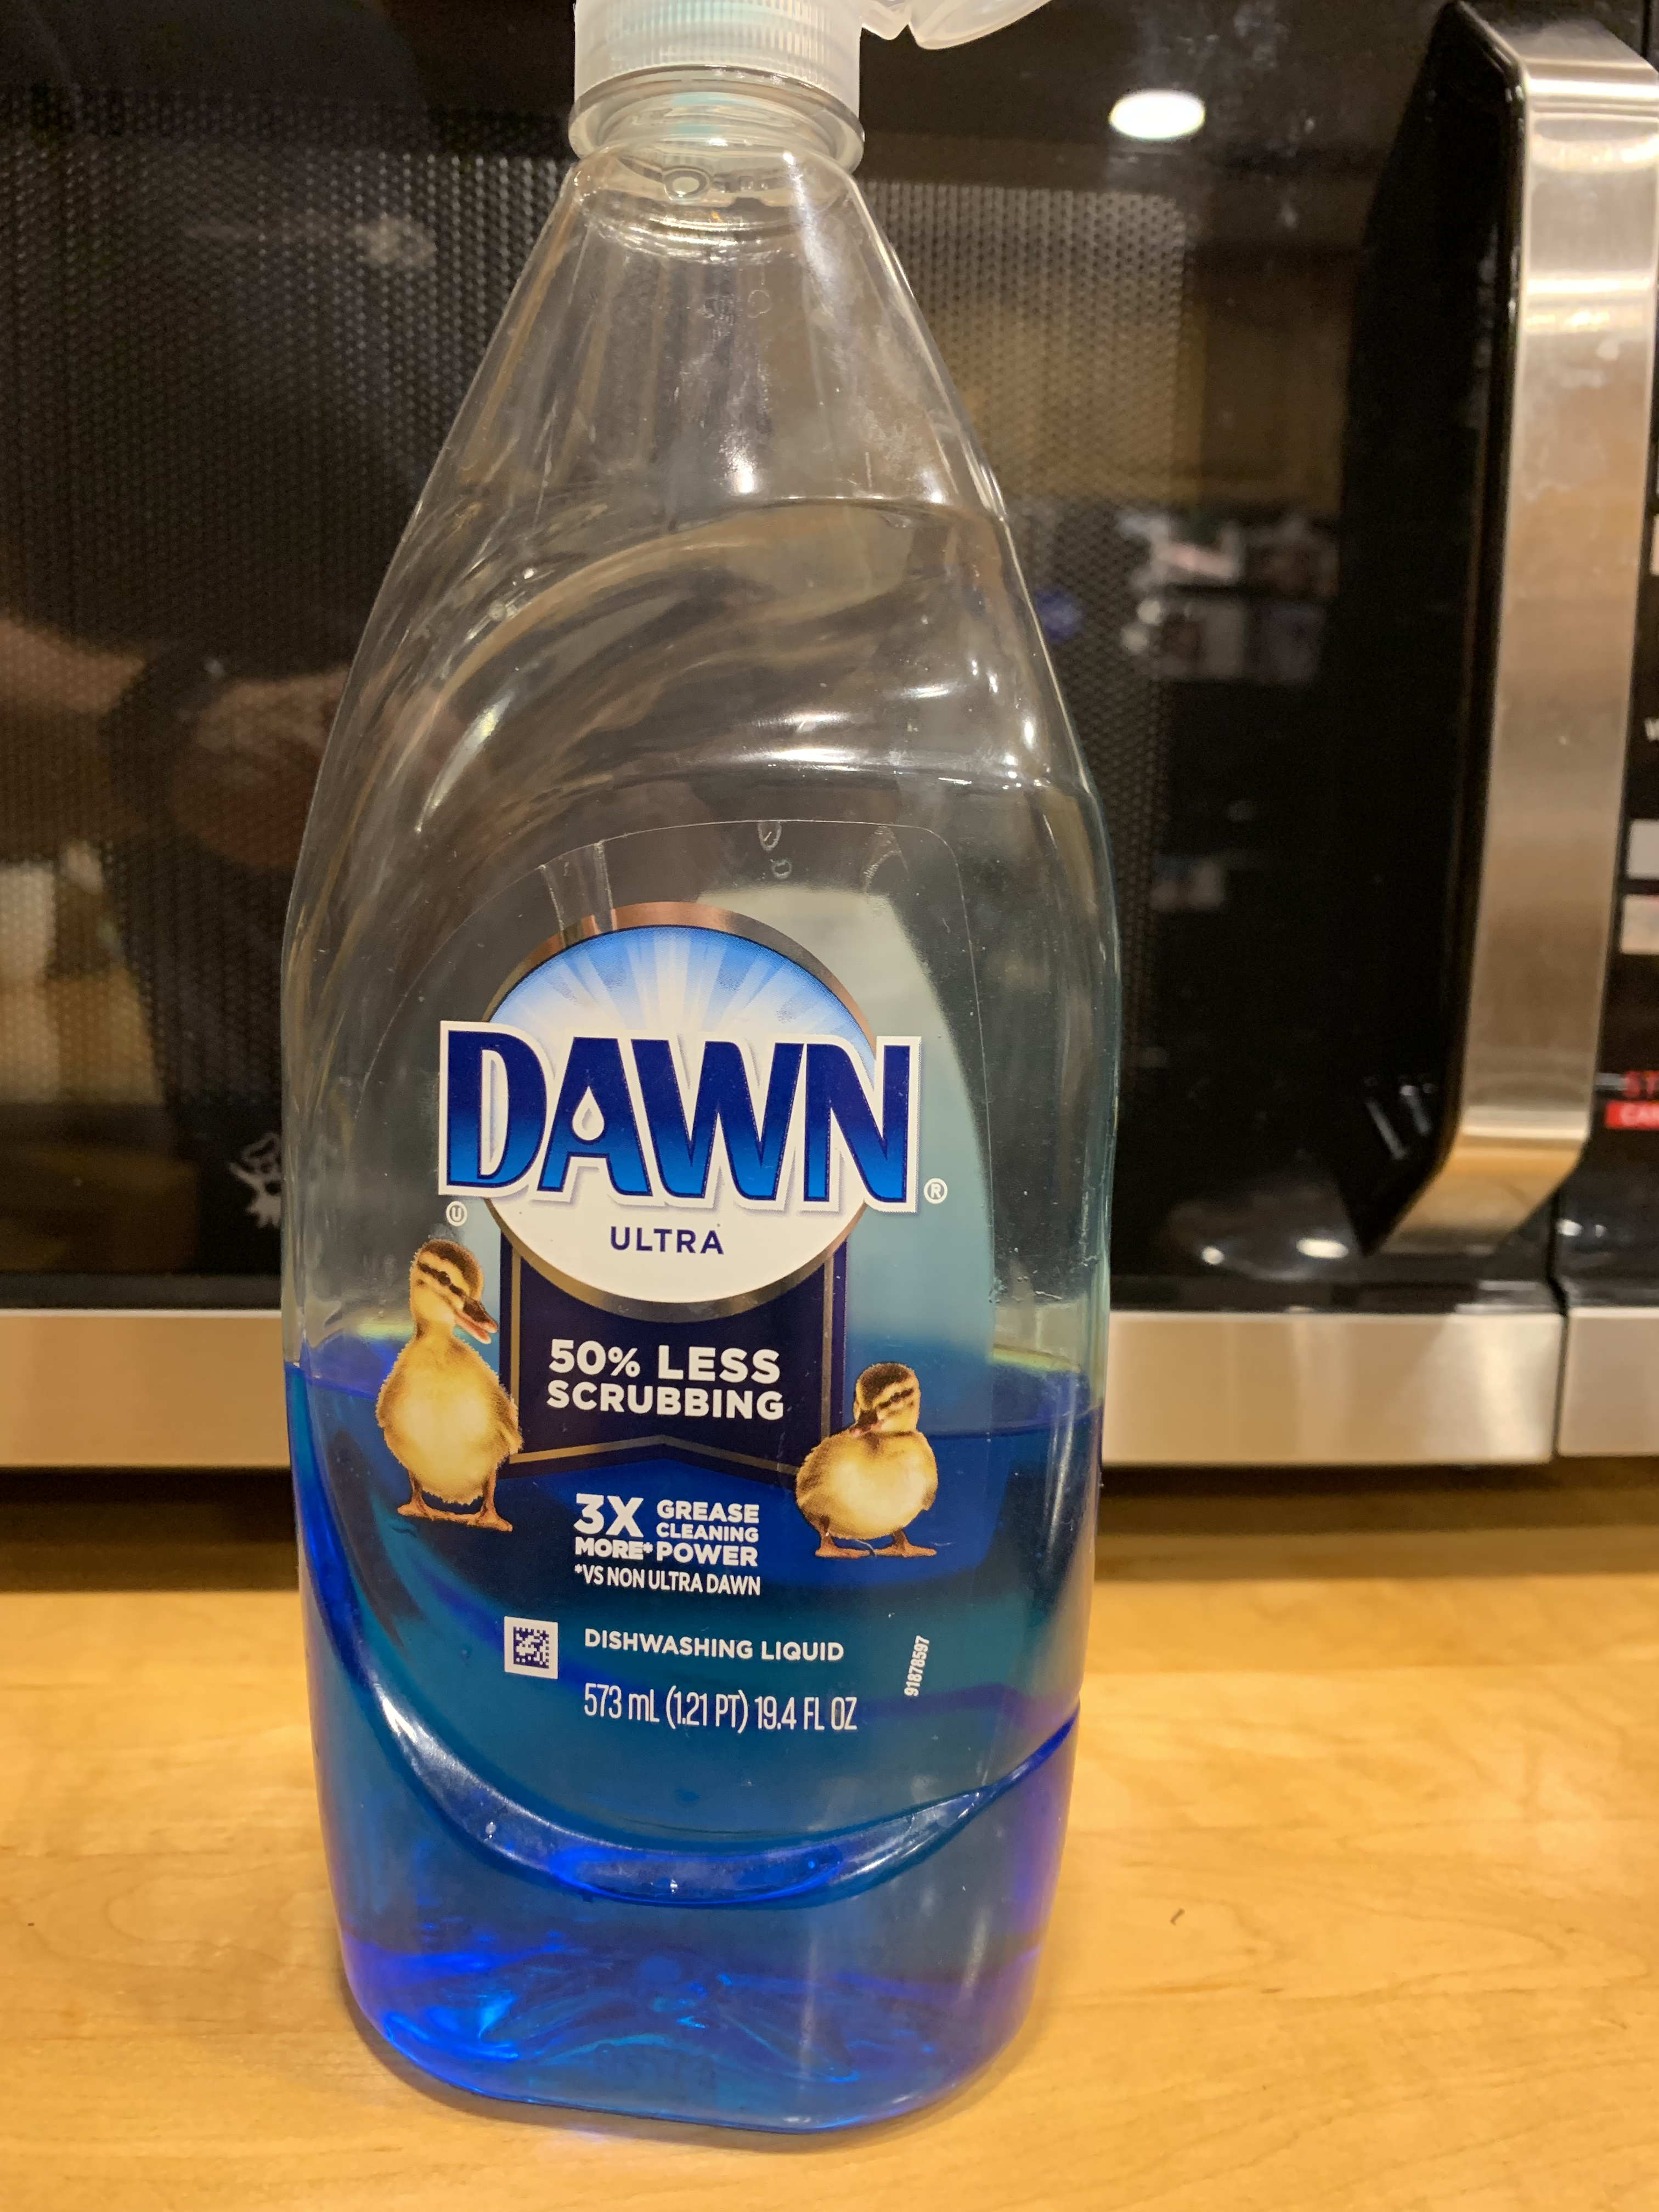

Slide 4
Sodium laureth sulfate =
sodium lauryl ether sulfate (SLES)
Sodium dodecyl sulfate (SDS or NaDS) =
sodium laurilsulfate =
sodium lauryl sulfate (SLS)

Slide 5
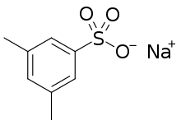
Hydrotrope v Surfactant
Hydrotropes:
Amphiphiles with high HLB (hydrophilic/lipophilic balance).
Hydrotropes typically have small tails. Hydrotropes don’t form assemblies (except a high concetration) but do increase solubilities of hydrophobic molecules in water.
Surfactants:
Amphiphiles with low HLB (hydrophilic/lipophilic balance).
Surfactants typically have long alkyl tails (C8–C20).

Slide 6
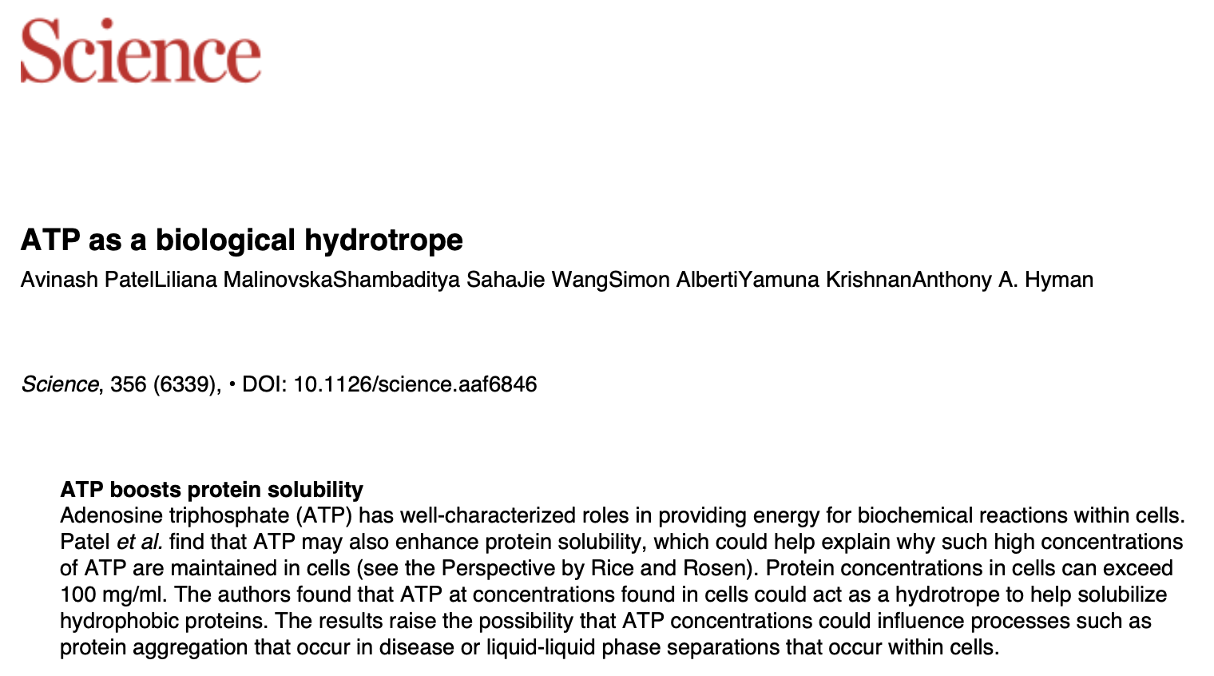

Slide 7
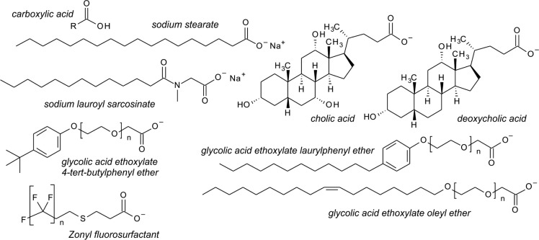
Amphiphiles

Slide 8
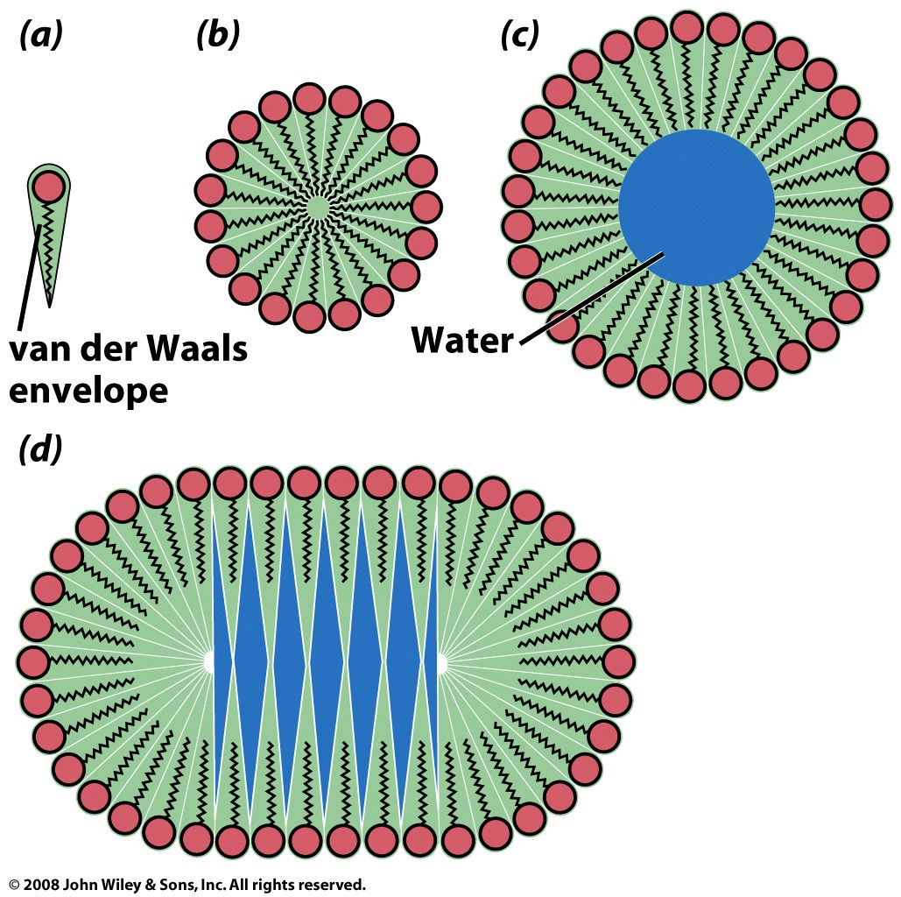
The shape of an amphiphile determines the type of assembly
single-tailed amphipaths

Slide 9
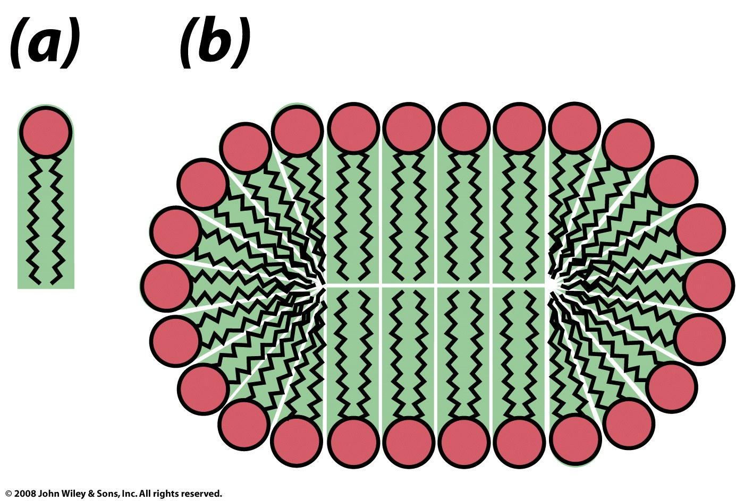
two-tailed amphipaths
Figure 9-14

Slide 10
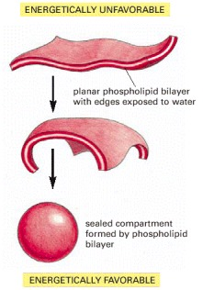
Amphipathic bilayers self-assemble in water.
Hydrophobic interactions are the primary driving force for assembly.
Exposed edges are unstable.
liposome
Molecular Biology of the Cell. 4th edition.
Alberts B, Johnson A, Lewis J, et al.
New York: Garland Science; 2002.

Slide 11
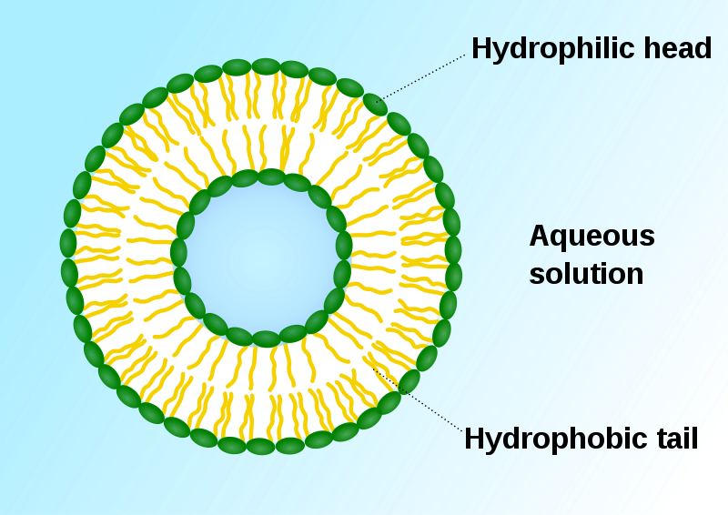
Lipid Bilayers; liposome
A liposome, with an inside and an outside: formed by phospholipids in an aqueous solution. Green: polar head groups.

Slide 12
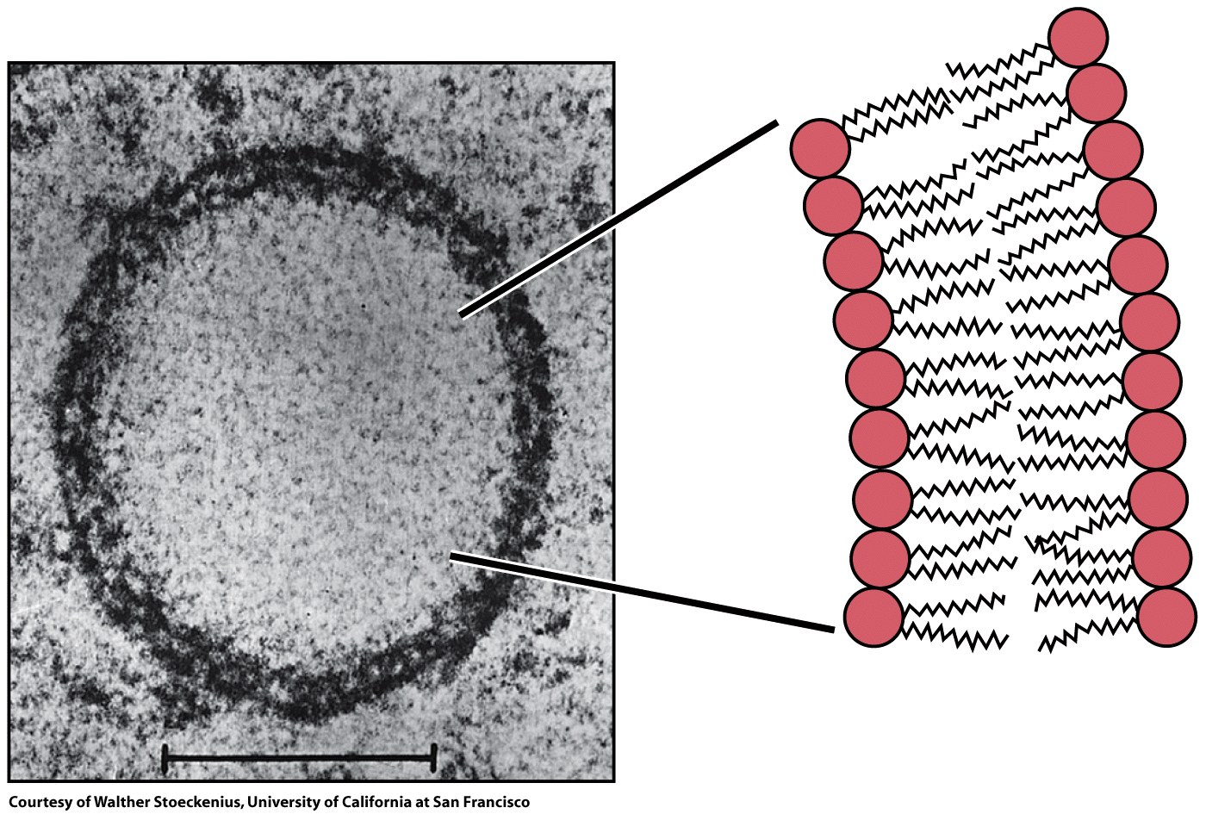
Figure 9-15

Slide 13
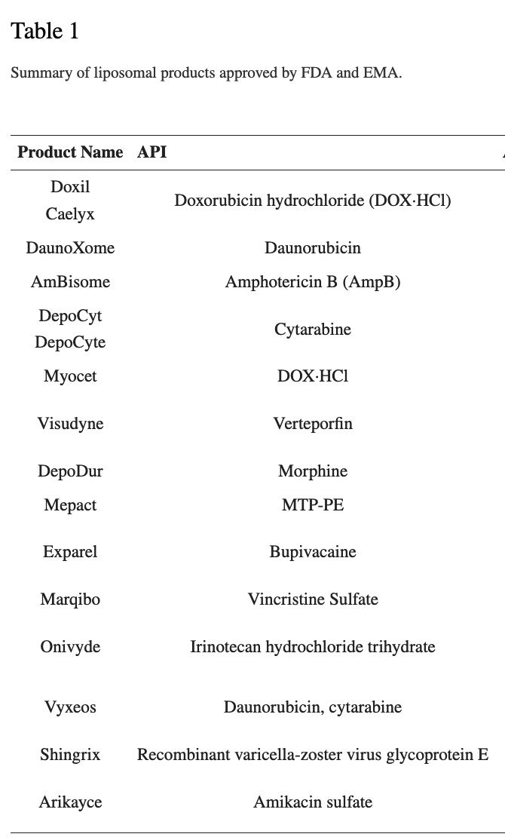

Slide 14
Lipid Bilayers
A lipid bilayer is a thin membrane formed by two layers of phospholipid/sphingolipid/etc. The membrane is a flat sheet with polar surfaces that sandwich a hydrophobic core. A membrane can form a continuous barrier that is impermeable to most hydrophilic molecules and ions.
The cell membranes of almost all living organisms and many viruses are made of a lipid bilayers, as are the membranes surrounding the cell nucleus and other organelles.
The cell membrane (plasma membrane) separates the interior of a cell from the outside.

Slide 15
Fatty acids:
Carboxylic acids of long chain hydrocarbons,
Amphipaths, surfactants
With wide spectrum of biological function
energy storage
structure (cell membranes in phospholipids)
precursors of hormones and bile salts,
facilitate absorption of fat-soluble vitamins (vitamin A)

Slide 16
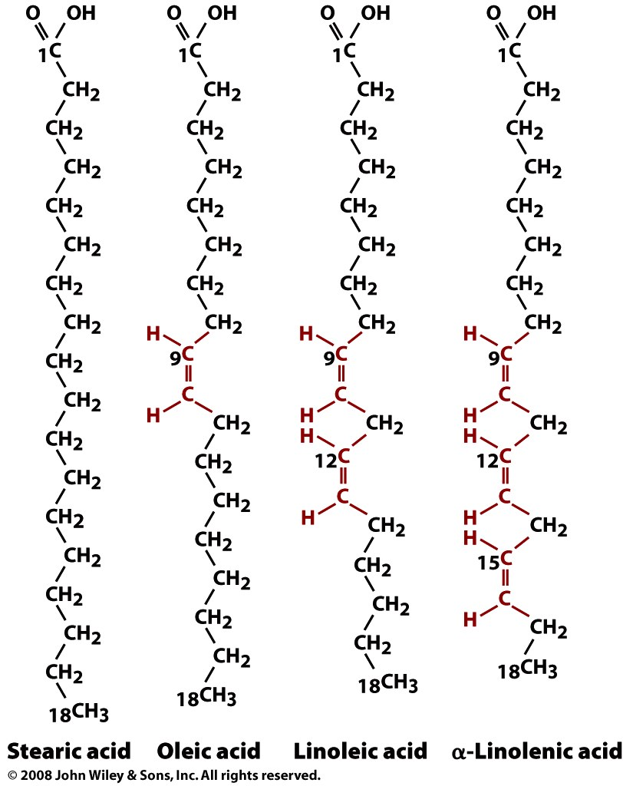
anions at physiological pH
Fatty Acids
Carboxylic acids of long chain hydrocarbons,
Amphipaths
Double bonds are always cis in biological fatty acids.
saturated
unsaturated
unsaturated
unsaturated

Slide 17
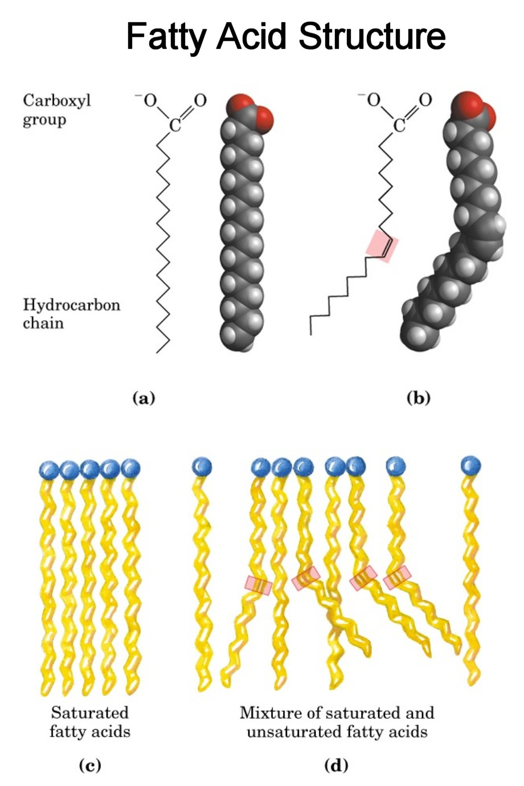
saturated
unsaturated

Slide 18
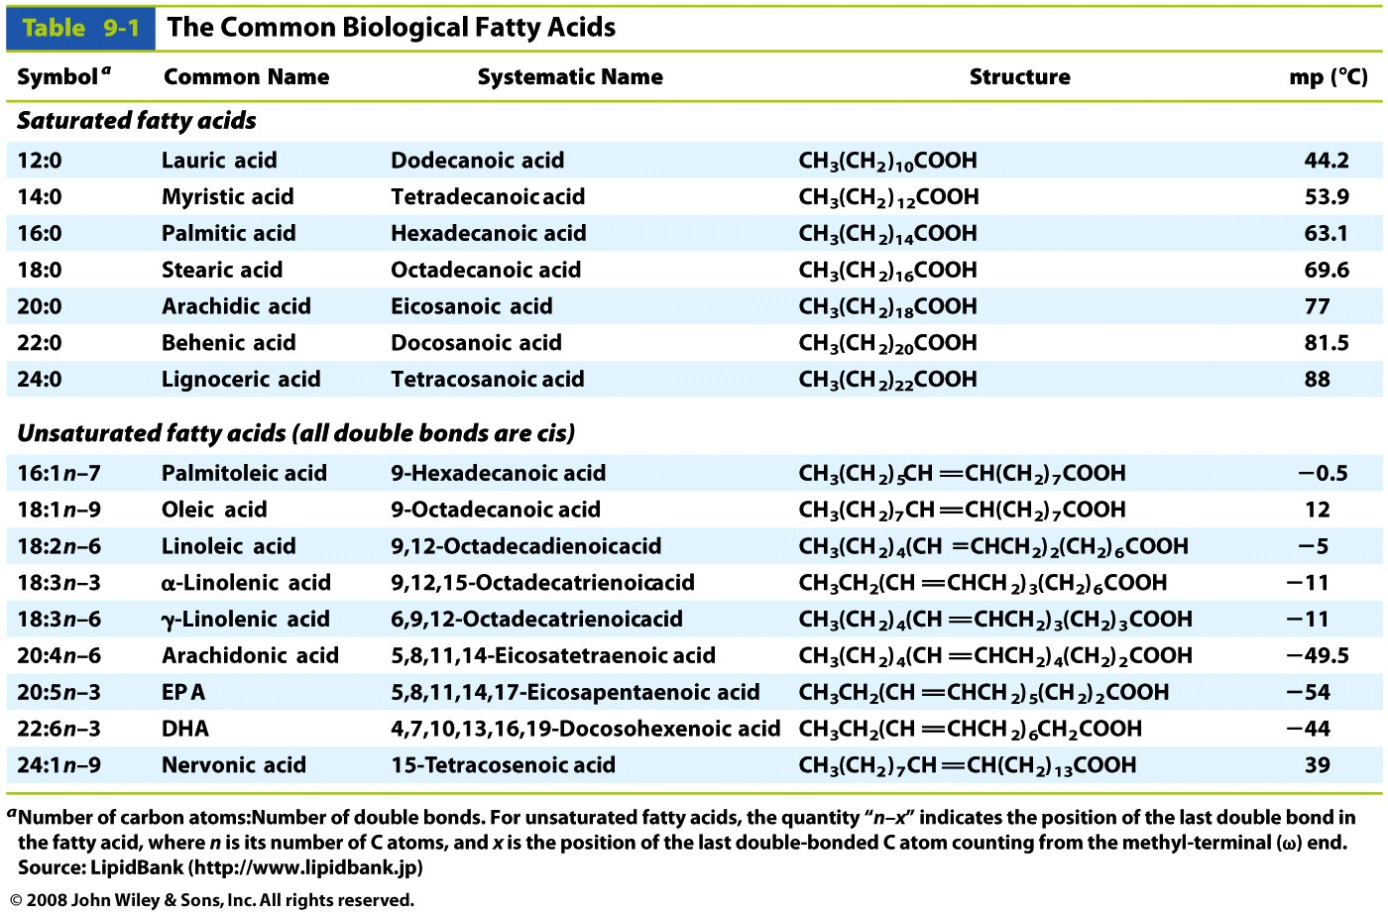
Table 9-1

Slide 19
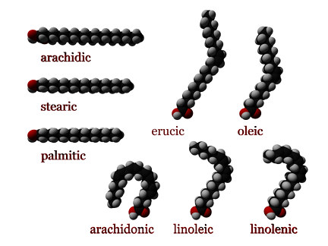

Slide 20
Unsaturated Fatty Acids (with double bonds)
These double bonds are cis isomers, not trans, in biological systems.
Cis: adjacent hydrogen atoms are on the same side of the double bond.
Cis double bonds cause the hydrocarbon tail to bend, restricts conformational freedom*, and alters packing between chains.
More double bonds (more unsaturation) means more bending, less flexibility and worse packing.
* a double bond is non-rotatable, and so it freezes the conformation.

Slide 21
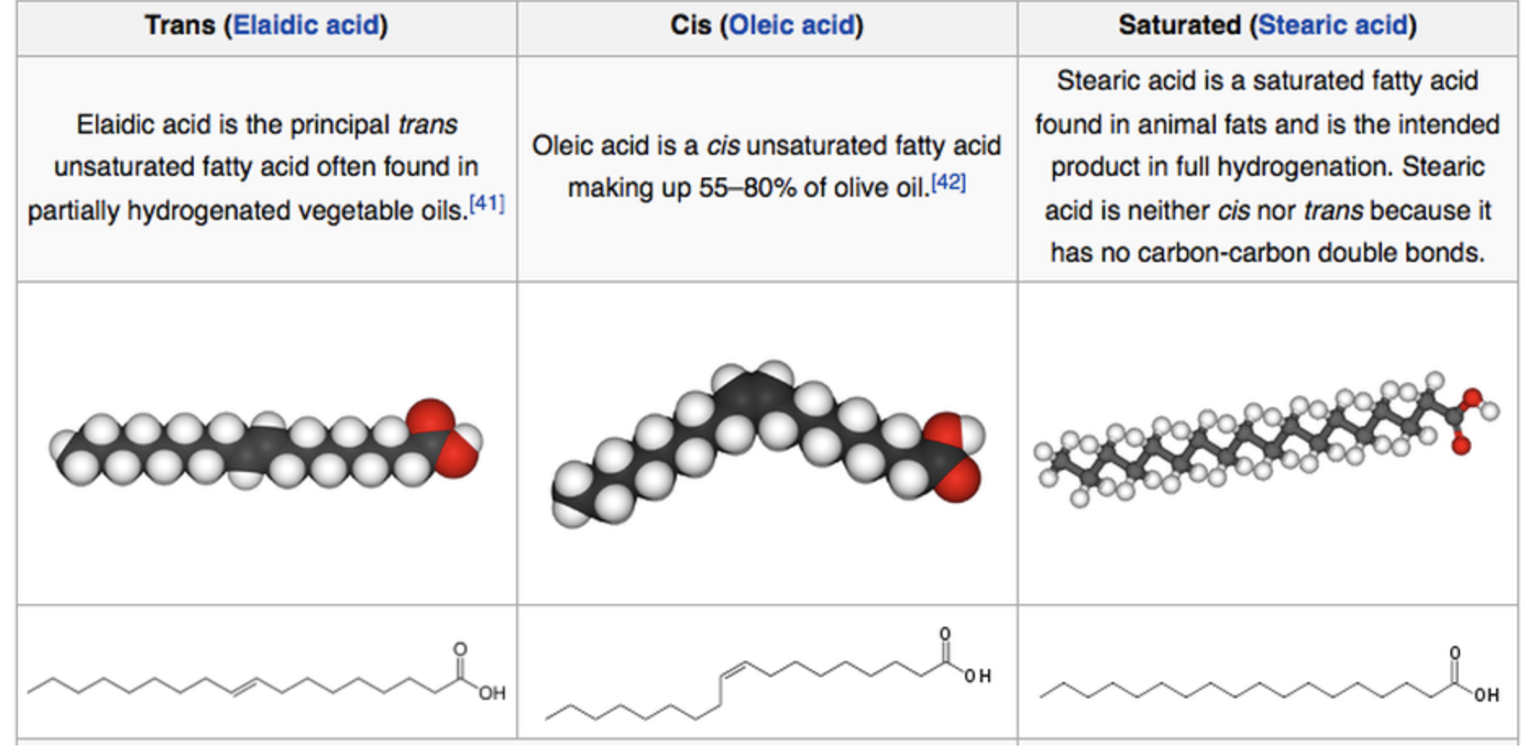
Trans fatty acids are made by industrial hydrogenation of vegetable oils. Trans fats are more robust and give superior performance in deep fryers

Slide 22
ω-Fatty Acids
n−3 fatty acids (aka ω−3 or omega-3 fatty acids) are unsaturated fatty acids with the first C=C bond in the n−3 position (the third bond from the methyl terminus).
α-Linolenic acid all-cis-9,12,15-octadecatrienoic acid, aka 18:3 (n−3).
Eicosapentaenoic acid (20:5, n−3; EPA)

Slide 23
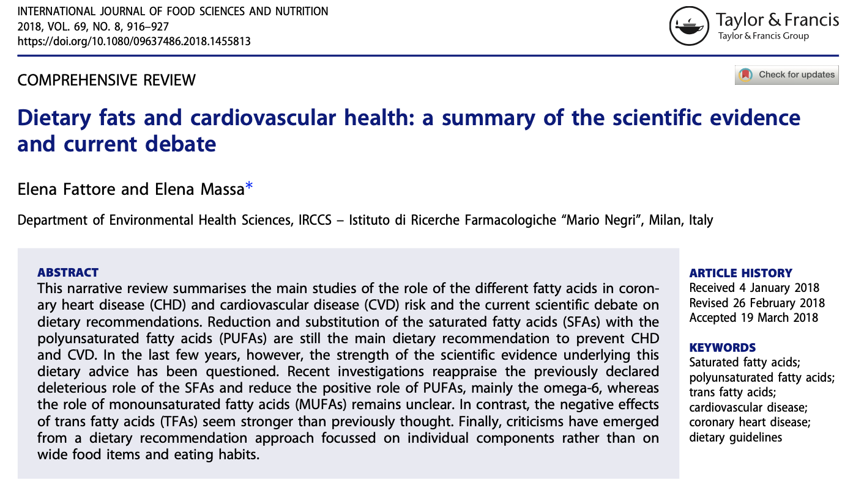
Food products can be listed as “0 grams of trans fats” if they contain less than 0.5 grams of trans fat per serving. Avoid “partially hydrogenated oils”.

Slide 24
Summary,
Polyunsaturated fatty acids (PUFA, have multiple cis double bonds) seem healthy.
Saturated fatty acids (no double bonds) are less healthy.
Omega-3 partially unsaturated fatty acids (double bonds near tail terminus) seem healthy; but effects not fully supported by recent meta-analyses of randomized controlled trials.
Trans fats – bad for you.

Slide 25
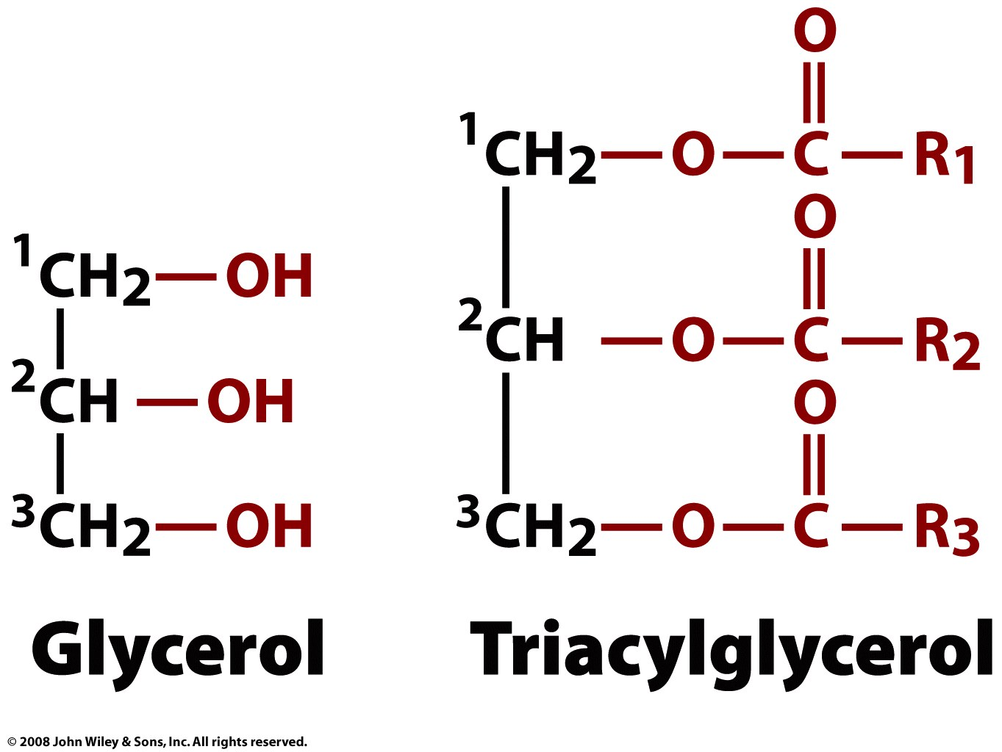
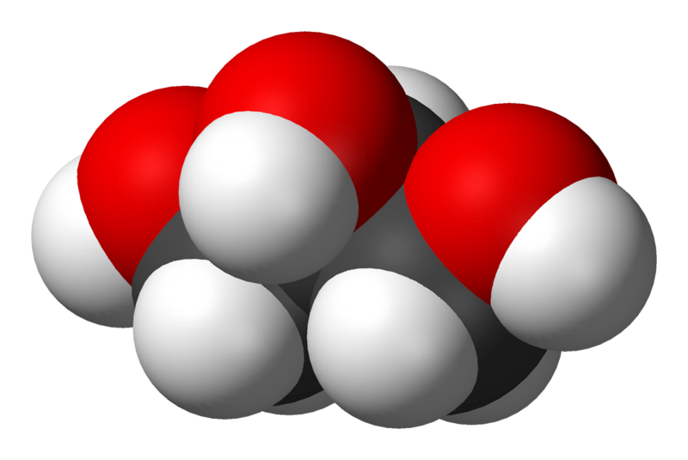
Triglycerides
(triglyceride)
A triglyceride is glycerol linked to three fatty acids, via ester linkages.

Slide 26
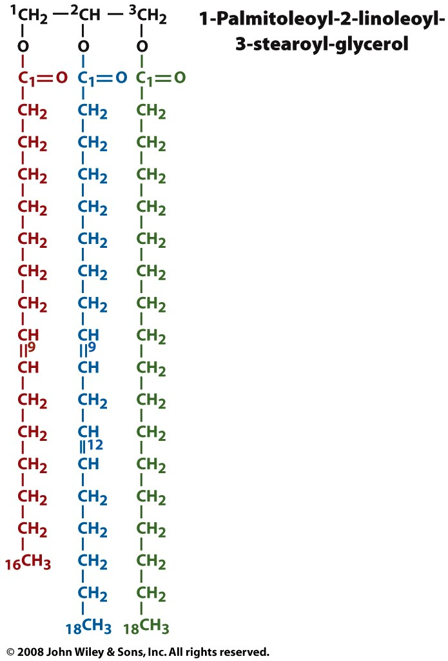
A triglyceride is glycerol linked to three fatty acids, via ester linkages. The three hydroxyl groups of the glycerol form esters with the carboxyl groups of the three fatty acids. A given triglyceride generally contains different types of fatty acids.
Fatty acids can be unsaturated, with C=C bonds, and polyunsaturated, with multiple C=C bonds. Double bonds lower the melting temp and increase the fluidity of the membrane.
Plant triglycerides are lower melting than animal triglycerides because they are less saturated (i.e., have more C=C bonds).
Fatty acids in biological triglycerides generally contain 16 - 20 carbon atoms. Fatty acids in eukaryotes contain even numbers of carbon atoms.
A high level of triglycerides in blood is linked with risk of heart disease. Triglycerides are not soluble in aqueous media, and are carried by proteins (lipoproteins)
A triglyceride
ester of
palmitoleic acid
ester of
linoleic acid
ester of
steric acid

Slide 27
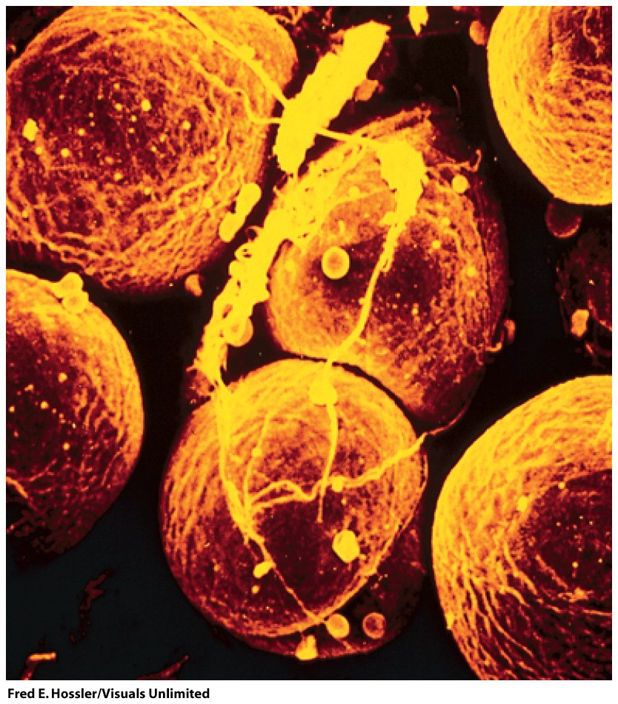
Adipocytes (fat cells, monovacuolar cells) contain lipid surrounded by cytoplasm. The nucleus is on the periphery. Fat is stored mostly as triglycerides and cholesteryl esters.
This is the densest form of stored energy in a biological system. The energy can be released slowly over long periods of time (as during starvation).
By contrast glycogen (polysachharide) stores can be released and used quickly.
Figure 9-2

Slide 28
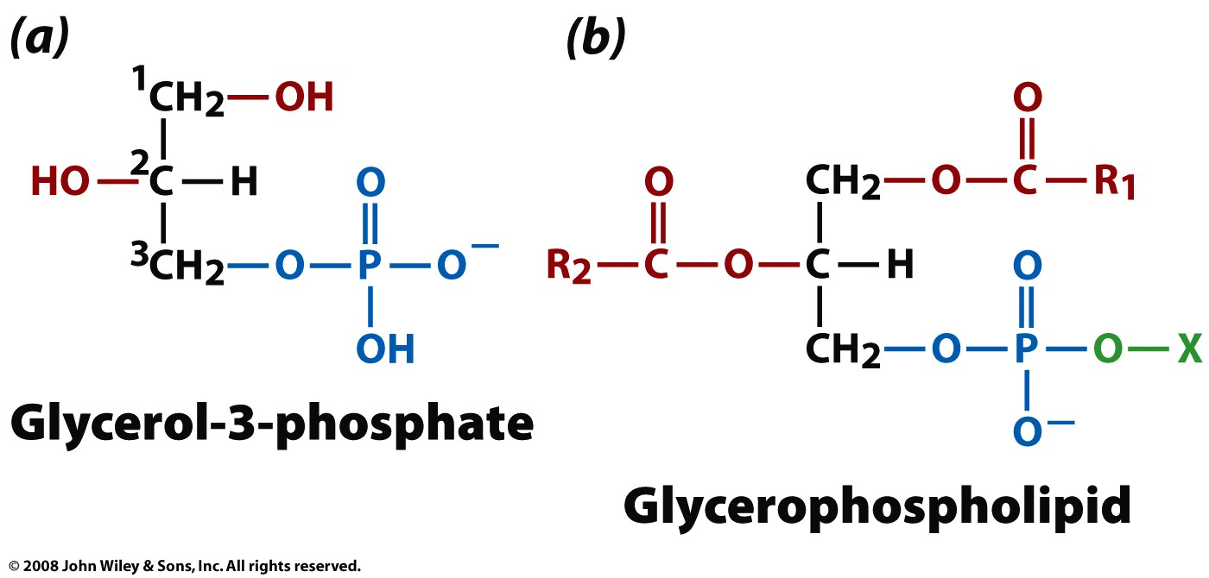
Phospholipids
Phospholipids are the major components of cell membranes.
A phospholipid is an amphipath, formed by a diglyceride,
linked to a phosphate group,
linked to a simple organic moiety like choline or ethanol amine (X, above).

Slide 29
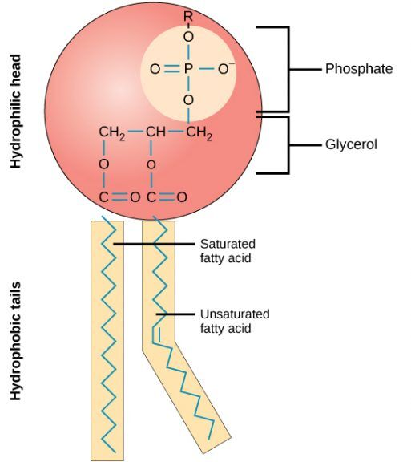
Phospholipid
Amphipath
Surfactant

Slide 30
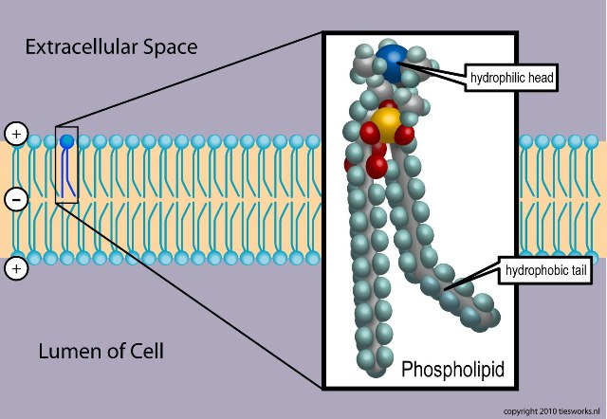

Slide 31
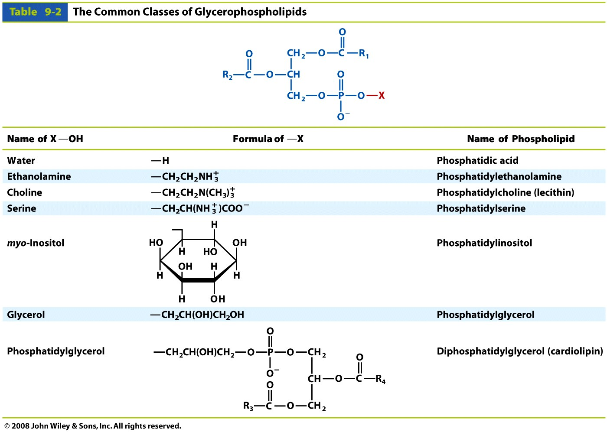
Table 9-2

Slide 32
Phosphatidylcholines are the primary components of biological membranes in eukaryotes.
Phosphatidylethanolamine is found predominantly in nervous tissue such as brain and neural tissue and is the principal phospholipid in bacteria.
Phosphatidylethanolamine membranes are more viscous (less fluid) than phosphatidylcholine membranes.
Phosphatidylserine is found on the cytosolic side of membranes.

Slide 33
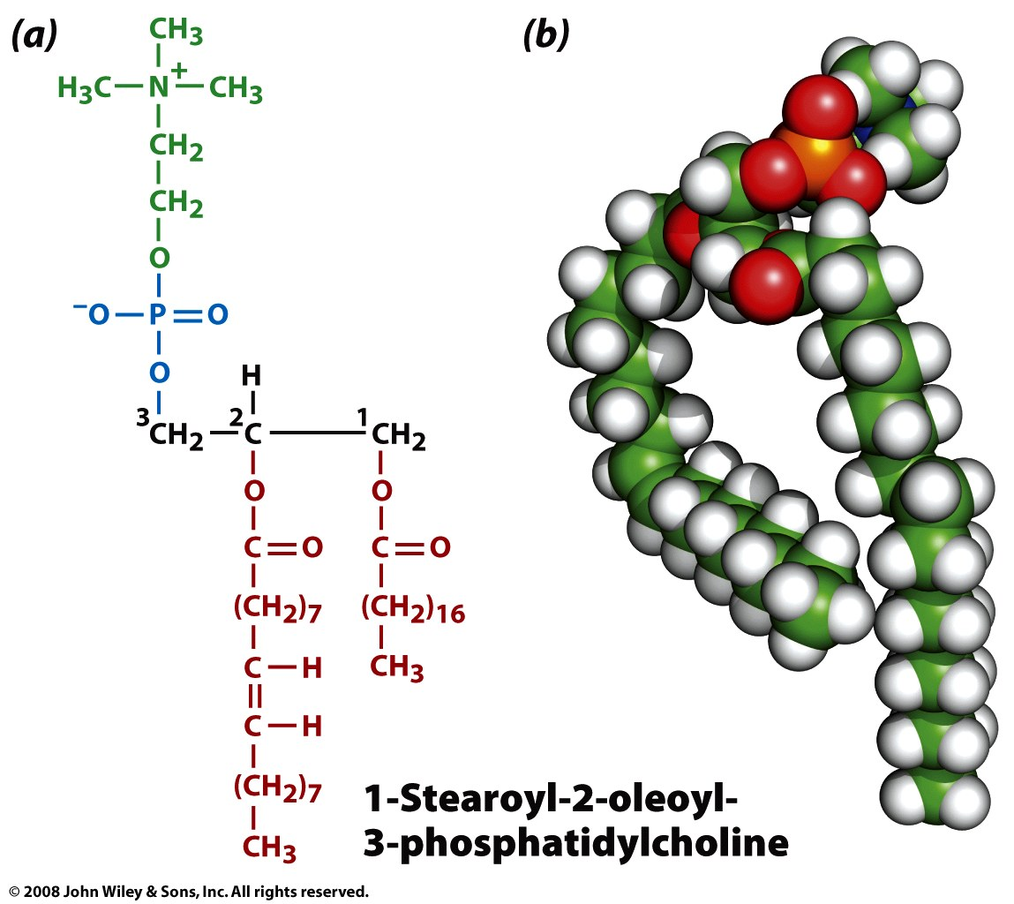
Figure 9-4

Slide 34
Glycosphingolipids & Myelin
GSLs are also important components of the myelin sheath that surrounds and insulates axons in the nervous system, contributing to the normal function of the nervous system.
(GSLs are also involved in a variety of biological processes, including the immune response, cell growth and differentiation, and apoptosis (programmed cell death).

Slide 35
Myelin
Myelin acts as an insulator, enabling electrical impulses to travel efficiently along the nerve fiber, increasing the speed and efficiency of neural communication. Myelin is produced by specialized cells called oligodendrocytes in the central nervous system and Schwann cells in the peripheral nervous system. Disorders that affect myelin, such as multiple sclerosis, can have a significant impact on the function of the nervous system.

Slide 36
Myelin
Features that distinguish glycosphingolipids in myelin from the glycosphingolipids found in the plasma membrane:
glycosphingolipids instead of phospholipids
a headgroup based on galactose,
high levels of fatty acid hydroxylation,
very-long-chain fatty acids (VLCFA) with chain lengths up to 26 carbons.
frequent plasmalogens (alk-1’-enylether bond at position sn-1 and acyl bond at position sn-2.)

Slide 37
Sphingosine
(2-amino-4-octadecene-1,3-diol) is an amino alcohol with an unsaturated (trans) 18-carbon hydrocarbon chain.
Sphingolipids are phospholipids that contain sphingosine.
Ceramide: a sphingosine plus a fatty acid.

Slide 38
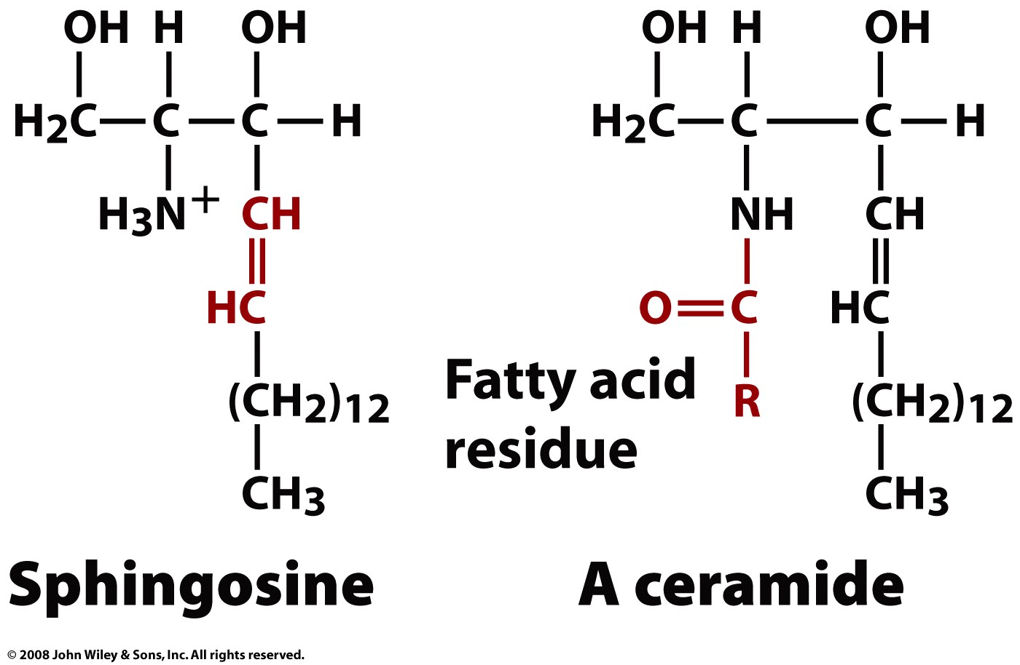
Page 252

Slide 39
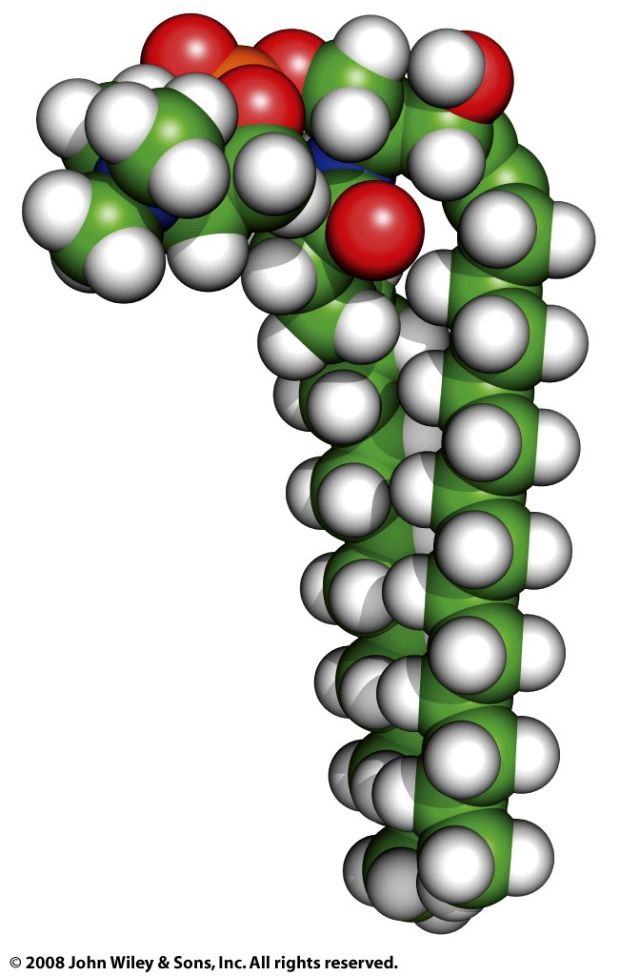
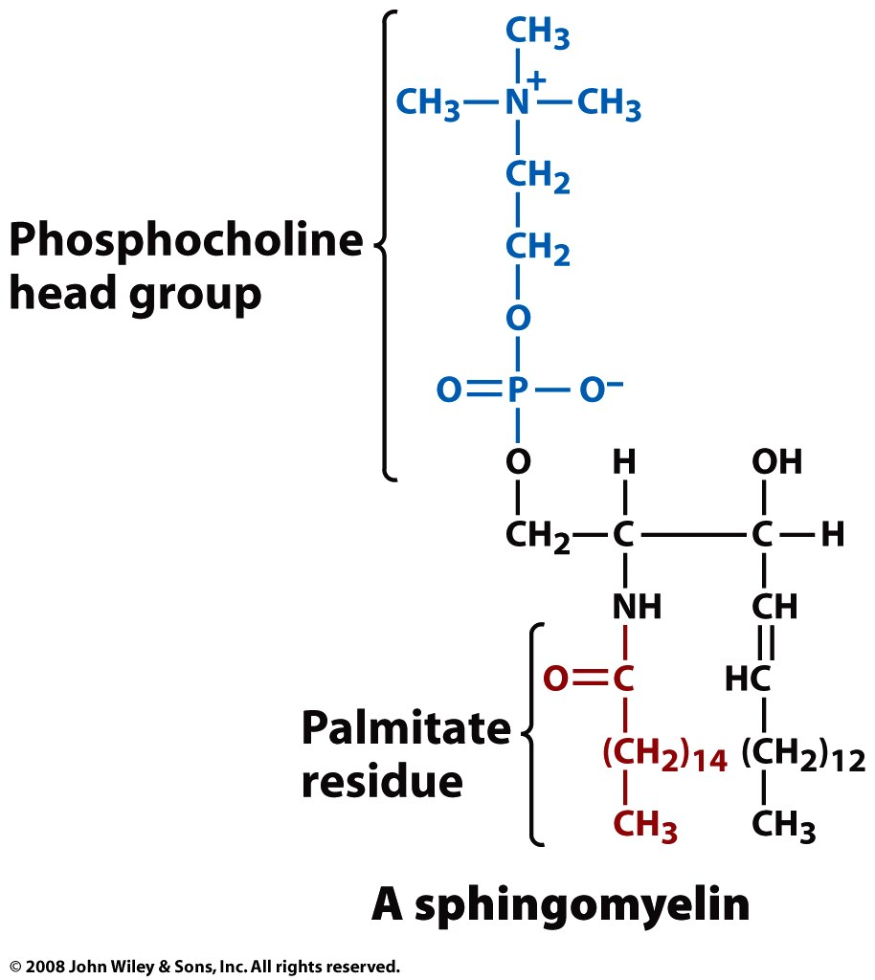

Slide 40
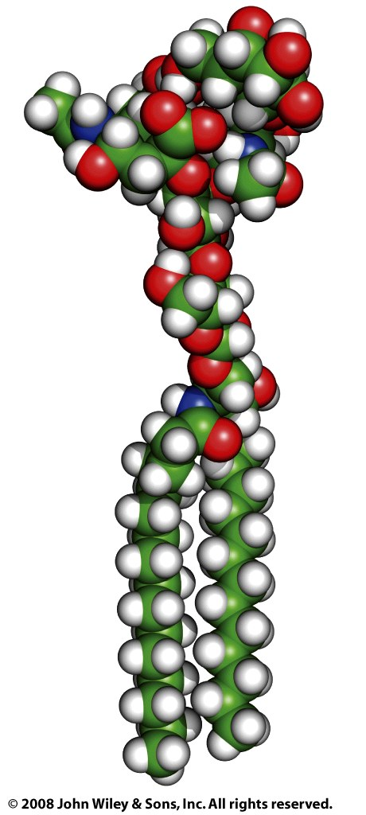
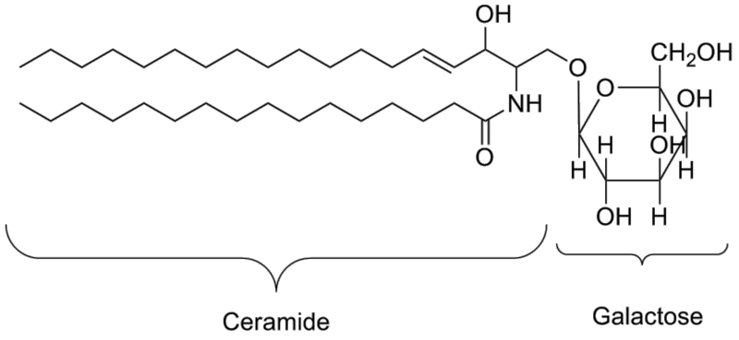
G_{M1}
Cerebroside (galactoceramide)
is a ceramide with a galactose at the 1-hydroxyl moiety.
Galactocerebrosides are found in oligodendrocytes in the brain

Slide 41
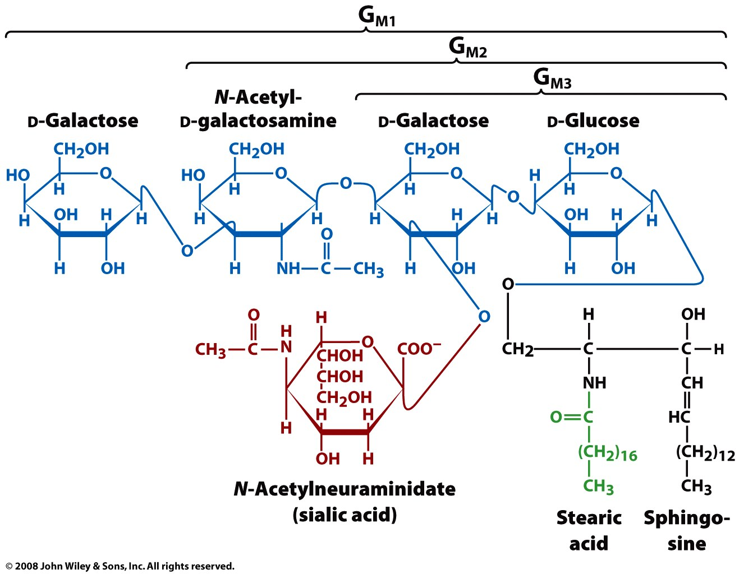
A ganglioside is a ceramide and an oligosaccharide, with one or more sialic acids (e.g. n-acetylneuraminic acid) linked to the saccharide. Gangliosides are concentrated on cell surfaces with the oligosaccharides providing recognition elements for extracellular molecules or surfaces of neighboring cells. Ganglioside are found predominantly in the nervous system where they constitute 6% of all phospholipids.

Slide 42
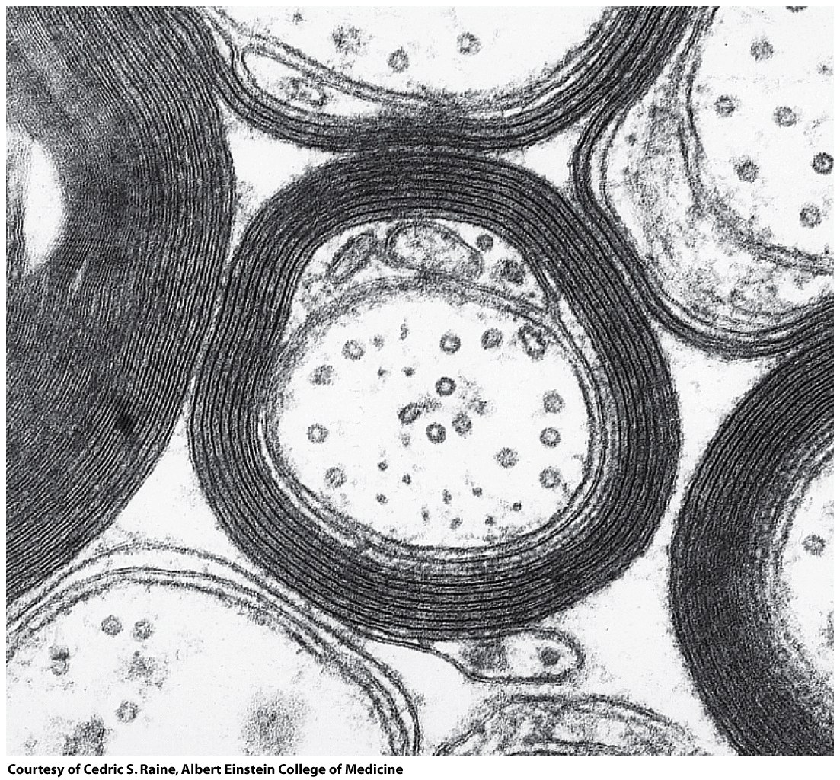
Roles of Sphingolipids.
Myelin is insulating sheath, surrounding the axons of a neurons. Myelinated axons are white ("white matter" of the brain). Myelin is made of proteins and lipids. The primary lipid is the sphingolipid cerebroside (galactocerebroside). Sphingomyelin is also abundant.
Demyelination (the loss of myelin sheath) is a defining characteristic neurodegenerative autoimmune diseases such as multiple sclerosis.
Electron micrograph of a myelinated axon.
Figure 9-8

Slide 43
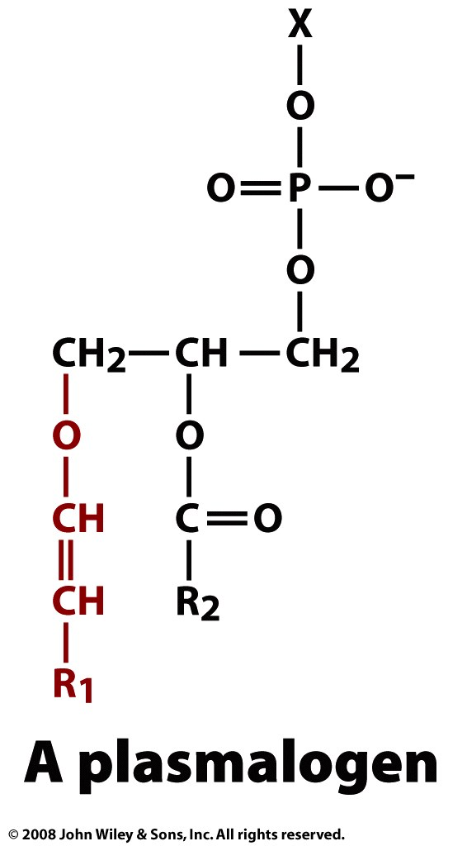
Plasmalogens are found nervous, immune, and cardiovascular tissue In human heart tissue, 30–40% of choline glycerophospholipids are plasmalogens. Almost 30% of the glycerophospholipids in the adult human brain and up to 70% of myelin sheath ethanolamine glycerophospholipids are plasmalogens
Although the functions of plasmalogens have not yet been fully elucidated, they can protect mammalian cells against the damaging effects of reactive oxygen species. They have been implicated as being signaling molecules and modulators of membrane dynamics. (Wikipedia)
Ether-phospholipids
vinyl
ether

Slide 44
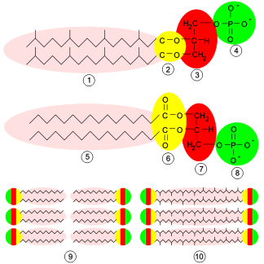
Archaea
Archaea differ from other living things in their cell membranes. Their are four fundamental differences between archaeal membranes and those of bacterial and eukaryotic cells: (1) chirality of glycerol, (2) ether versus ester linkage, (3) isoprenoid versus fatty acid chains, and (4) branching of side chains.
http://www.ucmp.berkeley.edu/archaea/archaeamm.html

