Slide 2
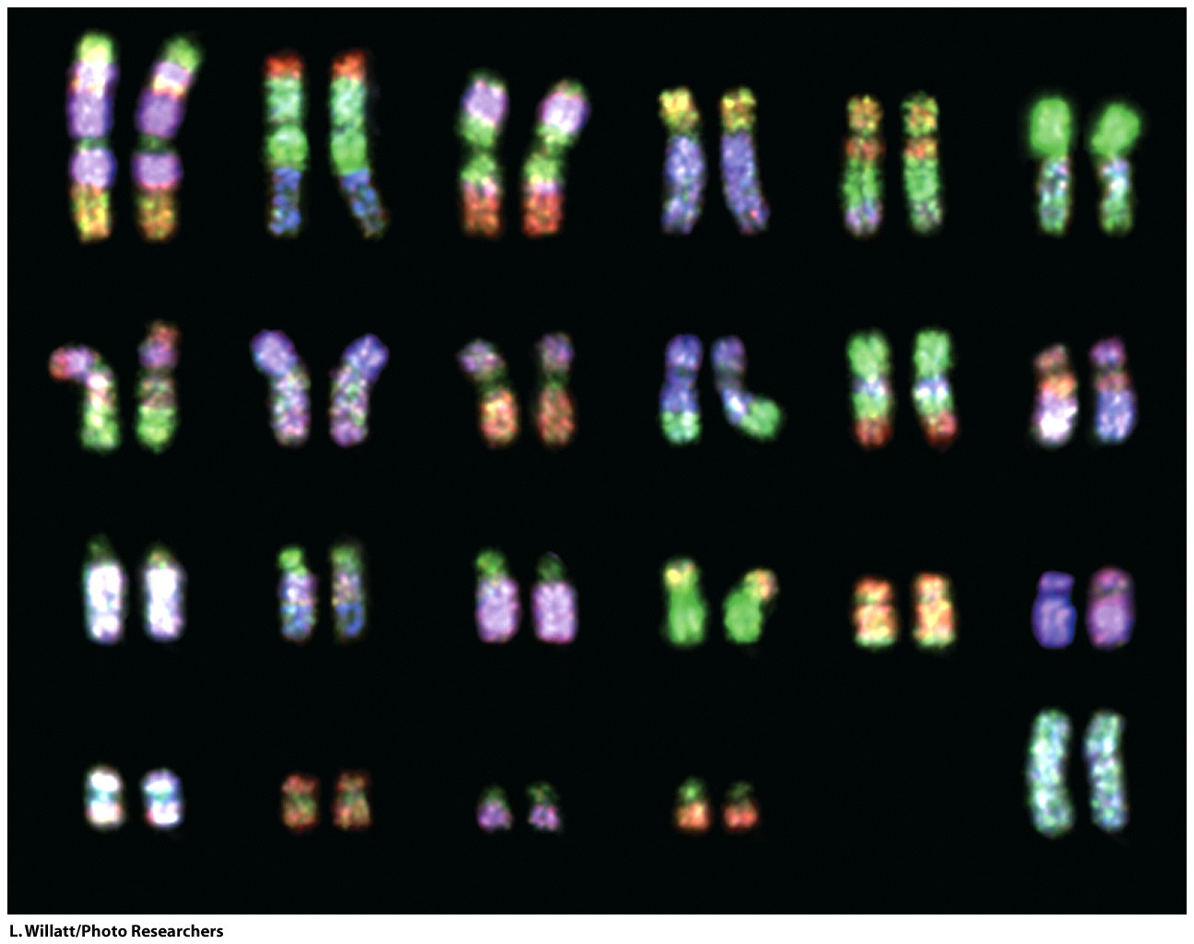
DNA replication starts with a double-stranded DNA duplex [two strands, paired to each other] and produces two daughter duplexes that are identical to each other and to the parent duplex. Each strand of the parent duplex is a template for production of the opposing complementary strand.

Slide 3
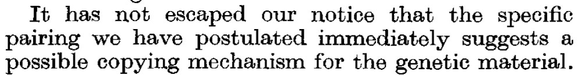

Slide 4
All polymerizations (replication, transcription, translation)
Have at least three distinct steps:
initiation
elongation
termination

Slide 5
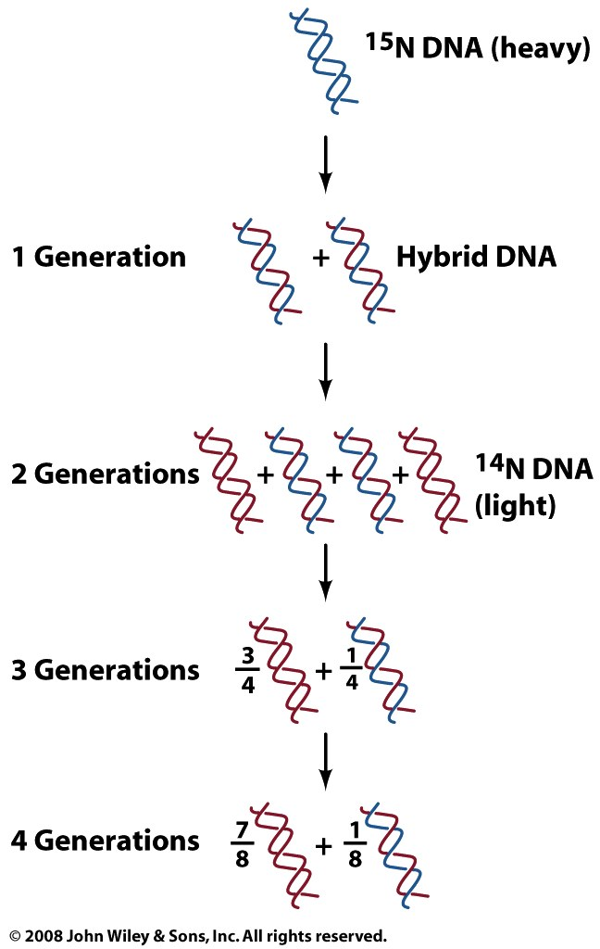
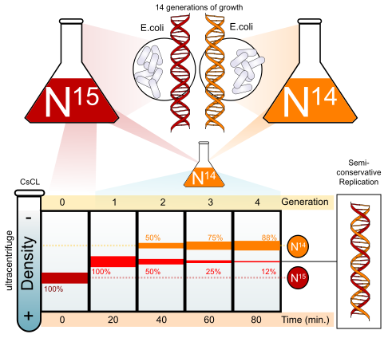
DNA Replication is Semiconservative
Meselson and Stahl (1958)
"The most beautiful experiment in biology.”
Semiconservative Model: Each daughter duplex contains one strand from the parent duplex and one newly synthesized strand.
The conservative model: an entire DNA duplex acts as a template for synthesis of an entirely new duplex.
The dispersive model: DNA is synthesized in short pieces that alternate from one strand to the other.
The Model
The Data

Slide 6
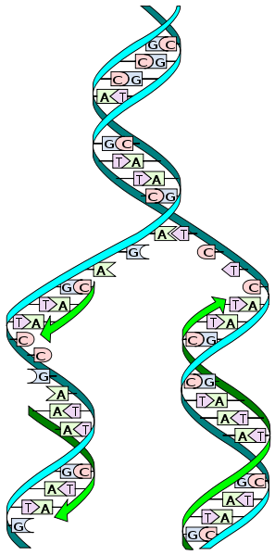
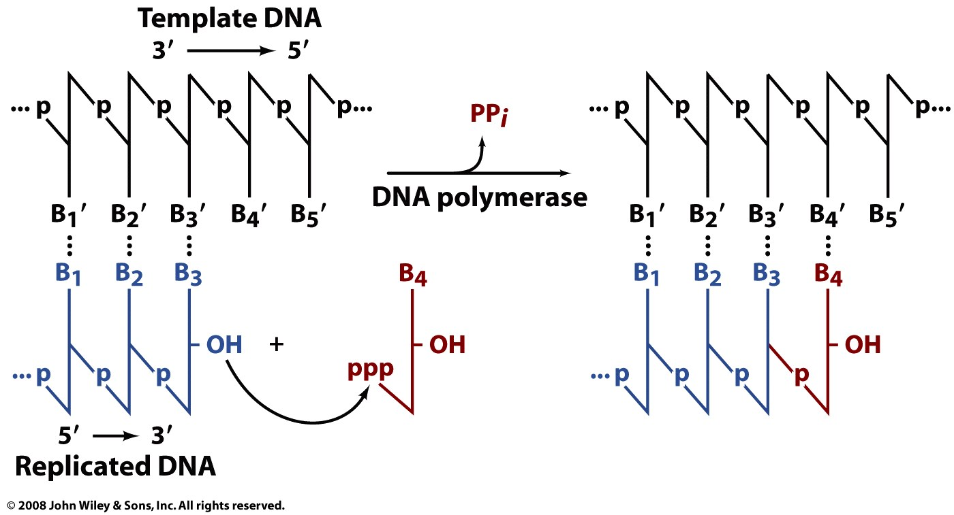
DNA replication (directionality)
(only in 5’ to 3’ direction)
DNA replication initiates at a specific location in a genome or plasmid, called an origin of replication. The DNA unwinds at the origin and the paired strands separate to allow initiation of replication. A replication origin is a DNA sequence that is recognized by replication initiator proteins. Initiator proteins recruit other proteins to separate the two strands and form a replication fork. The branch point, where single-strands meet the double strand, is called the replication fork. The replication fork moves.

Slide 7
DNA replication (directionality)
(only in 5’ to 3’ direction)
lagging
leading
A DNA polymerase can extend, but cannot initiate de novo synthesis. DNA polymerase requires a primer. Leading strand synthesis (right) and lagging strand synthesis (left) cannot work in the same way. Lagging stand synthesis has to keep priming.

Slide 8
DNA replication (required
chemical components)
DNA replication requires:
a template
a free 3’ hydroxyl group (requires a primer to start),
four 5’ dNTPs (triphosphate on the 5’ oxygen)
(the 3’oxygen is a nucleophile that attacks the 5’ P of the dNTP.
Magnesium (any reaction that uses any dNTP requires Mg²⁺).
DNA polymerase (lots of auxillary proteins in vivo)

Slide 9
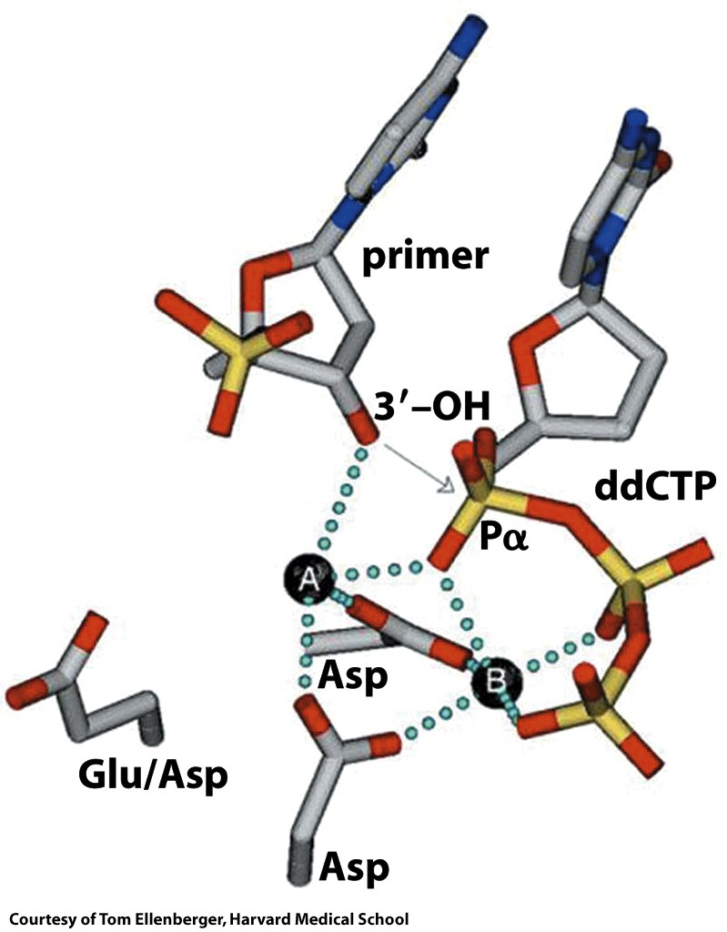
A polymerase active site, trapped with a ddCTP (dideoxy).
Figure 25-12

Slide 10
DNA replication (primers)
A DNA polymerase cannot form a strand de novo, from dNTPs alone. A polymerase can only extend a strand. Therefore a DNA polymerase requires a primer, which it extends. Primers in vivo are generally RNA, and are later excised and replaced by DNA.

Slide 11
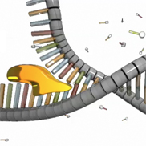
DNA replication (helicases)
A helicase (like dnaB) is a motor protein moves along a DNA duplex, separating the strands. A helicase uses energy derived from ATP hydrolysis. Single stranded binding proteins (SSBs) stablize and protect the ss DNA between the helicase and the polymerase.

Slide 12
DNA replication (primosome)
The primosome synthesizes a fragment of 1-10 RNA nucleotides that aneals to the single stranded DNA template. This RNA is used as a primer to initiate DNA polymerase. The primosome is utilized once on the leading strand of DNA and repeatedly, initiating each Okazaki fragment, on the lagging DNA strand.

Slide 13
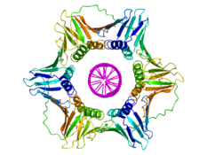
DNA replication (sliding clamp)
A DNA clamp associates with the polymerase + DNA, promoting processivity. Once the clamp assembles and is locked onto the template DNA, it cannot dissociate from the DNA without dissociating into monomers. It is very important the the polymerase does not fall of the DNA.

Slide 14
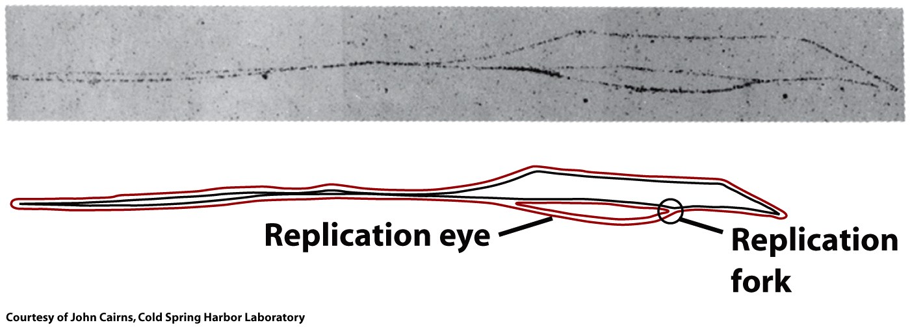
A Bacterium has one origin of replication within its genome.
Eukaryotes have large chromosomes and initiate replication at multiple origins.

Slide 15
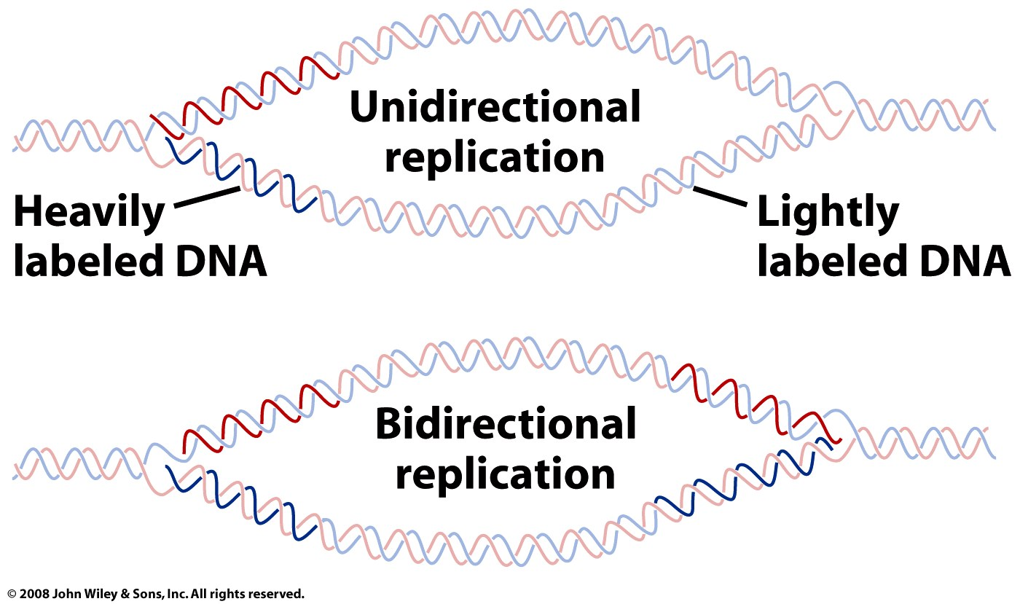
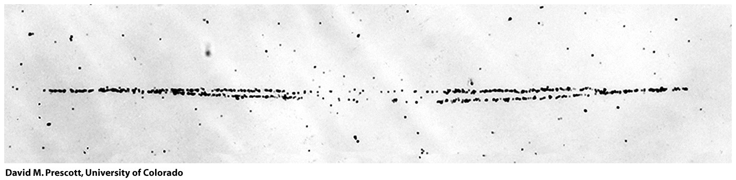
DNA replication is bidirectional

Slide 16
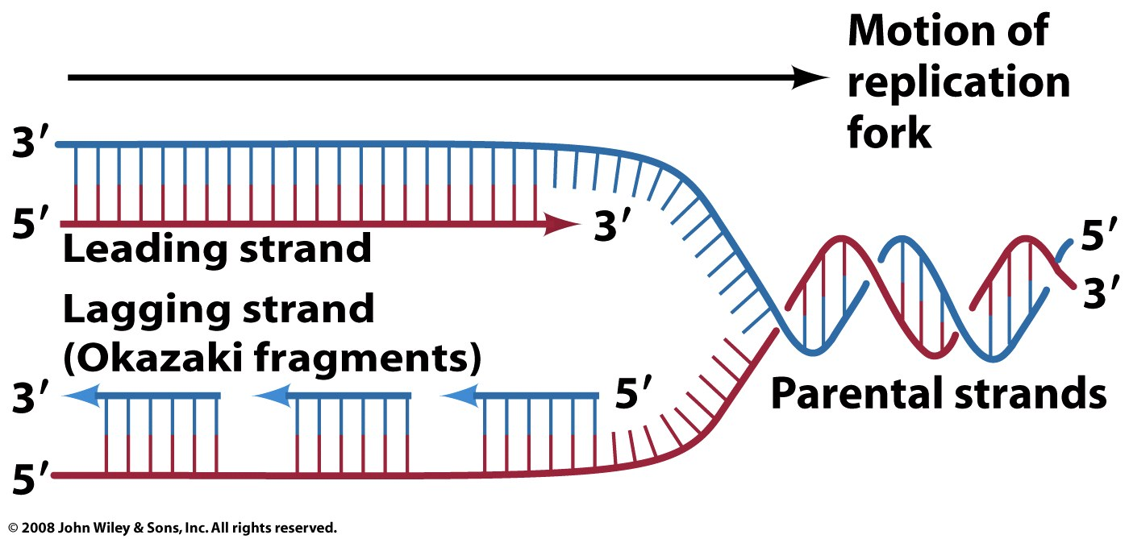
All DNA polymerases extend only in the 5’ to 3’ direction.
The Leading Strand: is extended in the 5’ to 3’ direction by continuous replication
The Lagging Strand: is effectively extended in the 3’ to 5 direction (net) by discontinuous replication (always in the 5’ to 3’ direction).

Slide 17
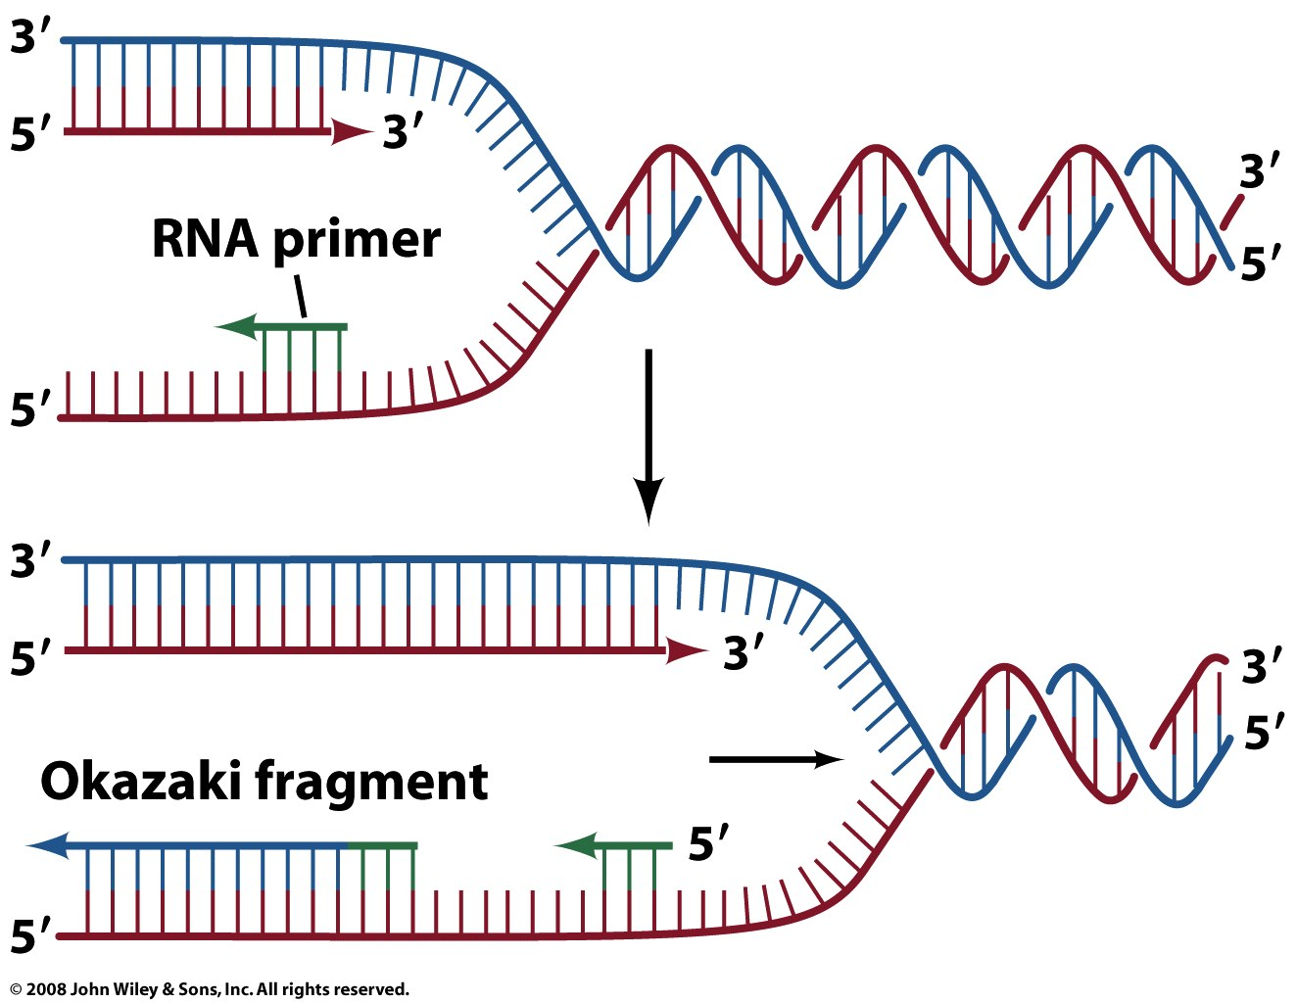
Figure 25-6

Slide 18
(1) The Free Energy of Fidelity or - How to replicate billions and billions of base pairs without making too many mistakes.
The problem:
The difference in free energy predicts an error rate of about 1/4000.

Slide 19
(2) The Free Energy of Fidelity or - How to replicate billions and billions of base pairs without making too many mistakes.
The solution:
Proofreading activity
1/4000 error rate in the incorporation step.
1/4000 error rate in the proof reading step.
1/4000 x 1/4000 = 1/16,000,000
That is one mistake in 16 million base pairs
Now add in mismatch repair.

Slide 20
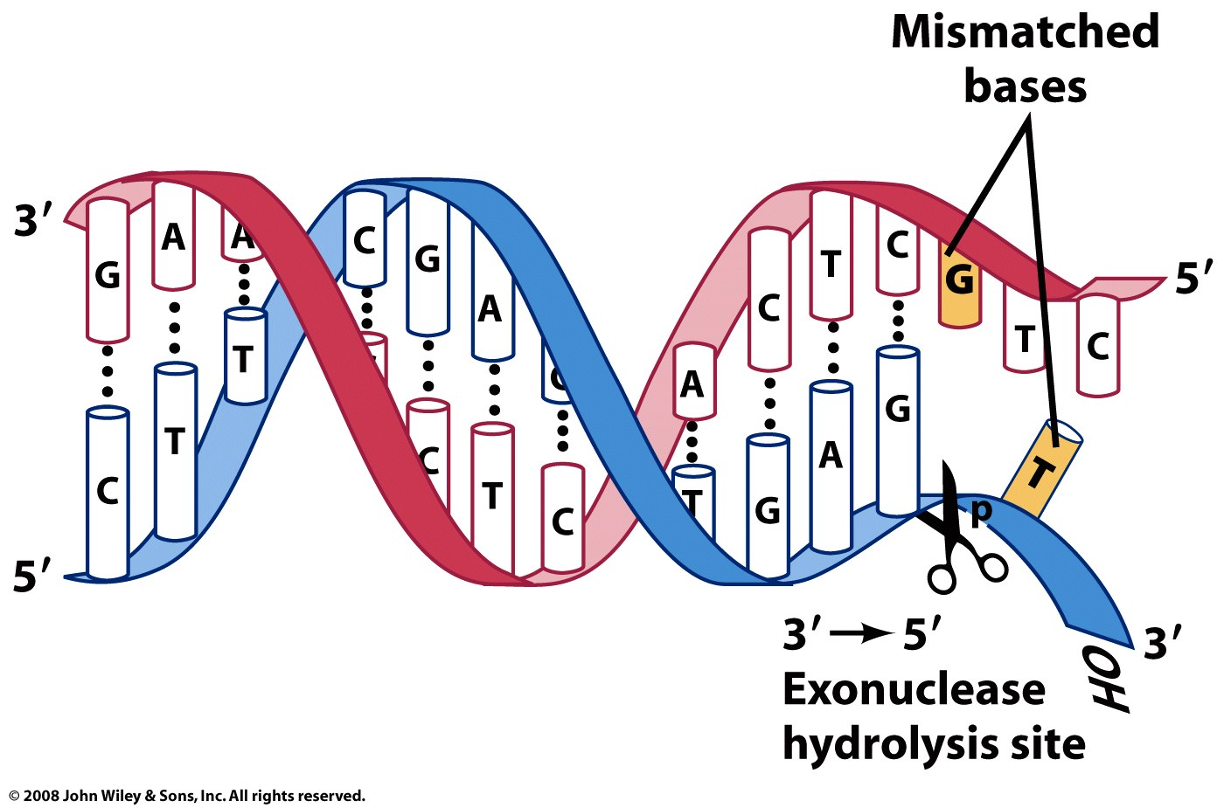
Proof reading
Figure 25-7

Slide 21
There are five different Bacterial DNA polymerases:
(we are interested in DNA Pol III of them for this class)
DNA Pol I: for DNA repair; has (a) 5’ -> 3' polymerase activity, (b) 3’ -> 5' exonuclease activity (for proofreading), and (c) 5’ -> 3' exonuclease activity (for RNA primer removal). This enzyme performs ‘nick translation’.
DNA Pol II: for DNA repair (SOS); has (a) 5’ -> 3' polymerase activity, and (b) 3 '-> 5' exonuclease activity.
DNA Pol III: the main polymerase (responsible for replication); (a) 5’ to 3' polymerase activity and (b) 3'->5' exonuclease activity.

Slide 22
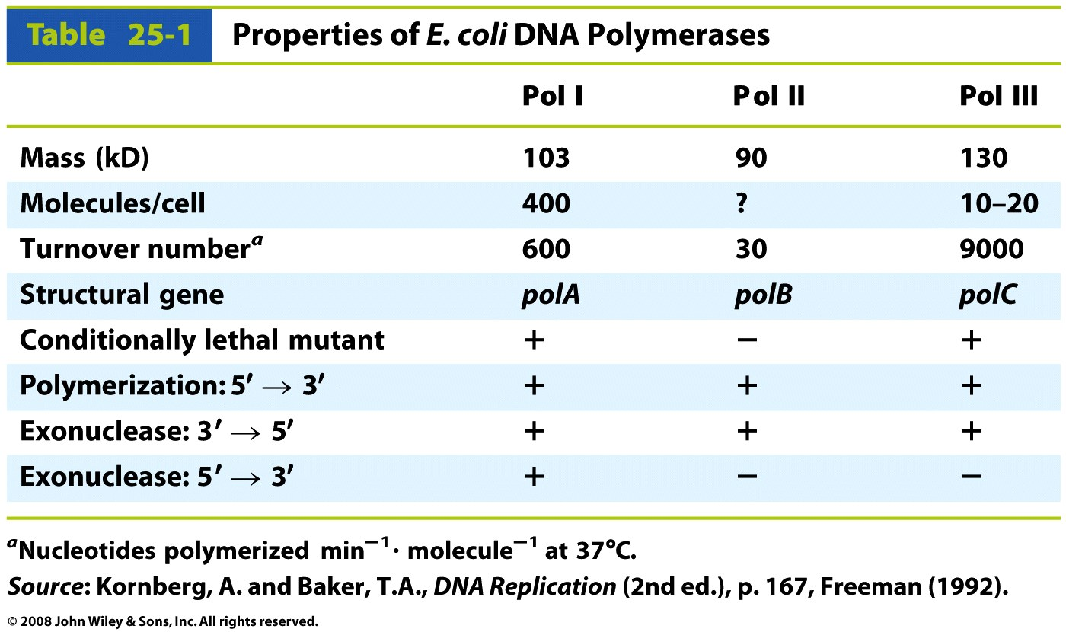
Table 25-1

Slide 23
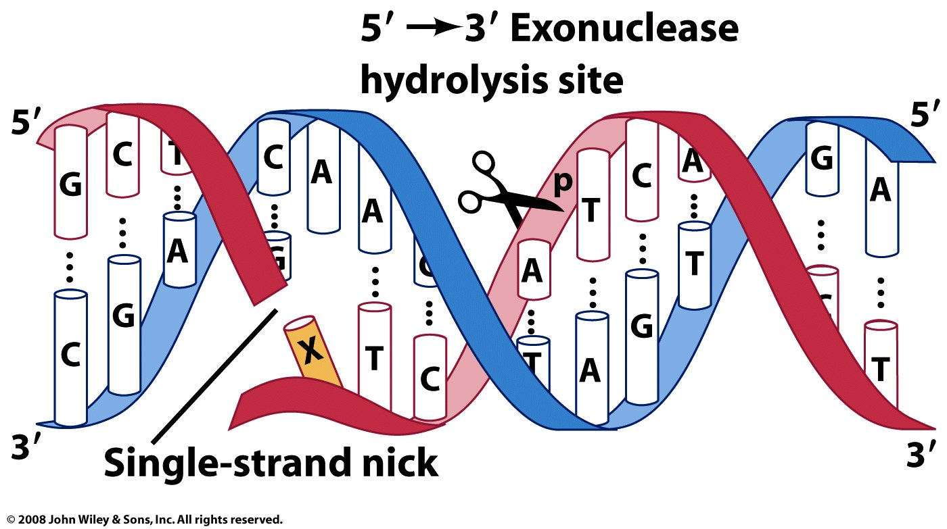
The 5’->3’ exonuclease activity chews in advance of the polymerase. It cannot cut an intact duplex. In this figure, the cut site (nick) is between X and G.

Slide 24
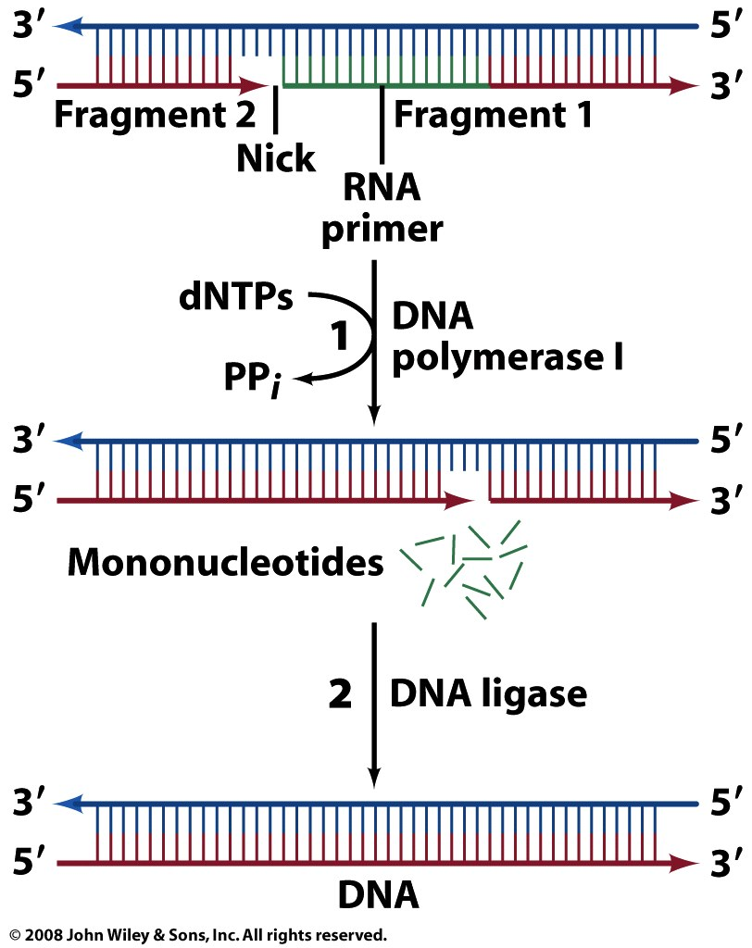
Excising the RNA primer.
Figure 25-9

Slide 25
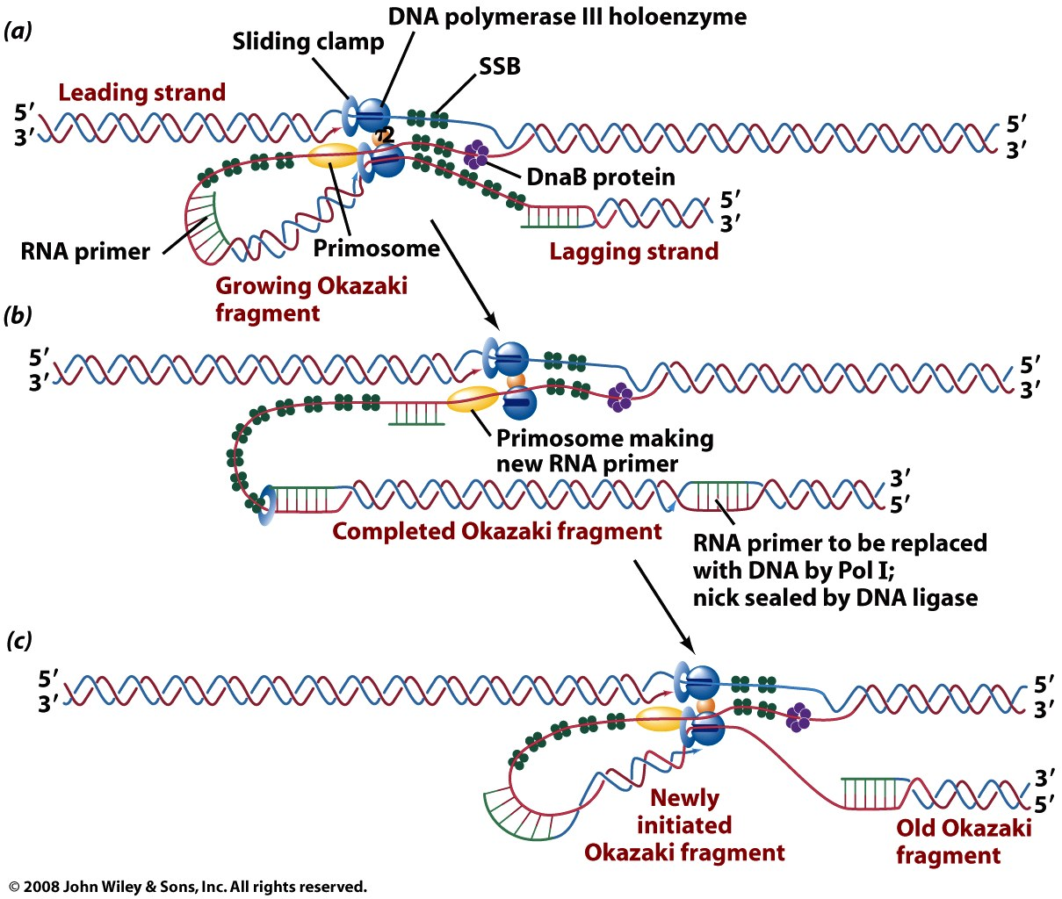
Figure 25-15

Slide 26
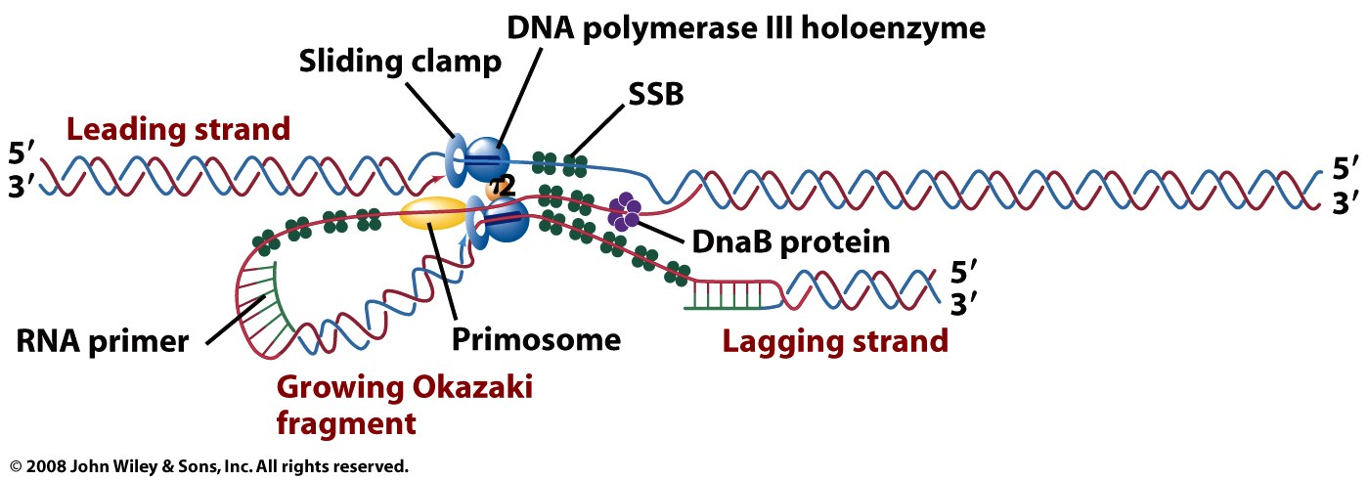
Figure 25-15a

Slide 27
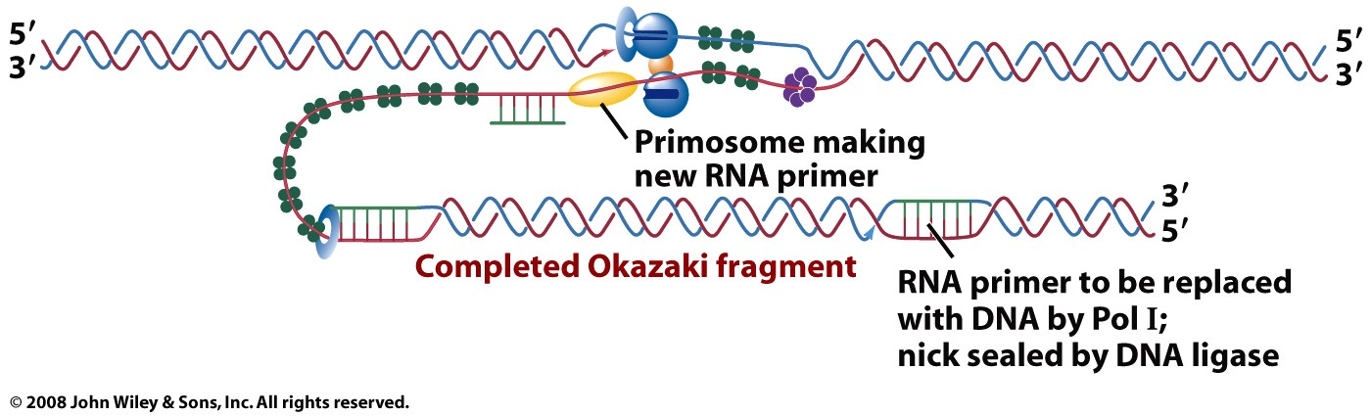
Figure 25-15b

Slide 28
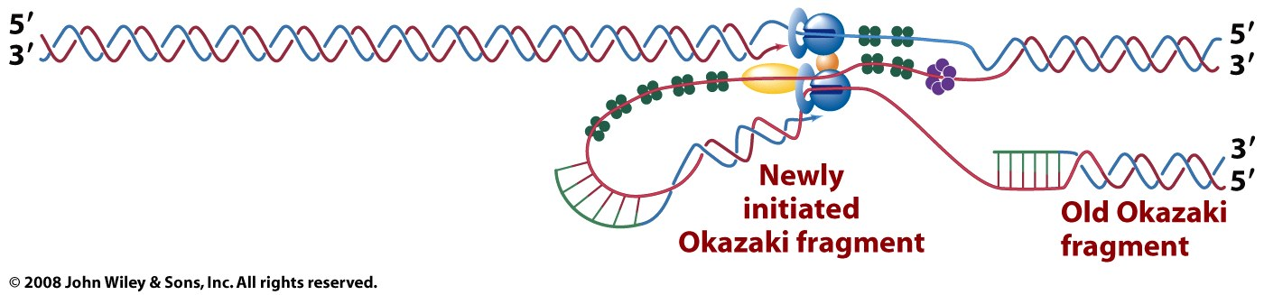
Figure 25-15c

Slide 29
DNA Damage & Repair
damaging agents:
uv light
other ionizing radiation (x-rays, etc)
alkylating agents [nitrosamines (tobacco) mustards]
oxidants (ROS: reactive oxygen species)
radicals
results:
chemical modification of DNA bases, sugars..)
single-strand breaks
double strand breaks
=>point mutations, insertions, deletions

Slide 30
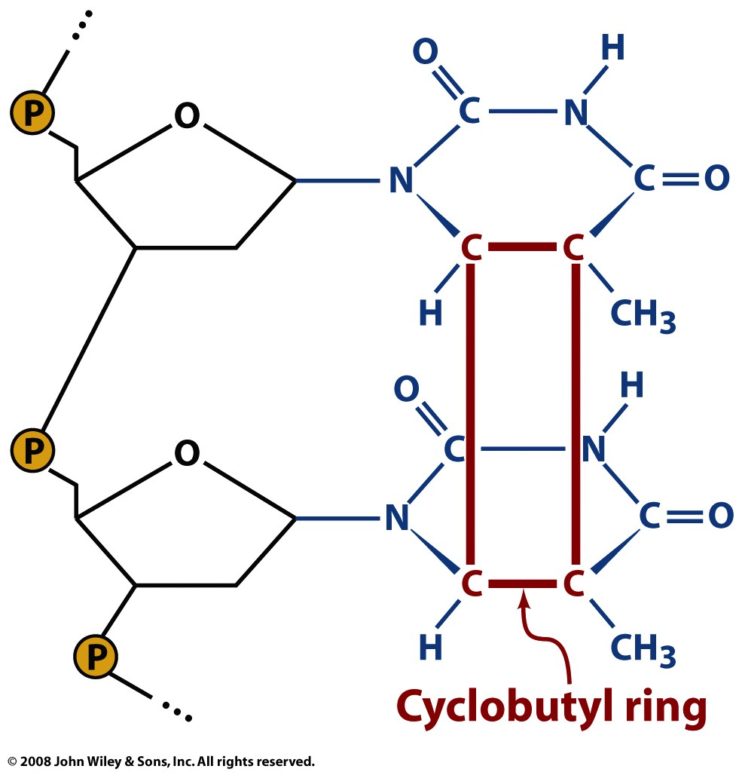
Figure 25-26

Slide 31
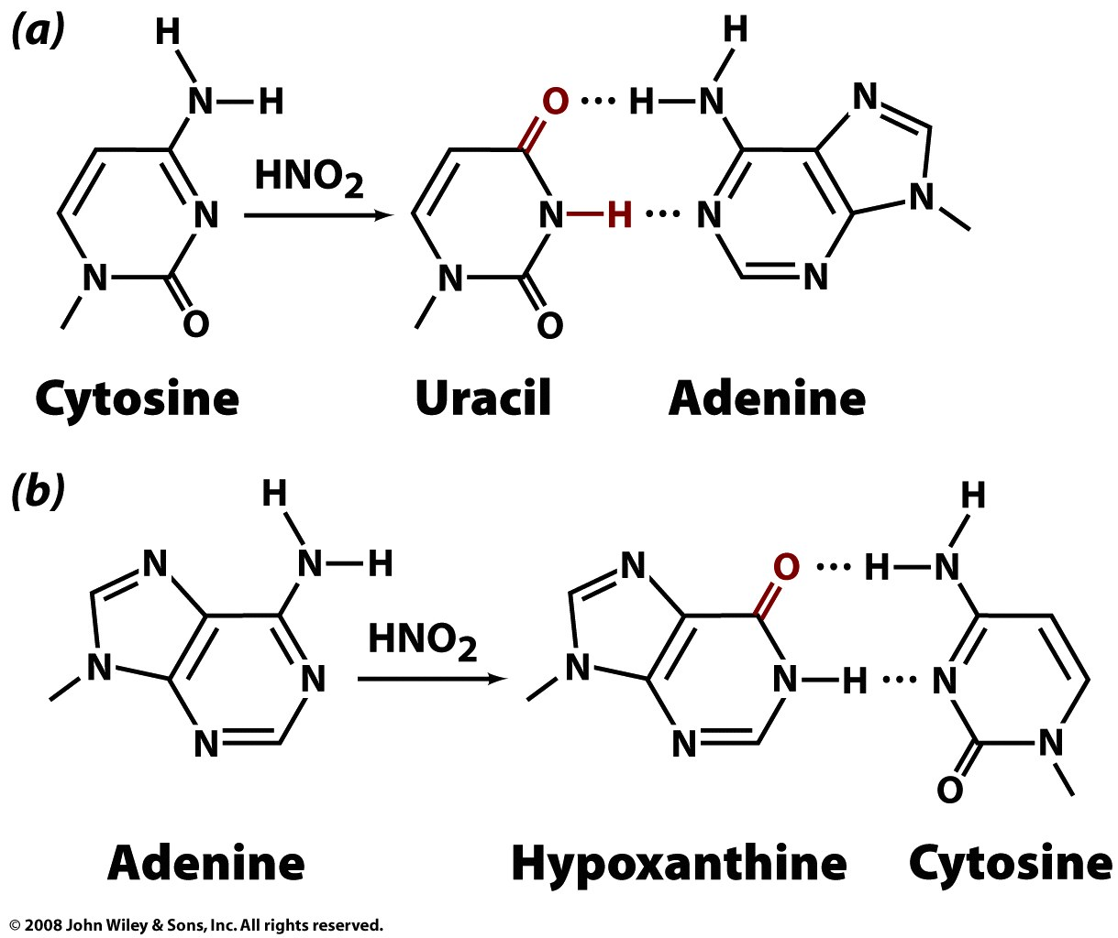
nitrates
Figure 25-27

Slide 32
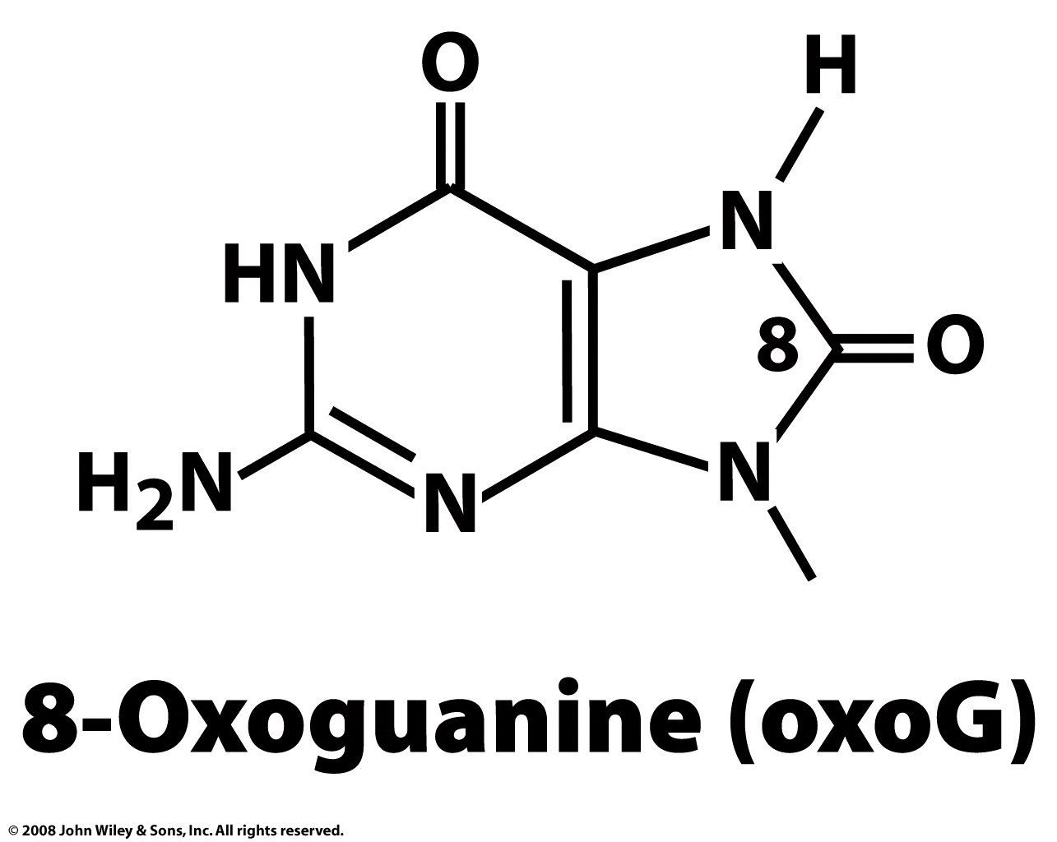
oxidized guanine
Page 917

Slide 33
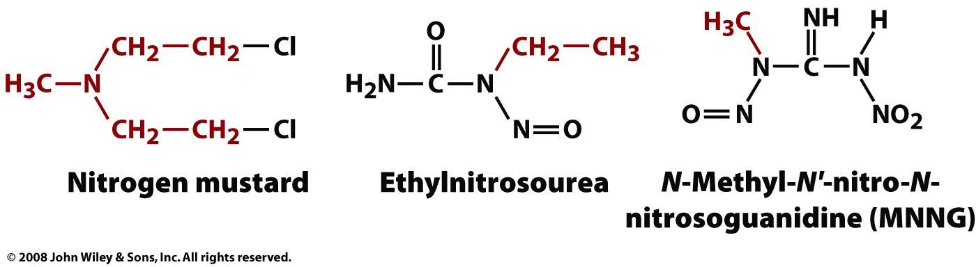
alkylating agents
Page 917

Slide 34
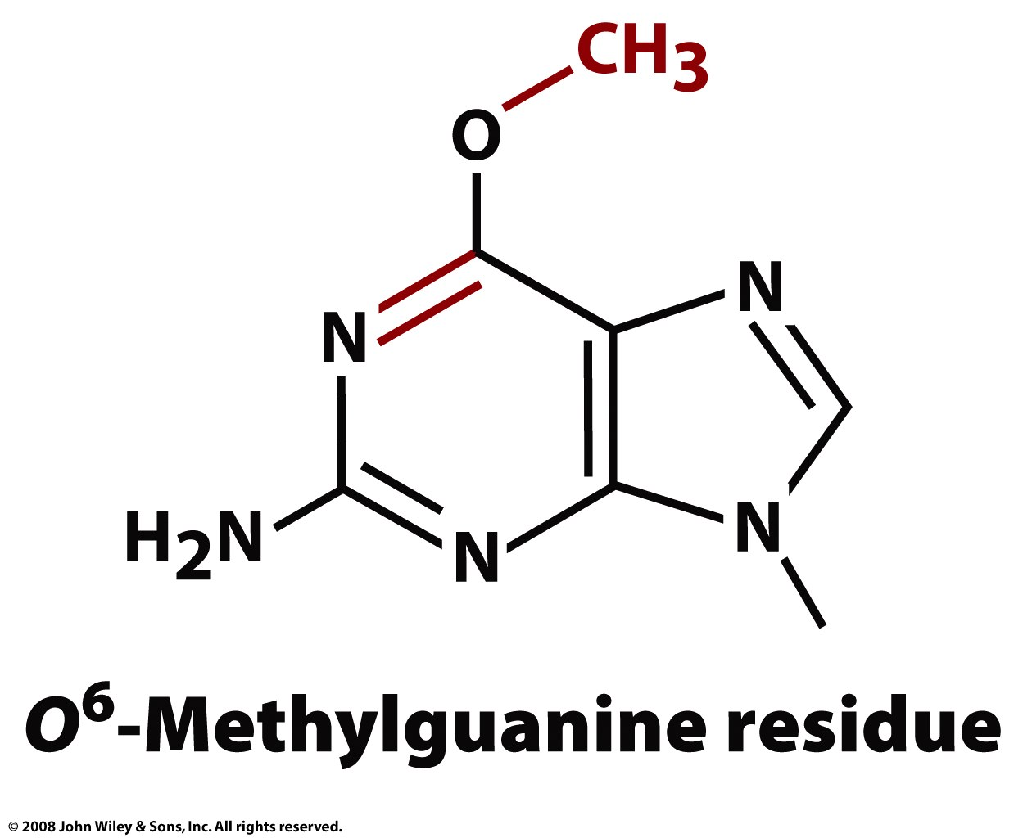
Page 917

Slide 35
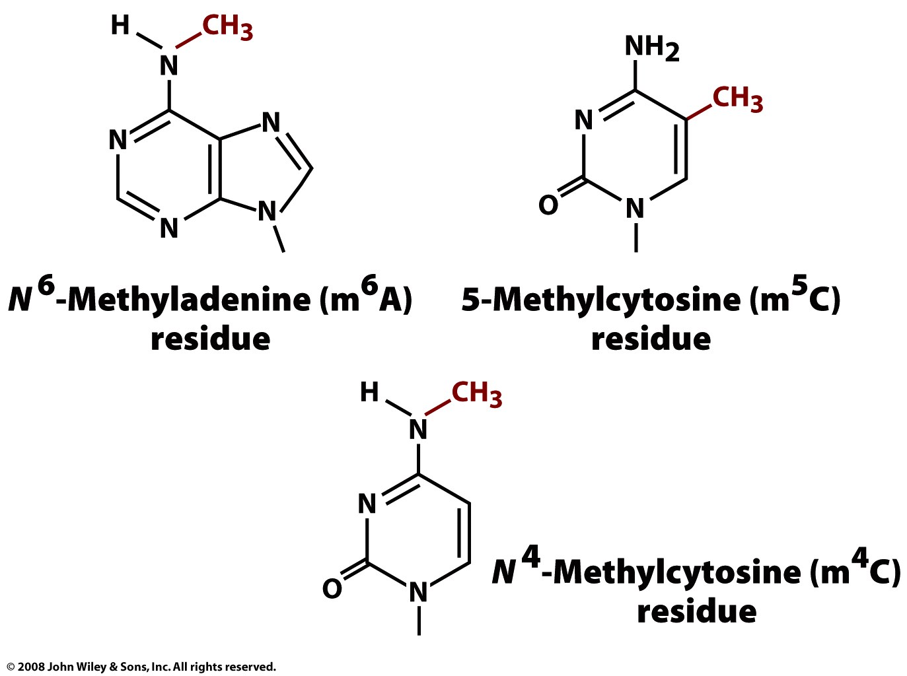
Box 25-4

Slide 36
Cancer is a disease of altered DNA structure or function. Most carcinogens damage DNA.
DNA repair systems are defenses that to protect genome integrity. Deficiencies in DNA repair lead to cancer.
Five primary DNA repair pathways
nucleotide excision repair,
base excision repair,
mismatch repair
nonhomologous end joining,
homologous recombinational repair.
Bifunctional alkylating agents (chlorambucil, carmustine) are widely used anti-cancer drugs.

Slide 37
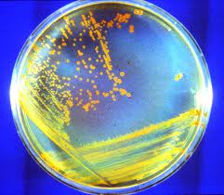
Conan the Bacterium
D. radiodurans can withstand an acute dose of 5,000 Gy (500,000 rad) of ionizing radiation with almost no loss of viability, and an dose of 15,000 Gy with 37% viability. 5,000 Gy will introduce several hundred double-strand breaks (DSBs) into an organism's DNA.
1 mGy: A chest X-ray or Apollo mission 5 Gy can kill a human,
200-800 Gy will kill E. coli,
4,000 Gy will kill a tardigrade.

Slide 38
BRCA
Cancer Sci. 2004 Nov;95(11):866-71.
Role of BRCA1 and BRCA2 as regulators of DNA repair, transcription, and cell cycle in response to DNA damage.
Yoshida K, Miki Y., Medical Research Institute, Tokyo Medical and Dental University, Tokyo 113-8510.
Abstract (shortened by LDW)
BRCA1 (BReast-CAncer susceptibility gene 1) and BRCA2 are tumor suppressor genes, the mutant phenotypes of which predispose to breast and ovarian cancers. BRCA genes contribute to DNA repair and transcriptional regulation in response to DNA damage. BRCAs transcriptionally regulate genes involved in DNA repair, the cell cycle, and apoptosis.

Slide 39
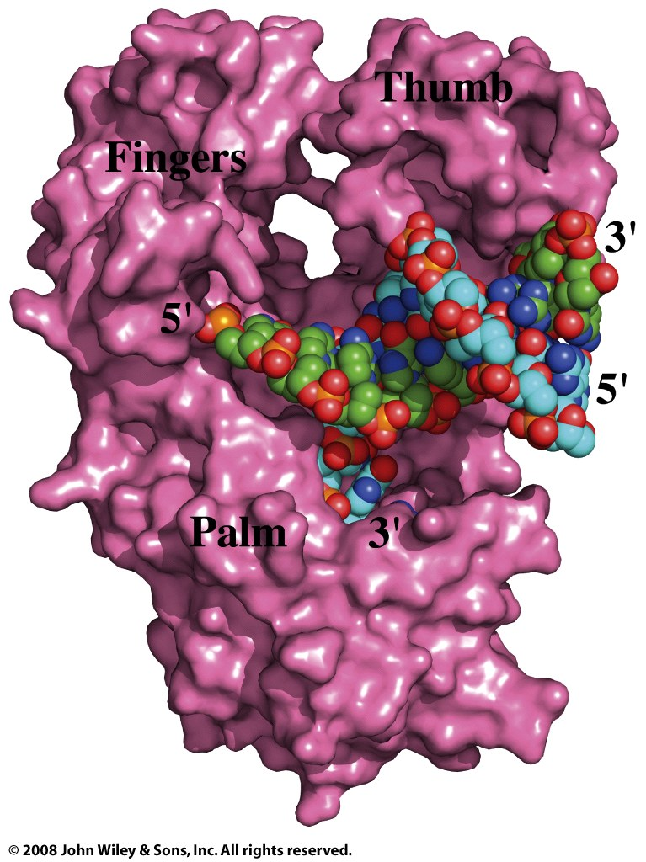
Stop here Chem 4511/6501 fall 2013.
Figure 25-10

Slide 40
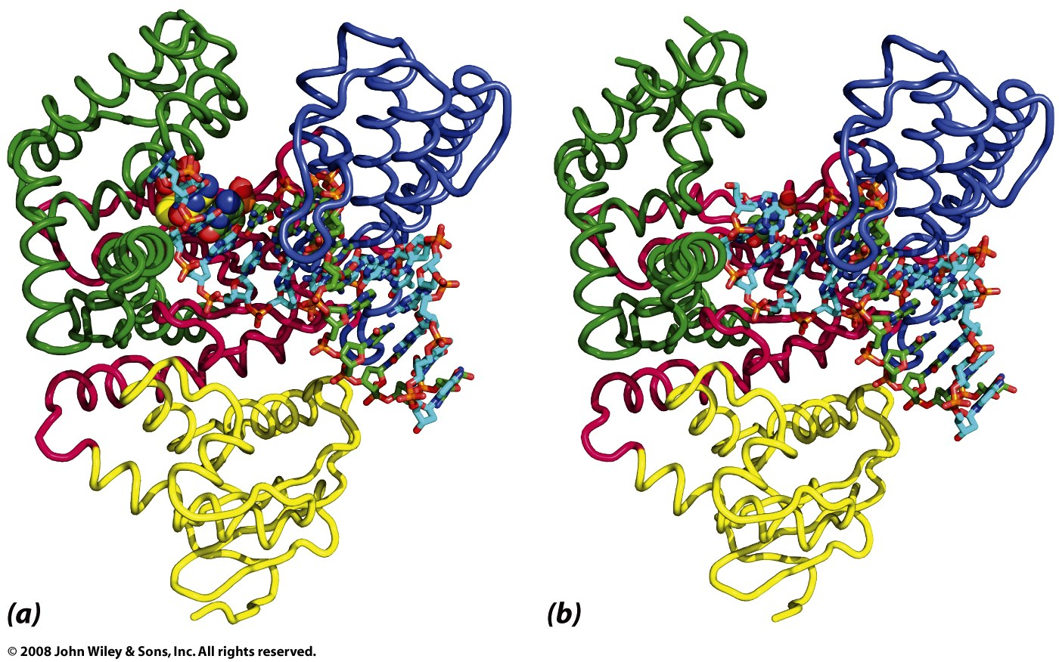
Figure 25-11

Slide 41
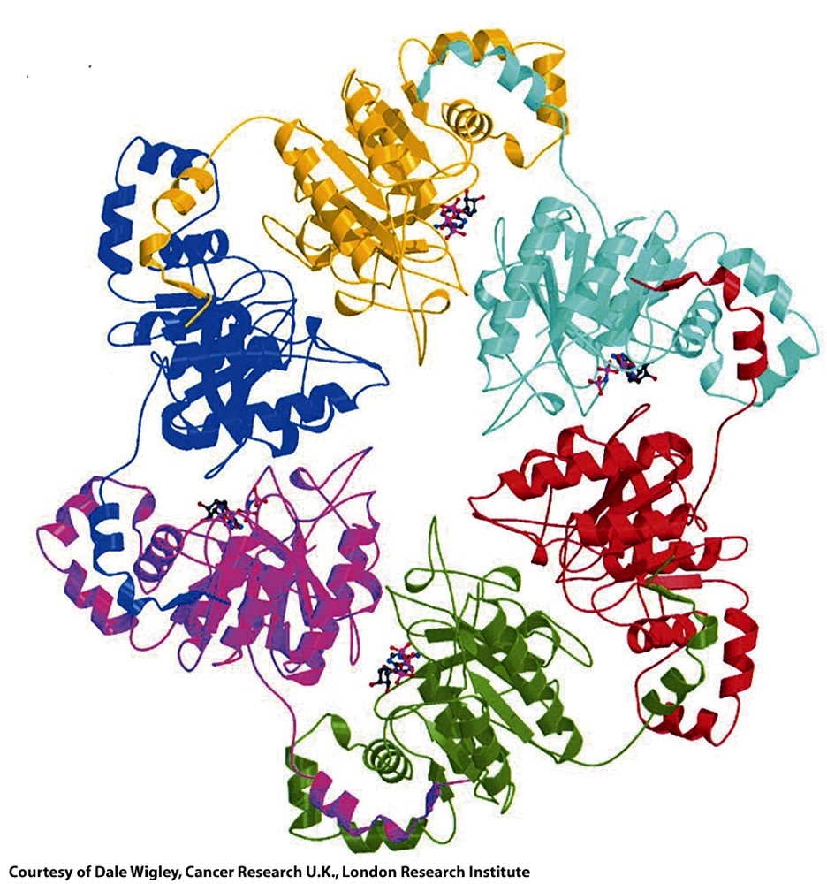
Figure 25-13

Slide 42
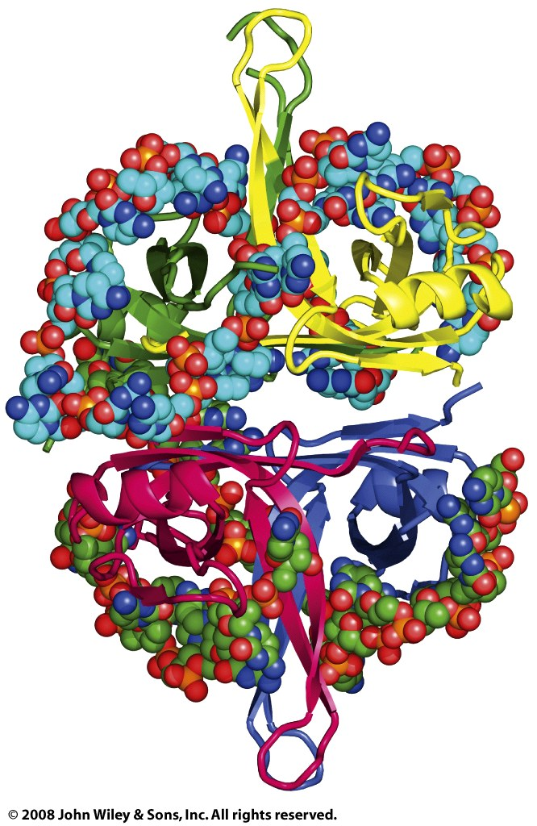
Figure 25-14

Slide 43
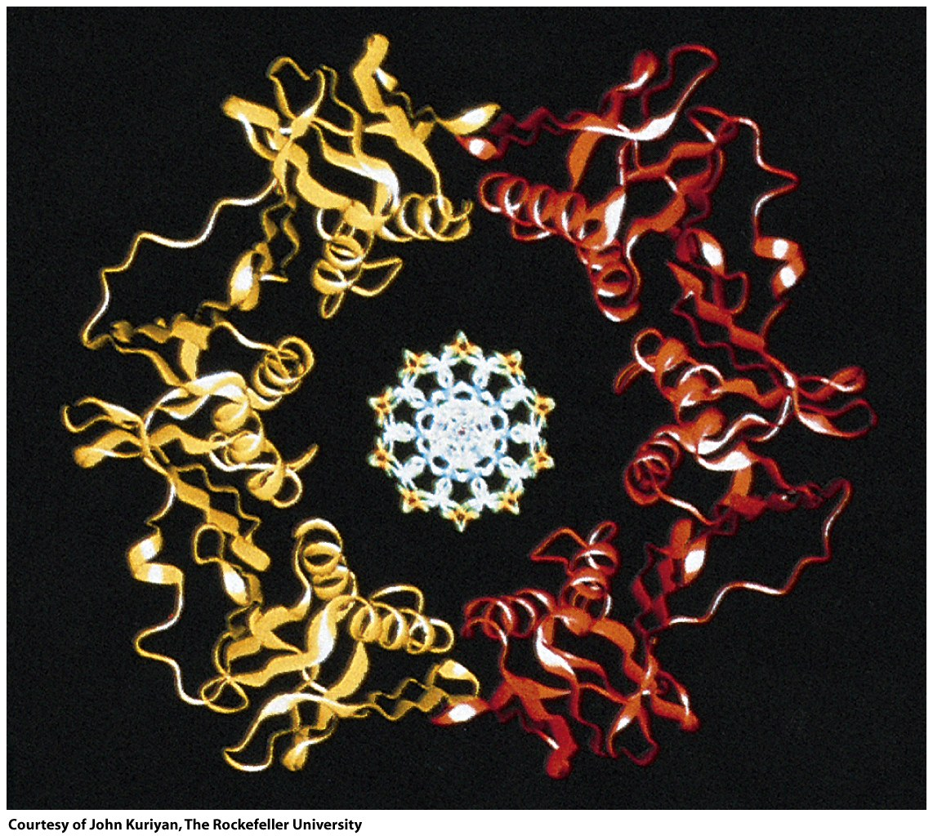
Figure 25-16a

Slide 44
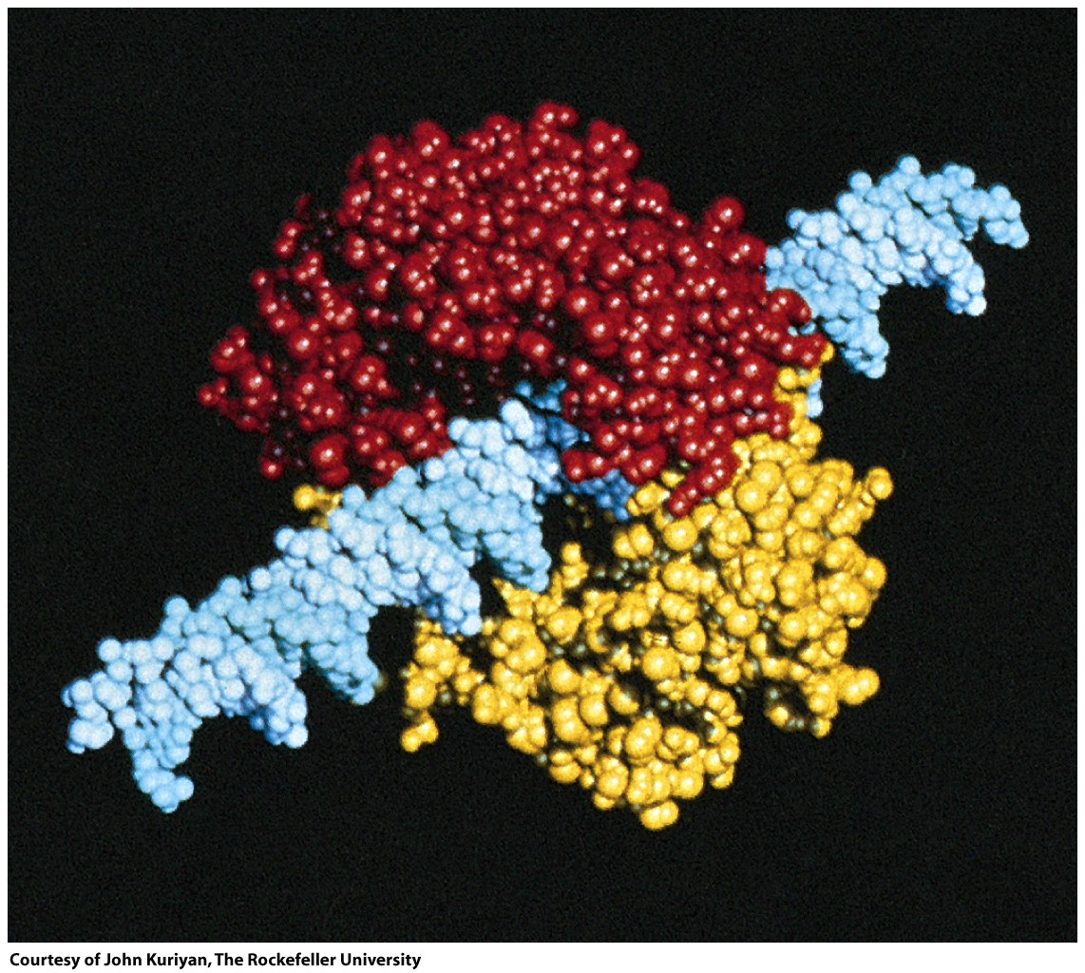
Figure 25-16b

Slide 45
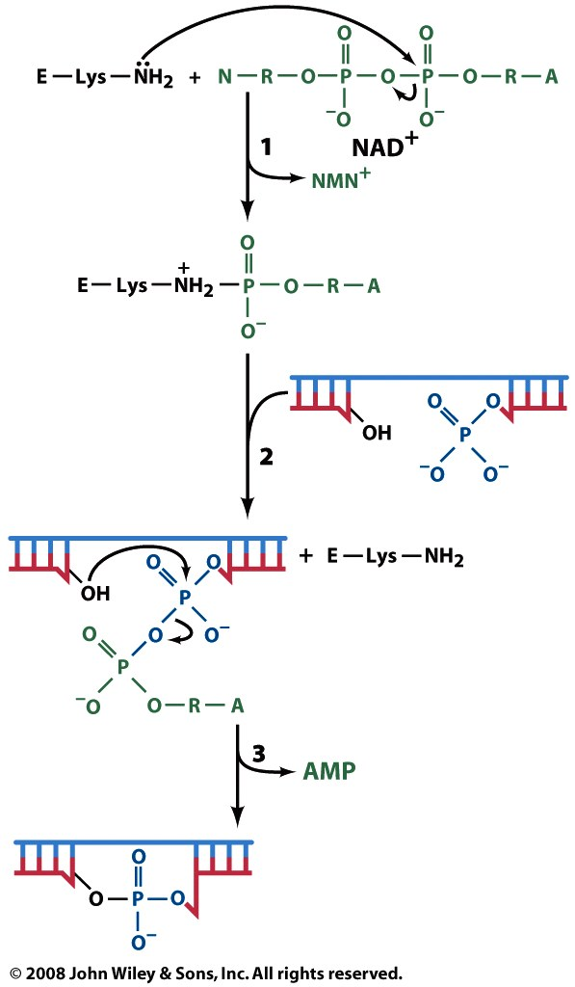
Figure 25-17

Slide 46
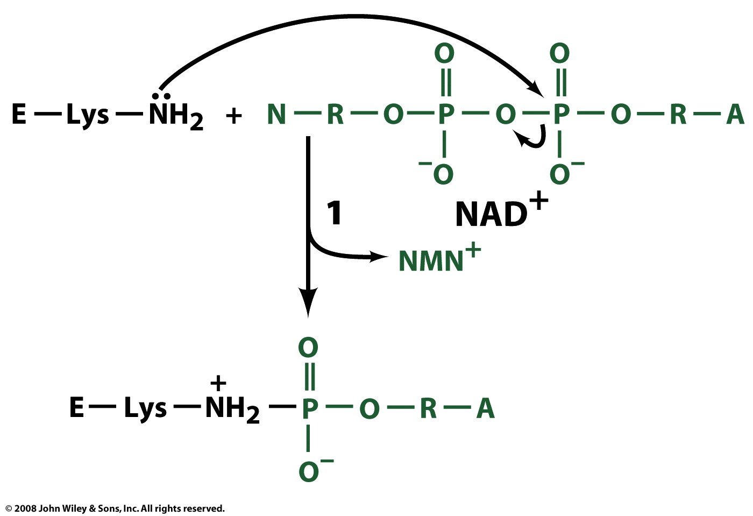
Figure 25-17 part 1

Slide 47
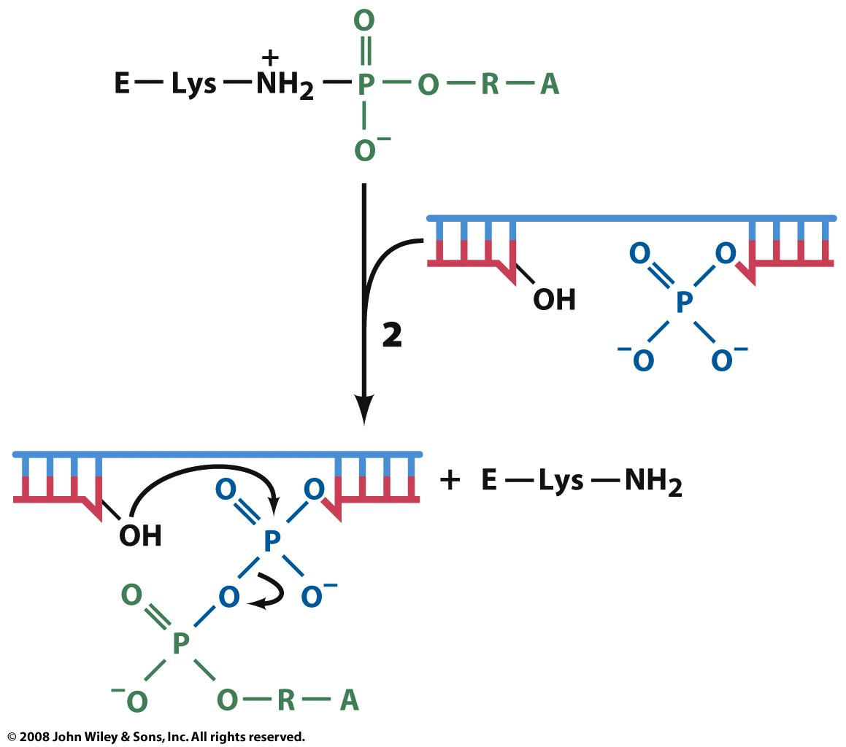
Figure 25-17 part 2

Slide 48
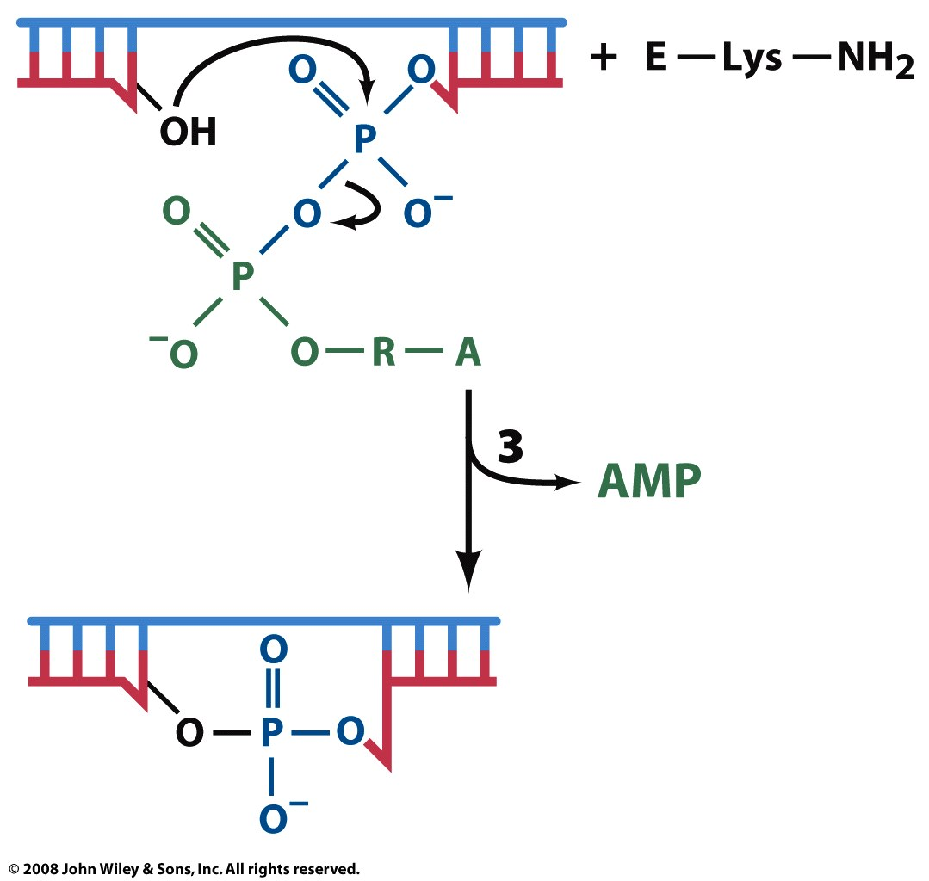
Figure 25-17 part 3

Slide 49
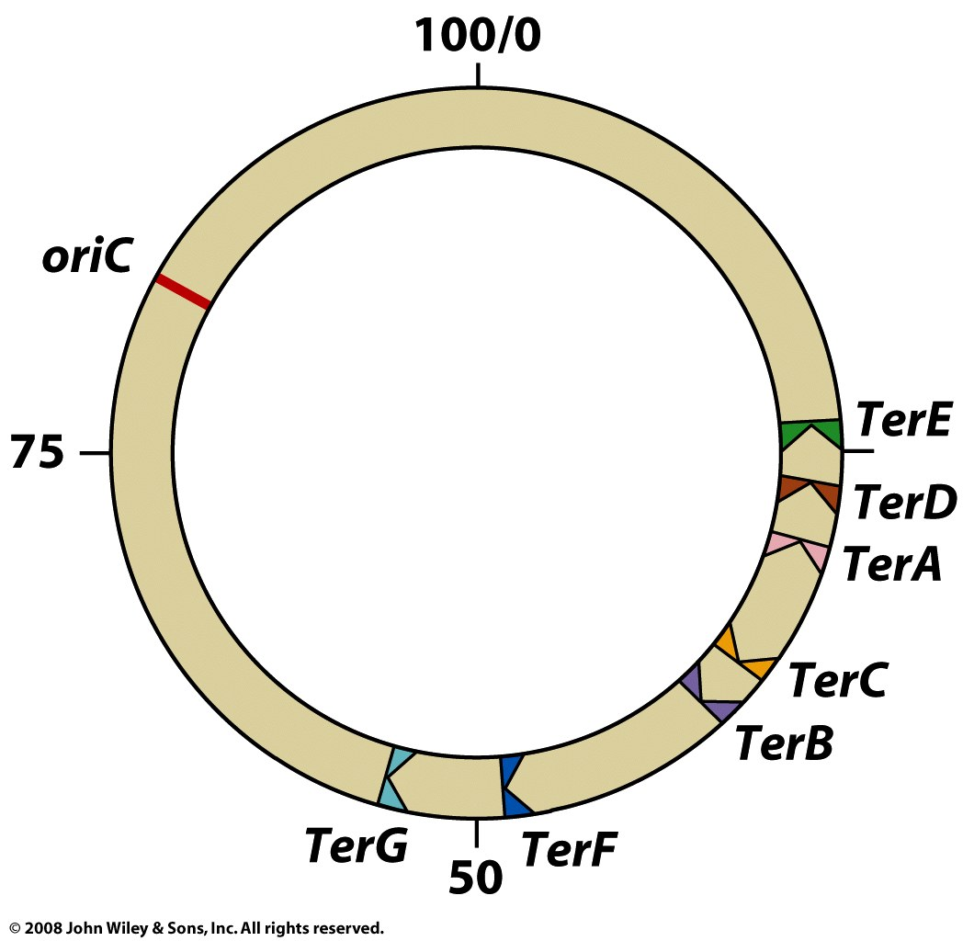
Figure 25-18

Slide 50
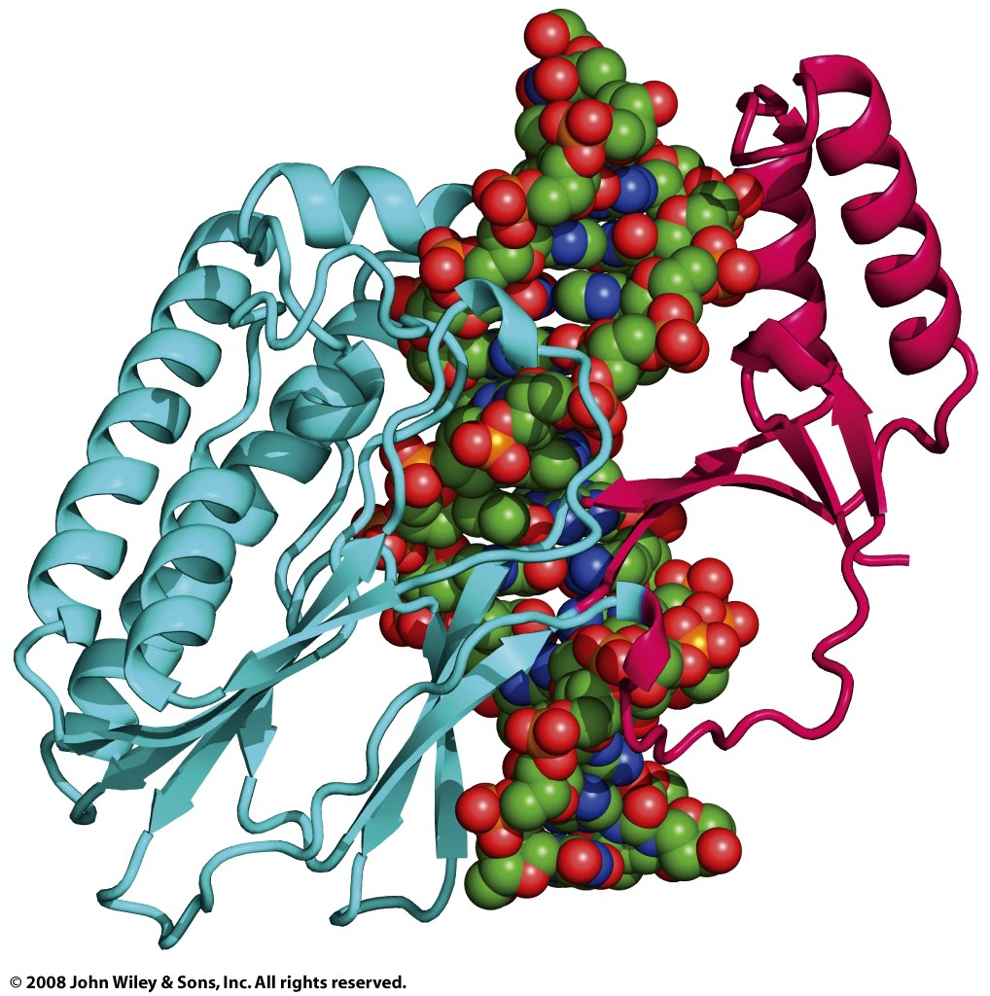
Figure 25-19

Slide 51
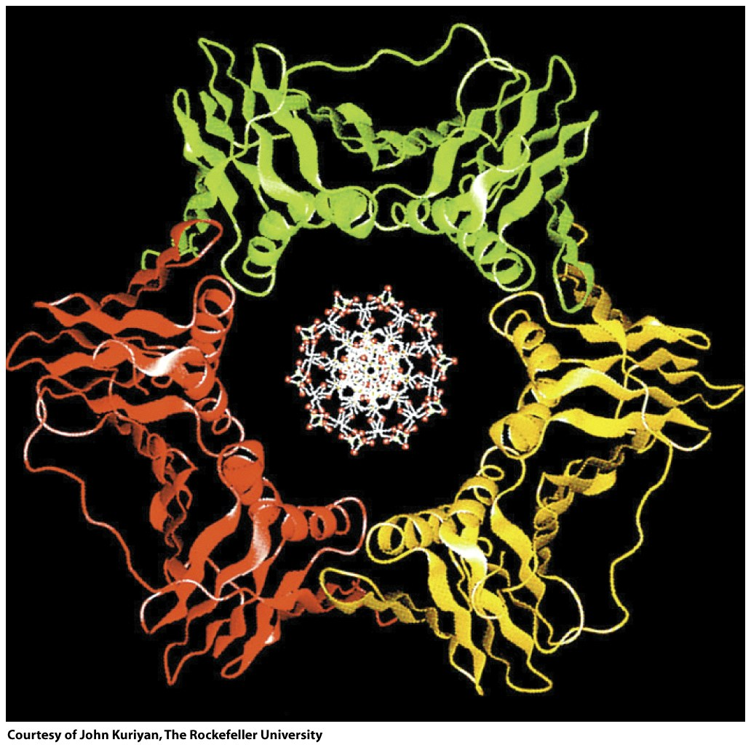
Figure 25-20

Slide 52
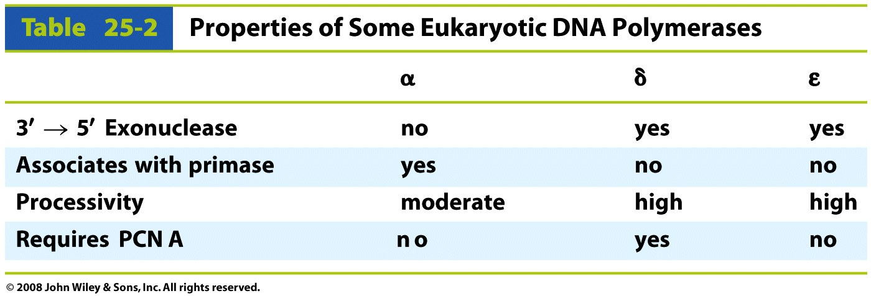
Table 25-2

Slide 53
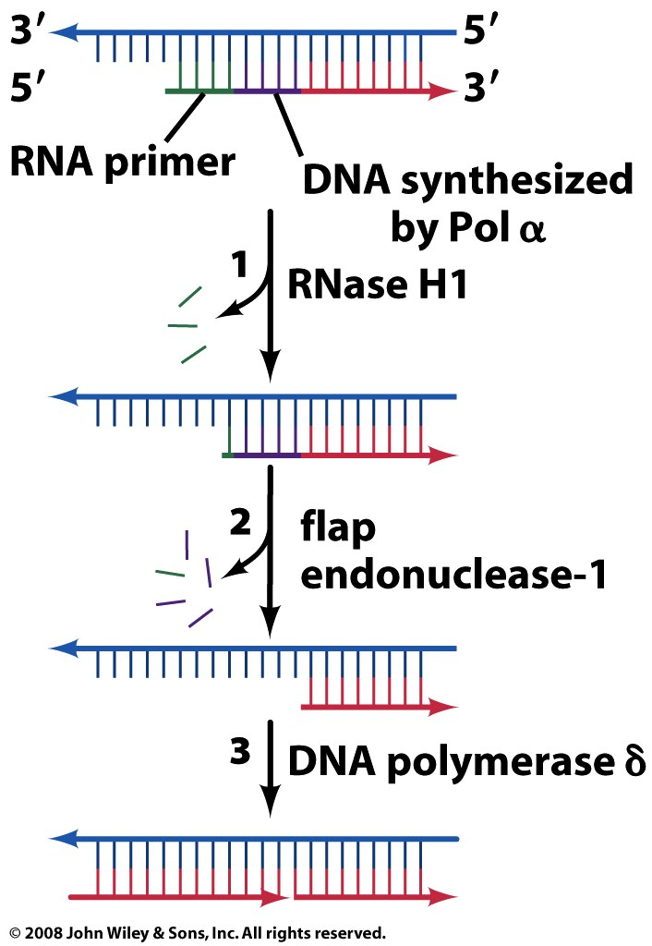
Figure 25-21

Slide 54
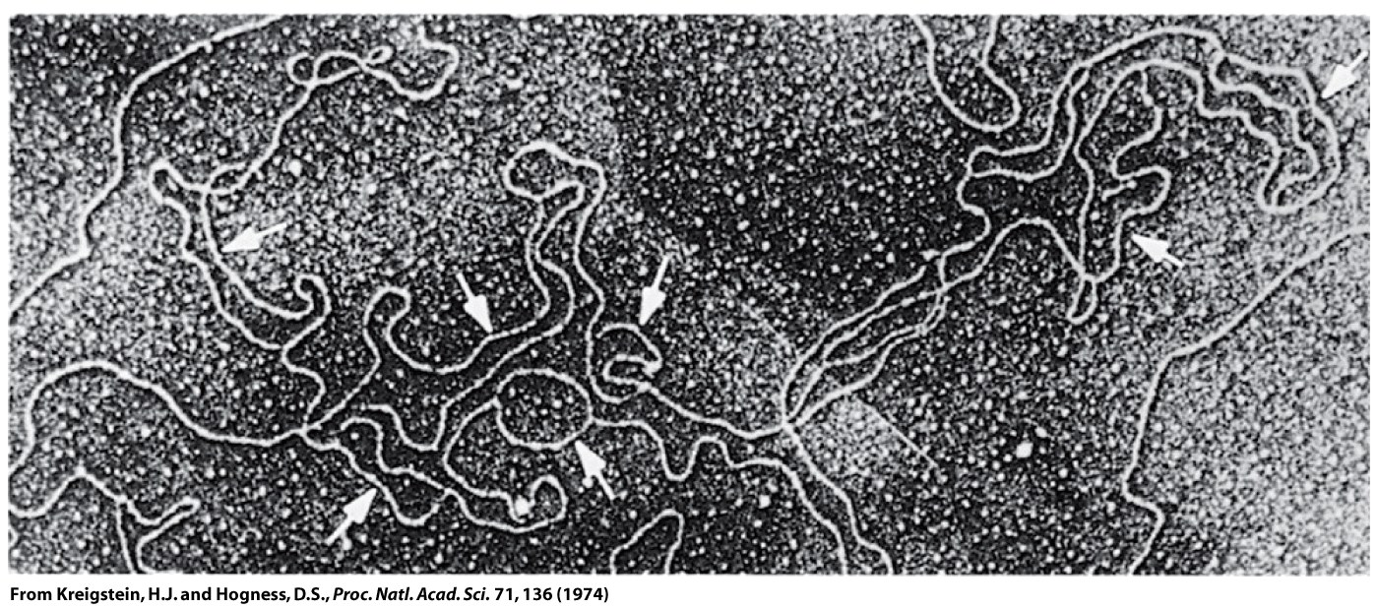
Figure 25-22

Slide 55
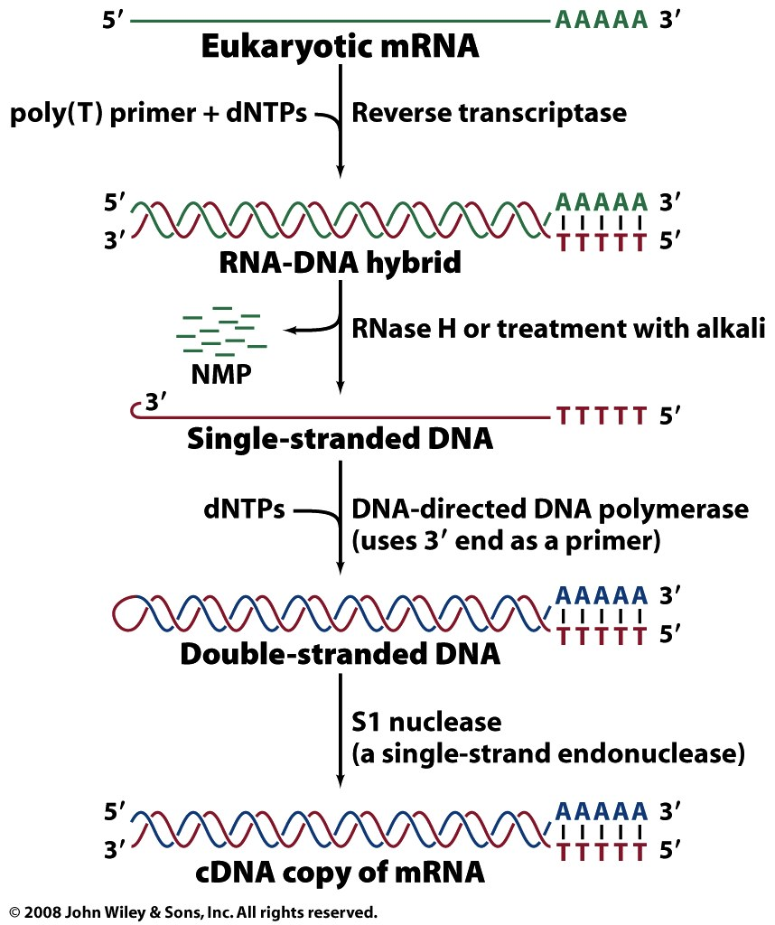
Box 25-2 figure 1

Slide 56
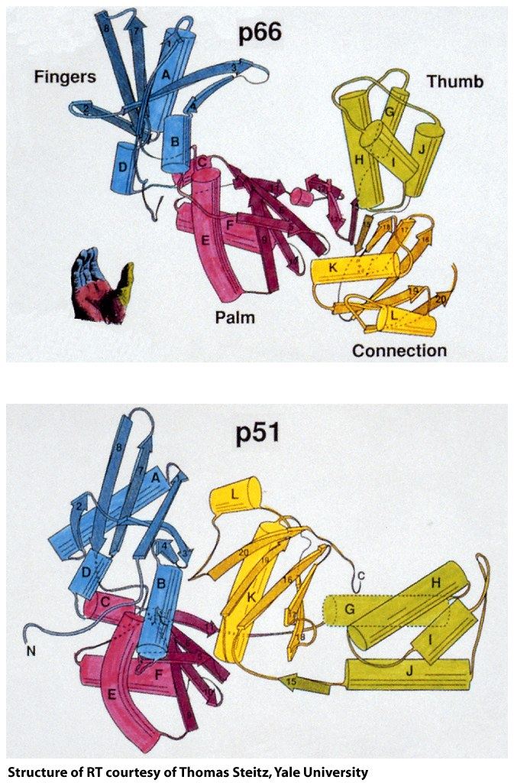
Box 25-2 figure 2

Slide 57
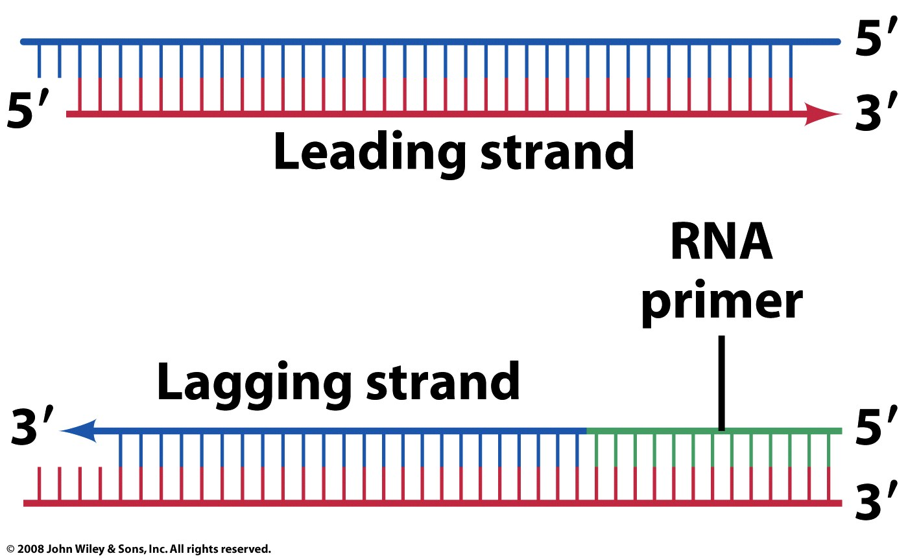
Figure 25-23

Slide 58
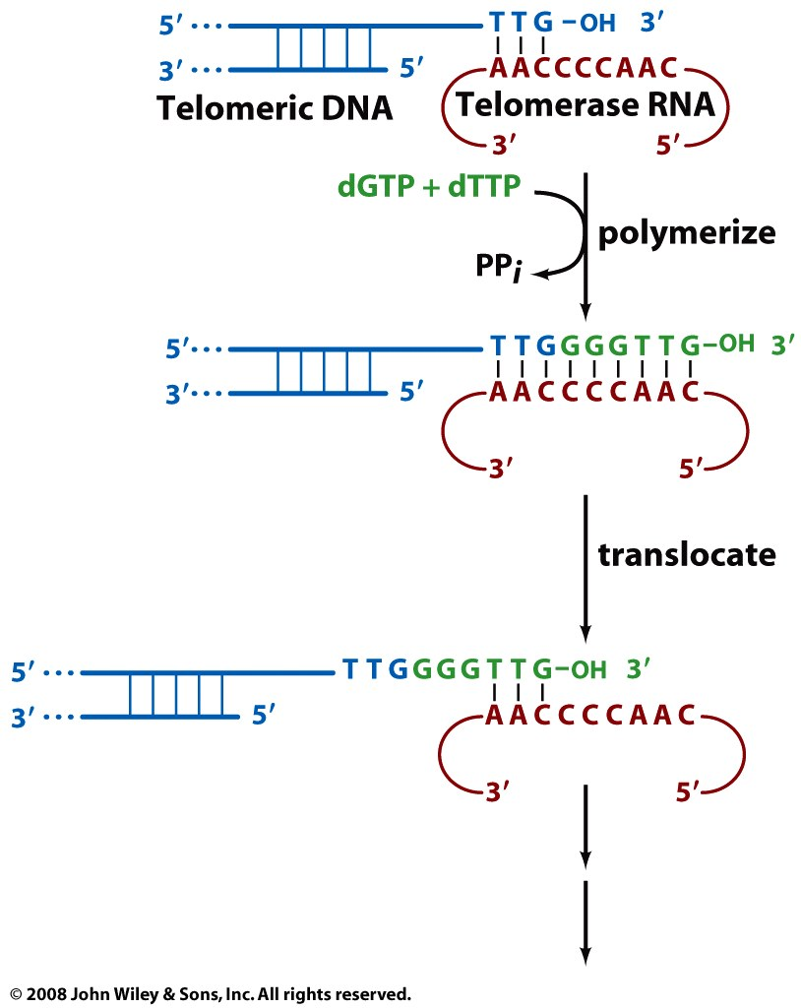
Figure 25-24

Slide 59
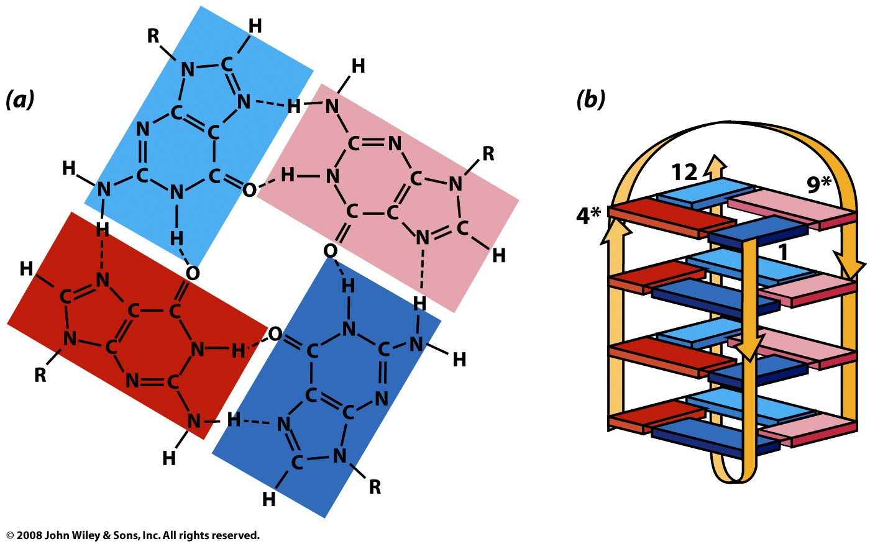
Figure 25-25

Slide 60

Figure 25-25a

Slide 61

Figure 25-25b

Slide 62
Figure 25-26

Slide 63
Figure 25-27

Slide 64

Figure 25-27a

Slide 65

Figure 25-27b

Slide 66
Page 917

Slide 67
Page 917

Slide 68
Page 917

Slide 69
Box 25-4

Slide 70

Figure 25-28

Slide 71

Figure 25-29

Slide 72

Figure 25-30

Slide 73

Figure 25-31

Slide 74

Figure 25-32

Slide 75

Figure 25-33

Slide 76

Figure 25-33 part 1

Slide 77

Figure 25-33 part 2

Slide 78

Figure 25-33 part 3

Slide 79

Figure 25-33 part 4

Slide 80

Figure 25-33 part 5

Slide 81

Figure 25-34

Slide 82

Figure 25-35

Slide 83

Figure 25-36

Slide 84

Figure 25-37

Slide 85

Figure 25-38

Slide 86

Figure 25-39

Slide 87

Figure 25-39 part 1

Slide 88

Figure 25-39 part 2

Slide 89

Figure 25-40

Slide 90

Figure 25-41

Slide 91

Figure 25-42

Slide 92

Figure 25-43a

Slide 93

Figure 25-43b

Slide 94

Figure 25-44

Slide 95

Figure 25-44 part 1

Slide 96

Figure 25-44 part 2

Slide 97

Figure 25-45

Slide 98

Figure 25-46

Slide 99

Figure 25-47

Slide 100

Page 936

Slide 101

Figure 25-48

Slide 102

Figure 25-49

Slide 103

Figure 25-49 part 1

Slide 104

Figure 25-49 part 2

Slide 105

Figure 25-49 part 3

Slide 106

Figure 25-49 part 4

Slide 107

Figure 25-50

Slide 108

Figure 25-50a

Slide 109

Figure 25-50b

