Slide 2
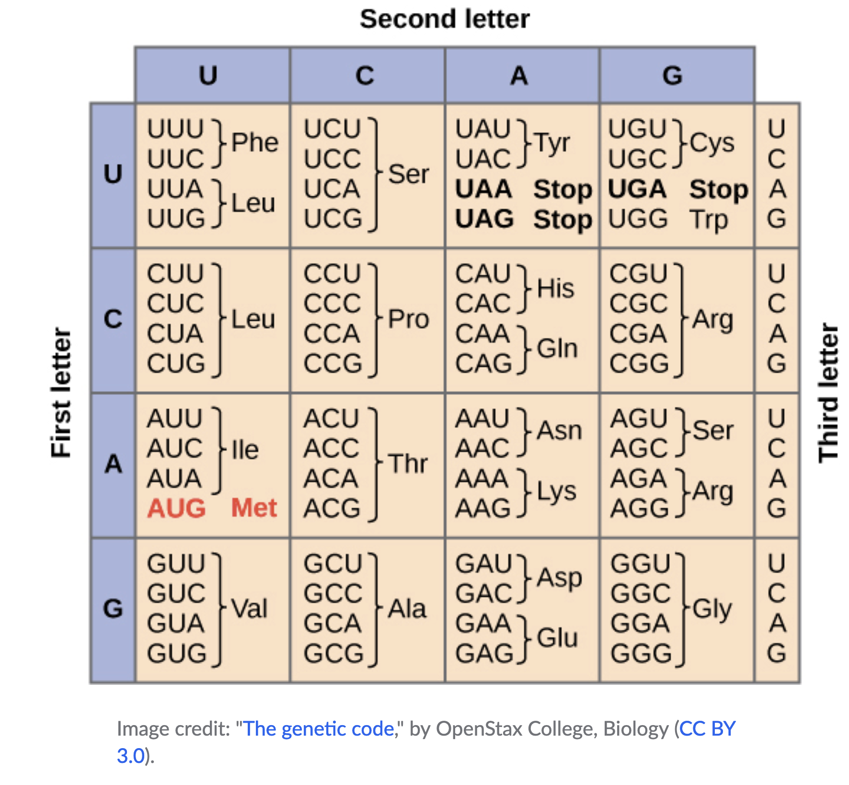

Slide 3


Slide 4
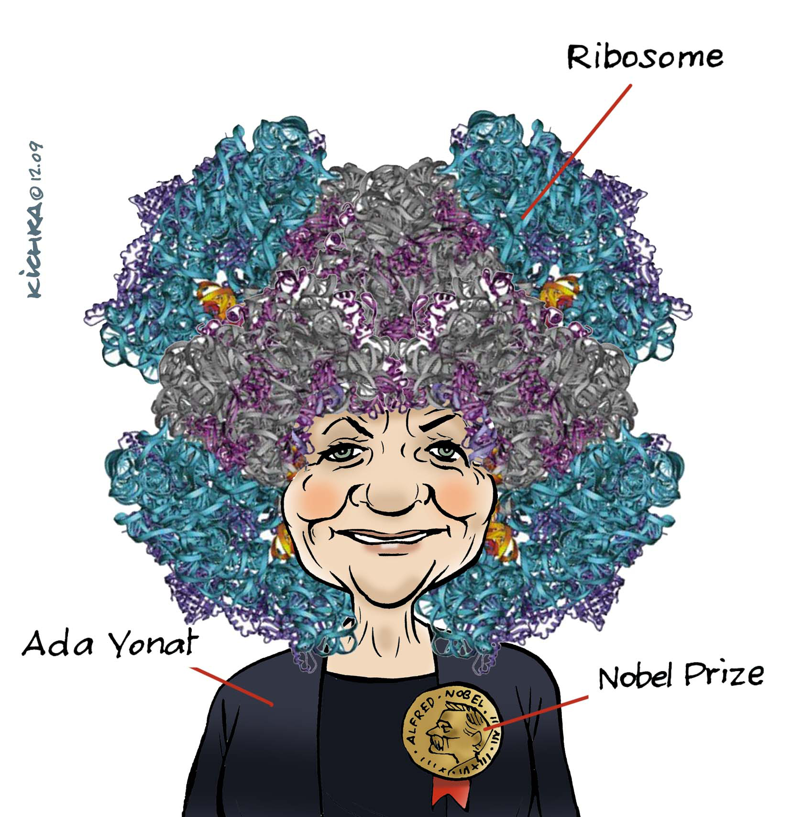

Slide 5
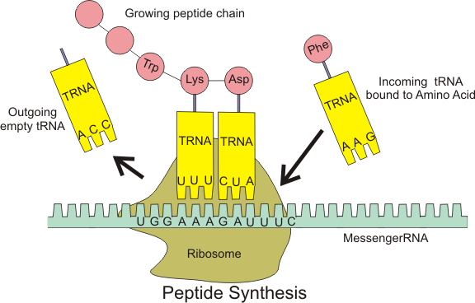
The Ribosome
A ribosome is rRNA-protein assembly that creates all coded proteins. The ribosome translates information contained mRNA into the amino acid sequence of a protein. Ribosomes use mRNA as a template for specifying the sequence of amino acids in a protein. The ribosome translocates mRNA, "reading" its sequence and producing a chain of amino acids of sequence specified by the mRNA according to the genetic code.

Slide 6
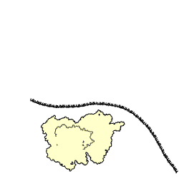
Nascent Polypeptide
(in the tunnel)
LSU
mRNA
SSU
Decoding Center
By Bensaccount at en.wikipedia, CC BY 3.0,
https://commons.wikimedia.org/w/index.php?curid=8287100

Slide 7
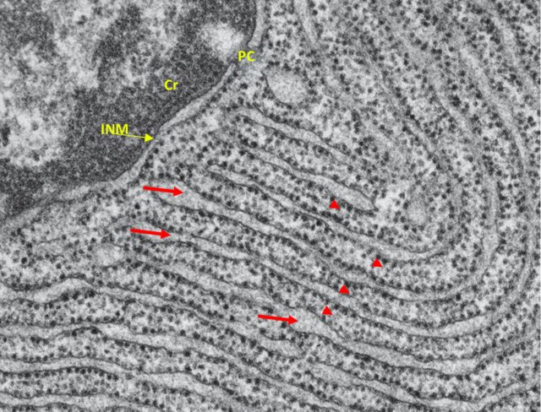
Nucleus and Rough Endoplasmic Reticulum. Cr, chromatin. PC, pore complex. INM, internal nuclear membrane. Red Arrows, ER cisternae. Arrows' heads, ribosomes. Modified from: (Schekman, 2004)

Slide 8
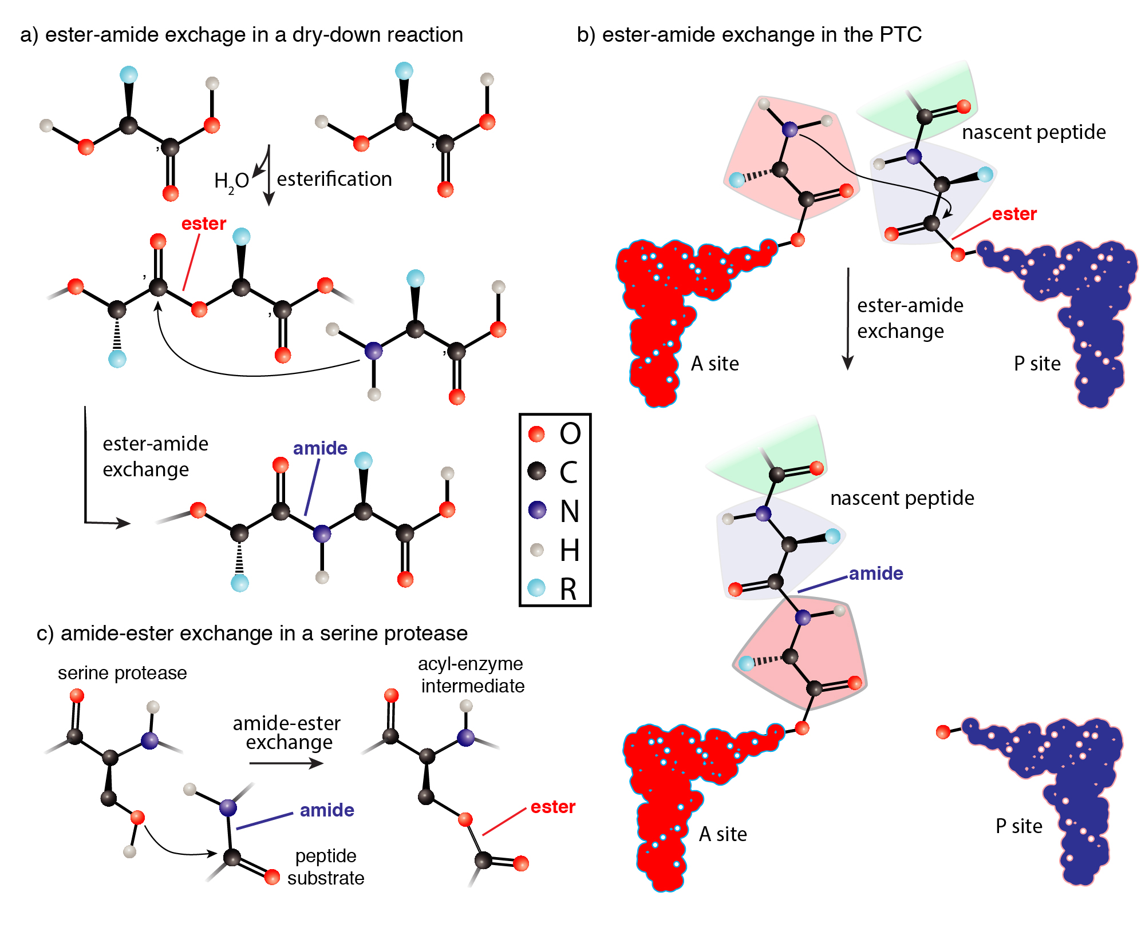
Notes:
Translation outrageously complex, produces coded protein by very simple chemistry

Slide 9
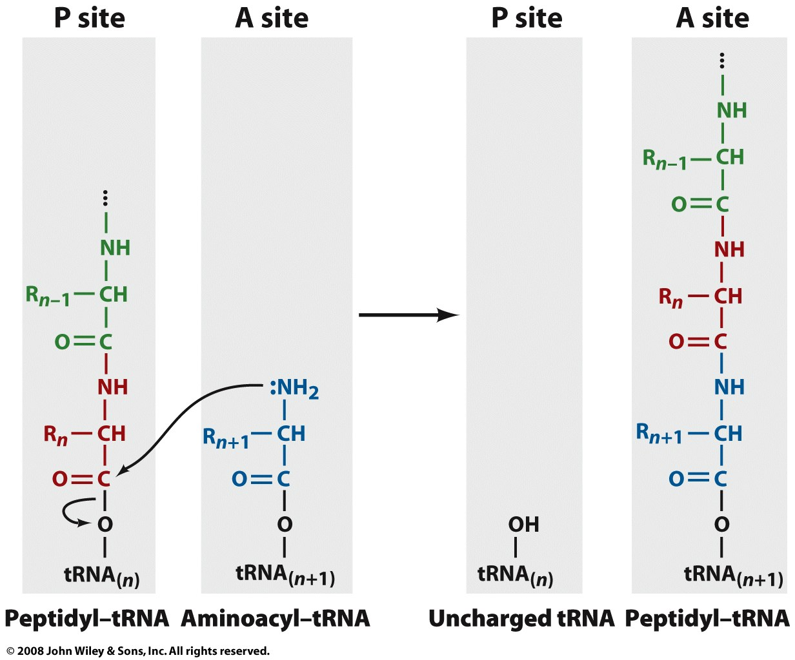
The Ribosome: The peptidyl transfer reaction

Slide 10
The Translation System
amino acids 20 of them
tRNAs 20 of them
Aminoacyl tRNA synthetases (aaRS’s)
20 of them
covalently link amino
acids to tRNAs
establish the genetic code
Ribosomes - MolWt>10⁶
ribosomal proteins
ribosomal RNA
decode mRNA
peptidyl transfer

Slide 11
Aminoacyl-tRNA Synthetases
Charge tRNAs (link them to amino acids)
Step 1: Activate the Amino Acid.
amino acid + ATP → aminoacyl-AMP + PPi
An activated amino acid = amino-acyl adenylate = aminoacyl-AMP
Step 2: Transfer the activated amino acid to the tRNA
aminoacyl-AMP + tRNA → aminoacyl-tRNA + AMP
Step 1 + 2:
amino acid + tRNA + ATP → aminoacyl-tRNA + AMP + Ppi

Slide 12
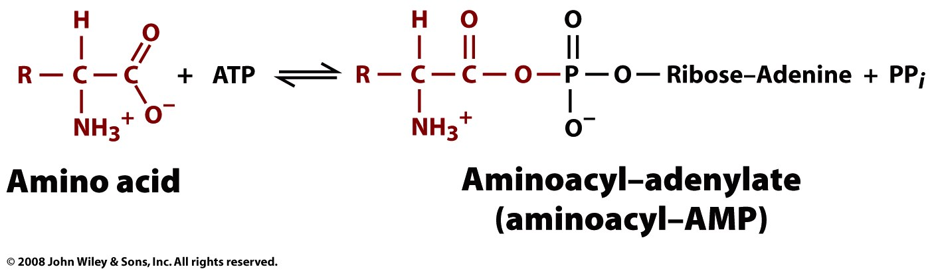
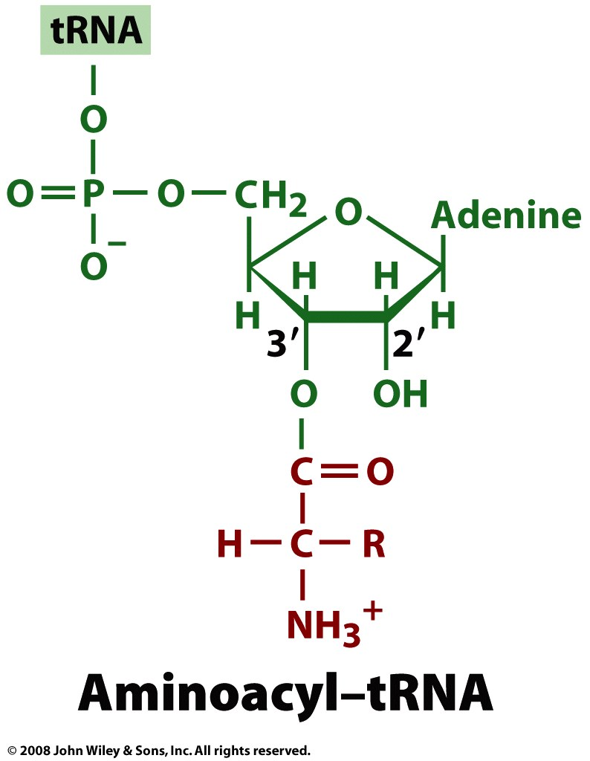
Aminoacyl-tRNA Synthetases
Figure 27-6

Slide 13
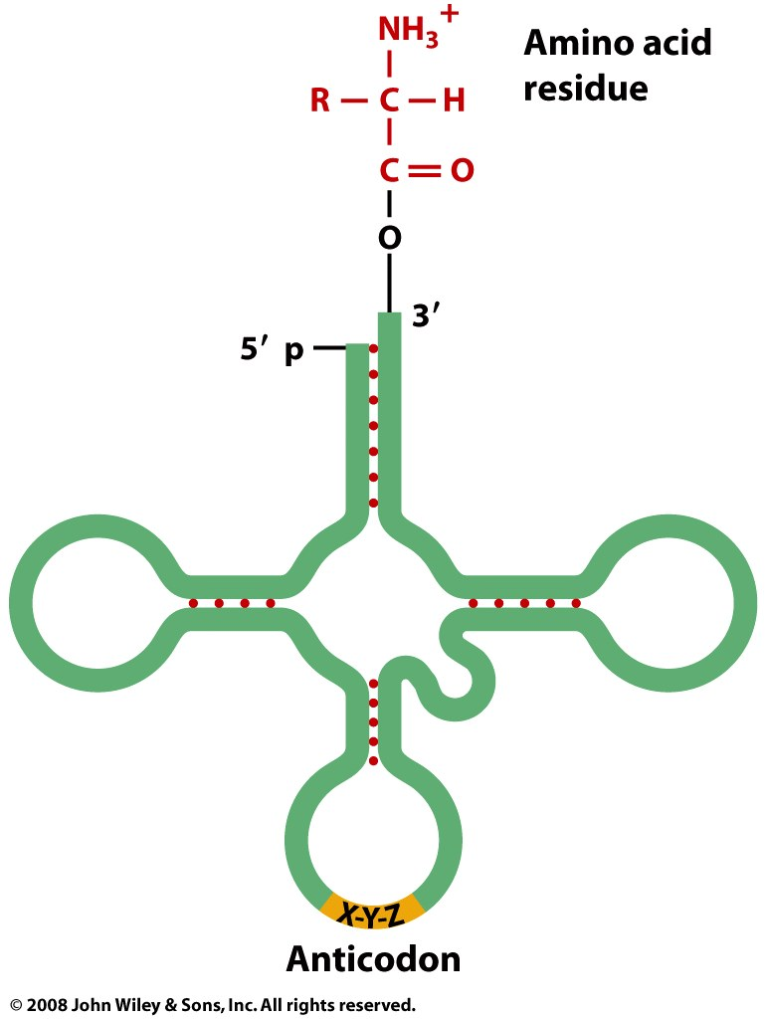
A “charged” tRNA, with an amino acid ester on the 3’ terminus.
Figure 27-1

Slide 14
Why is translation so much more complicated that replication and transcription?
Watson & Crick: Direct Templating is simple.

Slide 15
Why is translation so much more complicated that replication and transcription?
Replication and transcription use direct templating. Watson-Crick pairing directs incorporation of G opposite C and U (or T) opposite A (and vice versa).
Translation uses indirect templating [20x(aa+aaRS + tRNA)].
Why? It is not easy to transduce information from polynucleotide to polypeptide. The structures and assembly principles of these two polymers are antithetical.
RNA: anionic backbone, few sidechains of similar structure, assembles by sidechain-sidechain interactions.
Protein: neutral backbone, 20 sidechains of diverse structure, assembles by backbone-backbone interactions.

Slide 16
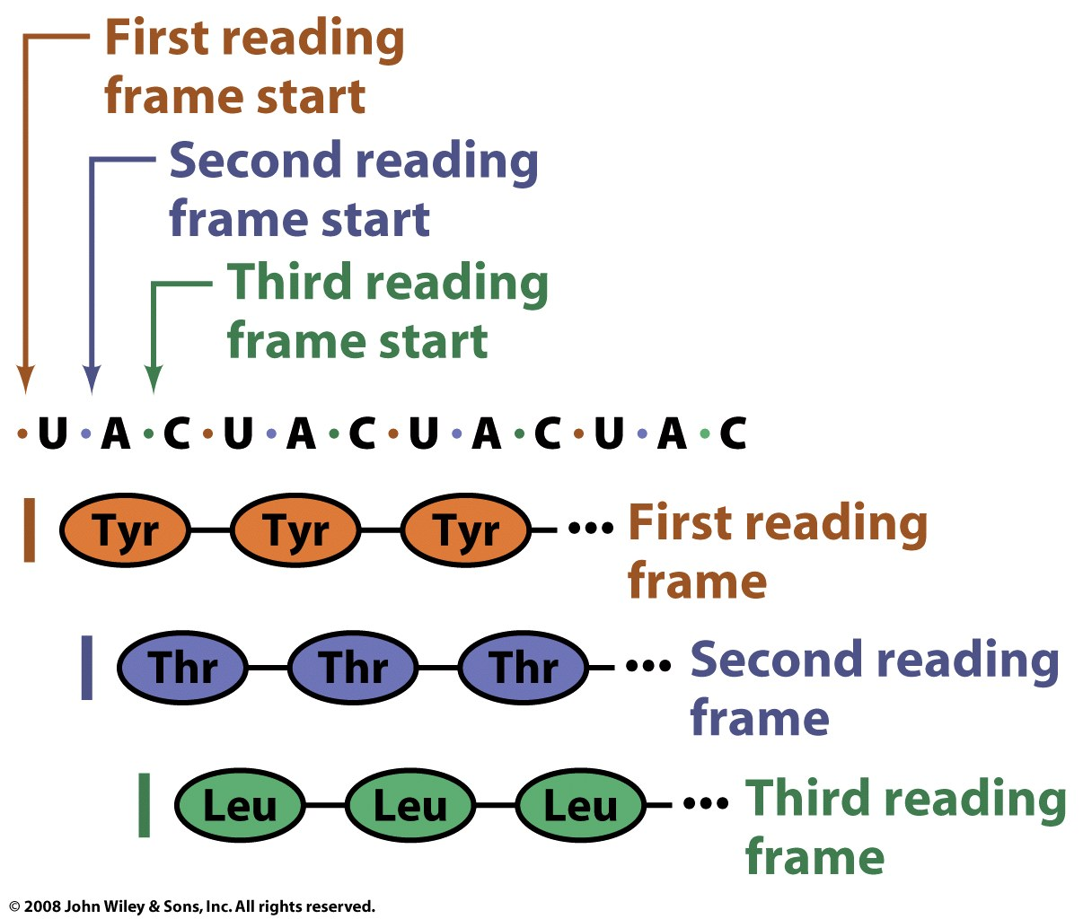
Three possible reading frames
Figure 27-2

Slide 17
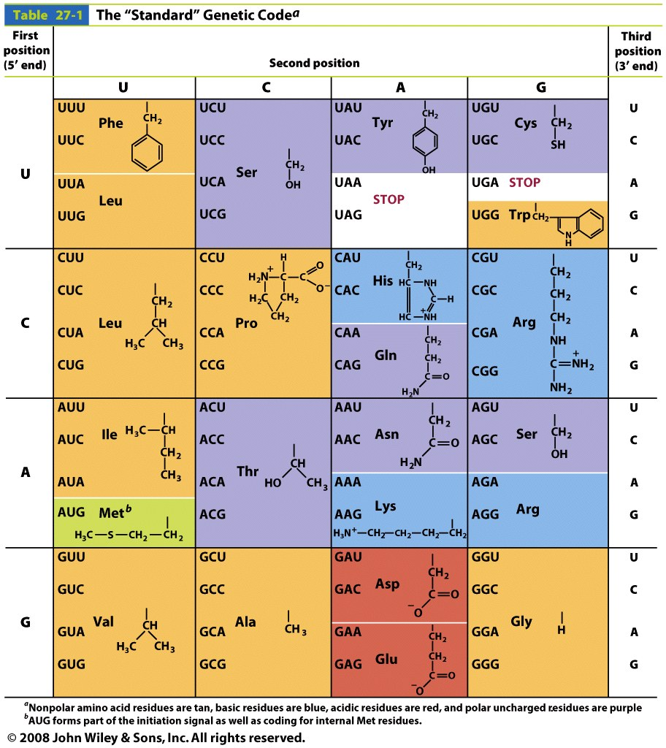
The genetic code is degenerate and non-random
Stop:
UGA UAG UAA

Slide 18
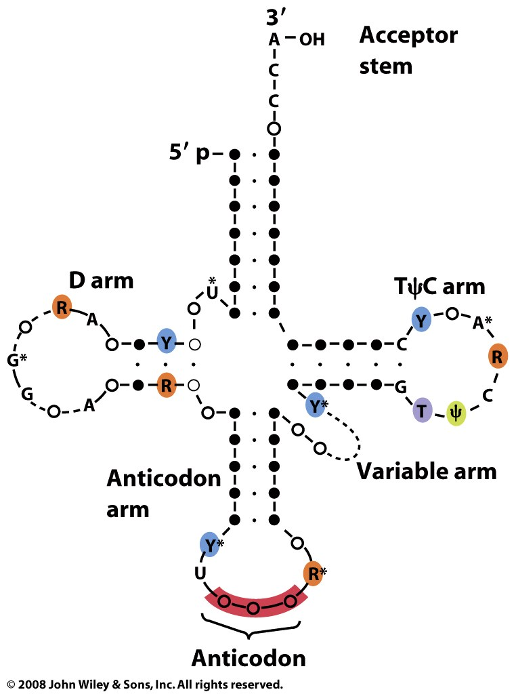
Figure 27-3

Slide 19
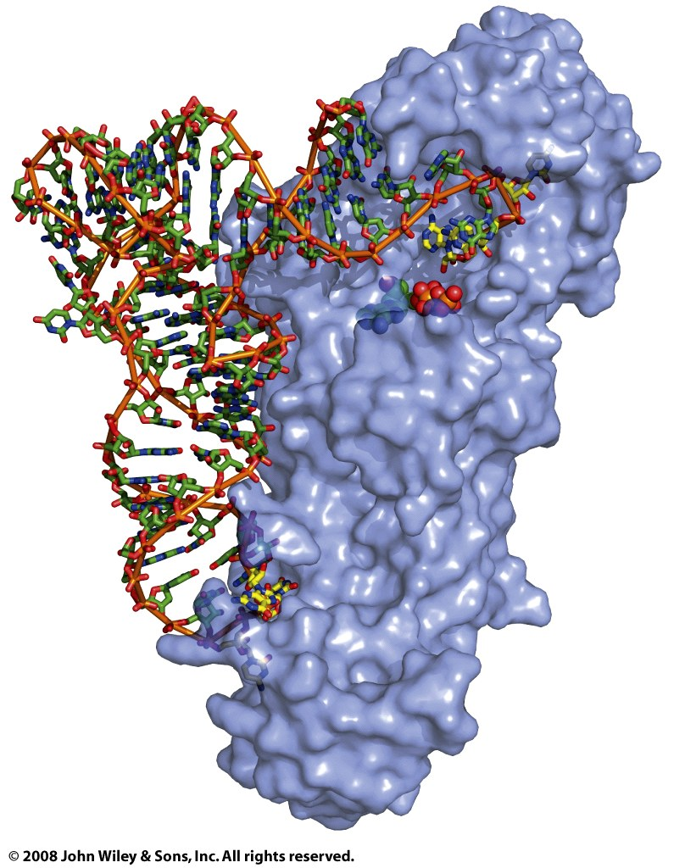
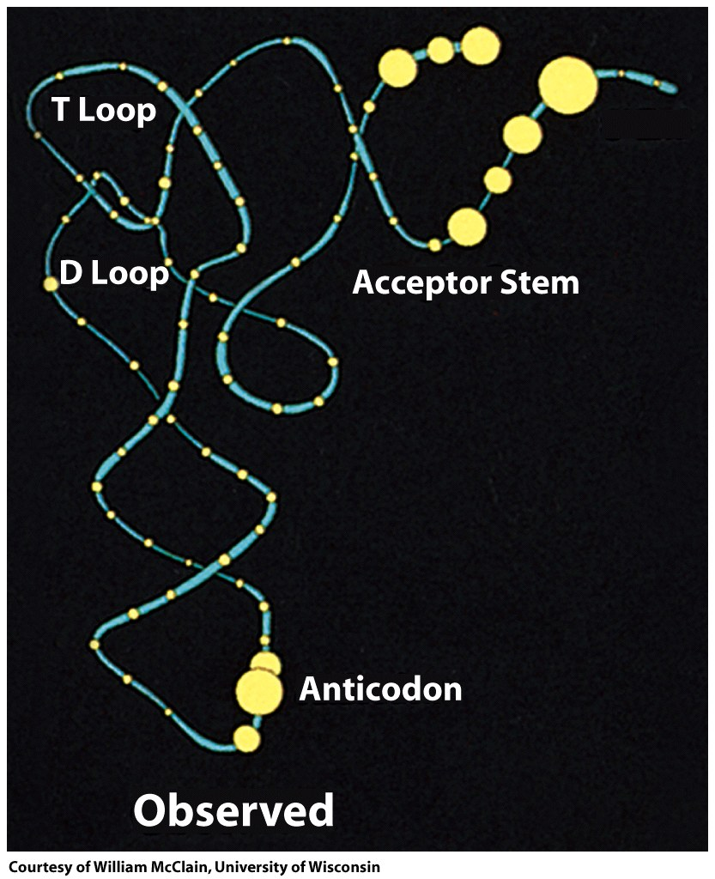
GlnRS bound to tRNA^{Gln} and ATP
In general
Figure 27-7

Slide 20
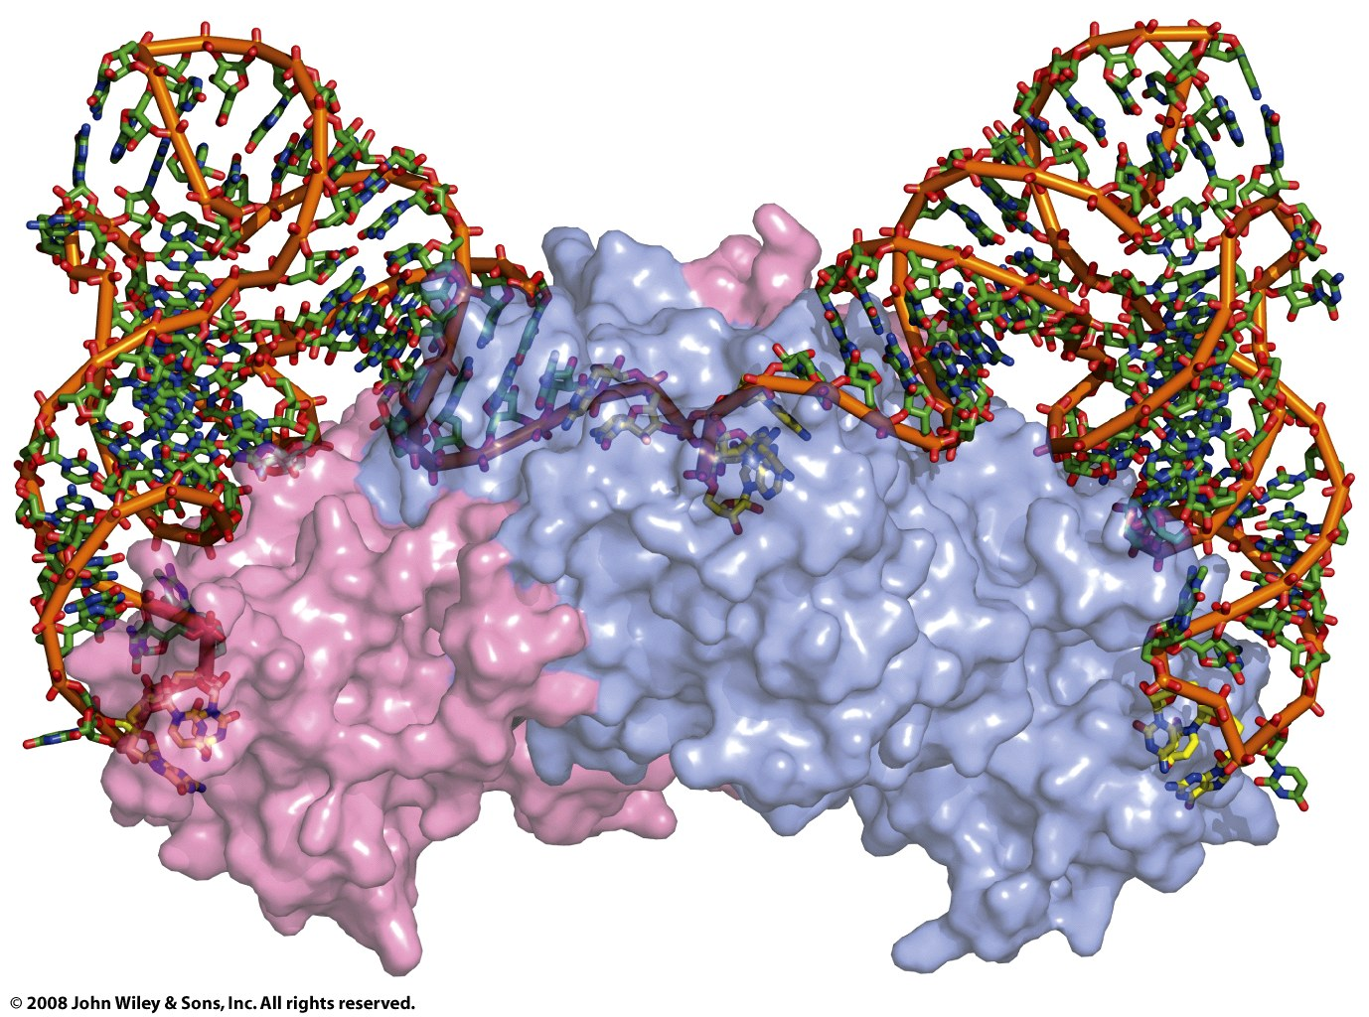
Induced fit
aspRS-tRNA^{asp}
Figure 27-9

Slide 21
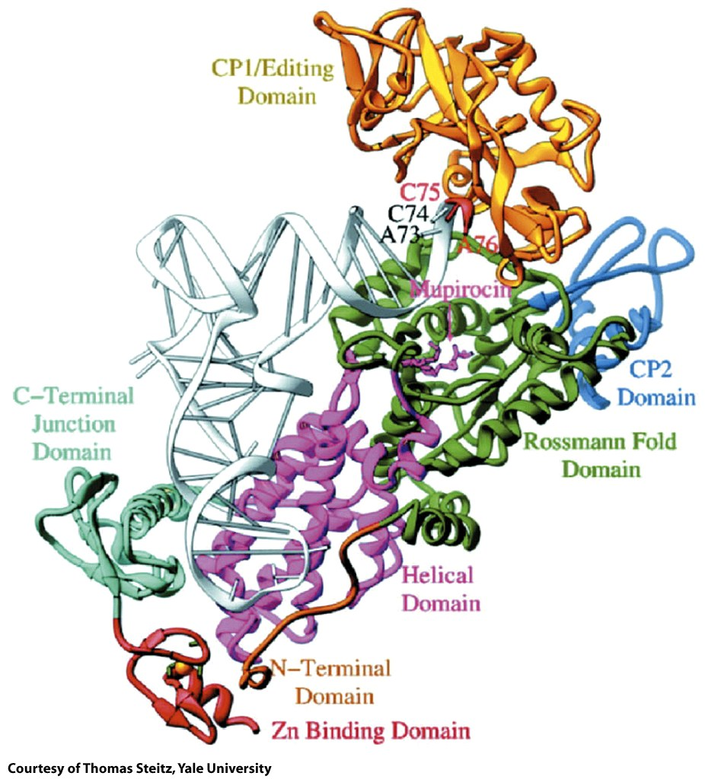
ileRS-tRNA^{ile}
Figure 27-10

Slide 22
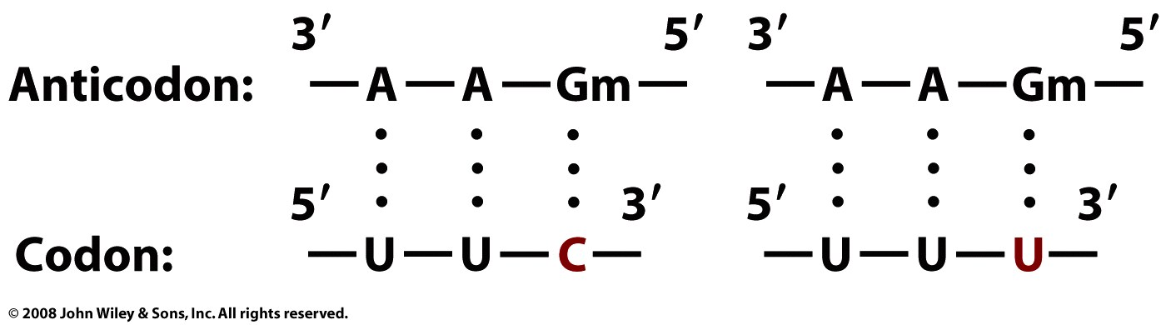
A tRNA can recognize multiple codons (which vary at their 3’ end. The 3rd position of the codon can wobble.
Page 998

Slide 23
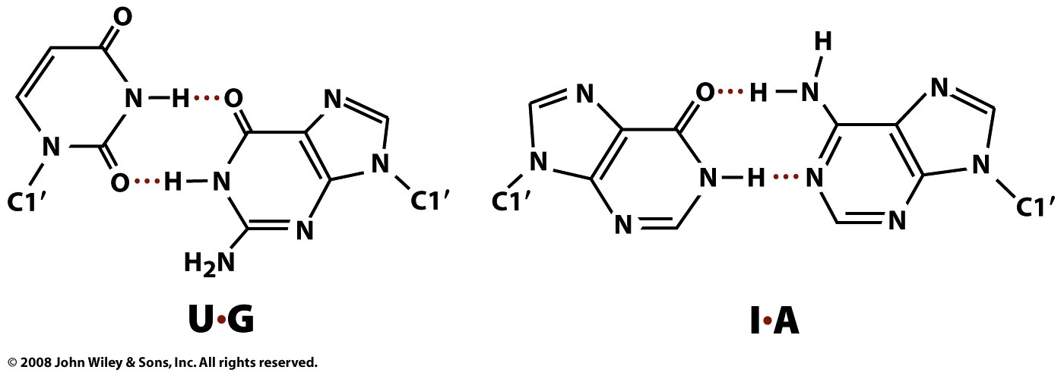
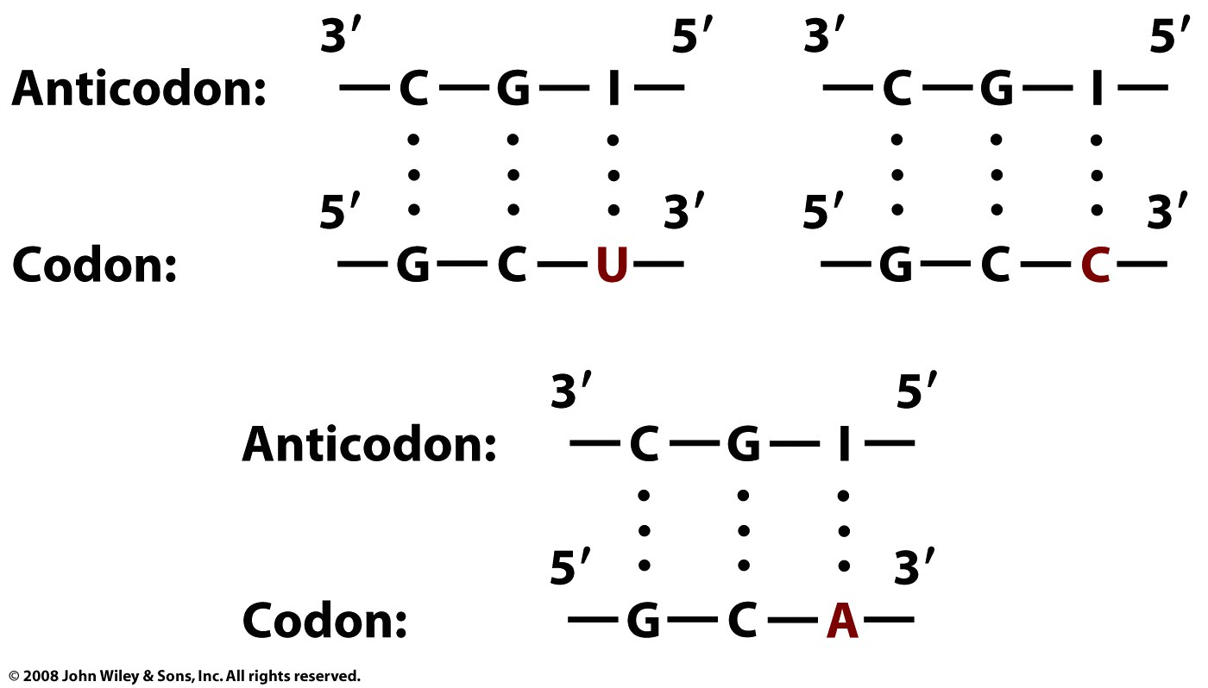
I =inosine

Slide 24
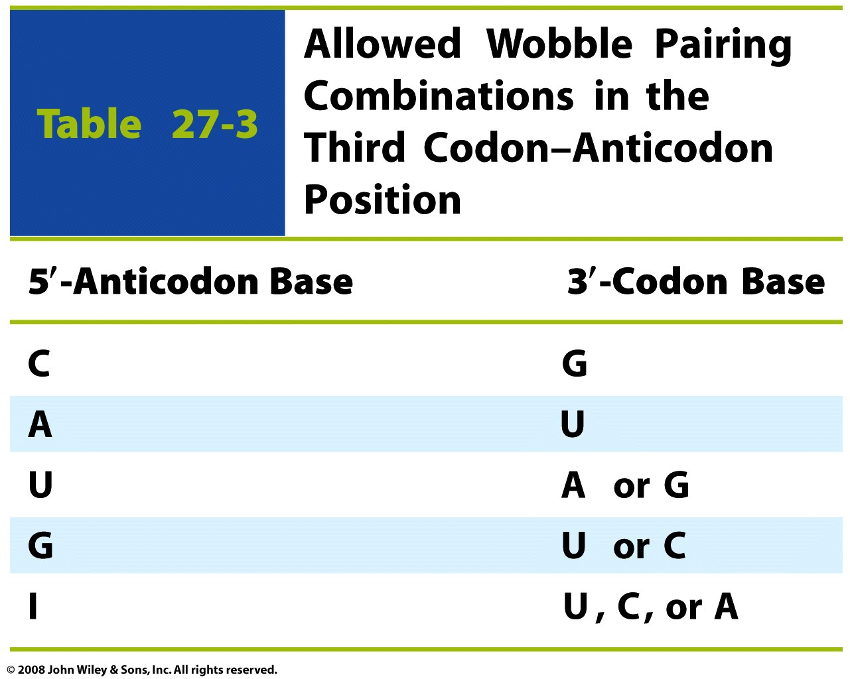
Table 27-3

Slide 25
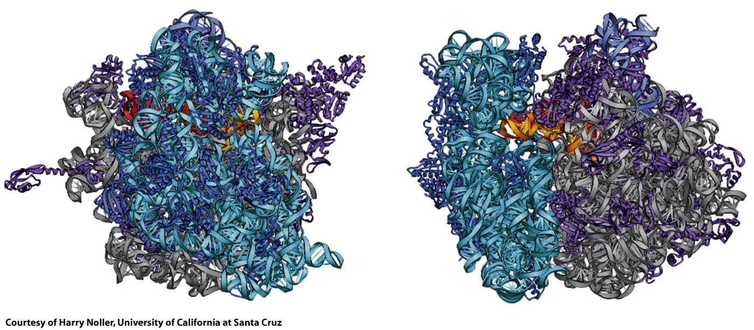
Assembled Ribosome
LSU
SSU
Figure 27-17

Slide 26
A functioning ribosome contains two subunits, which assemble independently and can pretty much ignore each other when not synthesizing protein. The two subunits SSU=30S (in bacteria) and LSU=50S (in bacteria) assemble into an intact ribosome (70S in bacteria) when synthesizing protein. The peptidyl transferase center is in the LSU and the decoding center is in the SSU.
Ribosomal components are often named by their Svedberg (s) values, which are based upon sedimentation rates. Prokaryotic ribosomes are 70S (assembled particles), 30s (SSU) and 50s (LSU).Eukaryotic ribosomes are 80S (assembled particle), 40s (SSU) and 60s (LSU) subunits.

Slide 27
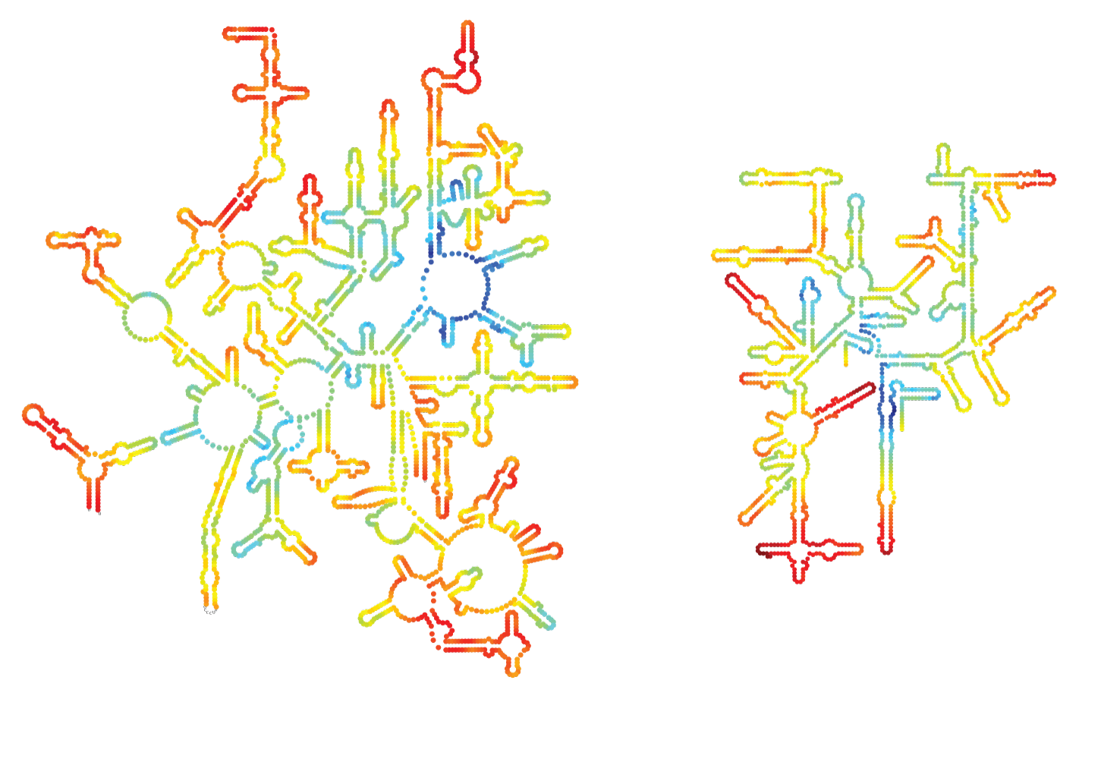
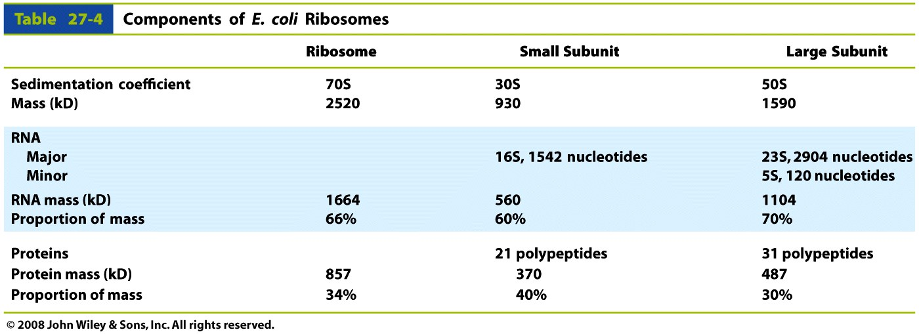
Bacterial Ribosome
Bacterial rRNAs
23S
16S
5S
LSU
SSU

Slide 28
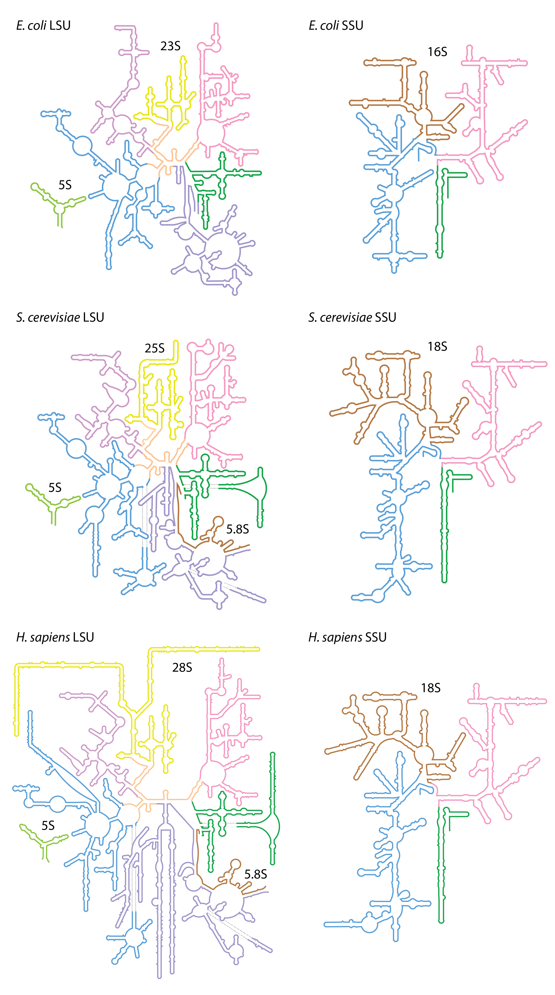

Slide 29
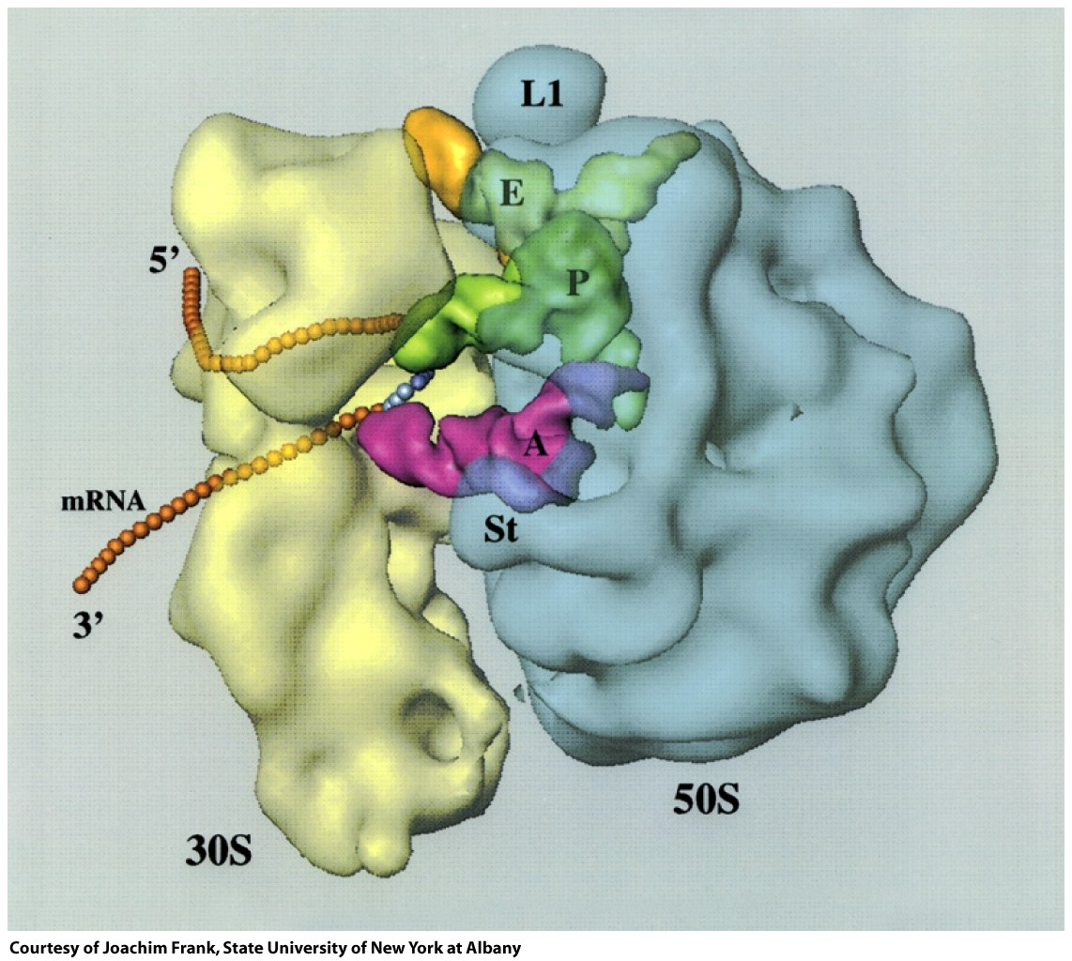
SSU
LSU
Figure 27-13b

Slide 30
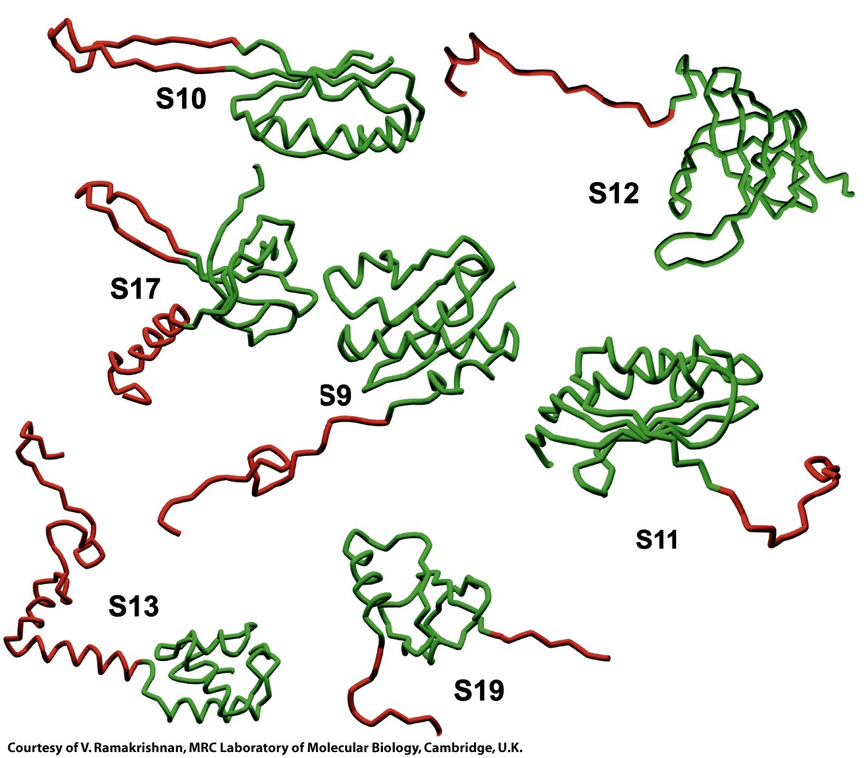
SSU proteins
Figure 27-16

Slide 31
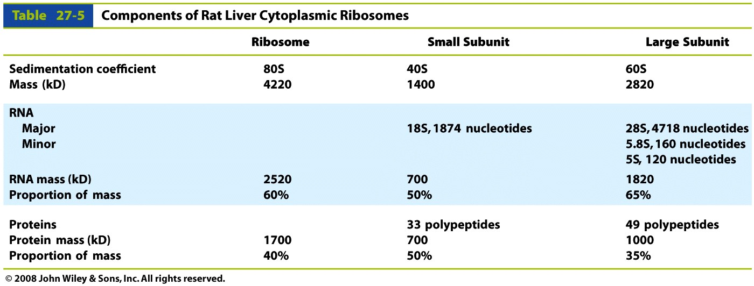
Eucaryotic Ribosomes
Table 27-5

Slide 32
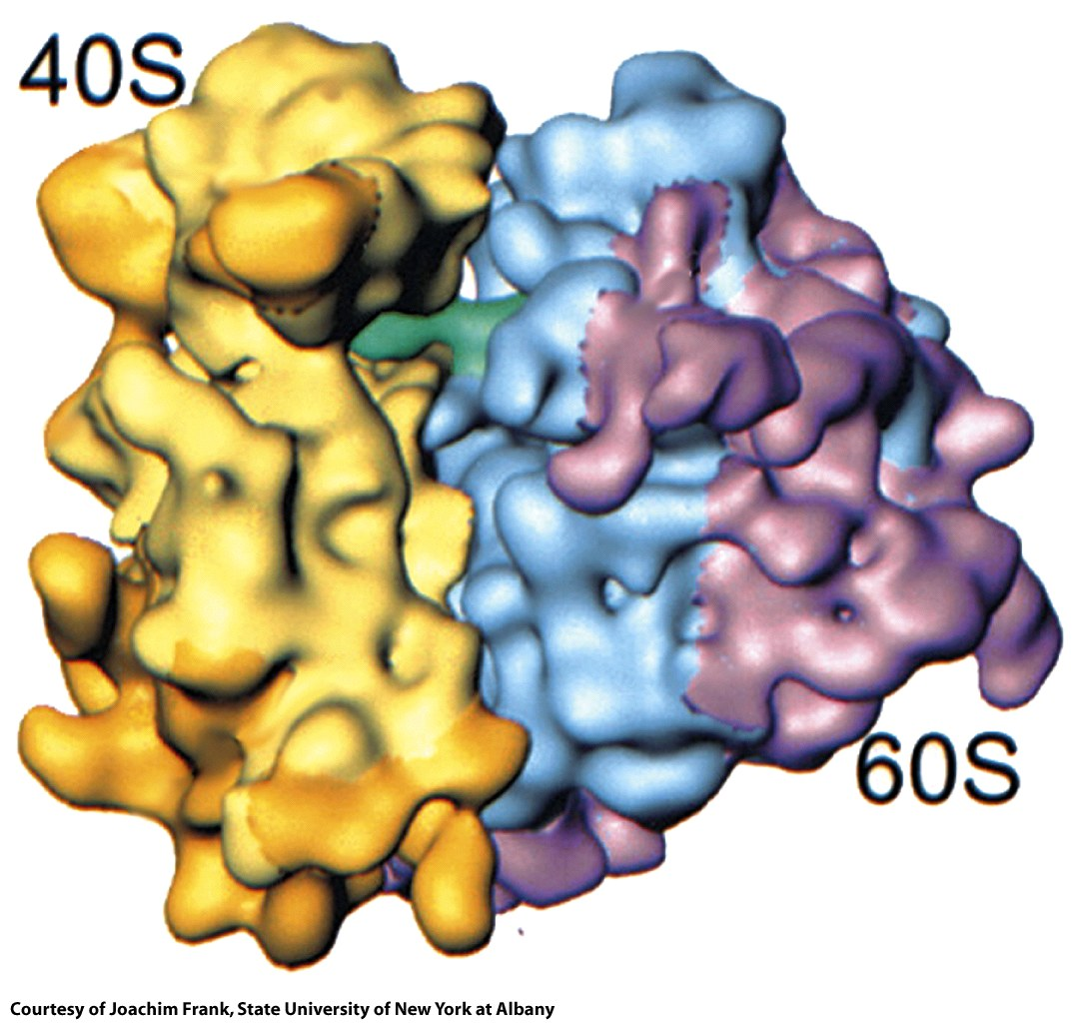
Figure 27-19

Slide 33
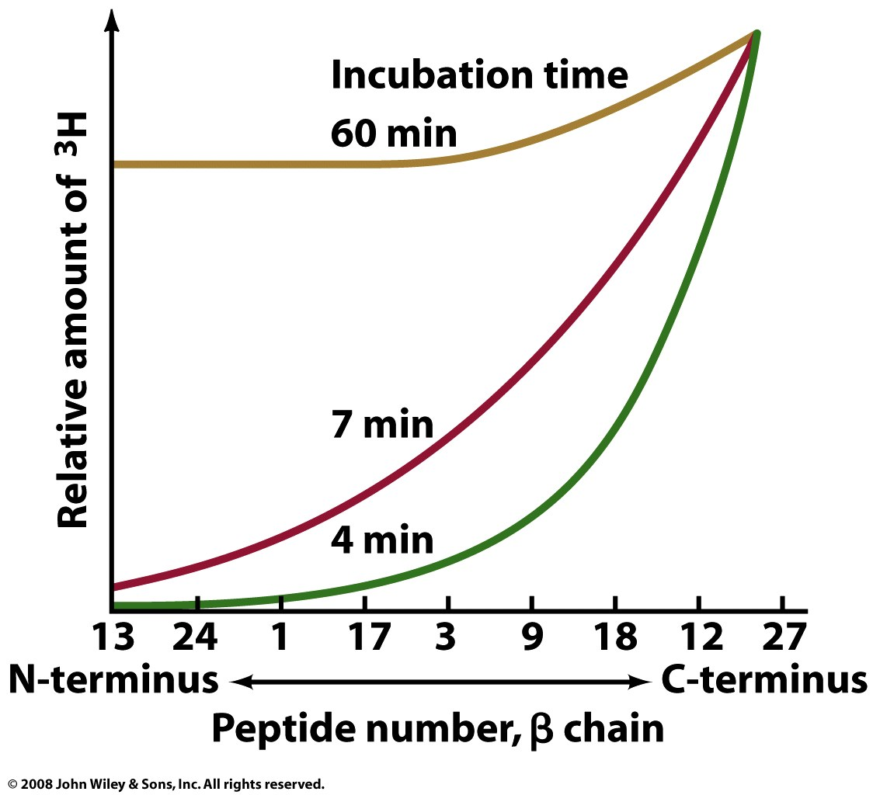
Translation proceeds in the N to C direction.
Add hot leucine, translate for time (t), do a tryptic digest (with trypsin).
Figure 27-20

Slide 34
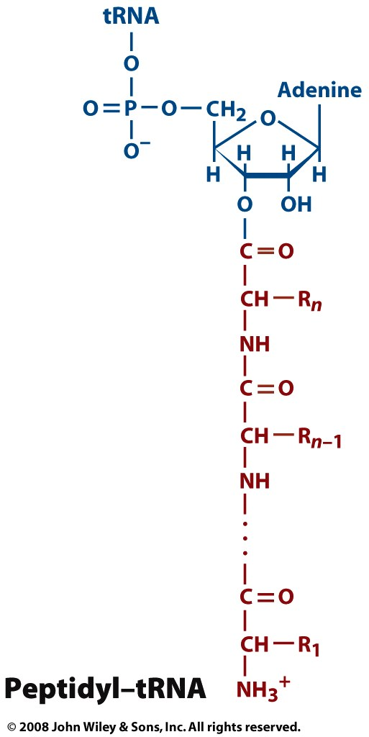
numbering scheme of a growing peptide.
The mRNA is read from the 5’ to 3’ direction.
Page 1009

Slide 35
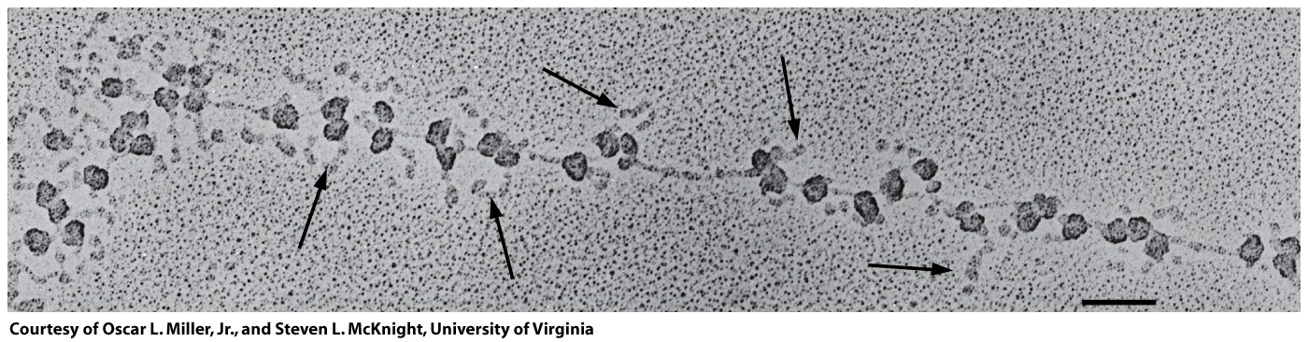
Active translation can occur on polysomes
3’ end of mRNA
5’ end of mRNA
Figure 27-22

Slide 36
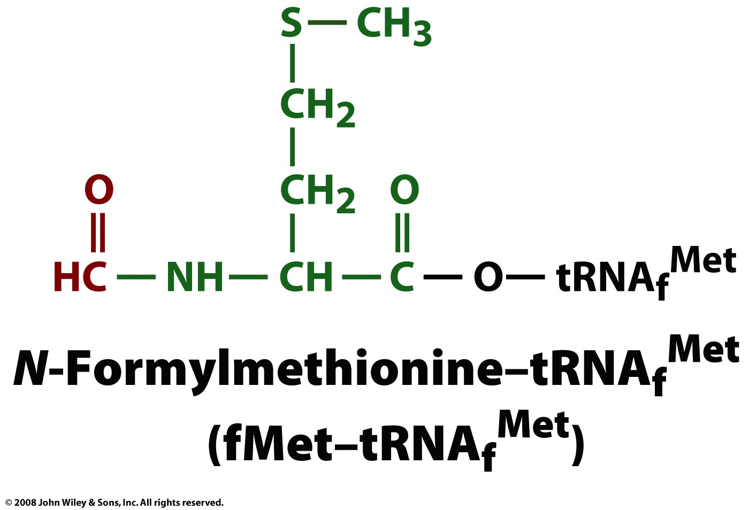
most proteins in e coli begin with f-methionine (which is removed after translation
Page 1010

Slide 37
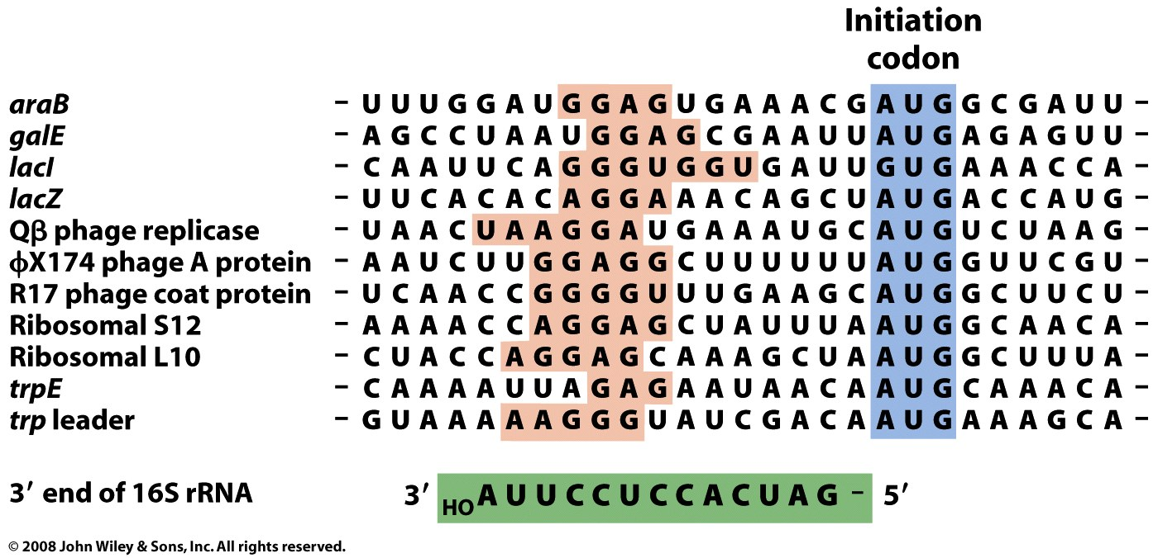
The Shine-Dalgarno sequence of the 16S (SSU) forms base pairs to 5' end of the mRNA (initiation sequence) with the help of initiation factors (IF).
Figure 27-23

Slide 38
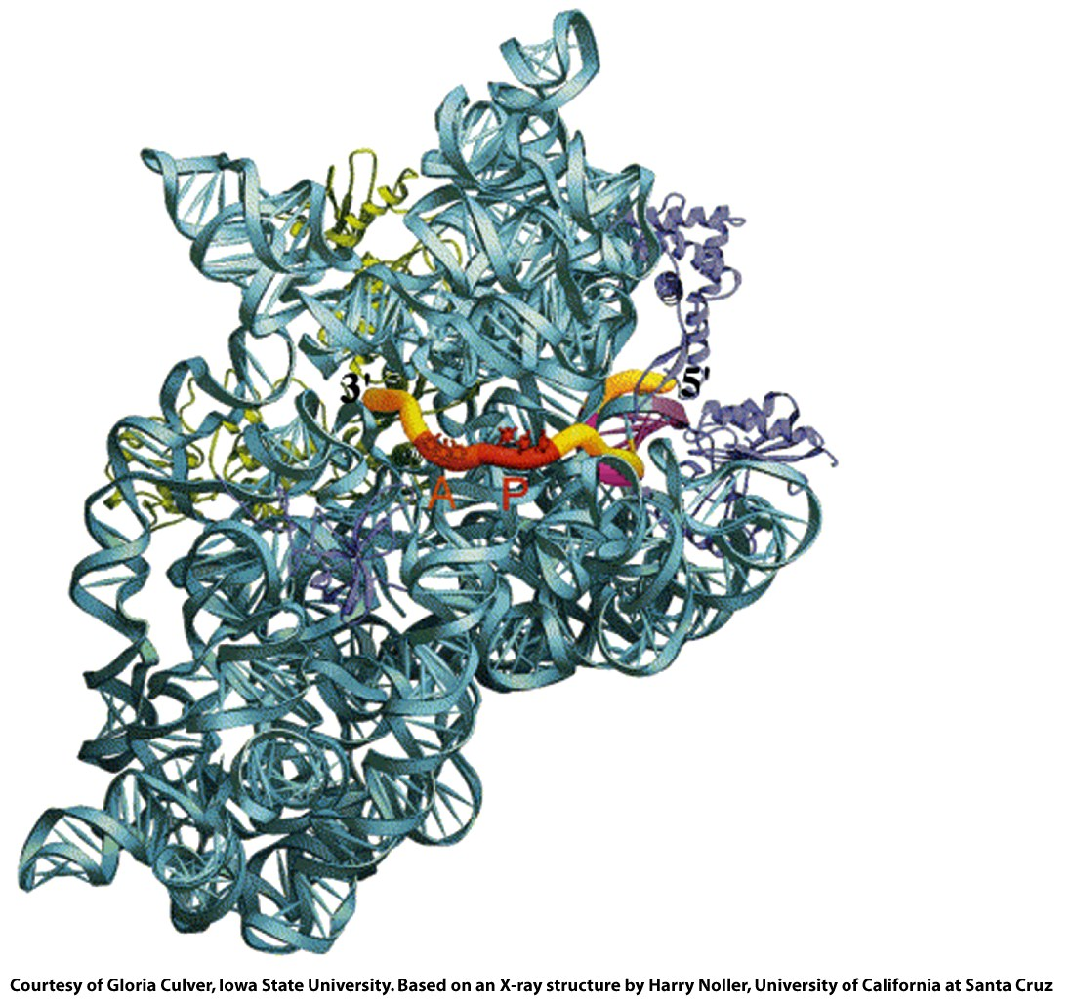
Initiation complex
SD is magenta
Figure 27-24

Slide 39
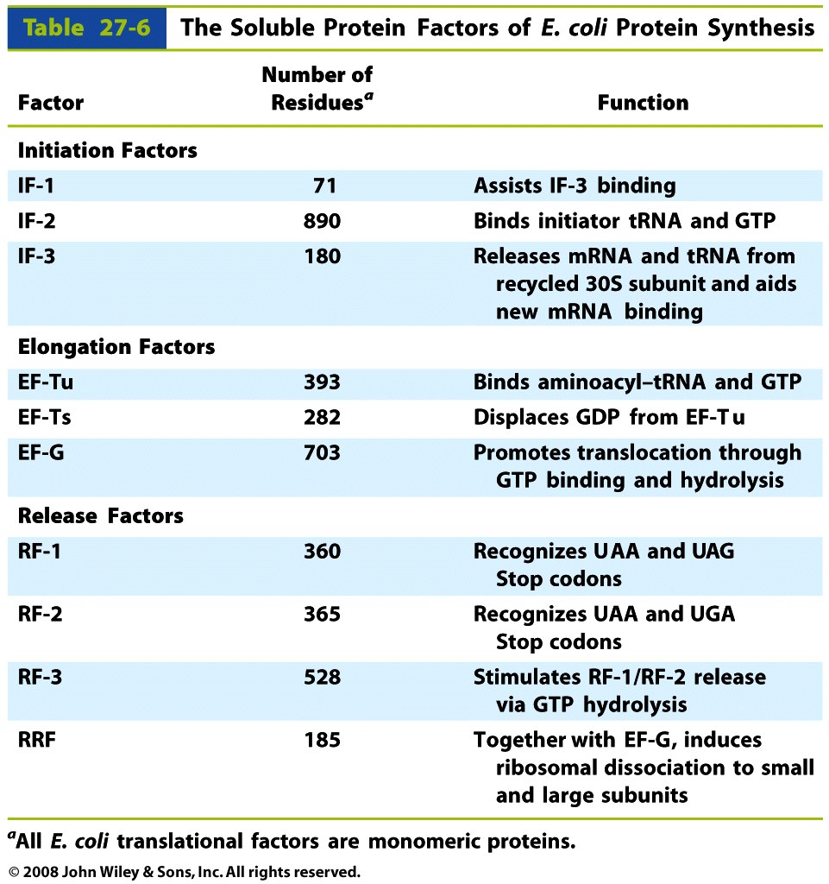
Table 27-6

Slide 40
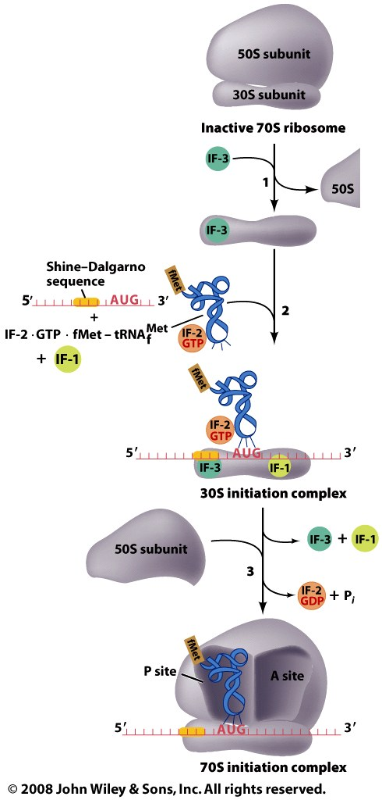
Figure 27-25

Slide 41
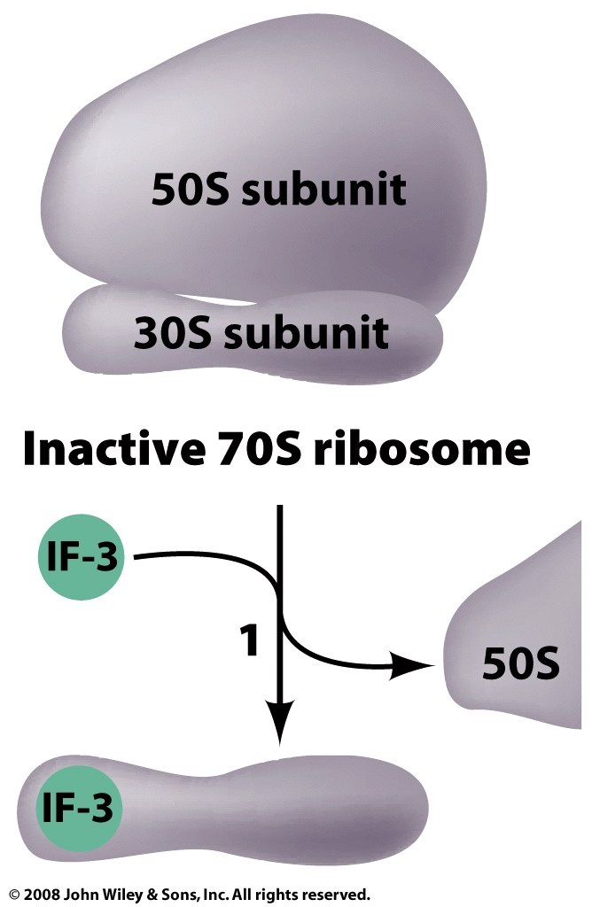
Figure 27-25 part 1

Slide 42
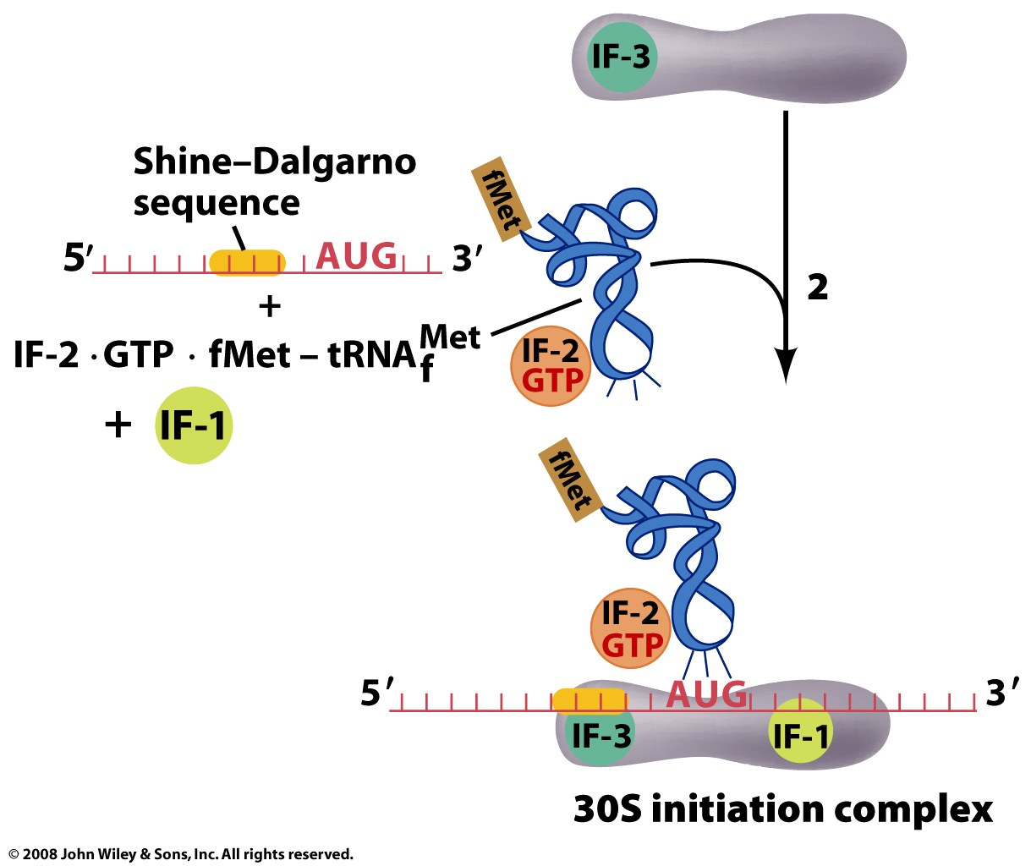
Initiation:
mRNA + Initiation Factor 2 (IF-2) + fMet-tRNA_{f}^{met}
The Shine-Dalgarno sequence of the 16S (SSU) forms base pairs to 5' end of the mRNA (initiation sequence) with the help of initiation factors (IF’s).
Figure 27-25 part 2

Slide 43
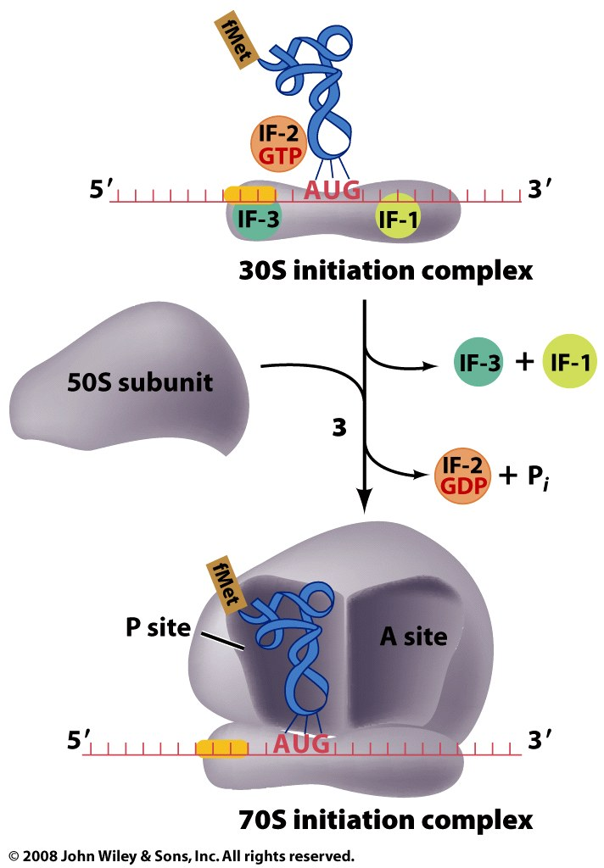
Figure 27-25 part 3

Slide 44
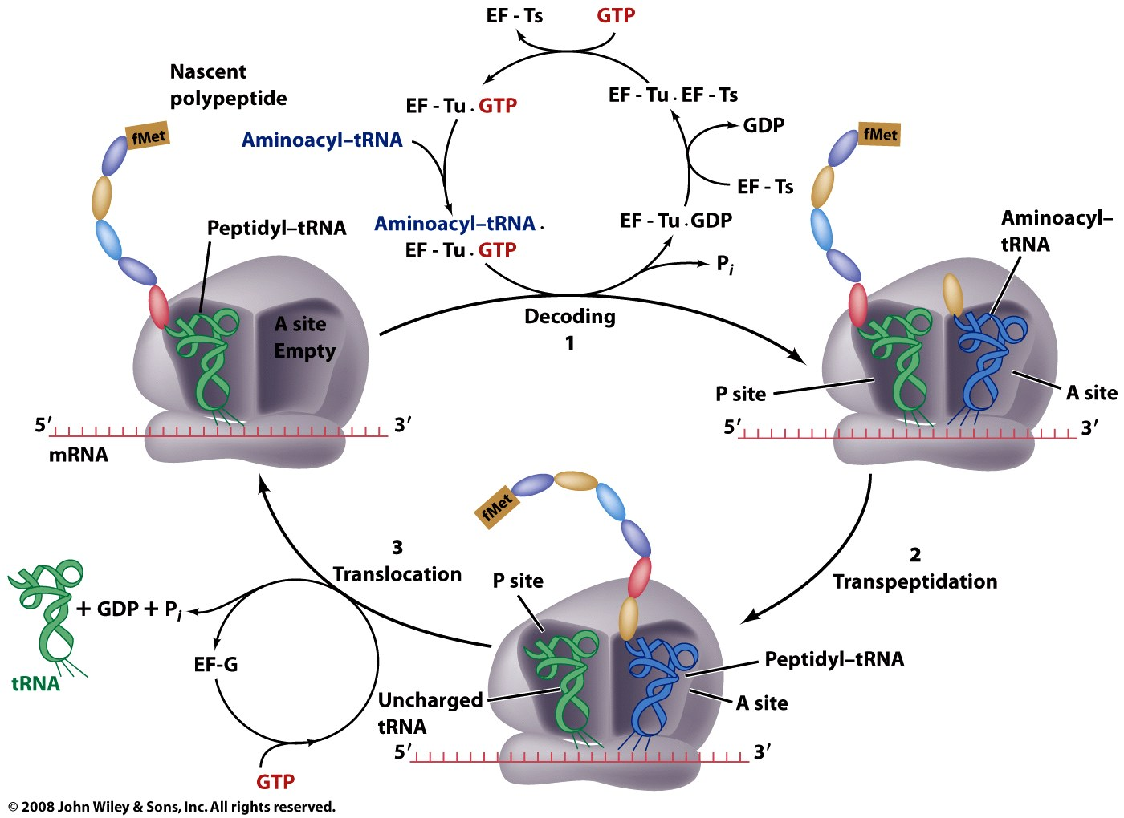
Figure 27-27

Slide 45
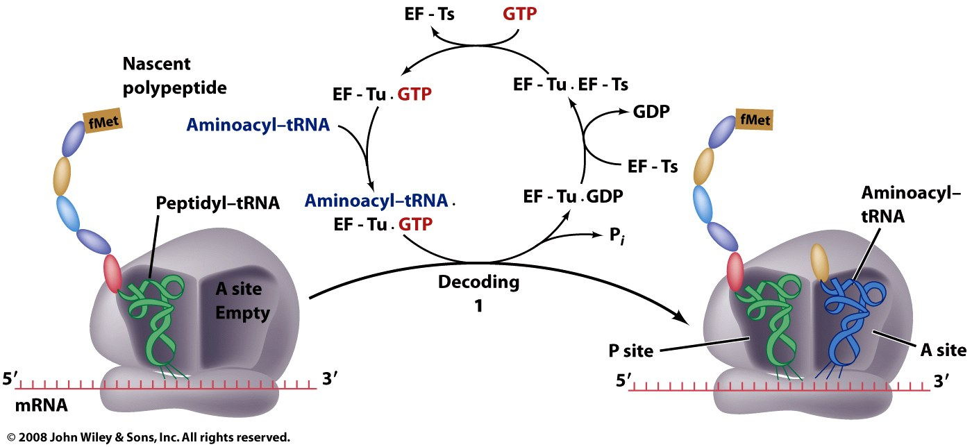
Figure 27-27 part 1

Slide 46
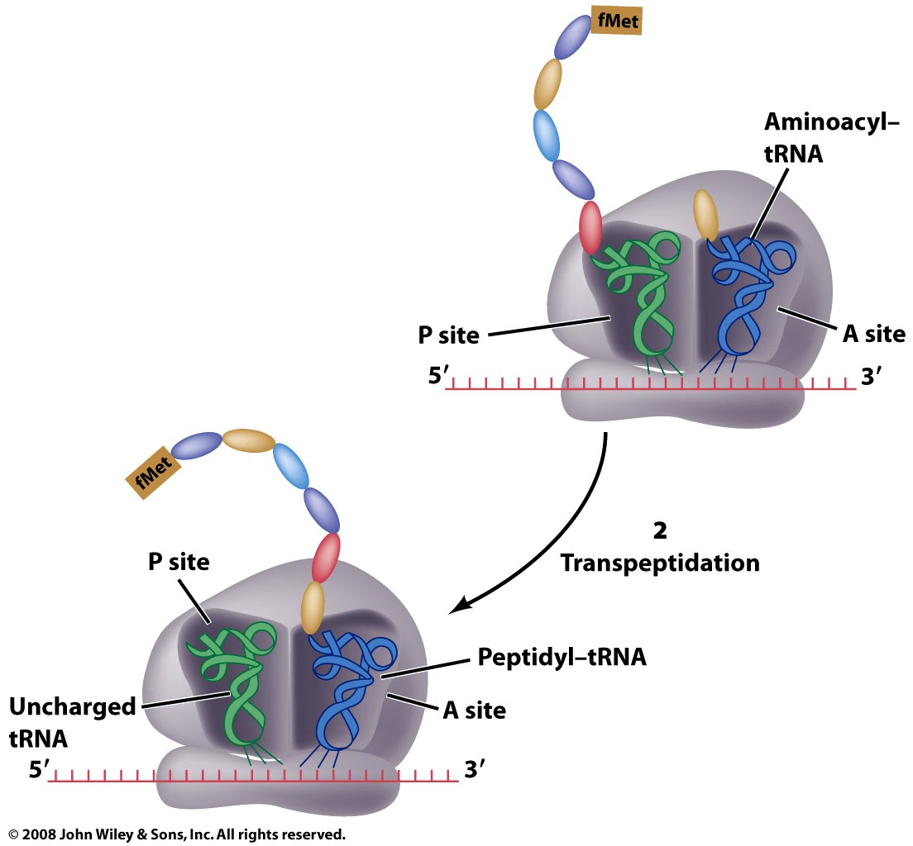
Figure 27-27 part 2

Slide 47
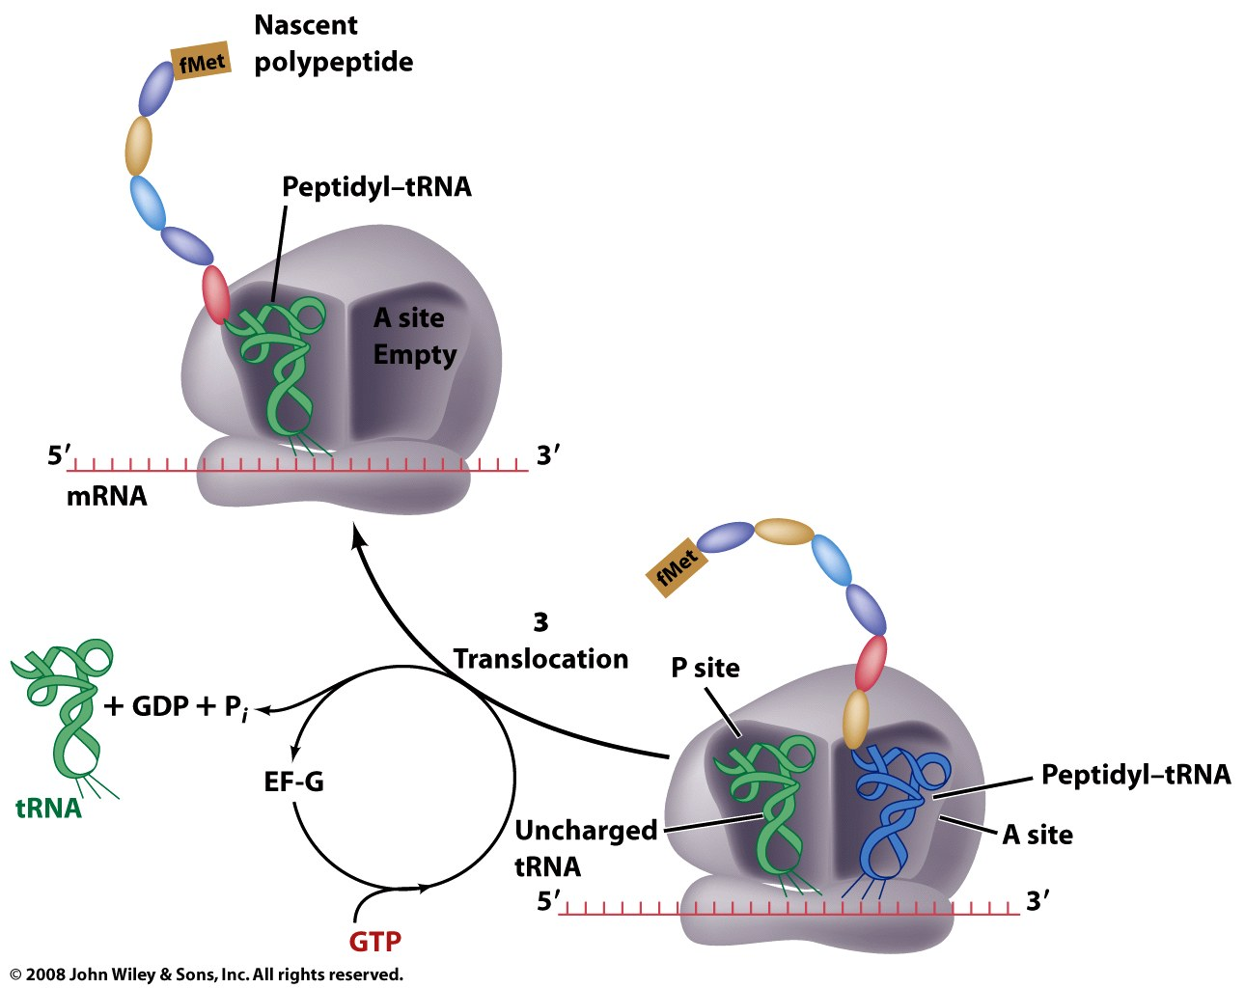
Figure 27-27 part 3

Slide 49
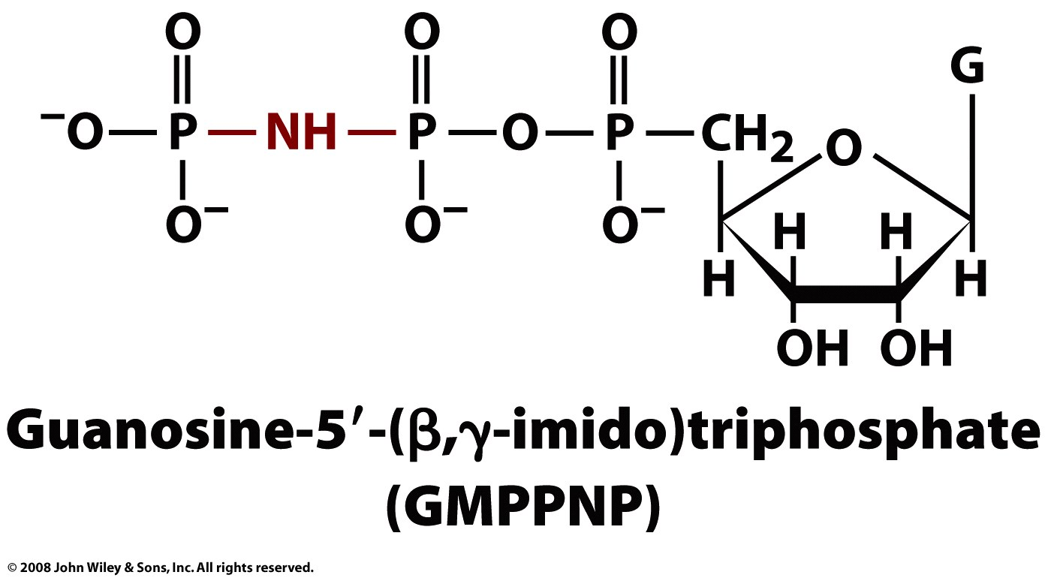
Page 1016

Slide 50
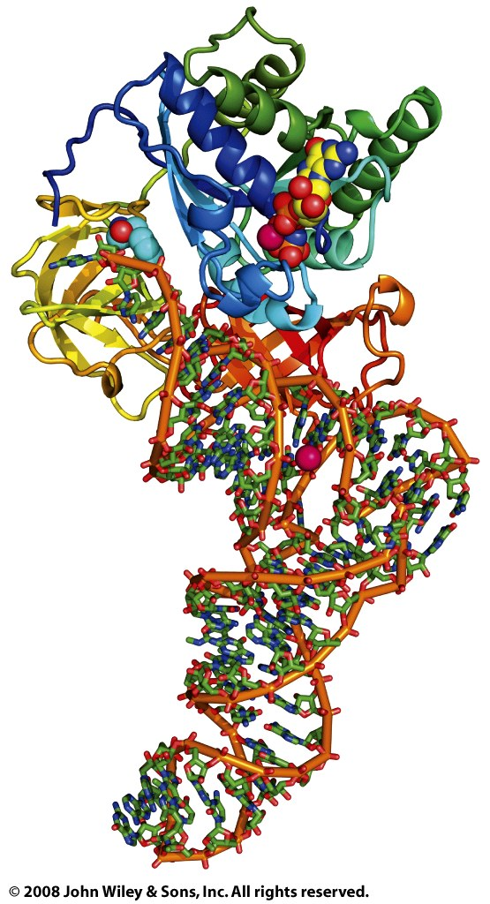
Figure 27-28

Slide 51
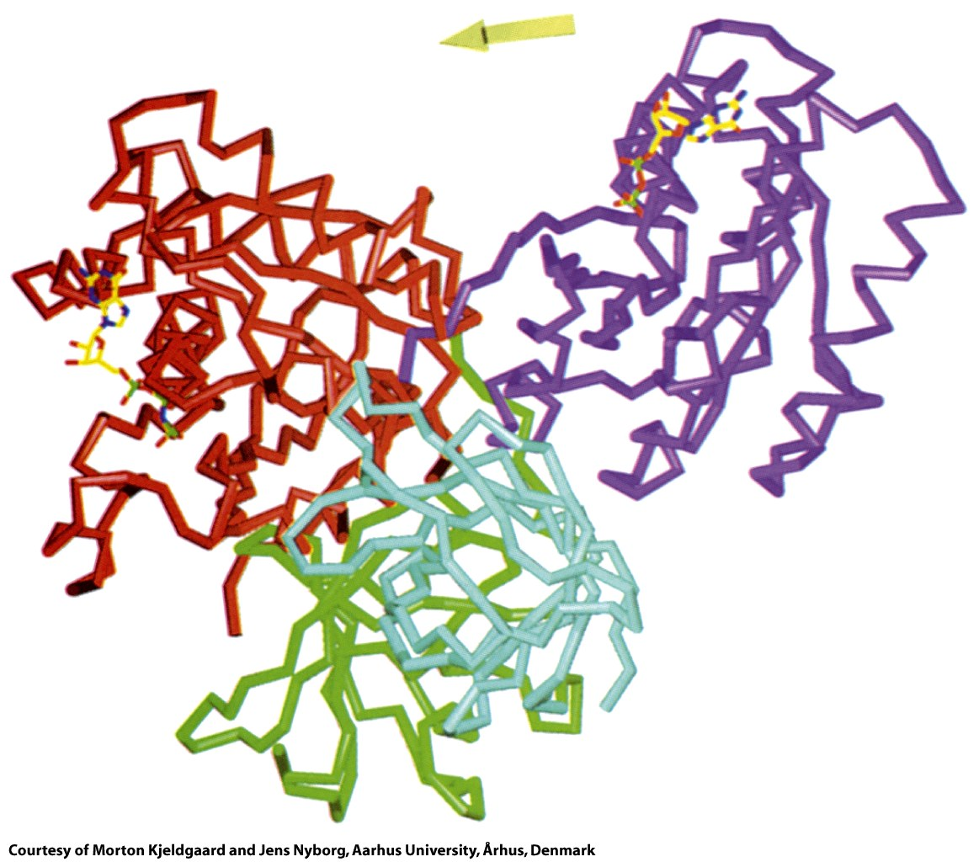
Figure 27-29

Slide 52
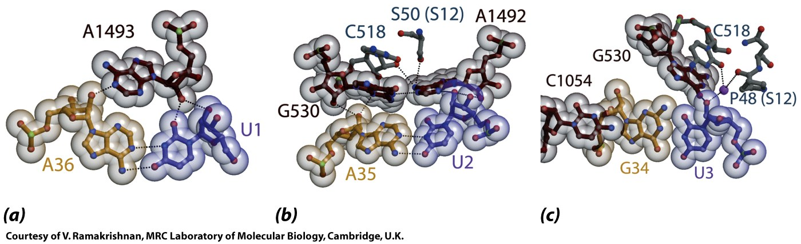
Figure 27-30

Slide 53
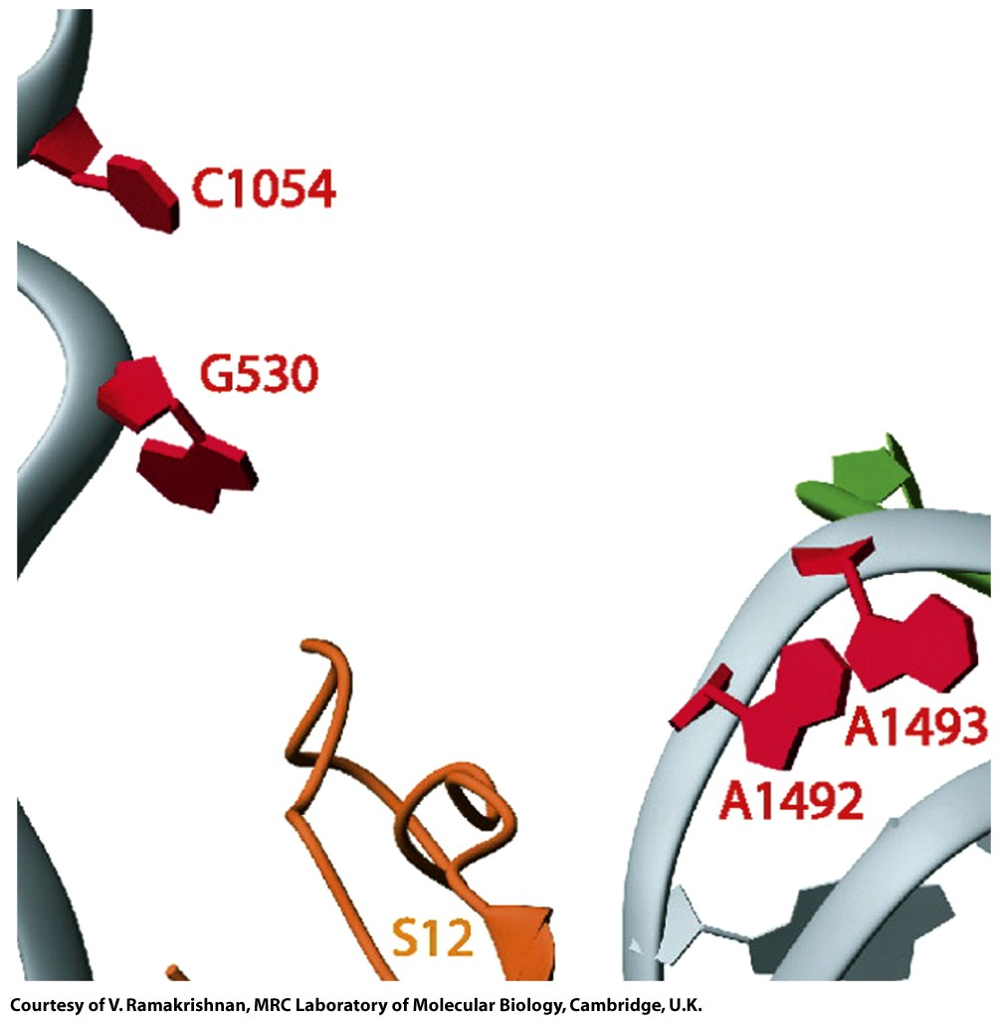
Figure 27-31a

Slide 54
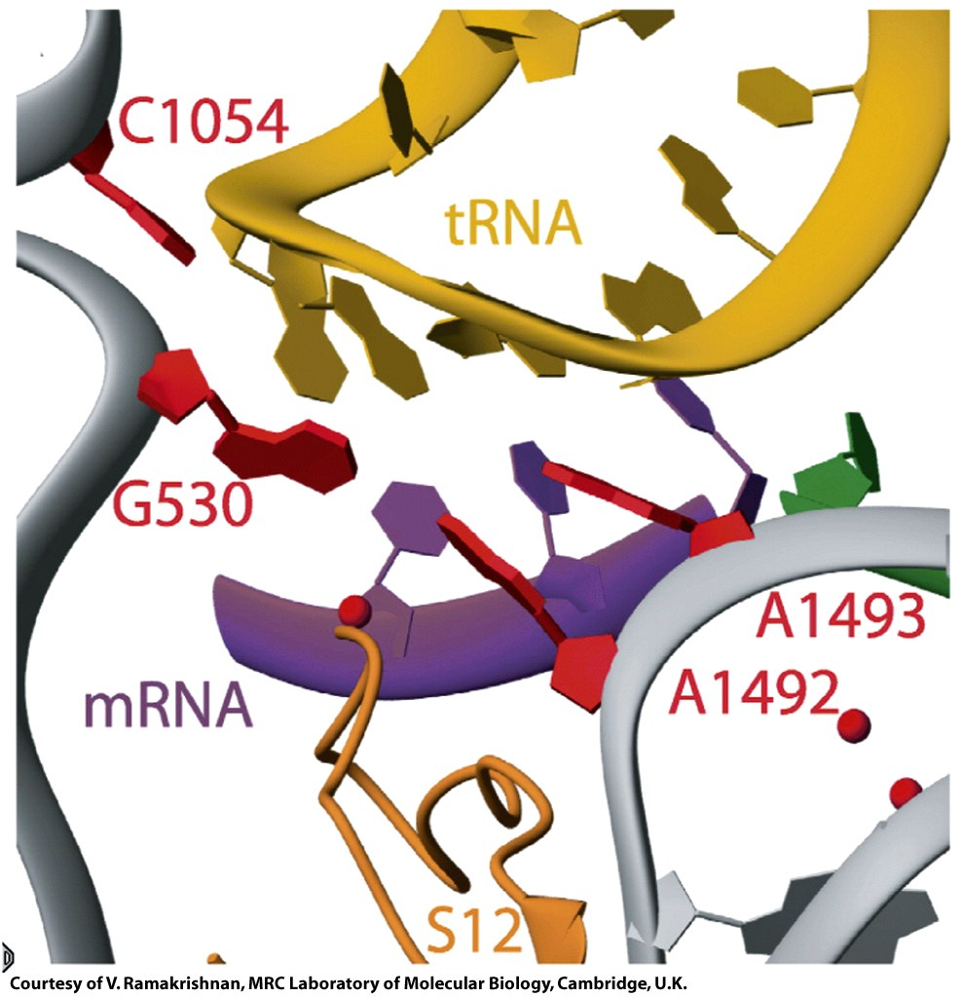
Figure 27-31b

Slide 55

Figure 27-32

Slide 56

Figure 27-33

Slide 57

Figure 27-34

Slide 58

Figure 27-35

Slide 59

Figure 27-35 part 1

Slide 60

Figure 27-35 part 2

Slide 61

Figure 27-35 part 3

Slide 62

Figure 27-35 part 4

Slide 63

Figure 27-35 part 5

Slide 64

Box 27-3 figure 1

Slide 65

Box 27-3 figure 2

Slide 66

Box 27-3 figure 3

Slide 67

Box 27-3 figure 4

Slide 68

Figure 27-36

Slide 69

Figure 27-36 part 1

Slide 70

Figure 27-36 part 2

Slide 71

Figure 27-36 part 3

Slide 72

Figure 27-36 part 4

Slide 73

Figure 27-36 part 5

Slide 74

Figure 27-37

Slide 75

Figure 27-38

Slide 76

Figure 27-39

Slide 77

Figure 27-40a

Slide 78

Figure 27-40b

Slide 79

Figure 27-41a

Slide 80

Figure 27-41b

Slide 81

Figure 27-42

Slide 82

Figure 27-43

Slide 84

21st amino acid: modification of serine after charging
Box 27-2 figure 1

Slide 85




Many bases of tRNA and rRNA are modified

Slide 86



Slide 87

Aminoacyl-tRNA Synthetases
Aminoacyl tRNA synthetases (aaRS's) are enzymes that charge tRNAs. aaRS's catalyze the addition of amino acids to the 3' ends of tRNAs. Each amino acid (except phe) is added to its cognate tRNA (tRNA^{phe}) by the corresponding aaRS (pheRS). For example alaRS adds ala to tRNA^{ala}. The ribosome transfers the correct amino acid from tRNA onto a growing polypeptide according the interaction between the anticodon on the tRNA and codon in the mRNA (the genetic code). There are two classes of aaRS’s

Slide 88


SSU
Figure 27-14a

Slide 89


LSU

Slide 90

LSU
E P A
Figure 27-18

Slide 91

Figure 27-15

Slide 92

Figure 27-15a

Slide 93

Figure 27-15b

