Slide 2
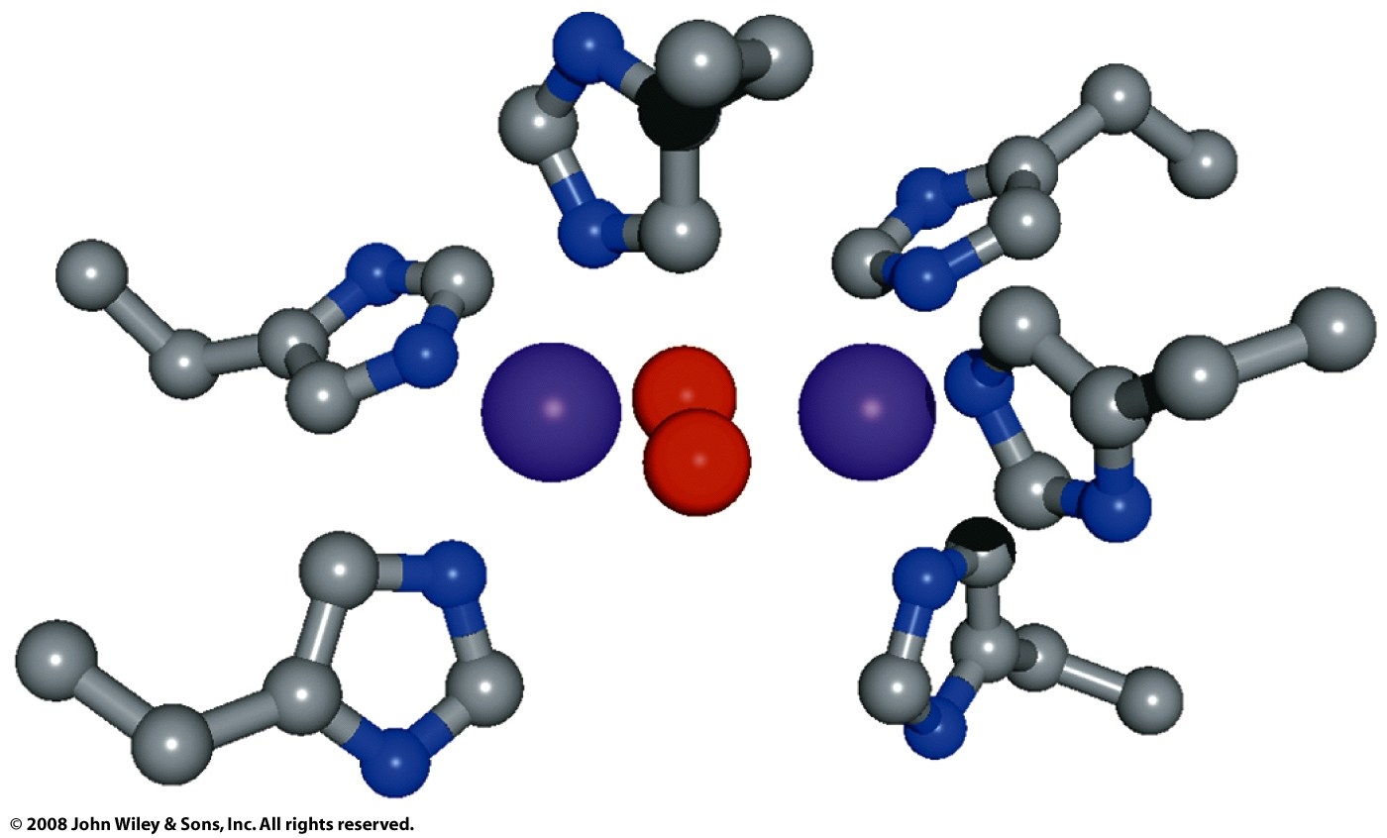

Slide 3
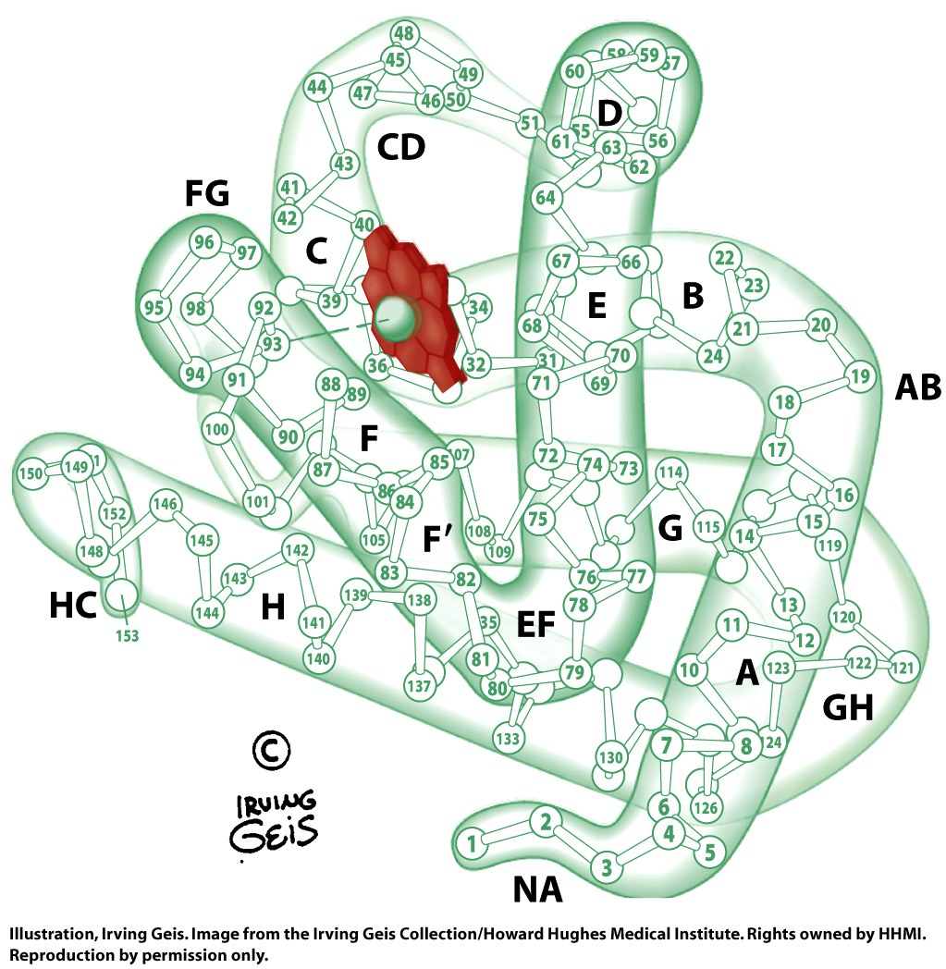
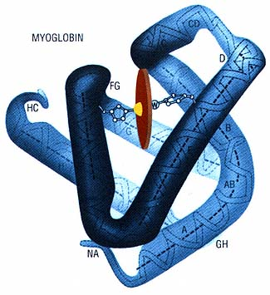
Myoglobin
MYB: muscle cells use MYB to accelerate O₂ diffusion and act as localized O₂ reserve. MYB increases O₂ solubility. Very abundant in marine mammals. Not found in blood.

Slide 4
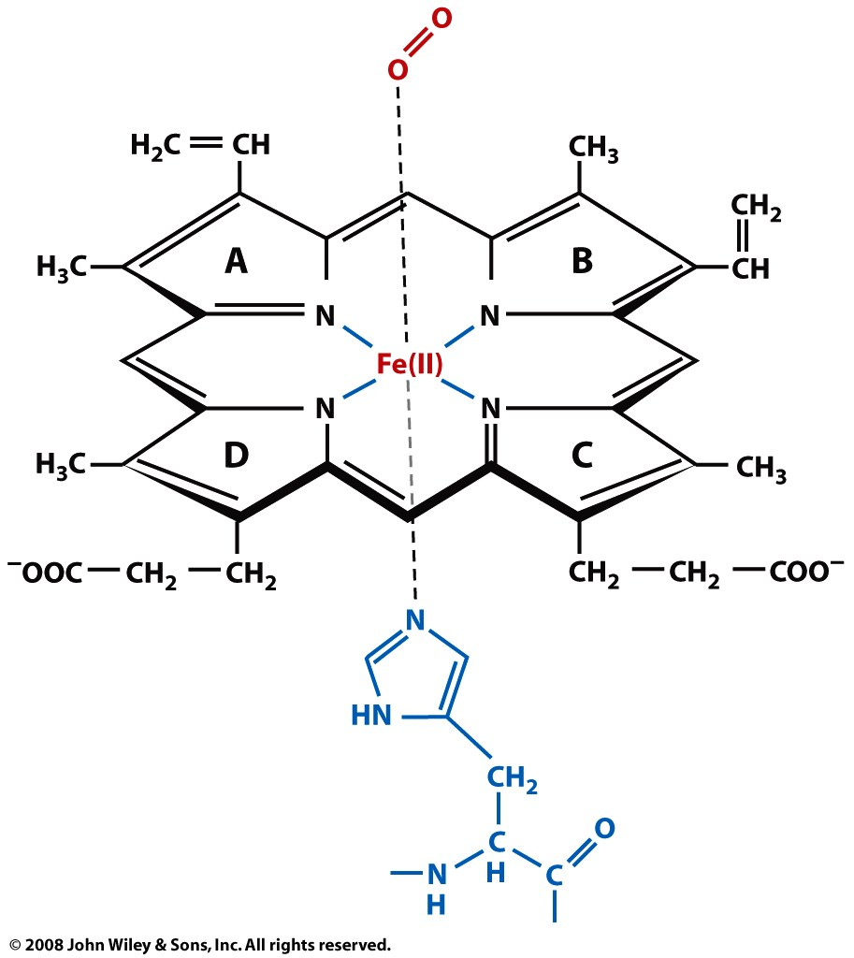

Slide 5
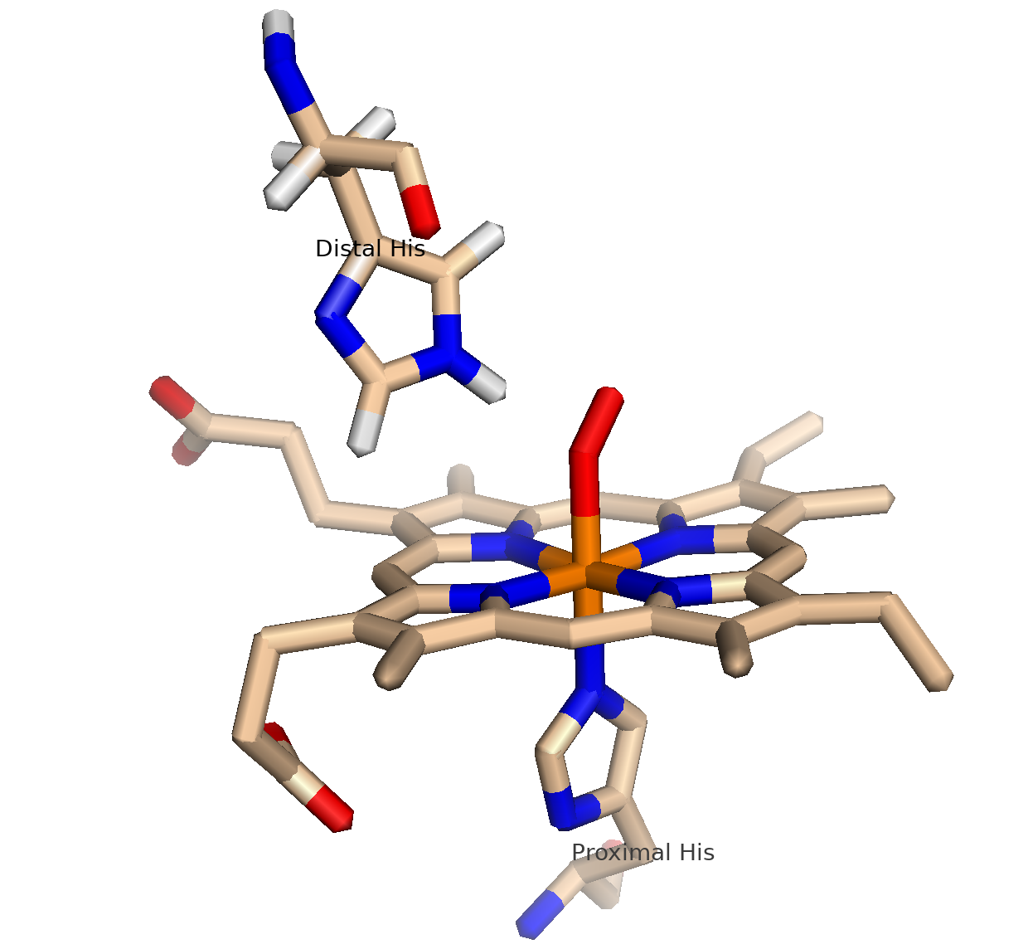
MYB
Binds reversibly to O₂
α-helical (globin fold: 8 helices: A-H)
Contains a heme with Fe(II) (prosthetic group)
Fe is 5 coordinate
4 porphyrin N atoms
1 His N atom
O₂ can be the 6th ligand
Fe(II) in MYO does not oxidize to Fe(III)
CO, NO and H₂S also bind to MYO
153 amino acids
16.7 KD
Myoglobin was the first protein to have its three-dimensional structure determined by x-ray diffraction

Slide 6
A heme: an iron [(Fe(II)] in a porphyrin ring.
The iron is the site of oxygen binding.
The iron is coordinated by four nitrogen atoms of the porphyrin.
The iron is also bound by imidazole ring of the F8 histidine residue (also known as the proximal histidine, which is in the F helix).
The sixth position can reversibly bind to oxygen.
Oxygen binds in an "end-on bent" geometry where one oxygen atom binds Fe and the other protrudes at an angle.
The iron is not oxidized (it does not rust). The binding is reversible.

Slide 7
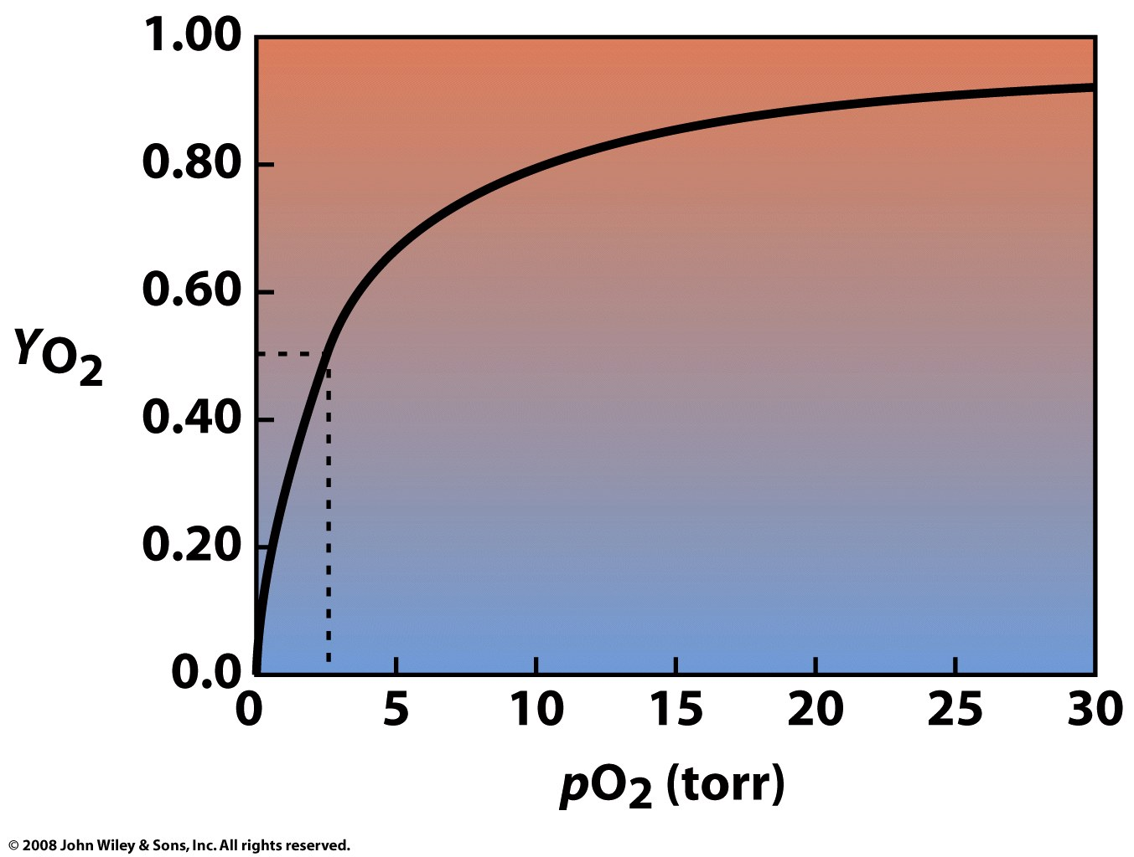
K= pO₂
When Y=0.5
K_{MB}=2.8 torr
(see page 180) VVP
Y (fraction saturation) rises sharply then levels off as it reaches a maximum. MYB is a monomer. It binds to O₂ non-cooperatively.
The binding curve is a simple hyperbola.

Slide 8
Mb + O₂ = MbO₂
K_{d} = ([Mb] [O₂]) / [MbO₂]

Slide 9
Hemoglobin
Hb
the iron-containing oxygen-transport metalloprotein in the red blood cells of all vertebrates
binds O₂ in the respiratory organs (lungs or gills) to tissues
binds CO₂ in tissues and releases it in lungs/gills
is a tetramer of four subunits (each a polypeptide chain)
with two α subunits (141 aa's) and two β subunits (146 aa's)
α2β2 (here α & β do not refer to α-helices and β-sheets)
α and β subunits both resemble myoglobin
α and β subunits are similar in sequence
both form alpha helical globin folds
human infants, 2 α chains and 2 γ chains.

Slide 10
Myoglobin v Hemoglobin

Slide 11
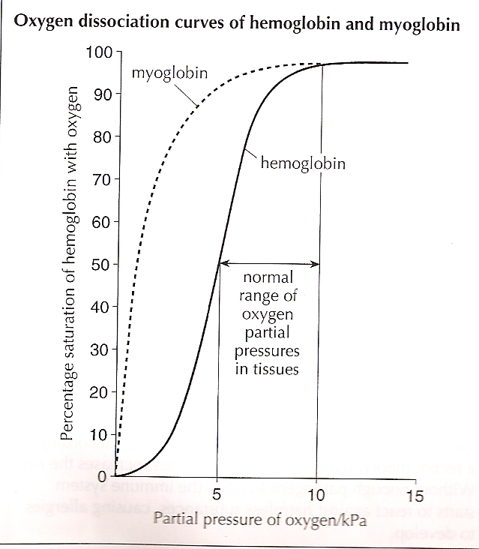
Myoglobin v Hemoglobin

Slide 12
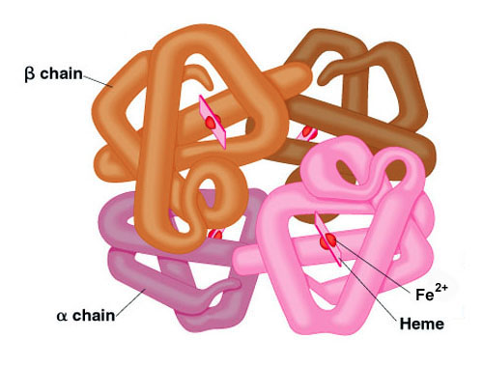
Hemoglobin
Hb binds cooperatively to O₂
Hb has four subunits (four O₂ binding sites)
O₂ binding to one subunit increases O₂ affinity of other subunits.

Slide 13
Hemoglobin
The oxygen affinity of (O₂)₃-hemoglobin is ~300 times greater than that of deoxy-hemoglobin [(O₂)₀-hemoglobin].
two states: tense (blue) (T) and relaxed (red) (R).
R has greater O₂ affinity, favored by
O₂ binding, high pH, low CO₂, or low 2,3 BPG favor R state
T has lower O₂ affinity, favored by
low pH, high CO₂ and high 2,3 BPG favor T state (release of O₂),
regulated by binding effector molecules at sites other than the active site (2,3 BPG).

Slide 14
Hemoglobin
Each subunit contains one Fe-heme
no bound O₂ => hemoglobin is in the T state (Tense State)
binding of one O₂ to one iron shifts the position of that Fe into the plane of the porphryn ring,
that shifts the proximal His, on the other side of the Fe, (His F8],
that shifts the position of helix F,
that changes the interfaces between the subunits
that changes the other O₂ binding sites (increases their O₂ affinity)
the O₂ affinity at the other three hemes increases
Linkage between the Fe the proximal His causes tertiary changes that transmit effects to other subunits.
The oxygen affinity of (O₂)₃-hemoglobin is ~300 times greater than that of deoxy-hemoglobin.
regulated by binding effector molecules at sites other than the active site (2,3 BPG).

Slide 15
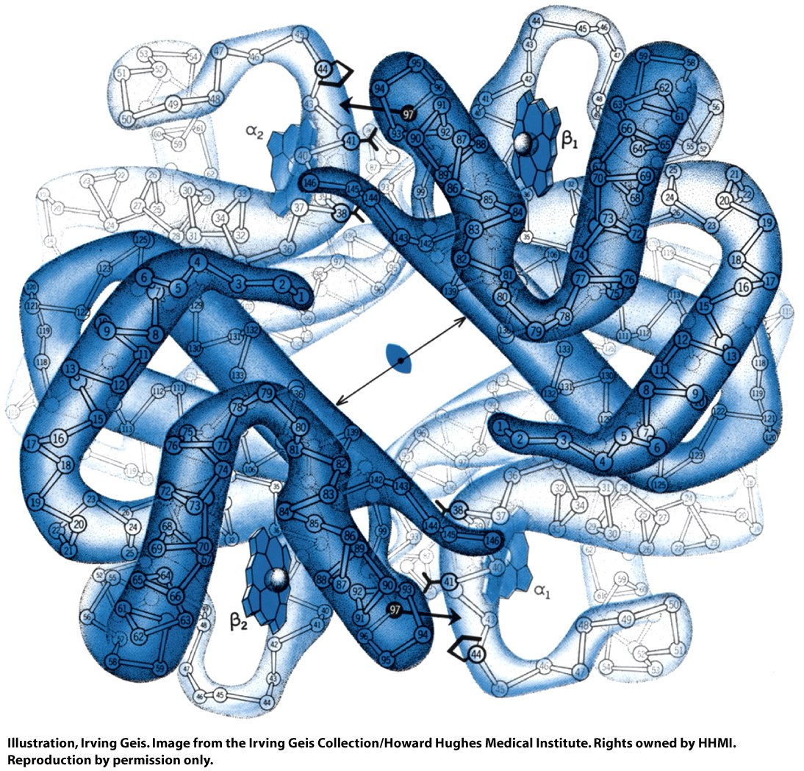
T-state,
Low O₂
affinity
Figure 7-5 part 1

Slide 16
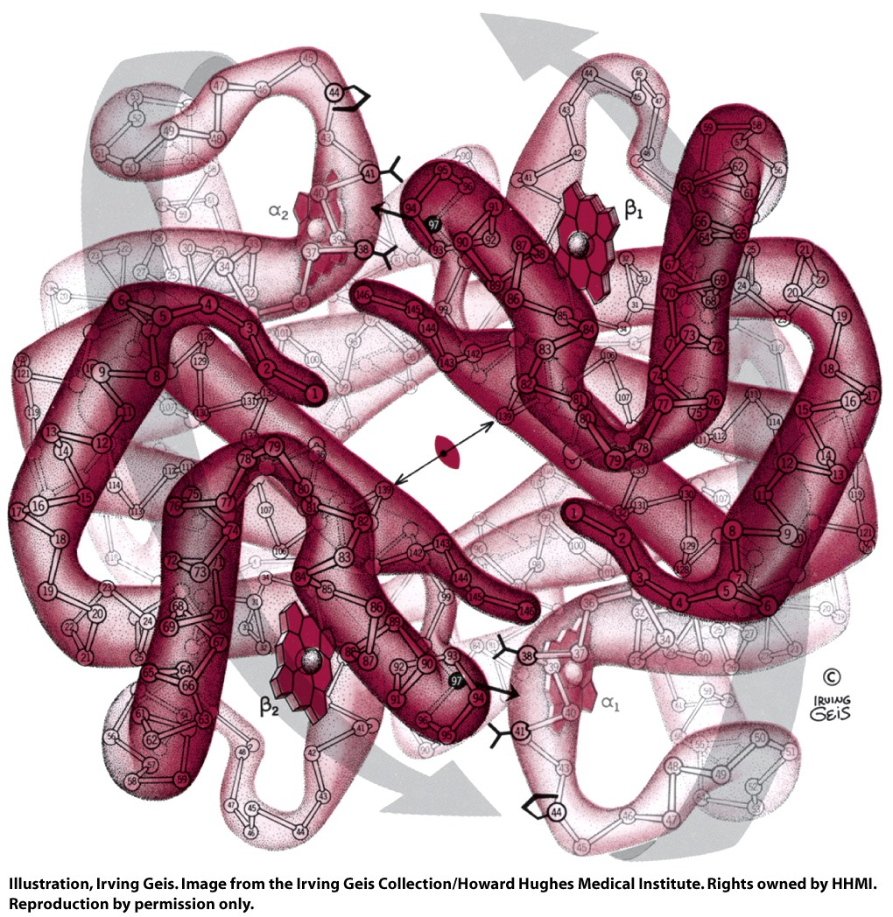
R-state,
High O₂
affinity
Figure 7-5 part 2

Slide 17
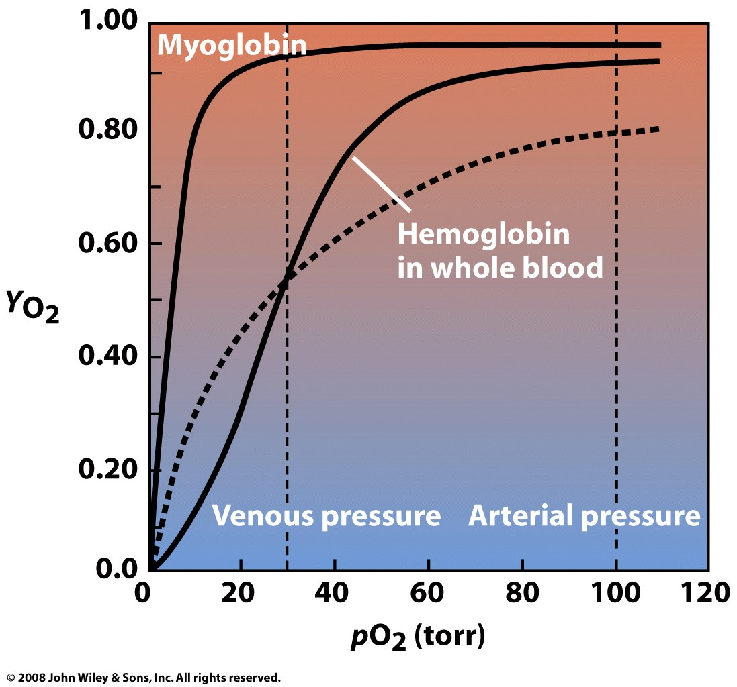

Slide 18
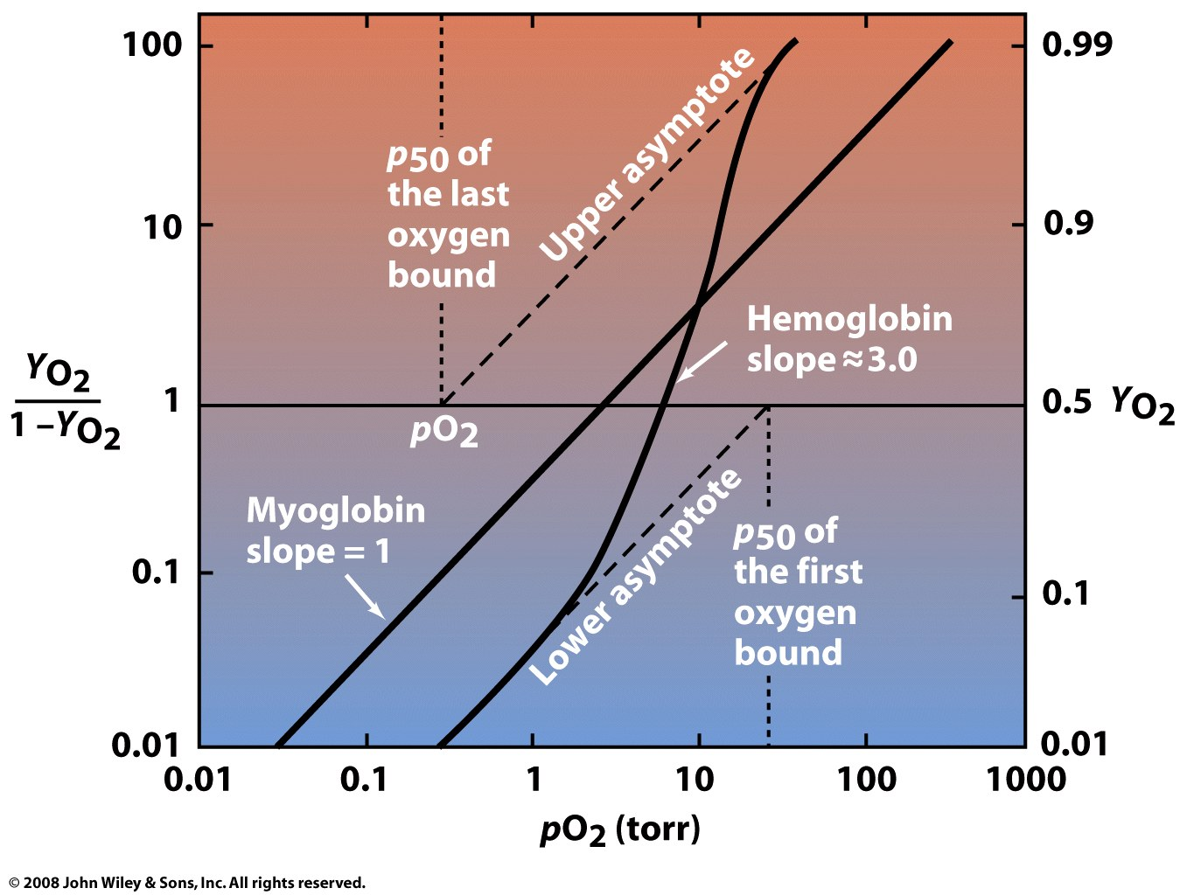
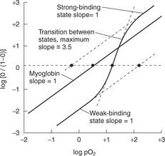
Figure 7-7

Slide 19
The Hill coefficient
describes cooperativity of ligand binding to proteins (or other macromolecules). The Hill coefficient is around 3 for hemoglobin.
n>1 - Positively cooperativity: Once one ligand molecule is bound to the protein, the affinity for other ligands increases.
n<1 - Negatively cooperativity: Once one ligand molecule is bound to the protein, the affinity for other ligands decreases.
n=1 - Noncooperative cooperativity: The affinity of the protein for a ligand molecule is independent on whether or not other ligands are already bound.

Slide 20
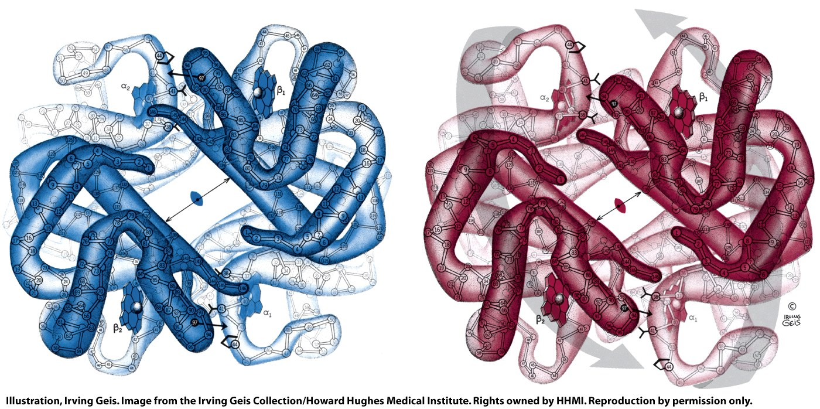
When oxygen binds to hemogolobin, atoms move, subunits move.
The iron atom that binds to O₂ moves into the plane of the porphyrin (0.6 Å).
The proximal histidine shifts with the iron toward the porphyrin ring.
Helix F8 moves with the proximal histidine
The porphyrin ring shifts sideways toward the outside of the tetramer.
These motions are transmitted to other three monomers in the tetramer.
The orientations and interactions between the subunits change.
The conformational changes activate the empty sites for binding of oxygen.
Therefore: O₂ binding is 'cooperative’.
The first O₂ bound increases the affinities of the empty sites.
Hb releases 0.6 protons per O₂ bound (lower pH means lower O2 affinity)
The oxygen binding curve of hemoglobin is sigmoidal, or S-shaped, as opposed to the hyperbolic curve of myoglobin

Slide 21
Cooperativity
requires protein oligomers (Hb is a tetramer, with 4 subunits)
(or multiple binding sites on a single subunit)
requires multiple conformations (T, R and intermediates between T and R)
subunit conformation is linked to ligand affinity (ligand binds better to R state)
subunit conformations are linked to each other
(T-state binds better to T-state
R-state binds better to R-state)
binding of a ligand to one subunit stabilizes the R-state in other subunits
Figure 7-16

Slide 22
Cooperative Binding:
Binding sites are ‘linked’. Events at one binding site influence other binding sites.
Three-ring binder analogy suggested by Tech student Scott Thourson, Biochem 6501, fall 2013

Slide 23
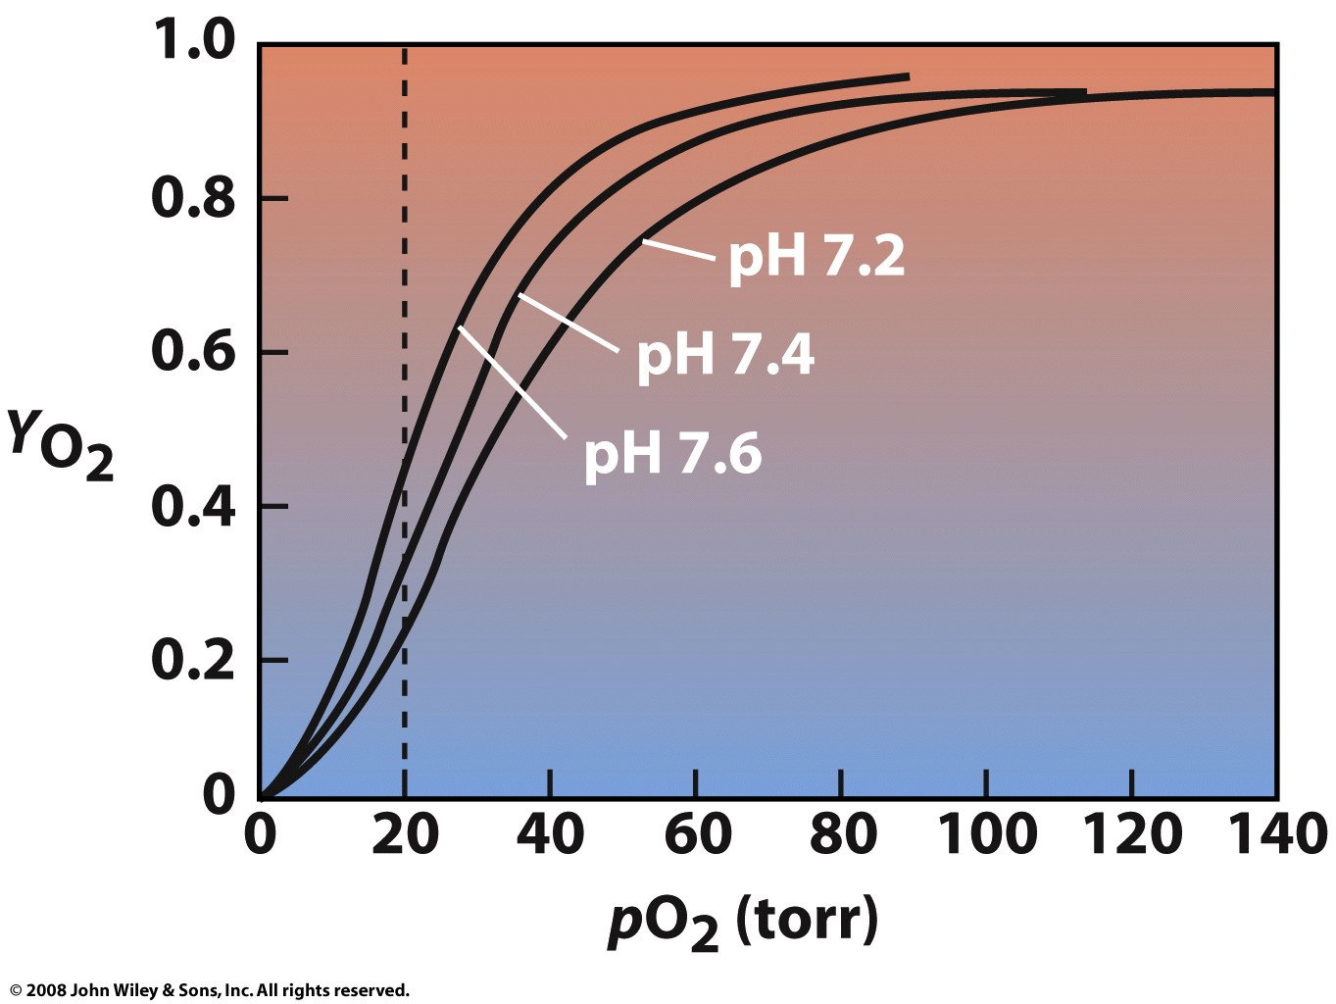
Bohr effect:
If Mb releases H⁺ upon binding of O₂, then lowering the pH (increasing H⁺) will decrease the affinity.
CO₂ decreases the pH
Active muscles get more O₂
Figure 7-11

Slide 24
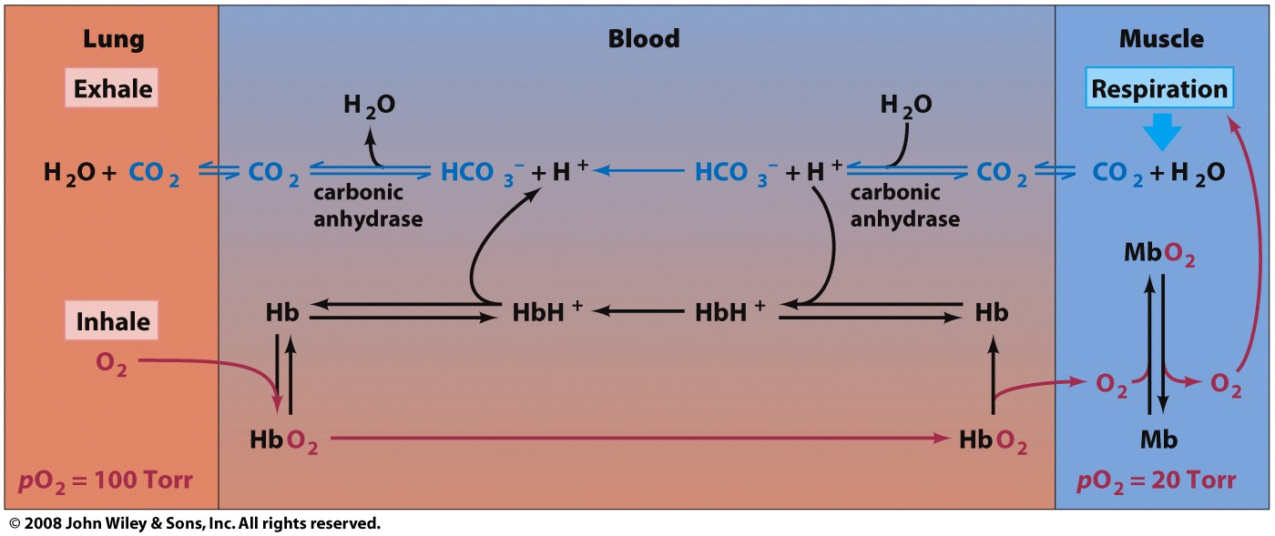
CO₂ => carbonic acid => low blood pH
hemoglobin releases H⁺ when O₂ binds
low pH (high [H⁺]) => O₂ release from hemoglobin
Confusing schematic from book
high pH
low pH
Figure 7-12

Slide 25
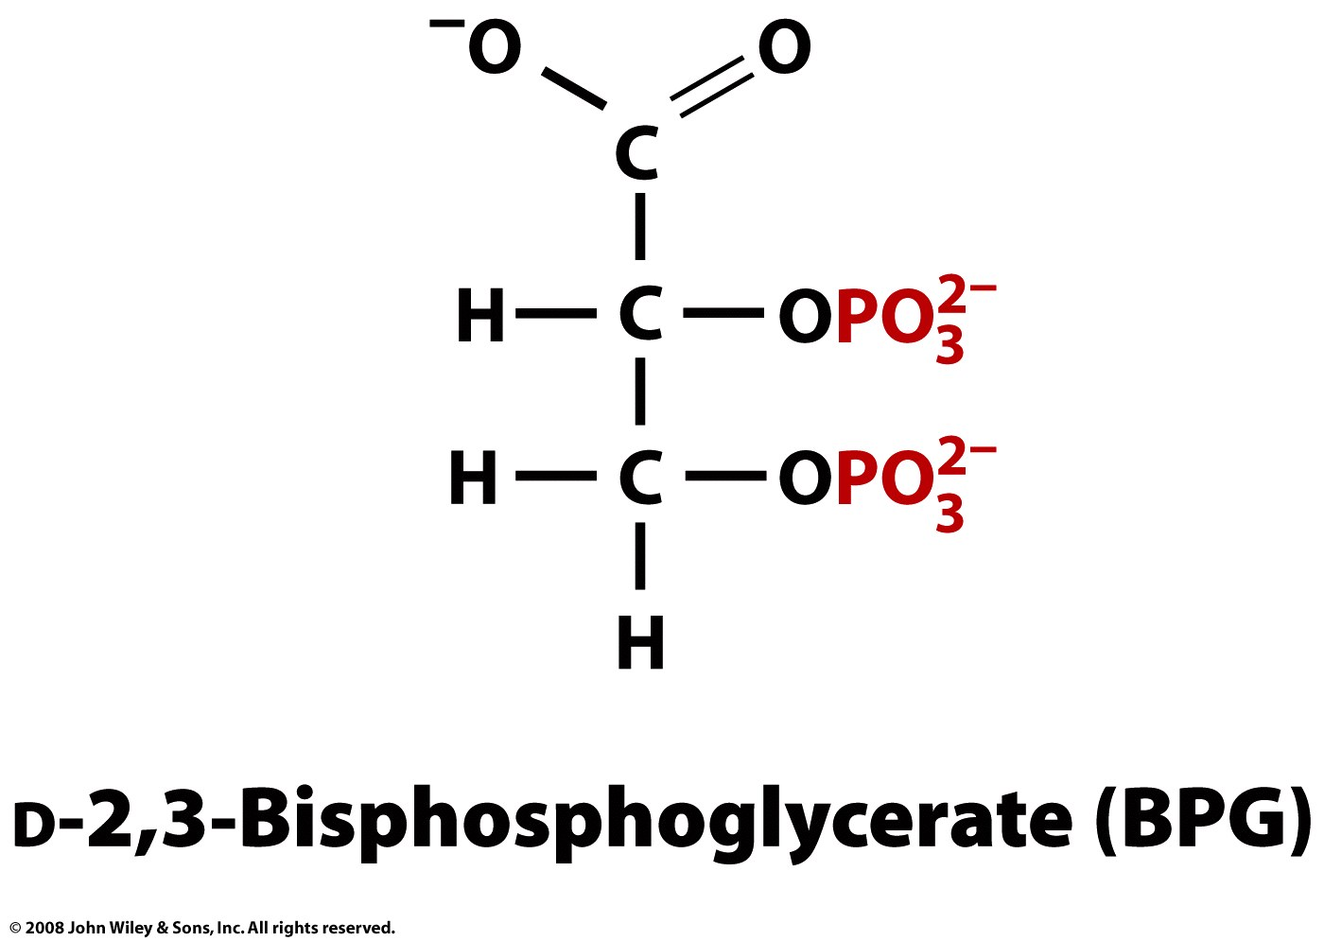
BPG lowers O₂ affinity of hemoglobin.
BPG binds to the T state (deoxy) not R state (oxy).
BPG is an allosteric effector (effects function by binding to a site other than the protein's active site).
BPG is involved in high altitude acclimatization
Page 191

Slide 26
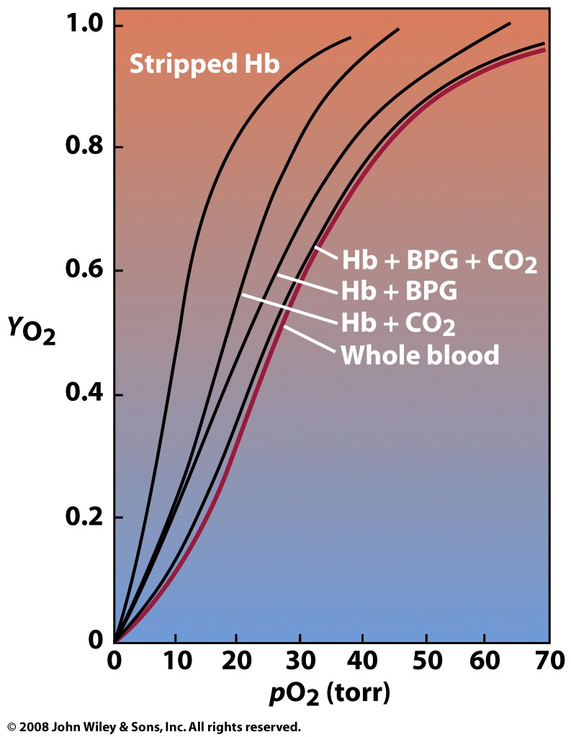
Figure 7-13

Slide 27
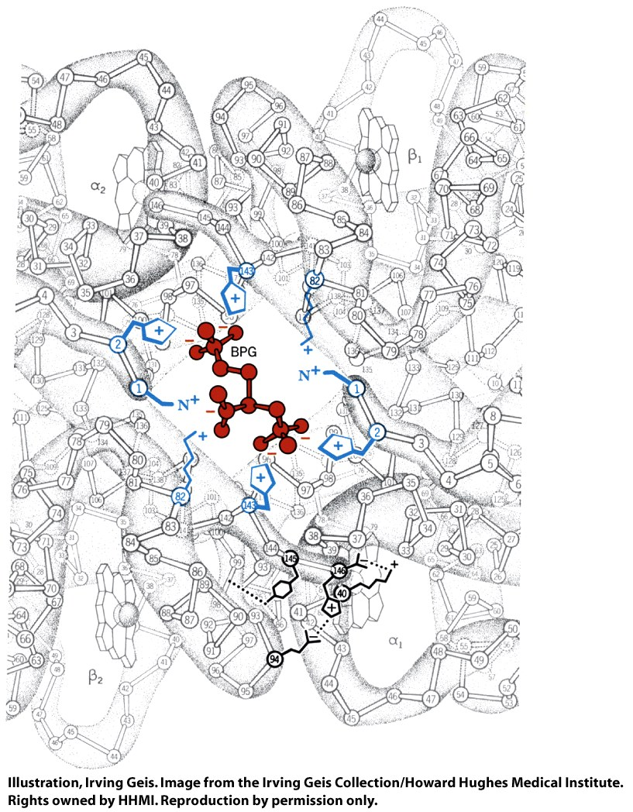
Figure 7-14

Slide 28
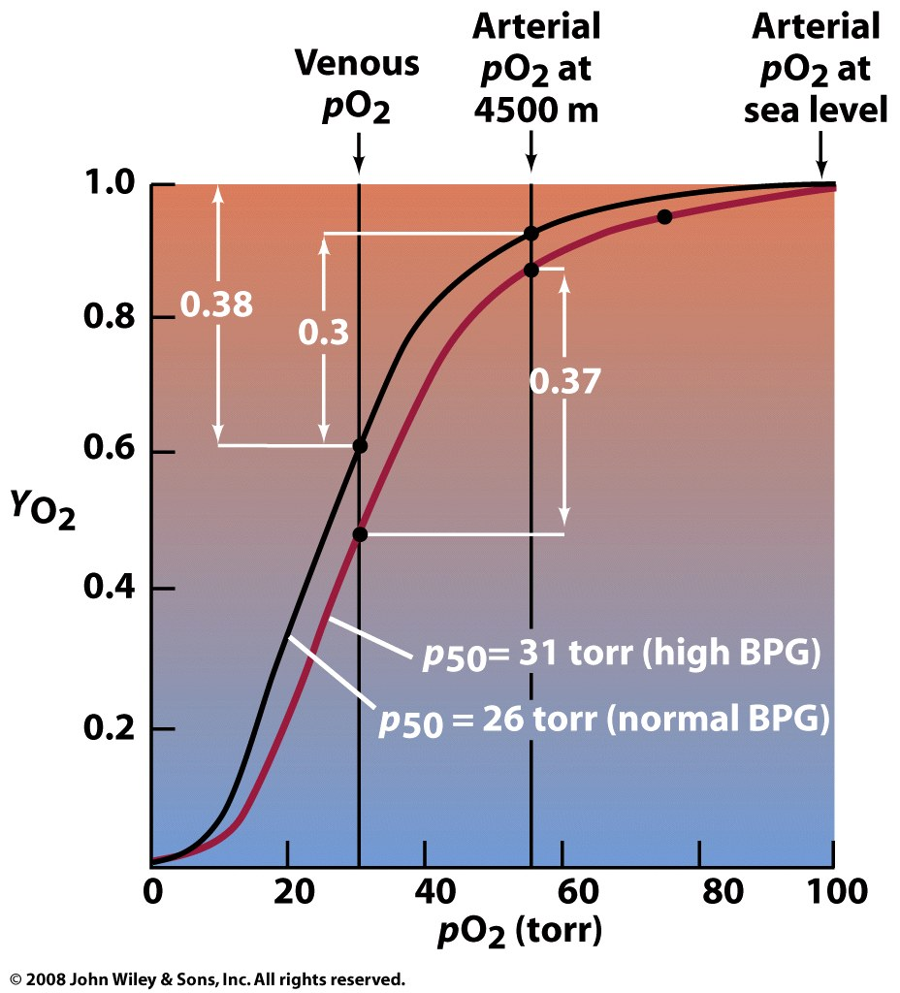
Box 7-3

Slide 29
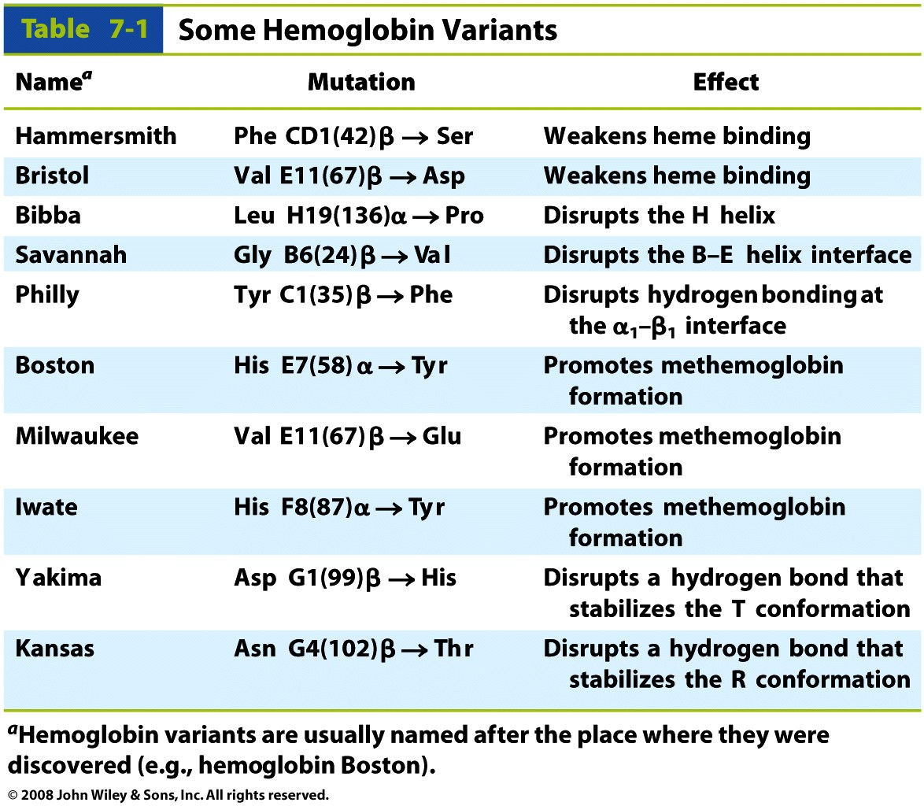
Hemoglobin mutations: nearly 950 hemoglobin variants.
Table 7-1

Slide 30
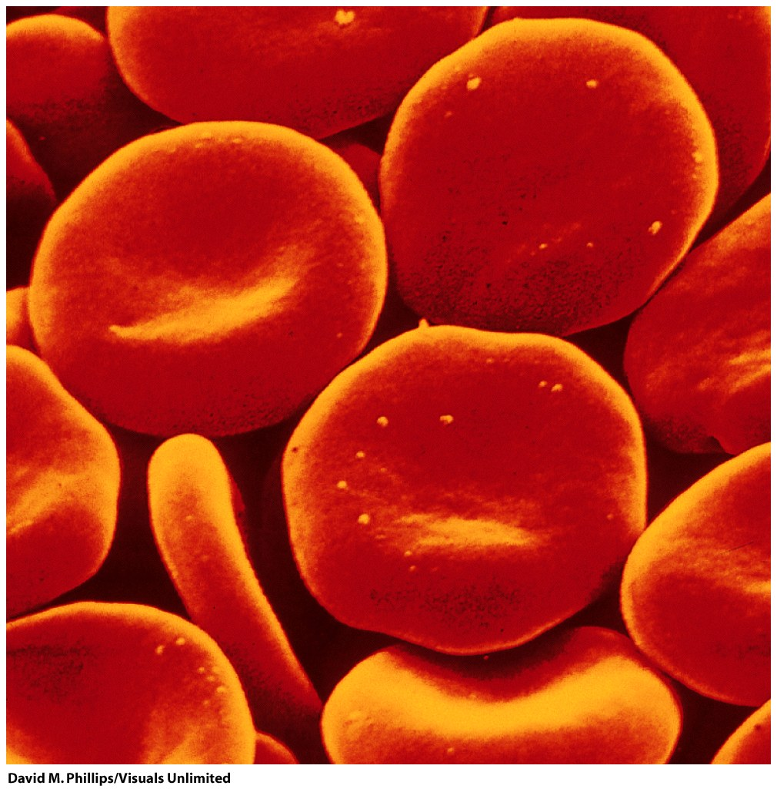
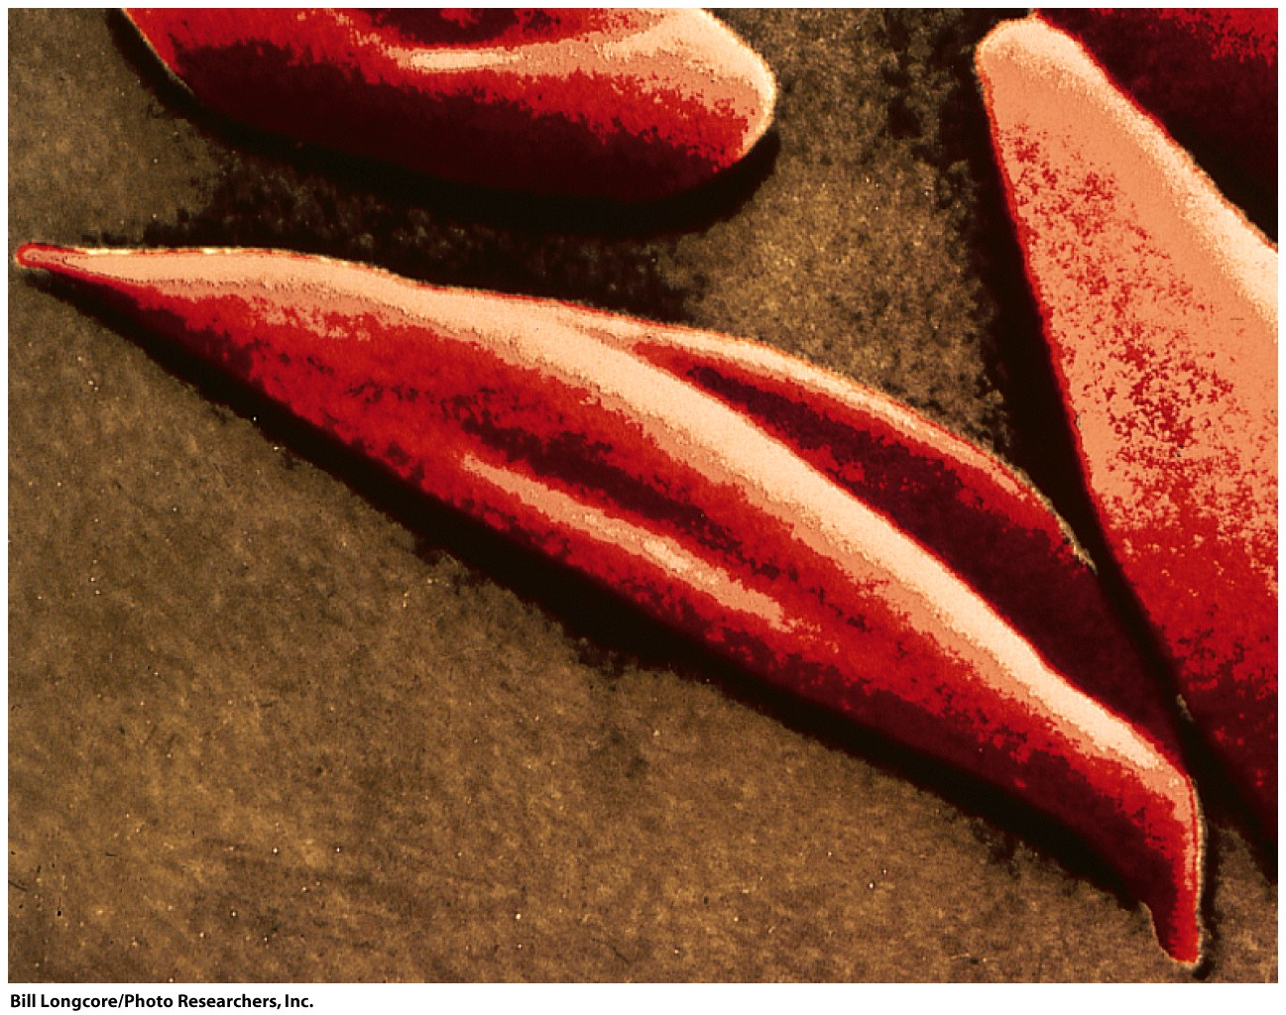
Sickle Cell: Glu(6) to Val in the β chain (Hemoglobin S, Vernon Ingram)
The mutation changes the packing between tetramers.
Causes long linear aggregates of tetramers in the T state (deoxy)
Heterozygous Hb S protects against malaria

Slide 31
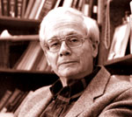
Vernon Ingram (died 2006): "The father of Molecular Medicine."
Ingram showed that the change in hemoglobin in sickle cell disease is a substitution of the glutamic acid by valine in position 6 of the β-chain. This was first demonstration that an amino acid change in a protein could cause a disease.

Slide 32
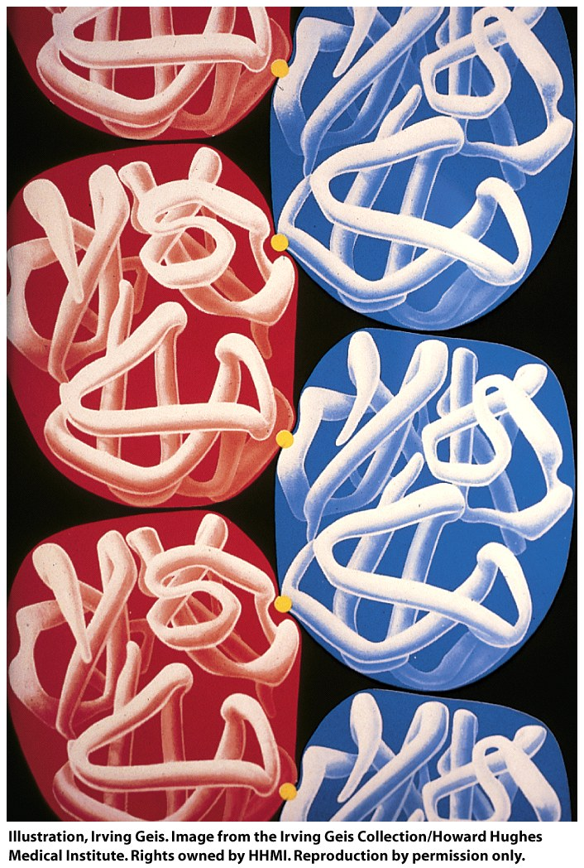
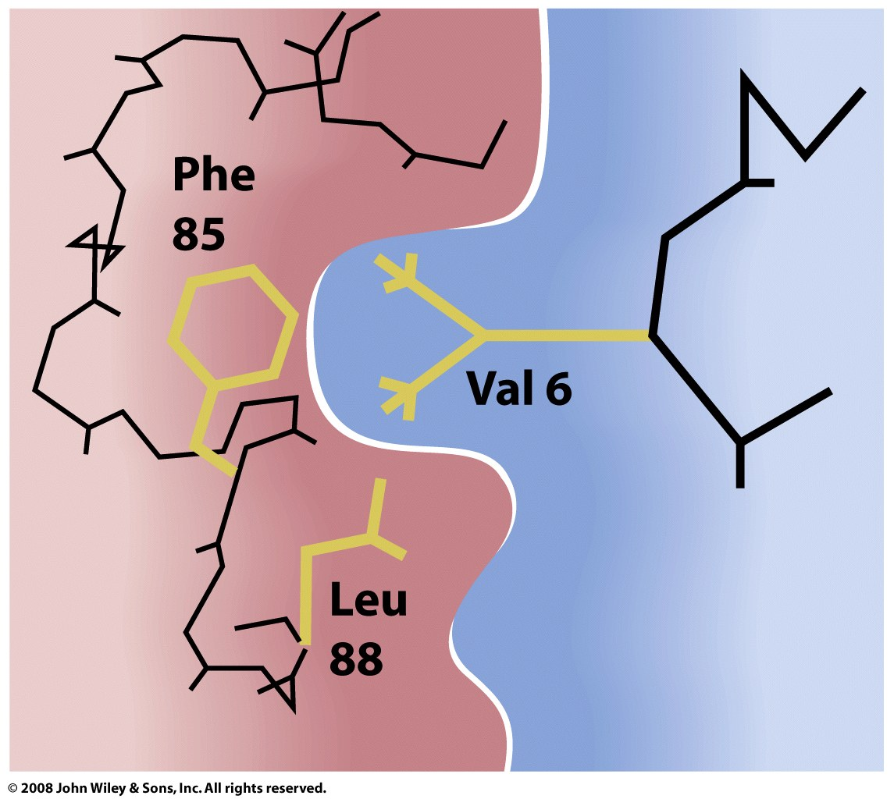
Figure 7-18a

Slide 33
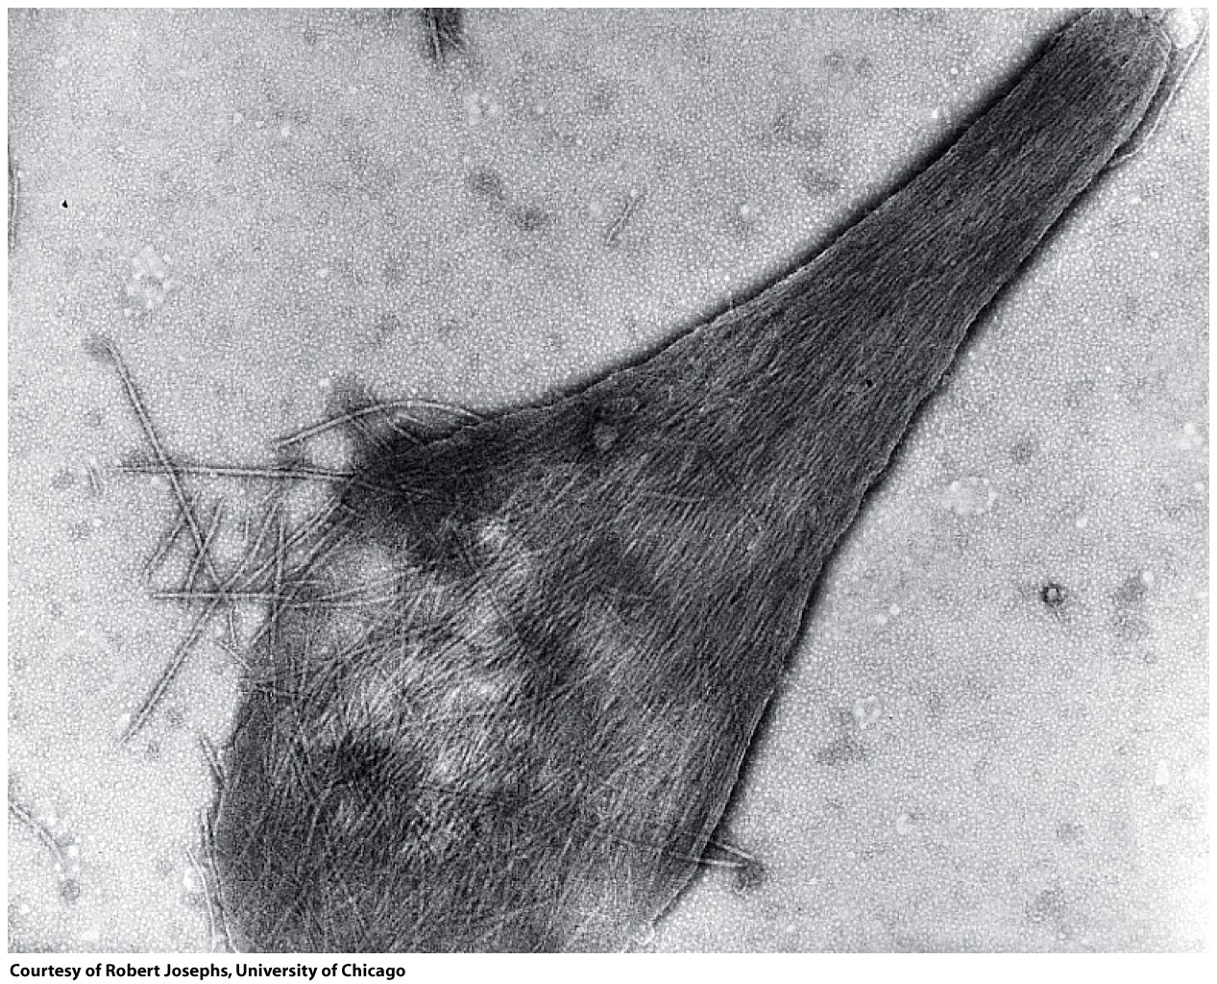
damaged sickled erythrocyte

Slide 34
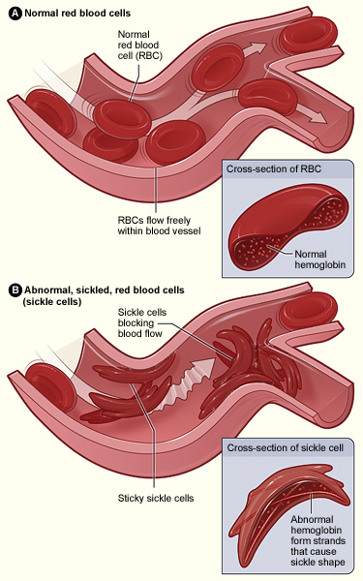

Slide 35
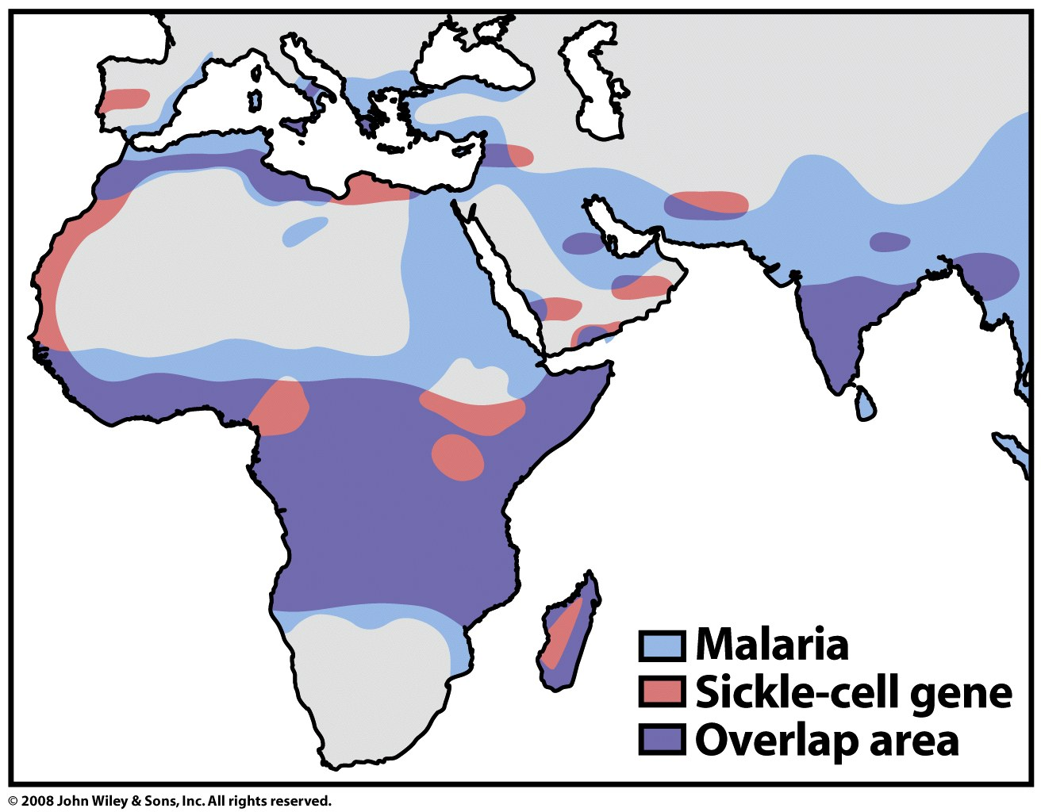
Figure 7-20

