Slide 1
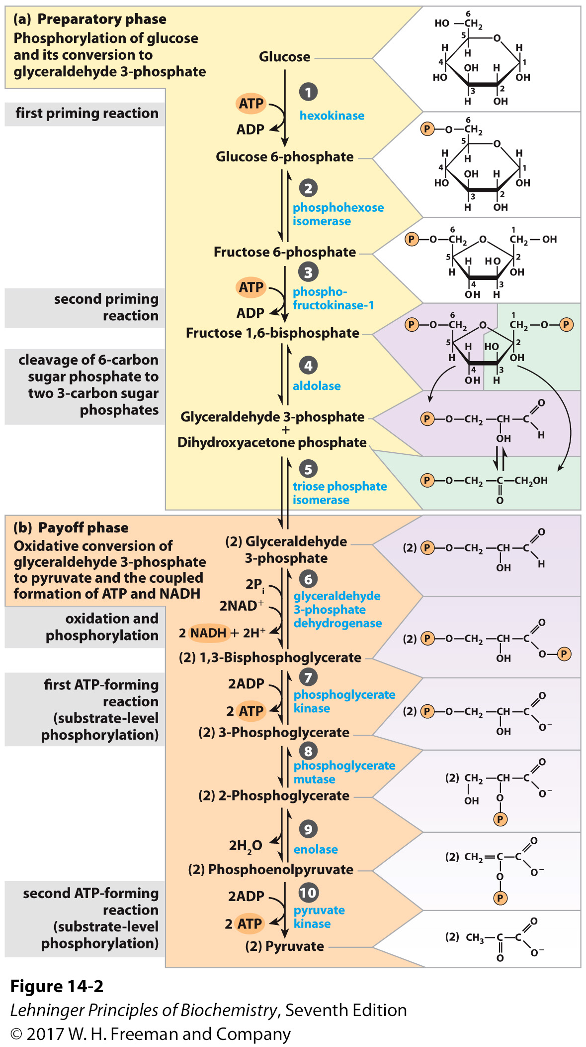
Phosphofructokinase
Catalyzes one of the rate-limiting enzymes in glycolysis
Catalyzes the transfer of a phosphoryl group from ATP to fructose-6-phosphate.
Produces fructose-1,6-bisphosphate
(which is both a product and an activator)
Requires Mg²⁺
Is a key regulatory enzyme in glycolysis
(the “pace-maker” of glycolysis)
responds to many different molecules and signals.

Slide 2
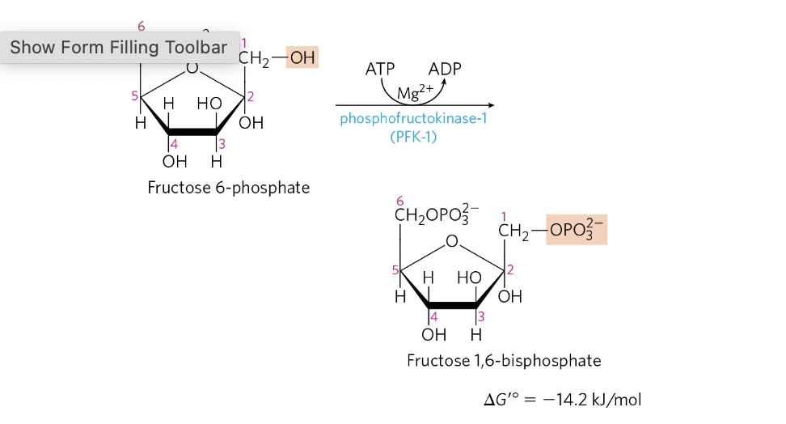
Phosphofructokinase
R state is fully active
T state is less active

Slide 3
