Slide 1
RNA Structure Understanding N\nucleic acids by comparison of RNA and DNA

Slide 2
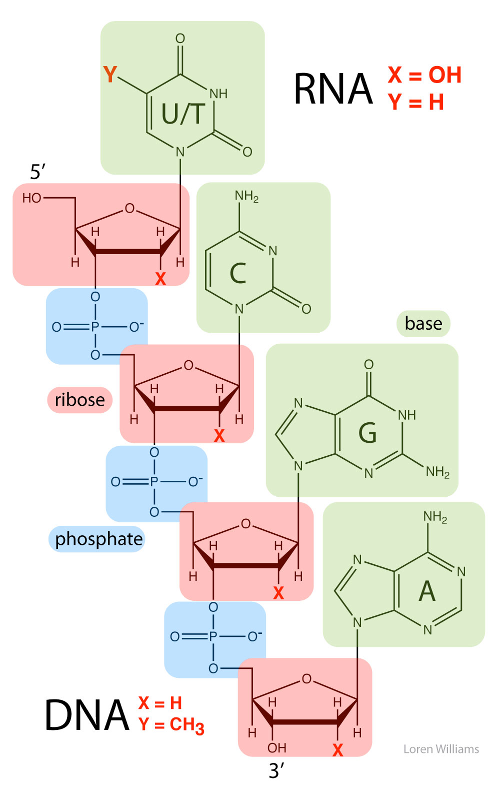

Slide 3
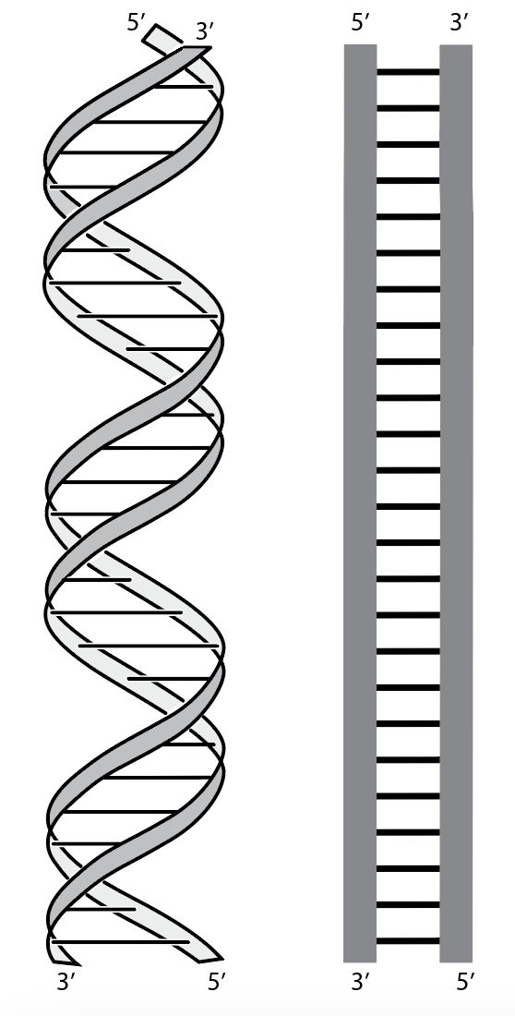
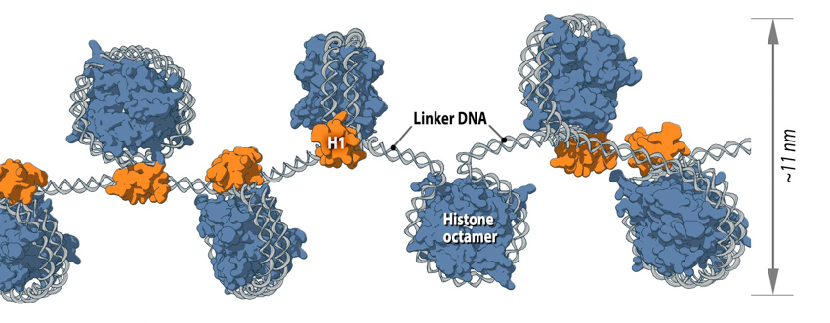
DNA RNA

Slide 4
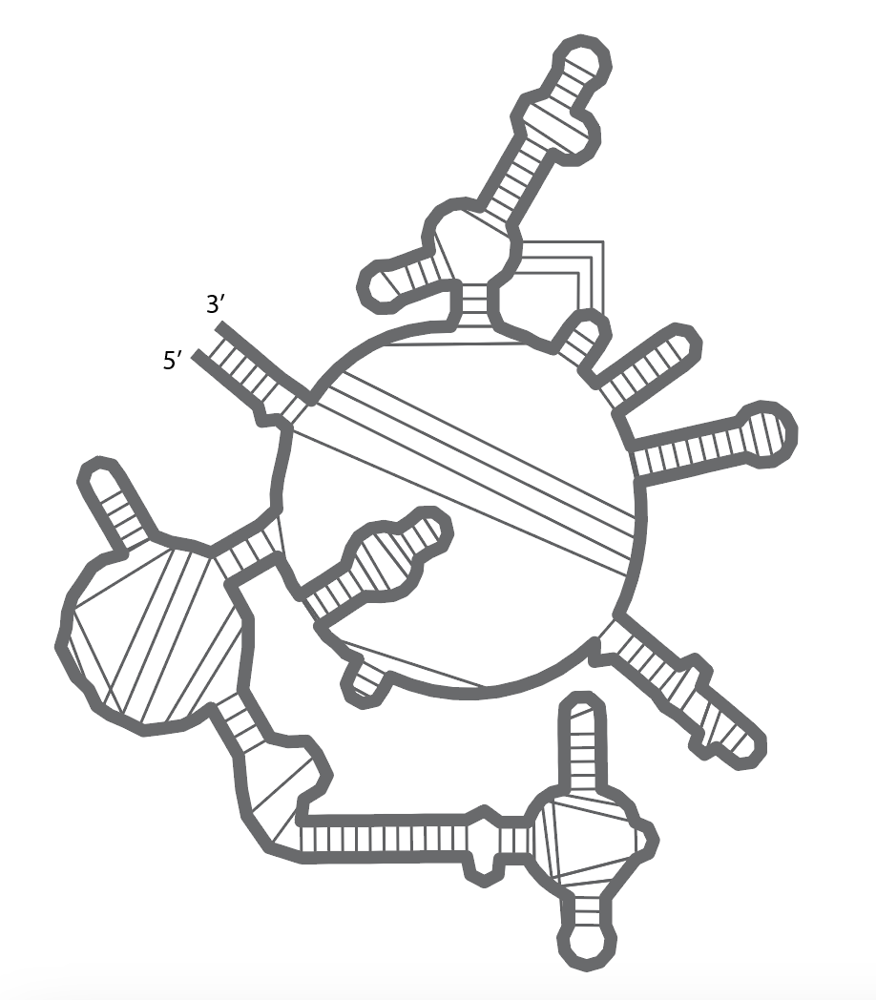
DNA RNA

Slide 5
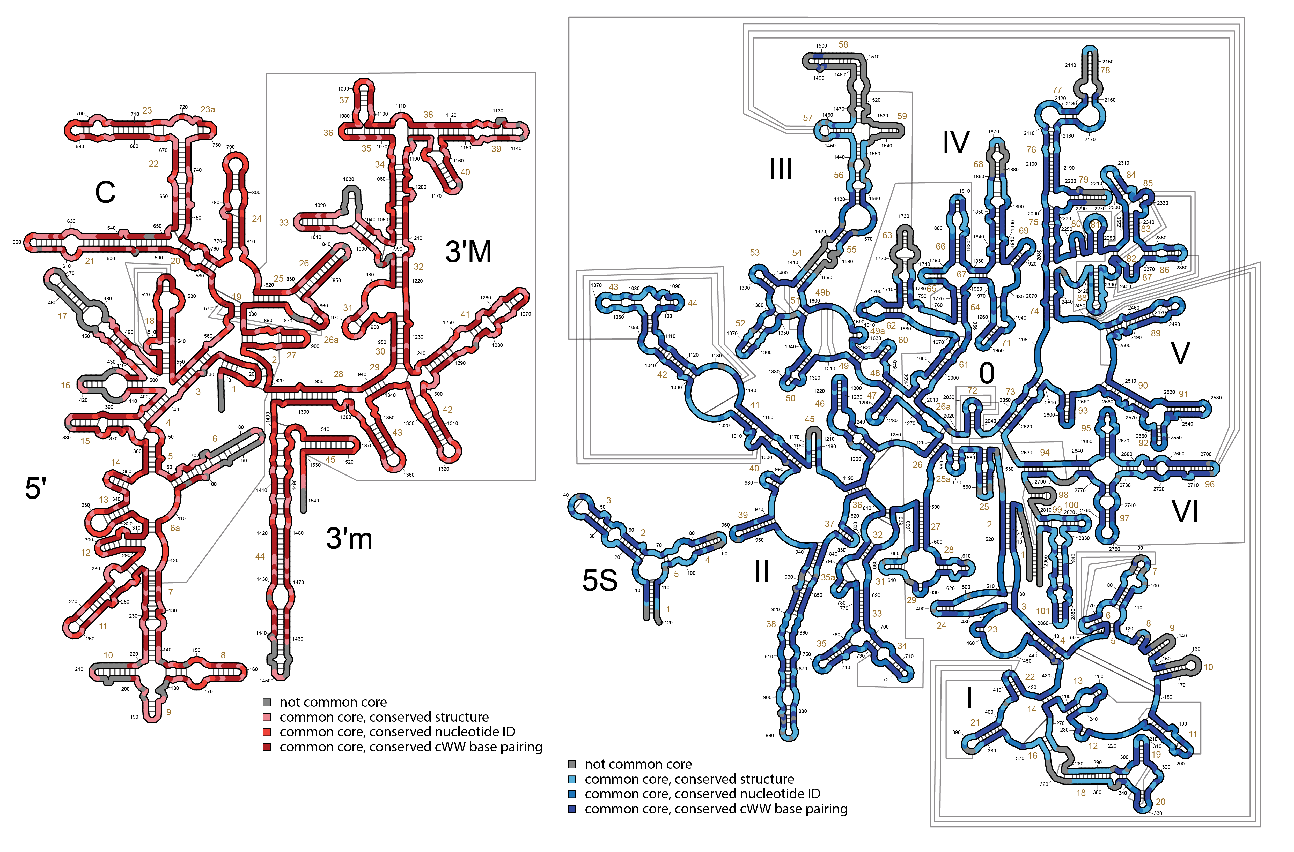
Ribosomal RNA
(rRNA)

Slide 6
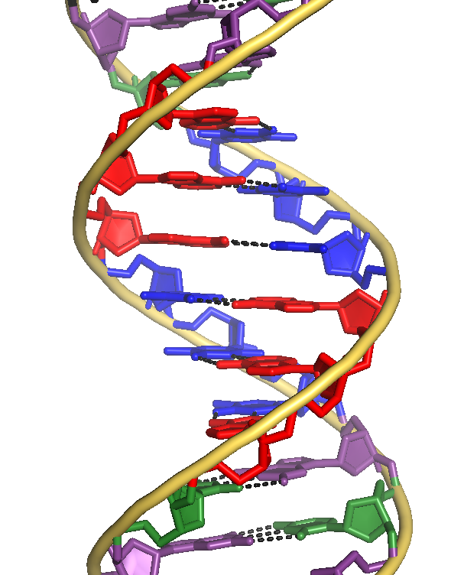
DNA RNA

Slide 7
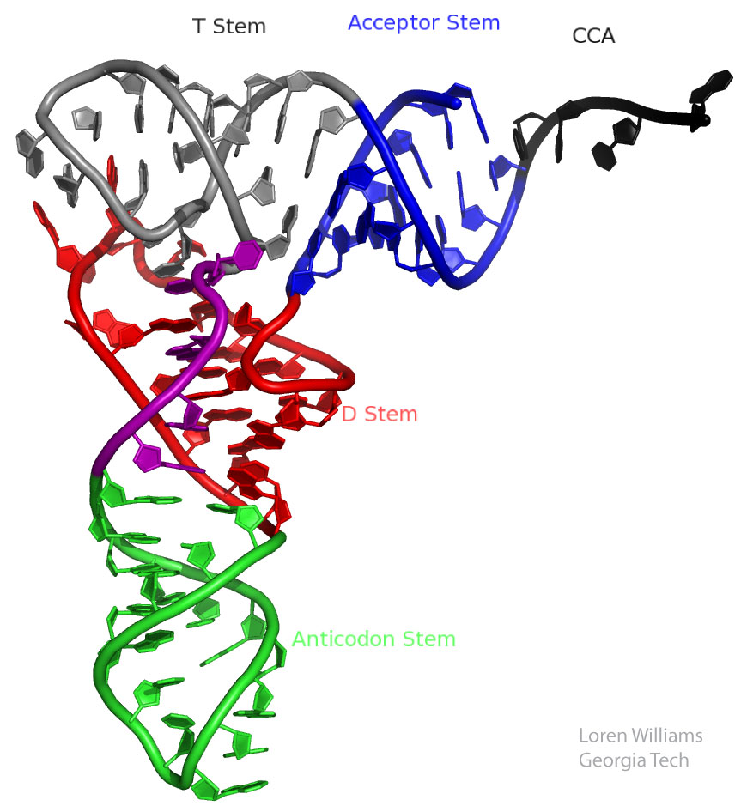
DNA RNA

Slide 8
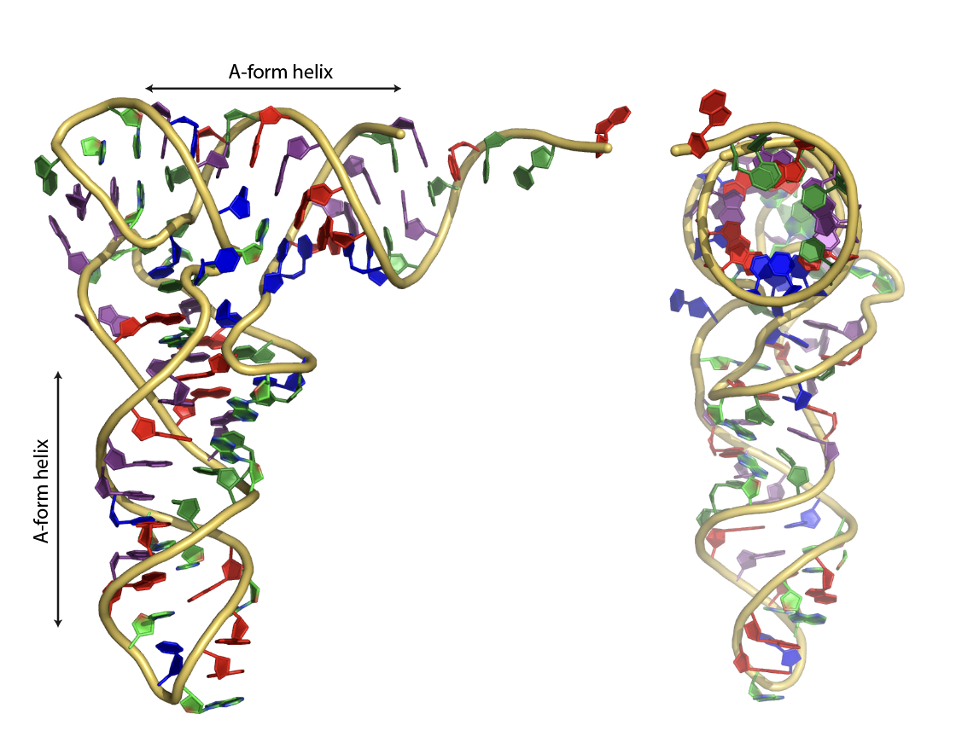
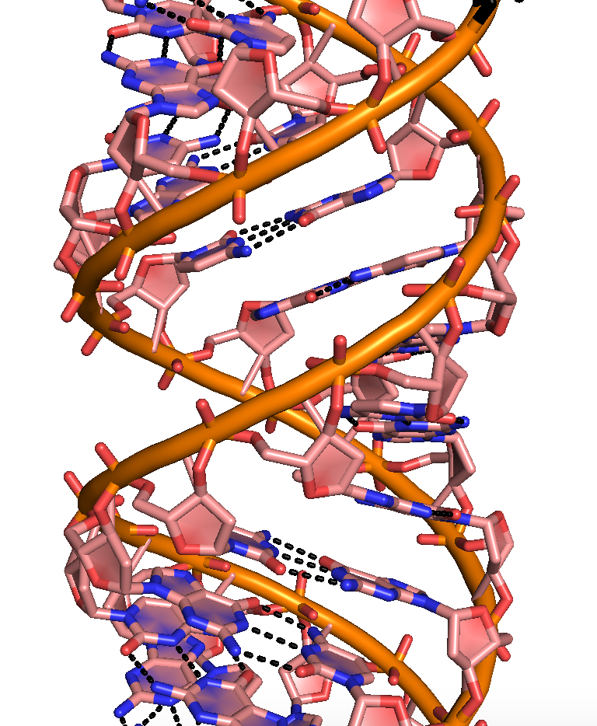
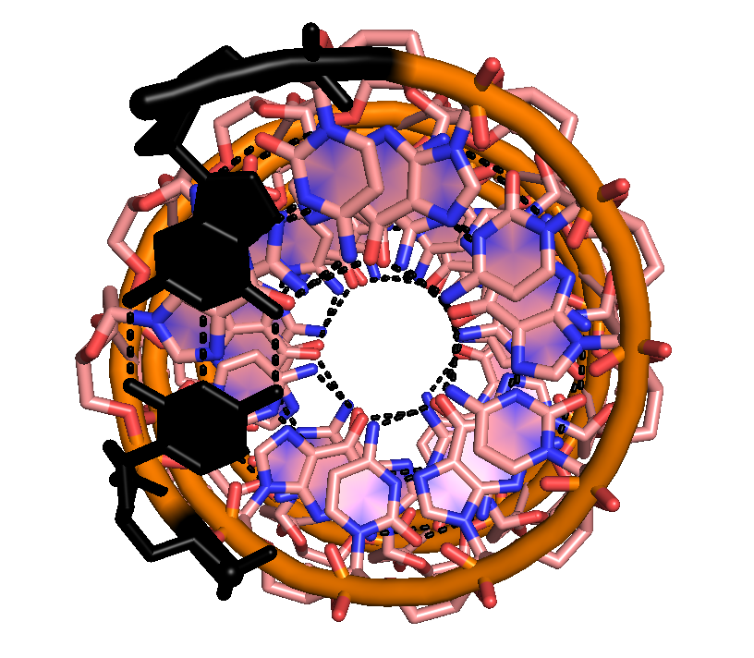

Slide 9
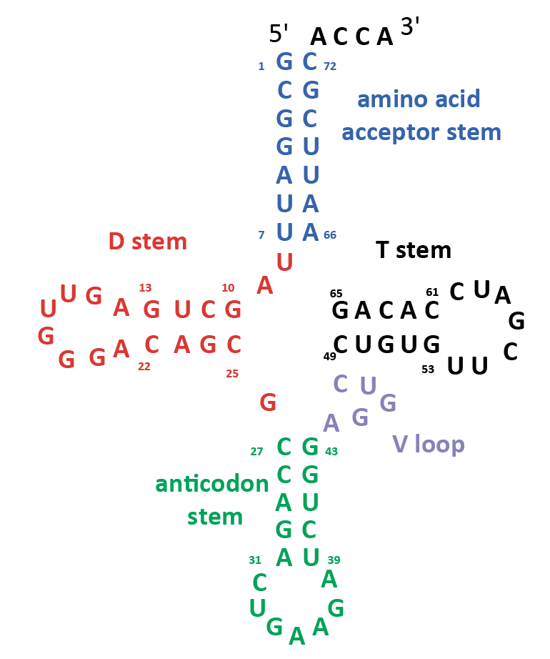

Slide 10
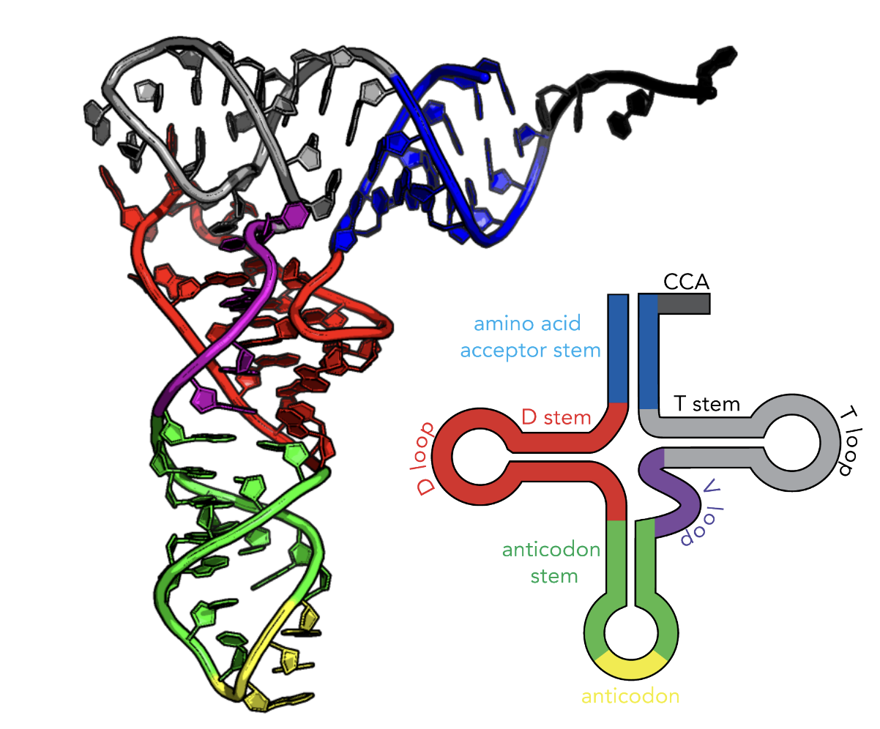

Slide 11
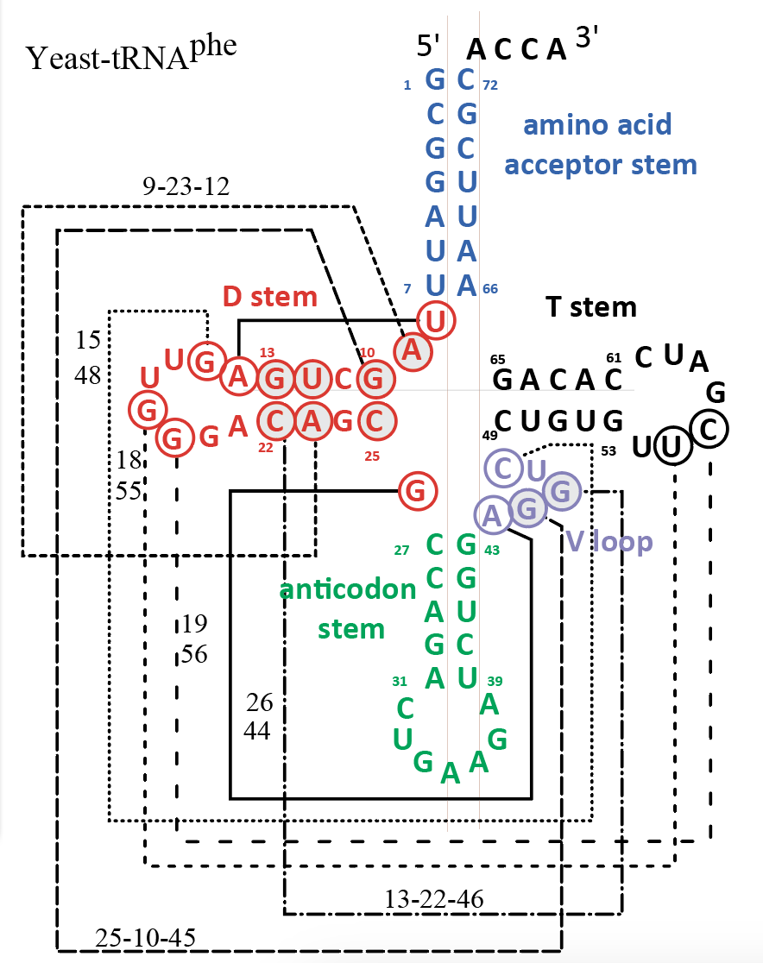

Slide 12
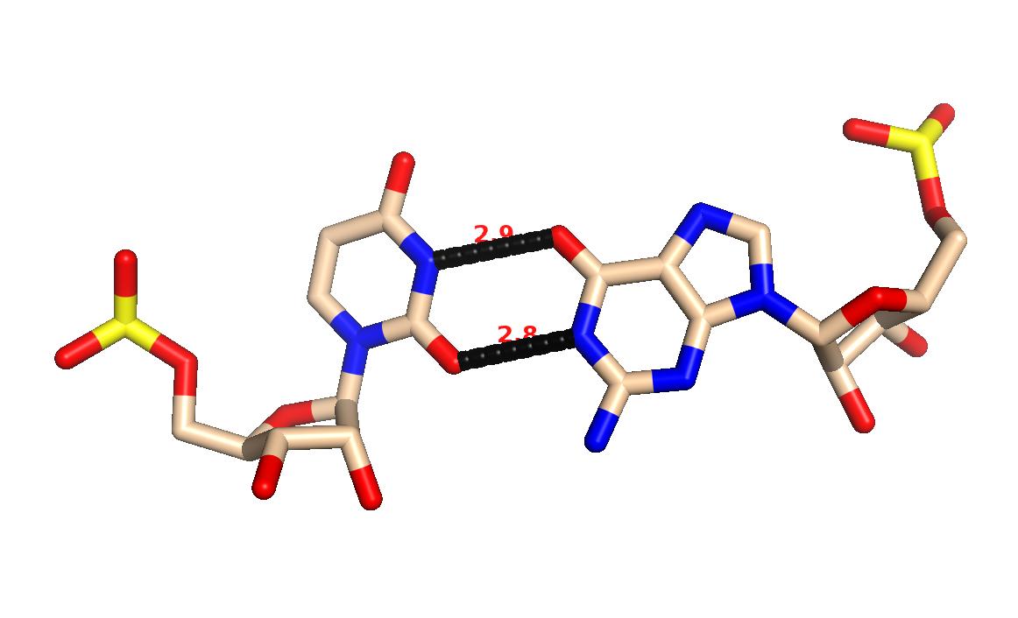
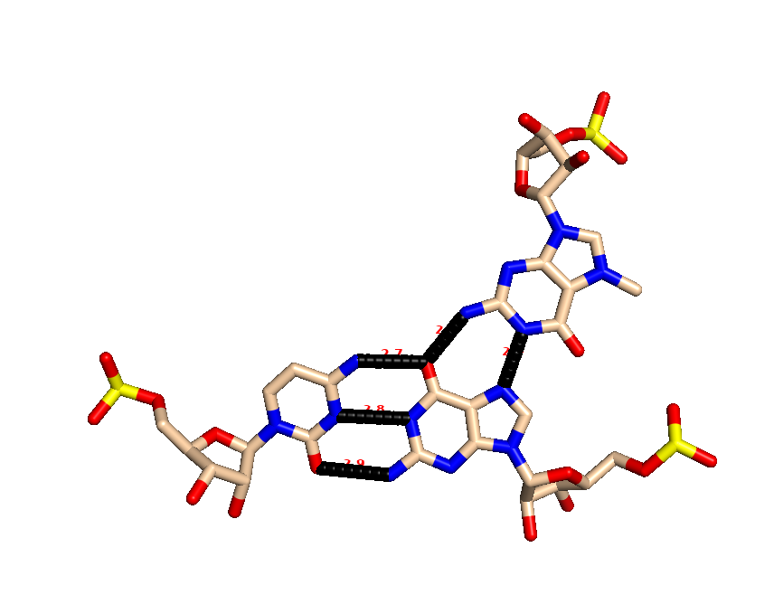
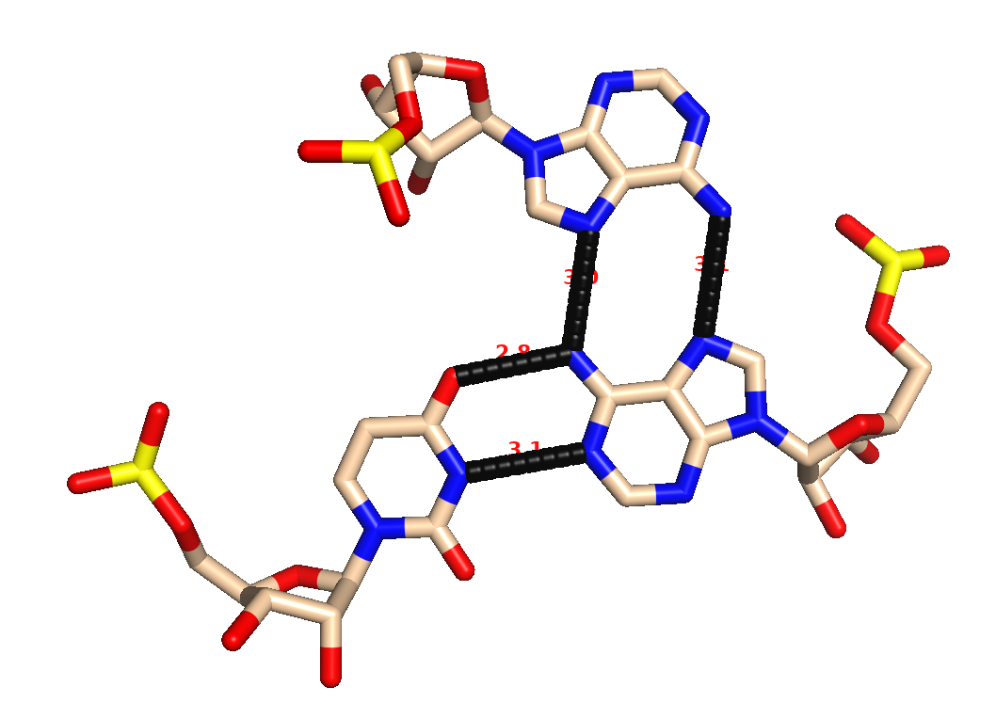

Slide 13
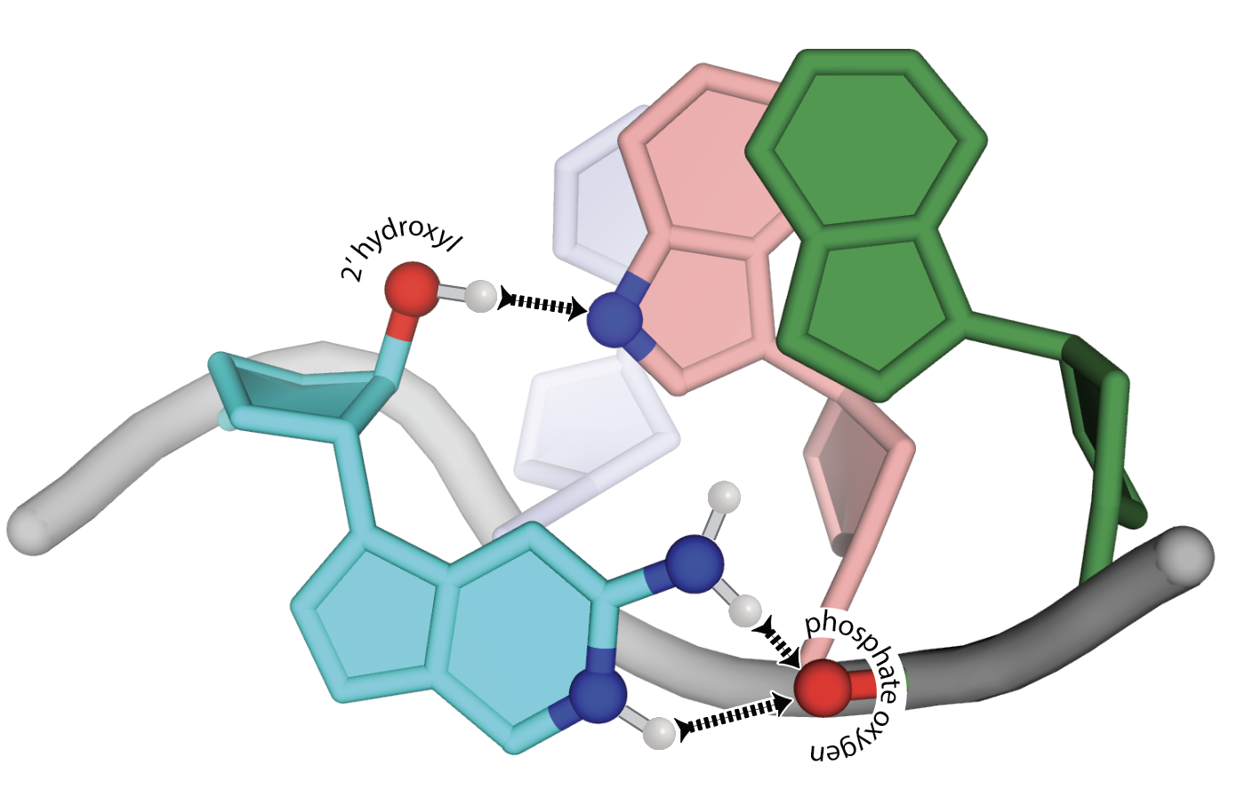
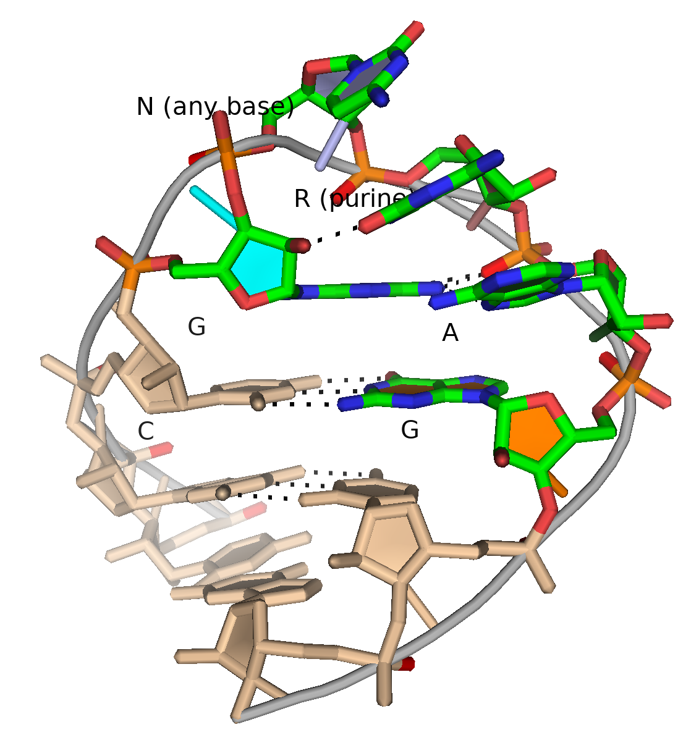
GNRA tetraloop

Slide 14
DNA RNA

Slide 15
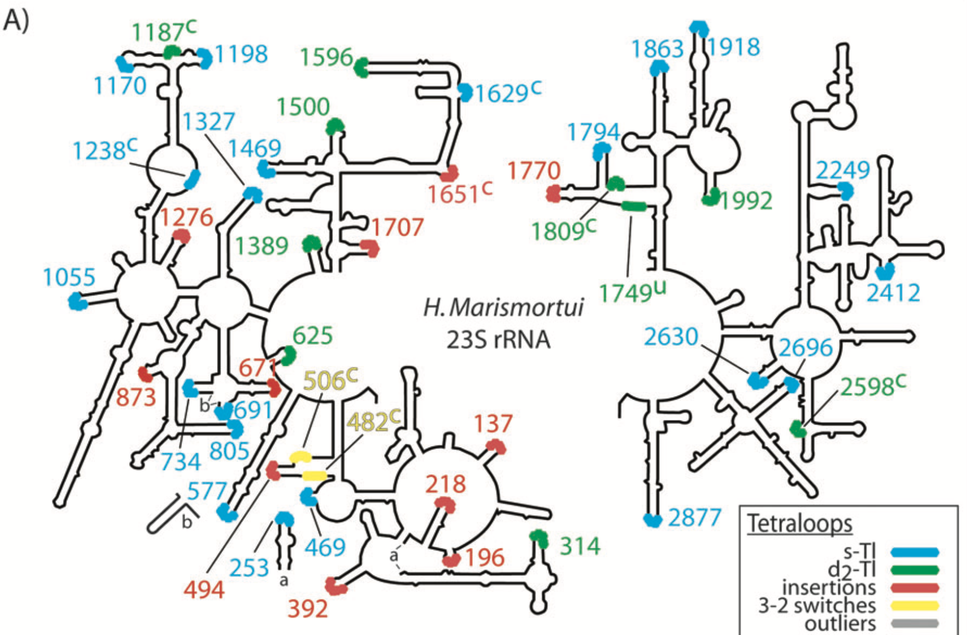

Slide 16
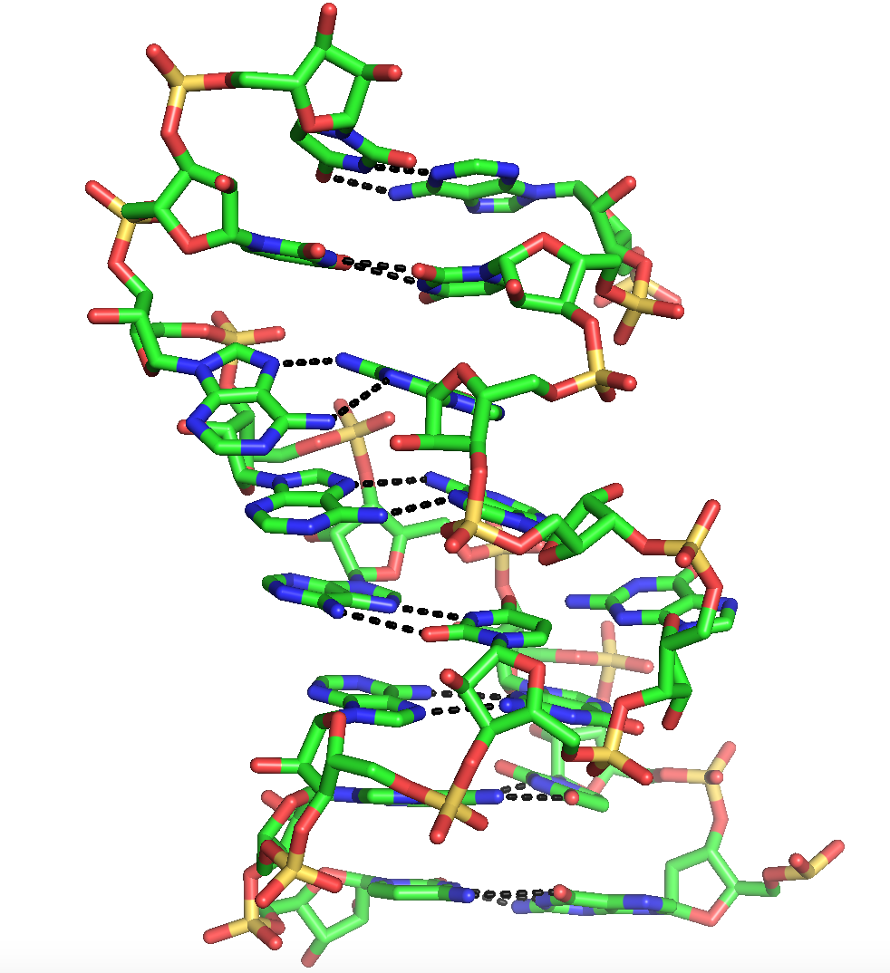
Helix 26a of the Ribosome

Slide 17
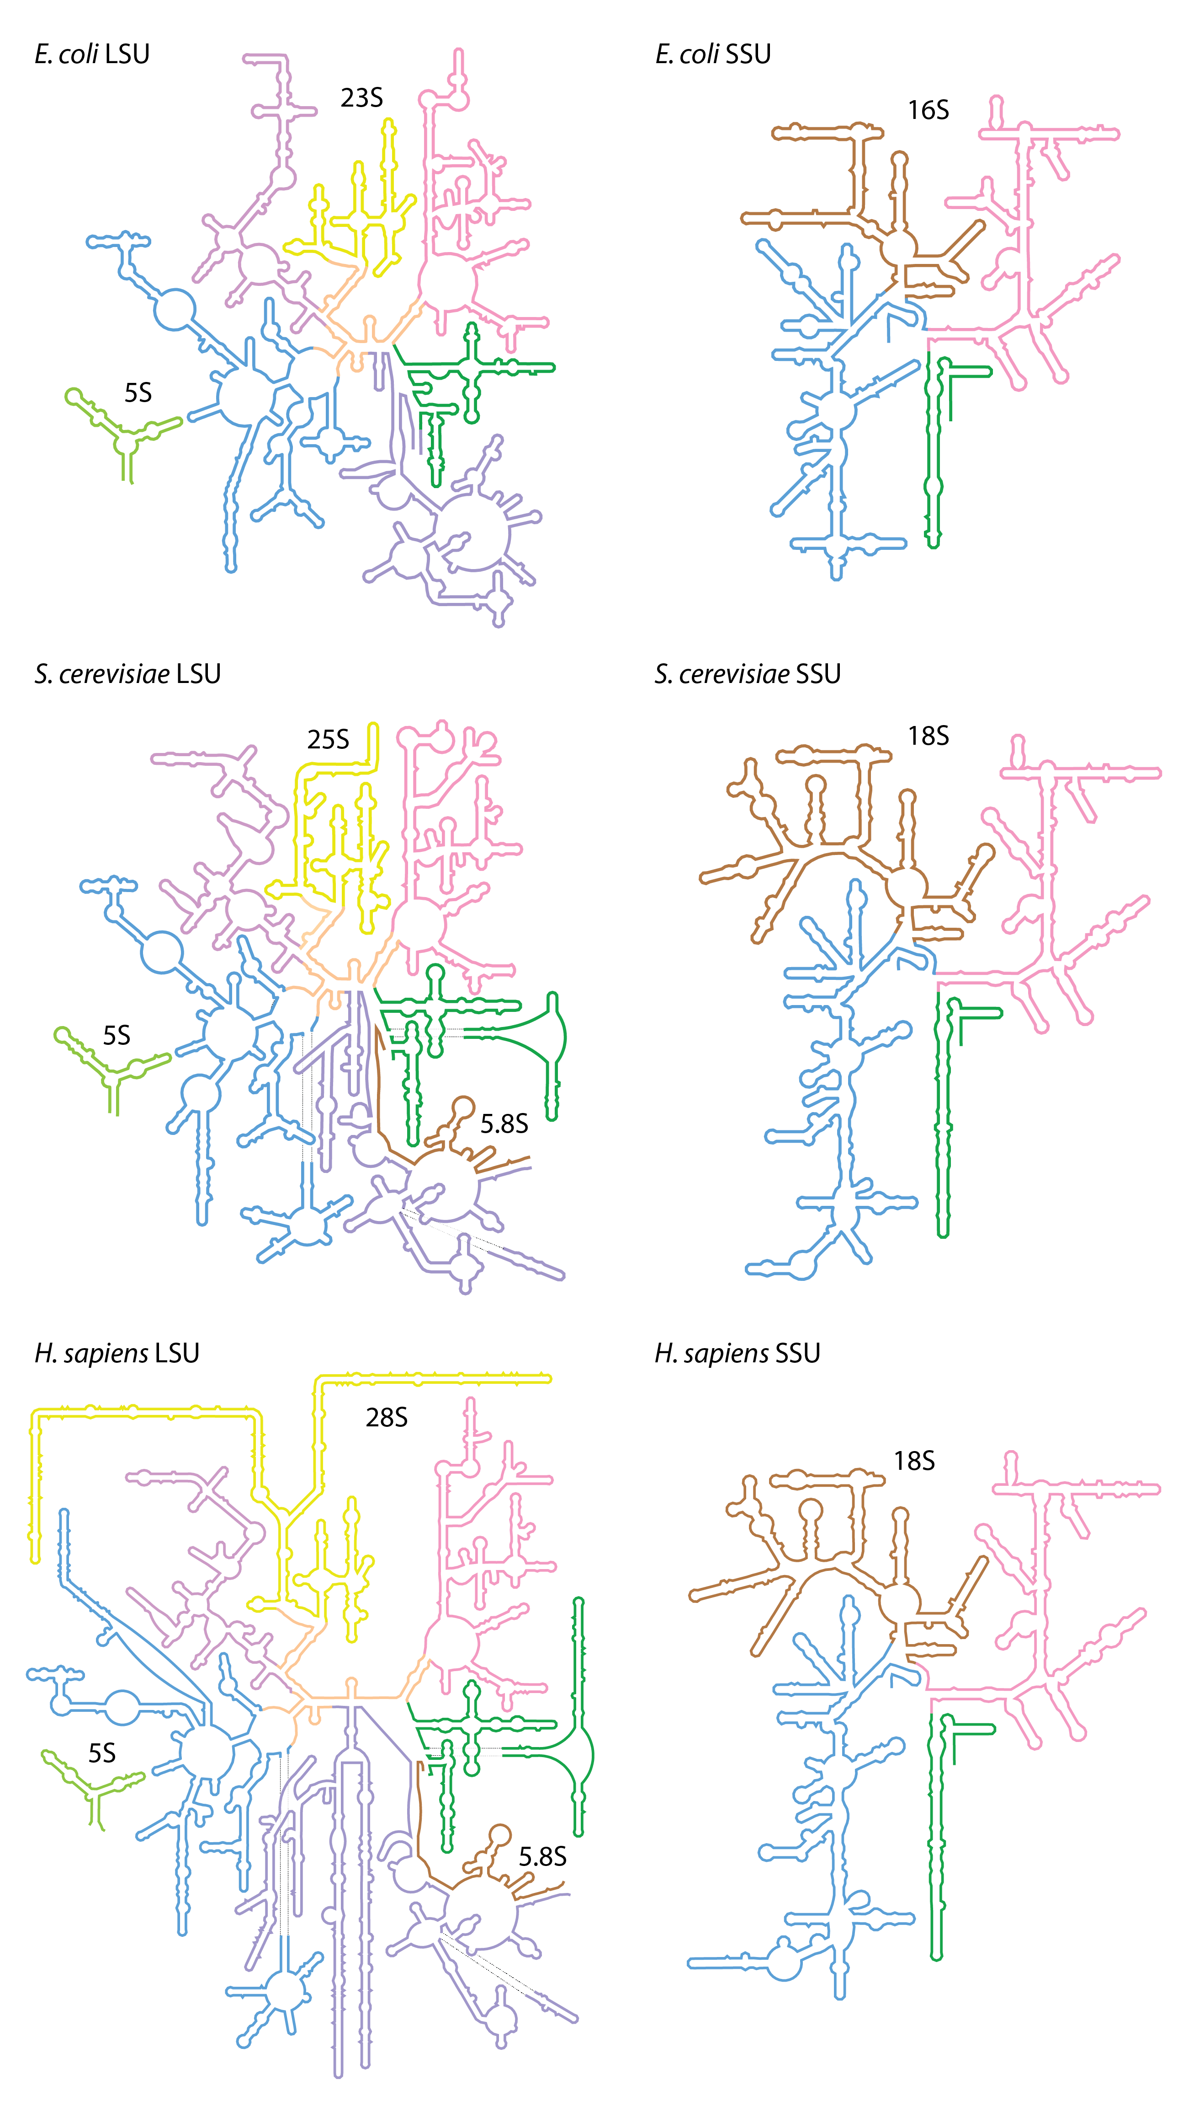

Slide 18
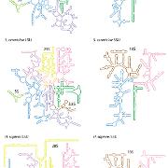
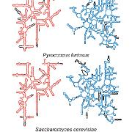
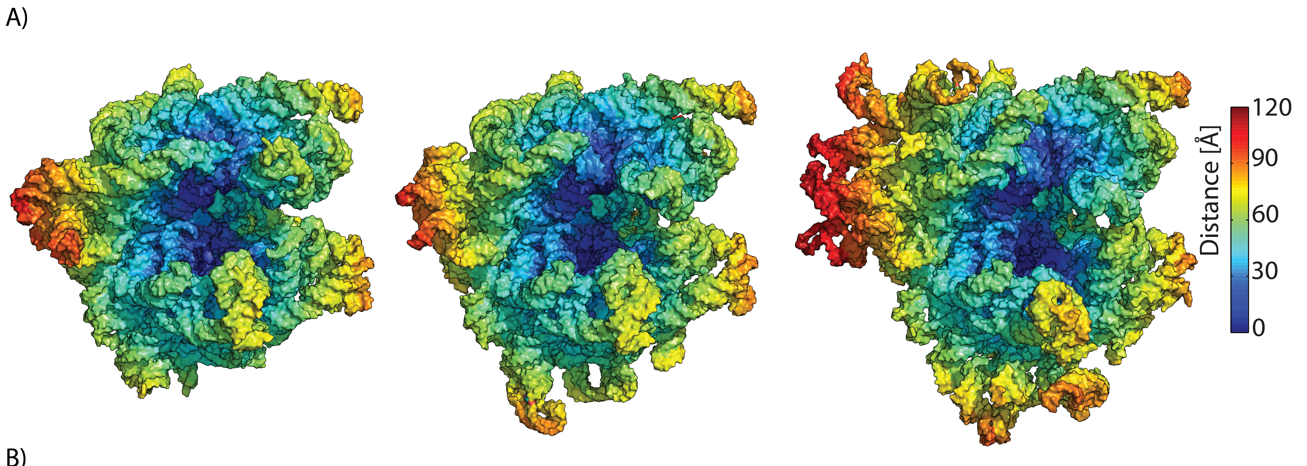
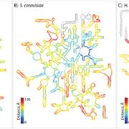
E coli P furiosus S. cerevisiae

Slide 19
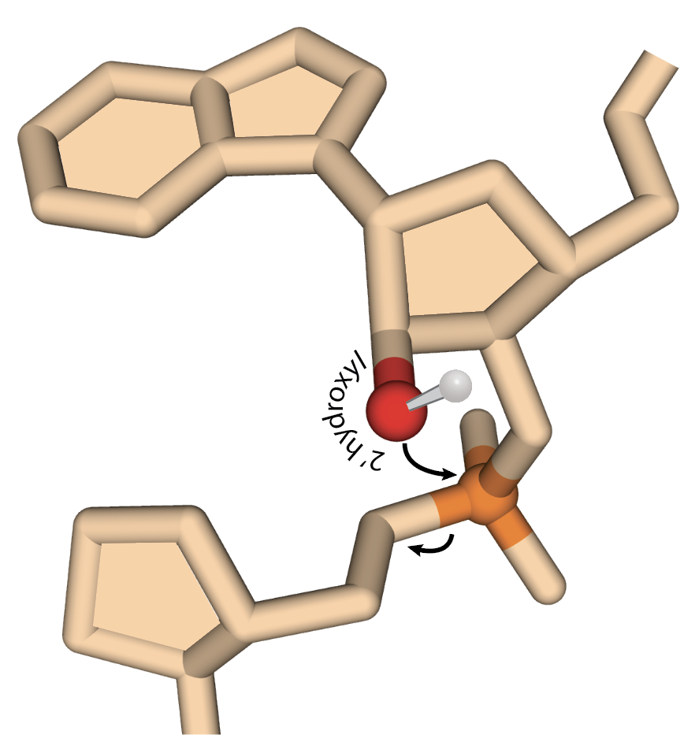

Slide 20
Ribozymes
The vast majority of catalysis in biology is conducted by proteins (enzymes).
But some catalysis is performed by RNA (ribozymes which are actually RNPs)
two kinds of reactions:
Peptidyl transfer in the ribosome
RNA cutting and pasting in the splicosome, RNAse P, etc

Slide 21
The ribosome

Slide 22
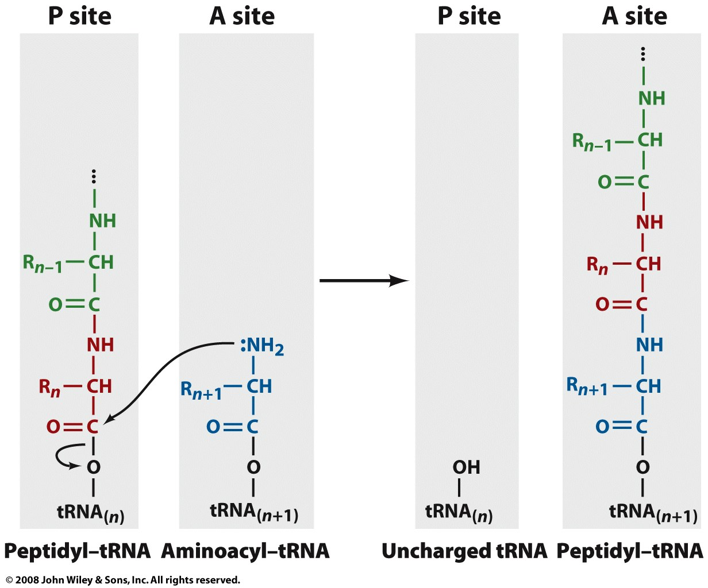
The Ribosome: The peptidyl transfer reaction

Slide 23
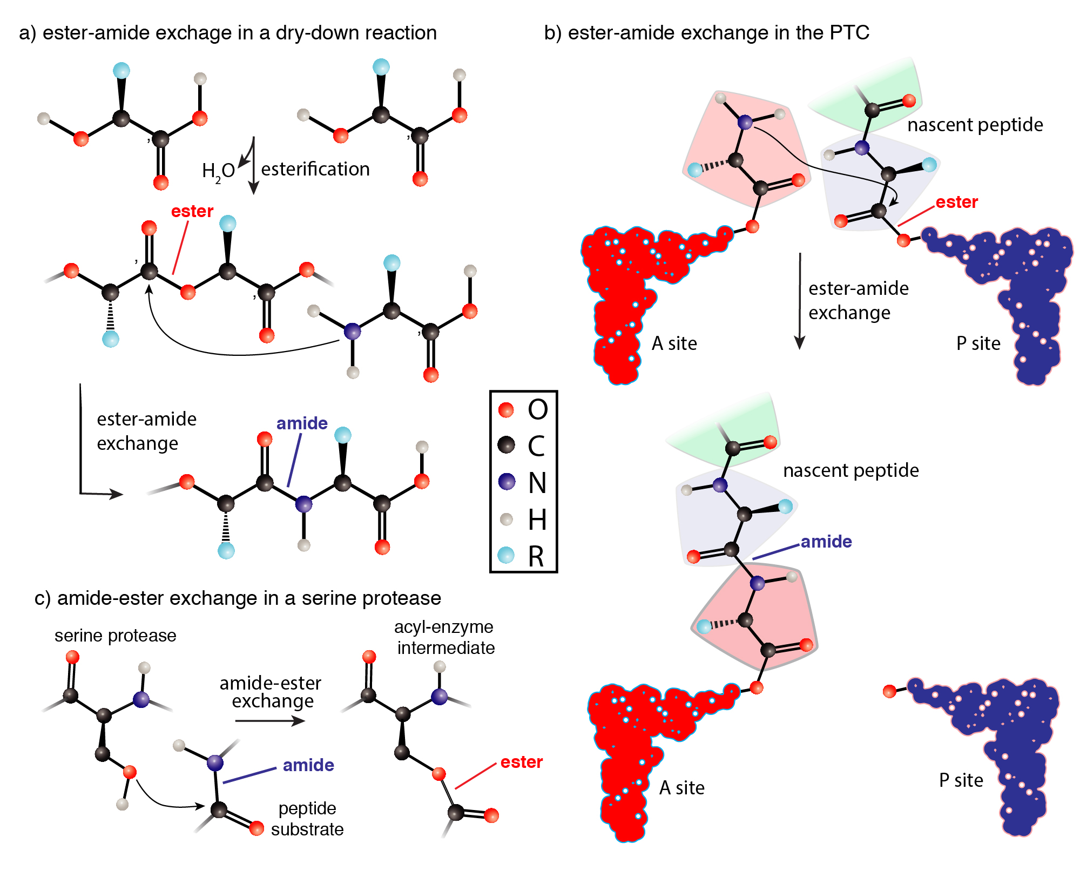
Notes:
Translation outrageously complex, produces coded protein by very simple chemistry

Slide 24
Splicing

Slide 25
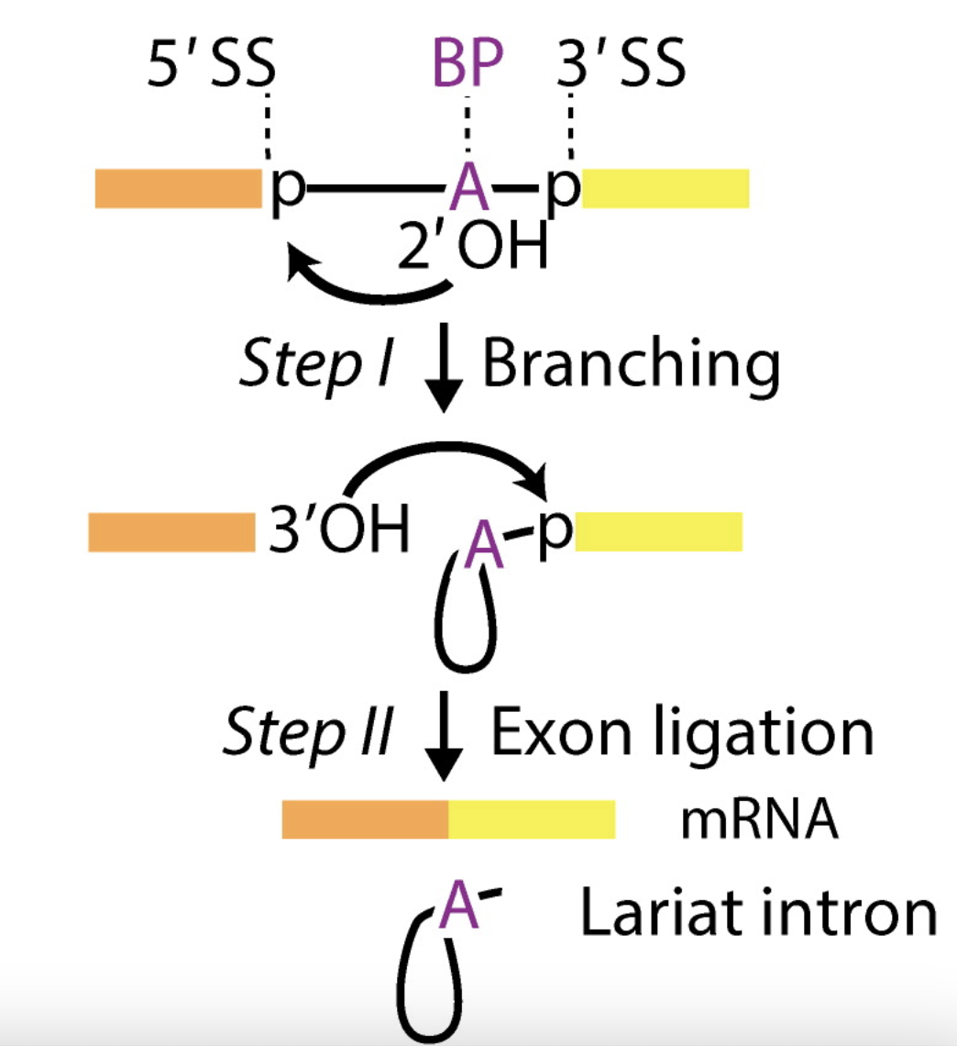
Exons of eukaryotic genes are interleaved by introns that are removed (spliced) from pre-mRNAs to form mature mRNAs.
A human has around 22,000 protein-coding genes. A gene has 8 introns on average.
The length of intron is around 1000 nucleotides on average.
exon
exon
Image from RNA Splicing by the Spliceosome, Annual Review of Biochemistry (2020)

