Slide 1
Globular Proteins

Slide 2
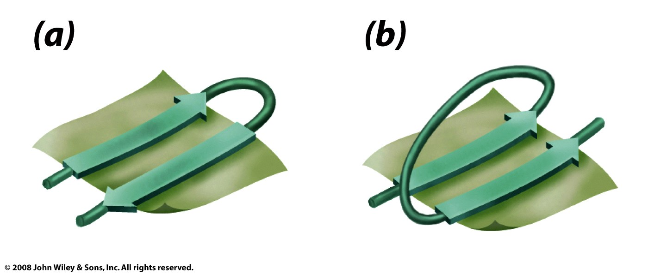
Antiparallel sheets often use beta turns
Parallel sheets use beta-alpha-beta
Figure 6-13

Slide 3
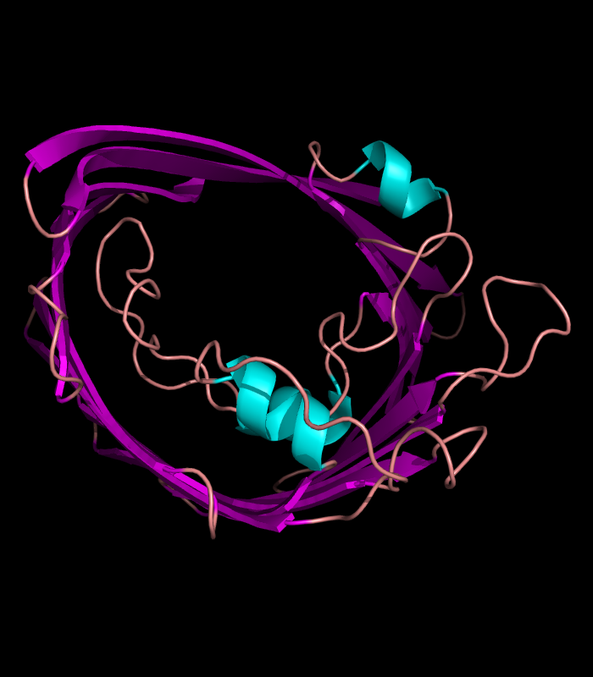
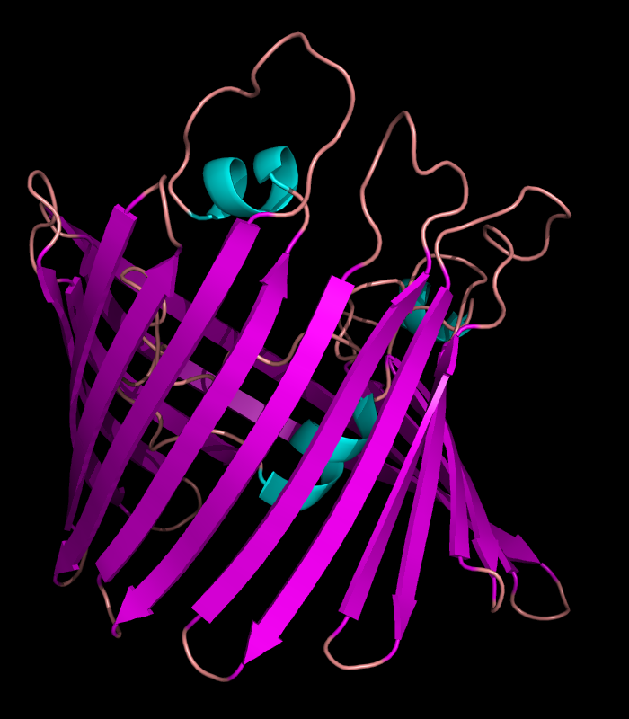
porin
all β-sheet (almost).

Slide 4
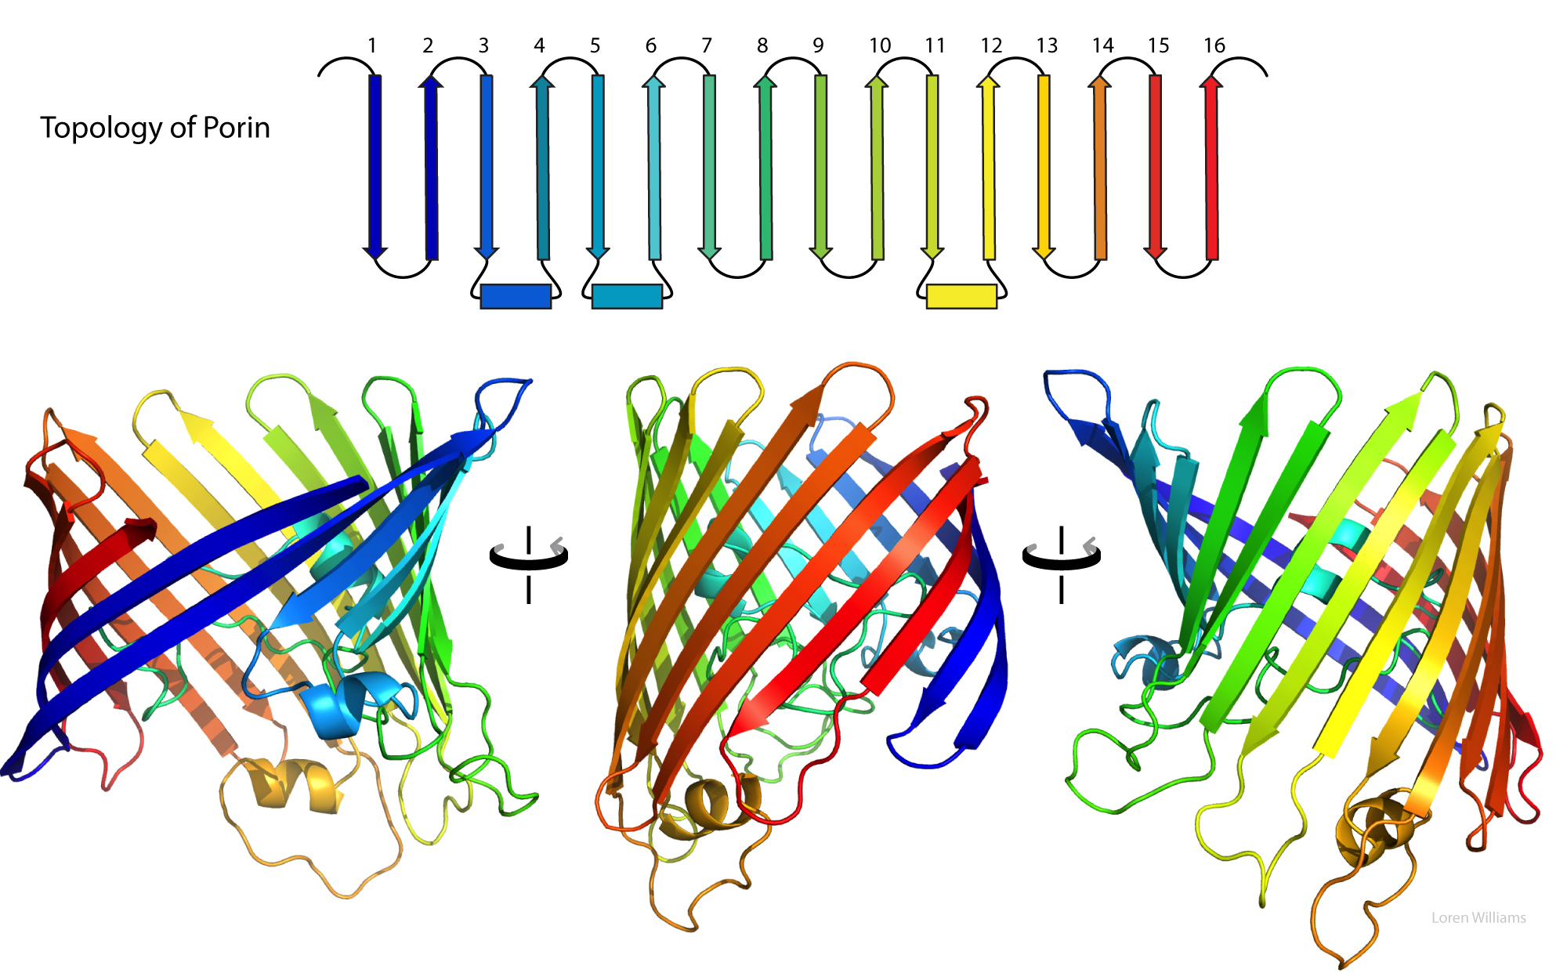

Slide 5
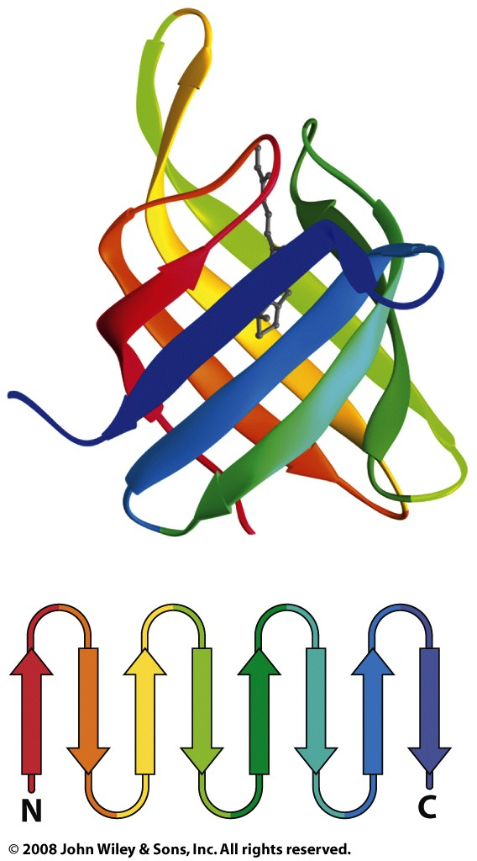
Retinol Binding Protein
Retinol and retinoic acid play crucial roles in the modulation of gene expression and overall development of an embryo. Regulation of transport and metabolism of retinol necessary for a successful pregnancy is accomplished via RBP.
all β-sheet

Slide 6
The TIM barrel
a conserved protein fold
15 distinct enzyme families are TIM barrels.
one of the most common protein folds
contains eight α-helices and eight parallel β-strands
contains alternating α-helix - β-strand - α-helix - β-strand-...
has a tightly packed core with many bulky hydrophobics
named after triosephosphate isomerase,
the active site is always at the C-terminal end beta barrel.
mixed β-sheet /α-helix (closed sheet)
There is very little sequence similarity between various TIM barrels

Slide 7
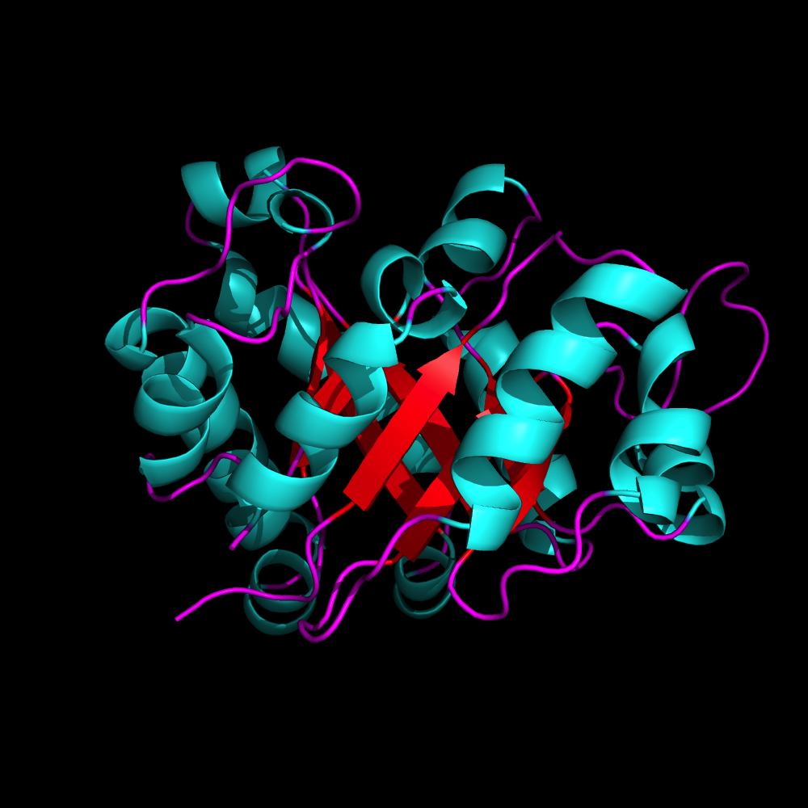
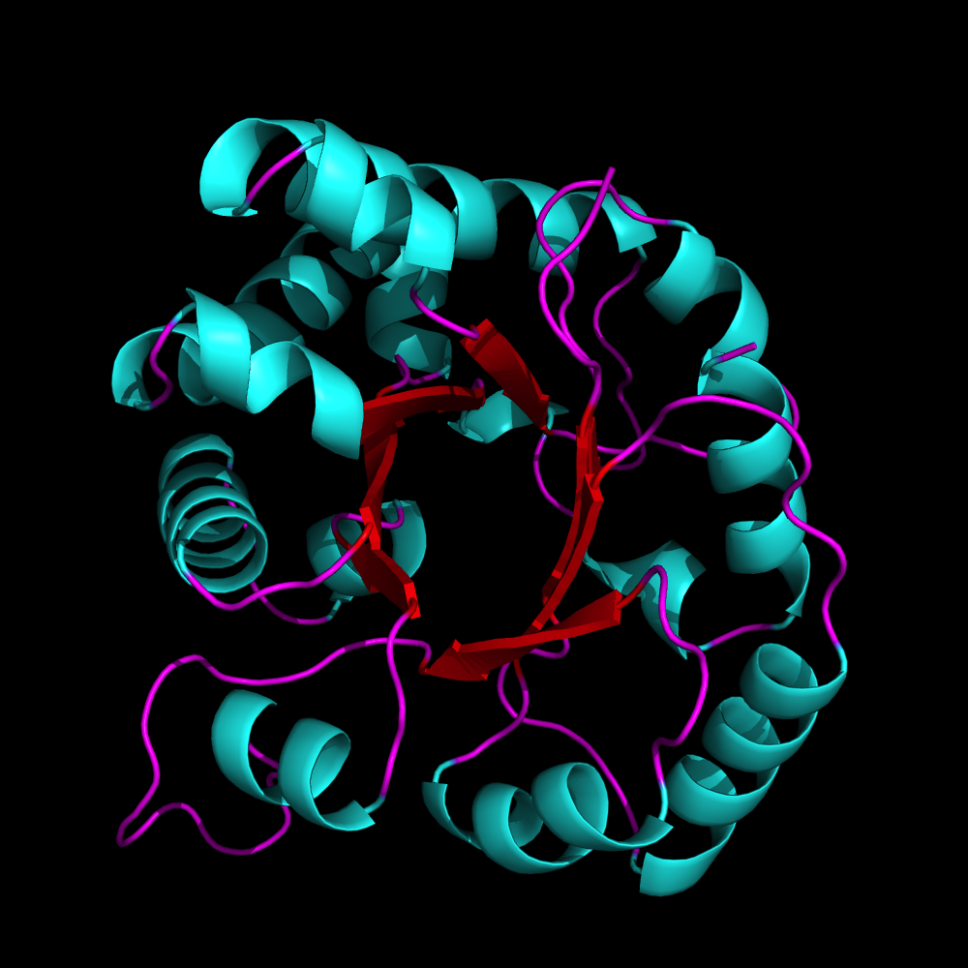
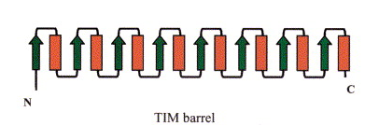
TIM Barrel

Slide 8
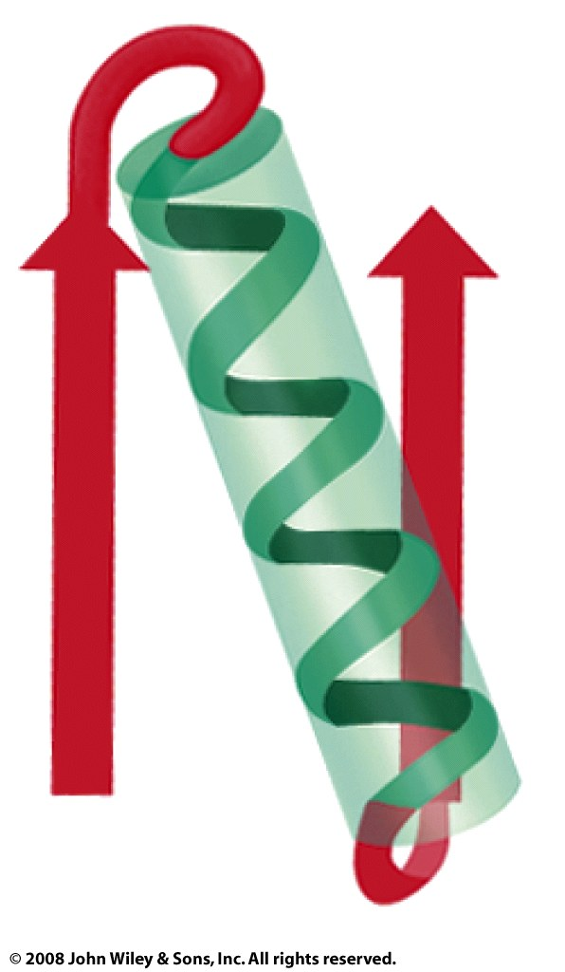
Figure 6-28a

Slide 9
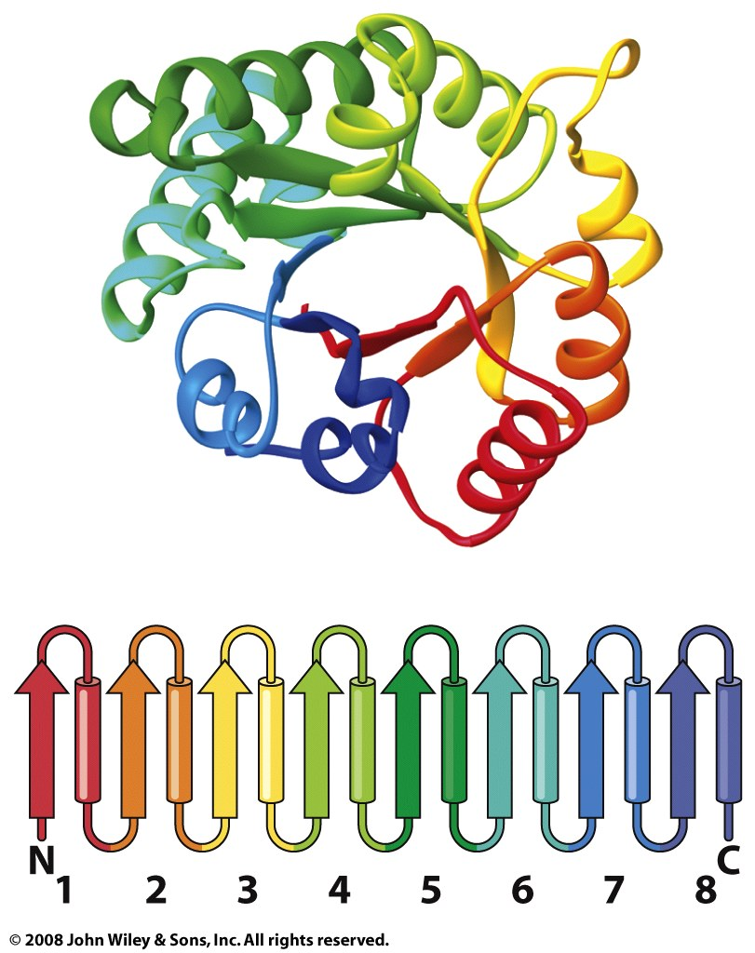
Figure 6-30c

Slide 10
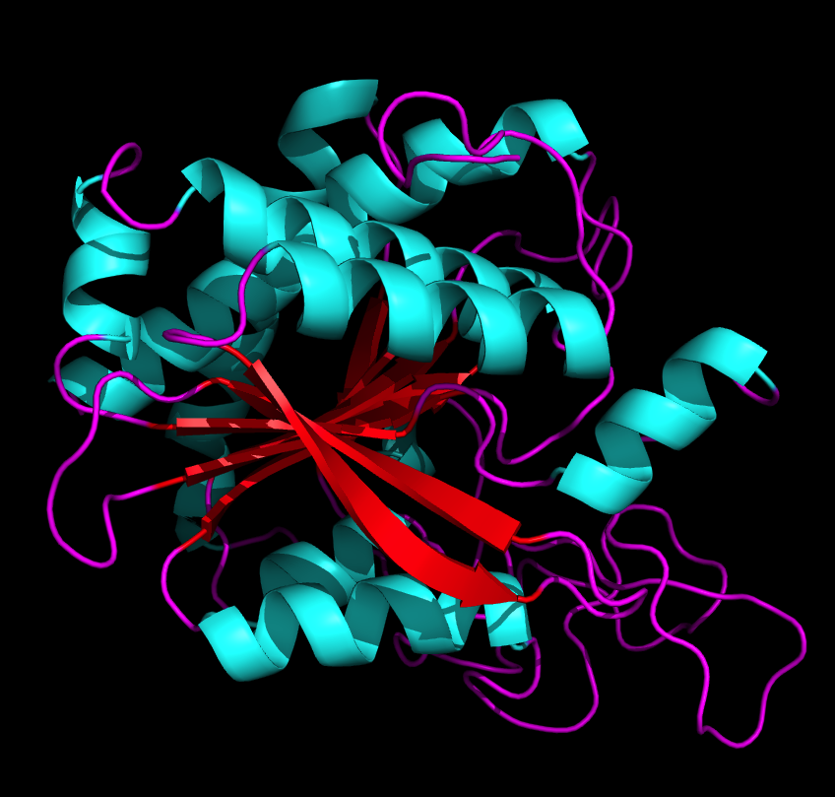
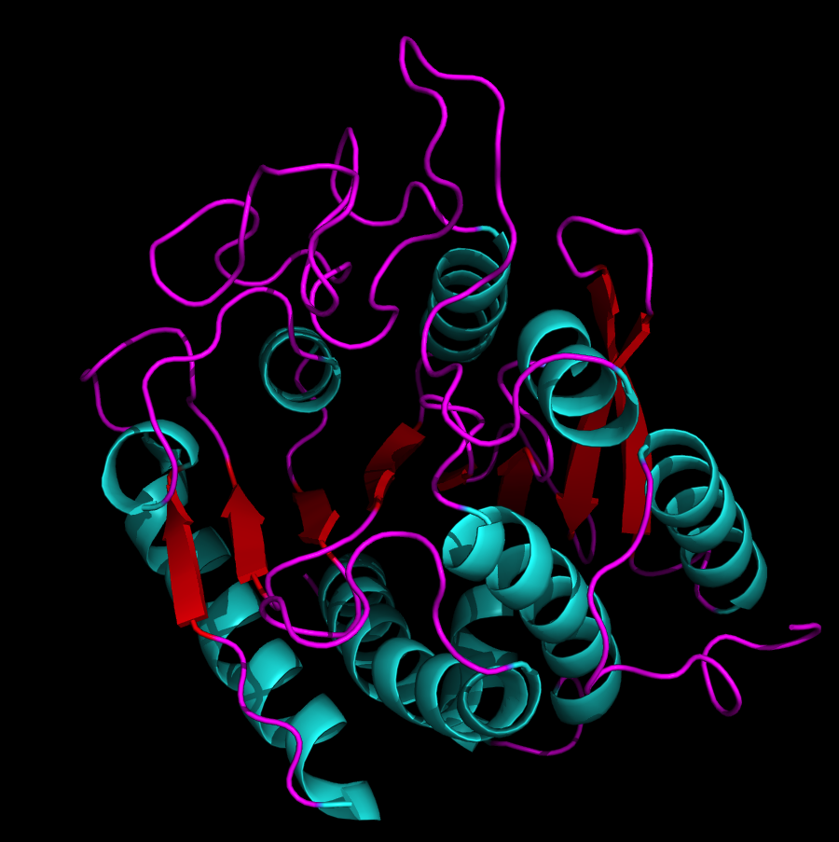
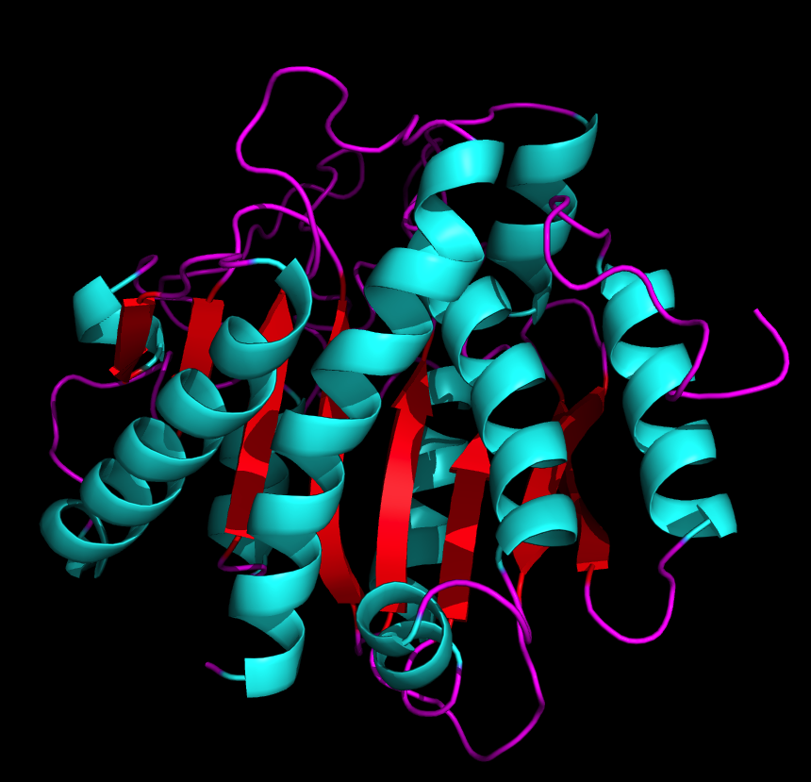
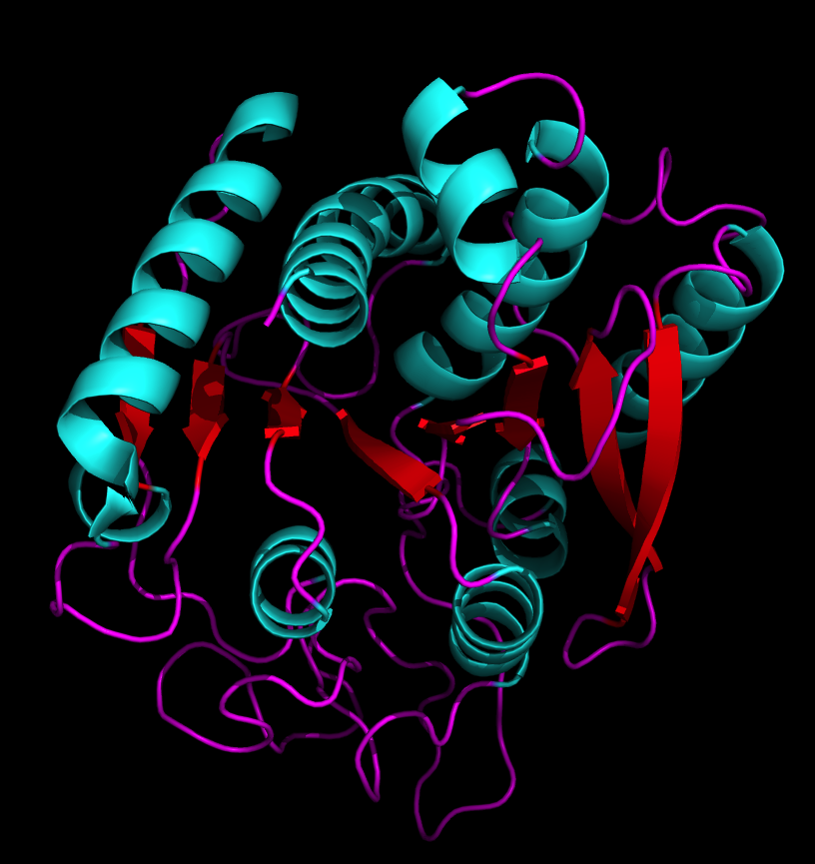
Carboxy-
peptidase
mixed β-sheet /
α-helix (open sheet)

Slide 11
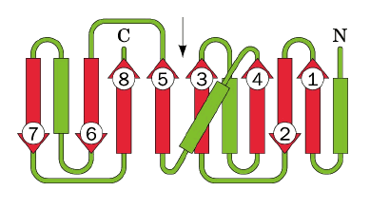
Carboxy-
peptidase

Slide 12
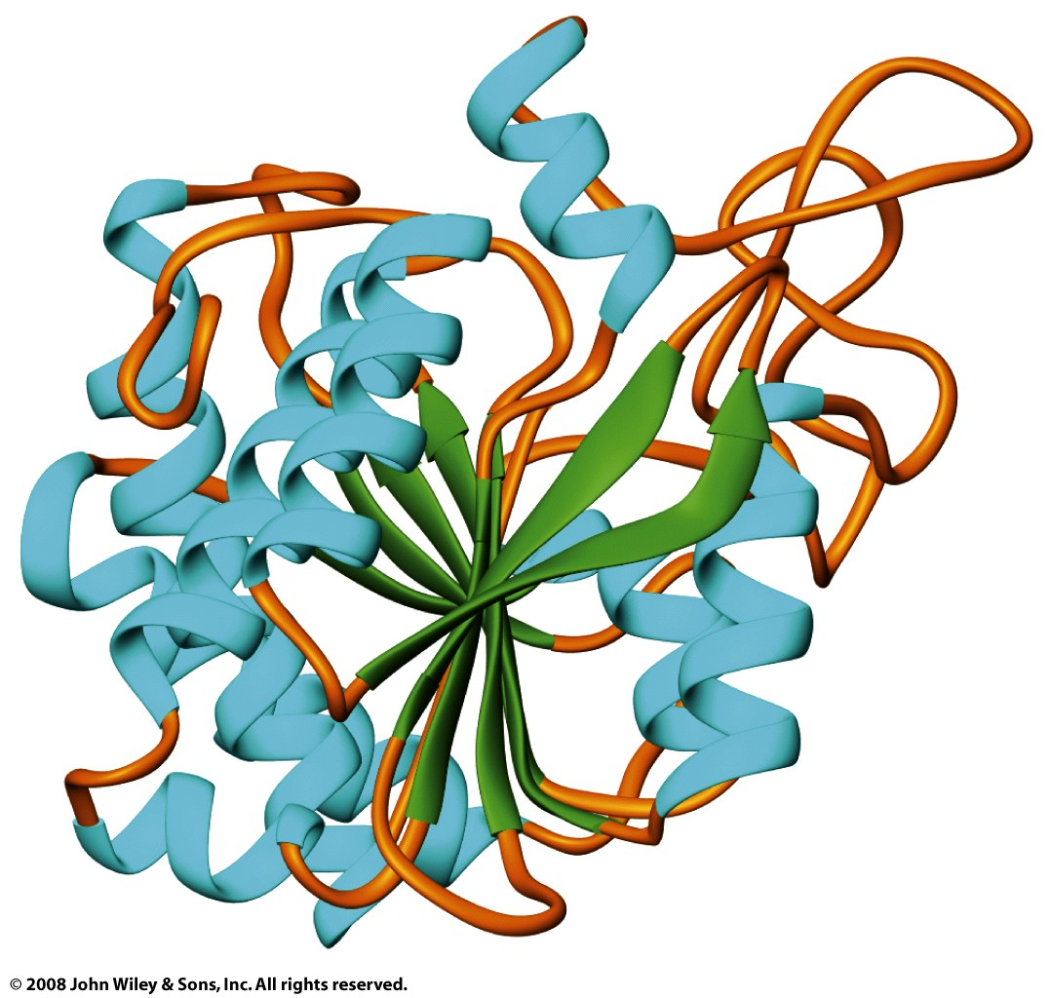

Slide 13
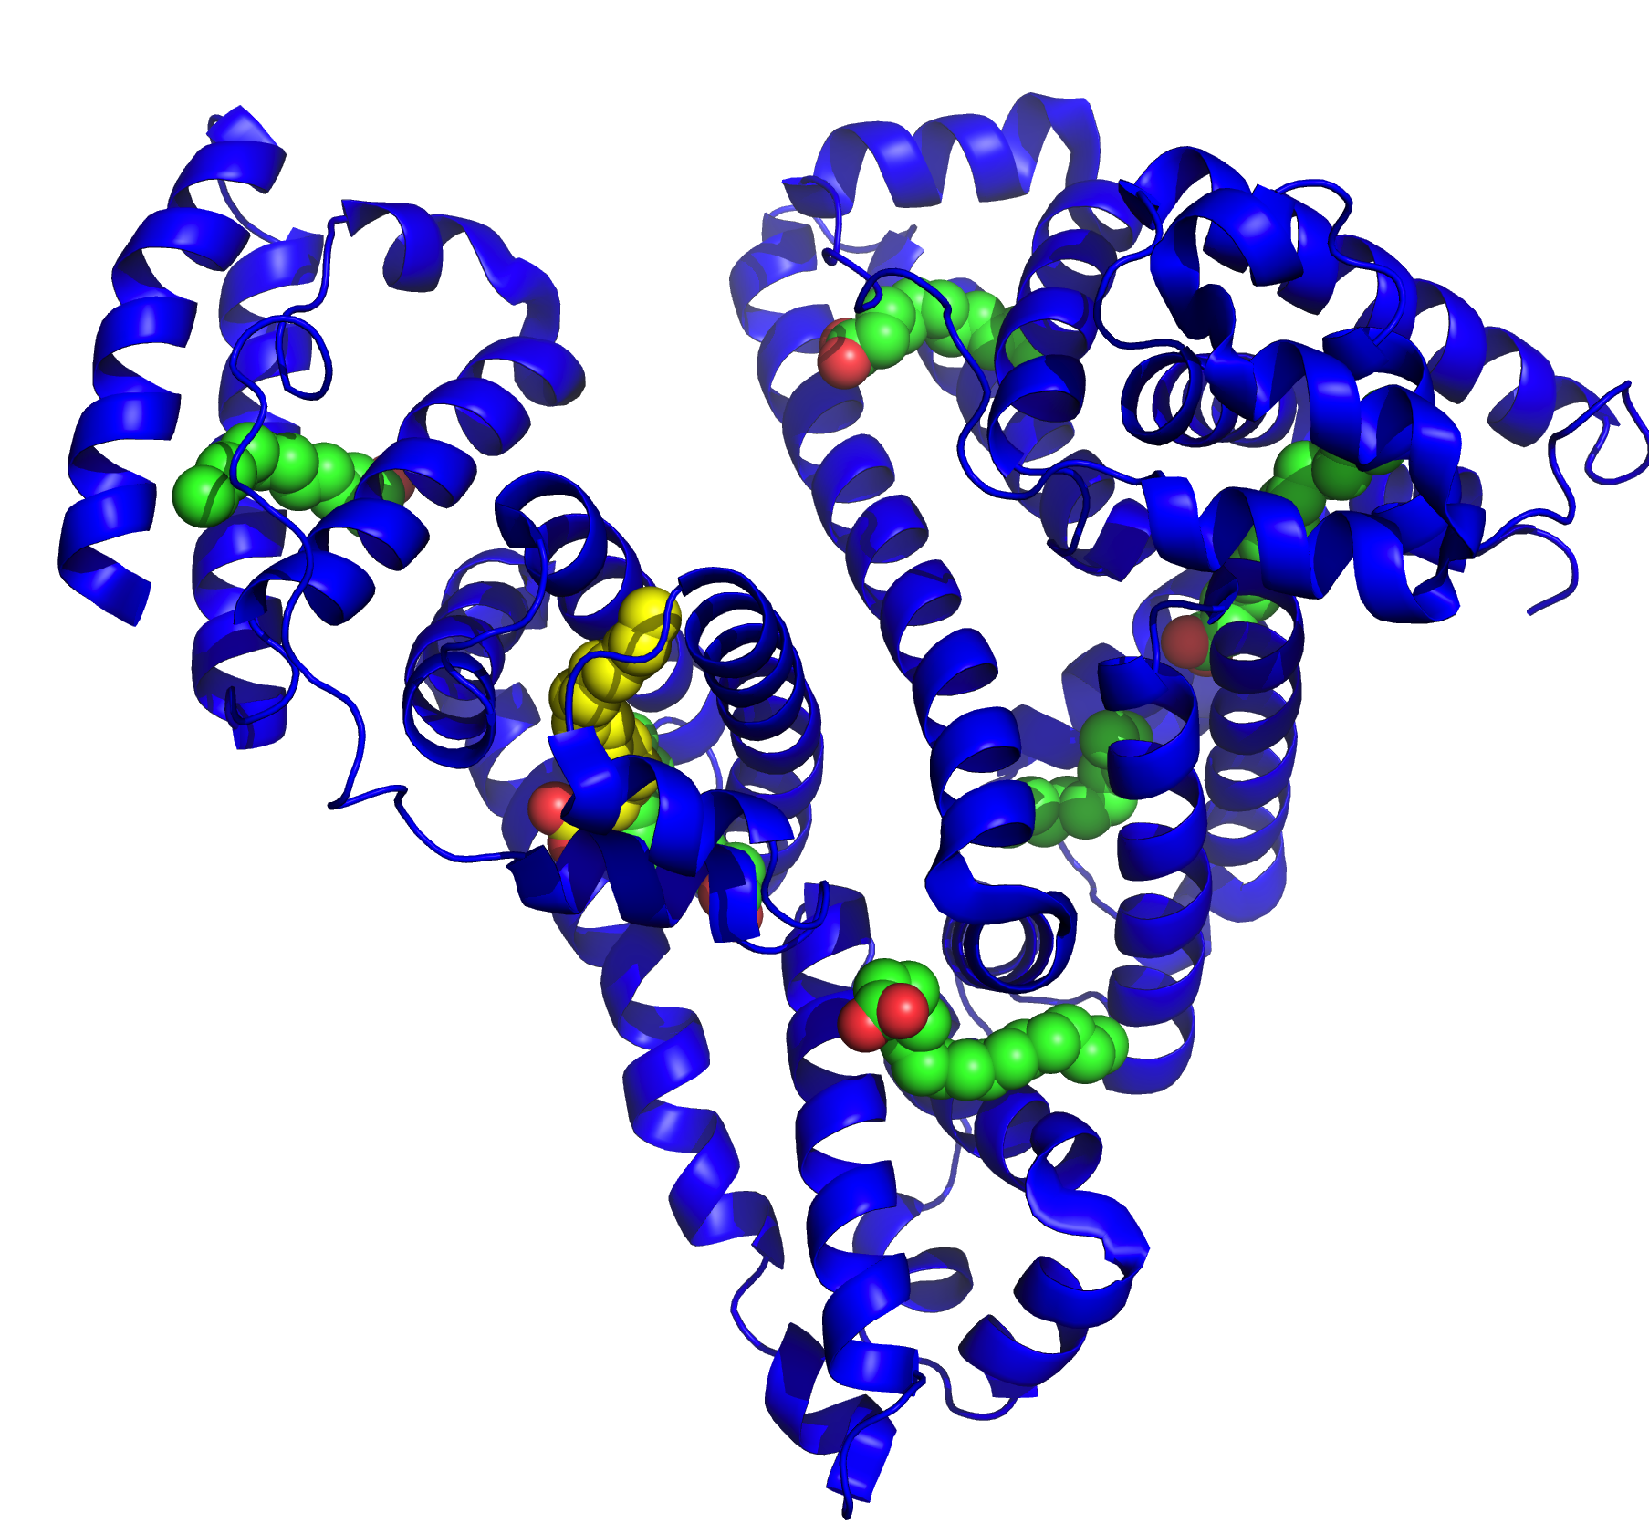
all α-helix

