Slide 1
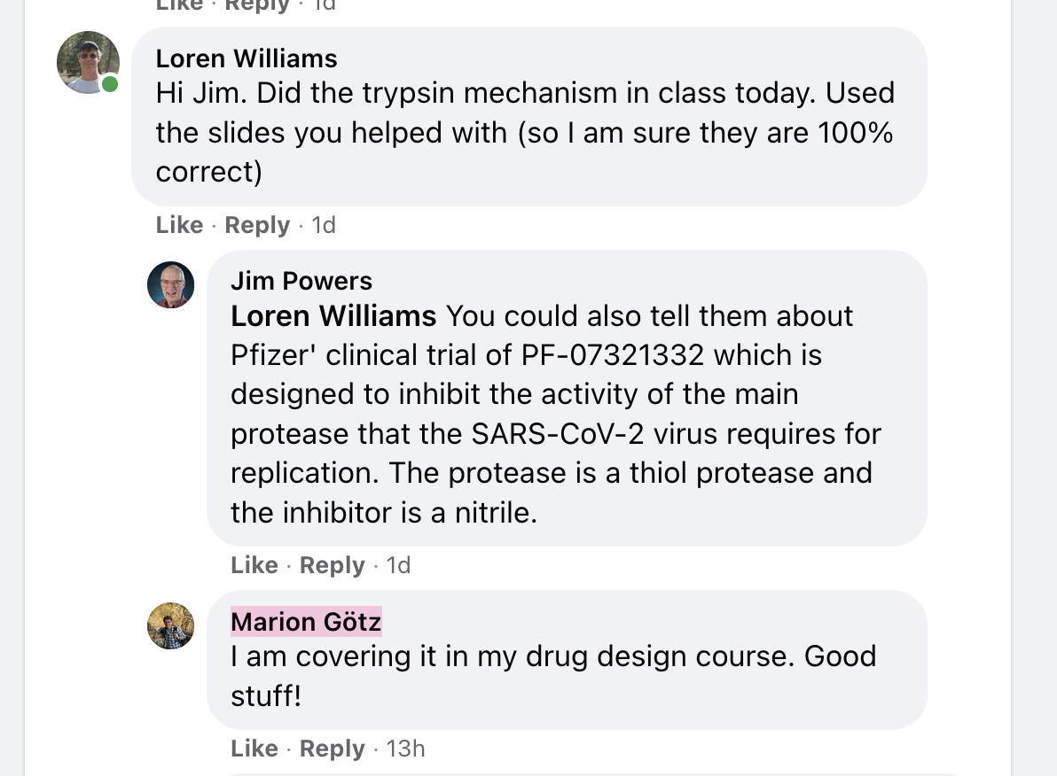

Slide 2
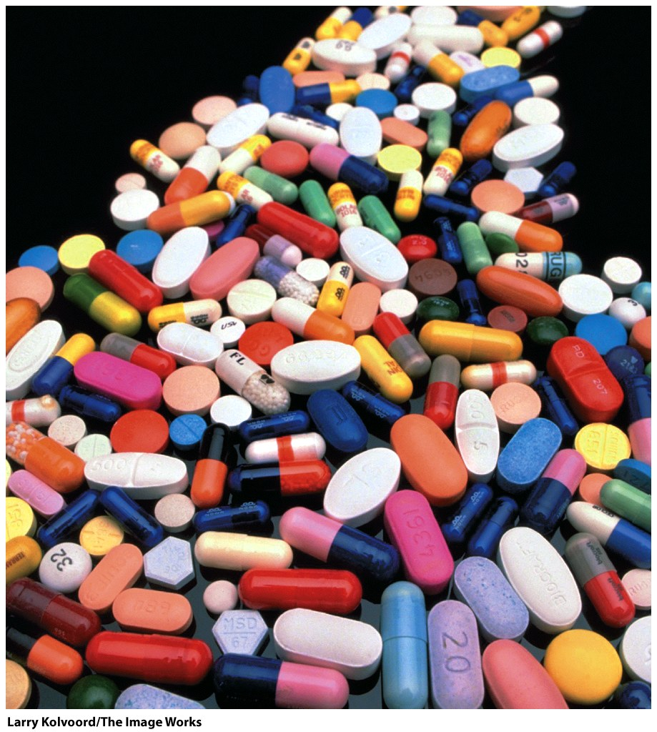
So good for you…
Many drugs are enzyme inhibitors.
Lipitor: HMG-CoA reductase, inhibits a liver enzyme that is important in biosynthesis of cholesterol (>$100 billion total sales since 1996).
Viread & Emtriva: reverse transcriptase inhibitors, anti-retrovirus (HIV).
Saquinavir: protease inhibitor, anti-retrovirus (HIV).

Slide 3
Eliquis™ (Apixaban), a Potent and Selective Inhibitor of Coagulation Factor Xa for the Prevention and Treatment of Thrombotic Diseases
Donald J.P. Pinto, Pancras C. Wong, Robert M. Knabb, Ruth R.Wexler
“Eliquis™ …We sought to identify a safe and efficacious inhibitor of Factor Xa with high oral bioavailability suitable … dosing with low peak/trough ratio to minimize the potential for bleeding liabilities. During the lead optimization phase, computer-aided drug design and X-ray crystallography were highly leveraged to drive affinity and selectivity by capitalizing on the larger S1 pocket of FXa. Oral bioavailability was achieved by driving affinity to the picomolar range followed by replacing the positively charged P1 group with a neutral P1 group. In clinical trials, apixaban was shown to be effective and safe in venous thromboembolism prevention and atrial Fibrillation trials.”

Slide 4
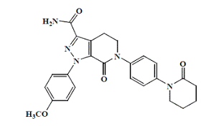
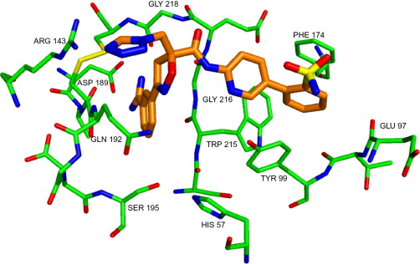
$16 billion in sales, 2020
#6 in sales

Slide 5
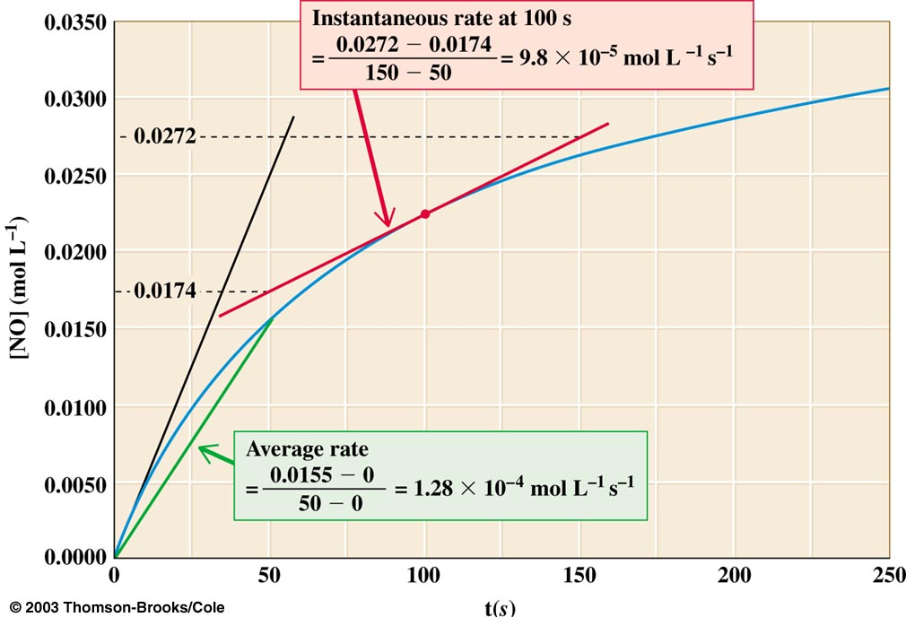
Reaction Rates (reaction velocities): To measure a reaction rate we monitor the disappearance of reactants or appearance of products.
e.g., 2NO₂ + F₂ → 2NO₂F
Measure
initial velocity =>
[product] = 0,
no back reaction

Slide 6
Reaction Order
Zero Order. The rate of a zero-order reaction is independent of the concentration of the reactant(s). Zero-order kinetics are observed when an enzyme is saturated by reactants.
First Order. The rate of a first-order reaction varies linearly on the concentration of one reactant. First-order kinetics are observed when a protein folds and RNA folds (assuming no association or aggregation), also radioactive decay.
Second Order. The rate of a second-order reaction varies linearly with the square of concentrations of one reactant (or with the product of the concentrations of two reactants). Second order kinetics are observed for formation of double-stranded DNA from two single-strands.

Slide 7
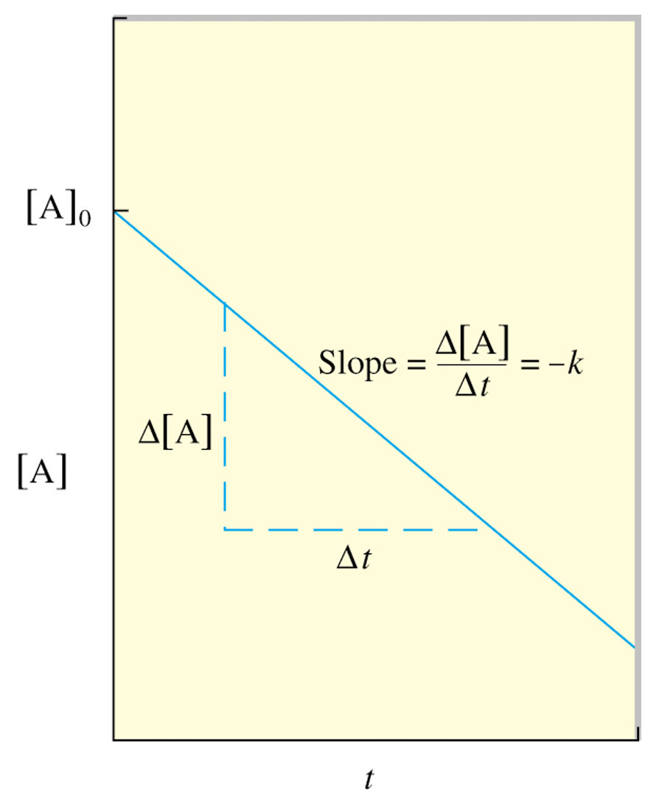
Use experimental data to determine the reaction order.
If a plot of [A] vs t is a straight line, then the reaction is zero order.
If a plot of ln[A] vs t is a straight line, then the reaction is 1st order.
If a plot of 1/ [A] vs t is a straight line, then the reaction is 2nd order.

Slide 8
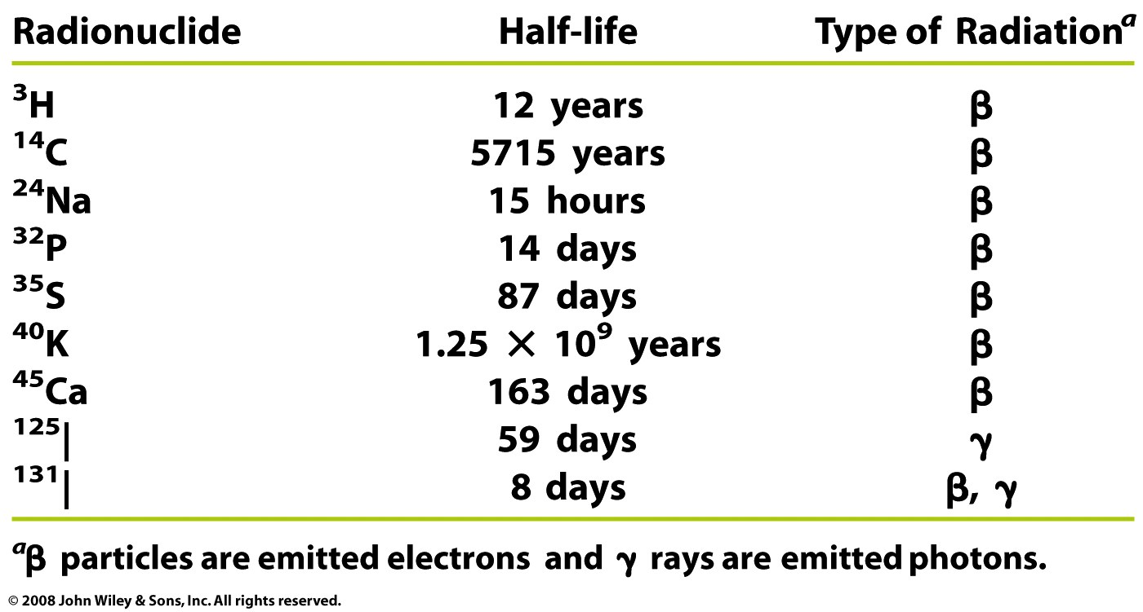
Radioactive decay: 1st order reaction
Box 12-1a

Slide 9
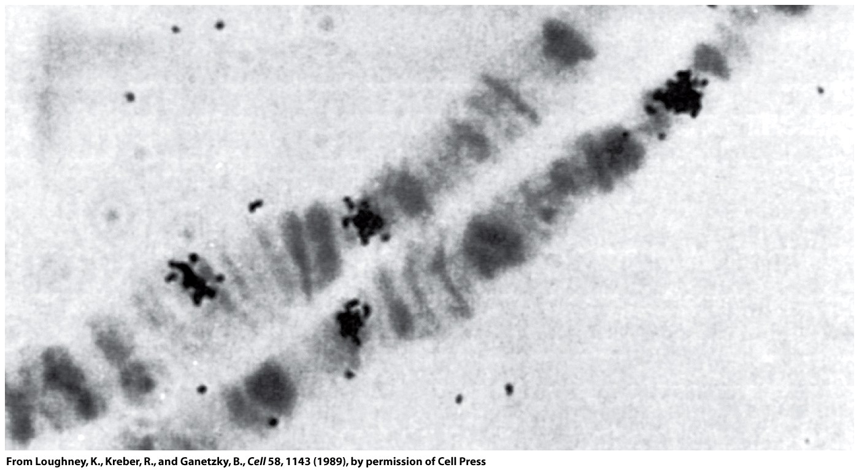
Radioactive decay: 1st order reaction
³²P
Box 12-1b

Slide 10
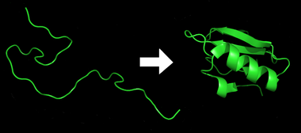
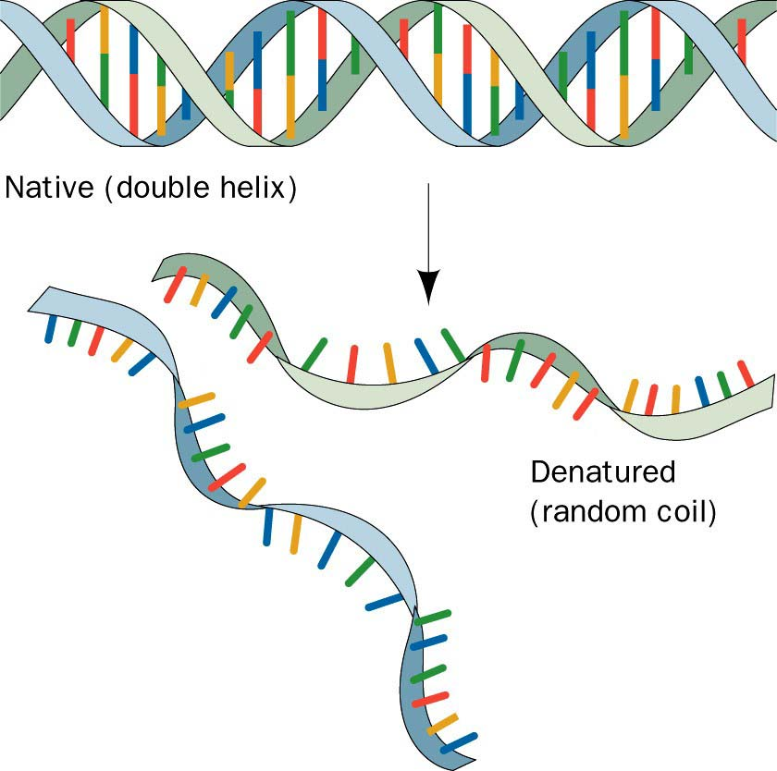
Protein Folding: 1st order reaction
DNA annealing: 2nd order reaction

Slide 11
Enzyme Kinetics
Each elementary step has reactant(s), a transition state, and product(s). Products that are consumed in subsequent elementary reaction are called intermediates.

Slide 12
Enzyme Kinetics
Kinetics is the study of reaction rates (time-dependent phenomena)
Rates of reactions are affected by
  Enzymes/catalysts
  Substrates
  Effectors
  Temperature
  Concentrations

Slide 13
Why study enzyme kinetics?
Enzyme Kinetics
Quantitative description of biocatalysis
Understand catalytic mechanism
Find effective inhibitors
Understand regulation of activity

Slide 14
General Observations
Enzyme Kinetics
Enzymes are able to exert their influence at very low concentrations ~ [enzyme] = nM
The initial rate (velocity) is linear with [enzyme].
The initial velocity increases with [substrate] at low [substrate].
The initial velocity approaches a maximum at high [substrate].

Slide 15
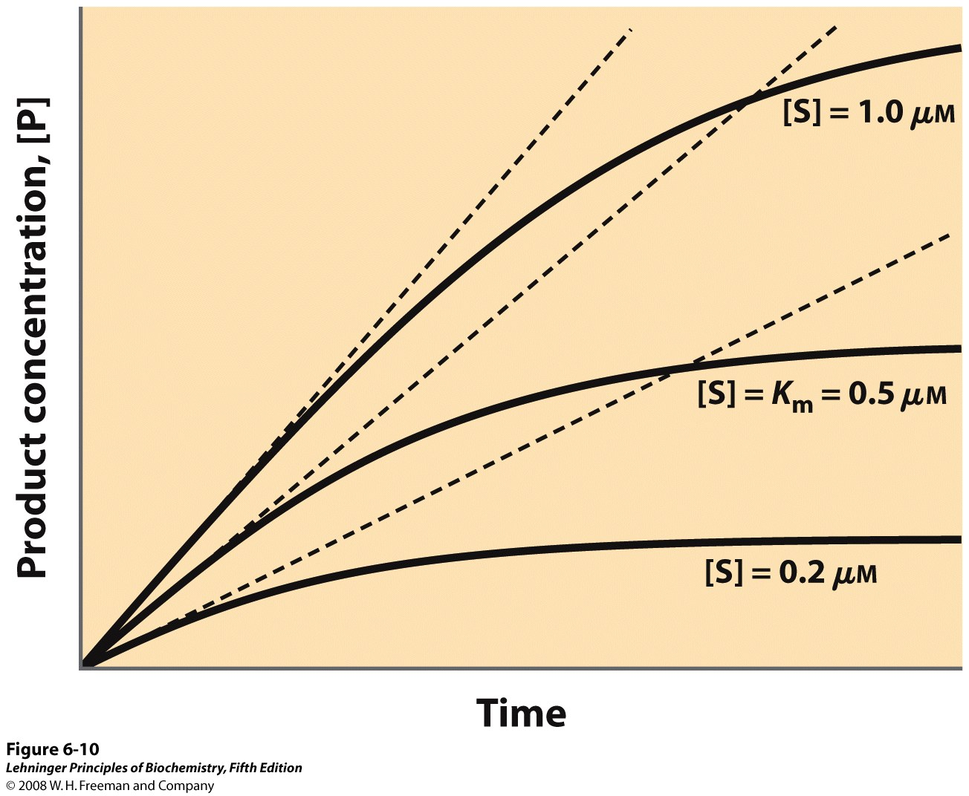
Enzyme Kinetics
The initial velocity increases with [S] at low [S].
Initial velocity
Notes:
FIGURE 6-10 Initial velocities of enzyme-catalyzed reactions. A theoretical enzyme catalyzes the reaction S ↔ P, and is present at a concentration sufficient to catalyze the reaction at a maximum velocity, V_{max}, of 1 μM/min. The Michaelis constant, K_{m} (explained in the text), is 0.5 μM. Progress curves are shown for substrate concentrations below, at, and above the K_{m}. The rate of an enzyme-catalyzed reaction declines as substrate is converted to product. A tangent to each curve taken at time = 0 defines the initial velocity, V₀, of each reaction.

Slide 16
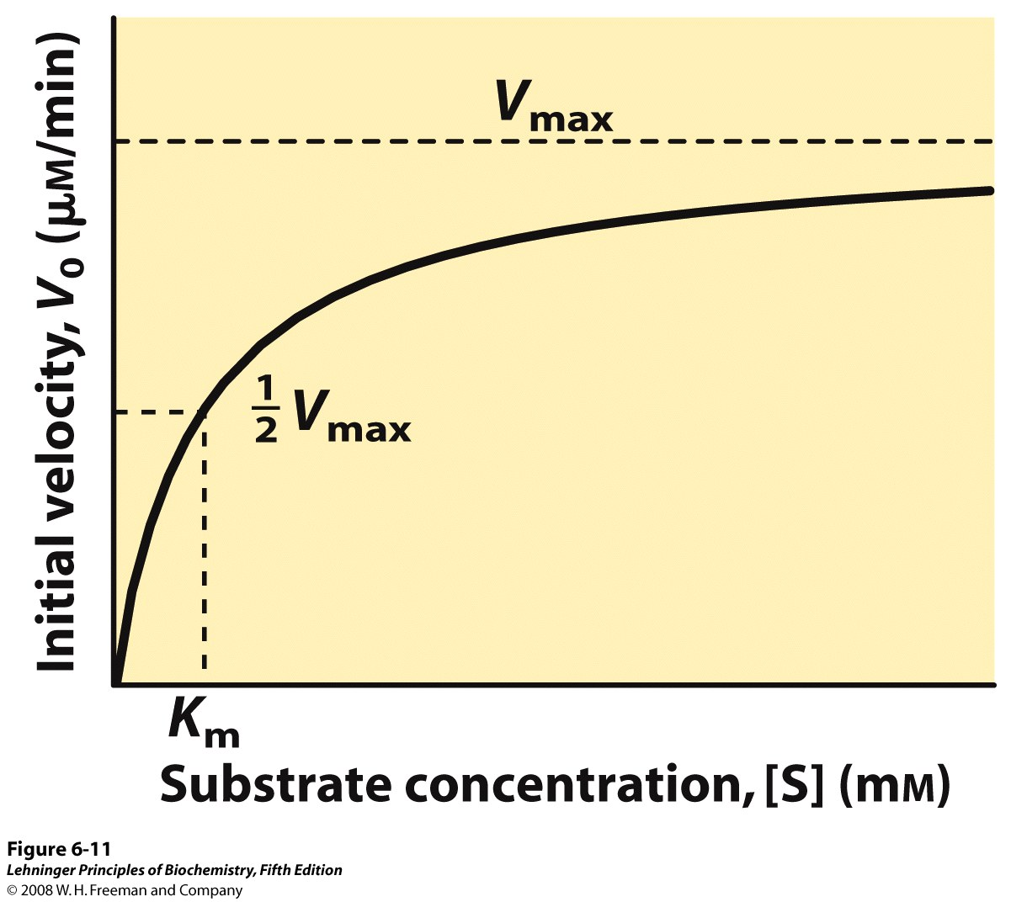
Enzyme Kinetics
The initial velocity increases with [S] at low [S].
[velocity =d[P]/dt, P=product]
The initial velocity approaches a maximum at high [S].
Notes:
FIGURE 6-11 Effect of substrate concentration on the initial velocity of an enzyme-catalyzed reaction. The maximum velocity, V_{max}, is extrapolated from the plot, because V₀ approaches but never quite reaches V_{max}. The substrate concentration at which V₀ is half maximal is K_{m}, the Michaelis constant. The concentration of enzyme in an experiment such as this is generally so low that [S] >> [E] even when [S] is described as low or relatively low. The units shown are typical for enzyme-catalyzed reactions and are given only to help illustrate the meaning of V₀ and [S]. (Note that the curve describes part of a rectangular hyperbola, with one asymptote at V_{max}. If the curve were continued below [S] = 0, it would approach a vertical asymptote at [S] = –K_{m}.)

Slide 17
Equations describing Enzyme Kinetics
Start with a mechanistic model
Identify constraints and assumptions
Do the algebra ...
Solve for velocity (d[P]/dt)

Slide 18
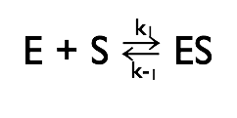
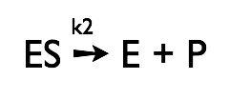
Michaelis-Menten Kinetics
Simplest enzyme mechanism
One reactant (S)
One intermediate (ES)
One product (P)

Slide 19
Michaelis-Menten Kinetics
First step: The enzyme (E) and the substrate (S) reversibly and quickly form a non-covalent ES complex (Michaelis Complex).
Second step: The ES complex undergoes a chemical transformation and dissociates to give product (P) and enzyme (E).
v=k₂[ES]
Many enzymatic reactions follow Michaelis–Menten kinetics, even though enzyme mechanisms are always more complicated than the Michaelis–Menten model.
For real enzymatic reactions use k_{cat} instead of k₂.

Slide 20
The Enzyme-Substrate Complex (ES)
Michaelis-Menten Kinetics
The enzyme binds non-covalently to the substrate to form a non-covalent ES complex
  the ES complex is known as the Michaelis complex.
  A Michaelis complex is stabilized by molecular interactions (non-covalent interactions).
  Michaelis complexes form quickly and dissociate quickly.

Slide 21
E + S → ES → E + P
Michaelis-Menten Kinetics
k_{cat} and the reaction velocity
←
k_{cat}
The enzyme is either free ([E]) or bound ([ES]): [E_{o}] = [ES] + [E].
At sufficiently high [S] all of the enzyme is tied up as ES (i.e., [E_{o}] ≈ [ES], according to Le Chatelier's Principle)
At high [S] the enzyme is working at full capacity (v=v_{max}).
The full capacity velocity is determined only by k_{cat} and [E_{o}].
k_{cat} = turnover #: number of moles of substrate produced per time per enzyme active site.

Slide 22
E + S → ES → E + P
Michaelis-Menten Kinetics
k_{cat}
←
For any enzyme it is possible (pretty easy) to determine k_{cat}.
To understand and compare enzymes we need to know how well the enzyme binds to S (i.e, what happens in the first part of the reaction.) k_{cat} does not tell us anything about how well the enzyme binds to the substrate.
so, … (turn the page and learn about K_{D} and K_{M}).

Slide 23
Assumptions
Michaelis-Menten Kinetics
k₁,k₋₁>>k₂ (i.e., the first step is fast and is always at equilibrium).
d[ES]/dt ≈ 0 (i.e., the system is at steady state.)
There is a single reaction/dissociation step (i.e., k₂=k_{cat}).
S_{Tot} = [S] + [ES] ≈ [S]
There is no back reaction of P to ES (i.e. [P] ≈ 0). This assumption allows us to ignore k₋₂. We measure initial velocities, when [P] ≈ 0.

Slide 24
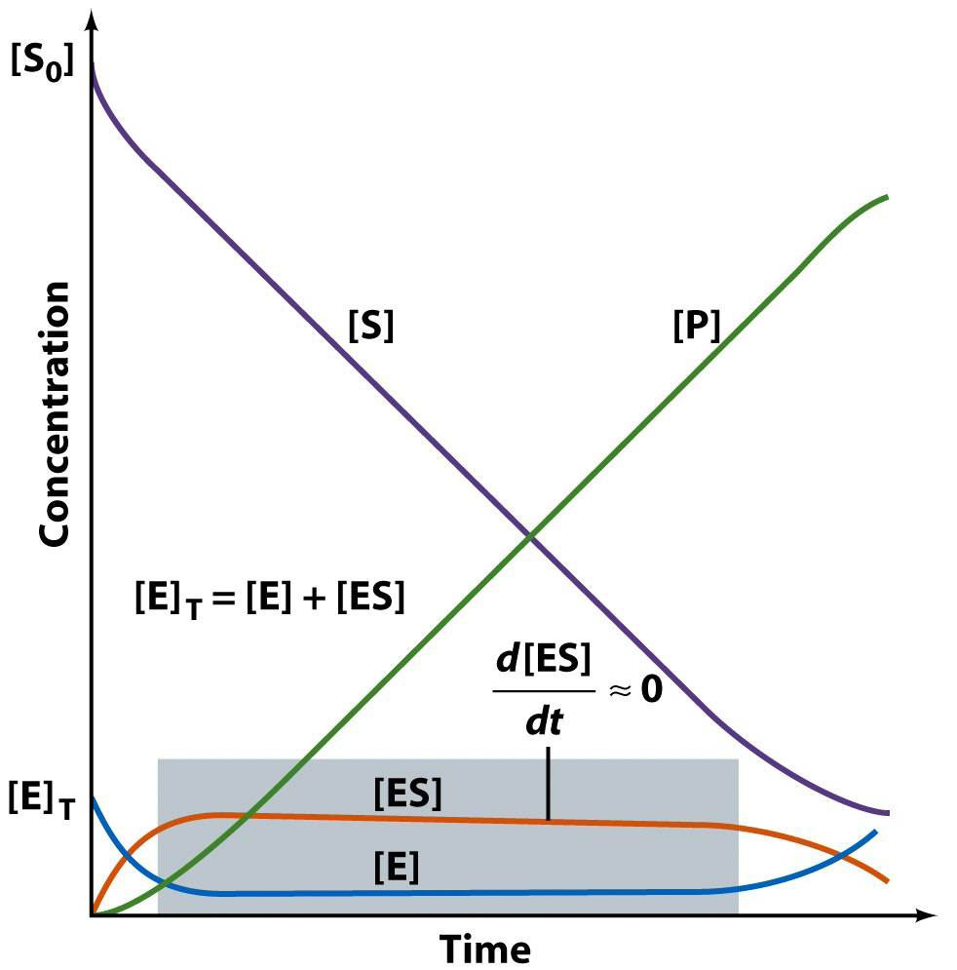
Michaelis-Menten Kinetics
The time dependence of everything (in a Michaelis-Menten reaction)

Slide 25
Michaelis-Menten Kinetics
Now: we derive the Michaelis-Menten Equation
d[ES]/dt = k₁[E][S] –k₋₁[ES] – k₂[ES] (eq 12-14 VVP)
= 0 (steady state assumption, see previous graph)
solve for [ES] (do the algebra)
[ES] = [E][S] k₁/(k₋₁ + k₂)
Define K_{M} (Michealis Constant)
K_{M} = (k₋₁ + k₂)/k₁ => [ES] = [E][S]/K_{M}
rearrange to give K_{M} = [E][S]/[ES]

Slide 26
Michaelis-Menten Kinetics
K_{M} = [E][S]/[ES]

Slide 27
Michaelis-Menten Kinetics

Slide 28
Michaelis-Menten Kinetics
K_{M} is the substrate concentration required to reach half-maximal velocity (v_{max}/2).

Slide 29
Significance of K_{M}
Michaelis-Menten Kinetics
K_{M} = [E][S]/[ES] and K_{M} = (k₋₁ + k₂)/k₁.
K_{M} is the apparent dissociation constant of the ES complex. A dissociation constant (K_{D}) is the reciprocal of the equilibrium constant (K_{D}=K_{A}⁻¹). K_{M} is a measure of a substrate’s affinity for the enzyme (but it is the reciprocal of the affinity).
If k₁,k₋₁>>k2, the K_{M}=K_{D}.
K_{M} is the substrate concentration required to reach half-maximal velocity (v_{max}/2). A small K_{M} means the sustrate binds tightly to the enzyme and saturates (max’s out) the enzyme.
The microscopic meaning of K_{m} depends on the details of the mechanism.

Slide 30
The significance of k_{cat}
Michaelis-Menten Kinetics
v_{max} = k_{cat} E_{tot}
k_{cat}: For the simplest possible mechanism, where ES is the only intermediate, and dissociation is fast, then k_{cat}=k₂, the first order rate constant for the catalytic step.
If dissociation is slow then the dissociation rate constant also contributes to k_{cat}.
If one catalytic step is much slower than all the others (and than the dissociation step), than the rate constant for that step is approximately equal to to k_{cat}.
k_{cat} is the “turnover number”: indicates the rate at which the enzyme turns over, i.e., how many substrate molecules one catalytic site converts to substrate per second.
If there are multiple catalytic steps (see trypsin) then each of those rate constants contributes to k_{cat}.
The microscopic meaning of k_{cat} depends on the details of the mechanism.

Slide 31
Significance of k_{cat}/K_{M}
Michaelis-Menten Kinetics
k_{cat}/K_{M} is the catalytic efficiency. It is used to rank enzymes. A big k_{cat}/K_{M} means that an enzyme binds tightly to a substrate (small K_{M}), with a fast reaction of the ES complex.
k_{cat}/K_{M} is an apparent second order rate constant
v=k_{cat}/K_{M}[E]₀[S]
k_{cat}/K_{M} can be used to estimate the reaction velocity from the total enzyme concentration ([E]₀). k_{cat}/K_{M} =10⁹ => diffusion control.
k_{cat}/K_{M} is the specificity constant. It is used to distinguish and describe various substrates.

Slide 32
Data analysis
Michaelis-Menten Kinetics
It would be useful to have a linear plot of the MM equation
Lineweaver and Burk (1934) proposed the following: take the reciprocal of both sides and rearrange.
Collect data at a fixed [E]₀.

Slide 33
Michaelis-Menten Kinetics
the y (1/v) intercept (1/[S] = 0) is 1/v_{max}
the x (1/[S]) intercept (1/v = 0) is -1/K_{M}
the slope is K_{M}/v_{max}

Slide 34
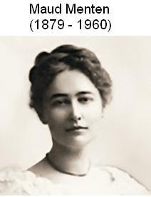
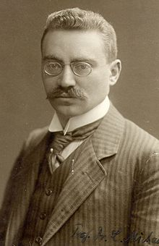
Leonor Michaelis
(1875 –1949)

Slide 35
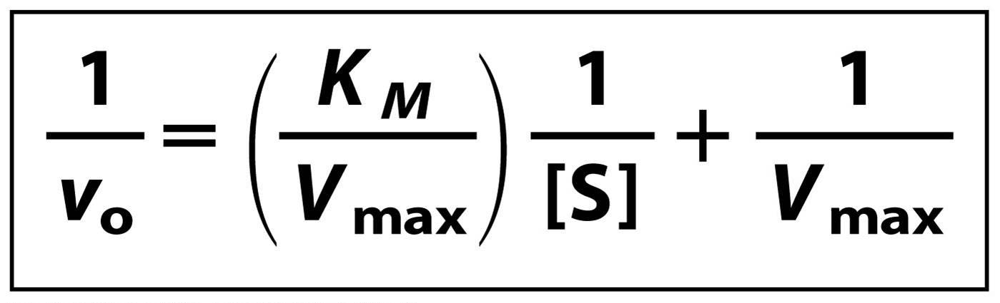
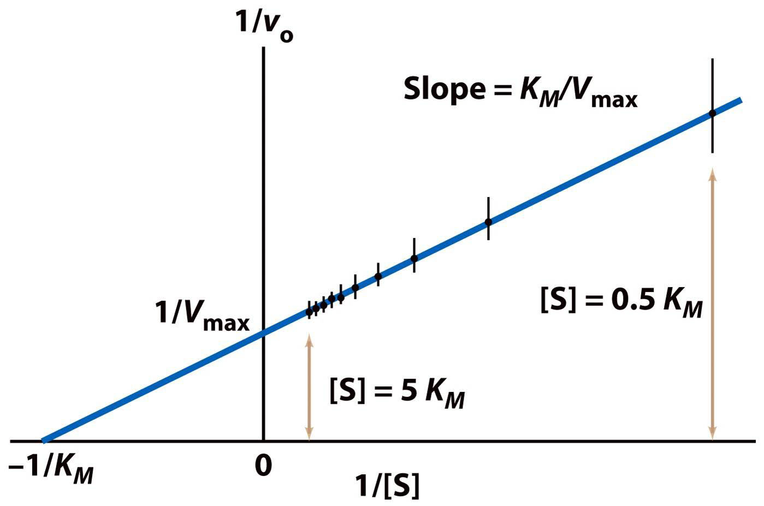
Michaelis-Menten Kinetics
Lineweaver-Burk-Plot
the y (1/v) intercept (1/[S] = 0) is 1/v_{max}
the x (1/[S]) intercept (1/v = 0) is -1/K_{M}
the slope is K_{M}/v_{max}

Slide 36
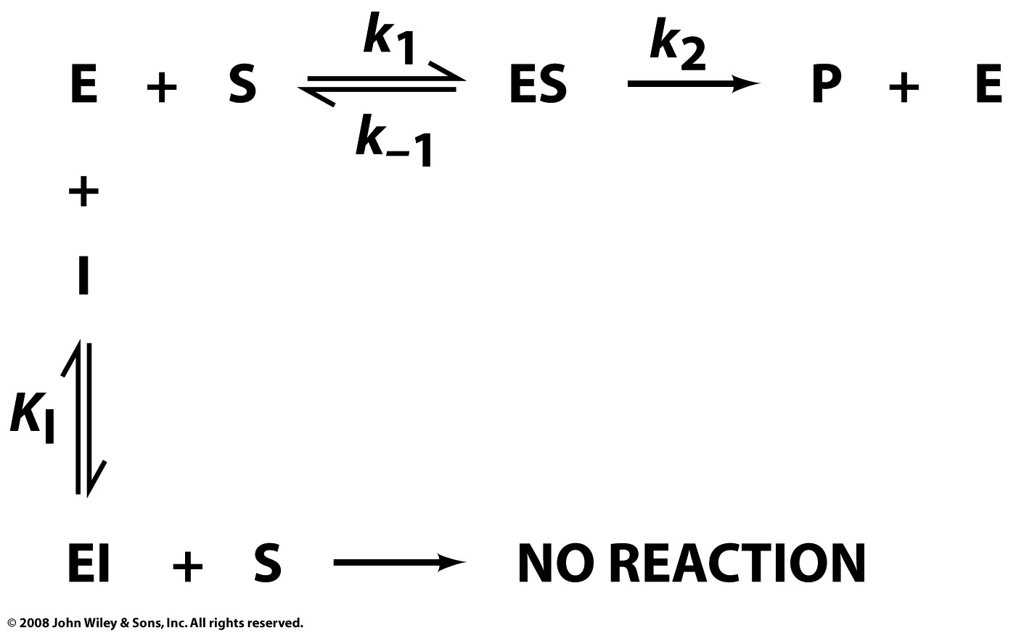
Competitive Inhibition
Page 378

Slide 37
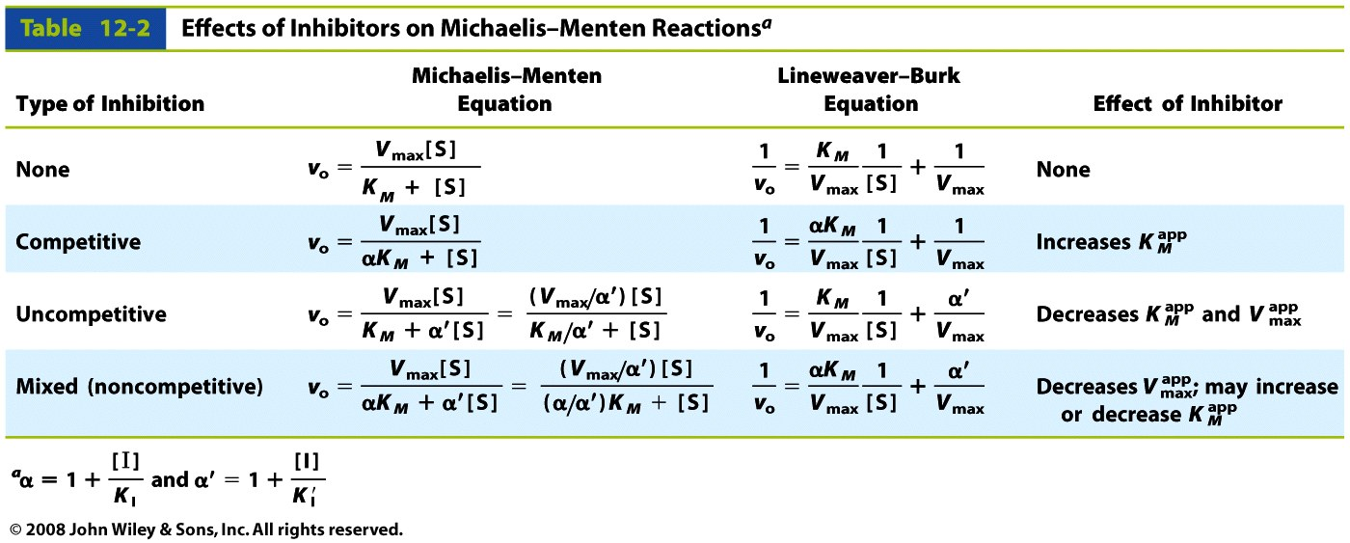
Enzyme Inhibition
Table 12-2

Slide 38
Competitive Inhibition

Slide 39
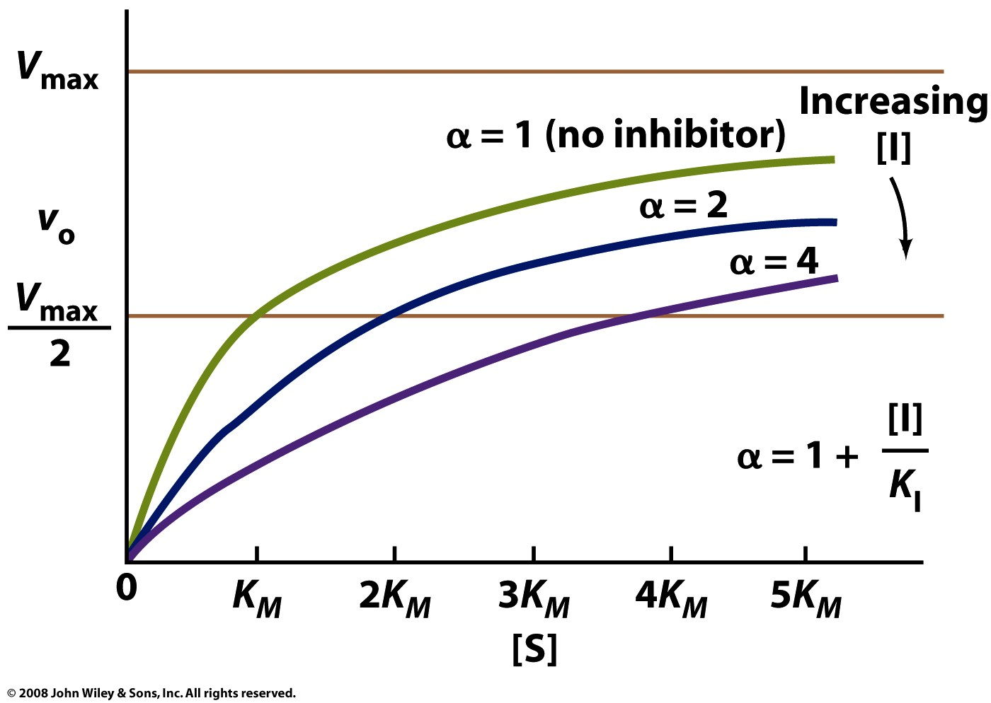
Competitive Inhibition
Figure 12-6

Slide 40
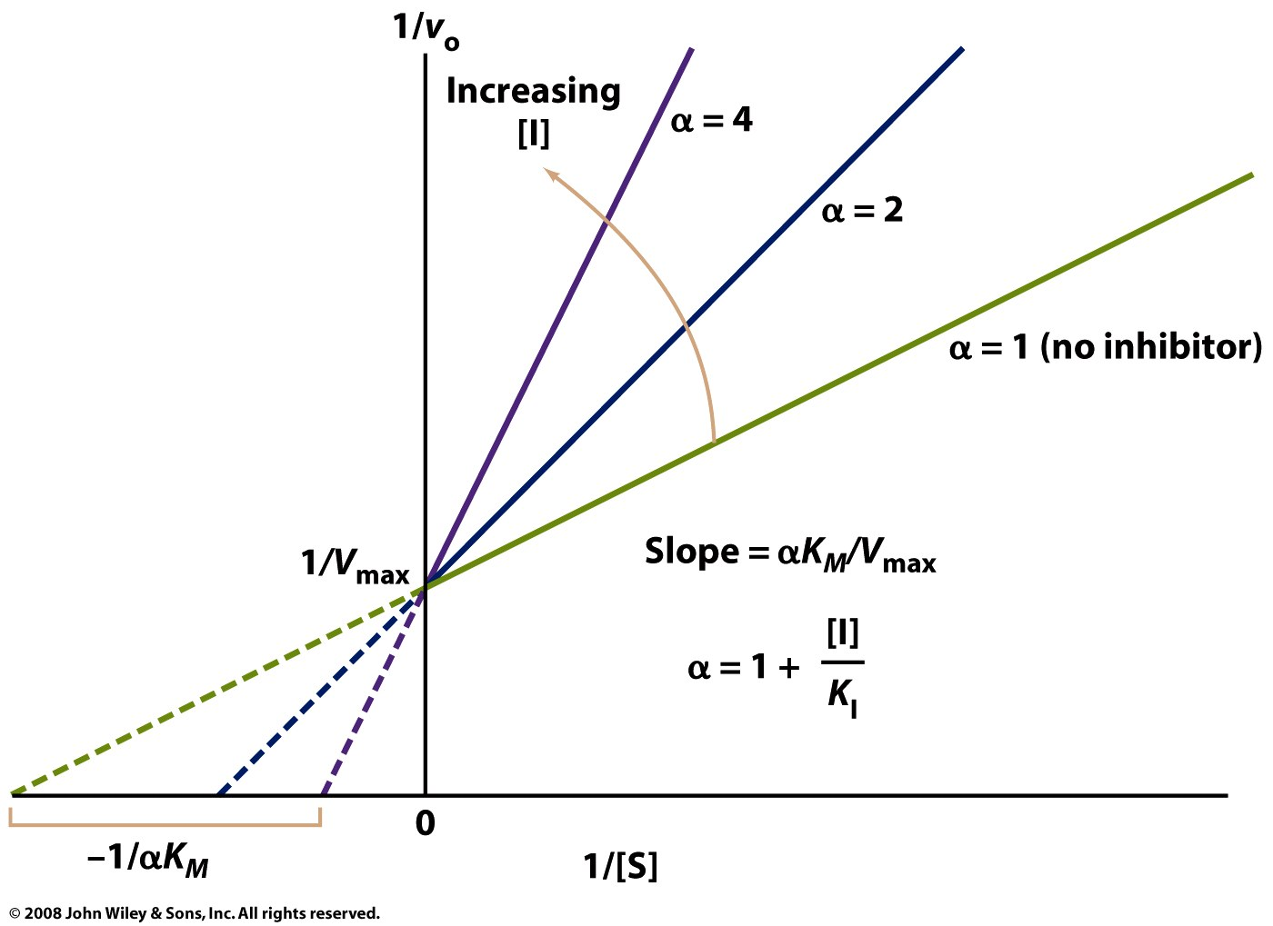
Competitive Inhibition
Figure 12-7

Slide 41
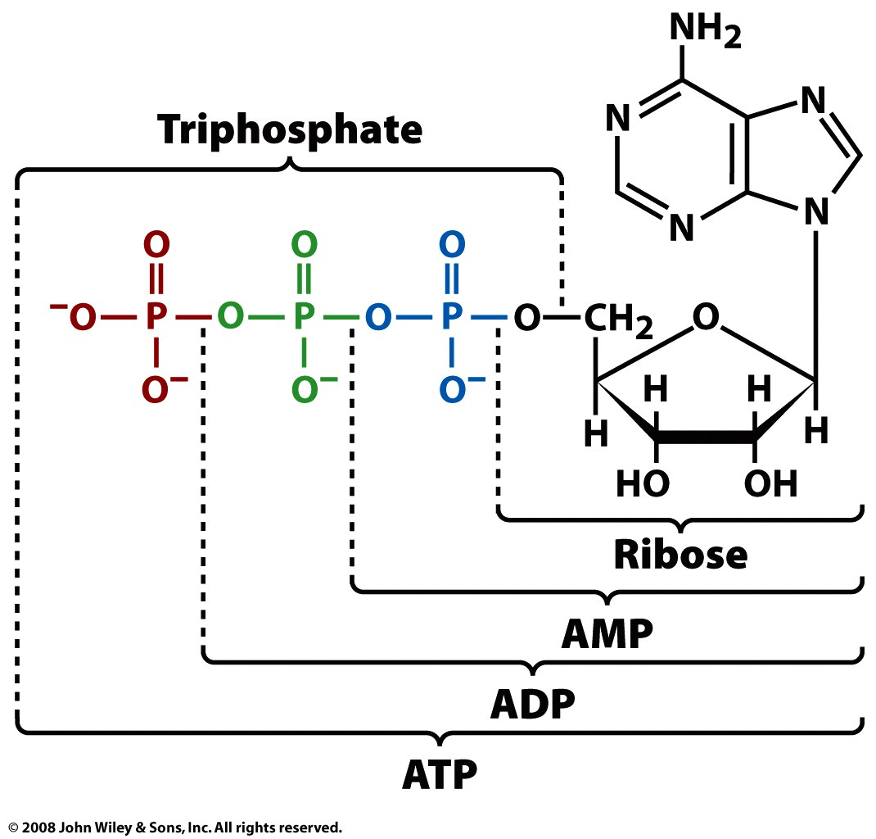
Competitive Inhibition
Product inhibition:
ADP, AMP can competitively inhibit enzymes that
hydrolyze ATP
Page 380

Slide 42
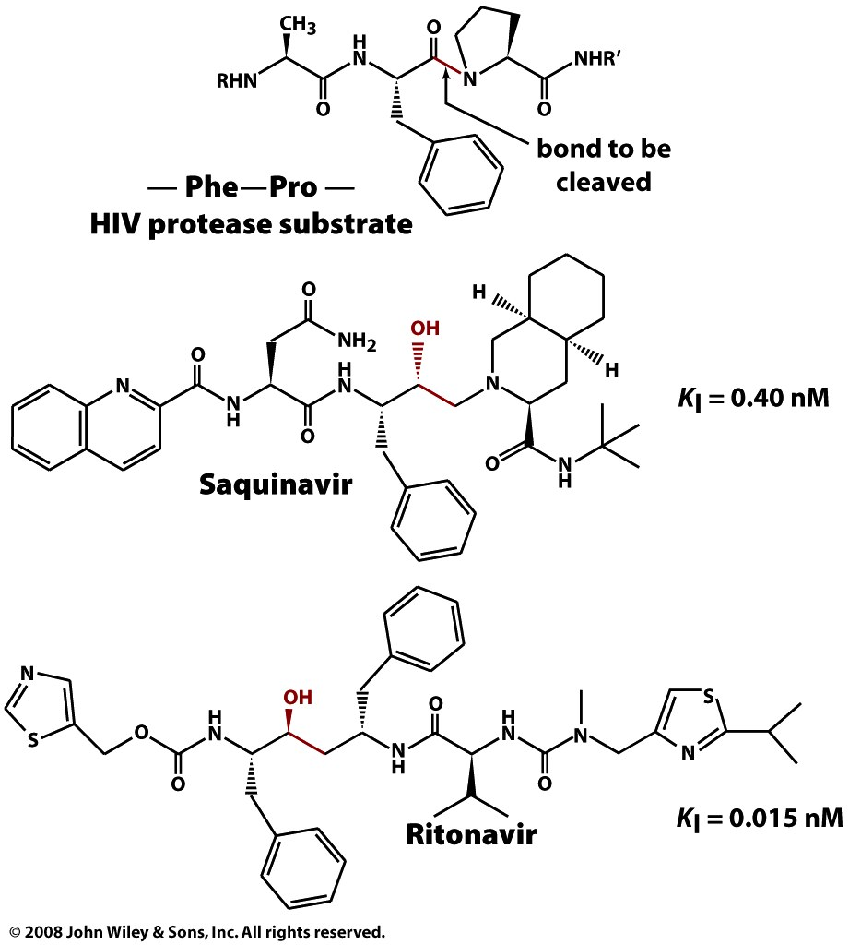
Competitive Inhibition
Box 12-4c

Slide 43
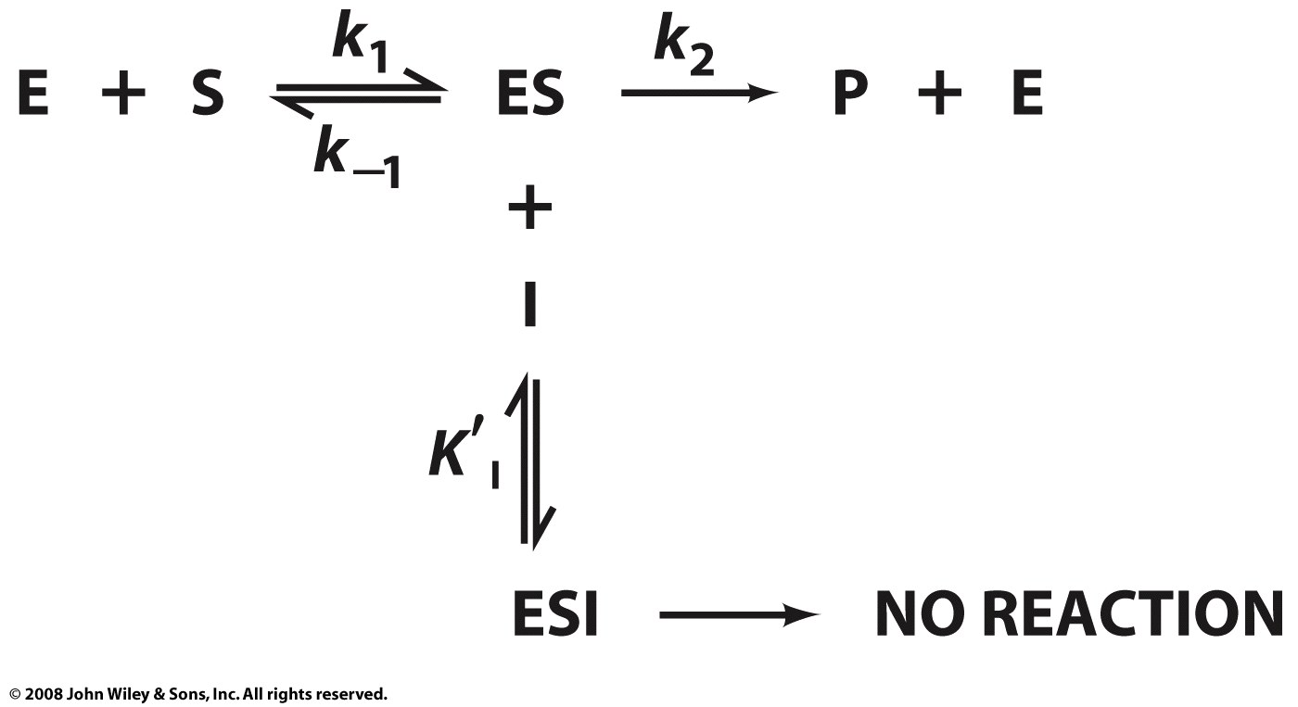
Uncompetitive Inhibition
Page 381

Slide 44
Uncompetitive Inhibition

Slide 45
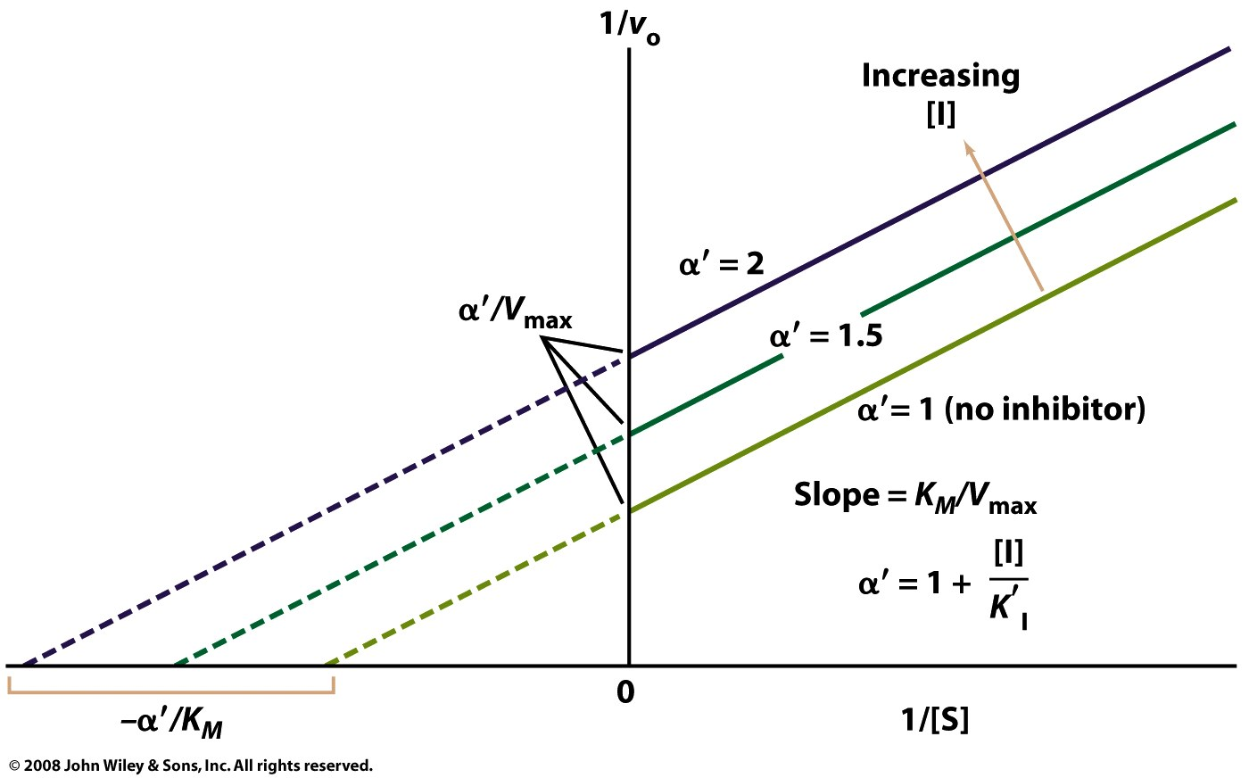
Uncompetitive Inhibition
Figure 12-8

Slide 46
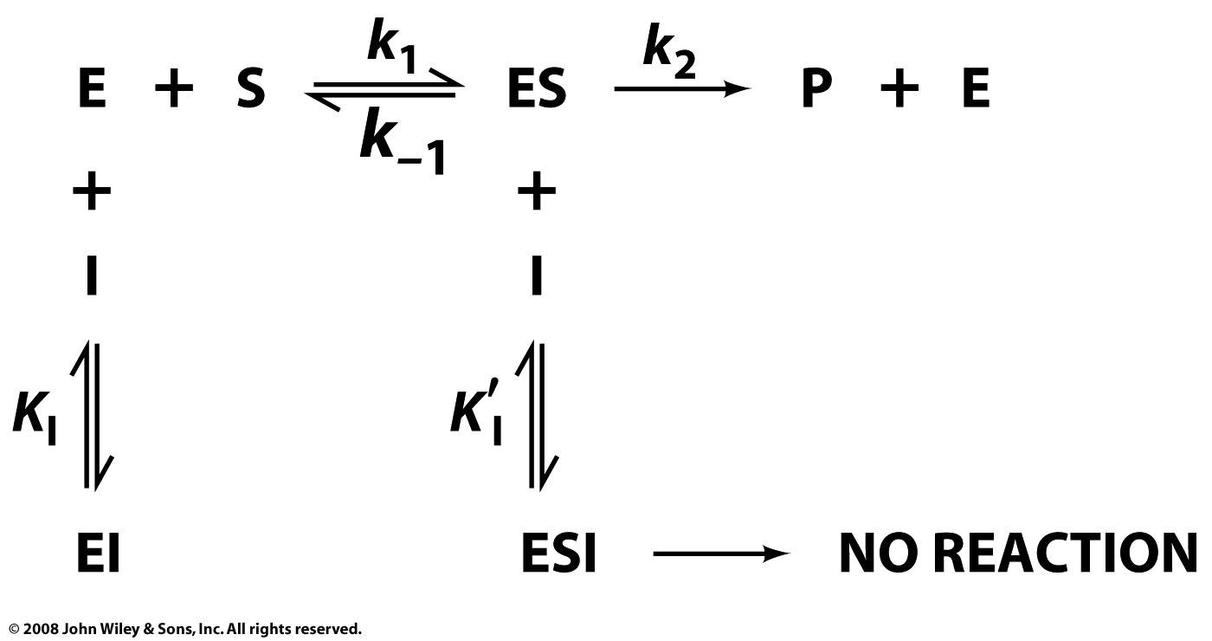
Mixed (competitive and uncompetitive) Inhibition
Page 382

Slide 47
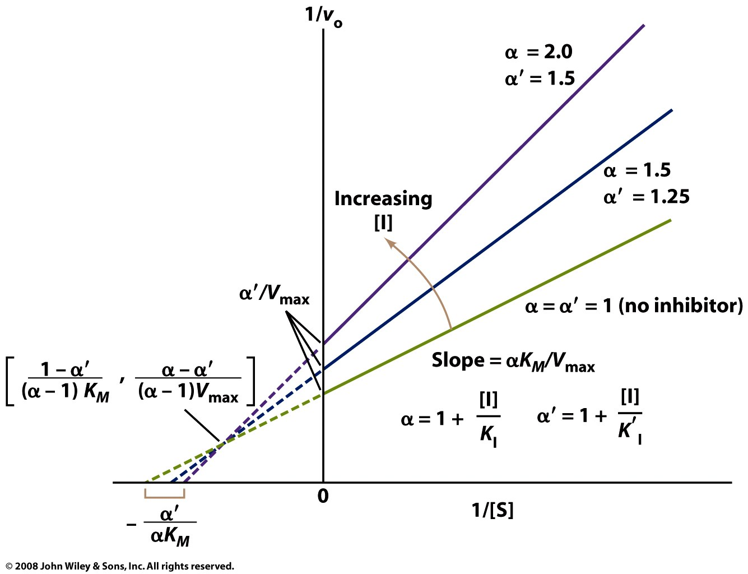
Mixed (competitive and uncompetitive) Inhibition
Figure 12-9

Slide 48
Table 12-2

Slide 49
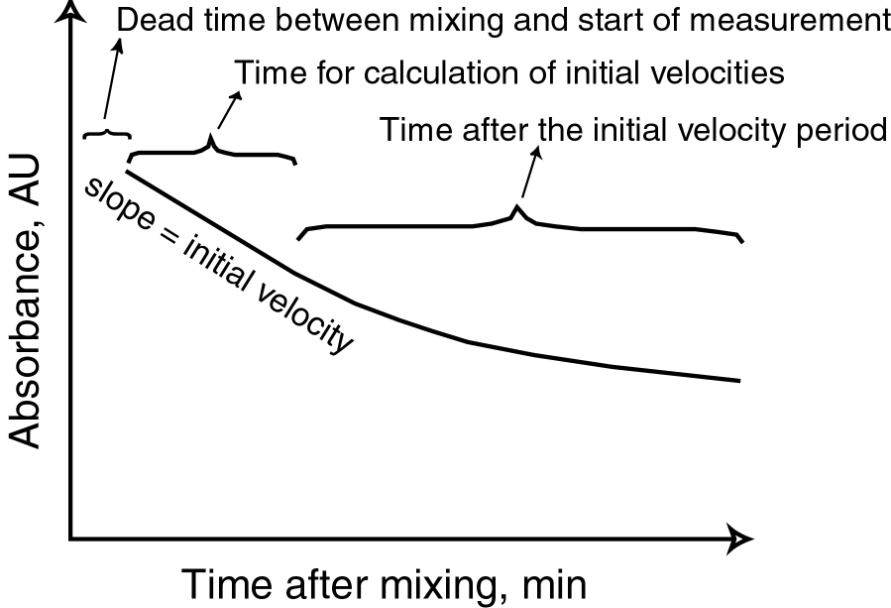
How MM kinetic measurements are made
*
*

Slide 50
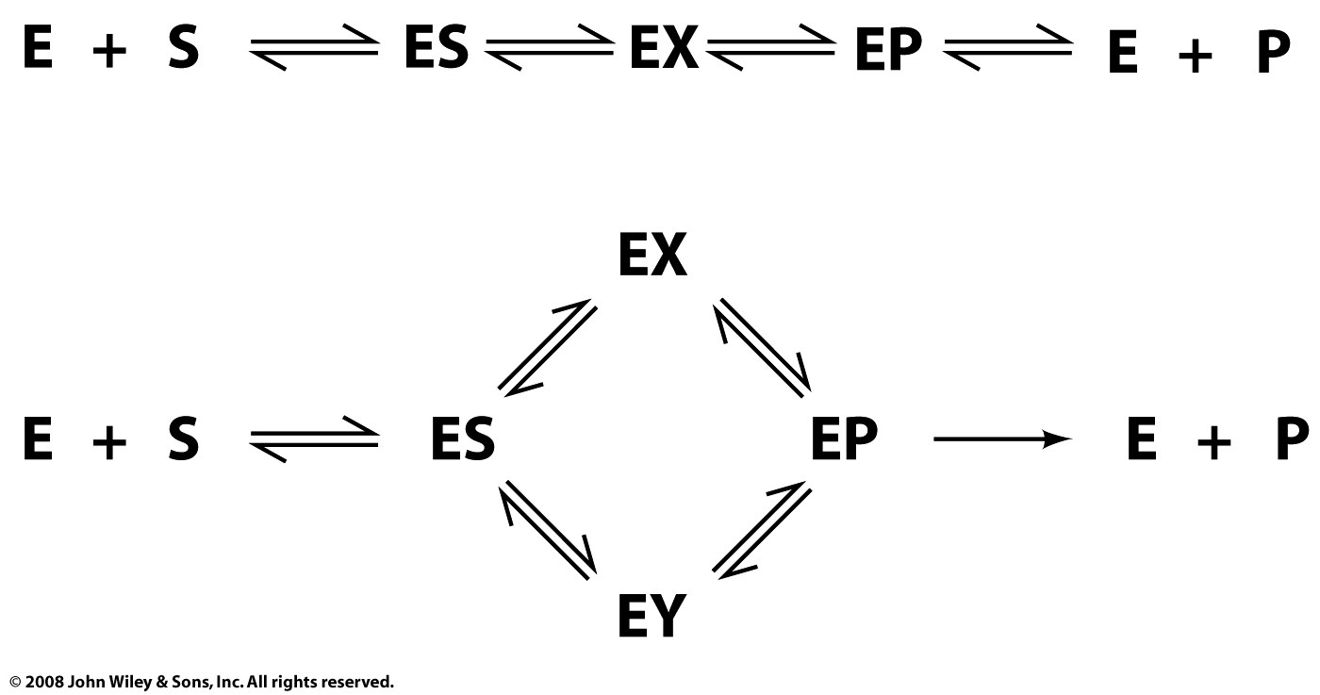
Real enzyme mechanisms
Page 374

Slide 51
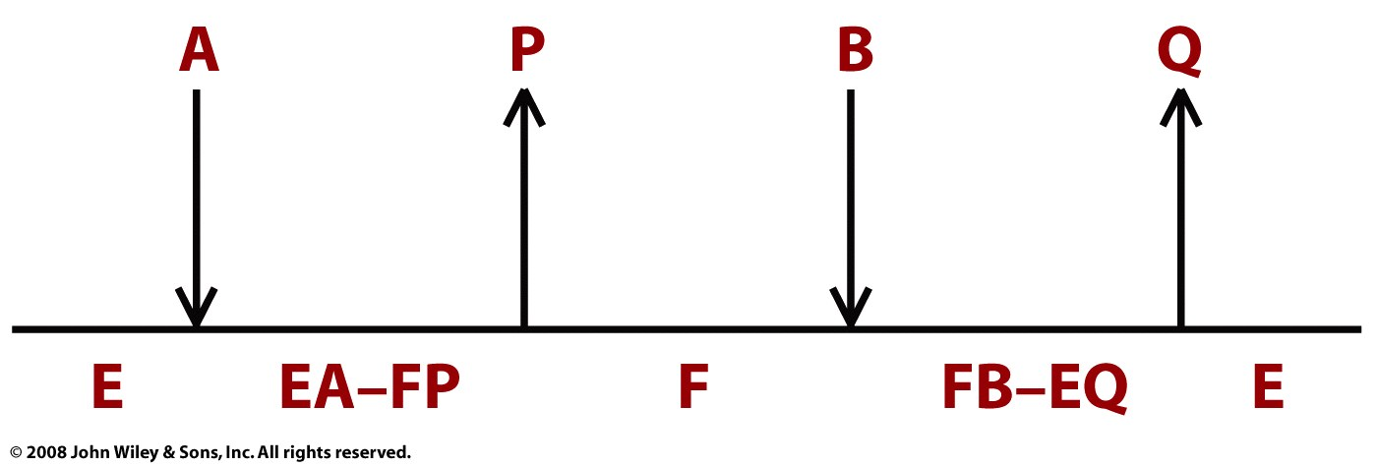
Bisubstrate Ping Pong:
Trypsin:
A = polypeptide
B = water
P = amino terminus
Q = carboxy terminus
Page 376

Slide 52
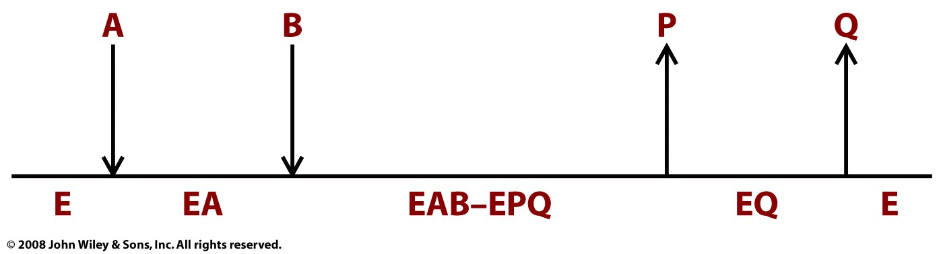
Other possibilities
Page 376

Slide 53
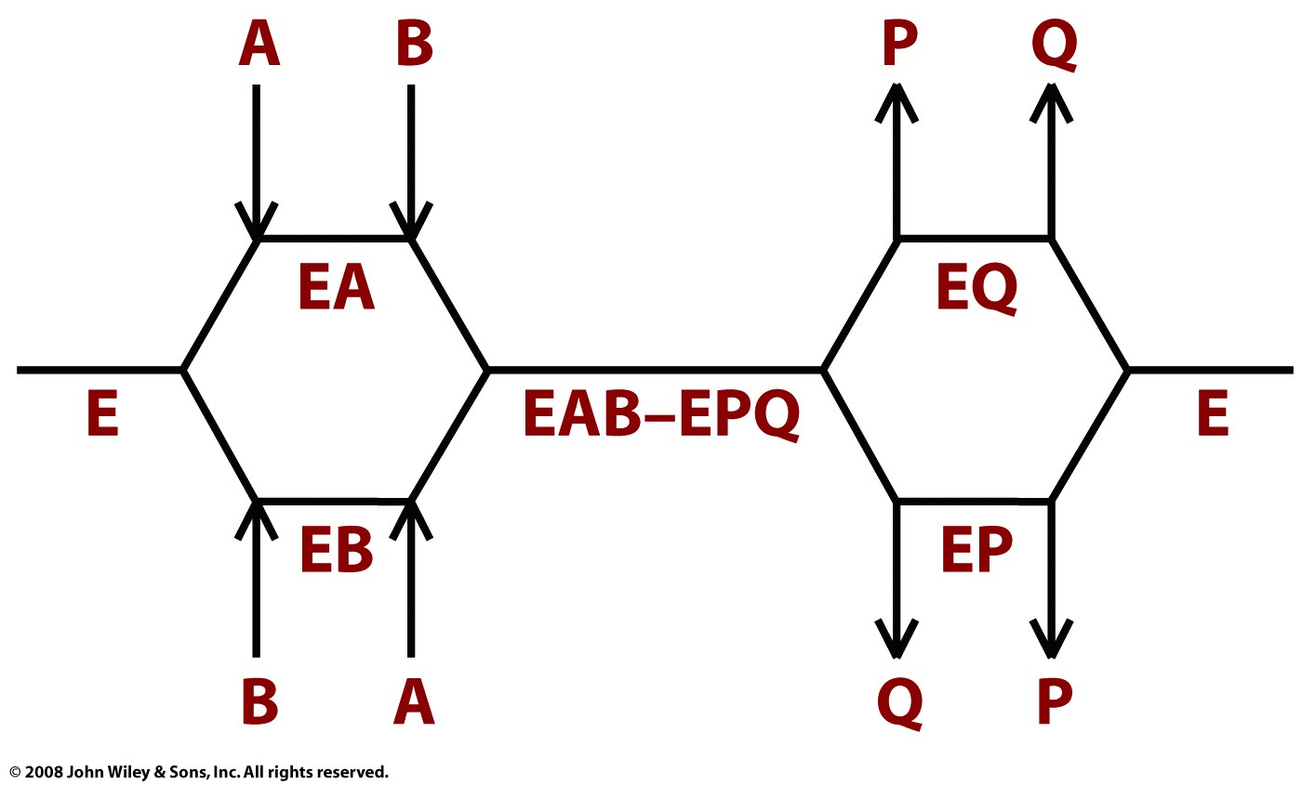
Page 376

Slide 54
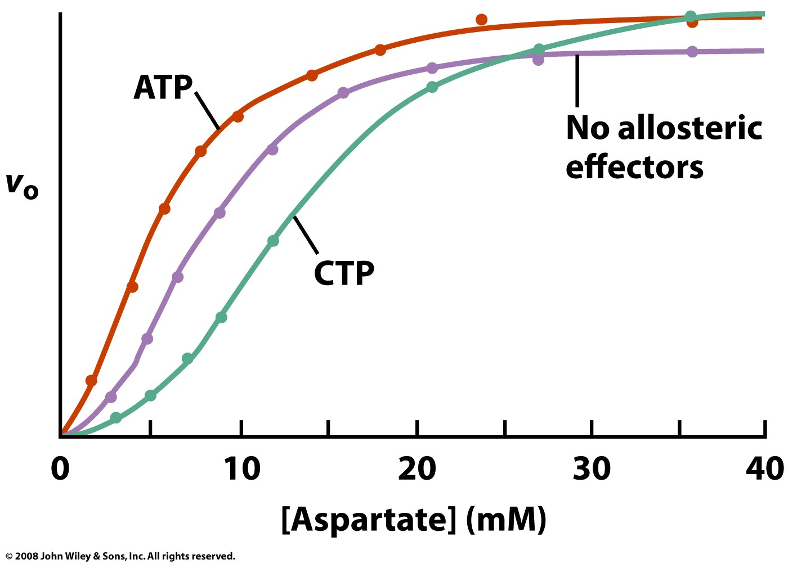
Not covered
Figure 12-10

Slide 55
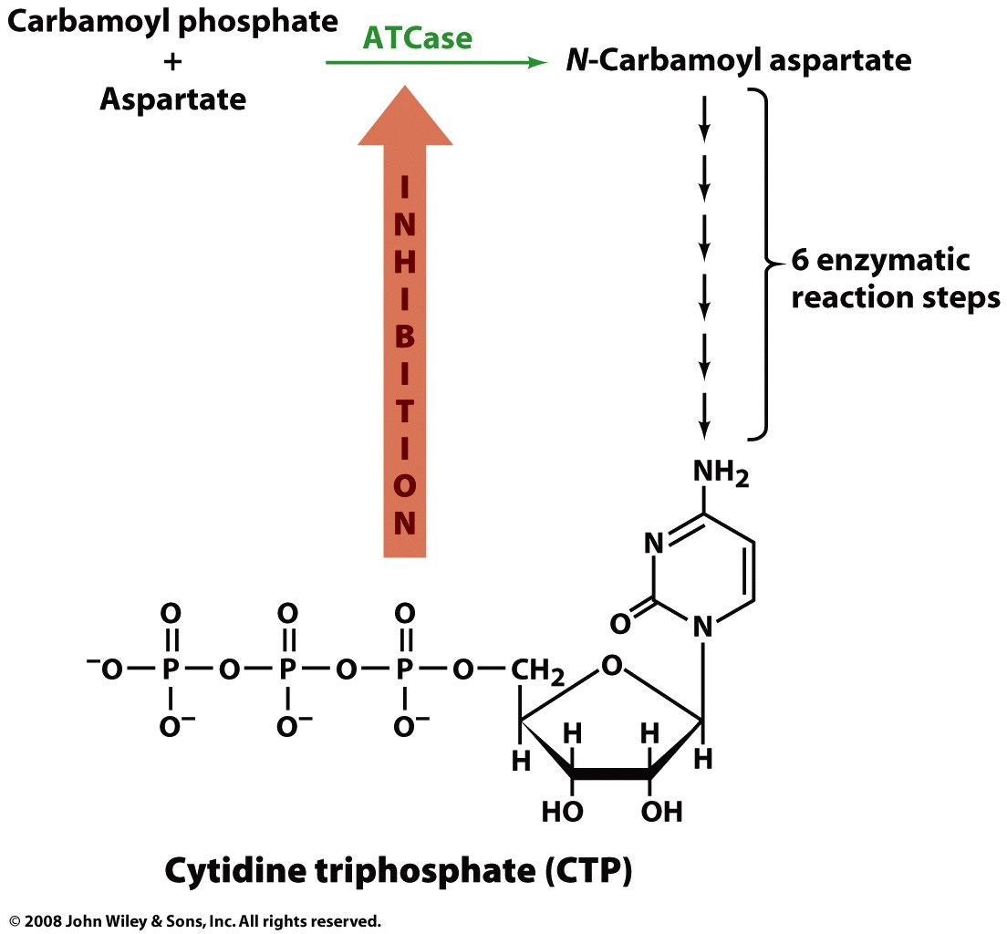
Not covered
Figure 12-11

Slide 56
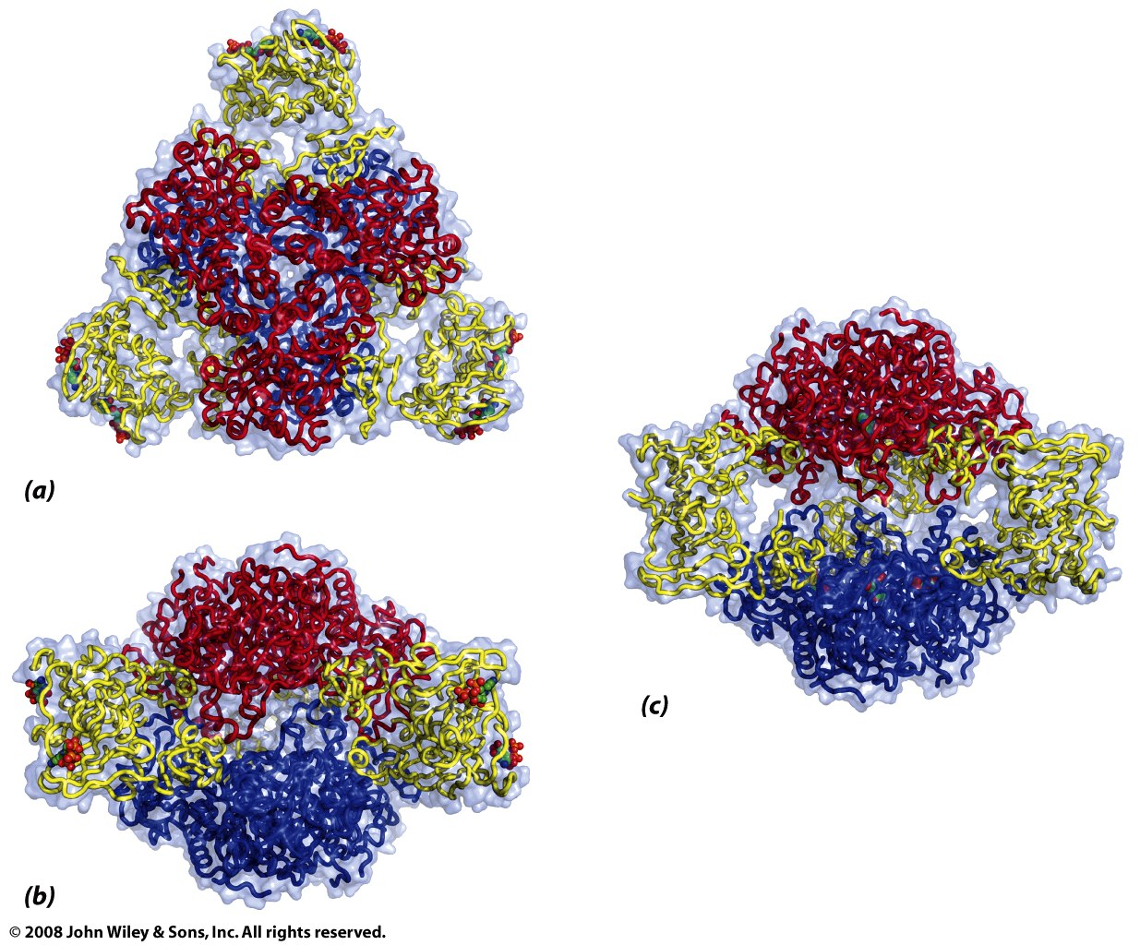
Not covered
Figure 12-12

Slide 57
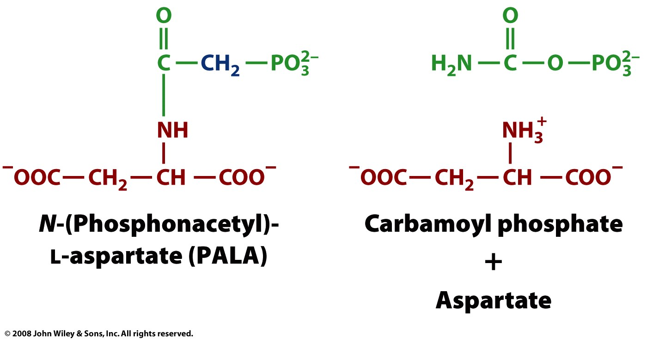
Not covered
Page 388

Slide 58
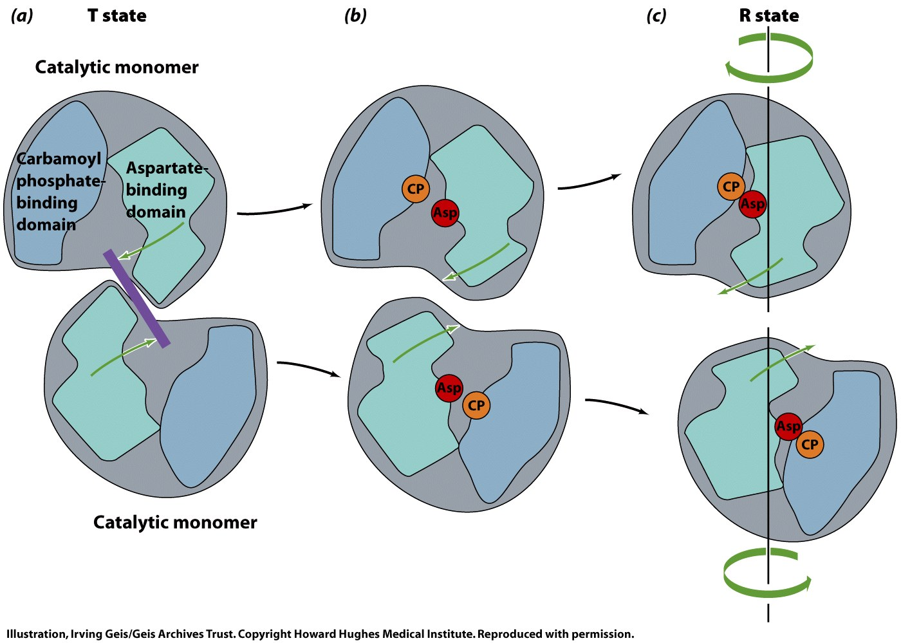
Not covered
Figure 12-13

Slide 59
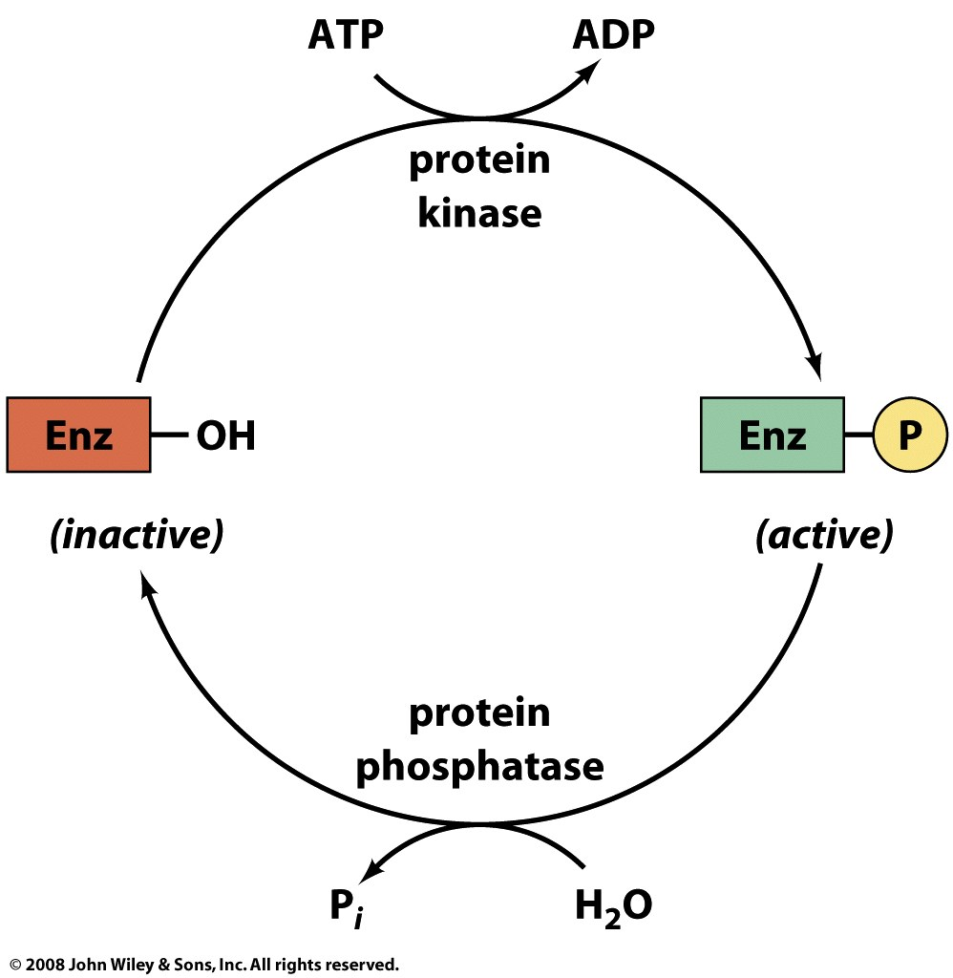
Not covered
Page 390

Slide 60
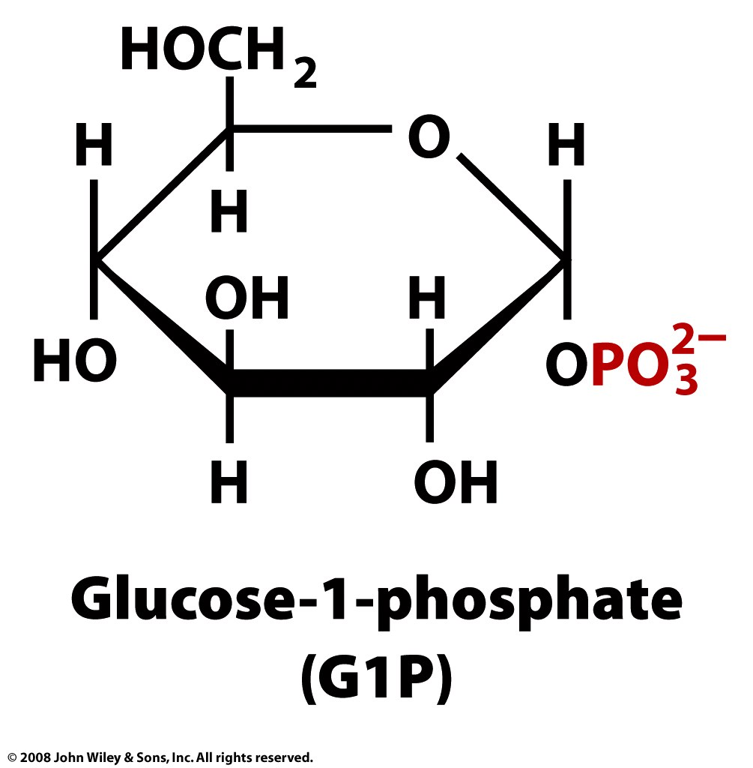
Not covered
Page 391

Slide 61
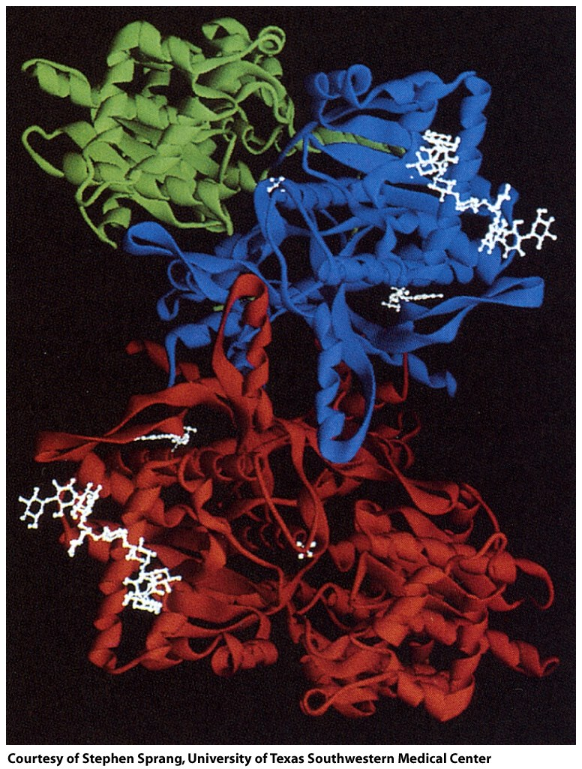
Not covered
Figure 12-14a

Slide 62
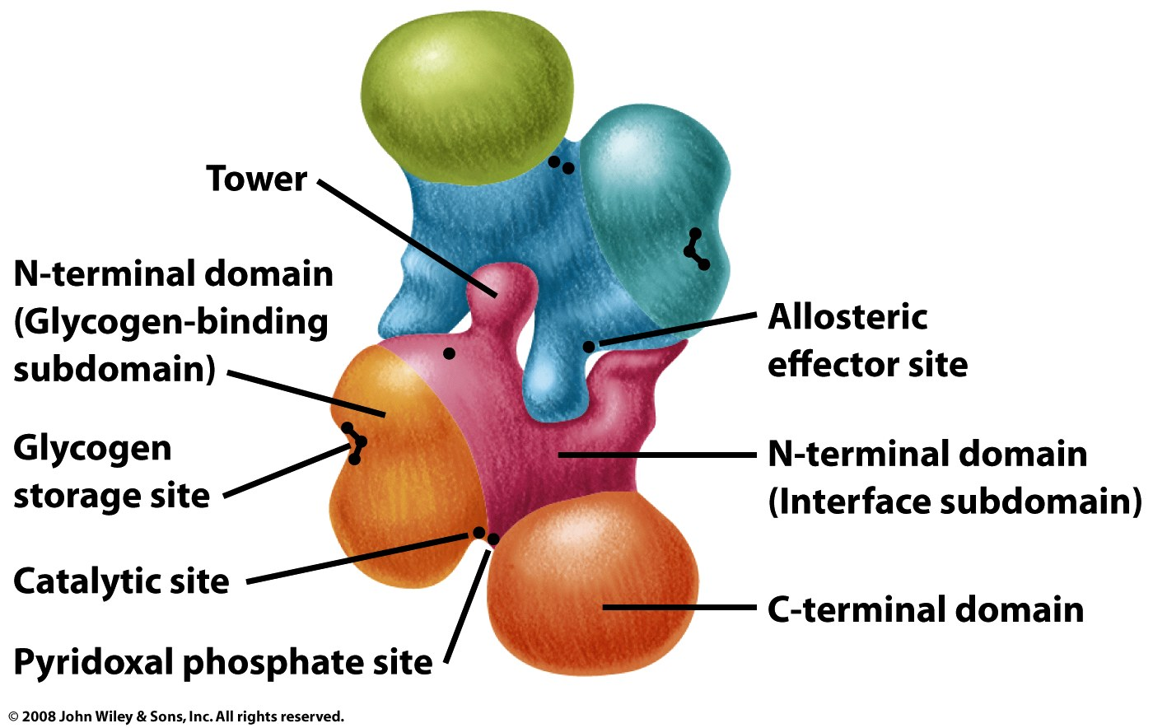
Not covered
Figure 12-14b

Slide 63
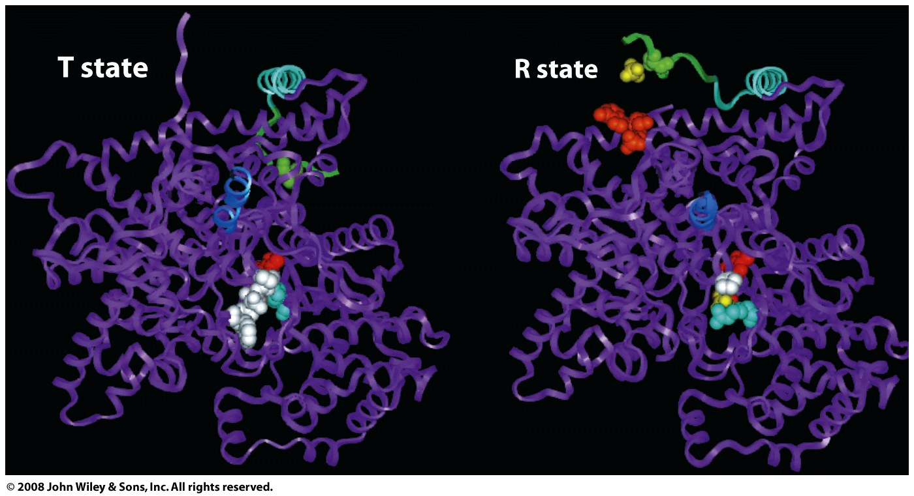
Not covered
Figure 12-15

Slide 64
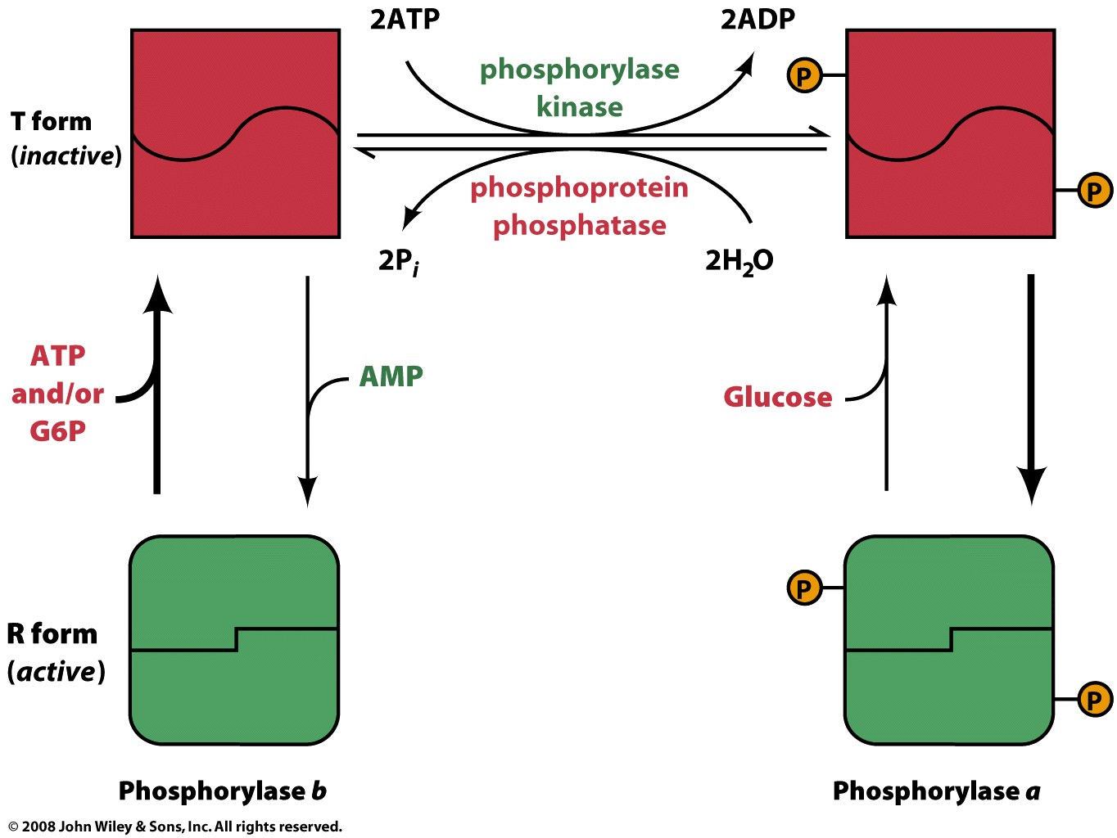
Not covered
Figure 12-16

Slide 65
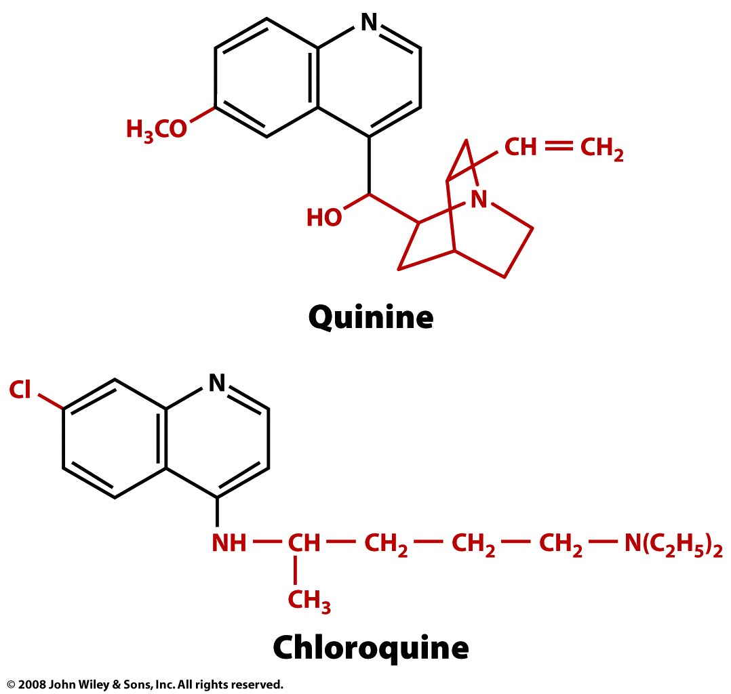
Not covered
Figure 12-17

Slide 66
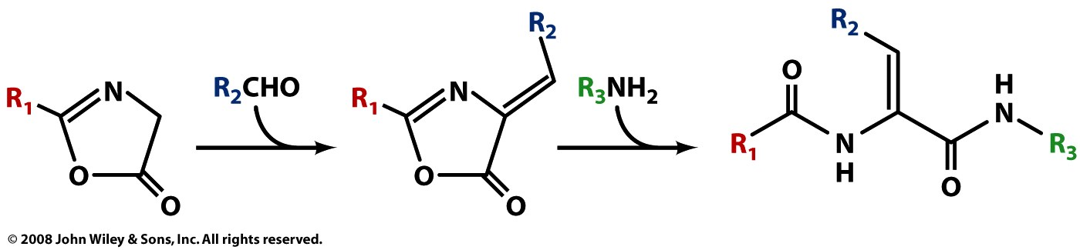
Not covered
Figure 12-18

Slide 67
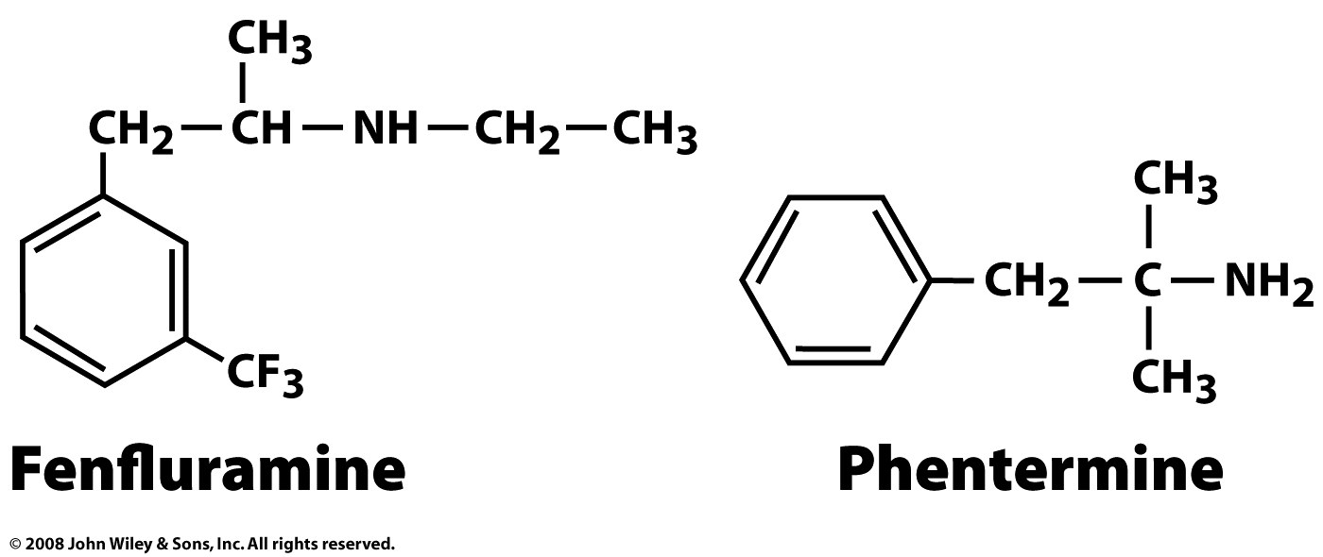
Not covered
Page 397

Slide 68
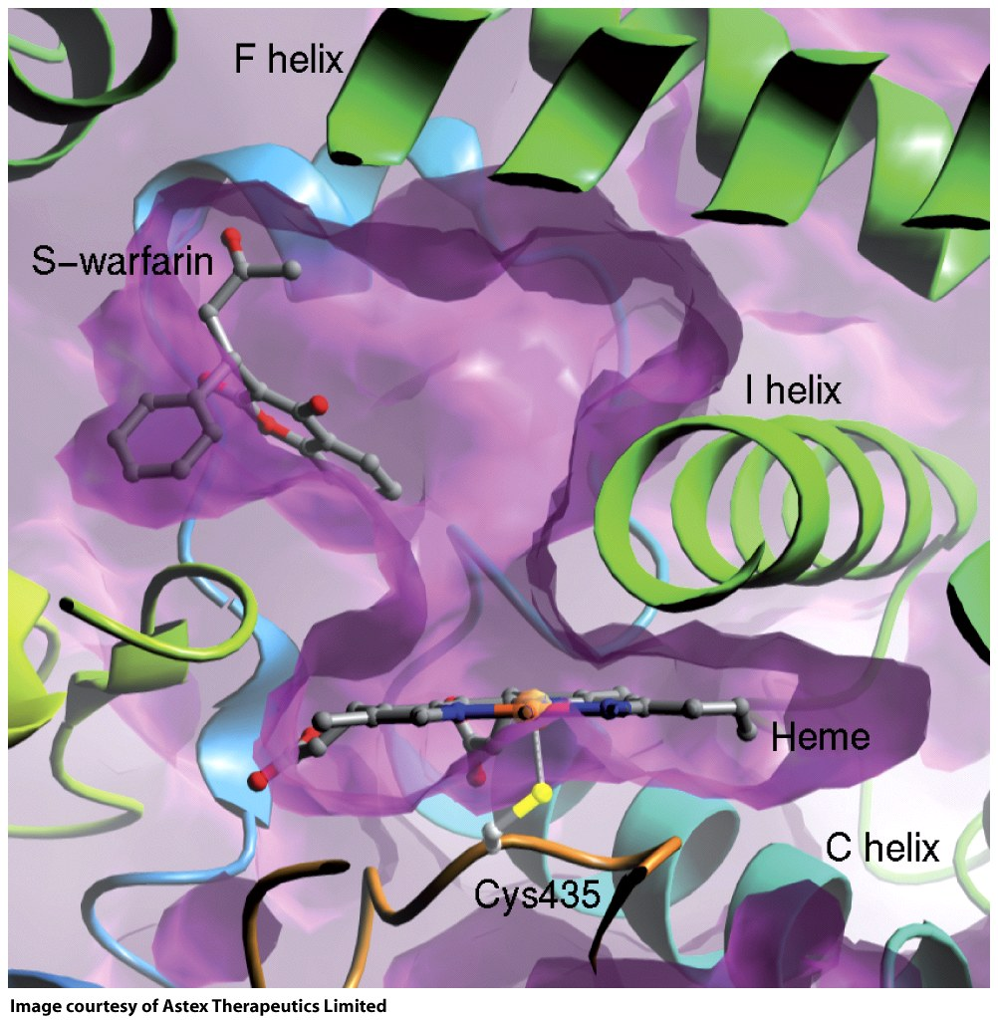
Not covered
Figure 12-19

Slide 69
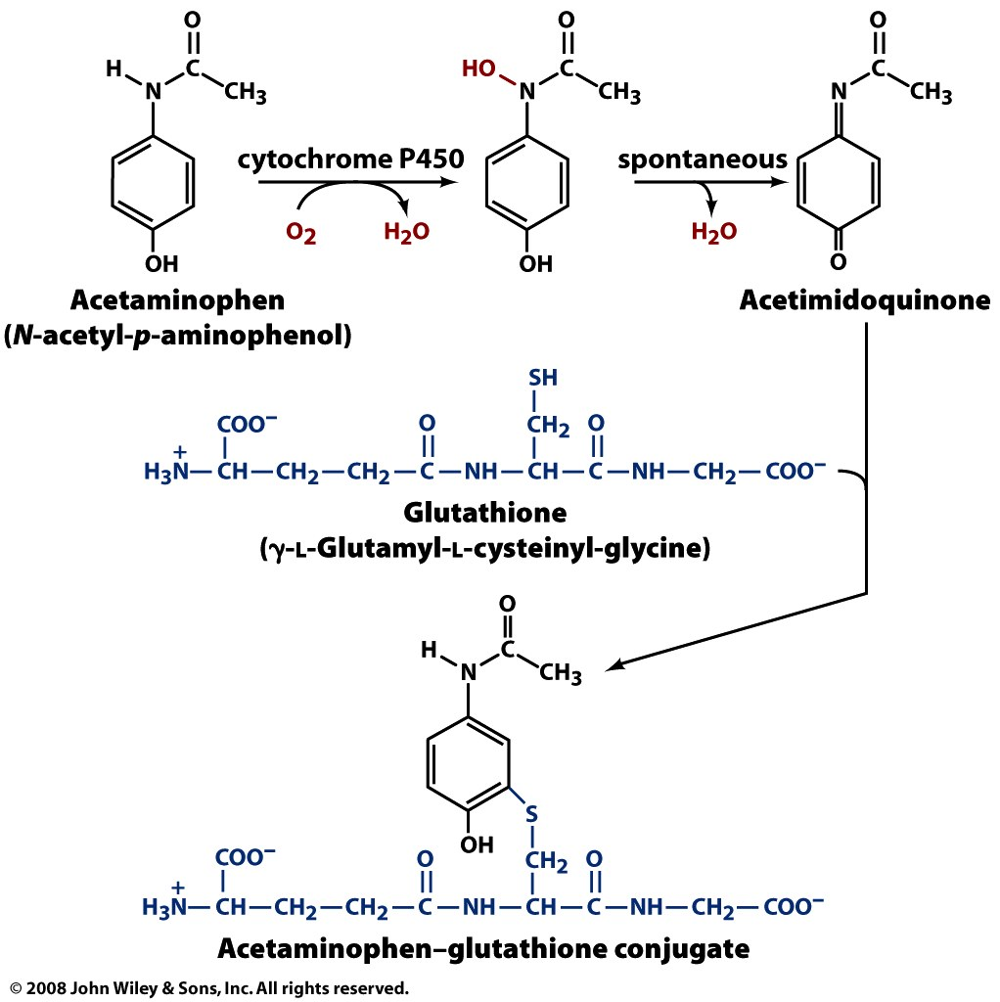
Not covered
Figure 12-20

