Slide 1
Motor Proteins and Translocases
Functions
muscle contraction,
cytokinesis,
chromosomal movements,
membrane trafficking,
organelle movements,
cellular migration,
translocation of DNA or protein substrates

Slide 2
Motor Proteins (continued)
Mechano-chemical coupling of ATP (sometimes GTP) hydrolysis and conformational changes
Some walk on cytoskeletal tracks
actin filaments
microtubules
Three superfamilies of motor proteins
Myosin (moves on actin filaments)
Kinesin (moves toward the plus end of microtubules toward cell surface, common ancestor with Myosin)
Dynein (moves toward the minus end of microtubules, toward cell interior)
Actin filaments
G-actin (monomer)
F-actin (assembled in microfilament)
dynamic and rapid remodeling
Microtububules
Tubulin filaments
- ends at centromere
+ ends near cell surface

Slide 3
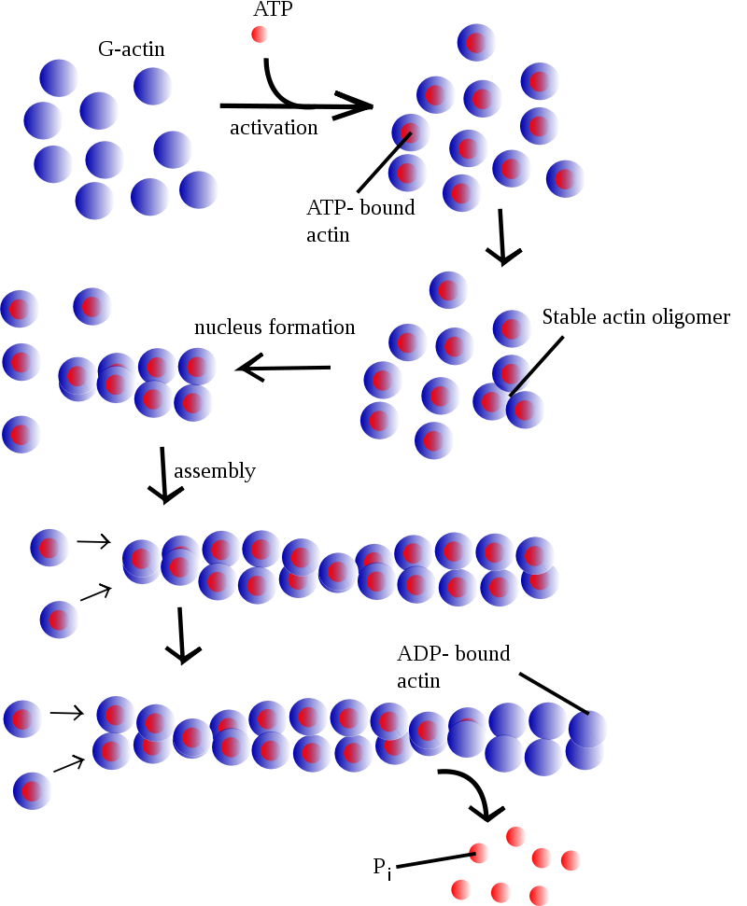

Slide 4
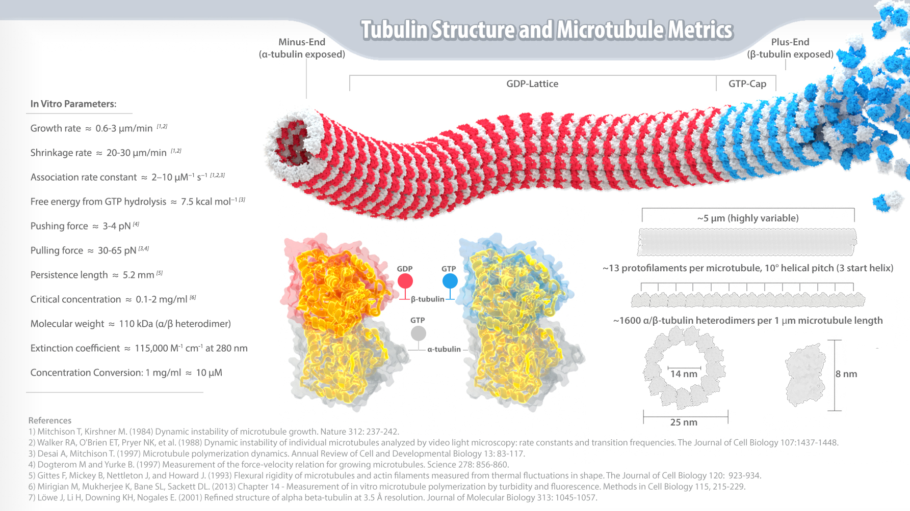

Slide 5
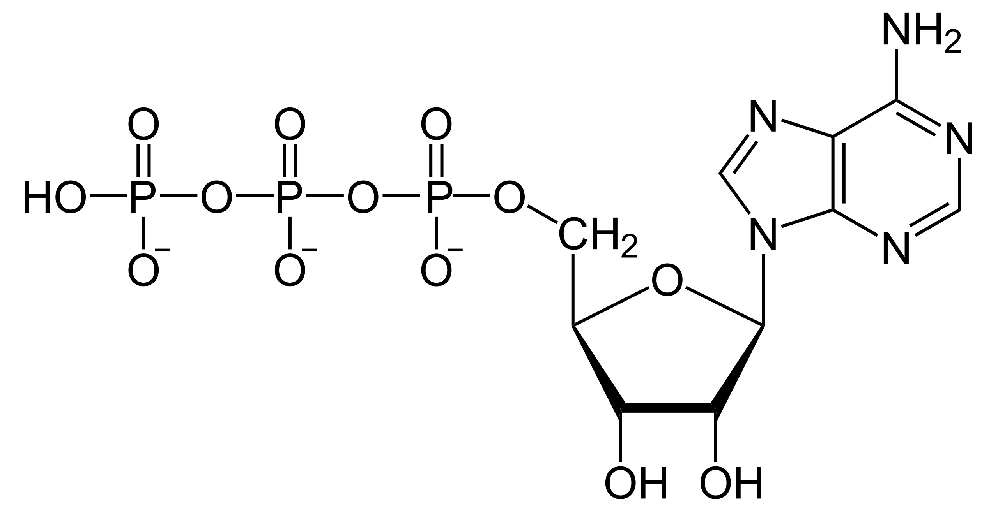
Energy Currency
Adenosine triphosphate (ATP , less commonly GTP)
a nucleotide triphosphate,
nitrogenous base (adenine, less commonly guanine),
a ribose sugar,
three serially bonded phosphates (α,β,γ)

Slide 6
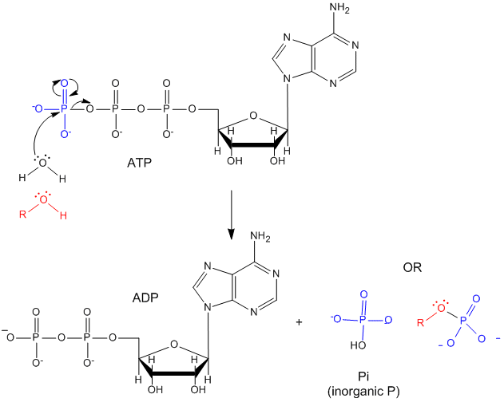

Slide 7
Energy Currency
ADP + Pi condensation to form ATP is driven by catabolic mechanisms, including respiration (releases energy from glucose), beta-oxidation (releases energy from fat), and ketosis (releases energy from fat, under carbohydrate restriction).
The spontaneous hydrolysis of ATP is used to drive non-spontaeous processes.
ATP is hydrolyzed by
anabolism (protein synthesis, etc),
ion transport,
muscle contraction,
nerve impulse propagation,
substrate phosphorylation,
RNA synthesis (NTPs are hydrolyzed)
and anabolism.

Slide 8
Energy Currency
You consume (and synthesize) around 2x your body weight every day.
[ATP] in vivo is around 2-5 mM
ATP/ADP = 1000
ATP is a hydrotrope
  i.e., an amphipath that solubilizes hydrophobic compounds but cannot form micelles or membranes

Slide 9
Motors
Bind ATP
Hydrolyze ATP
Release Phosphate
Release ADP
Repeat

Slide 10
Myosin

Slide 11
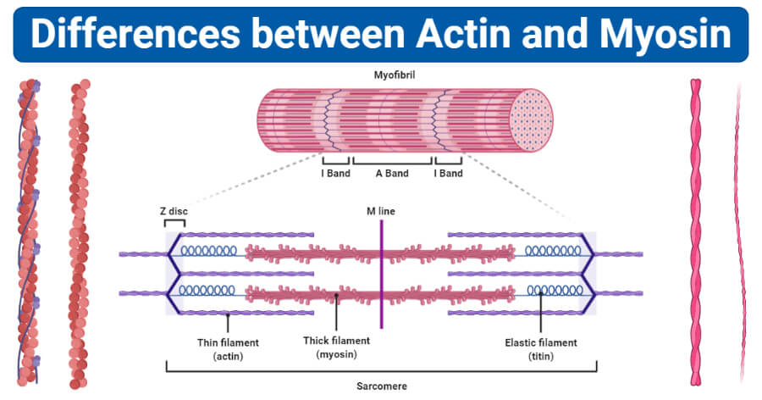
Myosin

Slide 12
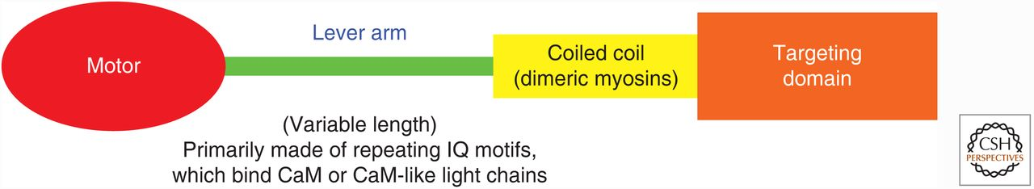
Domain structure myosin
Domain structure of the myosin superfamily; conserved motor domain and divergence in other domains that mediate movement amplification, self-association, and cargo binding.
H. Lee Sweeney, and Erika L.F. Holzbaur Cold Spring Harb Perspect Biol 2018;10:a021931
©2018 by Cold Spring Harbor Laboratory Press
Notes:
Domain structure of members of the myosin superfamily of proteins. This blueprint of the myosins shows the conserved motor domain and the divergence in other domains that mediate movement amplification, self-association, and cargo binding. CaM, calmodulin; IQ, isoleucine glutamine.

Slide 13
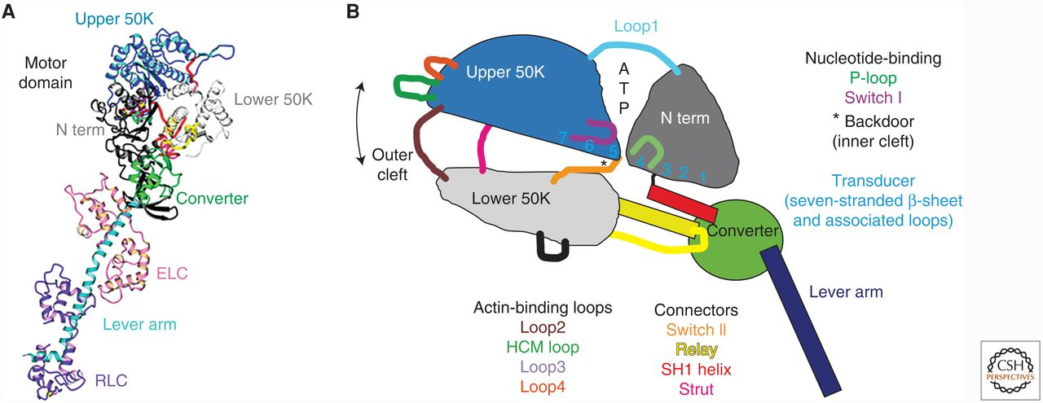
Structure of the myosin motor.
Myosin subdomains move relative to each other as rigid bodies
The converter subdomain is flexible and amplifies the movements of the SH1 helix and relay them into large movements of the lever arm.
Double-headed arrow indicates closure of the cleft between the upper and lower 50K subdomains upon actin binding, which results in a strong binding to actin and loss of P_{i} then ADP.
Rebinding of ATP following the dissociation of ADP reopens this cleft, causing myosin to dissociate from actin.
N term, amino terminal; ELC, essential light chain; 50K, 50-kDa subdomain; RLC, regulatory light chain.
H. Lee Sweeney, and Erika L.F. Holzbaur Cold Spring Harb Perspect Biol 2018;10:a021931
Notes:
Structure of the myosin motor. (A) Ribbon diagram of the first myosin state (ATP state) for which there was a high-resolution crystal structure (Rayment et al. 1993). The structure represents the S1 fragment of skeletal muscle myosin II, which precedes the coiled coil. In different colors are the major subdomains of the motor and the myosin lever arm with its associated light chains. (B) Diagrammatic interpretation of the subdomains that move relative to each other as relatively rigid bodies as myosin undergoes state transitions during its ATPase cycle. The converter subdomain is the most flexible and mobile of the subdomains and amplifies the movements of the SH1 helix and relay into large movements of the lever arm, of which it is the most proximal component. The color-coded loops and connectors are individually identified at the bottom of the figure. The double-headed arrow indicates closure of the cleft between the upper and lower 50K subdomains that occur on actin binding, which results in a strong binding interface with actin and loss of the ATP hydrolysis products (P_{i} followed by ADP). Rebinding of ATP following the dissociation of ADP reopens this cleft, causing myosin to dissociate from actin. N term, amino terminal; ELC, essential light chain; 50K, 50-kDa subdomain; RLC, regulatory light chain.

Slide 14
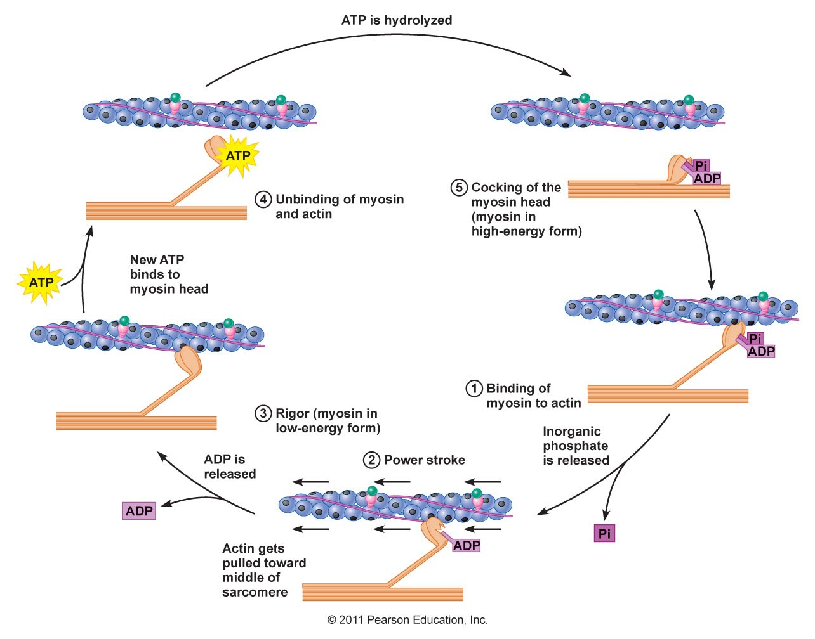
Notes:
Structure of the myosin motor. (A) Ribbon diagram of the first myosin state (ATP state) for which there was a high-resolution crystal structure (Rayment et al. 1993). The structure represents the S1 fragment of skeletal muscle myosin II, which precedes the coiled coil. In different colors are the major subdomains of the motor and the myosin lever arm with its associated light chains. (B) Diagrammatic interpretation of the subdomains that move relative to each other as relatively rigid bodies as myosin undergoes state transitions during its ATPase cycle. The converter subdomain is the most flexible and mobile of the subdomains and amplifies the movements of the SH1 helix and relay into large movements of the lever arm, of which it is the most proximal component. The color-coded loops and connectors are individually identified at the bottom of the figure. The double-headed arrow indicates closure of the cleft between the upper and lower 50K subdomains that occur on actin binding, which results in a strong binding interface with actin and loss of the ATP hydrolysis products (P_{i} followed by ADP). Rebinding of ATP following the dissociation of ADP reopens this cleft, causing myosin to dissociate from actin. N term, amino terminal; ELC, essential light chain; 50K, 50-kDa subdomain; RLC, regulatory light chain.

Slide 15
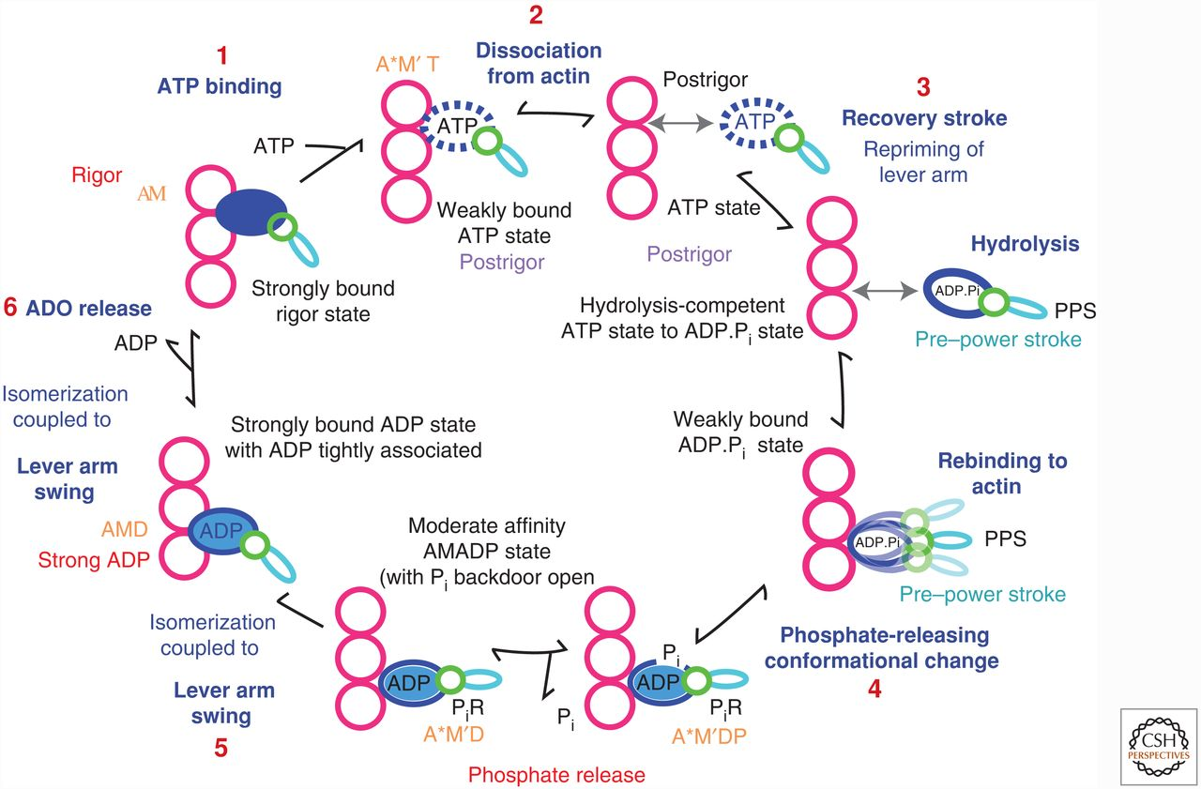
H. Lee Sweeney, and Erika L.F. Holzbaur Cold Spring Harb Perspect Biol 2018;10:a021931
Notes:
Myosin ATPase cycle on actin. The myosin states that bind weakly to actin and, thus, do not bear load or generate force and movement, are shown as noncolored. The myosin states that bind strongly to actin and generate force and movement are colored in shades of blue, becoming darker as the binding affinity increases. The binding of ATP to the rigor state (1) terminates the power stroke by causing myosin to dissociate from actin, forming the postrigor (PR) state (2). The repriming of the lever arm, known as the recovery stroke (3), occurs when myosin dissociated from actin in the PR state (or ATP state) undergoes an isomerization and hydrolyzes ATP to form the pre–power stroke state (PPS). Once the ATP is hydrolyzed, weak binding of the PPS myosin to actin can trigger a transition to the phosphate release (P_{i}R) state (4), which likely involves some movement of the lever arm and formation of higher-affinity, stereo-specific binding to actin. Release of phosphate then drives the reaction forward (essentially unidirectional) with a large movement of the lever arm to form the strong ADP state (5). A further isomerization of the motor leads to the release of phosphate and is coupled to a further movement of the lever arm, completing the myosin power stroke on actin (6).

Slide 17
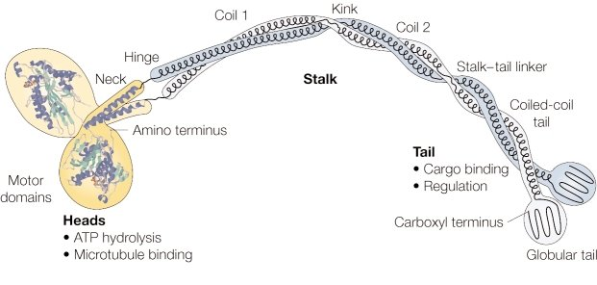
Domain organization of the conventional kinesin heavy-chain dimer, showing the crystal structure of the catalytic domains and the neck. The structure of the stalk and tail are inferred from electron microscopic images and coiled-coil prediction analyses. Regions predicted to form coiled-coils (neck, coil 1, coil 2, coiled-coil tail) and flexible regions (hinge, kink, stalk-tail linker) are indicated. Image from Günther Woehlke

Slide 18
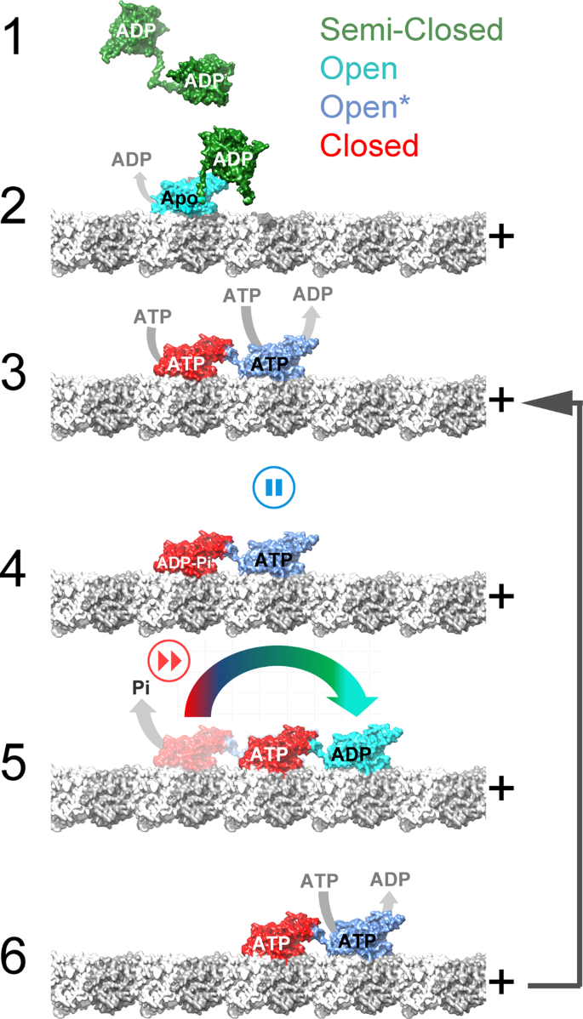
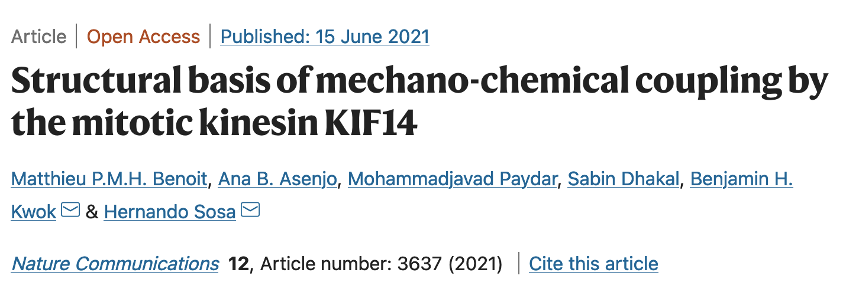
State 1. microtubule-unbound semi-closed, ADP-unbound conformation
State 2. One head is bound to the microtuble. ADP has been released, the ATP binding pocket is open. The second head remains in microtubule-unbound semi-closed, ATP-unbound. Both neck-linkers are undocked preventing the second head from binding to the next tubulin site.
State 3. A two-head microtubule-bound intermediate. First head (red); ATP binding induces closure of the nucleotide-binding pocket and neck-linker docking. The docked neck-linker positions the second head (blue). The second head binds to the microtubule with its neck-linker undocked and pulled backward by the microtubule-bound trailing head. The undocked neck-linker in the second head prevents it from adopting the closed catalytic conformation pausing hydrolysis until the first head releases from the microtubule. ATP hydrolysis is then favored in the neck-linker docked first head but not in the second head.
State 4. Inter-head tension causes partial undocking of the trailing head neck-linker accelerating detachment of the trailing head
State 5 A one-head-bound intermediate. In the one-head-bound intermediate, the neck-linker of the ATP-bound leading head docks and places the tethered head forward toward the plus end.
State 6. The two motor heads change leading and trailing positions and the now microtubule-bound leading head in the open configuration releases ADP and binds ATP (state 6). State 6 is similar to 3 but with the two heads exchanging leading and trailing positions and the whole molecule is displaced 8 nm in the plus direction
The major KIF14 motor domain conformations determined, semi-closed, open, open*, and closed (Table 2) are colored green, cyan blue, and red, respectively. α- and β-tubulin are colored light and dark gray, and the microtubule protofilaments are oriented with the plus end to the right.
State 1. microtubule-unbound semi-closed, ADP-unbound conformation
State 2. One head bound. One motor domain is bound to the microtuble, ADP has been released, the ATP binding pocket is open. The second motor domain remains in the microtubule-unbound semi-closed, ADP-unbound conformation. Both neck-linkers are undocked preventing the tethered motor domain from binding to the next tubulin site.
Opening of the nucleotide pocket in the microtubule-bound head induces ADP release and allows ATP binding.
State 3. A two-head microtubule-bound intermediate. ATP binding induces closure of the nucleotide-binding pocket and neck-linker docking of the bound head. The docked neck-linker positions the accompanying, tethered head in a leading position (toward the microtubule plus end). The leading head binds to the microtubule with its neck-linker undocked and pulled backward by the microtubule-bound trailing head. The undocked neck-linker in the leading head prevents it from adopting the closed catalytic conformation pausing hydrolysis until the trailing head releases from the microtubule. ATP hydrolysis is then favored in the neck-linker docked trailing head but not in the leading head.
State 4.In this state, inter-head tension caused partial undocking of the trailing head neck-linker accelerating detachment of the trailing head
State 5 A one-head-bound intermediate. In the one-head-bound intermediate, the neck-linker of the ATP-bound leading head docks and places the tethered head forward toward the plus end.
State 6. The two motor heads change leading and trailing positions and the now microtubule-bound leading head in the open configuration releases ADP and binds ATP (state 6). State 6 is similar to 3 but with the two heads exchanging leading and trailing positions and the whole molecule is displaced 8 nm in the plus direction

Slide 19
Kinesins. (Example KIF14) couples ATP hydrolysis and microtubule binding to generation of mechanical work.
There are three major conformations of the motor domain,
Transitions between the three states are governed by microtubule binding, ATP binding, ATP hydrolysis, ADP release and Pi release.
3) the neck-linker controls ATP hydrolysis; an undocked neck-linker prevents the ATP-binding pocket from closing and inhibits ATP hydrolysis;
4) thirteen neck-linker residues are required to assume a stable docked conformation;
5)
6) the two motor domains adopt distinct conformations when bound to the microtubule; and
7) the two-heads-bound-state introduces structural changes in both motor domains of KIF14 dimers.

