Slide 1
Carbohydrates
Compounds with the empirical formula (C H₂O)_{n} where n > 2
Aldehyde or ketone derivatives of polyhydroxyl alcohols
- consist only of carbon, hydrogen, and oxygen,
with a hydrogen:oxygen atom ratio of 2:1
(but can be modified)
monosaccharide: 1 sugar (aldose or ketose)
disaccharide: 2 sugars
oligosaccharide: 3-10 sugars
polysaccharide: >10
suffix -ose: glucose, sucrose (table sugar), lactose (milk), cellulose.
Used for
storage of energy (e.g., starch and glycogen)
structure
coenzymes
nucleic acid backbone
chemical markers (for cell recognition)

Slide 2
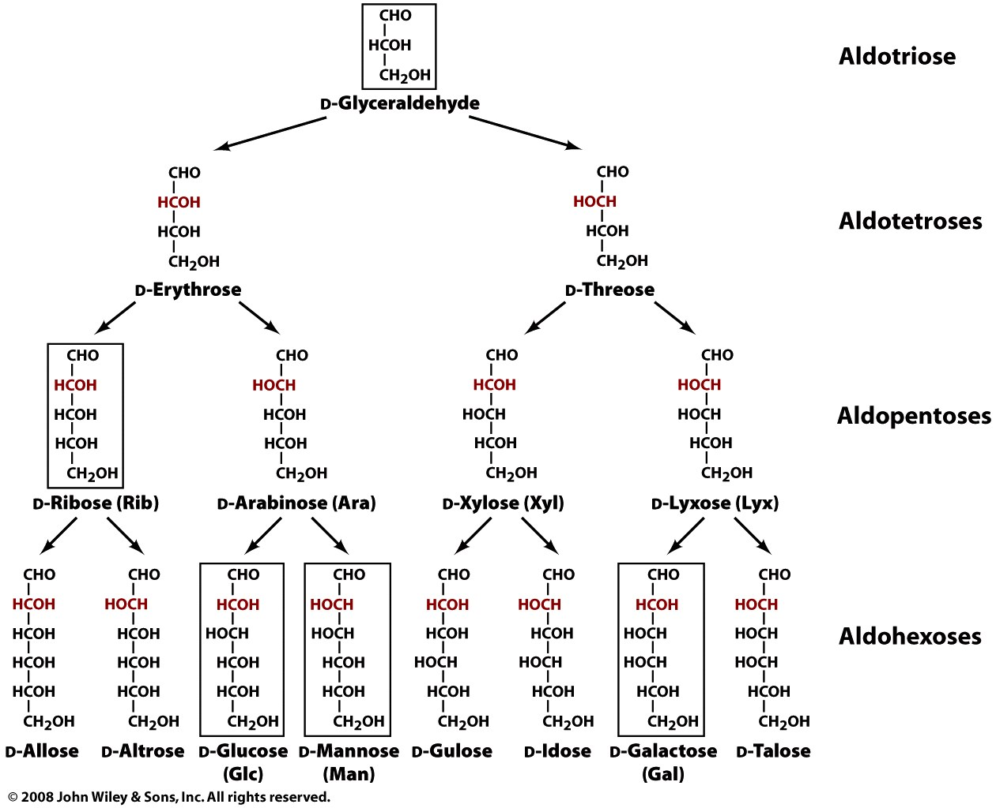
D-aldoses up to 6 carbons
‘linear form’
aka fischer projection

Slide 3
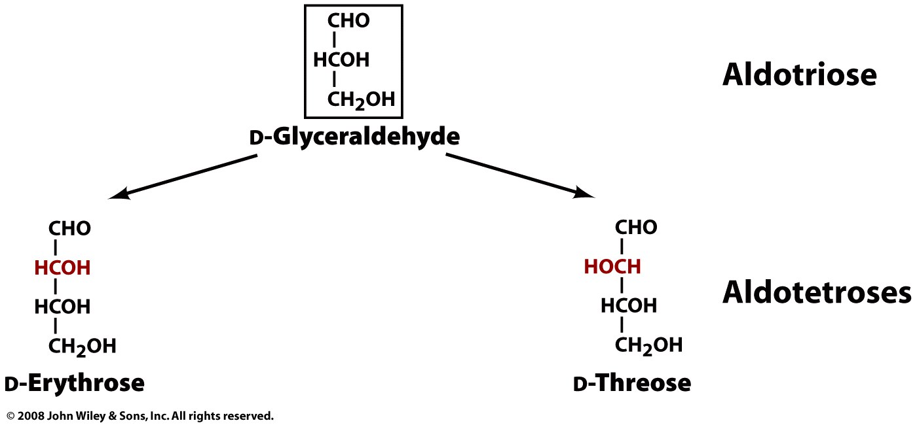
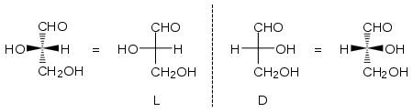
D
Fischer Projection

Slide 4
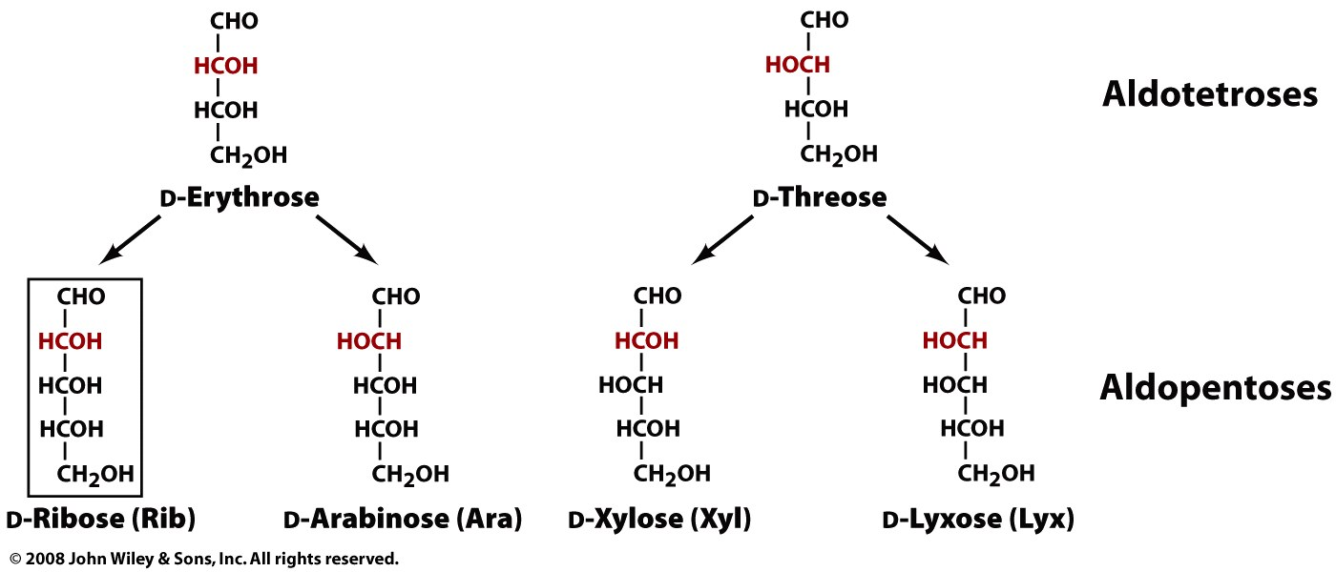
D
For L or D: Look at the the highest numbered chiral carbon (i.e., the chiral C most remote from the CHO). If it is the same sterochemistry as D-glyceraldehyde (i.e., HCOH), then the sugar is in the D-configuration.

Slide 5
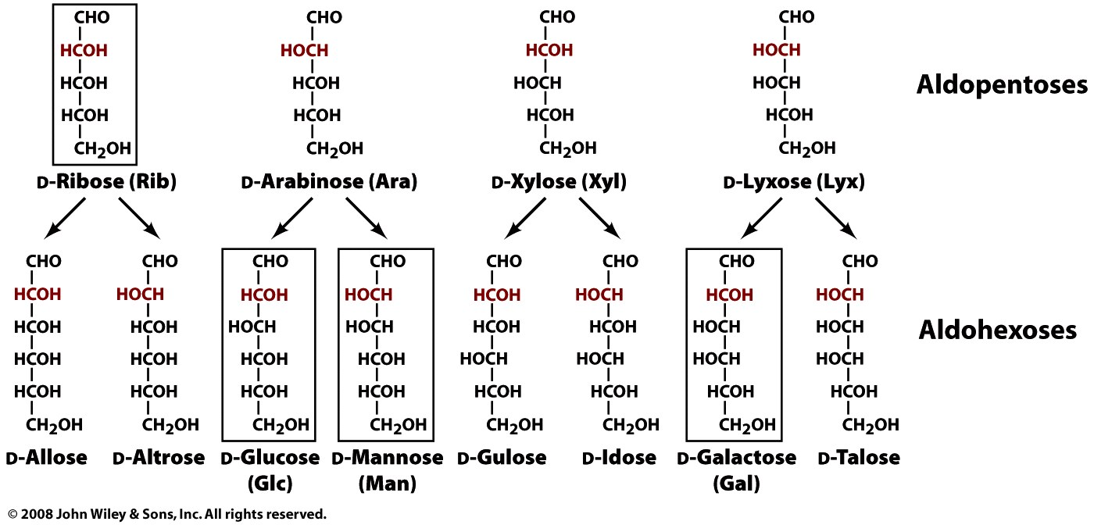
3 chiral carbons
2³=8
stereoisomers
D
4 chiral carbons
2⁴=16
Possible
stereoisomers

Slide 6
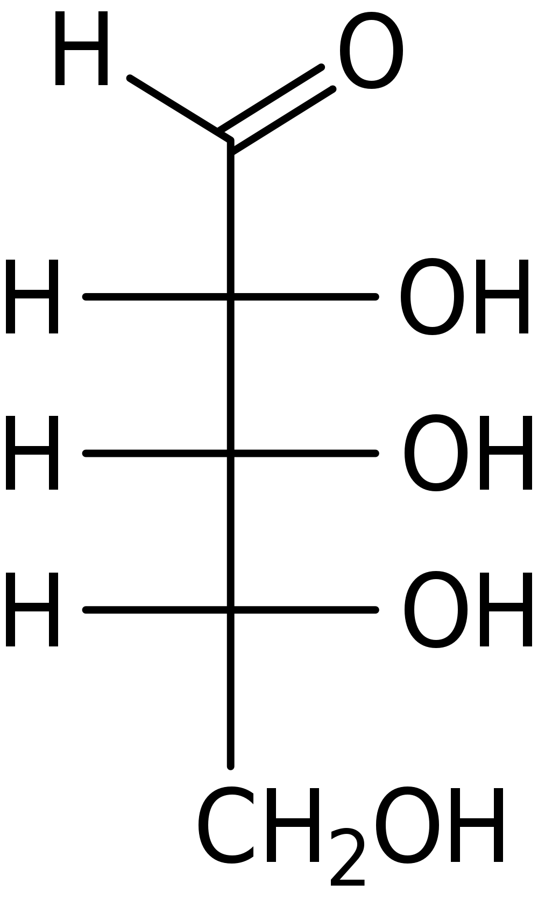
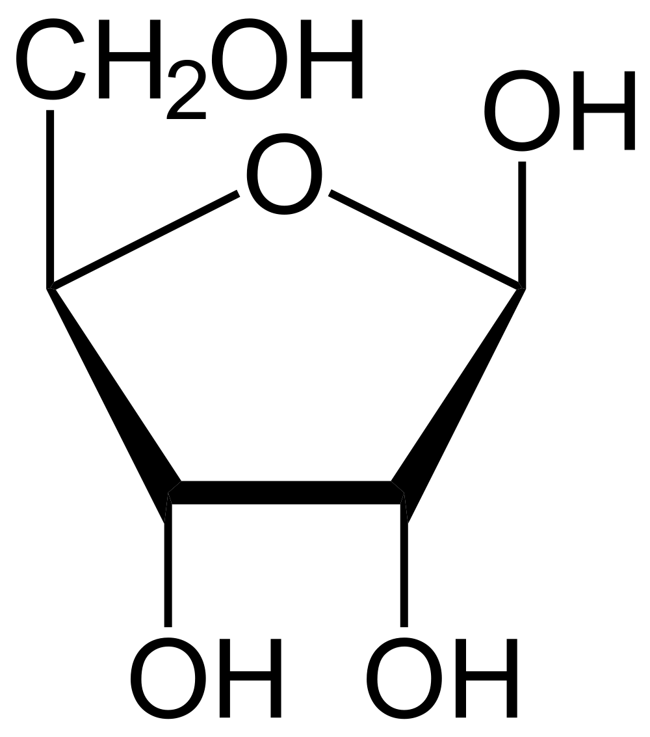
Ribose
RNA backbone.
DNA backbone (2’ deoxyribose).
Phosphorylated derivatives ATP and NADH (metabolism)
cAMP and cGMP (secondary messengers)
β-D-ribose
(furanose : 5-membered ring)
β => 1 OH (aka 1’ OH) is on the same side of the ring plane as CH₂OH)

Slide 7
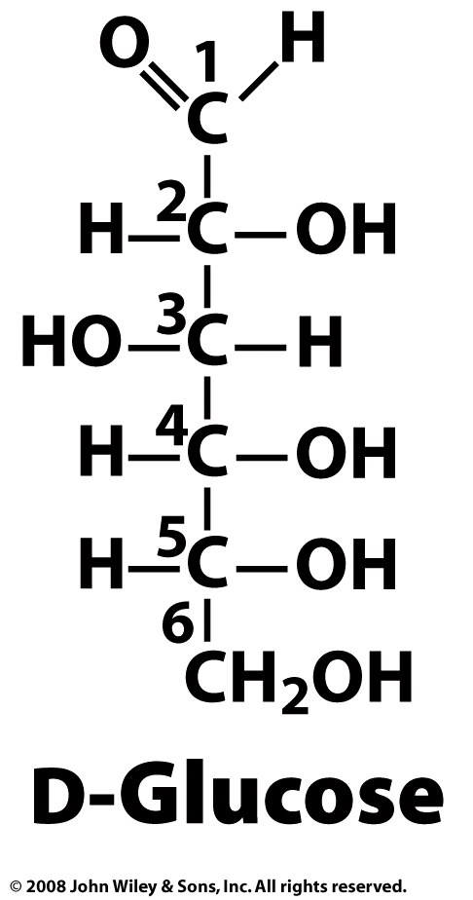
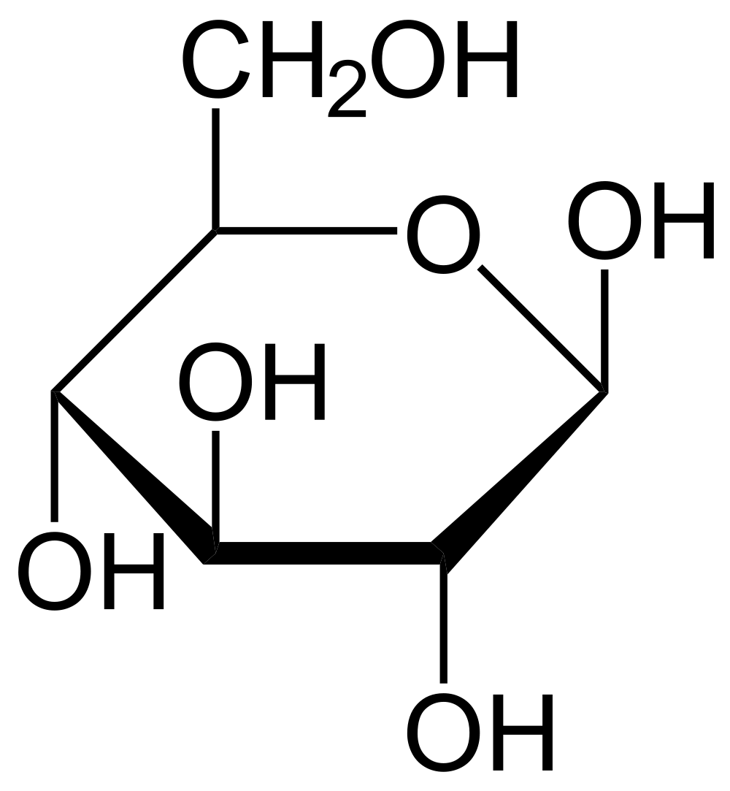
D-Glucose
4 chiral carbons
2⁴=16 possible aldohexose stereoisomers
source of energy
metabolic intermediate
primary product of photosynthesis
component of cellulose
component of (amylose) glycogen
component of chitin
component of sucrose (glucose-fructose)
component of lactose (glucose-galactose)
aka dextrose
Draw the Fischer projection (linear), Hayworth Projection (cyclic).
D
β-D-Glucose
(pyranose: 6-membered ring)

Slide 8
Fisher Projection
D

Slide 9
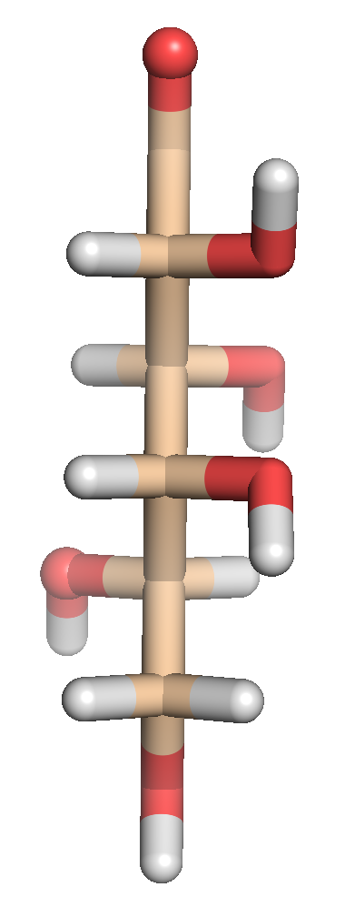
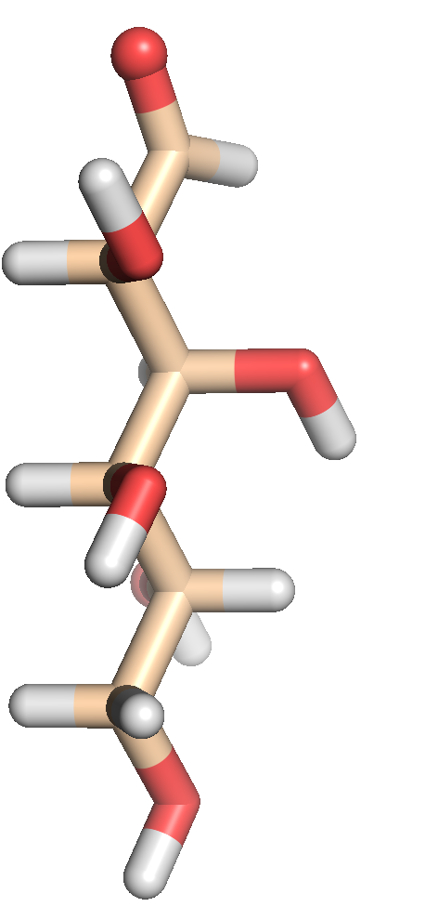
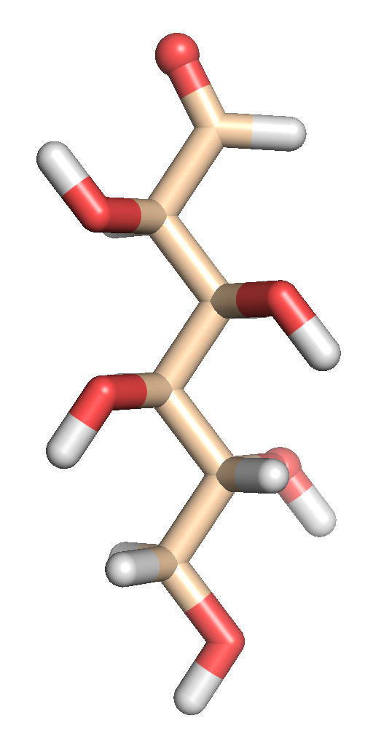
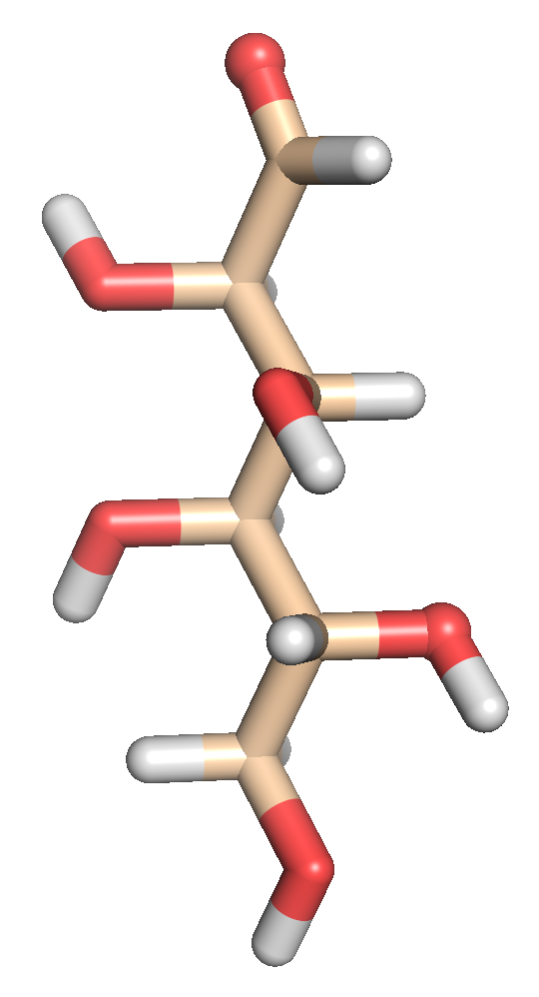
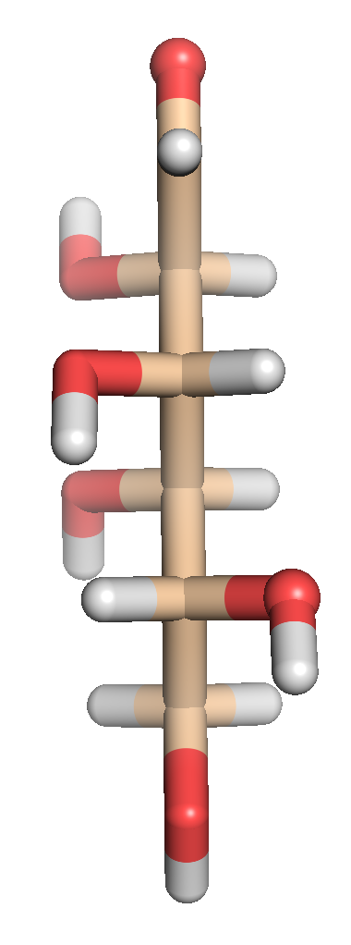
Rot 45°
Rot 45°
Rot 45°
Rot 45°
Rot 45°

Slide 10
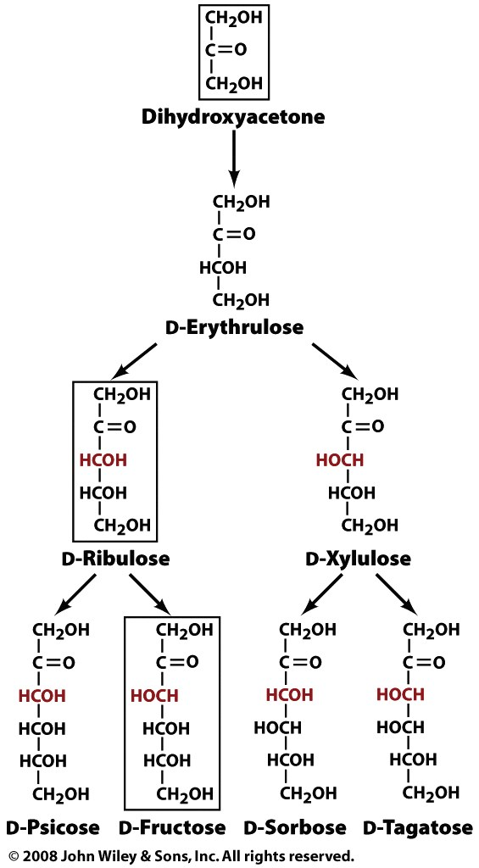
Ketoses
(one fewer chiral center
than aldoses)

Slide 11
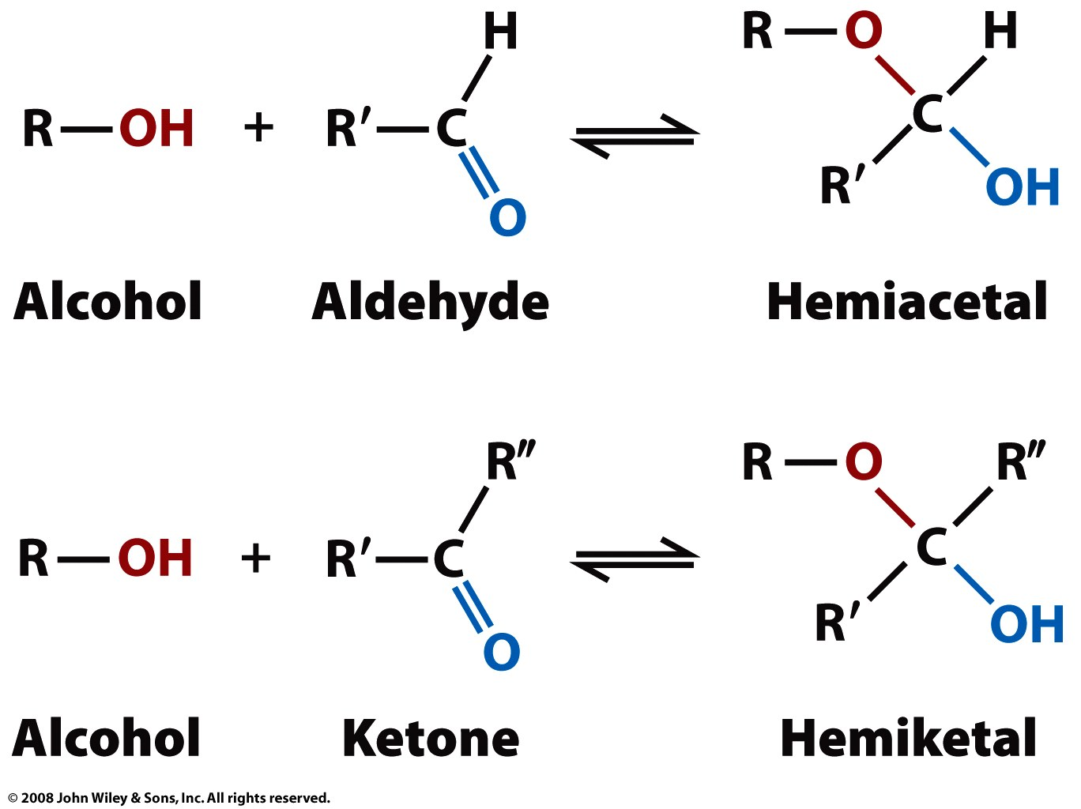
Cyclization Reactions
Page 221

Slide 12
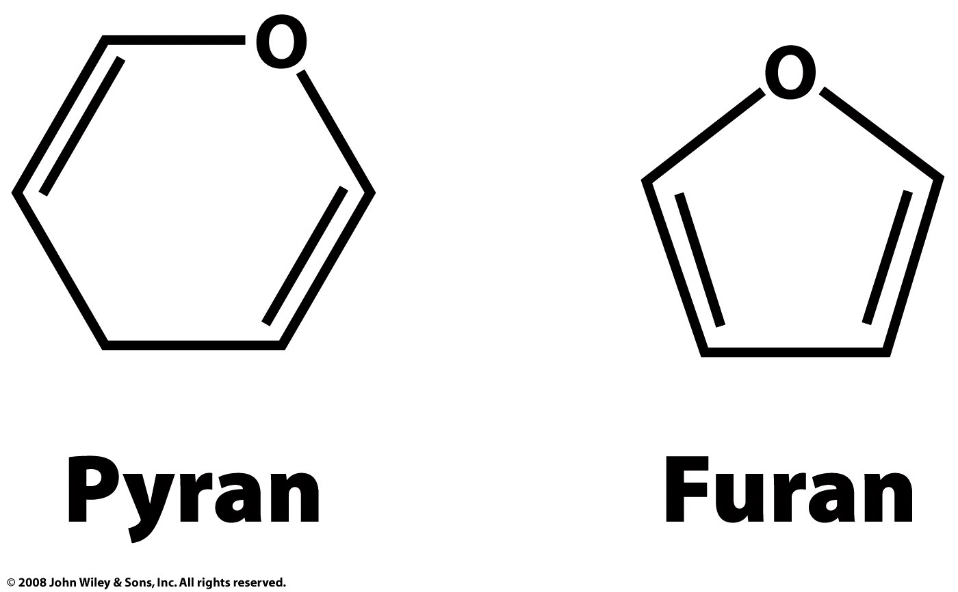
Rings
A pyranose is a six-membered ring consisting of five carbon atoms and one oxygen atom (with no double bonds). Example glucose.
A furanose is a five-membered ring consisting of four carbon atoms and one oxygen atom (with no double bonds). Example ribose.
Page 222

Slide 13
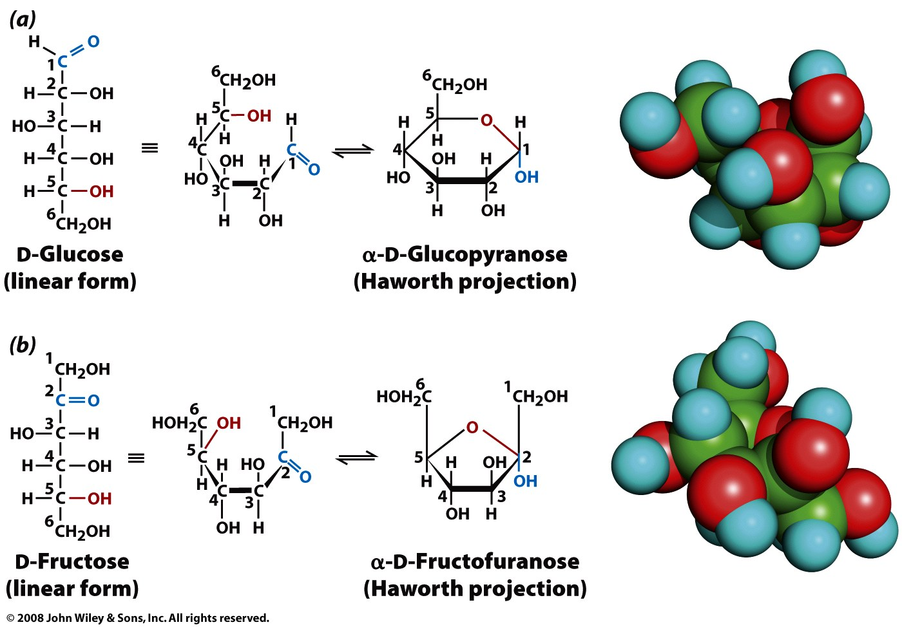
Figure 8-3

Slide 14
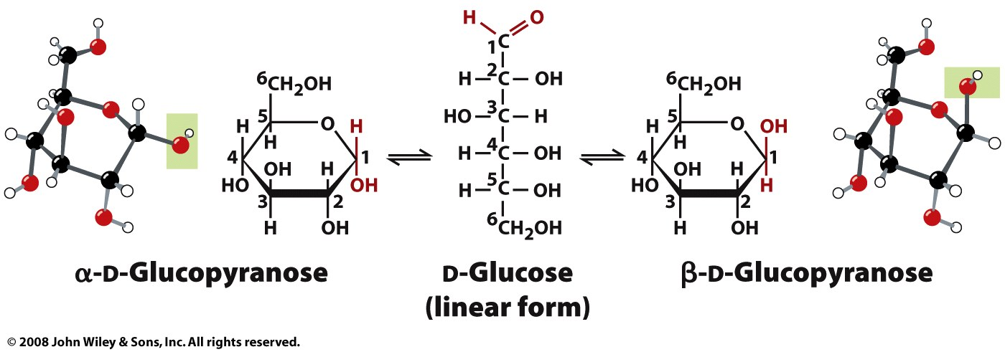

Slide 15
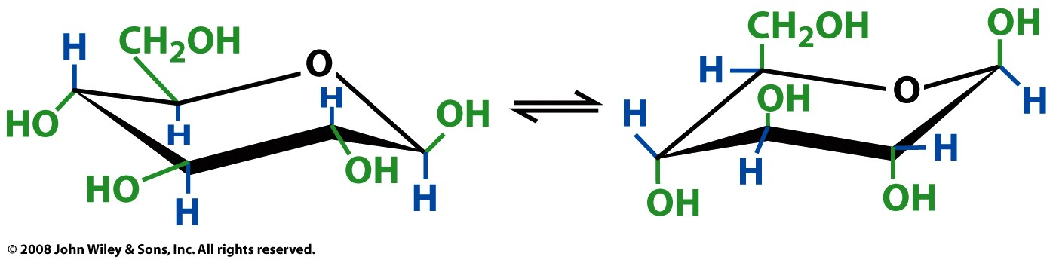
β-D-glucose conformations
all equatorial
(more stable)
all axial
(less stable)
Figure 8-5

Slide 16
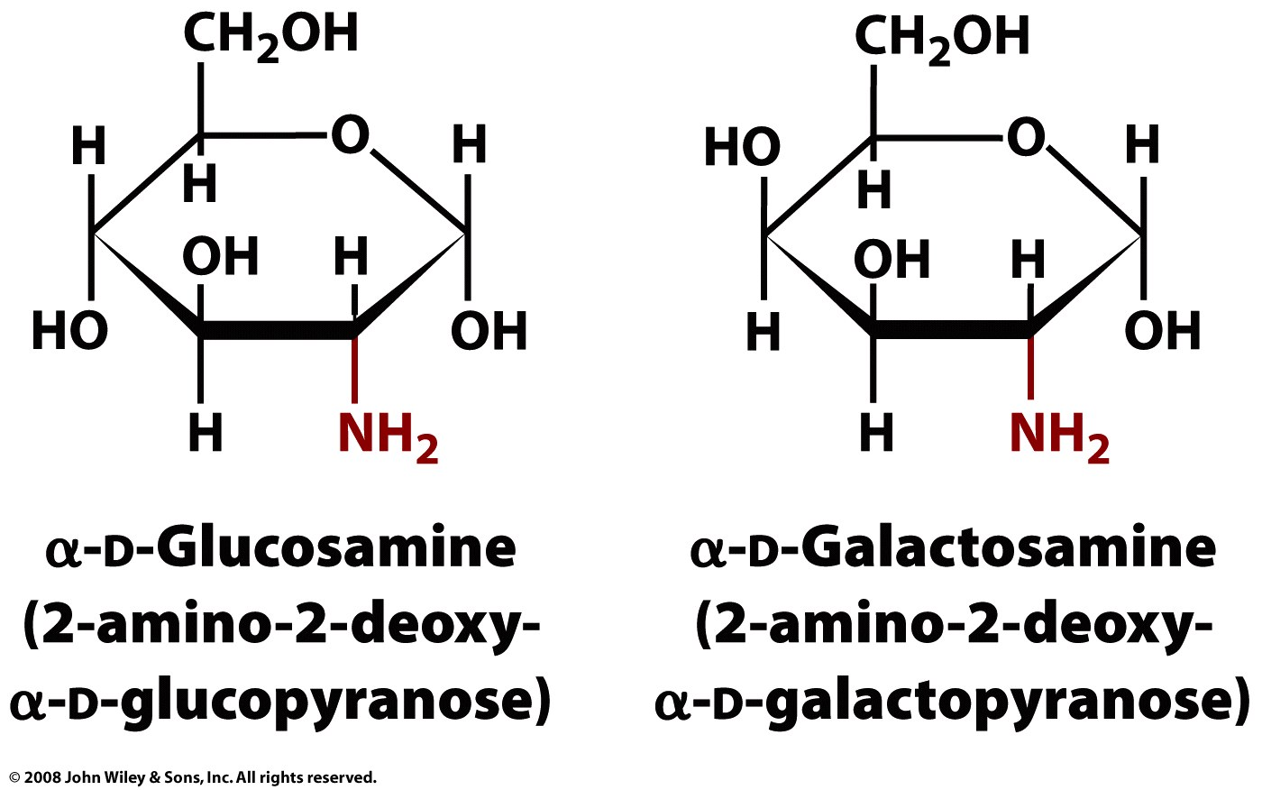
Amino sugars
Glucosamine: used in glycosylated proteins and lipids, chitosan and chitin (the exoskeletons of crustaceans, cell walls in fungi etc)
Page 225

Slide 17
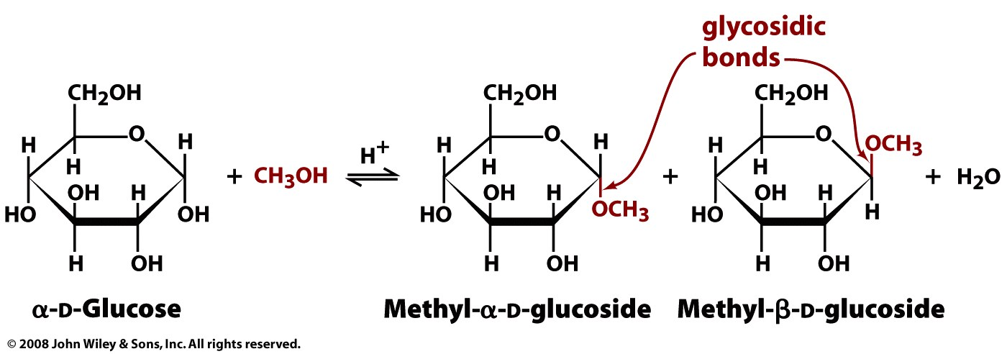
α => 1 OH is on the opposite side of the ring plane as CH₂OH)
β => 1 OH is on the same side of the ring plane as CH₂OH)
Figure 8-7

Slide 18
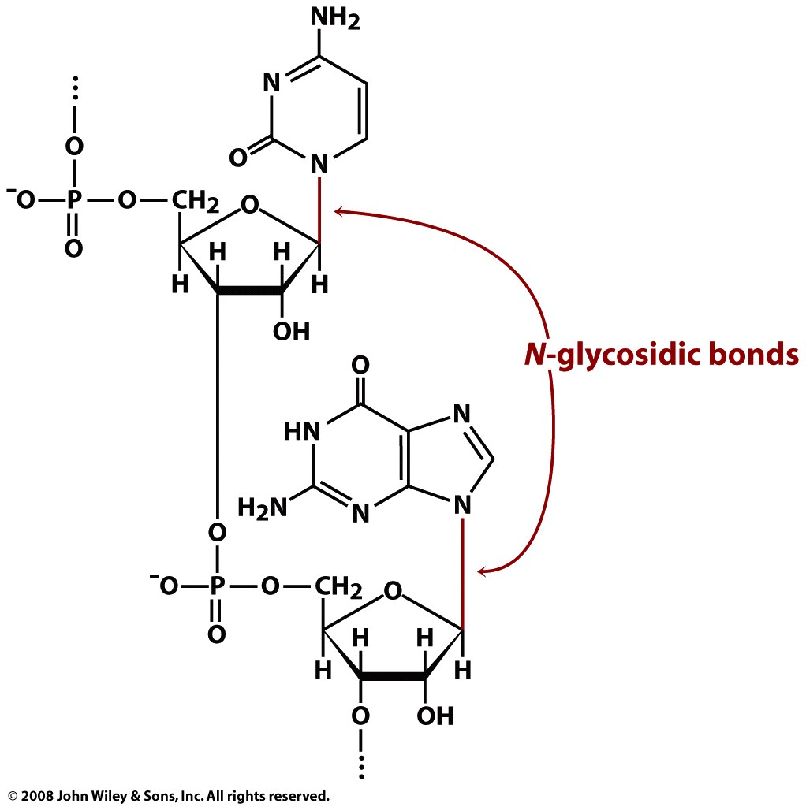
Page 226

Slide 19
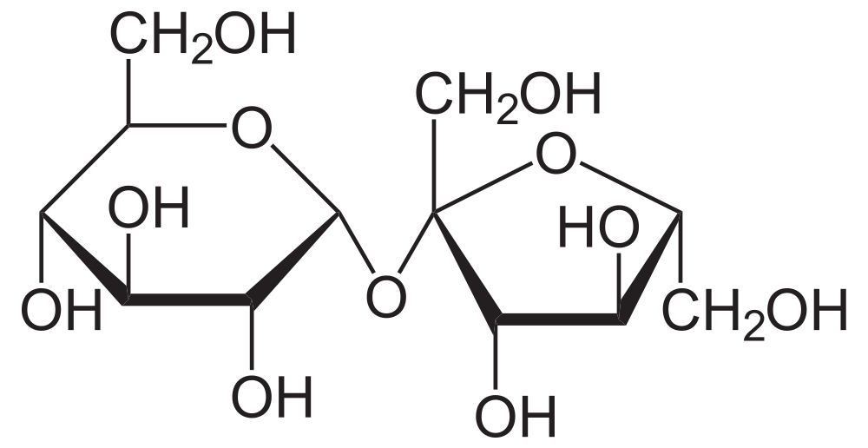
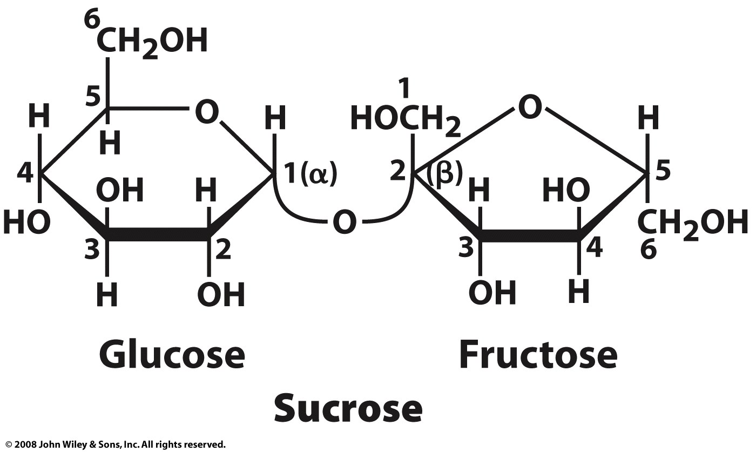
Disaccharides
Sucrose: table sugar
a disaccharide
glucose+fructose
O-α-D-glucopyranosyl-(1→2)-β-D-fructofuranoside
pyran: 6-membered ring
furan: 5-membered ring
sucrose is broken down to monosaccharides by sucrase or isomaltase glycoside hydrolases, which are found in the membrane of the microvilli in the small intestine. The monosaccharides are readily absorbed into the bloodstream.
α => 1 OH is on the opposite side of the ring plane as CH₂OH)
β => 1 OH is on the same side of the ring plane as CH₂OH)

Slide 20

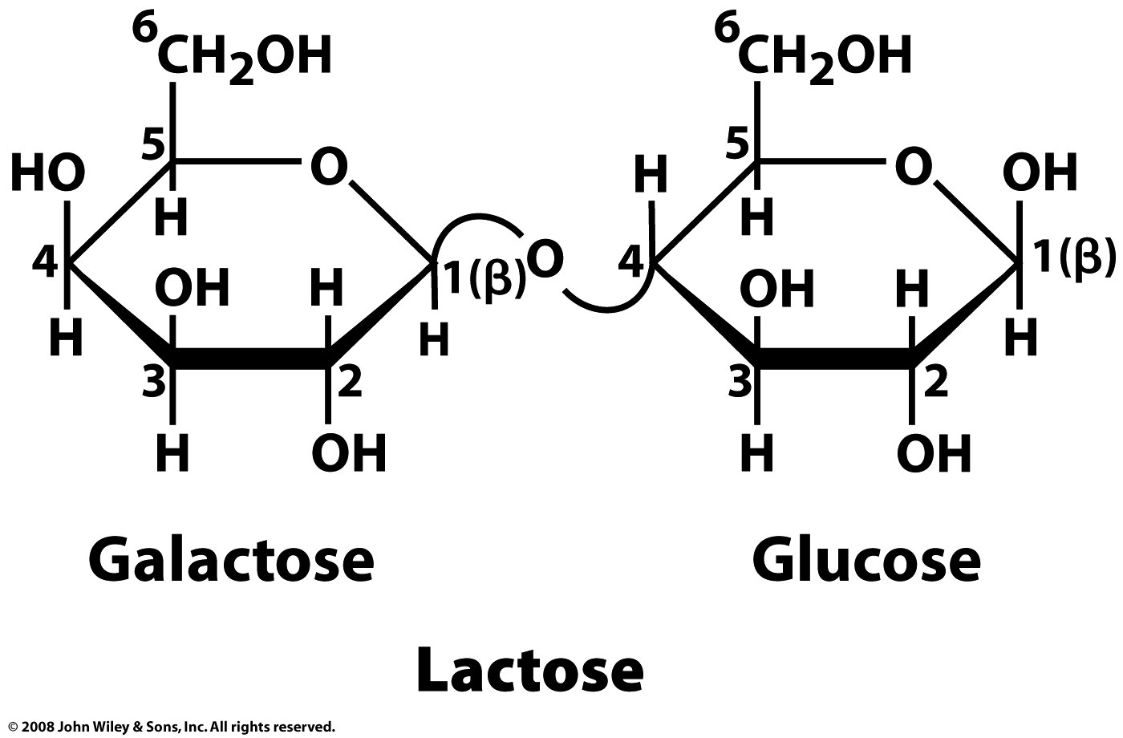
Disaccharides

Slide 21
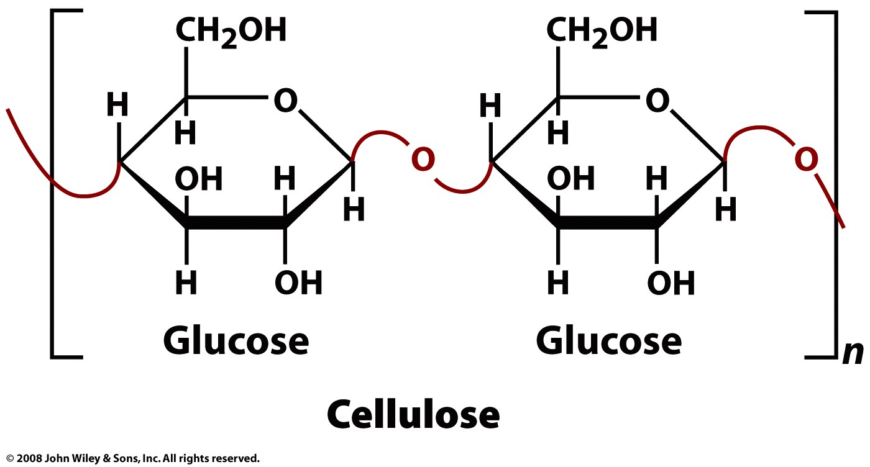
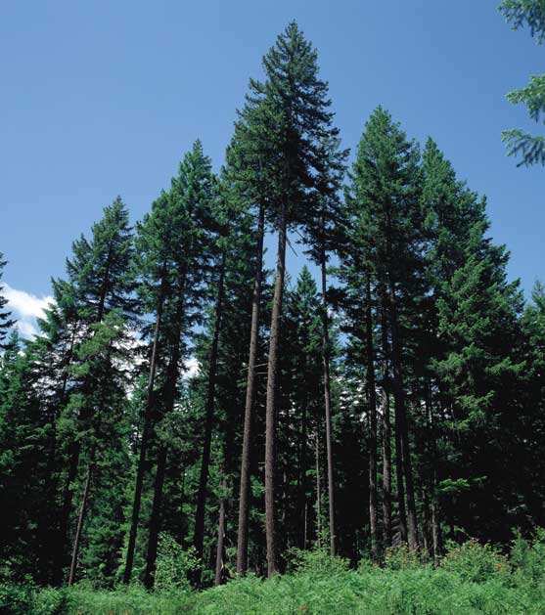
most common organic compound on our planet,
insoluble in water and most organic solvents,
D Glucose linked by β(1→4)-glycosidic bonds
several hundred to over ten thousand linked D-glucose residues.
Page 229

Slide 22
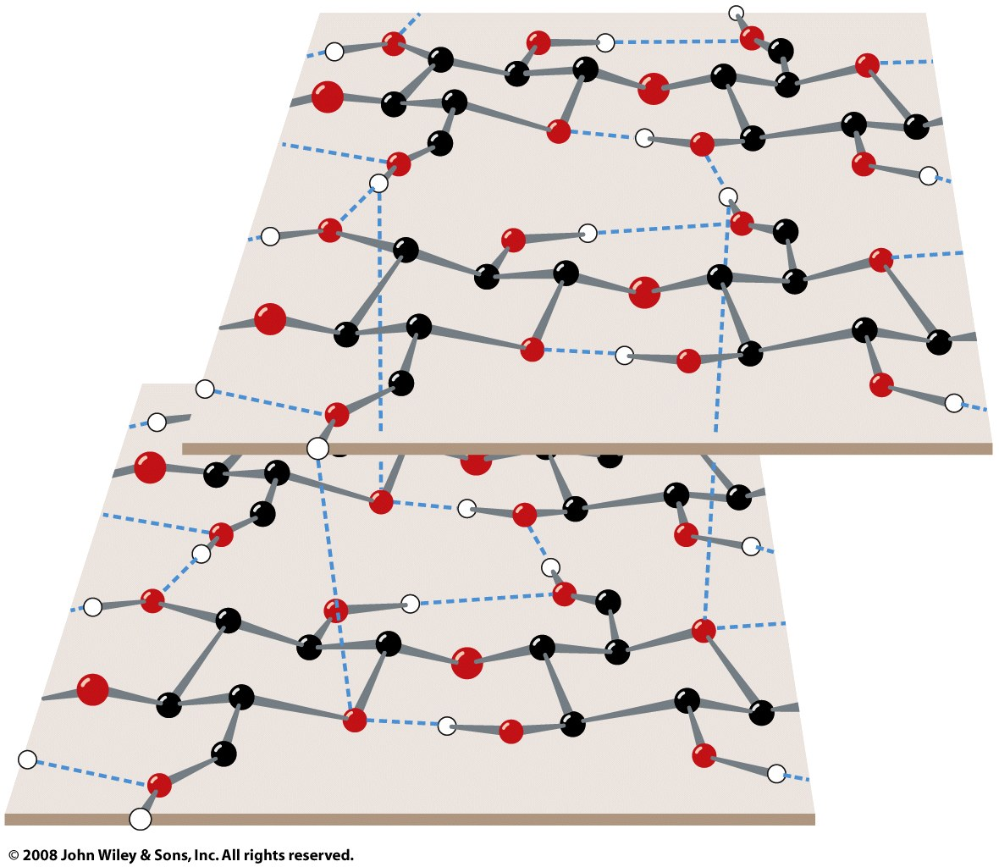
Figure 8-9

Slide 23
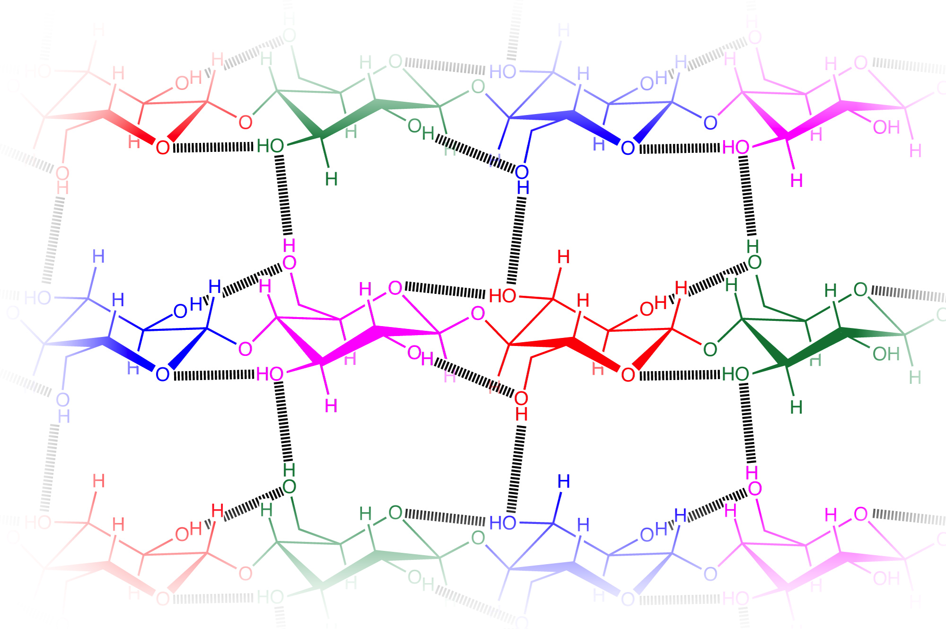

Slide 24
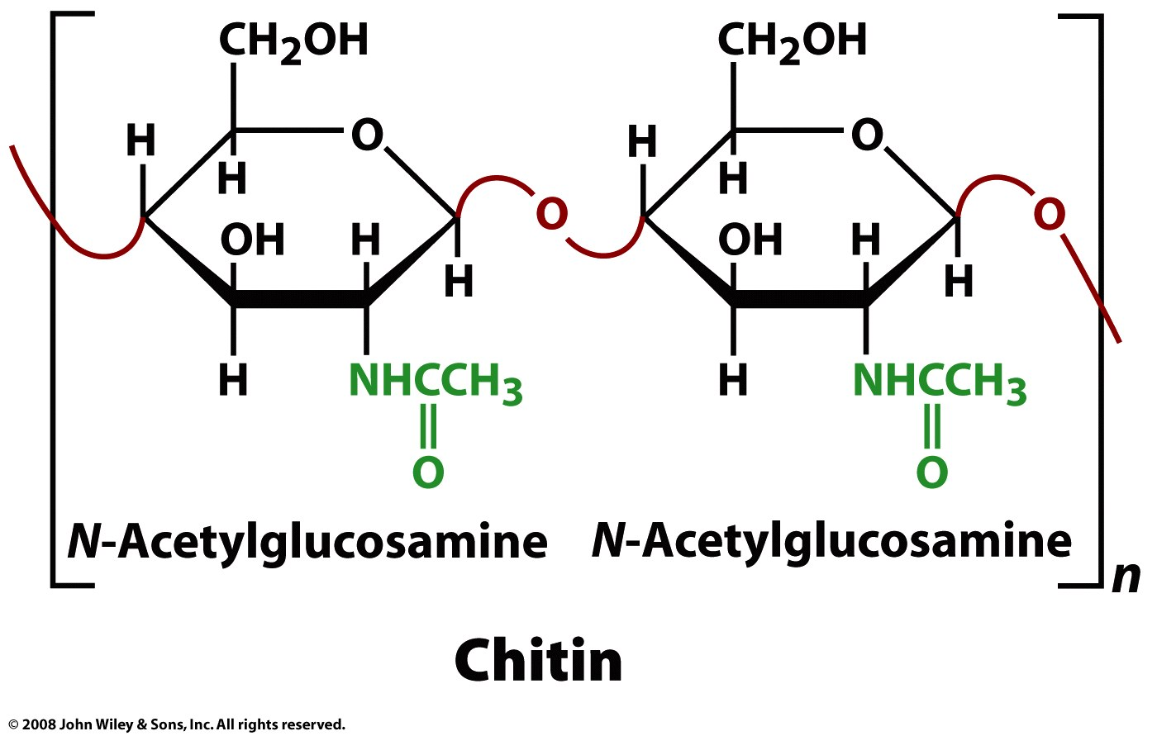
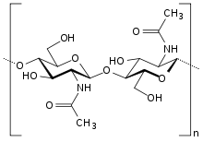
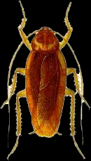
Same as cellulose except the 2-hydroxyl groups are replaced with acetyl amine (to give N-acetylglucosamine).
Chitin is cellulose with one hydroxyl group on each sugar replaced with an acetyl amine group.
Chitin is translucent and leathery. Modification and mineralization cause it to harden.

Slide 25
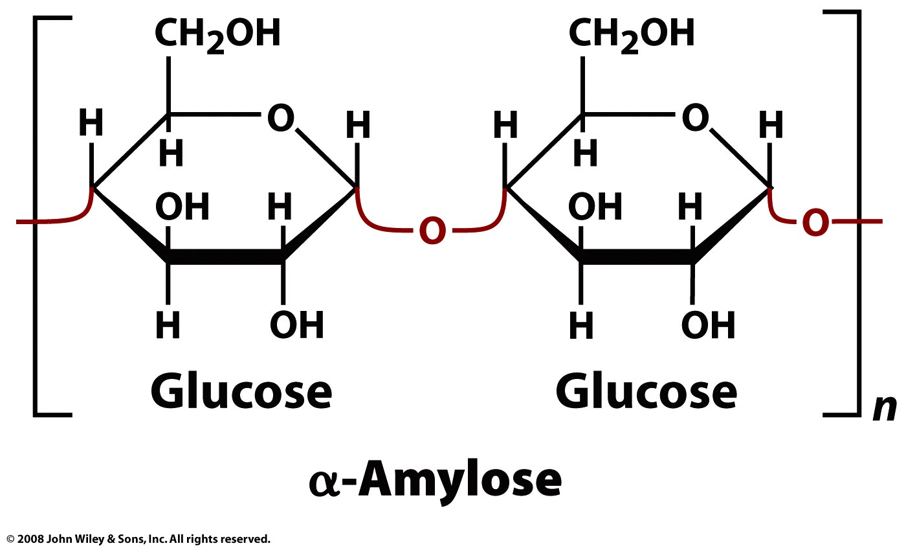
Amylose: linear α(1-4)−linked D-glucose
Page 230

Slide 26
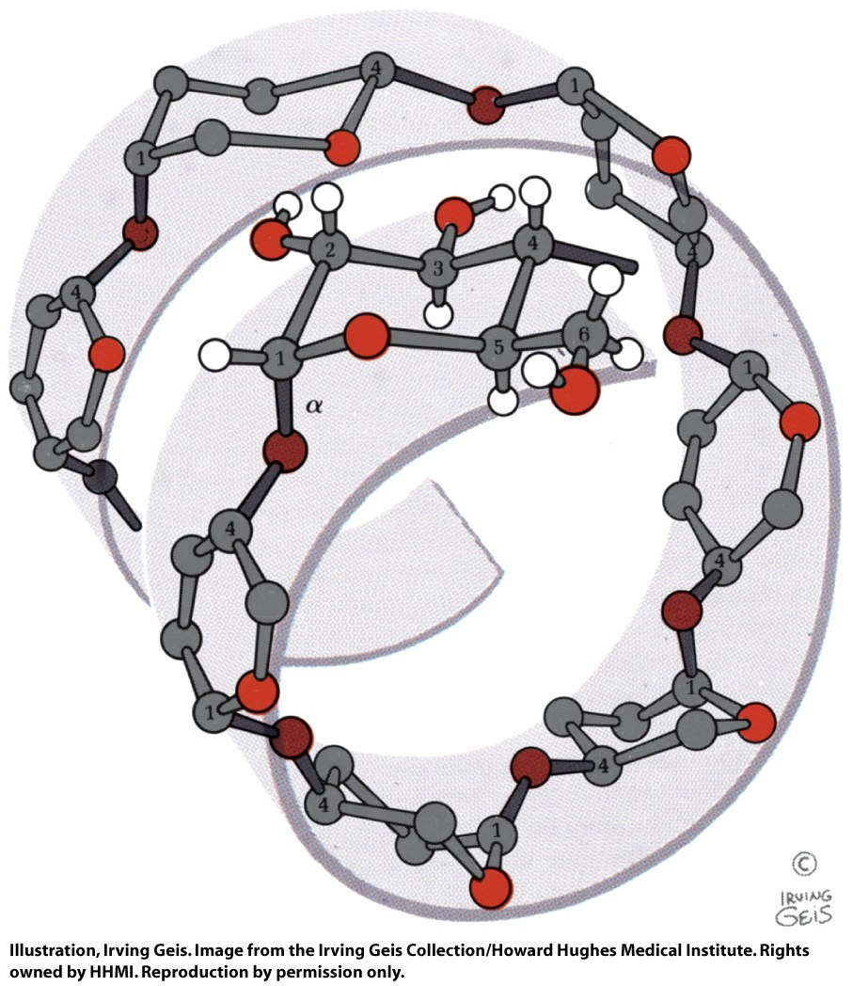
α(1-4)−linked D-glucose polymers form an irregular left-handed helix. Polyerization reduces osmotic pressure (which is colligative effect).
Amylose: linear α(1-4)−linked D-glucose
Figure 8-10

Slide 27
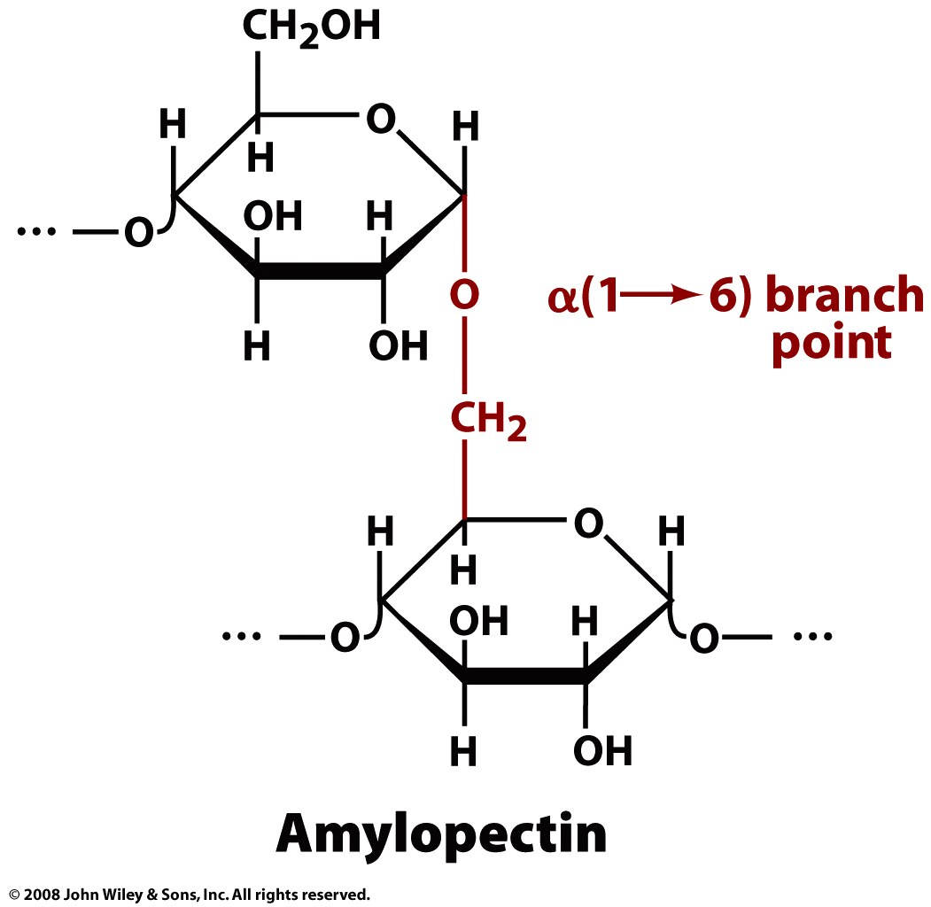
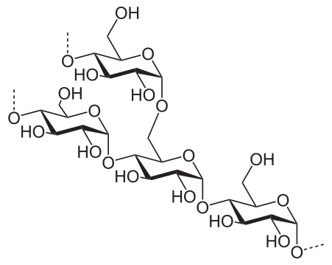
Amylopectice branches with α(1→6) bonds, every ~26 residues (glucoses).
Animals that eat plants (like us) produce the enzyme amylase, that hydrolyzes amylose.
Glycogen also branches with α(1→6) bonds, every ~10 residues.
Page 231

Slide 28
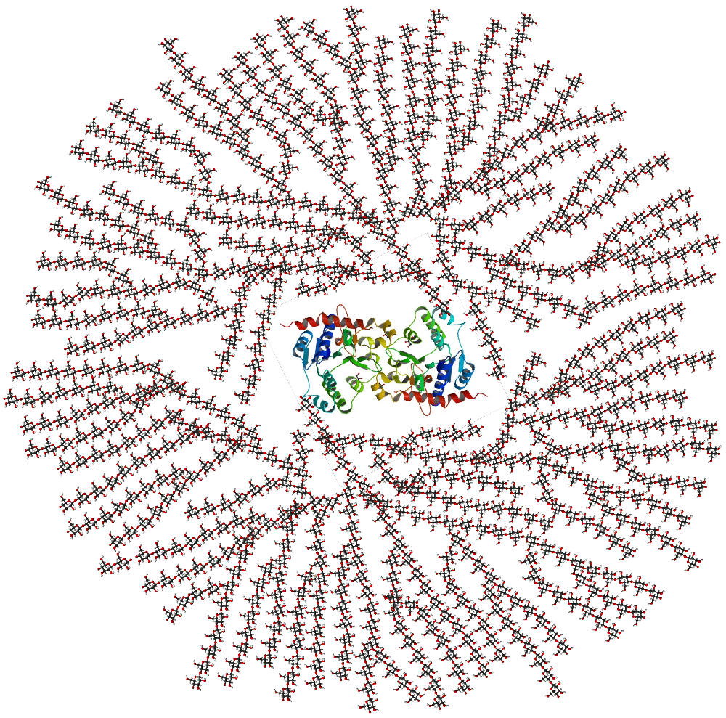
Glycogen
Your body stores chemical energy (glucose). This is a schematic 2-D cross-sectional view of glycogen. A core protein of glycogenin is surrounded by branches of glucose units. The entire globular granule may contain approximately 30,000 glucose units. Enzymes release glusose by chewing in from the ends.
This is from Wikipedia which apparently obtained it from E. Meléndez-Hevia, R. Meléndez and E. I. Canela (2000) "Glycogen Structure: an Evolutionary View", pp. 319–326 in Technological and Medical Implications of Metabolic Control Analysis (ed. A. Cornish-Bowden and M. L. Cárdenas), Kluwer Academic Publishers, Dordrecht

Slide 29
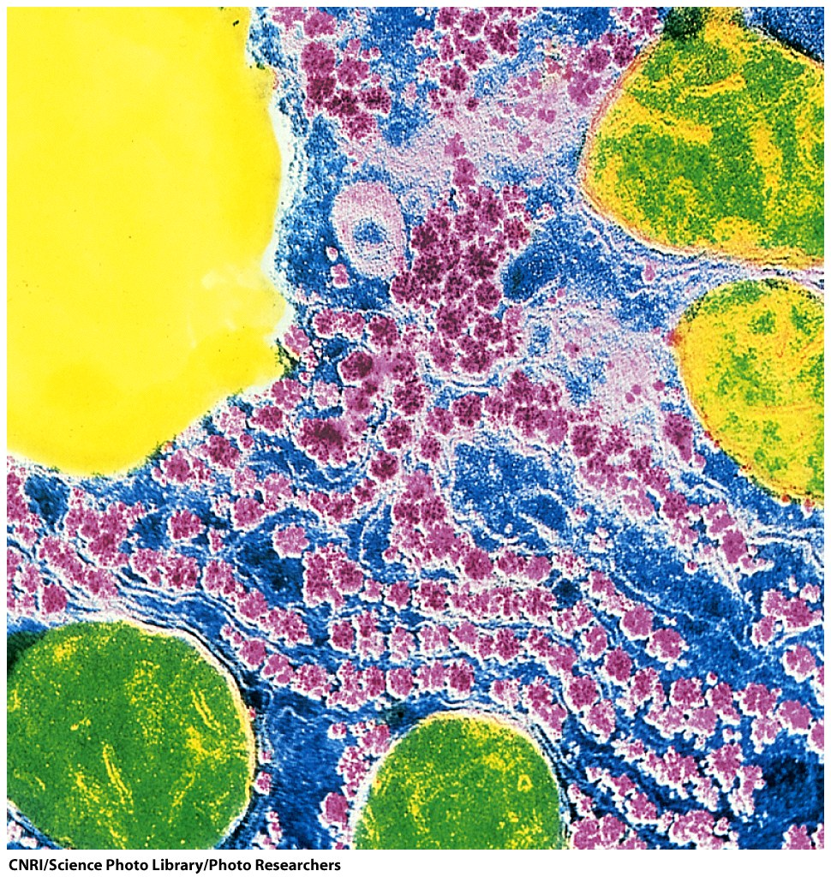
Glycogen granules in the liver (pink spheres).
Figure 8-11

Slide 30
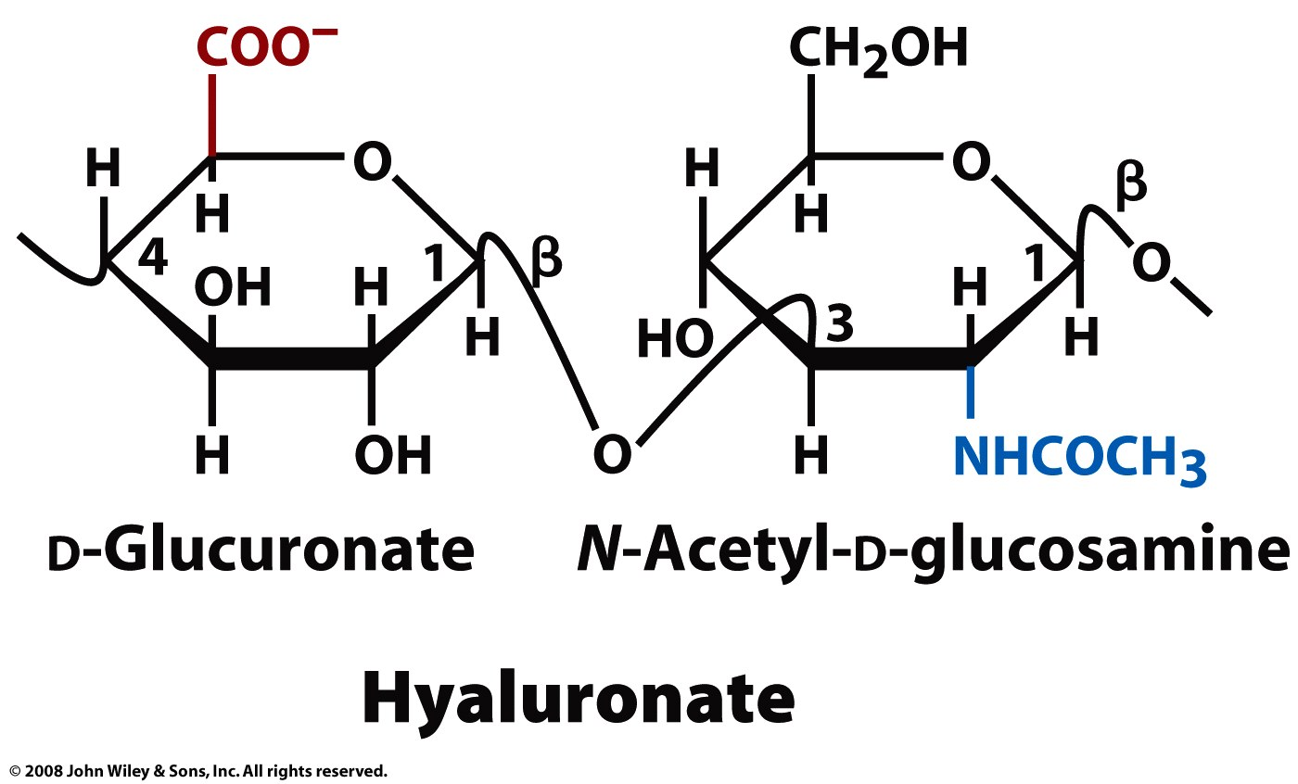
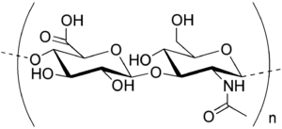
Glycosaminoglycans (GAGs)
Hyaluronate – (D-glucuronic acid + D-N-acetylglucosamine, with alternating β-1,4 and β-1,3 linkages) found in connective, epithelial, and neural tissues.
a component of cartilage, it coats each cell (chondrocyte),
imbibes water contributes to the resilience of cartilage (resistance to compression),
a major component of skin,
lubricates joints.
contributes to tissue hydrodynamics and movement,
rigid and extended, and can align under shear stress.
can have molecular weight reaching millions

Slide 31
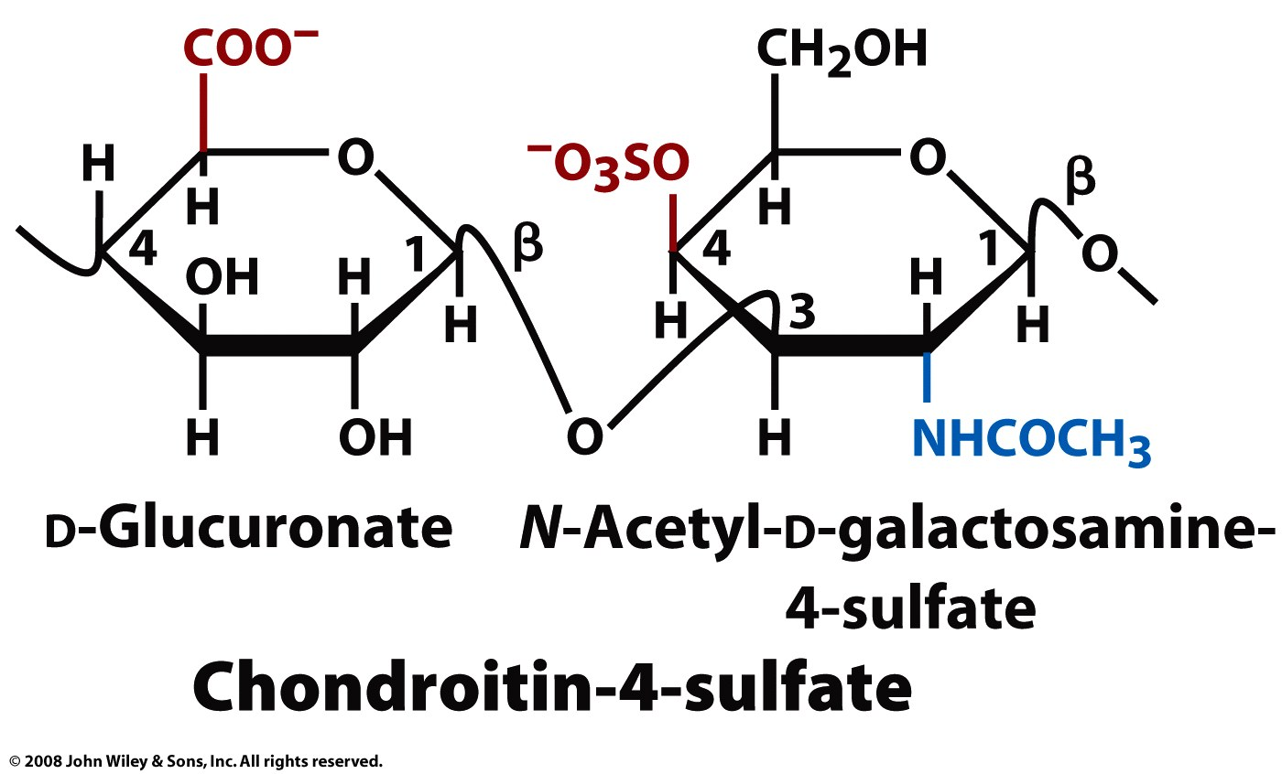
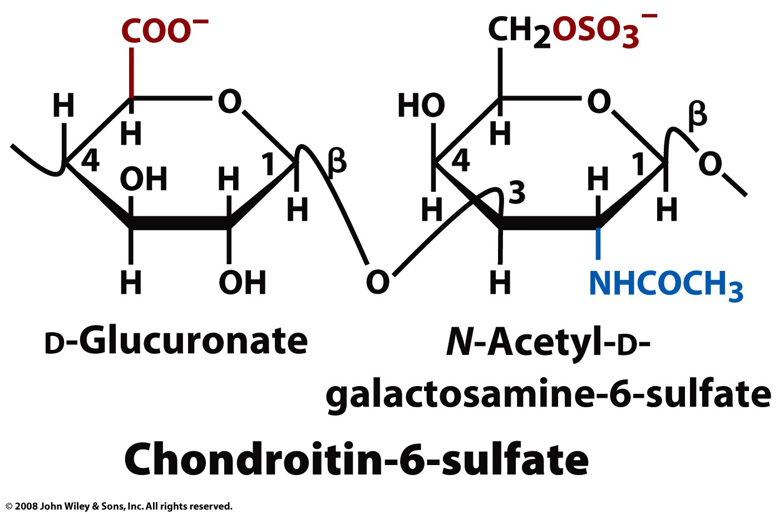
Glycosaminoglycans (GAGs)
Sulfonated glucosaminoglycans
Chondroitin sulfate: Linear chain of alternating N-acetylgalactosamine and glucuronic acid - attached to protein. A component of cartilage that gives resistance to compression.
Figure 8-12 part 2

Slide 32
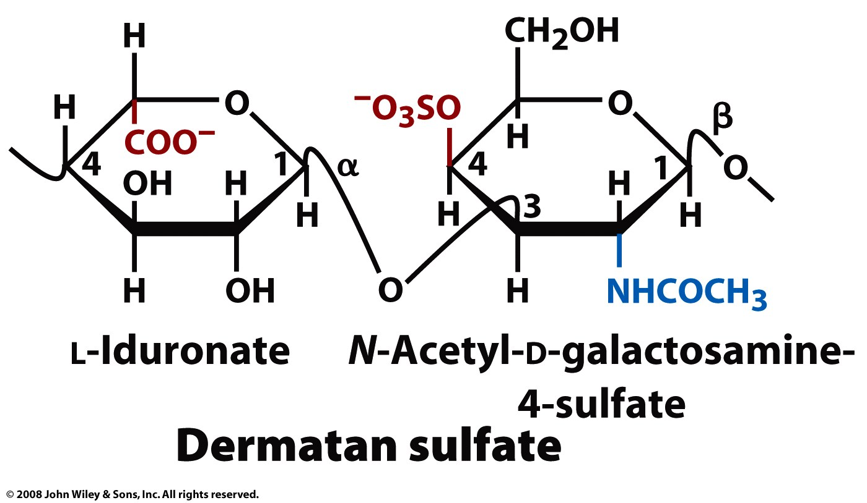
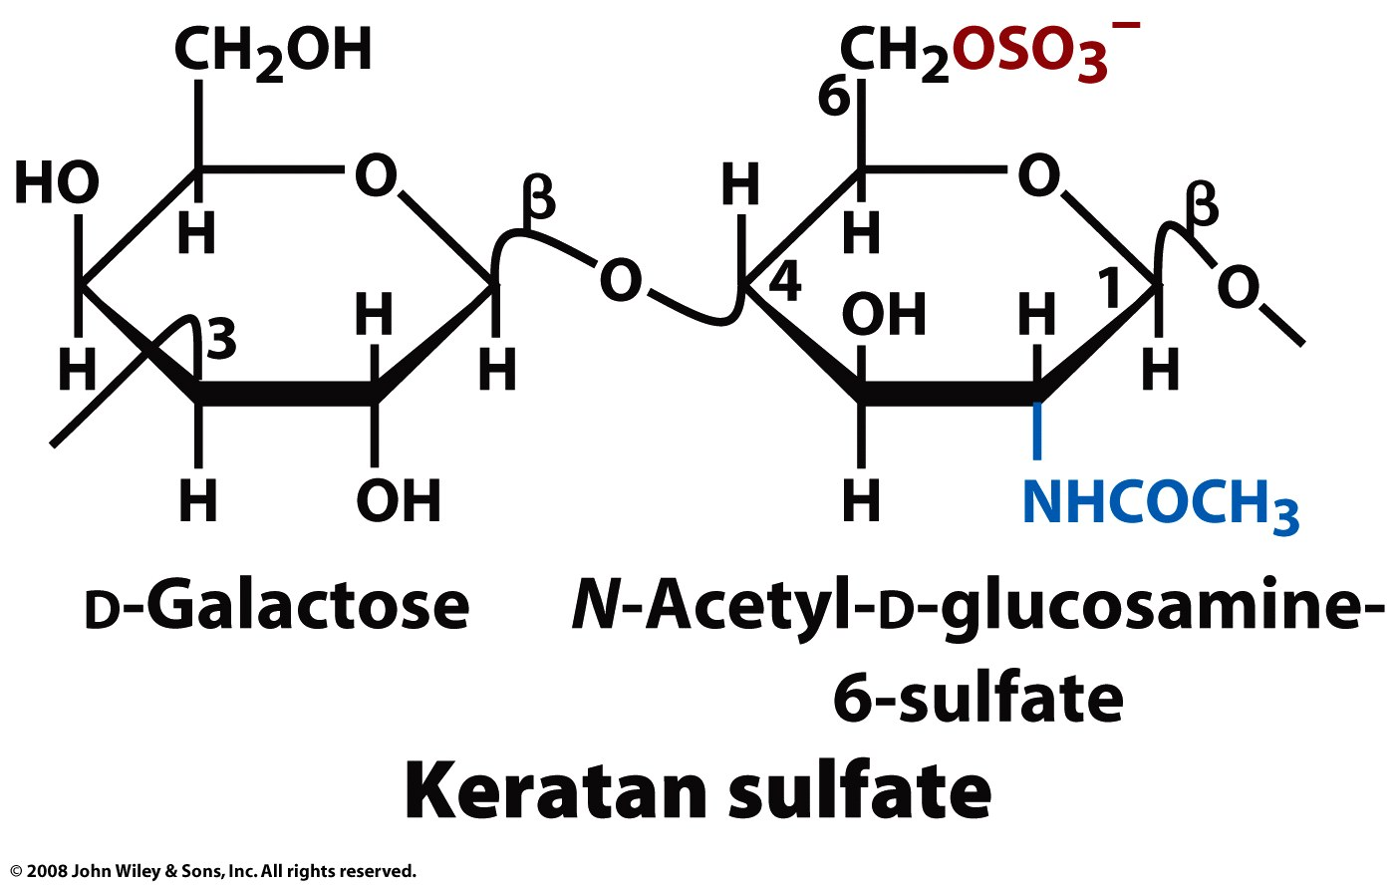
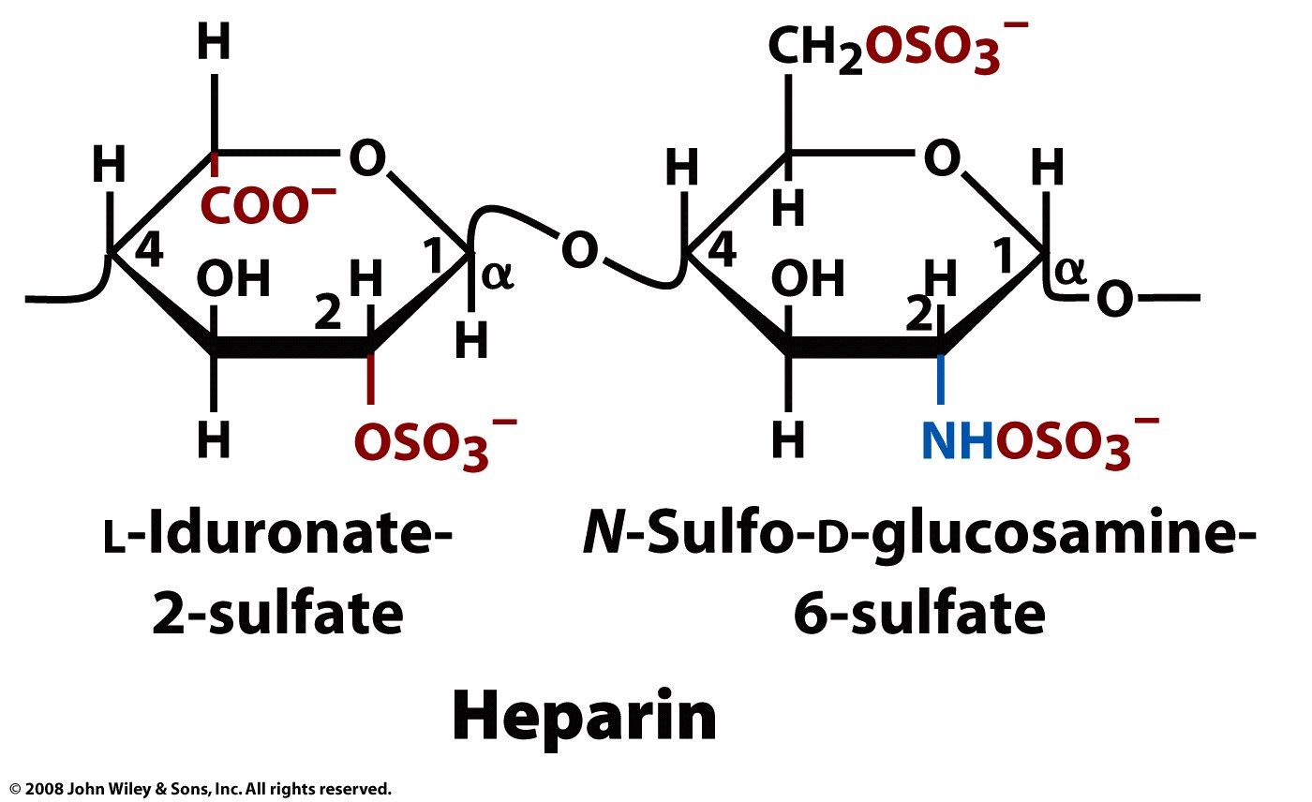
Heparin - a clotting inhibitor, has the highest negative charge density of any biological macromolecule (except polypyrophosphate).
Dermatan Sulfate – function?
Keratan Sulfate – in joints, cornea, cartilage, and bone - can act as a cushion to absorb mechanical shock.

Slide 33
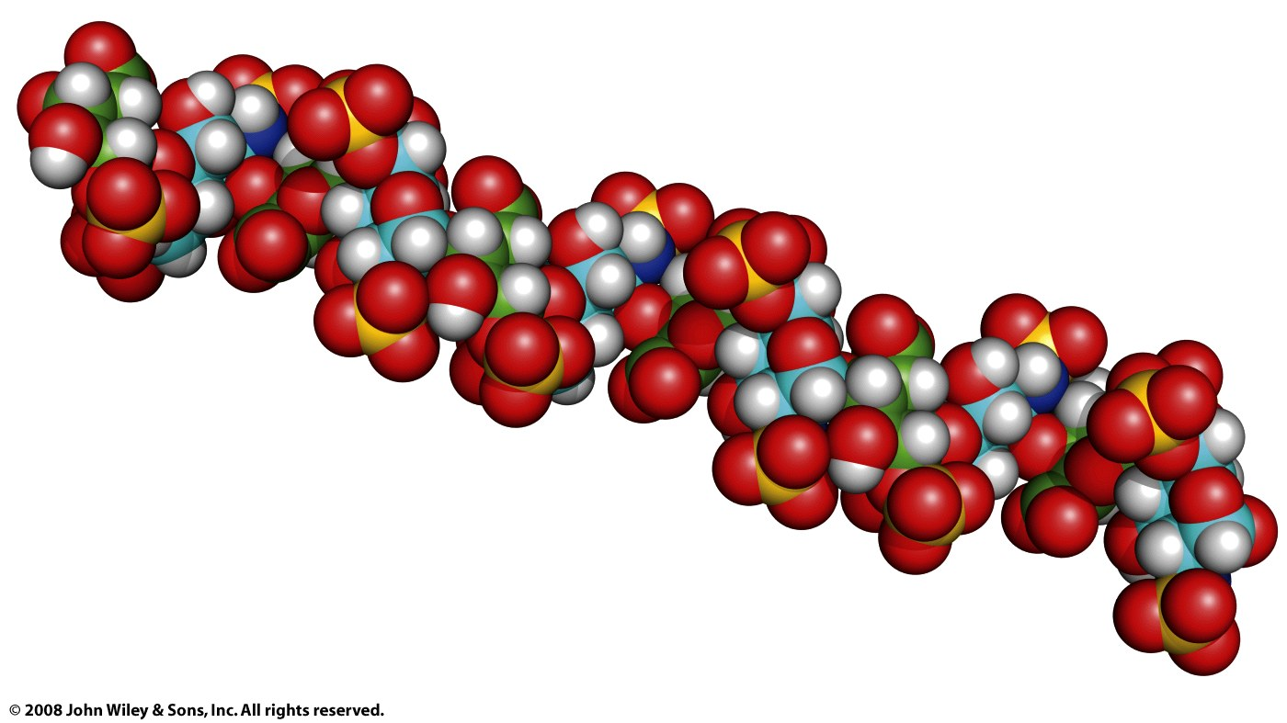
Figure 8-13

Slide 34
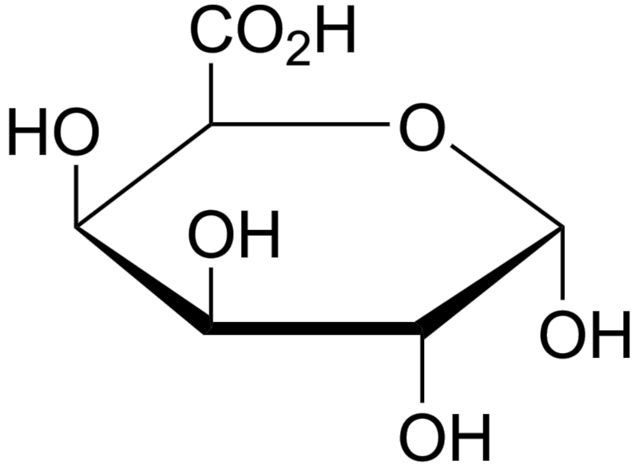
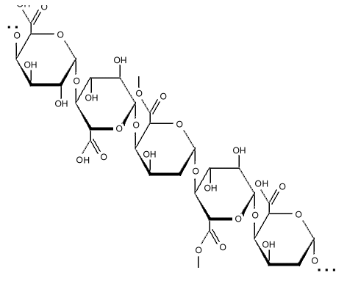
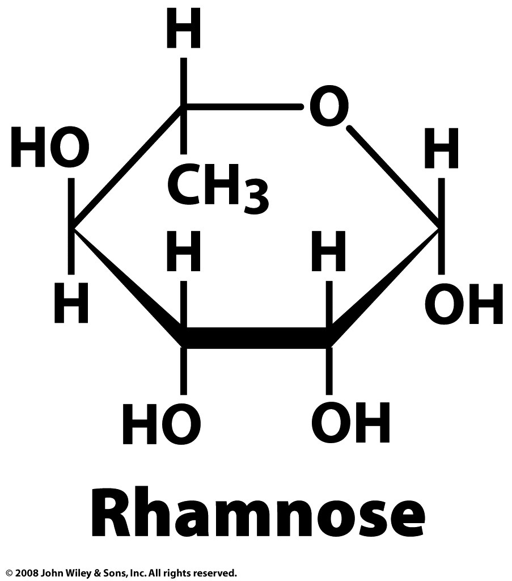
Pectins - are important components of plant cell walls, contain 1,4-linked α-D-galactosyluronic acids interspersed by rhamnoses.
Rhamnose - methyl-pentose (a 6-deoxy-hexose), is contained in pectins.

Slide 35


Stromatolites formed in shallow water by the trapping, binding and cementation of sedimentary grains by microbial biofilms, especially of cyanobacteria. Stromatolites contain some of the most ancient records of life on Earth
Biofilm - an aggregate of microorganisms sticking to each other and to a surface. The film contains a extracellular conglomeration of cellulose-like polysaccharides, DNA, and proteins.

