Slide 2
Control of Gene Expression is partly by Regulation of Transcription.
(for differentiation, cell type, development, exercise, diet, environmental stimuli, food sources, aging)
Specificity factors (sigma factors) alter the specificity of RNA polymerase for promoters (DNA sequences).
Repressors bind to DNA Operators, that are close to or overlapping the promoter region.
General transcription factors position RNA polymerase at the start of a protein-coding sequence and then release the polymerase to transcribe the mRNA.
Activators enhance interactions between the RNA polymerase and particular promoters.
Enhancers (far away from promoter) are bound by activators that loop the DNA, bringing a specific promoter to the initiation complex.
Silencers are DNA sequences that, when bound by particular transcription factors, can inhibit transcription
Epigenetics by DNA methylation & histone modification.

Slide 3
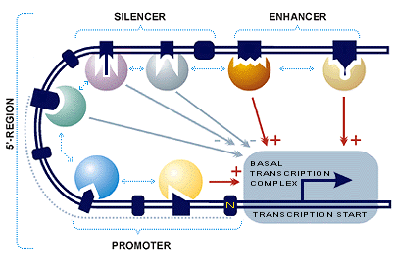
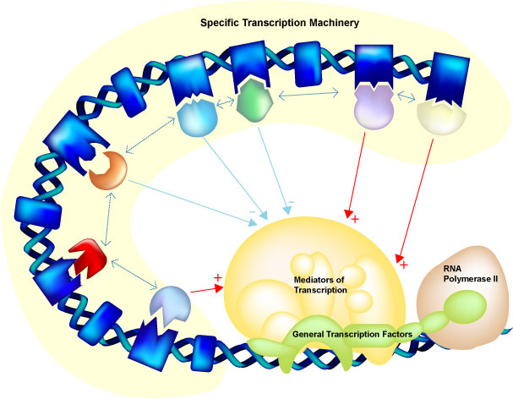
http://wwwmgs.bionet.nsc.ru/mgs/gnw/trrd/db_schema.shtml

Slide 4
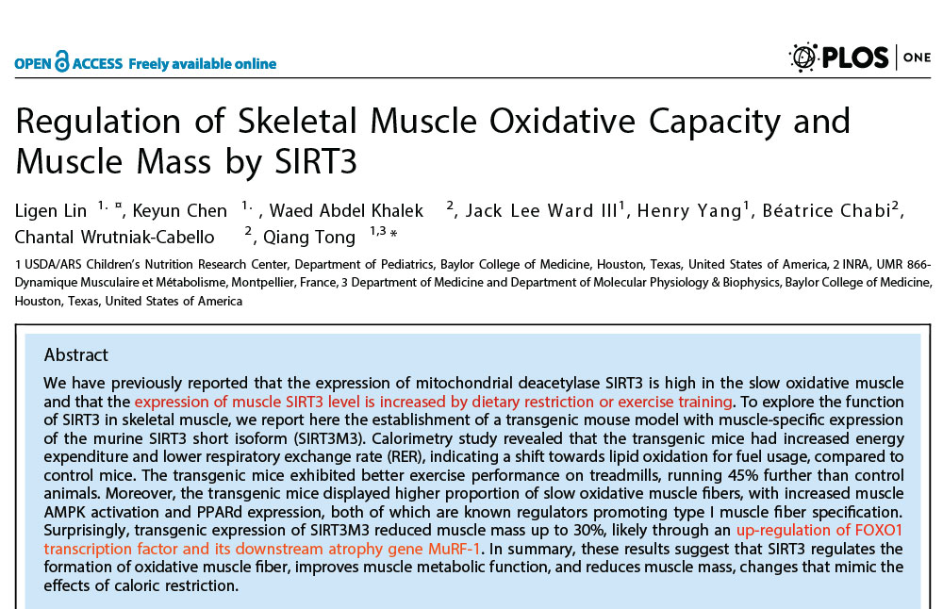
Go the CRC: Change your Gene Expression:
SIRTs regulate metabolism at the transcriptional level and more directly control the activity of metabolic enzymes.

Slide 5
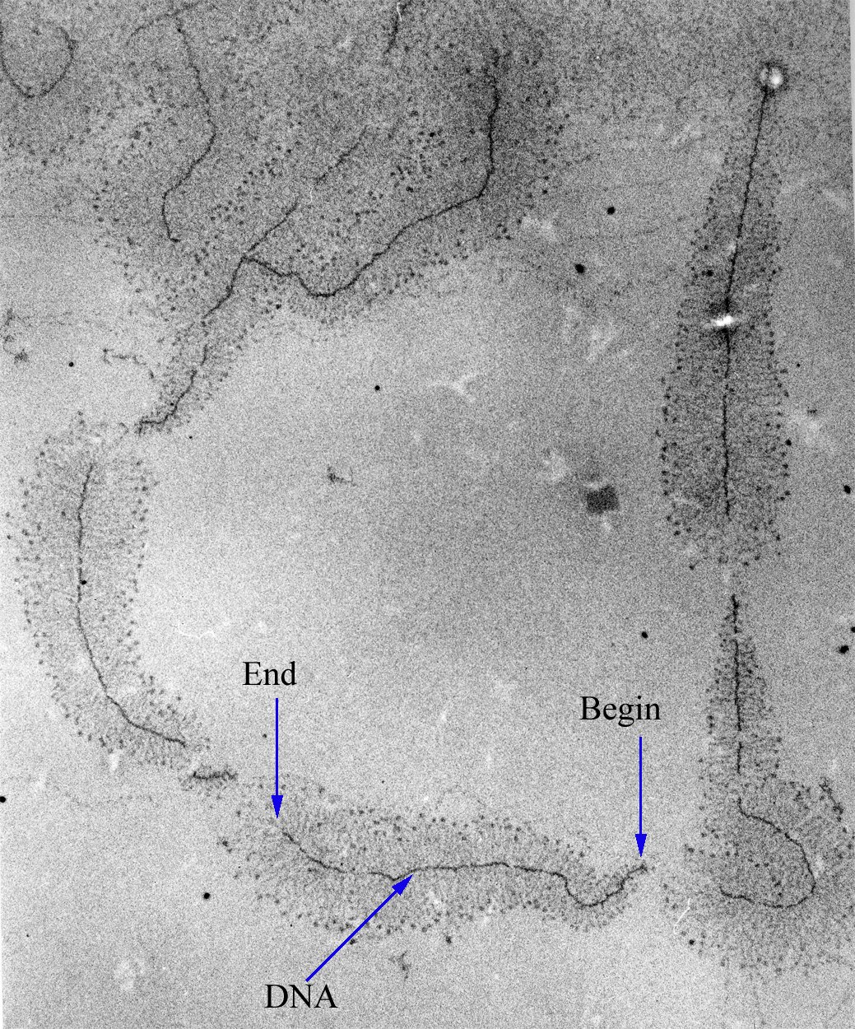
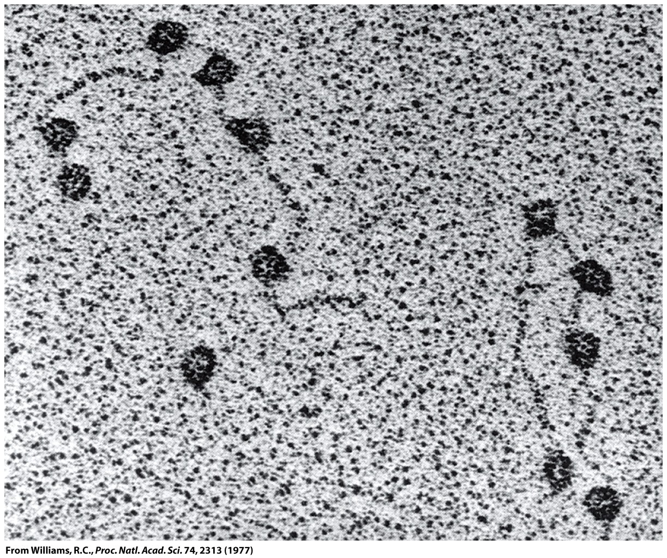
Rapid Transcription Reinitiation
Facilitated recycling: Preinitiation intermediates on activated genes can persist.
The retention of transcription proteins at an actively transcribed gene increases the frequency of subsequent transcription initiation

Slide 6
During transcription, an RNA complement (a transcript) of a DNA sequence is synthesized. If the DNA templete (antisense) sequence is '5 ...GGGCATT... 3', then the mRNA transcript (sense) has sequence 5' ...AAUGCCC... 3'.

Slide 7
All RNA is made by transcription. There are many types of RNAs.
Messenger RNAs (mRNA) are coding RNAs. mRNAs carry information contained within DNA to the ribosome, where they direct the sequence of amino acids during protein synthesis, according to the mRNA sequence and the 'genetic code'. The sequence of codons (nucleotide triplets) in an mRNA determines the amino acid sequence in a protein. Some mRNAs contain cis regulatory elements, such as riboswitches, in the untranslated regions (either 3' or 5' UTRs).
Ribosomal RNAs (rRNA) are structural and catalytic components of the ribosome, the large RNA-protein assembly where protein is synthesized in all living systems. In the ribosome, amino acids are transfered from tRNAs to a nascent (growing) polypeptide chain, with the amino acid sequence controlled by the mRNA. The peptidyl transferase center, which is the catalytic site of the ribosome, is all rRNA. So technically the ribosome is a ribozyme, not a protein enzyme.
Transfer RNAs (tRNA) are RNAs that become covalently linked to amino acids (activating the amino acids). tRNAs contain anti-codons that interact with condons on mRNAs. tRNAs transfer amino acids to a nascent polypeptide chain in the ribosome. The covalent linkage between a given amino acid and the correct (cognate) tRNA is catalyzed by a specific aminoacyl-tRNA synthetase (one for each amino acid). The aminoacyl-tRNA synthetases establish and enforce the genetic code.
MicroRNAs (miRNAs) are around 22 nucleotides in length and are found only in eukaryotic cells (but not fungi, algae, etc). miRNAs bind to complementary sequences on target mRNAs, usually resulting in down regulation and silencing of gene expression (mRNA degradation & sequestering and translational suppression)

Slide 8
All RNA is made by transcription. There are many types of RNA produced by transcription.
Messenger RNAs (mRNA) are coding RNAs. mRNAs carry information contained within DNA to the ribosome, where they direct the sequence of amino acids during protein synthesis, according to the mRNA sequence and the 'genetic code'. The sequence of codons (nucleotide triplets) in an mRNA determines the amino acid sequence in a protein. Some mRNAs contain cis regulatory elements, such as riboswitches, in the untranslated regions (either 3' or 5' UTRs).
Ribosomal RNAs (rRNA) are structural and catalytic components of the ribosome, the large RNA-protein assembly where protein is synthesized in all living systems. In the ribosome, amino acids are transferred from tRNAs to a nascent (growing) polypeptide chain, with the amino acid sequence controlled by the mRNA. The peptidyl transferase center, which is the catalytic site of the ribosome, is all rRNA. So technically the ribosome is a ribozyme, not a protein enzyme.
Transfer RNAs (tRNA) are RNAs that become covalently linked to amino acids (activating the amino acids). tRNAs contain anti-codons that interact with condons on mRNAs. tRNAs transfer amino acids to a nascent polypeptide chain in the ribosome. The covalent linkage between a given amino acid and the correct (cognate) tRNA is catalyzed by a specific aminoacyl-tRNA synthetase (one for each amino acid). The aminoacyl-tRNA synthetases establish and enforce the genetic code.
MicroRNAs (miRNAs) are around 22 nucleotides in length and are found only in eukaryotic cells (but not fungi, algae, etc). miRNAs bind to complementary sequences on target mRNAs, usually resulting in down regulation and silencing of gene expression (mRNA degradation & sequestering and translational suppression)

Slide 9
All RNA is made by transcription. There are many types of RNA produced by transcription.
Messenger RNAs (mRNA) are coding RNAs. mRNAs carry information contained within DNA to the ribosome, where they direct the sequence of amino acids during protein synthesis, according to the mRNA sequence and the 'genetic code'. The sequence of codons (nucleotide triplets) in an mRNA determines the amino acid sequence in a protein. Some mRNAs contain cis regulatory elements, such as riboswitches, in the untranslated regions (either 3' or 5' UTRs).
Ribosomal RNAs (rRNA) are structural and catalytic components of the ribosome, the large RNA-protein assembly where protein is synthesized in all living systems. In the ribosome, amino acids are transfered from tRNAs to a nascent (growing) polypeptide chain, with the amino acid sequence controlled by the mRNA. The peptidyl transferase center, which is the catalytic site of the ribosome, is all rRNA. So technically the ribosome is a ribozyme, not a protein enzyme.
Transfer RNAs (tRNA) are RNAs (~80 nts) that become covalently linked to amino acids (activating the amino acids). tRNAs contain anti-codons that interact with condons on mRNAs. tRNAs transfer amino acids to a nascent polypeptide chain in the ribosome. The covalent linkage between a given amino acid and the correct (cognate) tRNA is catalyzed by a specific aminoacyl-tRNA synthetase (one for each amino acid). The aminoacyl-tRNA synthetases establish and enforce the genetic code.
MicroRNAs (miRNAs) are around 22 nucleotides in length and are found only in eukaryotic cells (but not fungi, algae, etc). miRNAs bind to complementary sequences on target mRNAs, usually resulting in down regulation and silencing of gene expression (mRNA degradation & sequestering and translational suppression)

Slide 10
All RNA is made by transcription. There are many types of RNA produced by transcription.
Messenger RNAs (mRNA) are coding RNAs. mRNAs carry information contained within DNA to the ribosome, where they direct the sequence of amino acids during protein synthesis, according to the mRNA sequence and the 'genetic code'. The sequence of codons (nucleotide triplets) in an mRNA determines the amino acid sequence in a protein. Some mRNAs contain cis regulatory elements, such as riboswitches, in the untranslated regions (either 3' or 5' UTRs).
Ribosomal RNAs (rRNA) are structural and catalytic components of the ribosome, the large RNA-protein assembly where protein is synthesized in all living systems. In the ribosome, amino acids are transfered from tRNAs to a nascent (growing) polypeptide chain, with the amino acid sequence controlled by the mRNA. The peptidyl transferase center, which is the catalytic site of the ribosome, is all rRNA. So technically the ribosome is a ribozyme, not a protein enzyme.
Transfer RNAs (tRNA) are RNAs that become covalently linked to amino acids (activating the amino acids). tRNAs contain anti-codons that interact with condons on mRNAs. tRNAs transfer amino acids to a nascent polypeptide chain in the ribosome. The covalent linkage between a given amino acid and the correct (cognate) tRNA is catalyzed by a specific aminoacyl-tRNA synthetase (one for each amino acid). The aminoacyl-tRNA synthetases establish and enforce the genetic code.
MicroRNAs (miRNAs) are ~22 nucleotides in length and are found only in eukaryotic cells (but not fungi, algae, etc). miRNAs bind to complementary sequences on target mRNAs, usually resulting in down regulation and silencing of gene expression (mRNA degradation & sequestering and translational suppression)
Also: (1) Small nucleolar RNAs (snoRNAs) guide chemical modifications of other RNAs, mainly ribosomal RNAs, transfer RNAs and small nuclear RNAs. (2) Long Non-coding RNAs (lncRNAs), (3) (4)…

Slide 11
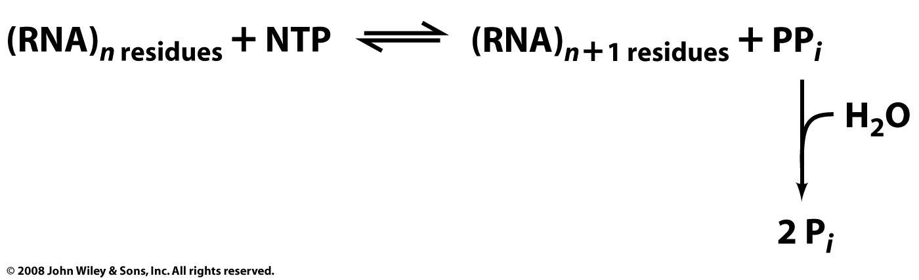
RNA polymerase (RNAP) is an enzyme that produces RNA using DNA as a template. RNAPs are essential to life and are found in all living systems.
RNAPs are nucleotidyl transferases that initiate synthesis de novo (do not require primers, unlike DNA polymerase) and add ribonucleotides to the 3' hydroxyl group of RNA molecules.

Slide 12
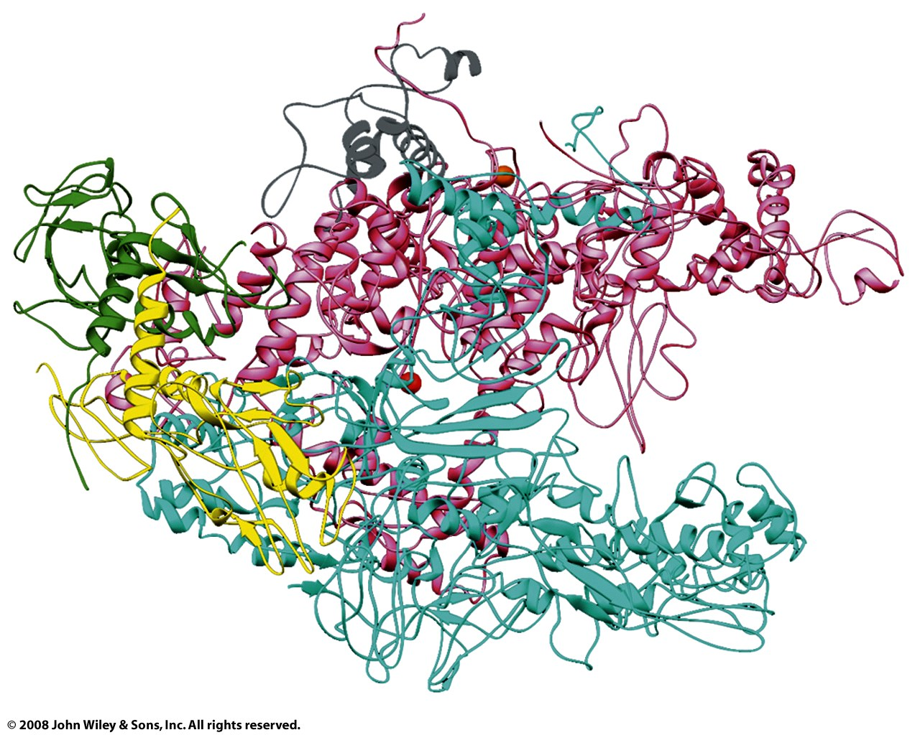
  α: yellow and green
  β: cyan
  β’: pink
  ω: gray
  σ: not shown here
Bacterial RNA polymerase:
Taq RNAP core enzyme
subunit structure α₂ββ’ωσ
* α: two α subunits (yellow,green) help with assembly and bind with regulatory elements.
* β: (cyan) the polymerase activity (catalyzes the synthesis of RNA).
* β': (pink) binds to DNA (nonspecifically) (β + β’ form claw).
* ω: (gray) promotes assembly
* σ: dissociates after initiation (not shown above, there are many different σ’s)

Slide 13
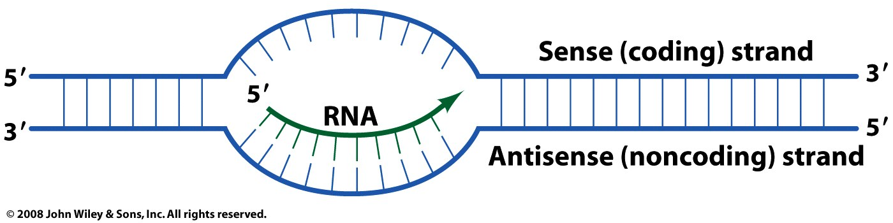
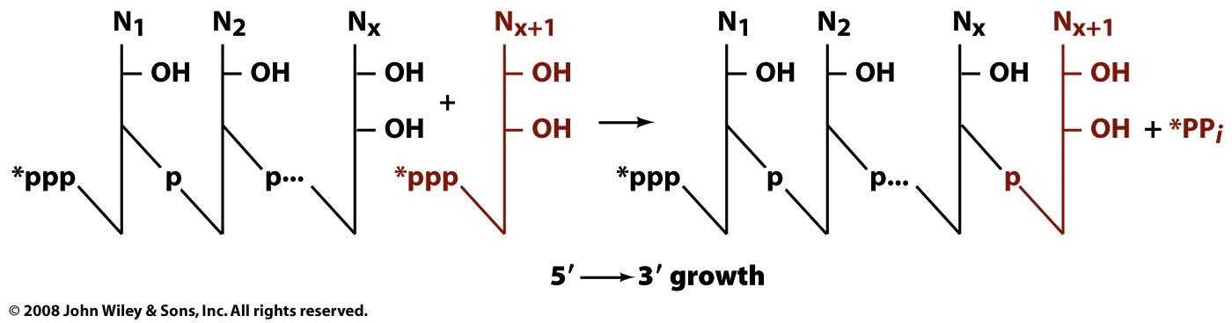
Only one strand of DNA is transcribed (unlike replication). The sense strand has the same sequence as the transcribed RNA.
The antisense strand is the DNA template.

Slide 14
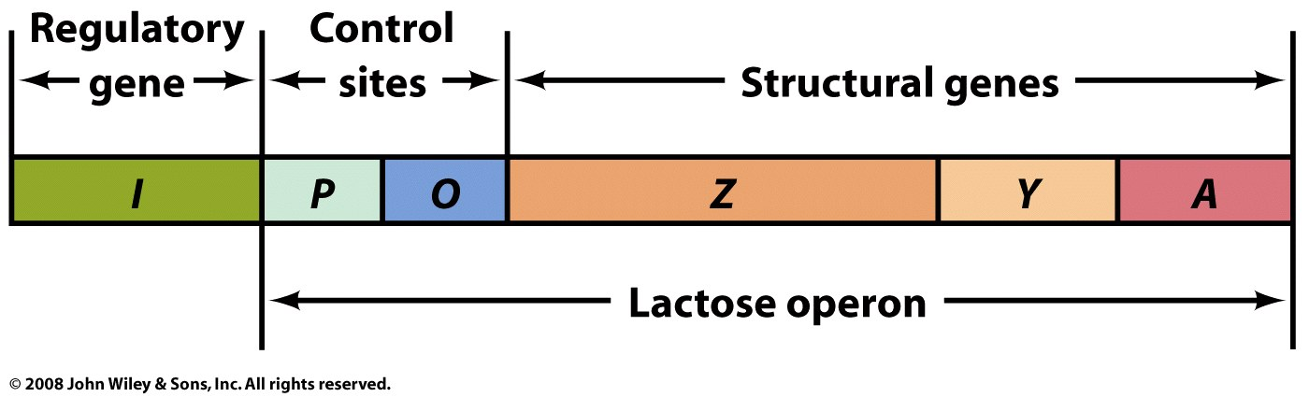
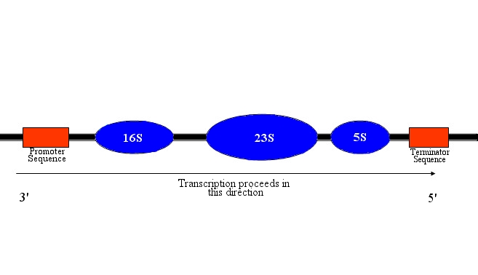
Bacterial genes are found in operons. The transcription of many genes with related functions can be controlled by a single control element (the σ factors). An operon is a cluster of genes under the control of a single regulatory signal or promoter. Eukaryotic genes are controlled independently (generally).

Slide 15
Steps in bacterial transcription
(1) Initiation
Starts at the +1 position, usually a purine. RNAP does not require a primer. Initiation involves a DNA Promoter, Transcription Factors, DNA Helicases, RNAP, Activators and Repressors. RNAP binds very tightly to the promotor (K_{D}=10⁻¹⁴M ). The promoter region (from -9 to +2) is melted (strands are separated), forming a transcription bubble.
Eukaryotes commonly use six General Transcription Factors (GTFs) to form a PreInitiation Complex (PIC). Transcription Factor IID (TF IID) contains TATA Box binding Protein (TBP). TBP binds to the TATA box but also to TATA-less promoters.

Slide 16
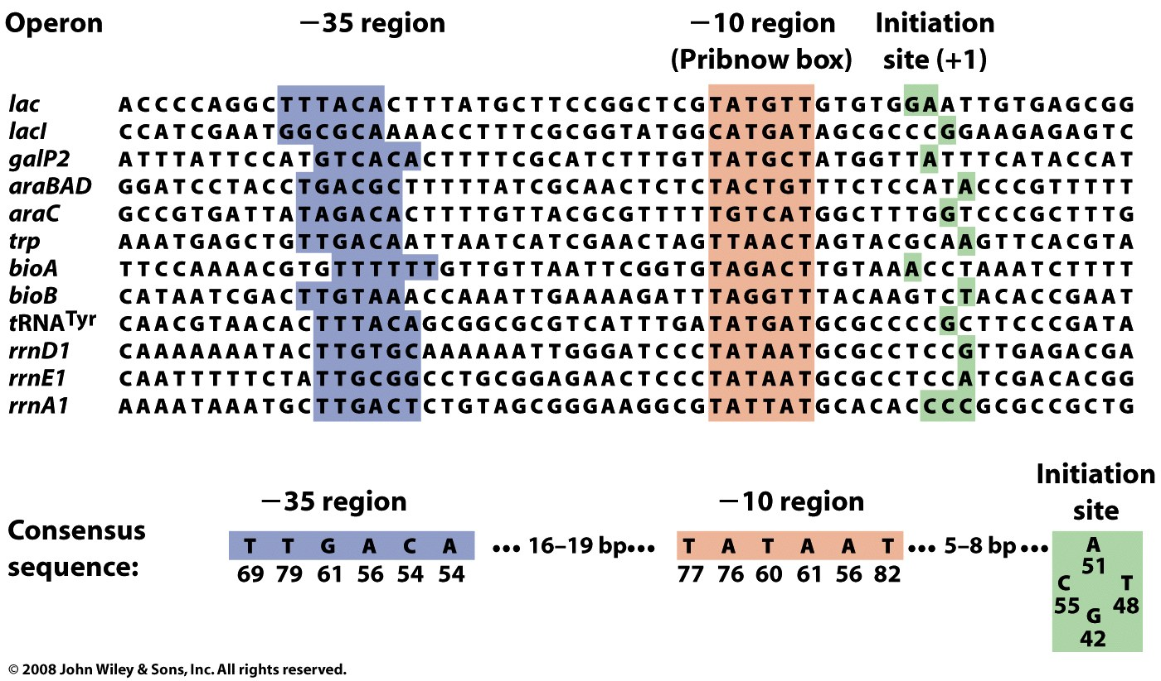
A promoter is a DNA sequence from -1 to around -40 (i.e., on the 5’ side of the sense strand of gene, upstream of the start site). RNAP binds to the Pribnow box during initiation which is the first region where base pairs are disrupted. The Pribnow box (TATAAT) is the most conserved part of the promoter.
Expression of genes (or operons) is controlled partly by various σ factors that recognize the -10 to -35 region. Different σ factors recognize different sequences. The α subunit recognizes an upstream element (-40 to -70 base pairs, TTGACA) of the DNA.

Slide 17
Steps in transcription
(2) Promoter clearance
After initiation the RNAP has a tendency to release truncated RNA transcripts (abortive initiation). Abortive initiation continues to occur until the σ factor rearranges and is released.
Eukaryotes: RNAP II clears the promoter and leaves behind some of the GTFs including TFIID (the second RNAP II complex can reinitiate more quickly than the first).

Slide 18
Steps in transcription
(3) Elongation
RNA polymerase traverses the DNA template (antisense) strand, and following the rules of Watson-Crick complementarity with the antisense strand, creates an RNA copy of the sense (coding) strand. Polymerization is processive (without dissociation). Transcripts can be thousands or even millions of nucleotides. The rate of polymerization is around 50 nucleotides/second, slower than replication. The error rate of transcription is around 1 in 4000. RNA polymerase traverses the template strand from 3' → 5'. Polymerization occurs in the 5' → 3' direction. The resulting RNA transcript is a copy of the sense (coding, non-template) strand, except that thymines are replaced with uracils, and deoxyriboses are replaced by riboses. A second RNAP can quickly reinitiate from the same site.
Eukaryotes: The C-Terminal Domain (CTD) of RpbI is phosphorylated and binds to a six protein complex called Elongator.

Slide 19
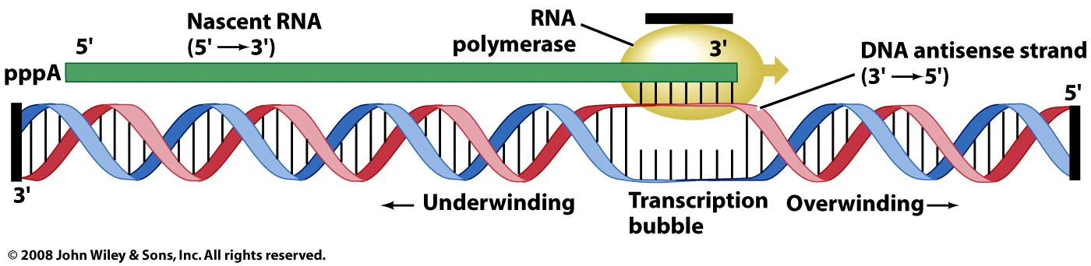
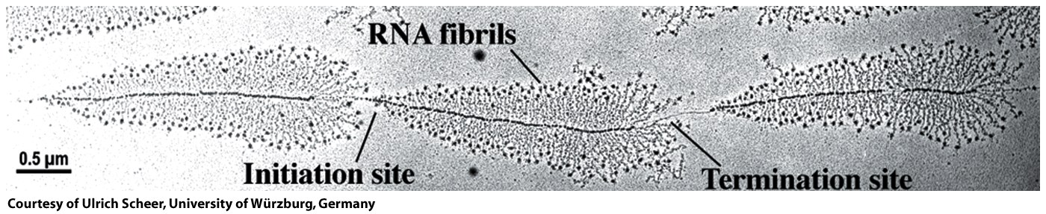
Topology issues during elongation.
gyrase
topoisomerase I
re-initiation
Figure 26-7

Slide 20
Steps in transcription
(4) Termination
Transcription terminates at specific sites. Bacteria use two strategies for termination.
In Rho-independent termination, the newly synthesized RNA molecule forms a G-C-rich stem-loop followed by a run of A's and U's. It seems the stem loop causes the RNAP to pause and ultimately to dissociate.
In the "Rho-dependent" termination, a protein "Rho" destabilizes the interaction between the template and the mRNA, thus releasing the newly synthesized mRNA from the elongation complex.
Eukaryotes lack specific transcription termination sites. The 3’ ends of the transcription product are heterogeneous, but are cleaned up by processing before translation (3’ poly A tails are added).

Slide 21
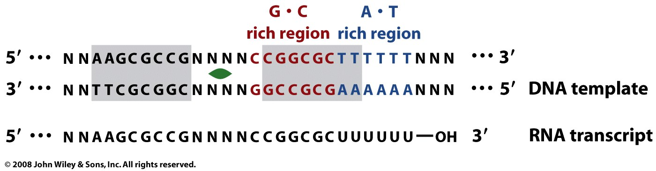
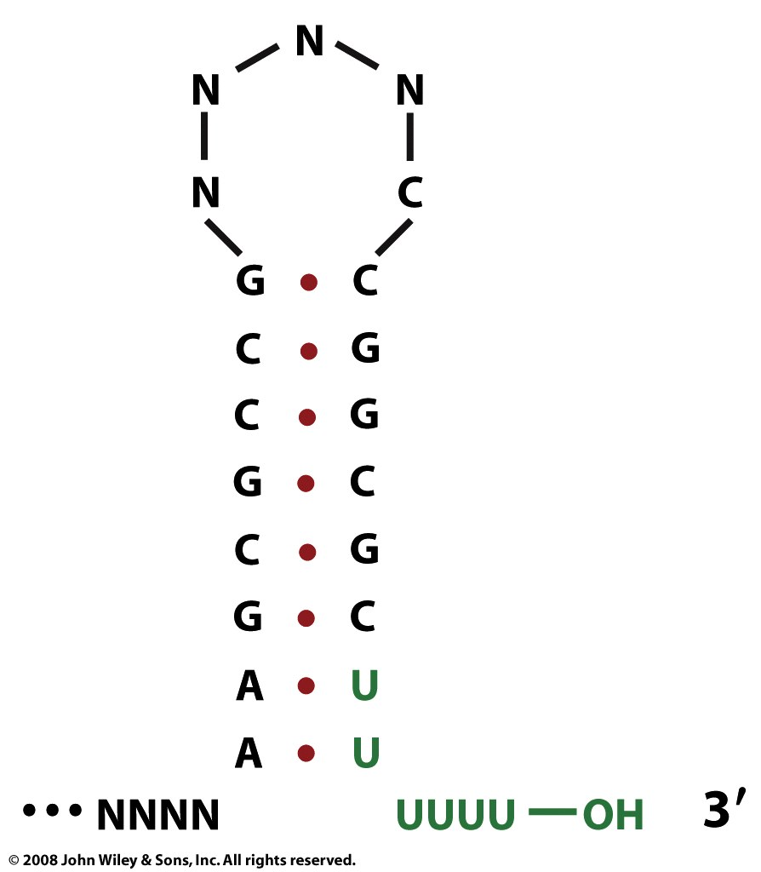
Rho-independent termination at a GC-rich palindrome.
Figure 26-9a

Slide 22
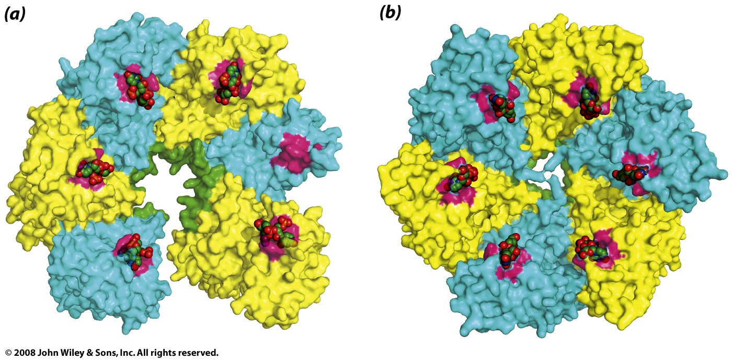
rho
The Rho factor recognizes ~70 nucleotides in the RNA product of transcription. The rho utilization site in the transcript (rut) is single-stranded, rich in cytosine and poor in guanine. Several rho binding sequences are known.

Slide 23
Nature. 2007 Jul 12;448(7150):157-62. Epub 2007 Jun 20.
Structural basis for transcription elongation by bacterial RNA polymerase.
Vassylyev DG, Vassylyeva MN, Perederina A, Tahirov TH, Artsimovitch I.
Source
Department of Biochemistry and Molecular Genetics, University of Alabama at Birmingham, Schools of Medicine and Dentistry, 402B Kaul Genetics Building, 720 20th Street South, Birmingham, Alabama 35294, USA. dmitry@uab.edu
Abstract: The RNA polymerase elongation complex (EC) is both highly stable and processive, rapidly extending RNA chains for thousands of nucleotides. Understanding the mechanisms of elongation and its regulation requires detailed information about the structural organization of the EC. Here we report the 2.5-A resolution structure of the Thermus thermophilus EC; the structure reveals the post-translocated intermediate with the DNA template in the active site available for pairing with the substrate. DNA strand separation occurs one position downstream of the active site, implying that only one substrate at a time can specifically bind to the EC. The upstream edge of the RNA/DNA hybrid stacks on the beta'-subunit 'lid' loop, whereas the first displaced RNA base is trapped within a protein pocket, suggesting a mechanism for RNA displacement. The RNA is threaded through the RNA exit channel, where it adopts a conformation mimicking that of a single strand within a double helix, providing insight into a mechanism for hairpin-dependent pausing and termination.

Slide 24
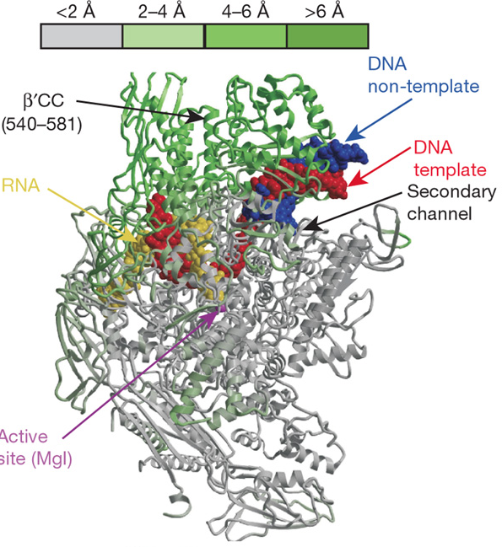
In these two views (the next page shows the view across the RNAP main channel), the RNAP core enzyme structure in the ttEC is colored from grey (less than 2 Å) to green (more than 6 Å) according to the deviation in the positions of the C_{a} atoms of the holoenzyme (PDB ID 2A6H).
The rest of the color scheme is
grey, RNAP;
red, DNA template;
blue, DNA non-template;
yellow, RNA; magenta,
The high-affinity Mg²⁺ ion, is also shown.
The green-grey coloring scheme shows changes in structure compared to the holoenzyme, which is the initiation complex. The holoenzyme contains σ, which enables promoter-specific transcription initiation.
from Vassylyev, Nature, 2007

Slide 25
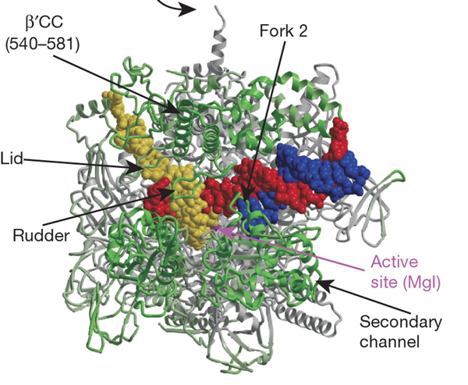
Here is a second view of the structure of the T. thermophilus RNAP EC (ttEC) at 2.5 Å resolution in which the core enzyme (subunit composition α₂ββ’ω) is bound to 14 base pairs (bp) of the downstream DNA, 9 bp of the RNA/DNA hybrid and seven single-stranded nucleotides of the displaced RNA transcript
from Vassylyev, Nature, 2007

Slide 26
In all organisms, transcription by DNA-dependent RNA polymerases (RNAPs) can be divided into three mechanistically and structurally distinct stages: initiation, elongation and termination. During initiation, RNAP recognizes a promoter, unwinds DNA near the start site (register i + 1) and begins RNA synthesis, using NTPs as both a primer and the substrates. Initiation is characterized by multiple rounds of abortive synthesis during which RNAP synthesizes and releases short RNA products. Once RNAP has made an RNA molecule 13–15 nucleotide long, in which 7–9 nucleotides pair with the DNA template strand in an RNA/DNA hybrid, the transcription complex undergoes promoter clearance and makes a transition to the elongation phase.
Elongation is highly processive: the elongation complex (EC) is capable of the uninterrupted synthesis of RNA chains thousands of nucleotides long, yet becomes abruptly destabilized at terminators that demarcate the RNA end, in many cases with single-nucleotide precision. The interplay between processive synthesis, transient halting at numerous 'roadblocks' and RNA release depends on the intricate network of interactions between RNAP, the nucleic acid signals and/or auxiliary transcription factors within the EC.
from Vassylyev, Nature, 2007

Slide 27
Eukaryotic Transcription:
Multiple RNAPs for different kinds of RNAs. Eukaryotes have more complicated polymerases and control mechanisms.
RNAPs + control proteins = ~100 proteins for recognition and initiation.
RNAP I: rRNAs (except 5S rRNA). Requires promoters and upstream promoters (between postions -107 and -187).
RNAP II: mRNAs. long diverse promoters. Around ¼ of human genes are regulated by a TATA box (position -27). TATA is found in both archaea and eukarya and is thought to be evolutionarily ancient.
Enhancers: promoters that are remote from the start site.
RNAP III: 5SrRNA, tRNA, small RNAs

Slide 28
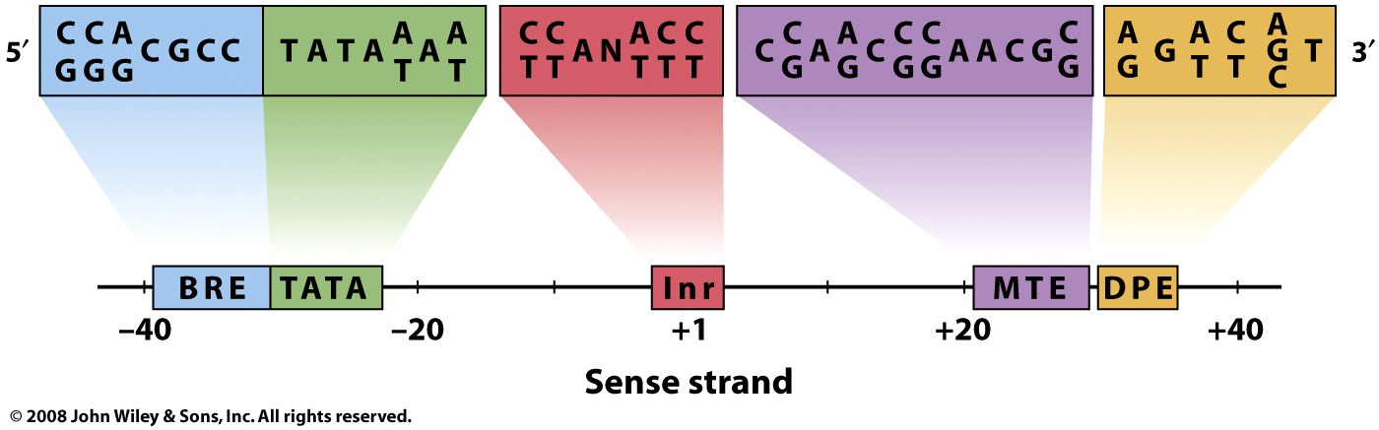
Core promoter sequences. A given promoter can contain all, some, or none of these.
Figure 26-14

Slide 29
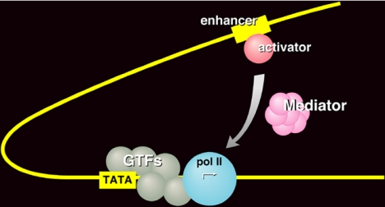

Slide 30
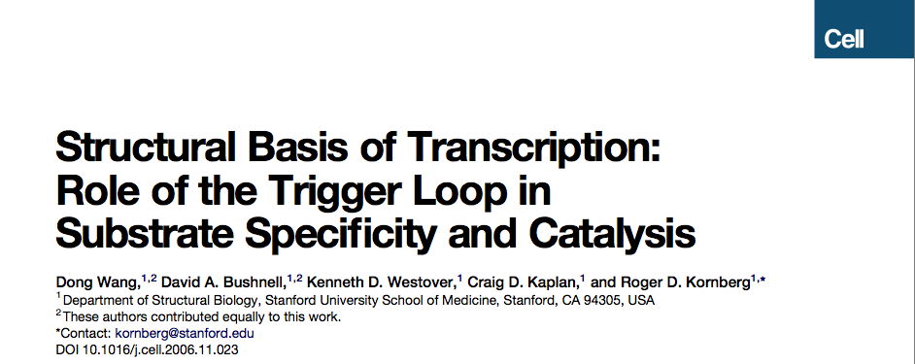
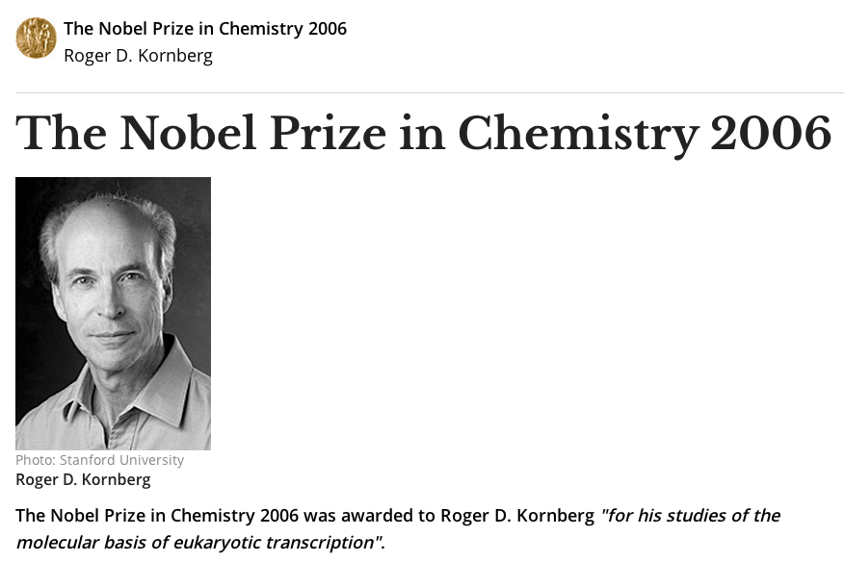
Cell 127: 941-954.

Slide 31
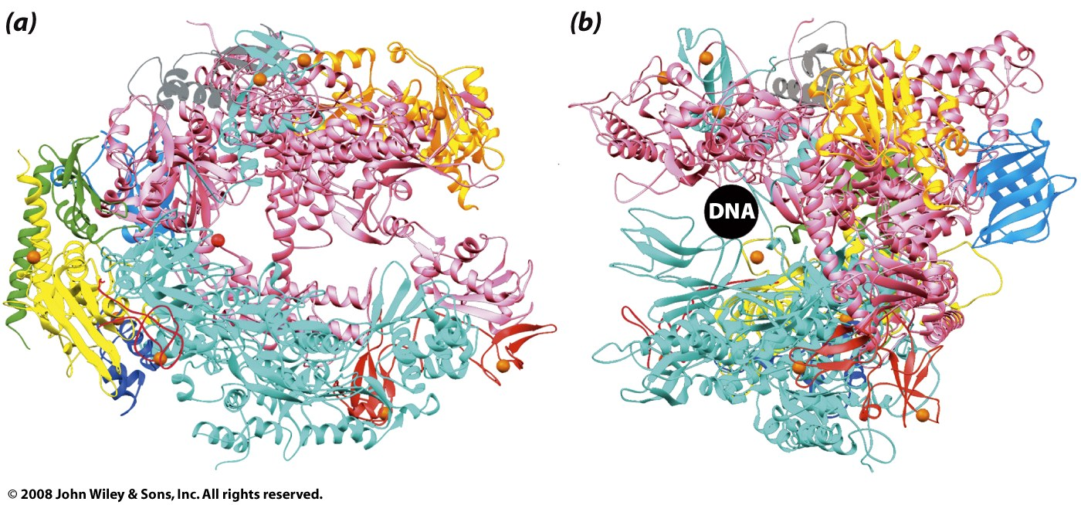
yeast RNAP II
  yellow and green [bacteria homolog: α:]
  Rpb2 (cyan, forms clamp, wall) [bacteria homolog: β]
  Rpb1 (pink, catalysis) [bacteria homolog: β’]
  gray [bacteria homolog: ω]
Notes:
bacteria
* α: two α subunits help with assembly and bind with regulatory elements.
* β: the polymerase activity (catalyzes the synthesis of RNA).
* β': binds to DNA (nonspecifically) (β + β’ form claw).
* ω: promotes assembly
* σ: dissociates after initiation (not shown above, there are many different σ’s)

Slide 32
yeast RNAP II
Rpb1 (pink) C-terminal domain: heptapeptide repeats
-(Pro-Thr-Ser-Pro-Ser-Try-Ser)_{26(yeast)-52(mammel)}-
unphosphorylated: initiation
phosphorylated: elongation
Figure 26-11

Slide 33
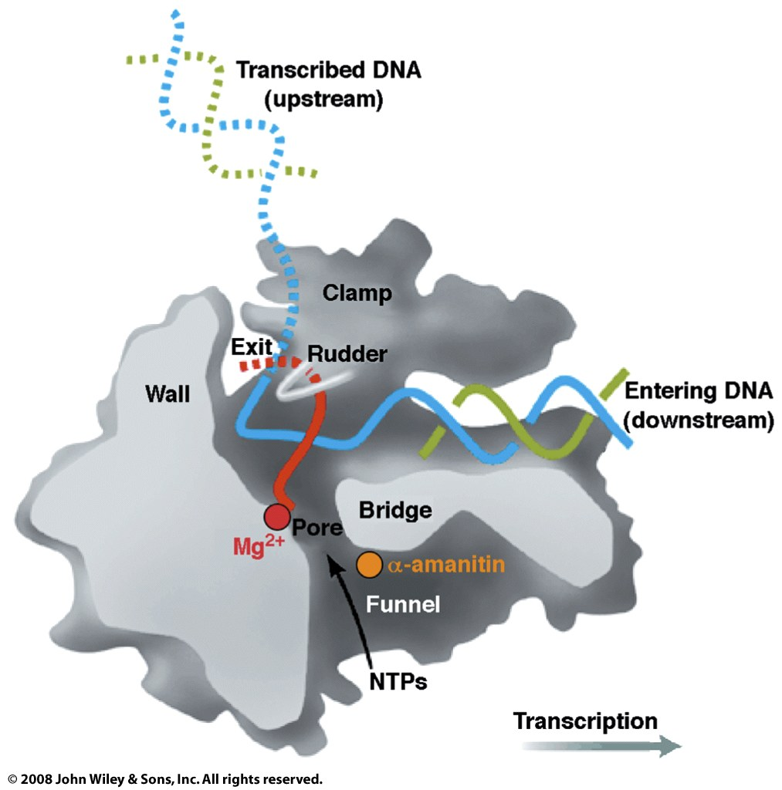
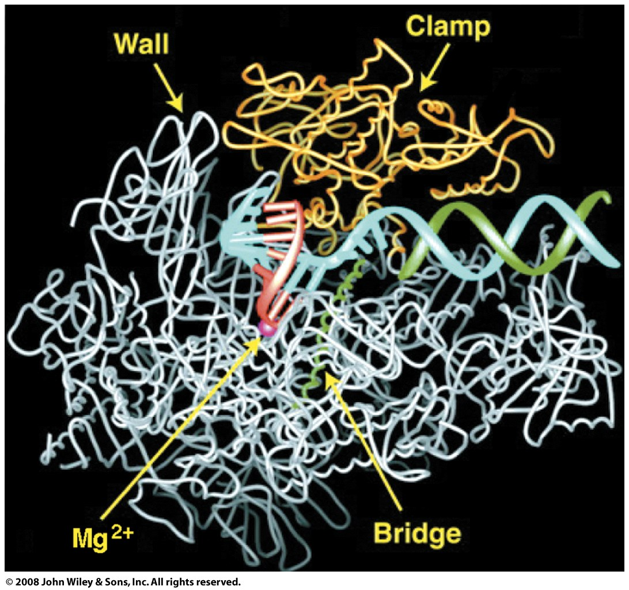
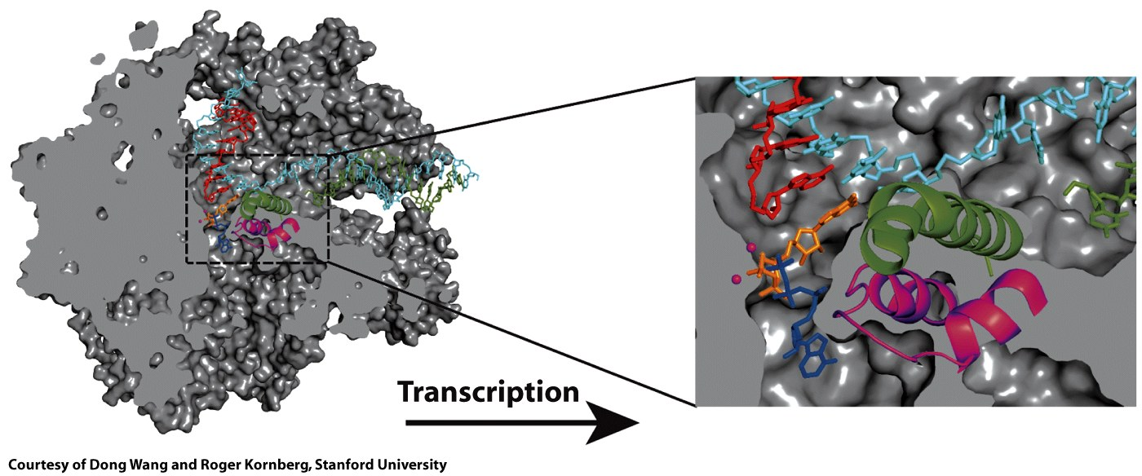
Trapped
elongation (minus rU)
RNAP II

Slide 34
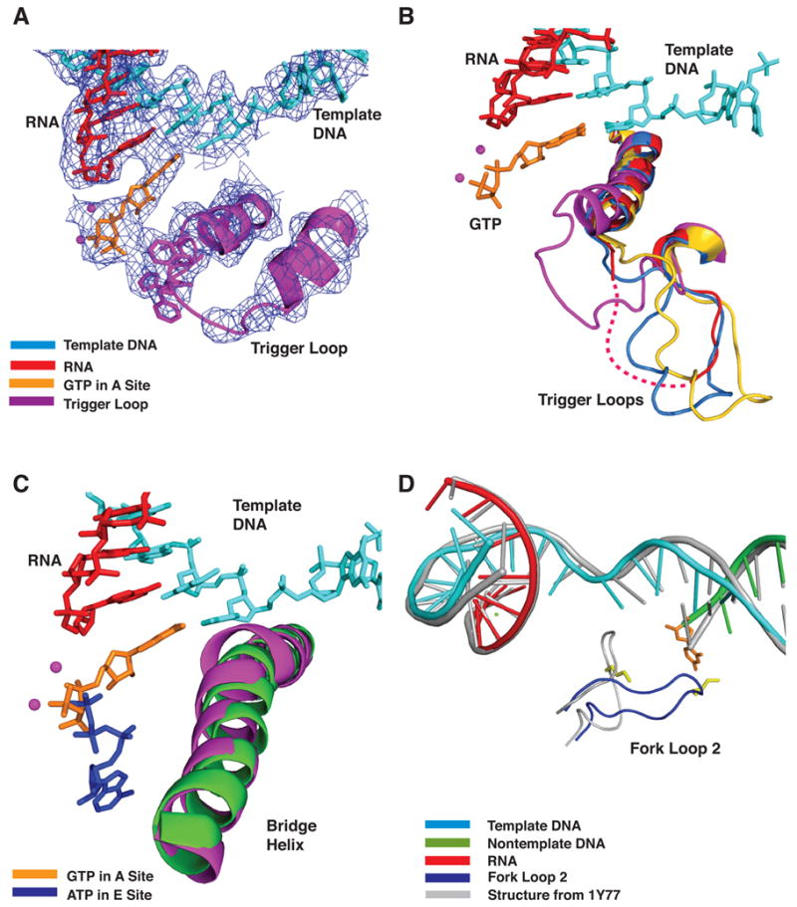
(A) DNA, RNA, trigger loop, and GTP in the A site. Electron density from x-ray diffraction.
(B) Multiple conformations of the trigger loop. Four Pol II transcribing complexes- GTP (A site, low Mg2+) in magenta, ATP (E site, low Mg2+, 1R9T) in red, UTP (E site, high Mg2+) in marine, and pol II-TFIIS (No nucleotide, high Mg2+, 1Y1V) in yellow are superimposed on Cα atoms in the bridge helix and trigger loop.
(C) Bridge helix movement in transcribing complex

Slide 35
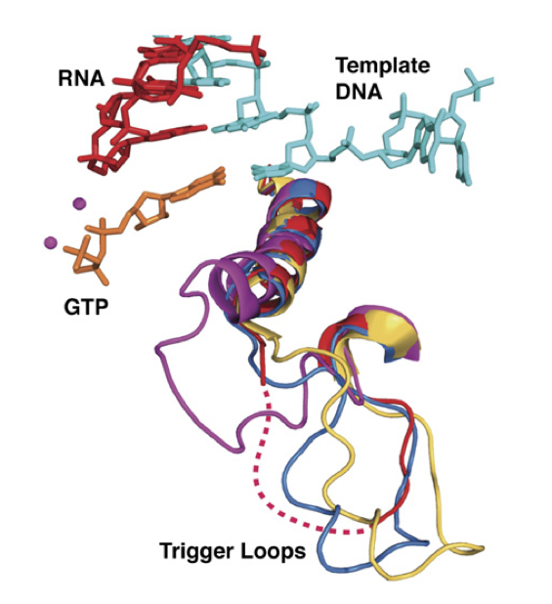

Slide 36
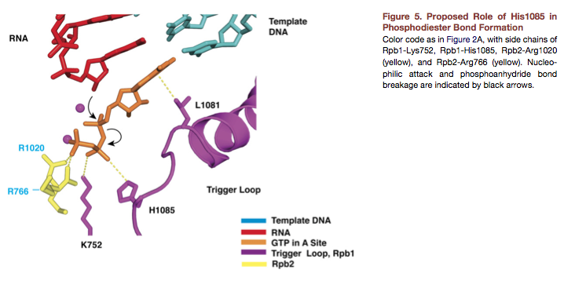

Slide 37
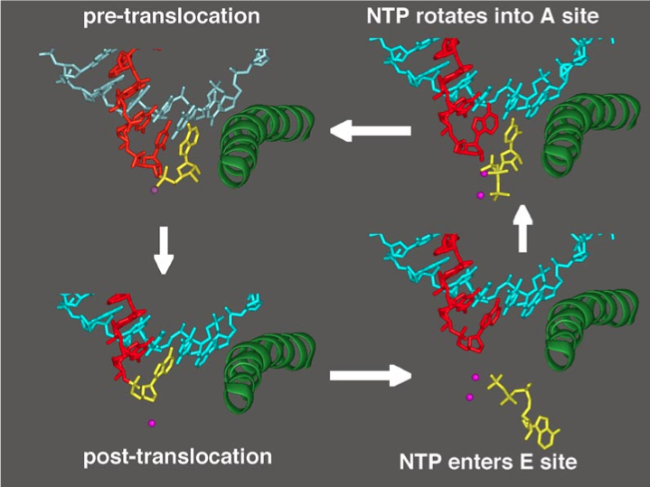

Slide 38
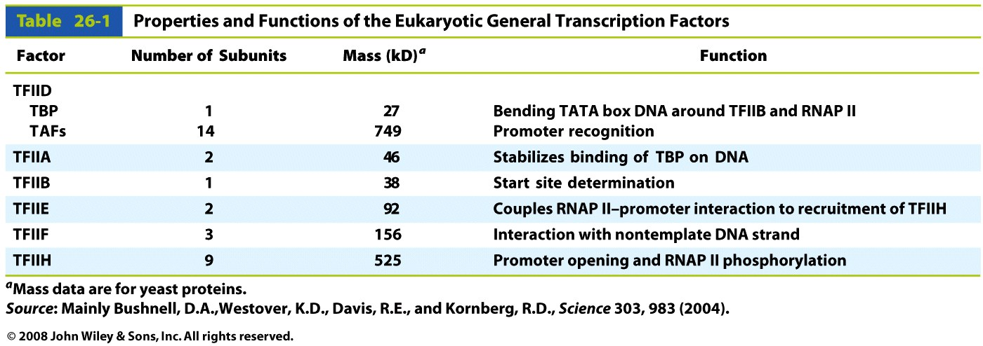
Transcription Factors

Slide 39
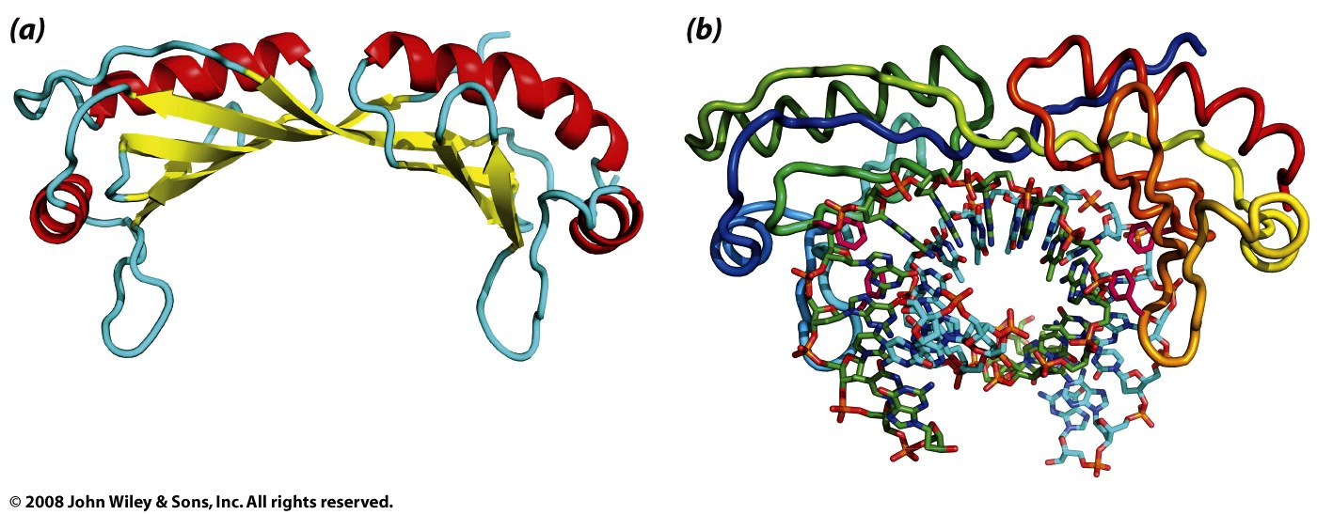
TBP: (part of TFIID)
Figure 26-15

Slide 40
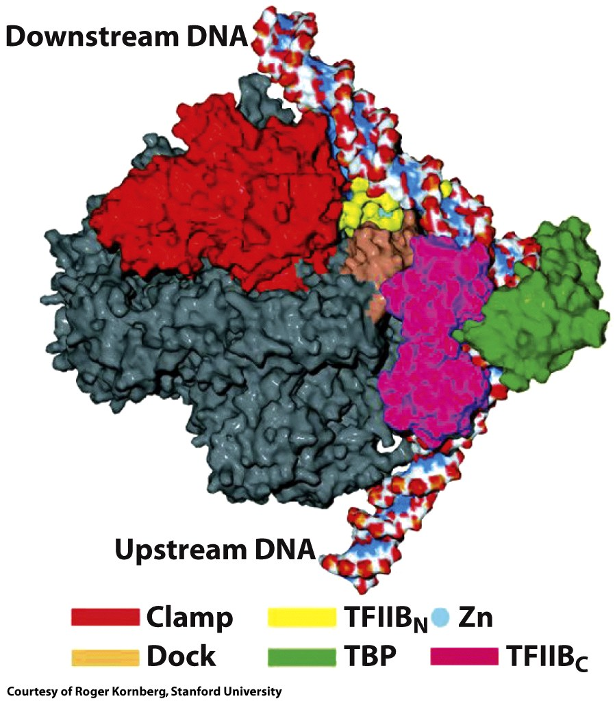
Figure 26-17b

Slide 41
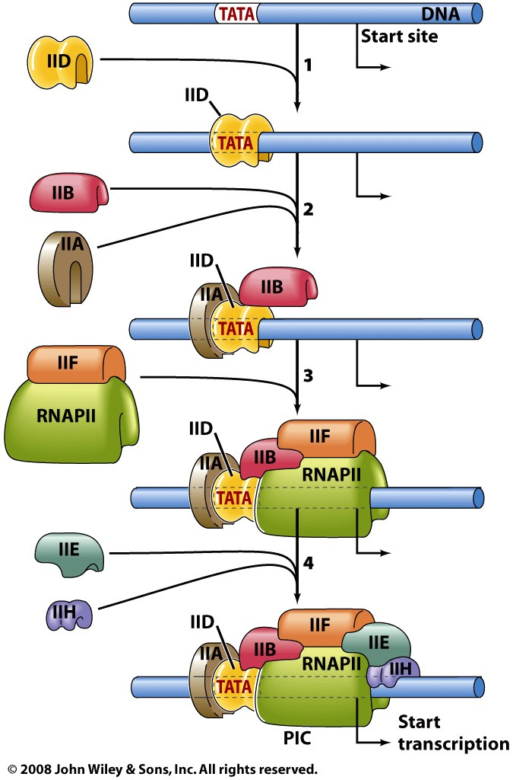
Transcription Factors

Slide 42
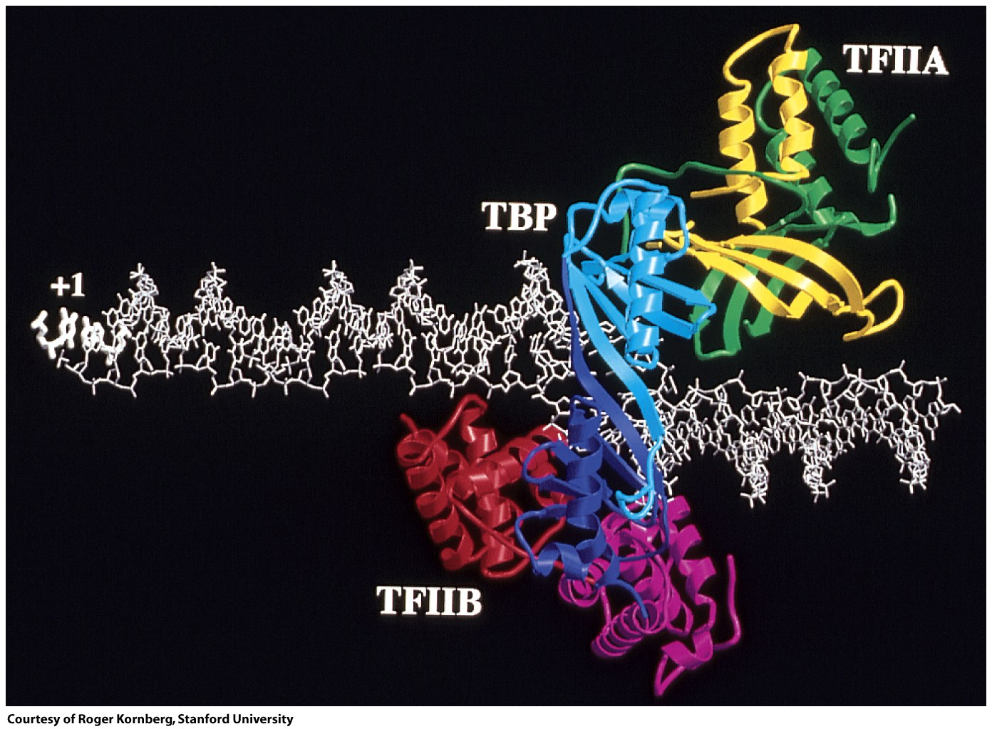
Figure 26-17a

Slide 43
Splicing
Introns
intragenic sequences that are not expressed in protein.
Exons
Sequences that are contained in mature mRNA and are expressed as proteins.
Intons are removed by RNA splicing, which follows transcription and precedes translation.

Slide 44
Splicing
-----------pre-mRNA------------
RNA splicing of pre-messenger RNA this text does not belong in the mature mRNA is the removal of introns and the ligation of exons.
-----------splice => mature mRNA------------
Exon: RNA splicing of pre-messenger RNA is the removal of introns and the ligation of exons.
----------- + ------------
Intron: this text does not belong in the mature mRNA
The numbers and sizes of introns is variable.
The average human gene is 30 kb, consisting of numerous splice sites. The human DHFR mRNA is 2000 nucleotides.
The DHFR gene is 31,000 nucleotides (6 exons).
cDNA: mRNA (reverse transcriptase) => copy DNA (clean, no introns)

Slide 45
Stop here

Slide 46
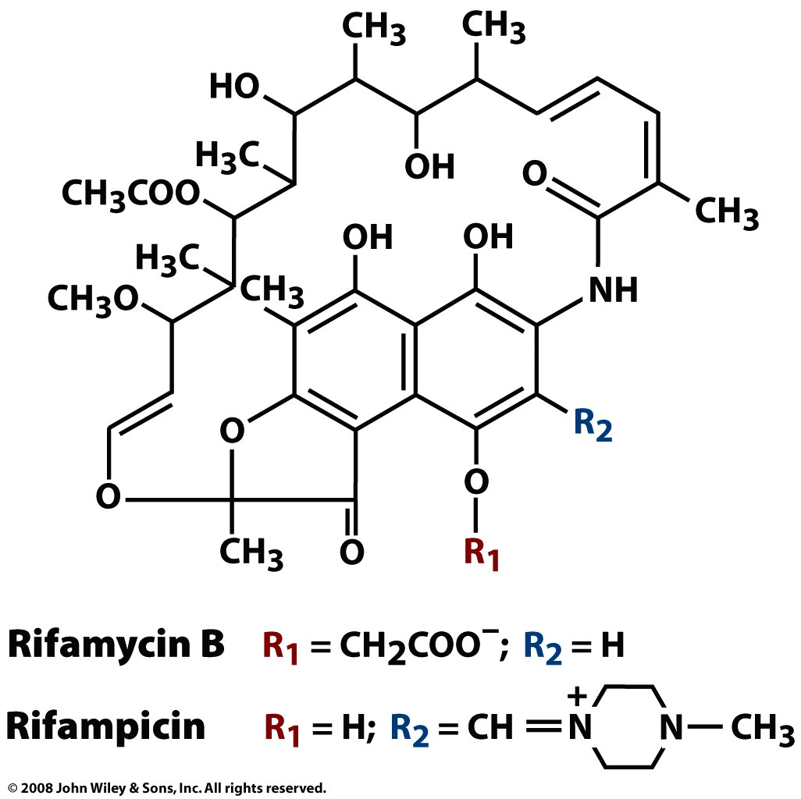
Box 26-2 figure 1

Slide 47
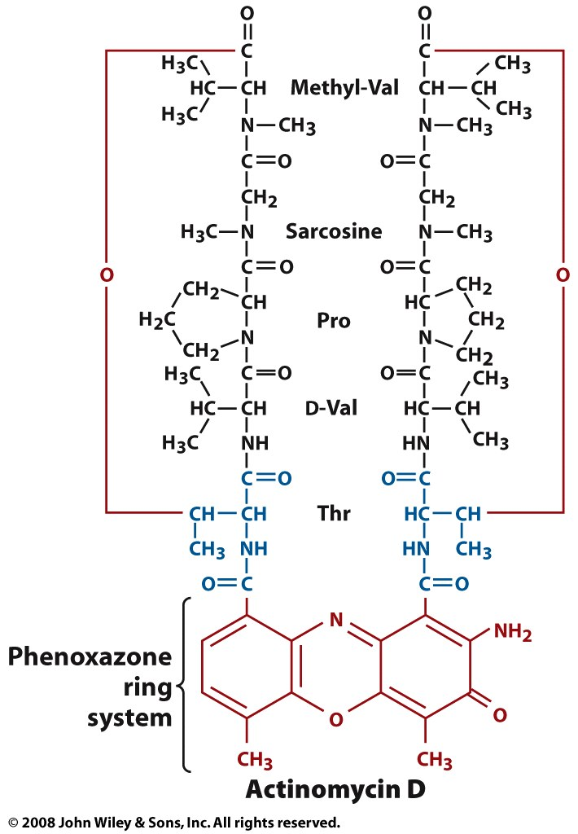
Box 26-2 figure 2

Slide 48
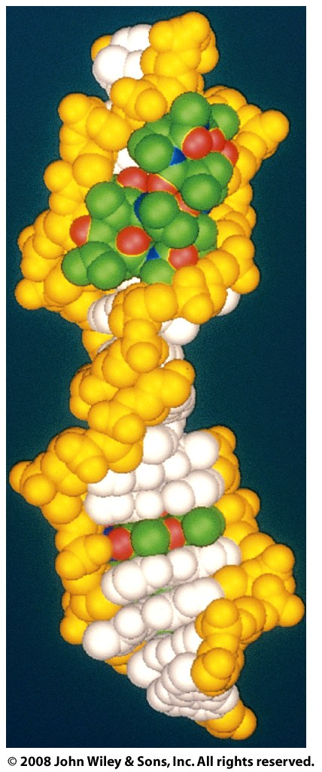
Box 26-2 figure 3

Slide 49
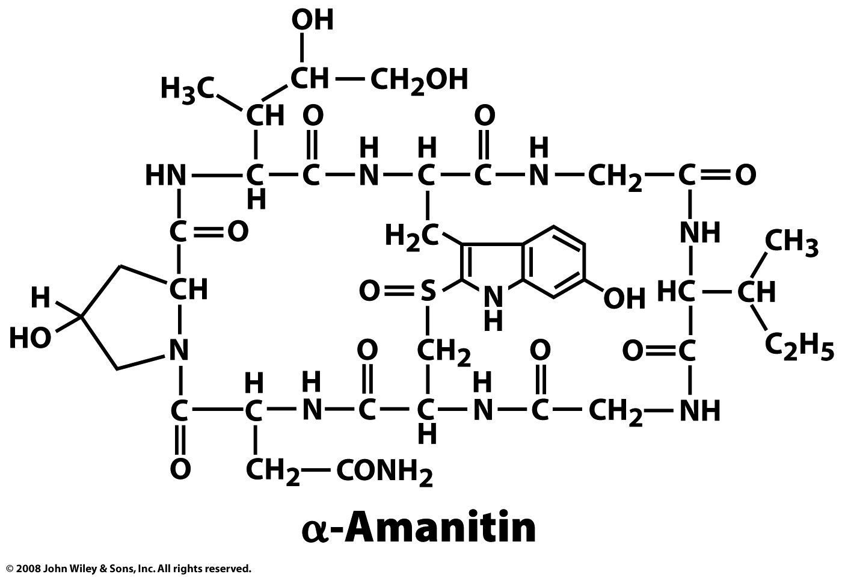
Box 26-2 figure 4

Slide 50
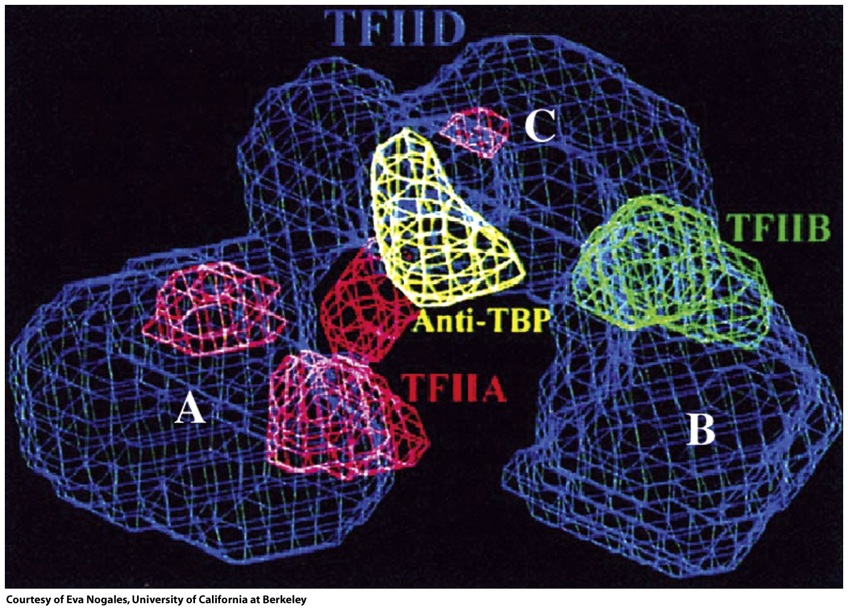
Figure 26-18

Slide 51
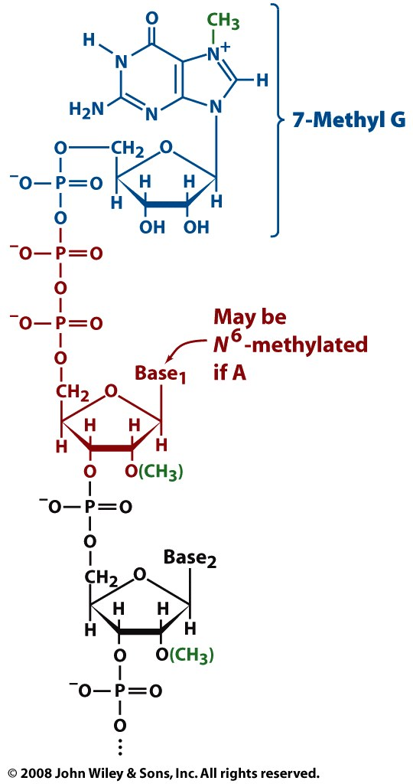
Figure 26-19

Slide 52
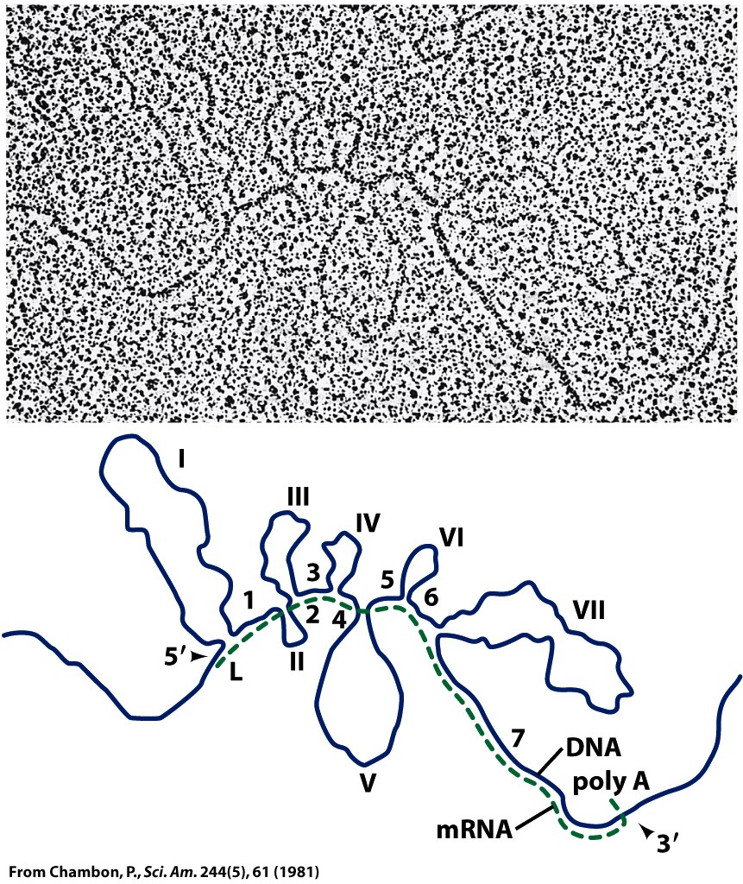
Figure 26-20

Slide 53
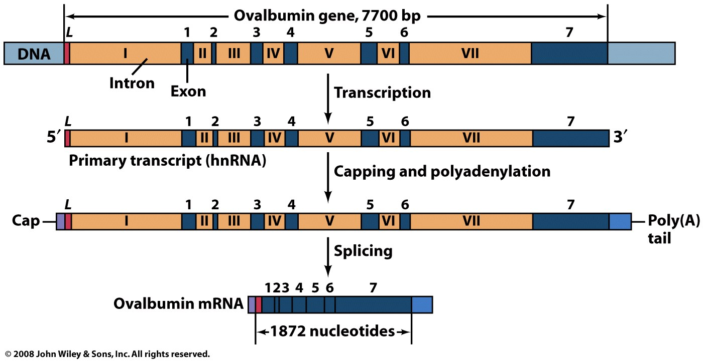
Figure 26-21

Slide 54
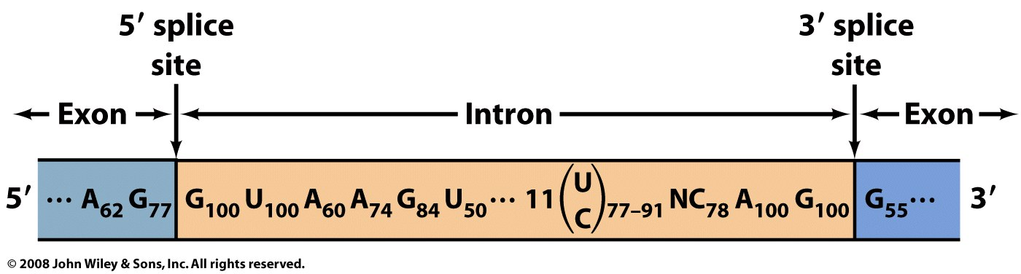
Figure 26-22

Slide 55
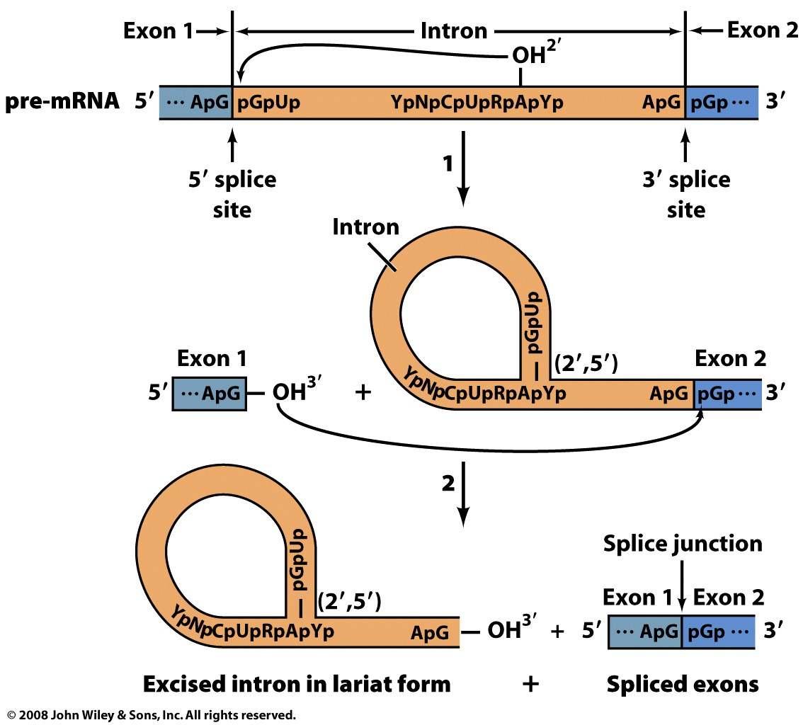
Figure 26-23

Slide 56
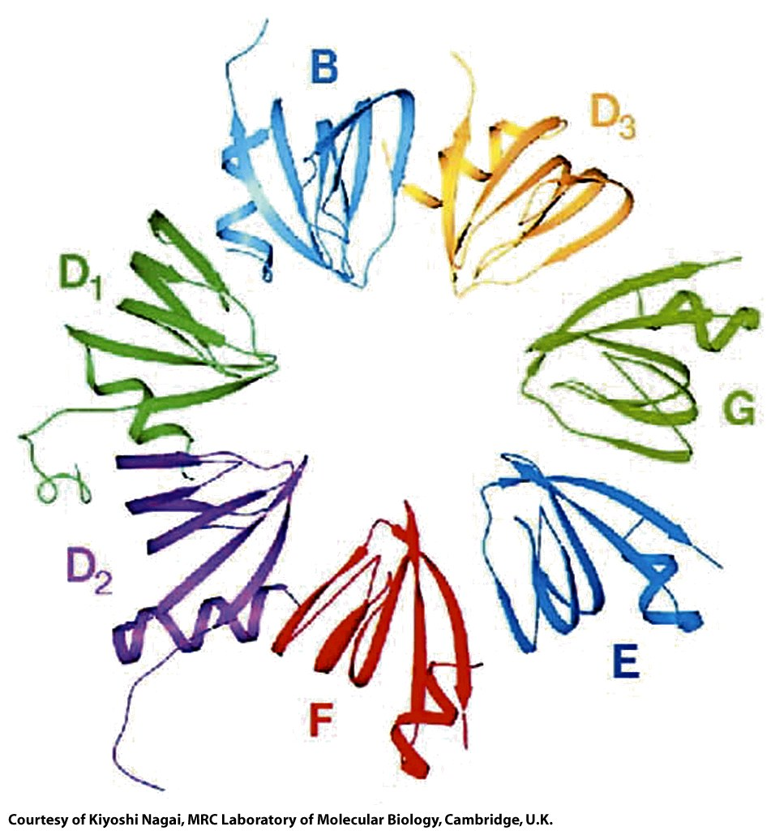
Figure 26-24

Slide 57
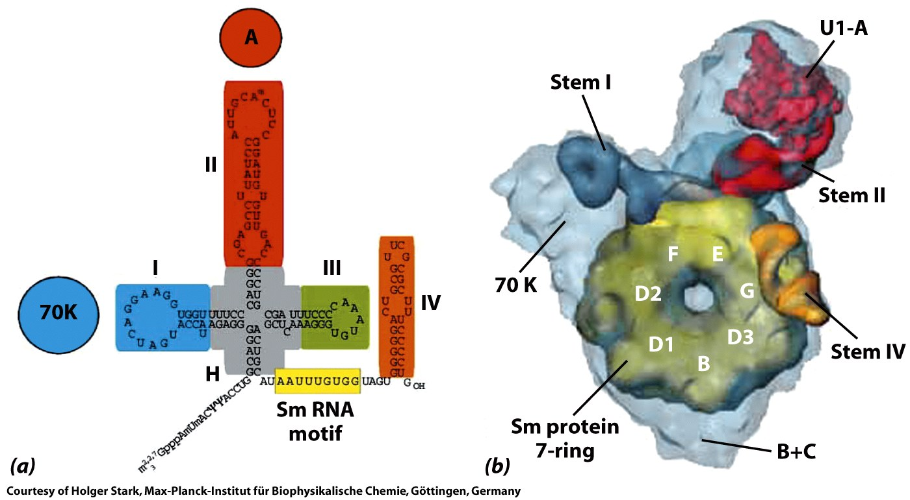
Figure 26-25

Slide 58
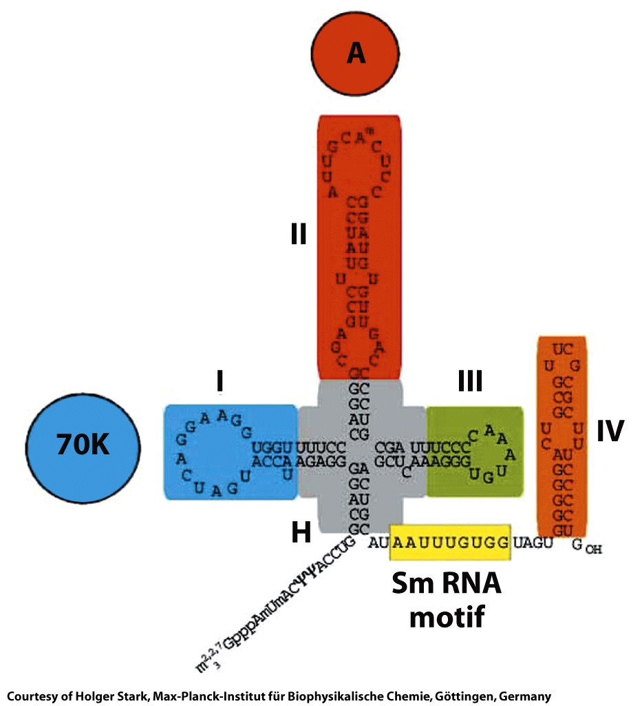
Figure 26-25a

Slide 59
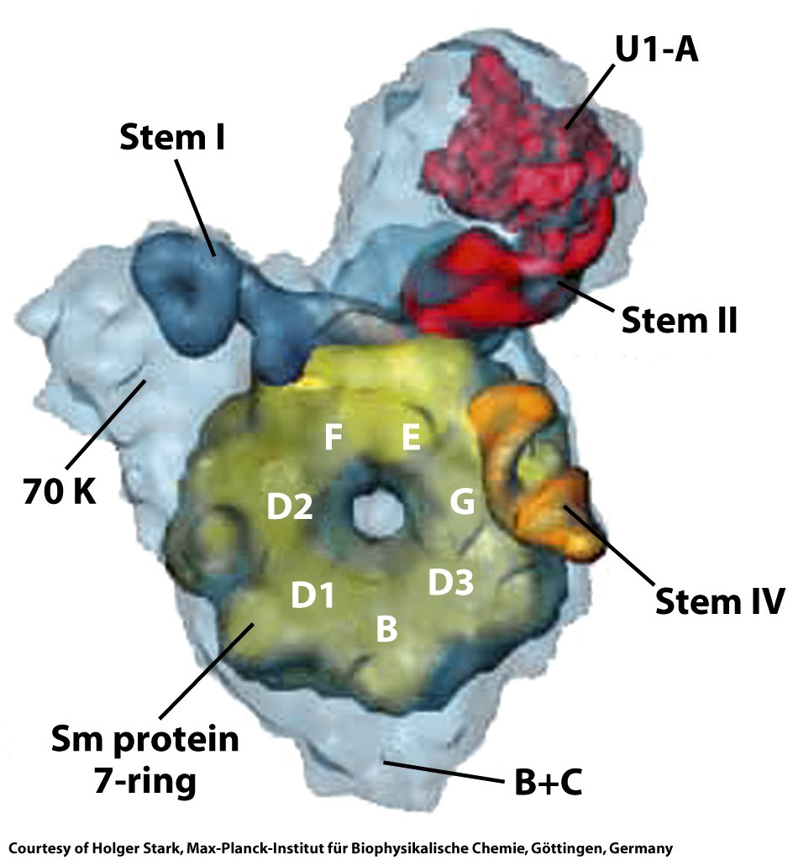
Figure 26-25b

Slide 60

Figure 26-26

Slide 61

Figure 26-27

Slide 62

Figure 26-28

Slide 63

Page 977

Slide 64

Page 977

Slide 65

Figure 26-29

Slide 66

Figure 26-29 part 1

Slide 67

Figure 26-29 part 2

Slide 68

Figure 26-29 part 3

Slide 69

Figure 26-30

Slide 70

Figure 26-30a

Slide 71

Figure 26-30b

Slide 72

Figure 26-31

Slide 73

Figure 26-32a

Slide 74

Figure 26-32b

Slide 75

Figure 26-33

