Slide 1
Section I. What is the RNA World?

Slide 2
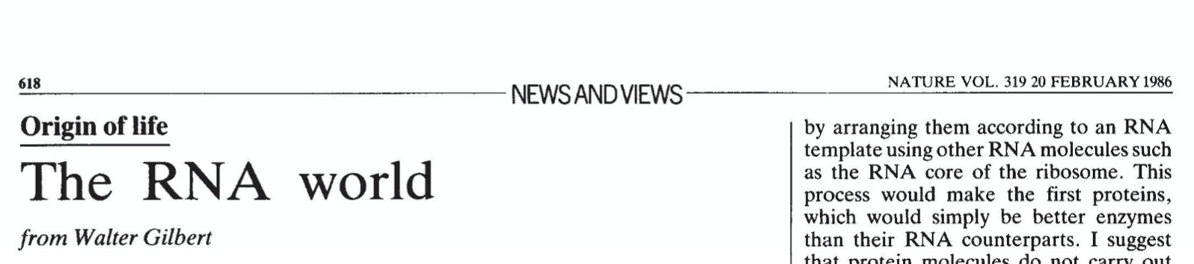

Slide 3
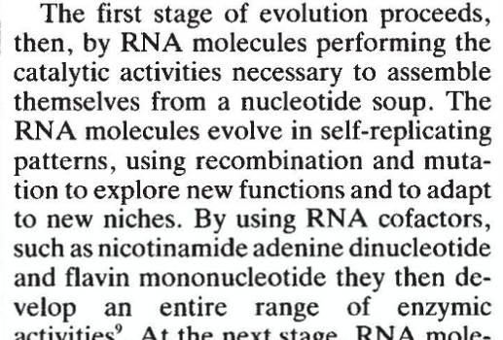
Stage 1
RNA is formed via abiotic processes
RNA catalytically self-polymerizes
RNA initiates self-replication
RNA initiates natural selection and Darwinian Evolution
(replication and selection)

Slide 4
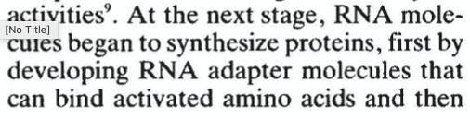
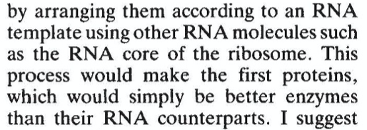
Stage 2
RNA invents the ribosome and coded proteins
(because proteins are better enzymes than RNA).

Slide 5
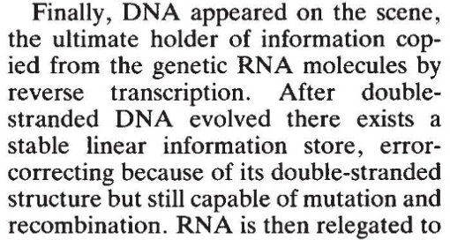
Stage 3
RNA and protein invent DNA
DNA is a better genomic material because it is
chemically more persistent than RNA, is double-stranded, etc

Slide 6
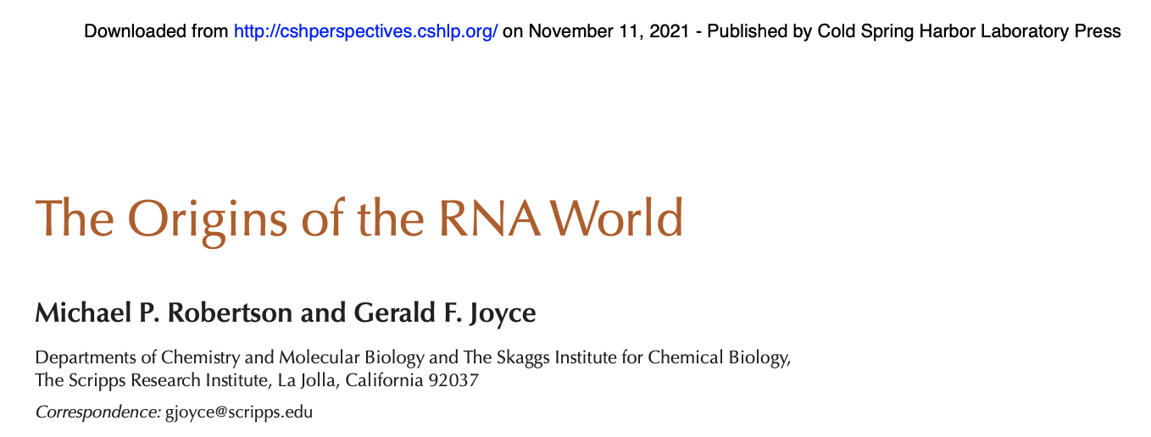
All RNA World hypotheses include three basic assumptions:
At some time in the evolution of life, genetic continuity was assured by self-replication of RNA
An RNA-based polymerase replicated RNA
Watson-Crick base-pairing was the key to replication;
During the RNA-World, genetically encoded proteins were not involved as catalysts.
Ribozymes preceded protein-based enzymes

Slide 7
Section II. Rationale for the RNA World

Slide 8

The Streetlight effect: we have to look where we can see.
“If RNA was not the first genetic material,
biochemistry might provide no clues to the origins of life.” (Orgel)

Slide 9
Leslie Orgel
If RNA was not the first genetic material, biochemistry might provide no clues to the origins of life….
However, if there were two or more worlds before the RNA world, the original chemistry might have left no trace in contemporary biochemistry. ….
…
The only potentially informational systems, other than nucleic acids, that have been discovered are closely related to nucleic acids.

Slide 10
Leslie Orgel
If RNA was not the first genetic material, biochemistry might provide no clues to the origins of life….
However, if there were two or more worlds before the RNA world, the original chemistry might have left no trace in contemporary biochemistry. … This gloomy prospect has not prevented discussion of alternative genetic systems.
…
The only potentially informational systems, other than nucleic acids, that have been discovered are closely related to nucleic acids.

Slide 11


RNA is enzymatic and informational:
enzymes

Slide 12
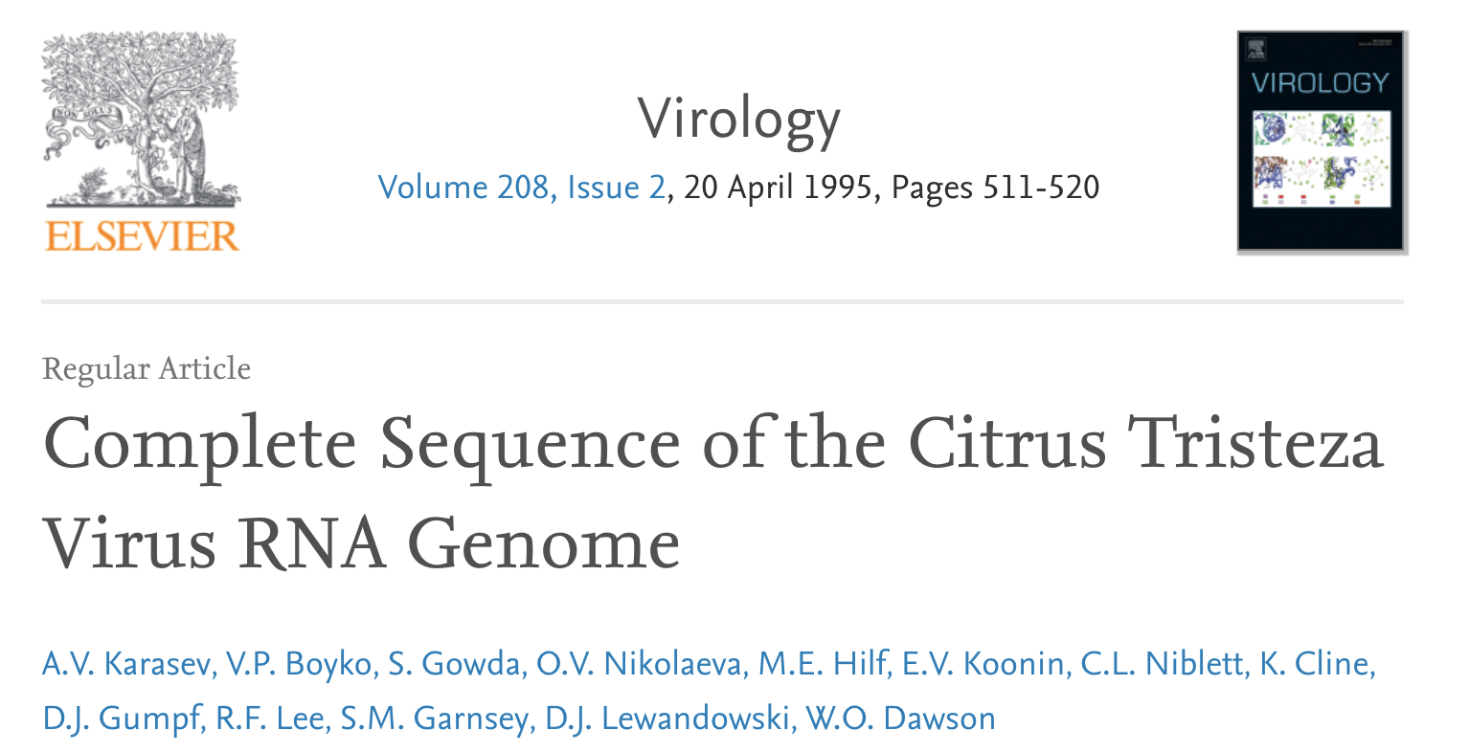
RNA is enzymatic and informational:
information

Slide 13
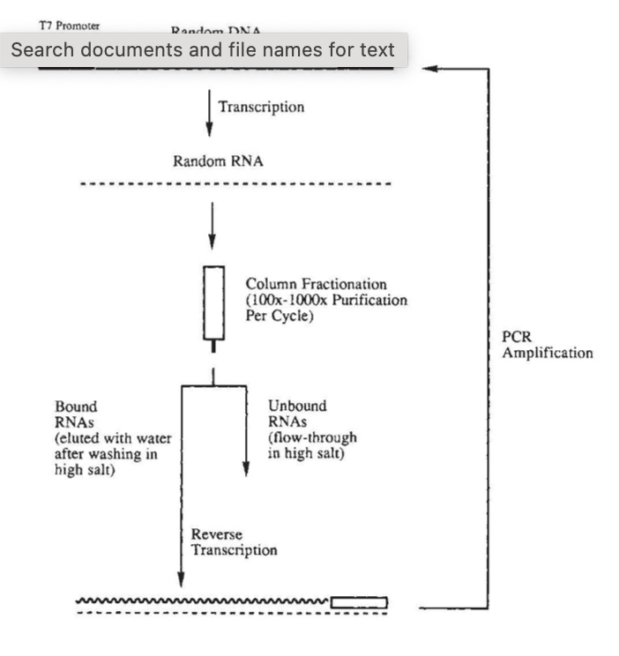
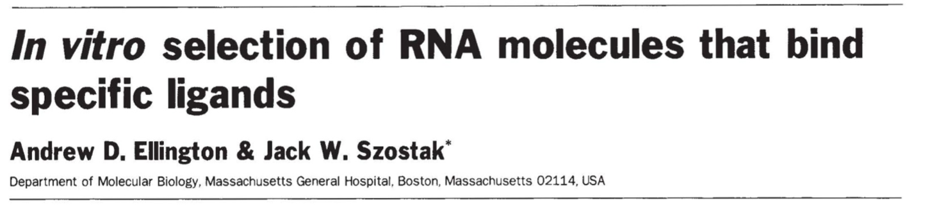
RNA sequences can be selected in vitro:
to produce a variety of enzymatic activities and binding functions.
(including a lame, semi-functional RNA polymerase)

Slide 14
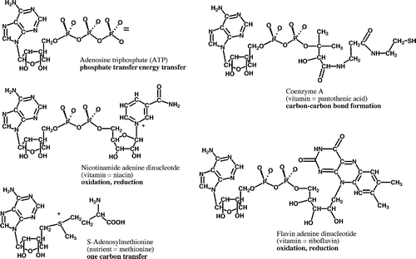
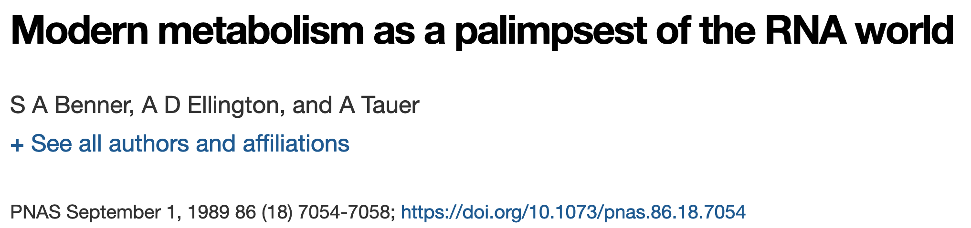
Metabolites indicate the importance of RNA
The incorporation of nucleotides into universal metabolic cofactors suggests that extant metabolism originated in a system where RNA especially significant

Slide 15
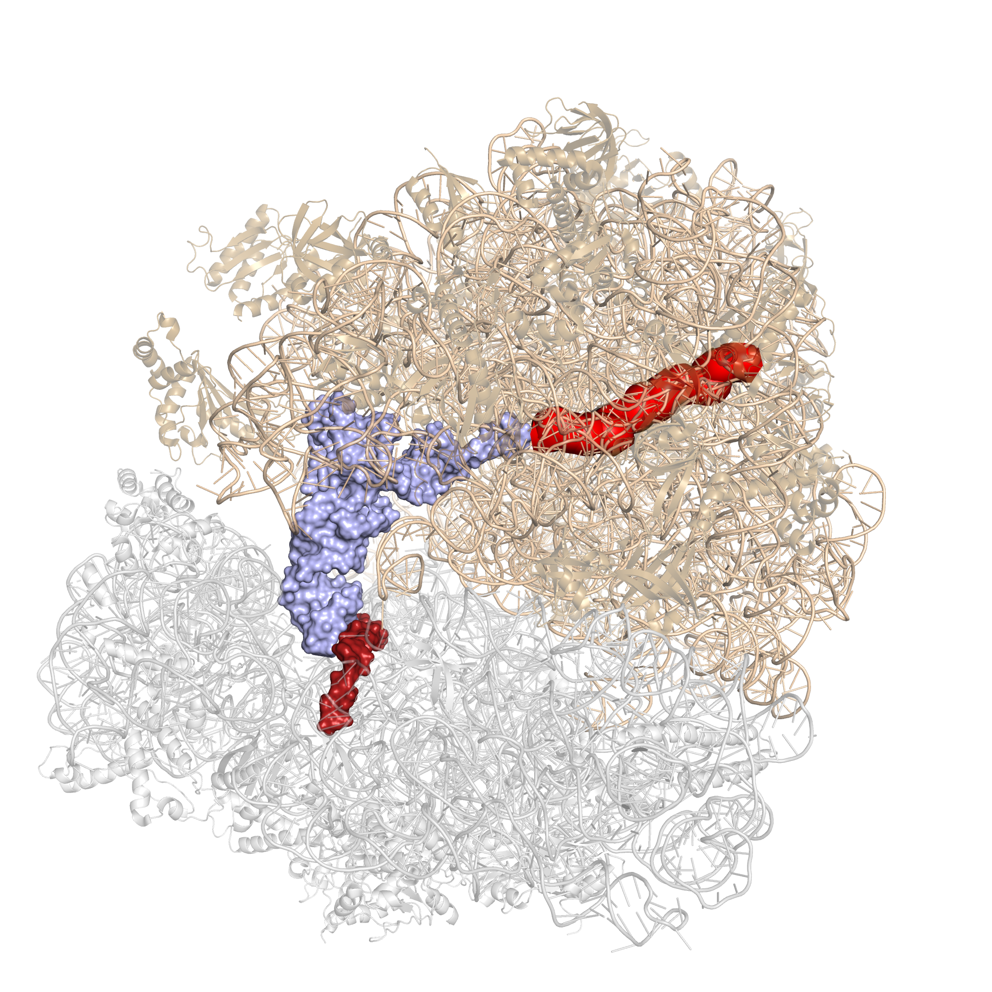
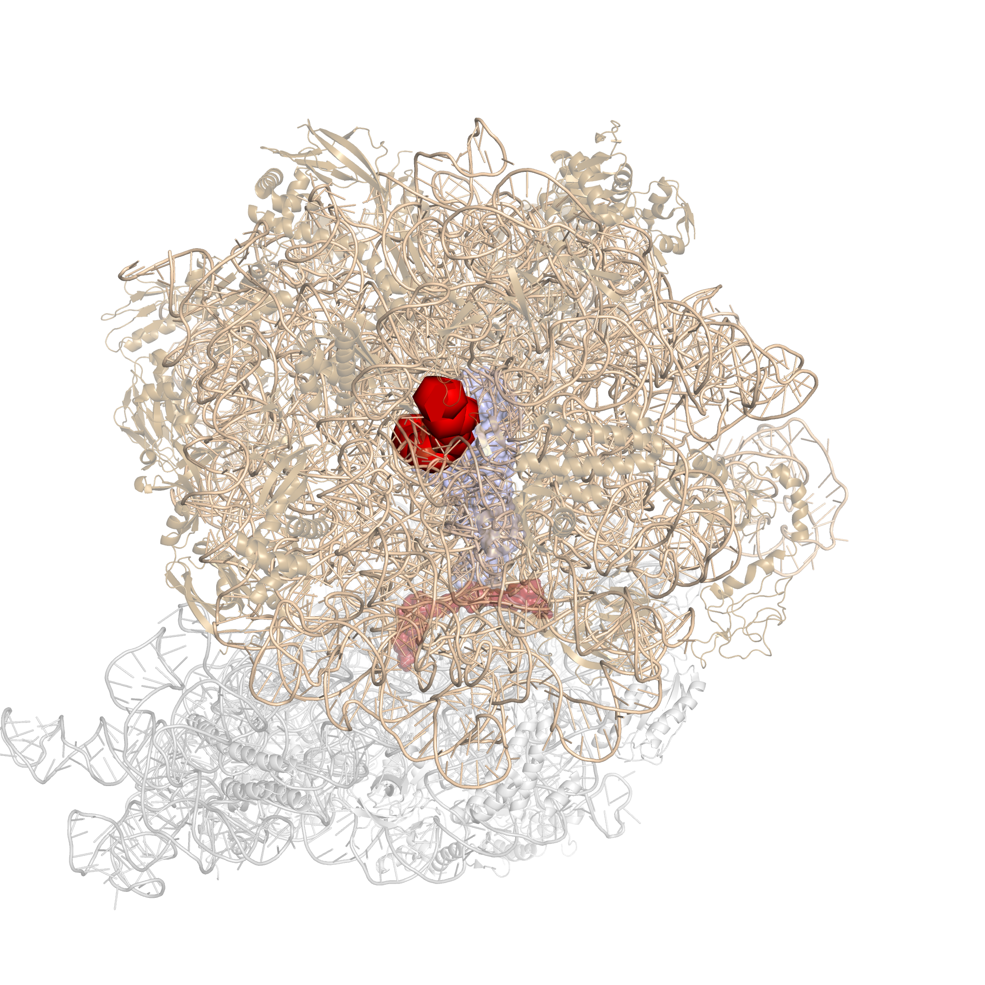
The ribosome is a ribozyme

Slide 16
RNA solves the chicken and egg dilemma
[The RNA world] ... solves the double improbability that multiple biopolymers would have coincidentally emerged already prepared to interact in an encoder-encoded relationship.

Slide 17
Section III. Issues with RNA World

Slide 18
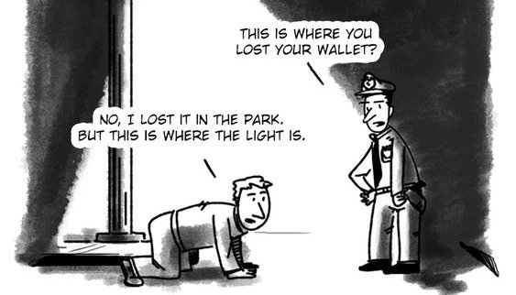
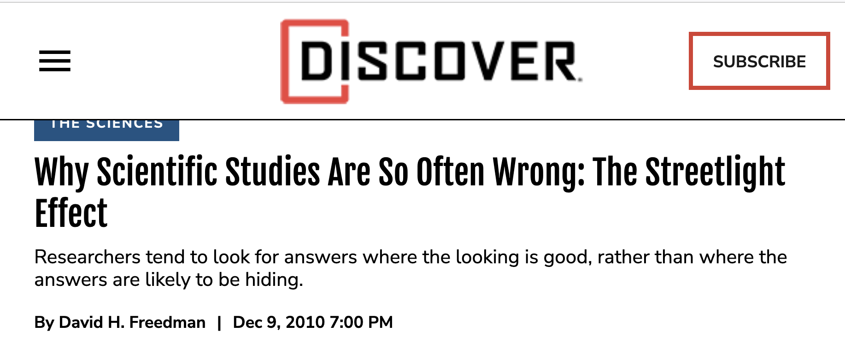
If RNA was not the first genetic material,
biochemistry might provide no clues to the origins of life (Orgel)

Slide 19
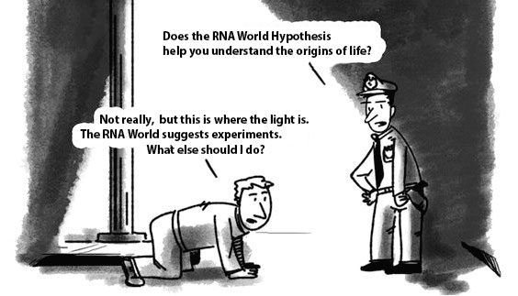

Slide 20
The RNA World is anti-evolutionary
In the RNA World – Biology self-invents. There was no evolution
before Darwinian evolution.
RNA World represents lack of imagination – relies on known biological processes to invent biology.
Religious God of the Gaps – If we don’t understand it, God did it.
RNA World God of the Gaps – If we don’t understand it, Darwin did it
(please note the irony).

Slide 21
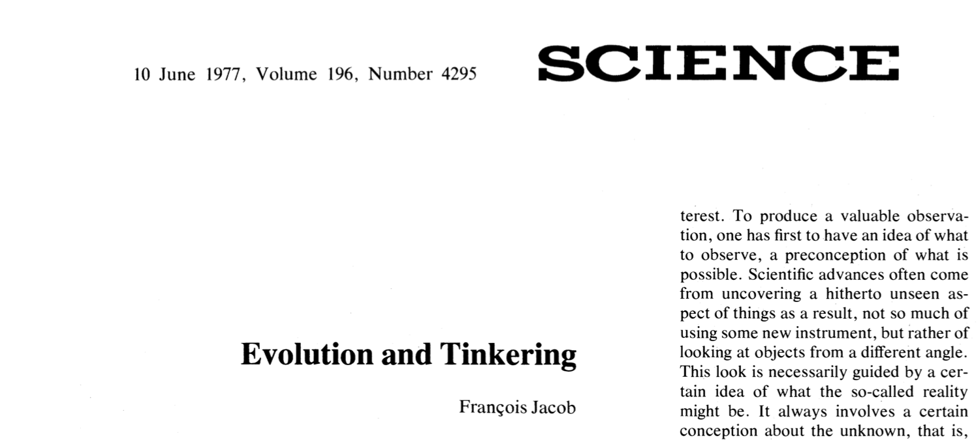

Slide 22
“…natural selection through replication and mutation was the only mechanism for evolving complex biochemical systems from simpler ones.” - Orgel (2004)
(Orgel LE (2004) Prebiotic Chemistry and the Origin of the RNA World. Crit Rev Biochem Mol Biol 39(2):99-123.)
“Eventually every polymer, no matter how stable, would have succumbed to degradation. A special class of polymers are those that are capable of self-replication.” - Joyce (2002)
(Joyce GF (2002) The Antiquity of RNA-Based Evolution. Nature 418(6894):214.)
"The theory of evolution by cumulative natural selection is the only theory we know of that is in principle capable of explaining the existence of organized complexity." – Dawkins (1996) (78)
(Dawkins R (1996) The Blind Watchmaker: Why the Evidence of Evolution Reveals a Universe without Design (WW Norton & Company).)
“Even if prebiotic processes replenishing [other polymers] are postulated, in the absence of hereditary mechanisms ensuring their production and diversification, sooner or later they would be exhausted.” – Lazcano (2018)
(Vázquez-Salazar A & Lazcano A (2018) Early Life: Embracing the RNA World. Curr Biol 28(5):R220-R222)

Slide 23
RNA World: Genetic systems arose by non-evolutionary processes
Genes
polymerases
energy transduction
arose spontaneously

Slide 24
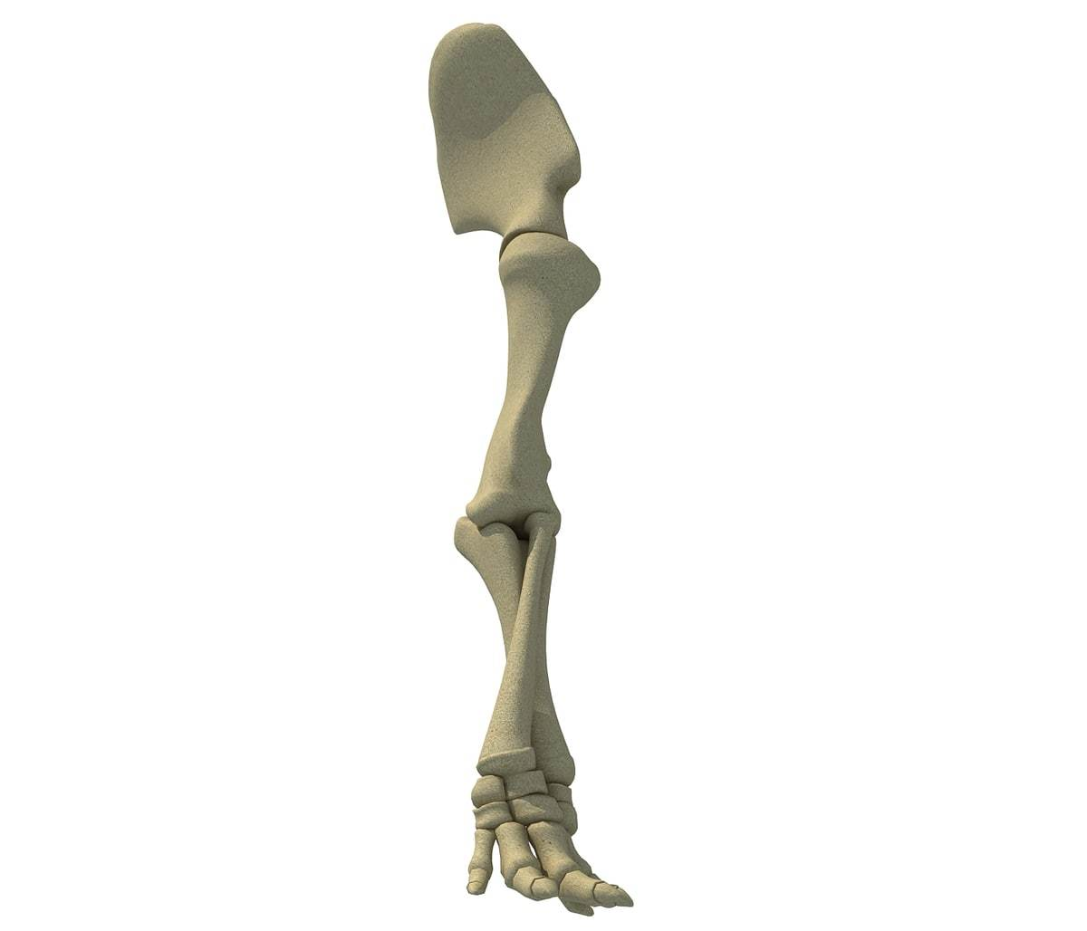
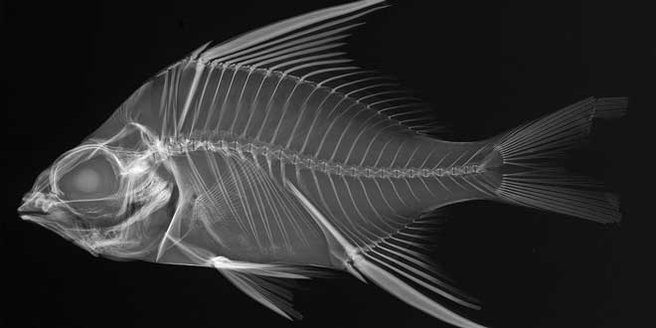
How does evolution actually work?
Evolution is outrageously creative and non-linear.
Extant function cannot be used to explain evolutionary history (1982: Gould and Vrba)
The fish fin is the ancestor of the elephant leg.
The function of an elephant leg is fundamentally different from the function of a fish fin.
If your only source of information was an extant elephant leg, would you be able to predict the fin of a fish?

Slide 25
Leslie Orgel
If RNA was not the first genetic material, biochemistry might provide no clues to the origins of life….
However, if there were two or more worlds before the RNA world, the original chemistry might have left no trace in contemporary biochemistry. … This gloomy prospect has not prevented discussion of alternative genetic systems.
…
The only potentially informational systems, other than nucleic acids, that have been discovered are closely related to nucleic acids.

Slide 26
Applying the logic of the RNA World to real biology
If elephant legs were not the first locomoting device, biology might provide no clues to the origins of locomotion. …
However, if there were two or more worlds before elephants walked on land, the original locomoting device might have left no trace in contemporary biology. … This gloomy prospect has not prevented discussion of alternative locomoting devices.
…
The only potentially locomoting devices, other than elephant legs, that have been discovered are closely related to elephant legs.

Slide 28
In real evolutionary systems there are no Chicken and Egg Questions
complex systems co-evolve

Slide 29



Slide 30
Focus on Evolution:
What specifically does it mean to Integrate and generalize evolutionary principles?
Break down various models by the evolutionary trajectory
Standard Model of the Origin of Life
Genetics/heredity is the only system of memory,
Genetics/heredity requires sophisticated polymers,
Genetics/heredity is necessary for evolution,
Evolution requires replication
Therefore,
Evolution is late (post polymer)
Non-evolutionary processes produced the initial genetic system.
Non-evolutionary processes produced sophisticated biopolymers.

Slide 31
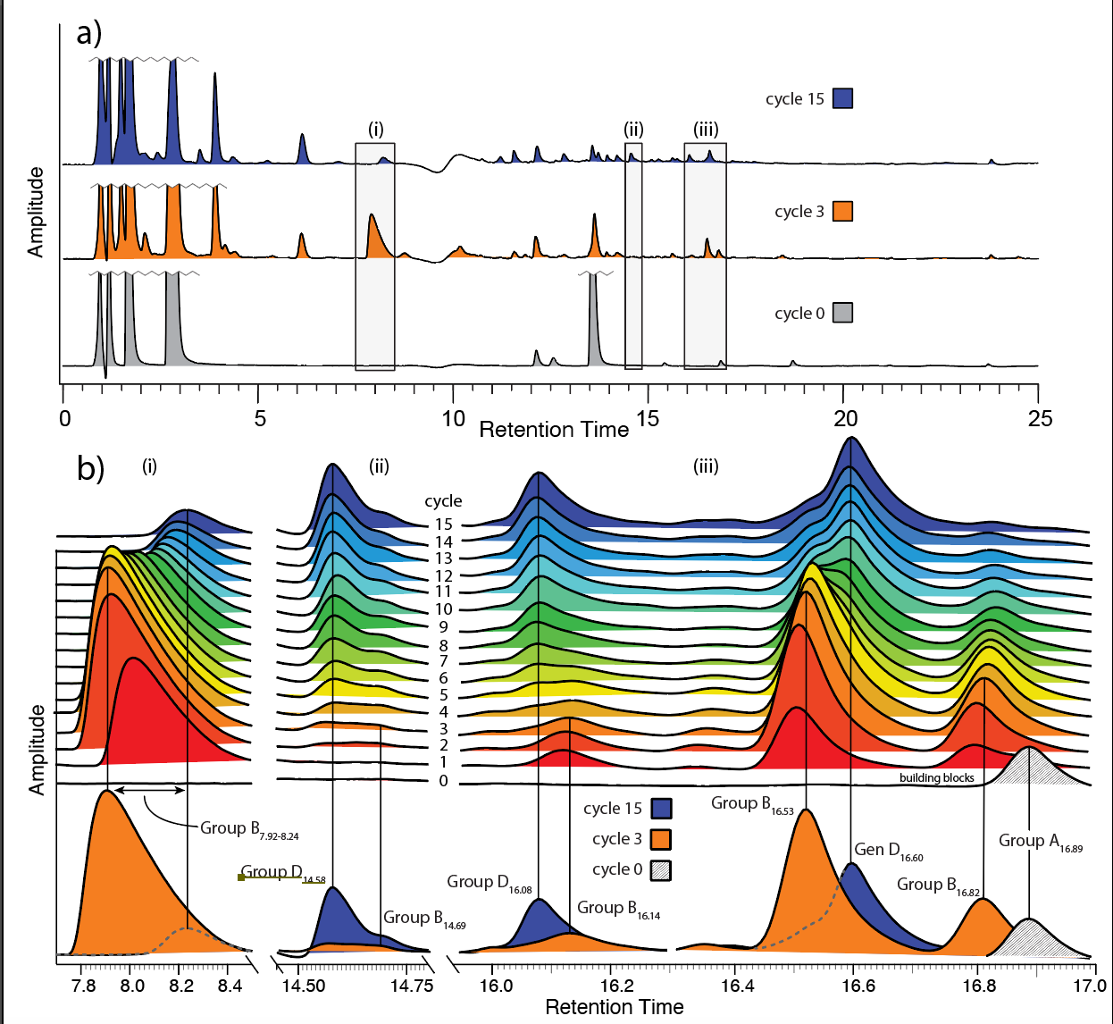
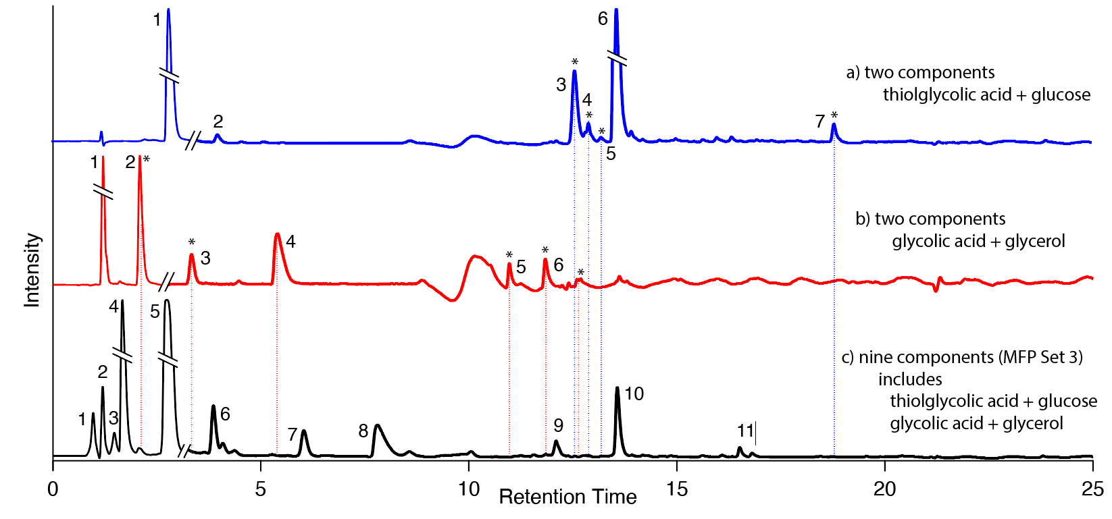
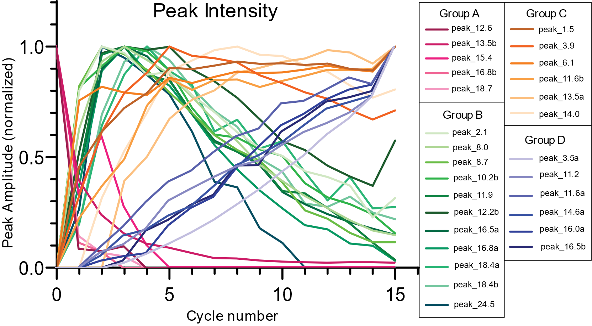
Alternative (evolutionary) model of the Origin of Life
Genetics is an example of a system of memory,
Non-genetic systems can exhibit memory
Prions, epigenetics,
The state of any evolving system is contingent on history
Selection can occurs in non-genetic systems,
Non-genetic systems can evolve,
In the OOL, evolution was early (pre-polymer),
Evolution does not require polymers,
Polymers have been exapted
original selected function are not the same as extant functions

