Slide 1




4/6/26: Chemical Evolution as a Model for the Origin of Life on Earth
Juliana DiGiacomo^{1,2}, Vahab Rajaei^{1,2}, Pau Capera-Aragonès^{1,2}, Vedika Agarwal^{1,2},
Alex Deans-Rowe^{1,2}, Loren Dean Williams*^{1,2}
¹NASA Center for Integration of the Origins of Life (iCOOL)
²School of Chemistry and Biochemistry, Georgia Institute of Technology, Atlanta, GA 30332 USA
Notes:
GM, thank u
Skip to outline quickly
16s

Slide 2
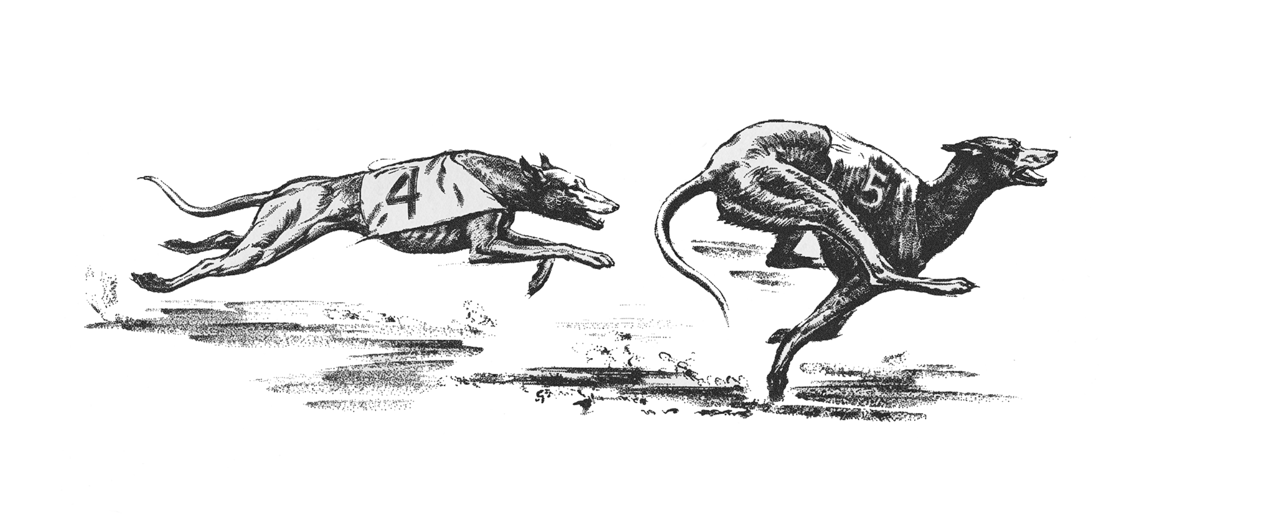
Presentation Outline
Introduction
  The state of models for the Origin of Life
  What is Chemical Evolution(CE)
  Why wet-dry cycling?
  The current state of CE
Long-term wet-dry cycling
Overcoming limitations of traditional wet-dry cycling
Conclusion
  Next steps
  Why should I care about the origin of life?

Slide 3
I. Introduction

Slide 4
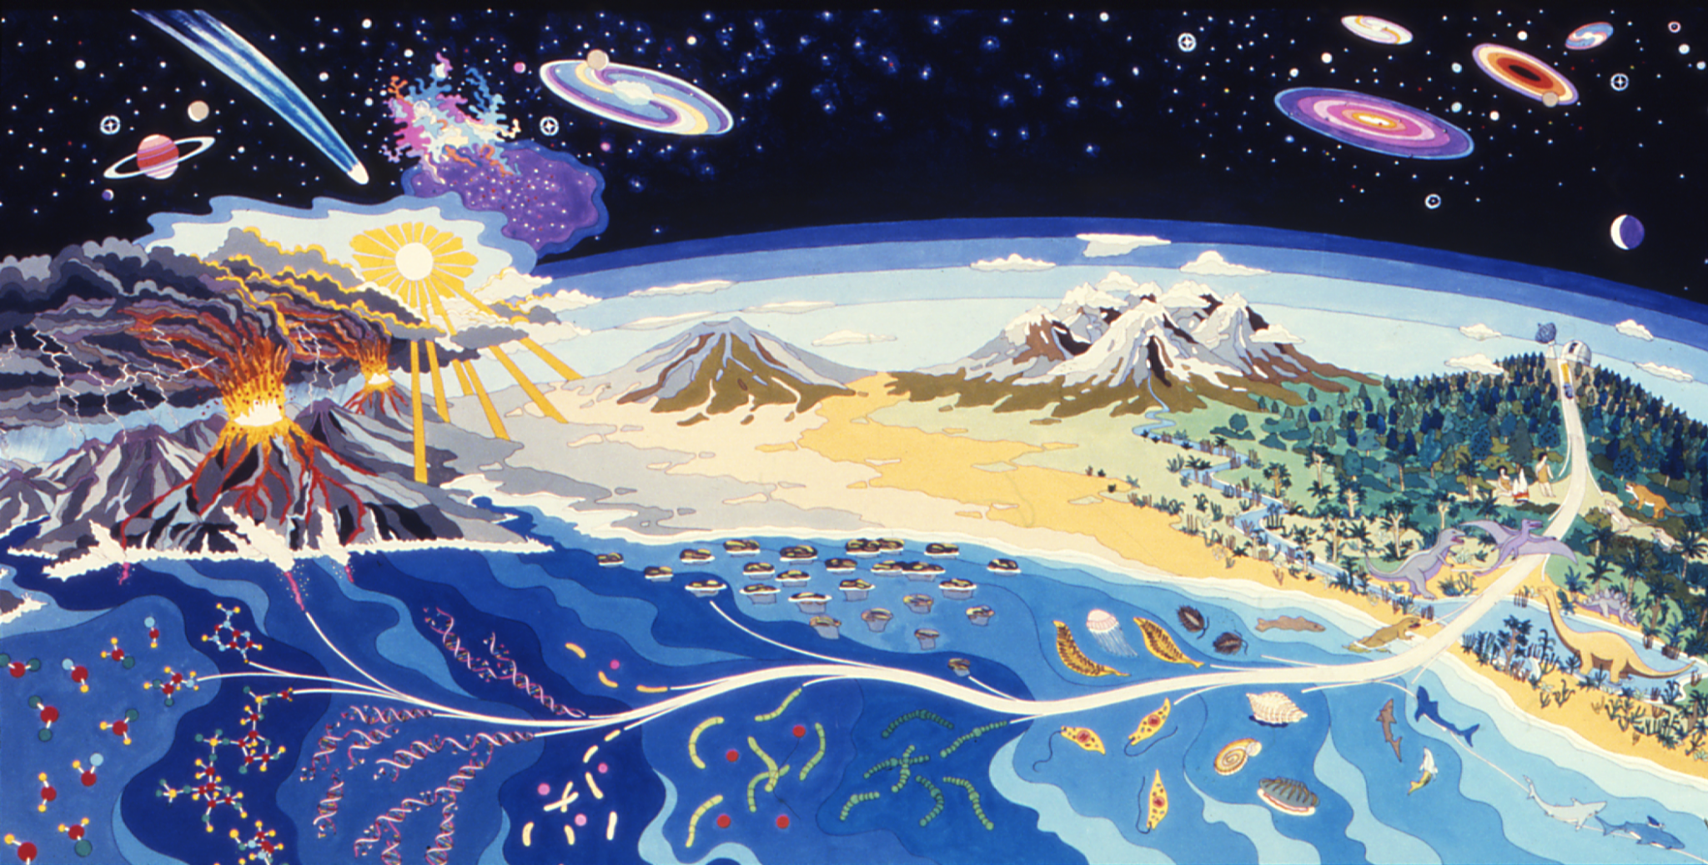
4.5 billion years
Present
Notes:
My work is in within the relm of the origins of life
So I aptly like to start my talk with this mural
The origin of life on Earth
Hanging in…
Visualization of that trans prebiotic world to present
….but what I want you to focus on is this area right here
45

Slide 5

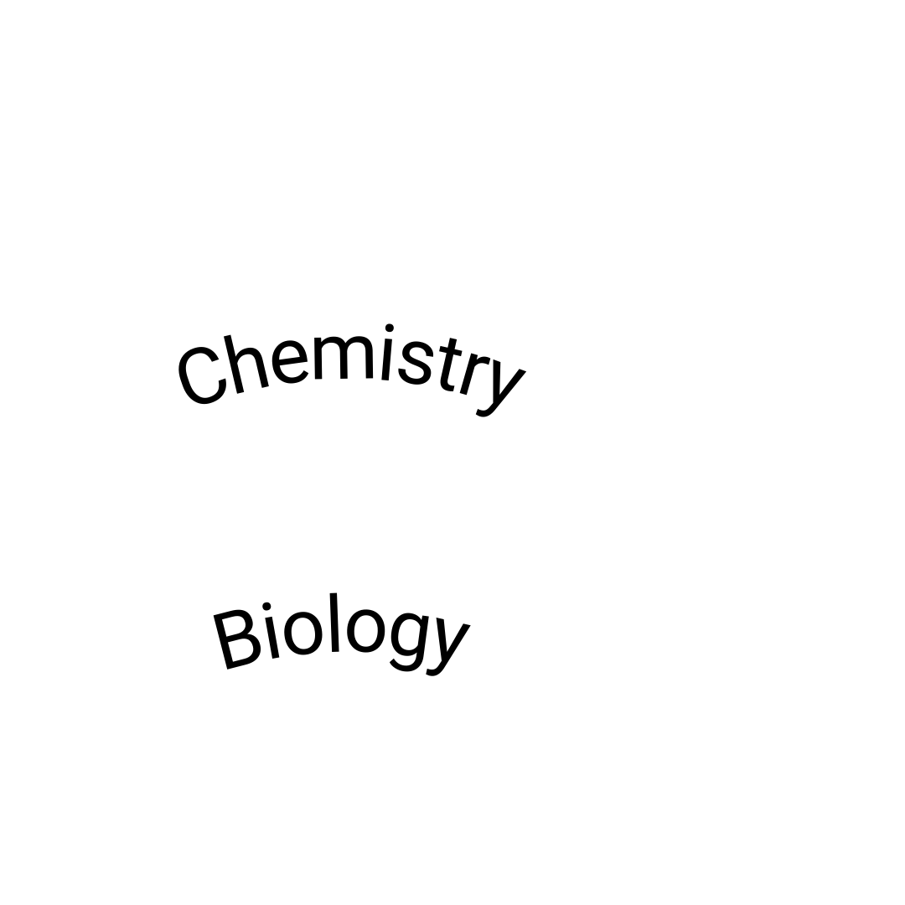
The Origin of Life: Where do we start?
Notes:
The origin of life is somewhere here…
Left, Feedstocks of small molecules forming larger compunds
Operating under the principles of
Right, Single celled organisms
But what about the trans
The answer to that is blurry at best

Slide 6
Prevailing Model: Targeted Synthesis
Targeted synthesis
Darwinian Evolution
Notes:
Under the prevailing models for the origin of life, there is a discrete transition
A great deal of orgins of life research is target directed synthesis,
which attempts to generate the biopolymers and machinery of extant, current life.
The RNA world, which you may have heard of, is one such theory
But these biopolymers are so complex and so fragile, that proposed targeted synthesis often require a series umprobable events and conditions
If there no force or system or machinery driving the formation of these building blocks, why would they do anything except decay and degrade?
In these prevailing model, That blurry transition remains unaccounted for

Slide 7
New Model: Introducing Chemical Evolution (CE)
Probability
Evolution
Continuous forms of evolutions drove
the emergence and advancement of life
Notes:
Incontrast to the existing paradigm, our model of Chemical evolution is a continuous and non-teleological process
Our model posits that continuous forms of evolution …..
Here Evolutionary phenomena account for a gradual transformation from chemistry to biology

Slide 8
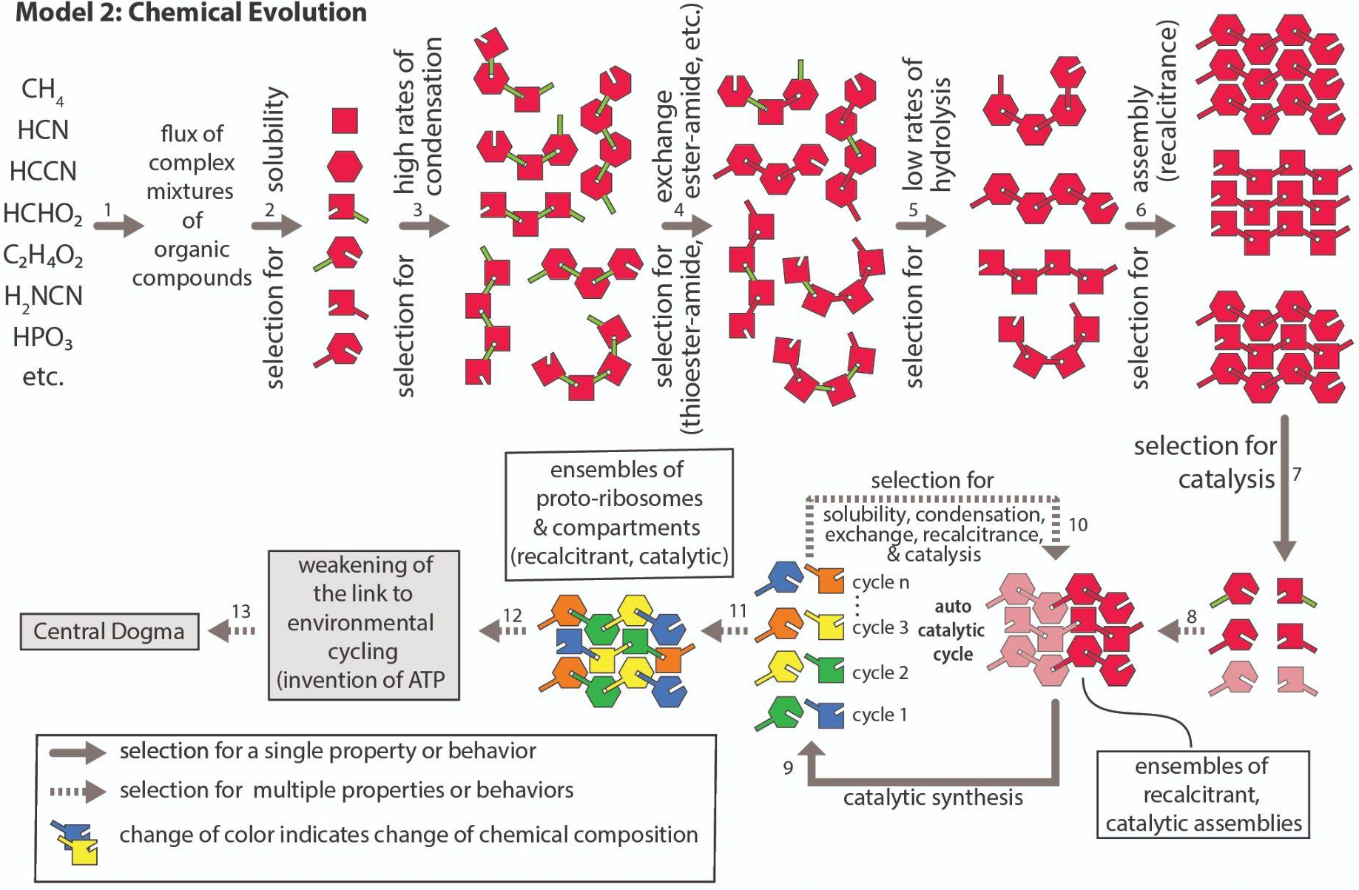

What is Chemical Evolution (CE)?
Transformation on the ensemble level
Emergent forms of order are driven by emergent forms for selection
Similar to Darwinian evolution
                Selection is additive and recursive
                Progress is nonlinear
selection for catalysis
(Matange et al., 2026)
Notes:
(CLICK) In our model, this transition takes place at the ensemble level where the entire chemical landscaped progressively decreased in entropy (or disorder) instead one single molecule.
Now I am going to walk through this figure, but you can follow along the numbers if you would like
(CLICK) As CE progresses, Emergent forms of order are driven by emergent forms for selection
The metric of selection changes, in theory, starting with selection by what can dissolve (CLOCK), then condense (CLOCK), perform exchange reactions (CLOCK,CLICK), assemble (CLOCK, and then perform autocatalysis(CLICK)
This is the same as what constitutes ‘fitness’ in darwinian evolution, and it changes with increased order….We see this in biolgy as well, What fitness is selecting for in a Bird with courting ritual vs bacteria
(CLICK 2)Moving to the lower part, These processes of selection are additive and recursive and,
in the aimless characteristic for persistent molecules and networks to accumulate,
we end up with ensembles including primitive versions of all universal biopolymers.
This process is in no way a linear march of progress, and led to many extinctions and dead ends but did culminate in one winner ensemble, which encompassed the central dogma we know today.
----
Chem rxn network, all mol catalyze each others formation
Autocst, williamson, 2024, hordjik 2019

Slide 9
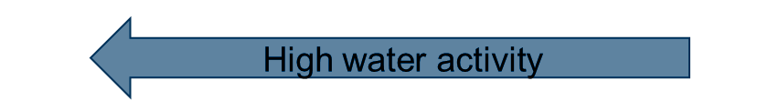
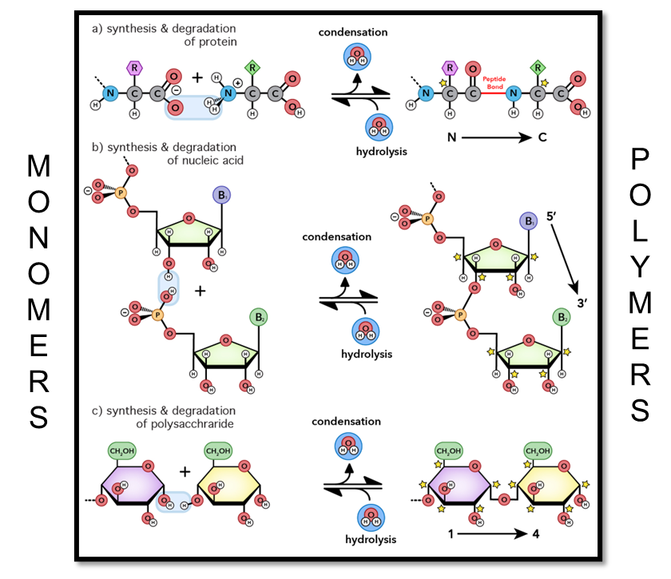

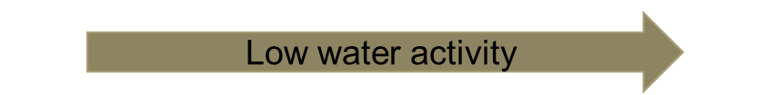
How Does Chemical Evolution Work?
Water is the currency of biopolymer bond breaking and making
Produced in condensation reactions
Used in hydrolysis reactions
Cycling of dehydrated and hydrated state
Wet/dry cycling feasible on the early Earth
A species resistance to breakdown selects for its prevalence in the system
  “Persistence principle”
(Runnels et al., 2018)
Notes:
What lies at the heart of chemical evolutions is water
The key here is that….
And thermodynamic favorability of which will dominate can be controlled by ossications in water activity driven by wet dry cycling
You are familiar with wet/dry cycling if you’ve ever…. Seen dew when you leave the house in the morning and this same process was feasible on the early earth
The final key real linchpin in the functionality of chemical evolution is that… “breakdown IN WATER”
______________________________
It’s inherent H-bonding capabilities along with a large dipole moment and high dielectric
is what allows extant biomolecules to spontaneously overcome transitions to lower entropy states and maintain the highly the ordered and patterned conformations
However, in a more active role, water's character as a reactive nucleophile drives numerous reactions such as
hydrolysis and condensation (ex.biopolymer formation, metabolism)
the generation of protons, hydroxide, carbon dioxide, peroxide, and other substances that trigger subsequent chemical reactions in water(ex. photosynthesis, proton pumping in electron transport chains),
changes in metal coordination that release or absorb water (Zn²⁺ coordination, Fe²⁺ coordination)
Stability-based sorting: Jan Toman (2017)

Slide 10
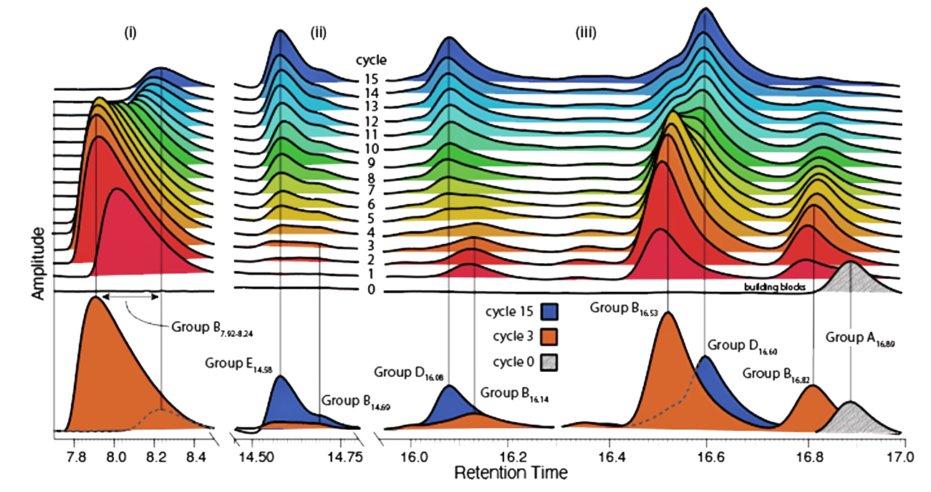

Chemical Evolution Thus Far (2024/2025)
Key characteristics
Continuous Chemical Change
Combinatorial Compression
Population Synchronicity
(Matange et al. 2025)
Notes:
expmntl evidnce to supprt + undrstand CE is ongoing and illuminating in adjusting the model.
I will be brief for the sake of this presentation, but
Several studies have allowed for the identification of three key phenomena
The figure show the results of a 15 cycle wet-dry cycling experiment of a prebiotic soup from red to blue analyzed by High-performance liquid chromatagraphy or HPLC
(CLICK)

Slide 11
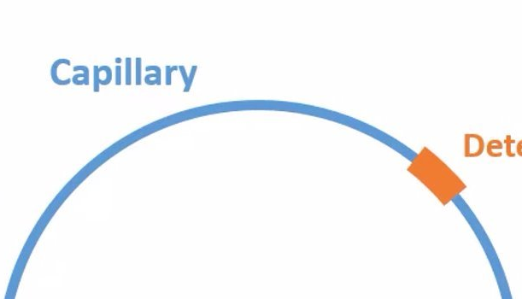
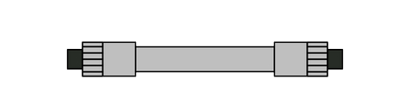
Chemical Evolution Thus Far (2024/2025)
Retention time
(Matange et al. 2025)
Notes:
(CLICK, CLICK) Briefly, HPLC works by separating compounds by size, shape, and polarity by how fast they can travel through or ‘be retained by’ a specialized column.
A detector shown in orange records how long it takes a particular compound to travel through the column
Which I have animated here (CLICK)
From this type of analysis, shown on the left…

Slide 12
Chemical Evolution Thus Far (2024/2025)
Key characteristics
Continuous Chemical Change
Combinatorial Compression
Population Synchronicity
(Matange et al. 2025)
Notes:
expmntl evidnce to supprt + undrstand CE is ongoing and illuminating in adjusting the model.
I will be brief for the sake of this presentation, but
Several studies have allowed for the identification of three key phenomena
The figure show the results of a 15 cycle wet-dry cycling experiment of a prebiotic soup from red to blue analyzed by High-performance liquid chromatagraphy or HPLC
(CLICK)
We have identified that in CE we have
1) Continuous Chemical Change –The system avoids chemical equilibrium, continuously transforming.

Slide 13
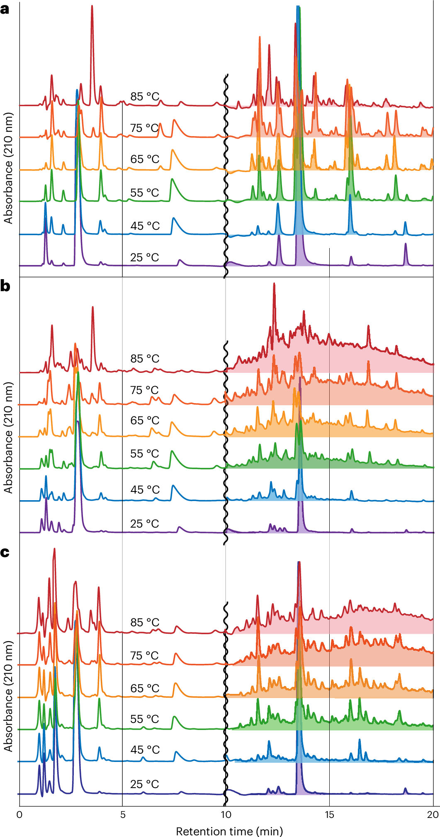

What is Combinatorial Compression?
Traditionally, mixtures undergoing chemical transformations tend to combinatorically explode
In CE, number of products remains small and does not scale with the number of reactants
3 Component System
9 Component System
Notes:
where increasing the number of reactants leads to an explo in molecular diversity this system exhibits
constraint-driven selection.

Slide 14
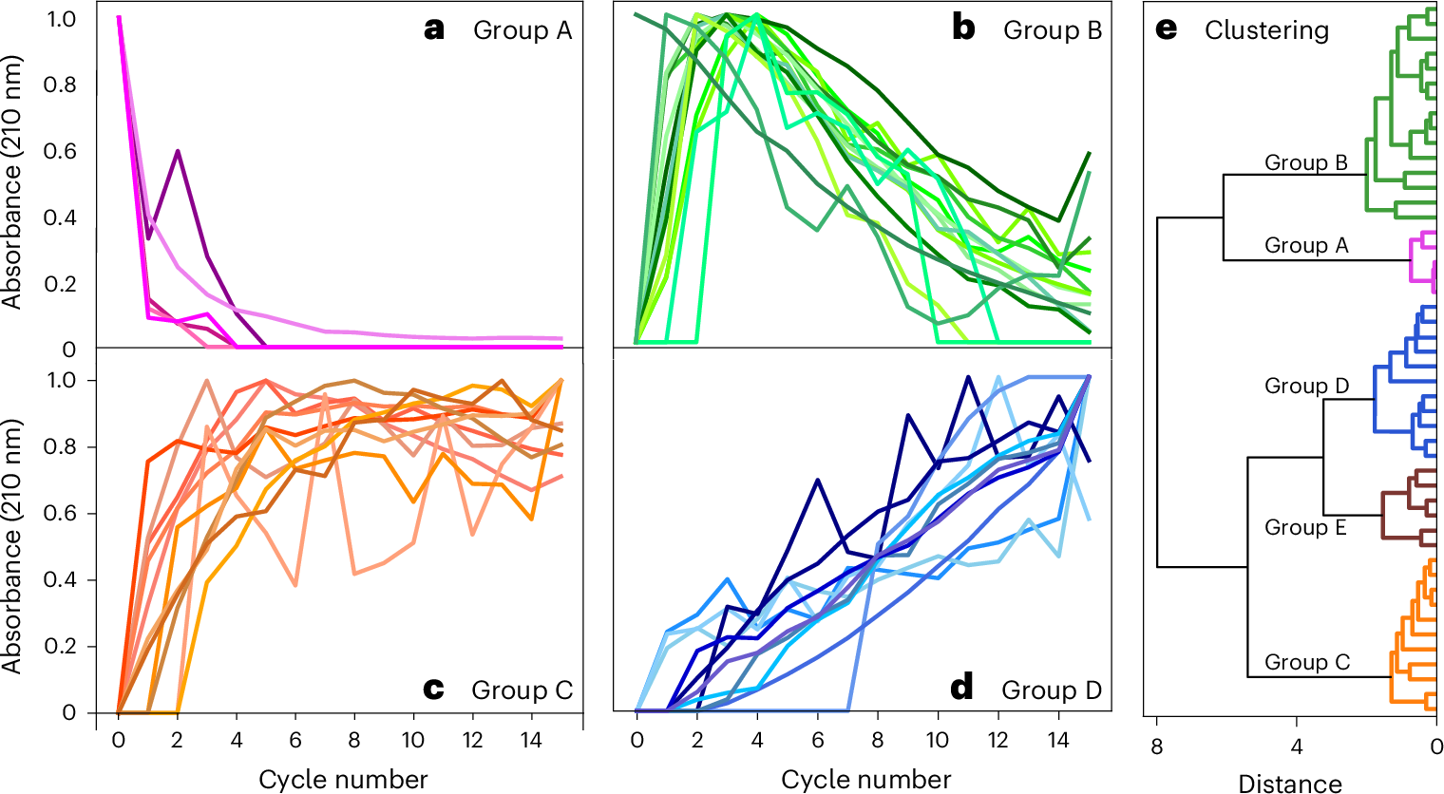
What is Population Synchronicity?
In CE, ensembles display synchronized population dynamics
Group A: Starting components plus their immediate condensation products that form before the first dry-down cycle
Group B: Sharply increase in population during cycles 1–3 and fall during cycles 4–15.
Group C: Increase during cycles 1–5 and remain nearly constant during cycles 6–15.
Group D: form in cycle 3 and then steadily increase through cycle 15.
Group E: remain nearly constant over 15 cycles.
Notes:
Rather than evolving independently, essembles of molecular species display synchronized population dynamics.

Slide 15
Chemical Evolution Thus Far (2024/2025)
Key characteristics
Continuous Chemical Change
Combinatorial Compression
Population Synchronicity
“The continuous change of molecular ensembles, driven by selection, reselection, and chemical sculpting, and is associated with continuous exploration of new chemical spaces and the avoidance of equilibrium.”
Issue: Robust experimental data limited to 20 cycles
(Matange et al. 2025)
Notes:
(CLICK) This has columinated so far in our current working definition for chemical evolution
However, this definition and these key characterisitcs are the conclusions of relatively short term experimentation (CLICK)
Robust data with a complex system is limited to at most 20 cycles
If we are to posit CE by hundreds of thousands of wet-dry cycles to be a model ………

Slide 16
II. Long-term(LT) Wet-Dry Cycling
Notes:
6:30 So we then conducteded LT wd cycling experimentation

Slide 17
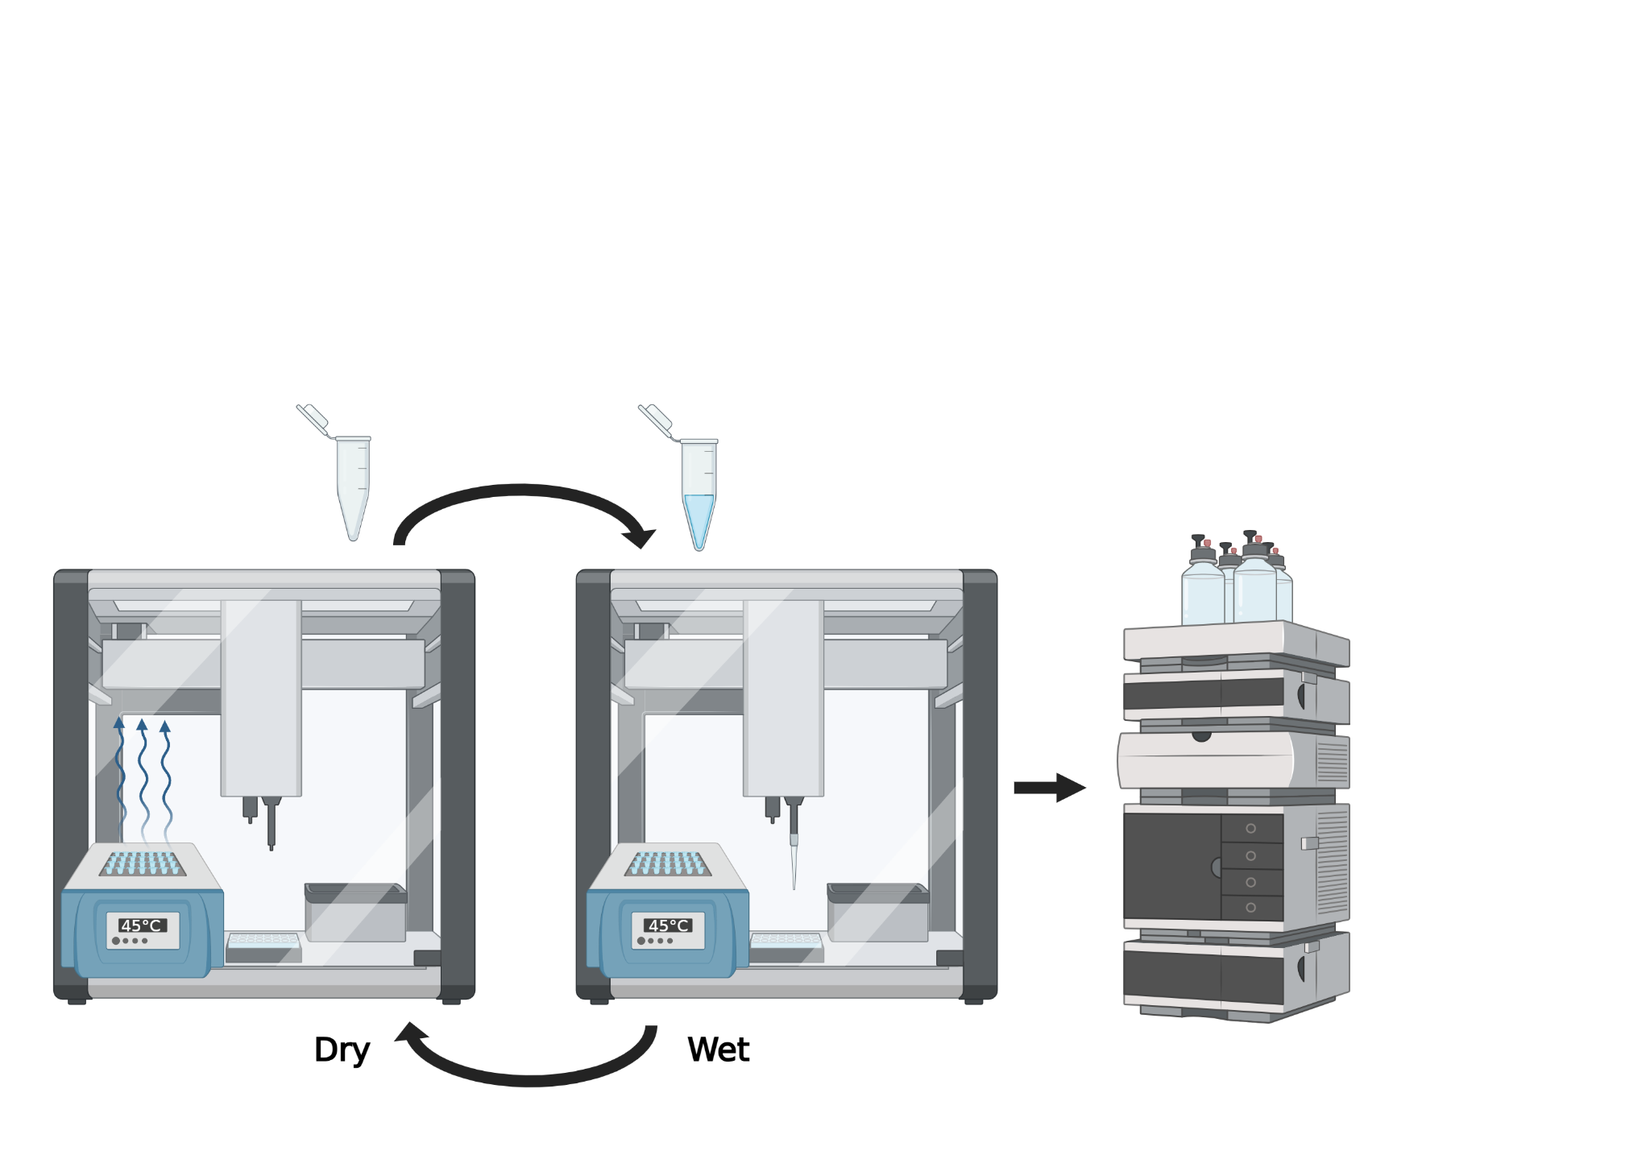
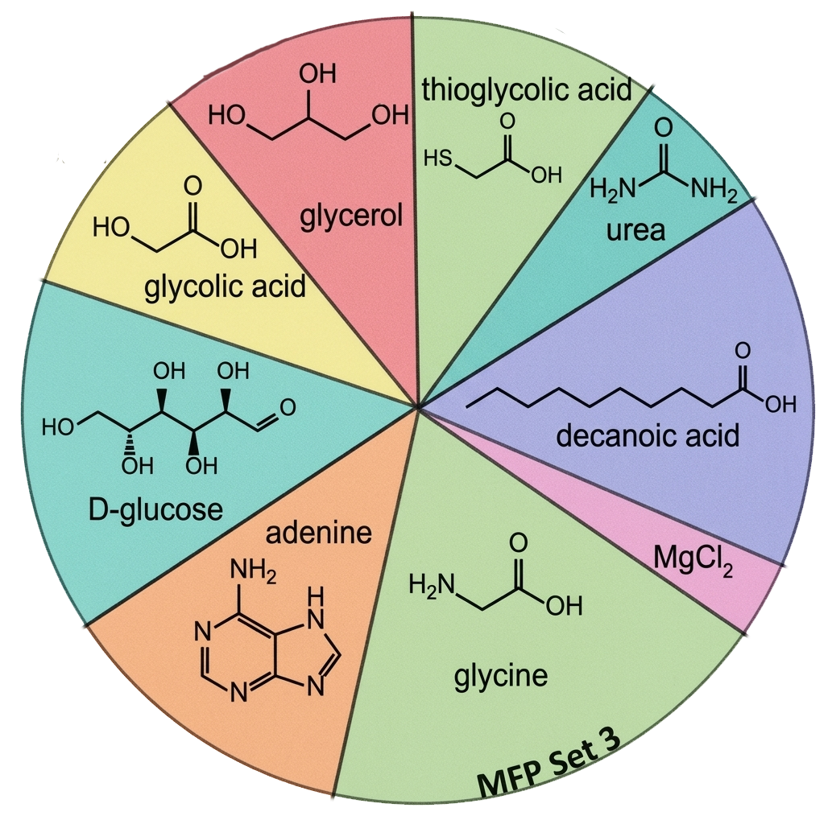
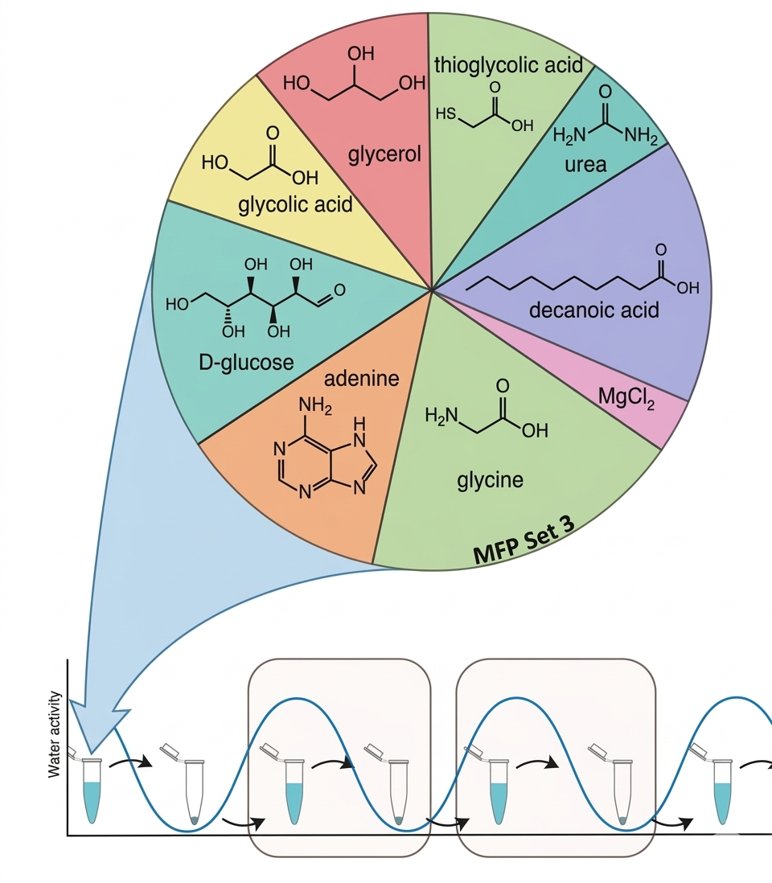
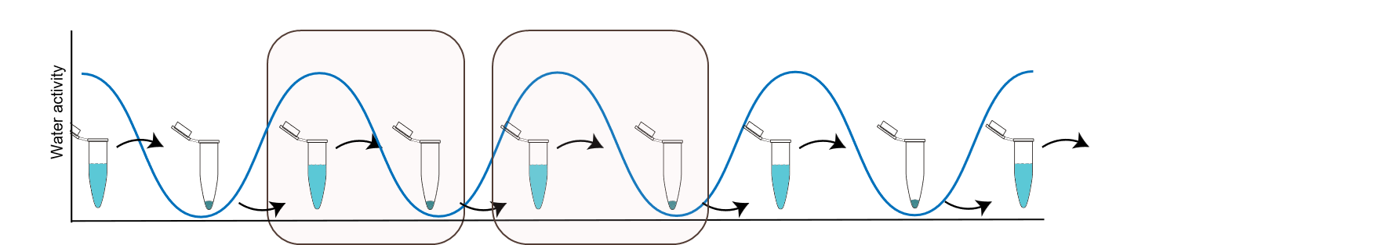
Methods for Wet-dry Cycling
Anoxic chamber
100 cycles, each 6 hours, at 45°C & 55°C
Rehydration volumes: 15μL (Starting volume 40μL)
Timepoints: 37 Samples collected
All runs performed in triplicate
Created with BioRender.com
Notes:
I quickly wanted to touch on the methods of our wet lab work, even though it is quite simple.
We start with aq sample which is inherently in the wet state
Over the cycling period, which in our case was 6h, water wil evaporate out leaving a dry state.
Samples are then rehydrated
to initiate the next cycle
I was so pleasantly surprised that biorender had an exact replica of opentrons ot-2 the robot we use for this
In our sample our starting material was a nine comp complex mix of ‘prebiotically relevant’ components
All aliquots were analyzed by HPLC and visualized with UV-Vis
------
, and the planned protocol was written in python using the OpenTrons API such that experiments were autonomous except to removal of the pre-allocated aliquots.

Slide 18
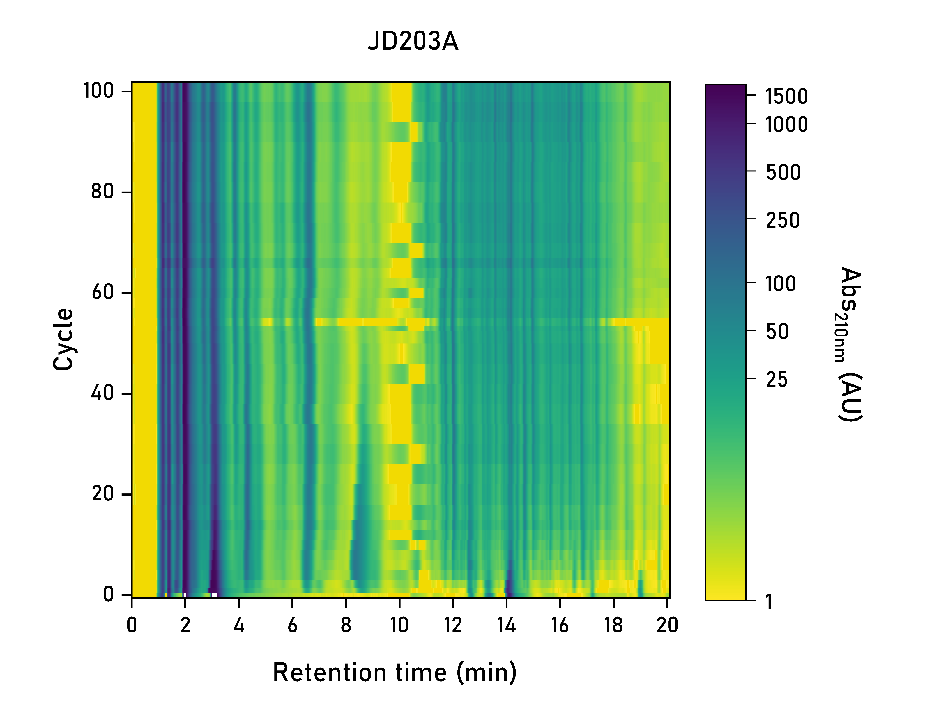
Traditional LT Wet-Dry Cycling Reaches Steady State
LT Cycling of a Complex Mixture
UV-VIS Absorbance over Cycling
Key elements of CE observed before cycle ~40
  Continuous Chemical Change
  Combinatorial Compression
  Population Synchronicity
Key elements of CE not observed over 100 cycles
Notes:
Here we have the first 100 cycle wet dry experiment of this nature
You can follow the chromatogram on the left from bottom to top where the bottom is….
Across the X axis represents a compounds retention time and peak heigh represents the compounds absorbance at 210nm.
What I want you to appreciate here is in the first 40 cycles….
However past this point, the peak distribution appears to stagnate
I have visualized the same data here on the right, and you see a bit more clearly how the the abs across the all retention times plateaus

Slide 19
III. Overcoming limitations of traditional wet-dry cycling
Notes:
8:15 min
So in this context our approach to facilitate CE fails
Is there a logical manner we overcome these limitations

Slide 20
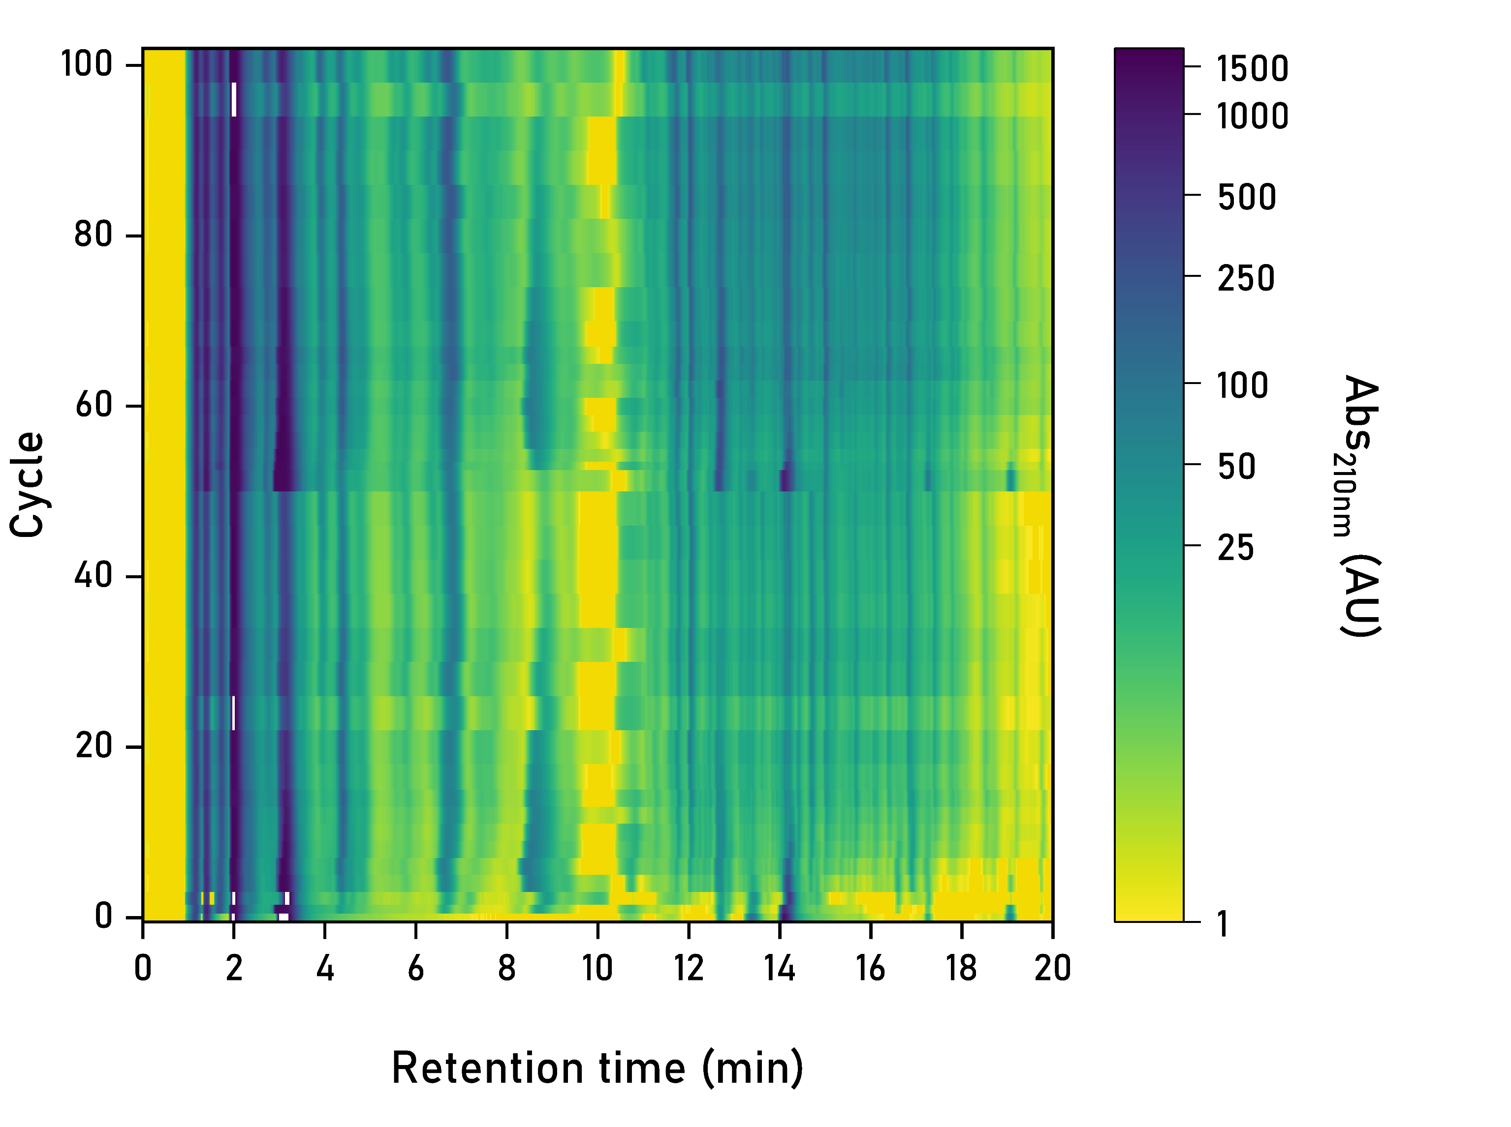
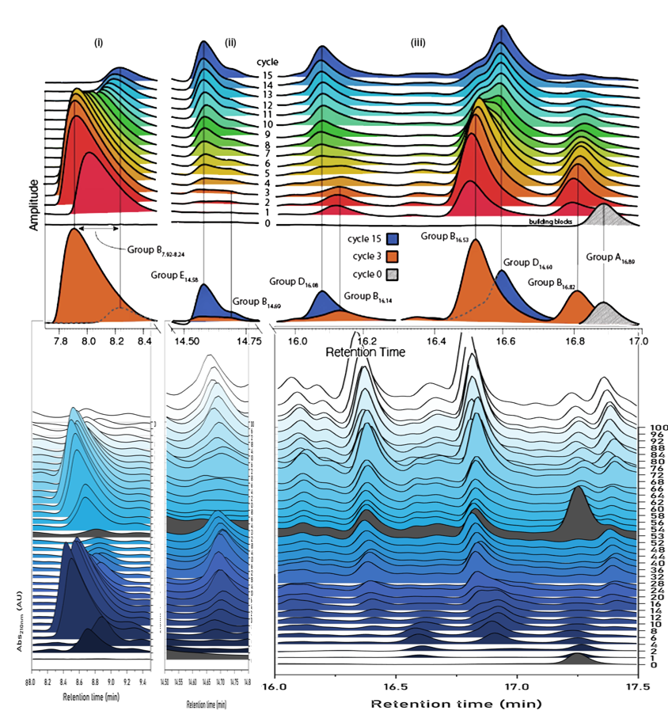

Feeding LT Wet-dry Cycling Delay Steady State
LT Cycling of a Complex Mixture, Fed
Continuous Chemical Change
Population Synchronicity
Fed
System
Key elements of CE rescued following feeding iteration
  More robust product diversity
  Combinatorial compression unclear
Rescued CE state sustained longer than original CE state
Notes:
The hypothesis we arrived at was feeding
Here on the right we have the same format of chromatogram
However what is unique is that at cycle 52, approximately halfway through the experiment
we replenished or ‘fed’ the system with the same nine-component starting solution
In this case it was only 25% of the number of moles the system started with
After feeding, the system explodes and the key elements are rescued.
Again I think this can be better appreciated in the heatmap in the center…..
Where you can see abs change and an overall heating up after feeding, signally a wide variety of products eluting at the same time.
Now to bring your attention all the way to the right, I have pull out some individual peaks to display that after feeding we continue to see synchronous changes in the population

Slide 21
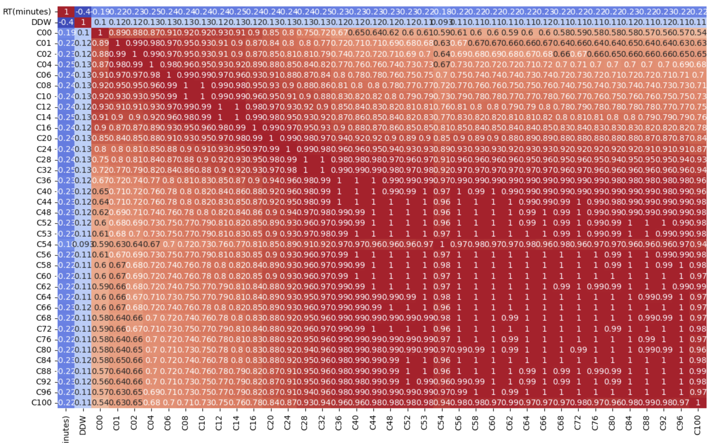
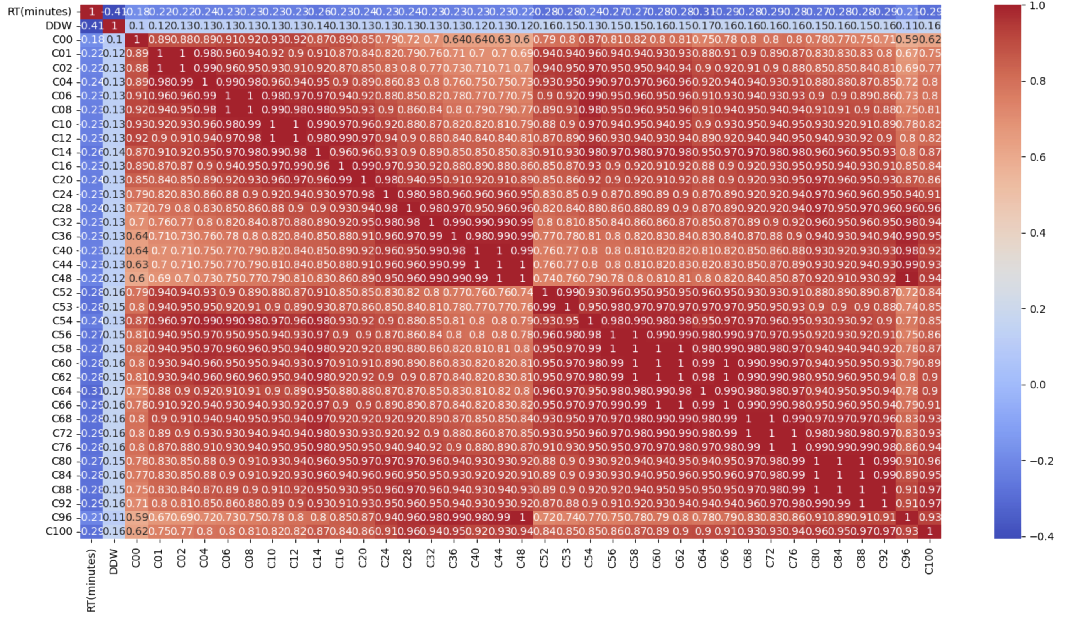
Feeding LT Wet-dry Cycling Delay Steady State
Correlation Matrix of Long-term Cycling, Unfed
Correlation Matrix of Long-term Cycling, Fed
Traditionally, system reaches steady state by cycle 44
  Consistent at 45°C/55°C
  Continuous change no longer observed
Fed, system does not reach steady state at cycle 100
  Consistent at 45°C/55°C
  Rate of change slows
Remaining species are likely:
  Non-volatile
  Deeply kinetically trapped
  Still reactive in given conditions
Notes:
What all of this discussion of the continuation of the key elements of chemical evolution really means is that the system does not reach equilibrium.
When we reach equilibrium, It means were dead, and the same goes for our system. I think these correlation matrices do a very good job of displaying this where essentially the darker red signifies higher similarity.
With Traditional WD….Every cycle become essentially identical to the next

Slide 22
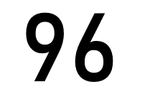
New Products in LT Chemical Evolution with Feeding
Variety of products after 100 cycles
  Accumulated starting material (*)
  Existing products in greater abundance
  Unique products not observed in unfed systems
Increased temperature impacts product abundance but not necessarily identity
New Key Characteristic:
Conversion efficiency in fed state greater than unfed state
  Higher abundance of existing products than molar input would predict from original CE state
Notes:
10.5min
Finally this is what I found the most interesting and think you should pay the most attention to.
I think it is not very surprise that feeding a depleted system revived chemical evolution.
However we observe a variety…..
The figures here show a colored trace of The subtraction of,
the cycle right before feeding from a cycle near the end of the experiment
This should in principle show us the peaks that arose only due to the feeding, while filtering what was already in the system at that point
The top, red shows the 55 case and lower, blue shows the 45 case
What we see is an accumulation….
And we see this at both 45C and 55C
Finally, and this is it, There seems to be a greater….
You can see in the figure I have also include the cycle 48 trace, the cycle right before feeding.
These are the products and abundances the system could produce in 48 cycles.
After feeding with just 25% of the starting material, the products and abundances the system could produce in 48 cycles is notably higher.
Suggest the efficiency of conversion of rctant to products is higher

Slide 23
“Hungry Dogs Run Faster”
Notes:
In this vein I want to take a quick aside to this motivational phrase. Which helps describe our system(read)
It was popularized by NFL player Jason Kelce,, center for the Philadelphia Eagles during the 2017-2018 season which culminated in their first superbowl win in franchise history. Go Birds.
The phrase represents that underdogs with an intense desire for success work harder and achieve more.
I have included this phrase because our starved CE systems, in a manner actually behave much like hungry dogs
Converting reactants they do get to products more efficiently

Slide 24
IV. Conclusion
Notes:
13 min

Slide 25
Next Steps
Multiple or continuous feeding
  Current experimentation describes the outcome of a single feeding iteration
  Existing and computation work suggest that multiple iterations of feeding could push CE to new chemical spaces and lower entropic states^{[8][10]}
Departure from present chemical library
  Current nine component library poses issues of complexity and analytical pipeline
  New libraries could target specific chemistries or chemical networks
  Smaller libraries may allow for more clear product identification
Cycles of gluttony and starvation
  Multiple instances of feeding followed by starvation of the system could act as a strong manner of eliciting efficiency, fitness, and selection
Notes:
I’m going to speed through this a bit but
Implementing
(read) which could push CE
….Arbitrary and gives us a narrow view of CE
…..Ratcheting the “hungry dog” phenomenon

Slide 26
Conclusions
Traditional wet-dry cycling method experiments only effective in short-term experiments
  Rate of continuous change markedly reduced after cycle 20
  Present system reaches steady state after approximately cycle 44
  The system is “starved”
Feeding the system with starting material rescues CE state
  Restores continuous chemical change, combinatorial compression, and population synchronicity
  Delays establishment of steady state, likely not indefinitely
  Grants increased conversion efficiency of reactants to products
    “Hungry dogs run faster”
Why should you care?
  The origin of life is a fundamental open question
    Awe and place in the universe
    Applications to life of other worlds
  Chemical Evolution can be harnessed as a new form of directed synthesis
Notes:
SO in conclusion
Why care
Still a completely Open question after over 80 years of dedicated research
On a human level, Understanding this inspires…
If youre not into all of that gushy stuff…
CE poses a very lucrative and novel approach to directed synthesis. Evolution has produced molecule that are unimaginable that we could never create denovo. Harnessing that process would be indispensable .

Slide 27



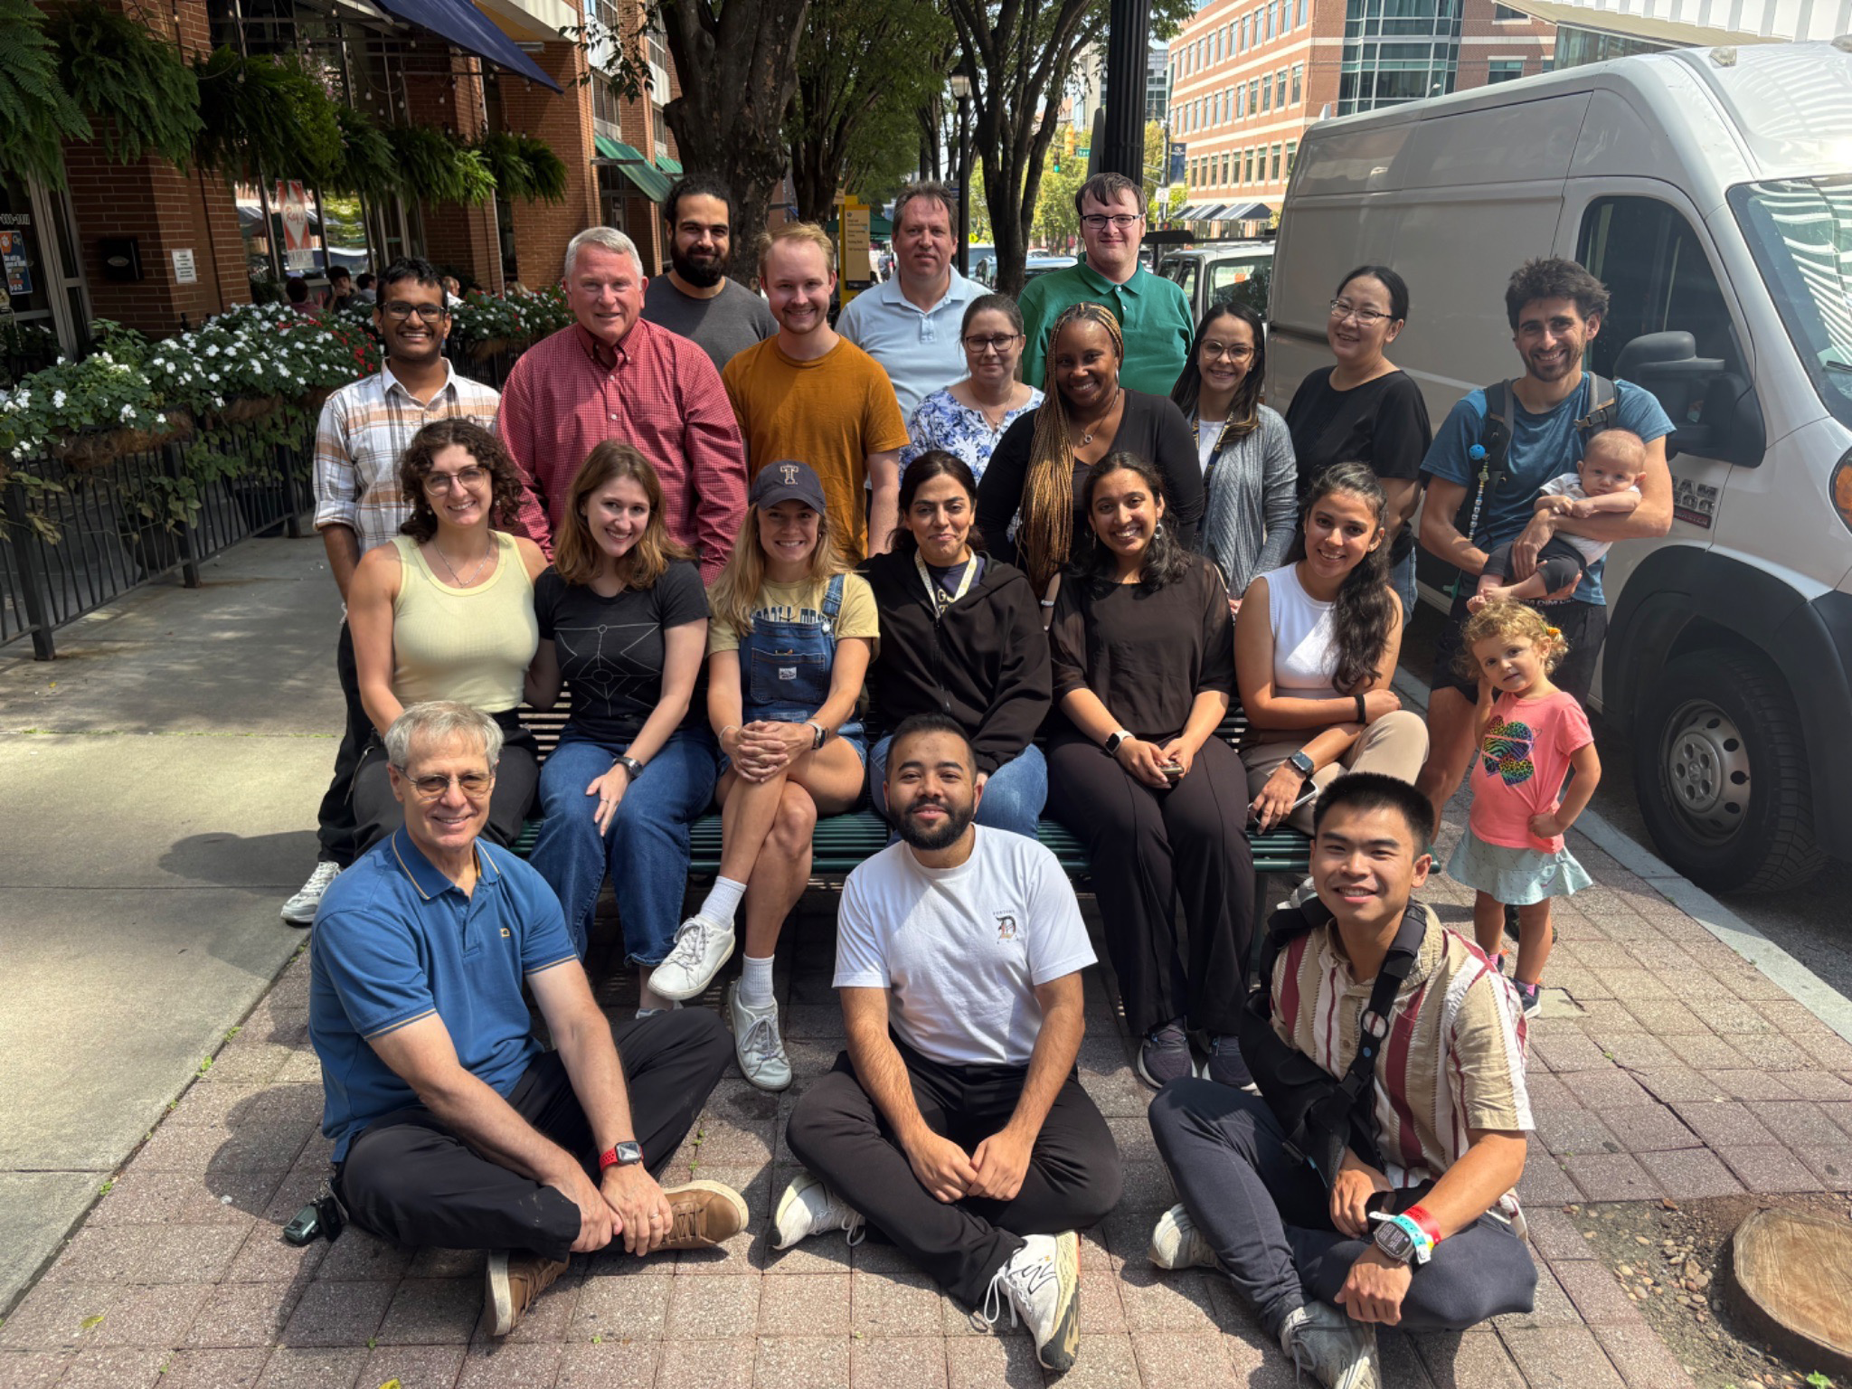



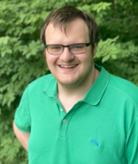





Acknowledgments
This work is supported by NASA grant no. 80NSSC24K0344, the GAANN Fellowship, and the Georgia Tech Astrobiology Fellowship
Dr. Loren Dean ​
Williams
Pau Capera-Aragonès
Dr. Moran ​
Frenkel-Pinter
Alex Deans-Rowe​
Vahab Rajaei
Notes:
So, with that I would like to acknowledge the funding that has allowed me to conduct this work
Also my advisor loren
All of the advice and inspiration
As well as our collaborators and fellow members of the lab
Thank you

Slide 28
Thank you!
Questions?

Slide 29
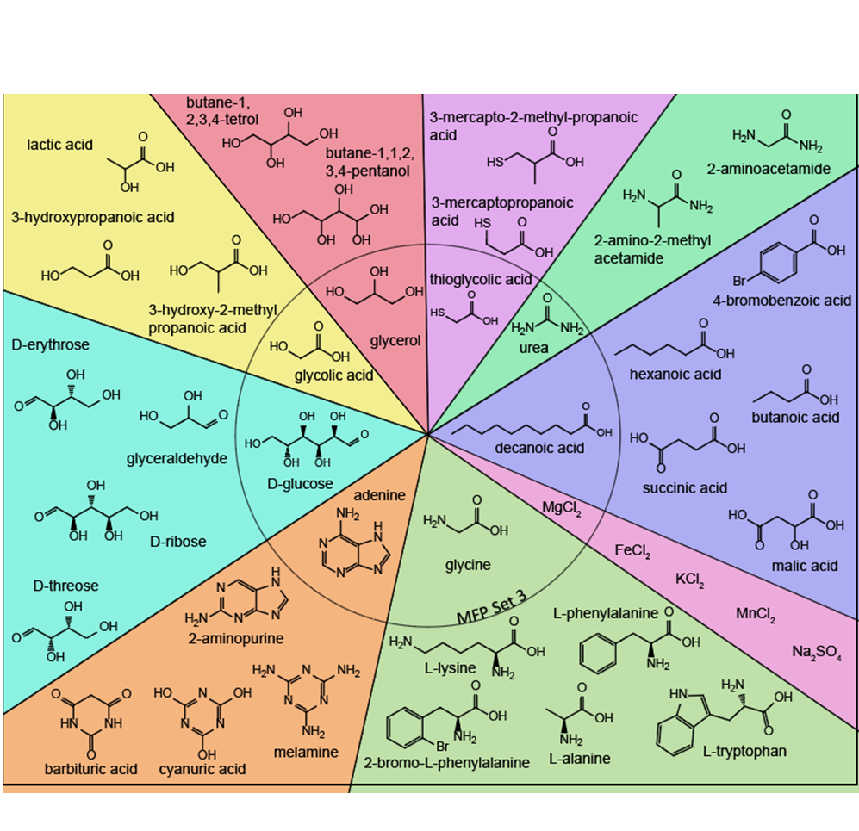
Library Design
Fairly soluble
Use diverse molecules capable of reacting via condensation-dehydration
  Hydroxyl groups
  Carboxylic acids
  Thiols
  Amines
  Esters
  Thioesters
  Amides
  Acetals
  Hemiacetals
Expecting messy outputs

Slide 30
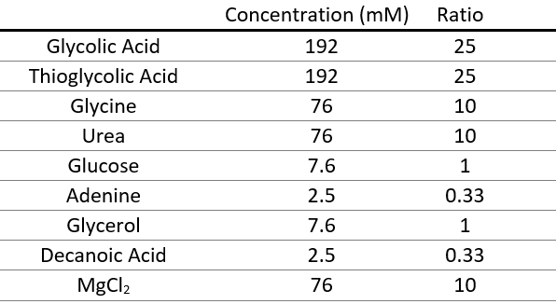
MFP 3 Nine Component Mixture Concentrations
Notes:
Such that total HA to AA is 5:1 optimal, identified in Moran

Slide 31
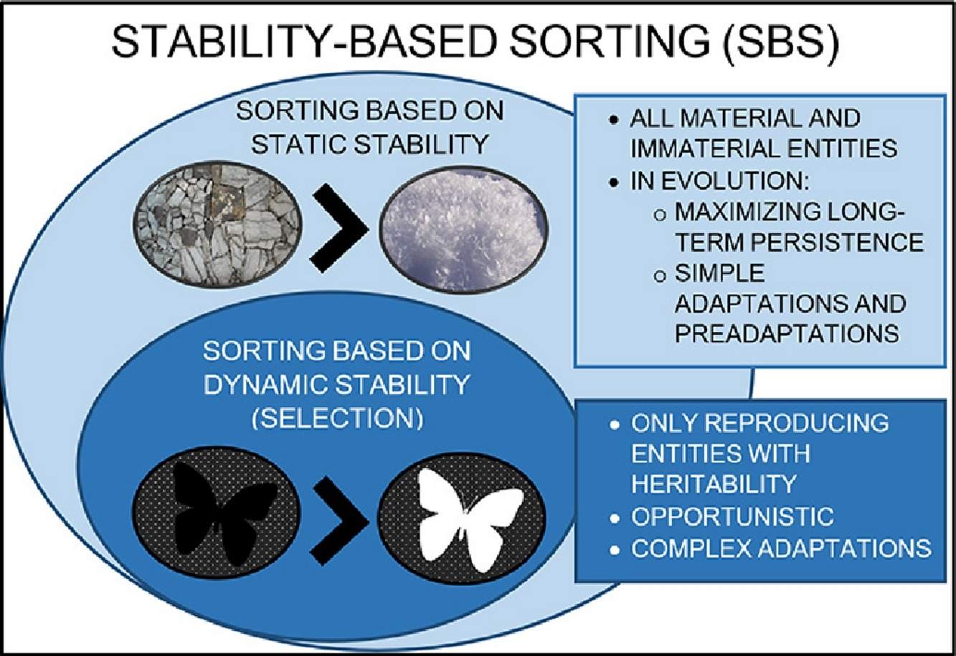
Persistence Principle
Natural selection is one form of a general process termed “stability-based sorting”.
Entities reproducing with heritability are sorted on the basis of dynamic stability.
All entities are sorted on the basis of static stability, i.e. persistence.
It produces simple adaptations and pre-adaptations, maximizing long-term persistence.
(Toman, 2017)

Slide 32
References
Green, Nicholas J., Jianfeng Xu, and John D. Sutherland. "Illuminating life’s origins: UV photochemistry in abiotic synthesis of biomolecules." Journal of the American Chemical Society 143, no. 19 (2021): 7219-7236.
Korenaga, J. Was There Land on the Early Earth?
Life 2021, 11, 1142. https://doi.org/10.3390/life11111142
M. Frenkel-Pinter, J. W. Haynes, M. C, A. S. Petrov, B. T. Burcar, R. Krishnamurthy, N. V. Hud, L. J. Leman, L. D. Williams, Proceedings of the National Academy of Sciences 2019, 201904849.
Matange, K., et al. (2023). Origins of life: Chemistry and evolution.
Le Vay, Kristian & Salibi, Elia & Song, Emilie & Mutschler, Hannes. (2020). Nucleic Acid Catalysis under Potential Prebiotic Conditions. Chemistry - An Asian Journal. 15. 10.1002/asia.201901590.
Frenkel-Pinter, M., et al. (2021). Water and life: The medium is the message. Journal of molecular evolution, 89(1), 2-11.
Edri, R., et al. (2023). Assembly‐driven protection from hydrolysis as key selective force during chemical evolution. FEBS letters, 597(23), 2879-2896.
Runnels, C. M., et al. (2018). Folding, assembly, and persistence: The essential nature and origins of biopolymers. Journal of Molecular Evolution, 86, 598-610.
Bada J. L., Bigham C., Miller S. L. (1994). Impact melting of frozen oceans on the early Earth: Implications for the origin of life. Proc. Natl. Acad. Sci. U.S.A. 91, 1248–1250.
Komura, M., Sotome, H., Miyasaka, H., Ogawa, T., & Tani, Y. (2023). Photoinduced crystal melting with luminescence evolution based on conformational isomerisation. Chemical science, 14(20), 5302–5308. https://doi.org/10.1039/d3sc00838j
Becker, S., Schneider, C., Okamura, H., & et al. (2018). Wet-dry cycles enable the parallel origin of canonical and non-canonical nucleosides by continuous synthesis. Nature Communications, 9(1), 163. https://doi.org/10.1038/s41467-017-02639-1
Suttle, M. D., Folco, L., Genge, M. J., & Russell, S. S. (2020). Flying too close to the Sun – The viability of perihelion-induced aqueous alteration on periodic comets. Icarus, 351, 113956. https://doi.org/10.1016/j.icarus.2020.113956
Matange, K., et al. (2023). Evolution of Complex Chemical Mixtures Reveals Combinatorial Compression and Population Synchronicity.
T. Lührs,C. Ritter,M. Adrian,D. Riek-Loher,B. Bohrmann,H. Döbeli,D. Schubert,& R. Riek, 3D structure of Alzheimer's amyloid-β(1–42) fibrils, Proc. Natl. Acad. Sci. U.S.A. 102 (48) 17342-17347, (2005).
Rufo, C., Moroz, Y., Moroz, O. et al. Short peptides self-assemble to produce catalytic amyloids. Nature Chem 6, 303–309 (2014). https://doi.org/10.1038/nchem.1894
Greenwald, J., Friedmann, M. P., & Riek, R. (2016). Amyloid Aggregates Arise from Amino Acid Condensations under Prebiotic Conditions. Angewandte Chemie (International ed. in English), 55(38), 11609–11613. https://doi.org/10.1002/anie.201605321

