Slide 1
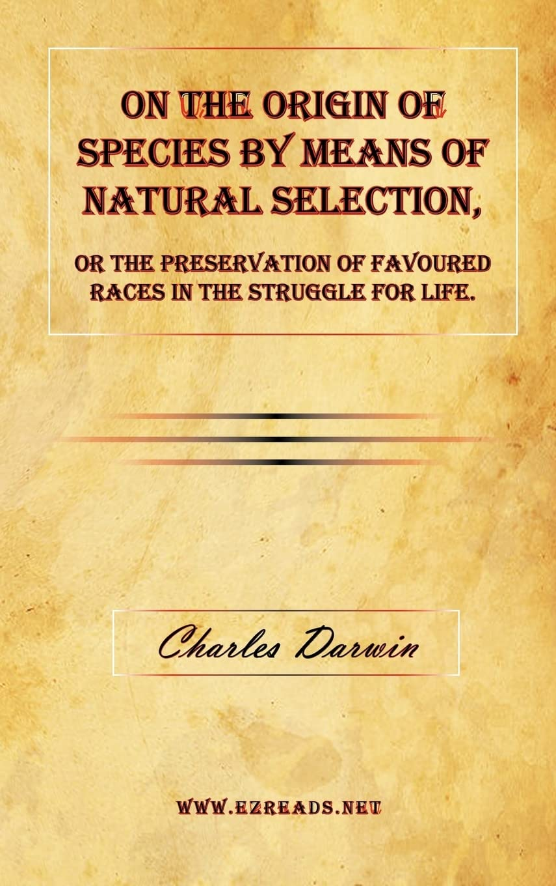
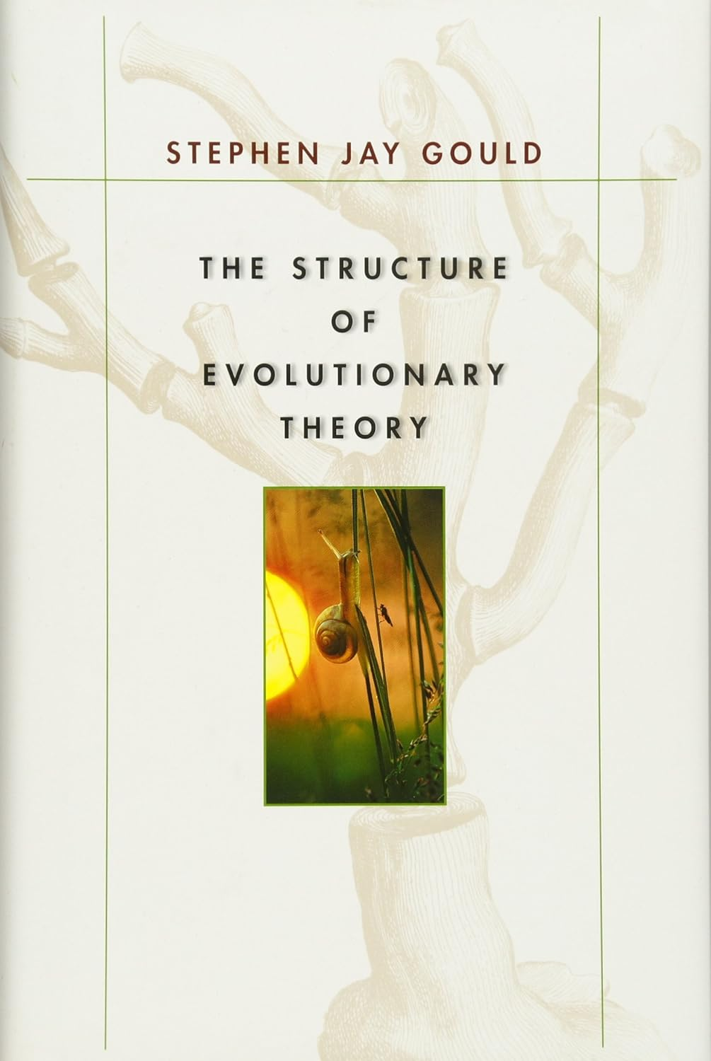

Slide 2
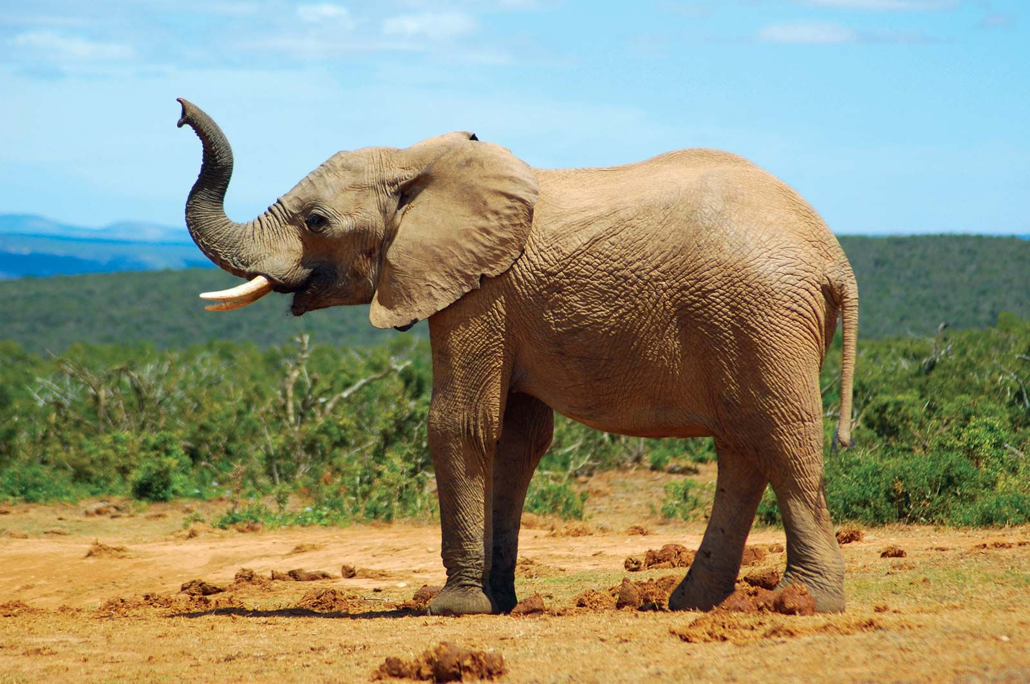
What does extant structure and Function tell us about origins and early evolution

Slide 3
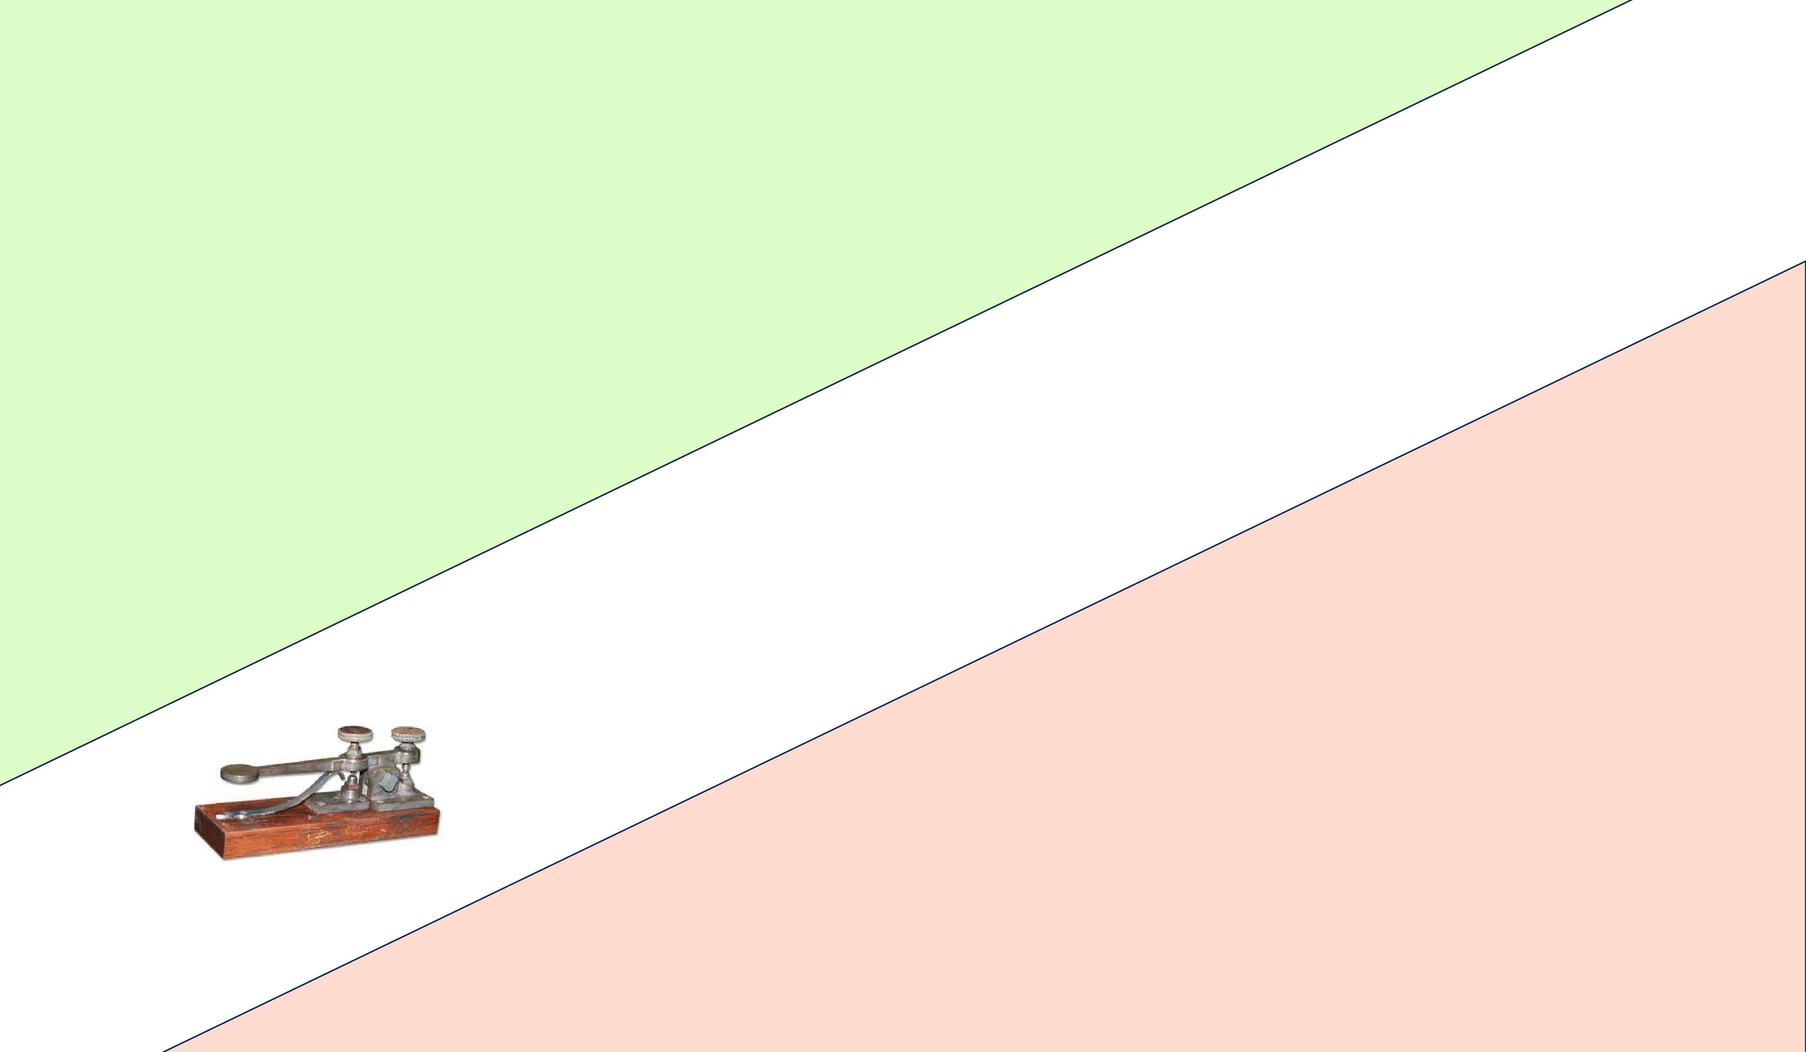
The Nature of Evolution:
Extant structure and function does not tell us about historical genesis
Notes:
A touch screen does not help us understand the origins of telephones.
The origins and evolution of telephones was dependent, always, on electricity.
Electronics transcends time, and specific systems and functions of the telephone. Electronics is the basis of all critical functions in telegraph, rotary phones, Blackberries and iPhones. The origins and evolution of the telephone can only be understood in context of development of solid state electronics and circuits. Touch screens are universal to extant telephones but are not relevant to the origins and early evolution of the phone.

Slide 4
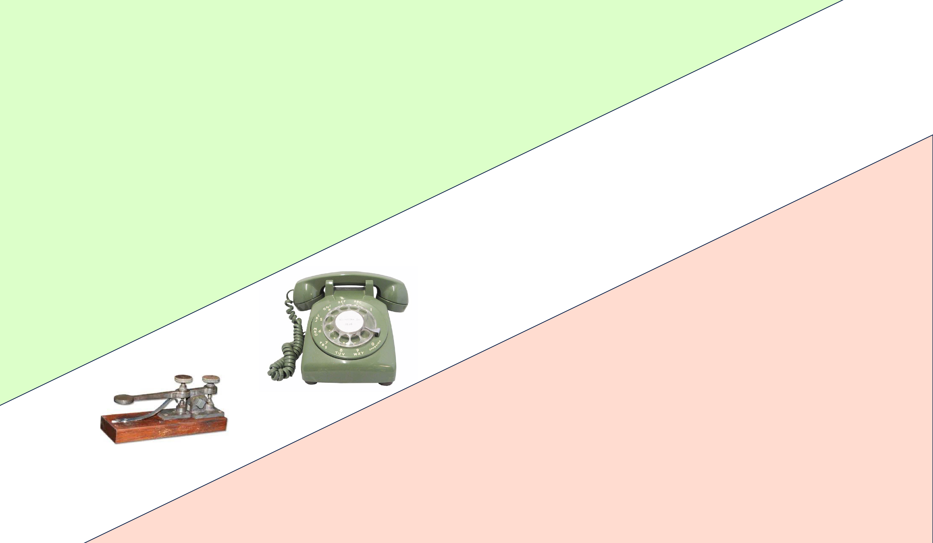
Notes:
A touch screen does not help us understand the origins of telephones.
The origins and evolution of telephones was dependent, always, on electricity.
Electronics transcends time, and specific systems and functions of the telephone. Electronics is the basis of all critical functions in telegraph, rotary phones, Blackberries and iPhones. The origins and evolution of the telephone can only be understood in context of development of solid state electronics and circuits. Touch screens are universal to extant telephones but are not relevant to the origins and early evolution of the phone.

Slide 5
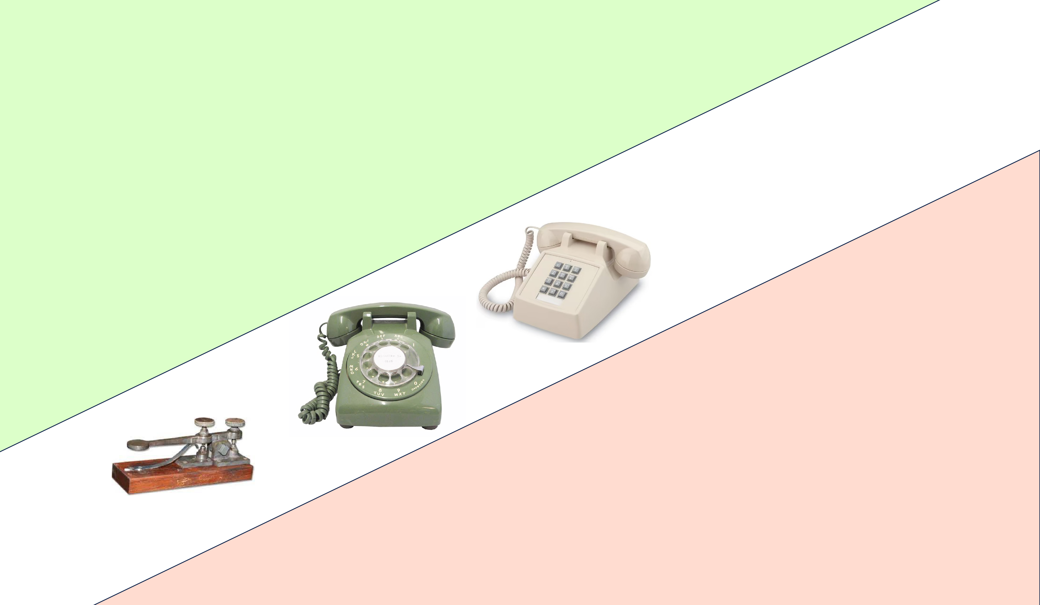
Notes:
A touch screen does not help us understand the origins of telephones.
The origins and evolution of telephones was dependent, always, on electricity.
Electronics transcends time, and specific systems and functions of the telephone. Electronics is the basis of all critical functions in telegraph, rotary phones, Blackberries and iPhones. The origins and evolution of the telephone can only be understood in context of development of solid state electronics and circuits. Touch screens are universal to extant telephones but are not relevant to the origins and early evolution of the phone.

Slide 6
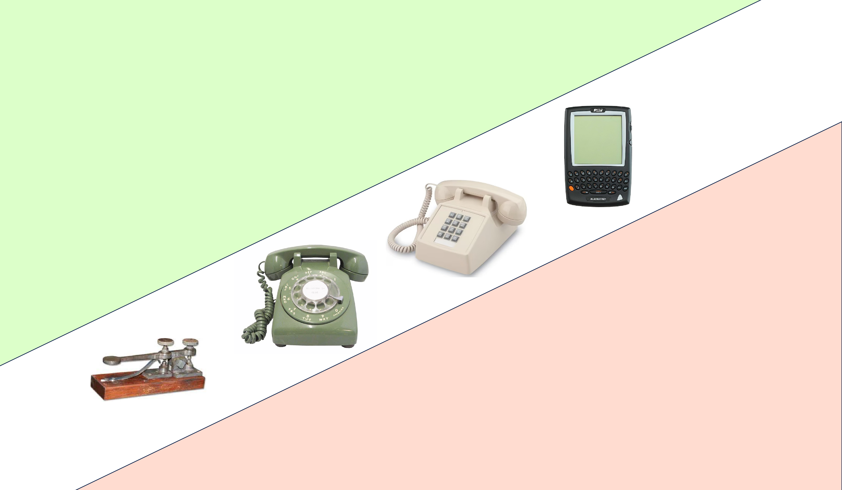
Notes:
A touch screen does not help us understand the origins of telephones.
The origins and evolution of telephones was dependent, always, on electricity.
Electronics transcends time, and specific systems and functions of the telephone. Electronics is the basis of all critical functions in telegraph, rotary phones, Blackberries and iPhones. The origins and evolution of the telephone can only be understood in context of development of solid state electronics and circuits. Touch screens are universal to extant telephones but are not relevant to the origins and early evolution of the phone.

Slide 7
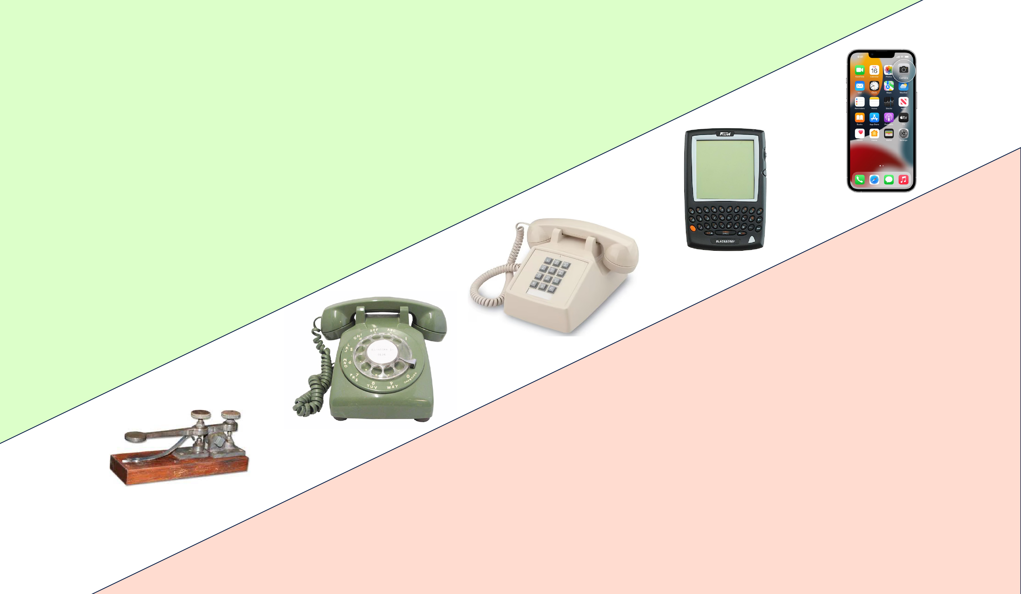
Notes:
A touch screen does not help us understand the origins of telephones.
The origins and evolution of telephones was dependent, always, on electricity.
Electronics transcends time, and specific systems and functions of the telephone. Electronics is the basis of all critical functions in telegraph, rotary phones, Blackberries and iPhones. The origins and evolution of the telephone can only be understood in context of development of solid state electronics and circuits. Touch screens are universal to extant telephones but are not relevant to the origins and early evolution of the phone.

Slide 8
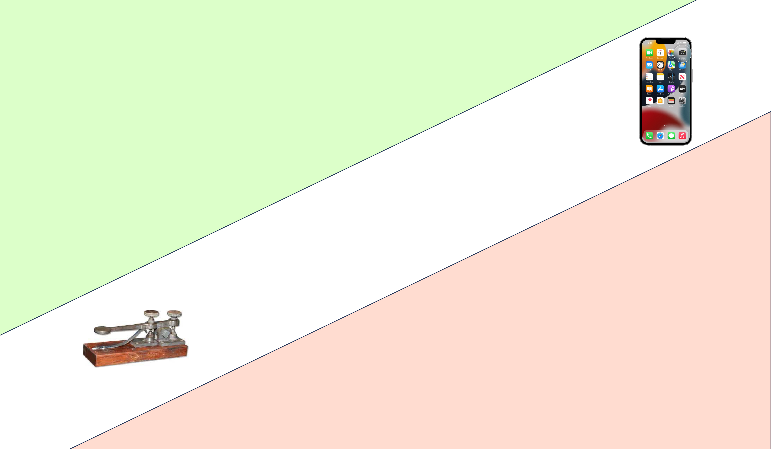
What does the iphone tell us about the historical genesis
of long-distance communication?
Notes:
A touch screen does not help us understand the origins of telephones.
The origins and evolution of telephones was dependent, always, on electricity.
Electronics transcends time, and specific systems and functions of the telephone. Electronics is the basis of all critical functions in telegraph, rotary phones, Blackberries and iPhones. The origins and evolution of the telephone can only be understood in context of development of solid state electronics and circuits. Touch screens are universal to extant telephones but are not relevant to the origins and early evolution of the phone.

Slide 9
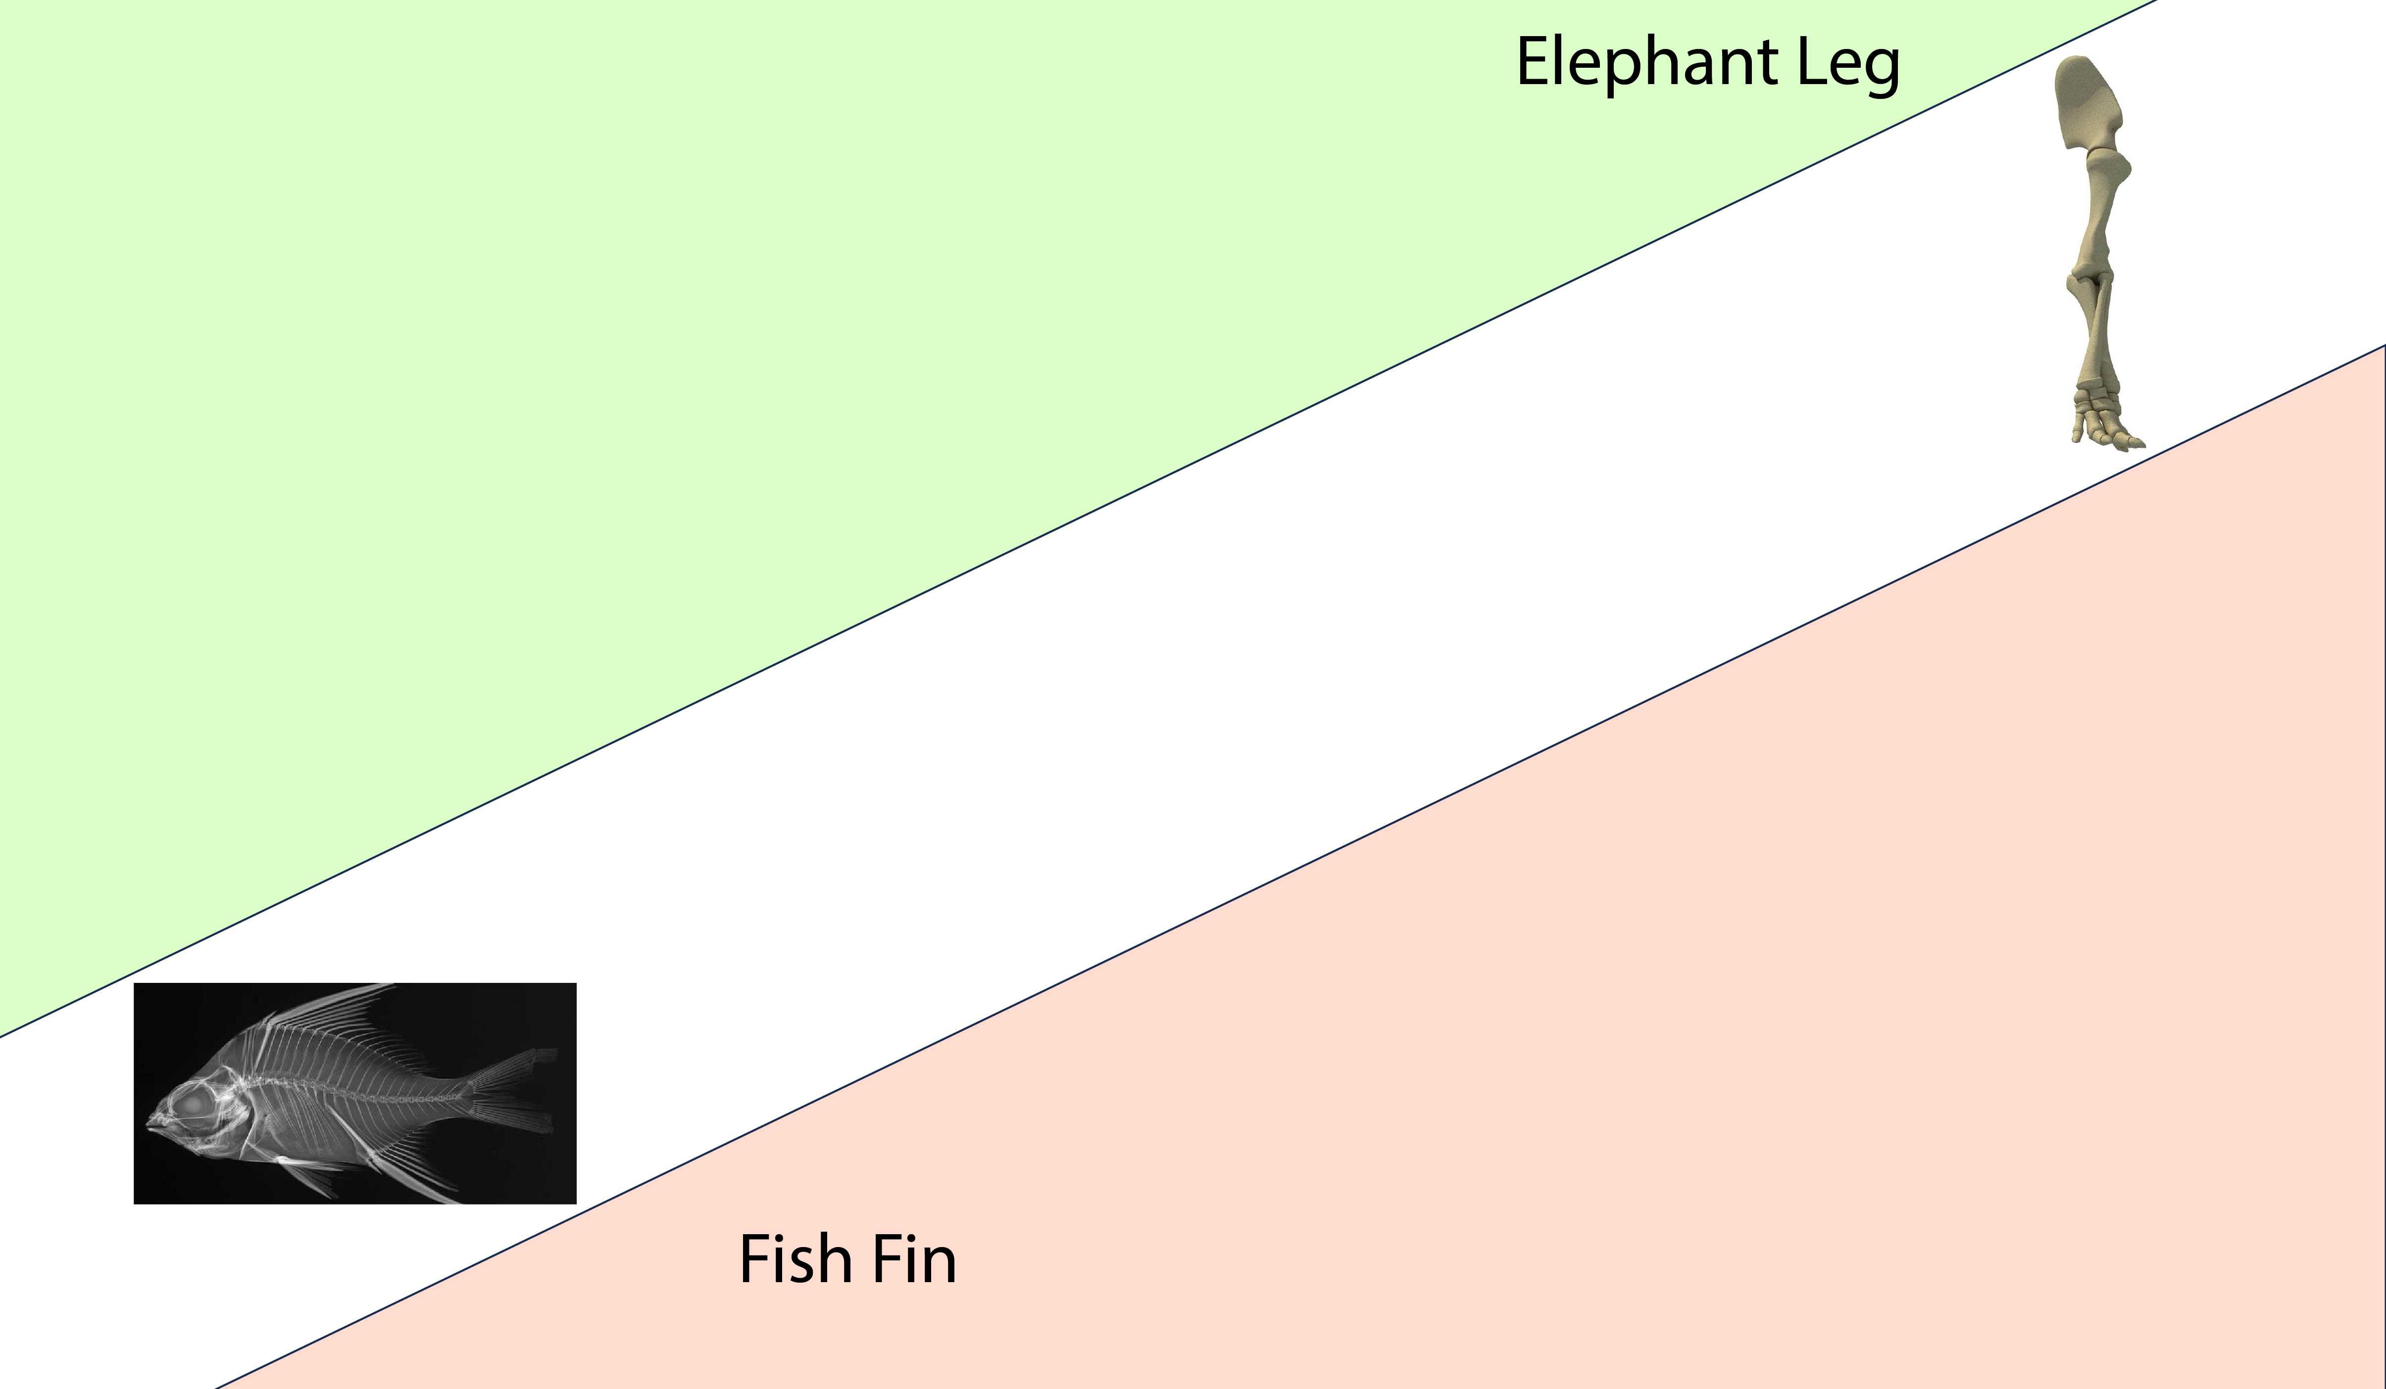
What does an elephant tell us about fish fins?
(fish fins are ancestors of elephant legs).

Slide 10
Gould and Vrba 1982; Gould 2002
Do not “conflate historical genesis with current utility”.
Exaptation: Function is transformed, and structure is remodeled.
Recursive exaptation/adaptation = breaks historical links.
Exaptations are not fashioned for their current role and reflect no attendant process beyond cooptation. They were built in the past …
for different roles.

Slide 12
To understand the origins of Life, many scientists project their favorite part of biology:
replication,
transcription,
translation,
the Krebs cycle,
gradients and ATP synthase…
RNA, DNA, protein, membranes
polymeric Information,
back to the origins of life.
All of these approaches are equally wrong (IMO).

Slide 13
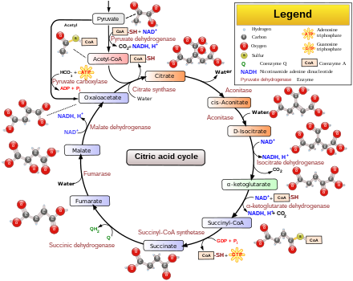
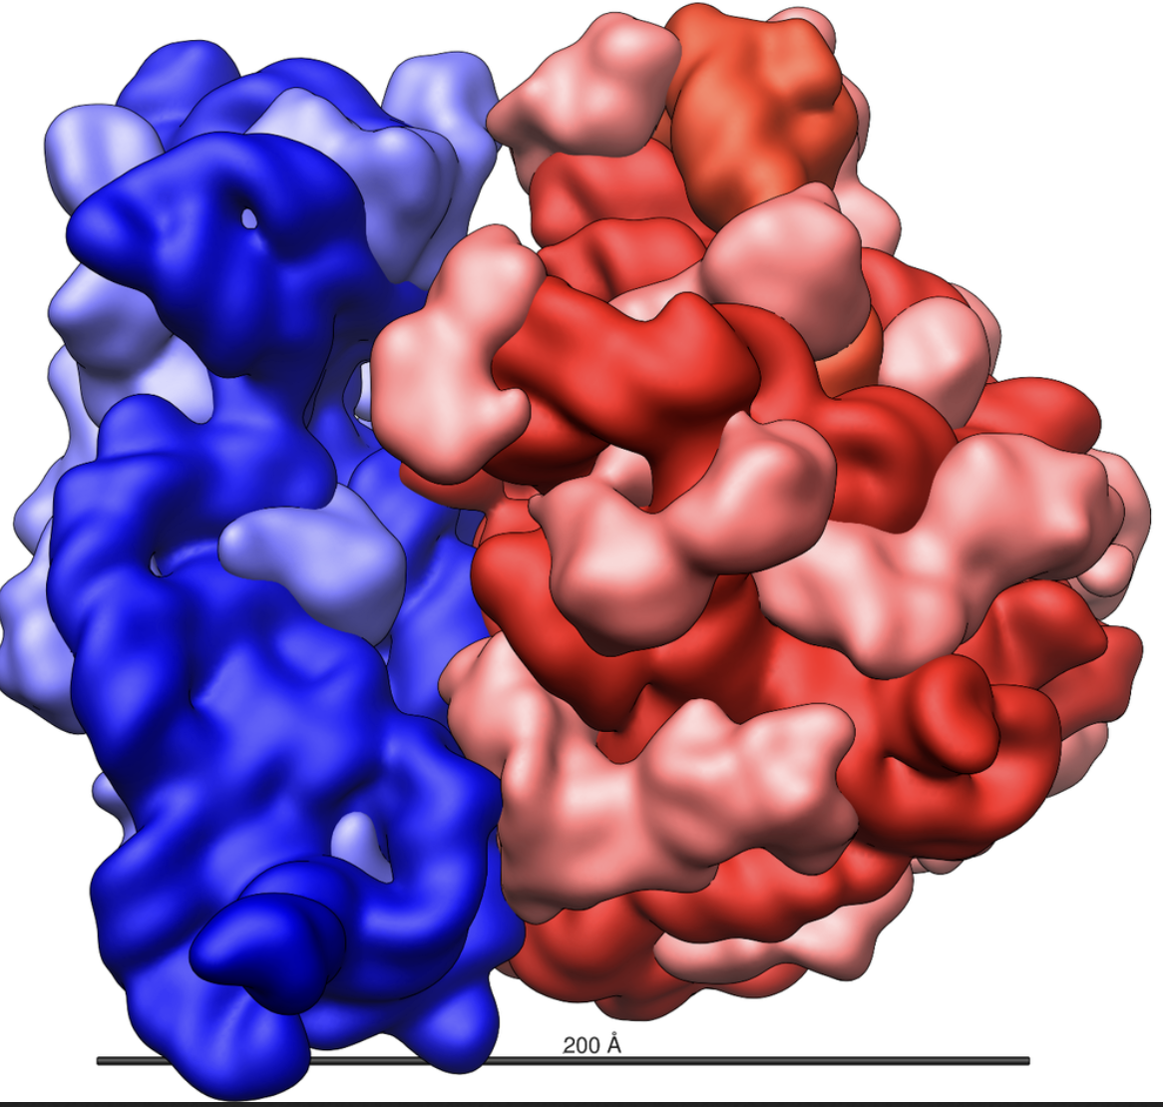
Extant replication, transcription, translation,
the Krebs cycle, NTPs,
20 chiral amino acids,
are shiny objects that do not inform us in a direct way about
the origins of life.
Notes:
A touch screen does not help us understand the origins of telephones.
The origins and evolution of telephones was dependent, always, on electricity.
Electronics transcends time, and specific systems and functions of the telephone. Electronics is the basis of all critical functions in telegraph, rotary phones, Blackberries and iPhones. The origins and evolution of the telephone can only be understood in context of development of solid state electronics and circuits. Touch screens are universal to extant telephones but are not relevant to the origins and early evolution of the phone.

Slide 14
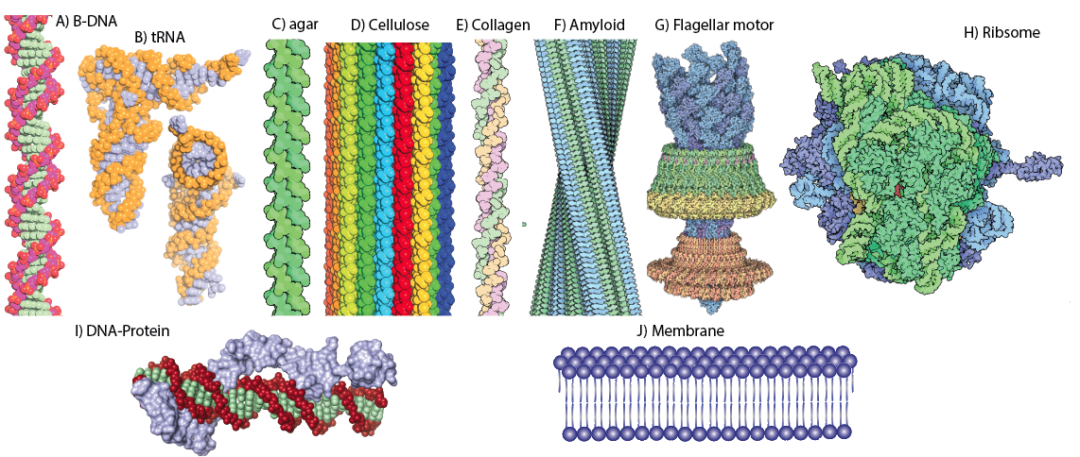
What came first,
RNA or protein?
DNA or RNA?
Compartments or metabolism?
Chicken and Egg dilemmas

Slide 15
Steve Benner’s statement of the chicken and egg problem?

Slide 16
Co-evolution refers to processes in which two or more species/systems exert selective pressures on each other, causing mutual evolutionary changes. Classic examples are:
Pollinators and Flowers: Flowers evolve specific shapes, colors, and scents to attract pollinators, while bees develop traits (like proboscis length) for accessing nectar in those flowers.
Predator-Prey Dynamics: Gazelles and cheetah have co-evolved to be exceptionally fast runners.
Parasites and Hosts: Hosts evolve defenses. Parasite evolve mechanisms to counter these host defenses.
Bacterial Symbionts and Hosts: Beneficial gut bacteria in humans help digest complex carbohydrates. The human immune system recognizes and tolerates beneficial bacteria while defending against pathogens.
Ants and Aphids: Some ants “farm” aphids by protecting them from predators and collecting honeydew that aphids secrete. The aphids benefit from protection, while ants have a reliable food source, illustrating a mutualistic co-evolution.

Slide 17
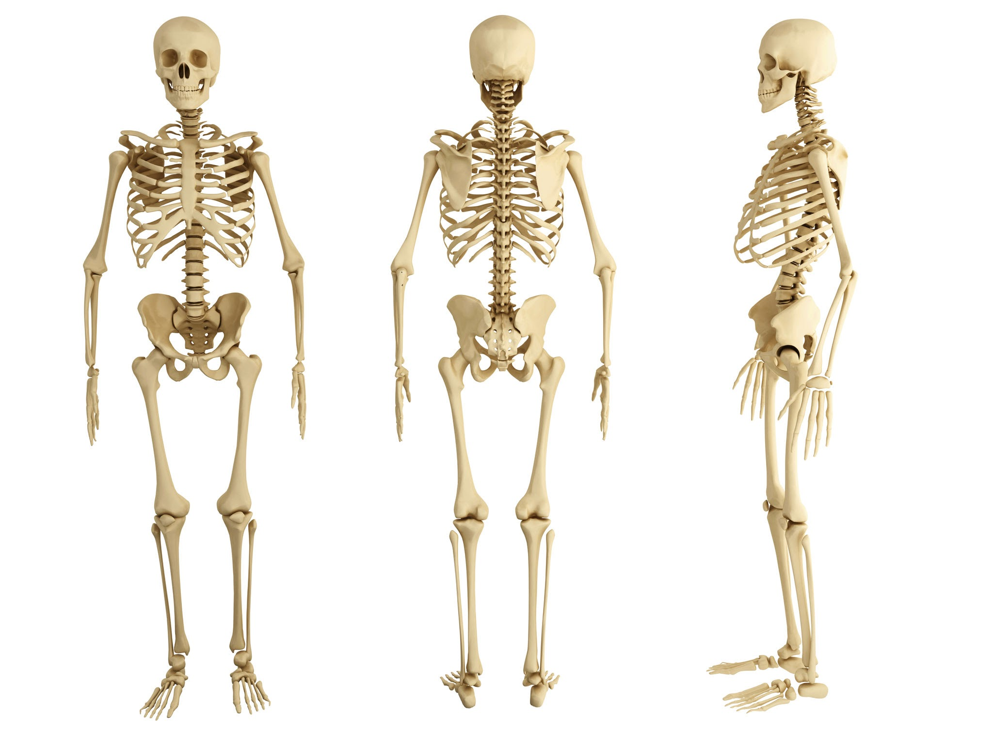
2) Chicken and egg v co-evolution
What came first,
the ulna and the radius?
What came first,
the femur or the tibia?
Bones co-evolve to maintain balance, mobility, and durability.
Density, porosity, and mineral composition co-evolve with macro-structure. Fish bones evolved structural properties for buoyancy. Birds optimize porosity for low density. Elephants optimize strength

Slide 18
2) Chicken and egg v co-evolution
X
What came first,
the ulna and the radius?
X
What came first,
the femur or the tibia?

Slide 19
What came first,
RNA or protein?
What came first,
RNA or DNA?

Slide 20
X
What came first,
RNA or protein?
X
What came first,
RNA or DNA?

