Slide 1
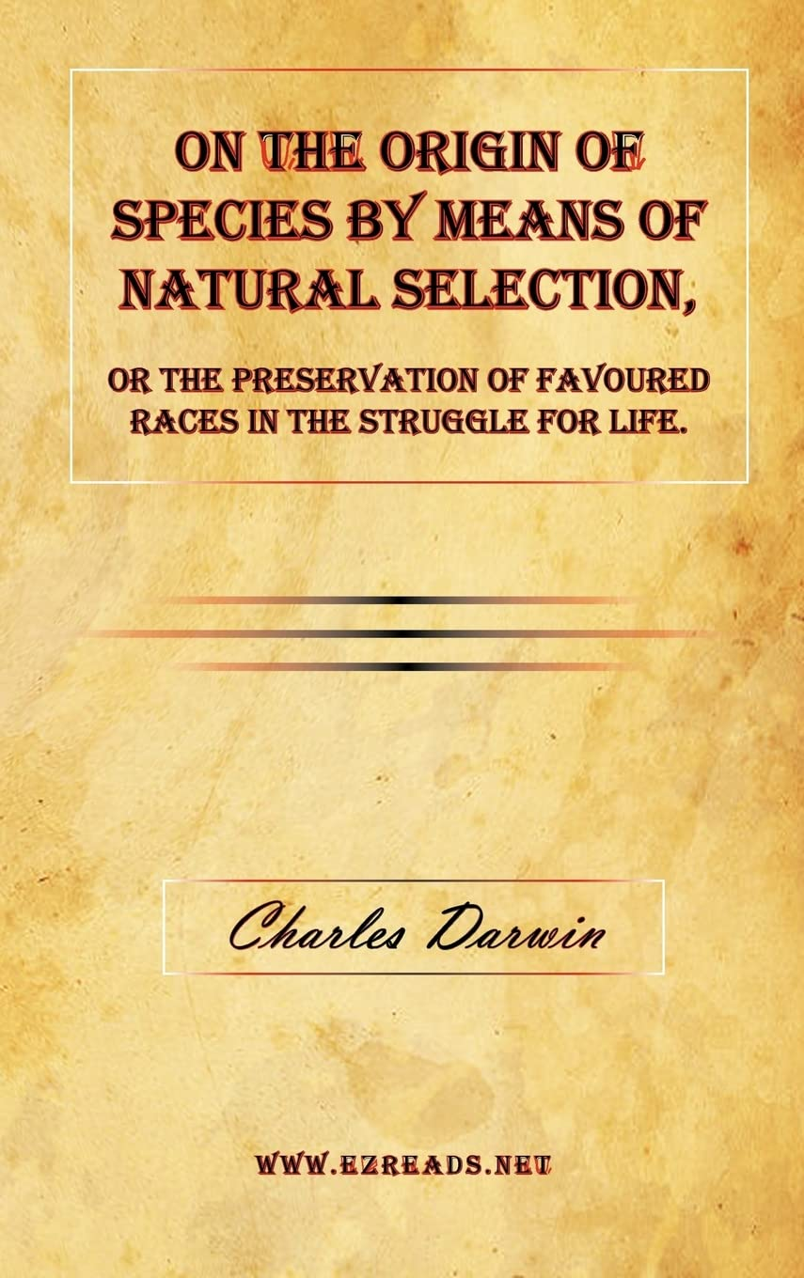
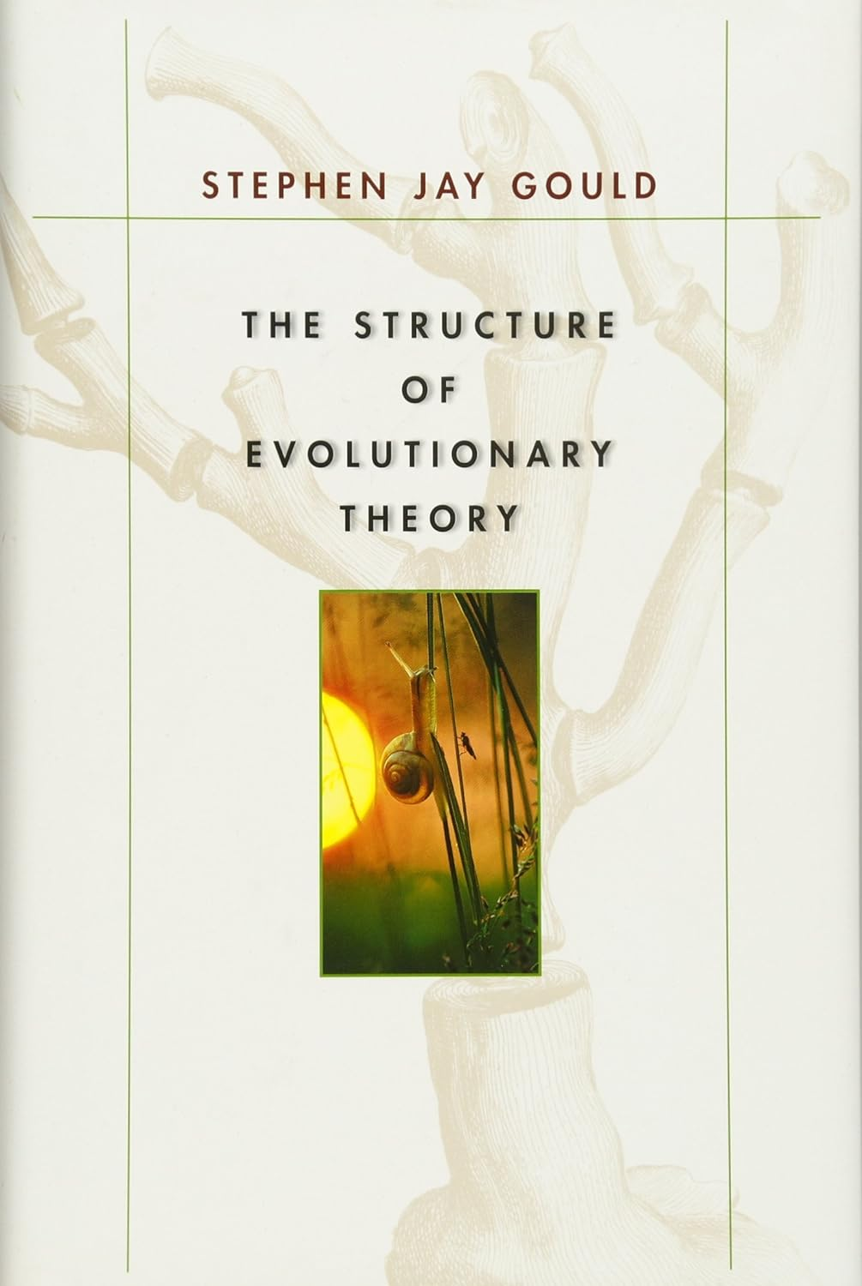

Slide 2
Part 2: Molecules.
The Paradox

Slide 3
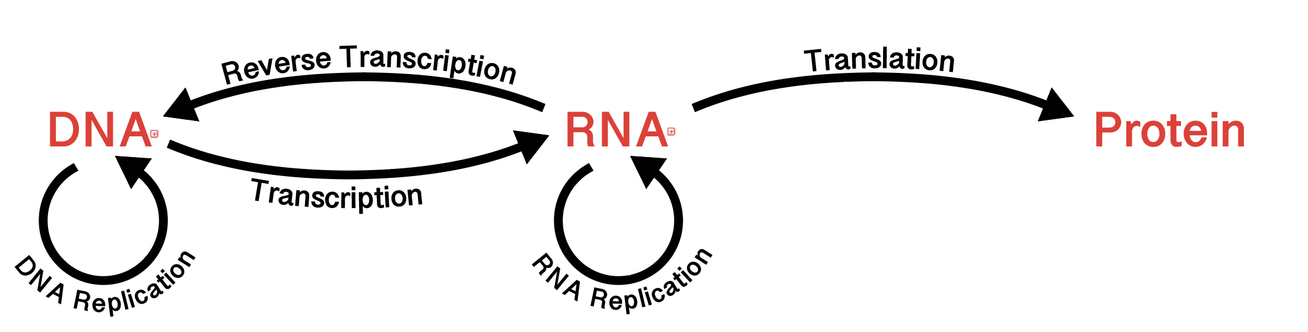
The Paradox
Darwinian evolution depends entirely on biopolymer backbones.
No polypeptide/polynucleotide, no Darwinian evolution.

Slide 4
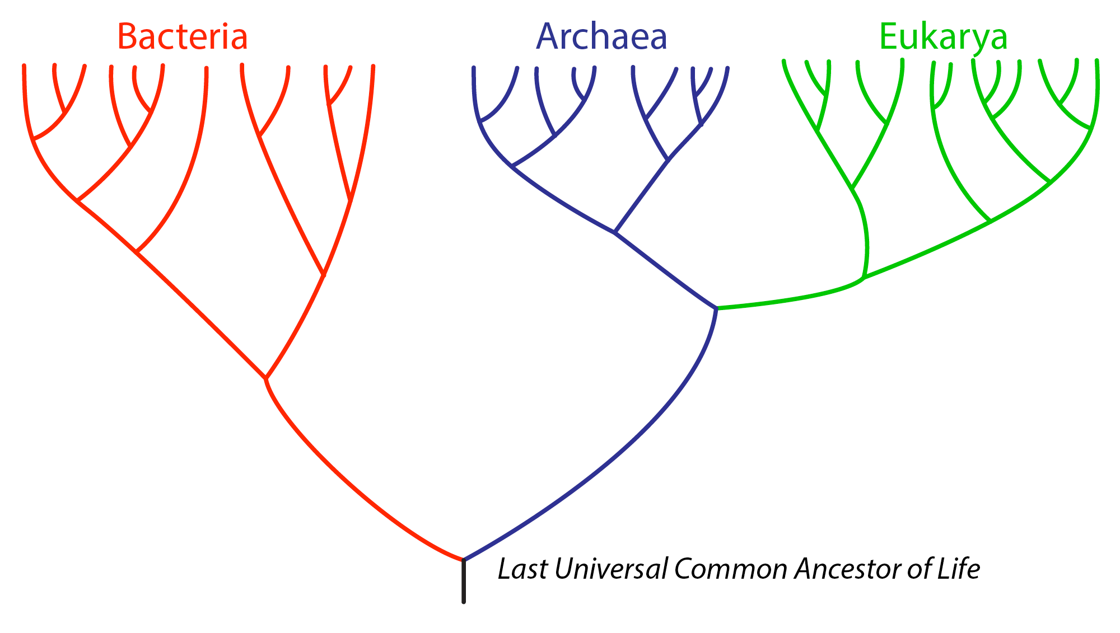

The Paradox
Darwinian evolution depends entirely on biopolymer backbones.
No polypeptide/polynucleotide, no Darwinian evolution.
Darwinian evolution cannot alter biopolymer backbones.
Nowhere in the vast and diverse tree of life do we find ribosomes made from anything but polypeptide and polynucleotide.

Slide 5

The Paradox
Darwinian evolution depends entirely on biopolymer backbones.
No polypeptide/polynucleotide, no Darwinian evolution.
Darwinian evolution cannot alter biopolymer backbones.
Nowhere in the vast and diverse tree of life do we find ribosomes made from anything other polypeptide, polynucleotide.
Biopolymer backbones are the products of evolution.
(see next).

Slide 6
What is the evidence that biopolymer backbones arose via evolutionary processes?
How do we recognize products of evolution in general?

Slide 7
The brain is a product of evolution.
The brain has function – to integrate and store information and to organize organismal actions and responses through transmission of electrical and chemical signals.
The brain is emergent. Sum is different from the parts.

Slide 8
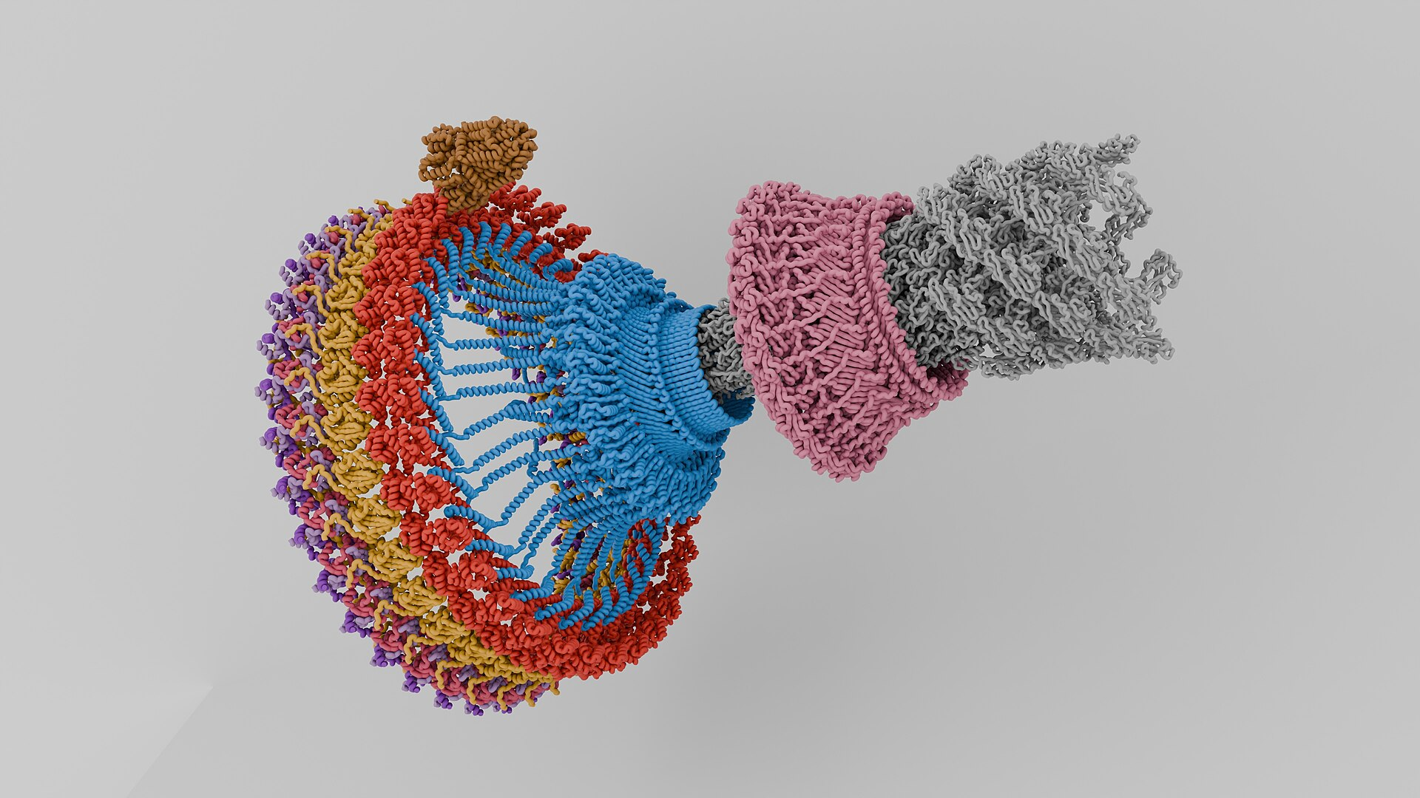

Slide 9
Polypeptide

Slide 10
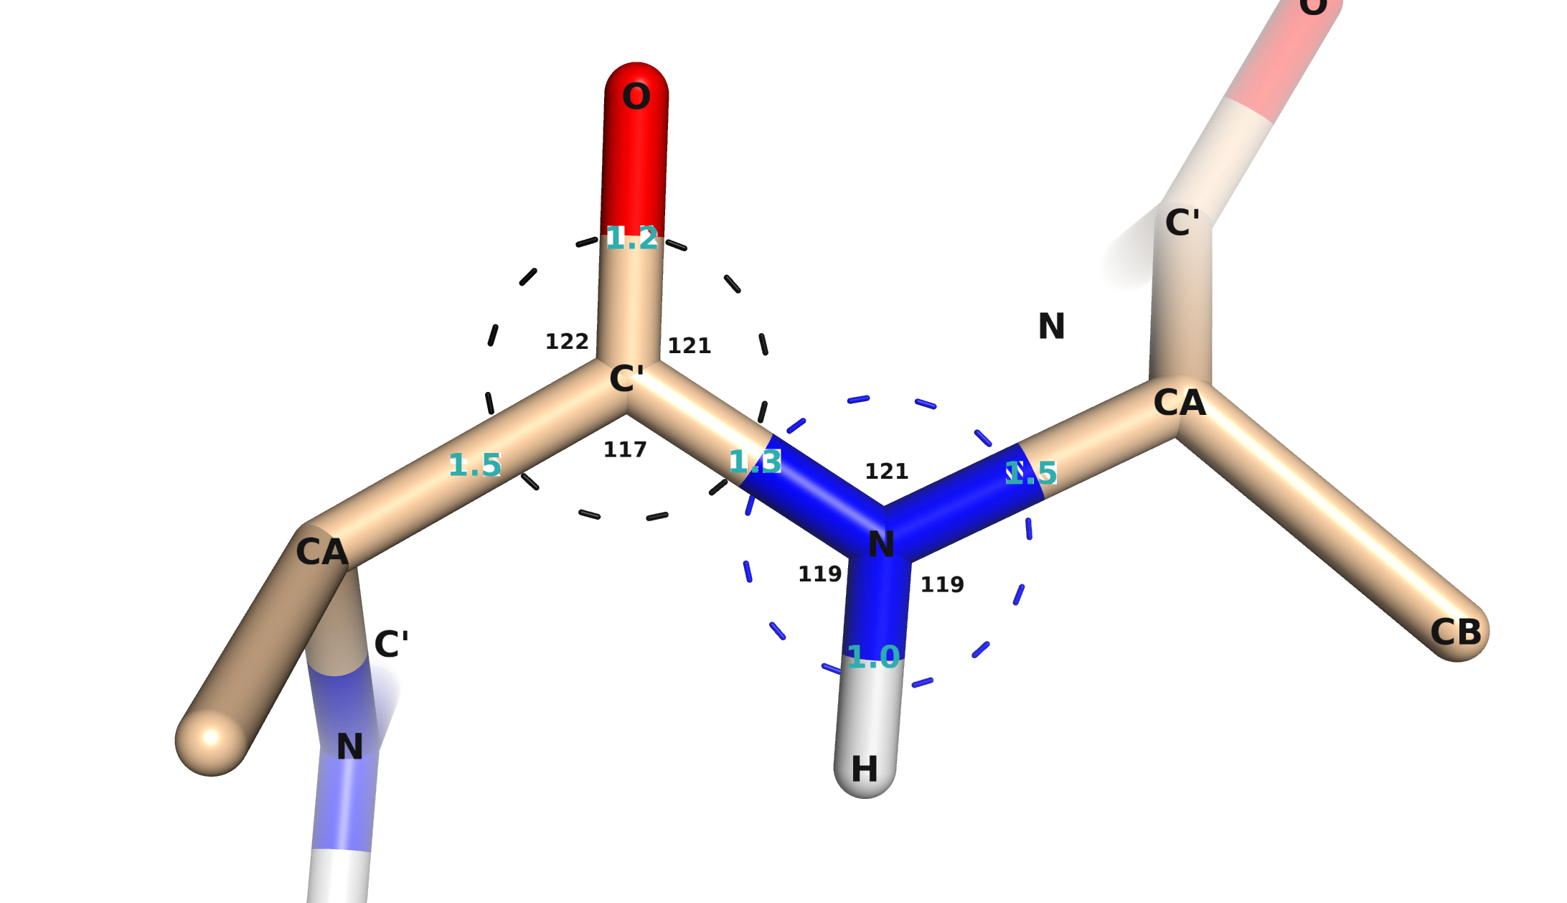
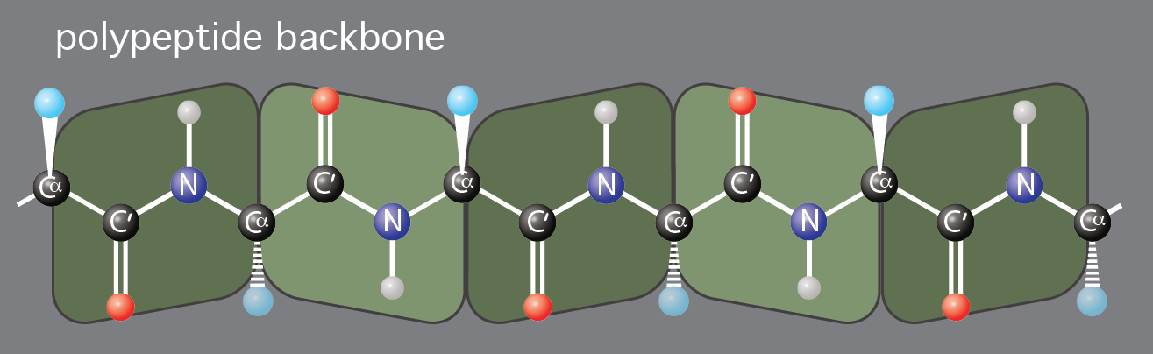
Part 2: The Polypeptide Backbone

Slide 11
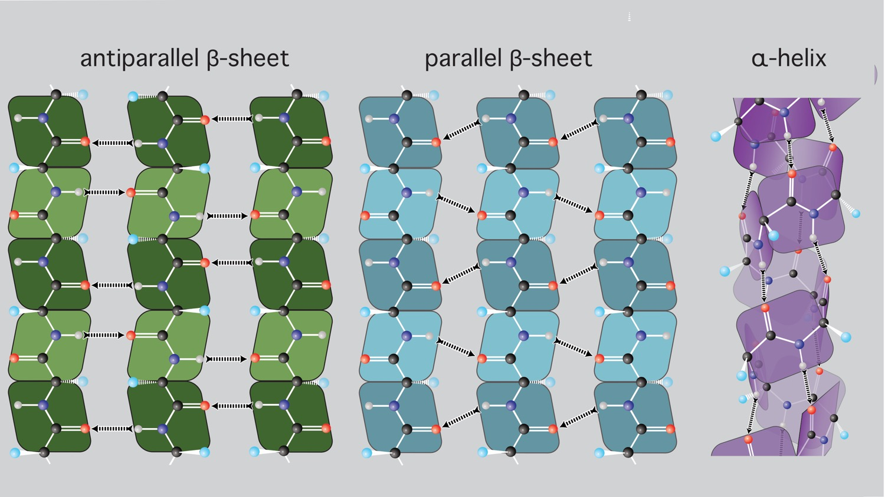
The polypeptide backbone
The polypeptide backbone is self-complementary in three distinct rotameric minima.

Slide 12
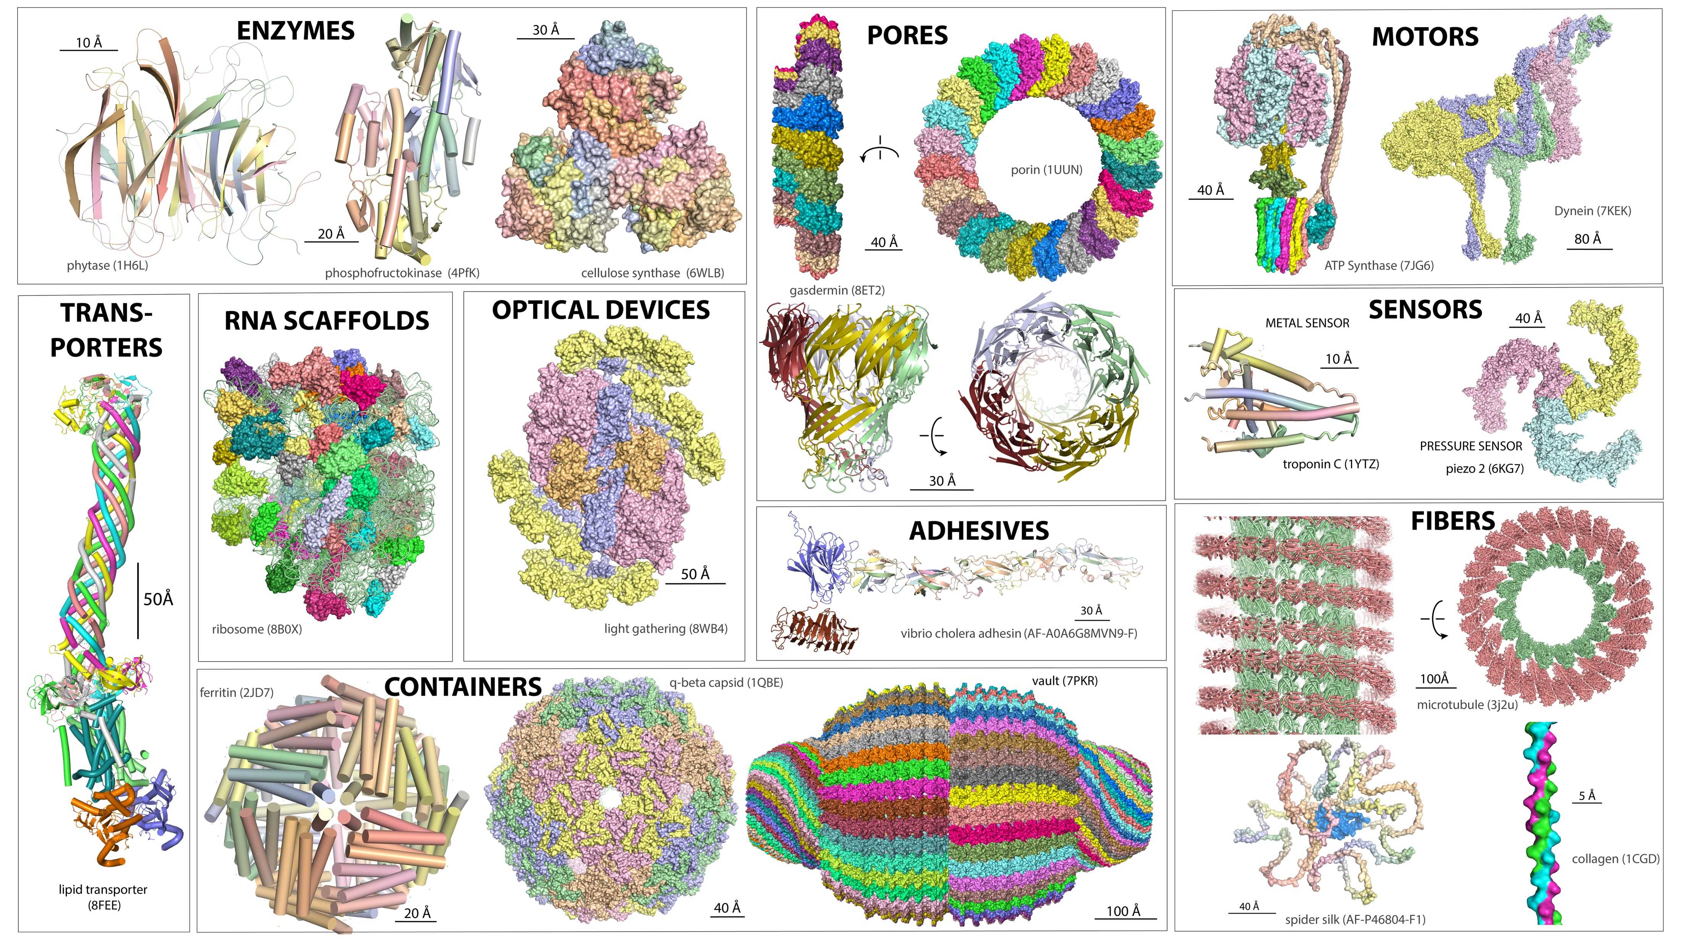

Slide 13
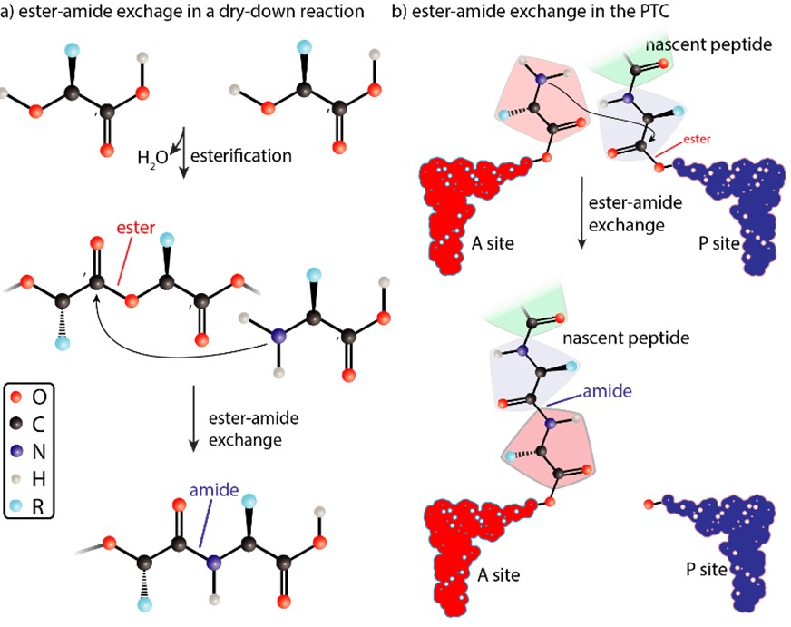
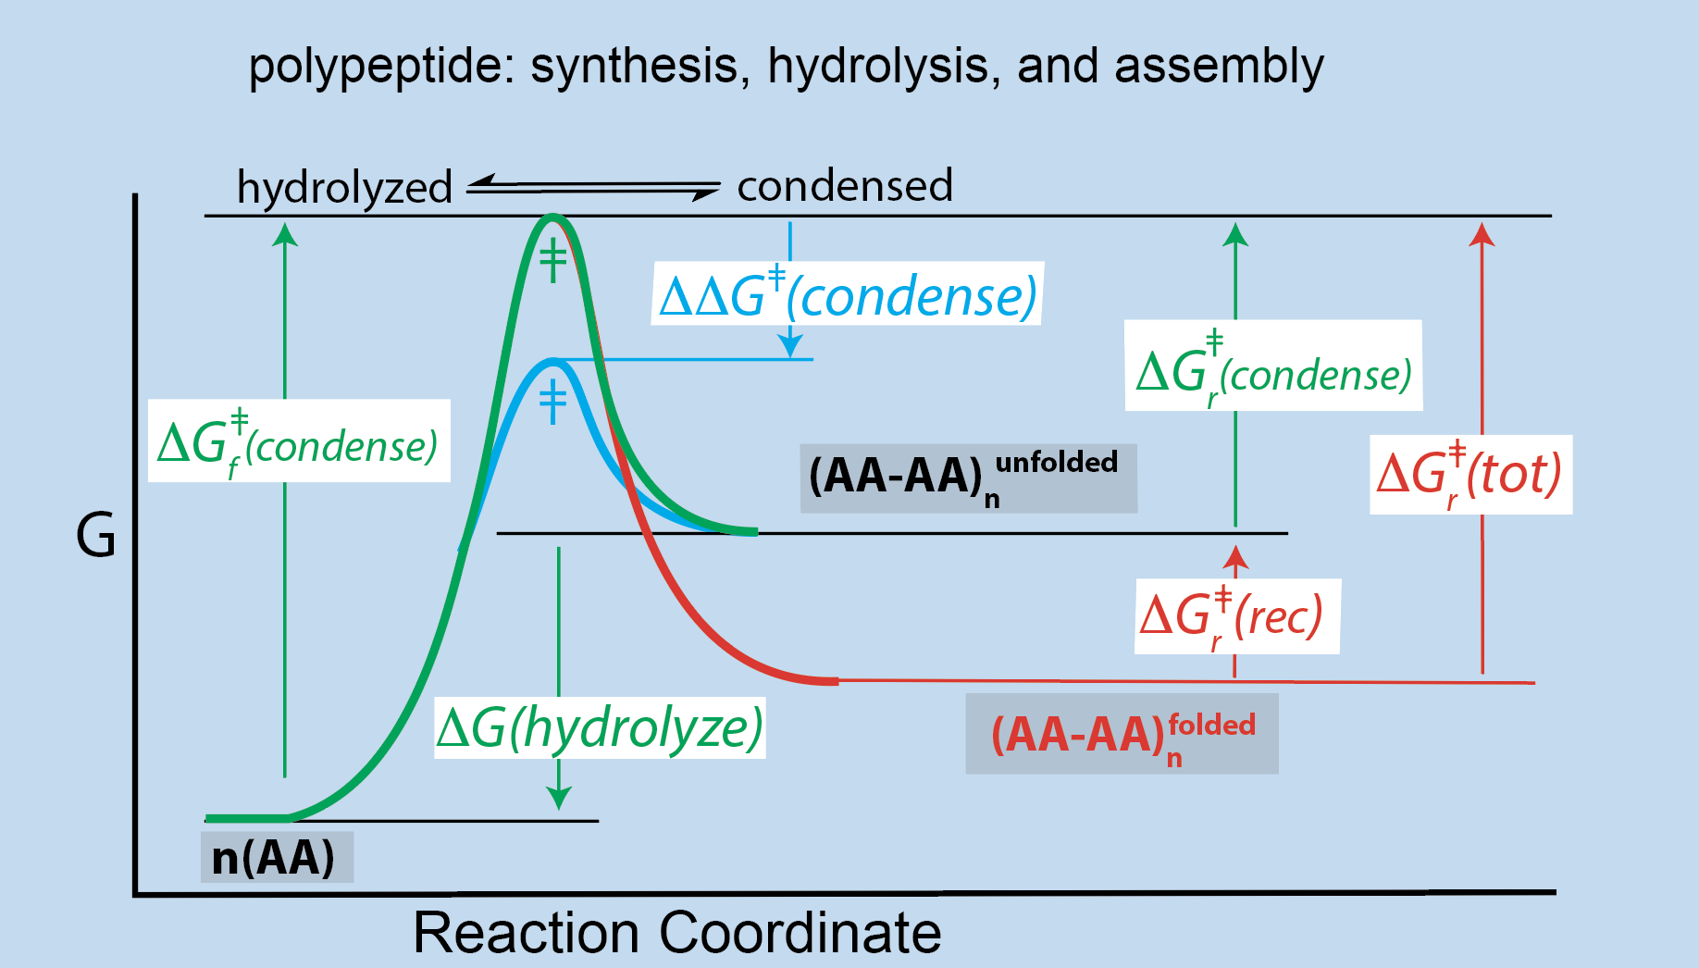
Ester-amide exchange
in dry down reactions in biology
The kinetics and thermodynamics of
condensation/hydrolysis of the polypeptide backbone are exactly matched relative to ester to allow ester-amide exchange and kinetic trapping.

Slide 14
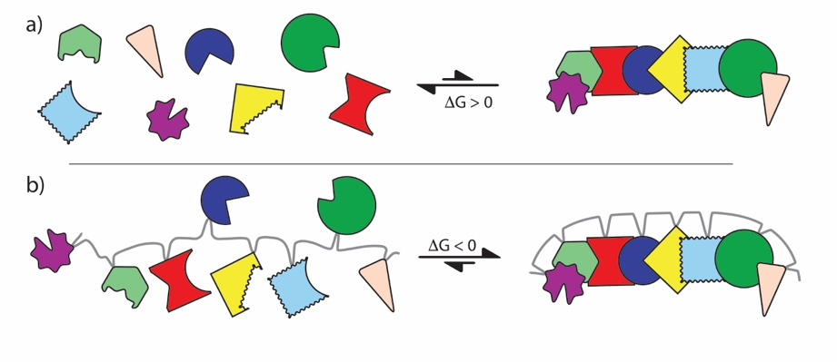
The biopolymers are emergent. Sum is different from the parts.
Illustration of emergence upon polymerization. A collection of unlinked building blocks do not assemble specifically but polymerized building blocks spontaneously assemble. Specific assembly is emergent on polymerization. The colored shapes represent biopolymer building blocks. The gray line represents a biopolymer backbone.

Slide 15
The properties of the pp backbone indicate it is the product of evolution.

Slide 16
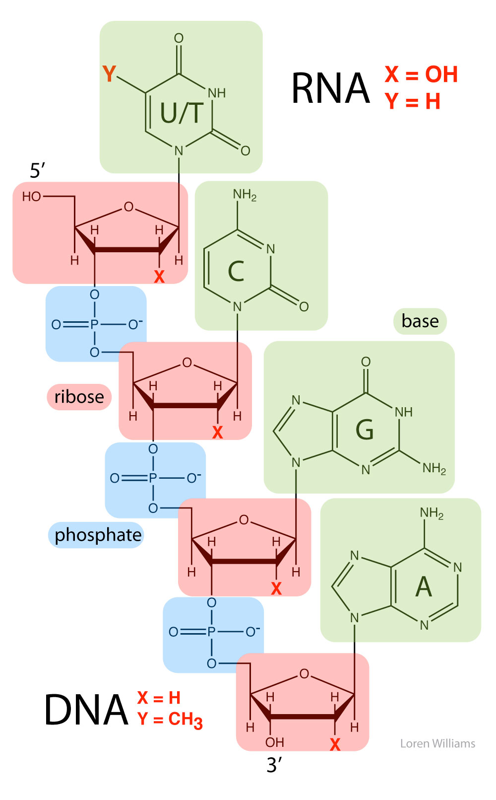
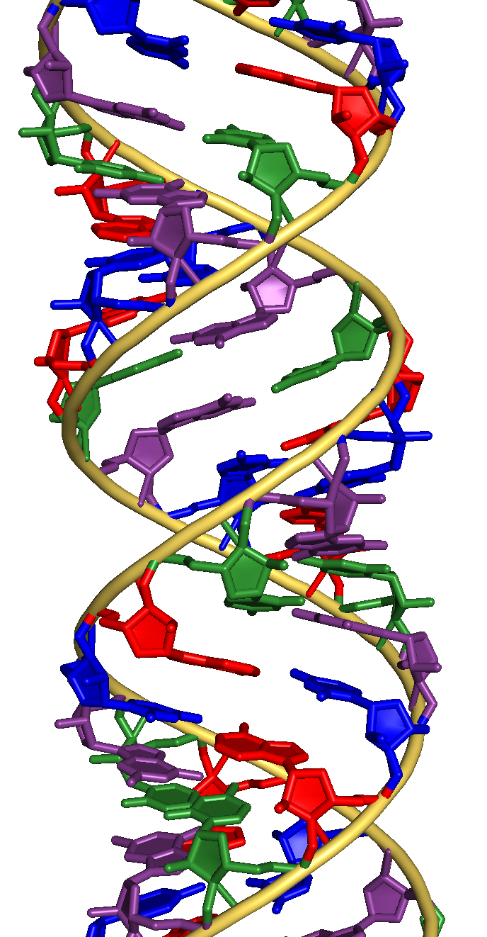
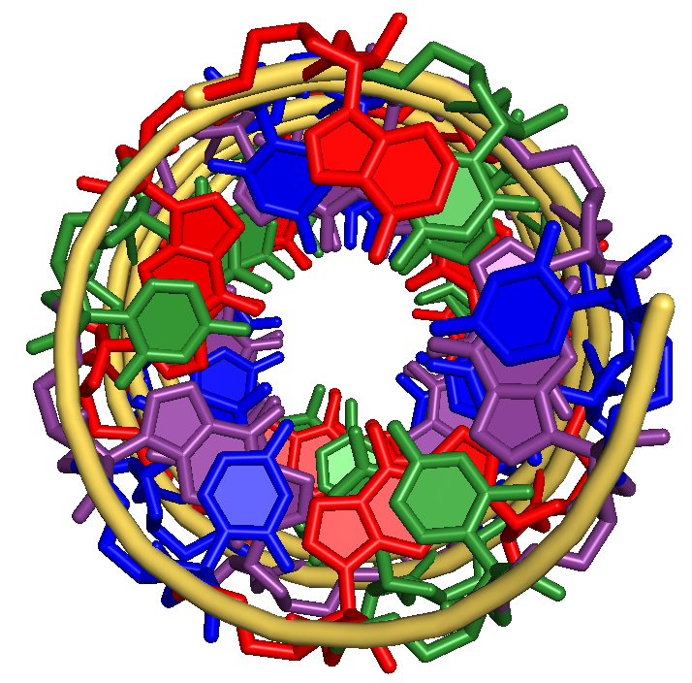

Slide 17
Darwinian evolution depends entirely on biopolymer backbones.
No polypeptide/polynucleotide, no Darwinian evolution.
Darwinian evolution cannot alter biopolymer backbones.
Nowhere in the vast and diverse tree of life do we find ribosomes made from anything other polypeptide, polynucleotide.
Biopolymer backbones are indistinguishable from magic
Biopolymer backbones are the products of evolution.
(will demonstrate that).
The Paradox is the dependence of Darwinian evolution on evolved biopolymer backbones, even though it has a total inability to evolve them.

