Slide 1
Enzyme Kinetics
Drug Development and Therapeutics: By understanding rates at which enzymes catalyze reactions, scientists can identify how inhibitors or activators affect these rates, allowing development of drugs that target specific enzymes in disease pathways.
Metabolic Engineering: Enzyme kinetics helps optimize metabolic pathways for industrial applications, such as biofuel production or pharmaceutical synthesis.
Diagnostic Applications: Enzyme kinetics can identify diseases that are associated with abnormal enzyme activities, enabling the diagnosis of diseases.

Slide 2
Enzyme Kinetics
4. Understanding Cellular Regulation: Enzyme kinetics is allows us to understand cellular processes and regulatory mechanisms.
5. Biochemical Research and Enzyme Mechanisms: Enzyme kinetics allows us to understand enzyme mechanisms at the molecular level. Parameters like the Michaelis constant (K_{m}​), turnover number (k_{cat})and maximum velocity (v_{max}​), determine how efficiently an enzyme catalyzes a reaction and how tightly it binds its substrates.

Slide 3
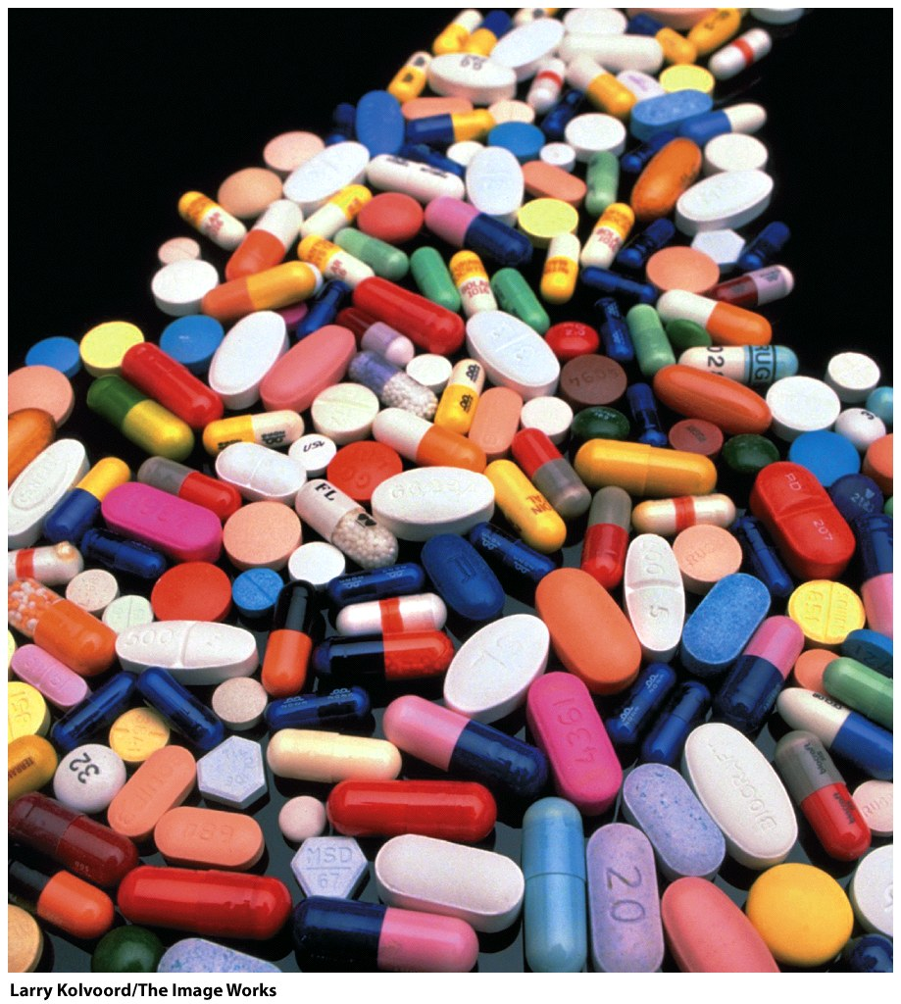
Many drugs are enzyme inhibitors.
Ibuprofin: Inhibits COX-1 and COX-2
(cyclooxygenases 1 & 2) and decreases synthesis of prostaglandins, which mediate inflammation, pain, fever, and swelling.
Aspirin is also COX-1,2 inhibitor. At low doses aspirin inhibits a COX involved in platelet formation.
Lipitor: Inhibits a liver enzyme (HMG-CoA reductase) that is important in biosynthesis of cholesterol (>$100 billion total sales since 1996).
Viread & Emtriva: reverse transcriptase inhibitors, anti-retrovirus (HIV).
Saquinavir: protease inhibitor, anti-retrovirus (HIV).
Paxlovid: protease inhibitor, RNA viruse (COVID).

Slide 4
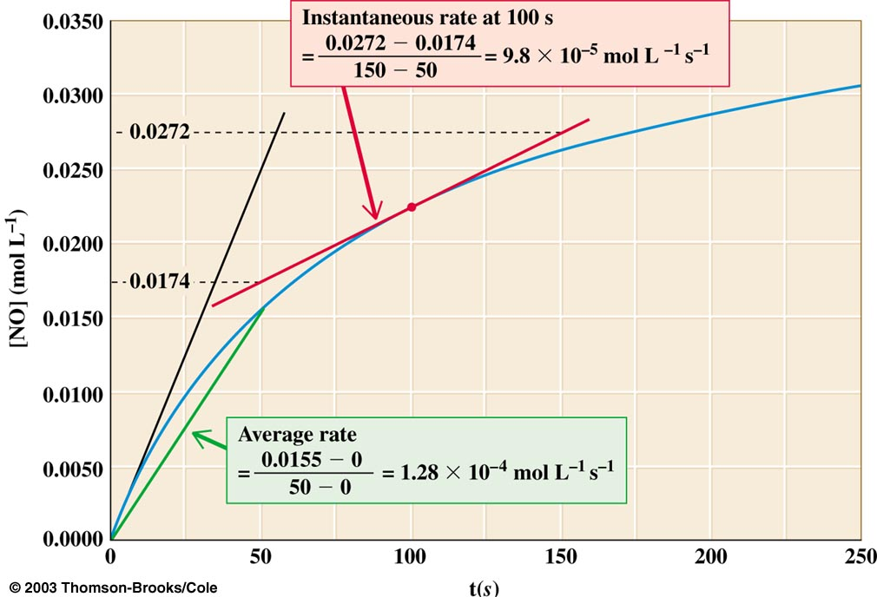
Brief review of chemical kinetics
Reaction Rates (reaction velocities): To measure a reaction rate we monitor the disappearance of reactants or appearance of products.
e.g., 2NO₂ + F₂ → 2NO₂F
We measure the
initial velocity, when
[product] = 0, and there is no back reaction

Slide 5
Reaction Order
Zero Order. The rate is independent of the concentration of the reactant(s). Zero-order kinetics are observed when an enzyme is saturated by reactants and in some photochemical reactions, where light drives a reaction, and the rate does not depend on the reactant concentration.
First Order. The rate varies linearly with the concentration of one reactant. First-order kinetics are observed when a protein folds or RNA folds (assuming no self-association or aggregation), and in radioactive decay or isomerization reactions.
Second Order. The rate varies with the square of concentrations of one reactant (or with the product of the concentrations of two reactants). Second order kinetics is commonly observed when two identical species combine to form a single product, as in formation of double-stranded DNA from annealing two single-strands or the combination of two identical free radical species to form a single product.

Slide 6
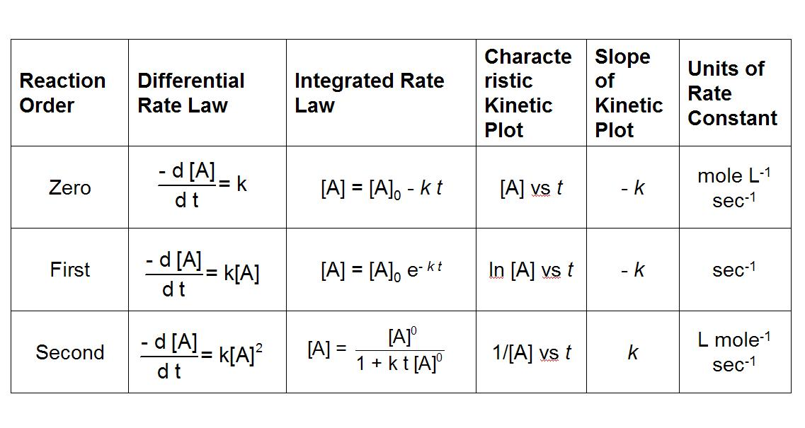

Slide 7
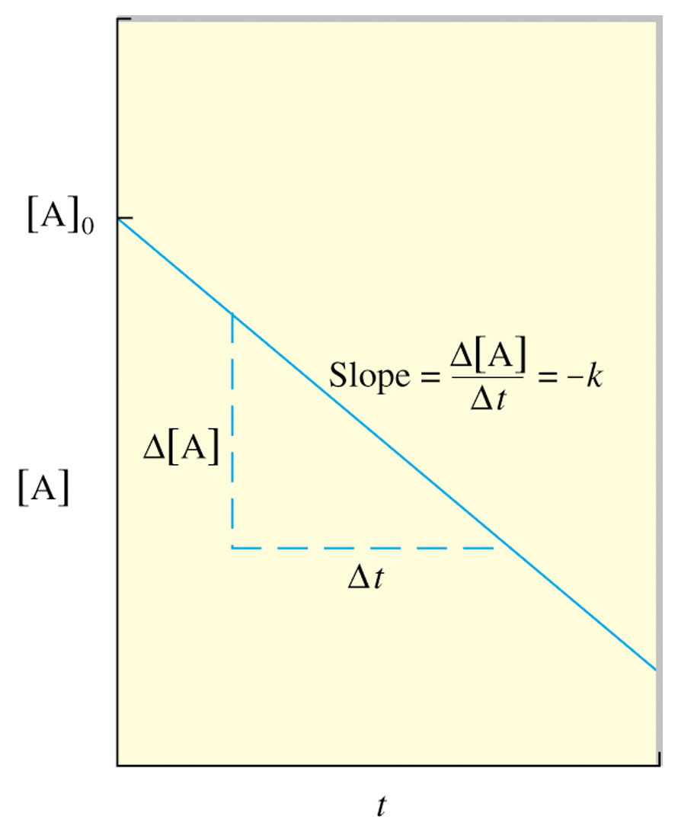
Use experimental data to determine the reaction order.
If a plot of [A] vs t is a straight line, then the reaction is zero order.
If a plot of ln[A] vs t is a straight line, then the reaction is 1st order.
If a plot of 1/ [A] vs t is a straight line, then the reaction is 2nd order.

Slide 8
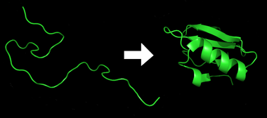
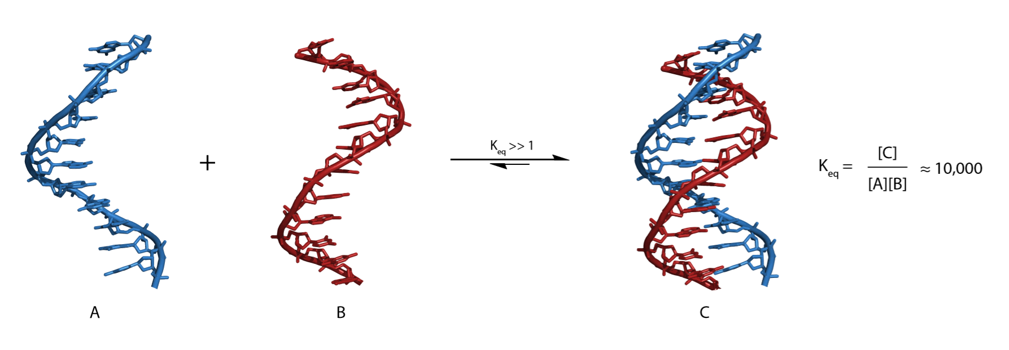
Protein Folding: 1st order process
DNA annealing: 2nd order process

Slide 9
Reactions and Elementary Reactions
An enzymatic reaction is composed of many elementary steps,
An elementary reaction represents the simplest "building block" of a reaction mechanism,
Each elementary reaction has reactant(s), a transition state, and product(s). Products that are consumed in a subsequent elementary reaction are called intermediates,
Each elementary reaction is characterized by its own rate law (zero, first or second order).
Our serine protease (trypsin) mechanism has 8 elementary reactions.

Slide 10
Enzymatic Kinetics
Enzyme Kinetics is the study of time-dependent phenomena biological phenomena.
Rates of enzymatic reactions are affected by
The enzyme type and concentration,
The substrate type and concentration,
Effectors, cofactors and inhibitors, and
Temperature, pH, salt, denaturants, viscosity.

Slide 11
General Observations
Enzymes influence reactions rates at very low concentrations (nanomolar).
The initial rate [initial velocity, i.e., initial d[P]/dt)] is linear with [enzyme].
The initial velocity increases with [substrate] at low [substrate].
Saturation: the initial velocity reaches a maximum at high [substrate] and does not change with increasing [substrate].

Slide 12
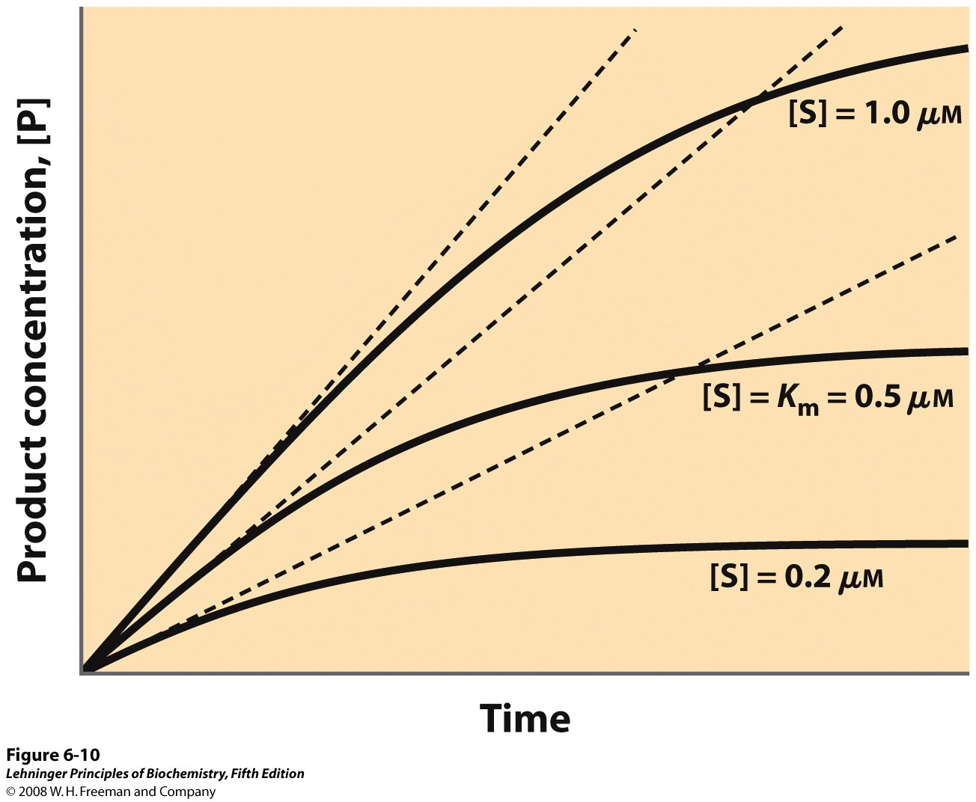
Enzyme Kinetics
The initial velocity (initial d[P]/dt) increases with [S] at low [S].
Initial velocity
Notes:
FIGURE 6-10 Initial velocities of enzyme-catalyzed reactions. A theoretical enzyme catalyzes the reaction S ↔ P, and is present at a concentration sufficient to catalyze the reaction at a maximum velocity, V_{max}, of 1 μM/min. The Michaelis constant, K_{m} (explained in the text), is 0.5 μM. Progress curves are shown for substrate concentrations below, at, and above the K_{m}. The rate of an enzyme-catalyzed reaction declines as substrate is converted to product. A tangent to each curve taken at time = 0 defines the initial velocity, V₀, of each reaction.

Slide 13
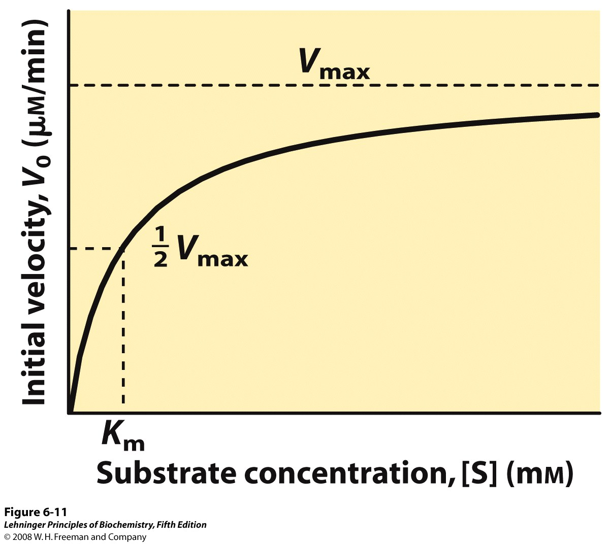
Enzyme Kinetics
The initial velocity increases with [S] at low [S].
(velocity =d[P]/dt, P=product)
Saturation: the initial velocity reaches a maximum at high [substrate] and does not change with increasing [substrate].
Notes:
FIGURE 6-11 Effect of substrate concentration on the initial velocity of an enzyme-catalyzed reaction. The maximum velocity, V_{max}, is extrapolated from the plot, because V₀ approaches but never quite reaches V_{max}. The substrate concentration at which V₀ is half maximal is K_{m}, the Michaelis constant. The concentration of enzyme in an experiment such as this is generally so low that [S] >> [E] even when [S] is described as low or relatively low. The units shown are typical for enzyme-catalyzed reactions and are given only to help illustrate the meaning of V₀ and [S]. (Note that the curve describes part of a rectangular hyperbola, with one asymptote at V_{max}. If the curve were continued below [S] = 0, it would approach a vertical asymptote at [S] = –K_{m}.)

Slide 14
Equations describing Enzyme Kinetics
Start with a mechanistic model
Identify constraints and assumptions
Do the algebra ...
Solve for velocity (d[P]/dt)

Slide 15
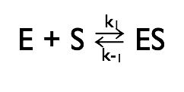
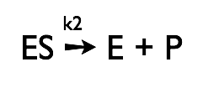
Michaelis-Menten Kinetics
Simplest mechanistic model
One reactant (S)
One intermediate (ES)
Two transition states
One product (P)

Slide 16
Michaelis-Menten Kinetics
First step: The enzyme (E) and the substrate (S) reversibly and quickly form a non-covalent ES complex (Michaelis Complex).
Second step: The ES complex undergoes a chemical transformation and dissociates to give product (P) and enzyme (E).
v=k₂[ES]
Many enzymatic reactions follow Michaelis–Menten kinetics, even though enzyme mechanisms are always more complicated than the Michaelis–Menten model.
For real enzymatic reactions use k_{cat} instead of k₂.

Slide 17
The Enzyme-Substrate Complex (ES)
Michaelis-Menten Kinetics
The enzyme binds non-covalently to the substrate to form a non-covalent ES complex
the ES complex is known as the Michaelis complex.
A Michaelis complex is stabilized by molecular interactions (non-covalent interactions).
Michaelis complexes form quickly, and dissociate quickly (activation energies are low)

Slide 18
E + S → ES → E + P
Michaelis-Menten Kinetics
ES, k_{cat} and the reaction velocity
k₁
←
k_{cat}
k₋₁
The enzyme is either free ([E]) or bound ([ES]): [E_{o}] = [E]_{TOT}= [ES] + [E].
At high [S] all of the enzyme is tied up as ES (i.e., [E_{o}] ≈ [ES], (Le Chatelier's Principle)
At high [S] the enzyme is working at full capacity (v_{o}=v_{max}).
The maximum velocity (v_{max}) is determined only by k_{cat} and [E_{o}].
k_{cat} = turnover #: number of moles of substrate produced per time per enzyme molecule.

Slide 19
E + S → ES → E + P
Michaelis-Menten Kinetics
k₁
k_{cat}
←
k₋₁
For any enzyme it is possible (pretty easy) to determine k_{cat}. (measure v at high [S])
To understand and compare enzymes we need to know how well the enzyme binds to S (i.e, what happens in the first part of the reaction.) k_{cat} does not tell us anything about how well the enzyme binds to the substrate.

Slide 20
Make some Assumptions
Michaelis-Menten Kinetics
E + S → ES → E + P
k₁
k_{cat}
k₋₁
k₁,k₋₁>>k_{cat} (i.e., the first step is fast and is always at ~equilibrium).
d[ES]/dt ≈ 0 (i.e., the system is at steady state.)
There is a single reaction/dissociation step (i.e., k₂=k_{cat}).
E_{Tot} = [E] + [ES]
There is no back reaction of P to ES (i.e. [P] ≈ 0). This assumption allows us to ignore k₋₂. We measure initial velocities, when [P] ≈ 0.

Slide 21
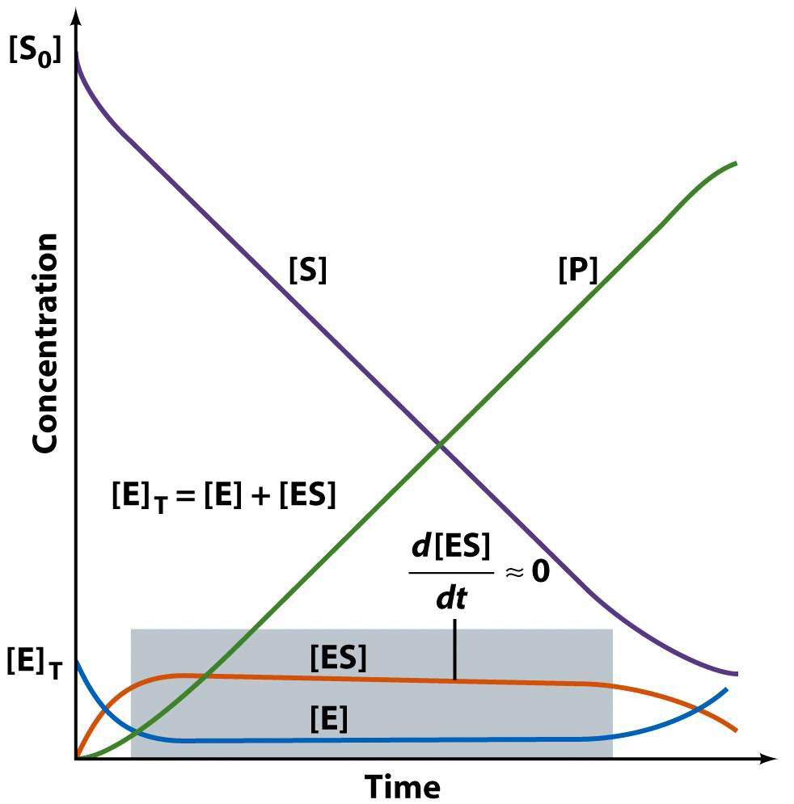
Michaelis-Menten Kinetics
Michaelis-Menten Kinetics
E + S → ES → E + P
k₁
k_{cat}
←
k₋₁
The time dependence of everything (in a Michaelis-Menten reaction)

Slide 22
Michaelis-Menten Kinetics
E + S → ES → E + P
k₁
k_{cat}
←
k₋₁
Now: we derive the Michaelis-Menten Equation
d[ES]/dt = k₁[E][S] –k₋₁[ES] – k₂[ES]
= 0 (steady state assumption, see previous graph)
solve for [ES] (do the algebra)
[ES] = [E][S] k₁/(k₋₁ + k₂)
Define K_{M} (Michealis Constant)
K_{M} = (k₋₁ + k₂)/k₁ => [ES] = [E][S]/K_{M}
rearrange to give K_{M} = [E][S]/[ES]

Slide 23
Michaelis-Menten Kinetics
E + S → ES → E + P
k₁
k_{cat}
←
k₋₁
$$v_{o}= \frac{v_{max} [S]}{K_{M}+[S]}$$
This is the Michaelis-Menton Equation (page 547 Lehninger)
When [S] = K_{M}, the velocity is half v_{max}
$$v_{o}= \frac{v_{max} [S]}{[S]+[S]}=\frac{v_{max}}{2}$$

Slide 24
Michaelis-Menten Kinetics
K_{M} is the substrate concentration required to reach half-maximal velocity (v_{max}/2).

Slide 25
Significance of K_{M}
Michaelis-Menten Kinetics
K_{M} = [E][S]/[ES] and K_{M} = (k₋₁ + k₂)/k₁.
K_{M} is the apparent dissociation constant of the ES complex. A dissociation constant (K_{d}) is the reciprocal of an equilibrium constant (K_{d}=K_{a}⁻¹). K_{M} is a measure of substrate affinity for the enzyme (small K_{d} = high affinity).
If k₁,k₋₁ >> k_{cat}, the K_{M} is approximated by K_{d} (see previous slide)
K_{M} is the substrate concentration required to reach half-maximal velocity (v_{max}/2). A small K_{M} means the substrate binds tightly to the enzyme and saturates (max’s out) the enzyme.
The microscopic meaning of K_{M} depends on the details of the mechanism.

Slide 26
The Significance of the Dissociation Constant (K_{d})
The dissociation constant (K_{d}) is the reciprocal of the equilibrium constant (K_{e})
For protein binding to a ligand, we have Free Protein and Bound Protein (Complex)
Free + Ligand Complex
(this reasonably describes E + S = ES if k_{cat}<< k₁,k₋₋₁)
K_{d} = [Free][Ligand]/[Complex] (the units of K_{d} are M)
At 50% binding, [Complex]/[Free] = 1, and K_{d}= [Ligand]
If K_{d}=10⁻⁹ M, then 50% of ligand is bound 10⁻⁹ M ligand (tight binding)
If K_{d}=10⁻⁶ M, then 50% of ligand is bound 10⁻⁶ M
If K_{d}=10⁻³ M, then 50% of ligand is bound 10⁻³ M (weak binding)
←
←

Slide 27
The significance of k_{cat}
Michaelis-Menten Kinetics
v_{max} = k_{cat} [E]_{tot}
k_{cat}: For the simplest possible mechanism, where ES is the only intermediate, and dissociation of P is fast, then k_{cat}=k₂, the first order rate constant for the catalytic step.
If there are multiple catalytic steps (see trypsin) then each of those rate constants contributes to k_{cat}.
If one catalytic step is much slower than all the others (and than the dissociation of P), than the rate constant for that step is approximately equal to k_{cat}.
k_{cat} is the “turnover number”: indicates the rate at which the enzyme turns over, i.e., the number of substrate molecules converted to product per second per enzyme.
The microscopic meaning of k_{cat} depends on the details of the mechanism.
If dissociation of P is slow then the dissociation rate constant also contributes to k_{cat}.

Slide 28
Significance of k_{cat}/K_{M}
Michaelis-Menten Kinetics
k_{cat}/K_{M} is the catalytic efficiency. It is used to rank enzymes. A big k_{cat}/K_{M} means that an enzyme binds tightly to a substrate (small K_{M}), with a fast reaction of the ES complex, and it is a good enzyme.
k_{cat}/K_{M} is an apparent second order rate constant
v_{o}=(k_{cat}/K_{M} ) [E]₀[S]
k_{cat}/K_{M} can be used to estimate the reaction velocity from the total enzyme concentration ([E]₀). k_{cat}/K_{M} =10⁹ => diffusion control.
k_{cat}/K_{M} is the specificity constant. It is used to distinguish and describe various substrates for a given enzyme.

Slide 29
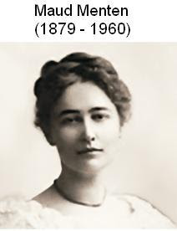
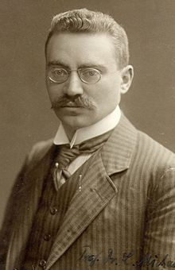
Leonor Michaelis
(1875 –1949)

Slide 30
Data analysis
Michaelis-Menten Kinetics
It would be useful to have a linear plot of the MM equation
Lineweaver and Burk (1934) proposed the following: take the reciprocal of both sides and rearrange.
Collect data at a fixed [E]₀.

Slide 31
Michaelis-Menten Kinetics
the y (1/v) intercept (1/[S] = 0) is 1/v_{max}
the x (1/[S]) intercept (1/v = 0) is -1/K_{M}
the slope is K_{M}/v_{max}

Slide 32
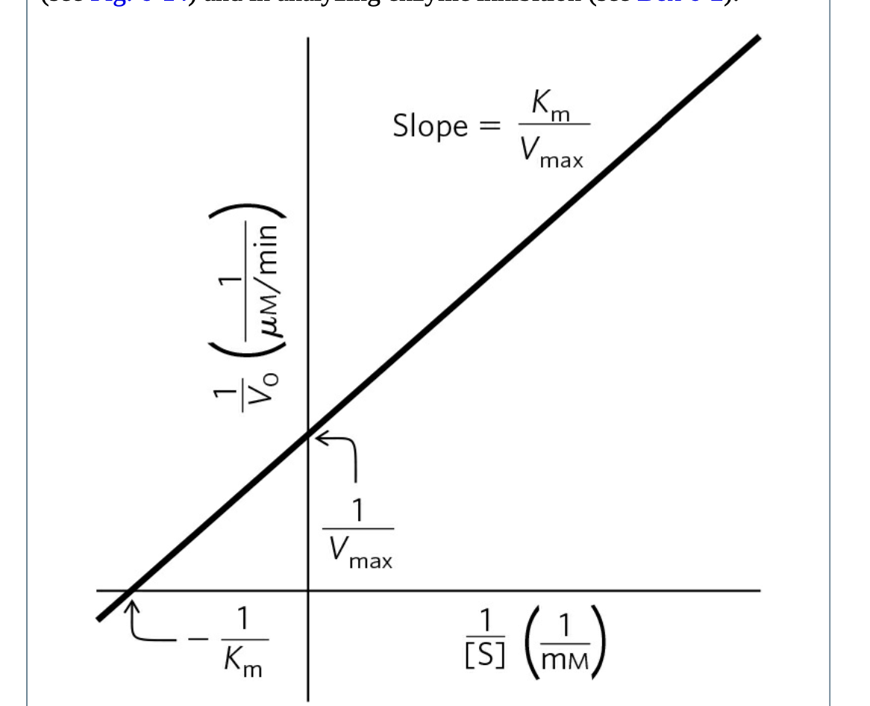
Michaelis-Menten Kinetics
Lineweaver-Burk-Plot
the y (1/v) intercept (1/[S] = 0) is 1/v_{max}
the x (1/[S]) intercept (1/v = 0) is -1/K_{M}
the slope is K_{M}/v_{max}

Slide 33
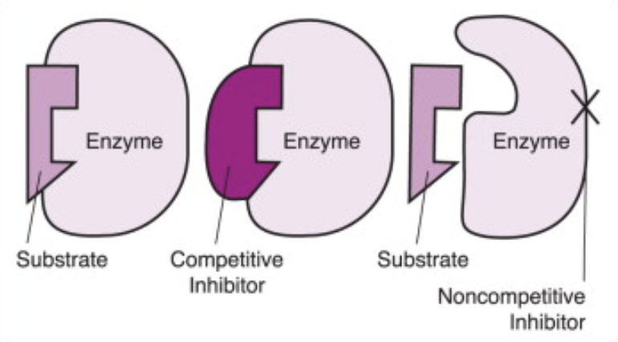
Enzyme Inhibition
Competitive inhibition,
The inhibitor binds to the active site and competes with the substrate for binding.
Noncompetitive, Uncompetitive inhibition,
The inhibitor binds to allosteric site.
Non-competitive inhibitors bind to the enzyme or enzyme–substrate complex. Uncompetitive inhibitors bind only to the enzyme–substrate complex.

Slide 34
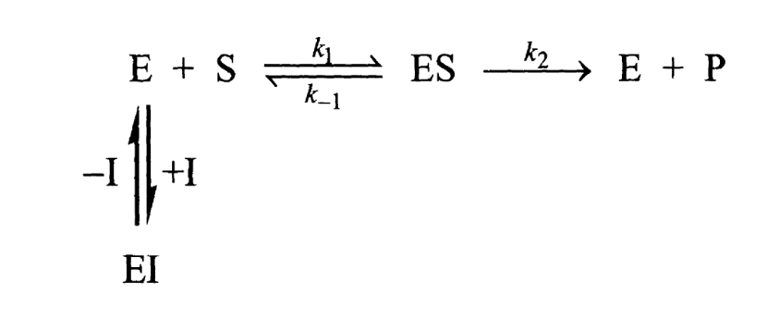
Competitive Inhibition
Page 378

Slide 35
Competitive Inhibition
Page 378

Slide 36
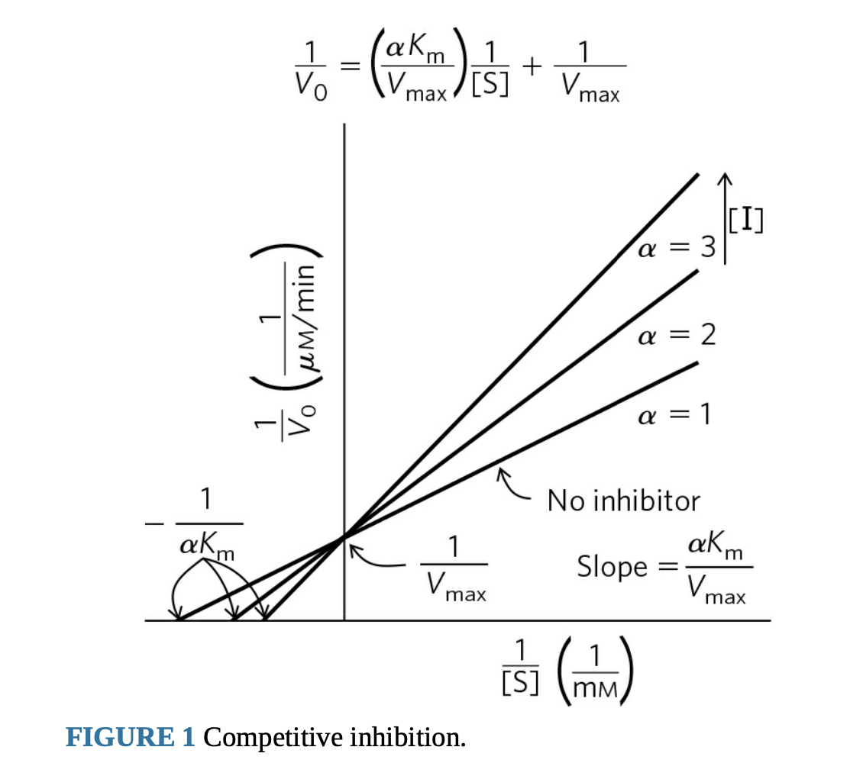
Competitive Inhibition
Page 378

Slide 37
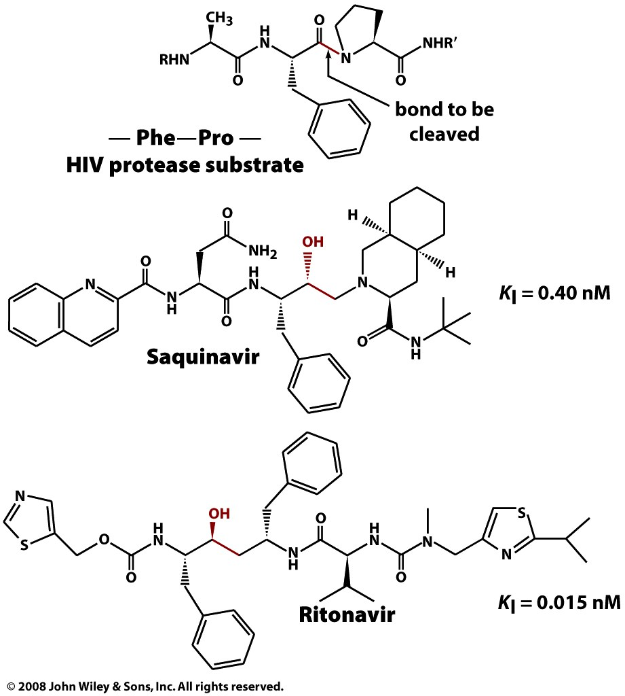
Competitive Inhibition
Box 12-4c

Slide 38
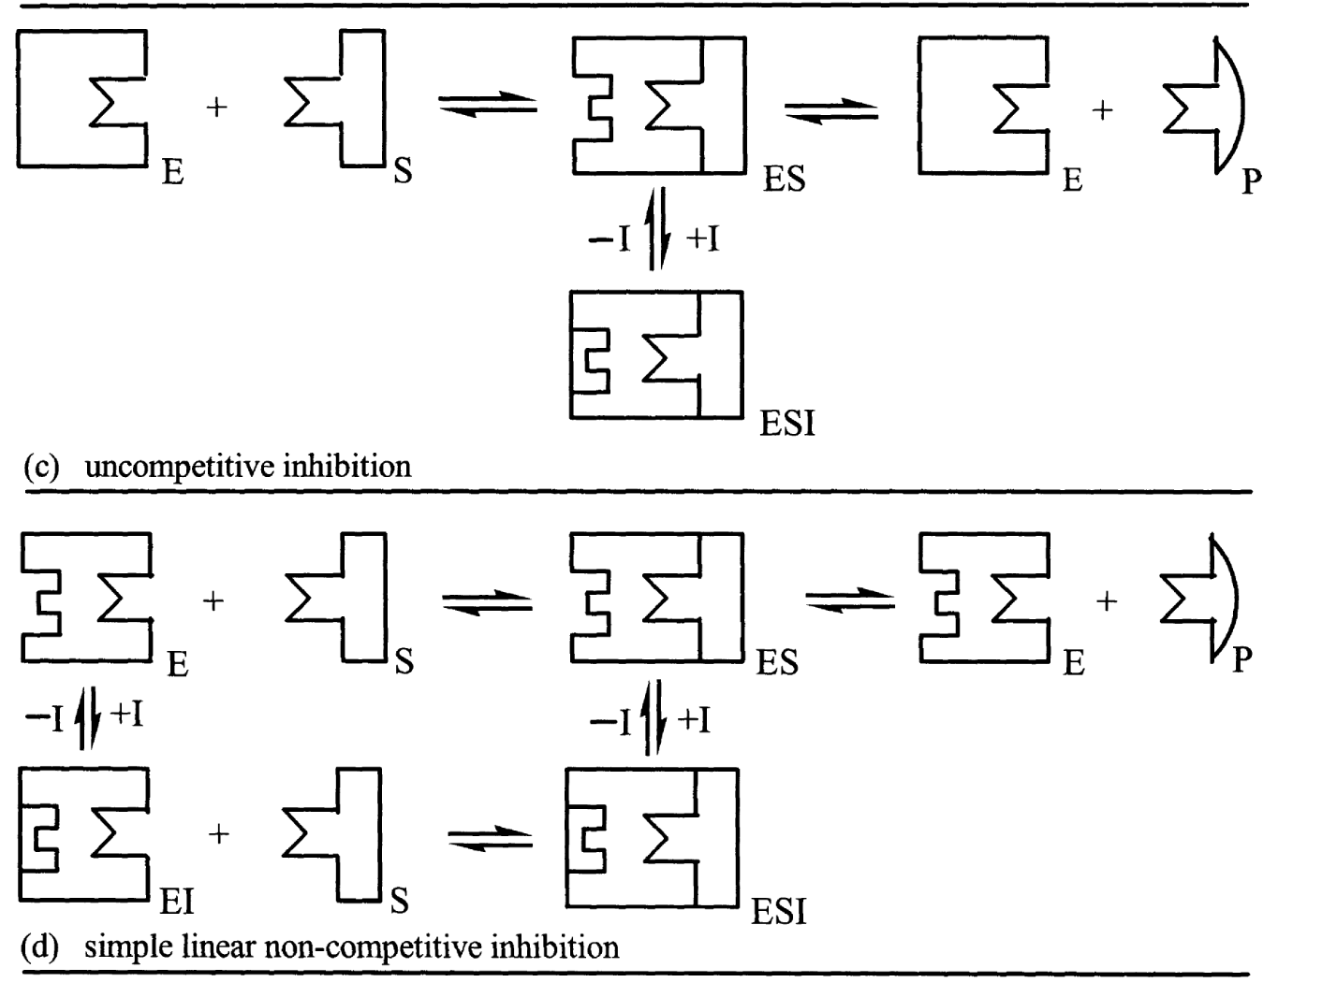

Slide 39
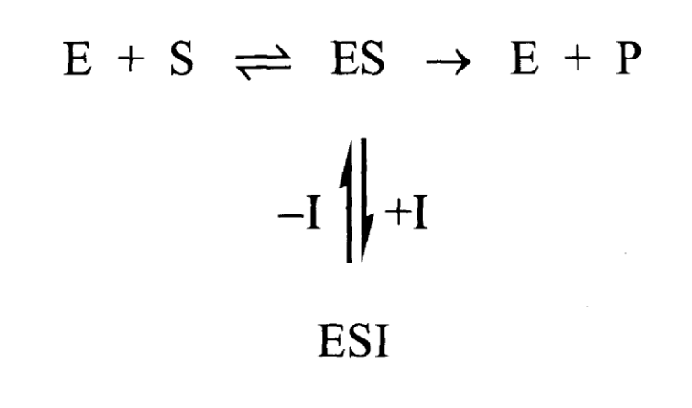
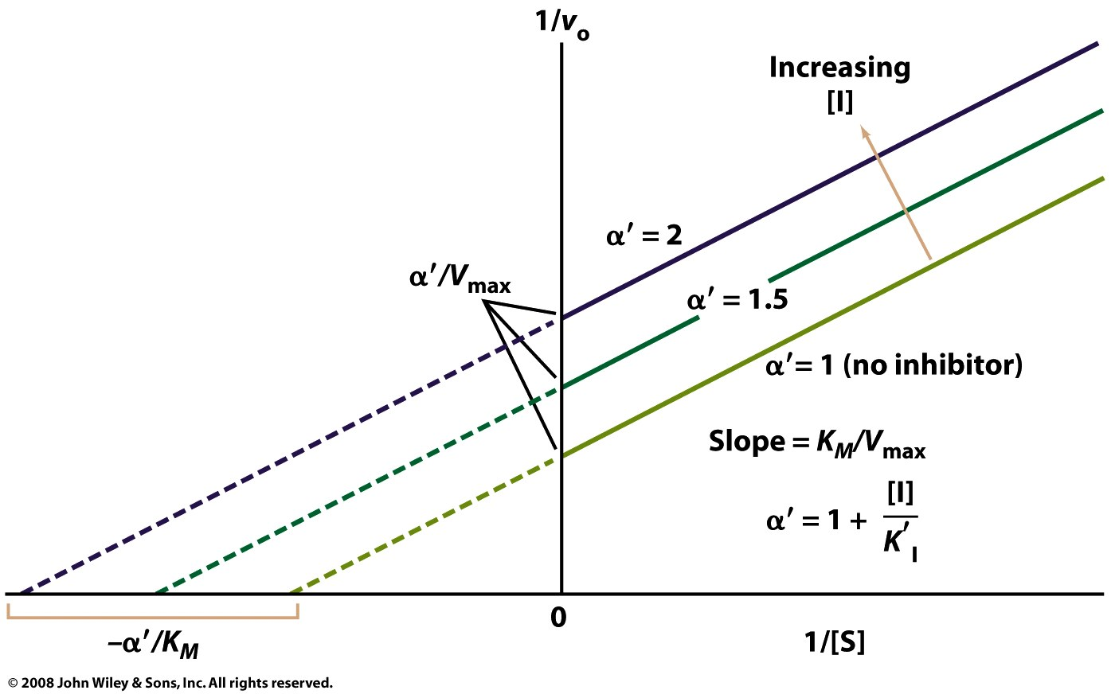
Uncompetitive Inhibition

Slide 40
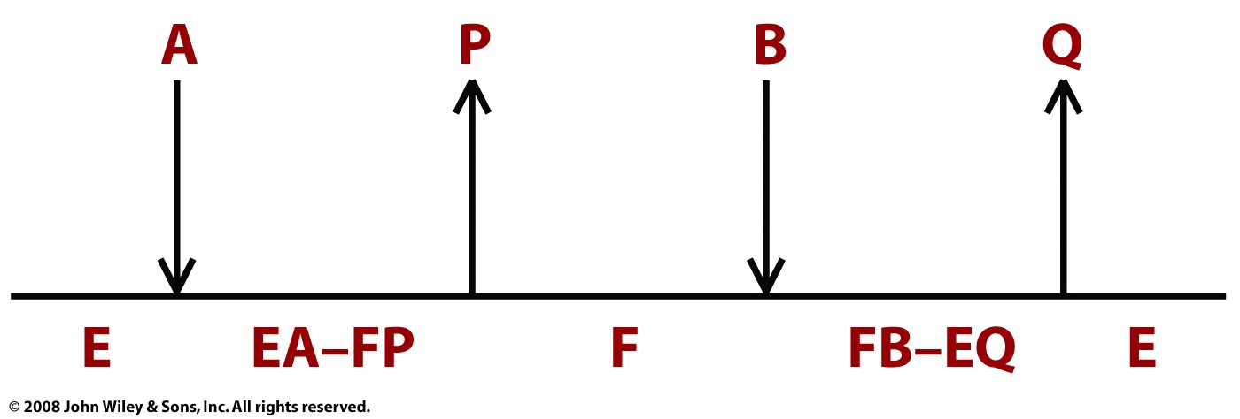
Bisubstrate Ping Pong:
Trypsin:
A = polypeptide
B = water
P = amino terminus
Q = carboxy terminus
Page 376

Slide 41
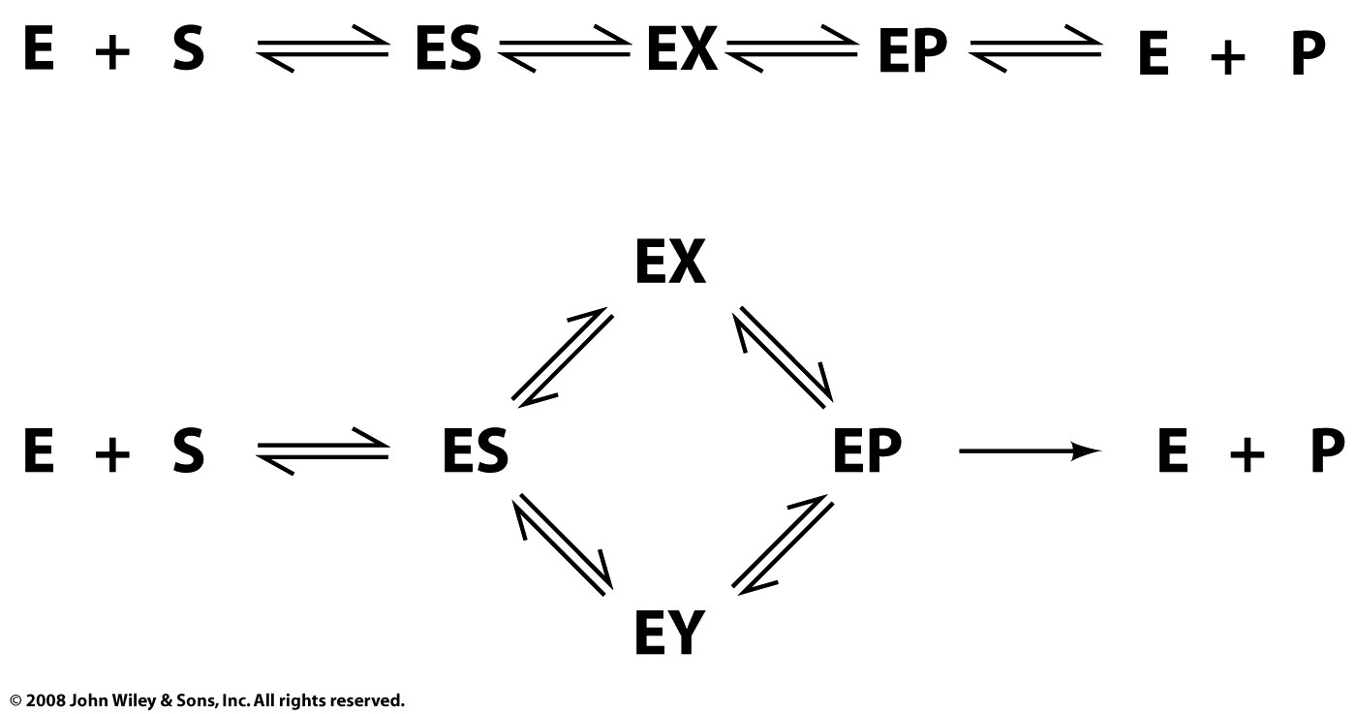
Real enzyme mechanisms
Page 374

Slide 42
Other possibilities
Page 376

Slide 43
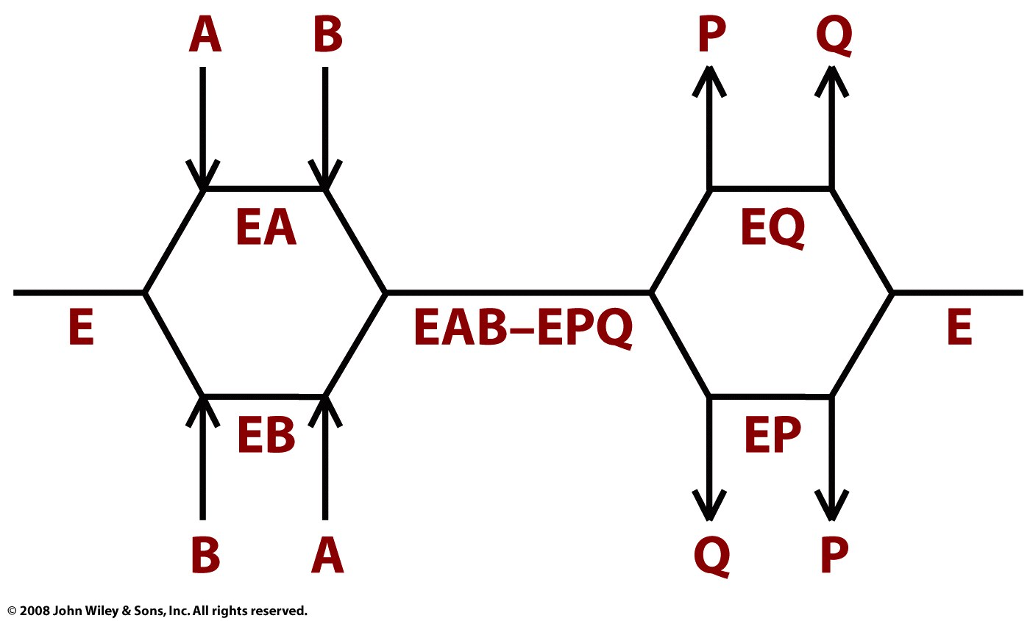
Page 376

