Slide 1
Motor Proteins (Translocases)
use chemical energy to move themselves along a linear track, with the direction of sliding dependent on the structural polarity of the track.
do work (force x distance) by coupling nucleoside triphosphate (ATP, GTP, UTP…) hydrolysis to a large-scale conformational change.
Examples:
muscle contraction,
cytokinesis & chromosomal movements,
organelle movements,
cellular migration,
polymerization of DNA, RNA, polysaccharide and protein

Slide 2
Motor Proteins (continued)
That walk on cytoskeletal tracks
Three superfamilies of motor proteins
Myosin (walk on actin filaments)
Kinesin (walk toward the plus end of microtubules toward cell surface, common ancestor with Myosin)
Dynein (walk toward the minus end of microtubules, toward cell interior)
Microtububules
Tubulin filaments
- ends at centromere
+ ends near cell surface
Actin filaments
G-actin (monomer)
F-actin (assembled in microfilament)
dynamic and rapid remodeling

Slide 3
Motor Proteins (in general)
Bind ATP
Hydrolyze ATP
Release Phosphate & Translocate (move)
Release ADP
Repeat

Slide 4
Actin Treadmilling

Slide 5
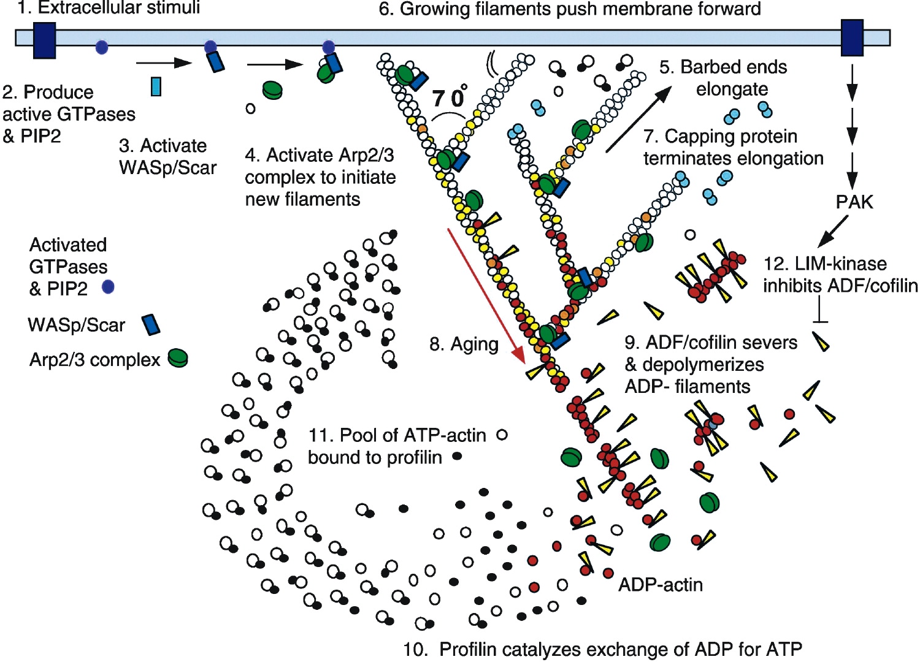
Rapid growth at the barbed end of the new branch pushes the membrane forward. Capping protein terminates growth within a second or two. Filaments age by hydrolysis of ATP bound to each actin subunit (white subunits turn yellow) followed by dissociation of phosphate (subunits turn red).
Volume 112, ISSUE 4, P453-465, February 21, 2003 Annual Review of Biophysics and Biomolecular Structure,

Slide 6
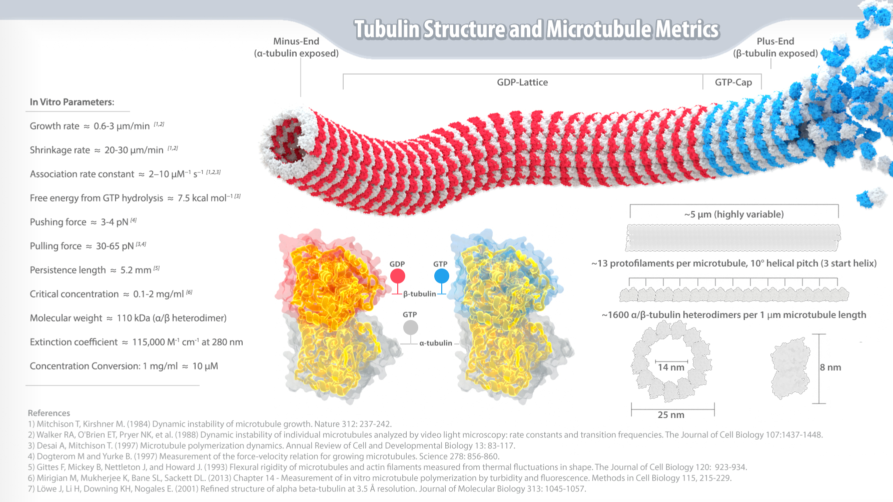

Slide 7
Muscle

Slide 8
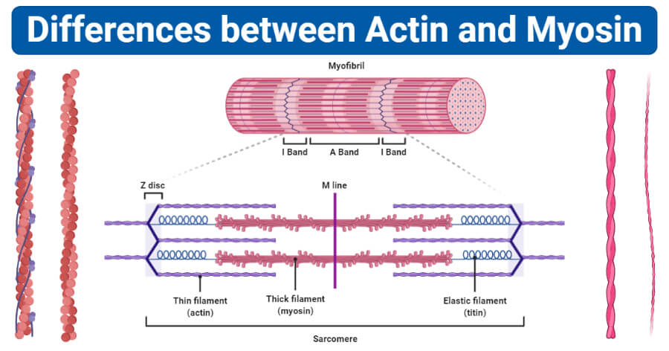
Myosin

Slide 9
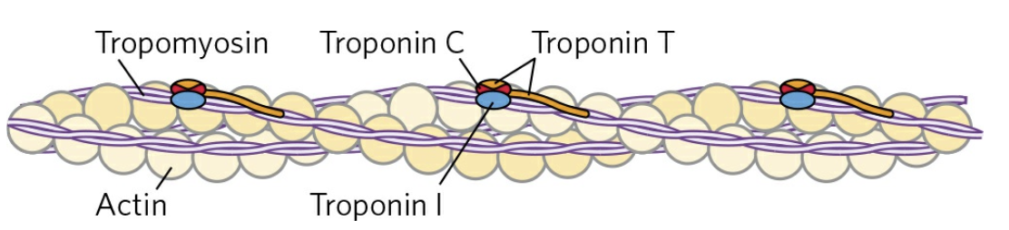
Muscle cells contain the sarcoplasmic reticulum (SR), which is a special form of endoplasmic reticulum that is dedicated to Ca²⁺ handling.
SR vacuums Ca²⁺ ions from the cytosol and stores it.
A nerve impulse causes release of Ca²⁺ ions from the sarcoplasmic reticulum.
The released Ca²⁺ bind to troponin.
Ca²⁺ binding causes a conformational change in the tropomyosin-troponin complexes.
This conformational change exposes the myosin-binding sites on the thin filaments.
The muscle contracts.
Notes:
Domain structure of members of the myosin superfamily of proteins. This blueprint of the myosins shows the conserved motor domain and the divergence in other domains that mediate movement amplification, self-association, and cargo binding. CaM, calmodulin; IQ, isoleucine glutamine.

Slide 10
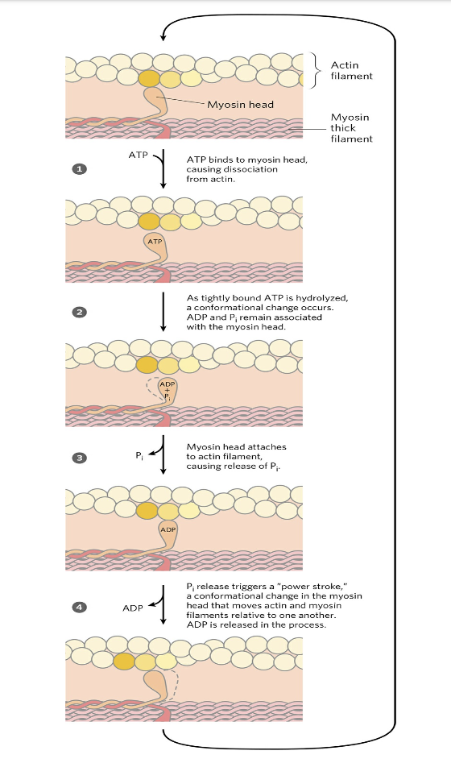

Slide 11
ADP is released after the power stroke

Slide 12
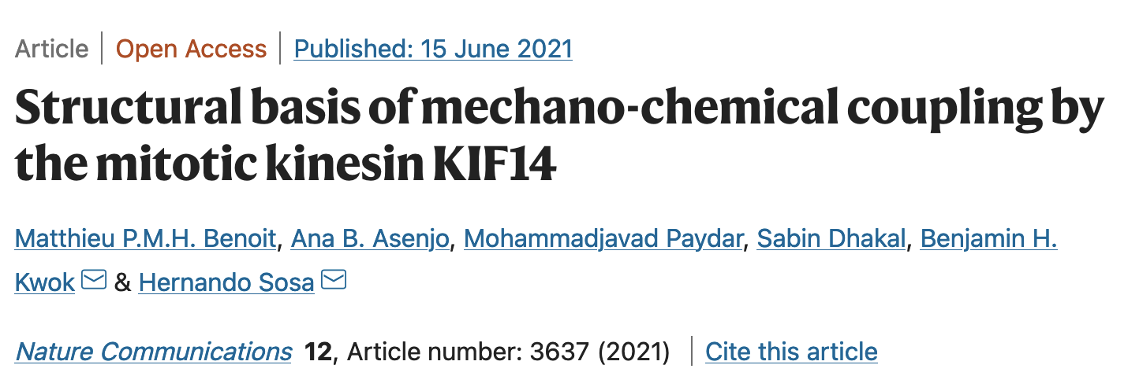
Kinesins. (Example KIF14) couples ATP hydrolysis and microtubule binding to generation of mechanical work.
There are three major conformations of the motor domain,
Transitions between the three states are governed by microtubule binding, ATP binding, ATP hydrolysis, ADP release and Pi release.
3) the neck-linker controls ATP hydrolysis; an undocked neck-linker prevents the ATP-binding pocket from closing and inhibits ATP hydrolysis;
4) thirteen neck-linker residues are required to assume a stable docked conformation;
5)
6) the two motor domains adopt distinct conformations when bound to the microtubule; and
7) the two-heads-bound-state introduces structural changes in both motor domains of KIF14 dimers.

Slide 13
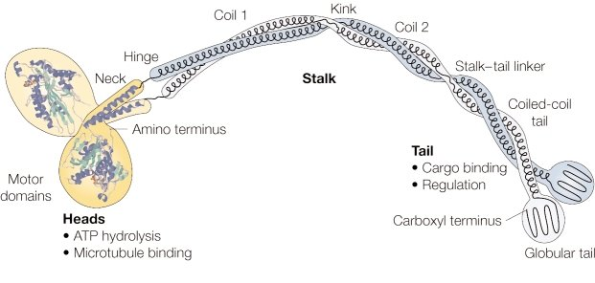
kinesin
kinesin
Domain organization of the conventional kinesin heavy-chain dimer, showing the crystal structure of the catalytic domains and the neck. The structure of the stalk and tail are inferred from electron microscopic images and coiled-coil prediction analyses. Regions predicted to form coiled-coils (neck, coil 1, coil 2, coiled-coil tail) and flexible regions (hinge, kink, stalk-tail linker) are indicated. Image from Günther Woehlke

