Slide 1
BASIC Bio-THERMO

Slide 2
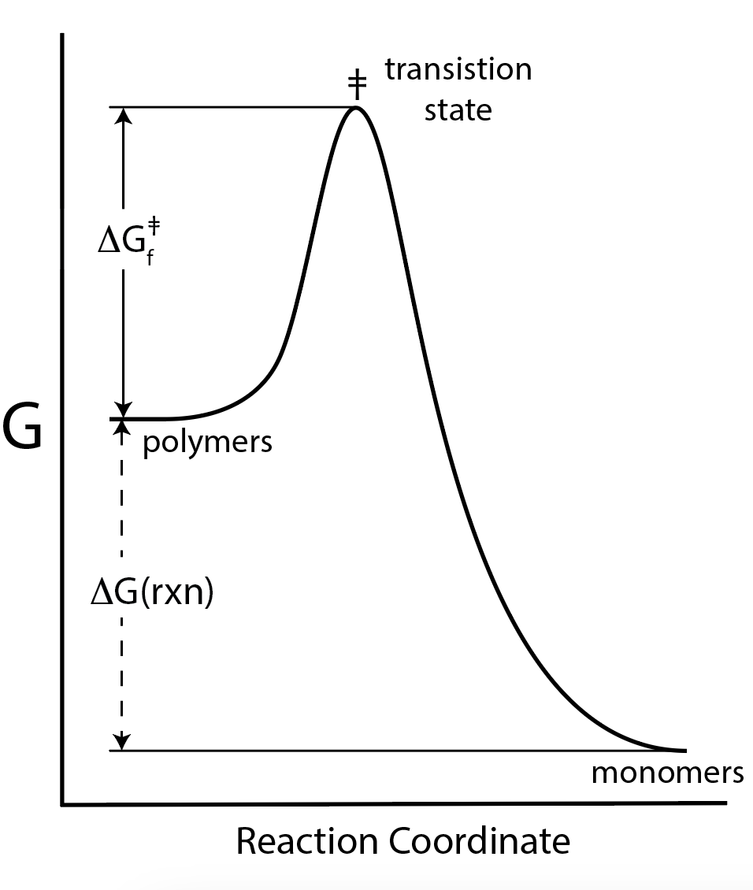
Kinetics vs Thermo
  Thermodynamics predicts reaction direction and “driving force”.
  Thermodynamics assumes infinite time.
  Equilibrium is not time-dependent.
  Kinetics describes change with time (reaction rates).
  Graphite and diamond are two forms of carbon. Graphite is thermodynamically favored, but kinetically trapped. At STP diamond coverts to graphite, but it converts very very very (etc) slowly.
  Oxygen and hydrogen together at STP form water, but unless you add a spark, the reaction is very very very (etc) slow. Oxygen and hydrogen are thermodynamically favored, but kinetically trapped.

Slide 3
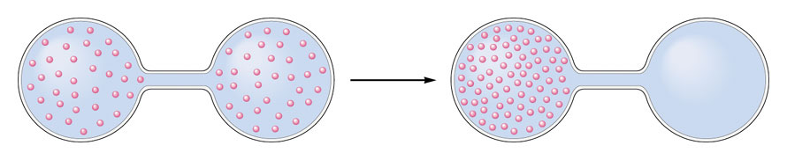
Spontaneity and Driving Force
What is driving force? What is a spontaneous process?
Expansion of a gas to fill a vacuum is a spontaneous process.
There is a ‘driving force’ for the gas to spontaneously fill all available space.
A gas will spontaneously expand to fill all available space.
The entropy of the universe increases when the gas expands to fill a vacuum.
The reverse process (compression of a gas to create a vacuum) is non-spontaneous.

Slide 4
Definitions of Entropy (S)
Entropy is a measure of the number of ways in which energy or molecules can be arranged.
When you heat something, you increase its entropy.
When you mix things, you generally increase their entropy.
When you break a thing into pieces, you generally increase entropy.
When you expand perfect gas into a vacuum, you increase its entropy.
If a system has several available macrostates, it will spontaneously proceed to the macrostates with the largest number of available microstates.
The macrostate with the greatest probability (largest number of available microstates) has the greatest entropy.

Slide 5
Definitions of Entropy (S)
S = k_{B} ln Ω Joules/Kelvin
K_{b} = Boltzmann’s constant, the gas constant per molecule (R/N_{A})
Ω = the number of available microstates.
∆S = q/T J / mol-K

Slide 6
Why is there a driving force to reach thermal equilibrium?
Brick A (cold)
Brick B (hot)
at t_{initial}
↓
Brick A (warm)
Brick B (warm)
at t_{final}
heating brick A increases its entropy cooling brick B decreases its entropy
ΔS(A) > 0 (warms) ΔS(B) < 0 (cools)
The warming brick gains more entropy than the cooling brick looses
|ΔS(A)| > |ΔS(B)|
ΔS(uni) = ΔS(A) + ΔS(B)
ΔS(uni) > 0
Thermal equilibration is a spontaneous process.

Slide 7
First Law of Thermodynamics
Energy is conserved. The change in the energy (E) of a system is equal to the work done on it plus the heat transferred to it.
ΔE = q + w
Second Law of Thermodynamics
For a spontaneous process the Entropy of the universe (S_{universe} = the entropy of the system plus its surroundings) increases.
ΔS_{universe} > 0 spontaneous
Third Law of Thermodynamics
In any thermodynamic process involving only pure phases at equilibrium, the entropy change, ΔS, approaches zero at absolute zero temperature; also the entropy of a crystalline substance approaches zero at 0K.
ΔS = 0 at 0 K
Notes:
9

Slide 8
Gibbs Free Energy
ΔG = ΔH_{sys} - TΔS_{sys}
Is a measure of driving force (same as Δs_{universe}), but it allows us to focus on the system only, without considering the surroundings.
ΔG = - TΔS_{universe}
  ΔG = ΔH_{sys} - TΔS_{sys}
ΔG = ΔG° + RT ln Q
ΔG° = -RTlnK
G is called
    Gibbs Function, or
    Gibbs Free Energy, or
    Free Energy.

Slide 9
Free Energy
ΔG < 0 Spontaneous Forward
ΔG = 0 Equilibrium
ΔG > 0 Spontaneous Reverse
Entropy
ΔS_{univ} > 0 Spontaneous Forward
ΔS_{univ} = 0 Equilibrium
ΔS_{univ} < 0 Spontaneous Reverse

Slide 10
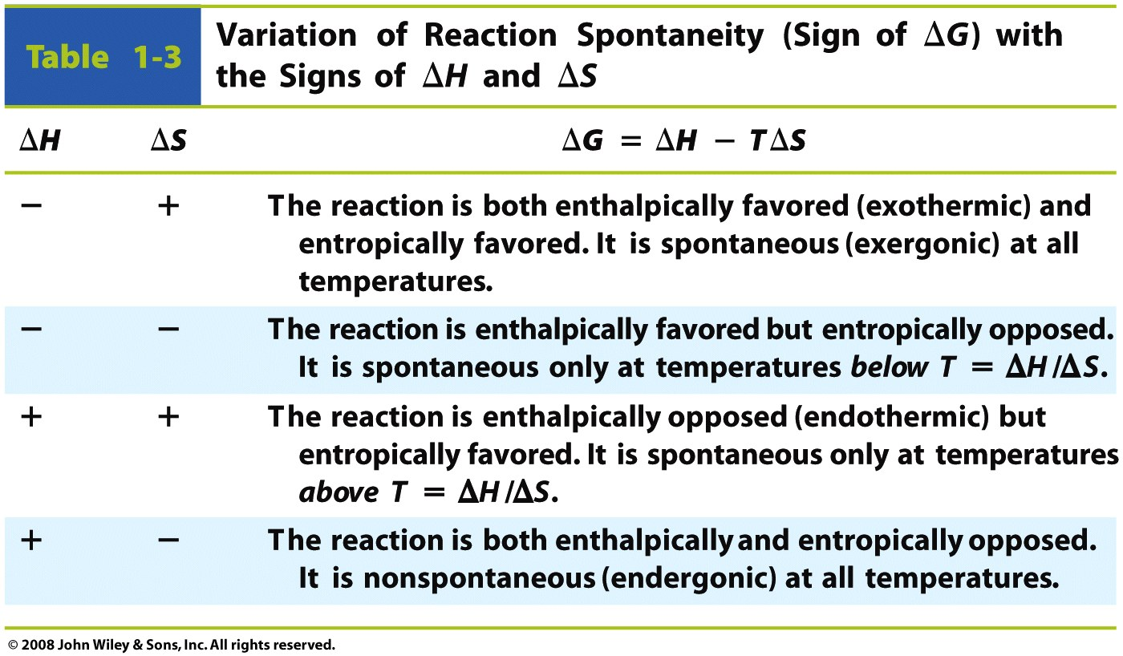

Slide 11
Special Rules in Biology: Energy Currency
ATP – Adenosine triphosphate the energy currency of the cell.
ATP hydrolysis is coupled to non-spontaneous reactions – pushing them up hill
Concentration of ATP in a cell: ~ 5 mM
ATP is the medium of energy exchange. ATP mediates energy transfer between many many processes in a cell.

Slide 12
All these condensation reactions are up hill (non-spontaneous) in water. The equilibrium is far to the left.
In vivo they are coupled to ATP hydrolysis and are driven to the right.

Slide 13
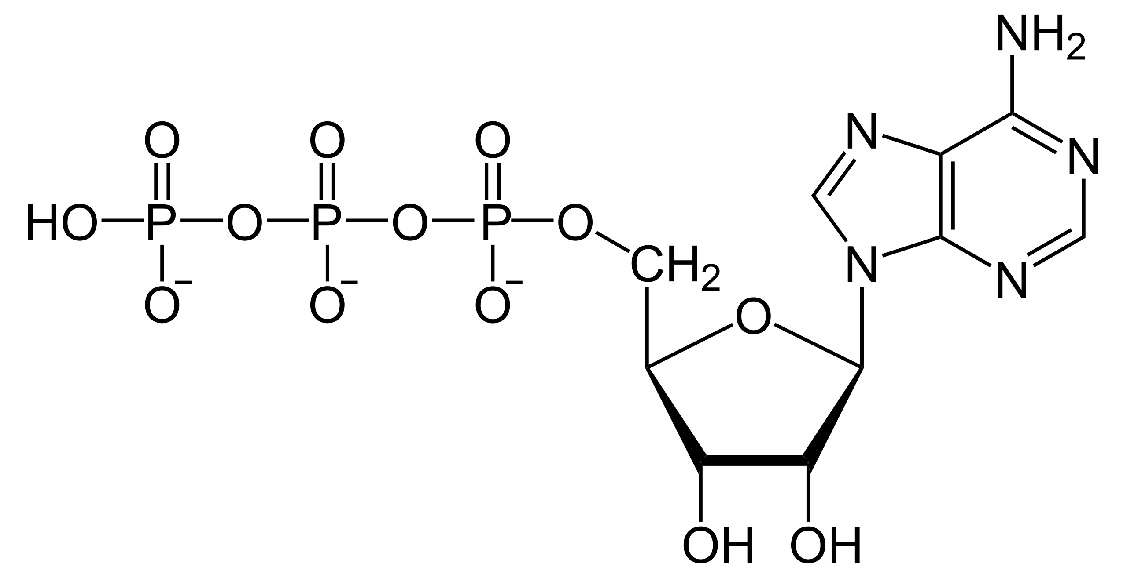
Energy Currency
Adenosine triphosphate (ATP, less commonly GTP)
a nucleotide triphosphate,
nitrogenous base (adenine, less commonly guanine),
a ribose sugar,
three serially bonded phosphates (α,β,γ)

Slide 14
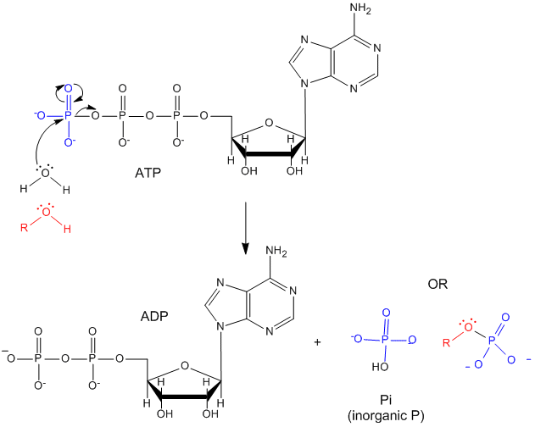

Slide 15
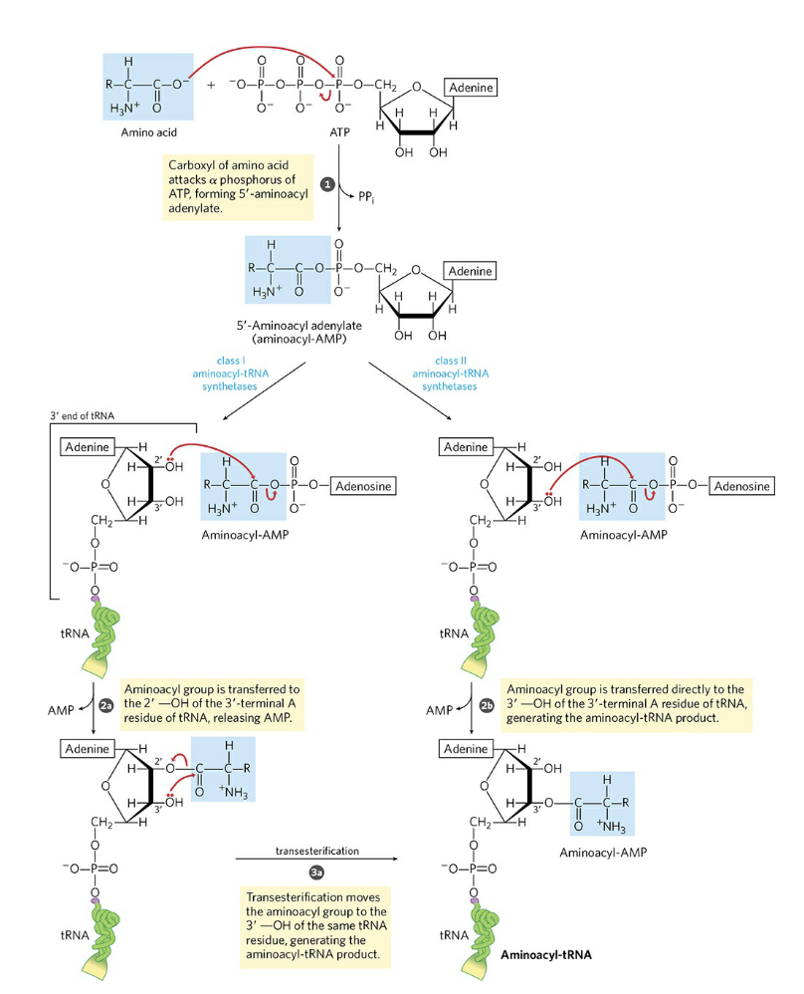
This reaction shows how an amino acid is activated by phosphorylation. ATP is cleaved to activate the amino acid
Activated
amino
acid

Slide 16
Energy Currency
ADP + Pi condensation to form ATP is driven by catabolic mechanisms, including respiration (releases energy from glucose), beta-oxidation (releases energy from fat), and ketosis (releases energy from fat, under carbohydrate restriction).
The spontaneous hydrolysis of ATP is used to drive non-spontaeous processes.
ATP is hydrolyzed by
  ion transport,
  muscle contraction,
  nerve impulse propagation,
  substrate phosphorylation,
  RNA synthesis (NTPs are hydrolyzed)
  DNA synthesis (dNTPs are hydrolyzed)
  Protein Synthesis

Slide 17
ATP
You consume (and synthesize) around 2x your body weight every day.
[ATP] in vivo is around 2-5 mM
ATP/ADP = 1000
ATP is a hydrotrope
  i.e., an amphipath that solubilizes hydrophobic compounds but cannot form micelles or membranes

