Slide 1
Carbohydrates

Slide 2
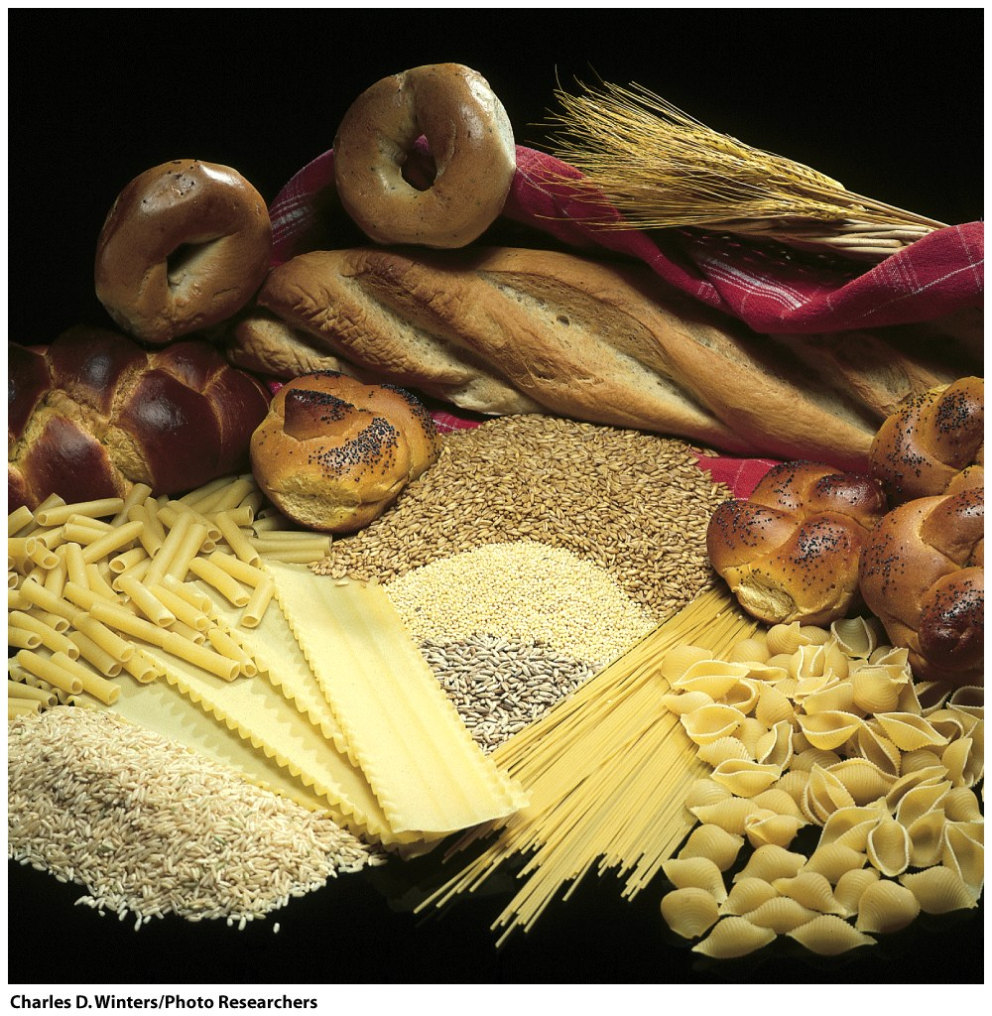
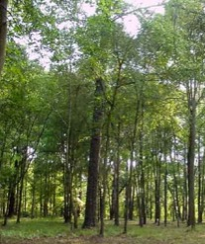
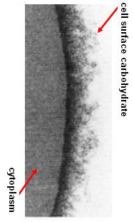

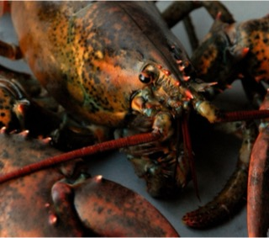
Energy storage
and more….
Structural materials
(C·H₂O)_{n (n≥3)}
Carbohydrates are the most abundant biological molecule.

Slide 3
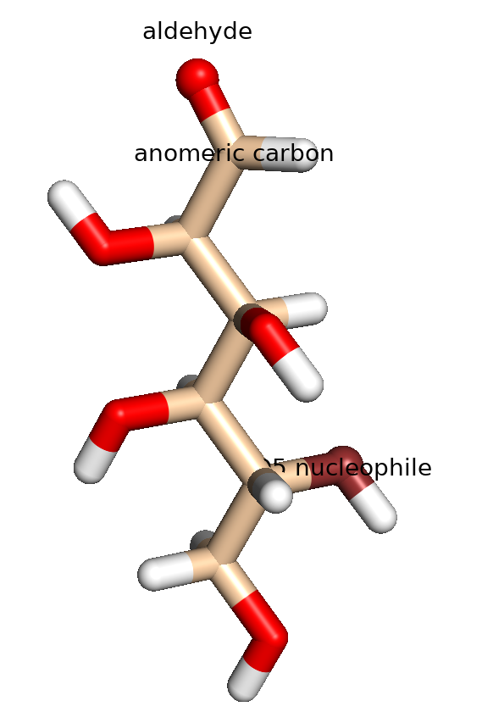
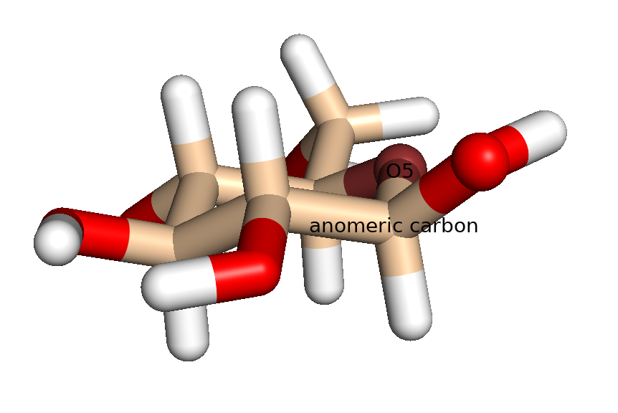
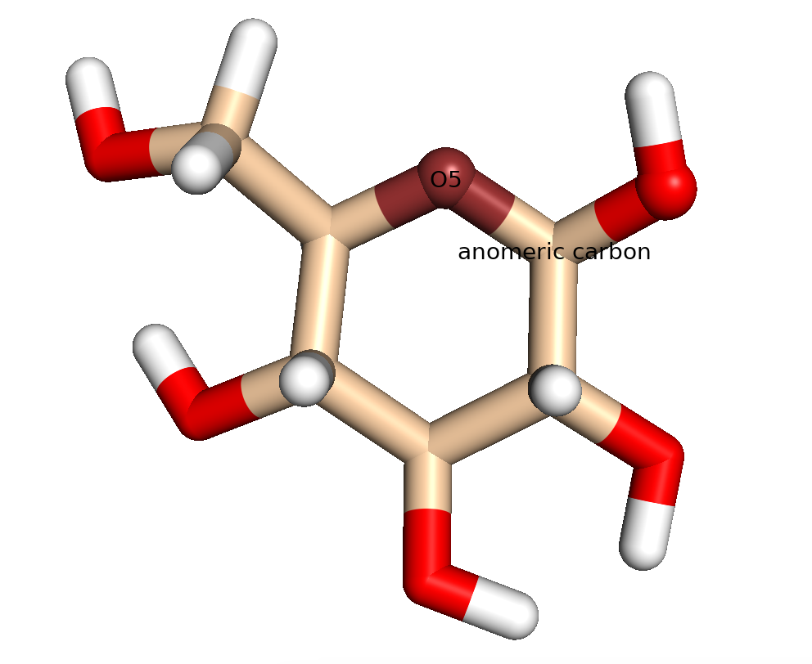
β-D-glucose

Slide 4
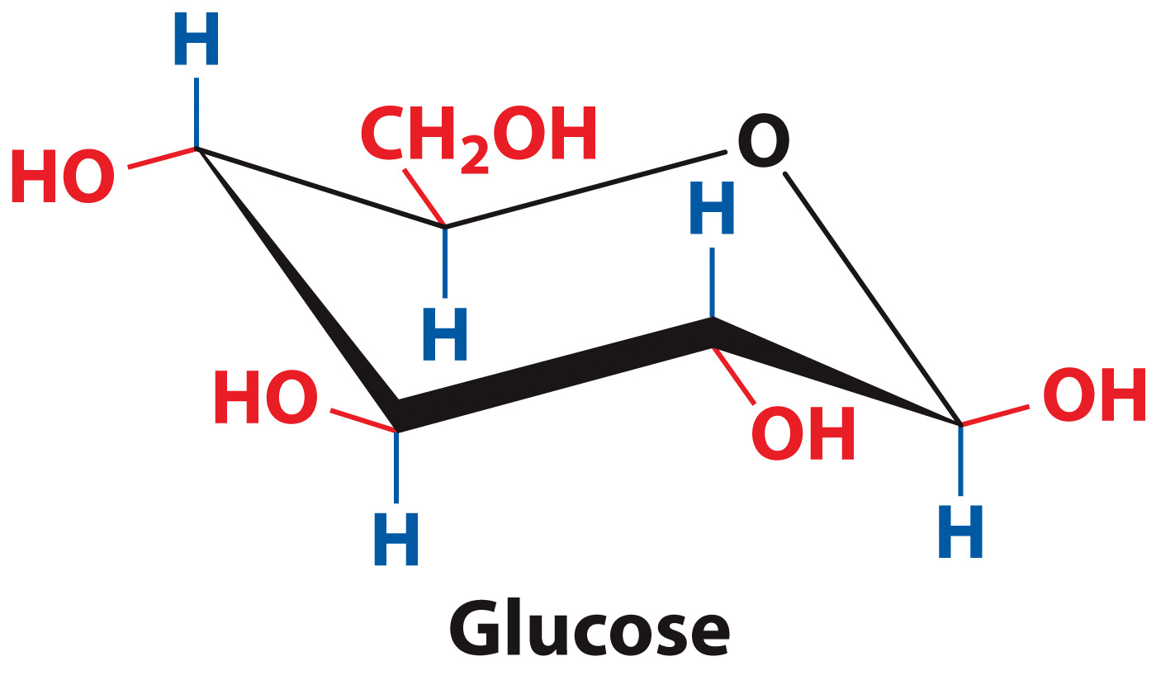
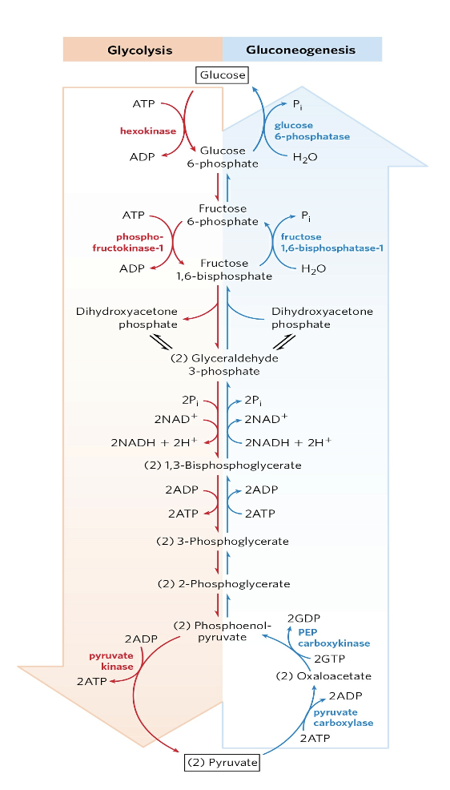
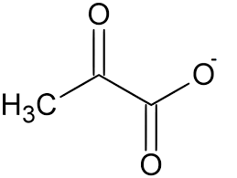
Oxidation State of C’s = 0
(Chair representation)
Pyruvate
Oxidation State of C’s = -3, 2, 3

Slide 5


Slide 6
Carbohydrates
Named so because many have formula C_{n}(H₂O)_{n}
Produced from CO₂ and H₂O via photosynthesis in plants, and by gluconeogenesis by you, fungus, bacteria, archaea, etc.
Range from as small as glyceraldehyde (M_{w} = 90 g/mol) to as large as amylopectin (M_{w} > 200,000,000 g/mol)
Fulfill a variety of functions, including:
  energy sources and energy storage
  structural components of cell walls and exoskeletons
  informational molecules in cell-cell signaling
Can be covalently linked with proteins and lipids

Slide 7
Carbohydrates
Basic nomenclature:
  number of carbon atoms in the carbohydrate + “ose”
  example: triose, pentose, hexose
Common functional groups:
  All carbohydrates have a carbonyl functional group (well not really).
  aldehydes = aldose
  ketones = ketose

Slide 8
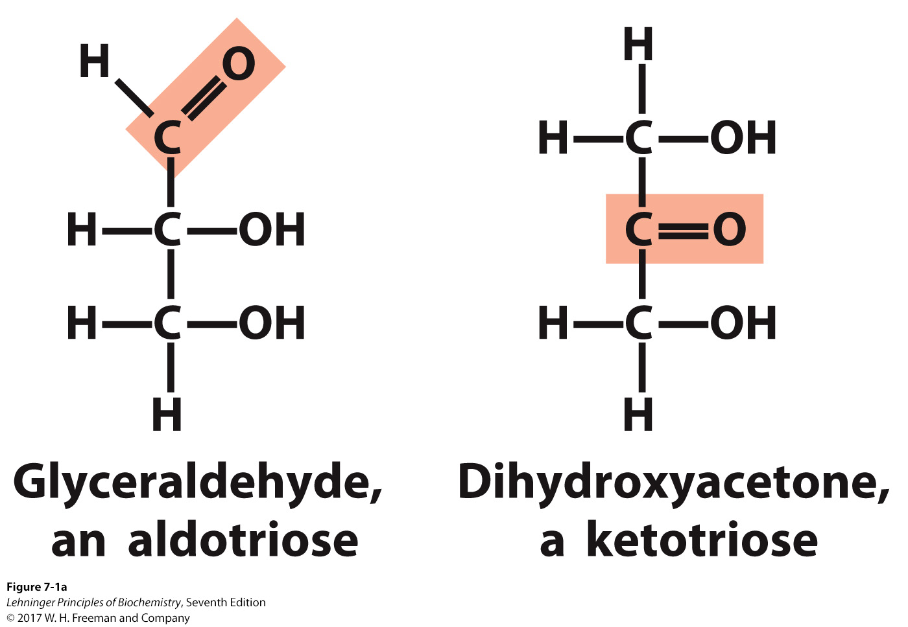
Carbohydrates Can Be Constitutional Isomers*
  An aldose is a carbohydrate with aldehyde functionality.
  A ketose is a carbohydrate with ketone functionality.
* same molecular formula, but different connectivities
Notes:
FIGURE 7-1a Representative monosaccharides. (a)Two trioses, an aldose and a ketose. The carbonyl group in each is shaded.

Slide 9
Carbohydrates are Chiral

Slide 10
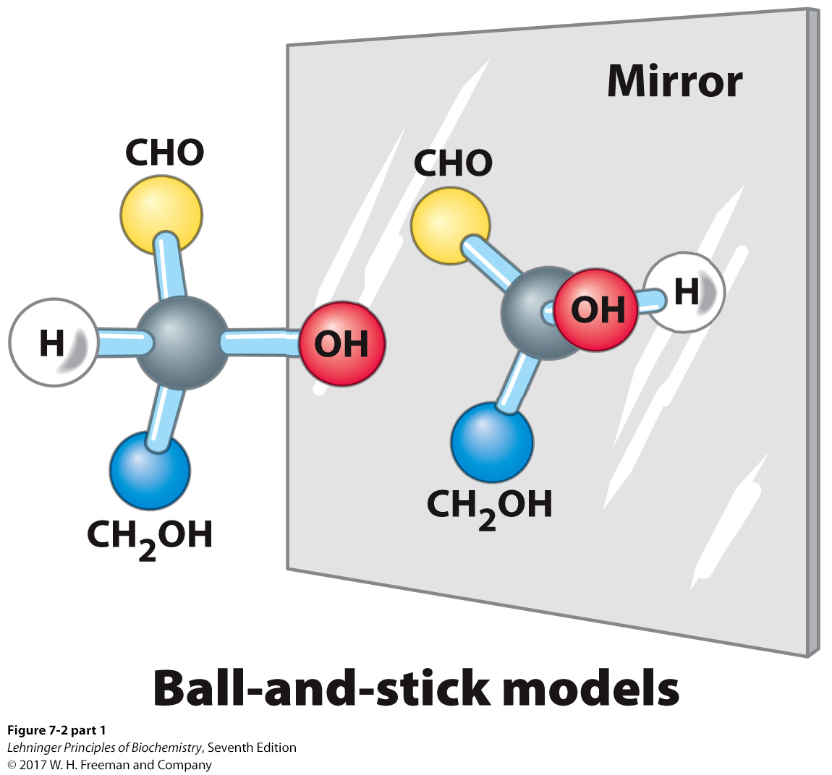
Enantiomers Are Mirror Images
Notes:
FIGURE 7–2 (part 1) Three ways to represent the two enantiomers of glyceraldehyde. The enantiomers are mirror images of each other. Ball-and-stick models show the actual configuration of molecules. Recall (see Fig. 1–18) that in perspective formulas, the wide end of a solid wedge projects out of the plane of the paper, toward the reader; a dashed wedge extends behind.

Slide 11
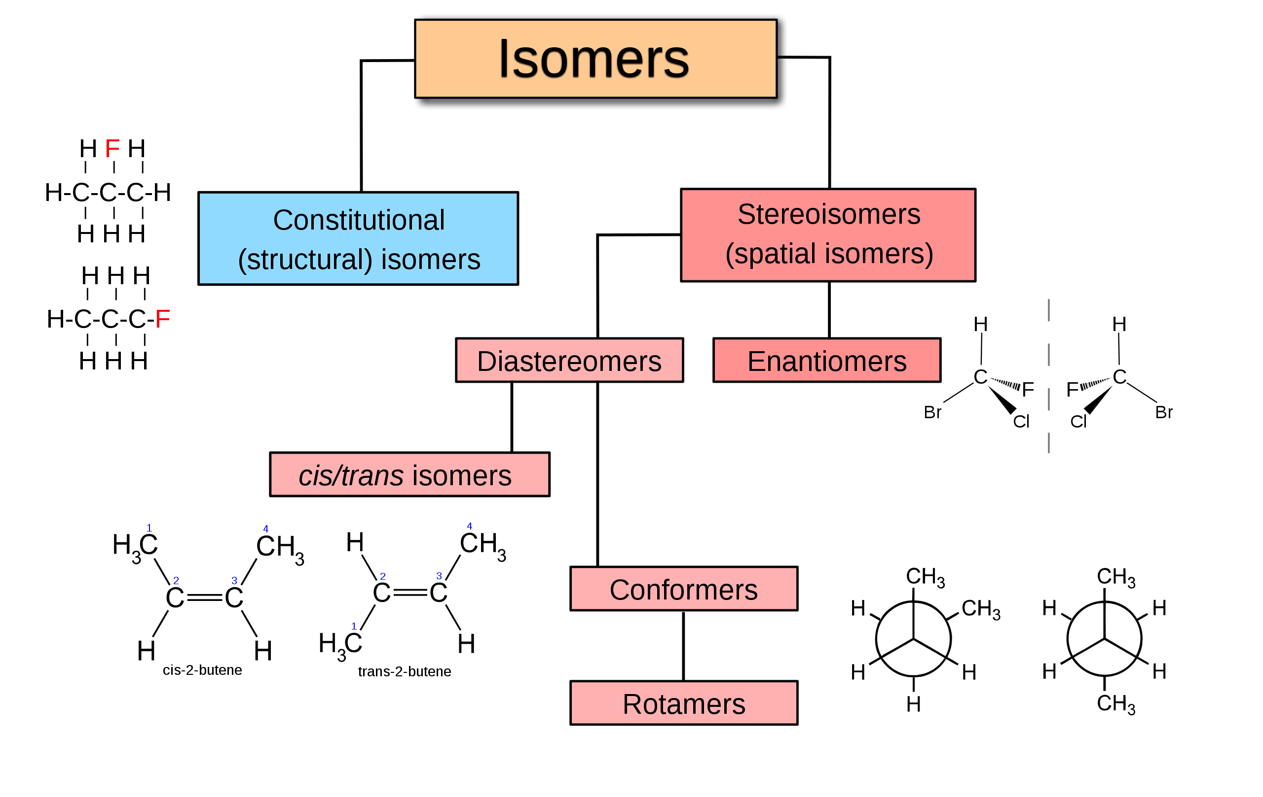
***
**
*
* mirror images
** same molecular formula, same connectivity, different arrangements of atoms in space, not enantiomers
*** same molecular formula, but different connectivities

Slide 12
Carbohydrates Can Be Stereoisomers
Enantiomers
  stereoisomers that are nonsuperimposable mirror images
In sugars that contain many chiral centers, only the one that is most distant from the carbonyl carbon is designated as d (right) or l (left).
d and l isomers of a sugar are enantiomers (mirror images).
  For example, l- and d-glucose
Most hexoses in living organisms are d stereoisomers.
Some simple sugars occur in the l form, such as l-arabinose.

Slide 13
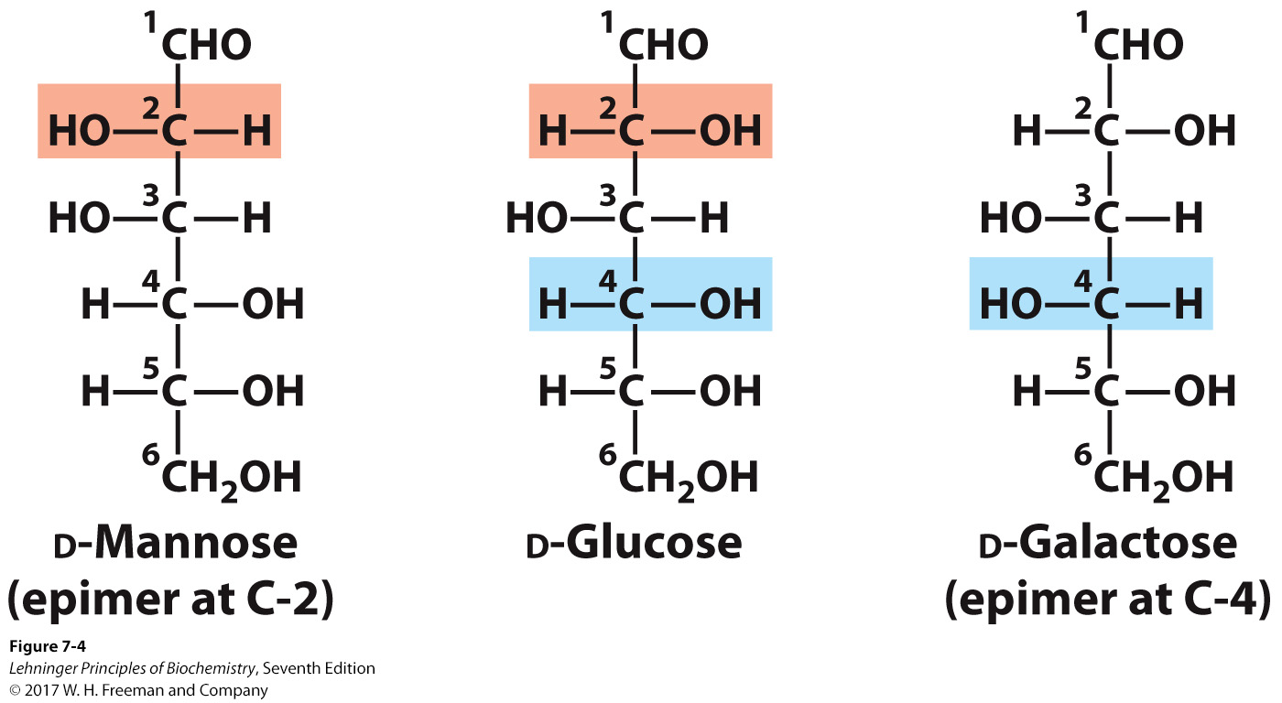
Epimers*
d-Mannose and d-galactose are both epimers of d-glucose (differ at only one chiral center).
d-Mannose and d-galactose vary at more than one chiral center and are diastereomers, but not epimers.
* stereoisomers that differ in the configuration at only one chiral carbon atom
Notes:
FIGURE 7–4 Epimers. D-Glucose and two of its epimers are shown as projection formulas. Each epimer differs from D-glucose in the configuration at one chiral center (shaded light red or blue).

Slide 14
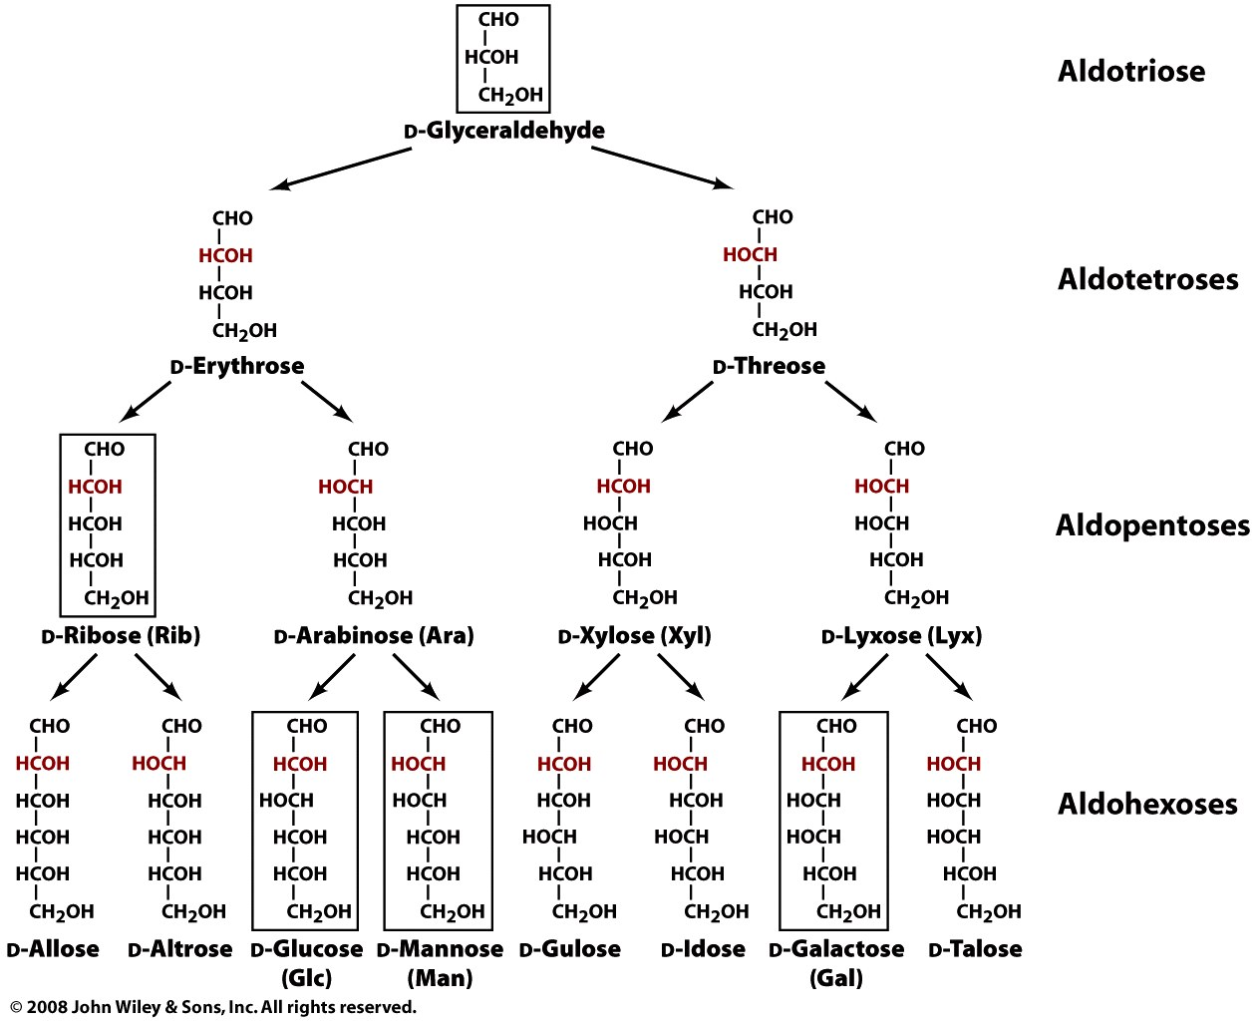
The D-aldoses with up to six carbon atoms
D sugars have the same
absolute configuration at the
asymmetric center farthest
from their carbonyl group.
Figure 8-1

Slide 15
D-aldoses up to 6 carbons
‘linear form’
aka fischer projection

Slide 16
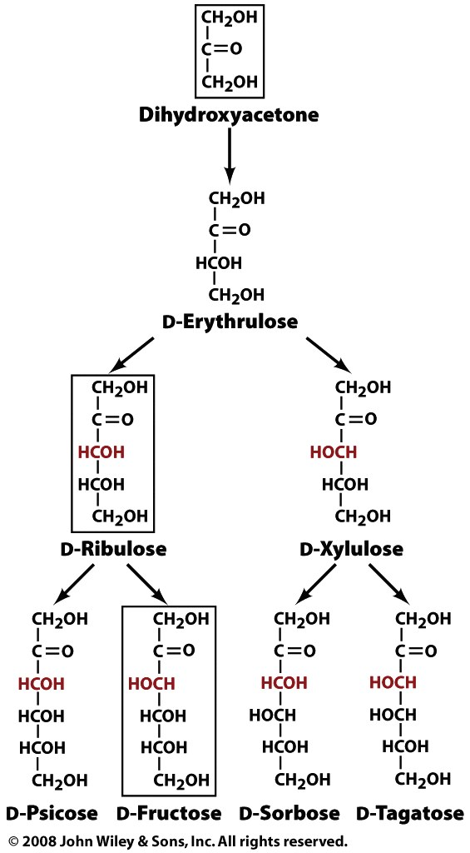
Ketoses
(one fewer chiral center
than aldoses)

Slide 17
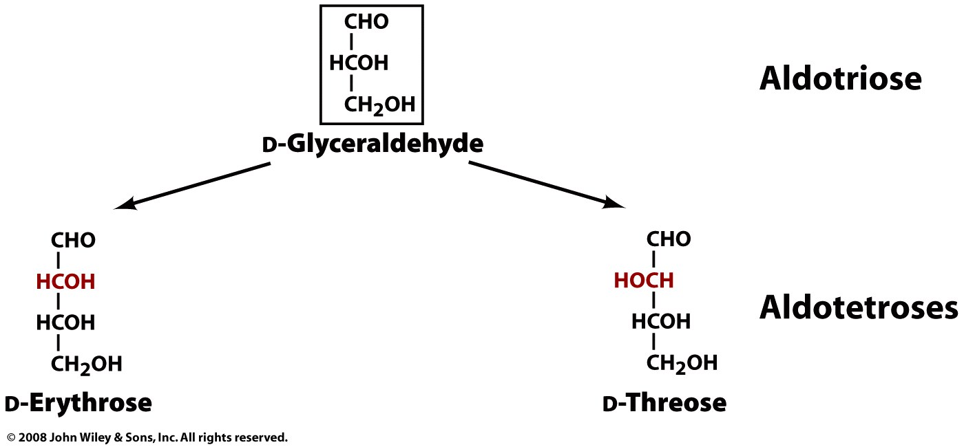
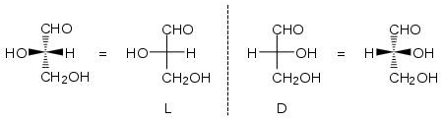
D
Fischer Projection

Slide 18
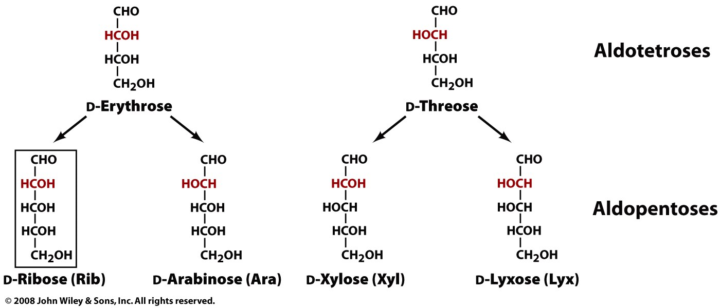
D
For L or D: Look at the the highest numbered chiral carbon (i.e., the chiral C most remote from the CHO). If it is the same sterochemistry as D-glyceraldehyde (i.e., HCOH), then the sugar is in the D-configuration.

Slide 19
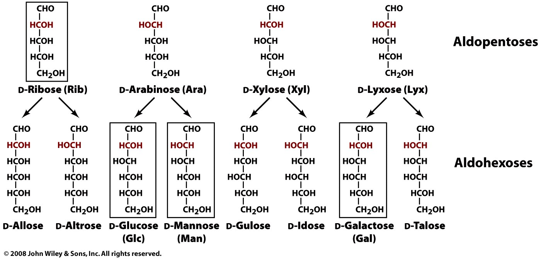
3 chiral carbons
2³=8
stereoisomers
D
4 chiral carbons
2⁴=16
Possible
stereoisomers

Slide 20
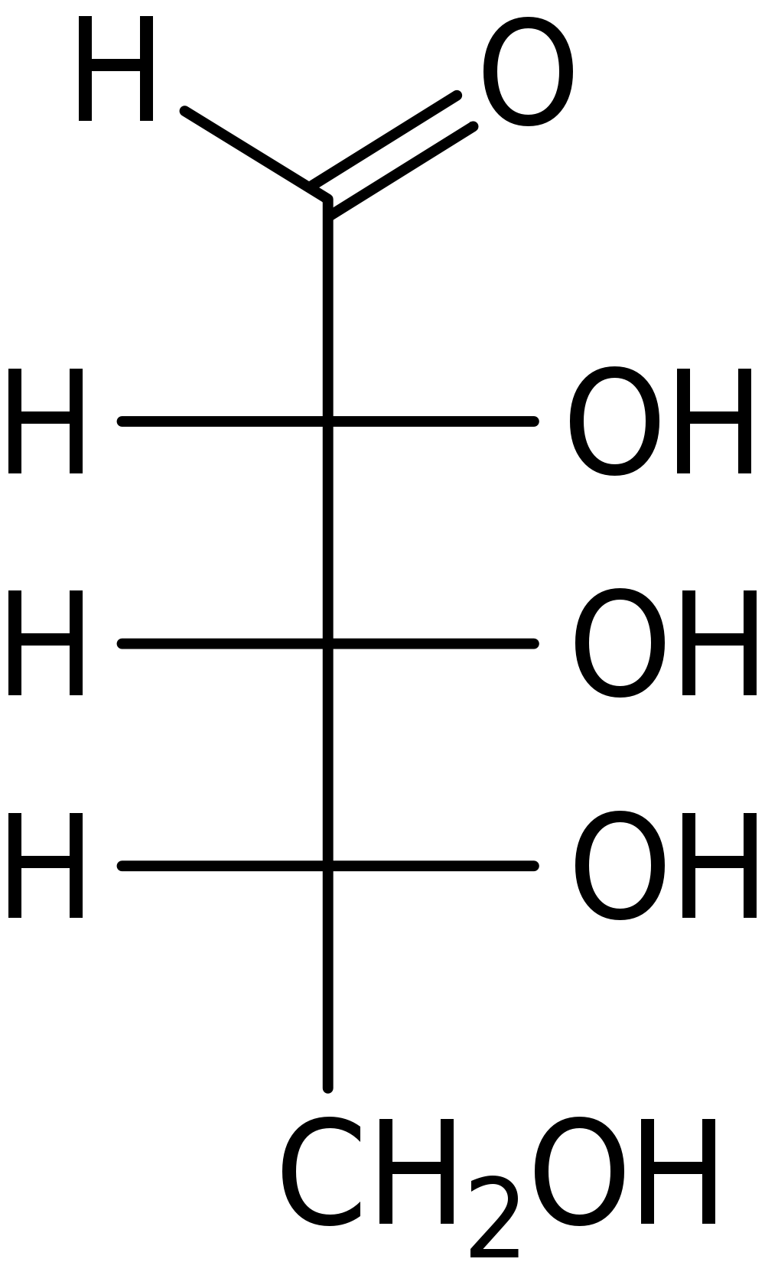
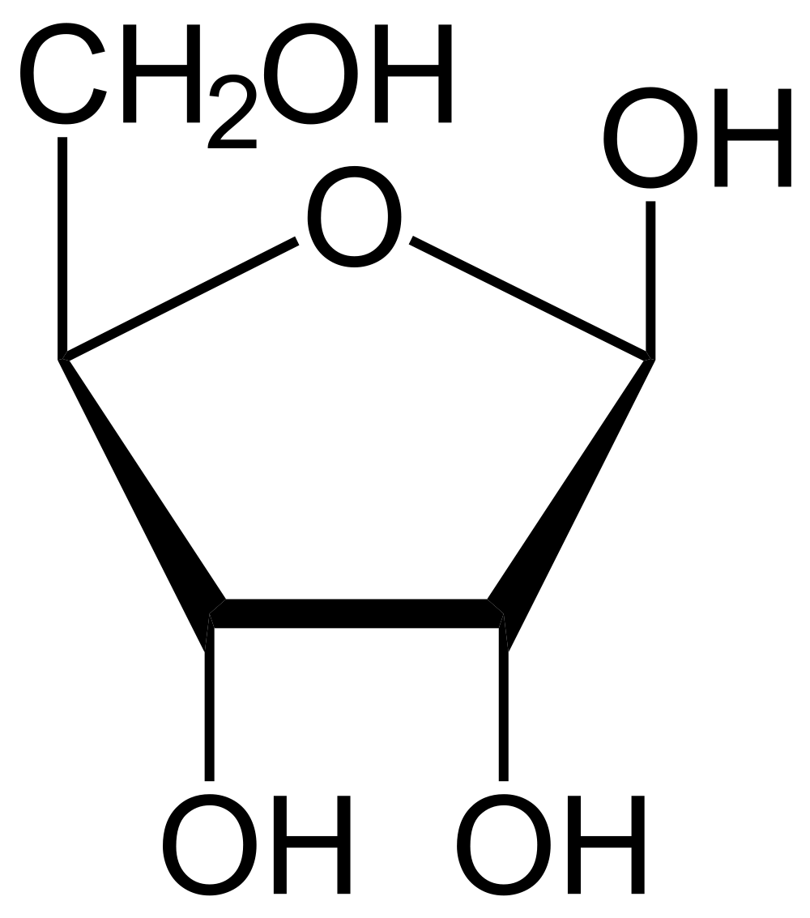
Ribose
RNA backbone.
DNA backbone (2’ deoxyribose).
Phosphorylated derivatives ATP and NADH (metabolism)
cAMP and cGMP (secondary messengers)
β-D-ribose
(furanose : 5-membered ring)
β => 1 OH (aka 1’ OH) is on the same side of the ring plane as CH₂OH)

Slide 21
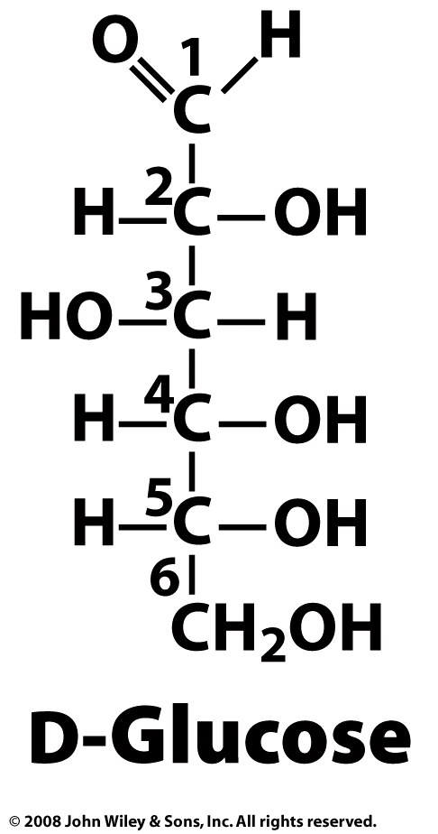
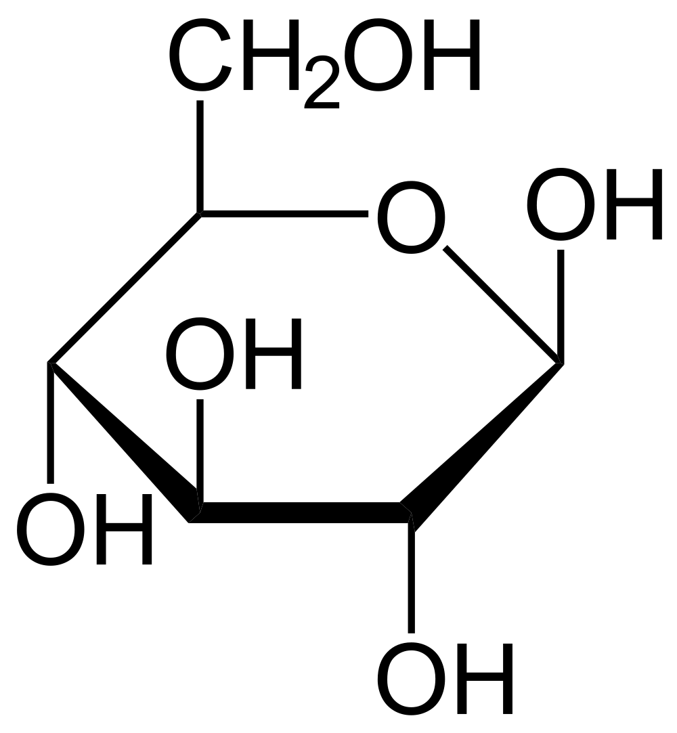
D-Glucose
4 chiral carbons
2⁴=16 possible aldohexose stereoisomers
source of energy
metabolic intermediate
primary product of photosynthesis
component of cellulose
component of (amylose) glycogen
component of chitin
component of sucrose (glucose-fructose)
component of lactose (glucose-galactose)
aka dextrose
Draw the Fischer projection (linear), Hayworth Projection (cyclic).
D
β-D-Glucose
(pyranose: 6-membered ring)

Slide 22
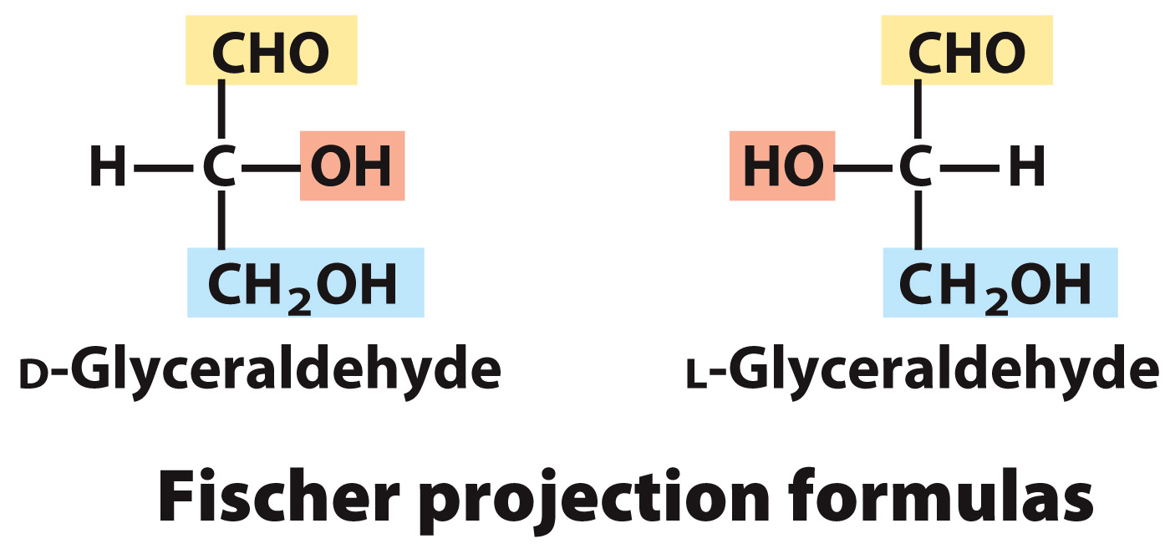
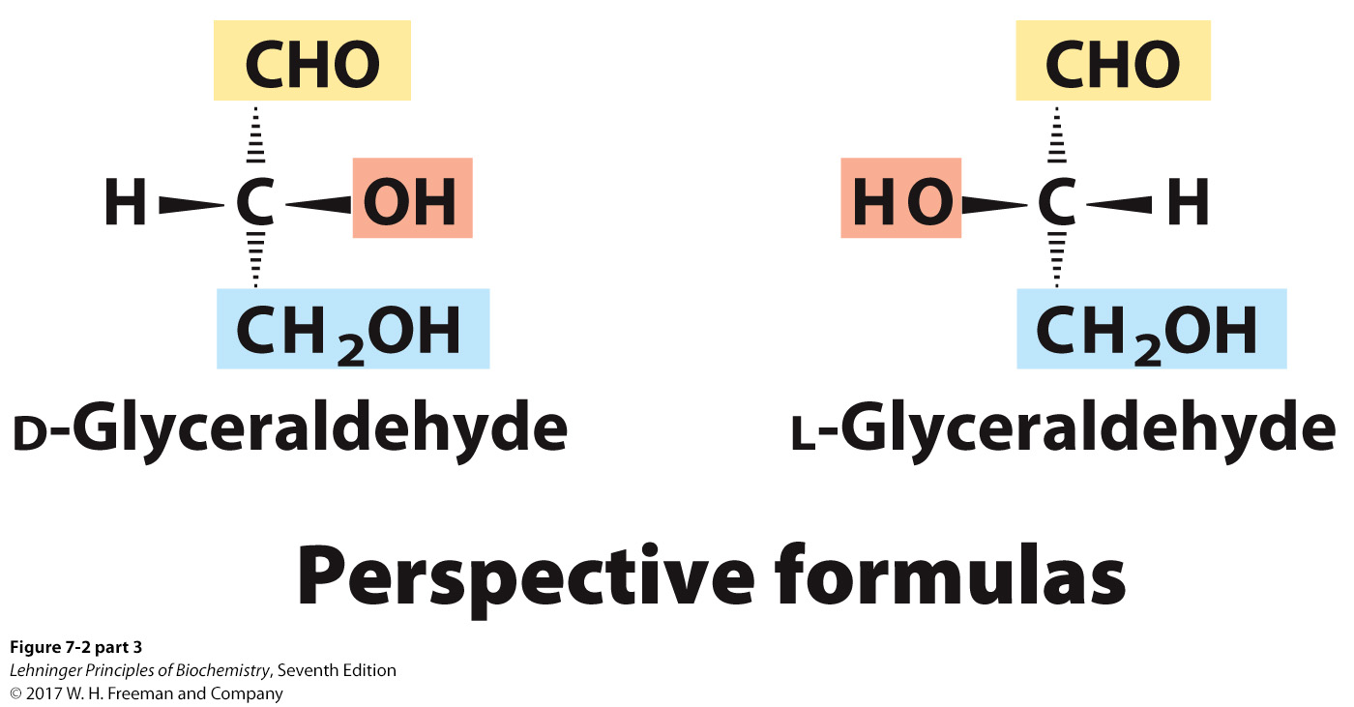
Drawing Monosaccharides
Chiral compounds can be drawn using perspective formulas.
However, chiral carbohydrates are usually represented by Fischer projections.
Horizontal bonds are pointing toward you; vertical bonds are projecting away from you.
l
Notes:
FIGURE 7-2 (part 2) Three ways to represent the two enantiomers of glyceraldehyde. The enantiomers are mirror images of each other. Ball-and-stick models show the actual configuration of molecules. Recall (see Fig. 1–18) that in perspective formulas, the wide end of a solid wedge projects out of the plane of the paper, toward the reader; a dashed wedge extends behind. FIGURE 7-2 (part 3) Three ways to represent the two enantiomers of glyceraldehyde. The enantiomers are mirror images of each other. Ball-and-stick models show the actual configuration of molecules. Recall (see Fig. 1–18) that in perspective formulas, the wide end of a solid wedge projects out of the plane of the paper, toward the reader; a dashed wedge extends behind.

Slide 23
PyMol

Slide 24
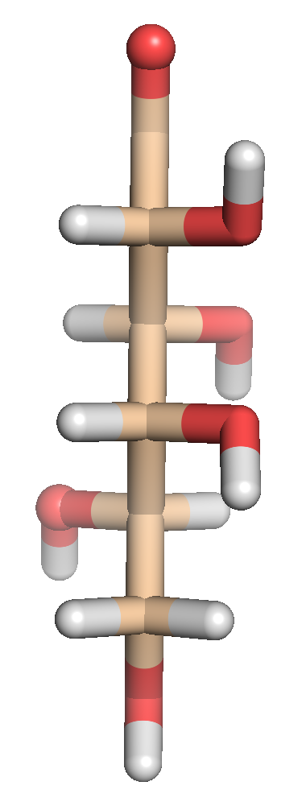
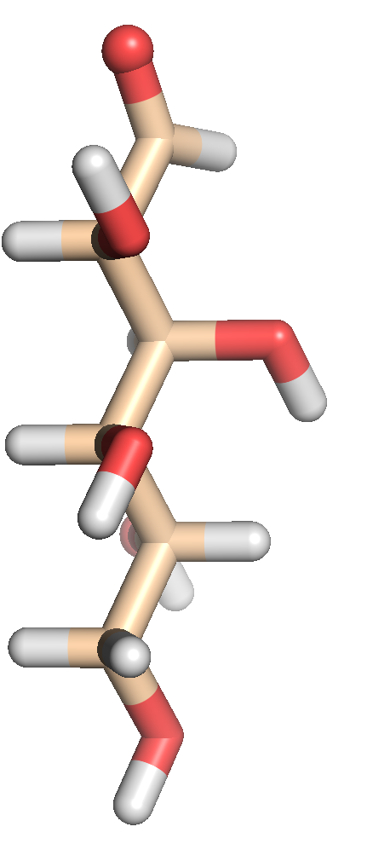
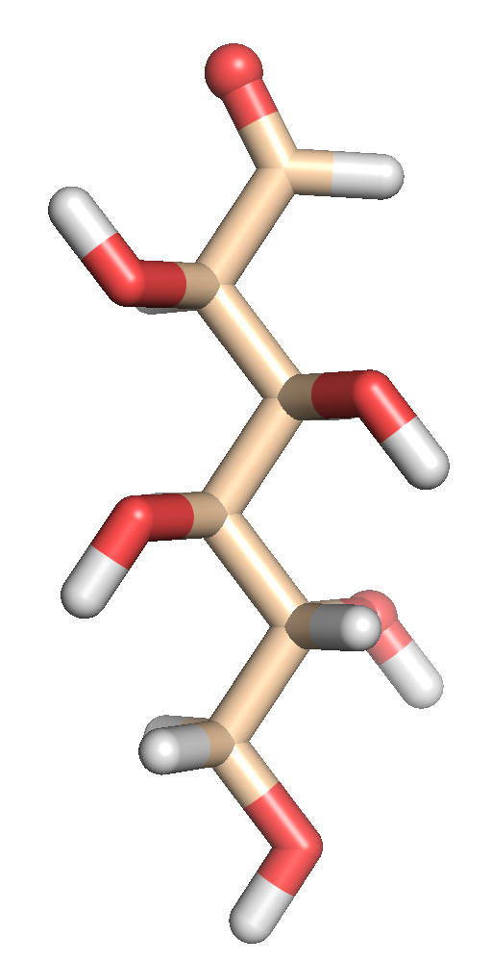
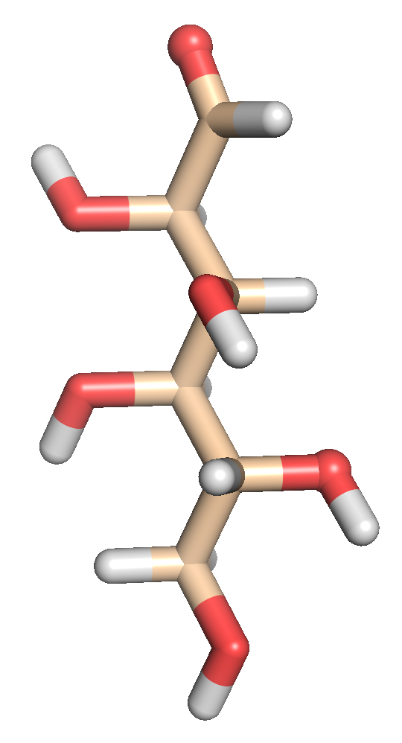
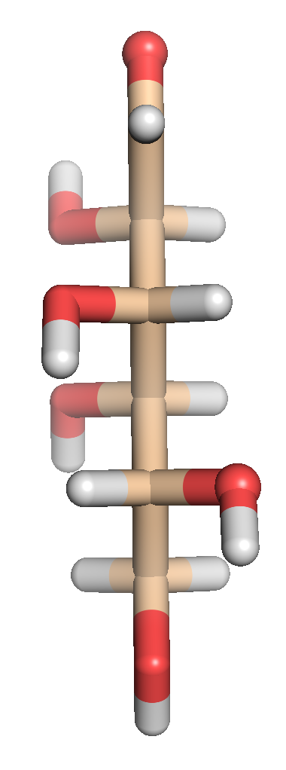
Rot 45°
Rot 45°
Rot 45°
Rot 45°
Rot 45°
Fischer Projection

Slide 25
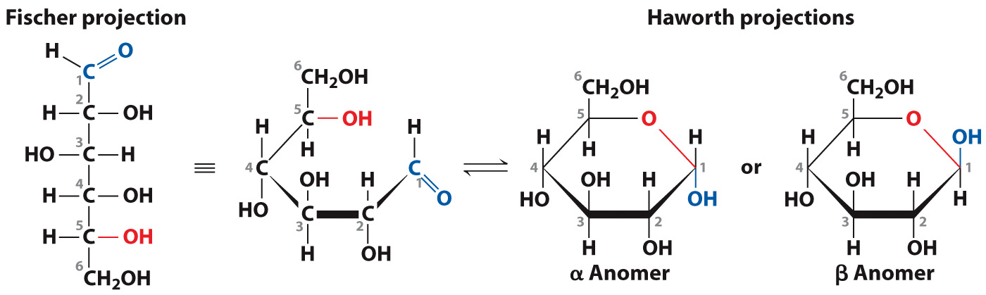
In a linear Fischer projection, the horizontal bonds point out of the page and the vertical bonds point below the page.
Glucose cyclizes to form a six-membered ring represented by a Haworth projection, in which the heaviest bonds point out from the plane of the page.
The α and β anomers freely interconvert so these two forms are considered these same sugar.

Slide 26
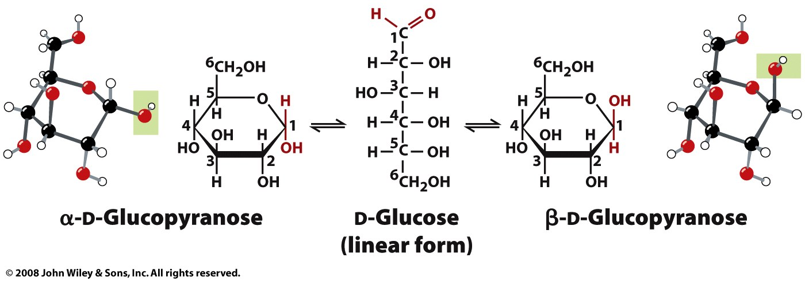
Another way to represent the interconversion of D-glucopyranose between its α and β forms.
C1 is the called anomeric carbon. Each sugar
has two “anomers”, the α and β anomers.

Slide 27
The sugar ring puckers so that each C atom can retain its tetrahedral bonding geometry. The substituents of each carbon may point either above the ring (axial positions) or outward (equatorial positions).
β-D-Glucose can adopt a chair conformation in which all its bulky ring substituents (the —OH—OH and —CH2OH—CH2OH groups) occupy equatorial positions.
In all other hexoses, some of these groups must occupy the more crowded—and therefore less stable—axial positions. The greater stability of β-D-glucose may be one reason for its abundance among monosaccharides.

Slide 28
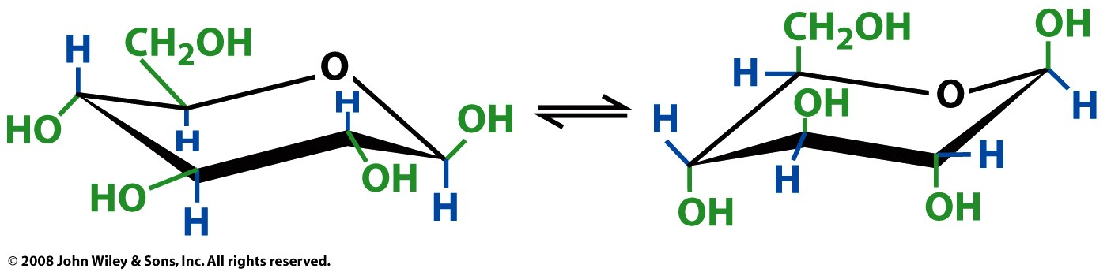
β-D-glucose conformations
all equatorial
(more stable)
all axial
(less stable)
Figure 8-5

Slide 29
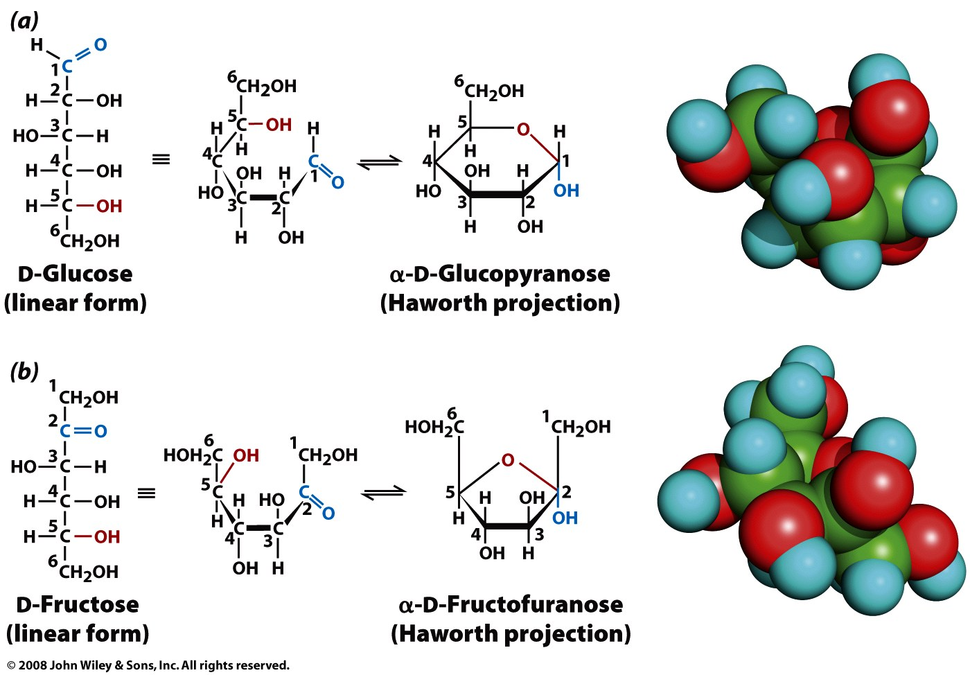
Figure 8-3

Slide 30
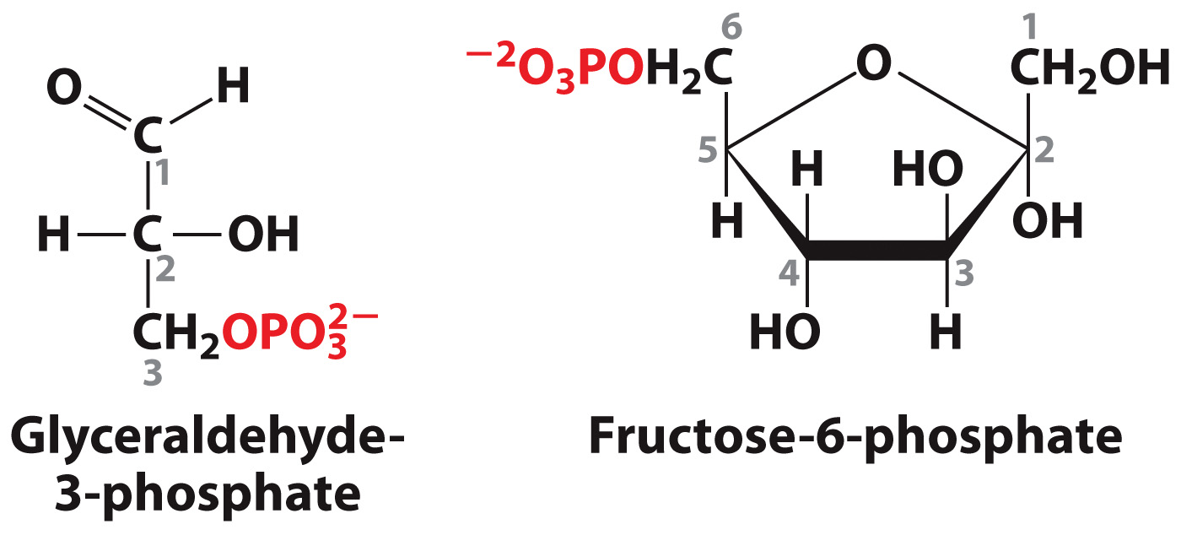
modifications:
Phosphorylated sugars, including glyceraldehyde-3-phosphate and fructose-6-phosphate, appear as intermediates in the metabolic pathways for breaking down glucose (glycolysis) and synthesizing it (photosynthesis).

Slide 31
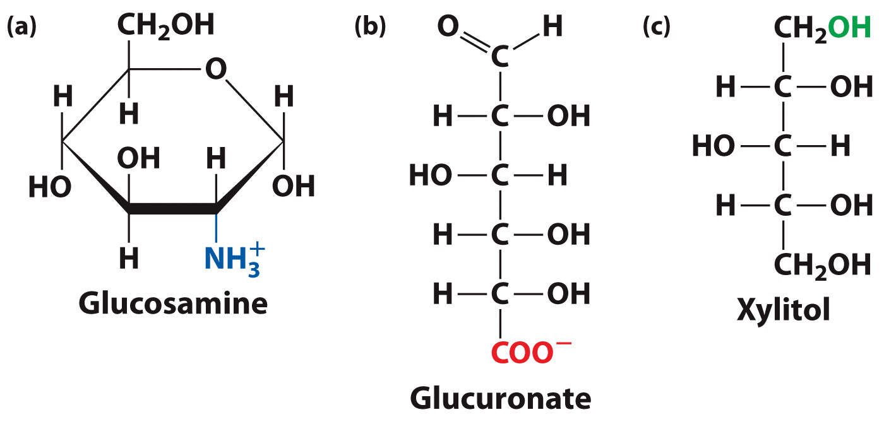
More monosaccharide modifications
In an amino sugar NH3+ replaces an OH group.
Reduction yields sugars with additional hydroxyl groups.
Oxidation yields sugars with carboxylate groups.

Slide 32
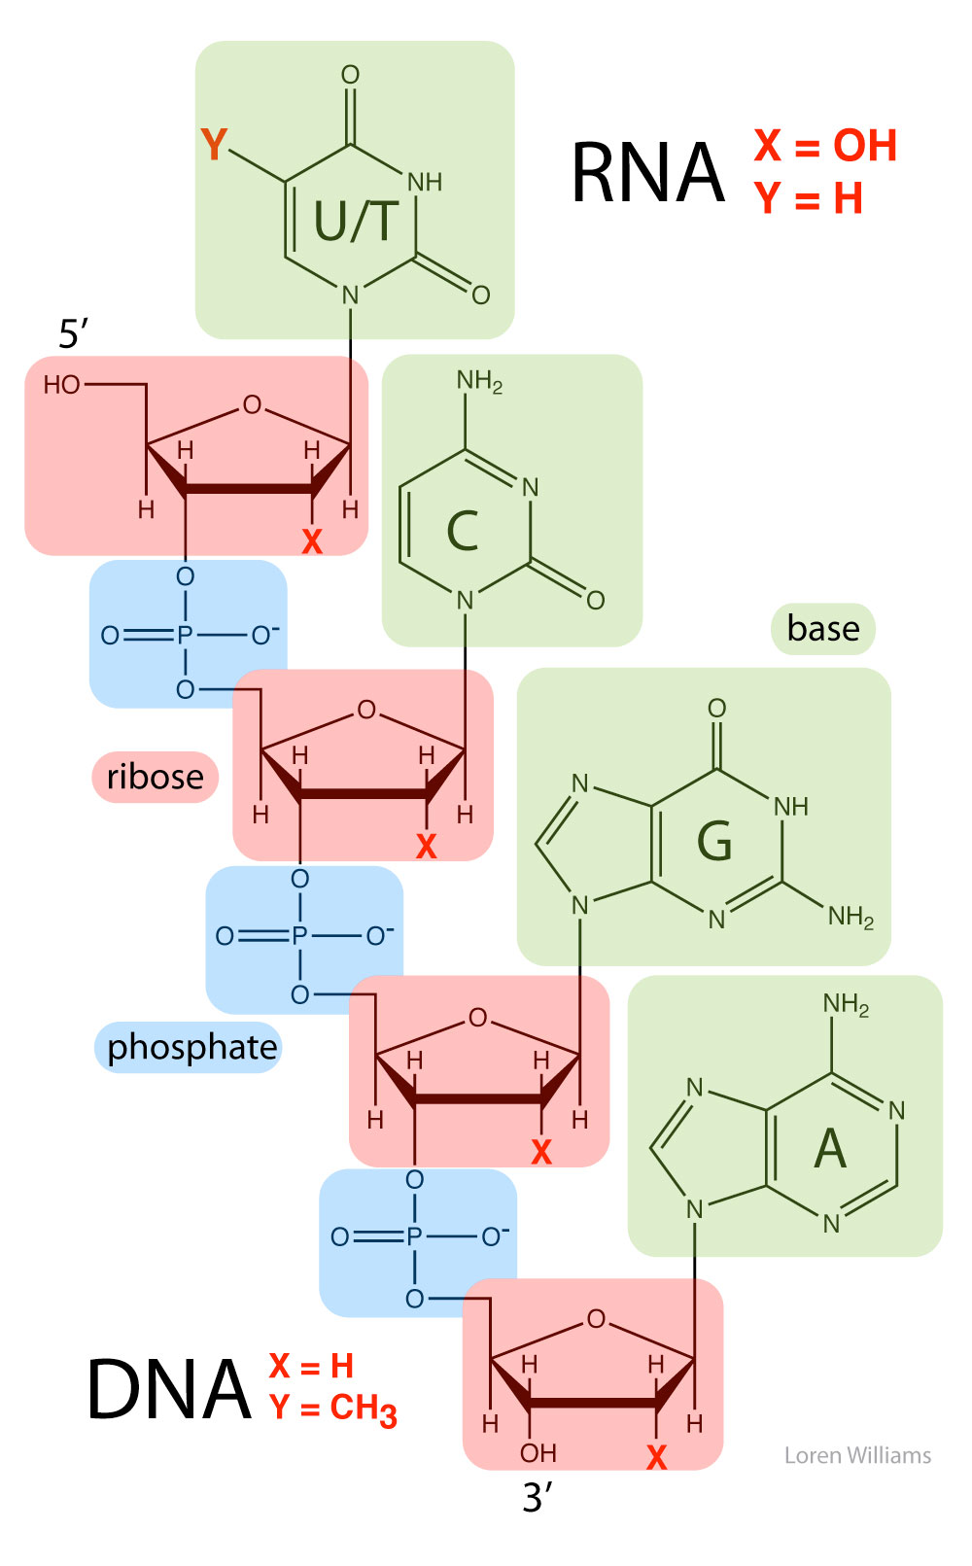

Slide 33
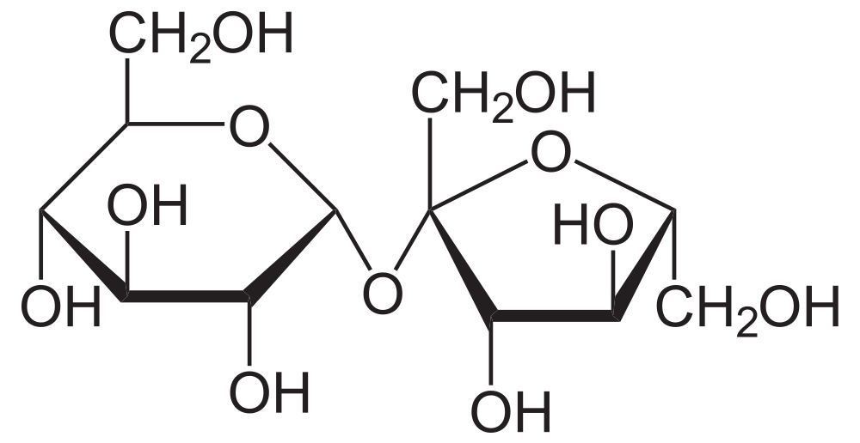
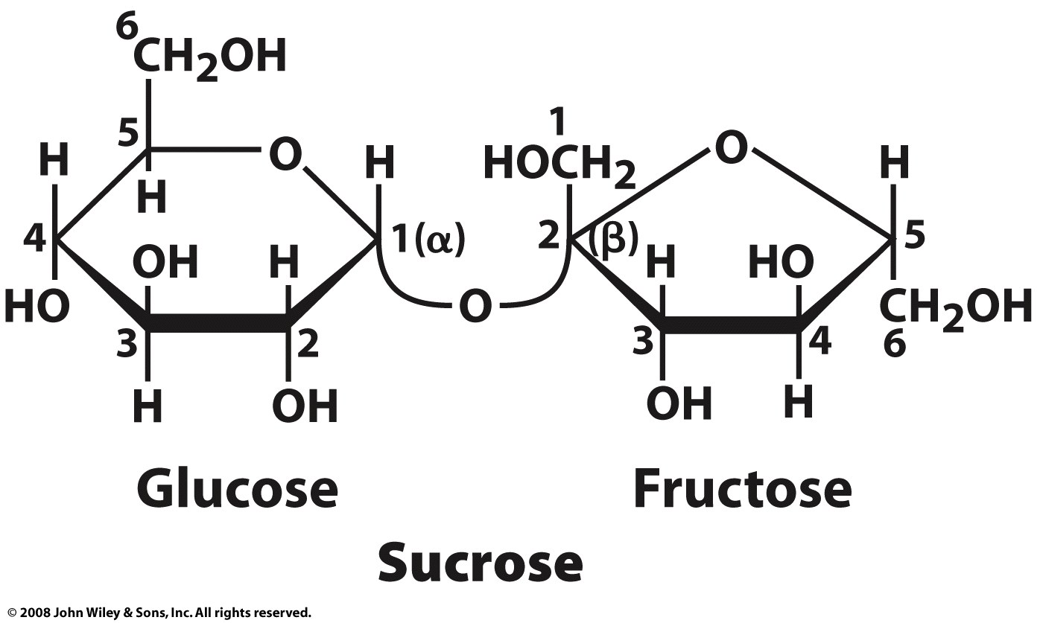
Disaccharides
Sucrose: table sugar
a disaccharide
glucose+fructose
O-α-D-glucopyranosyl-(1→2)-β-D-fructofuranoside
pyran: 6-membered ring
furan: 5-membered ring
sucrose is broken down to monosaccharides by sucrase or isomaltase glycoside hydrolases, which are found in the membrane of the microvilli in the small intestine. The monosaccharides are readily absorbed into the bloodstream.
α => 1 OH is on the opposite side of the ring plane as CH₂OH)
β => 1 OH is on the same side of the ring plane as CH₂OH)

Slide 34
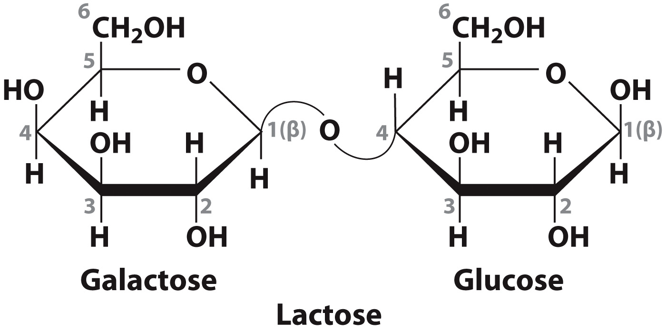
A glycosidic bond links two monosaccharides to generate a disaccharide. In nature, disaccharides occur as intermediates in the digestion of polysaccharides and as a source of metabolic fuel. For example, lactose, secreted into the milk of lactating mammals, consists of galactose and glucose:
Note that the anomeric carbon (C1) of galactose is linked to C4 of glucose via a β-glycosidic bond.

Slide 35
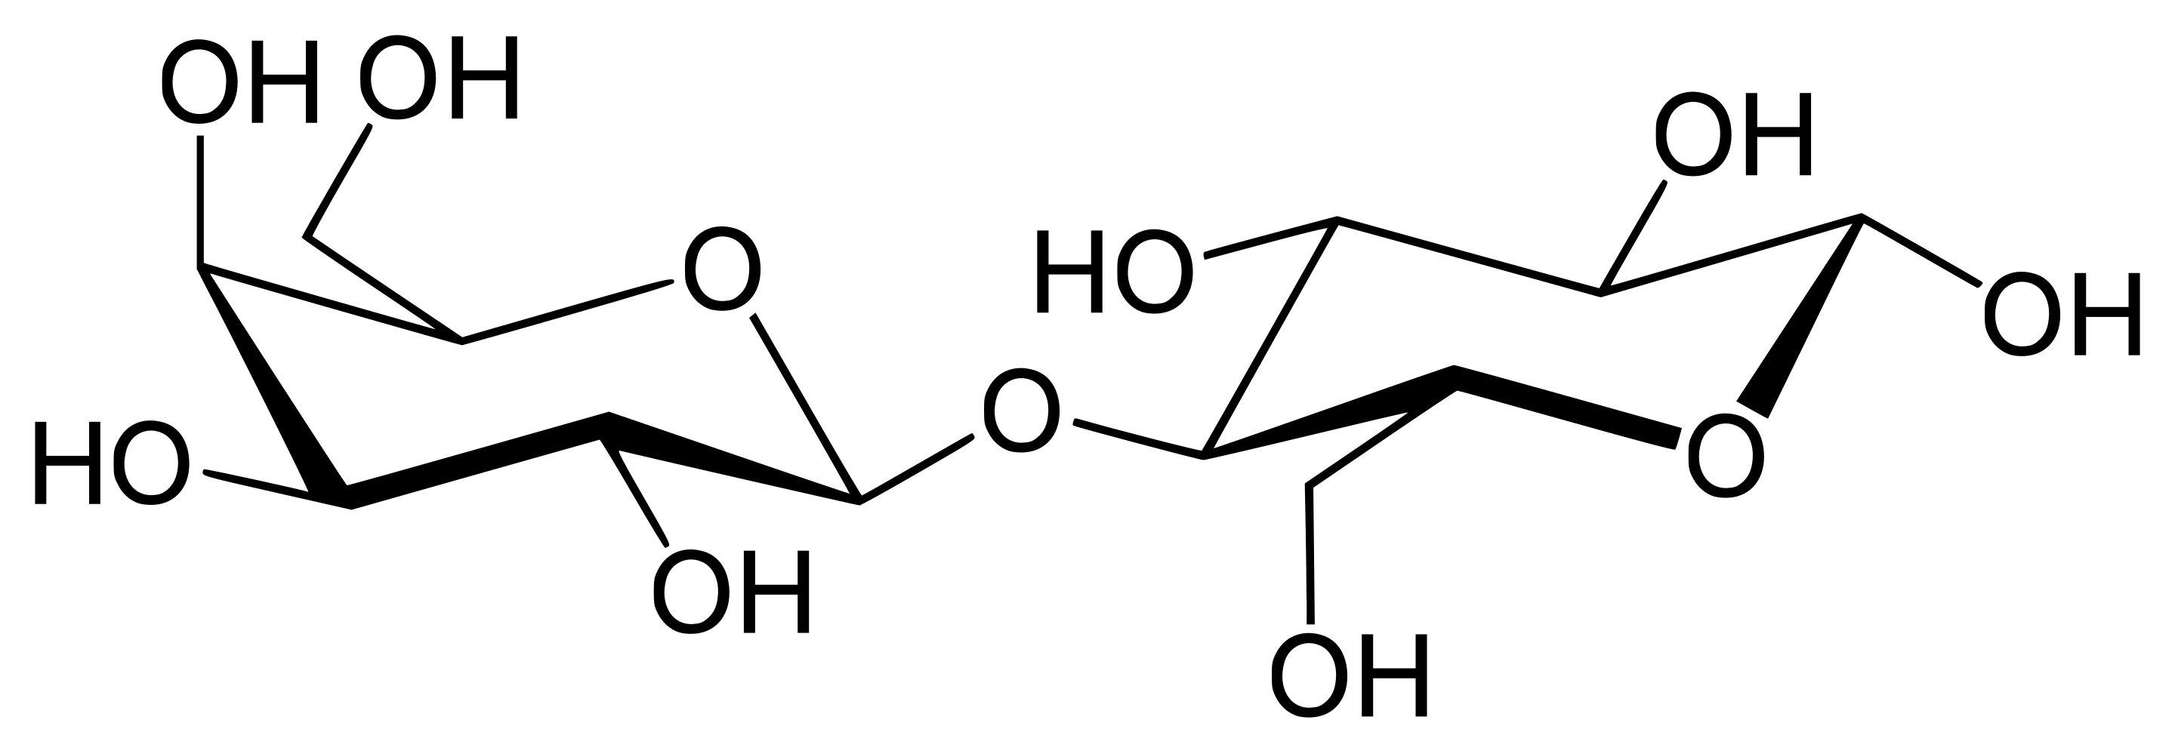
A more realistic representation of lactose

Slide 36
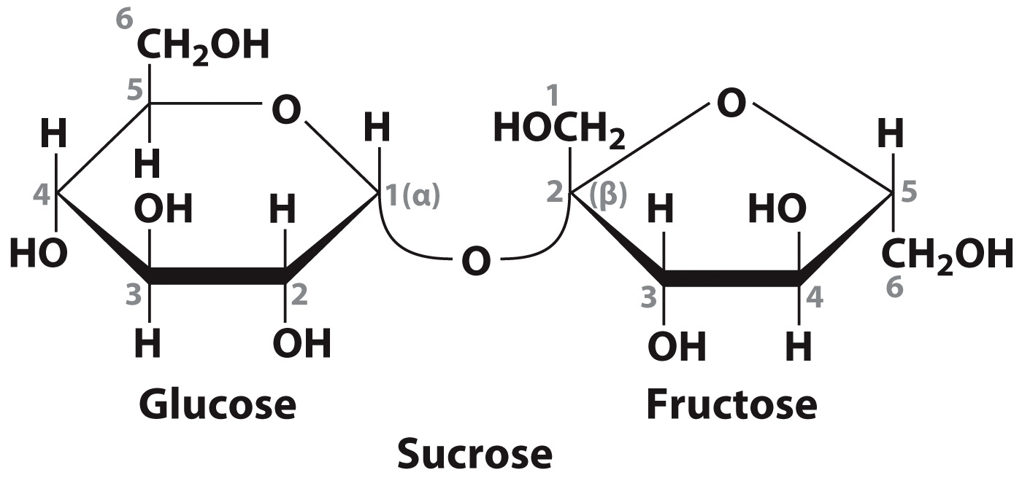
Sucrose, or table sugar, is the most abundant disaccharide in nature:
In this molecule, the anomeric carbon of glucose (in the α configuration) is linked to the anomeric carbon of fructose (in the β configuration).
Sucrose is the major form in which newly synthesized carbohydrates are transported to be used as a fuel or stored as starch for later use.

