Slide 1
Review monosaccharides
glucose
fructose
Disasaccharide
maltose (glucose+glucose)
sucrose (glucose+fructose)
Polysaccharacides
cellulose
amylose
amylopectin
glycogen
chitin

Slide 2
Carbohydrates
Compounds with the empirical formula (C H₂O)_{n} where n > 2
Aldehyde or ketone derivatives of polyhydroxyl alcohols
- consist only of carbon, hydrogen, and oxygen,
with a hydrogen:oxygen atom ratio of 2:1
(but can be modified)
monosaccharide: 1 sugar (aldose or ketose)
disaccharide: 2 sugars
oligosaccharide: 3-10 sugars
polysaccharide: >10
suffix -ose: glucose, sucrose (table sugar), lactose (milk), cellulose.
Used for
storage of energy (e.g., starch and glycogen)
structure
coenzymes
nucleic acid backbone
chemical markers (for cell recognition)

Slide 3
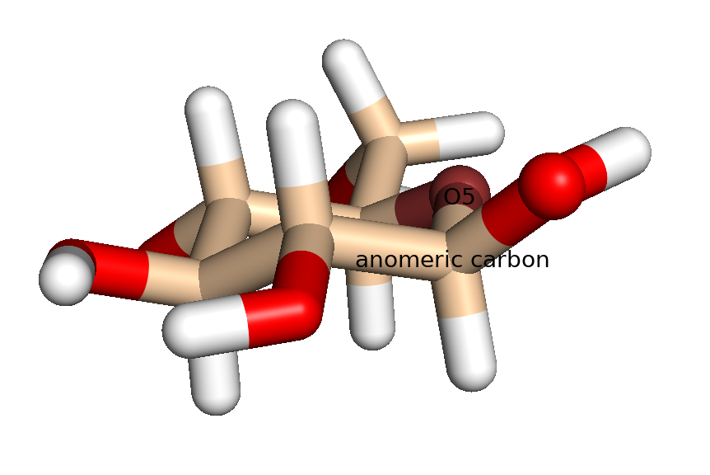
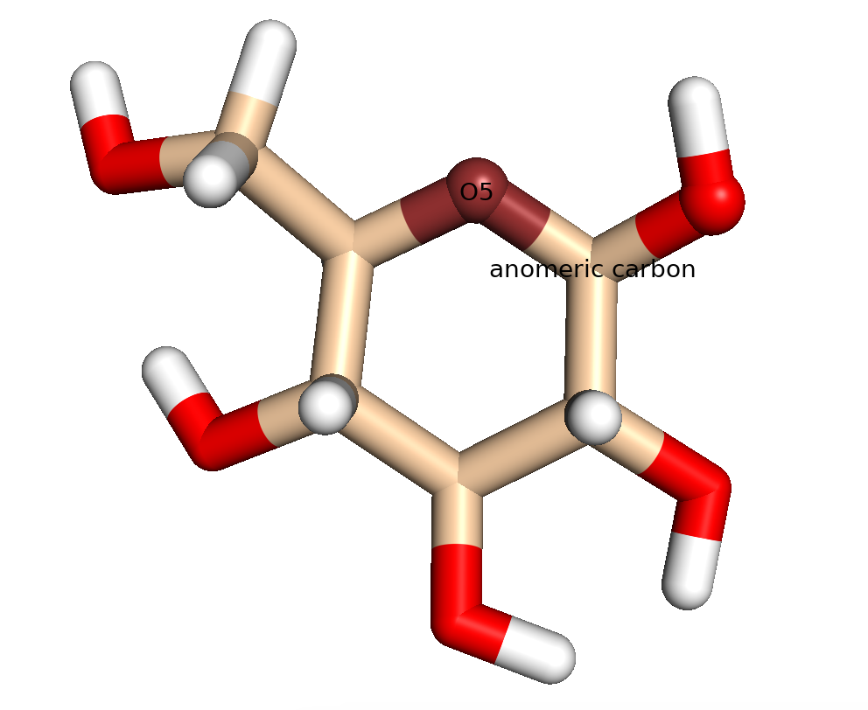
Monosaccharides
β-D-glucose
β
Pyranose
(6-membered ring)
The anomeric carbon of glucose is the 1-C
(the carbon atom bonded to 2 oxygen atoms)
α => The 1-OH is on the opposite side of the ring plane as CH₂OH)
β => The 1-OH is on the same side of the ring plane as CH₂OH)

Slide 4
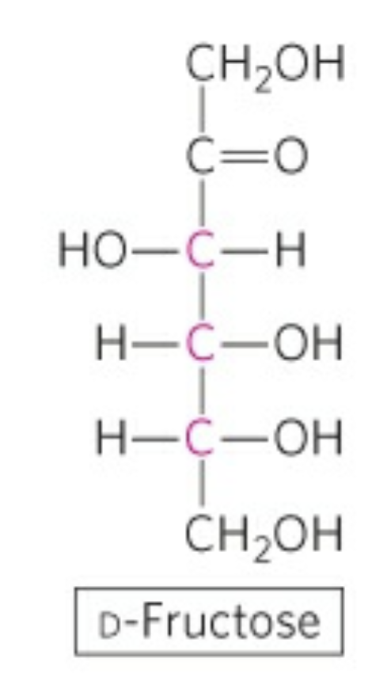
D-fructose

Slide 5
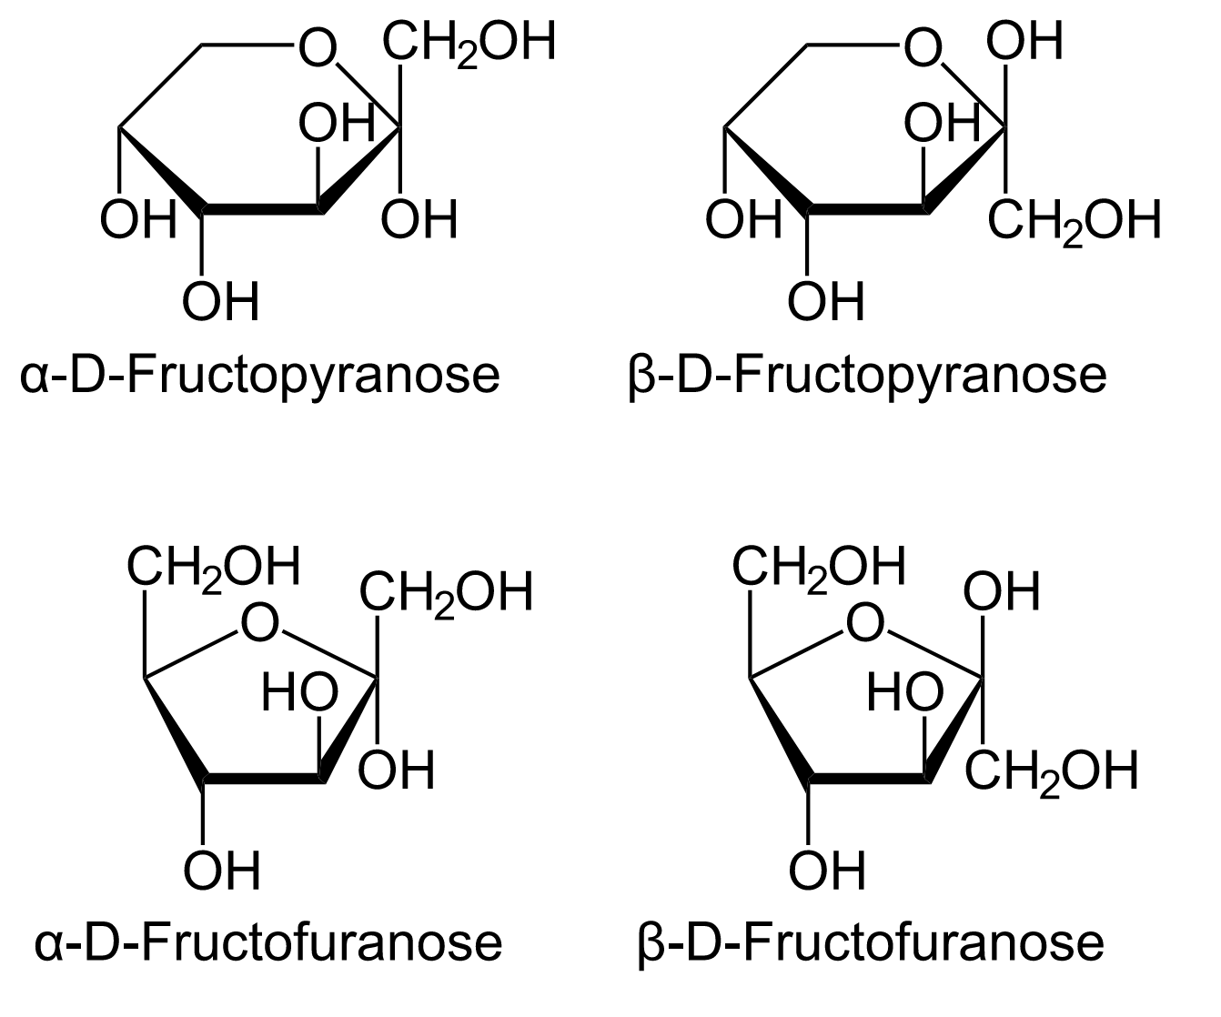

Slide 6
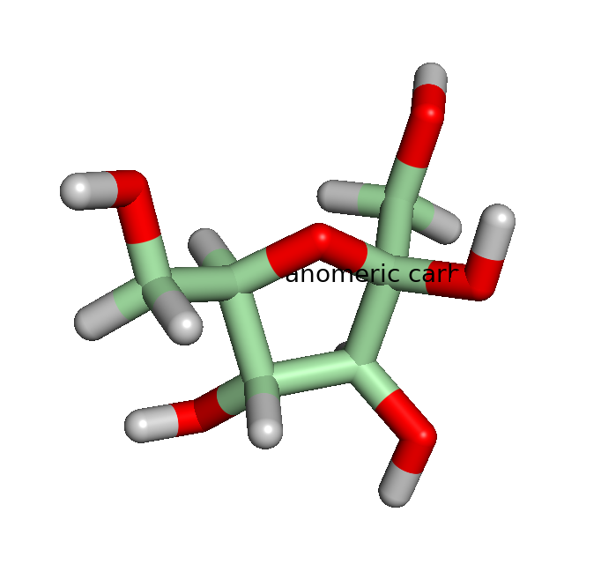
α-D-fructose (furan)

Slide 7
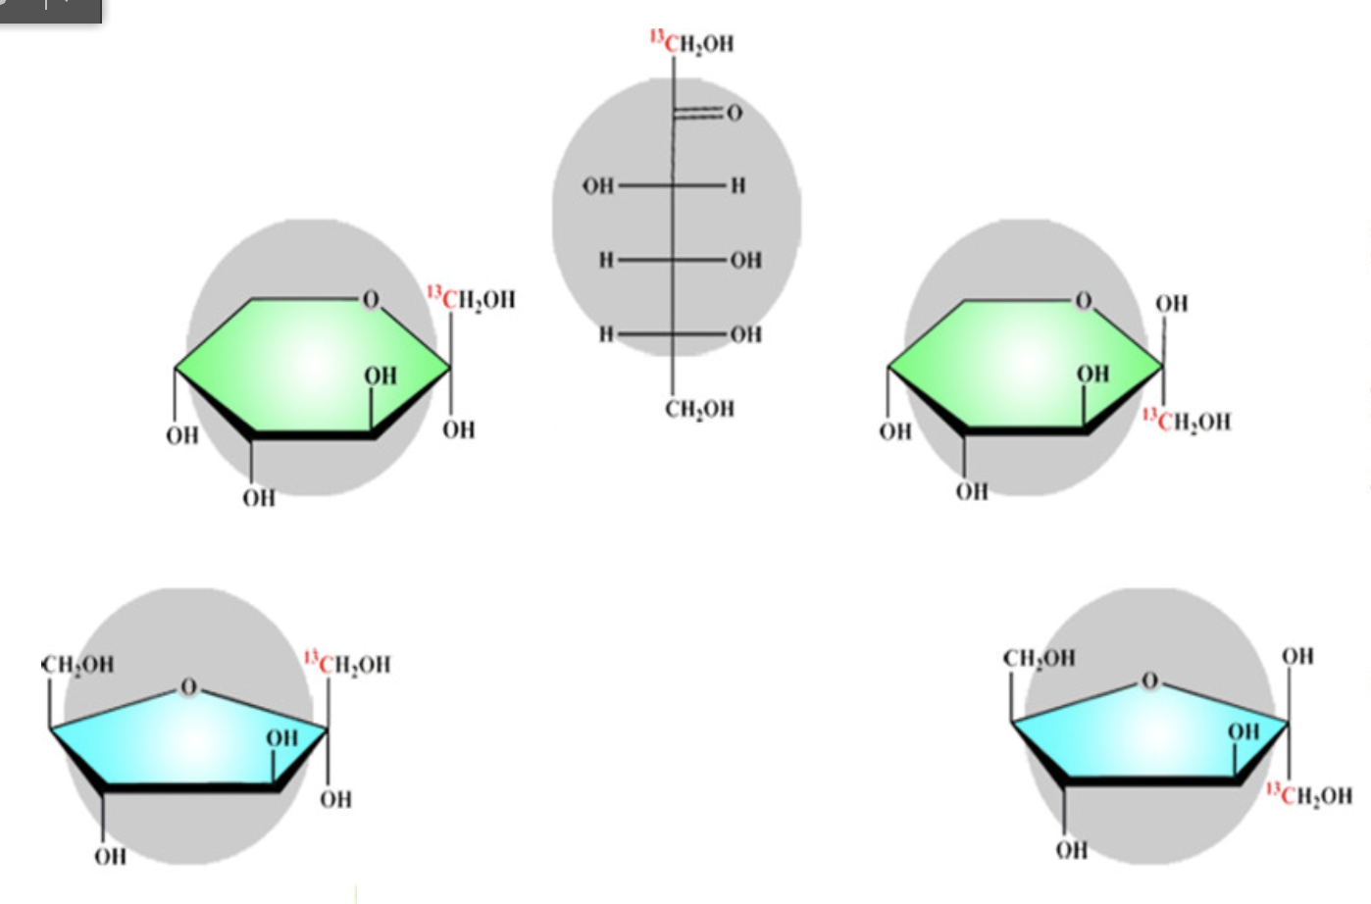
D-fructose
Linear
Pyranose
(6-membered ring)
Furanose
(5-membered ring)

Slide 8
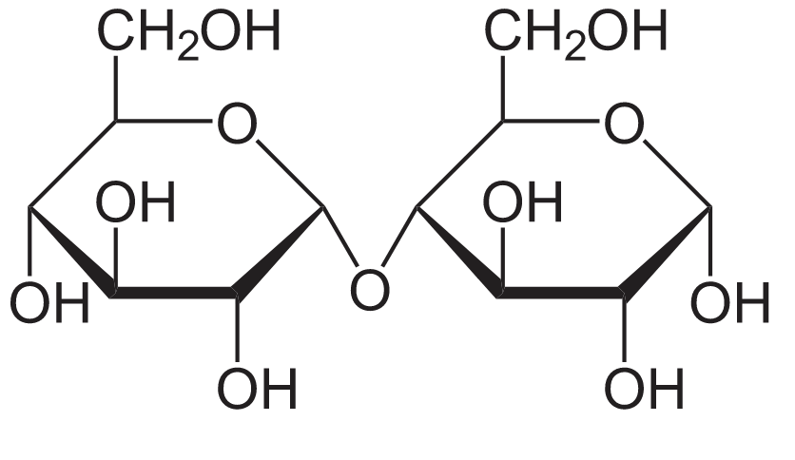
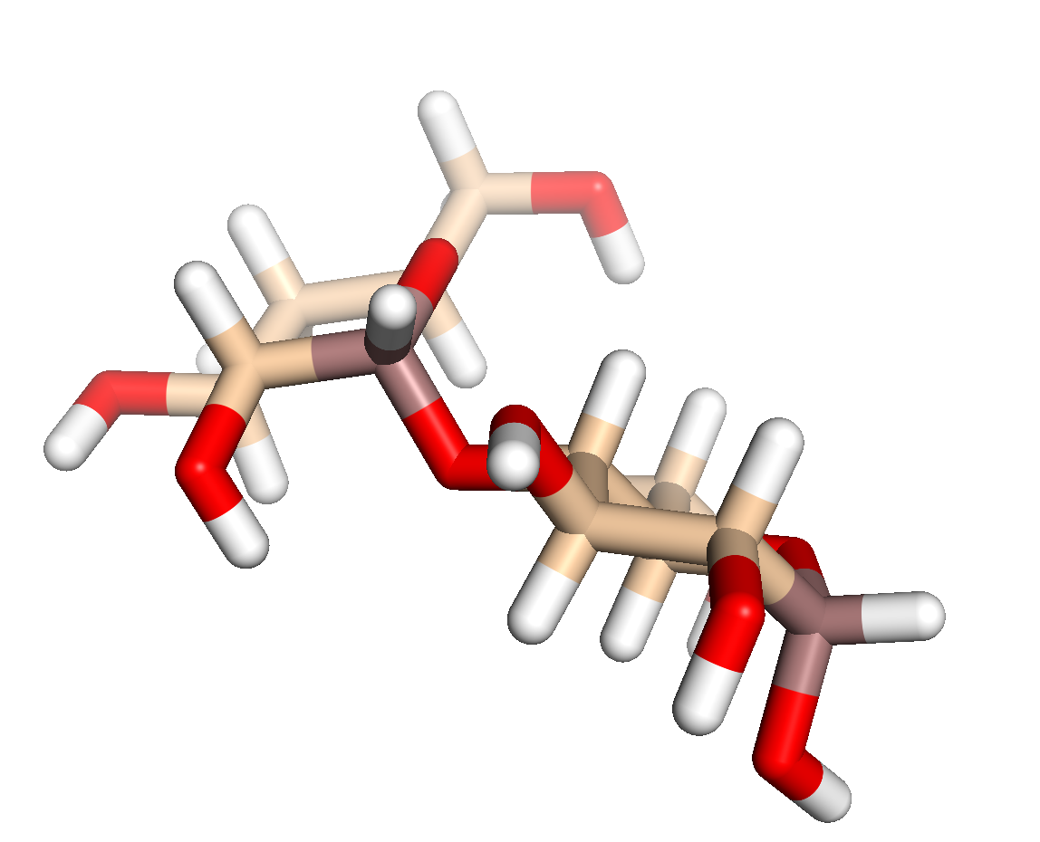
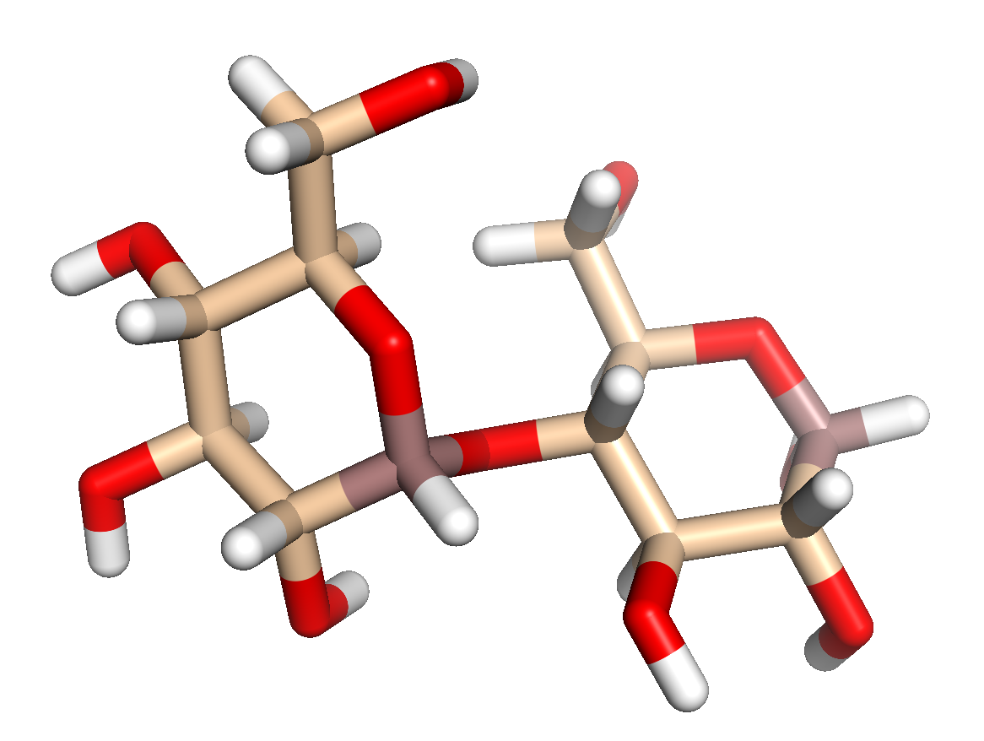
Disaccharides
Maltose: table sugar
a disaccharide
glucose+glucose
pyran: 6-membered ring

Slide 9
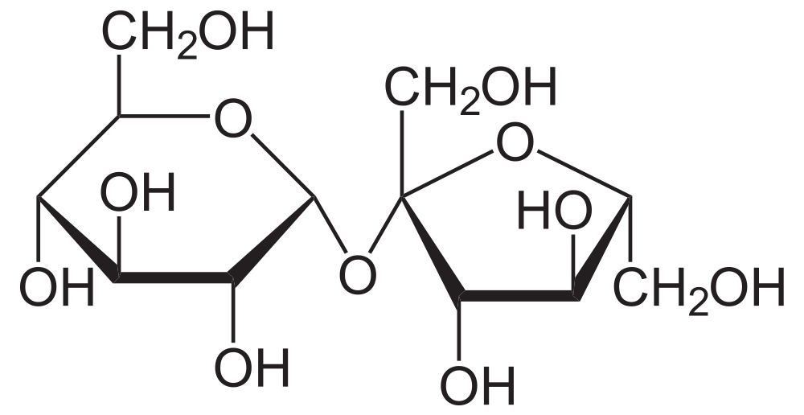
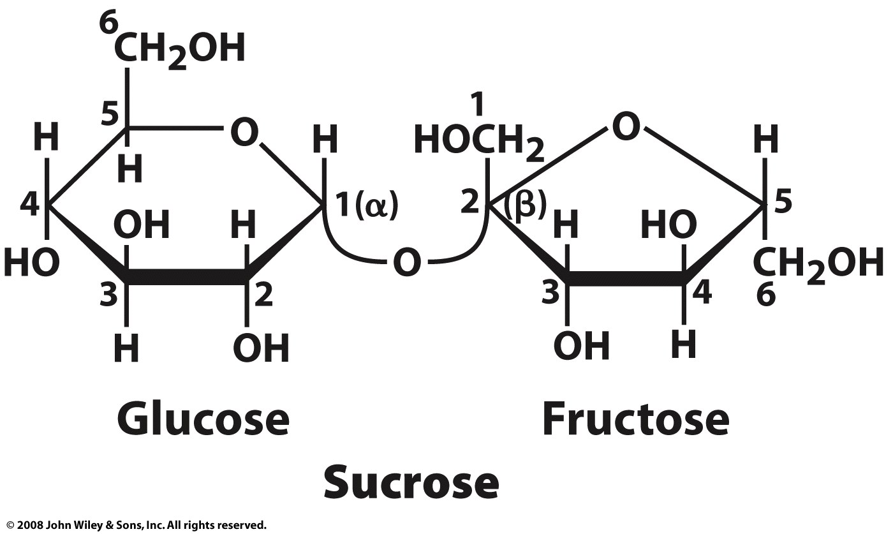
Disaccharides
Sucrose: table sugar
a disaccharide
glucose+fructose
O-α-D-glucopyranosyl-(1→2)-β-D-fructofuranoside
pyran: 6-membered ring
furan: 5-membered ring
sucrose is broken down to monosaccharides by sucrase or isomaltase glycoside hydrolases, which are found in the membrane of the microvilli in the small intestine. The monosaccharides are readily absorbed into the bloodstream.
α => 1 OH is on the opposite side of the ring plane as CH₂OH)
β => 1 OH is on the same side of the ring plane as CH₂OH)

Slide 11

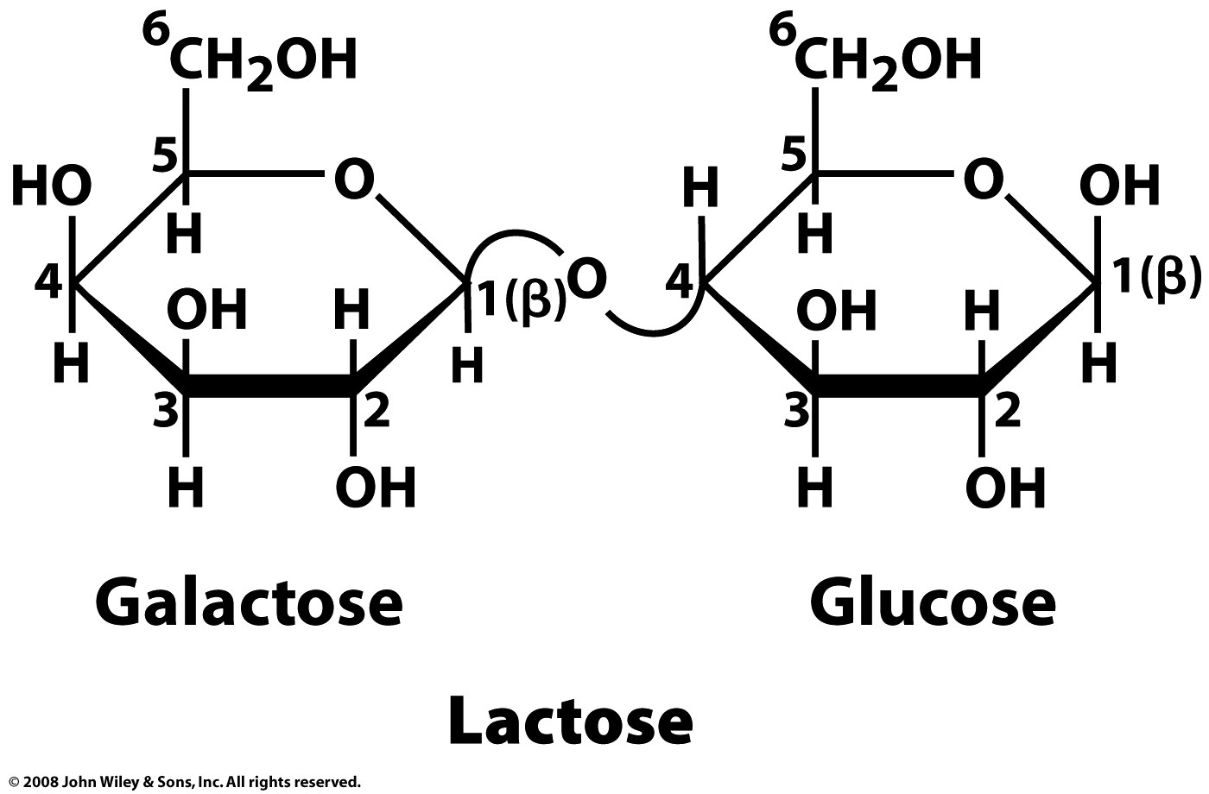
Disaccharides

Slide 12
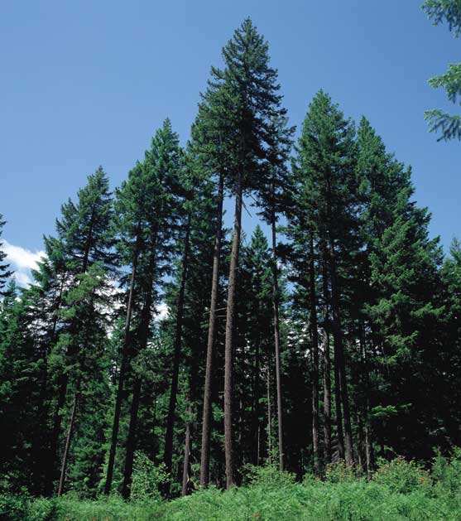
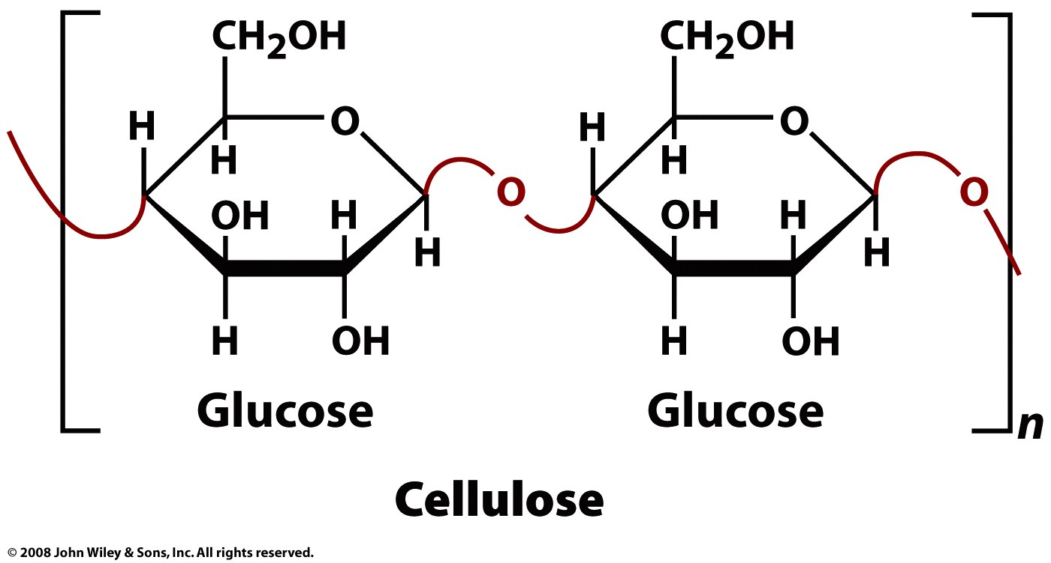
Polysaccharides
Cellulose
most common organic compound on our planet,
insoluble in water and most organic solvents,
linear β (1-4) - linked D-glucose
several hundred to over ten thousand linked D-glucose residues.
Page 229

Slide 13
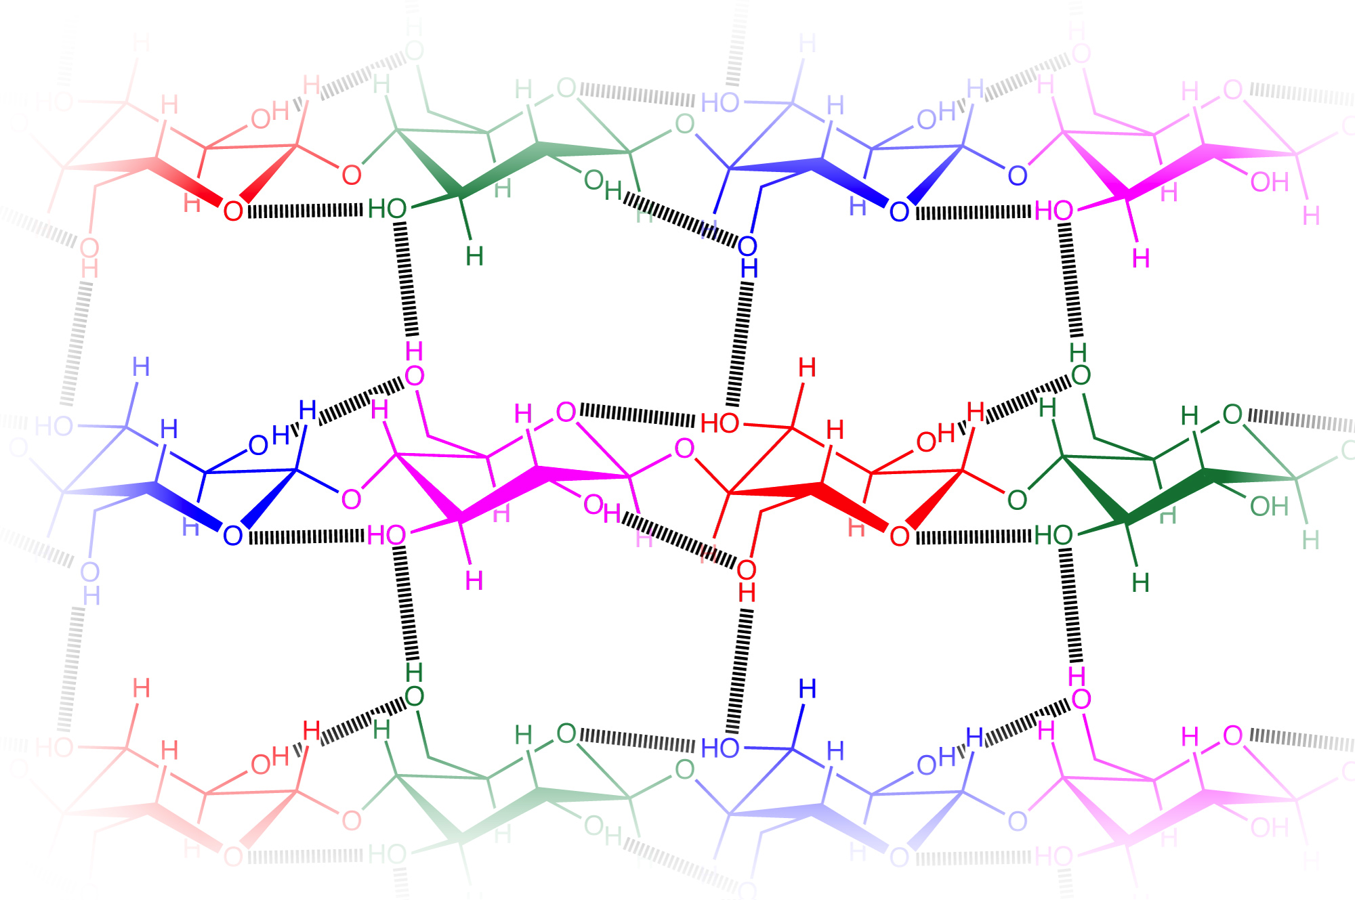

Slide 14
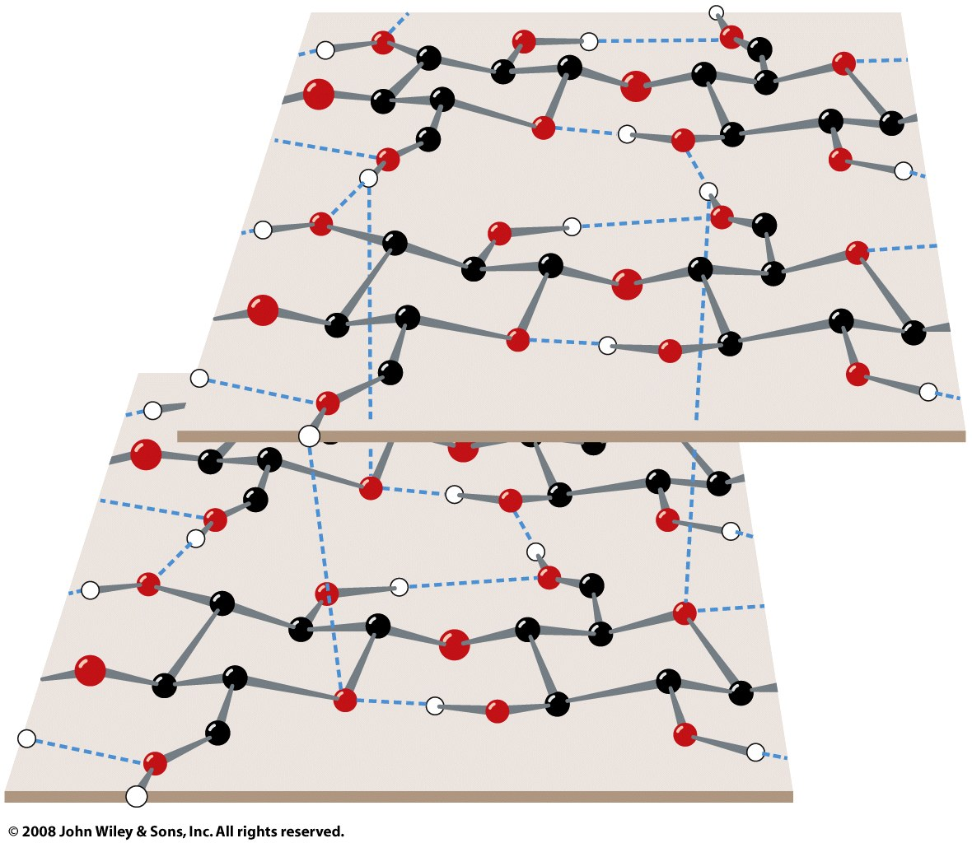
Figure 8-9

Slide 15
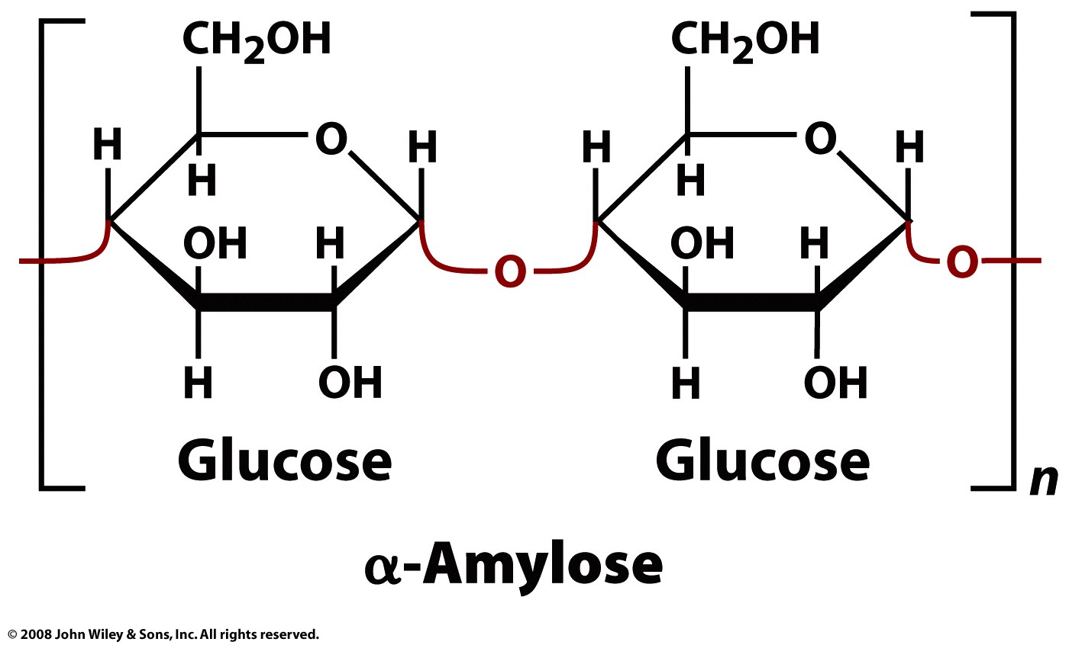
Amylose: linear α(1-4)−linked D-glucose
Page 230

Slide 16
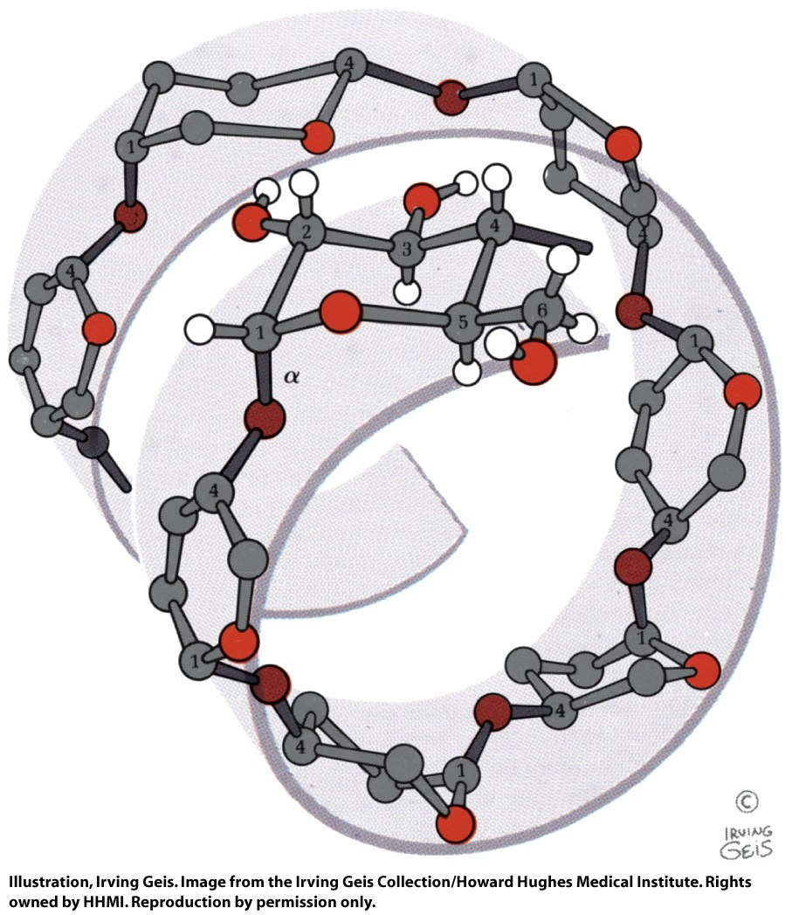
α(1-4)−linked D-glucose polymers form an irregular left-handed helix. Polyerization reduces osmotic pressure (which is colligative effect).
Amylose: linear α(1-4)−linked D-glucose
Figure 8-10

Slide 17
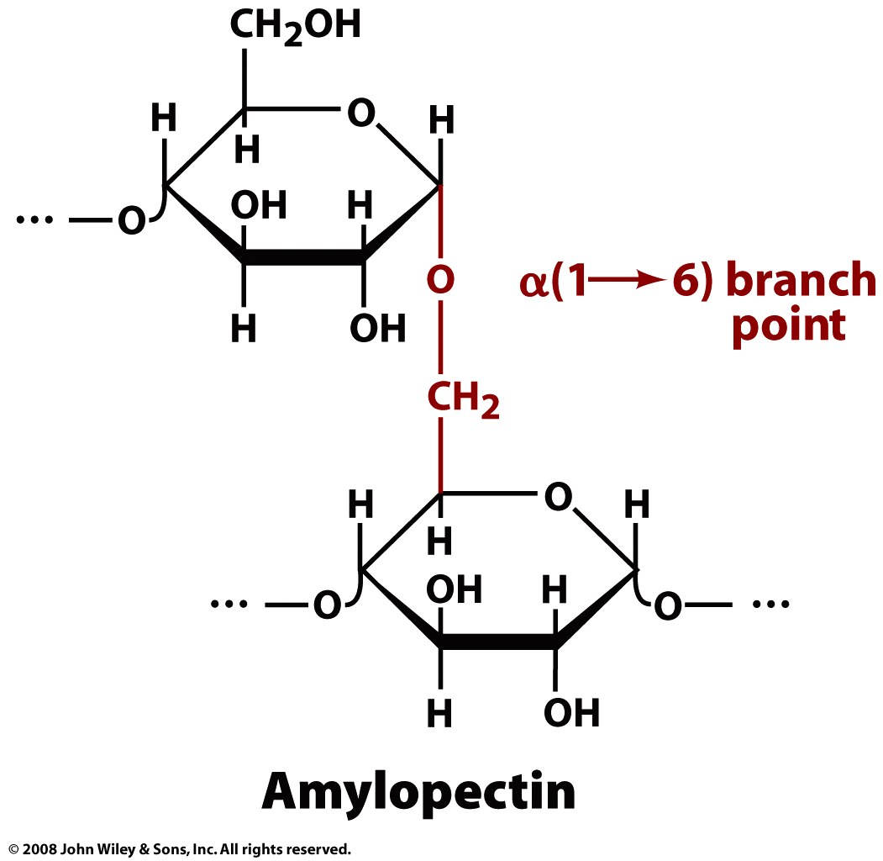
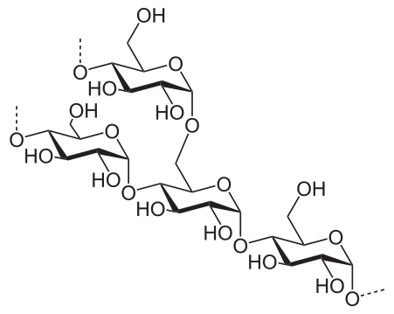
Amylopectice branches with α(1→6) bonds, every ~26 residues (glucoses).
Animals that eat plants (like us) produce the enzyme amylase, that hydrolyzes amylose.
Glycogen also branches with α(1→6) bonds, every ~10 residues.
Page 231

Slide 18
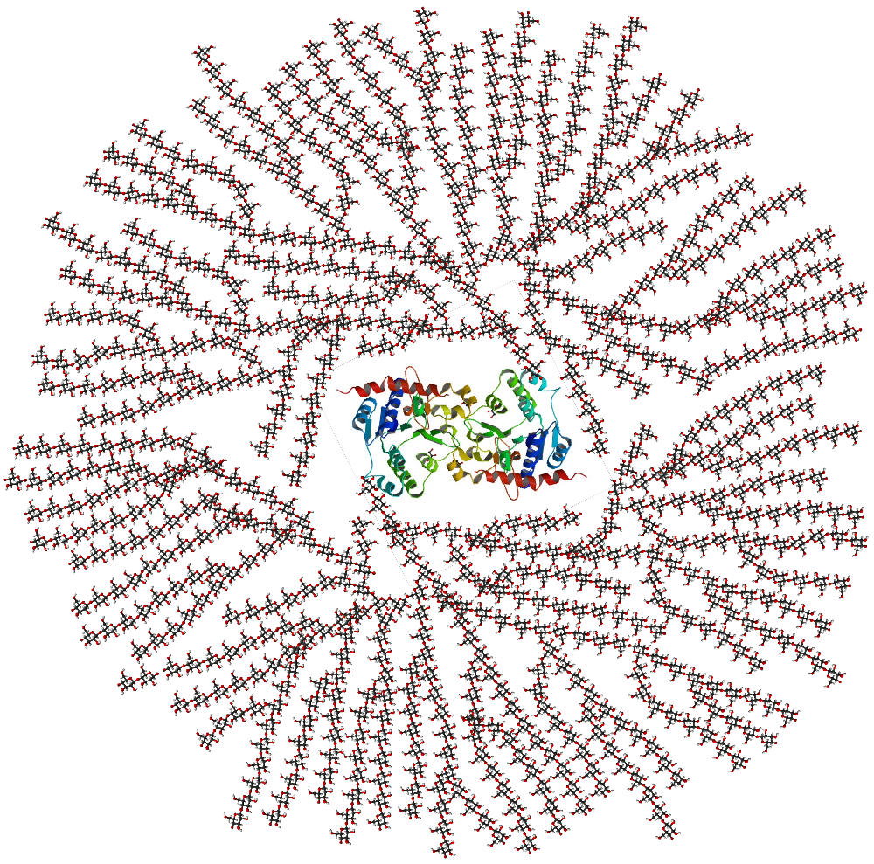
Glycogen
Your body stores chemical energy (glucose). This is a schematic 2-D cross-sectional view of glycogen. A core protein of glycogenin is surrounded by branches of glucose units. The entire globular granule may contain approximately 30,000 glucose units. Enzymes release glusose by chewing in from the ends.
This is from Wikipedia which apparently obtained it from E. Meléndez-Hevia, R. Meléndez and E. I. Canela (2000) "Glycogen Structure: an Evolutionary View", pp. 319–326 in Technological and Medical Implications of Metabolic Control Analysis (ed. A. Cornish-Bowden and M. L. Cárdenas), Kluwer Academic Publishers, Dordrecht

Slide 19
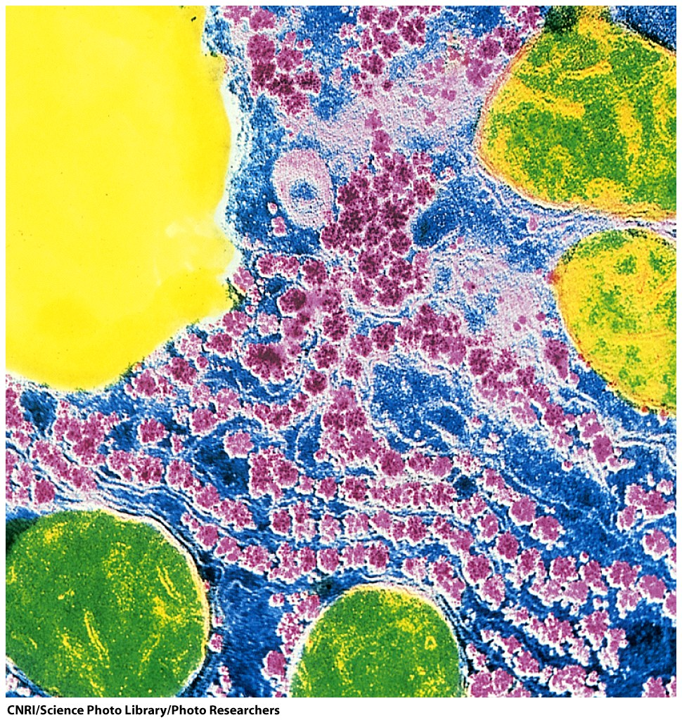
Glycogen granules in the liver (pink spheres).
Figure 8-11

Slide 20
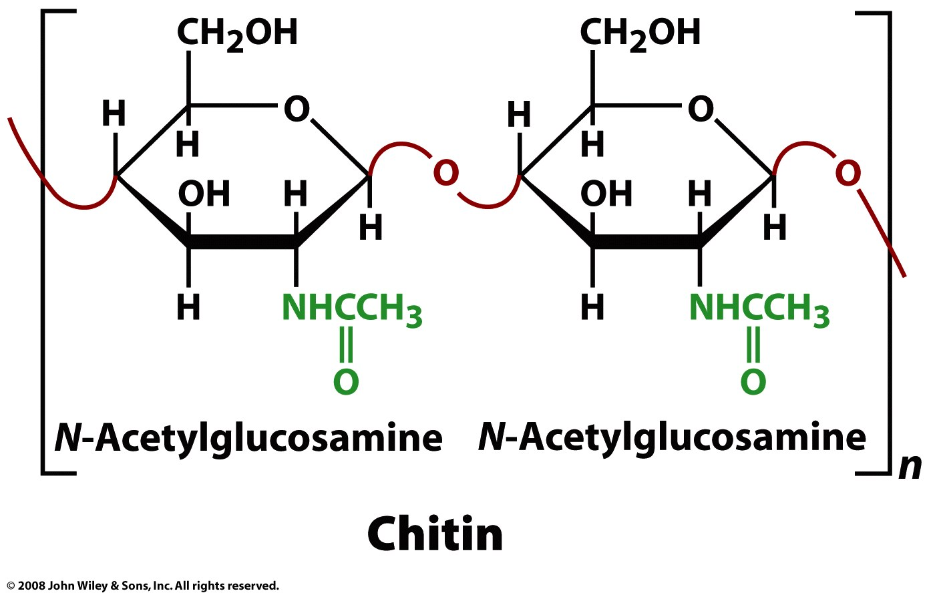
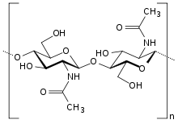
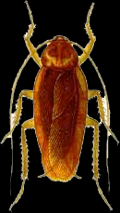
Same as cellulose except the 2-hydroxyl groups are replaced with acetyl amine (to give N-acetylglucosamine).
Chitin is cellulose with one hydroxyl group on each sugar replaced with an acetyl amine group.
Chitin is translucent and leathery. Modification and mineralization cause it to harden.

Slide 21
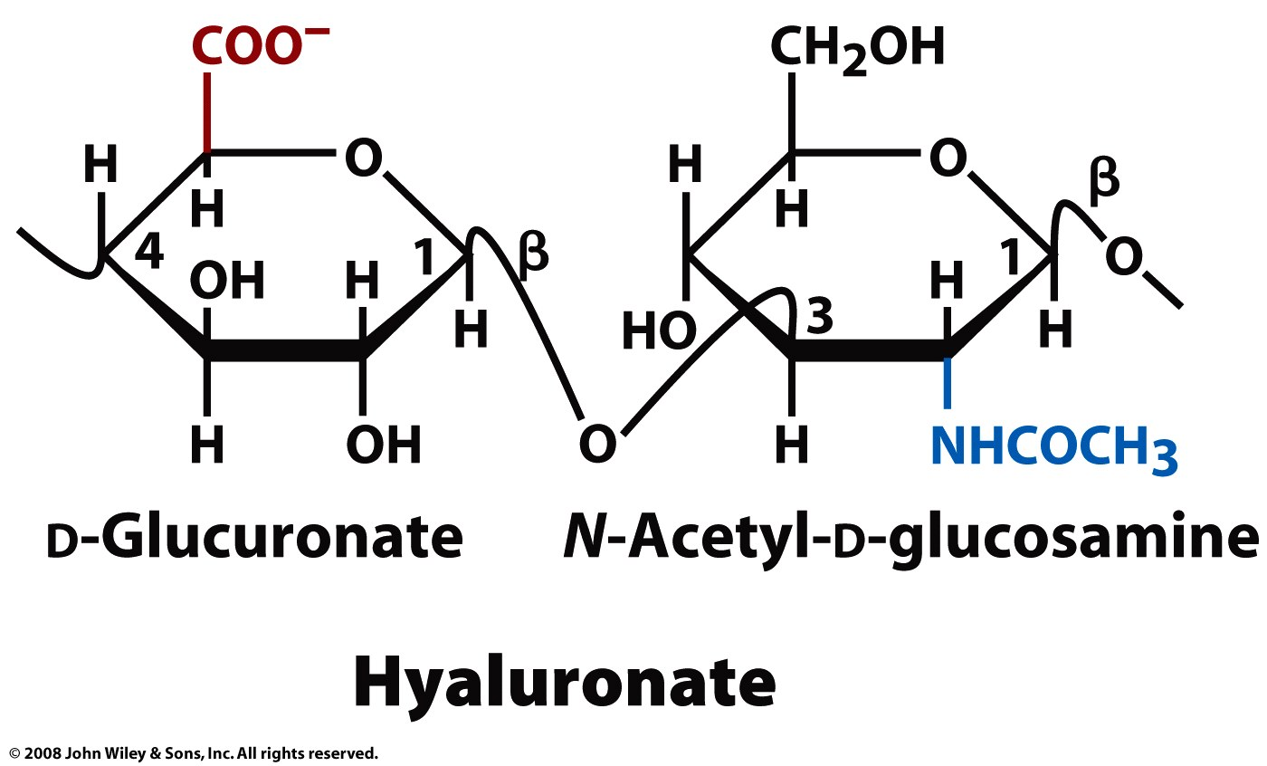
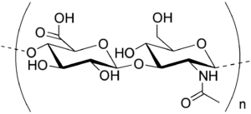
Glycosaminoglycans (GAGs)
Hyaluronate – (D-glucuronic acid + D-N-acetylglucosamine, with alternating β-1,4 and β-1,3 linkages) found in connective, epithelial, and neural tissues.
a component of cartilage, it coats each cell (chondrocyte),
imbibes water contributes to the resilience of cartilage (resistance to compression),
a major component of skin,
lubricates joints.
contributes to tissue hydrodynamics and movement,
rigid and extended, and can align under shear stress.
can have molecular weight reaching millions

Slide 22
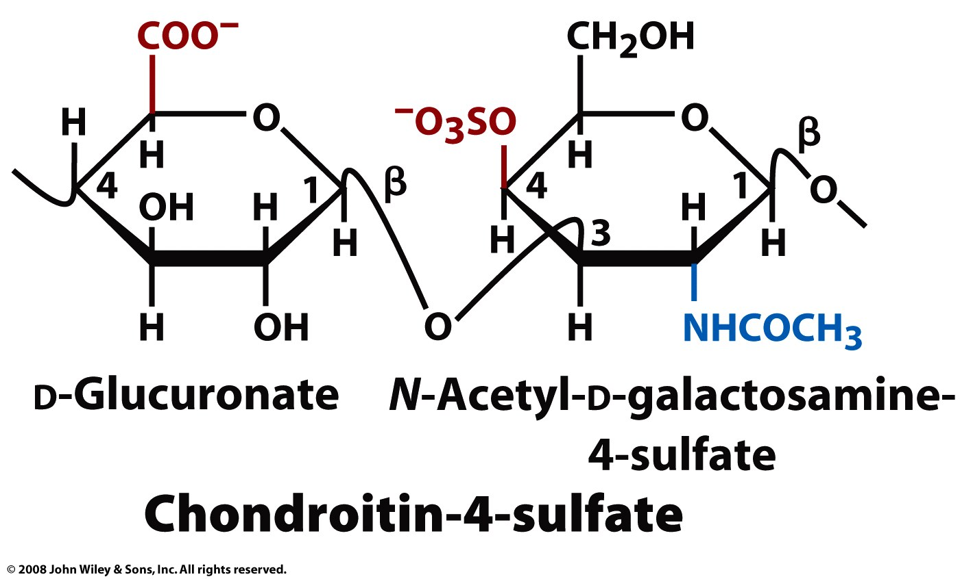
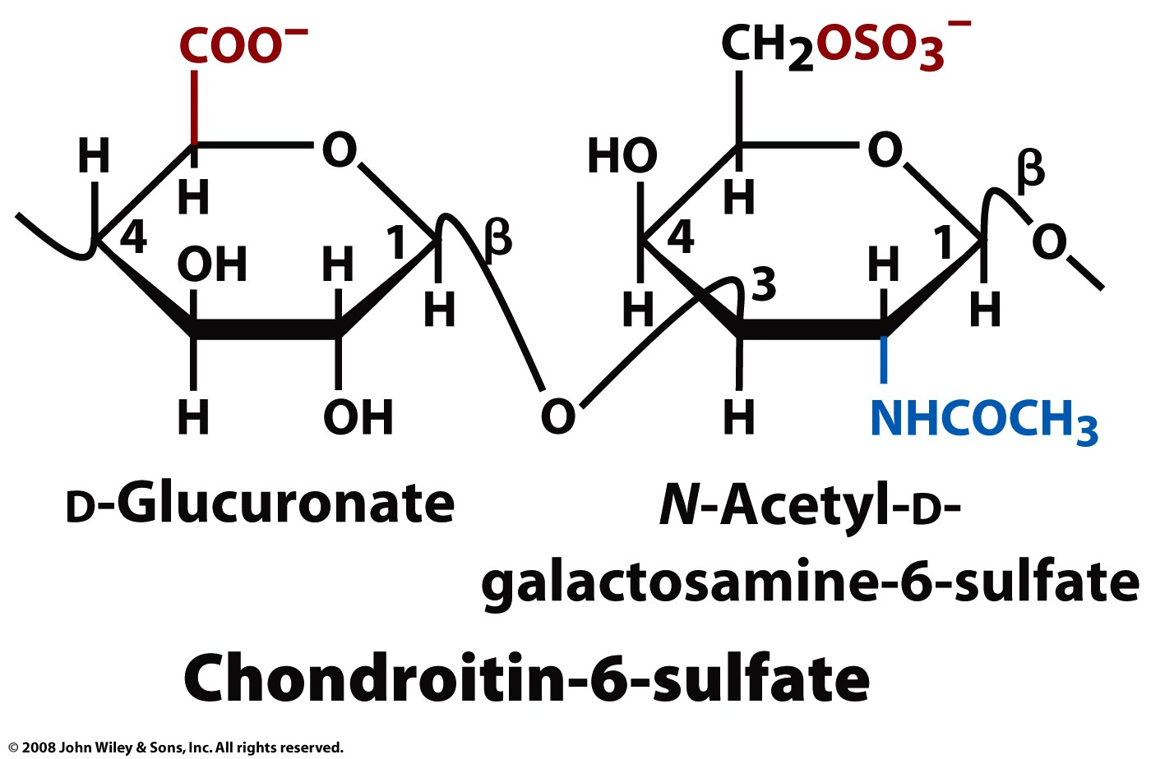
Glycosaminoglycans (GAGs)
Sulfonated glucosaminoglycans
Chondroitin sulfate: Linear chain of alternating N-acetylgalactosamine and glucuronic acid - attached to protein. A component of cartilage that gives resistance to compression.
Figure 8-12 part 2

Slide 23
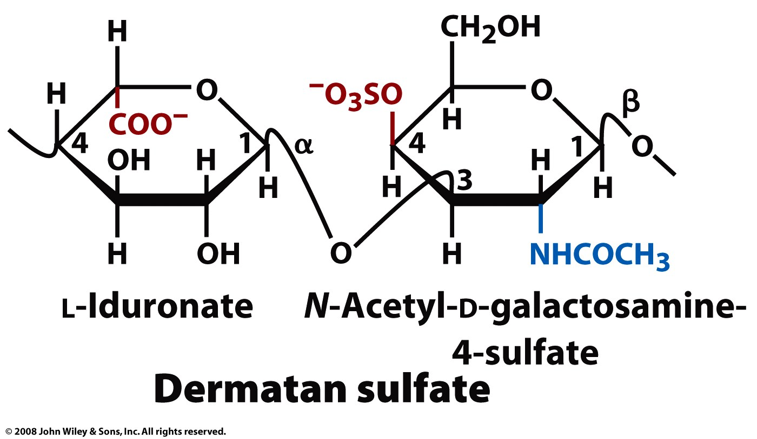
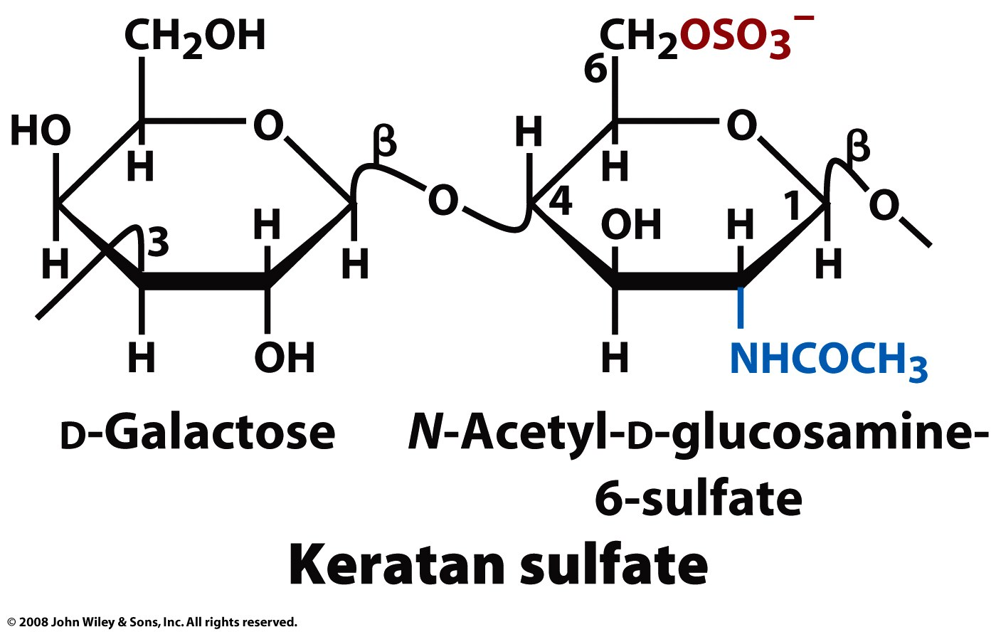
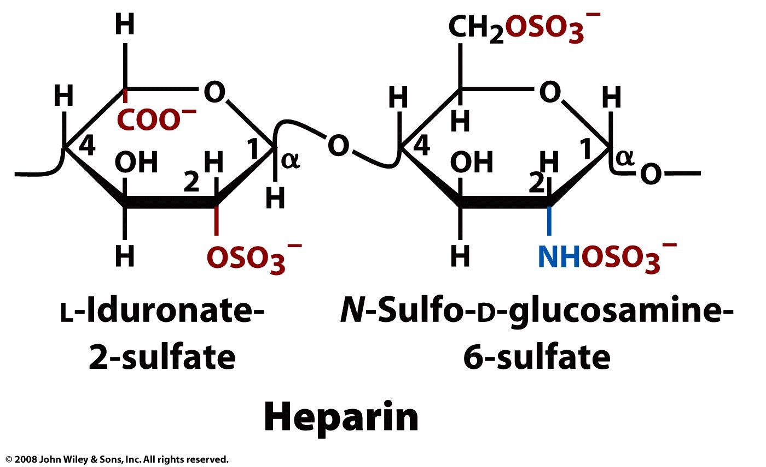
Heparin - a clotting inhibitor, has the highest negative charge density of any biological macromolecule (except polypyrophosphate).
Dermatan Sulfate – function?
Keratan Sulfate – in joints, cornea, cartilage, and bone - can act as a cushion to absorb mechanical shock.

Slide 24
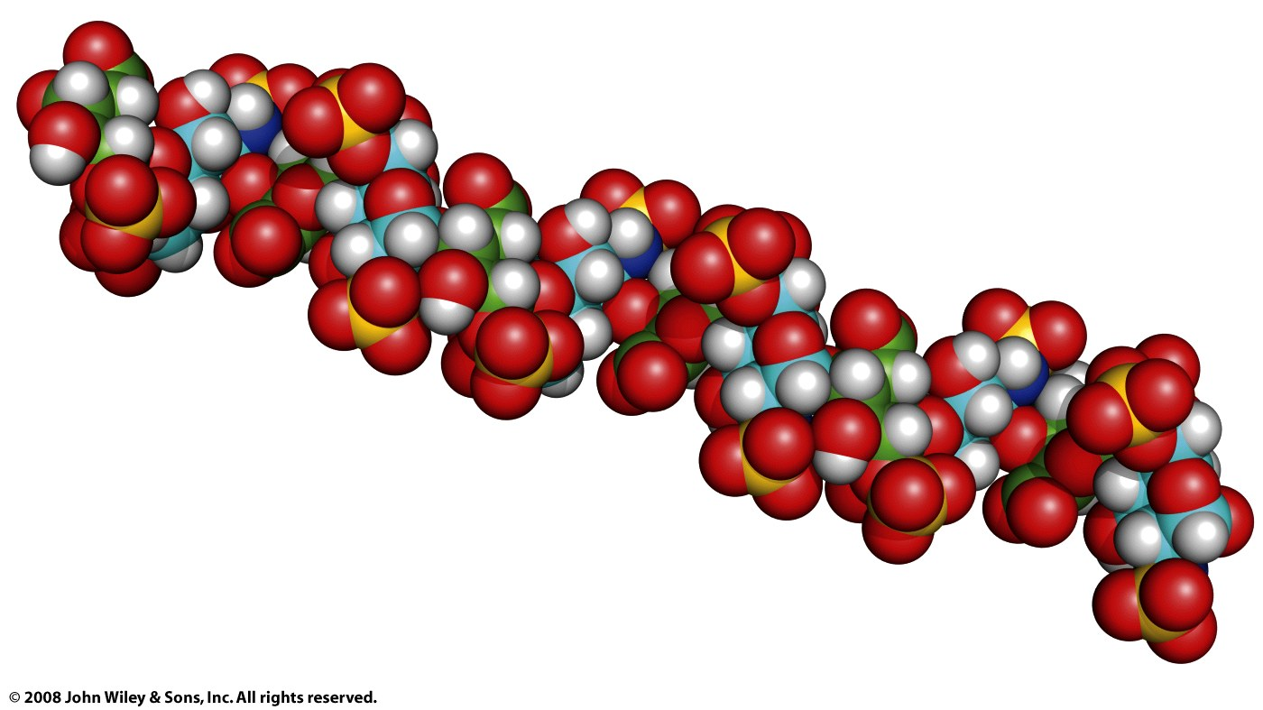
Figure 8-13

Slide 25
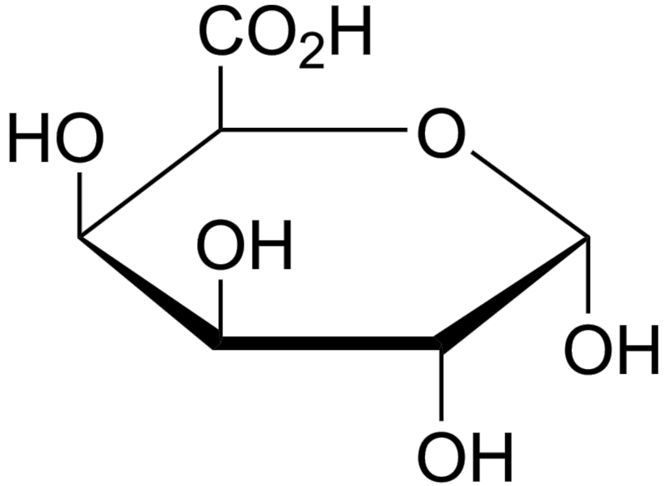
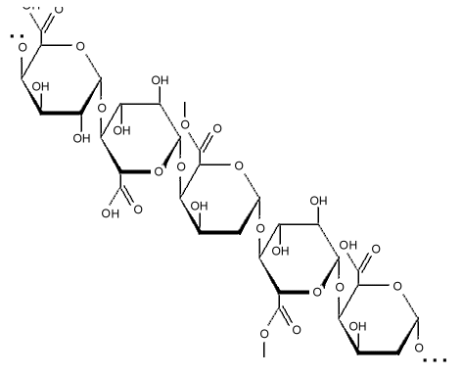
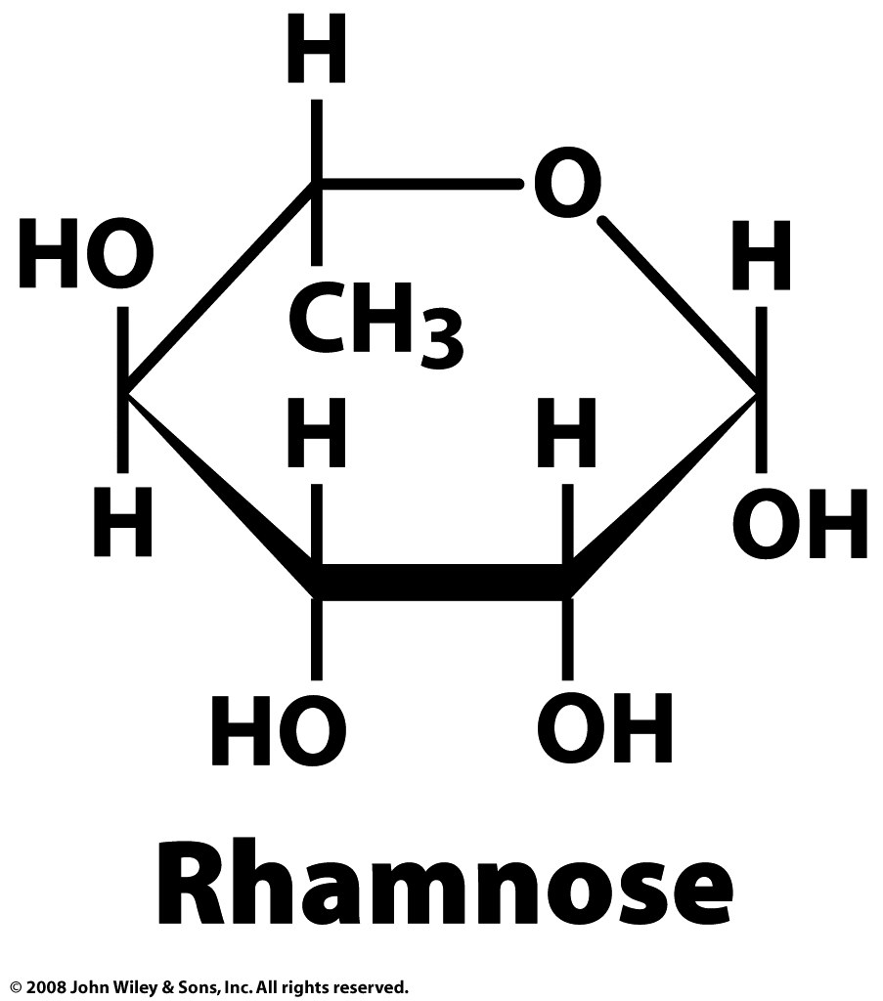
Pectins - are important components of plant cell walls, contain 1,4-linked α-D-galactosyluronic acids interspersed by rhamnoses.
Rhamnose - methyl-pentose (a 6-deoxy-hexose), is contained in pectins.

