Slide 1
Biological Membranes
Membranes
are bilayers
are formed by two layers of phospholipid/sphingolipid/etc
are two-dimensional liquids
enclose and separate aqueous compartments
are selective barriers (water and ions cannot pass)
contain small molecules (cholesterol, etc)
contain large molecules (proteins)

Slide 2
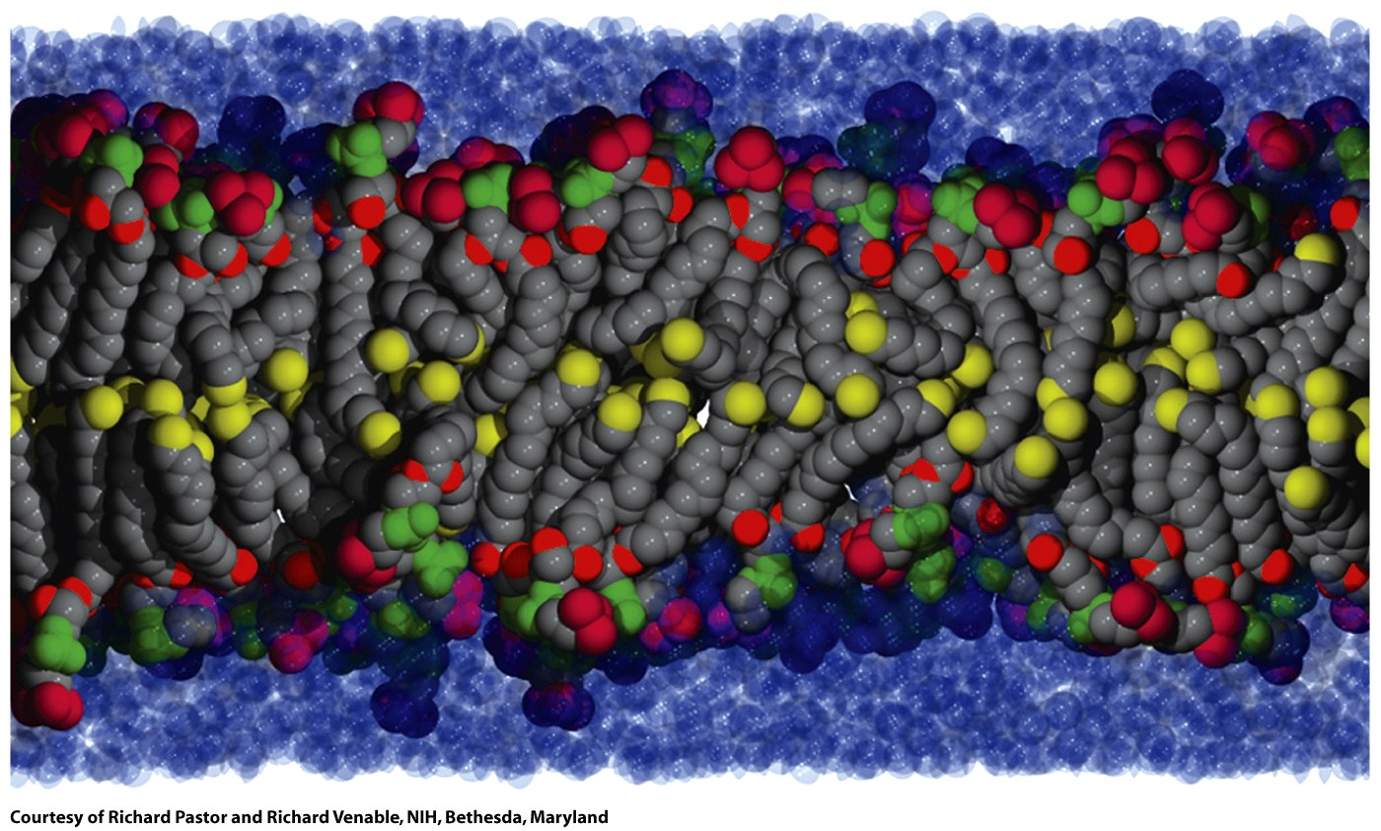
A biological bilayer is fluid, dynamic and disordered. Here the terminal carbon atoms are yellow.
Figure 9-17

Slide 3
Membrane Proteins
can be up to half of the mass the membrane
transport ions and metabolites across membranes
transport proteins and RNA across membranes
send and receive chemical signals
propagate electrical impulses
attach cells to each other
anchor other proteins to specific locations in the cell
regulate intracellular vesicular transport
Control membrane lipid composition
organize and maintain shapes of organelles and cells

Slide 4
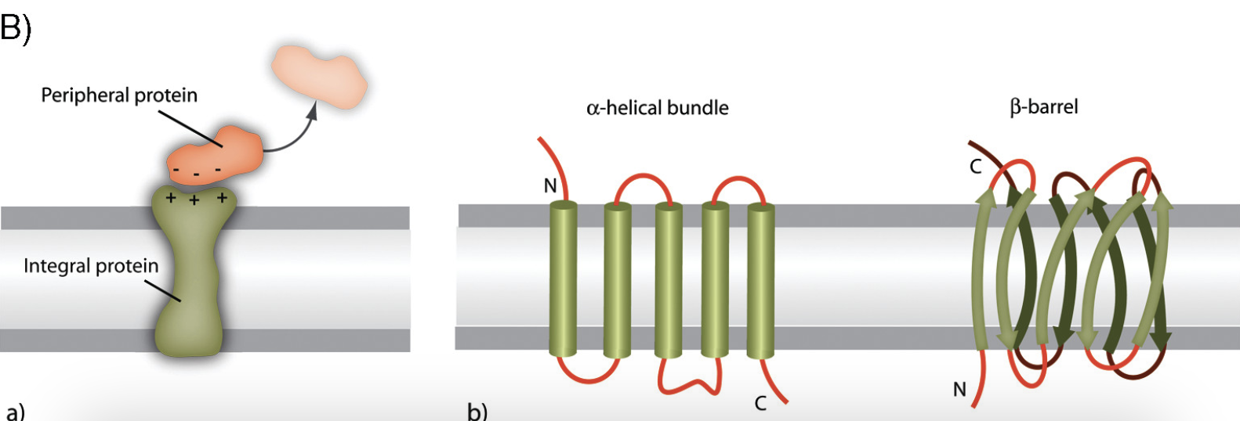
Membrane proteins can be peripheral or integral. Integral membrane proteins come in two flavors: α-helical bundles and β-barrels.

Slide 5
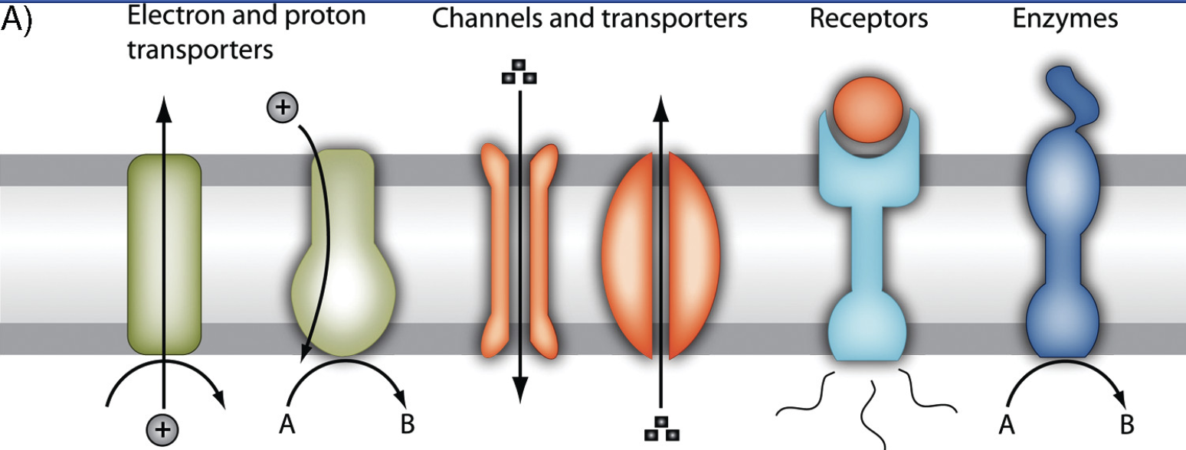
Membrane proteins are involved in
energy transport during photosynthesis or respiration,
transport of molecules across membranes,
transmission of chemical signals across membran
catalysis of chemical reactions.

Slide 6
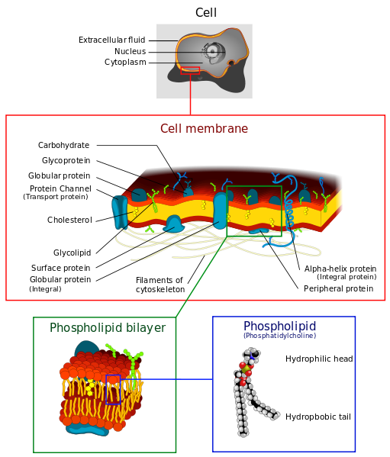
from wikipedia

Slide 7
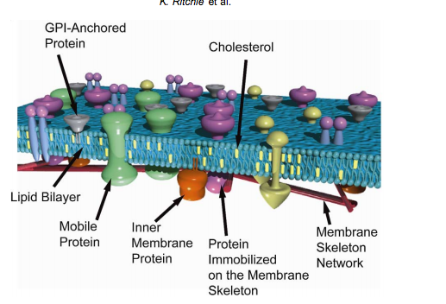
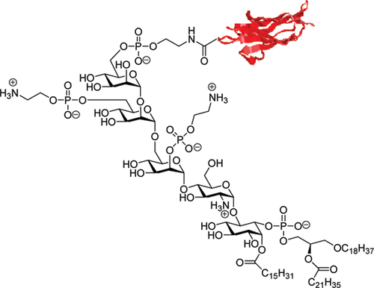
GPI:
Glycosylphosphatidylinositol
Molecular Membrane Biology, 2003, 20, 13/18

Slide 8
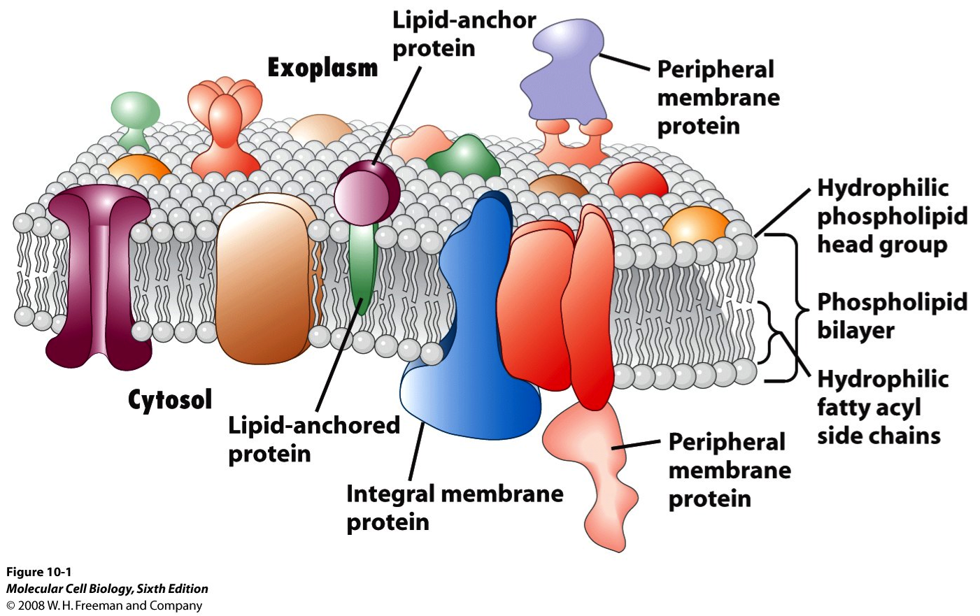

Slide 9
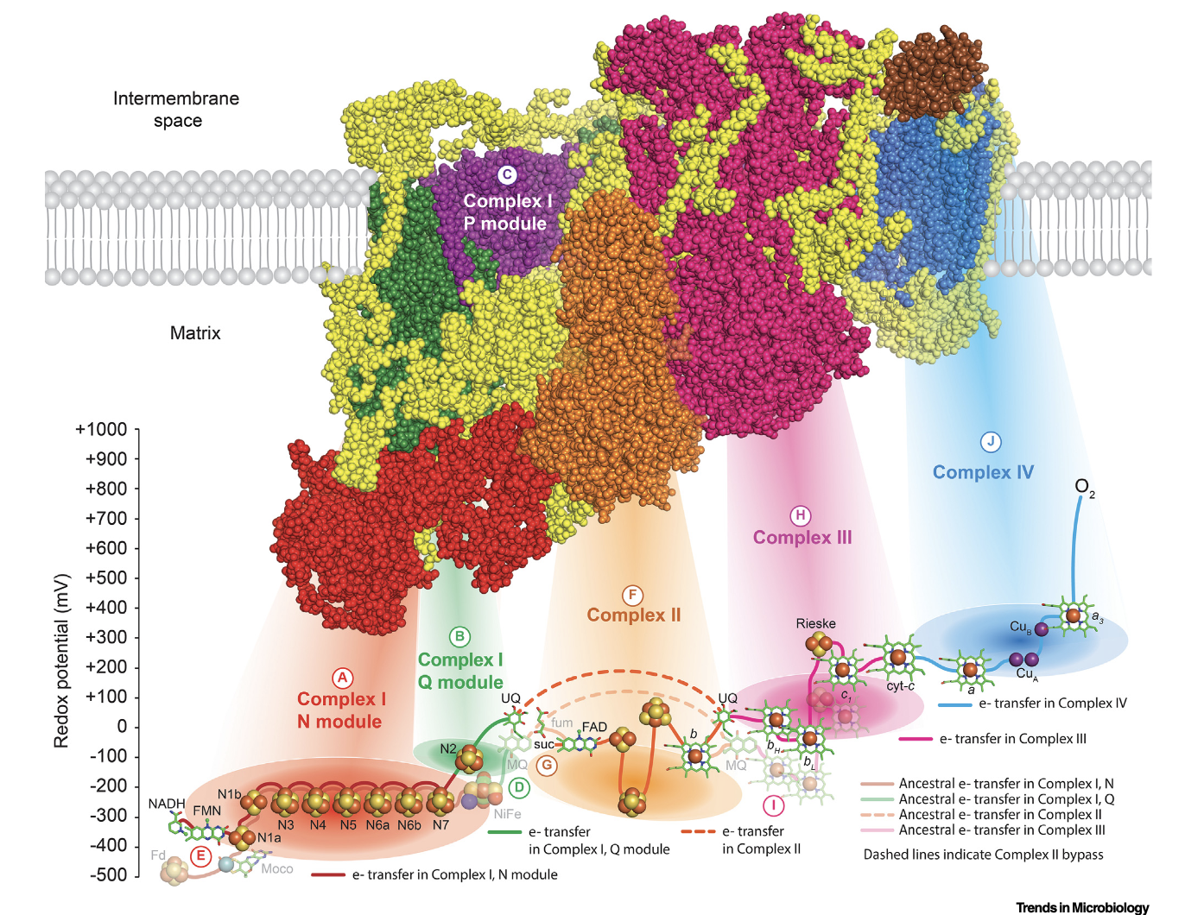

Slide 10
Membrane Potentials
Membrane redox potential refers to differences in the electron transfer potential between the inside and outside of the membrane. The inside of a cell is more reductive than the outside of a cell.
Membrane chemical potential refers to differences in chemical concentrations between the inside and outside of the membrane. A high concentration of glucose a cell drives transport of glucose across membrane.
Membrane electrostatic potential Is the difference in electrical charge between the inside and outside of the membrane. The inside of the cell has a negative potential compared to the outside, typically around -70 mV. A net negative charge inside a cell is related to negatively charged DNA, RNA, membranes, etc, and the efflux of positively charged potassium ions.

Slide 11
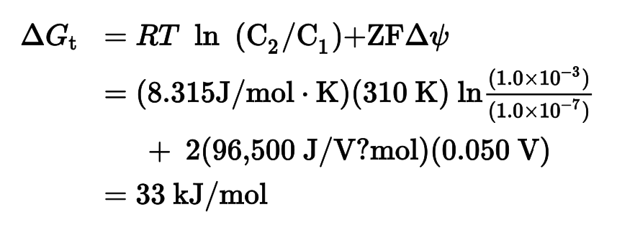
The driving force (ΔG) for ion transport out of a cell, across the membrane, has two parts
(1) the effect of the concentration gradient (chemical potential)
(2) the effect of voltage difference (electric potential)
$$ΔG_{t}= RT ln\left(\frac{C_{inside}}{C_{outside}}\right){+ ZFΔψ}$$
For Ca²⁺
$${∆G}_{t}= RT ln\left(\frac{{10}^{−7}}{{10}^{−3}}\right){+2 x \frac{6,500 J}{V}\left(0.05\frac{V}{mol}\right)}=33 kJ/mol$$
Both terms are > 0,
Ca²⁺ does not spontaneously flow out of a cell ${∆G}_{t}>0$.
Ca²⁺ spontaneously flows into a cell.
What happens if the concentration outside the cell decreases from 10⁻⁷ to 10⁻⁸ M?
$$ΔΔG_{t}= RT ln\left(\frac{C_{outside initial}}{C_{outside final}}\right){=RT ln} \frac{{10}^{−7}}{{10}^{−8}} =RT\ln\left(10\right)>0$$
The ΔG of transfer from inside to outside becomes larger (less favorable)

Slide 12
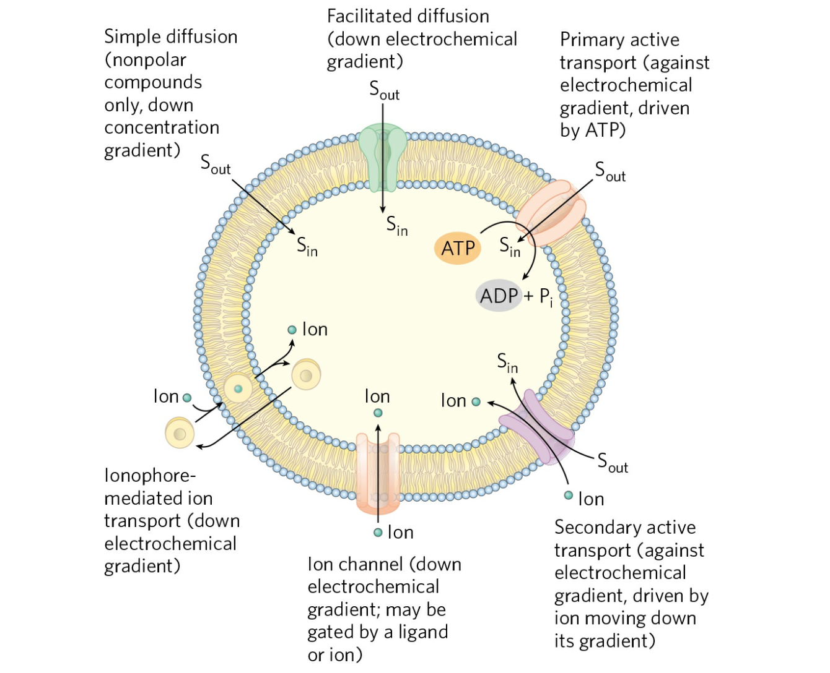

Slide 13
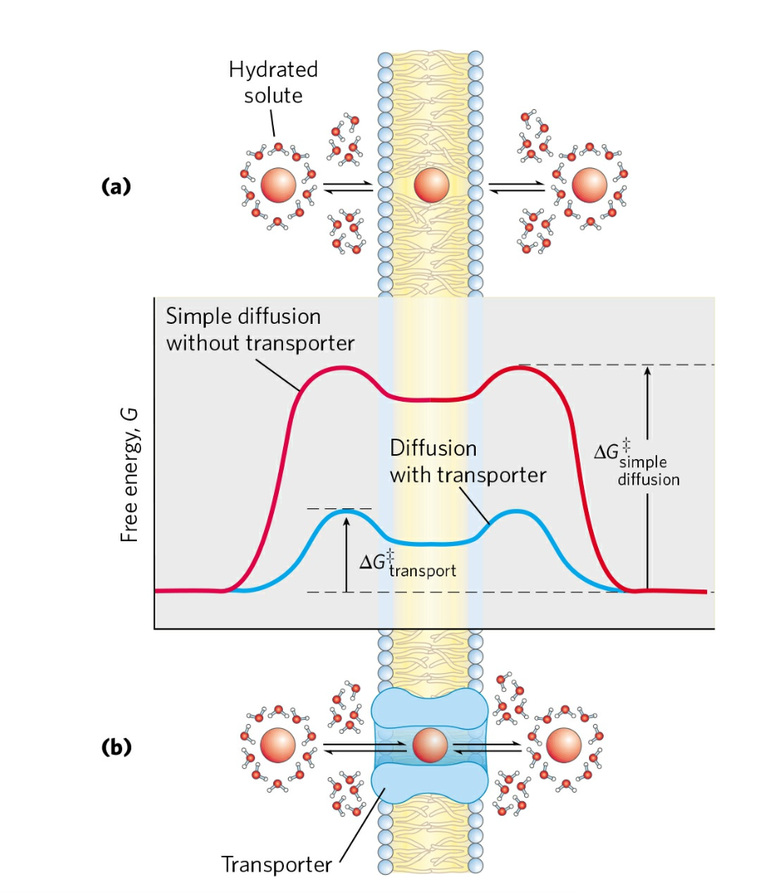

Slide 14
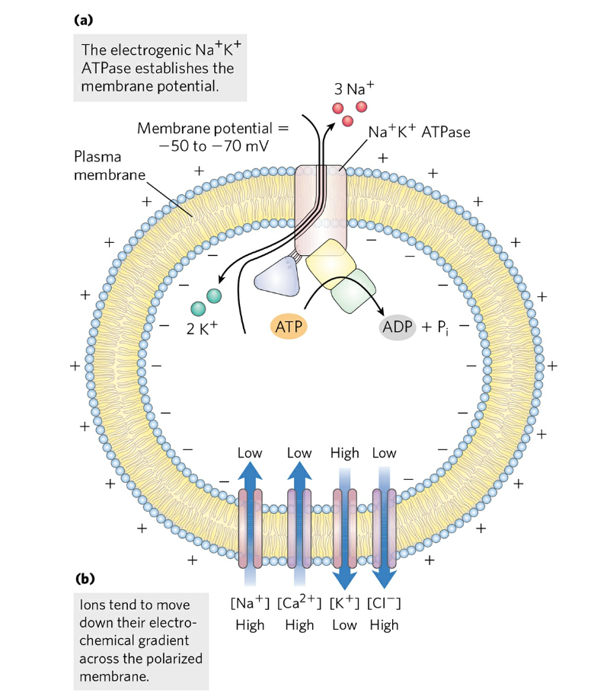
The Na⁺/K⁺-ATPase
Each cycle:
Exports 3 Na⁺.
Imports 2 K⁺.
Exports net 1 positive charge.
Hydrolyzes 1 ATP
The result:
extracellular concentration sodium ions 5x the intracellular concentration,
intracellular concentration of potassium ions 30x the extracellular concentration
Negative electrical potential inside the cell
Cells expend a large fraction of their ATP (30%, up to 70% in nerve cells) to maintain Na⁺/K⁺ gradients

