Slide 1
Lipids:
Molecules that are hydrophobic or amphiphilic
fatty acids,
Trigycerides (fatty acids + glycerol),
phospholipids,
sphingolipids,
saccharolipids,
polyketides,
sterols,
prenols,
peptides (sometimes).

Slide 2
Amphipaths (aka Amphiphiles)
An amphiphath is schizophrenic molecule with both hydrophilic (water soluble) and hydrophobic (lipophilic) character.
amphiphaths have distinct molecular regions.
One or more hydrophobic tail(s) - sometimes hydrocarbon (non-polar, cannot form hydrogen bonds, water insoluble).
A hydrophilic head group - polar (alcohol) and/or charged (ammonium, carboxylate, phosphate, sulfate, and sulfonates).
Surfactants are amphiphaths.
Surfactants form aggregates in water with a hydrophobic core (tails) and a hydrophilic surface (head groups), which is in contact with surrounding water.
Examples of surfactants
soap [Na⁺ or K⁺ salt of a fatty acid (carboxylic acid with aliphatic tail)]
detergent (Na⁺ or K⁺ salt of a sulfonate with aliphatic tail)
phospholipid
lipoprotein

Slide 3
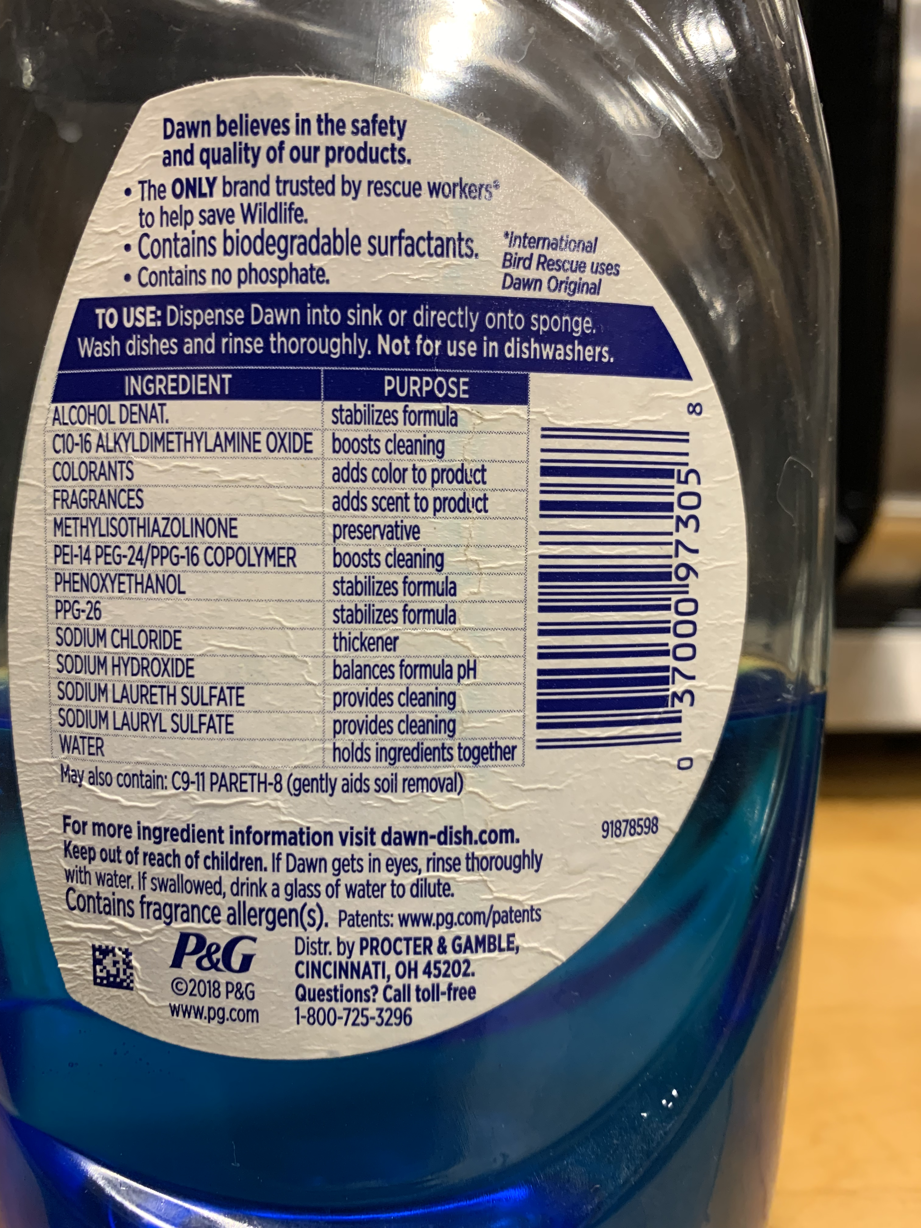
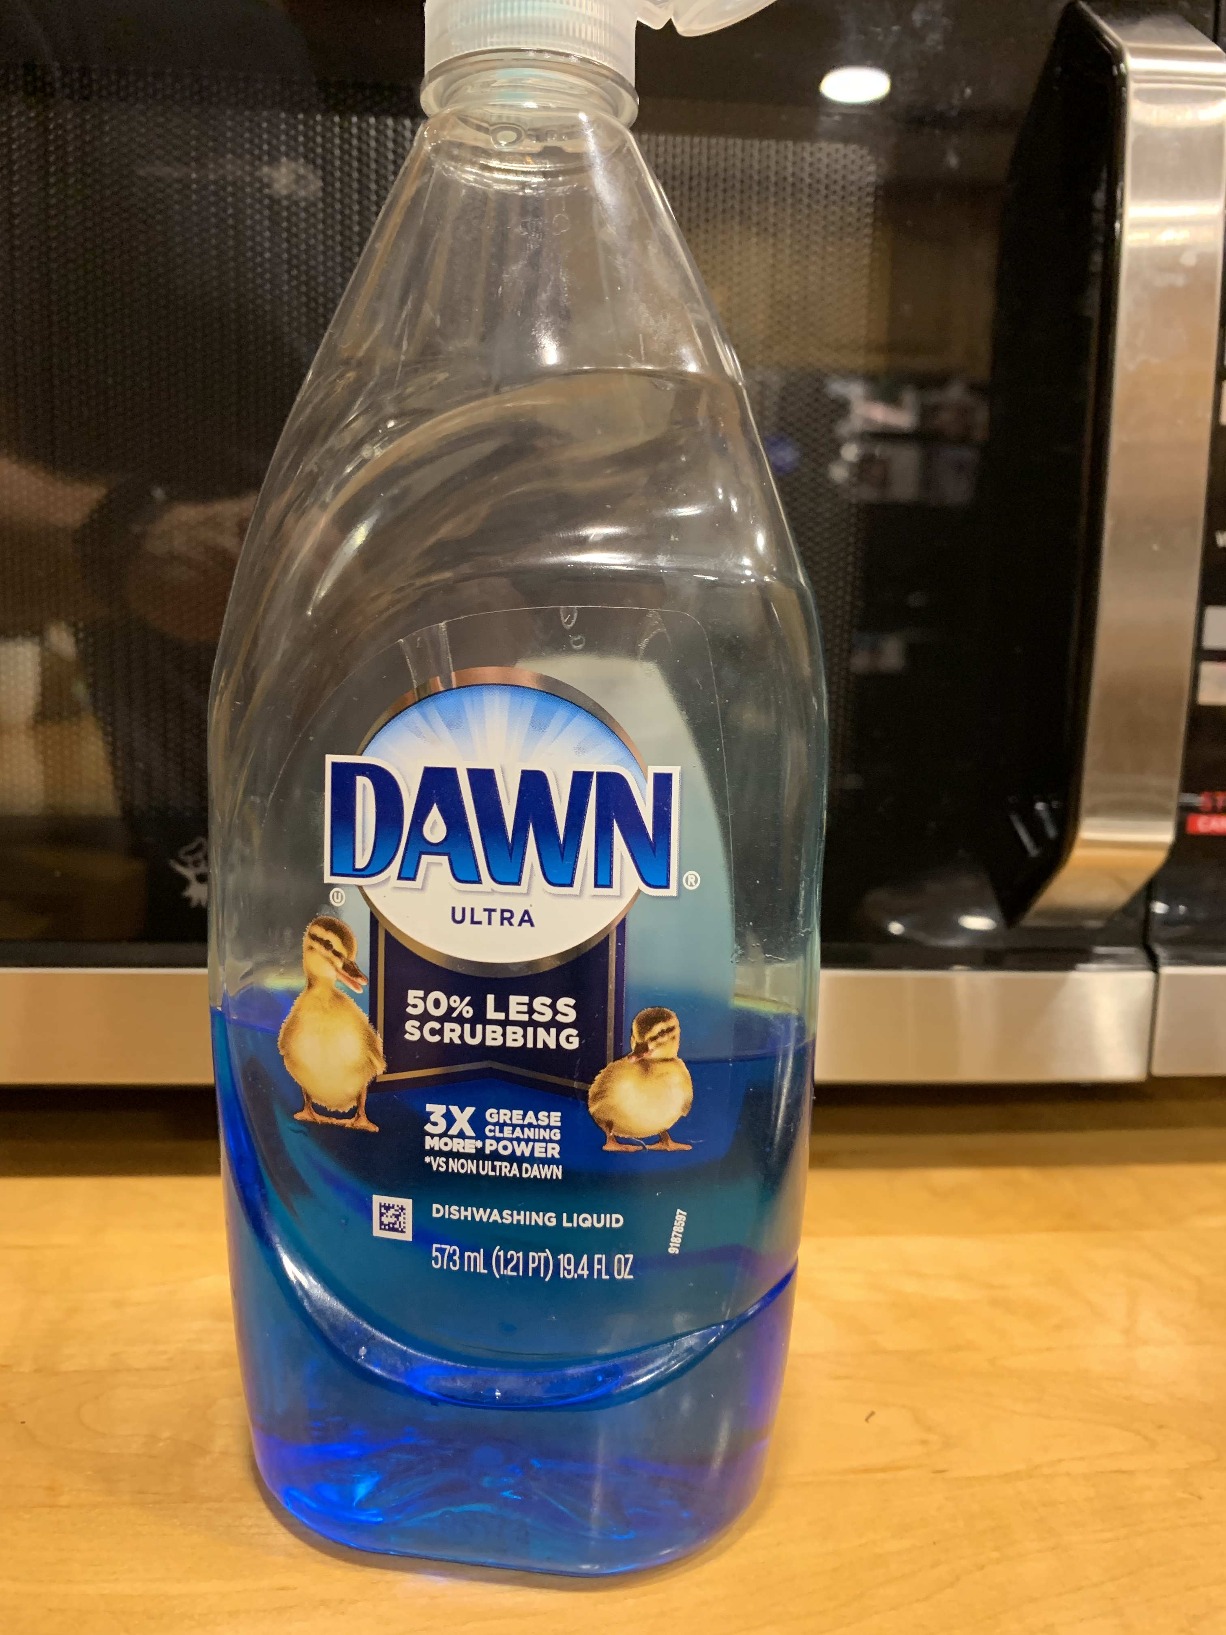

Slide 4
Amphiphile in dish soap:
Sodium dodecyl sulfate (SDS or NaDS) =
AKA Sodium lauryl sulfate (SLS)
12-carbon hydrophobic alkyl chain attached to a sulfate group.

Slide 5
Sodium dodecyl sulfate (SDS or NaDS) =
sodium lauryl sulfate (SLS)
12-carbon hydrophobic alkyl chain attached to a sulfate group,
Amphiphile in dish soap:
Sodium laureth sulfate =
Sodium lauryl ether sulfate (SLES)
SLES is less irritating to skin and eyes than SDS.

Slide 6
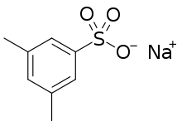
Hydrotrope v Surfactant
Hydrotropes:
Amphiphaths with high HLB (hydrophilic/lipophilic balance).
Hydrotropes typically have small tails. Hydrotropes don’t form assemblies (except a high concentration) but do increase solubilities of hydrophobic molecules in water.
Surfactants:
Amphiphaths with low HLB (hydrophilic/lipophilic balance).
Surfactants typically have long alkyl tails (C8–C20).
Surfactants form assemblies.

Slide 7
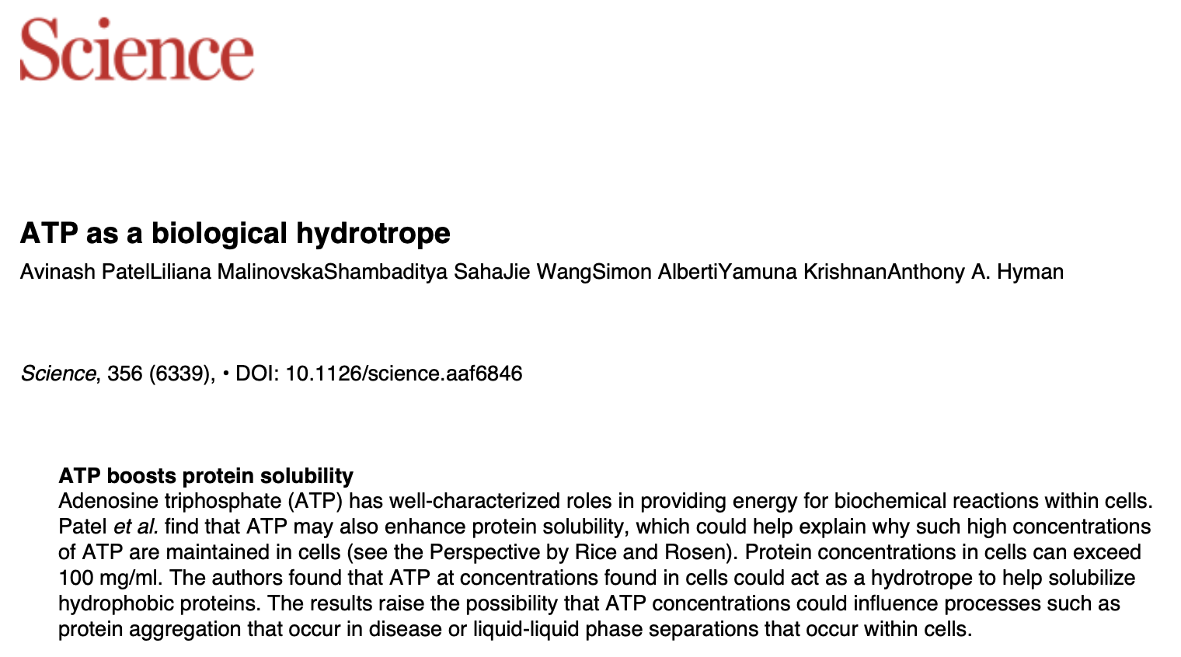

Slide 8
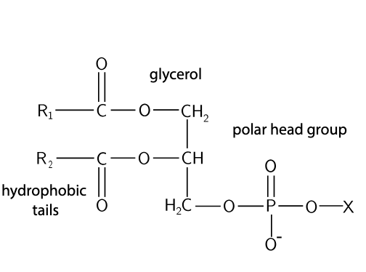
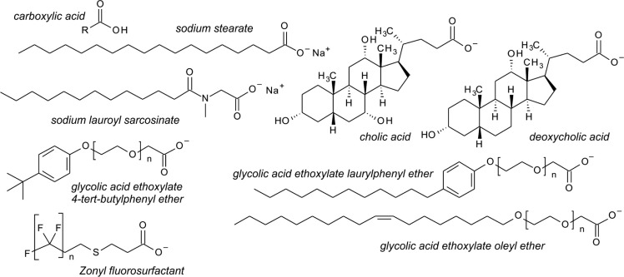
Amphiphaths

Slide 9
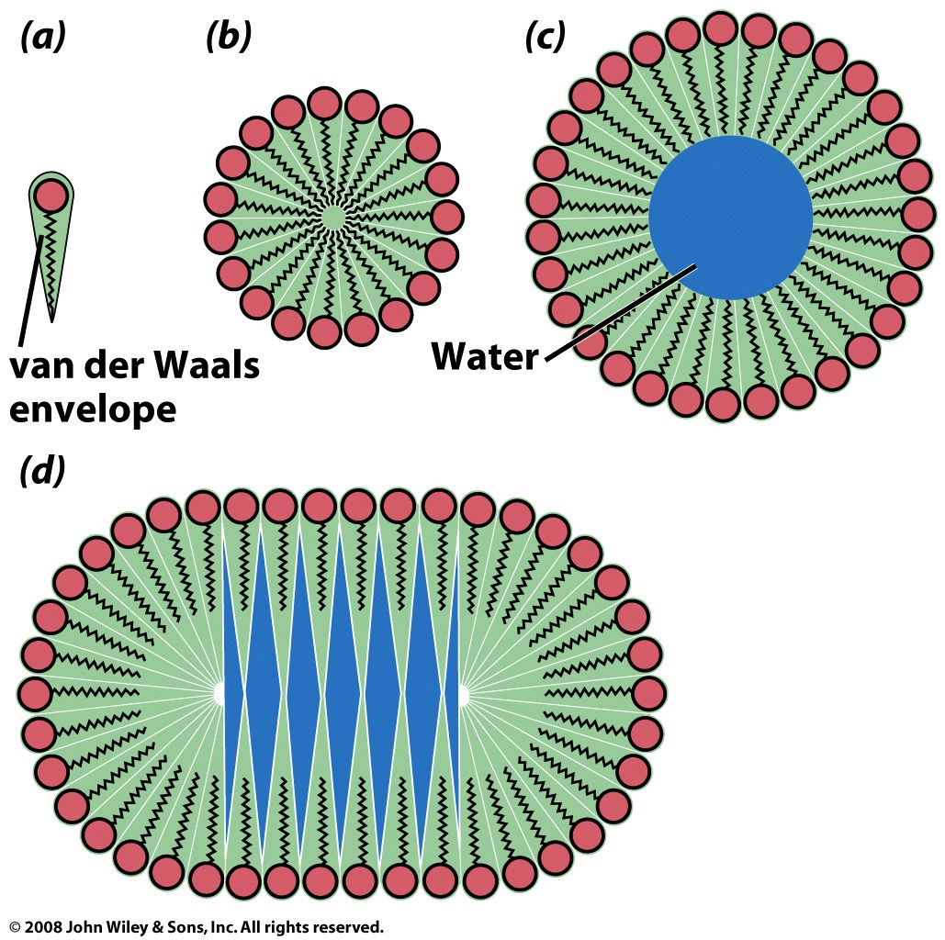
The shape of an amphiphile determines the type of assembly
unfavorable
single-tailed amphipaths
unfavorable

Slide 10
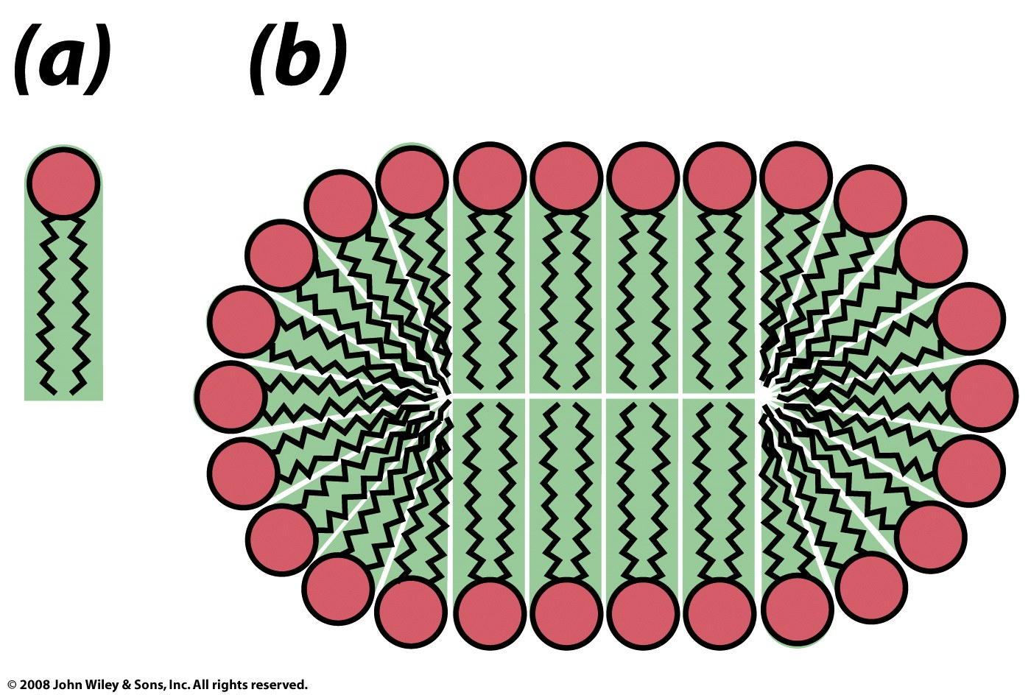
two-tailed amphipaths
Figure 9-14

Slide 11
Lipid Bilayers
A lipid bilayer is a thin membrane formed by two layers of phospholipid/sphingolipid/etc. The membrane is a flat sheet with polar surfaces that sandwich a hydrophobic core. A membrane can form a continuous barrier that is impermeable to most hydrophilic molecules and ions.
The cell membranes of almost all living organisms and many viruses are made of a lipid bilayers, as are the membranes surrounding the cell nucleus and other organelles.
The cell membrane (plasma membrane) separates the interior of a cell from the outside.

Slide 12
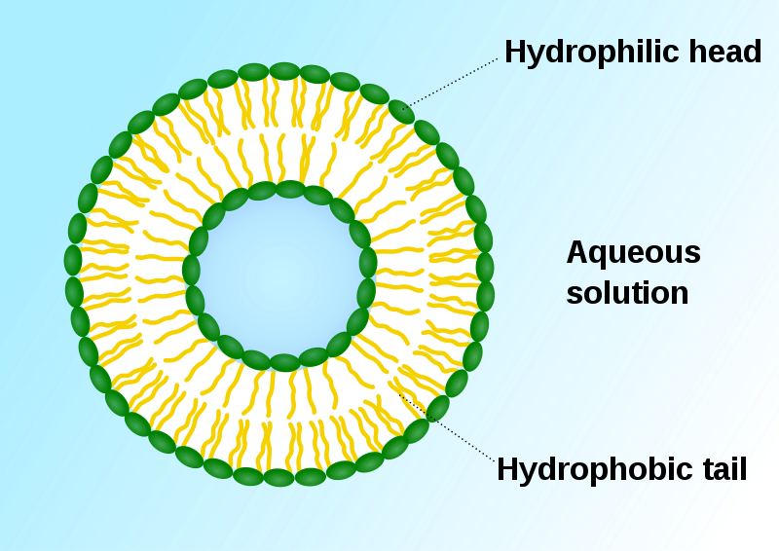
Lipid Bilayers; liposome
A liposome, with an inside and an outside: formed by phospholipids in an aqueous solution. Green: polar head groups.

Slide 13
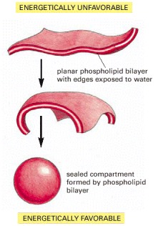
Amphipathic bilayers self-assemble in water.
Hydrophobic interactions are the primary driving force for assembly.
Exposed edges are unstable.
liposome
Molecular Biology of the Cell. 4th edition.
Alberts B, Johnson A, Lewis J, et al.
New York: Garland Science; 2002.

Slide 14
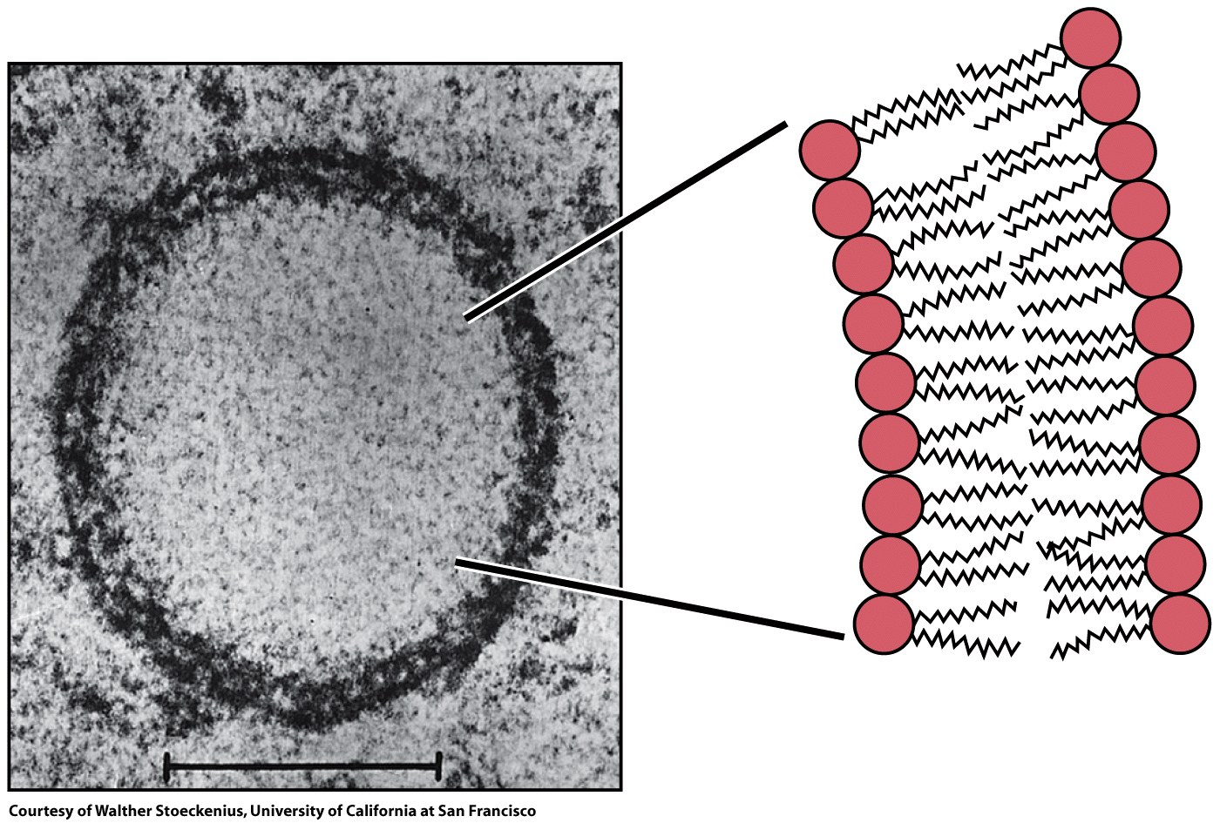
Figure 9-15

Slide 15
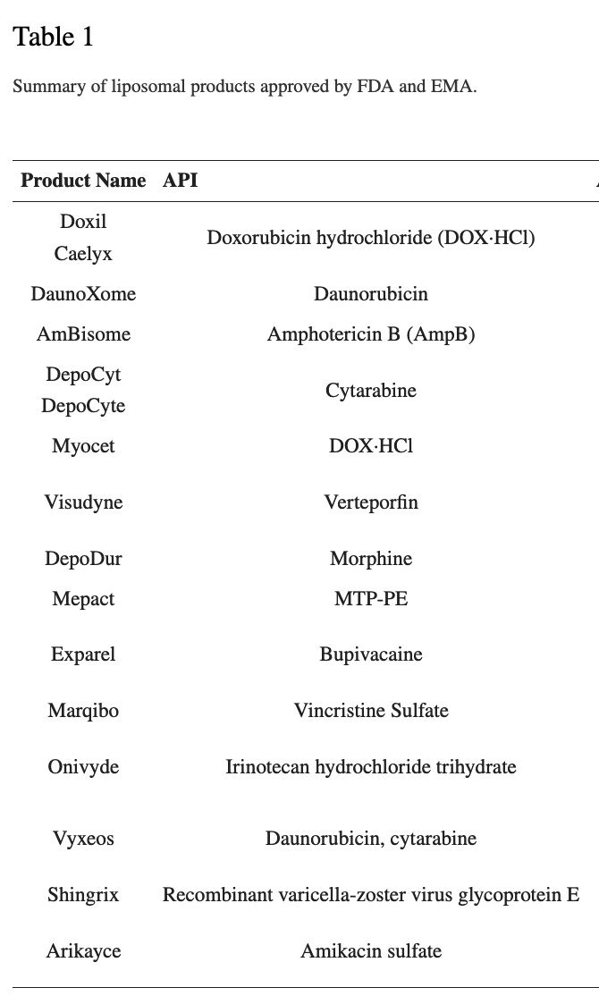
Liposomal Drug Delivery

Slide 16
Glycerophospholipids
Phospholipids are the major components of cell membranes
(in bacteria and eukarya, but not in archaea).
Made of
fatty acids
glycerol 3-phosphate
head groups

Slide 17
Fatty Acids
Carboxylic acids with hydrocarbon chains
4 to 36 carbons long (C4 to C36)
saturated fatty acids contain no C=C bonds
PUFAs (poly unsaturated fatty acids) contain C=C bonds
C=C bonds are always cis
Have a wide spectrum of biological functions
energy storage
structure (cell membranes in phospholipids)
precursors of hormones and bile salts,
facilitate absorption of fat-soluble vitamins (vitamin A)

Slide 18
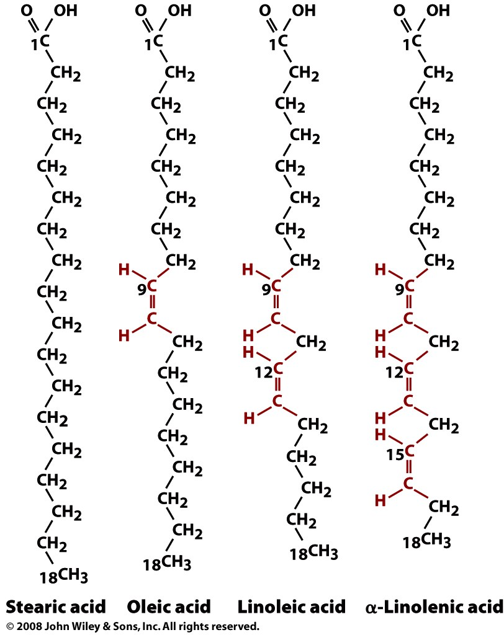
anions at physiological pH
Carboxylic acids of long chain hydrocarbons,
Amphipaths
Double bonds are always cis in biological fatty acids.
saturated
unsaturated
unsaturated
unsaturated

Slide 19
Unsaturated Fatty Acids (with double bonds)
These double bonds are cis isomers, not trans, in biological systems.
Cis: adjacent hydrogen atoms are on the same side of the double bond.
Cis double bonds cause the hydrocarbon tail to bend, restricts conformational freedom*, and alters packing between chains.
More double bonds (more unsaturation) means more bending, and worse packing and greater mobility in the assembly.

Slide 20
Nomenclature 1;
the chain length
number of double bonds, separated by a colon.
Position od double bonds indicated by superscripted delta
eicosapentaenoic acid is 20:5(Δ^{5,8,11,14,17})
Nomenclature 2;
The carbon that is most distant from the carboxyl group—is called ω (omega) and is given the number 1 (C-1). The positions of the double bonds are indicated relative to the ω carbon.. PUFAs with a double bond between C-3 and C-4 are called omega-3 (ω-3) fatty acids, and those with a double bond between C-6 and C-7 are omega-6 (ω-6) fatty acids.
Eicosapentaenoic acid is referred to as an omega-3 fatty acid, emphasizing the biologically important double bond in the omega-3 position.

Slide 21
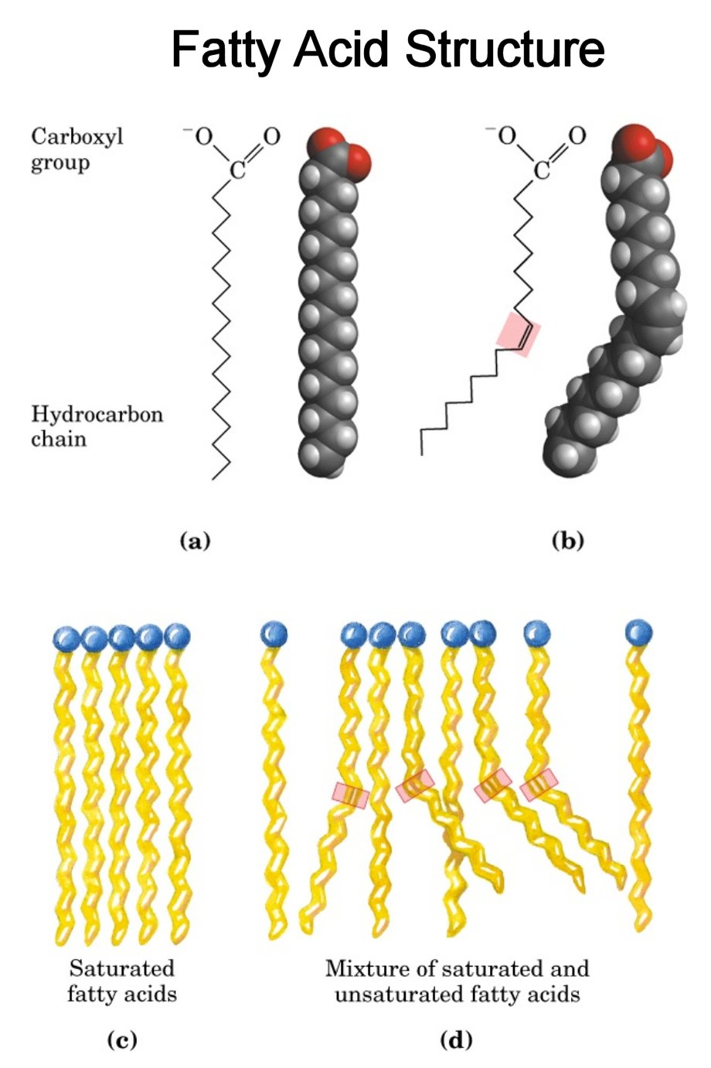
saturated
unsaturated

Slide 22
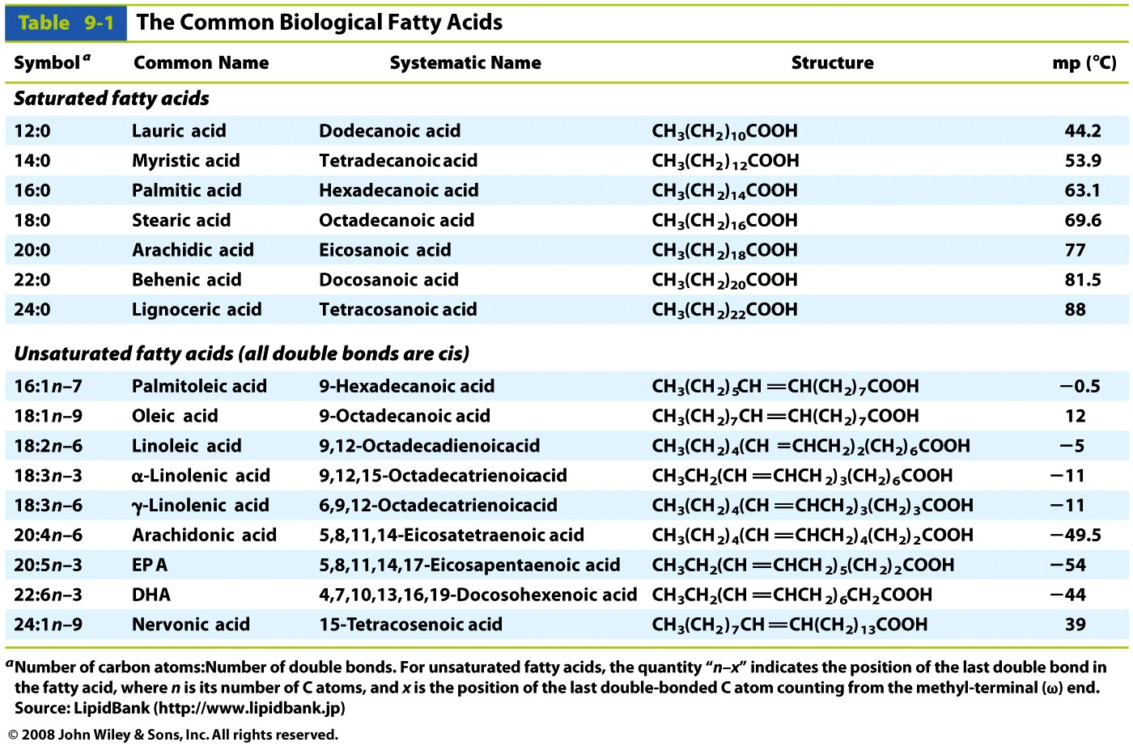
Table 9-1

Slide 23
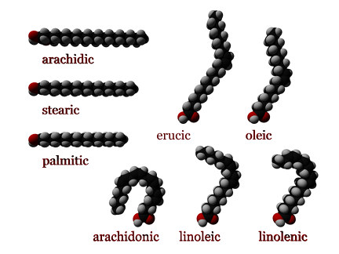

Slide 24
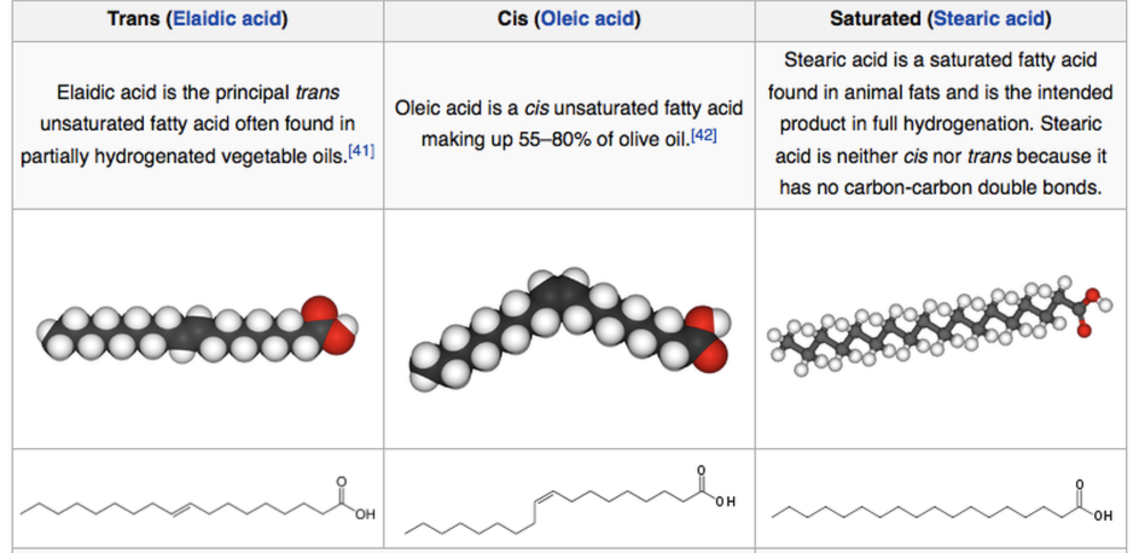
Trans fatty acids are made by industrial hydrogenation of vegetable oils. Trans fats are more robust and give superior performance in deep fryers

Slide 25
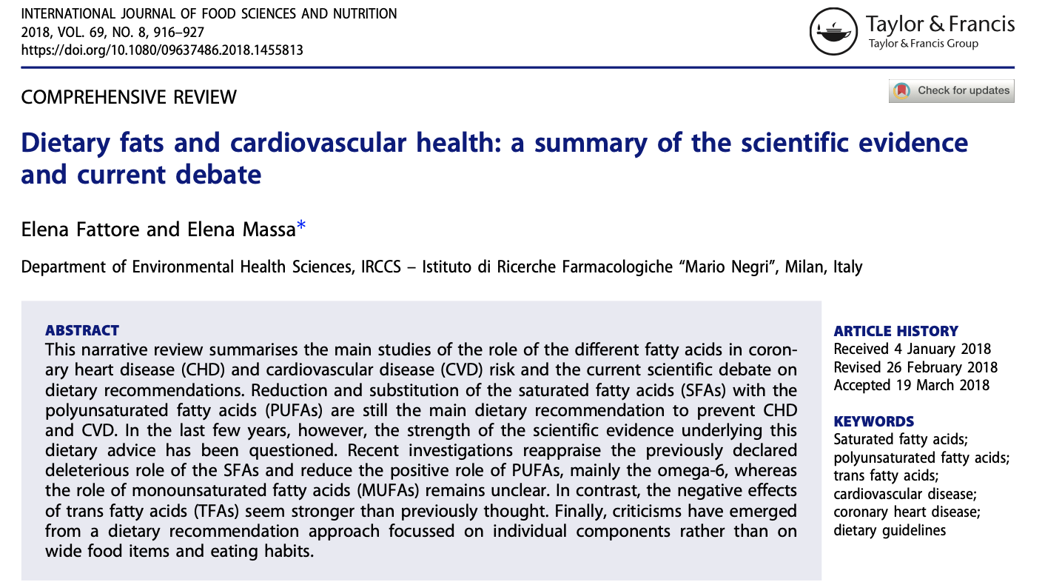
Food products can be listed as “0 grams of trans fats” if they contain less than 0.5 grams of trans fat per serving. Avoid “partially hydrogenated oils”.

Slide 26
Summary,
Polyunsaturated fatty acids (PUFA, have multiple cis double bonds) (healthy).
Saturated fatty acids (no double bonds) are (less healthy).
Omega-3 partially unsaturated fatty acids (double bonds near tail terminus) seem healthy; but effects not fully supported by recent meta-analyses of randomized controlled trials.
PUFAs are not chemically stable (turn rancid).
Hydrogenated fats are more stable
Industrially hydrogenated fats contain trans double bonds
(unhealthy).

Slide 27
Glycerol 3-phosphate
L-Glycerol 3-phosphate, the backbone of phospholipids.

Slide 28
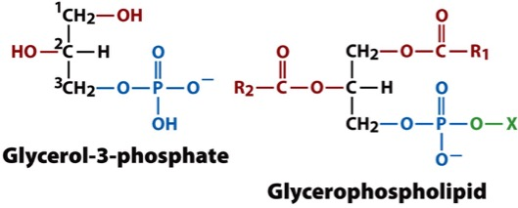
Glycerophospholipids
(fatty acids+glycerol 3-phosphate+head group)
Membrane lipids (amphipaths) in which two fatty acids are attached via ester linkages to the first and second carbons of glycerol, and a highly polar or charged group is attached through a phosphodiester linkage to the third carbon.

Slide 29
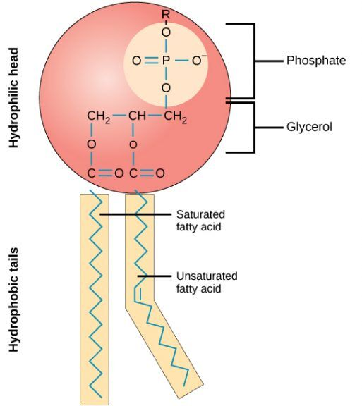
Glycerophospholipids generally contain a
C16 or C18 saturated fatty acid at C-1 of glycerol.
C18 or C20 unsaturated fatty acid at C-2 of glycerol.

Slide 30
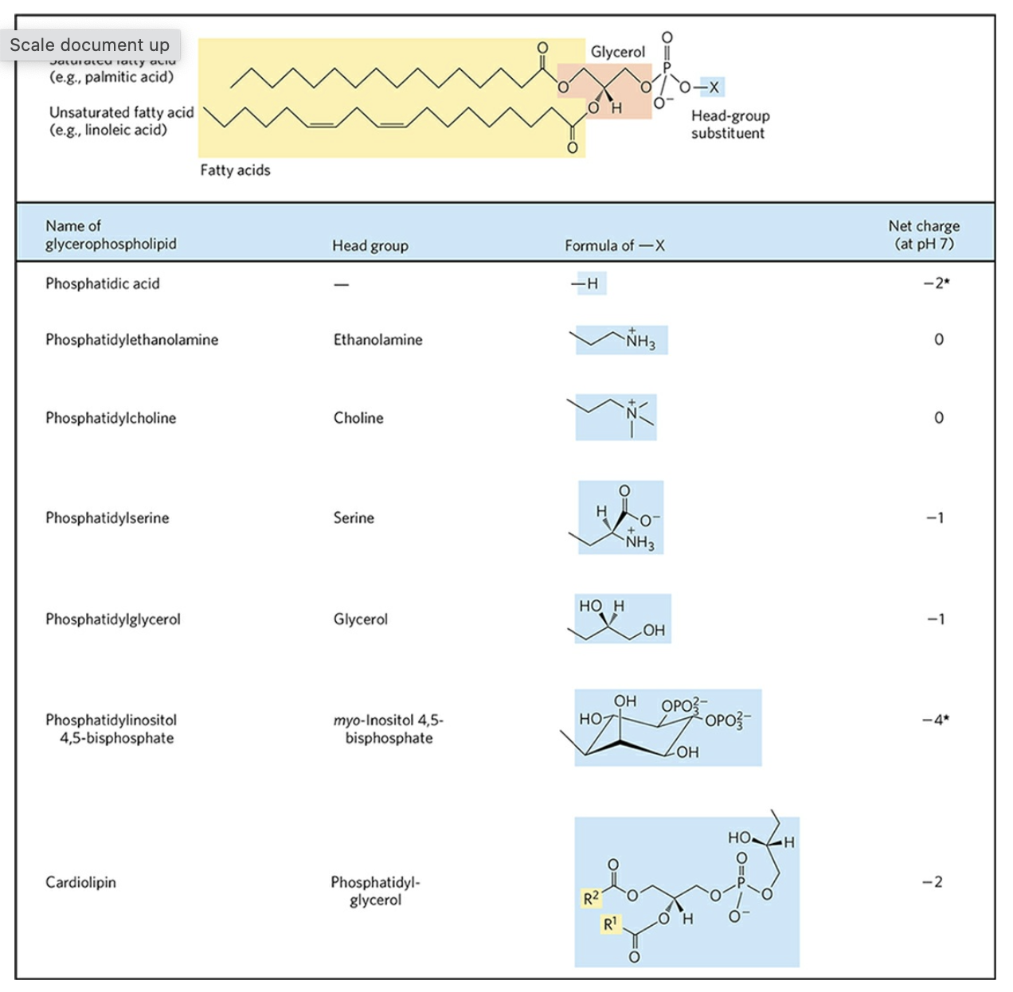
head groups
of
glycerol-
phospholipids

Slide 31
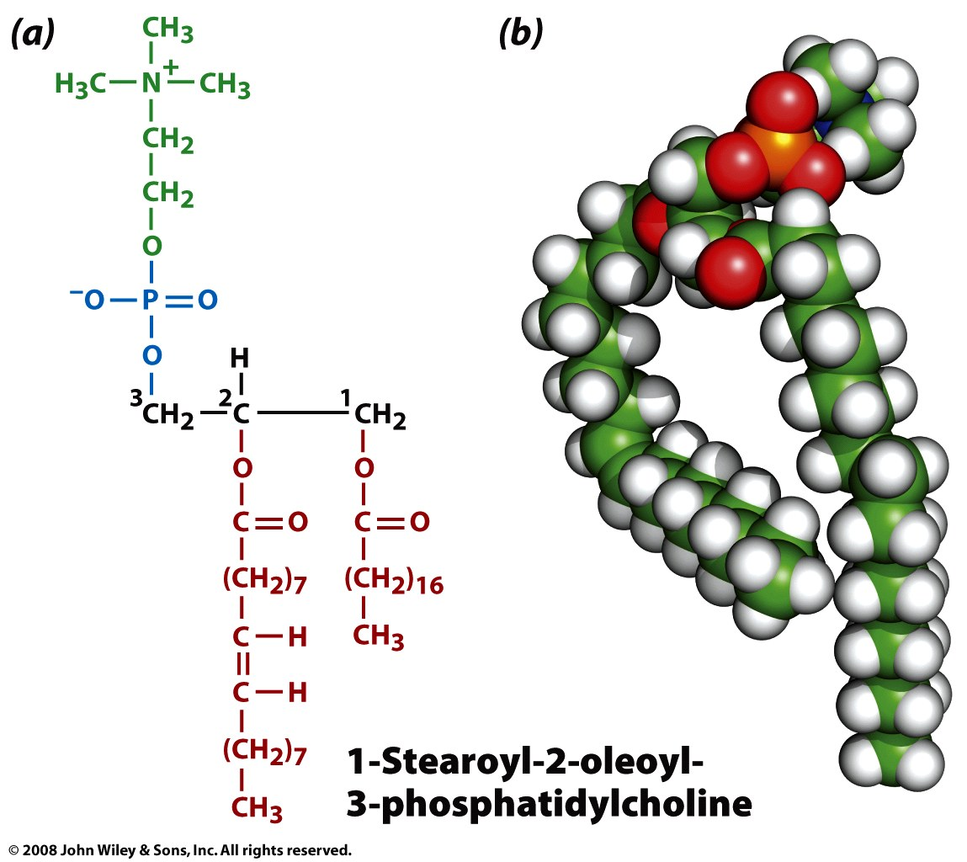
Example: Glycierophospholipid with choline headgroup

Slide 32
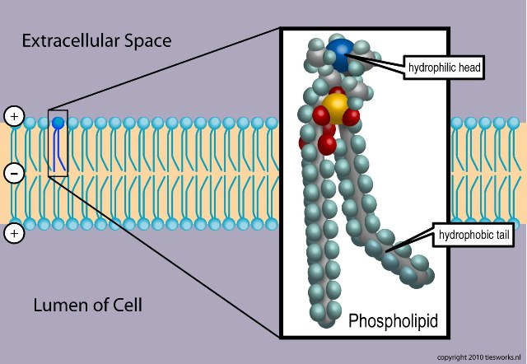

Slide 33
Phosphatidylcholines are the primary components of biological membranes in eukaryotes.
Phosphatidylethanolamine is found predominantly in nervous tissue such as brain and neural tissue and is the principal phospholipid in bacteria.
Phosphatidylethanolamine membranes are more viscous (less fluid) than phosphatidylcholine membranes.
Phosphatidylserine is found on the cytosolic side of membranes.

Slide 34
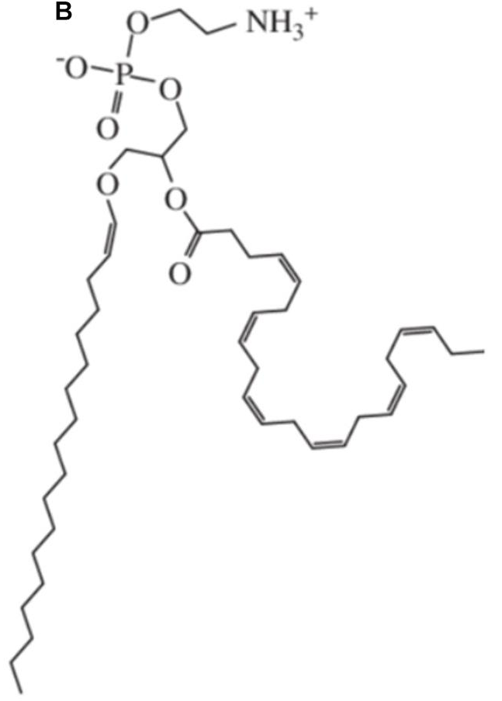
Plasmalogens (vinyl-ether lipids)
Compose about half of the human cardiovascular cell membrane phospholipids,
Are endogenous antioxidants that protect phospholipids, unsaturated fatty acids, and lipoproteins from oxidative stress,
Effect membrane rigidity/fluidity, fission/fusion, and morphological transitions.

Slide 35
Plasmalogens (vinyl-ether lipids)
Glycerol backbone.
sn-1 Position: Fatty alcohol linked via a vinyl ether bond.
sn-2 Position: Fatty acid esterified to glycerol.
sn-3 Position: Phosphorylated head group, such as ethanolamine (in phosphatidylethanolamine plasmalogens) or choline (in phosphatidylcholine plasmalogens).

Slide 36
Sphingosine and Ceramides
(2-amino-4-octadecene-1,3-diol) is an amino alcohol with an unsaturated (trans) 18-carbon hydrocarbon chain.
Ceramide: a sphingosine plus a fatty acid.
Sphingolipids are phospholipids that contain sphingosine.

Slide 37
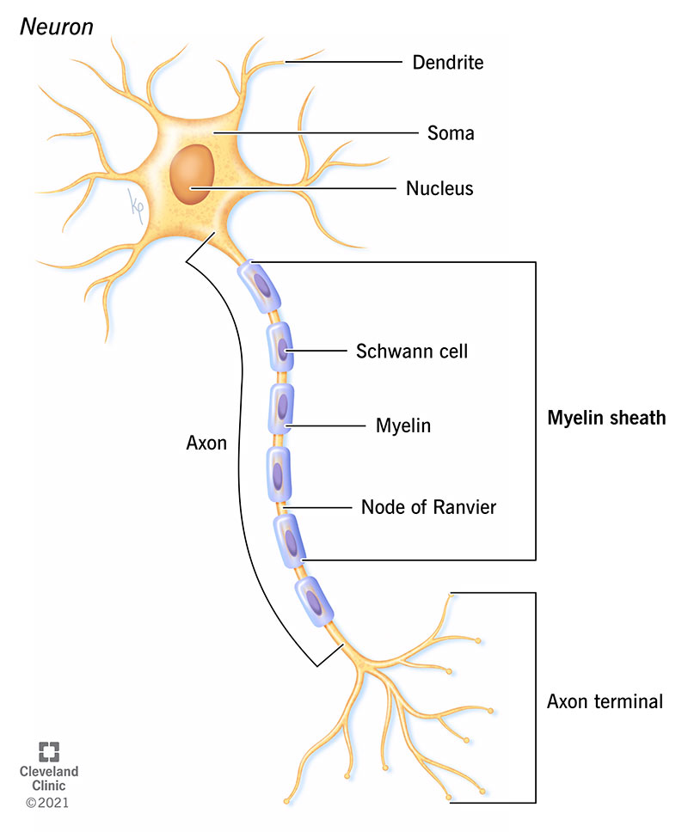
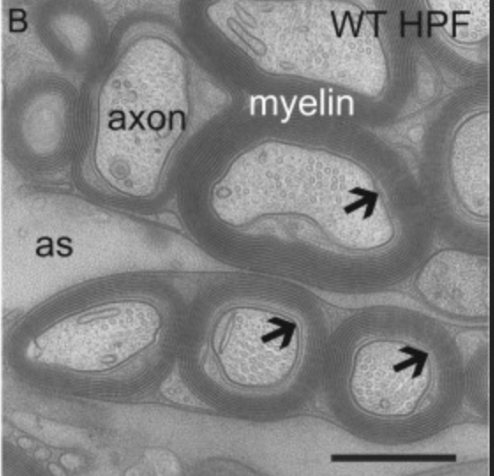
Myelin
Evolution: myelination co-occurred with jaws and the primary sections of the vertebrate brain (forebrain, midbrain, hindbrain).
Structure: Sheaths that wrap around axons of neurons. Myelin is made of proteins and lipids. The primary lipid is the sphingolipid cerebroside (galactocerebroside).
Function: Myelin sheets engulf axons and increase conduction speed and energy efficiency of action potential (AP) conduction.
Myelinated axons in the CNS of mouse
500 nm

Slide 38
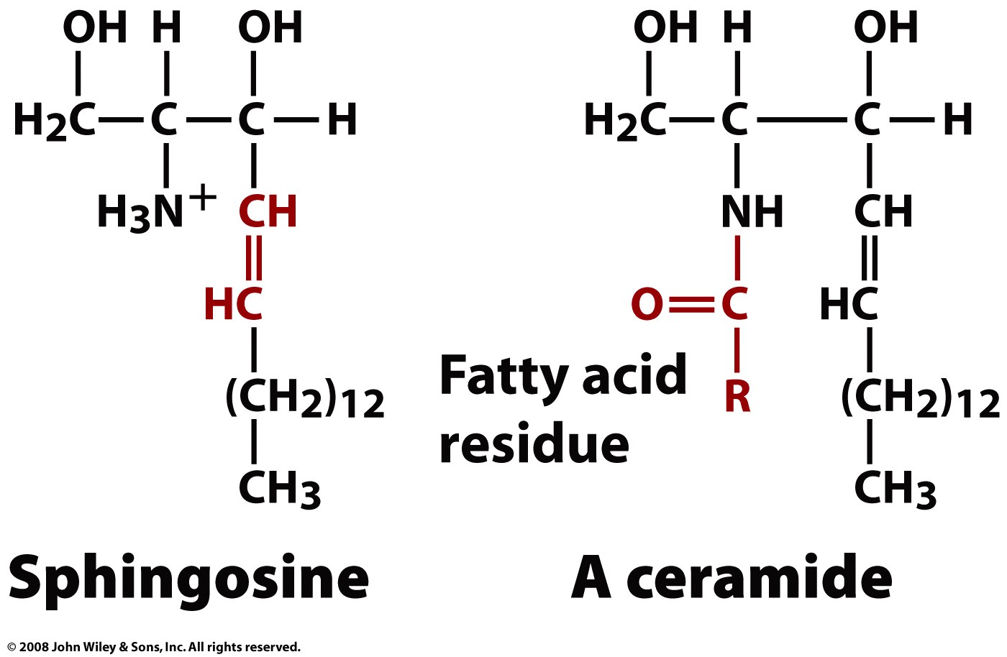
Page 252

Slide 39
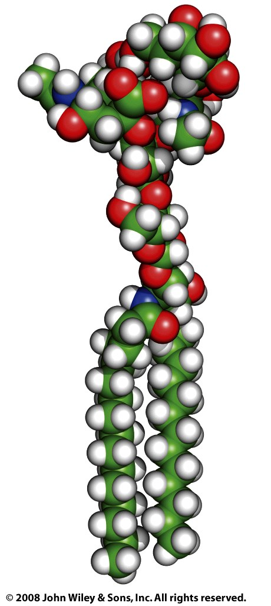
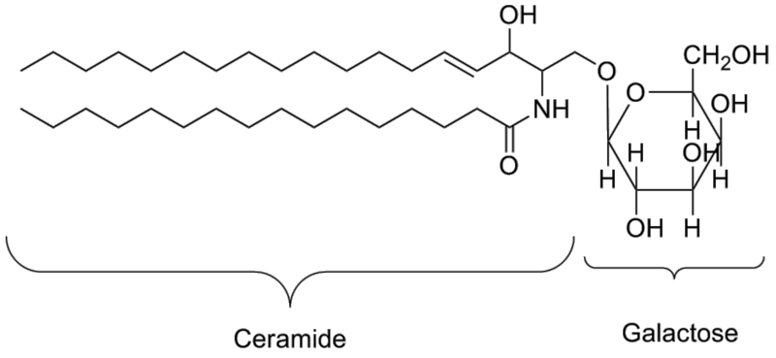
G_{M1}
Cerebroside (galactoceramide)
is a ceramide with a galactose at the 1-hydroxyl moiety
Ceramides are found in the outermost layer of the skin. They form a "mortar" between skin cells ("bricks"), preventing water loss and protecting against environmental damage.

Slide 40
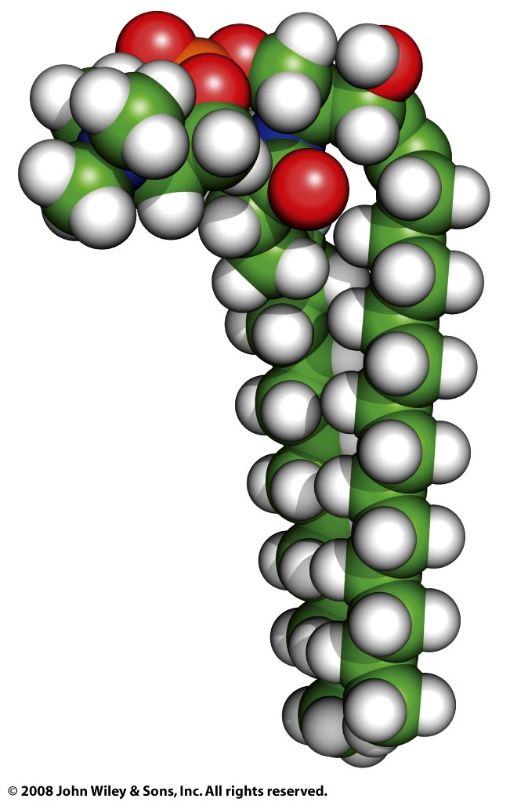
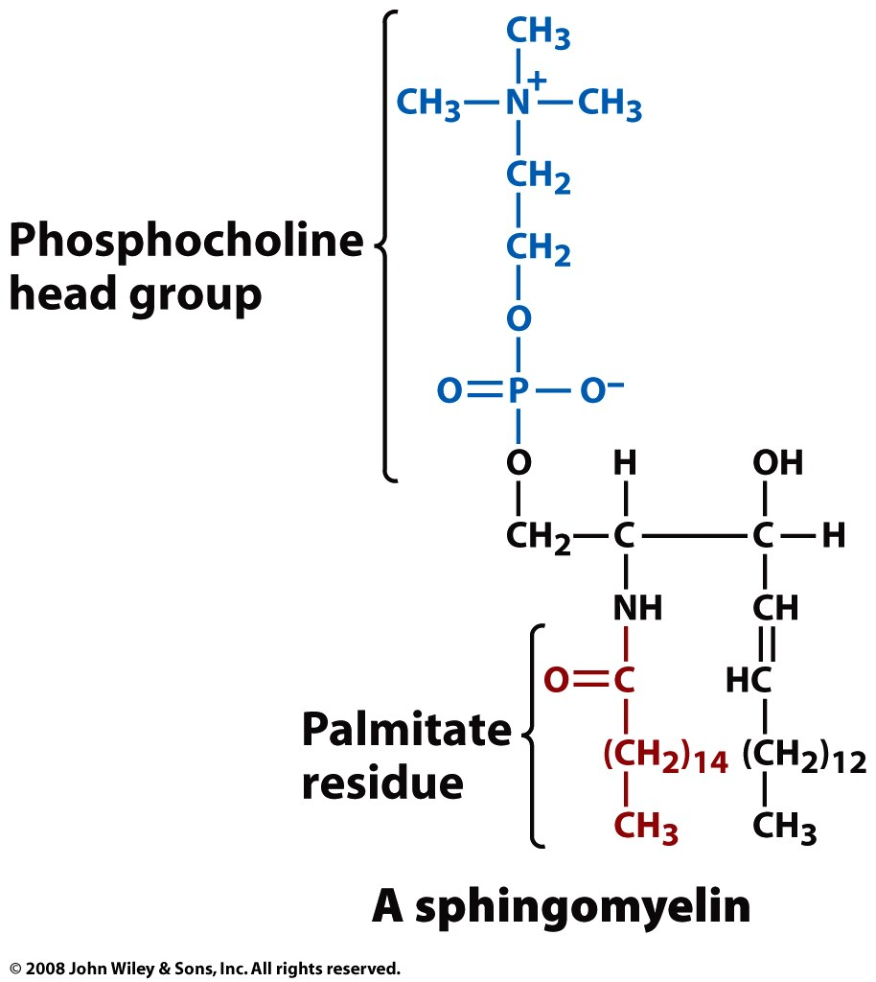

Slide 41
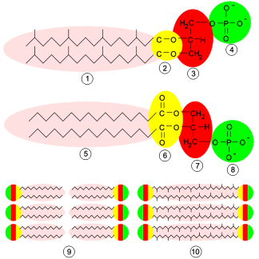
Archaeal Membranes
Archaea differ from other living things in their cell membranes. There are four fundamental differences between archaeal membranes and those of bacterial and eukaryotic cells: (1) chirality of glycerol, (2) ether versus ester linkage, (3) isoprenoid versus fatty acid chains, and (4) branching of side chains.
http://www.ucmp.berkeley.edu/archaea/archaeamm.html

Slide 42
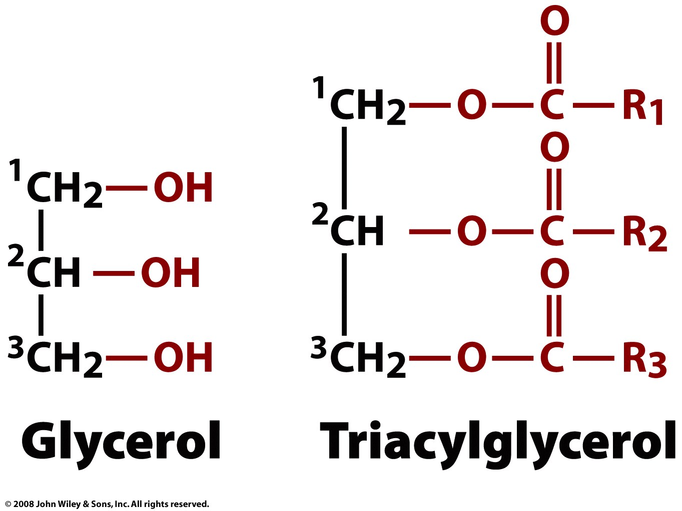
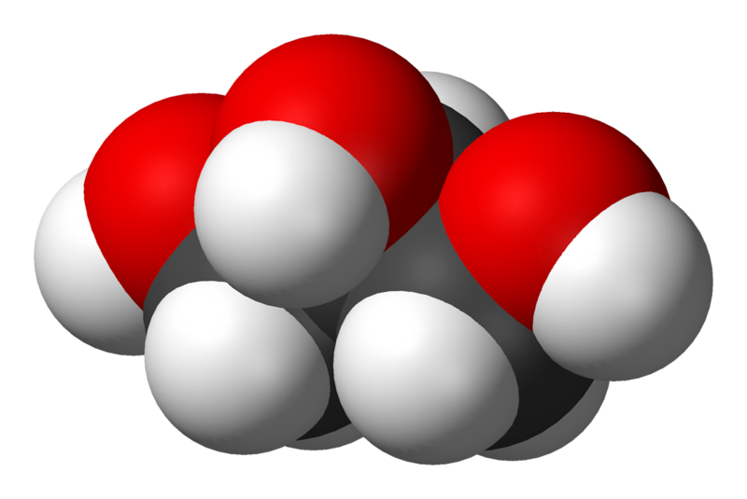
Energy Storage: Triglycerides
A triglyceride is glycerol linked to three fatty acids, via ester linkages.

Slide 43
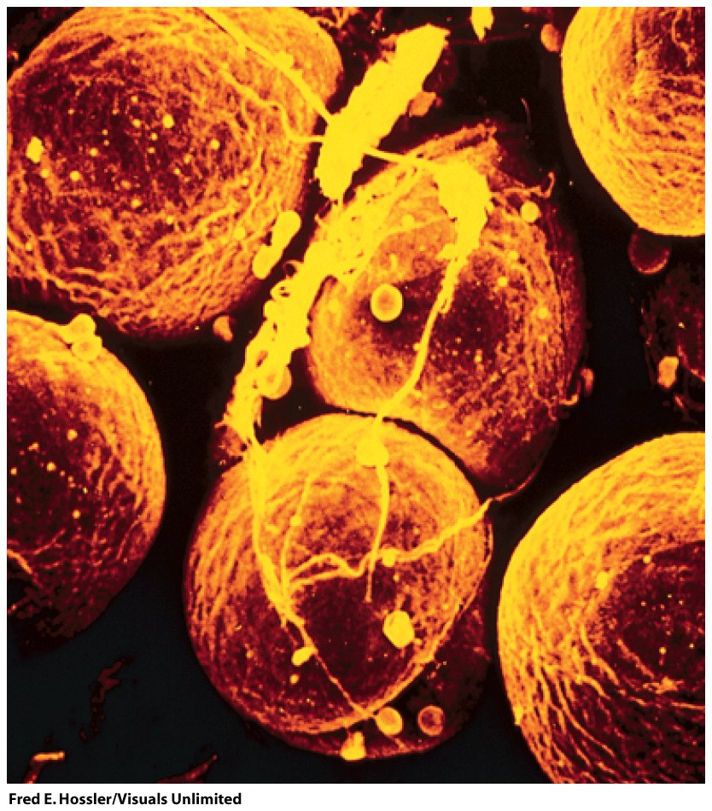
Adipocytes (fat cells, monovacuolar cells) contain lipid surrounded by cytoplasm. The nucleus is on the periphery. Fat is stored mostly as triglycerides and cholesteryl esters.
This is the densest form of stored energy in a biological system. The energy can be released slowly over long periods of time (as during starvation).
By contrast glycogen (polysachharide) stores energy that can be released and used quickly.
Figure 9-2

Slide 44
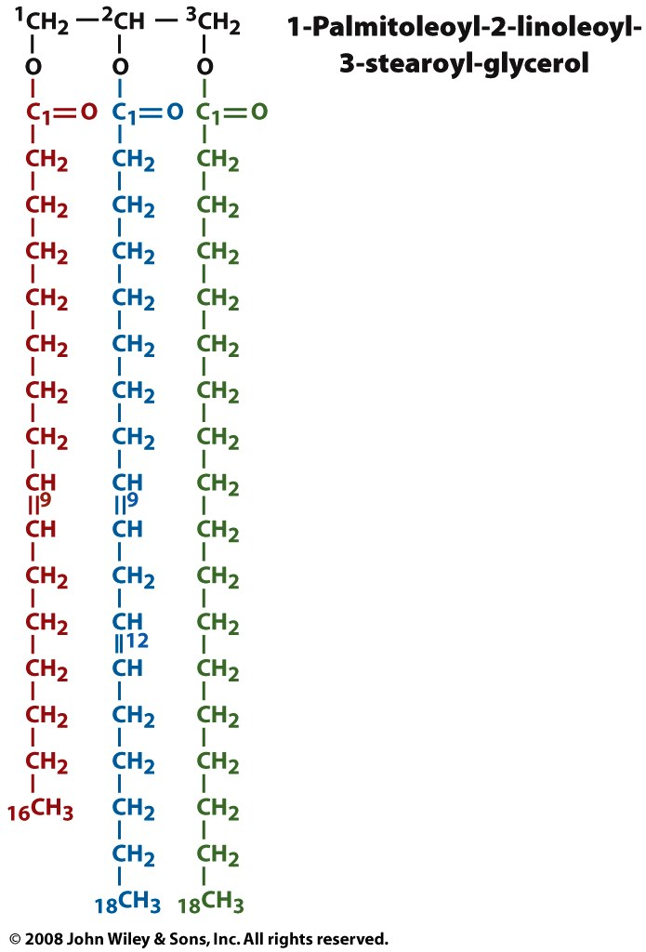
A triglyceride is glycerol linked to three fatty acids, via ester linkages. The three hydroxyl groups of the glycerol form esters with the carboxyl groups of the three fatty acids. A given triglyceride generally contains different types of fatty acids.
Plant triglycerides are lower melting than animal triglycerides because they are less saturated (i.e., have more C=C bonds).
Fatty acids in biological triglycerides generally contain 16 - 20 carbon atoms. Fatty acids in eukaryotes contain even numbers of carbon atoms.
A high level of triglycerides in blood is linked with risk of heart disease. Triglycerides are not soluble in aqueous media, and are carried by proteins (lipoproteins)
A triglyceride
ester of
palmitoleic acid
ester of
linoleic acid
ester of
steric acid

Slide 45
