Slide 1
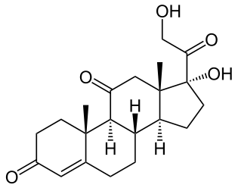
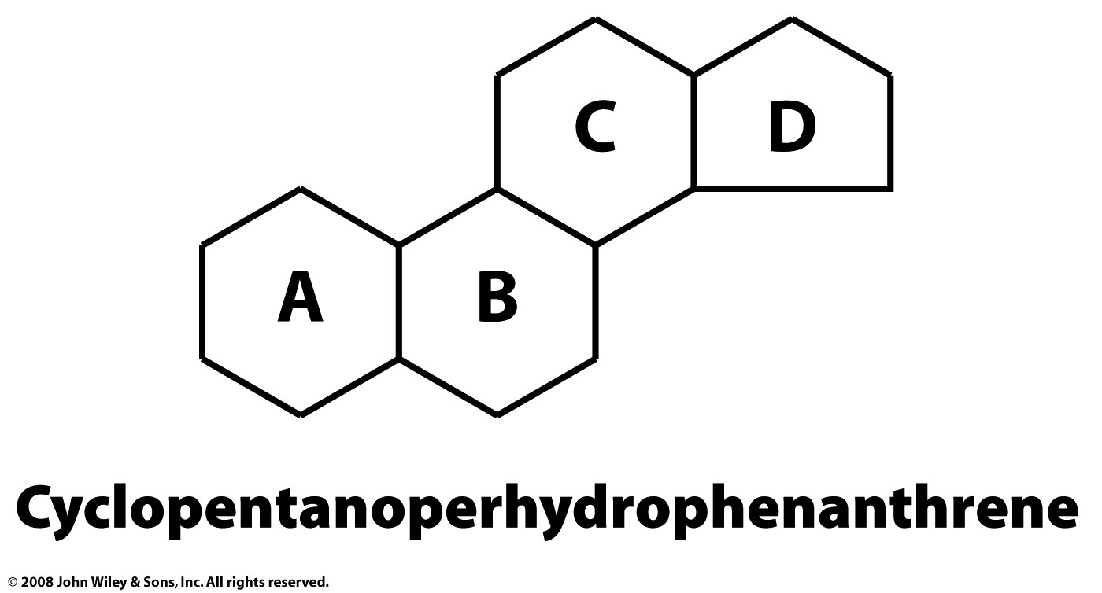
Steroids
A steroid is composed of four fused rings. Cholesterol, estradiol, cortisone and testosterone, dexamethasone are steroids.
The core of a steroid is formed by three cyclohexane rings (designated as rings A, B, and C) and a cyclopentane ring (the D ring). Different steroids have different functional groups attached to this four-ring core and have various oxidation states of the rings.
Hundreds of different steroids are found in plants, animals, and fungi.
Cortisone

Slide 2
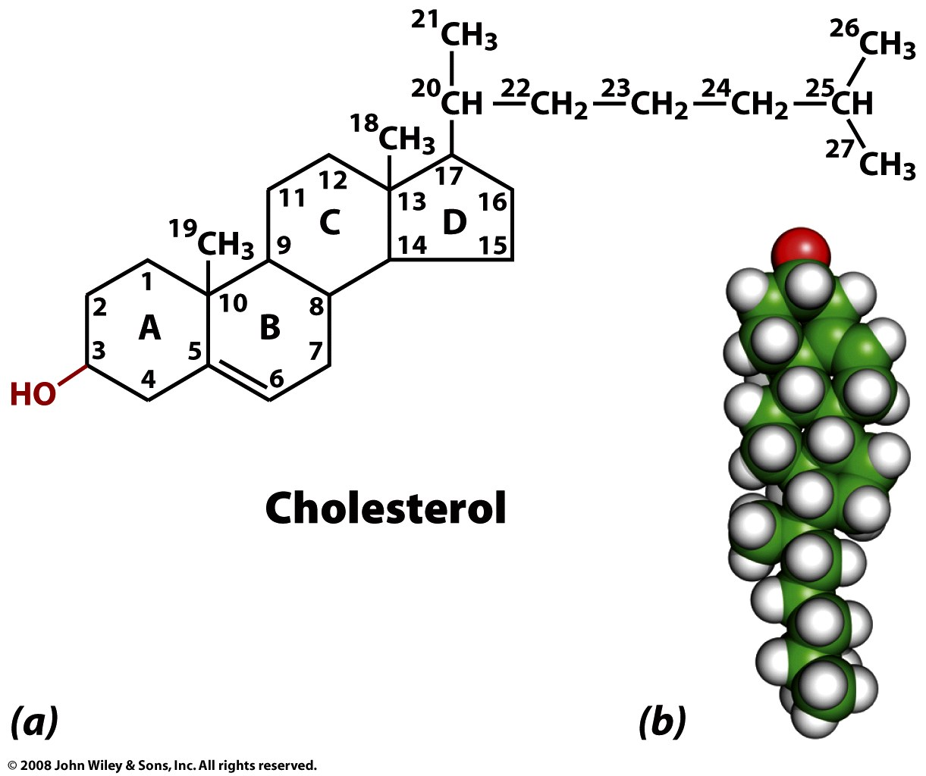
Cholesterol composes 30-40% (mol/mol) of animal membrane lipids.
Cholesterol modulates membrane permeability and fluidity.
A high level of serum cholesterol is an indicator for cardiovascular disease.
Cholesterol is a precursor of steroid hormones in mammels.

Slide 3
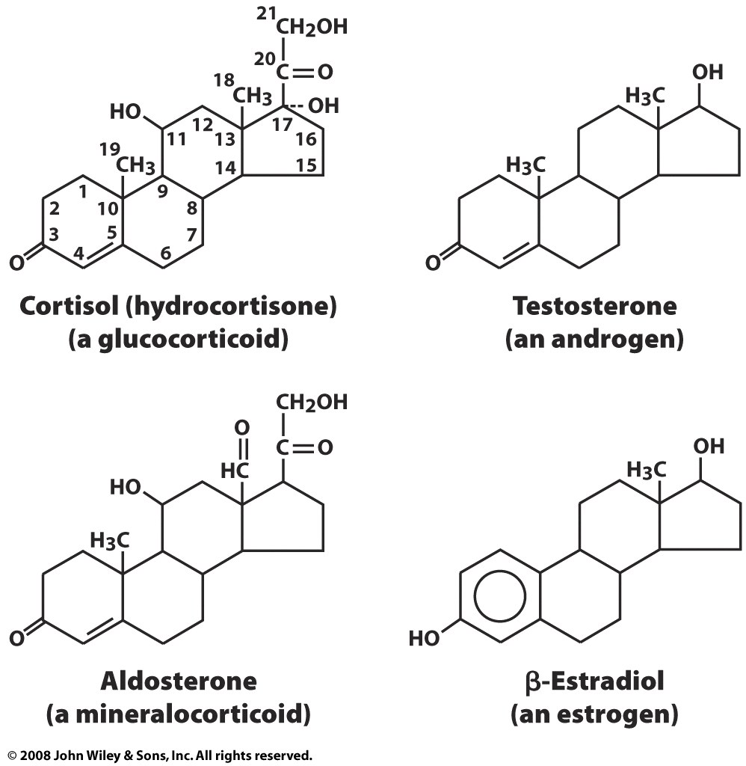

Slide 4
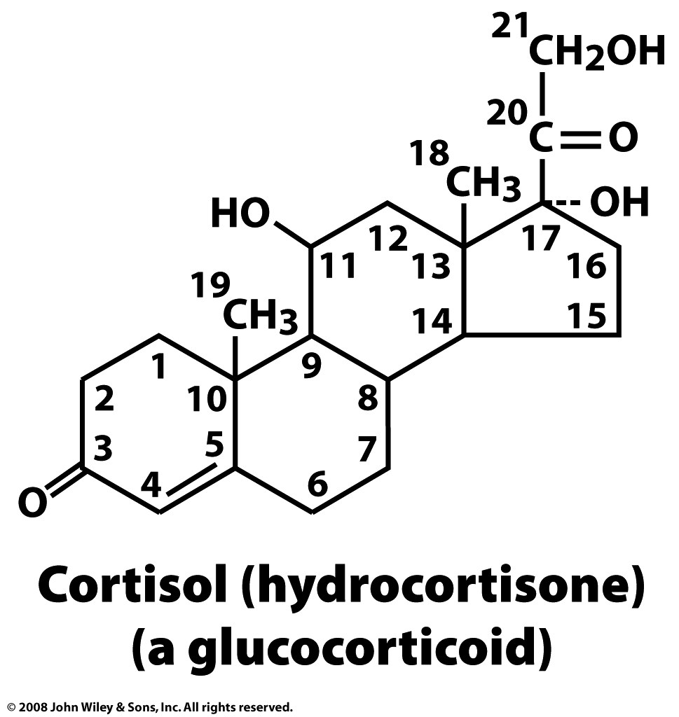
Cortisol is a steroid hormone, or a glucocorticoid, produced by the adrenal gland. It is released in response to stress, to increase blood sugar by stimulating gluconeogenesis, which is the breakdown of protein and fat to provide metabolites that can be converted to glucose.
Your brain needs glucose. If you skip breakfast (ensuring your glycogen stores are depleted) and engage in sustained exercise (1) your insulin levels will fall, (2) your body will secrete of glucagon, adrenaline, growth hormone and cortisol. You will feel bad. After a while you will pass out.
So eat breakfast.

Slide 5
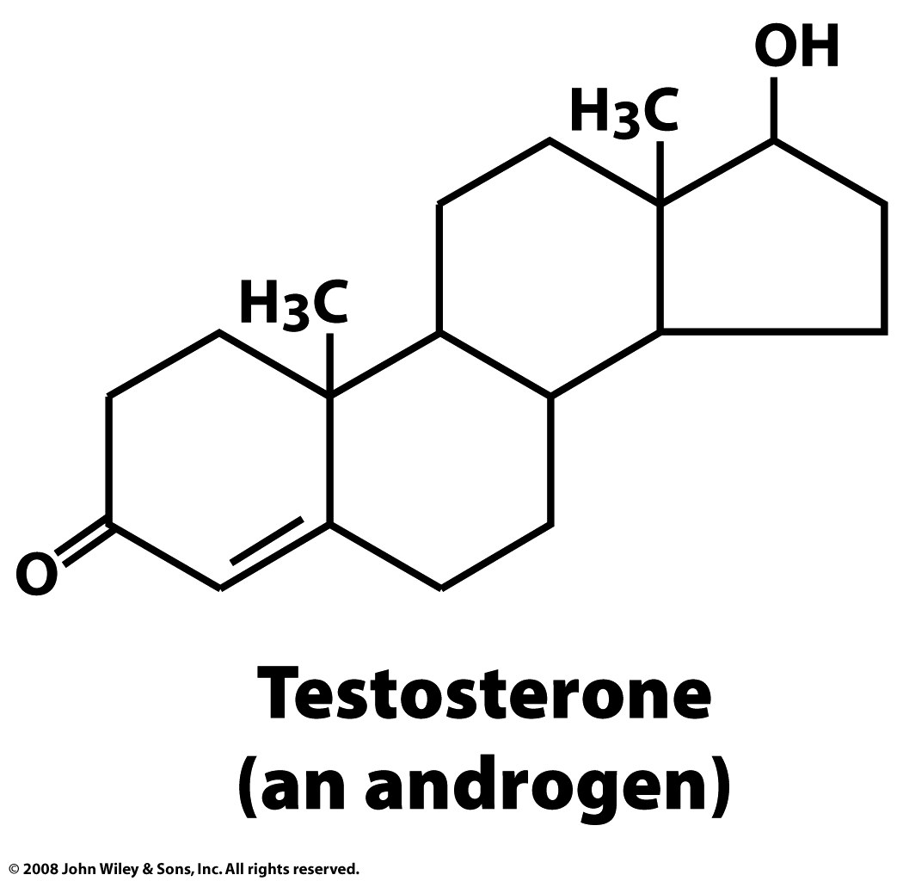
Testosterone is found in most vertebrates. In mammals, testosterone is primarily secreted in the testes of males and the ovaries of females. Testosterone is the principal male sex hormone. Testosterone plays a key role in the development of male reproductive tissues, and promotes increased muscle, bone mass and the growth of body-hair.
An androgen is a compound, usually a steroid hormone, that stimulates or controls the development and maintenance of male characteristics in vertebrates by binding to androgen receptors.
An anabolic is a compound that promotes anabolism (cell growth).
(and an anabolic)

Slide 6
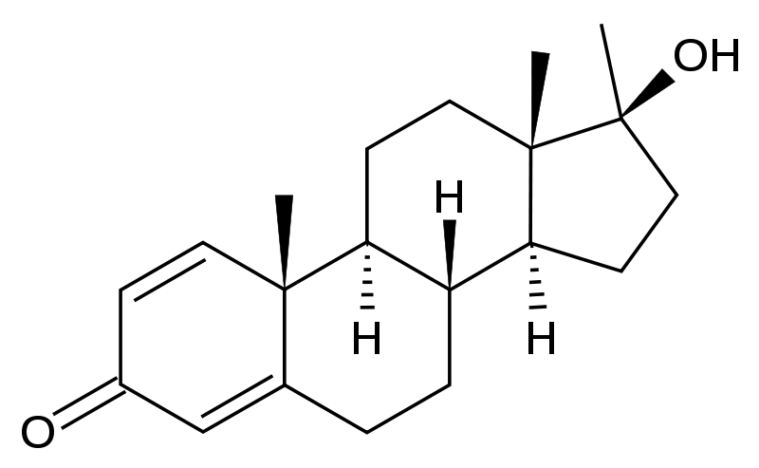
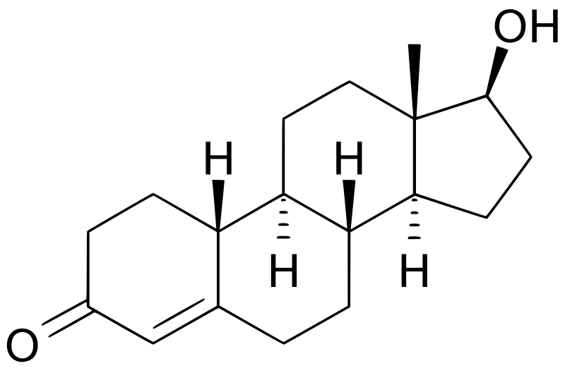
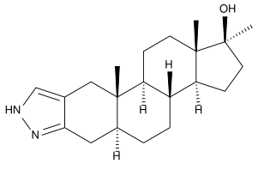
Methandrostenolone (Dianabol)
To be a professional baseball player,
take anabolic steroids.
Nandrolone
Stanozolol

Slide 7
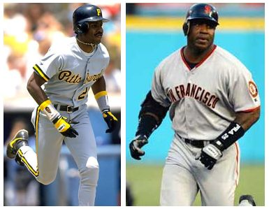
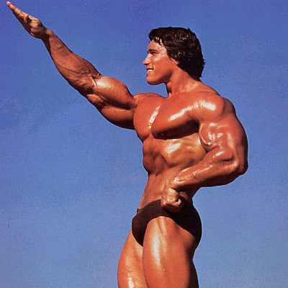
A Small Sample of Confirmed Anabolic Steroid Users
Mark McGwire (Oakland Athletics, St. Louis Cardinals)
Roger Clemens (New York Yankees)
Barry Bonds (Giants/Pirates)
Jose Canseco (Oakland A's, Texas Rangers, etc)
Alex Rodriguez (Seattle Mariners, Texas Rangers, etc.)
Arnold Schwarzenegger (Body builder)
Marion Jones (America Sprinter, 2000 Olympic 3 gold, 2 bronze)
Maurice Greene (America Sprinter, 2000 Olympic 2 gold, 2004 Olympic silver and bronze)
Ben Johnson (Canadian sprinter, 1988 Olympic gold)
Linford Christie, (British sprinter, 1992 Olympic gold)
Royce Gracie (mixed martial arts)
Shoaib Akhtar (a Pakistani cricketer)
Mohammed Asif (another Pakistani cricketer)
Sean Sherk (Lightweight Champion)
Petr Korda (tennis)

Slide 8
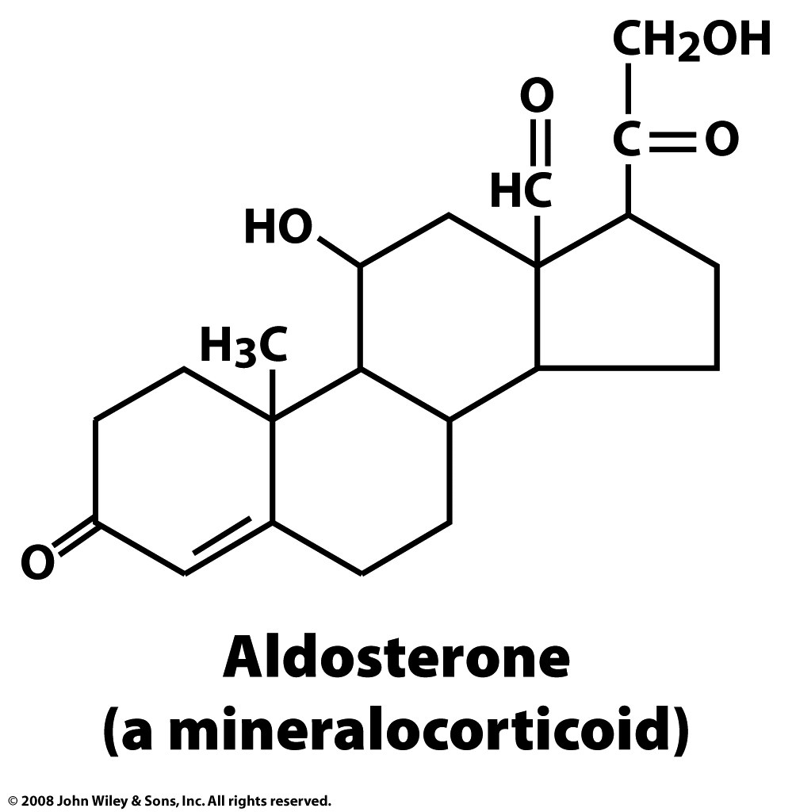
Aldosterone increases the absorption of sodium ions and water, and the secretion potassium ions from the kidneys, therefore increasing blood volume and pressure. Drugs that interfere with the secretion or action are antihypertensives.

Slide 9
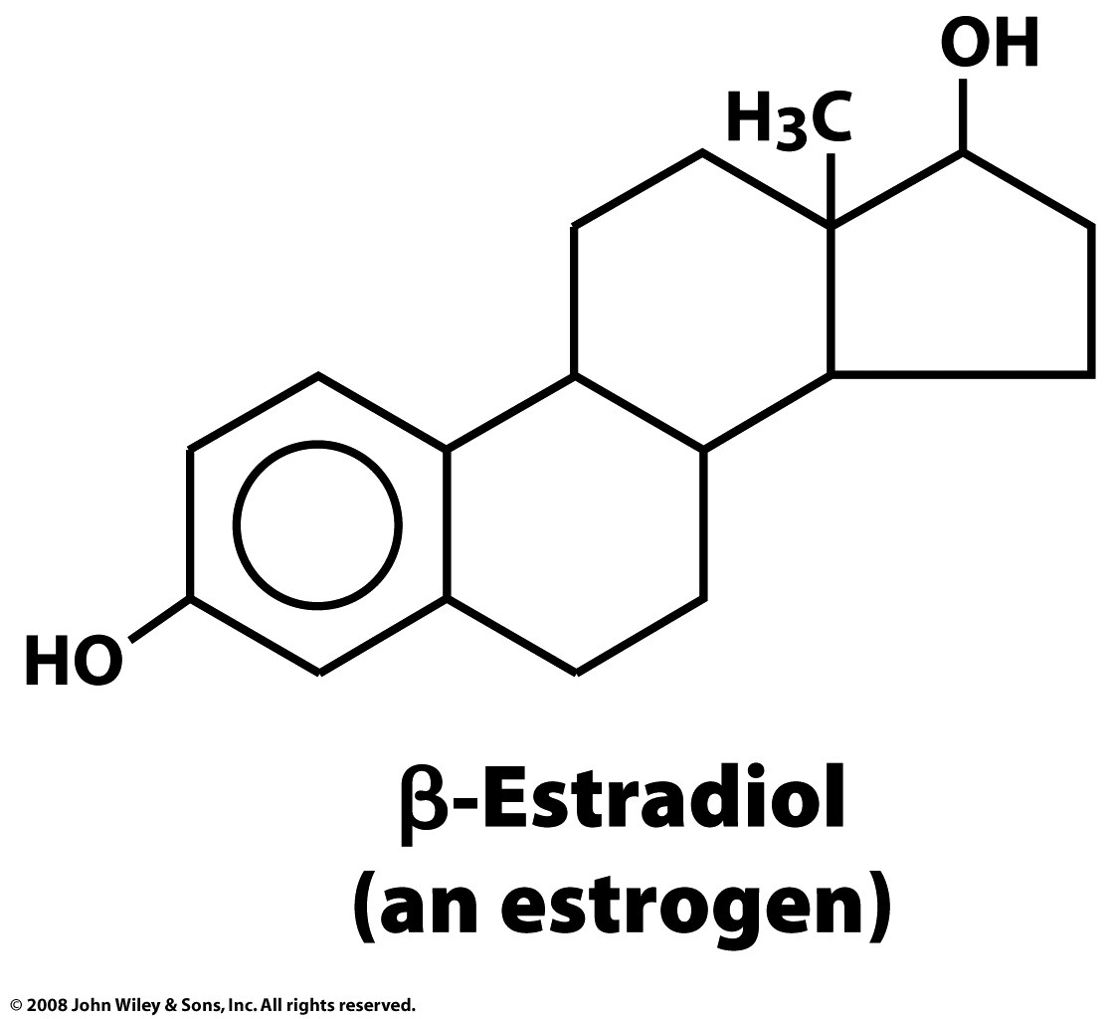
Estradiol is the predominant female sex hormone driving development of secondary sex characteristics. During pregnancy, estradiol is supplemented by placental production. Post menopausal women lose bone mass due to low estradiol.

Slide 10
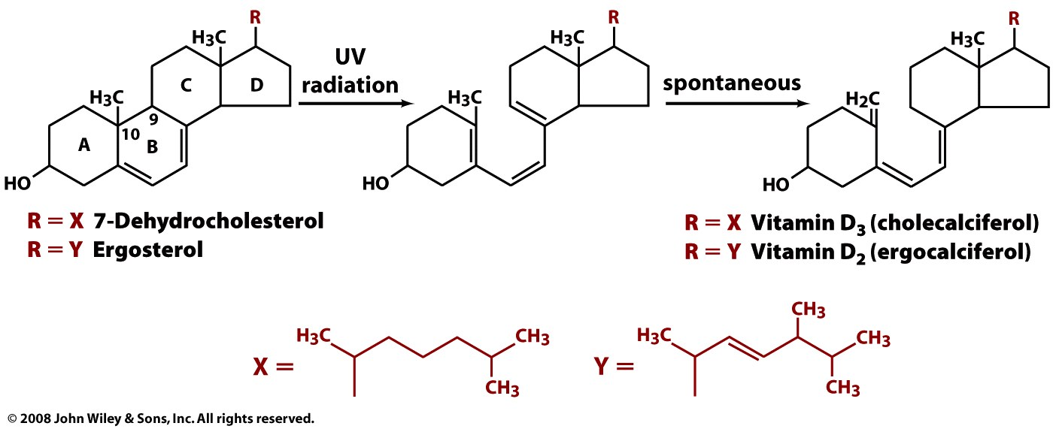
Vitamin D
7-Dehydrocholesterol is photo-synthetically (270–290 nm) converted (breaking the B-ring) to vitamin D3 (cholecalciferol) in the epidermis (skin). This is a non-enzymatic reaction.
Ergosterol is photo-synthetically converted to vitamin D2 (ergocalciferol).
These steroid-like molecules are precursors to hydroxylated compounds (dihydroxycolecalciferol) that regulate mineralization (Calcium-absorption), growth and remodeling of bone.
Ergosterol is found in fungal cell membranes, but not animal cell membranes.
Milk is supplemented with vitamin D (Vitamin D refers to either ergocalciferol or cholecalciferol or both).

Slide 11
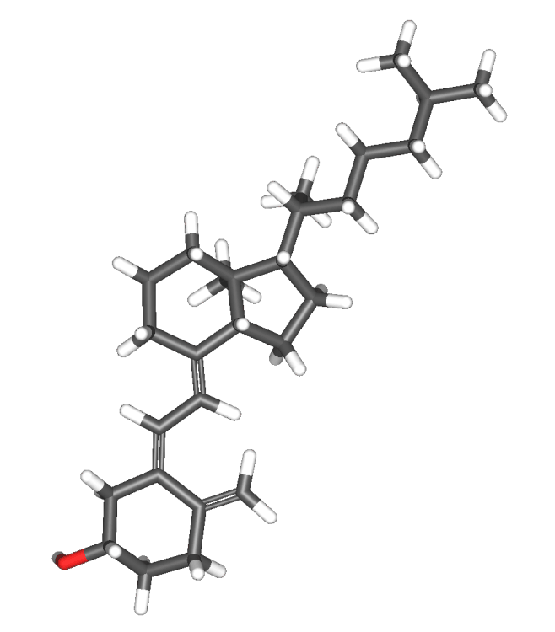
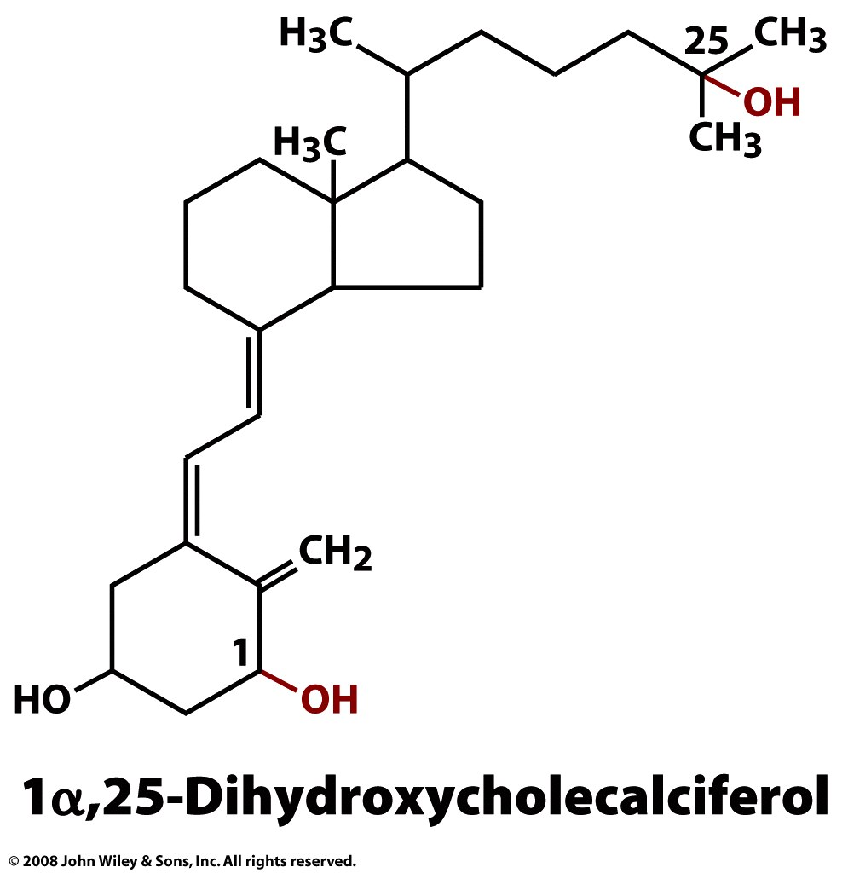
Vitamin D
Active, produced in the liver
Cholecalciferol (vitamin D3)
Page 256

Slide 12
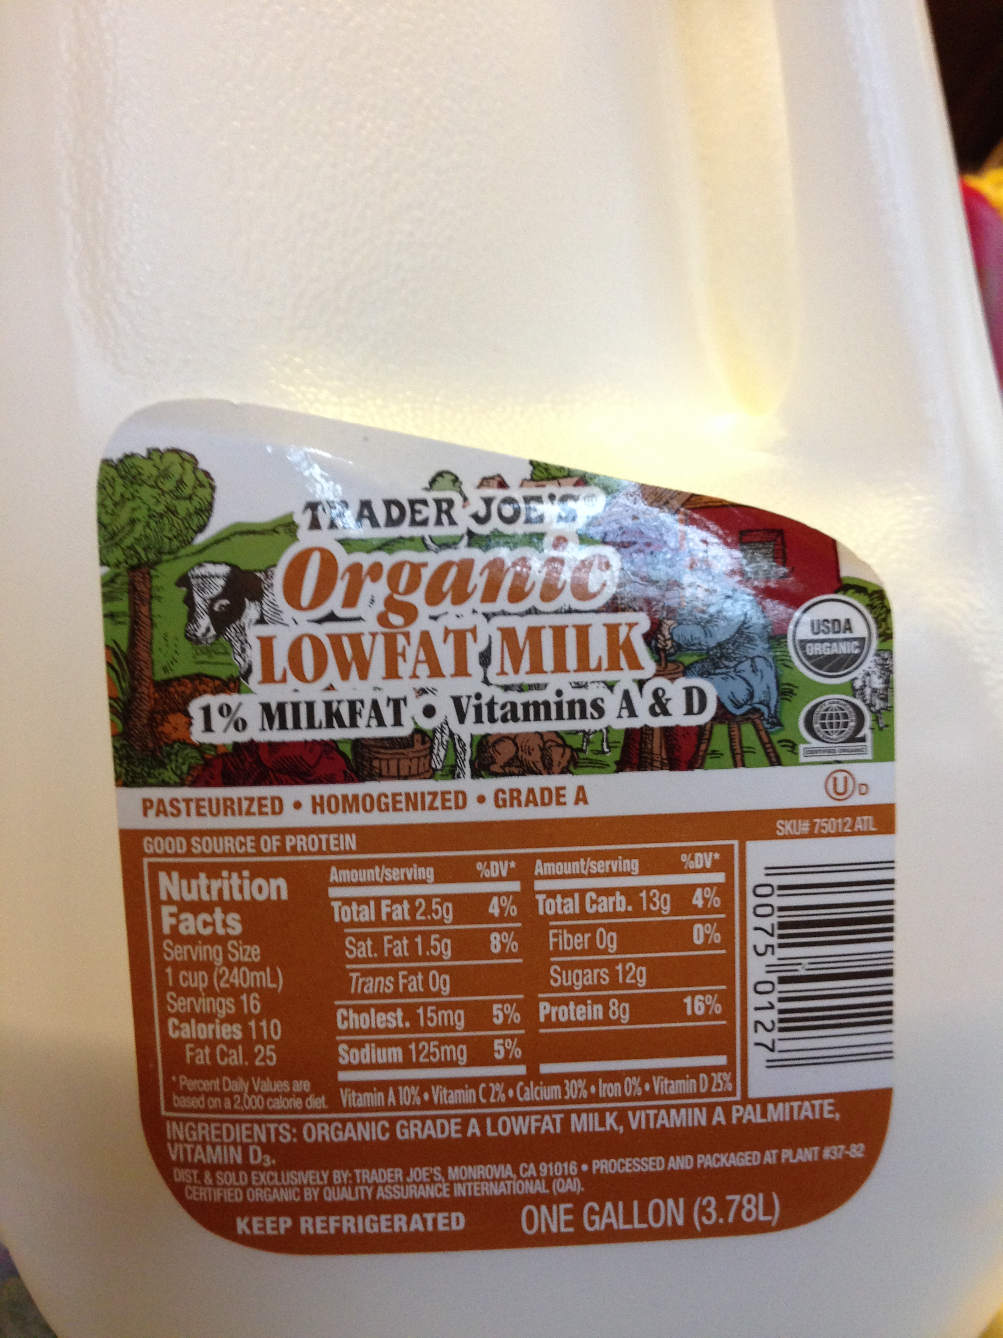

Slide 13
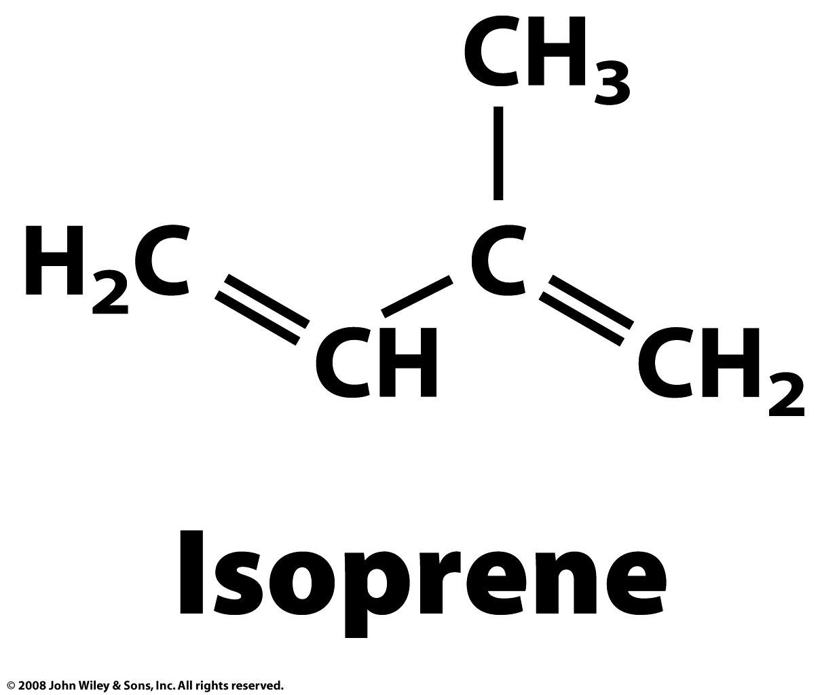
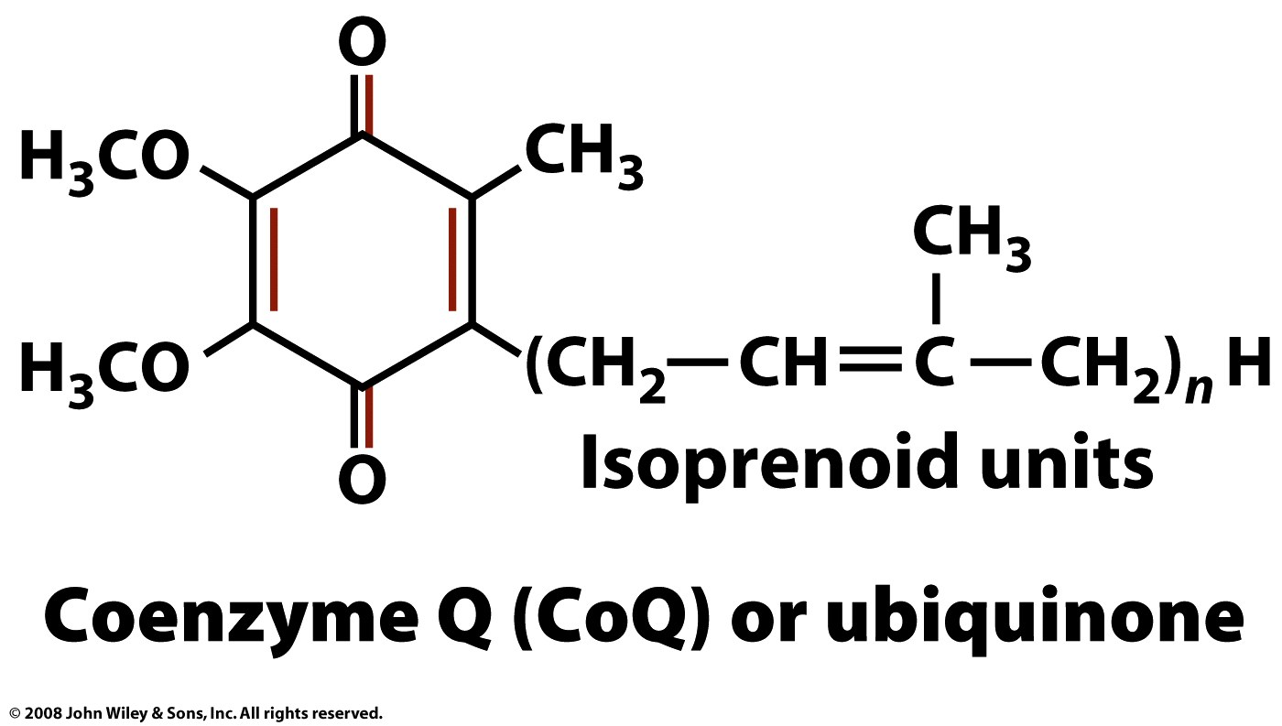
Other lipids
Isoprenoids
CoQ (is oxidized/reduced) during oxidative phosphorylation i.e., it is an electron acceptor/donor.
Page 257

Slide 14
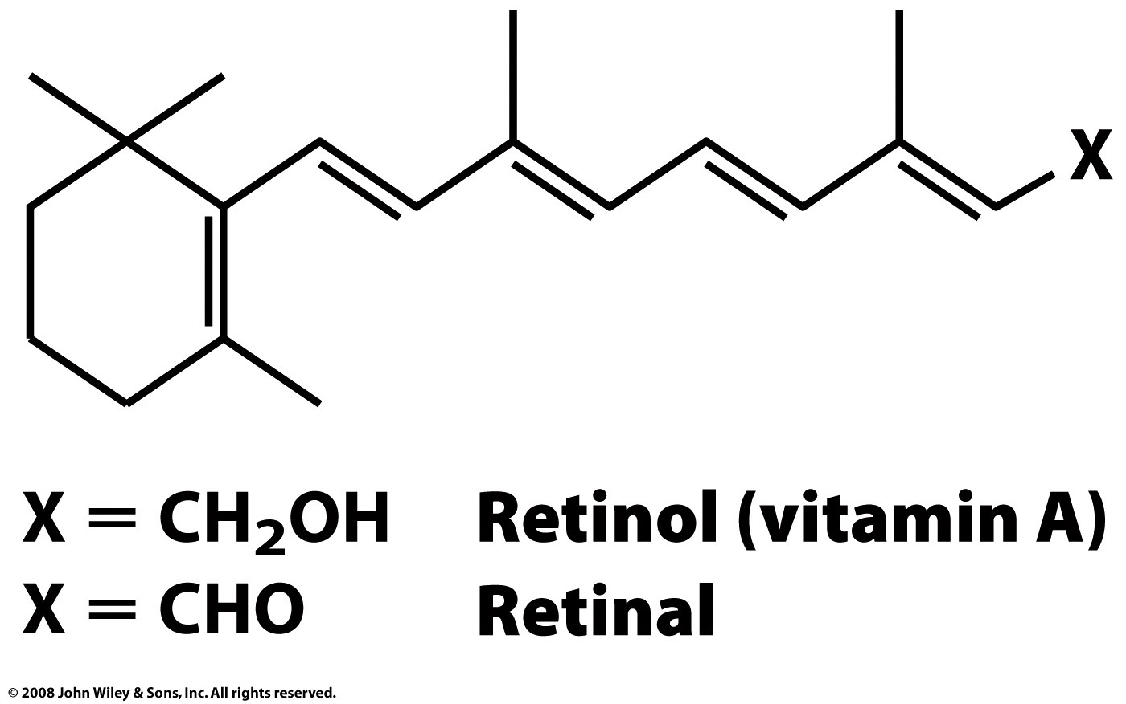
Other lipids
Retinal: Photo receptor
photons cause isomerization
Retinal is contained in Rhodopsin, found in photoreceptor cells of the retina. Rhodopsin is involved in the initial processes the perception of light.
Page 257

Slide 15
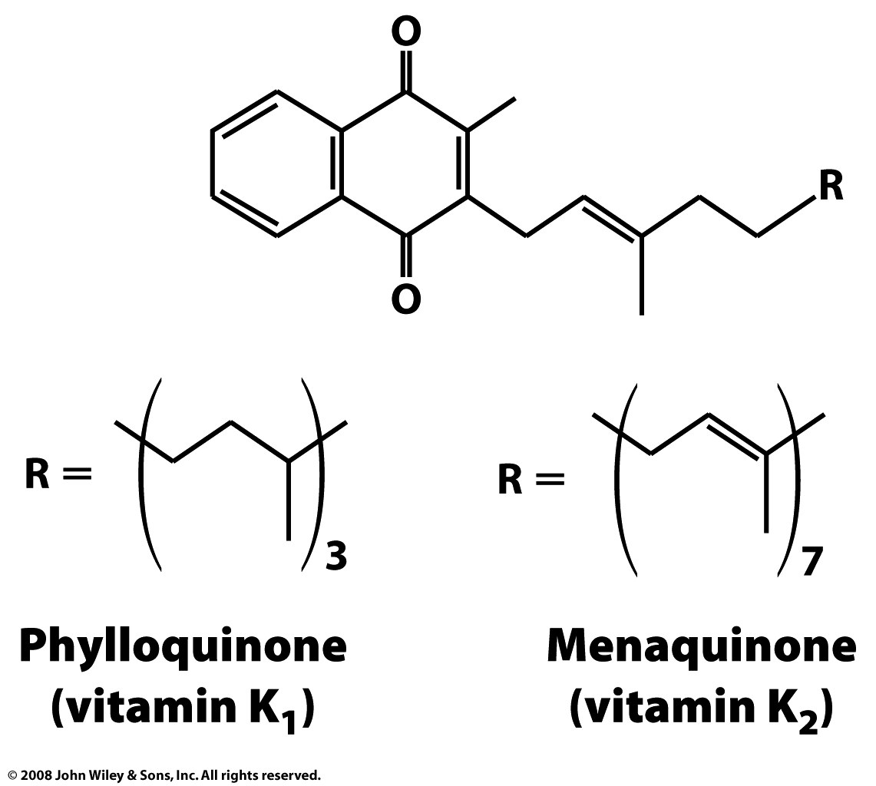
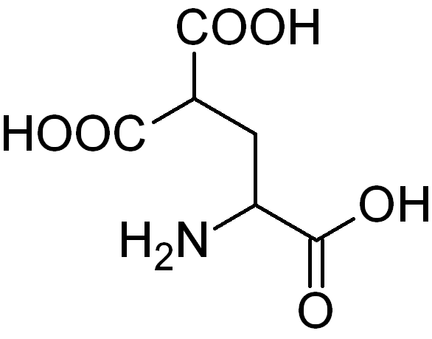
Other lipids
Vitamin K is involved in carboxylation of Glutamic acids during blood clotting.
carboxyglutamic acid
Page 258

Slide 16
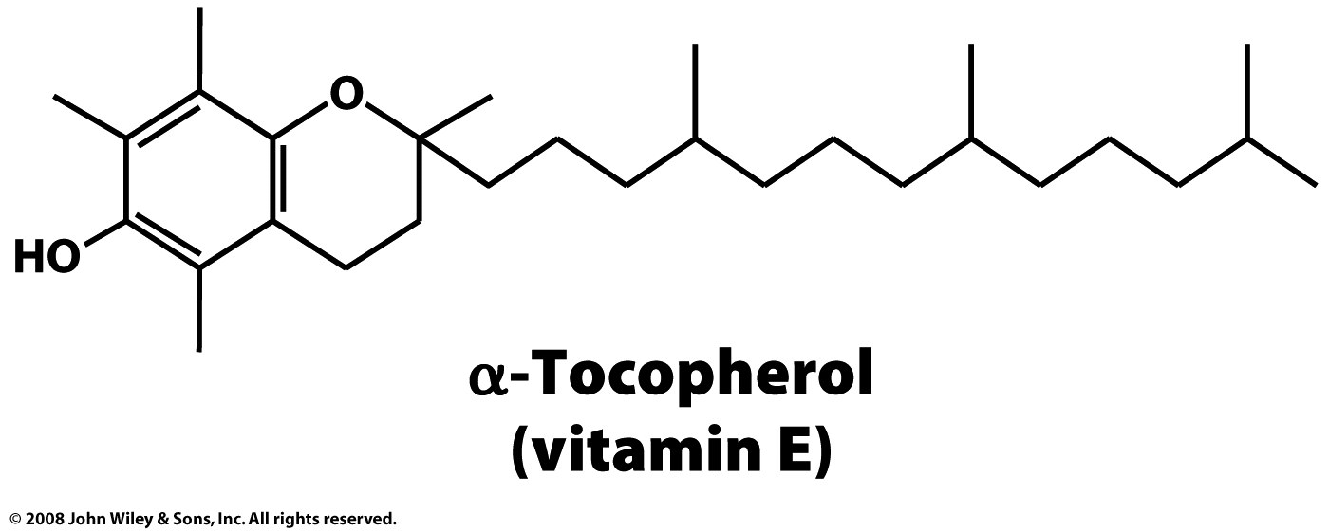
Other lipids
Antioxidant in cell membranes
Page 258

Slide 17
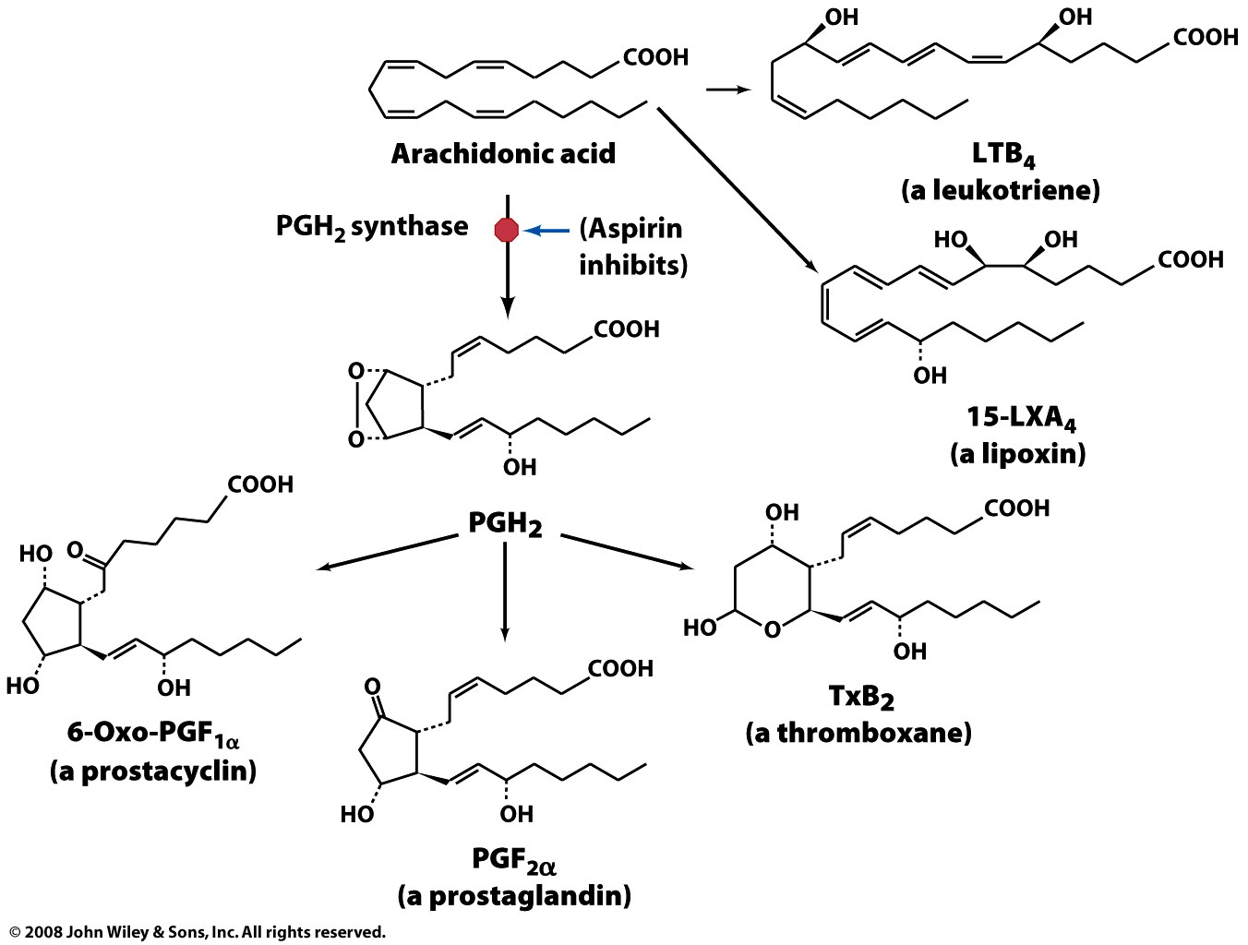
Prostaglandins
Figure 9-12

