Slide 1
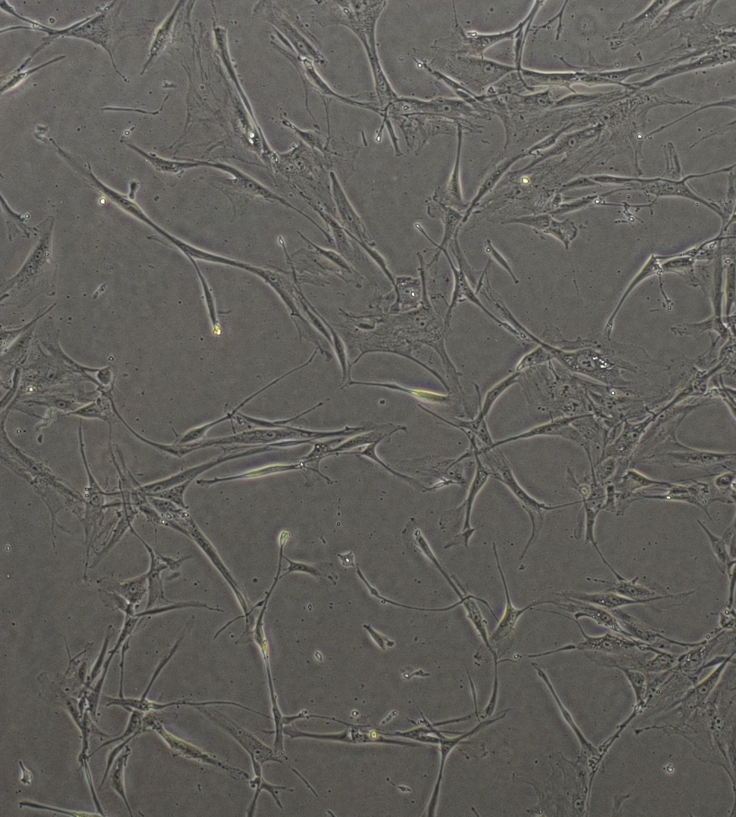
STEROID HORMONES AND PROSTATE CANCER
EMILY TOSCANO GUERRA
PhD. student

Slide 2
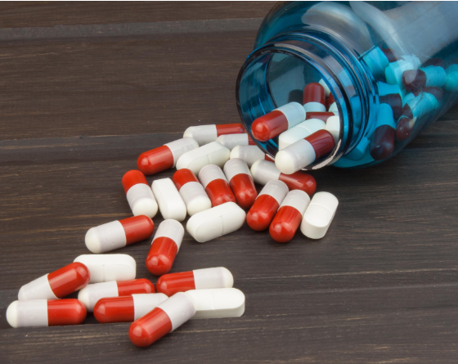
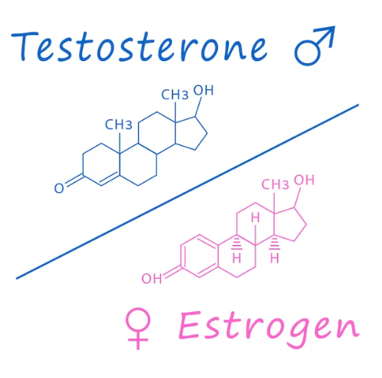
STEROIDS
Acting a siganling molecules (hormones) and drugs (medicine)
Steroids occur naturally and have various physiological effects
Acting as a cell membrane component
Acting as sexual hormones

Slide 3
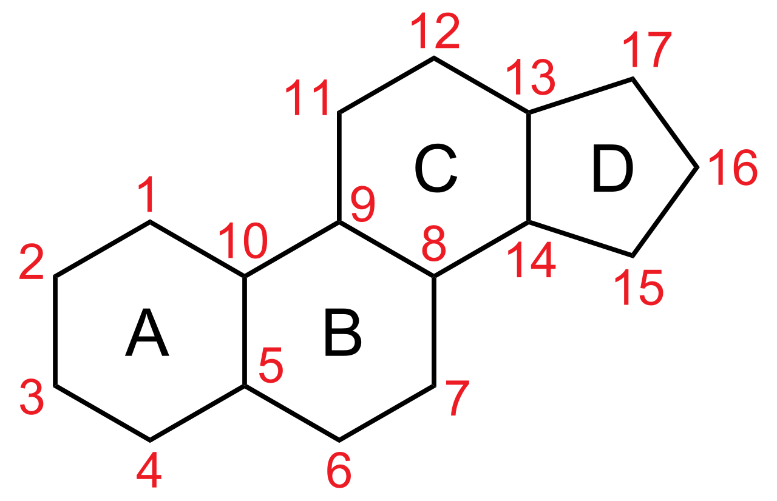
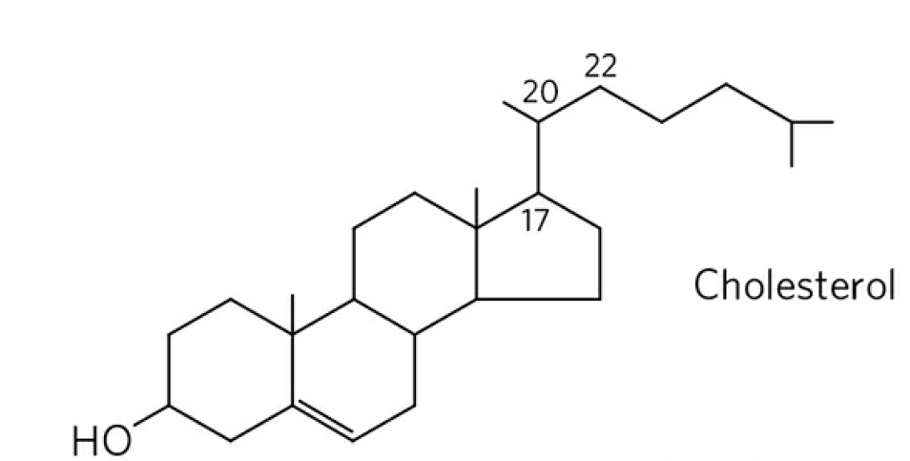
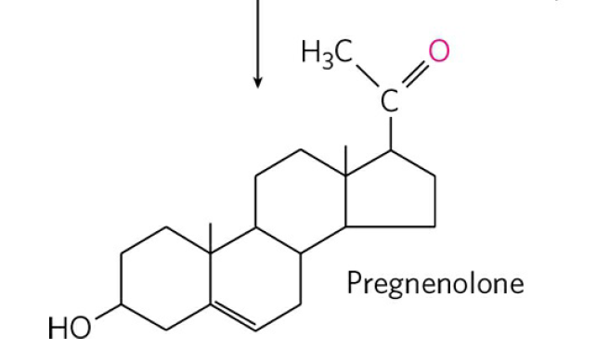
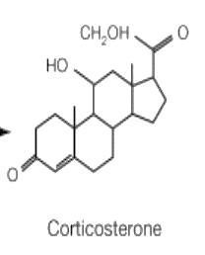
ESTEROIDS DEFINITION AND STRUCTURE
Steroids are lipophilic molecules consisting of four interconnected carbon rings, the so-called cyclopentanoperhydrophenanthrene rings, also known as sterane.
Different steroids have different functional groups attached to this four-ring core.
Corticosterone

Slide 4
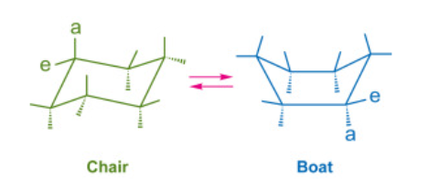
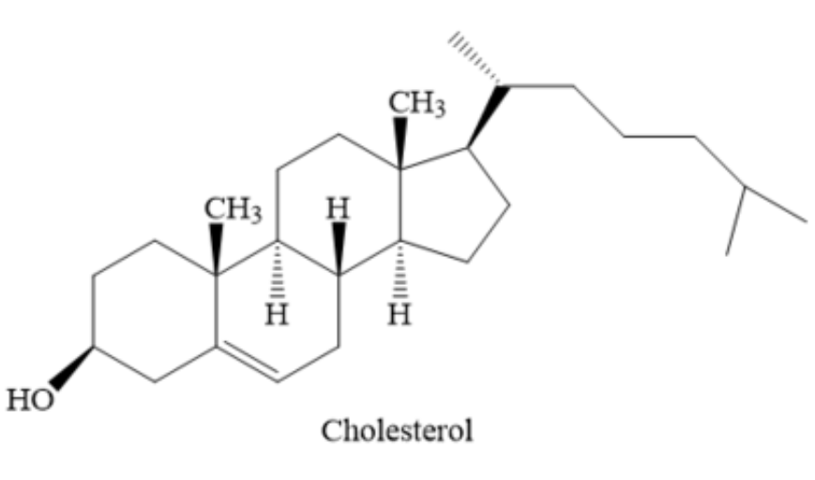
SPATIAL CONFORMATION OF STERANE
The 3-D structure of steroids ar not planar in shape. The six-carbon atoms of a cyclohexane ring are not fixed rigidly in space but are capable of interchanging through turning and twisting between several structural arrangements in space called conformations.
Each of the two substituent groups on the six-carbon atoms of the cyclohexane ring may exist in either the general plane of the ring: equatorial (e) or perpendicular to the ring plane: axial (a).
Google: “3d Model of Cholesterol
(American Chemical Society)”

Slide 5
STEROID PRECURSORS
SQLE
Steroids
Is a steroid?

Slide 6
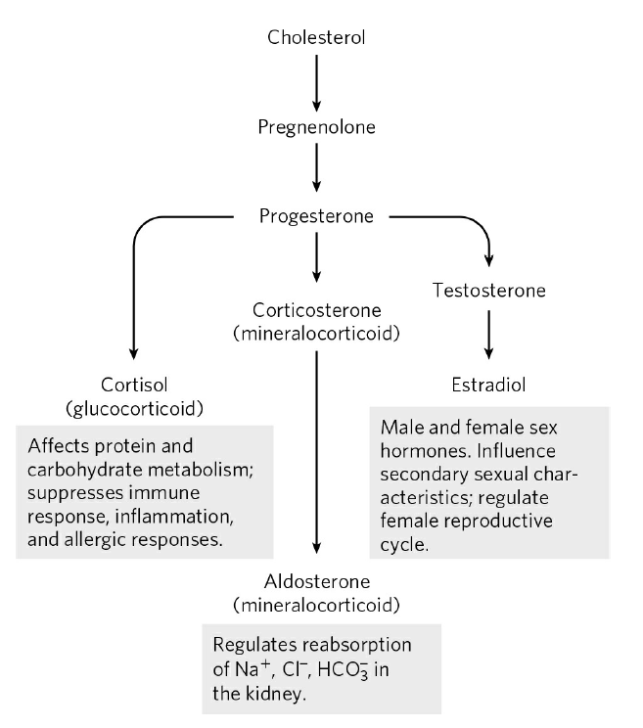
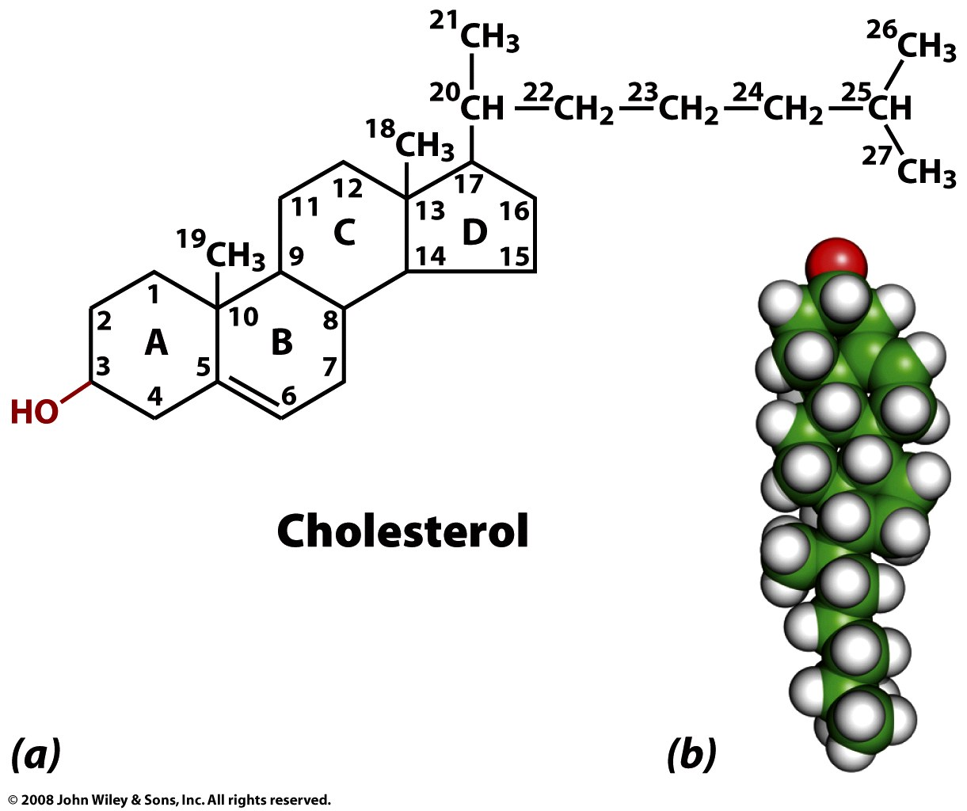
Cholesterol composes 30-40% (mol/mol) of animal membrane lipids.
Cholesterol modulates membrane permeability and fluidity.
A high level of serum cholesterol is an indicator for cardiovascular disease.
Cholesterol is a precursor of steroid hormones in mammals.

Slide 7
CORTICOSTEROIDS
Signaling molecules → Hormones

Slide 8
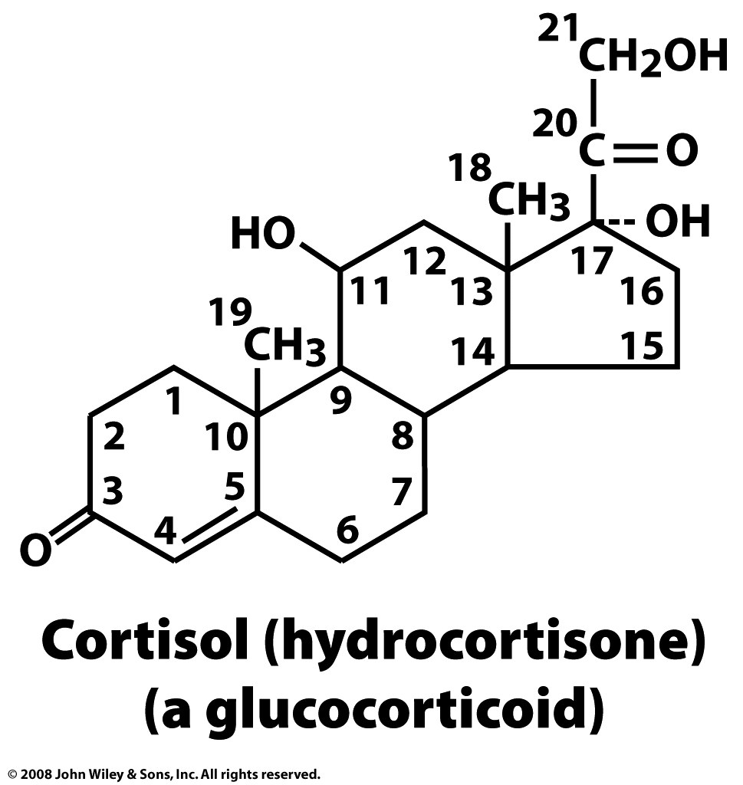
Cortisol is a steroid hormone, or a glucocorticoid, produced by the adrenal gland. It is released in response to stress, to increase blood sugar by stimulating gluconeogenesis, which is the breakdown of protein and fat to provide metabolites that can be converted to glucose.
Your brain needs glucose. If you skip breakfast (ensuring your glycogen stores are depleted) and engage in sustained exercise (1) your insulin levels will fall, (2) your body will secrete of glucagon, adrenaline, growth hormone and cortisol. You will feel bad. After a while you will pass out.
So eat breakfast.

Slide 9
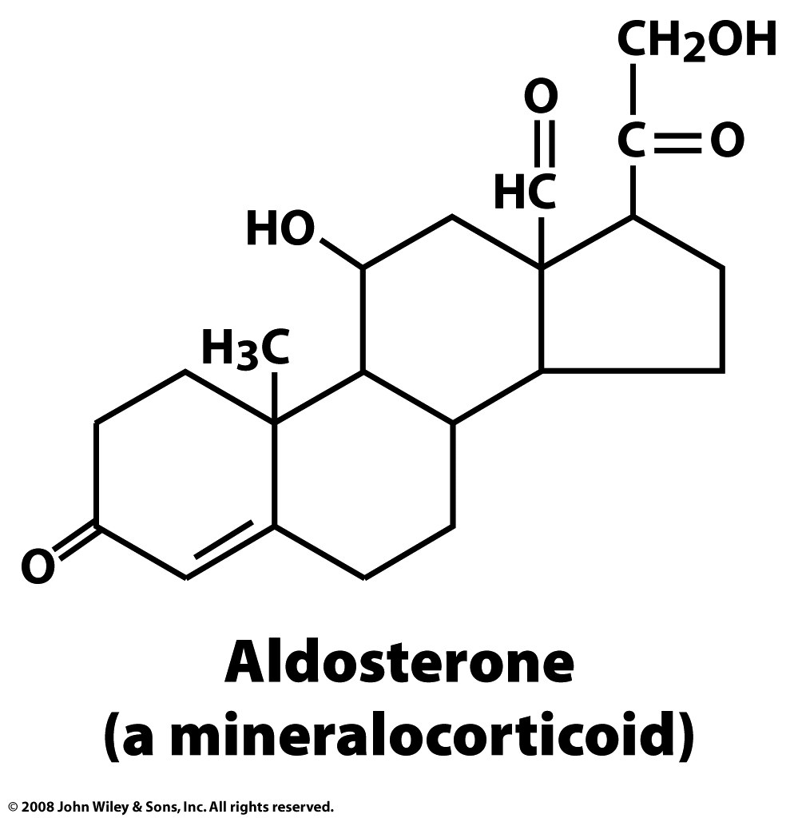
Aldosterone increases the absorption of sodium ions and water, and the secretion potassium ions from the kidneys, therefore increasing blood volume and pressure. Drugs that interfere with the secretion or action are antihypertensives.

Slide 10
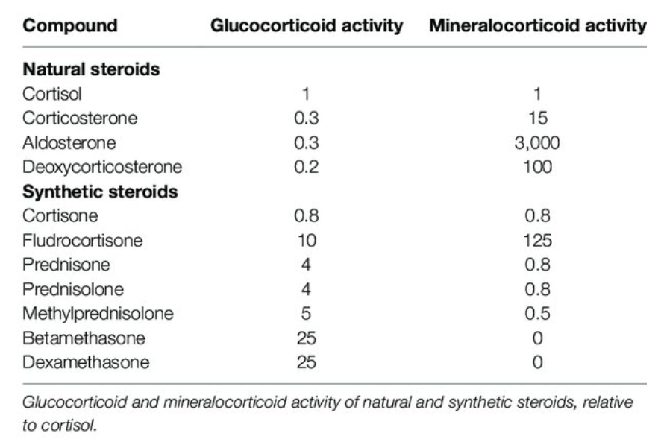
Gluco-mineralocorticoid activity
Heming N, Sivanandamoorthy S, Meng P, Bounab R and Annane D (2018) Immune Effects of Corticosteroids in Sepsis. Front. Immunol. 9:1736.

Slide 11
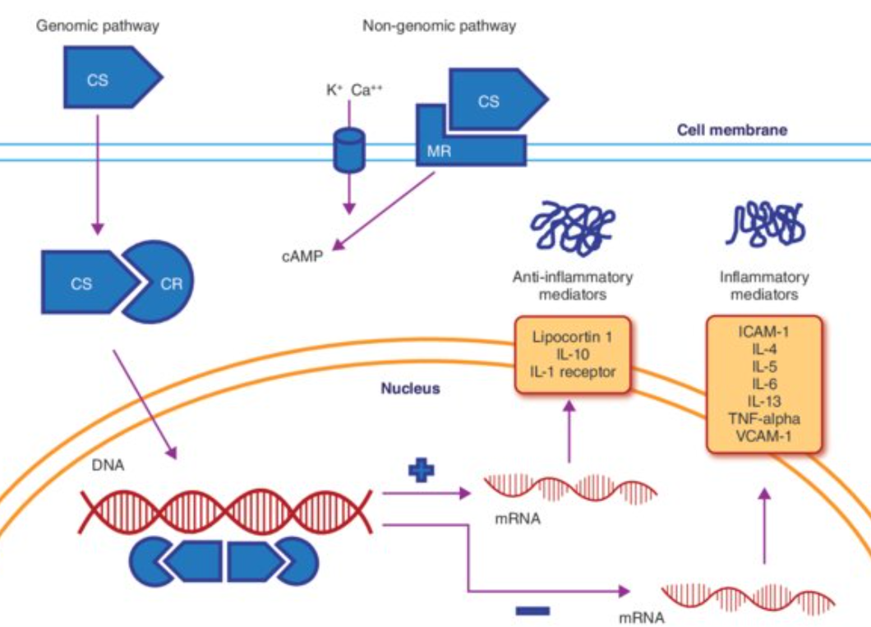
Dexamethasone
Amti-inflammatory effect

Slide 12
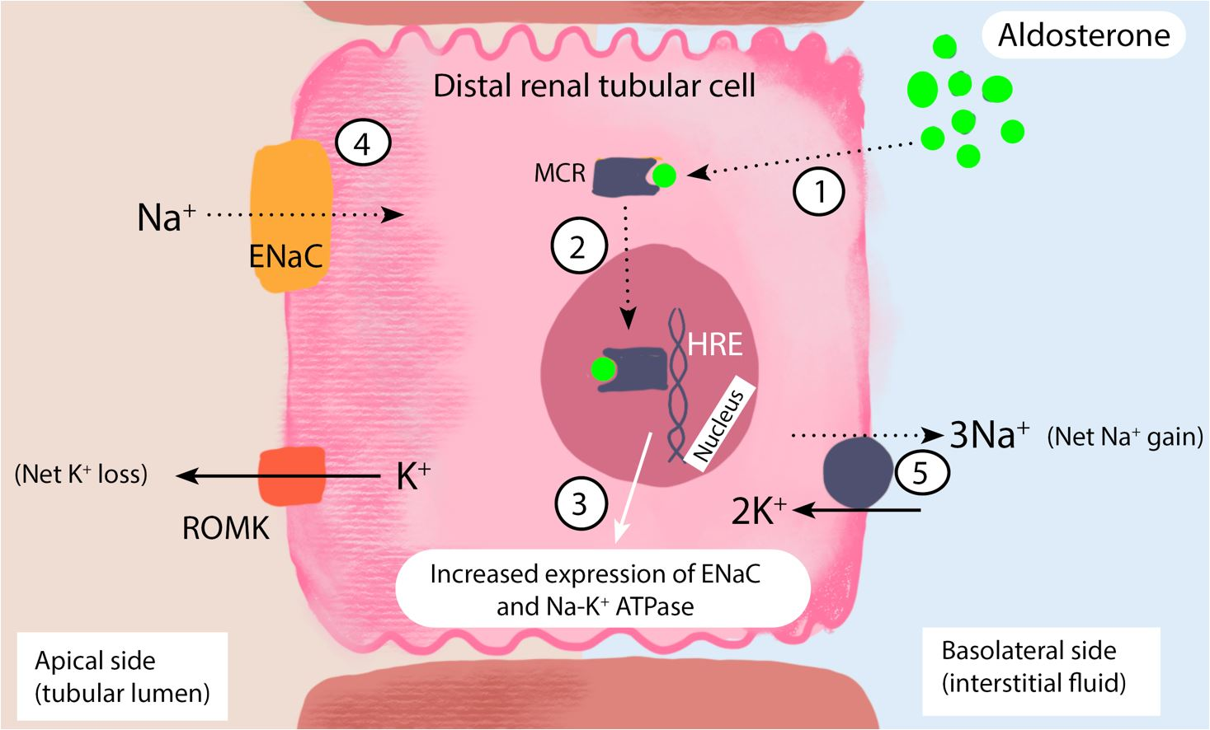
Aldosterone
Increase Blood pressure

Slide 13
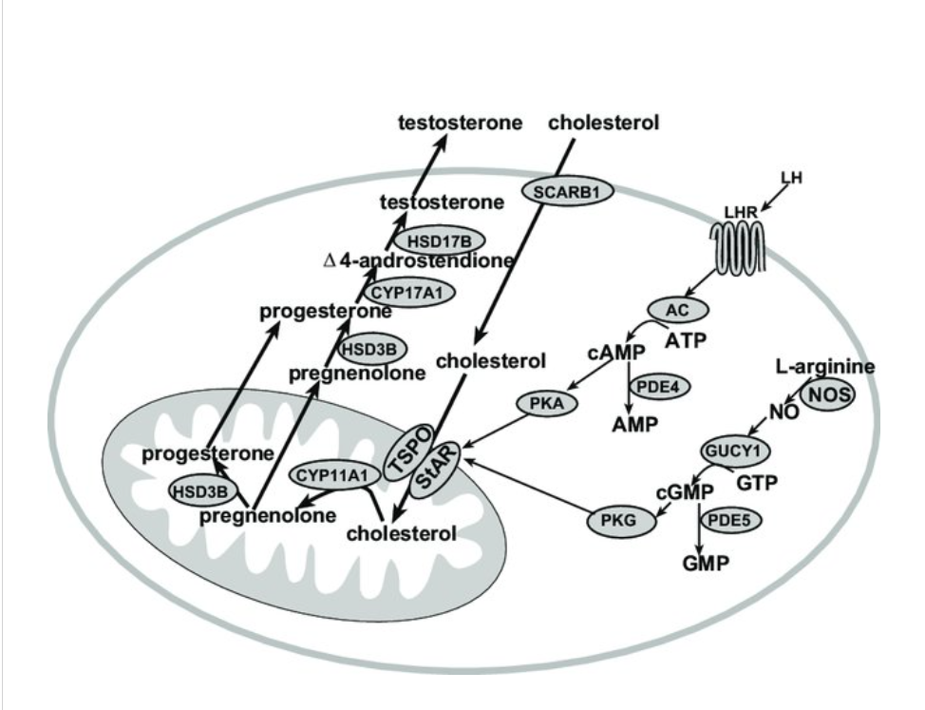
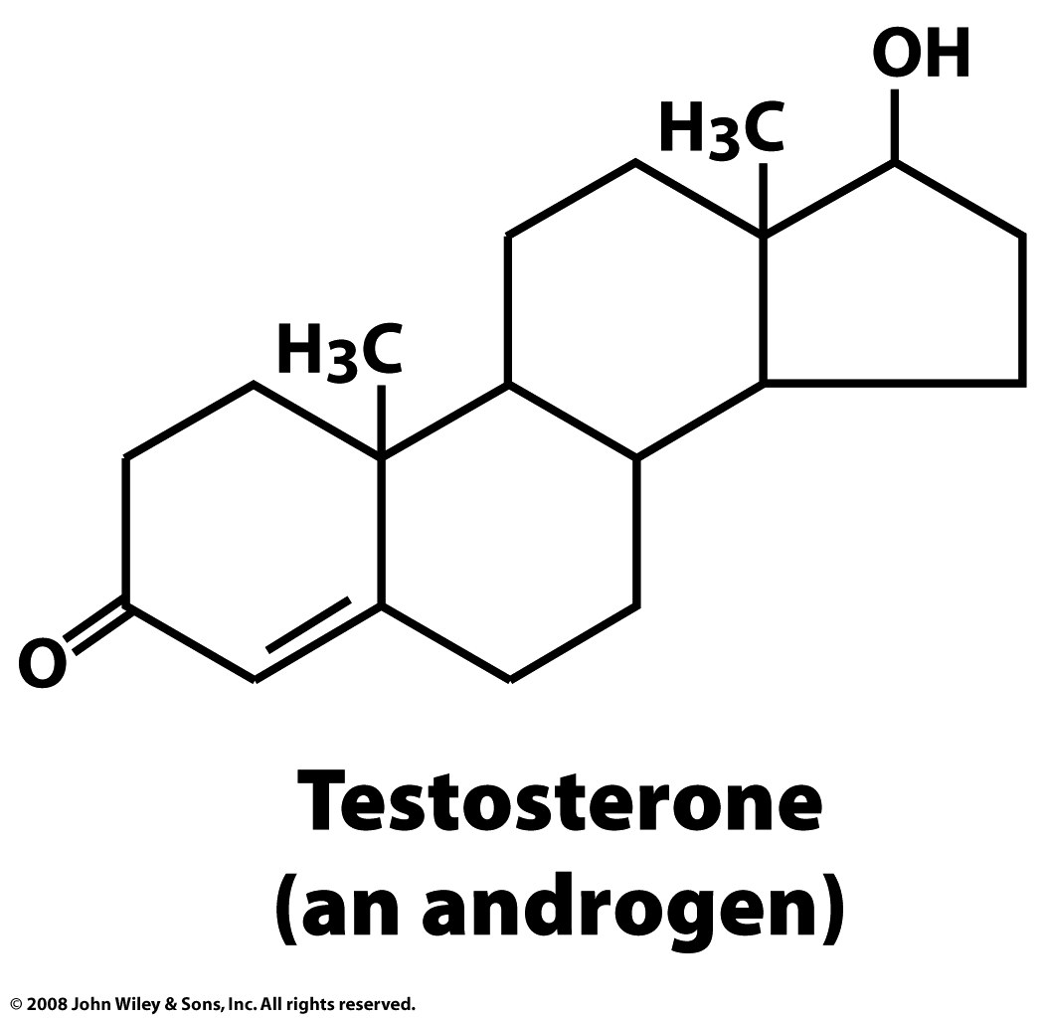
Testosterone is produced by Leydig cells in the interstitial space of the testis. As a result of the local production, testosterone levels in the testis in men are 25 to 125-fold greater in the testis (340 to 2,000 nM) as compared to serum (8.7–35 nM).
Natasa J. Stojkov, et al. 2013

Slide 14
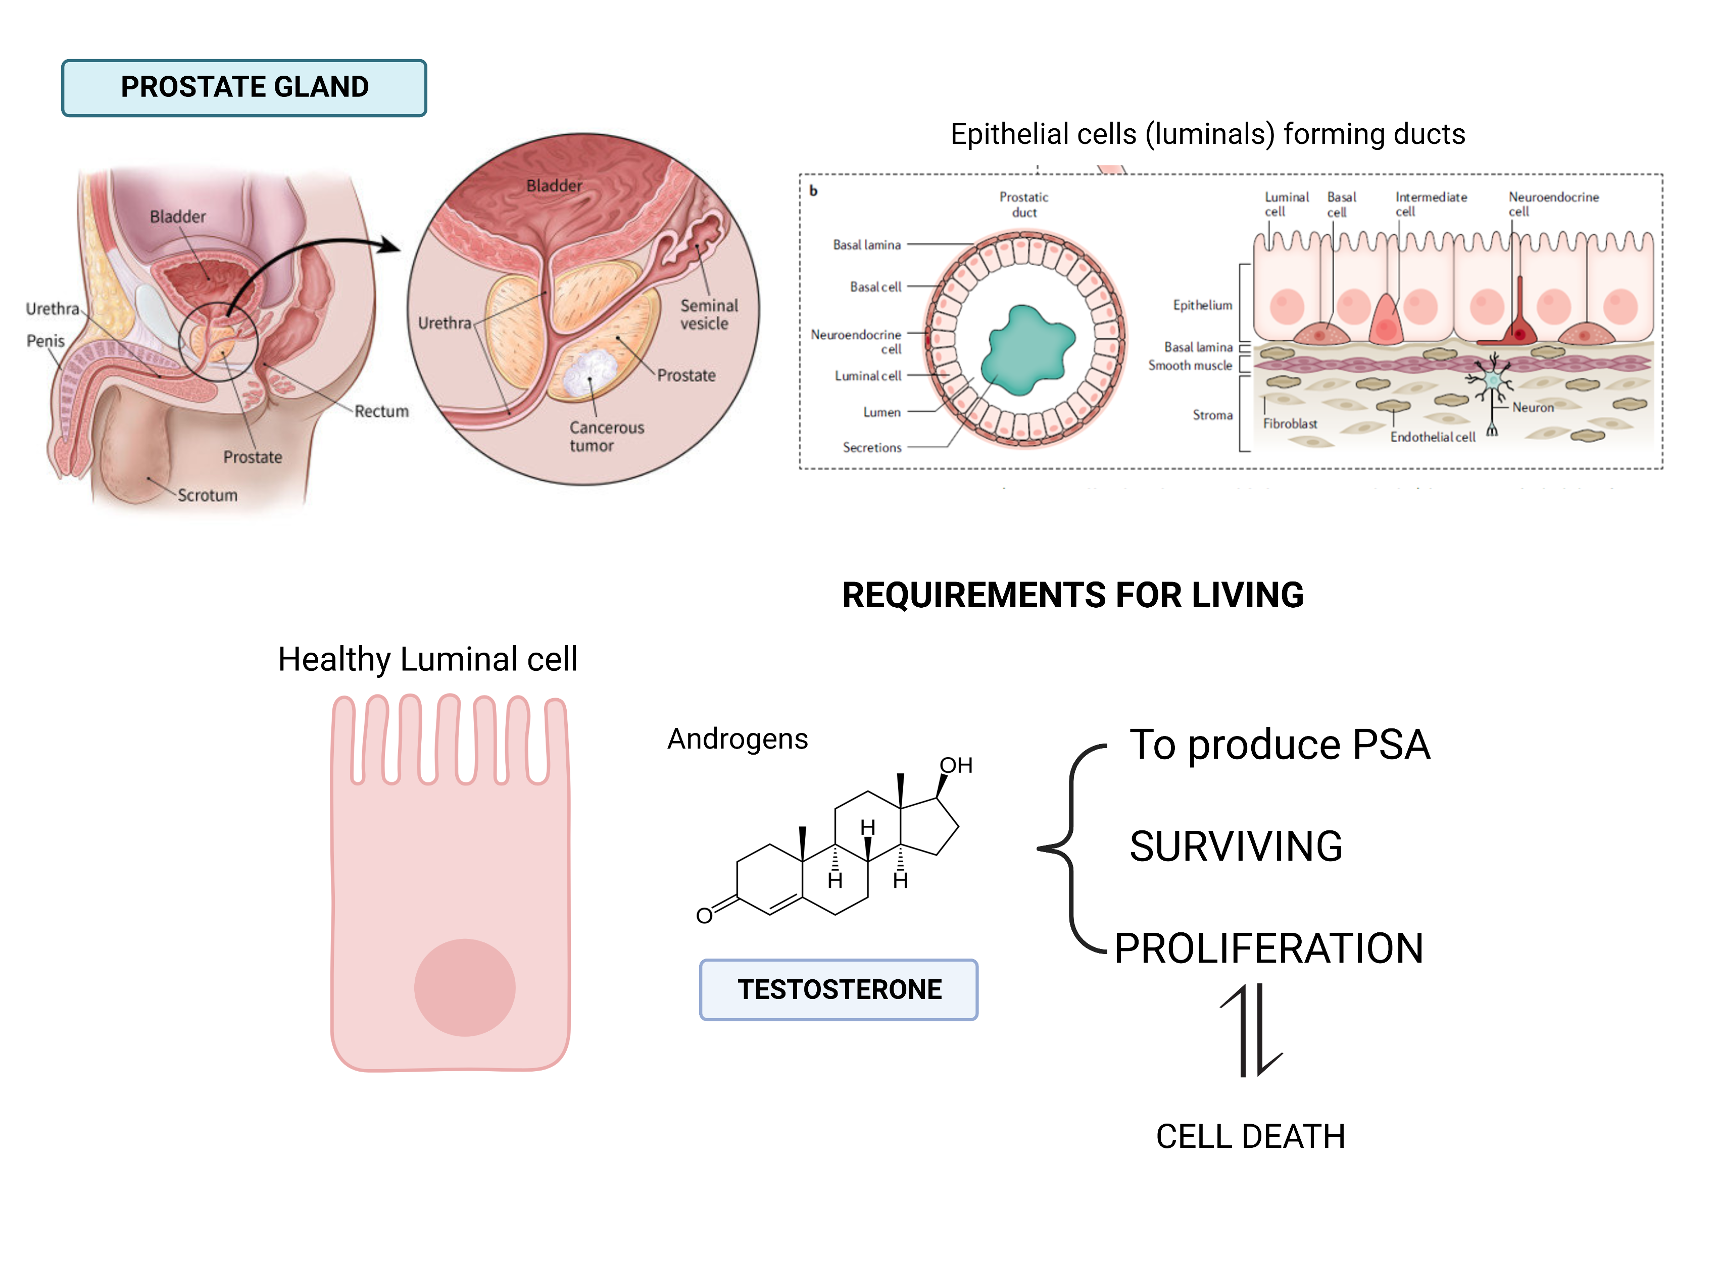

Slide 16
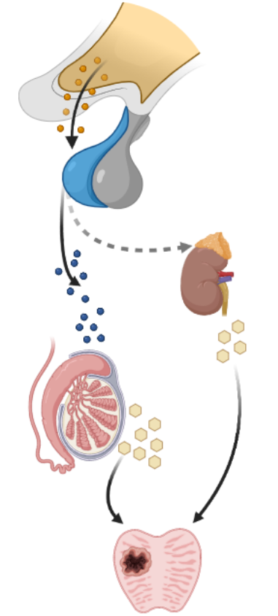
Androgen Deprivation Therapy
ADT
Luteinizing hormone-releasing hormone (LHRH) agonists
Drugs to block Testosterone synthesis
Leuprolide
Abiraterone
Inhibit CYP17A1 enzyme
Enzalutamide
Androgen receptor inhibition
Notes:
Prostate cancer is one of the cancers with the highest survival rates, however, this rate drops dramatically until 30% when is detected lately. The main problem is when tumor develops resistance to Androgen deprivation therapy, that is the conventional treatment for prostate cancer. One of the mechanisms proposed to explain the develop of resistance is the intratumorally steroid hormone synthesis, that means that tumor produce it own testosterone to survive. To study this mechanism, we need models that represent primary tumor heterogeneity.

Slide 17
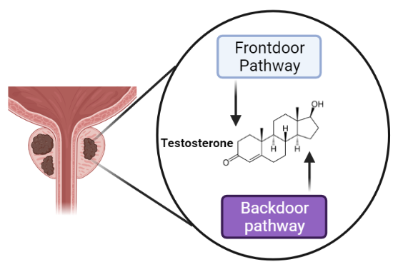
Intratumoral De Novo steroid hormone synthesis
Castration Resistance
Tumor Aggressiveness
Few models available to study cancer progression and do not represent primary tumor heterogeneity

Slide 19
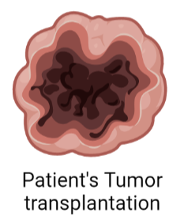
CELL LINES
XENOGRAFTS
https://doi.org/10.1016/j.urology.2017.04.020

Slide 20
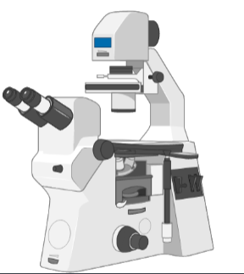
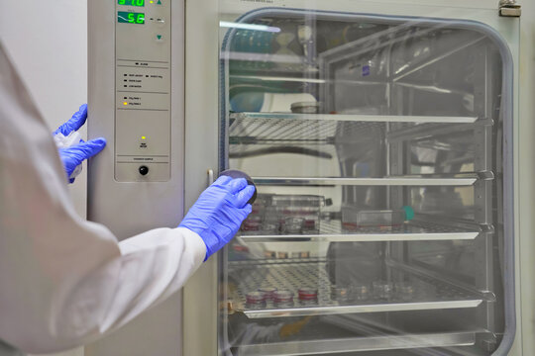
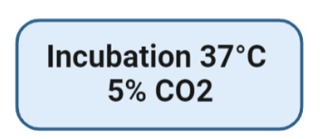

Slide 22
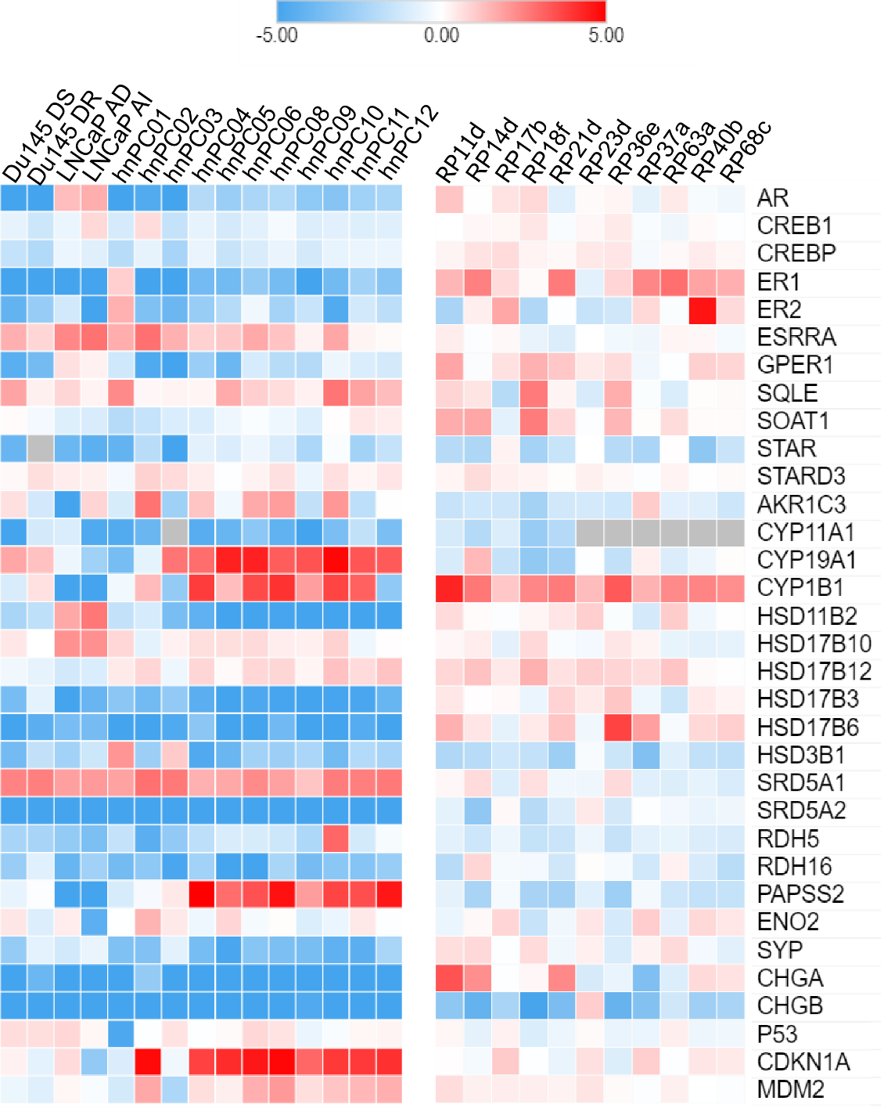
Steroidogenesis pathway in hormone-naïve primary cultures
Changes in gene expression profiles in hormone naïve primary cultures show steroidogenic reprogramming
Log2 fold change
De novo synthesis of Testosterone and estrogen in primary cultures
a
b
c

Slide 23
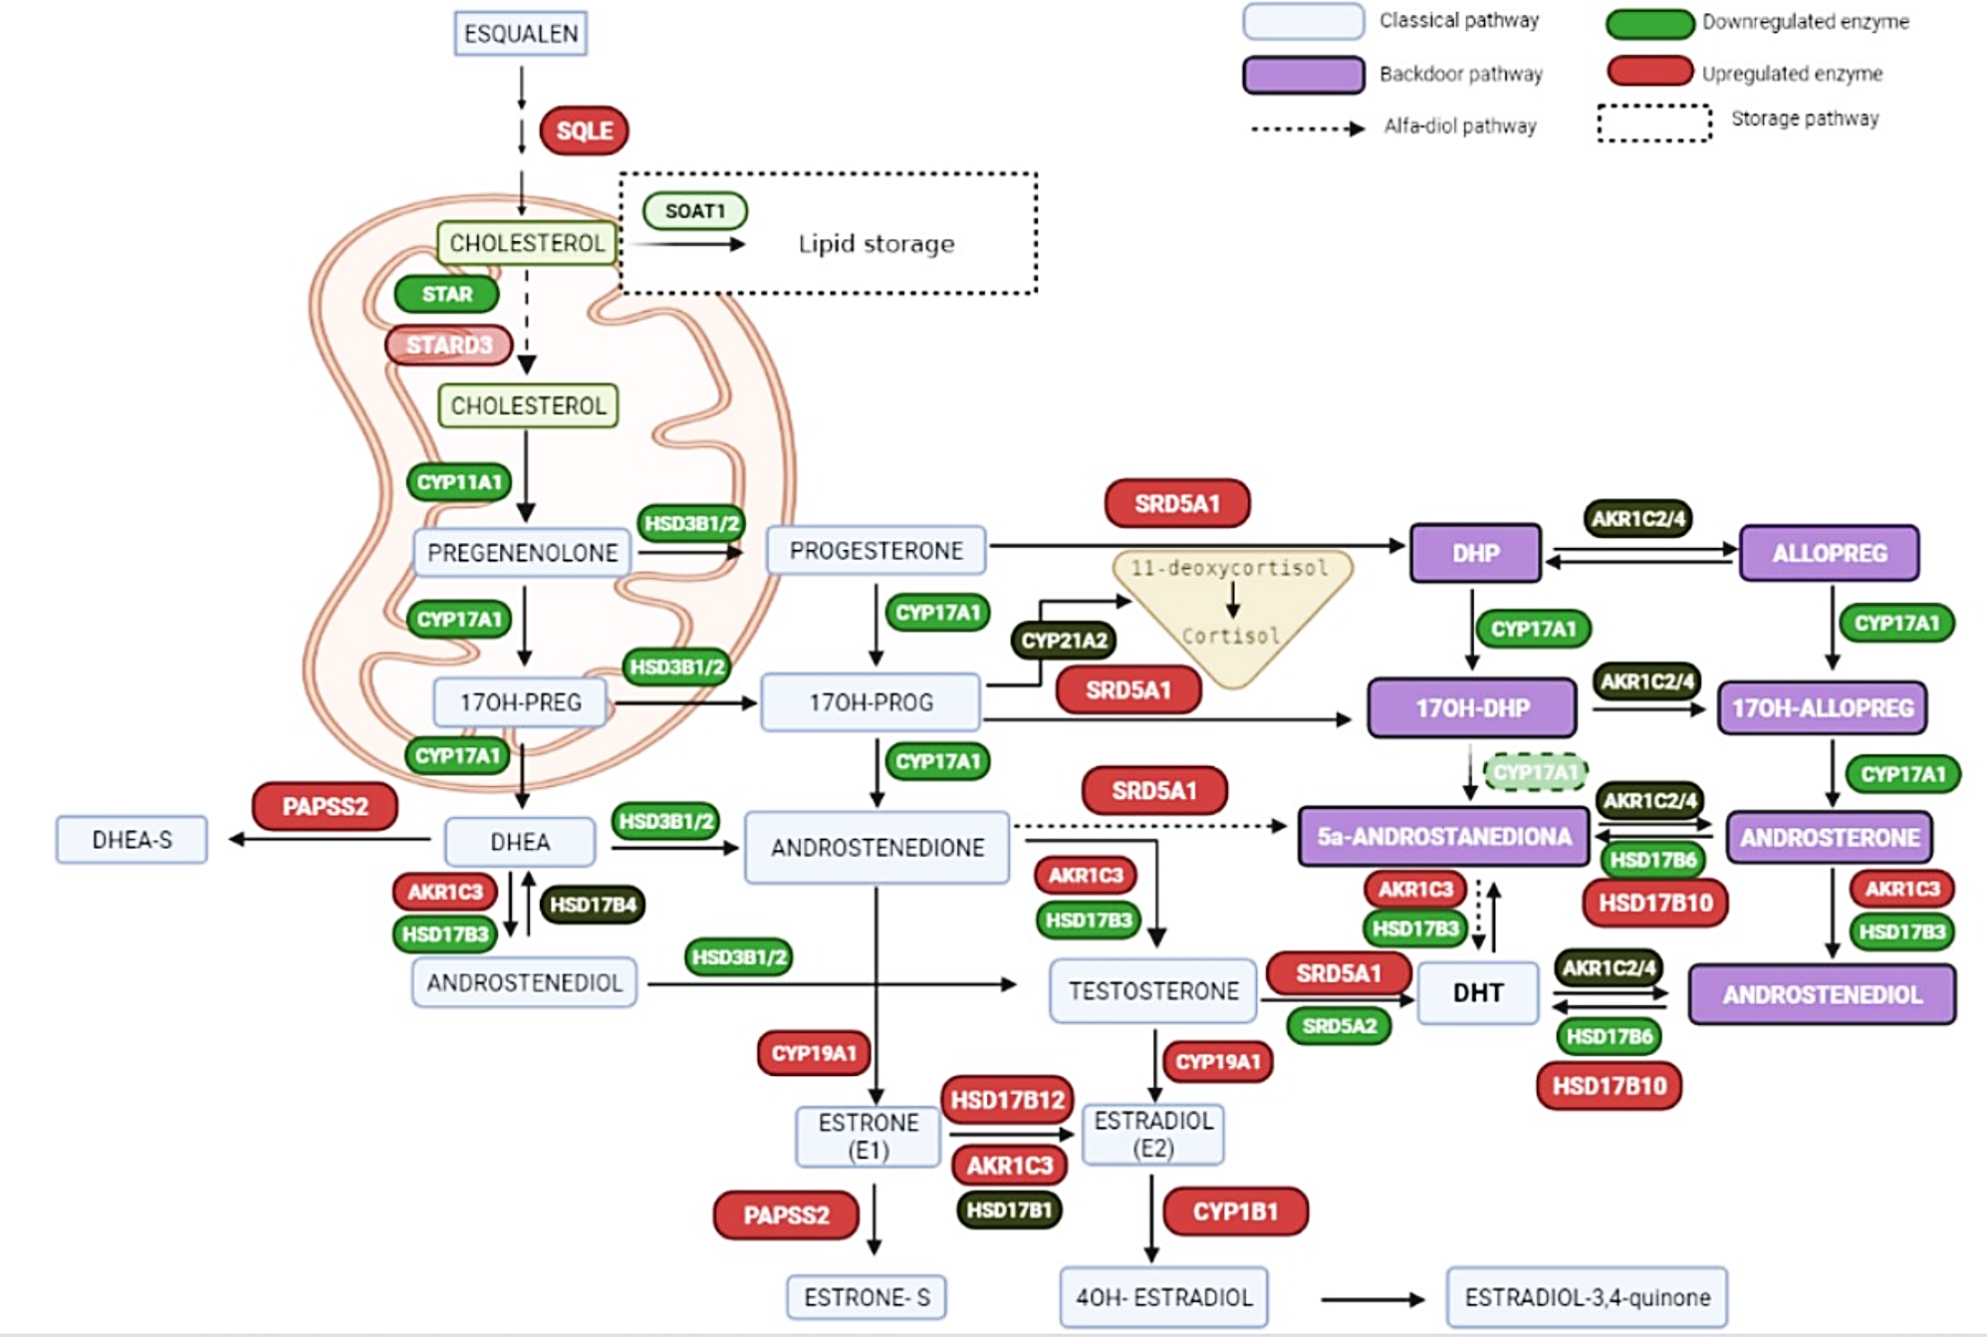
Steroidogenesis pathway in hormone-naïve primary cultures

