Slide 1
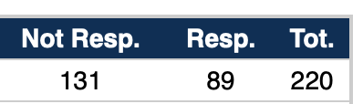

Slide 2
The red part does not happen (it seems impossible)

Slide 3
What does translation do?
Reads mRNA (polynucleotide)
Writes coded protein (polypeptide)
Translation transduces information (changes its form).
Information is transduced from polynucleotide to polypeptide.

Slide 4
Why is translation so much more complicated that replication and transcription?
Replication and transcription use direct templating. Watson-Crick pairing directs incorporation of G opposite C and U (or T) opposite A (and vice versa). Base pairing is easy.
Translation uses indirect templating [20x(aa+aaRS + tRNA)]. The amino acid never touches the codon. There are many factors that act between the AA and the codon.
Why? Not sure. But it is difficult to transduce information from polynucleotide to polypeptide. The structures and assembly principles of these two polymers are so different.
  RNA: anionic backbone, few sidechains of similar structure, assembles by sidechain-sidechain interactions.
  Protein: neutral backbone, 20 sidechains of diverse structure, assembles by backbone-backbone interactions.

Slide 5
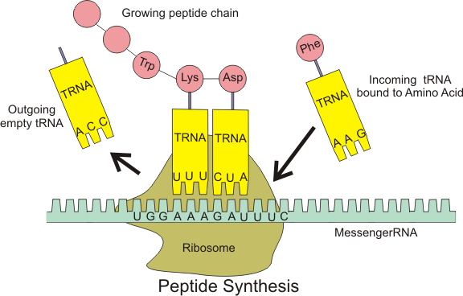
The Ribosome
A ribosome is rRNA-protein assembly that creates all coded proteins. The ribosome translates information contained mRNA into the amino acid sequence of a protein. Ribosomes use mRNA as a template for specifying the sequence of amino acids in a protein. The ribosome translocates mRNA, "reading" its sequence and producing a chain of amino acids of sequence specified by the mRNA according to the genetic code.

Slide 6
The Ribosome
Exit Peptide Amino acid
anticodon
codon
codon
codon
codon
codon

Slide 7
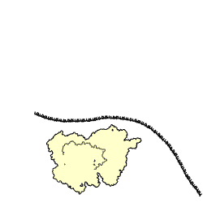
Nascent Polypeptide
(in the exit tunnel)
LSU
mRNA
SSU
Decoding Center
By Bensaccount at en.wikipedia, CC BY 3.0,
https://commons.wikimedia.org/w/index.php?curid=8287100

Slide 8
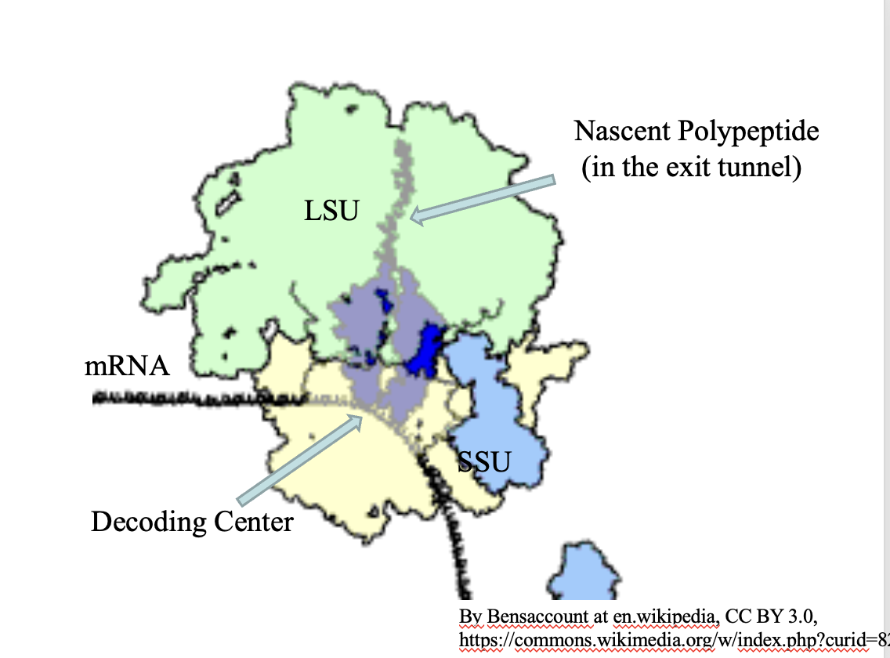
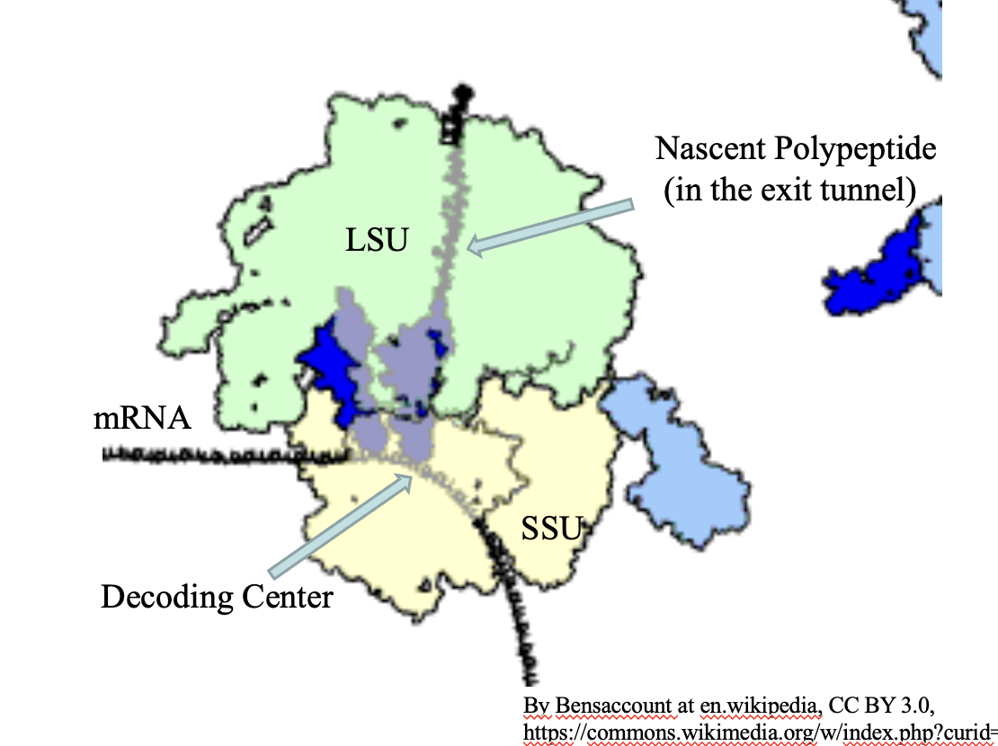

Slide 9
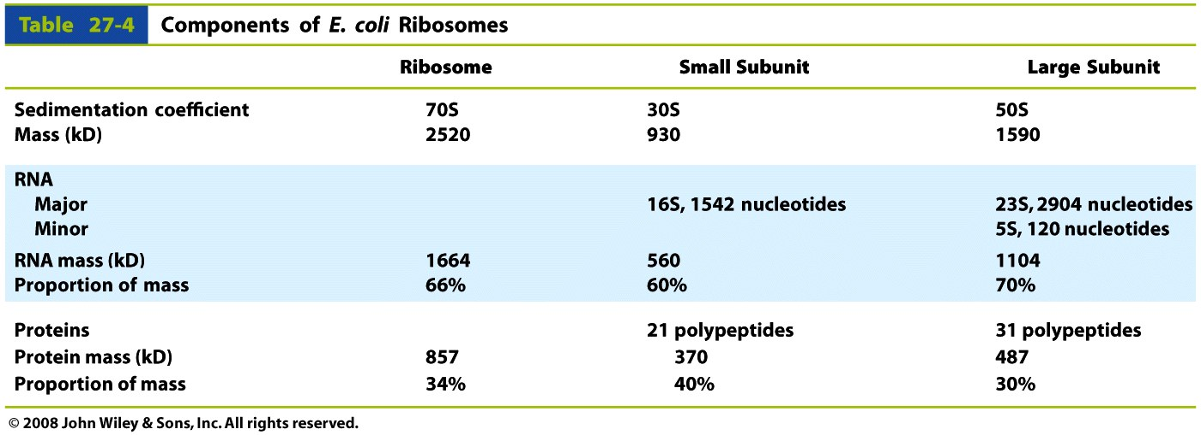
Bacterial Ribosome
Bacterial rRNAs

Slide 10
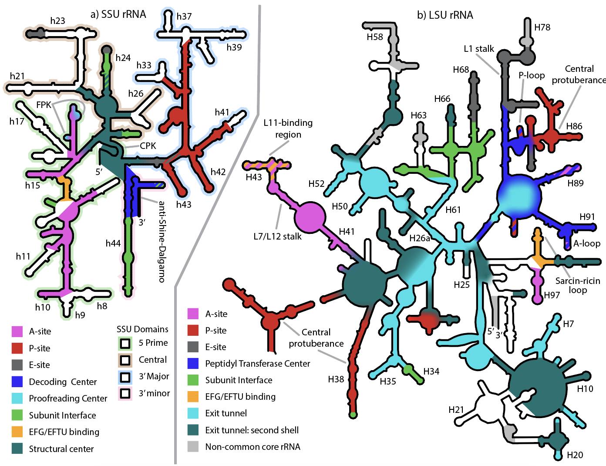
Bacteria
16S rRNA
23S rRNA
5S rRNA

Slide 11
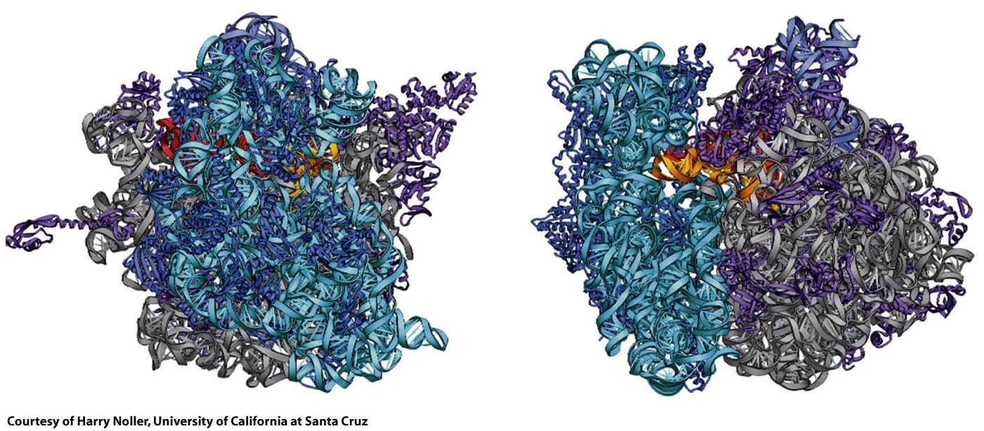
Assembled Ribosome
tRNAs
LSU
SSU
SSU
Figure 27-17

Slide 12
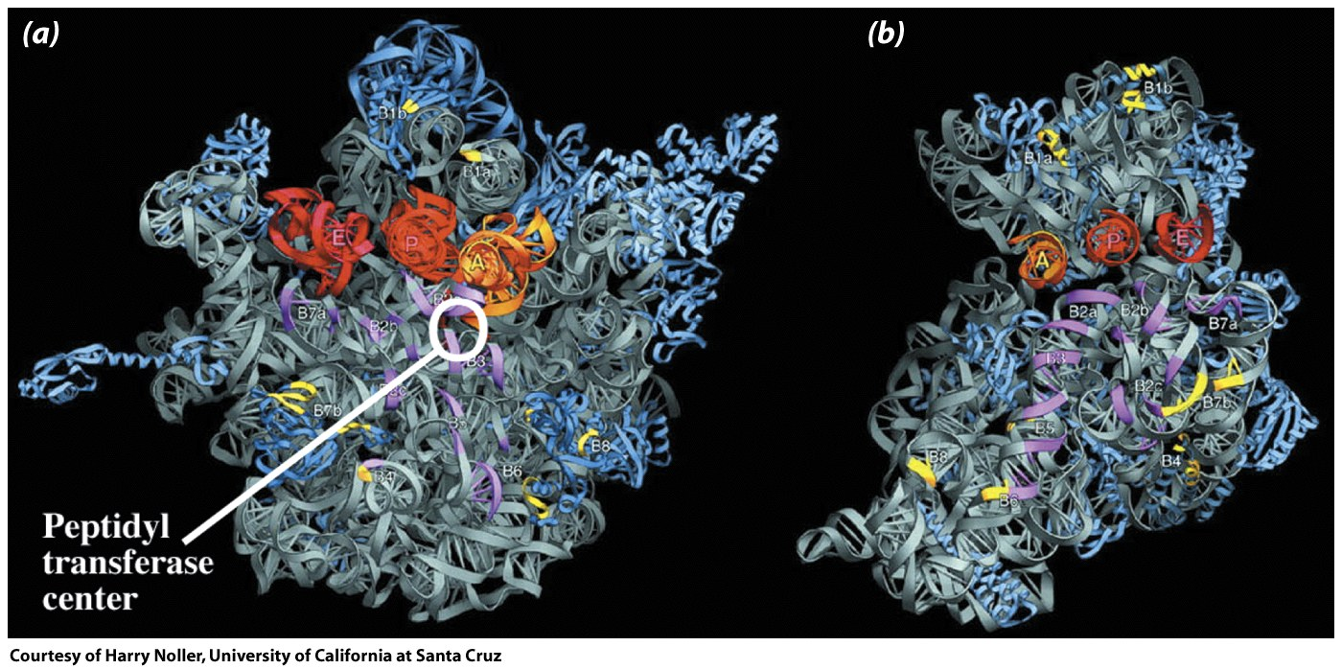
LSU
E P A
tRNAs
SSU
LSU
Figure 27-18

Slide 13
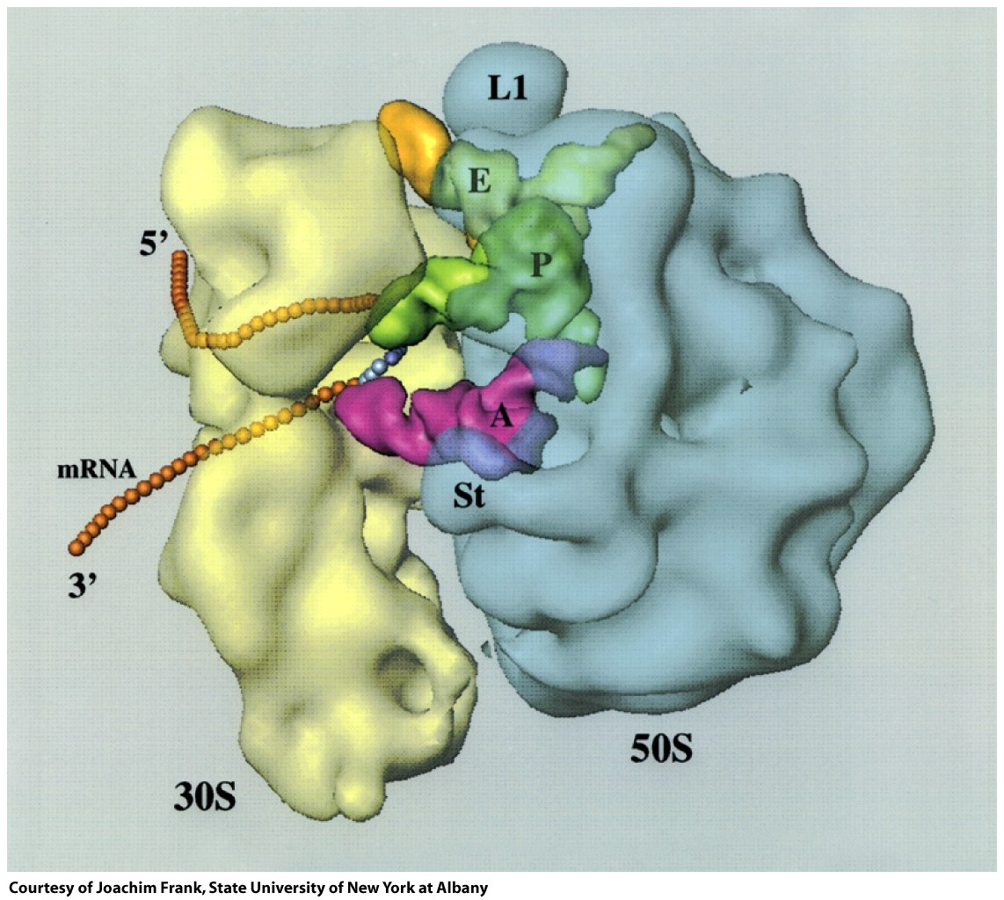
SSU
LSU
Figure 27-13b

Slide 14
What molecules are involved in translation
Amino acids 20 of them (are polymerized)
tRNAs 20 of them (are ‘charged’ by aaRSs, then ‘discharged’, in the ribosome)
Aminoacyl tRNA (aaRSs) 20 of them (covalently link amino synthetases amino acids to tRNAs (charge tRNAs, hydrolyze ATP),
establish/enforce the genetic code
Ribosomes MolWt > 10⁶ Daltons
ribosomal proteins (> 50 of them)
ribosomal RNA (> 4000 nts)
decode mRNA
catalyze peptidyl transfer

Slide 15
Aminoacyl-tRNA Synthetases
Charge tRNAs (link them to amino acids)
Step 1: Activate the Amino Acid.
amino acid + ATP → aminoacyl-AMP + PPi
An activated amino acid = amino-acyl adenylate = aminoacyl-AMP
Step 2: Transfer the activated amino acid to the tRNA
aminoacyl-AMP + tRNA → aminoacyl-tRNA + AMP
An activated amino acid = amino-acyl tRNA
Step 1 + 2:
amino acid + tRNA + ATP → aminoacyl-tRNA + AMP + PPi

Slide 16
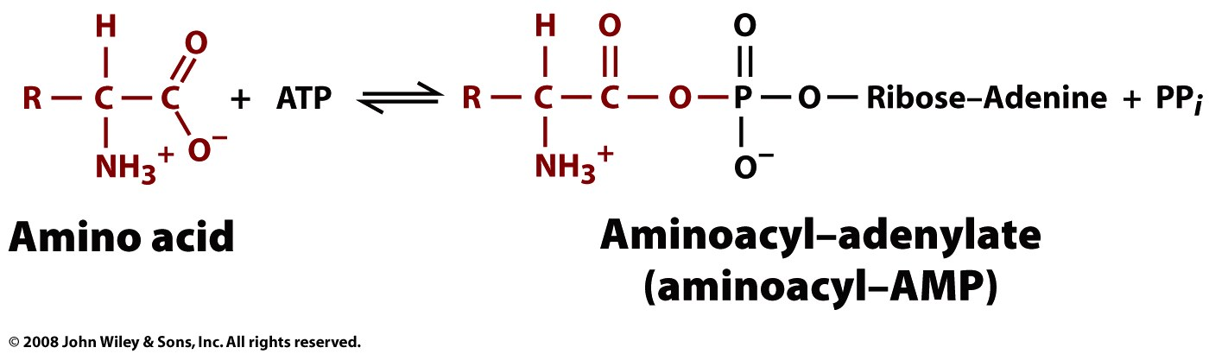
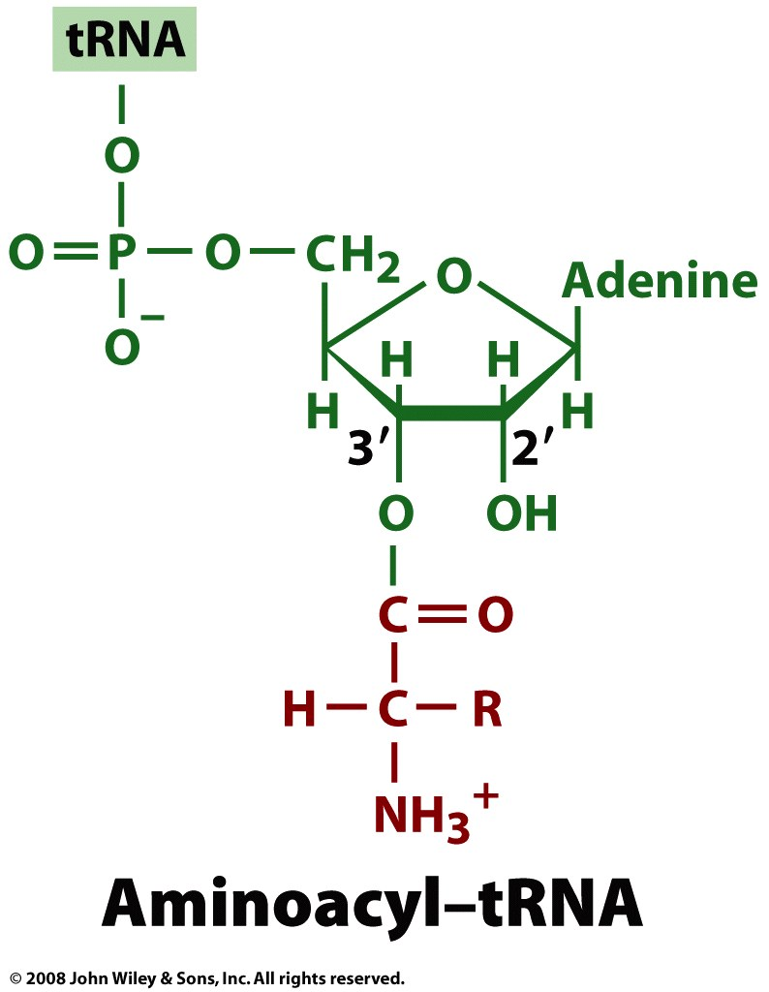
Aminoacyl-tRNA Synthetases

Slide 17
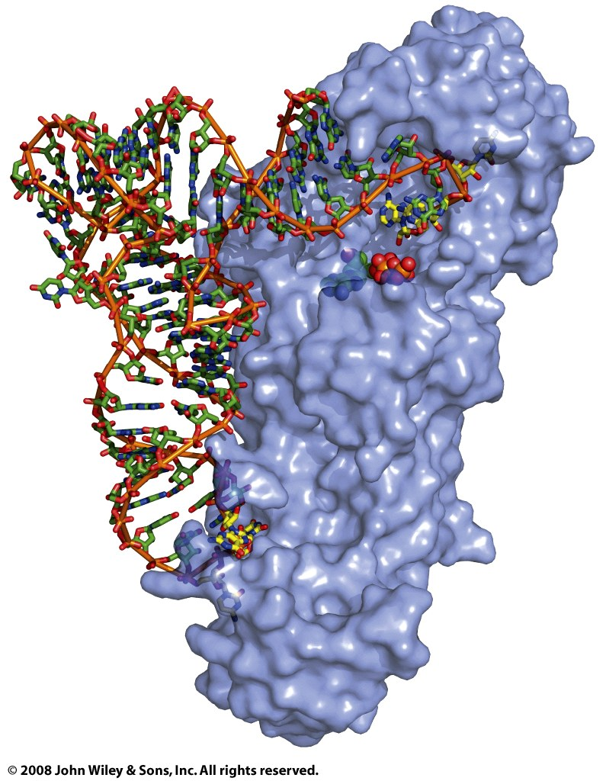
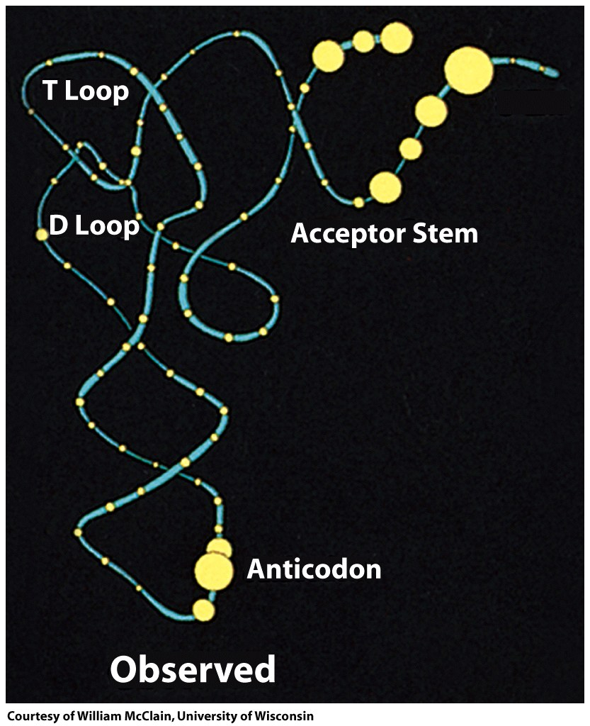
GlnRS bound to tRNA^{Gln} and ATP
Figure 27-7

Slide 18
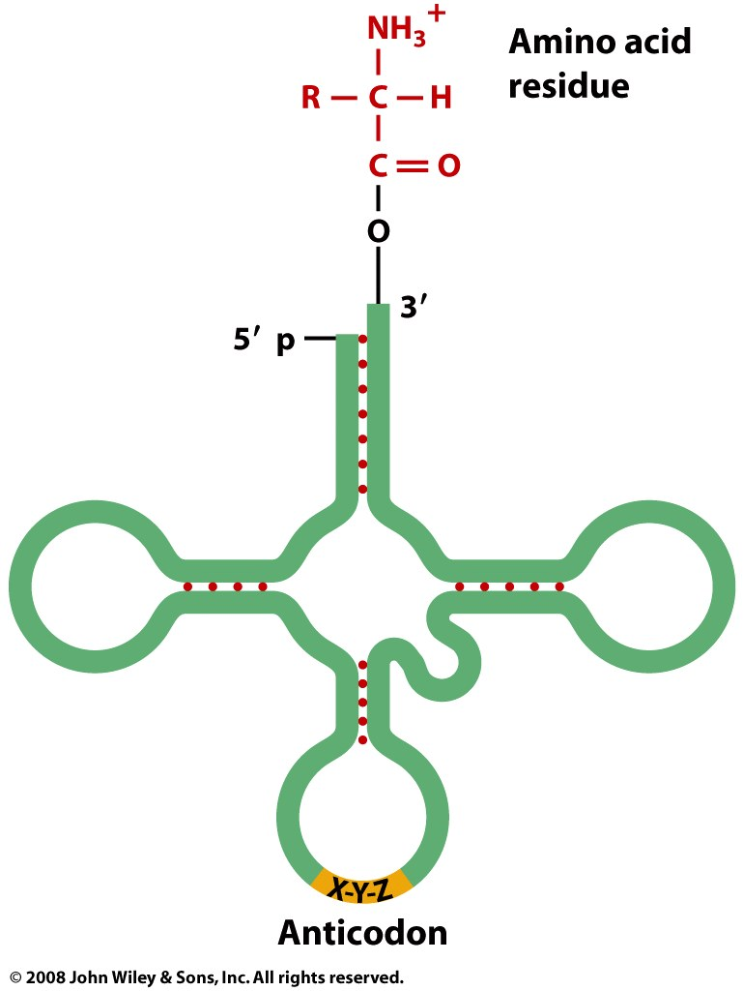
A “charged” tRNA, with an amino acid ester on the 3’ terminus.
Figure 27-1

Slide 19
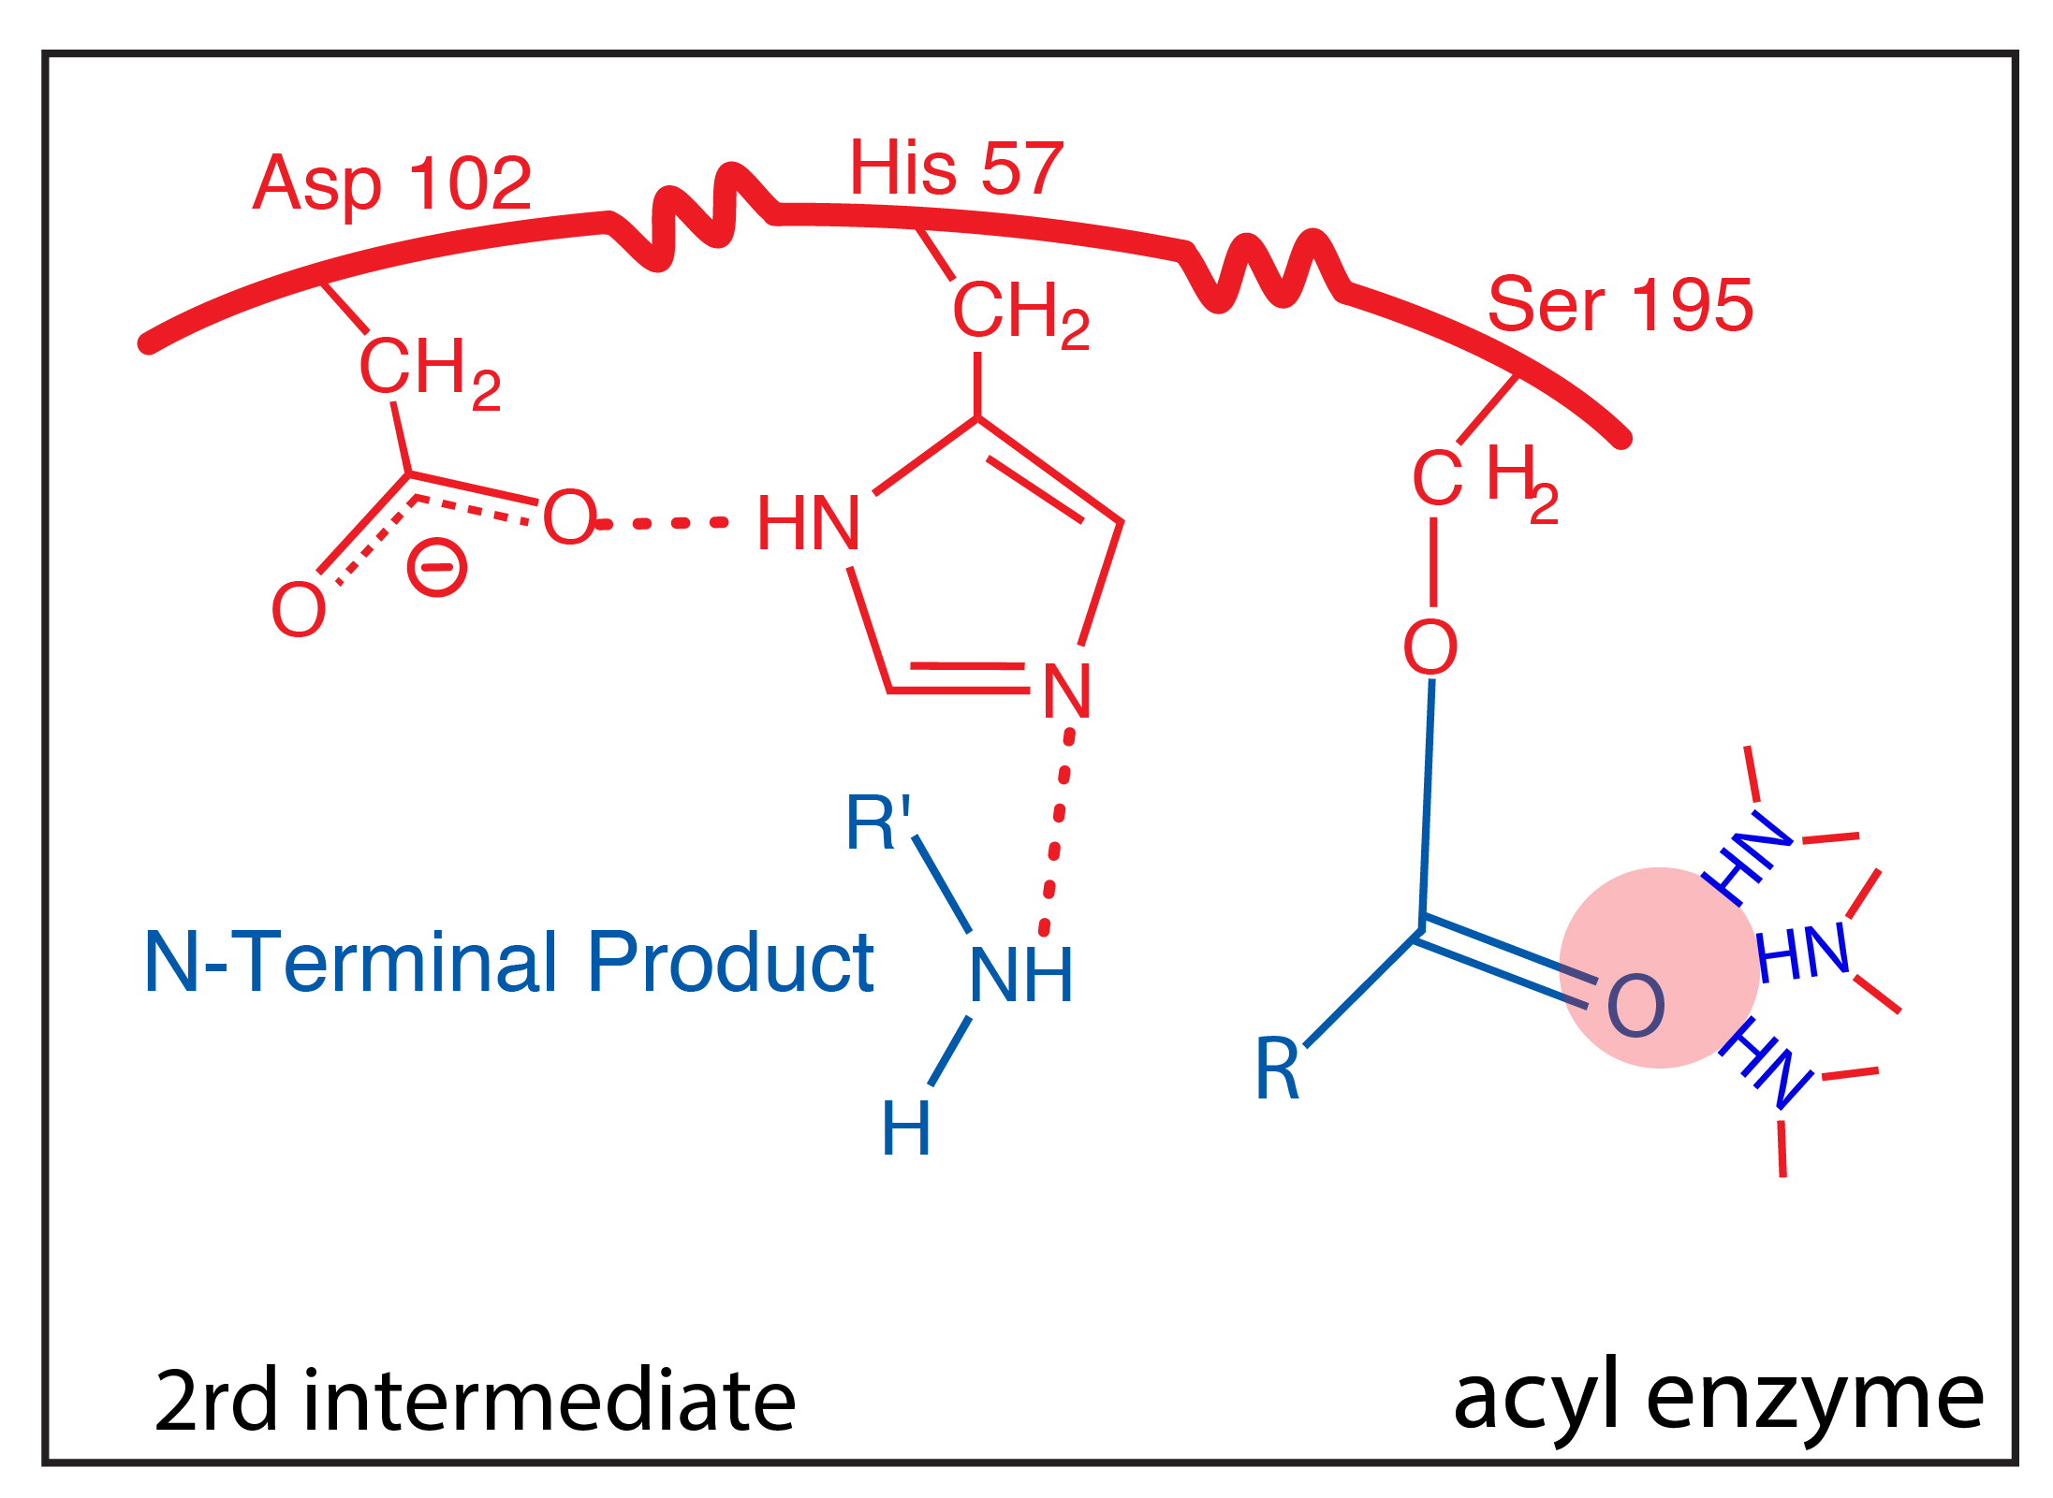
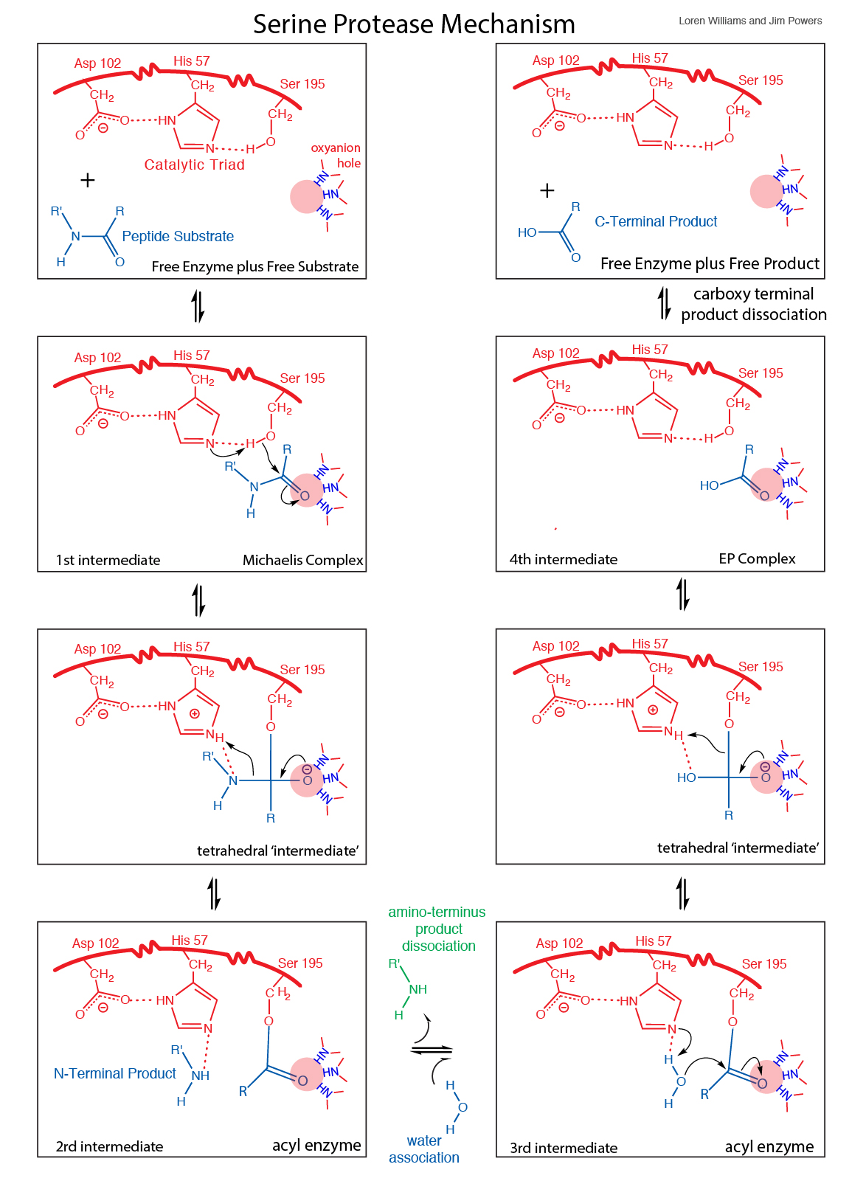
Remember the serine protease mechanism?
The activation energy for direct cleavage of a peptide bond is very high.
To cleave a peptide bond, the enzyme forms an acyl enzyme intermediate (an ester intermediate).

Slide 20
The activation energy for direct synthesis of a peptide bond is very high.
To make a peptide bond, an enzyme forms an acyl-tRNA intermediate (an ester intermediate).

Slide 21
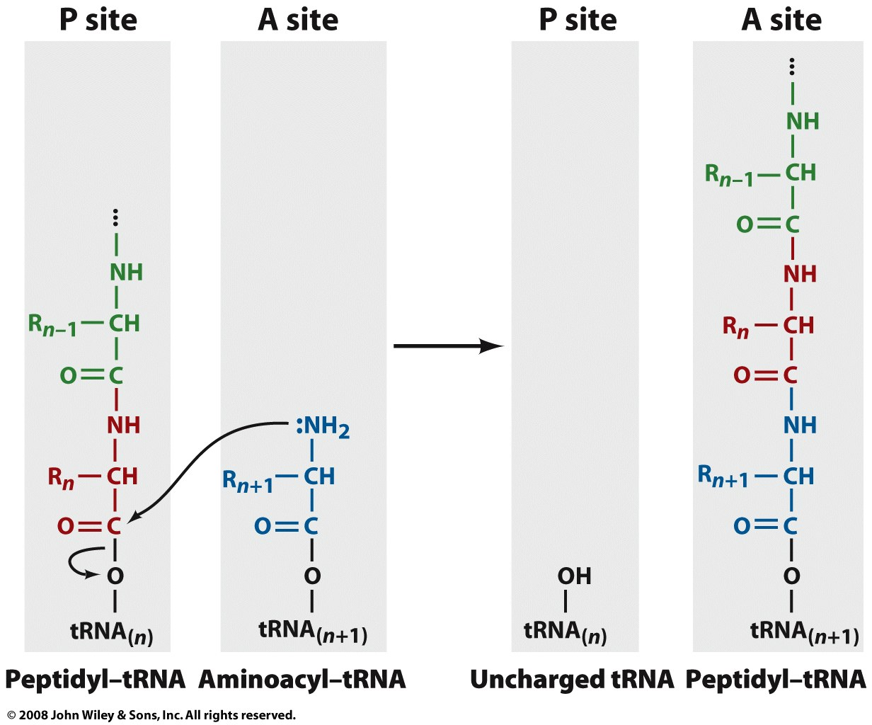
The Ribosome: The peptidyl transfer reaction

Slide 22
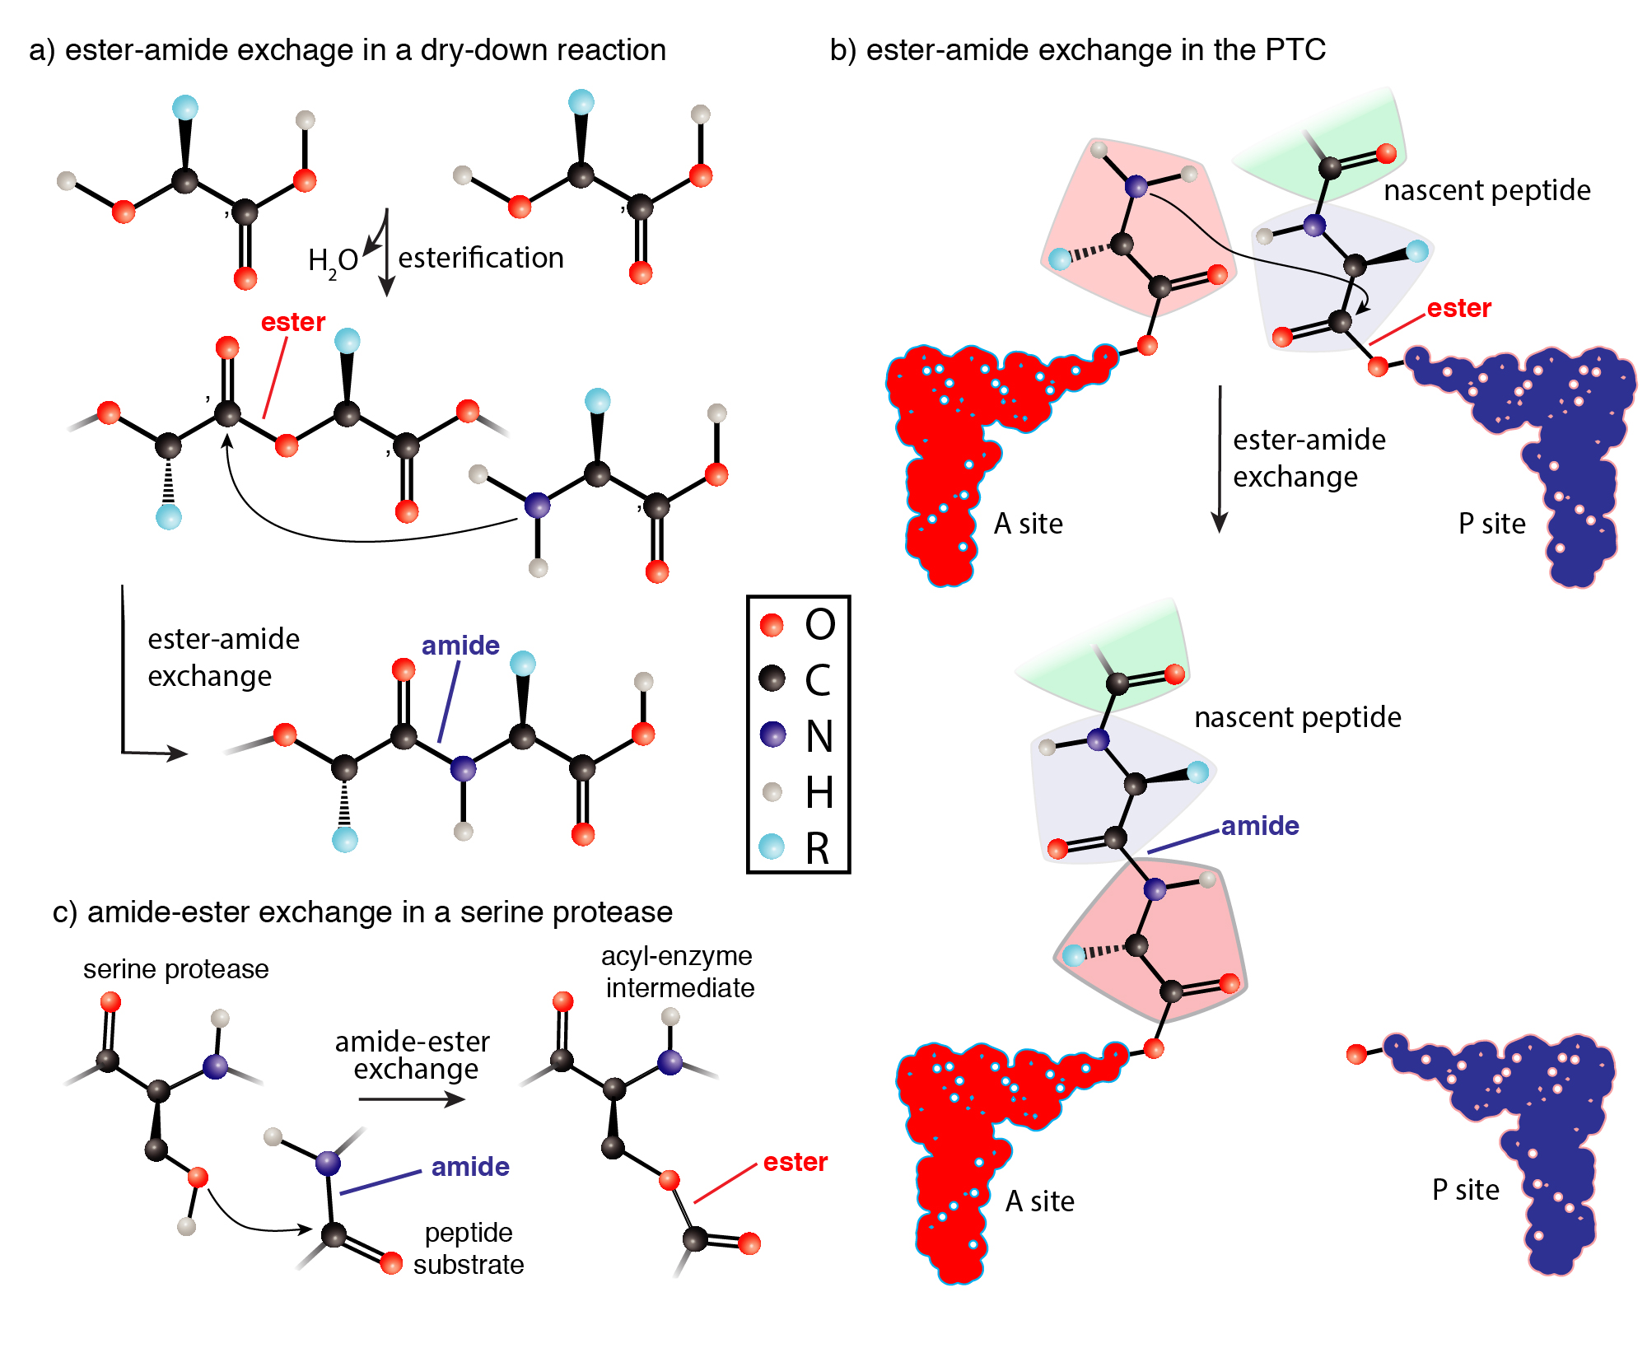
To synthesize a peptide bond, form an amino acyl tRNA intermediate (an ester intermediate).
Notes:
Translation outrageously complex, produces coded protein by very simple chemistry

Slide 24
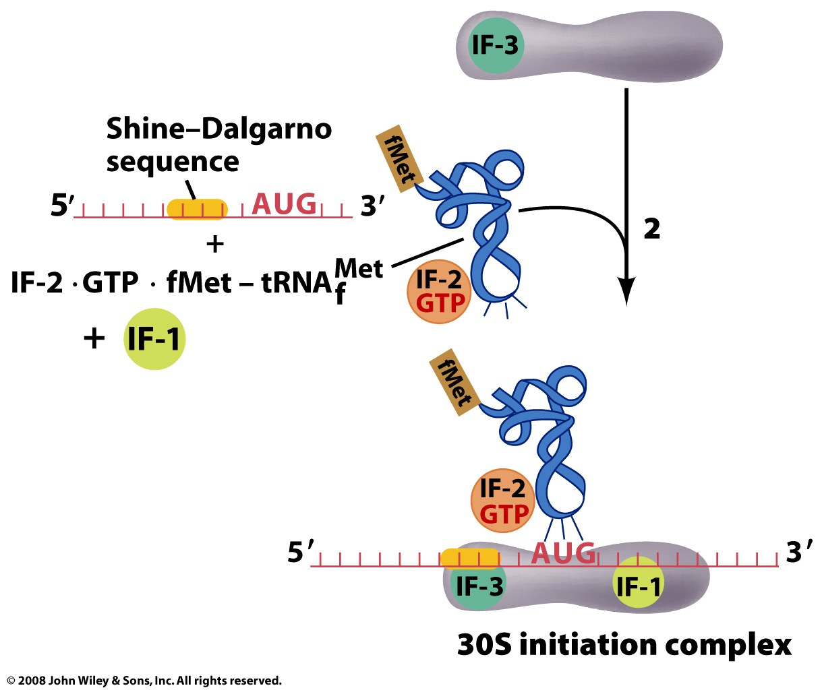
Initiation:
mRNA + Initiation Factor 2 (IF-2) + fMet-tRNA_{f}^{met}
The Shine-Dalgarno sequence of the 16S (SSU) forms base pairs to 5' end of the mRNA (Anti-SD sequence, i.e., initiation sequence) with the help of initiation factors (IF’s).
Figure 27-25 part 2

Slide 25
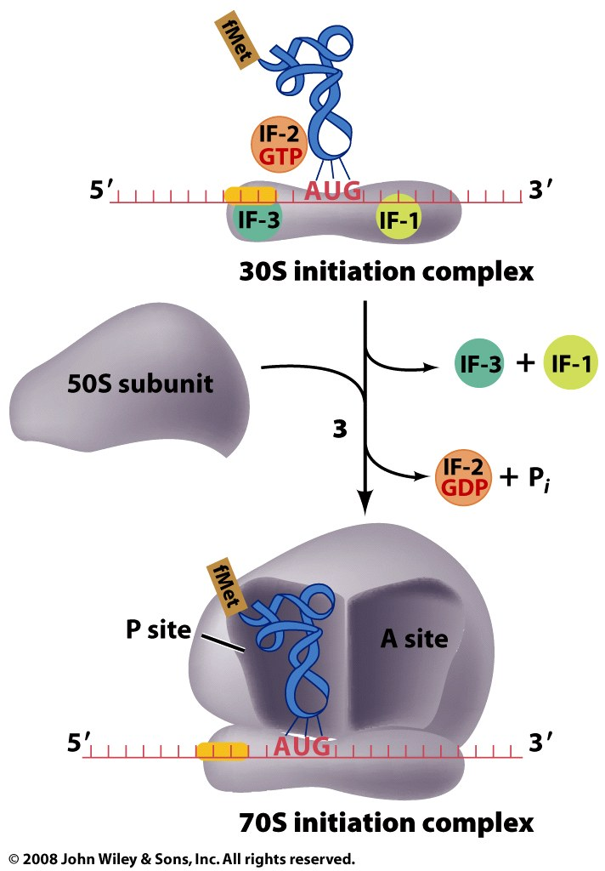
Figure 27-25 part 3

Slide 26
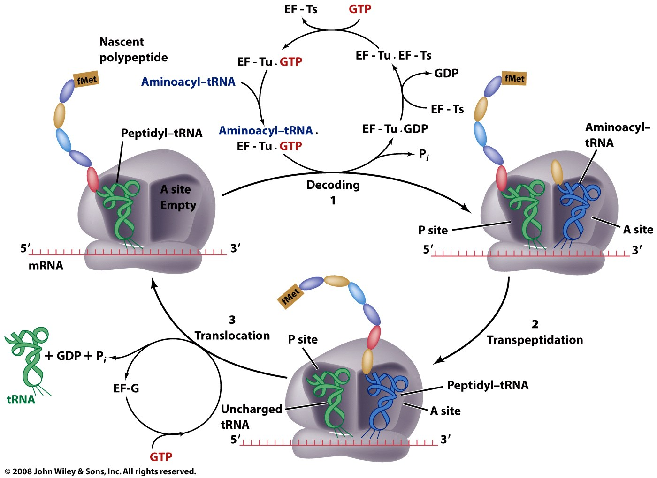
Elongation
Figure 27-27

Slide 27


Slide 28
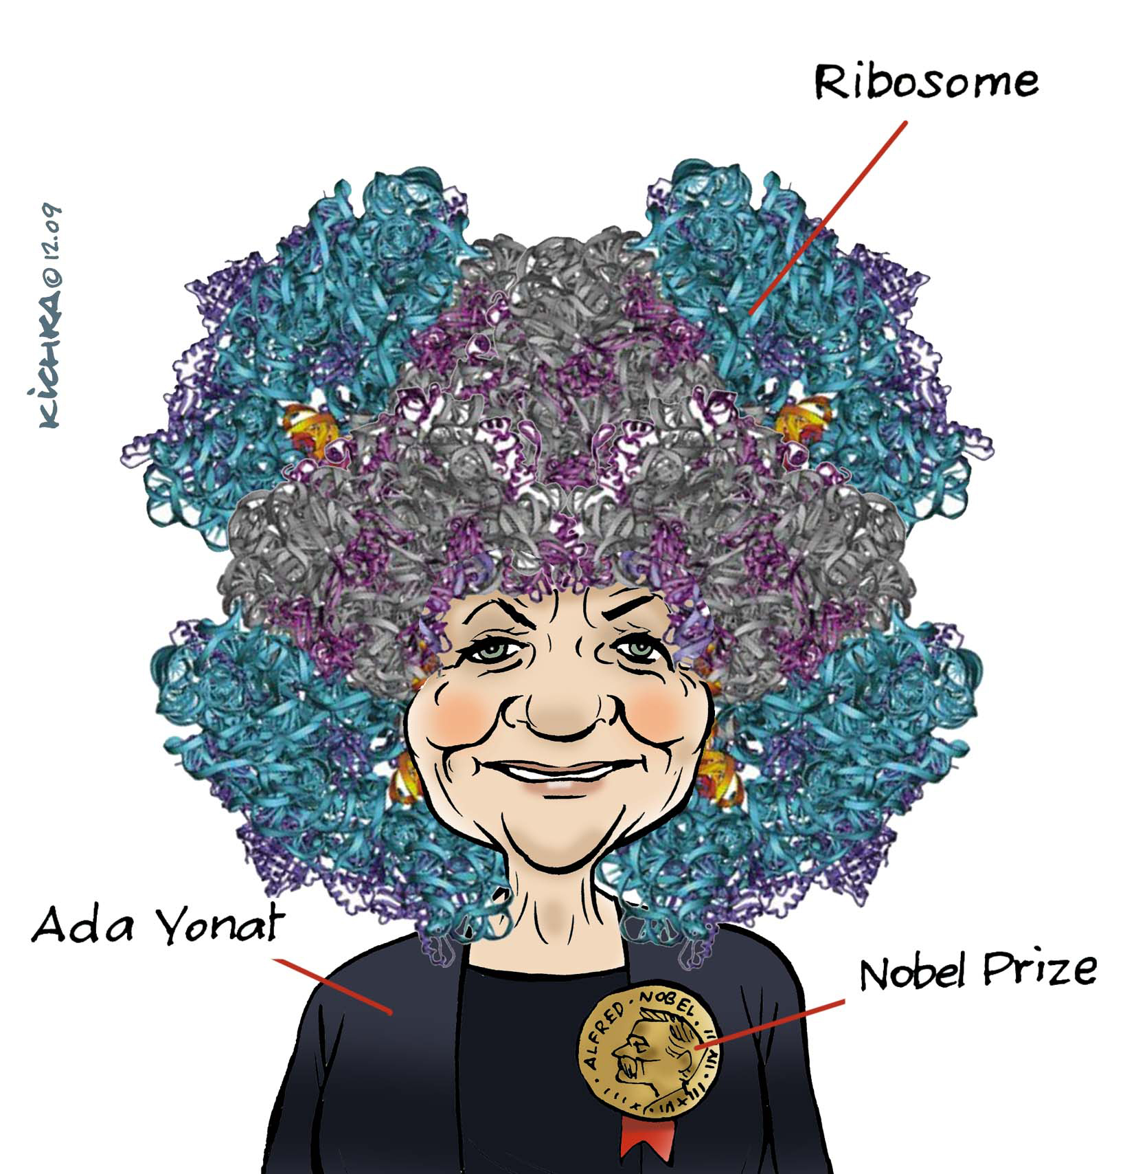

Slide 29
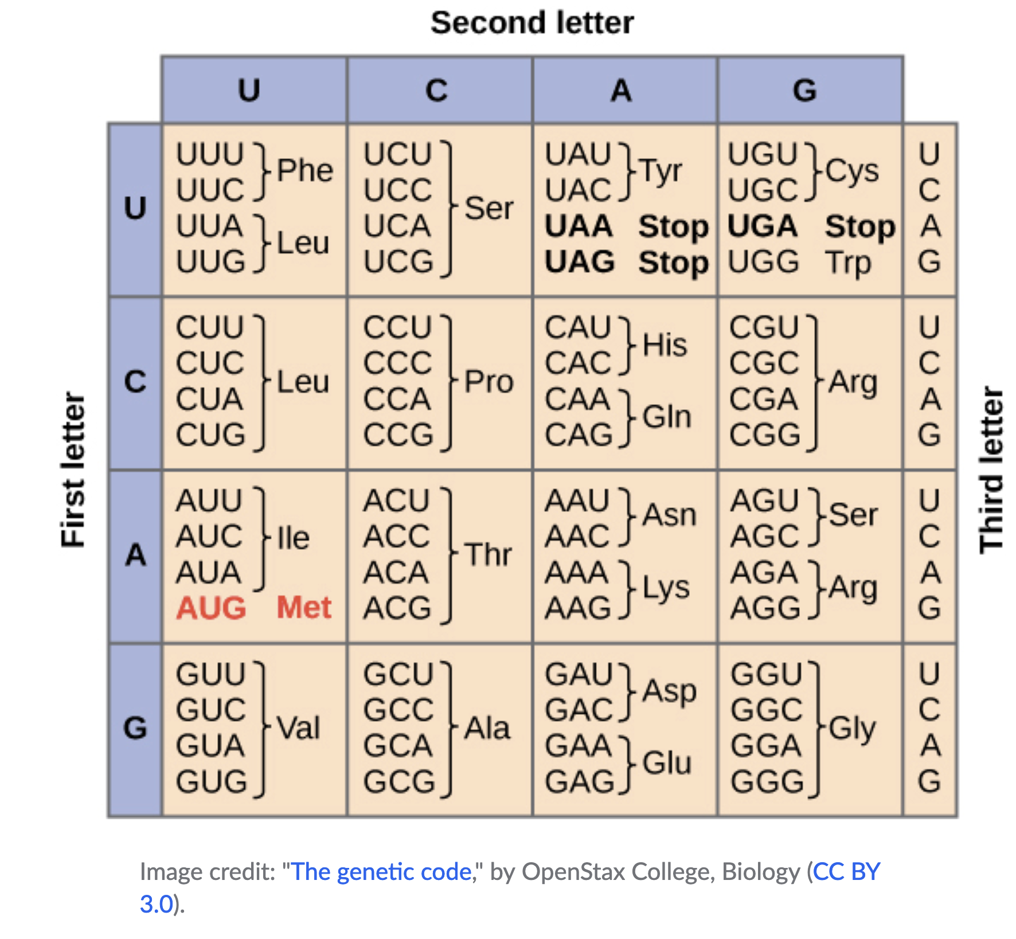
mRNA and The Genetic Code

Slide 30
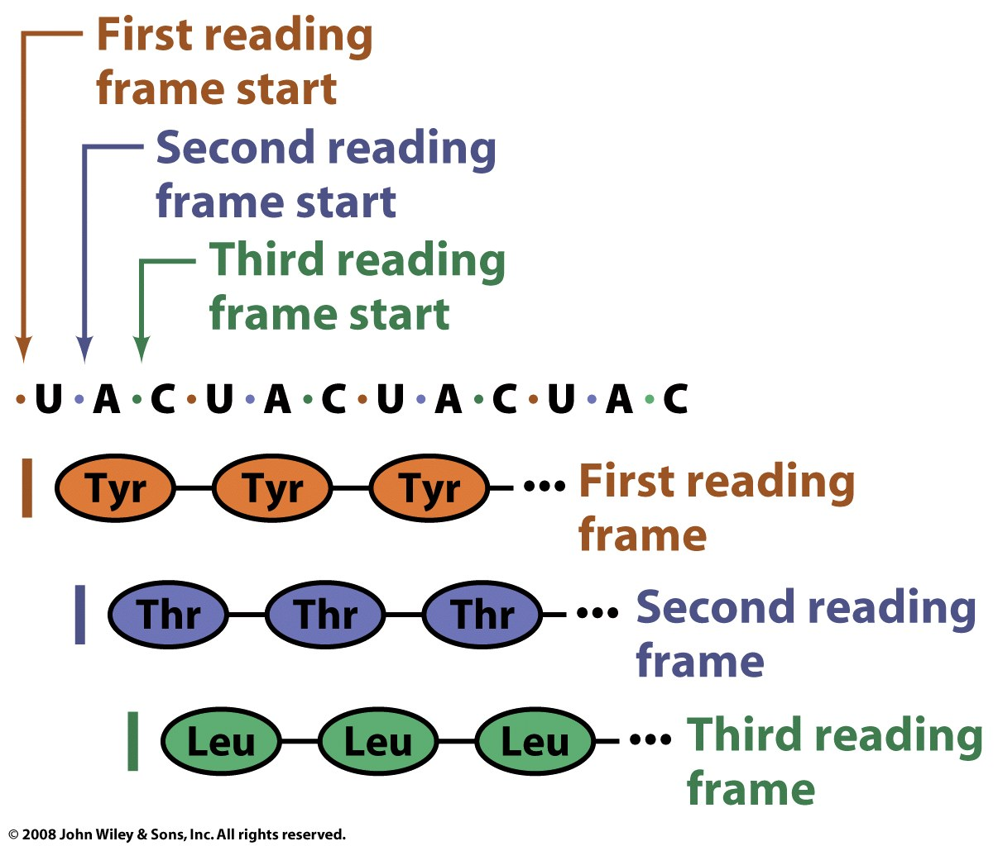
Three possible reading frames
Figure 27-2

Slide 31
Nascent Polypeptide
(in the exit tunnel)
LSU
mRNA
SSU
Decoding Center
By Bensaccount at en.wikipedia, CC BY 3.0,
https://commons.wikimedia.org/w/index.php?curid=8287100

Slide 32
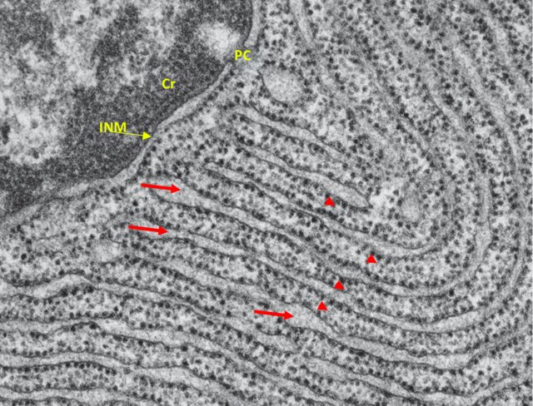
Nucleus and Rough Endoplasmic Reticulum. Cr, chromatin. PC, pore complex. INM, internal nuclear membrane. Red Arrows, ER cisternae. Arrows' heads, ribosomes. Modified from: (Schekman, 2004)

Slide 33
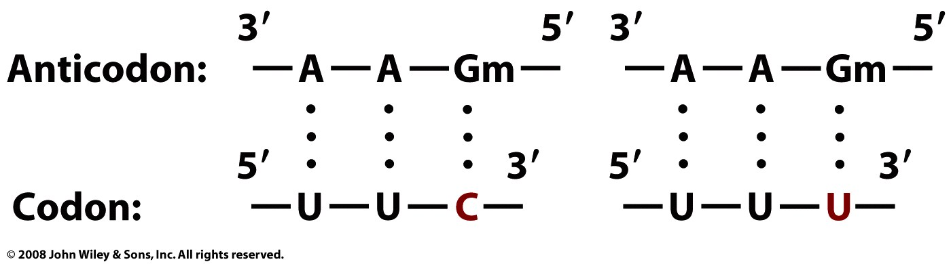
A tRNA can recognize multiple codons (which vary at their 3’ end).
The 3rd position of the codon can wobble with the 5’ position of the anticodon
Page 998

Slide 34
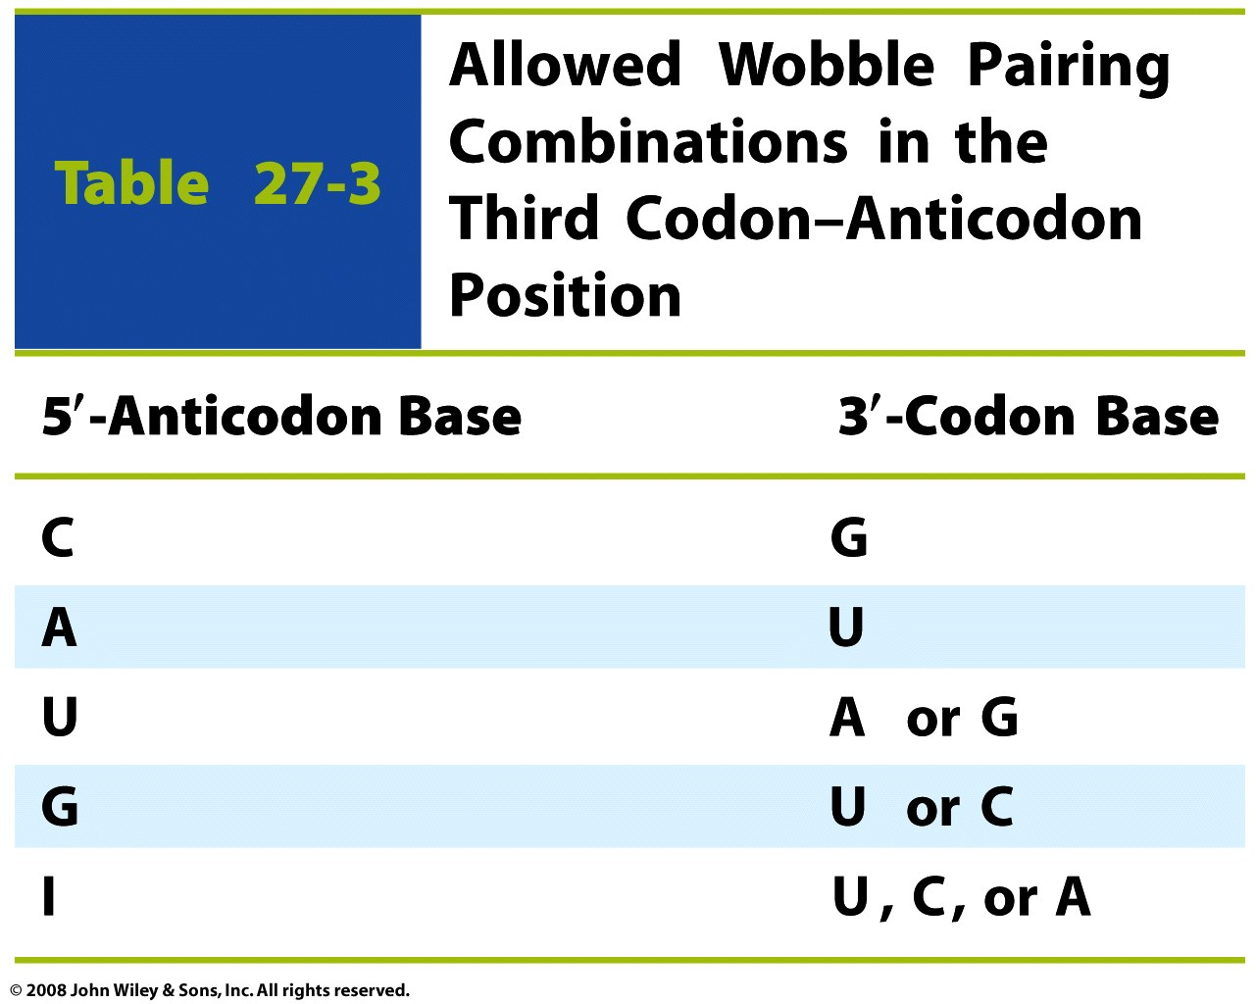
Table 27-3

Slide 35
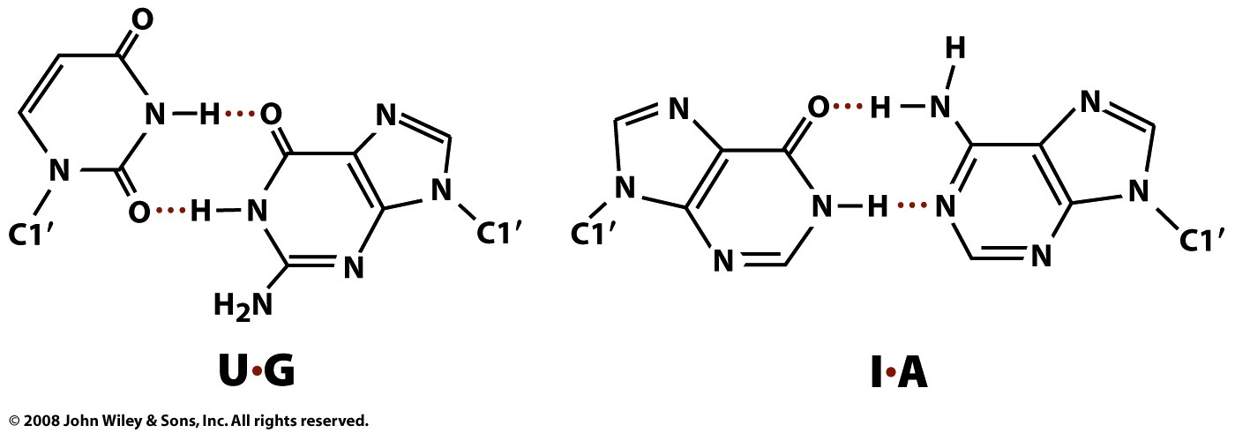
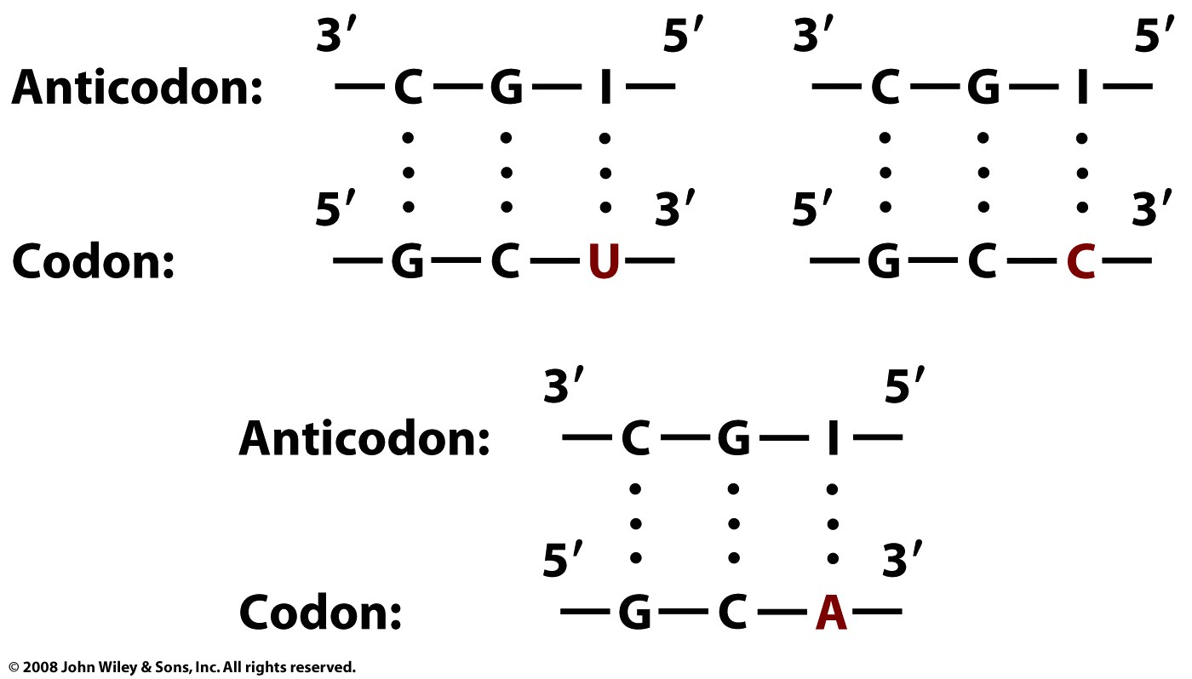
I =inosine

Slide 36
A functioning ribosome contains two subunits, which assemble independently and can pretty much ignore each other when not synthesizing protein. The two subunits SSU=30S (in bacteria) and LSU=50S (in bacteria) assemble into an intact ribosome (70S in bacteria) when synthesizing protein. The peptidyl transferase center is in the LSU and the decoding center is in the SSU.
Ribosomal components are often named by their Svedberg (s) values, which are based upon sedimentation rates. Prokaryotic ribosomes are 70S (assembled particles), 30s (SSU) and 50s (LSU).Eukaryotic ribosomes are 80S (assembled particle), 40s (SSU) and 60s (LSU) subunits.

Slide 37
