Slide 1
Sequence Searching and Alignment
Example question. I know that the bacterium E. coli has enolase, which is an important metabolic enzyme. Do archaea have enolase? If so what is the sequence?

Slide 2
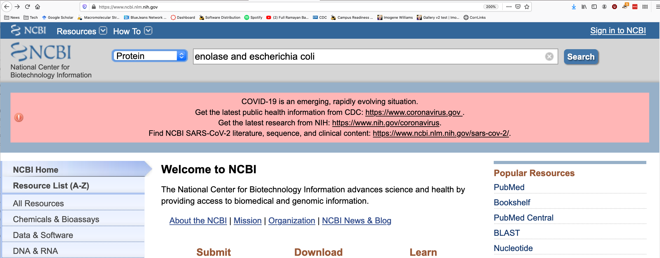
Get the e coli enolase sequence
https://www.ncbi.nlm.nih.gov/
<a href="powerpoint_ldw/8_alignment.pptx">Sequence Searching</a><br>

Slide 3
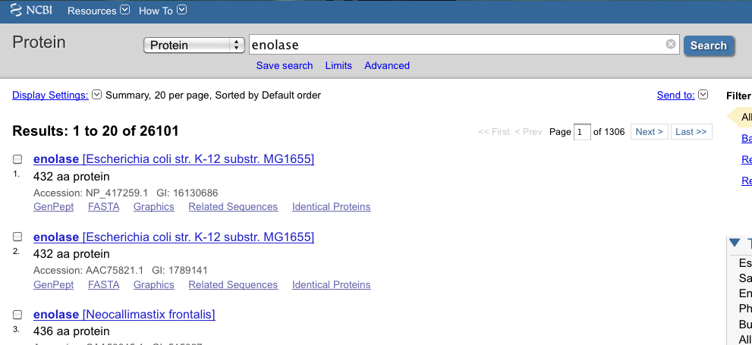

Slide 4
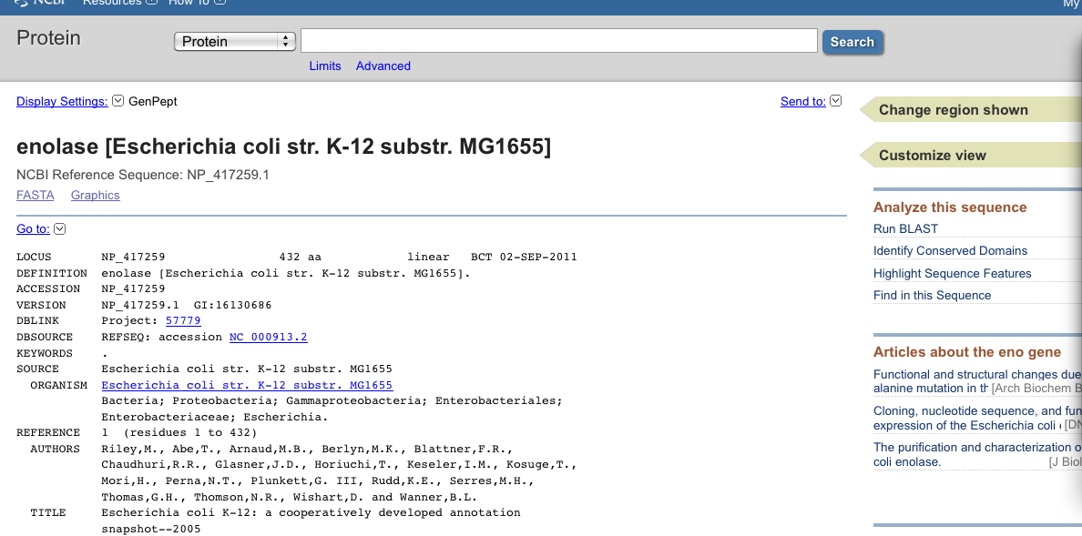
Blast the e coli sequence against an archaean organism

Slide 5
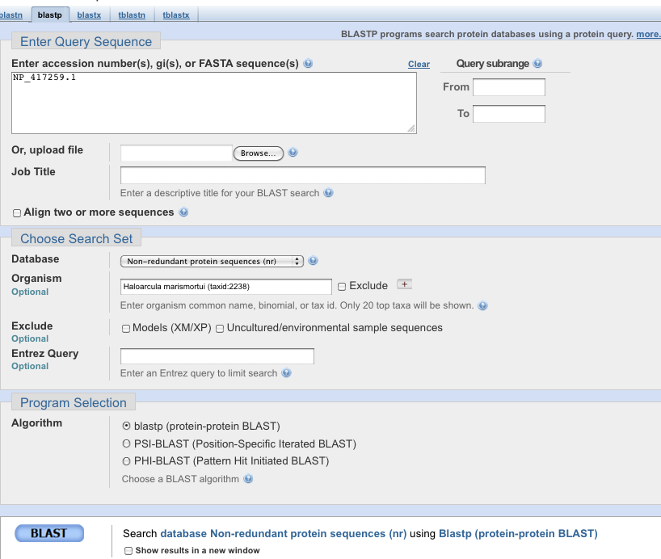

Slide 6
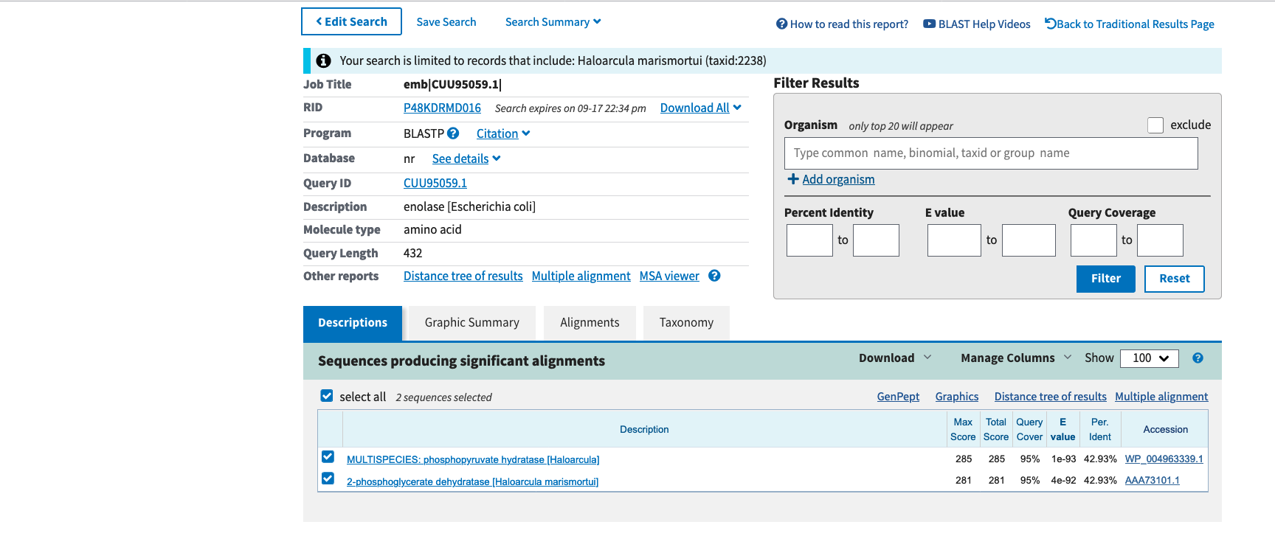

Slide 7
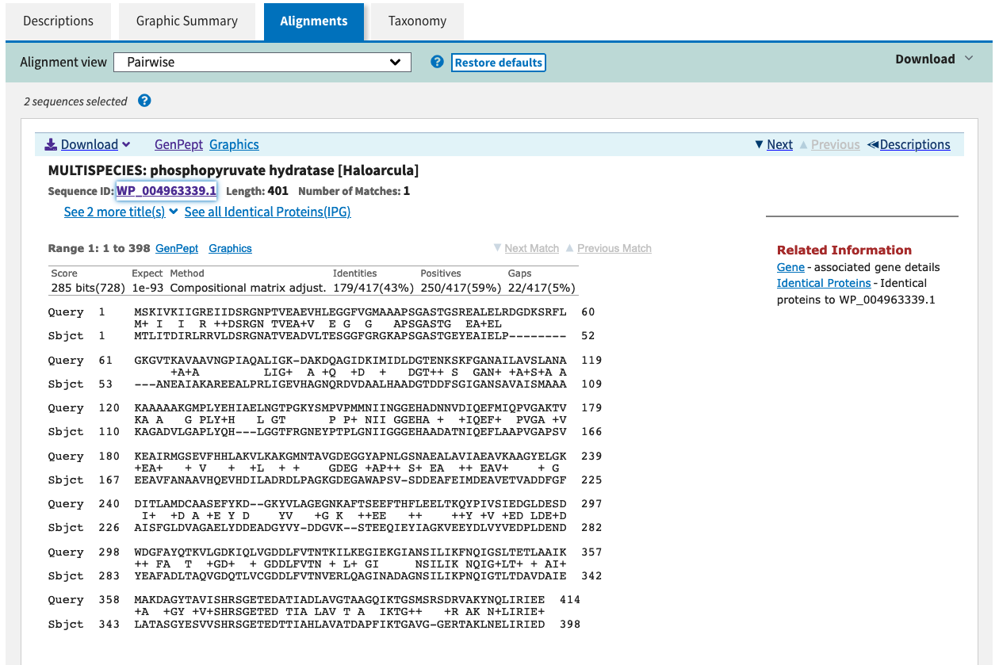

Slide 8
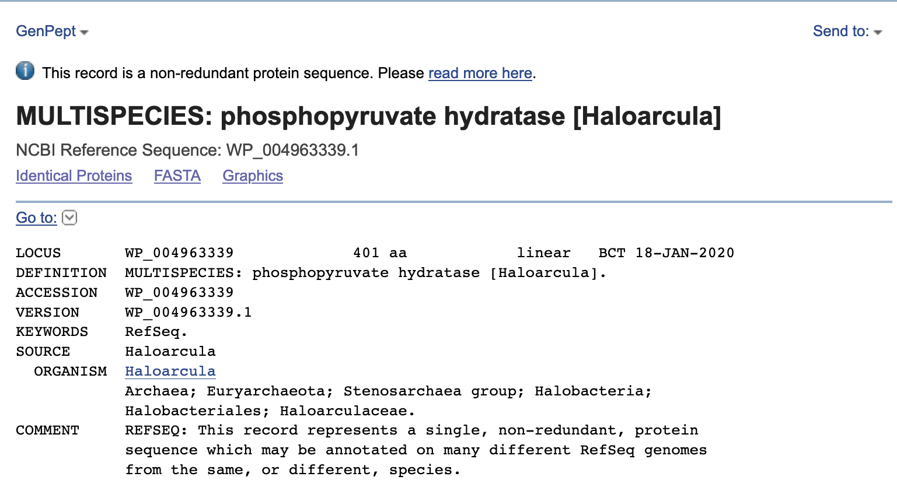

Slide 9
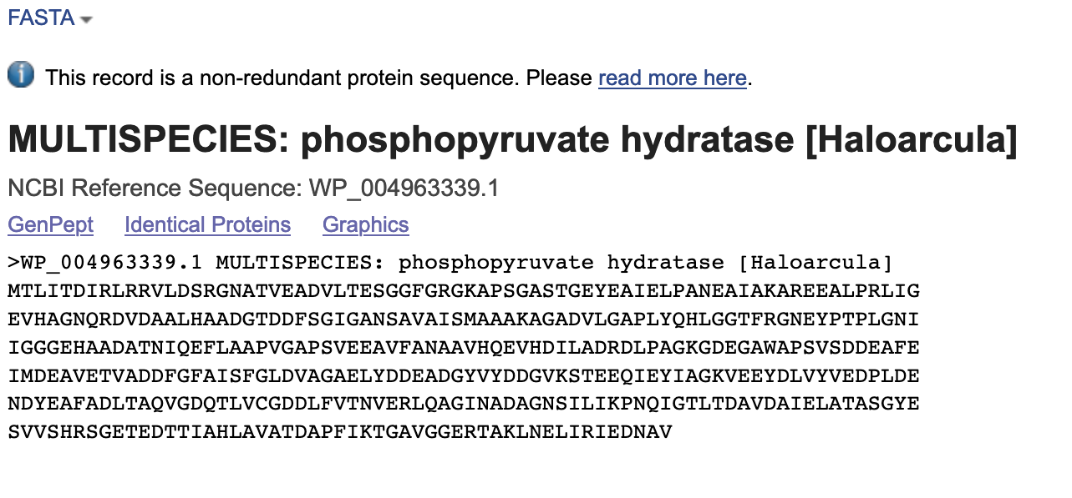
This is the haloarcula marismortui sequence of enolase

Slide 10
4511/6501 stop here

Slide 11
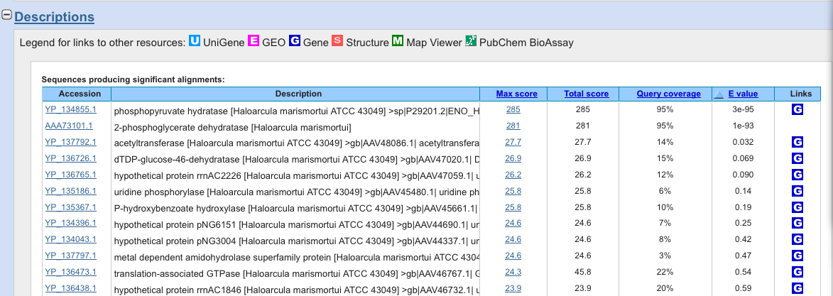

Slide 12
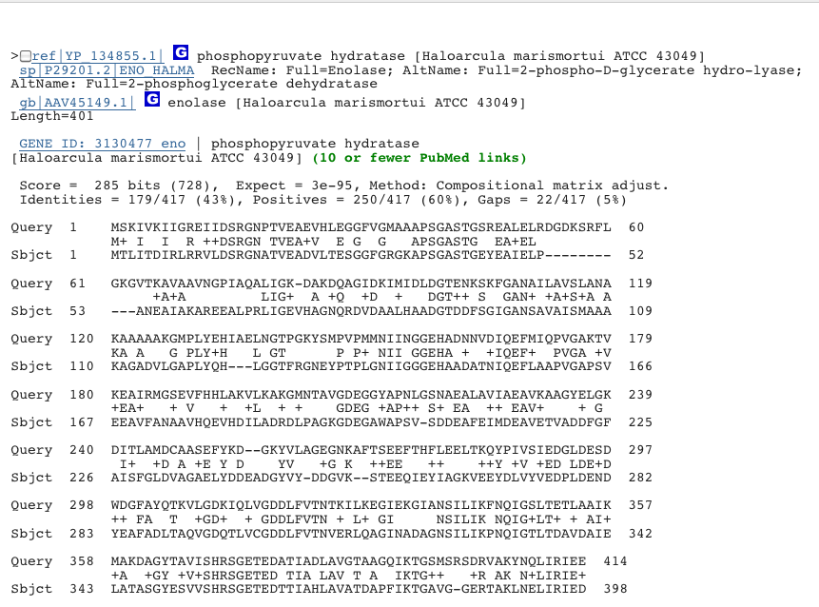

Slide 13
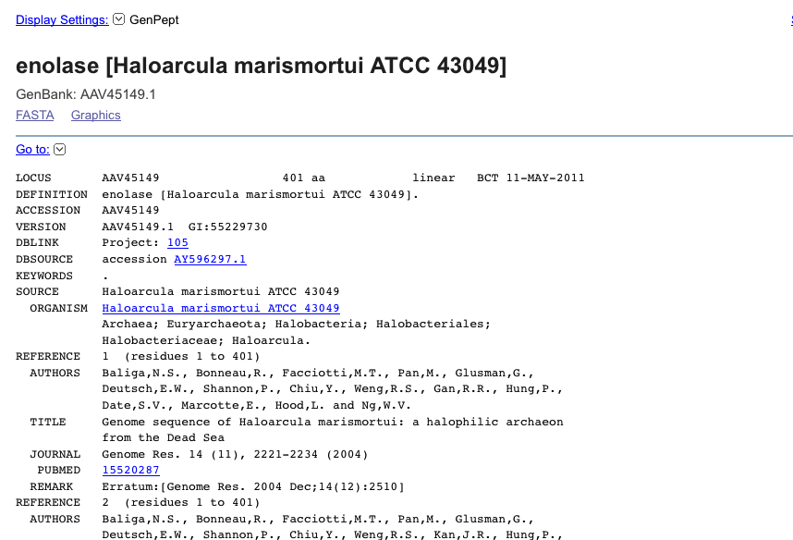
Scroll down…

Slide 14
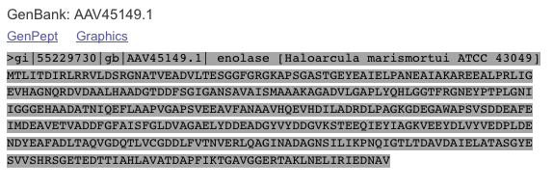
Copy and paste the sequence, including the header to a text file.

Slide 15
>gi|55229730|gb|AAV45149.1| enolase [Haloarcula marismortui ATCC 43049]
MTLITDIRLRRVLDSRGNATVEADVLTESGGFGRGKAPSGASTGEYEAIELPANEAIAKAREEALPRLIG
EVHAGNQRDVDAALHAADGTDDFSGIGANSAVAISMAAAKAGADVLGAPLYQHLGGTFRGNEYPTPLGNI
IGGGEHAADATNIQEFLAAPVGAPSVEEAVFANAAVHQEVHDILADRDLPAGKGDEGAWAPSVSDDEAFE
IMDEAVETVADDFGFAISFGLDVAGAELYDDEADGYVYDDGVKSTEEQIEYIAGKVEEYDLVYVEDPLDE
NDYEAFADLTAQVGDQTLVCGDDLFVTNVERLQAGINADAGNSILIKPNQIGTLTDAVDAIELATASGYE
SVVSHRSGETEDTTIAHLAVATDAPFIKTGAVGGERTAKLNELIRIEDNAV
Edit the header of the file. Put part of the organism name into the first field and the enzyme name in the second field, as I have done below. Do not delete the vertical lines or add spaces.
>gi|Haloarcula|enolase|AAV45149.1|enolase [Haloarcula marismortui ATCC 43049]
MTLITDIRLRRVLDSRGNATVEADVLTESGGFGRGKAPSGASTGEYEAIELPANEAIAKAREEALPRLIG
EVHAGNQRDVDAALHAADGTDDFSGIGANSAVAISMAAAKAGADVLGAPLYQHLGGTFRGNEYPTPLGNI
IGGGEHAADATNIQEFLAAPVGAPSVEEAVFANAAVHQEVHDILADRDLPAGKGDEGAWAPSVSDDEAFE
IMDEAVETVADDFGFAISFGLDVAGAELYDDEADGYVYDDGVKSTEEQIEYIAGKVEEYDLVYVEDPLDE
NDYEAFADLTAQVGDQTLVCGDDLFVTNVERLQAGINADAGNSILIKPNQIGTLTDAVDAIELATASGYE
SVVSHRSGETEDTTIAHLAVATDAPFIKTGAVGGERTAKLNELIRIEDNAV
Now get the sequence of the next organism and put it in the text file

Slide 16
Repeat off of this until you have collected all your sequence data.

Slide 17
>gi|Haloarcula|enolase|AAV45149.1|enolase [Haloarcula marismortui ATCC 43049]
MTLITDIRLRRVLDSRGNATVEADVLTESGGFGRGKAPSGASTGEYEAIELPANEAIAKAREEALPRLIG
EVHAGNQRDVDAALHAADGTDDFSGIGANSAVAISMAAAKAGADVLGAPLYQHLGGTFRGNEYPTPLGNI
IGGGEHAADATNIQEFLAAPVGAPSVEEAVFANAAVHQEVHDILADRDLPAGKGDEGAWAPSVSDDEAFE
IMDEAVETVADDFGFAISFGLDVAGAELYDDEADGYVYDDGVKSTEEQIEYIAGKVEEYDLVYVEDPLDE
NDYEAFADLTAQVGDQTLVCGDDLFVTNVERLQAGINADAGNSILIKPNQIGTLTDAVDAIELATASGYE
SVVSHRSGETEDTTIAHLAVATDAPFIKTGAVGGERTAKLNELIRIEDNAV
>gi|Drosophila|enolase|AAV45149.1|[Drosophila melanogaster] MTIKAIKARQIYDSRGNPTVEVDLTTELGLFRAAVPSGASTGVHEALELRDNDKANYHGKSVLKAVGHVN
DTLGPELIKANLDVVDQASIDNFMIKLDGTENKSKFGANAILGVSLAVAKAGAAKKGVPLYKHIADLAGN
KEIILPVPAFNVINGGSHAGNKLAMQEFMILPTGATSFTEAMKMGSEVYHHLKNVIKAKFGLDATAVGDE
GGFAPNIQSNKEALNLISDAIAKAGYTGKIEIGMDVAASEFYKDGQYDLDFKNEKSDKSQWLPADKLANL
YQEFIKDFPIVSIEDPFDQDHWEAWSNLTGCTAIQIVGDDLTVTNPKRIATAVEKKACNCLLLKVNQIGT
VTESIAAHLLAKKNGWGTMVSHRSGETEDSFIGDLVVGLSTGQIKTGAPCRSERLAKYNQILRIEEEIGA
GVKFAGKSFRKPQ
Put all of your sequences (with edited headers, together in one file and save it. Then go to an alignment program - T-coffee, Clustal, Muscle, etc

Slide 18
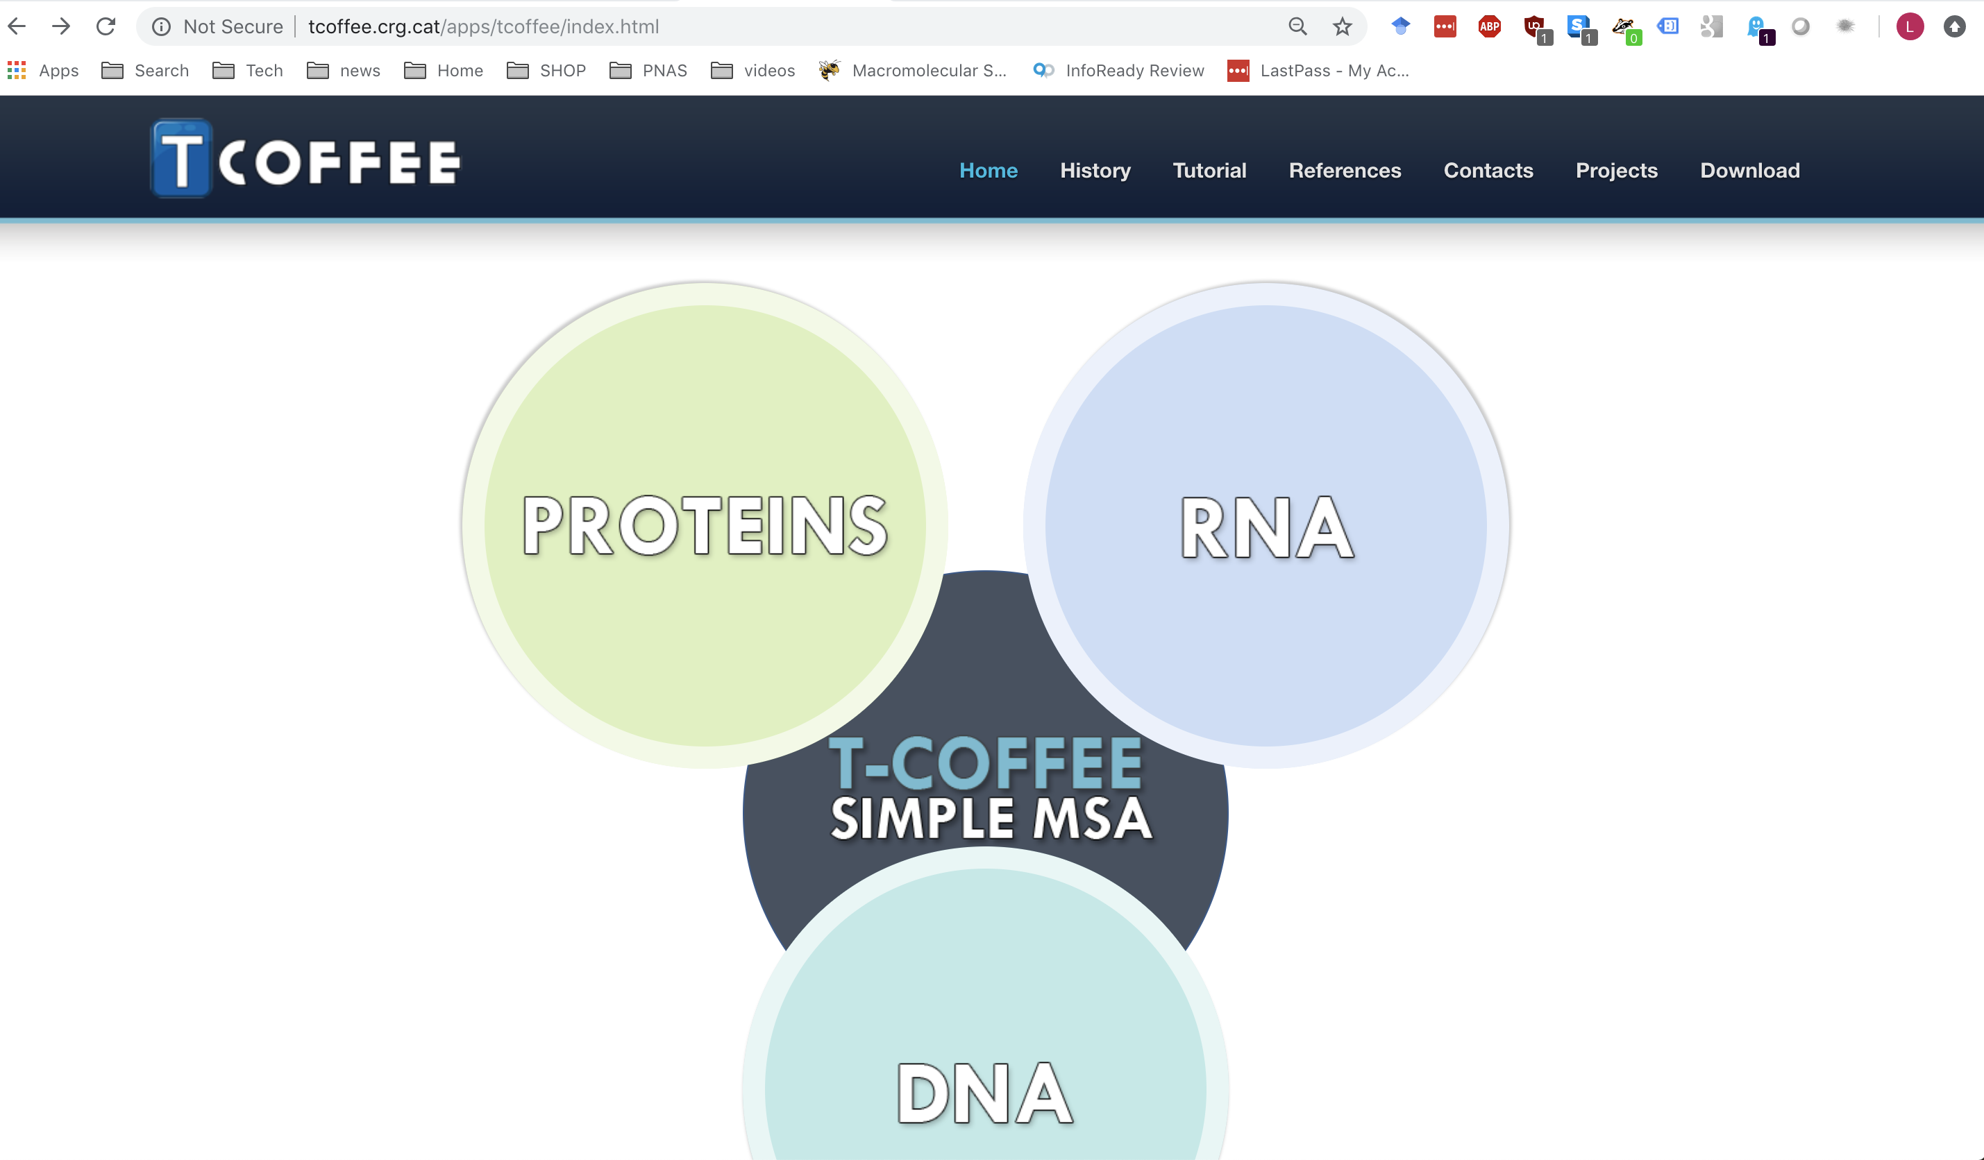

Slide 19
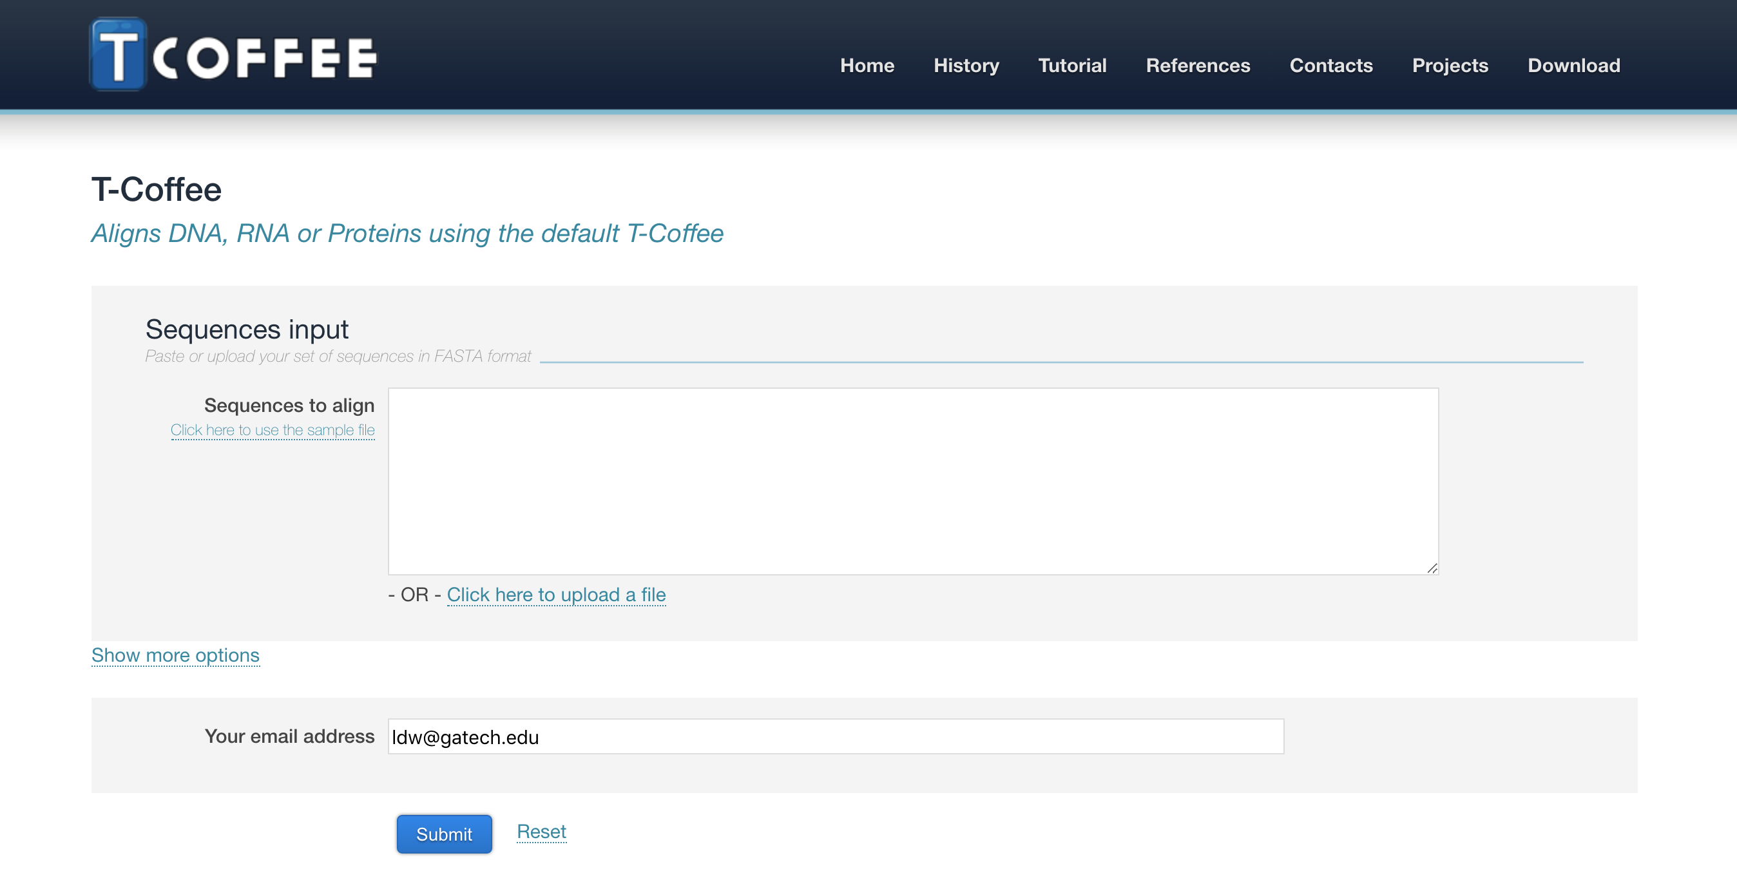
Paste your fasta sequences

Slide 20
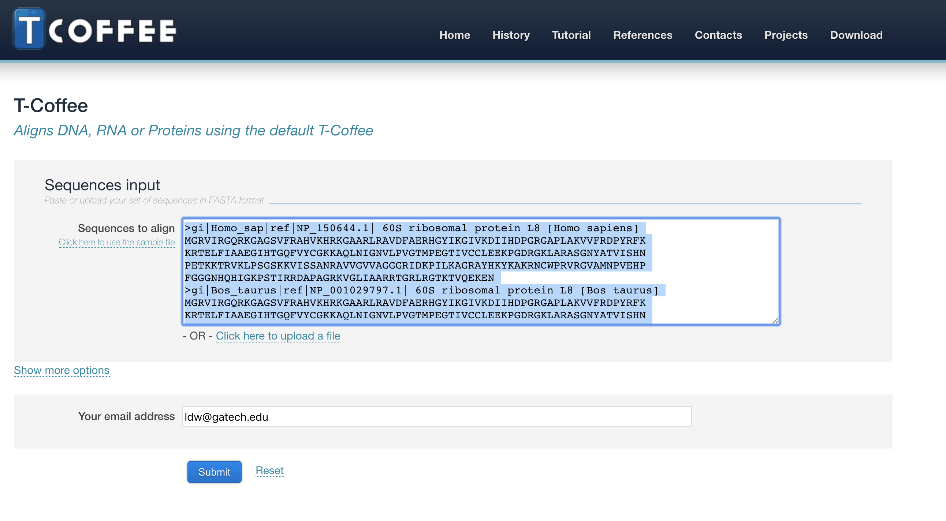
submit

Slide 21
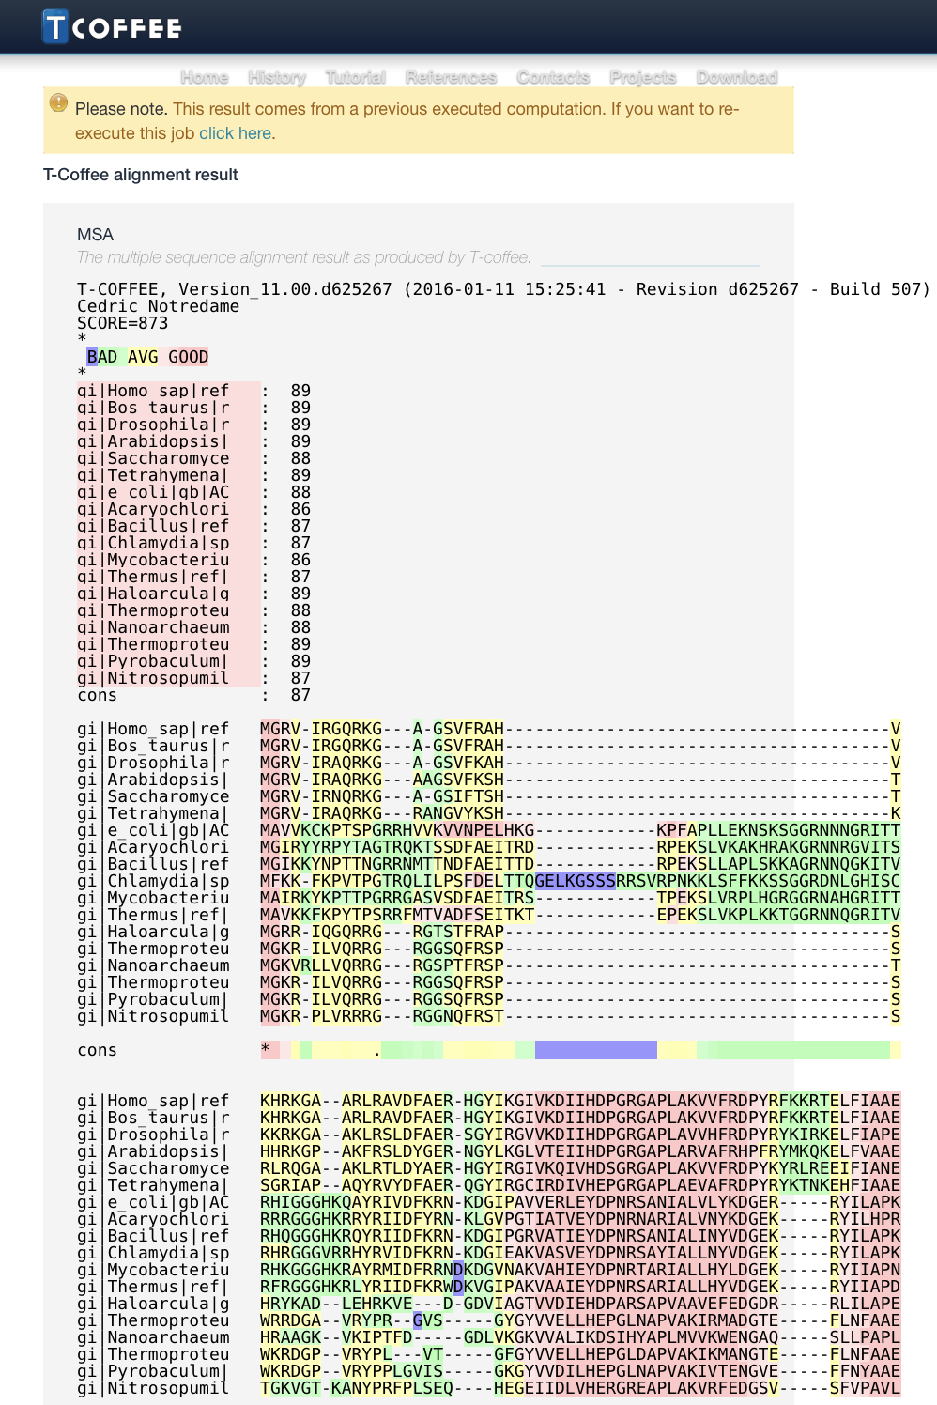
Aligned sequences

Slide 24
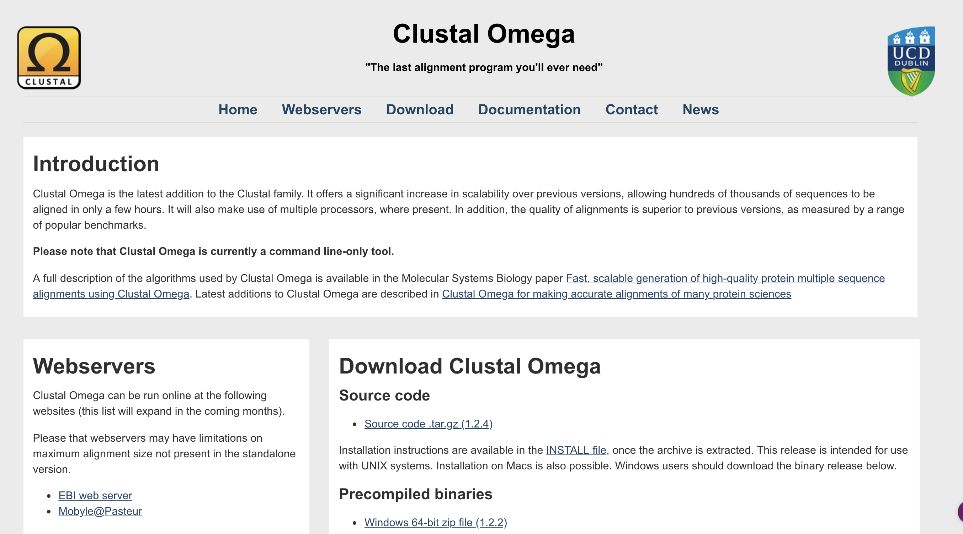

Slide 25
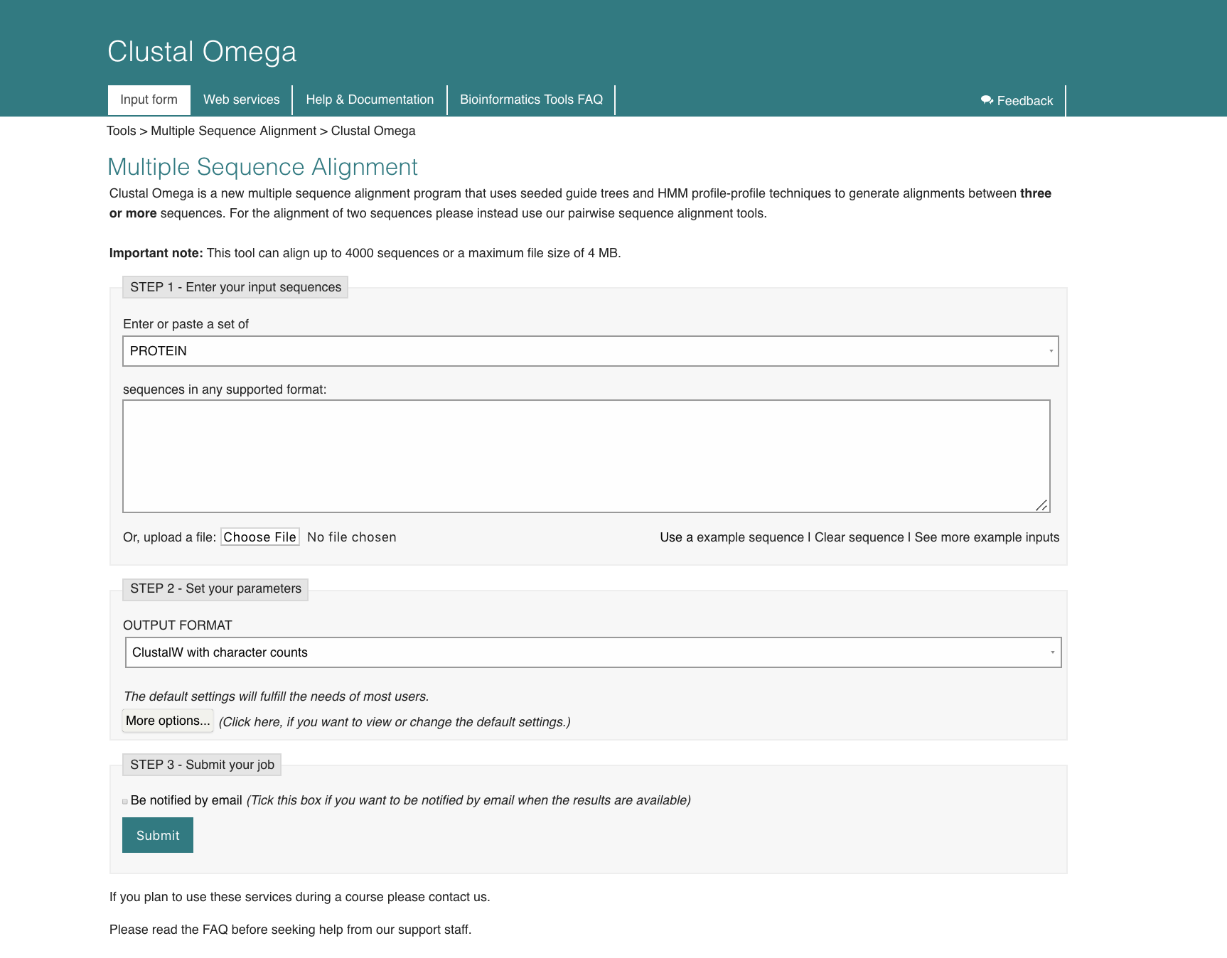
Paste
Fasta
file
submit

Slide 26
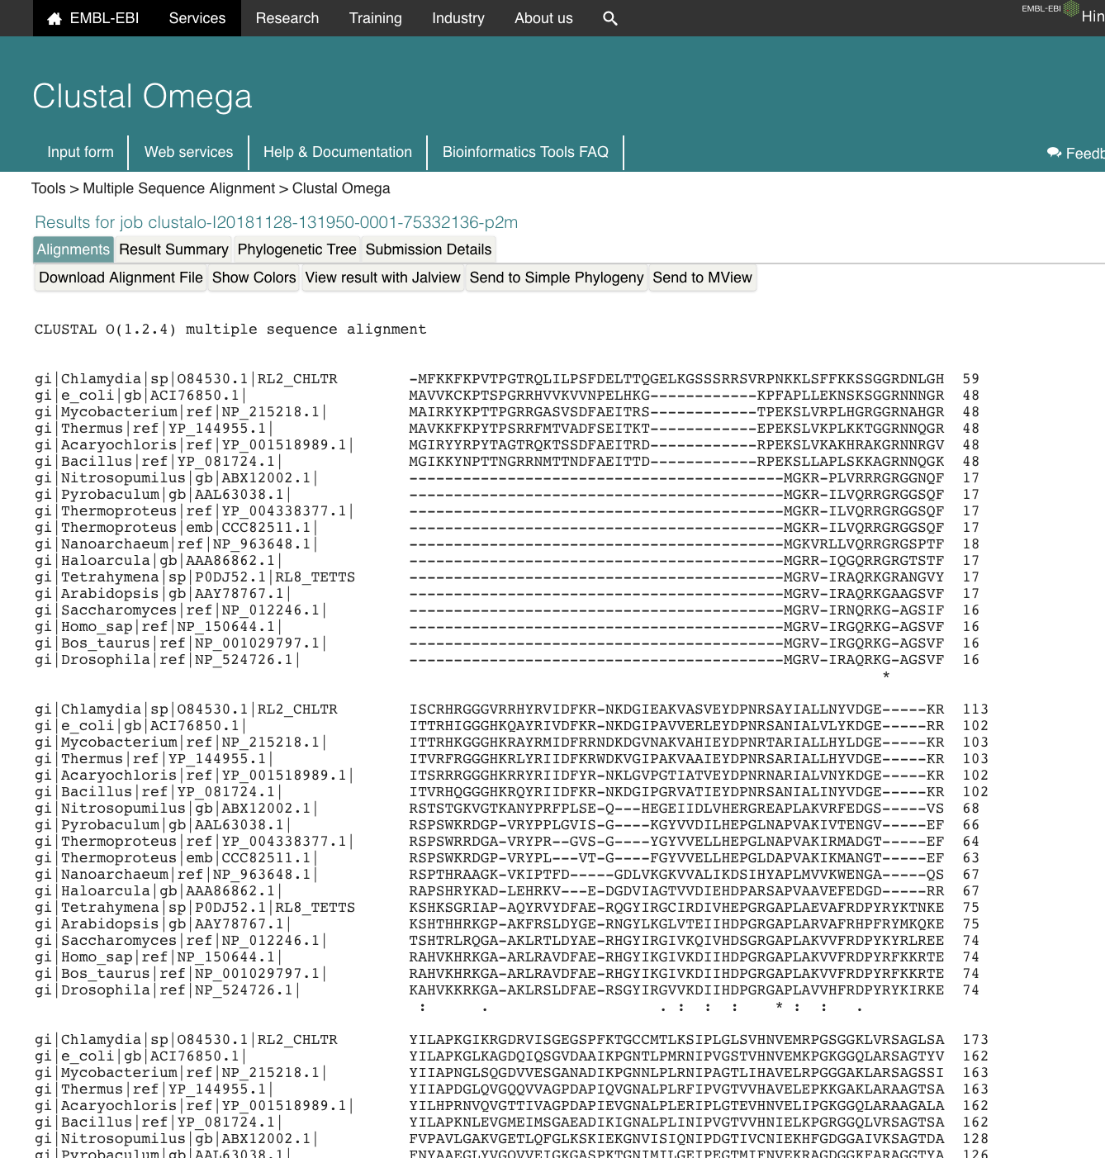
Make a
Distance tree

Slide 27
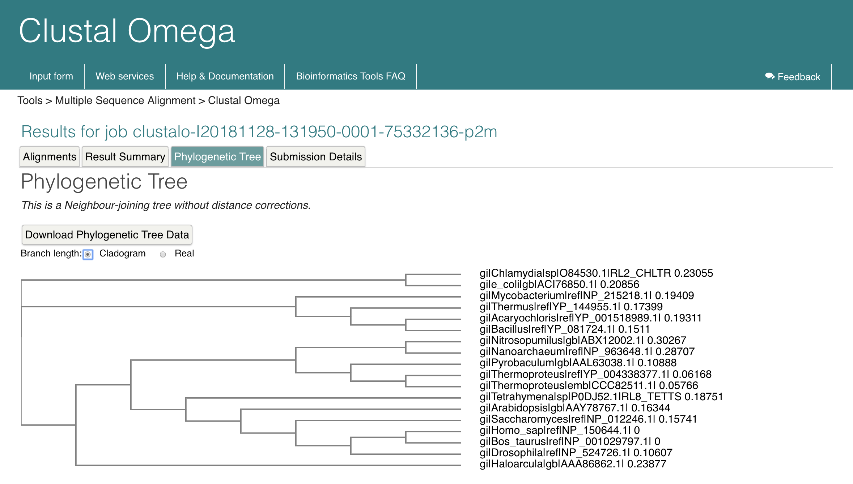

Slide 28
The following slides on the Needleman–Wunsch algorithm are from
http://www.maths.tcd.ie/~lily/pres2/sld001.htm
Aoife McLysaght
Murfit Institute of Genetics University of Dublin, Trinity College Dublin 2 Ireland

