Slide 1
Today
Review basic concepts in kinetics
rates
rate constants
relationship between activation free energies and reaction free energies
effect of enzymes on all of this
Learn about
classes of enzymes
general principles of enzymes – how do they work?
(i.e., elements of enzymatic catalysis)

Slide 2
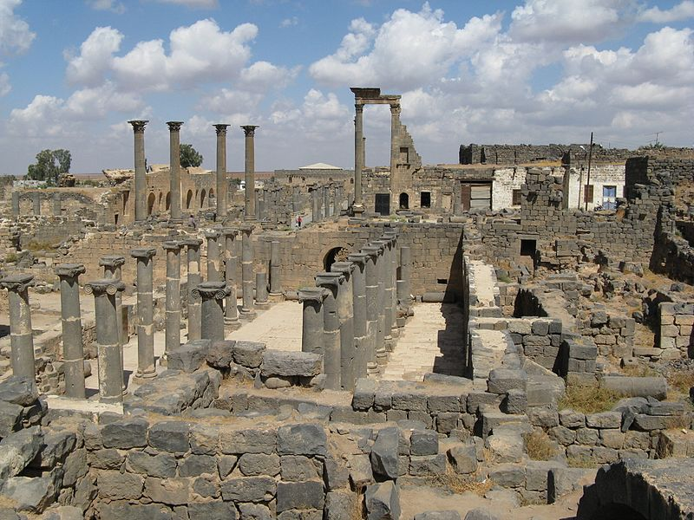

Slide 3
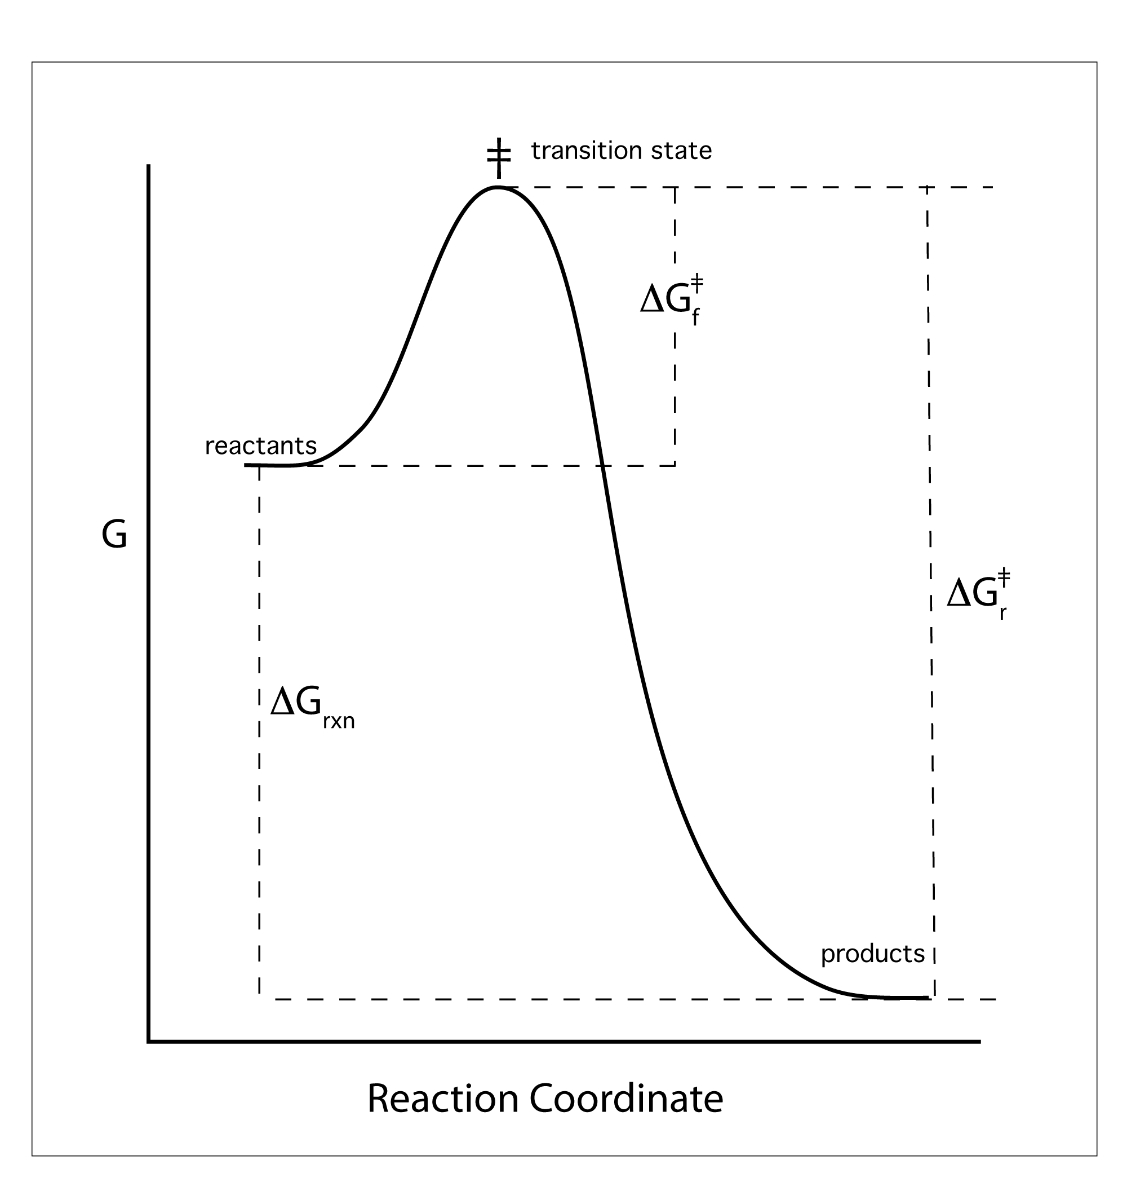
A Reaction Coordinate
For these slides:
assume one mole of reactants goes to one mole of products under standard conditions.
i.e., G = Gº

Slide 4
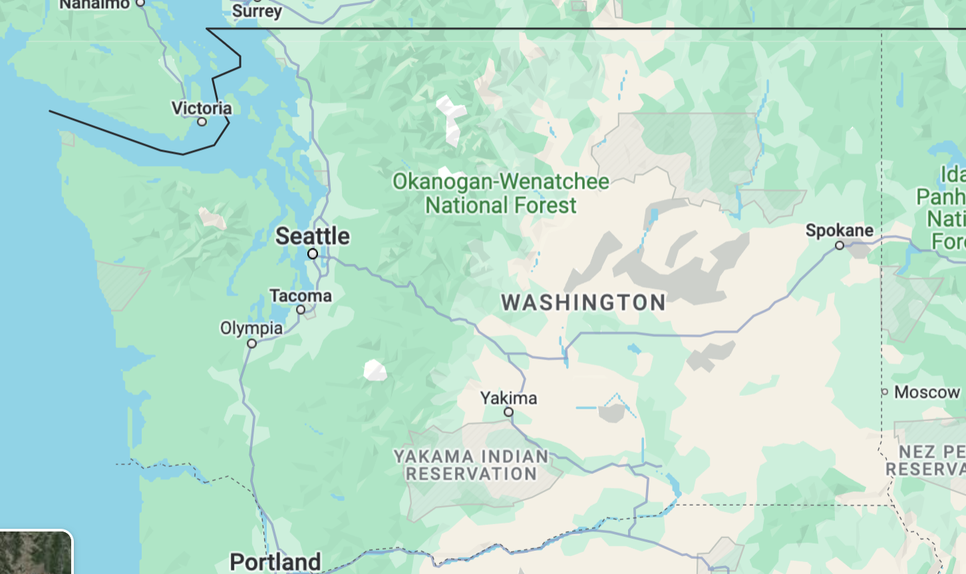
What is a transition state?
The highest energy species (most unstable species) along the reaction coordinate.

Slide 5
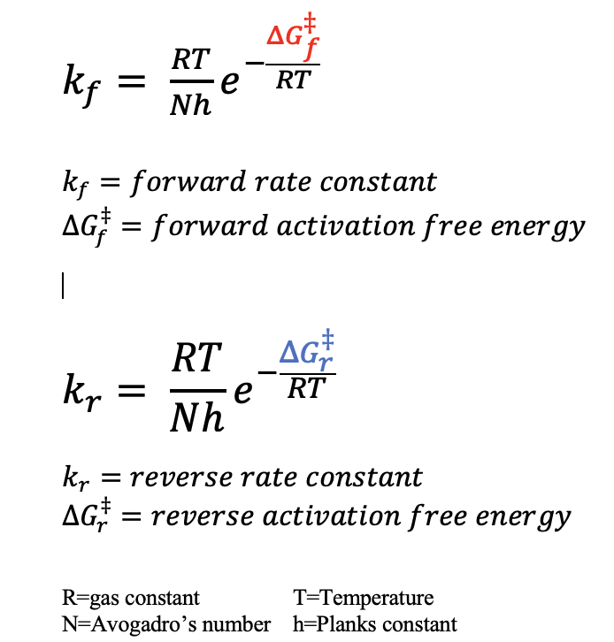

Slide 6
For these slides:
Assume 1 mole of reactants goes to one mole of products under standard conditions, i.e., G = Gº

Slide 7
What does an enzyme
do to this graph?

Slide 8
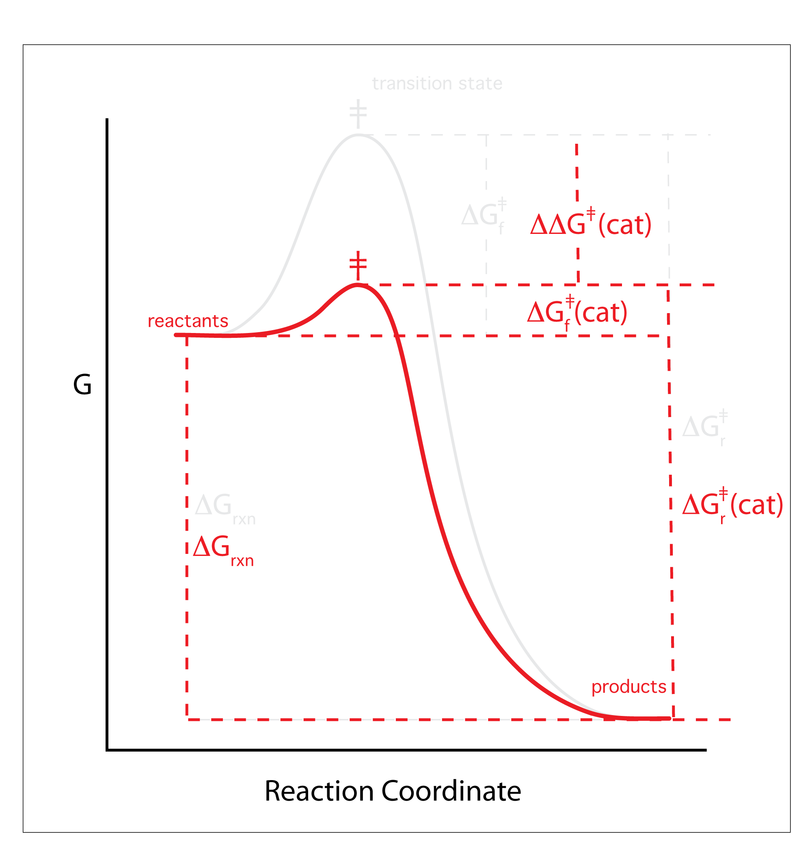
For these slides:
Assume 1 mole of reactants goes to one mole of products under standard conditions, i.e., G = Gº
An enzyme stabilizes the
transition state…
but not products or
Reactants.

Slide 9
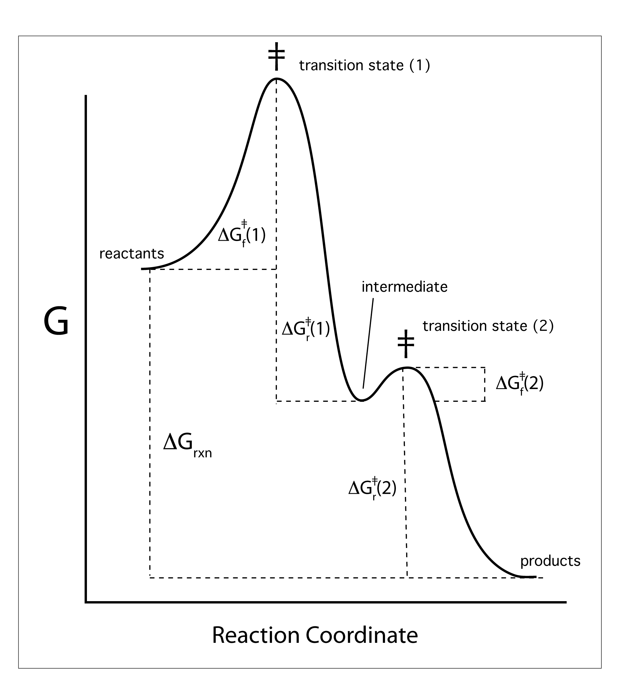
An enzyme uses
multiple transition states (at peaks of the reaction coordinate),
separated by intermediates (at dimples in the reaction coordinate).

Slide 10
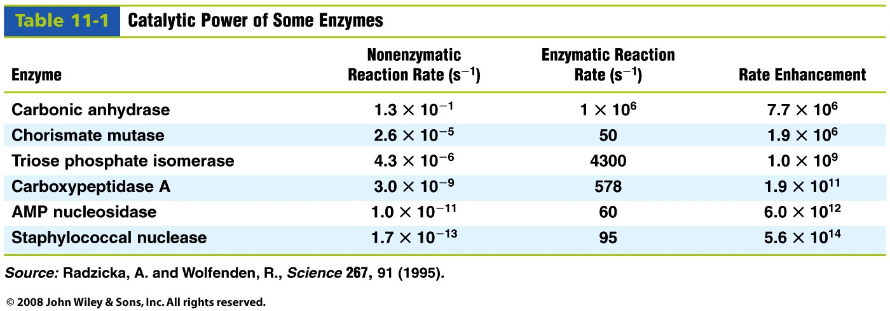
ENZYMES
make reactions go at
high reaction rates,
that can be controled by cooperativity, and allosterism,
with high specificity (no side reactions),
under mild conditions (37 deg, low conc).
Table 11-1

Slide 11
There are 7 General Classes of Enzymes
Here
or here
https://enzyme.expasy.org/

Slide 12
There are 7 General Classes of Enzymes
1 Oxidoreductases.
(oxidases, oxygenases, peroxidases) catalyze the transfer of electrons from one molecule (the oxidant, the hydrogen or the electron donor) to another molecule (the reductant, the hydrogen or electron acceptor).
2 Transferases.
catalyze the transfer of a functional group from one molecule to another. Examples are acyl transferases that catalyze the transfer of acyl groups and peptidyl transferase that transfers an amino acid.
3 Hydrolases.
catalyze the cleavage of a covalent bond using water. Exampes of hydrolases are esterases, that cleave ester bonds, and proteases that cleave amide bonds.
4 Lyases.
catalyze the cleavage of a covalent bond by mechanisms other than hydrolysis or oxidation, often forming a double bond or adding a new ring structure. An example is the lyase that acts on ATP resulting in the formation of cAMP and PPi.

Slide 13
There are 7 General Classes of Enzymes
5 Isomerases.
catalyze structural rearrangement. An example is alanine racemase, which catalyzes the conversion of L-alanine to D-alanine.
6 Ligases.
catalyze the chemical linkage of two large molecules. An example is DNA ligase, which catalyzes the chemical joining of two fragments of DNA.
7. Translocases.
move another molecule or ion, sometimes across a cell membrane. Examples are processive polymerases, and systems that import proteins into organelles

Slide 14
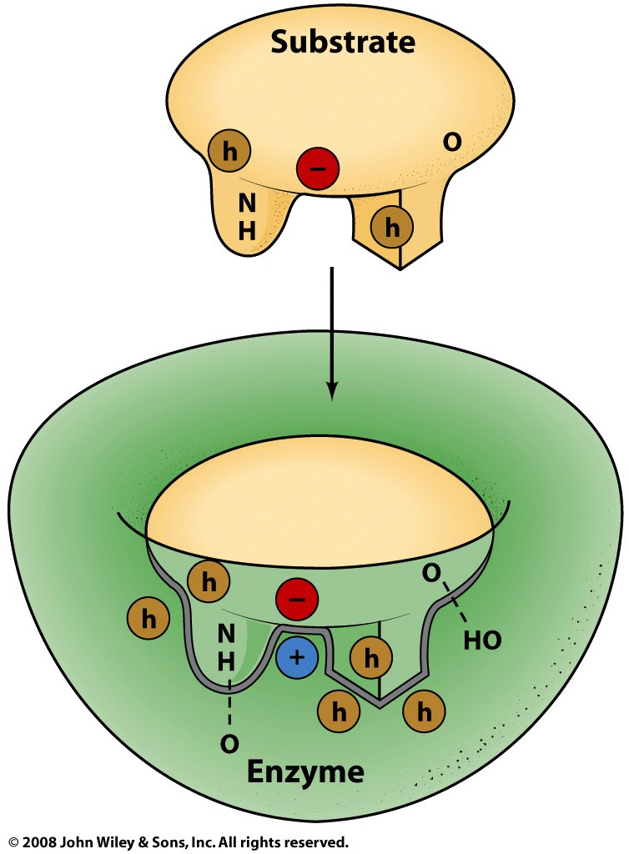
How do enzymes work?
Enzymes bind to specific substrates,
with stereospecificity
but bind preferentially to transition states
some enzymes are non-specific
can cleave ester or peptide
via complementarity non-covalent interactions
but often form covalent intermediates
sometimes ‘lock and key’
the enzyme does not move
sometimes ‘induced fit’
the enzyme wraps around the substrate
or the transition state.
Figure 11-1

Slide 15
Elements of Enzyme Catalysis
Catalytic mechanisms incorporate one or more of these elements.
an enzyme
can be both an acid and a base,
can covalently link an intermediate,
can use metal ions for structure and/or chemistry,
can stabilize transition states with proximity and orientation,
can bind preferentially to transition states, and
is usually a protein but can be RNA.

Slide 16
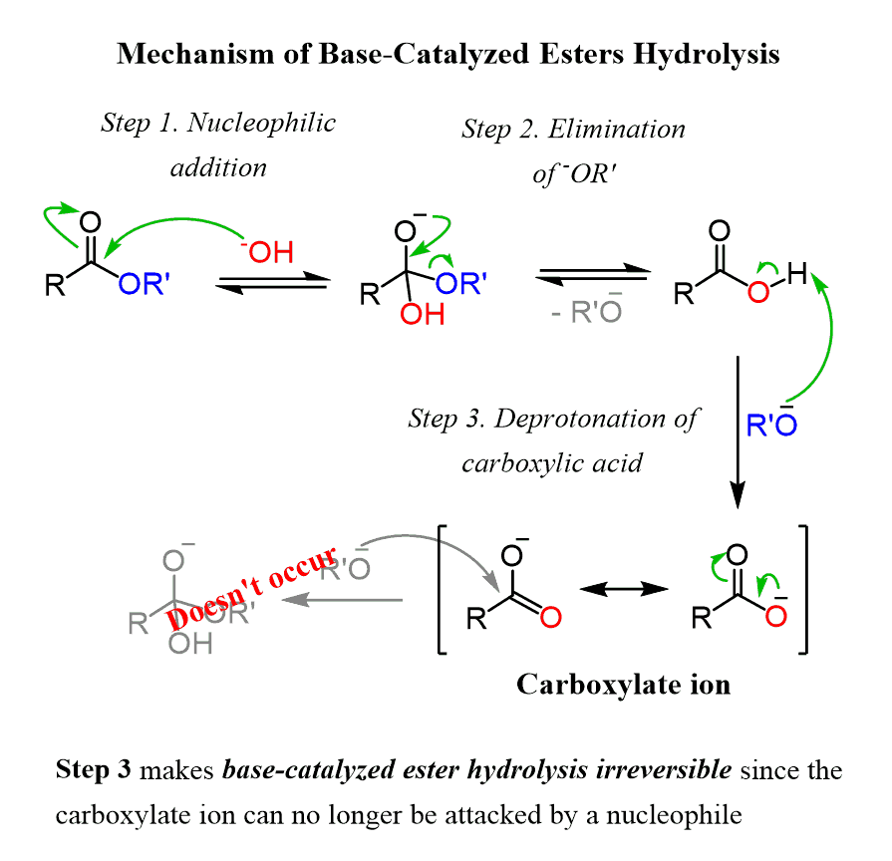
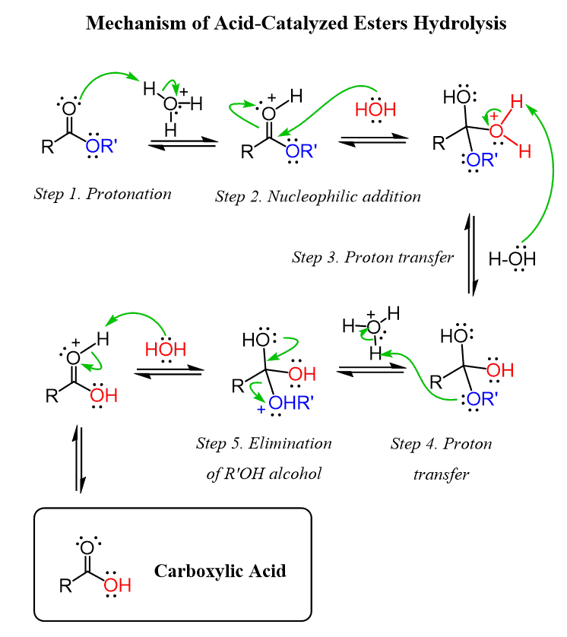
Non-Enzymatic Catalysis
Acid catalyzed hydrolysis OR Base catalyzed hydrolysis
Enzymes can use both acids and bases in the same reaction.

Slide 17
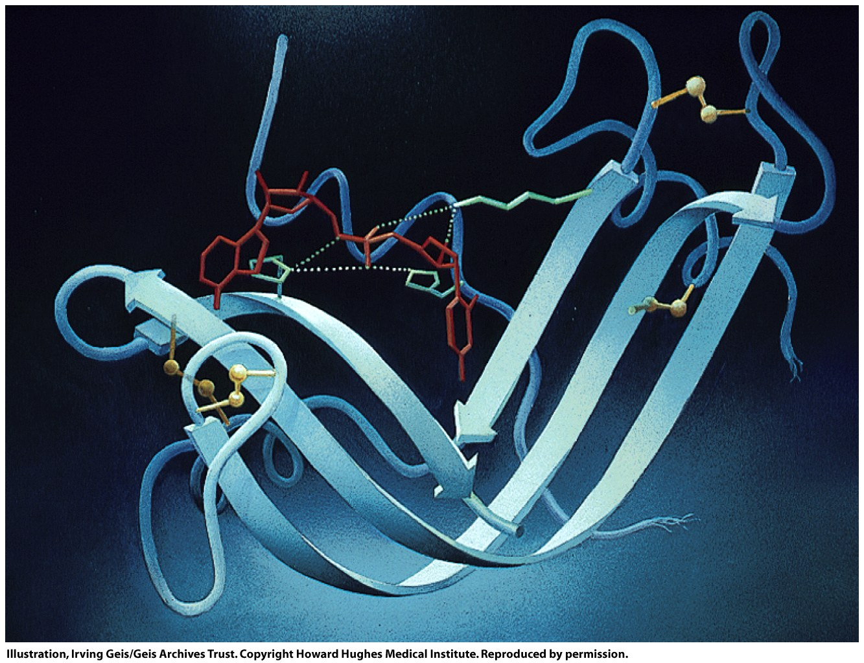
And Example of Enzymatic Catalysis
an acid and a base
Figure 11-9

Slide 18
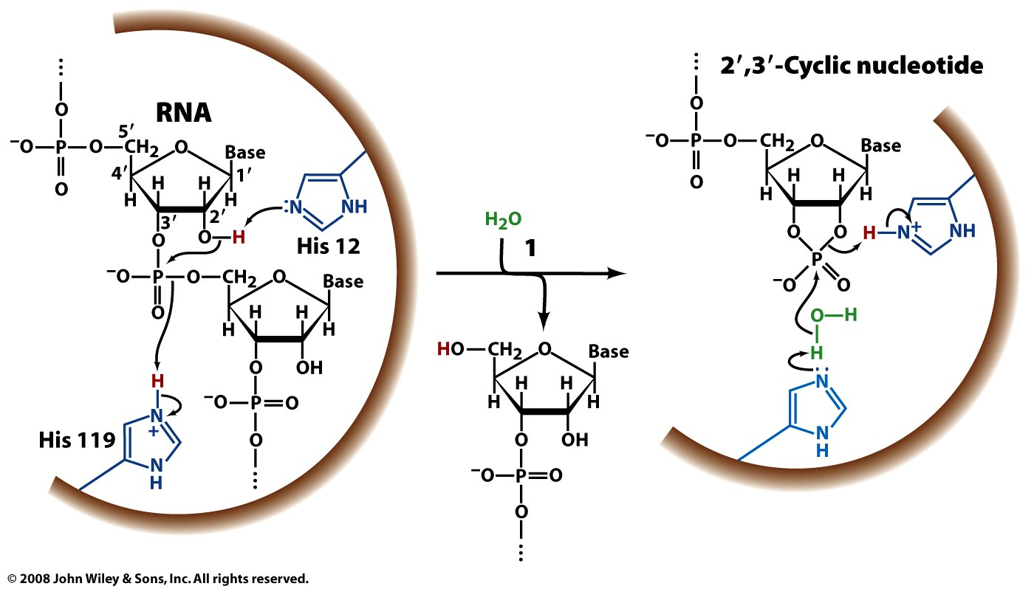
Figure 11-10 part 1

Slide 19
Covalent Intermediates
enzyme
nucleophile
Page 334

Slide 20
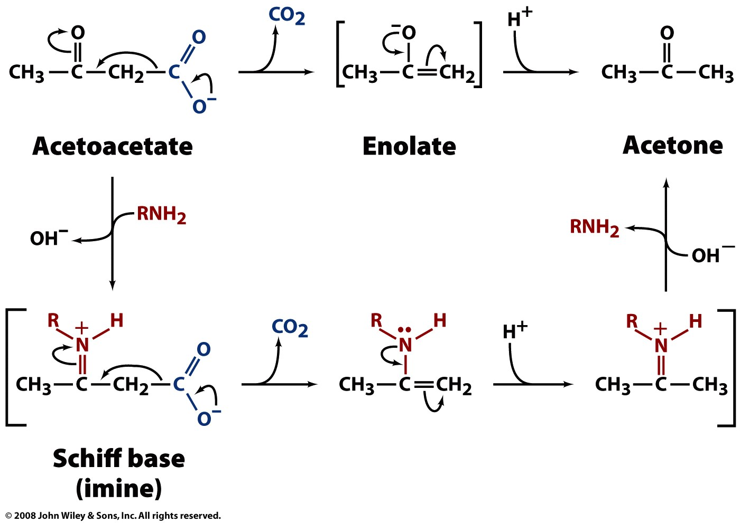
Covalent Intermediates
uncatalyzed reaction
(nucleophile on enzyme)
catalyzed reaction
Figure 11-11

Slide 21
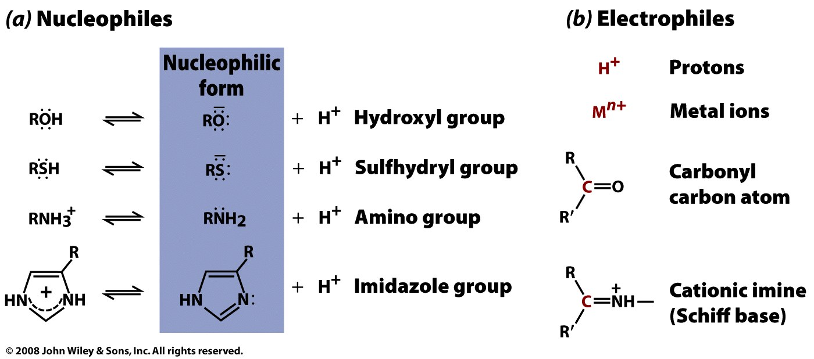
Covalent Intermediates
Also: acyl-enzyme intermediates (ester intermediates)
Figure 11-12

Slide 22
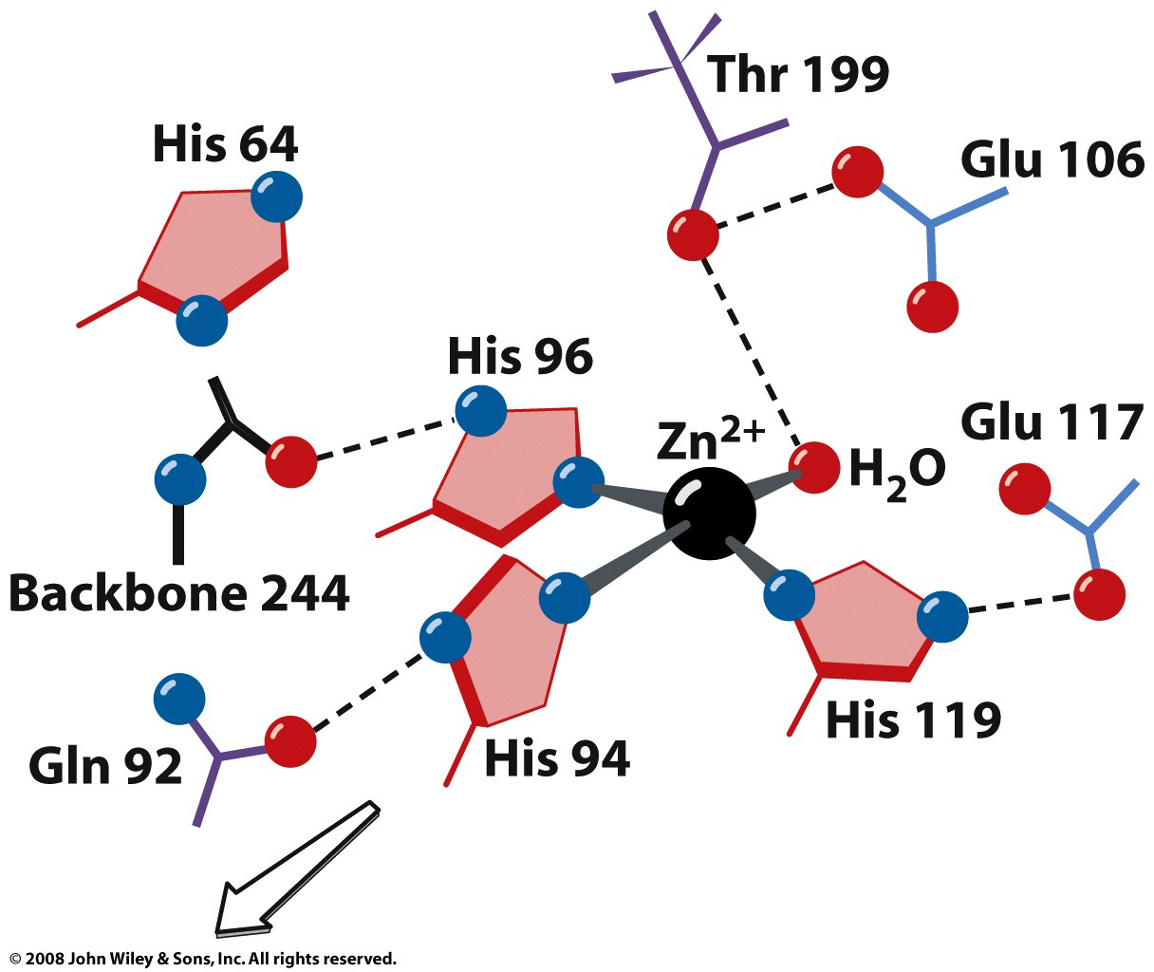
Metal ions in catalysis:
Carbonic Anhydrase
The carbonic anhydrase,
a metalloenzyme (contains a Zn²⁺)
catalyzes the conversion of bicarbonate and a proton to carbon dioxide and water
also catalyzes the the reverse: conversion of carbon dioxide and water to bicarbonate and a proton
is a very efficient enzyme
causes carbonated drinks to rapidly degas in your mouth the Zn²⁺ is square planer is coordinated by three His
plus one water molecule
the water molecule is polarized by the Zn and is highly acidic
Figure 11-13a

Slide 23
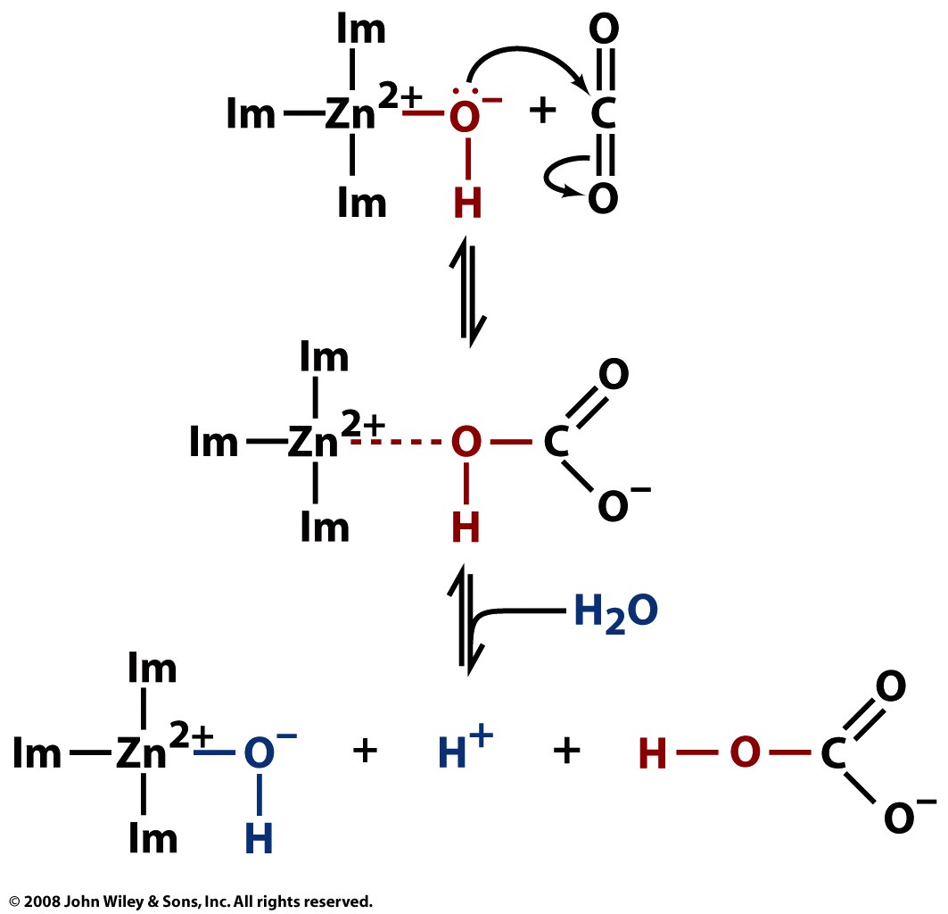
Figure 11-13b

Slide 24
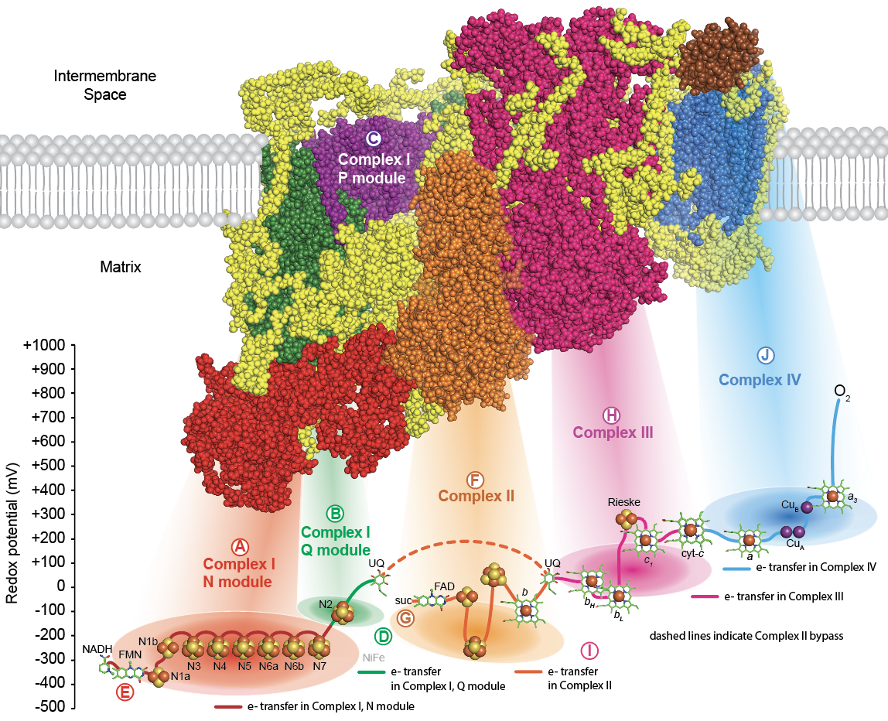

Slide 25
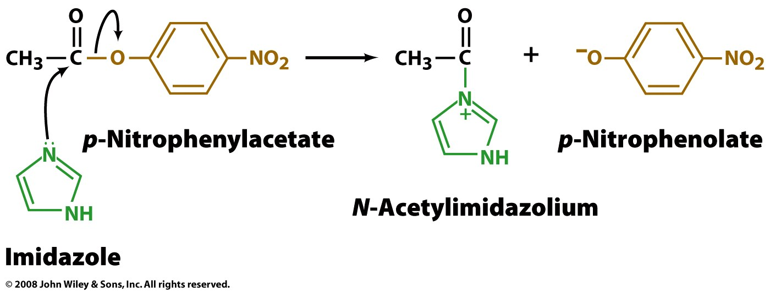
Proximity and Orientation: Entropy Trapping
(i) Proximity increases reaction rates
Slower
Faster
Page 336

Slide 26
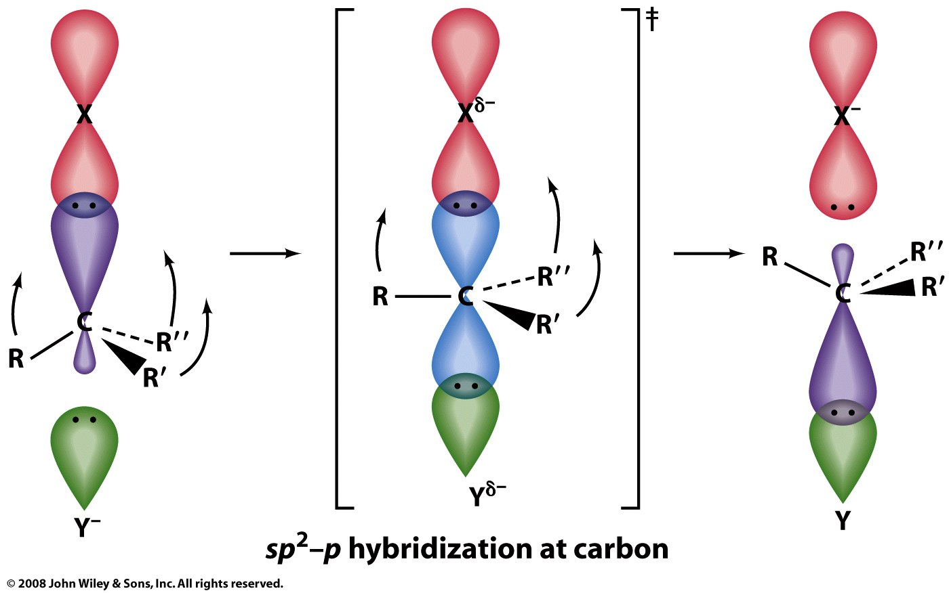
(ii) Orientation increases reaction rates:
(i.e., correct + fixed orientation increases reaction rates.)
For example an S_{N}2 reaction reaction is fastest if the attacking nucleophile approaches the electrophilic C along the line of the leaving group bond, from the opposite side of the C.
Figure 11-14

Slide 27
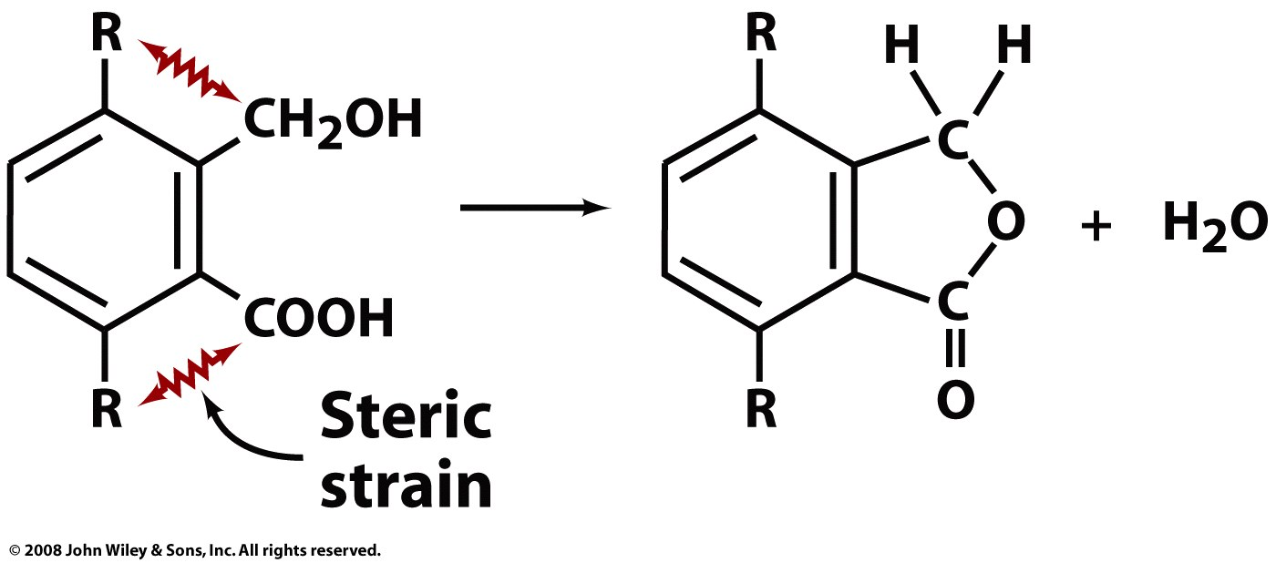
Preferential Binding to Transition States
The transition state can be stabilized by mechanically distorting the substrate to a non-ground state conformation that is close to the transition state conformation.
This example shows how a non-enzymatic transition state can be stabilized (Big R-group lowers ΔG‡)
Page 338

Slide 28
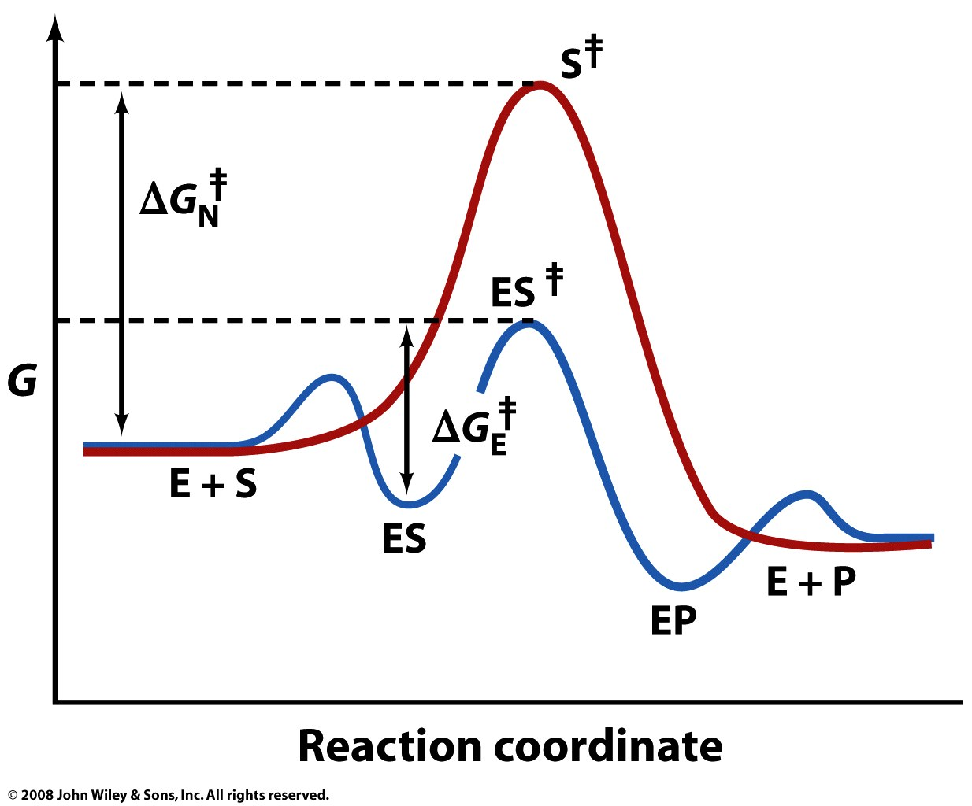
Binding to Transition States
In fact, all the elements of catalysis discussed in this section (acid base, metals, proximity and orientation) will lower ΔG‡ and will contribute to a graph shape like this. The small double headed arrow is the binding free energy of the substrate to the enzyme. I think that to be specifically related to binding to the transition state, this graph should have H (enthalpy) on the vertical axis and should explain that the binding energy can be converted to mechanical distortion of the substrate toward the transition state.
E + S ⇌ ES ⇌ EP ⇌ E + P
Figure 11-15

Slide 29
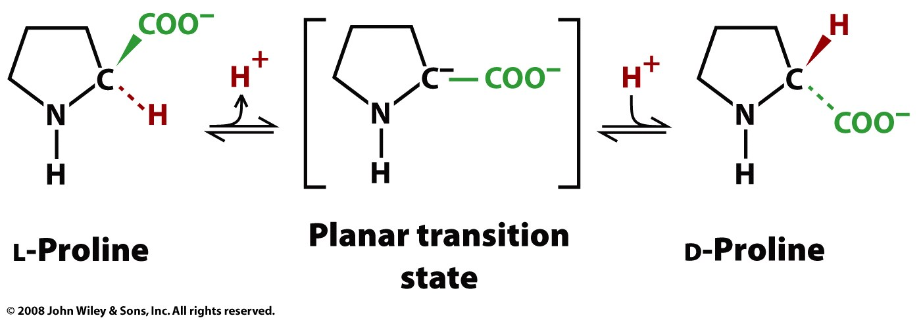
Transition State Analogs
‡

Slide 30
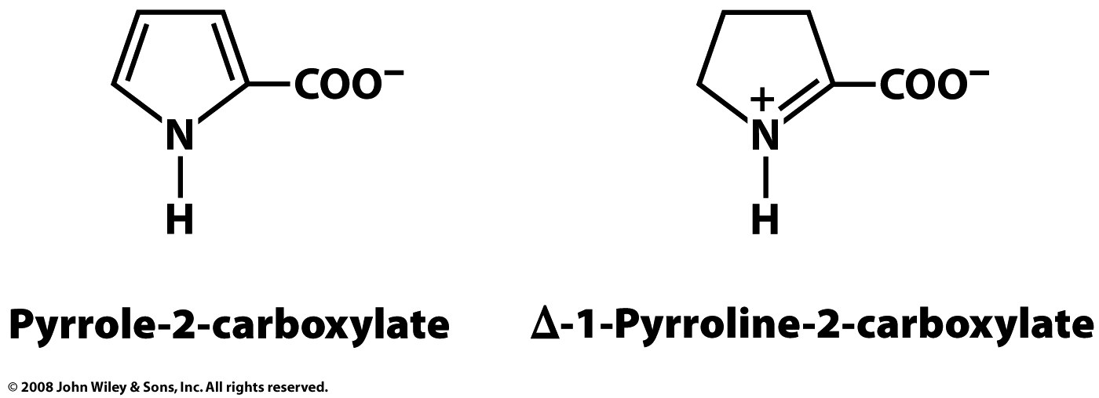
Transition State Analogs
‡

