Slide 1
DNA

Slide 2
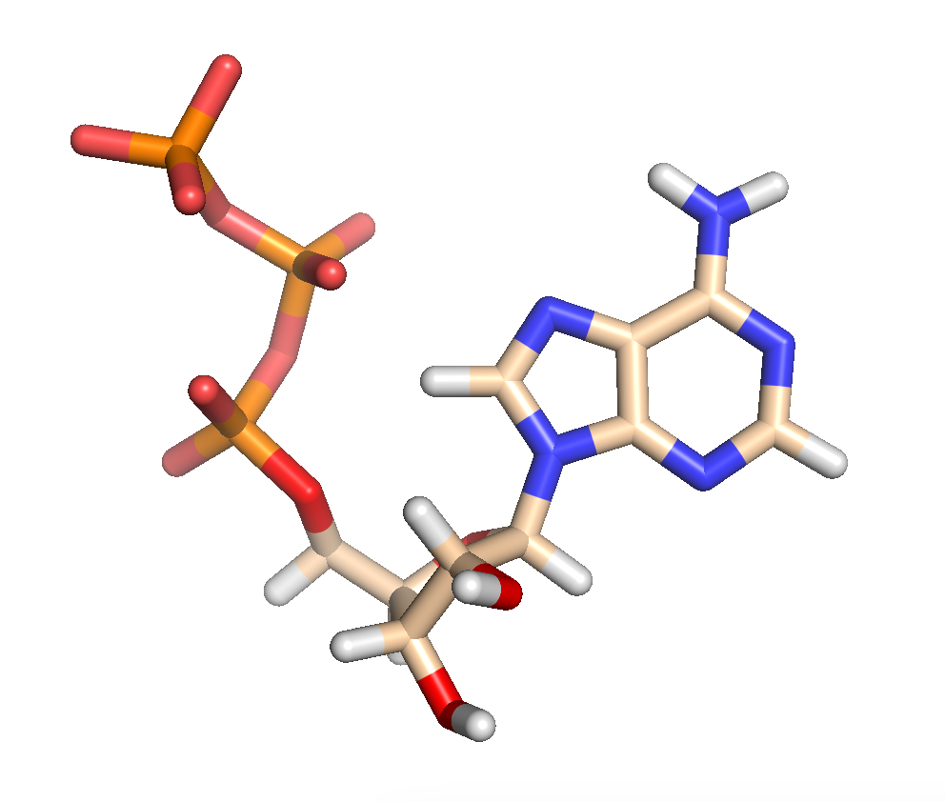
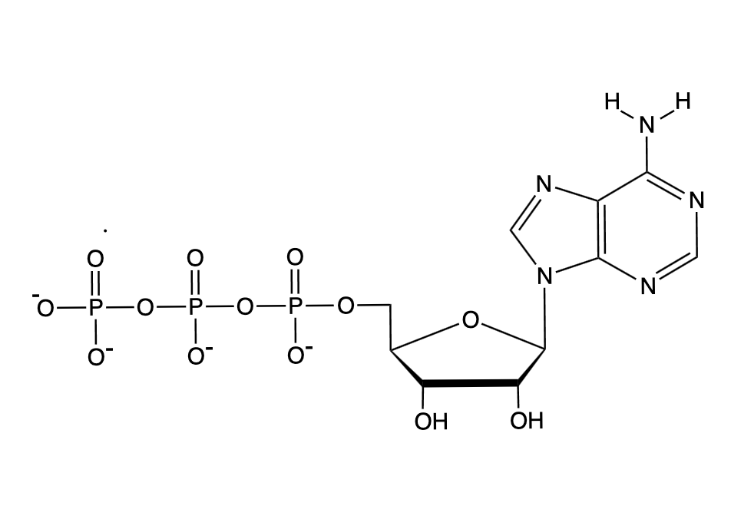
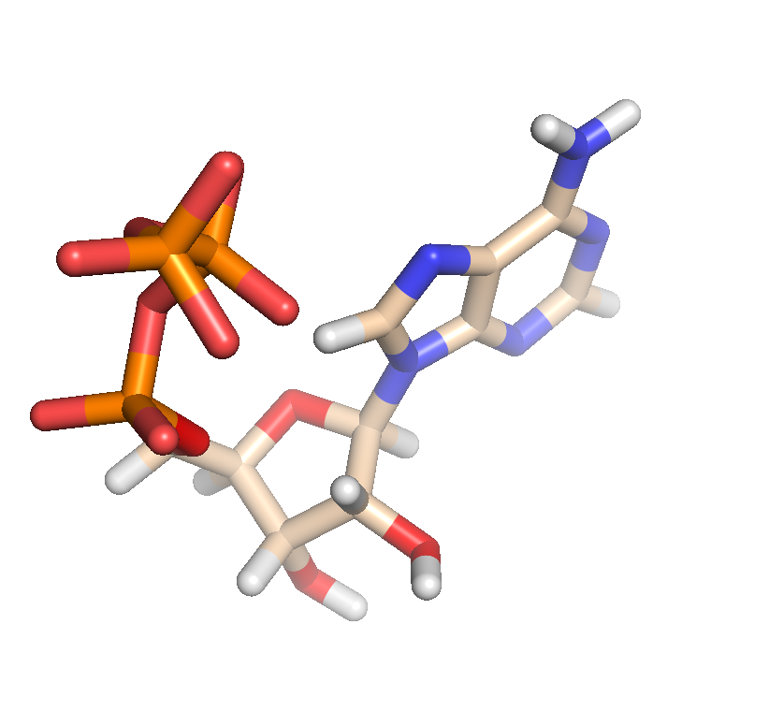
4 NTPs (used to synthesize RNA)
UTP, CTP GTP, ATP
4 dNTPs used to synthesize DNA)
dTT, dCTP, dGTP and dATP
APT is also the biological energy currency.

Slide 3
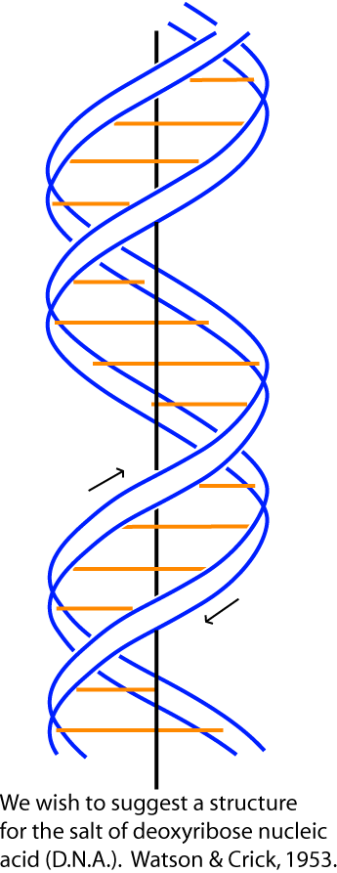
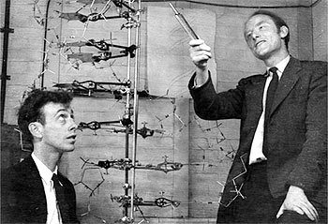
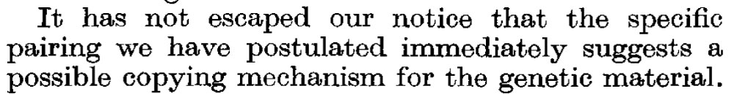
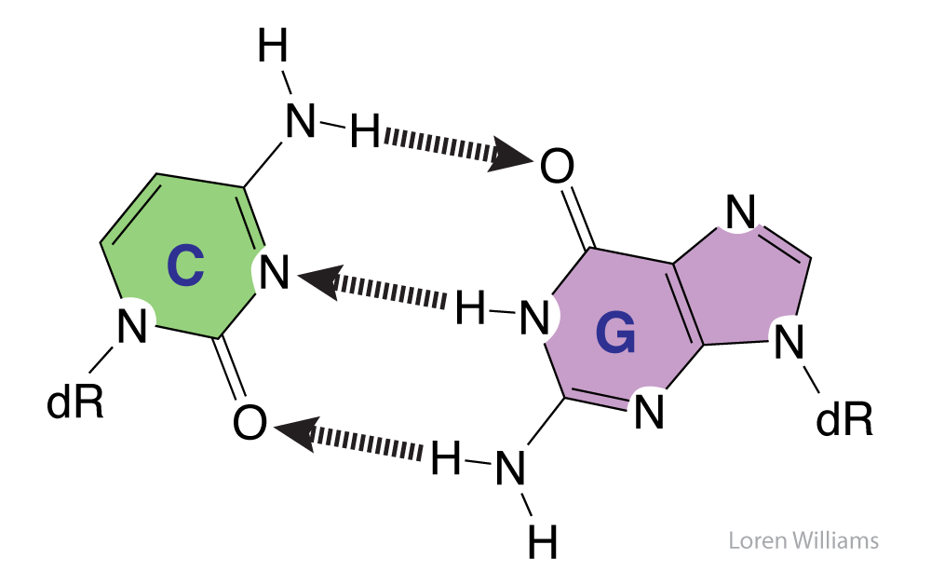
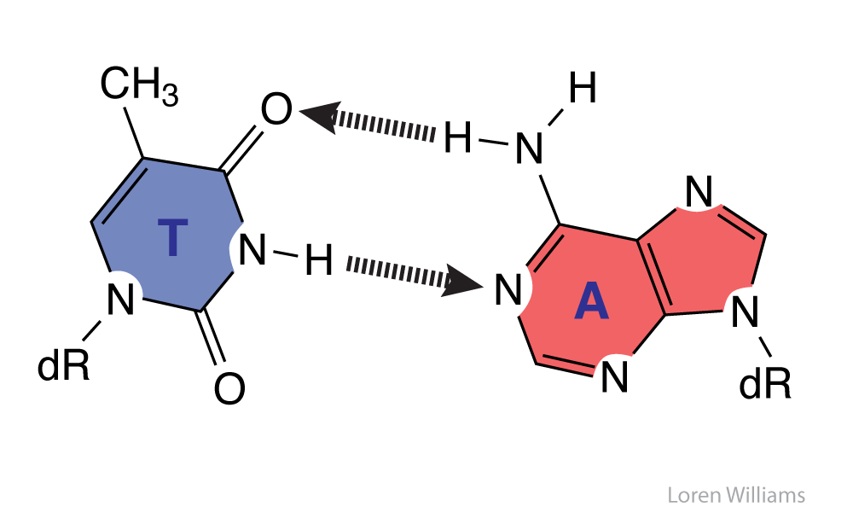
DNA
Watson, J. D., and Crick, F. H. (1953) Molecular Structure of Nucleic Acids: A Structure for Deoxyribose Nucleic Acid., Nature 171, 737-738.

Slide 4
Watson Crick
Wilkins Stokes Wilson

Slide 5
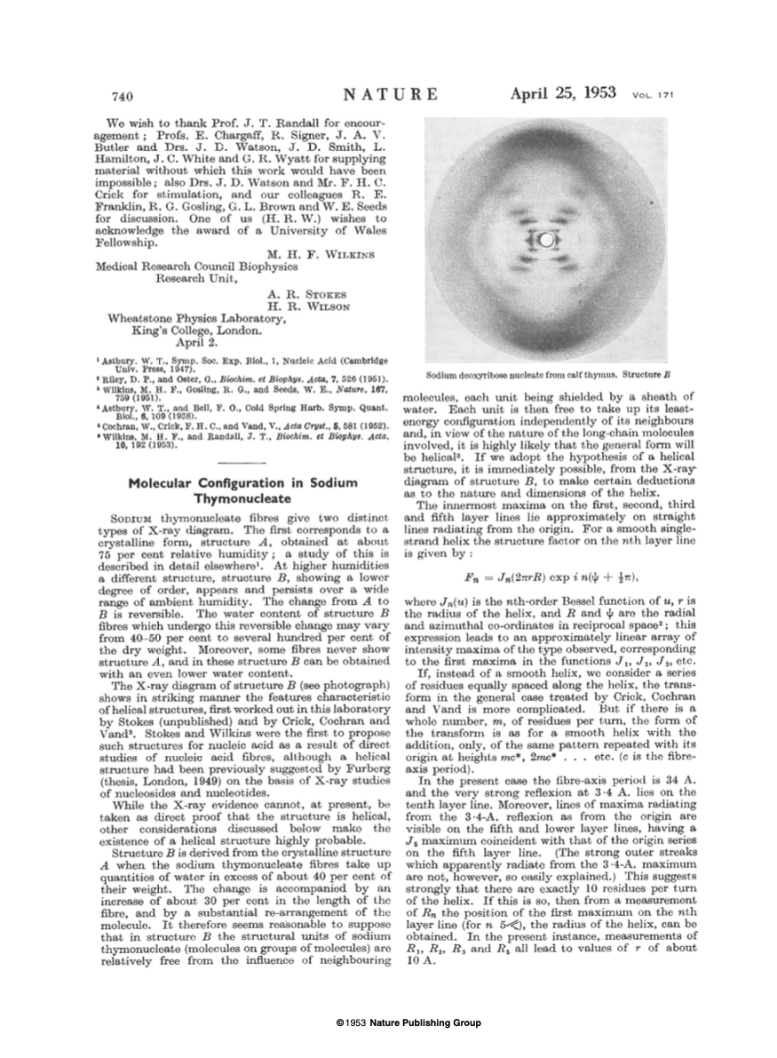
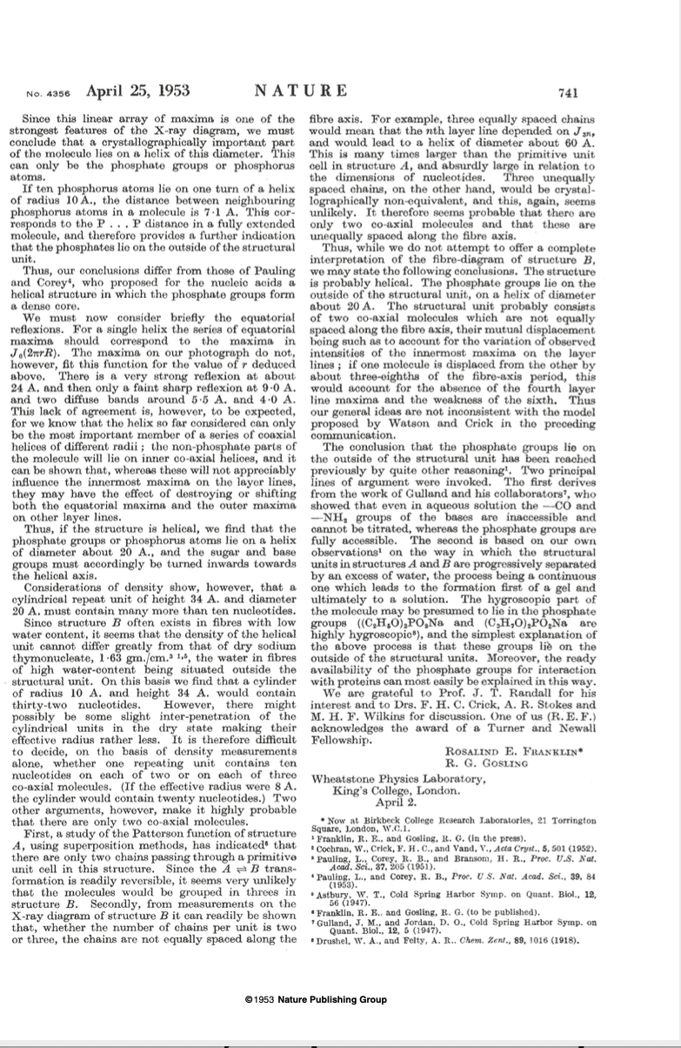
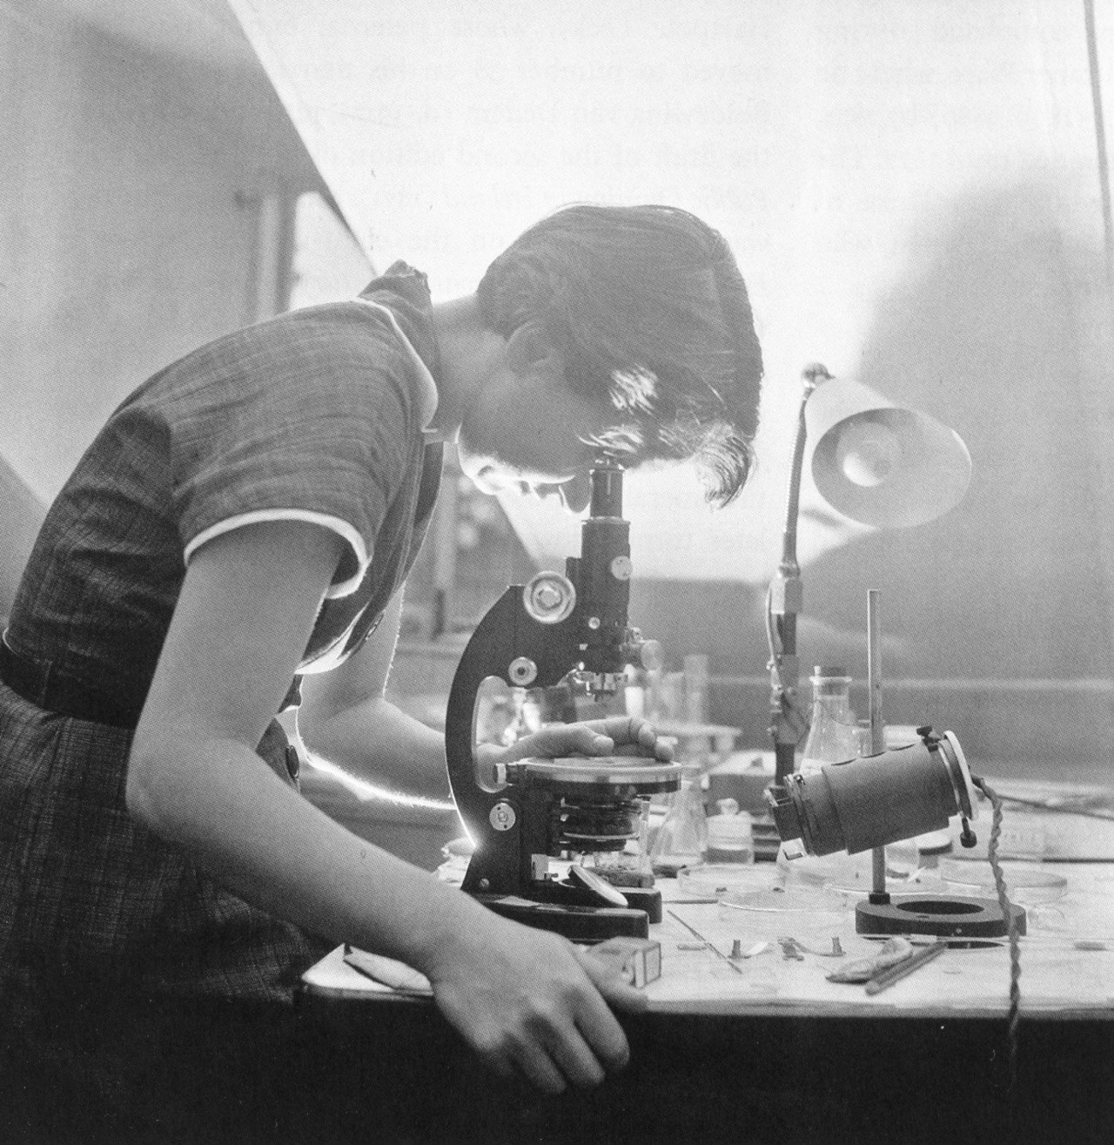
Franklin and Gosling

Slide 6
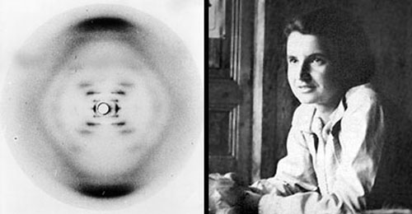
photo 51
Ray Gosling, Rosalind Franklin

Slide 7
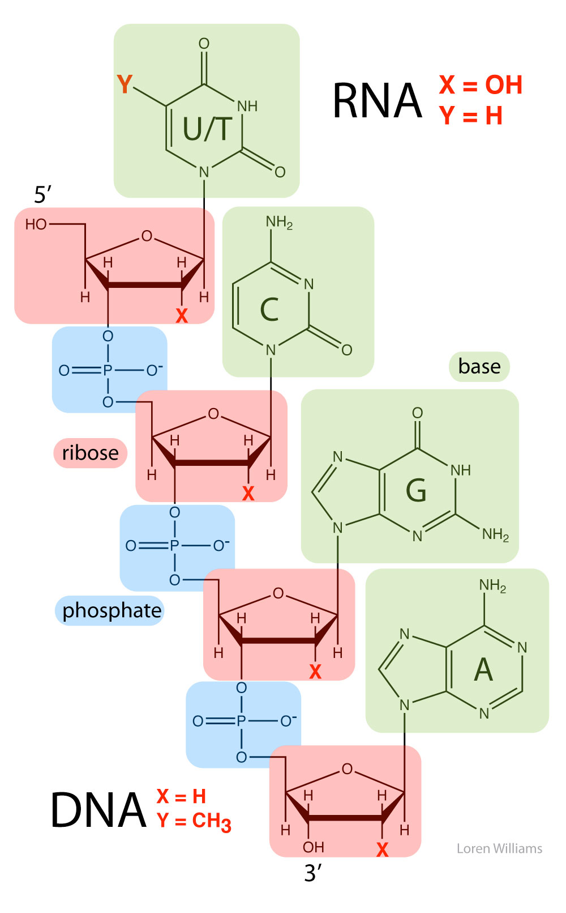
Nucleic Acid Covalent Structure
5’
3’

Slide 8
DNA has no HB donors on the backbone. It has many HB acceptors. It is self-repulsive (anionic).
The DNA backbone cannot self-assemble.
Compare DNA to protein, which has equal number of acceptors and donors and a self-complementary backbone)

Slide 9
Canonical
Base Pairs in double-stranded DNA
(aka: Watson-Crick
base pairs)

Slide 10
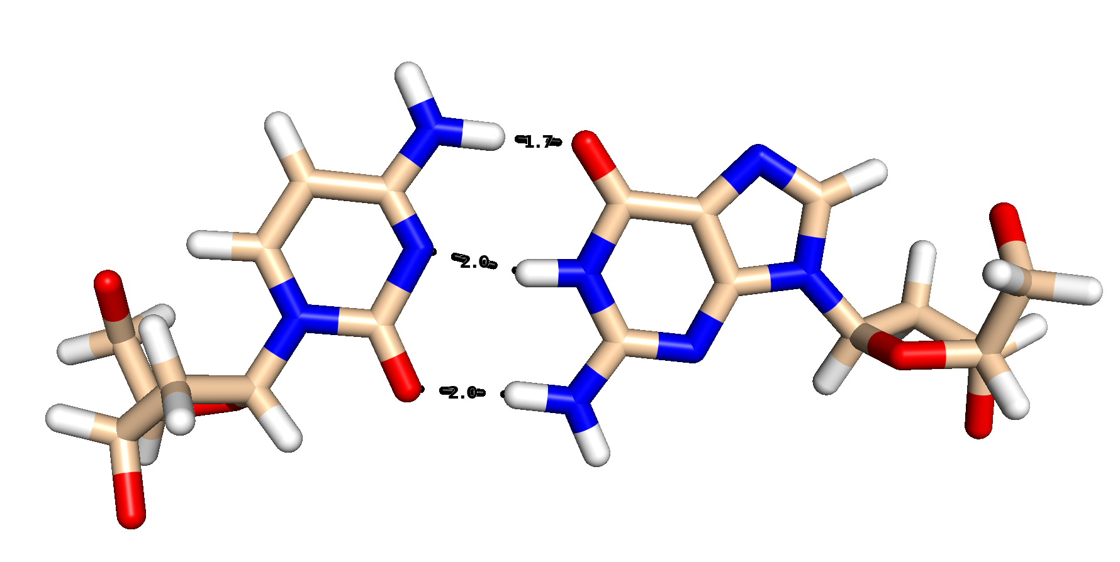
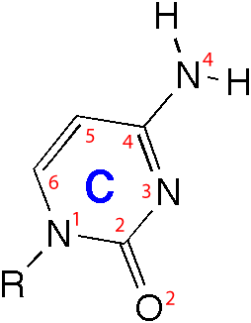
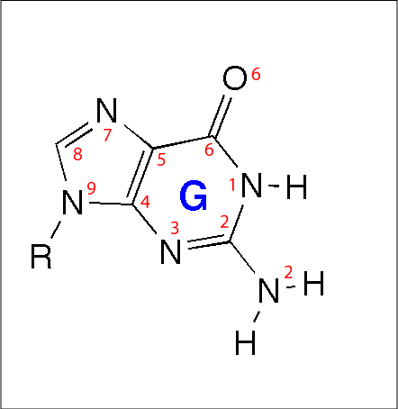
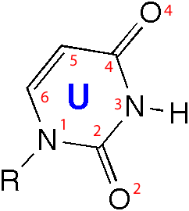
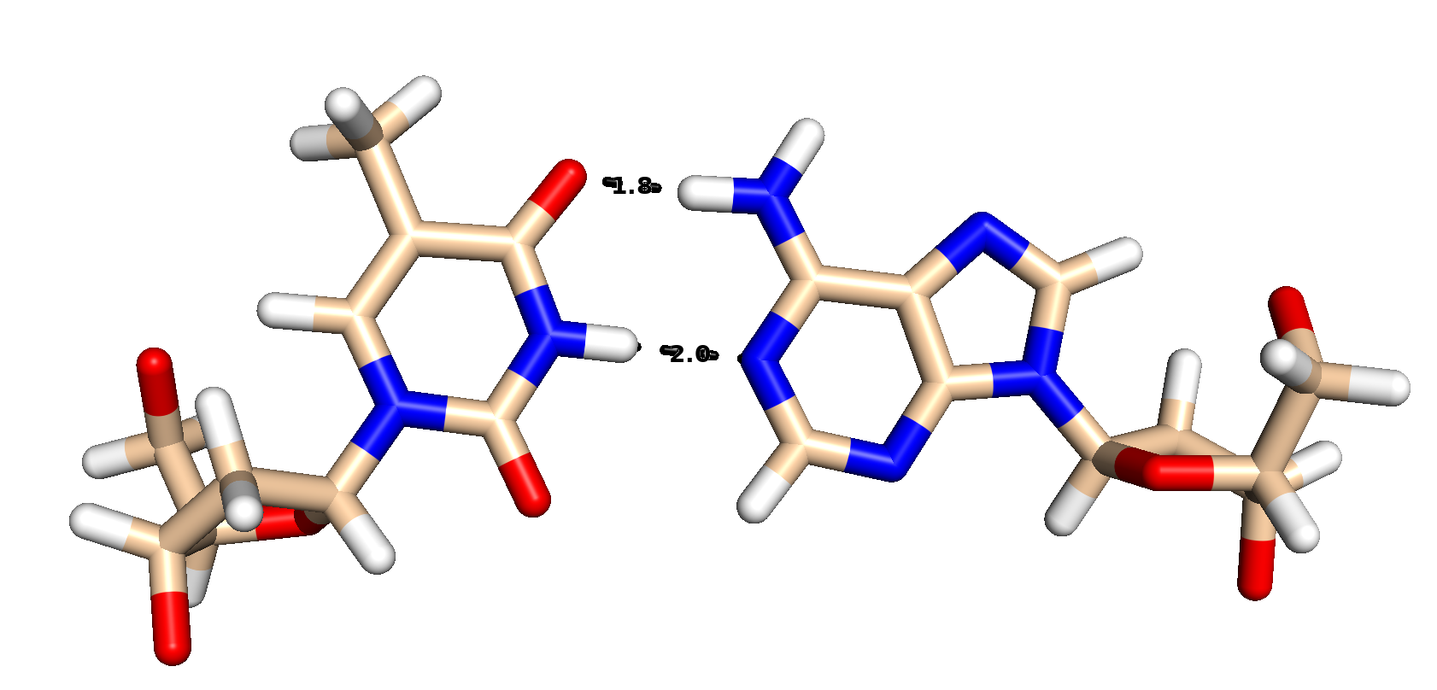
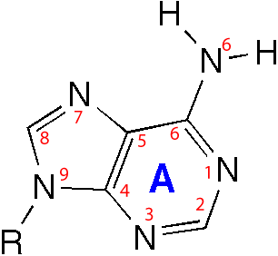

Slide 11
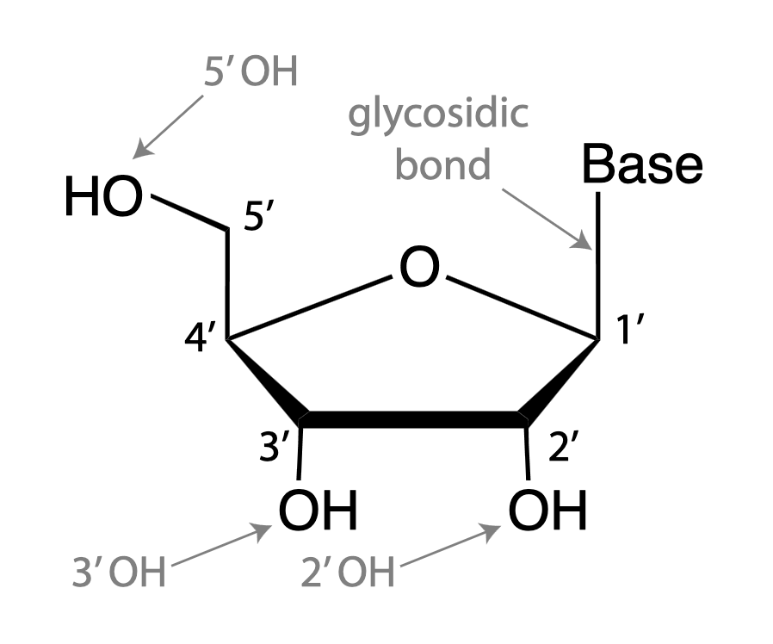
From the flashcards

Slide 12
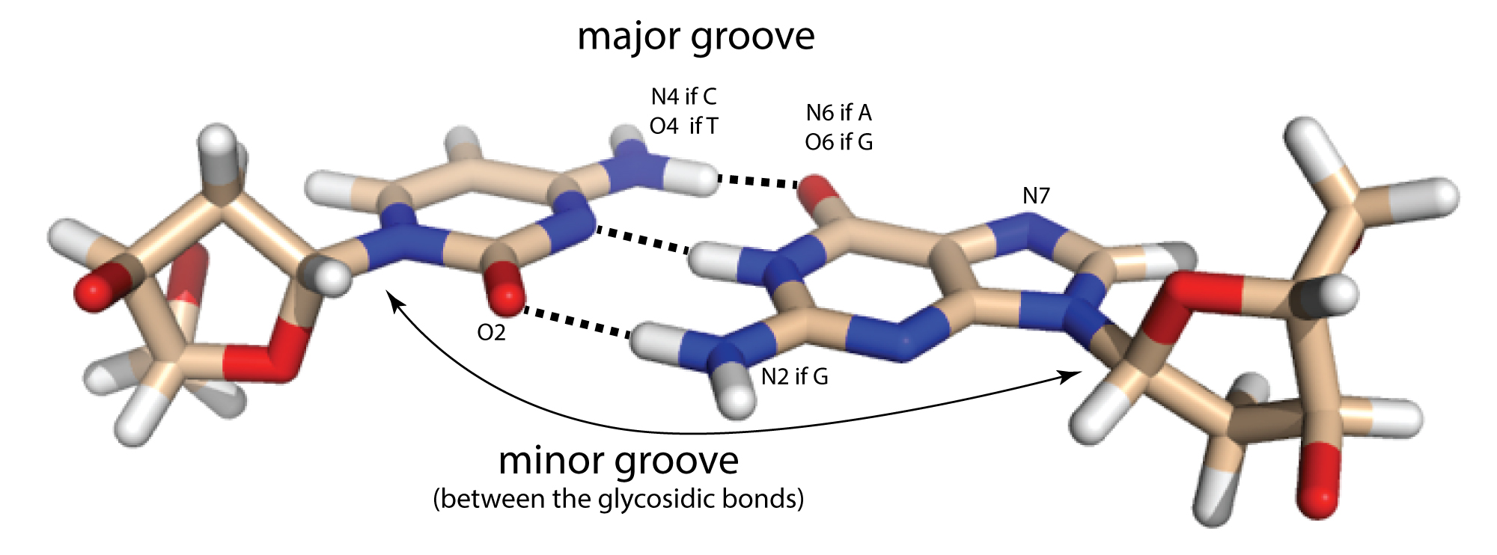

Slide 13
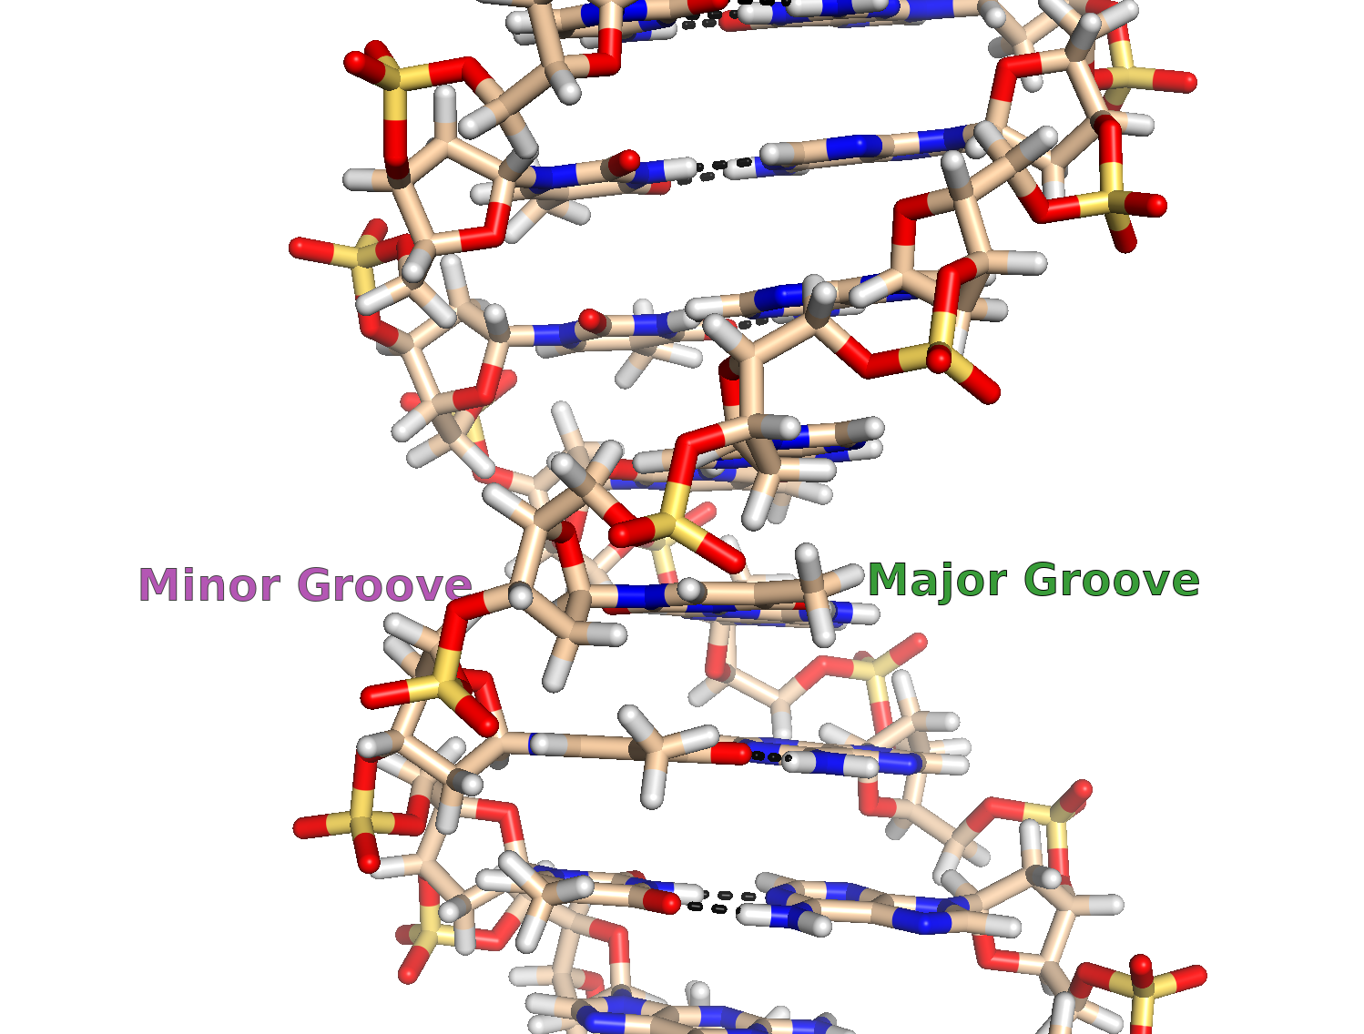
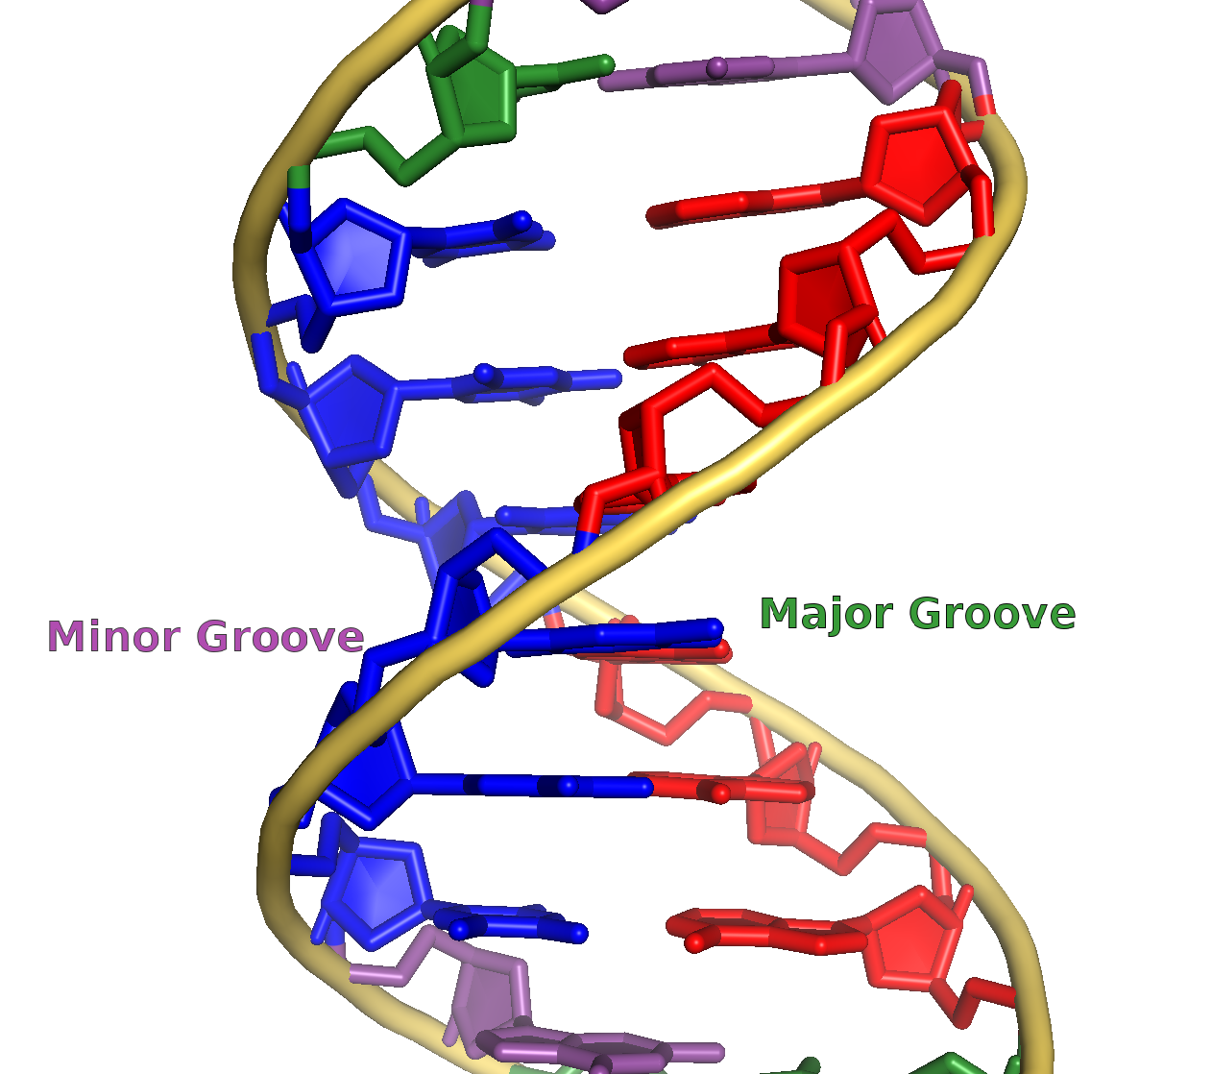

Slide 14
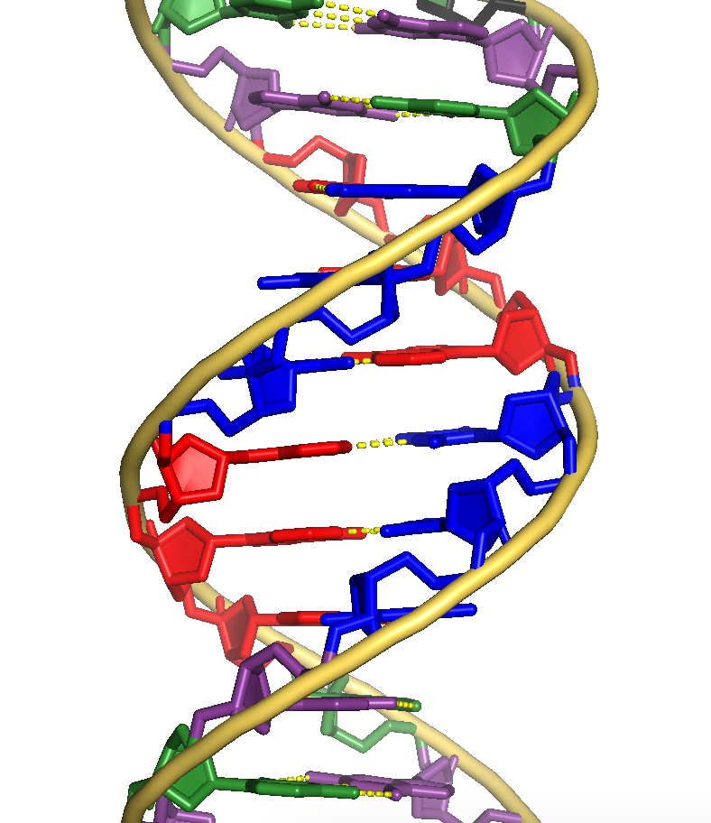
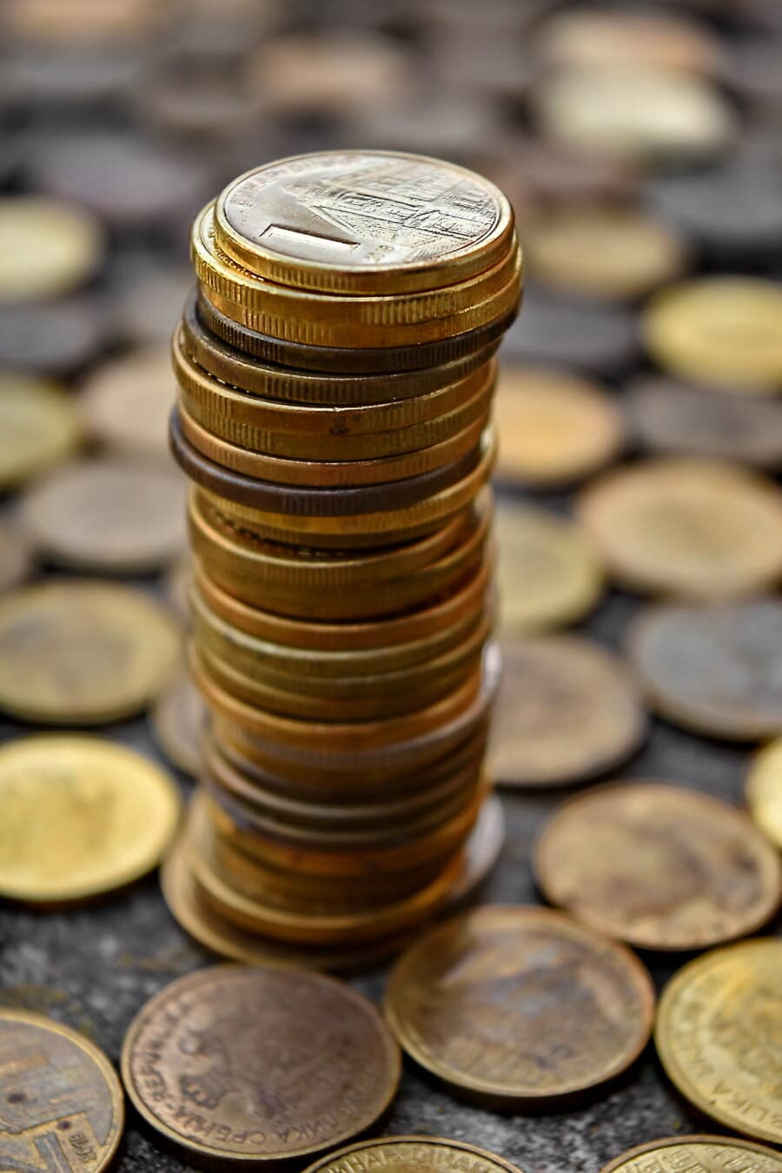
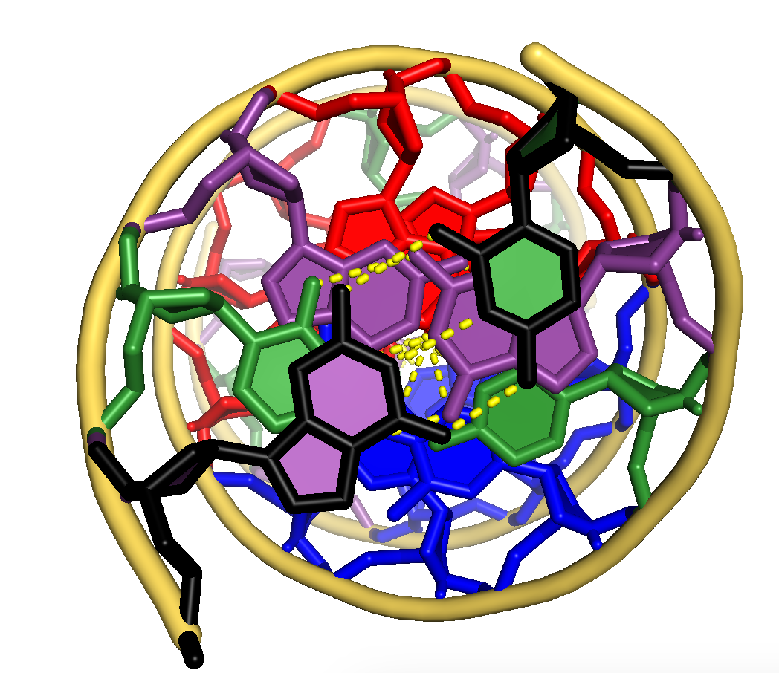
B-Form Helix
(B-DNA)

Slide 15
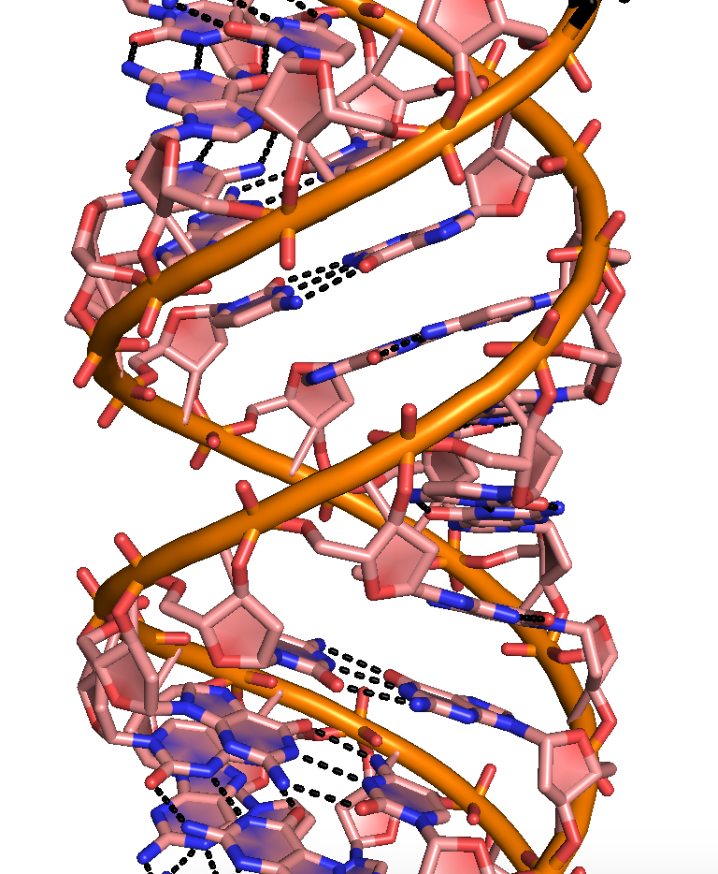
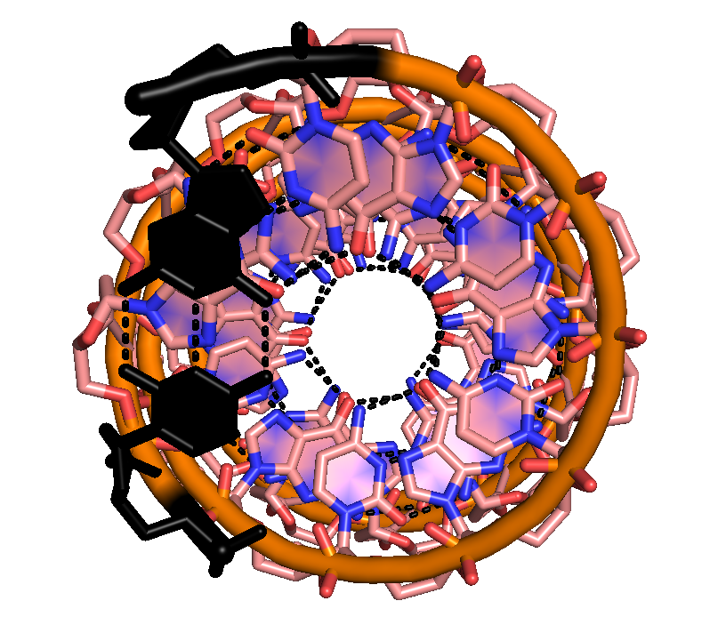
A-Form Helix
(A-DNA, RNA)

Slide 16
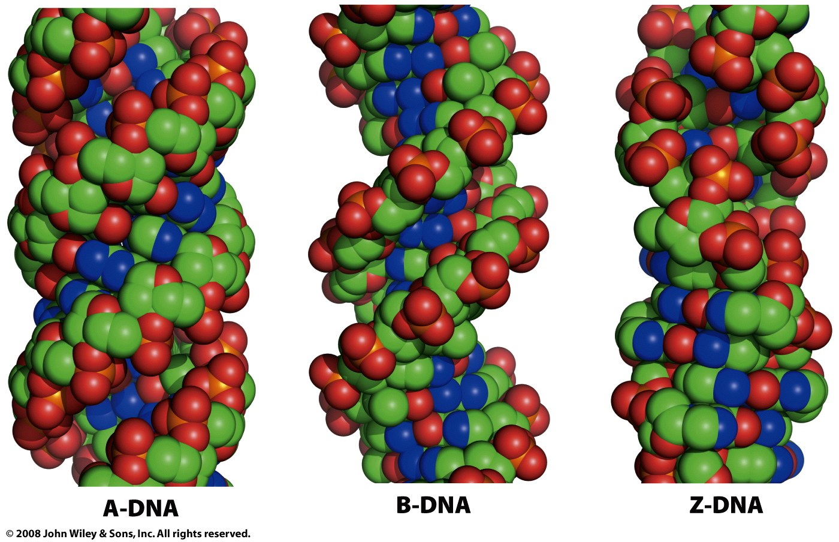
Figure 24-2b

Slide 17
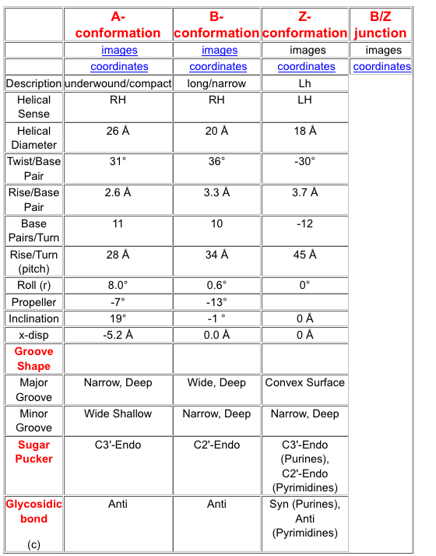
Helical
Parameters

Slide 18
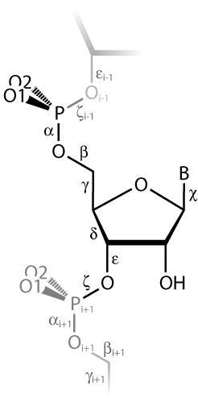
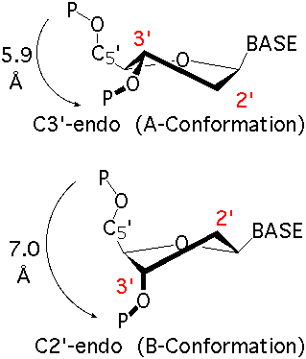
Torsion Angles
&
Sugar Puckers

Slide 19
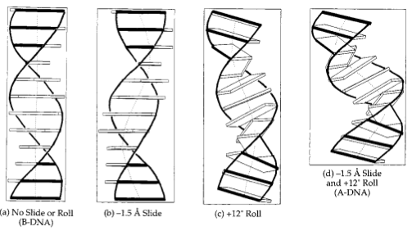
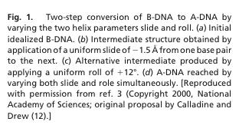

Slide 20
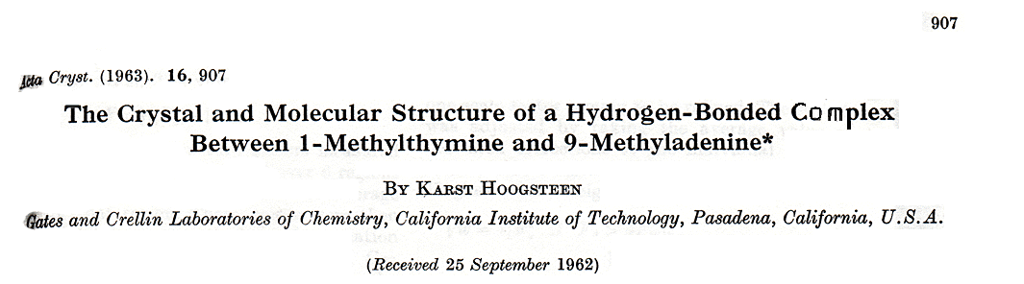
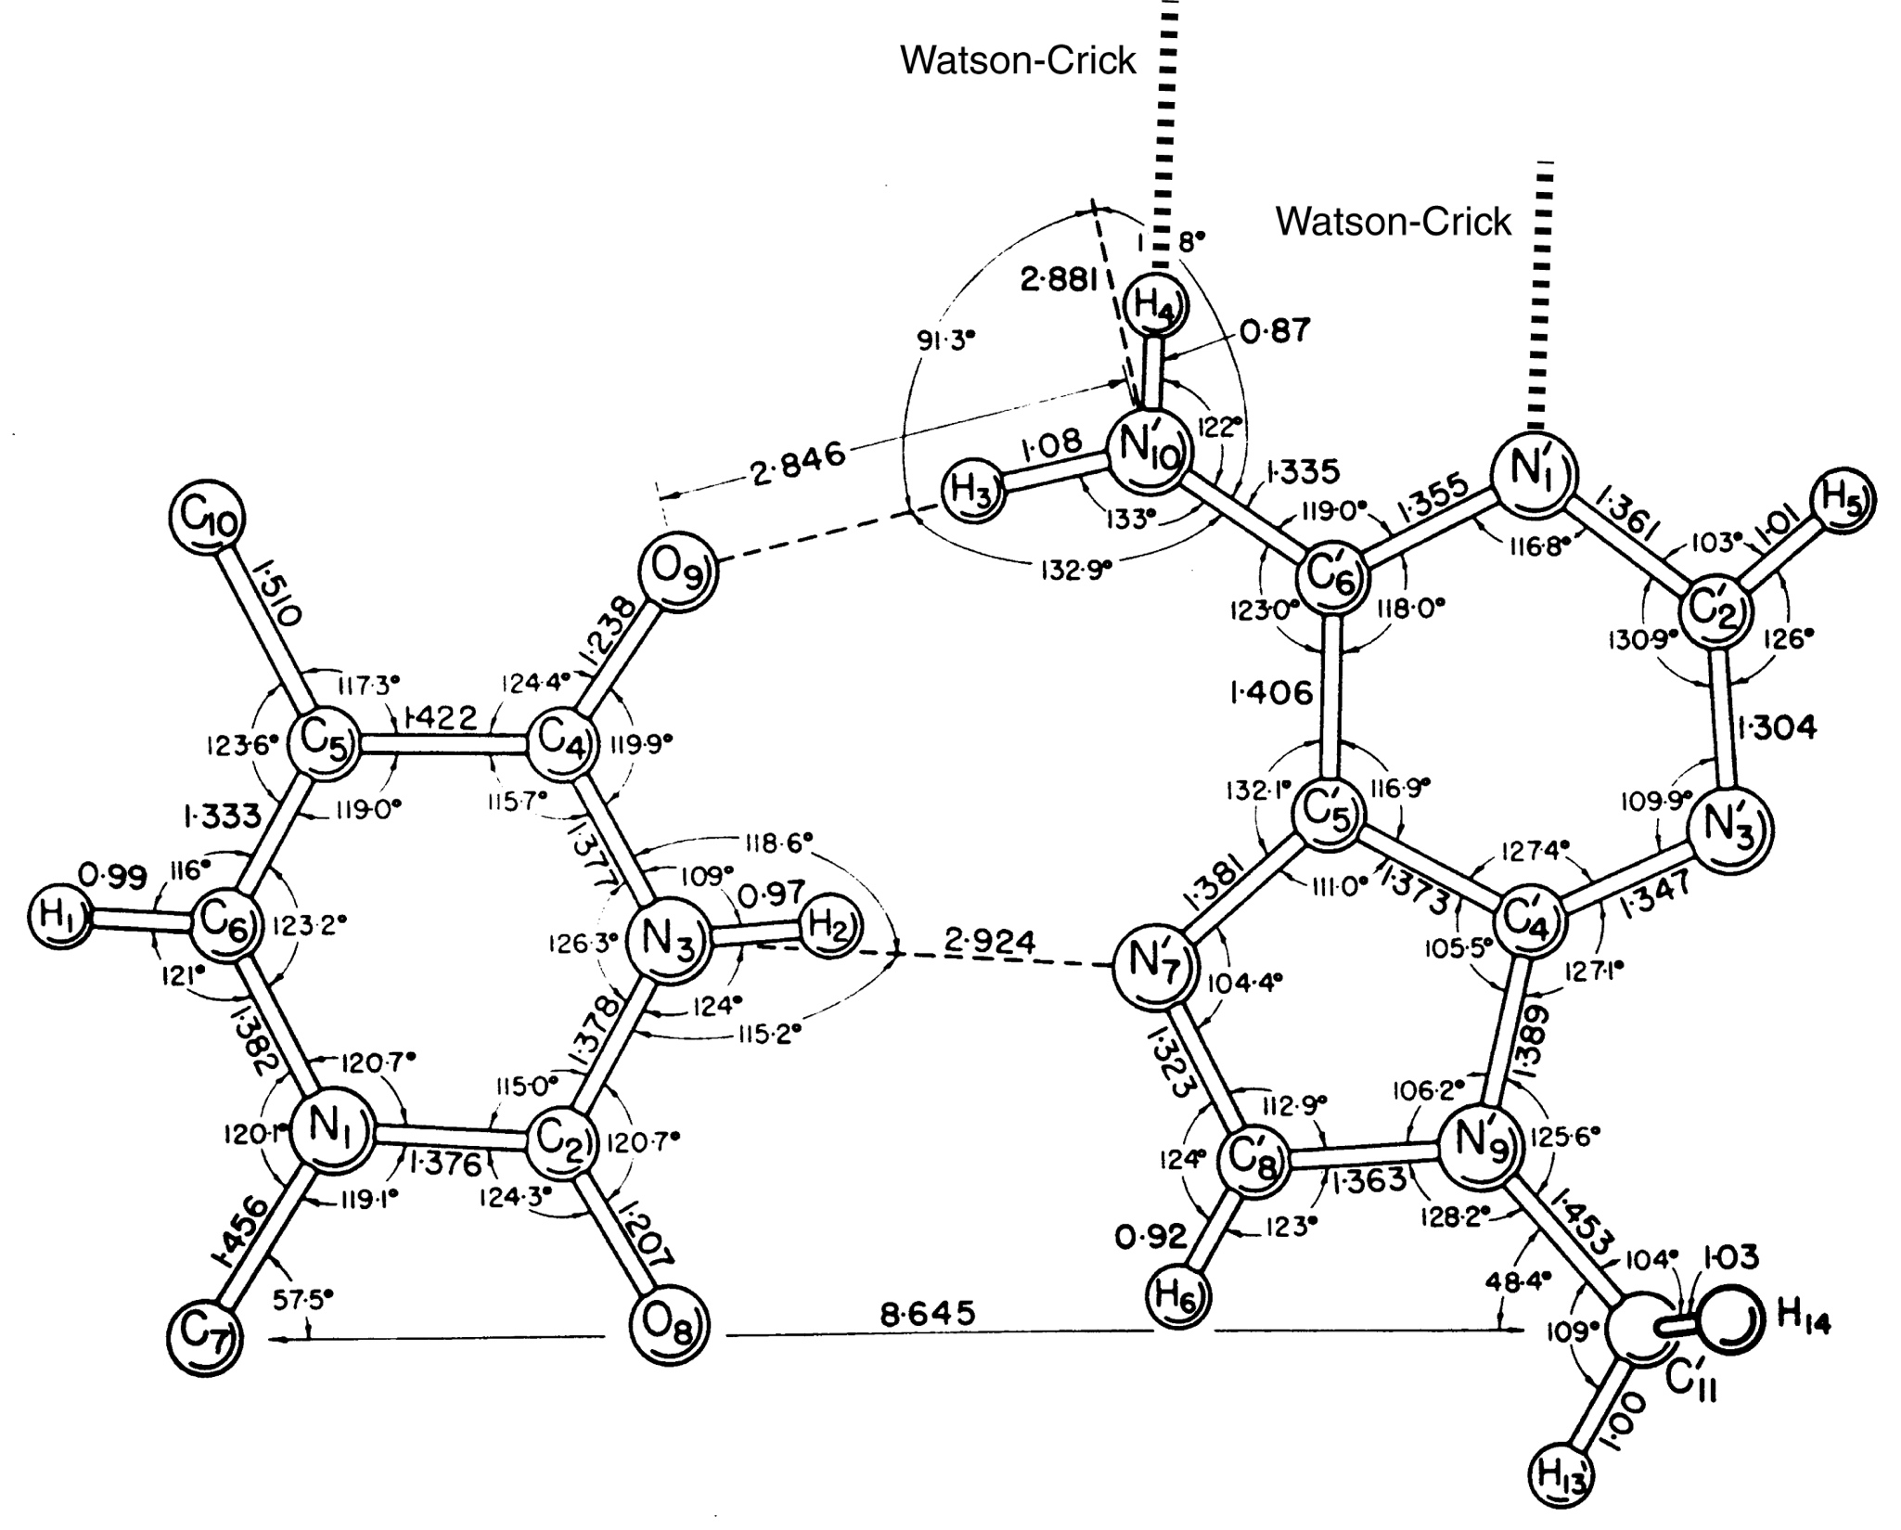

Slide 21
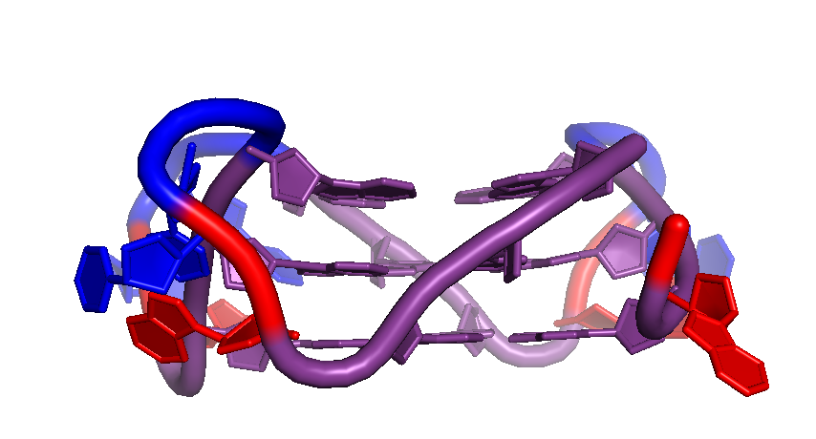
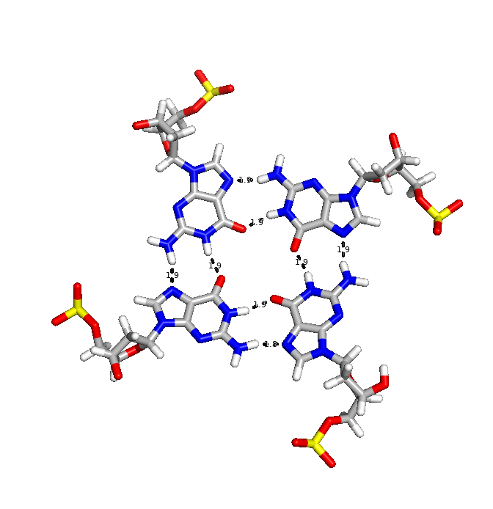
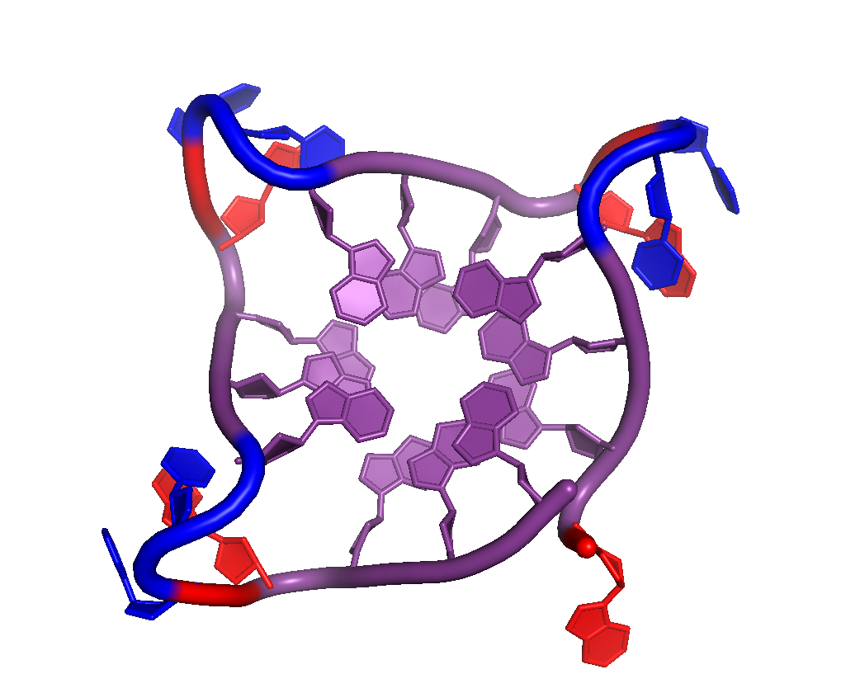
G-quadruplexes
G₃N₃G₃N₃G₃N₃G₃

Slide 22
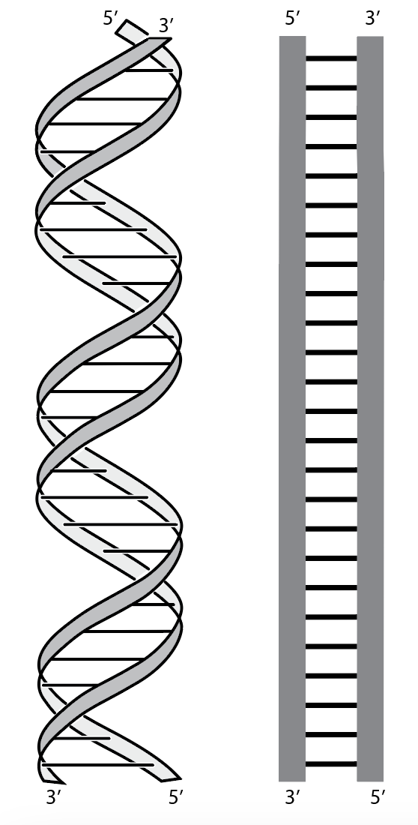
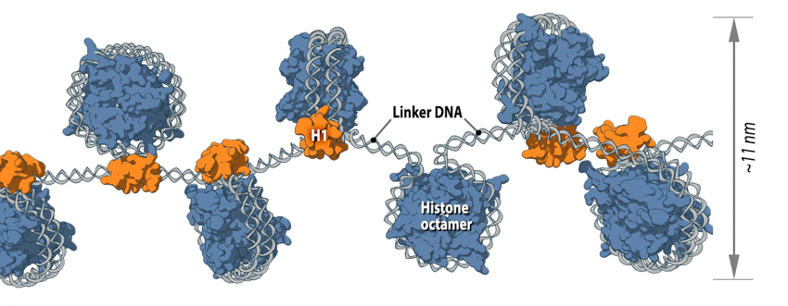
DNA RNA
Chromatin: packaging of DNA in
eukaryotic nuclei.

