Slide 1
Intrinsically Disordered Proteins

Slide 2
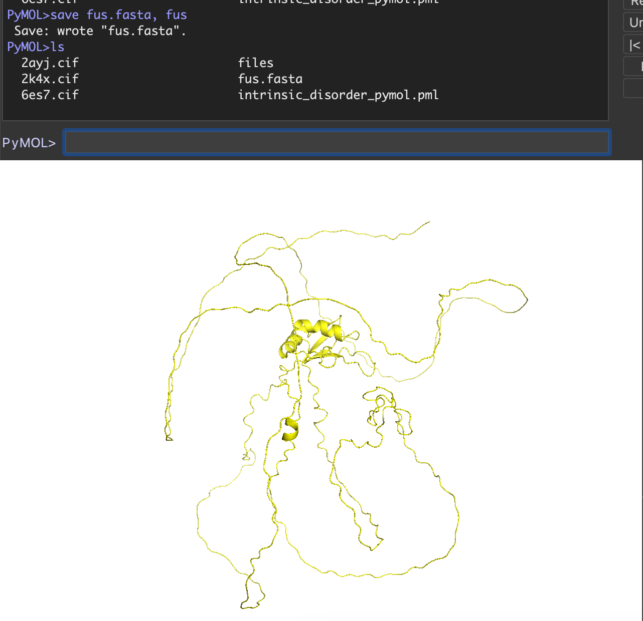

Slide 3
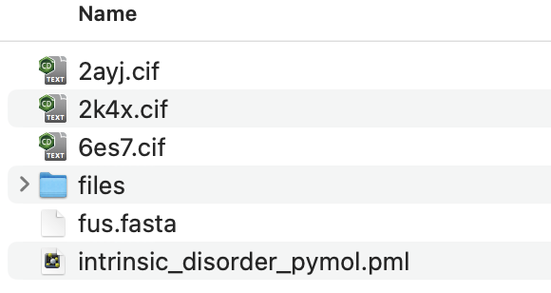
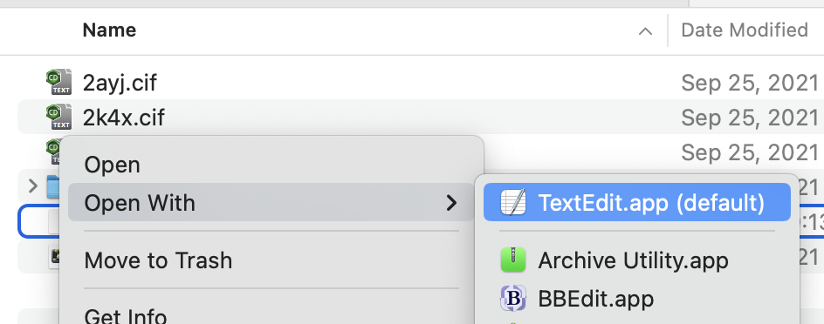

Slide 4


Slide 5
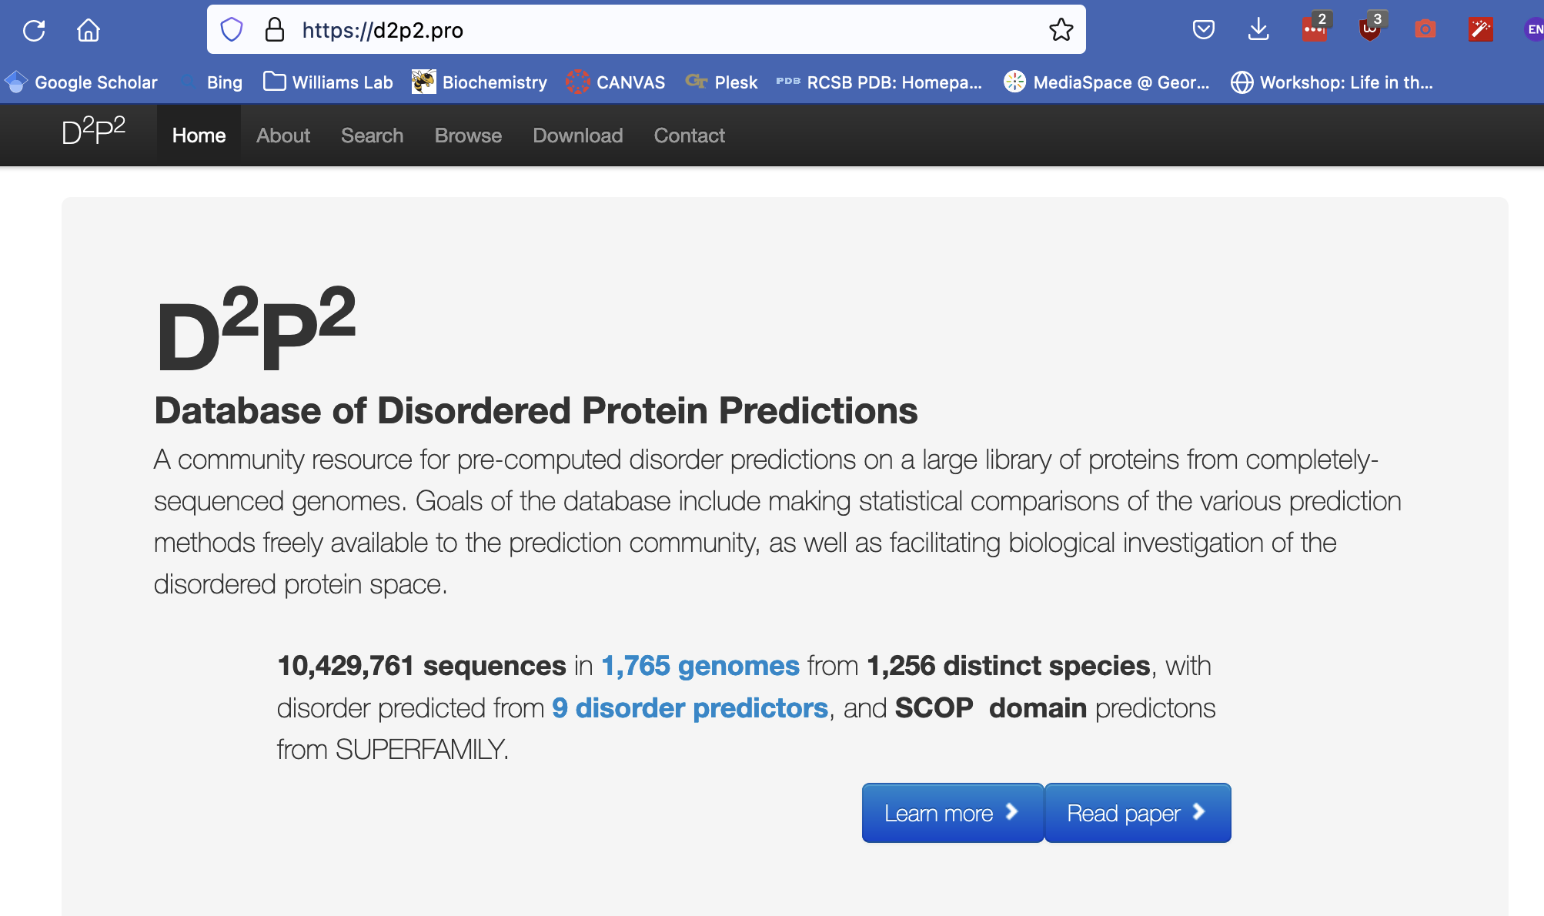


Slide 6
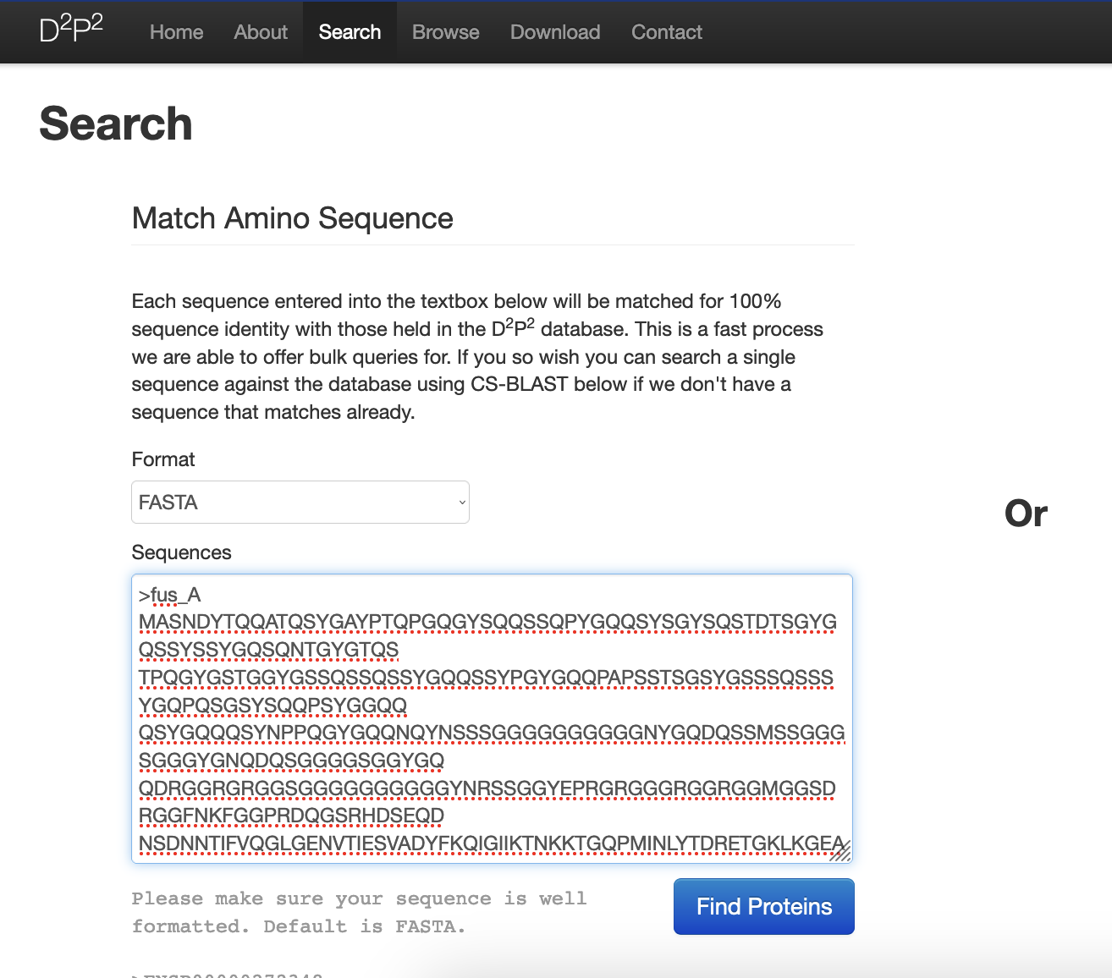

Slide 7
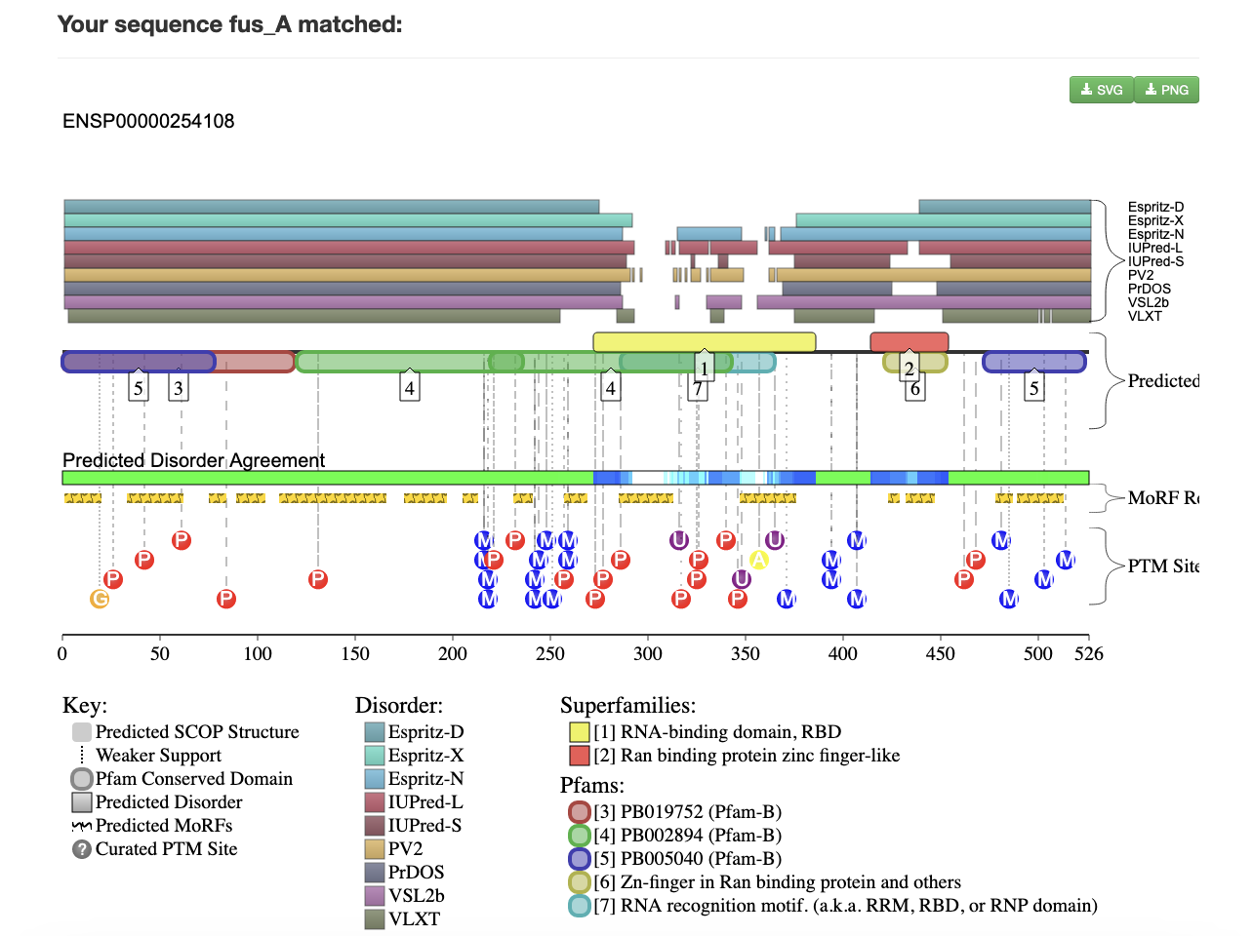

Slide 8
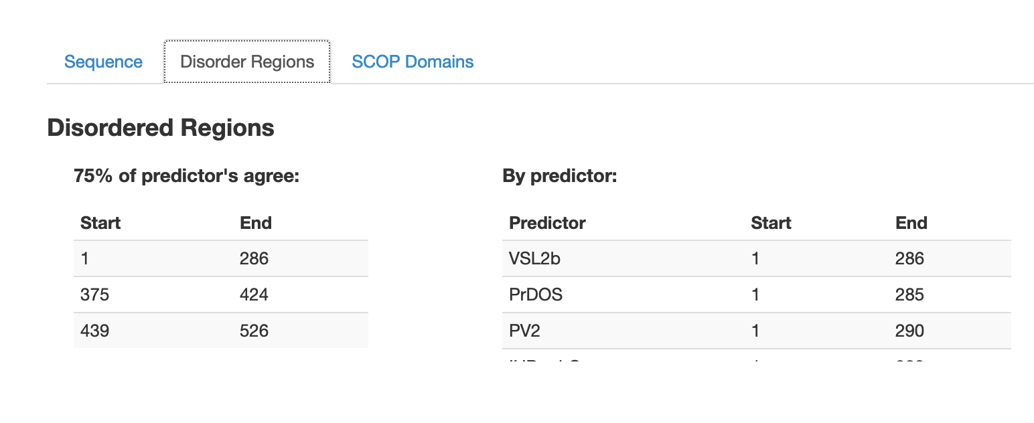

Slide 9
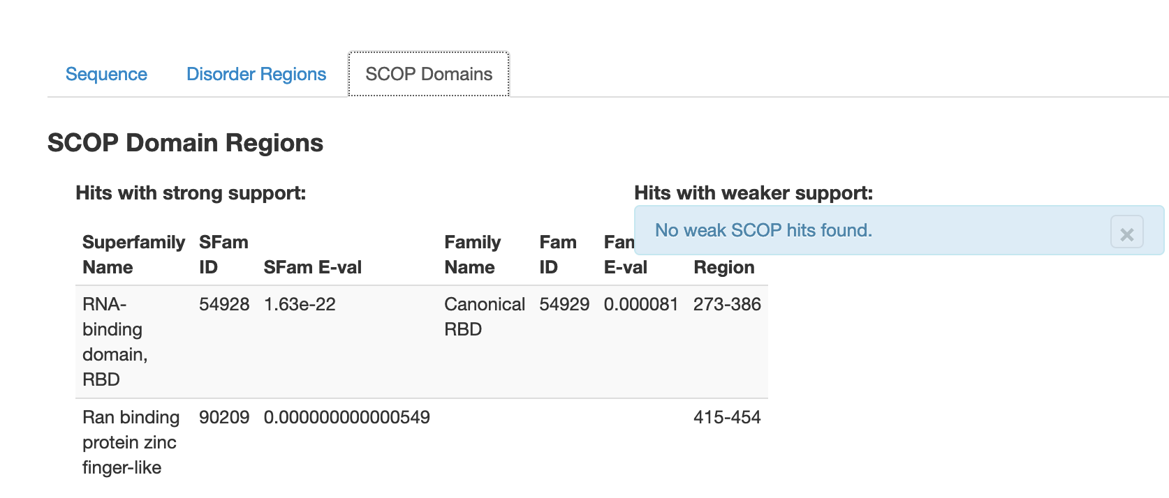


Slide 10
create structured, (resi 273-386 or resi 415-454) and fus
create disordered, (resi 1-286 or resi 375-424 or resi 439-526) and fus

