Slide 1
A Time Line

Slide 2
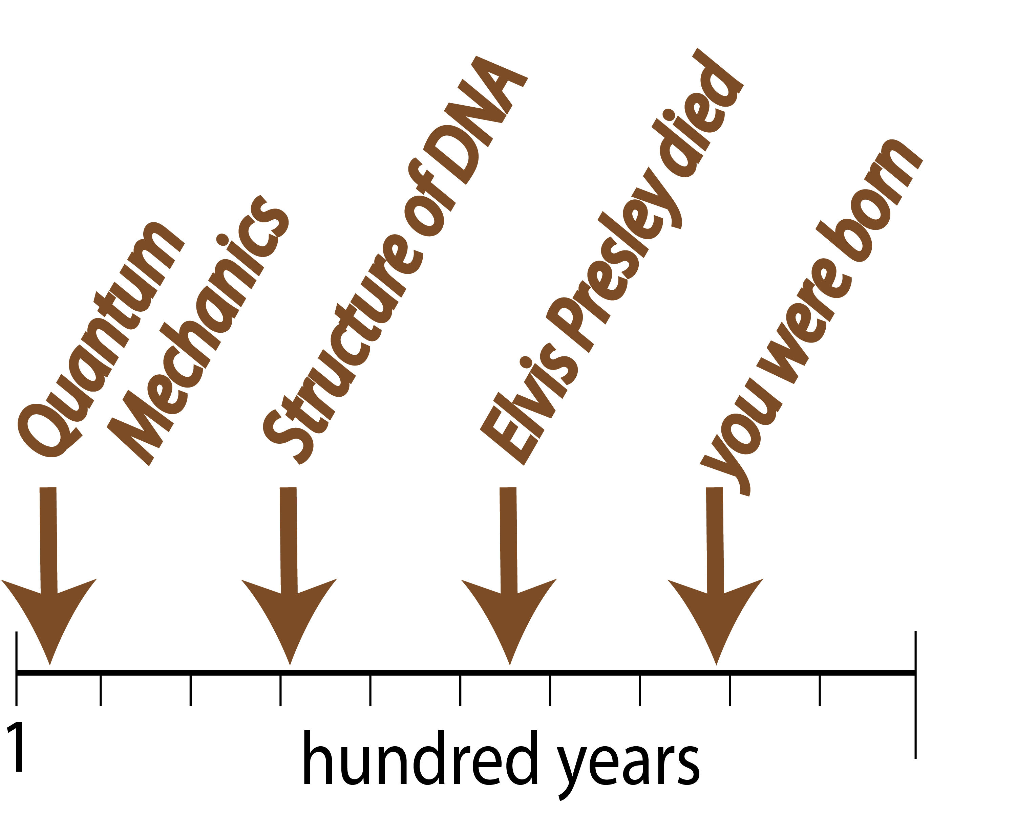

Slide 3
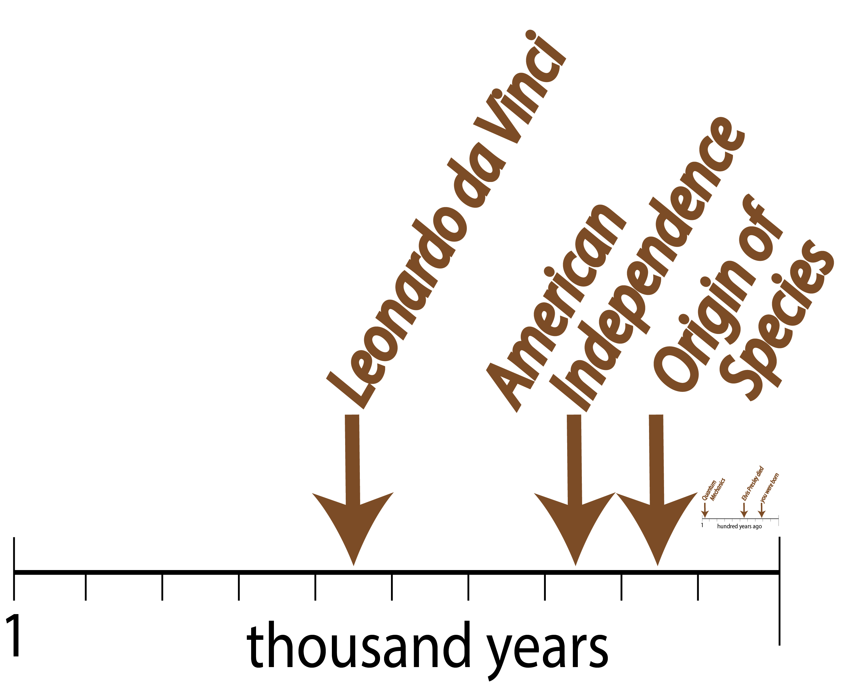

Slide 4
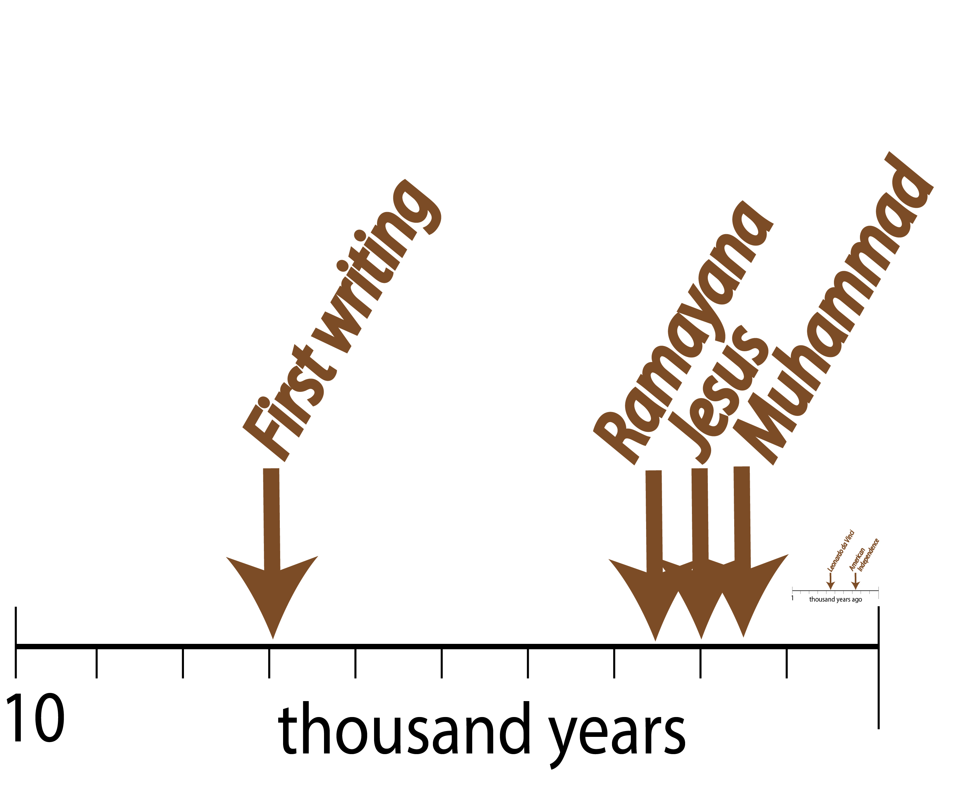

Slide 5
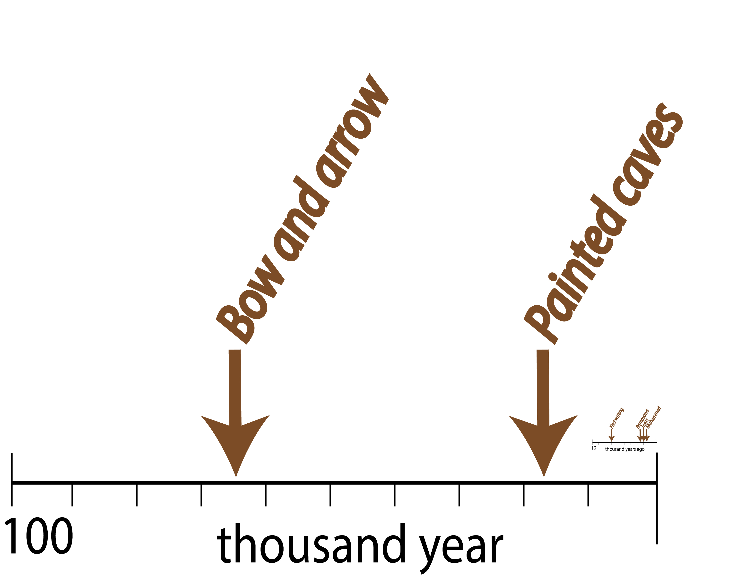

Slide 6
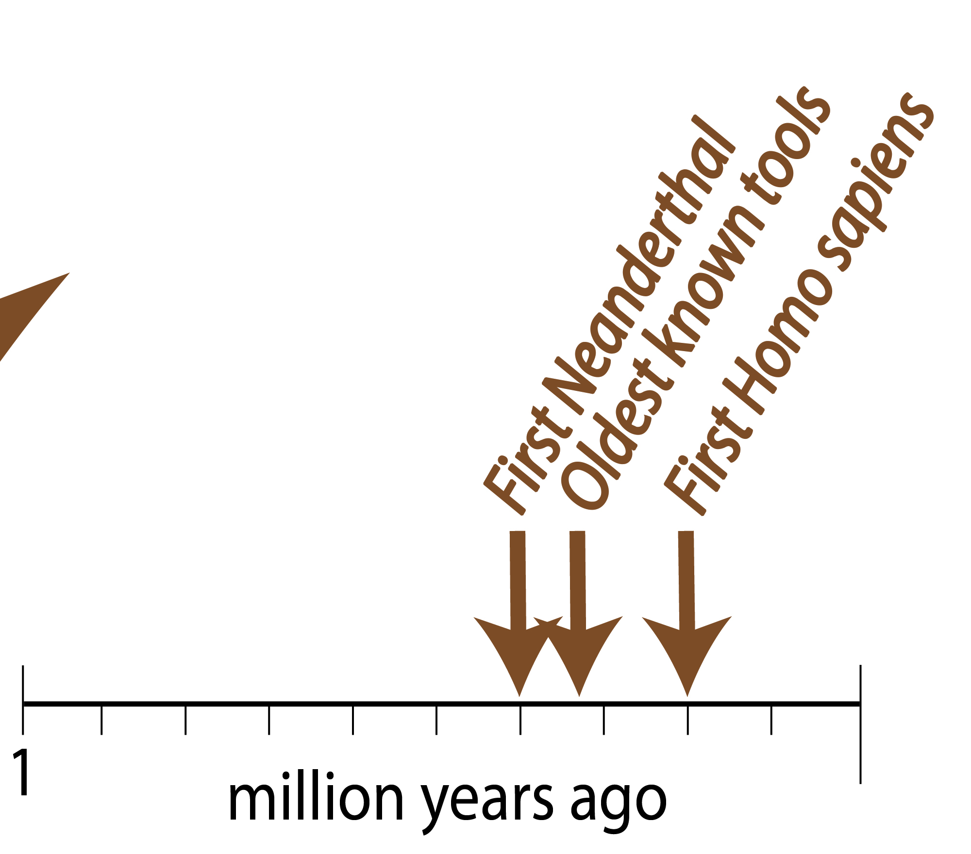

Slide 7
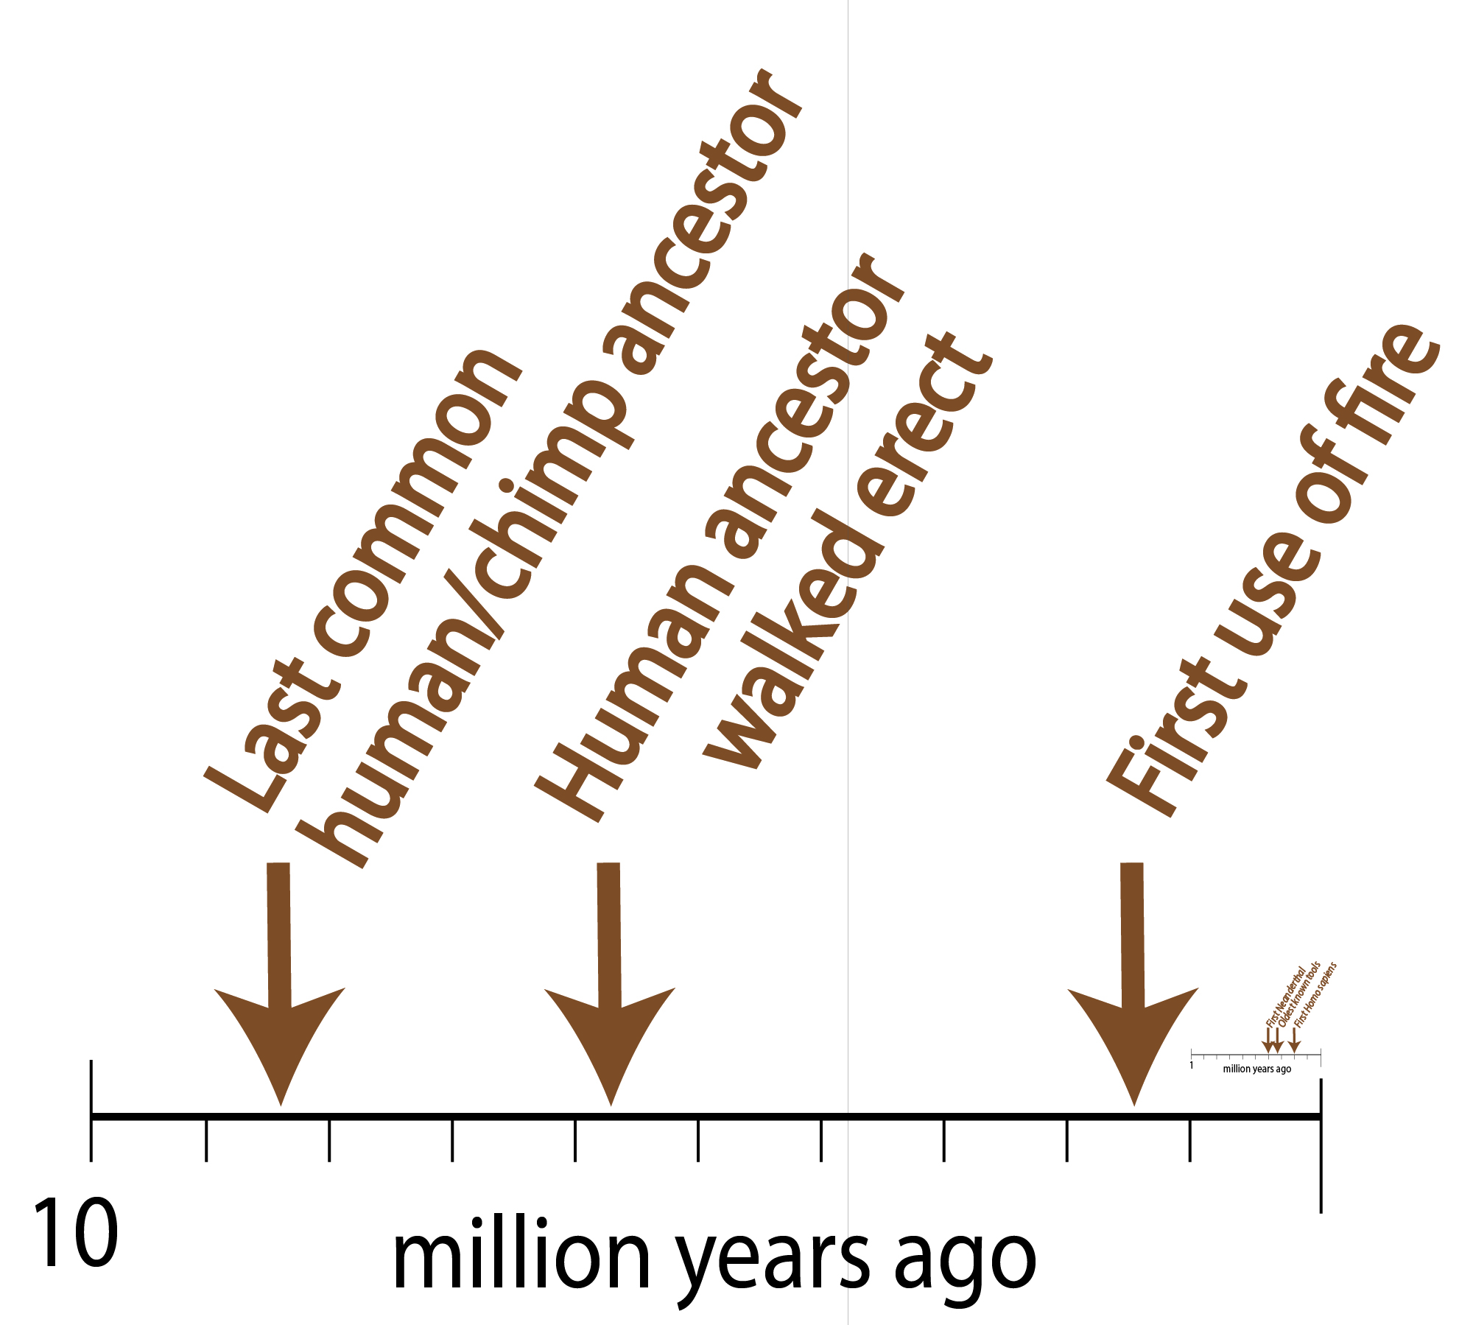

Slide 8
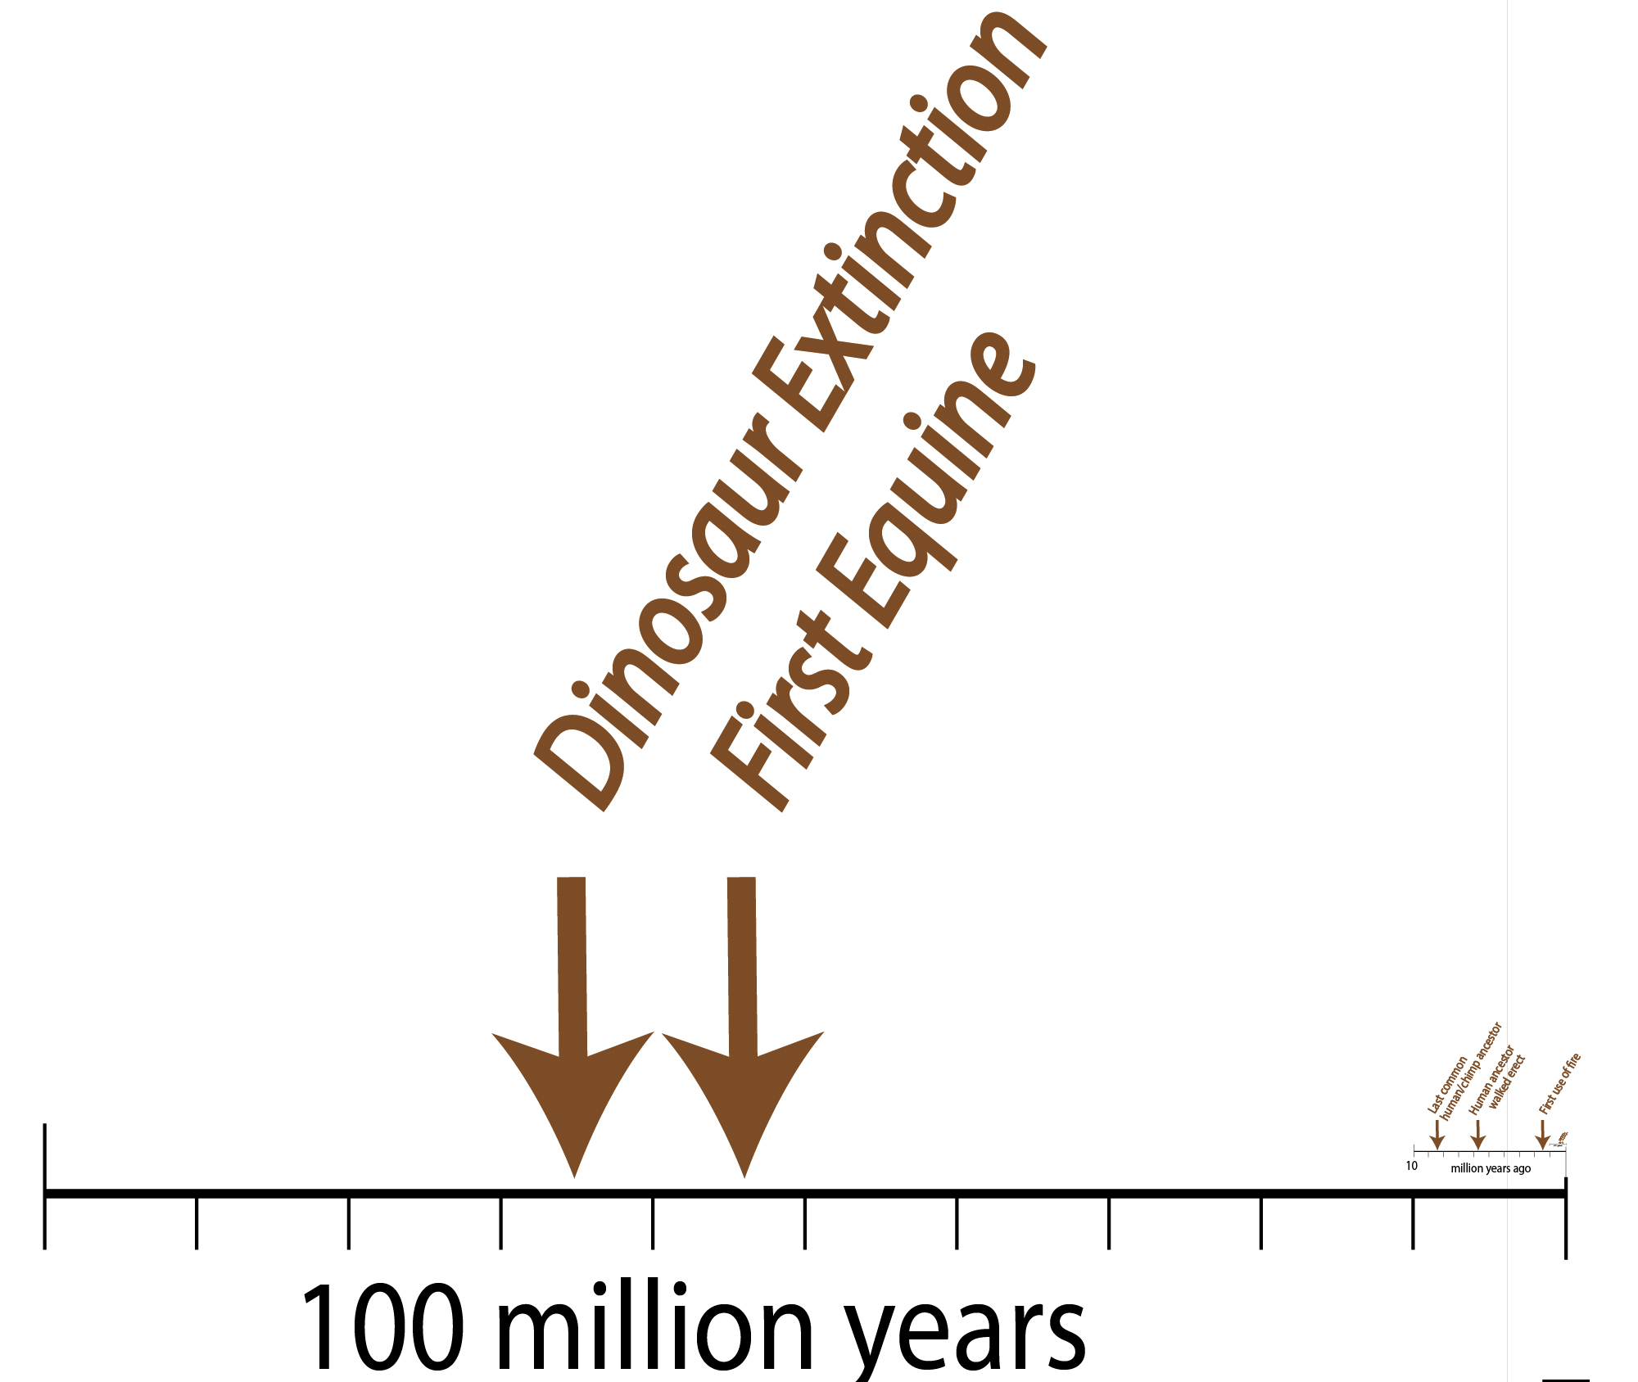
Billion years ago

Slide 9
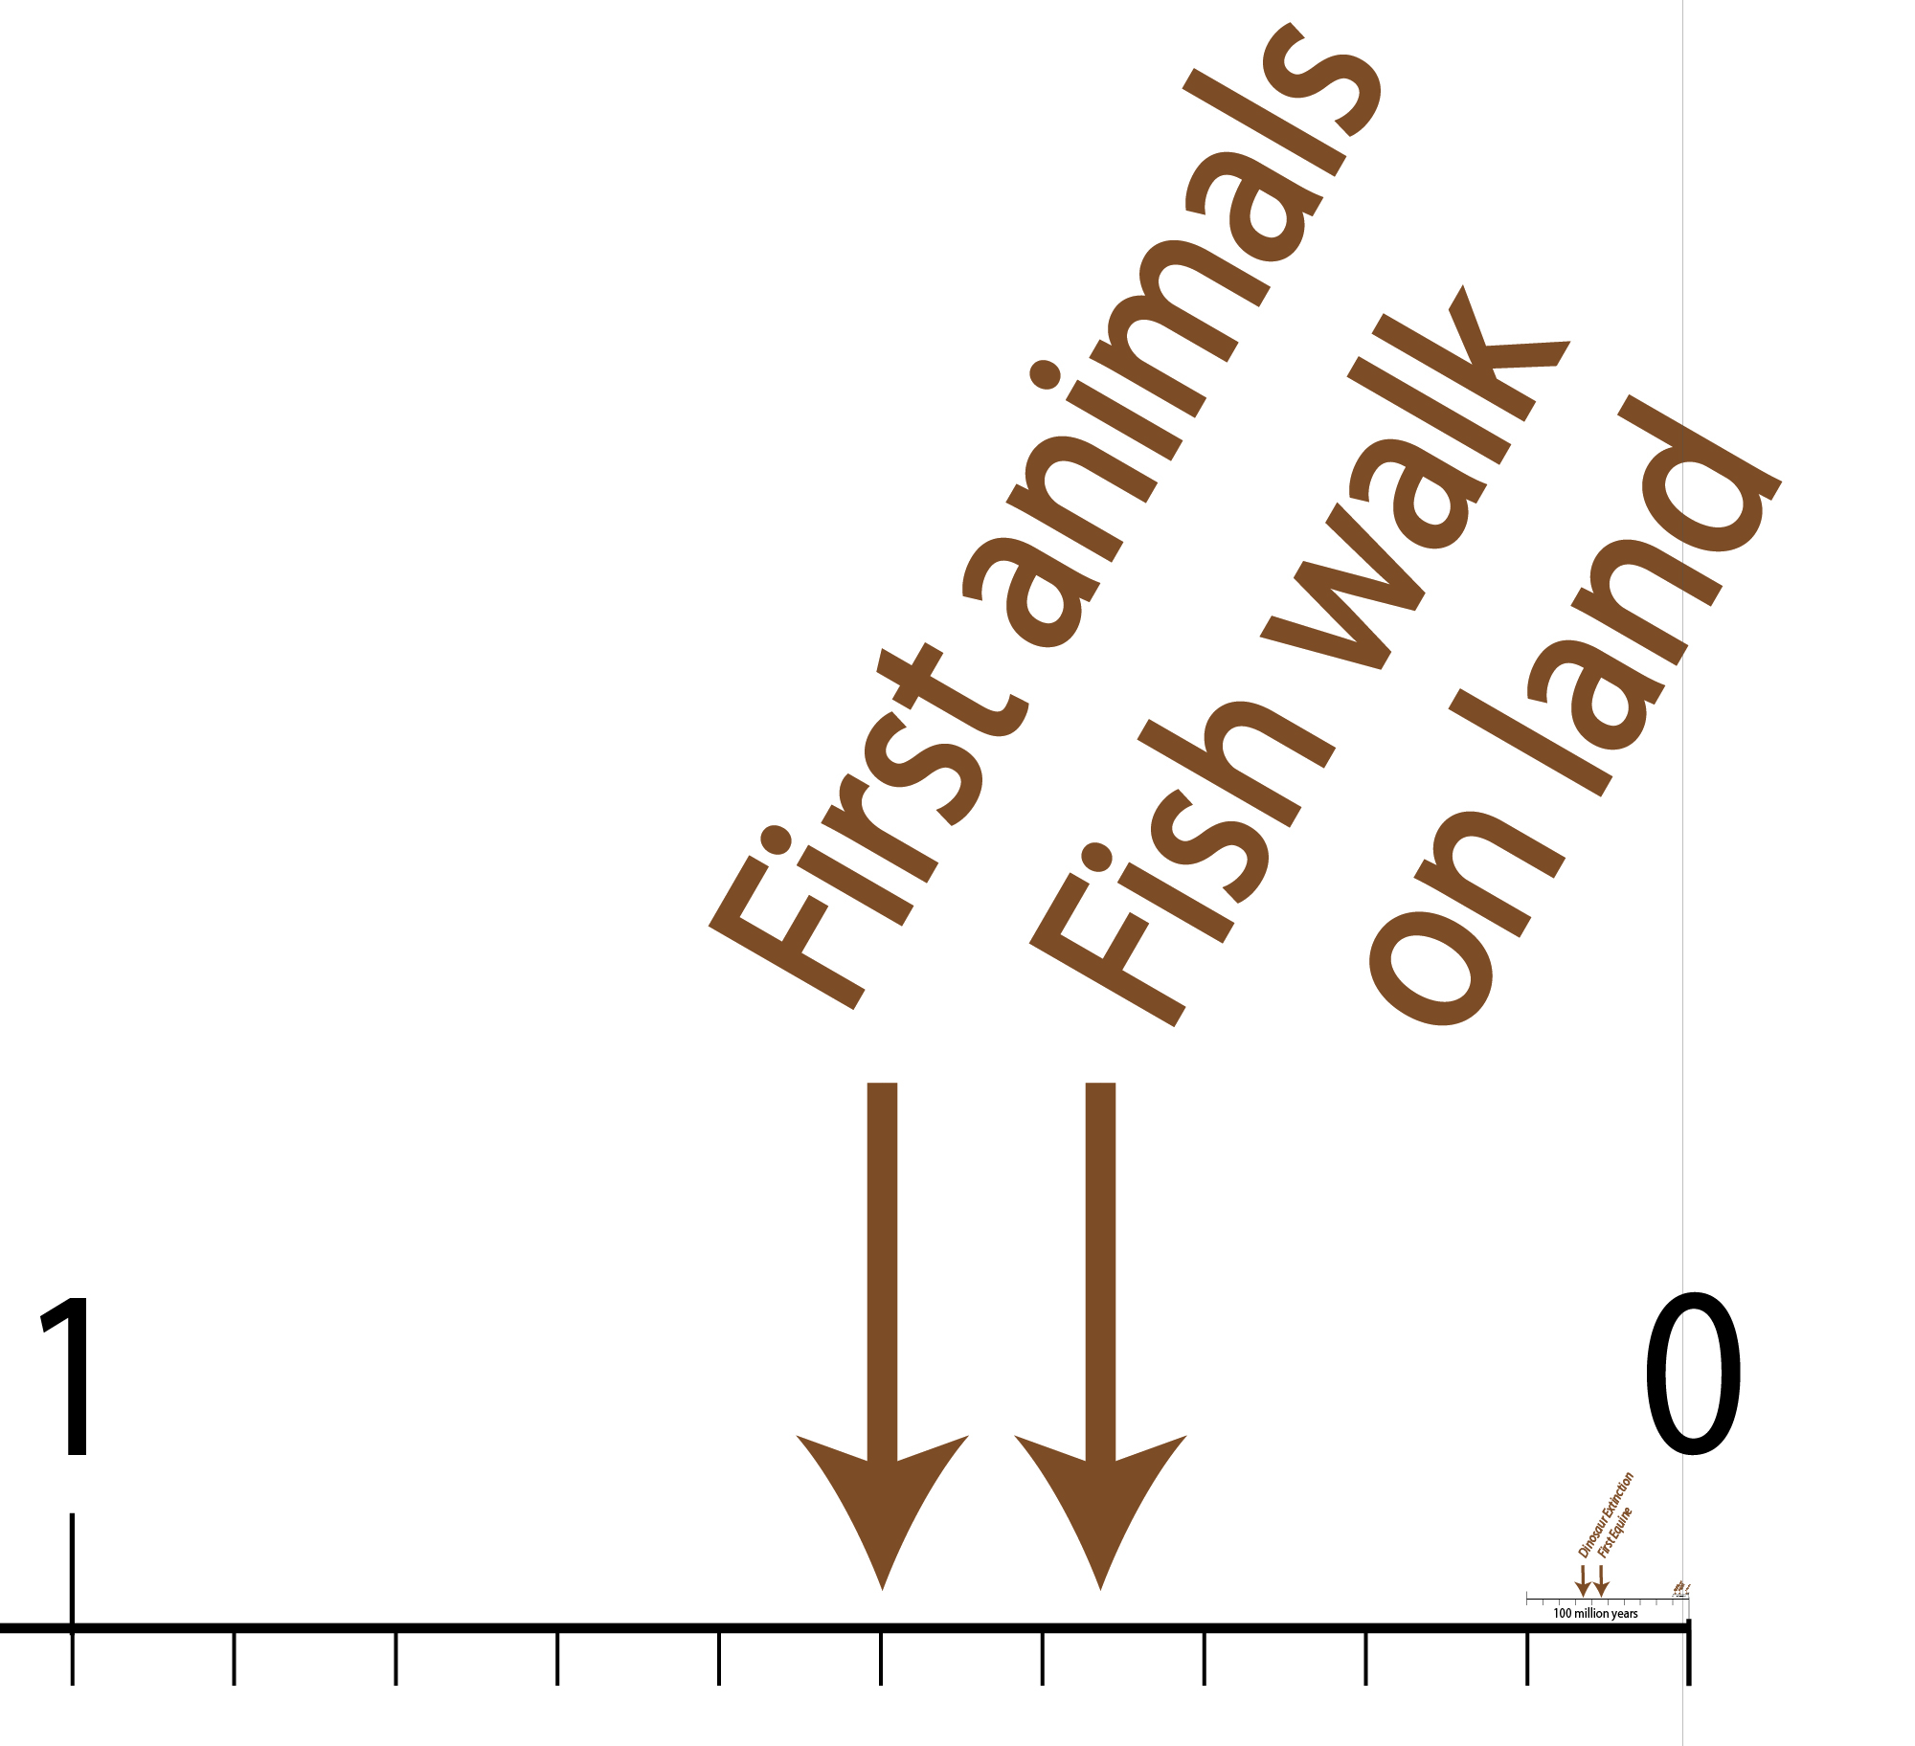
billion years ago

Slide 10
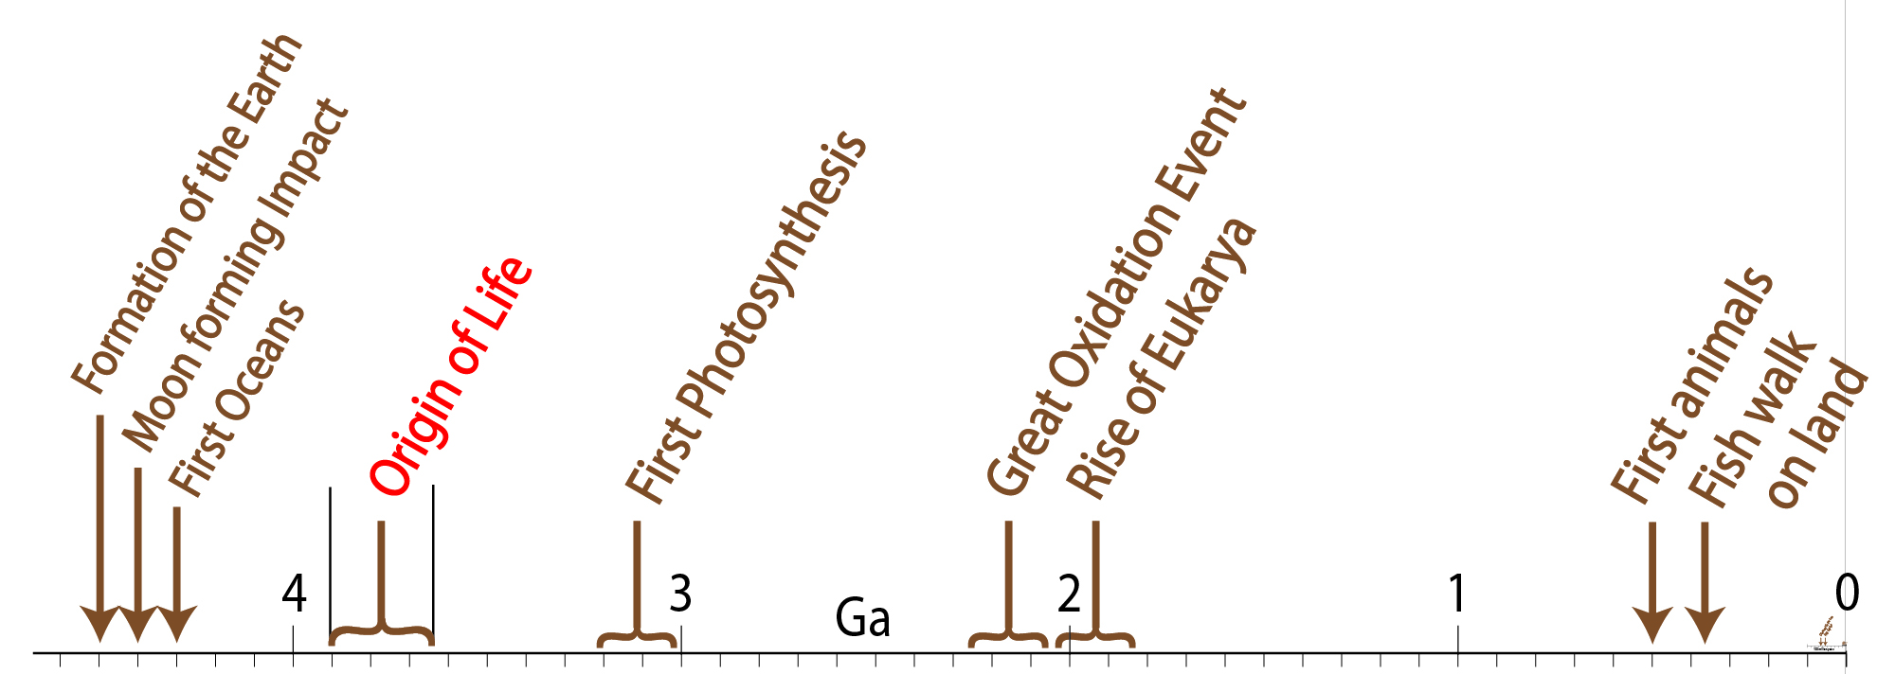
billion years ago

Slide 11
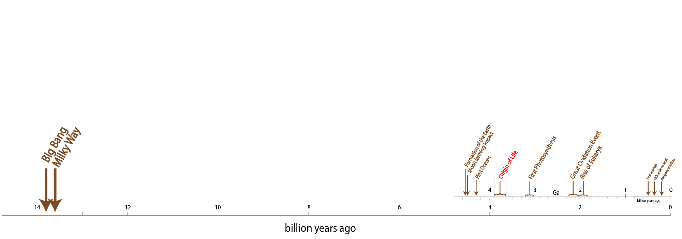

Slide 12
Biopolymers: keys to understanding the OOL
(and biochemistry)
Biopolymers can only be understood collectively
You have to study at them all together to fully understand any of them.

Slide 13
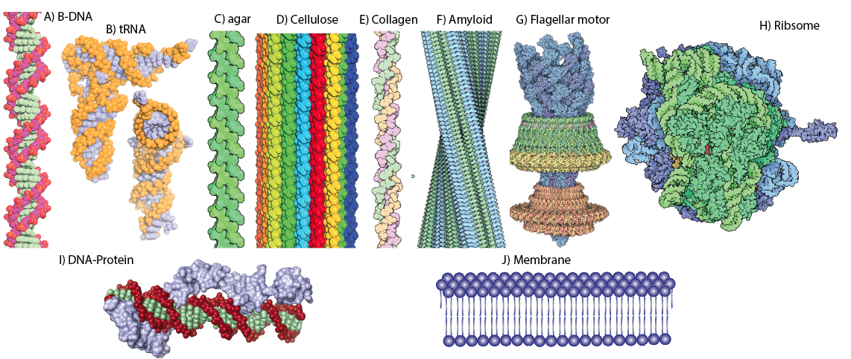
Biopolymers: masters of the universe (of assembly)

Slide 14
Assemblies are
stabilized by complementary non-covalent interactions (H-bonds, dipolar interactions, hydrophobic surfaces, shapes…),
can be intermolecular or intramolecular,
can homomolecular or heteromolecular,
generally exclude covalent interactions (bonds),
and can arise via annealing, folding, binding, association, aggregation, or crystallization.

Slide 15
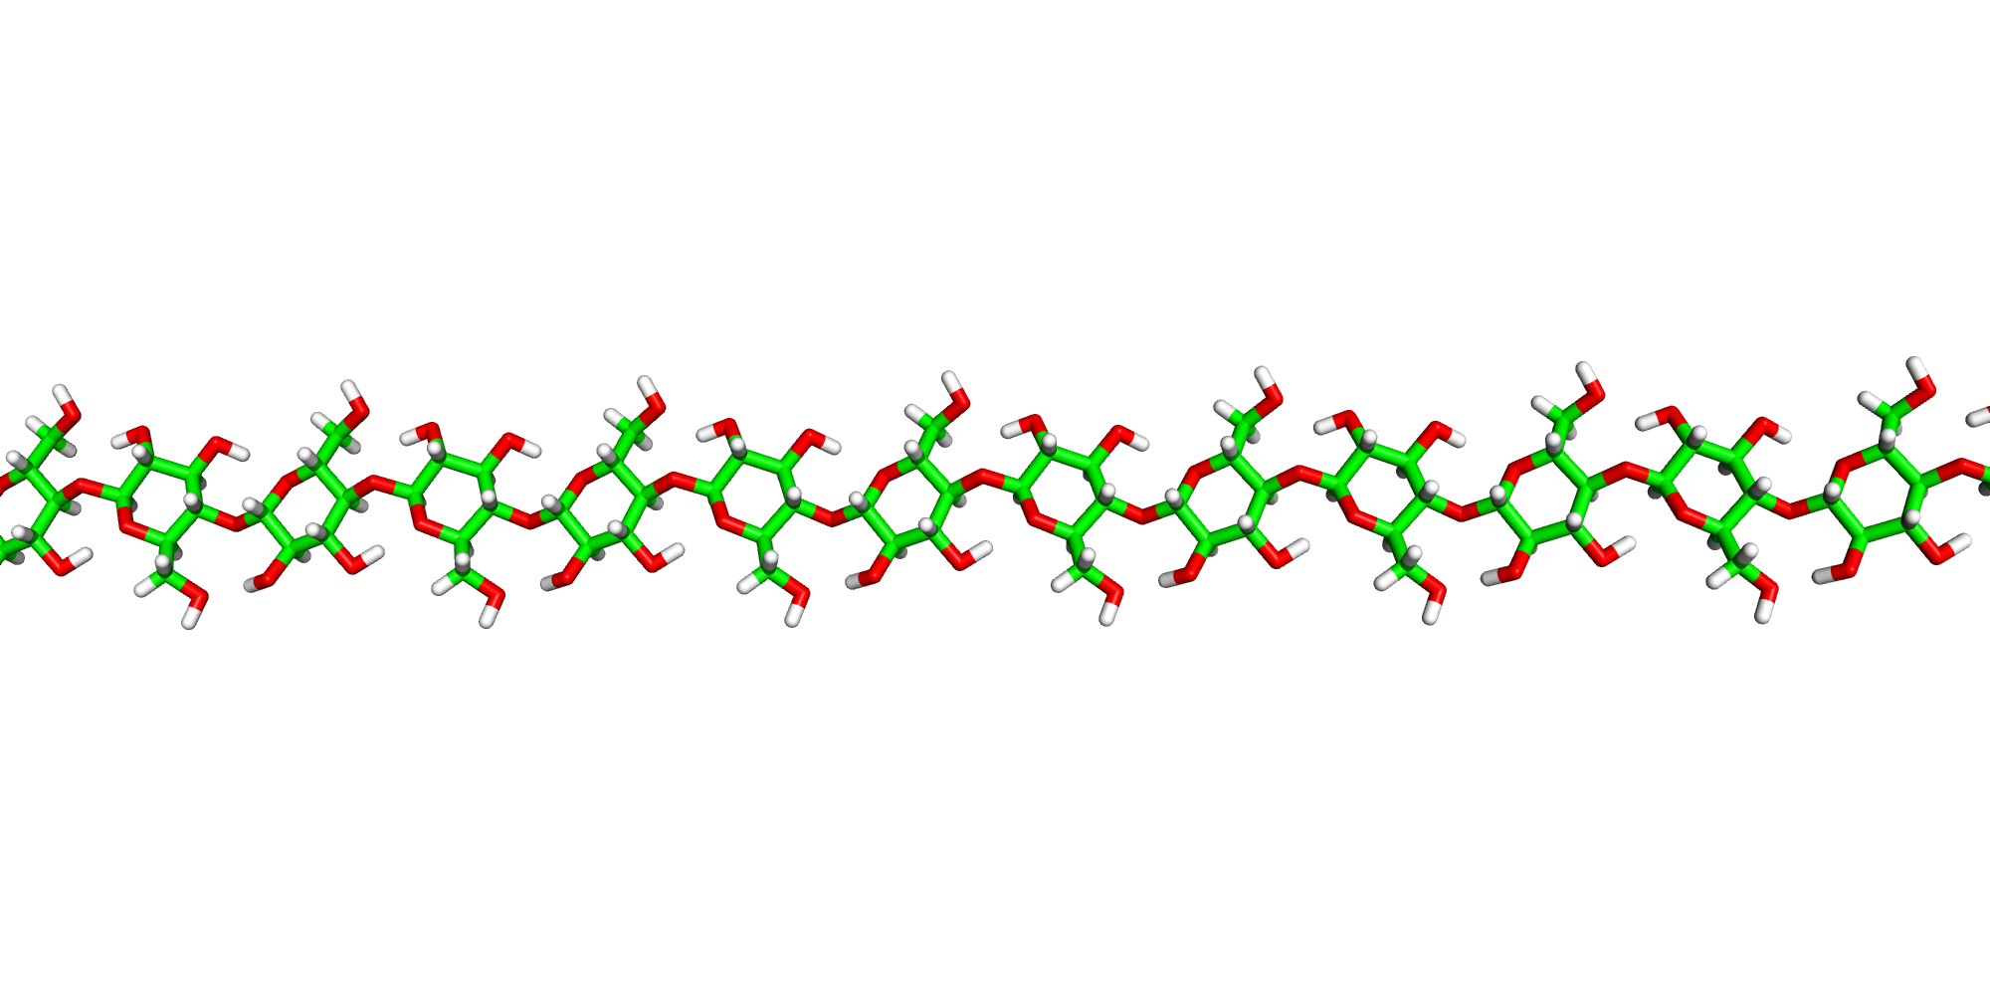
Poly (1,4) β−D-glucose
5 million years – lifetime of each glycosidic bond
[(1,4) β−D-glucose]

Slide 16
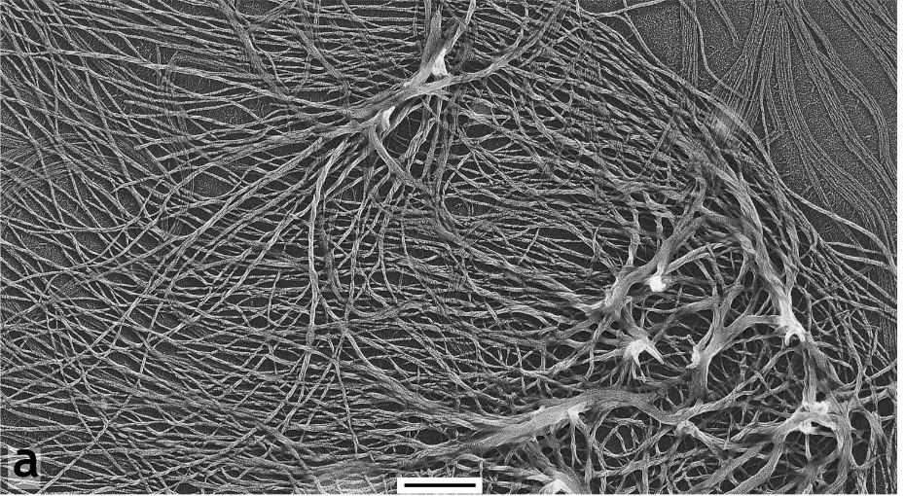
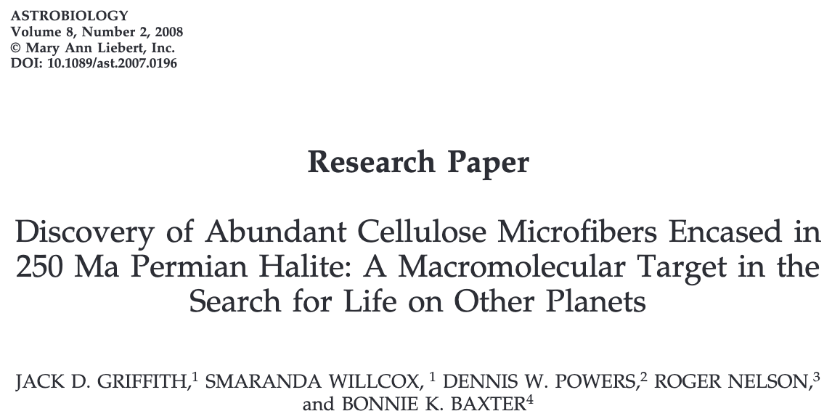
Cellulose: intact after
250 million years
4.7 million years – lifetime of each [(1,4) β−D-glucose] linkage

Slide 17
How does poly (1,4) β−D-glucose
outlive its intrinsic chemical lifetime?
How do biopolymers in general
outlive their intrinsic chemical lifetimes?

Slide 18
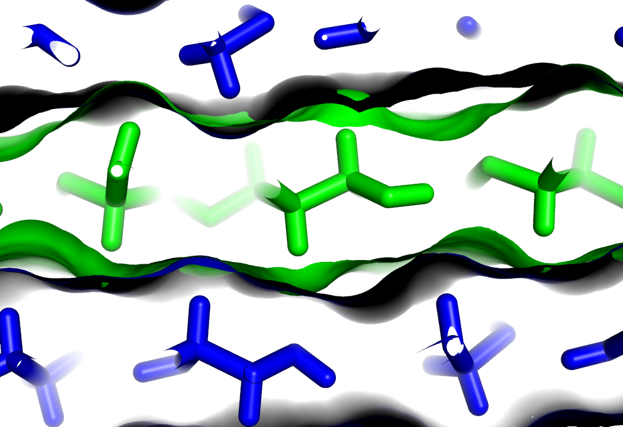

Slide 19
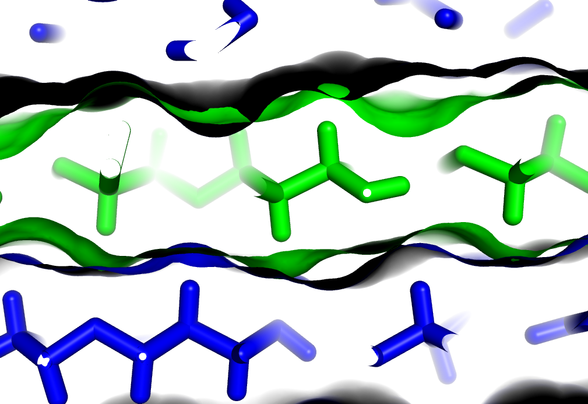

Slide 20
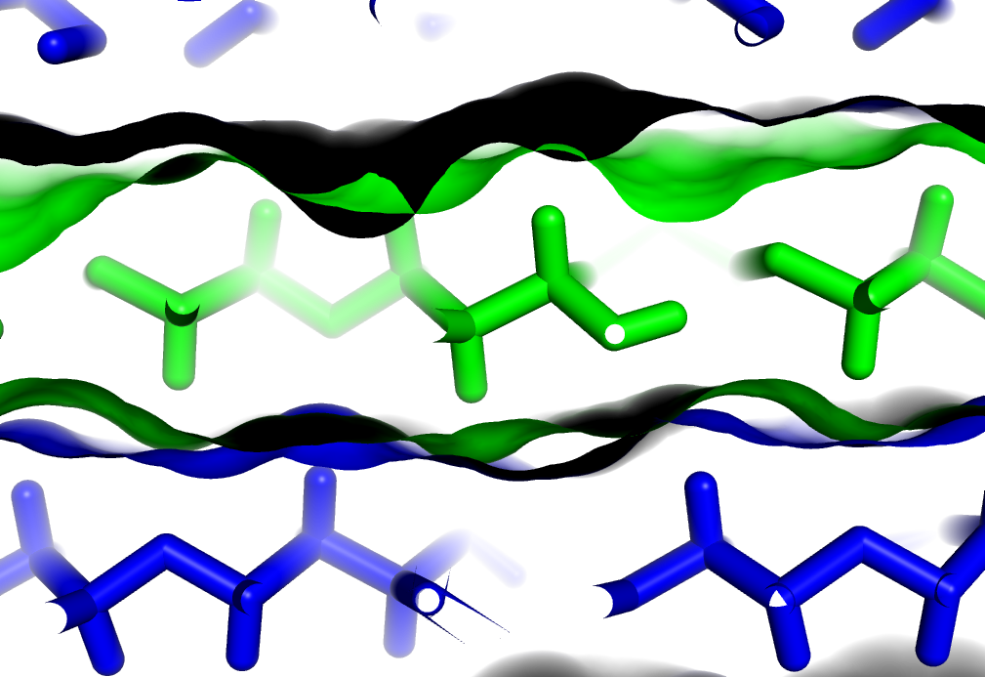

Slide 21
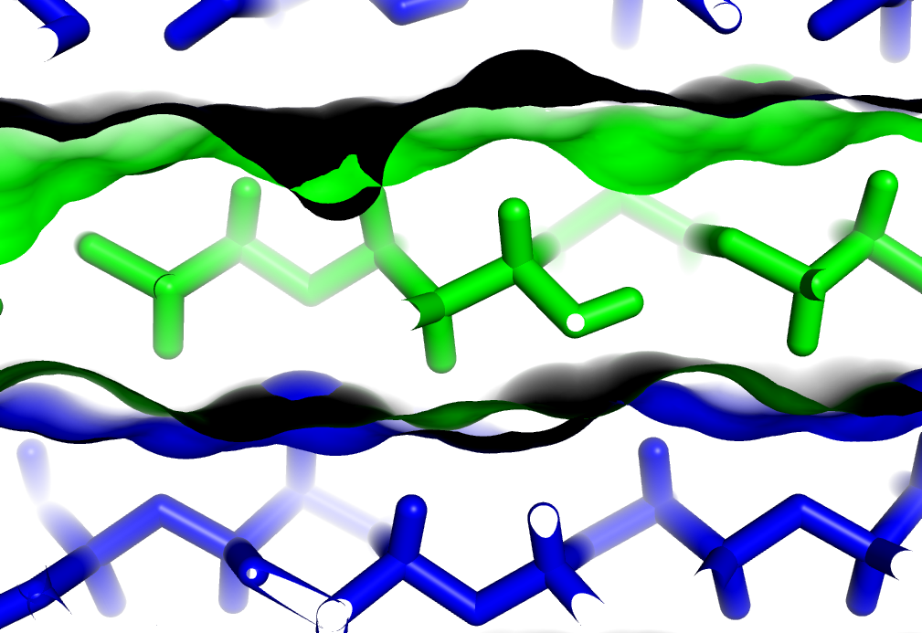

Slide 22
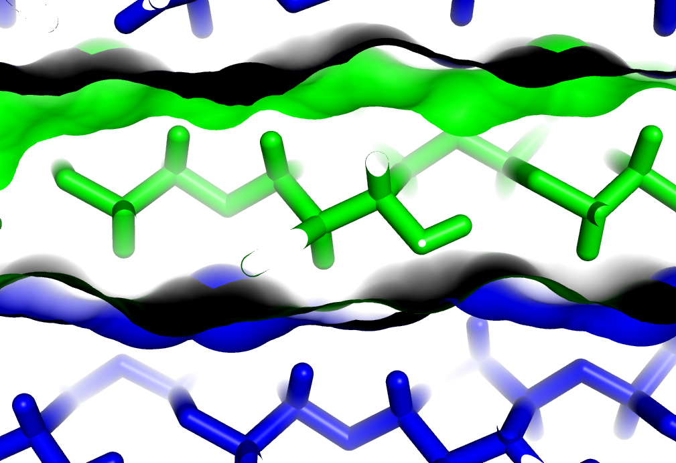

Slide 23
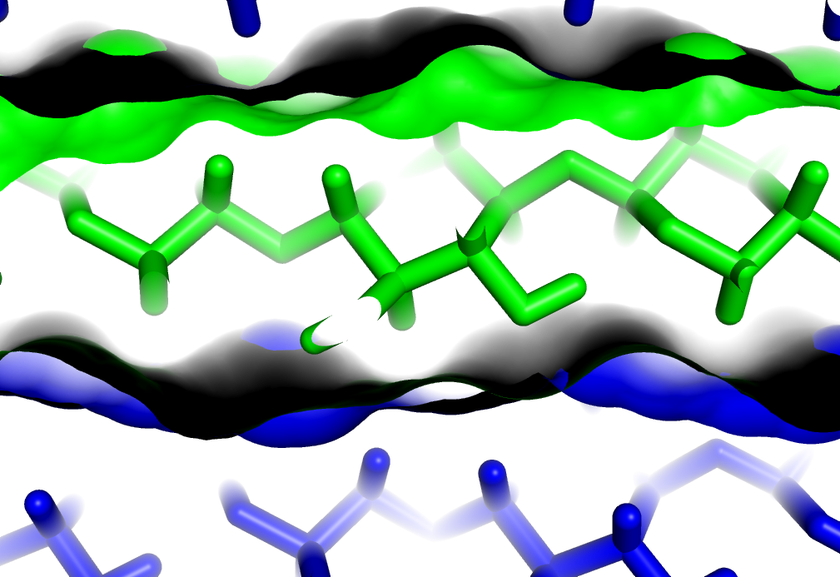

Slide 24
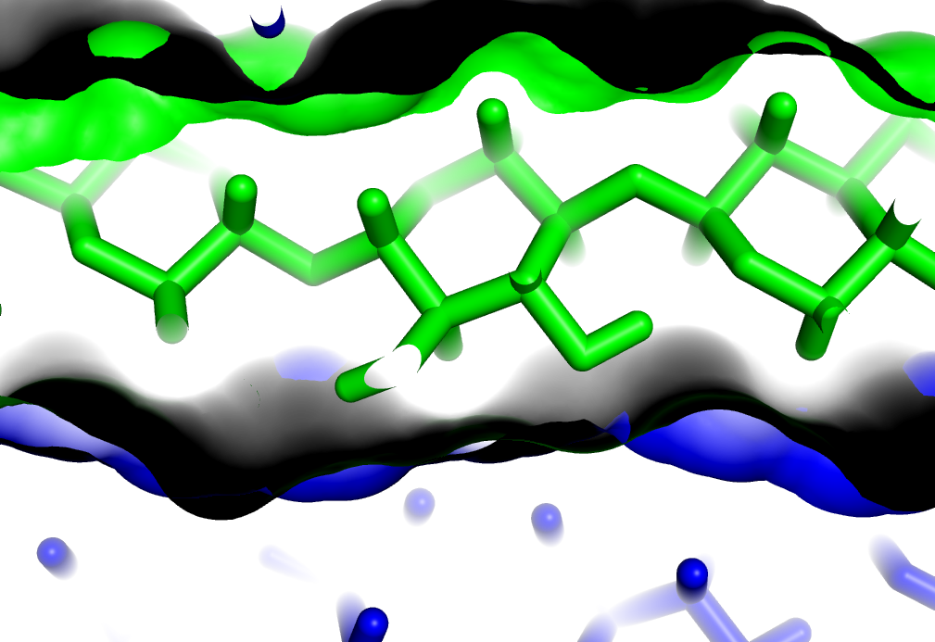

Slide 25
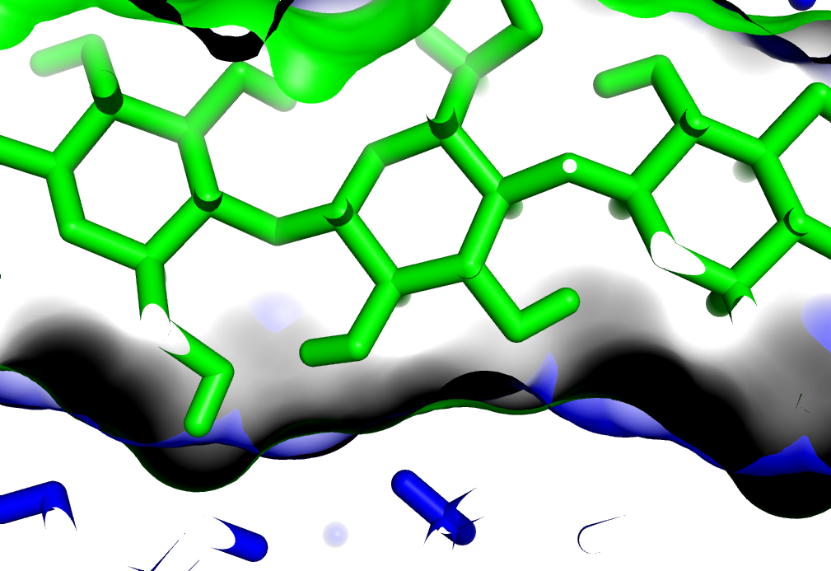

Slide 26
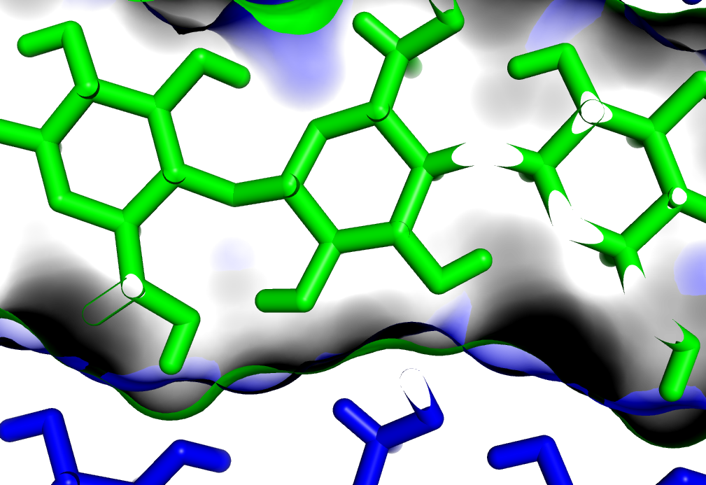

Slide 27
complementary non-covalent interactions
H-bonds,
dipolar interactions,
hydrophobic surfaces,
shape.
stop
Recalcitrance: Assembly prevents access to transition states

Slide 28
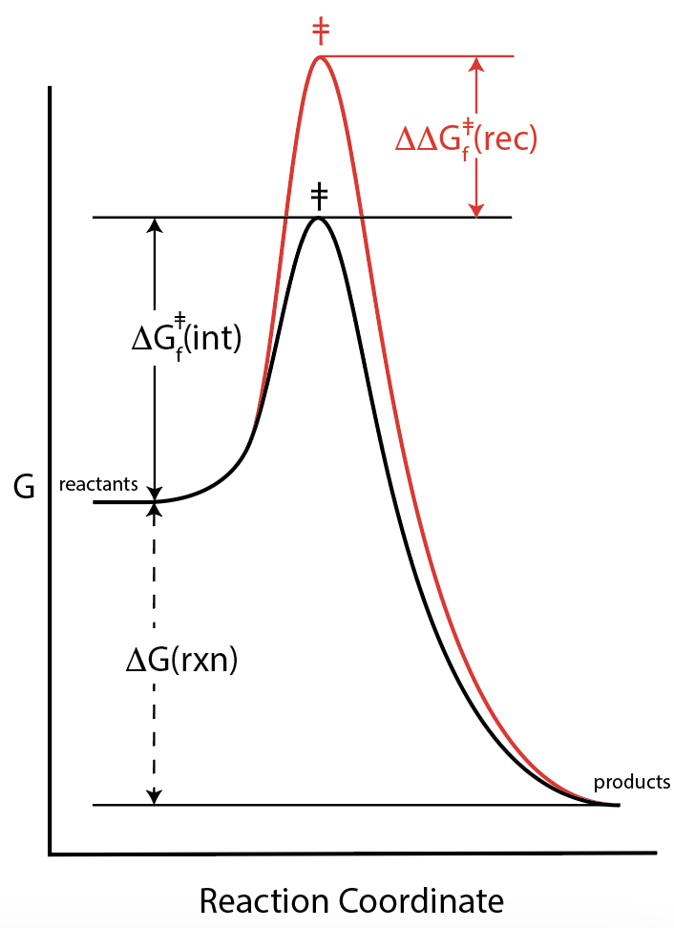
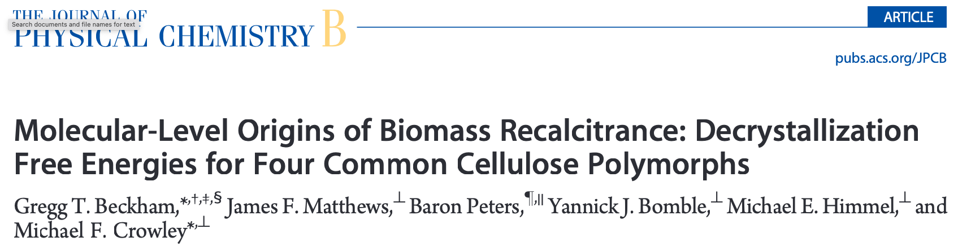
$${ΔG}_{hydrolysis}^{‡}= {ΔG}_{intrinsic}^{‡}+ {ΔΔG}_{recalcitrance}^{‡}$$
Hydrolysis of assembled cellulose
Hydrolysis of an
isolated strand
Disassembly
Cellulose cannot be hydrolyzed in the assembled state.
Cellulose must disassemble before it can hydrolyze.

Slide 29
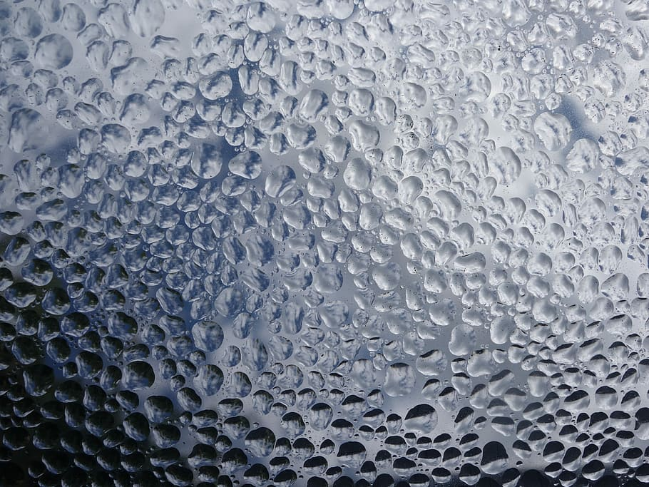
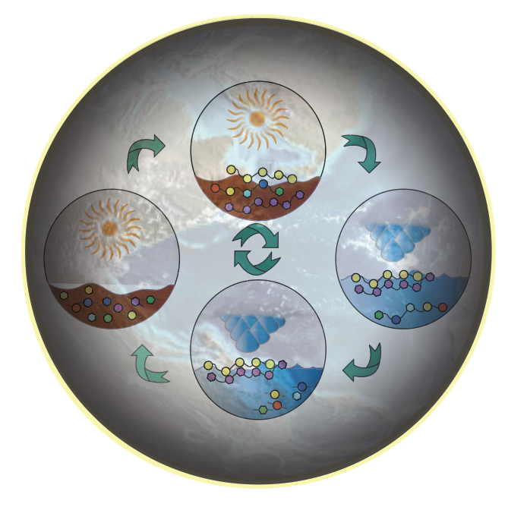
Geochemical processes (spinning planets) cause organics to polymerize (by dehydration) and depolymerize (by hydrolysis).

Slide 30
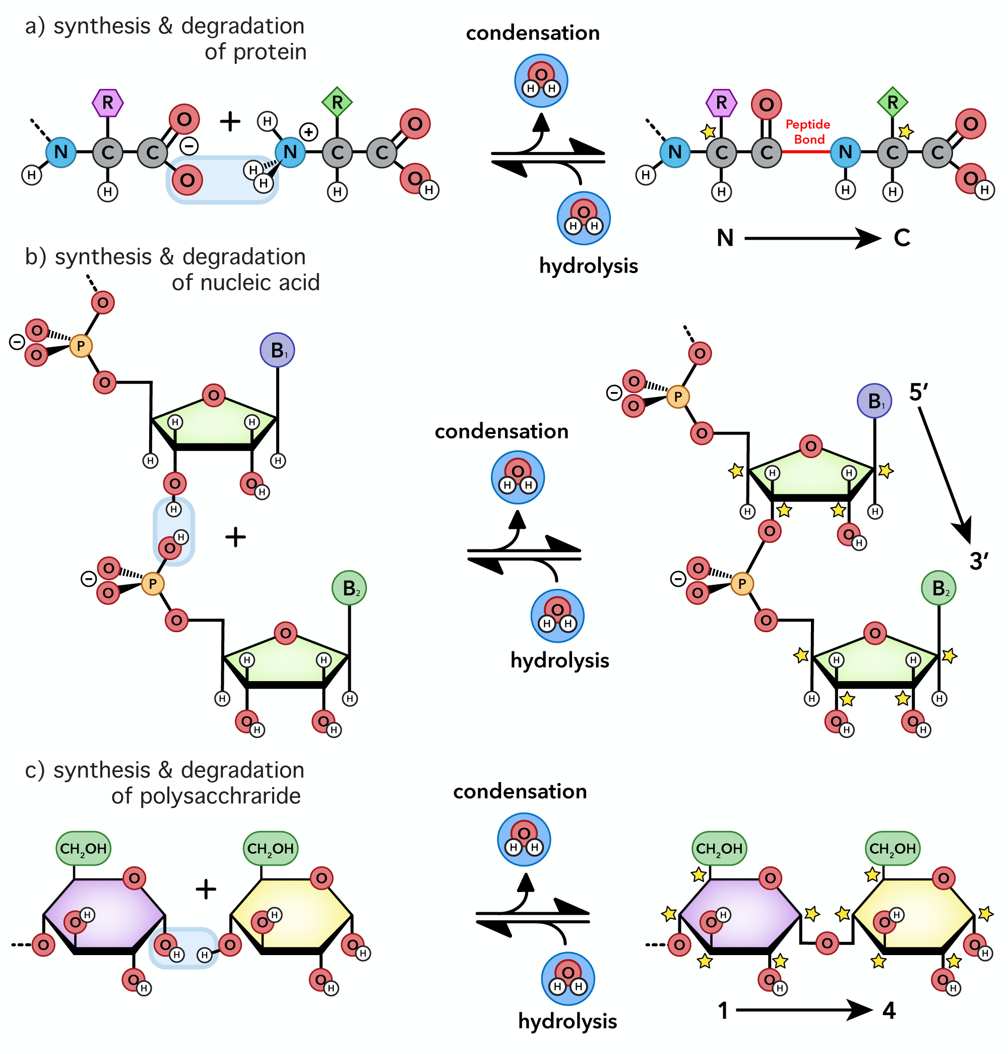
Biological systems cause ‘building blocks’ to polymerize (by dehydration) and depolymerize (by hydrolysis).

Slide 31
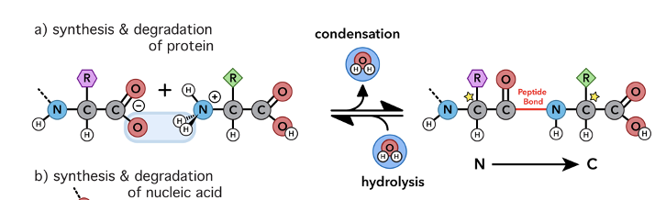
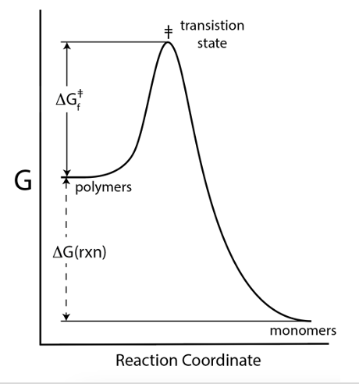
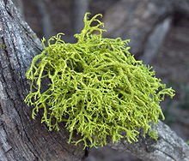
all show incredible proficiencies of assembly and co-assembly,
all are synthesized by condensation-dehydration,
all are thermodynamically unstable / kinetically trapped,
all show finely tuned recalcitrance via self-complementarity (see ds DNA, tRNA…), and
all are molecular symbionts
  hetero-recalcitrance (RNA protects protein / protein protects RNA, see ribosome)
  RNA synthesizes protein / protein synthesizes RNA

