Slide 1
Protein “Functions” are
Catalysis
enzymes like GAPDH, phosphofructokinase, trypsin...
Structure
fibers like collagen (tendon), keratin (hair, nails), fibroin (silk, spider web)
Work
motors (convert chemical energy to work (muscle, polymerases, ATPase)
Containment
ferritin (nanobox for Fe storage)
Transport
hemoglobin
Pumps
Na⁺ K⁺ pump, proton pumps
Pores
  porin, etc
Adhesives
marine muscles, barnacles…

Slide 2
Protein function is modulated/regulated by
protein synthesis and degradation,
sequestration (association with ligands or other proteins),
covalent modification (there are 500 known protein modifications, including phosphorylation, acetylation, glycosylation, myristoylation..),
proteolytic activation (example, proteolytic activation of the protrypsin zymogen or preproinsulin to insulin)
allosterism; the binding of a ligand to one site can affect the binding of anther ligand at a different binding site on the same protein. What is a ligand? A ligand is a smallish molecule that binds by non-covalent interactions. O₂ is an allosteric ligand (i.e., allosteric effector) of hemoglobin and is a non-allosteric ligand of myoglobin [page 454, Lehninger, 7th Edition].

Slide 3
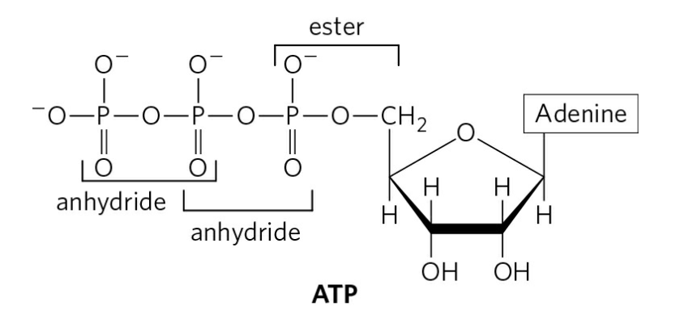
Example of Regulation
Phosphofructokinase
PFK-1
Glycolysis generates two ATPs net and two pyruvate molecules, which subsequently leads to 36 ATPs from oxidative phosphorylation.

Slide 4
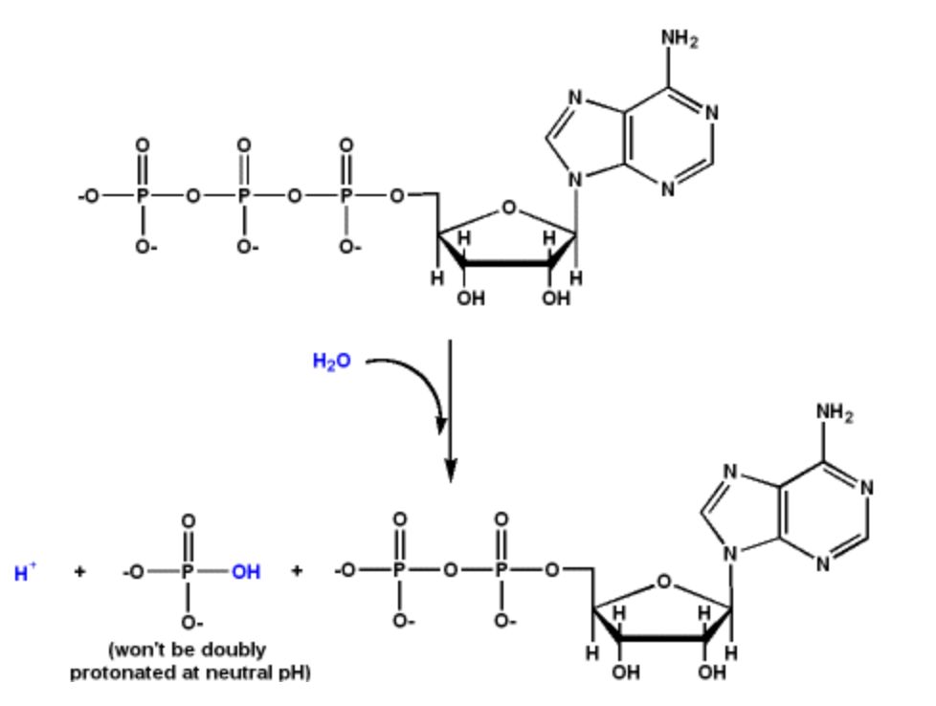
ATP
ADP
AMP (not shown)

Slide 5
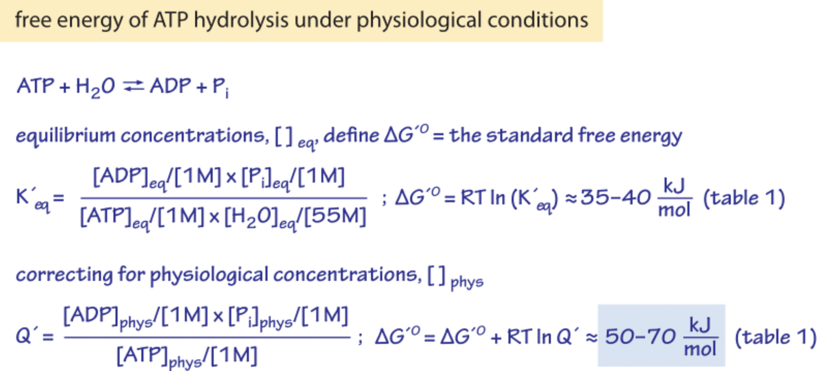
Sign error

Slide 6
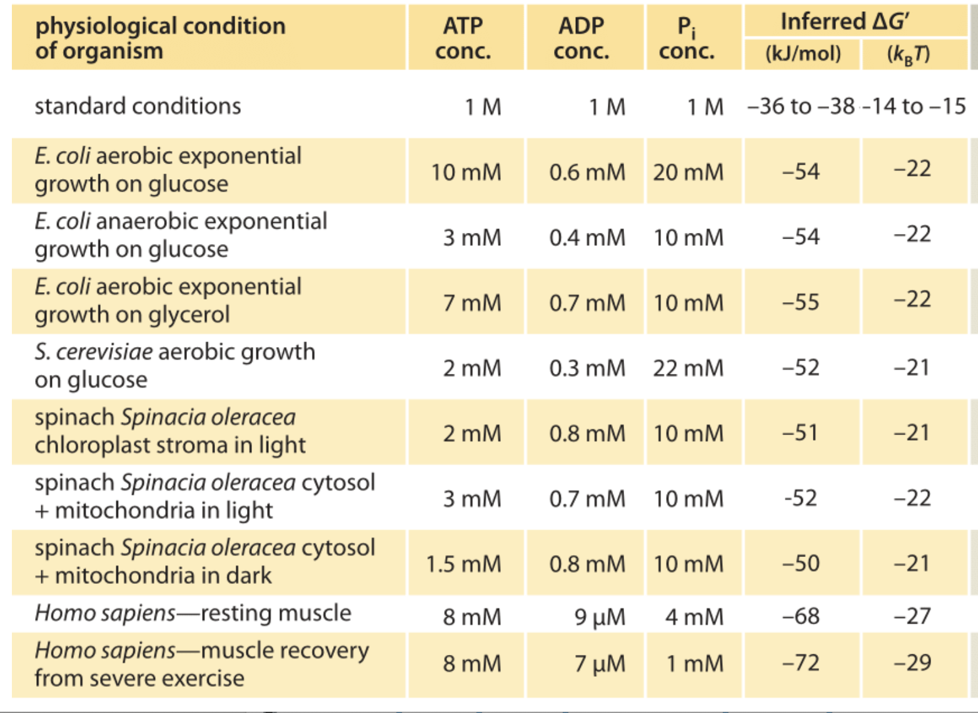

Slide 7
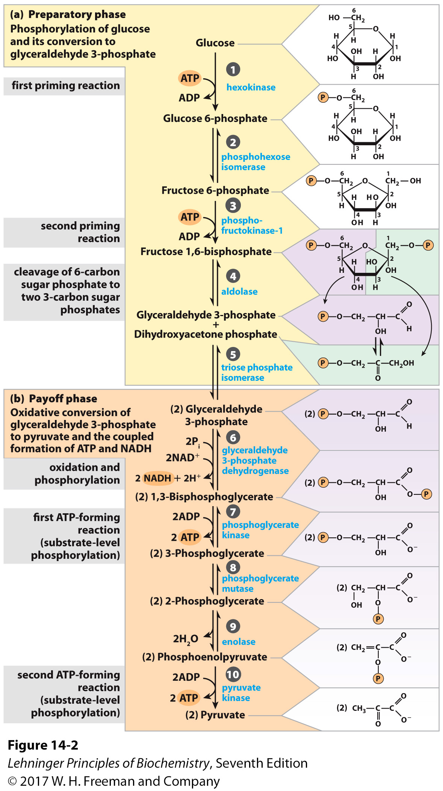
Phosphofructokinase
Catalyzes the committed step of glycolysis.
Controls glycolysis flux - is a key regulator of glycolysis
(called the “pace-maker” of glycolysis)
responds to many different molecules and signals.
Catalyzes the transfer of a phosphoryl group from ATP to fructose-6-phosphate.
Produces fructose-1,6-bisphosphate
(which is both a product and an activator)
Requires Mg²⁺

Slide 8
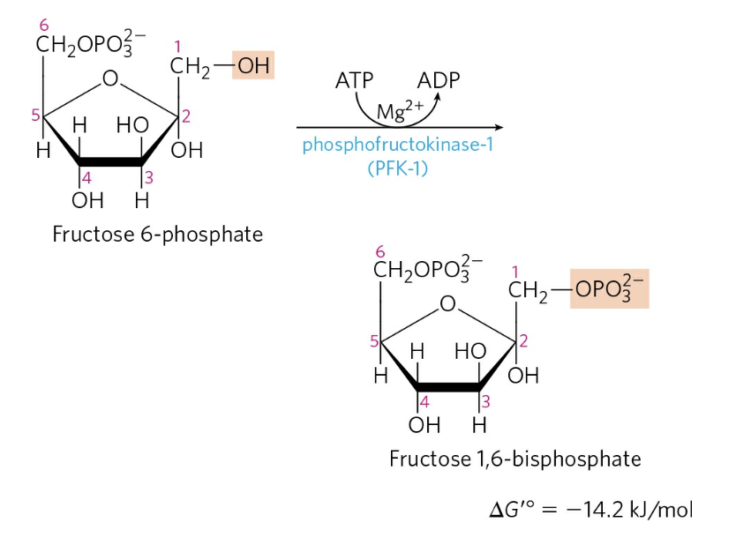
Phosphofructokinase
(PFK-1)

Slide 9
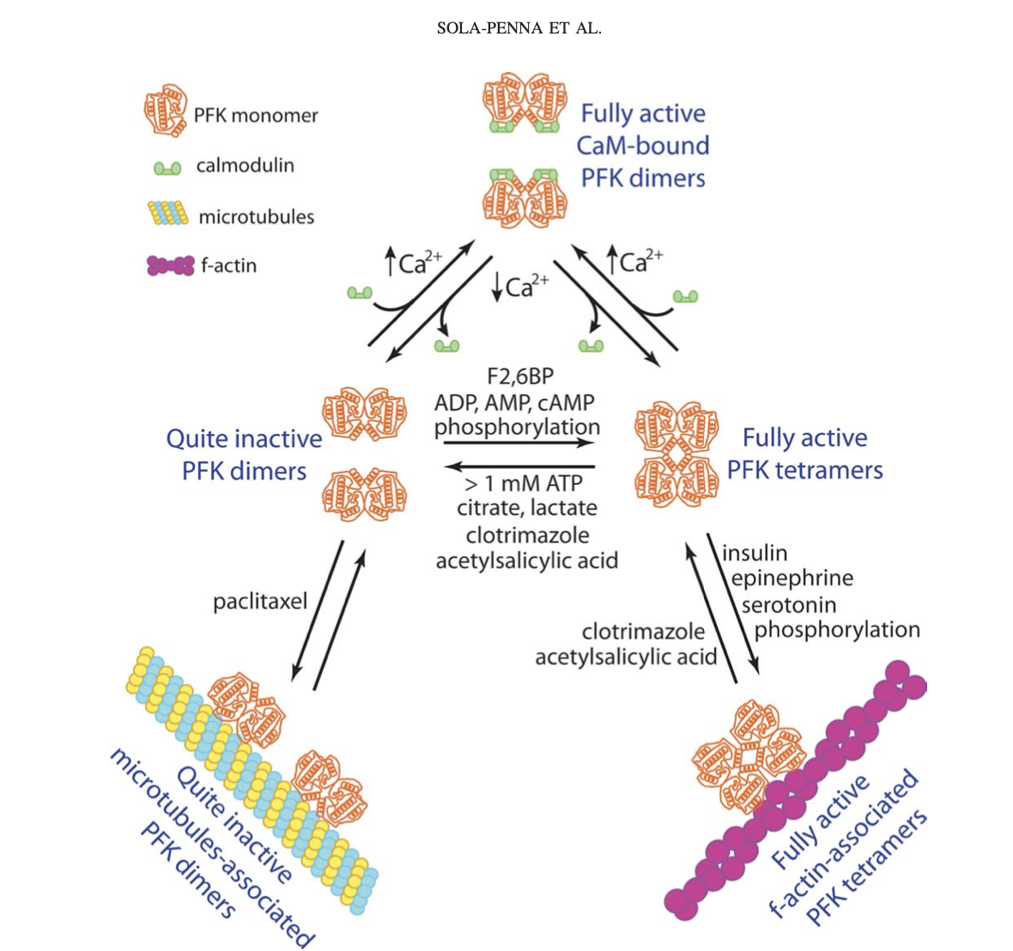
PFK-1 has 2 different ATP binding sites.
An ATP can bind in the catalytic site.
An ATP can bind in the allosteric site.
F2,6BP= Fructose-2,6-bisphosphate

