Slide 1
RNA

Slide 2
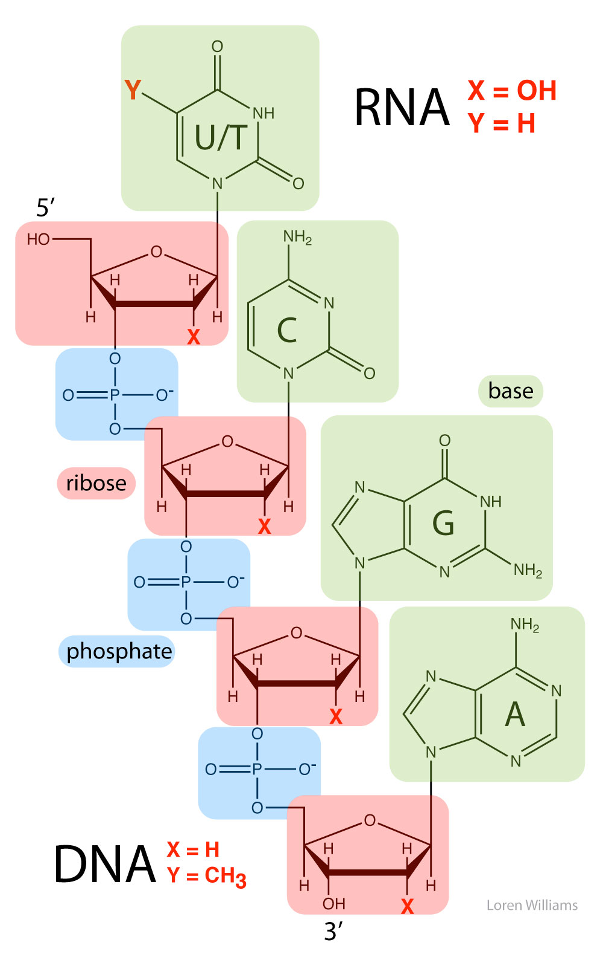

Slide 3
The hydroxyl group on the 2’ position of RNA can act as a HB donor. It is a HB donor in a sea of HB acceptors.
The 2’ OH acts like sticky tape.

Slide 4
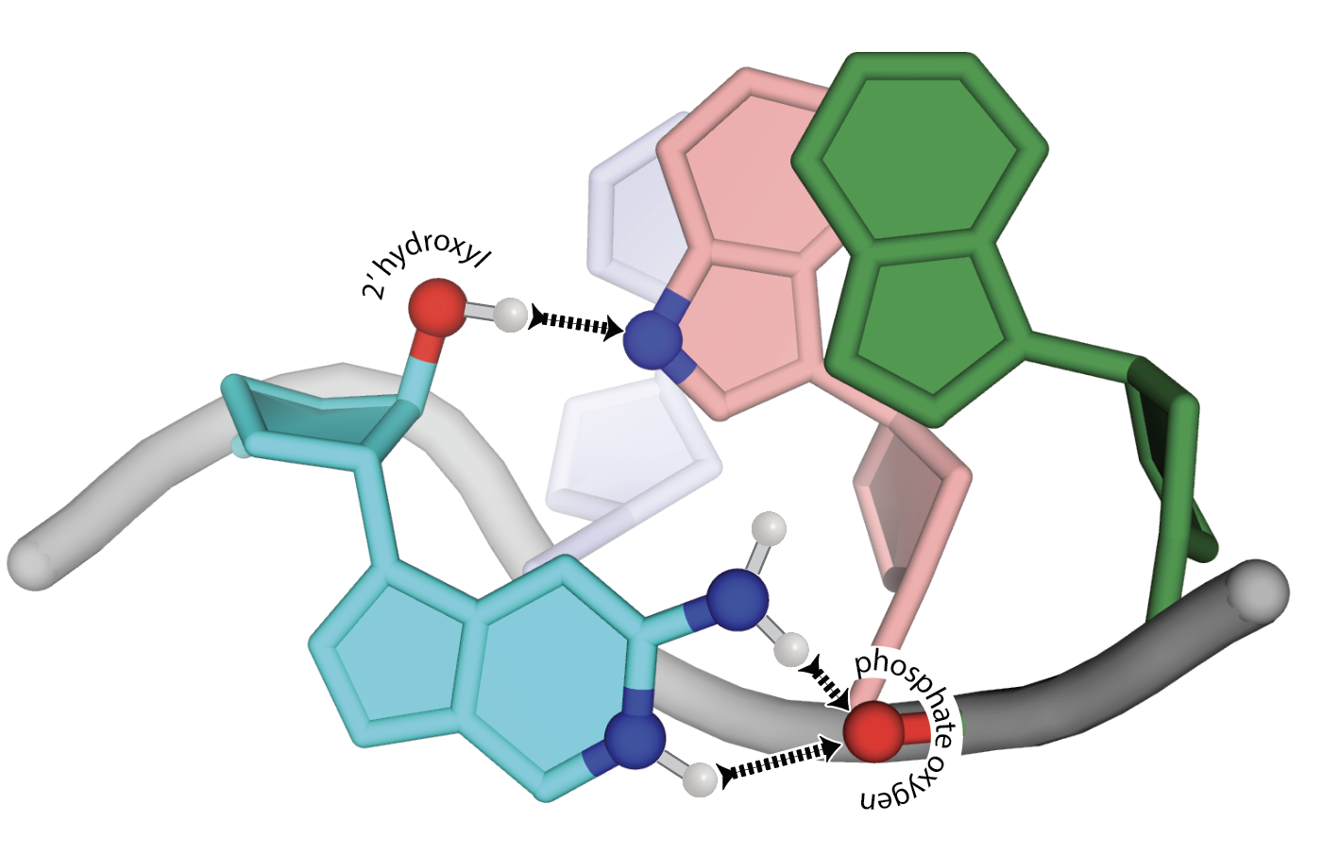

Slide 5
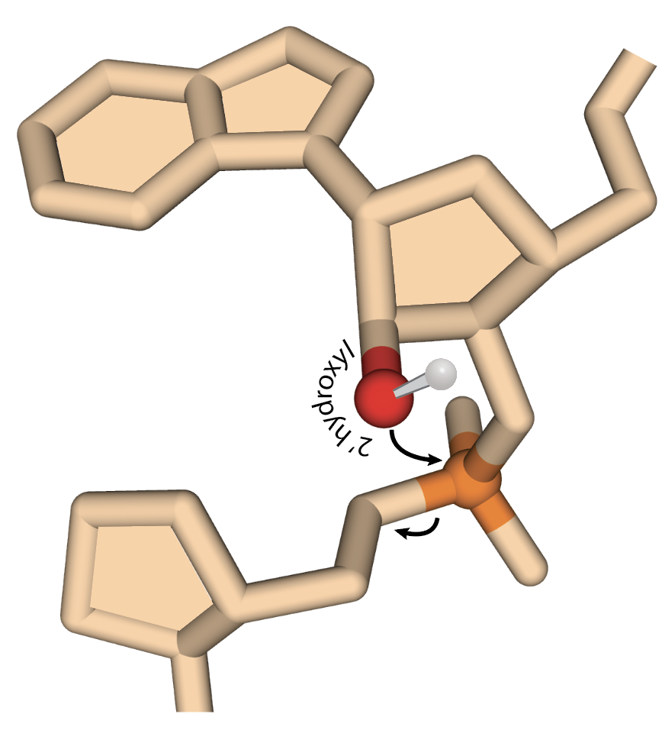
“RNA has gun amied at its own head”
Professor Nick Hud

Slide 6
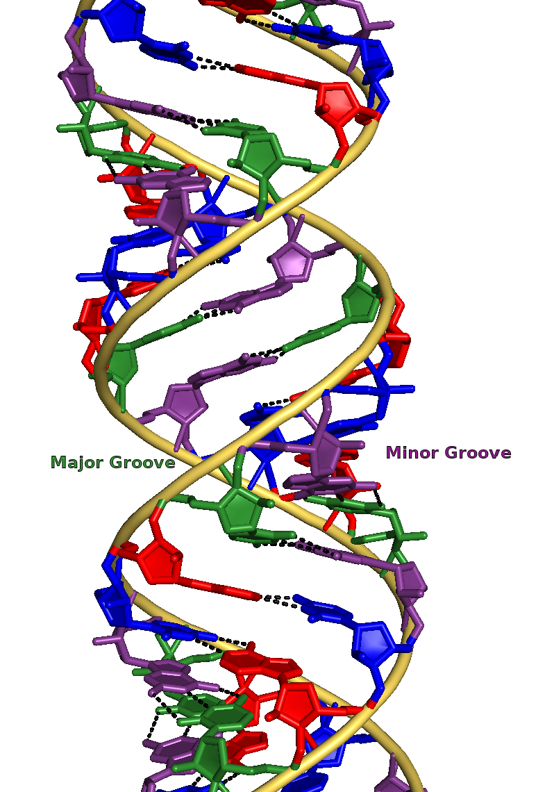
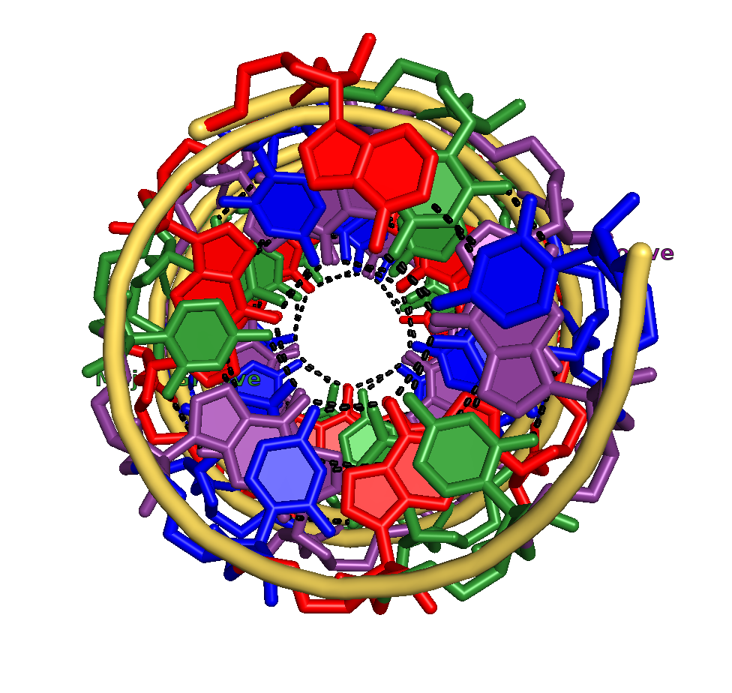
Double-Stranded RNA A-form helix

Slide 7
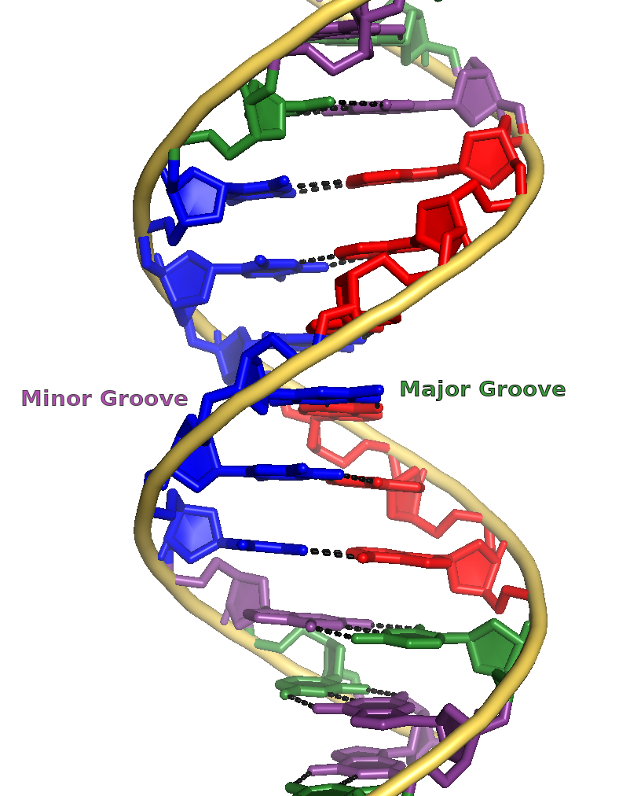
DNA (almost always B-form)
RNA (A-form + other structures)
10
base pairs/turn
11
base pairs/turn

Slide 8
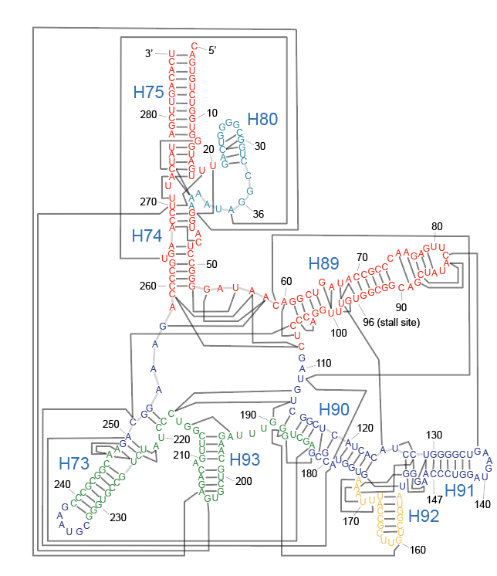
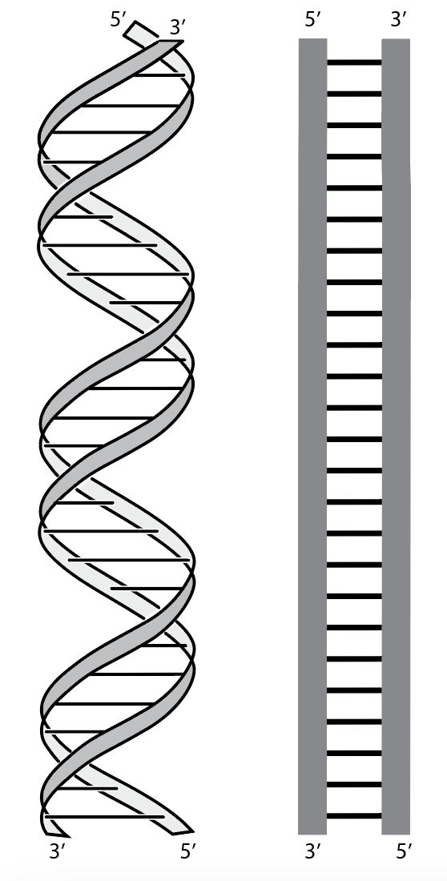
RNA Assembles into globular structures
DNA tends not to assemble
(except for base-base interactions)
The backbone is self-repulsive

Slide 9
DNA RNA
Primary structure:
is the sequence
Secondary structure:
local helices
Tertiary structure:
long range interactions

Slide 10
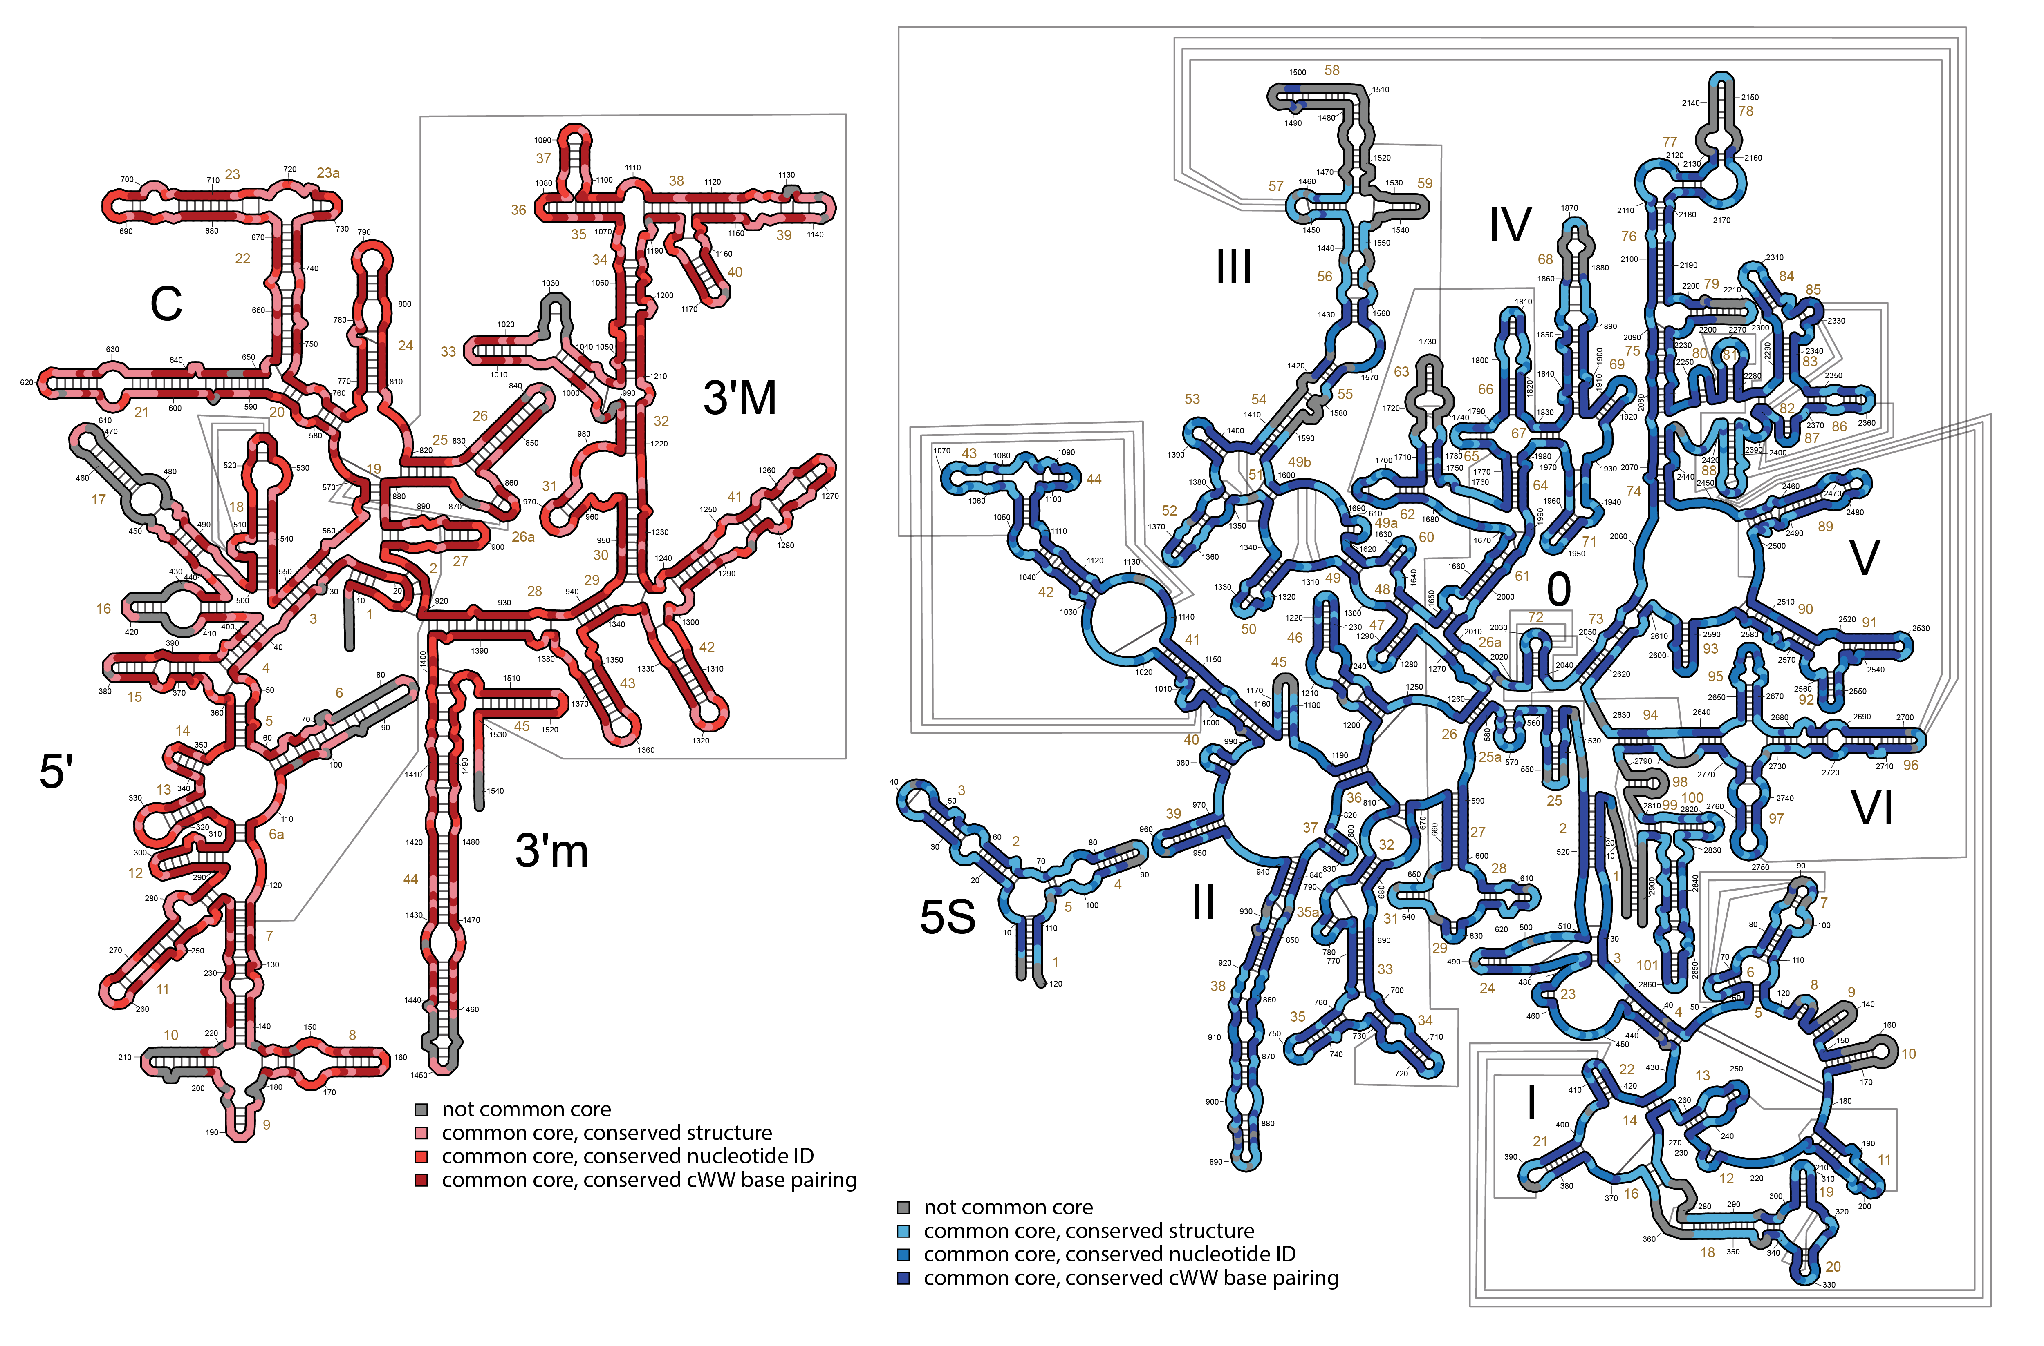
Ribosomal RNA
(rRNA)

Slide 11
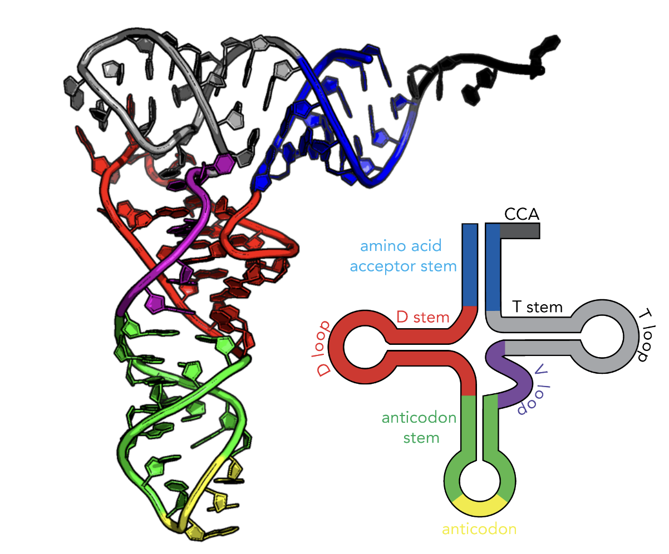
anticodon

Slide 12
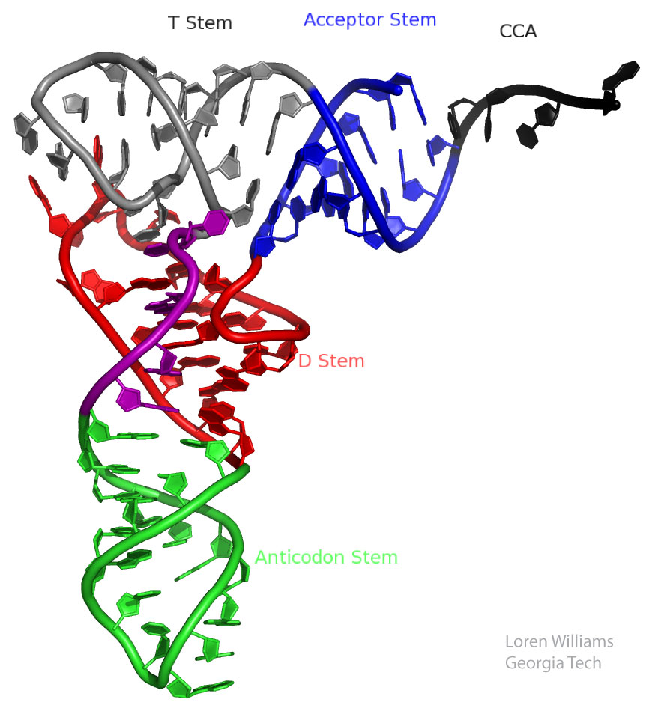
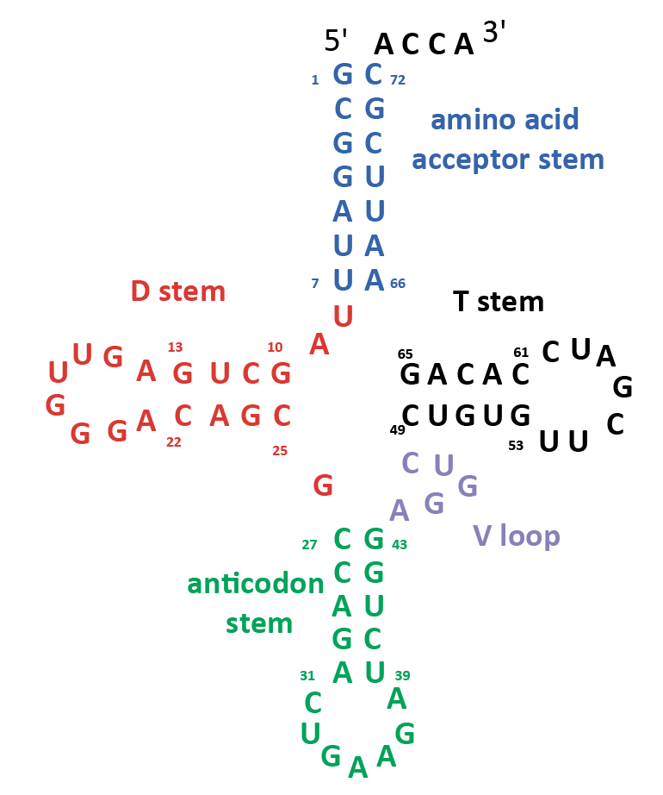

Slide 13
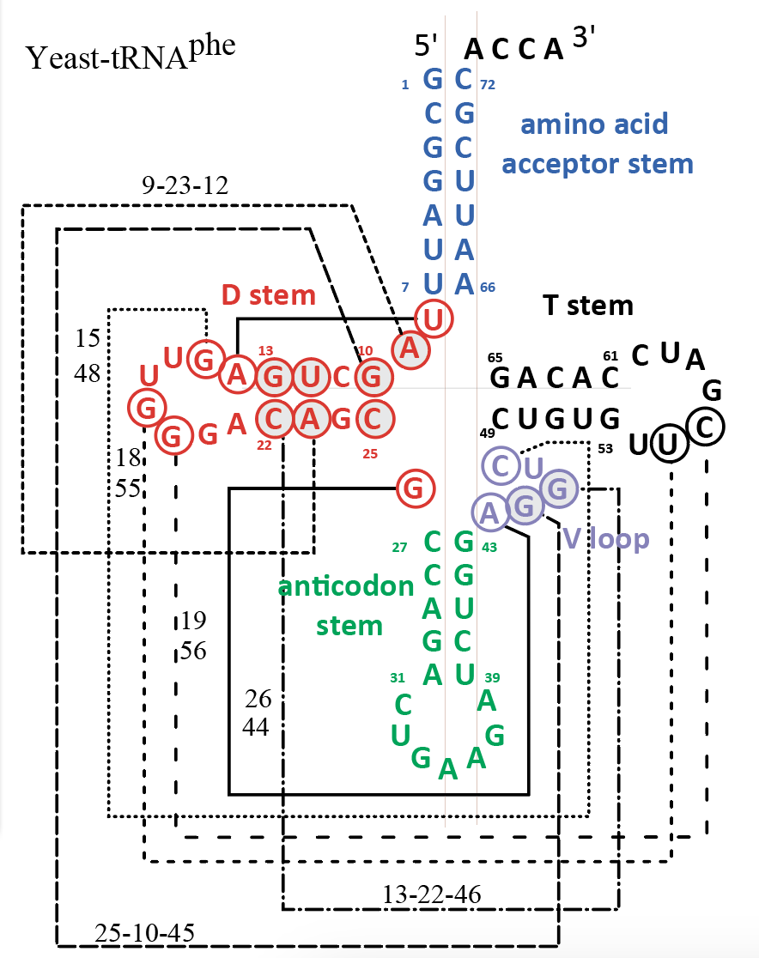
Primary structure:
sequence
Secondary structure:
local helices
Tertiary structure:
long range

Slide 14
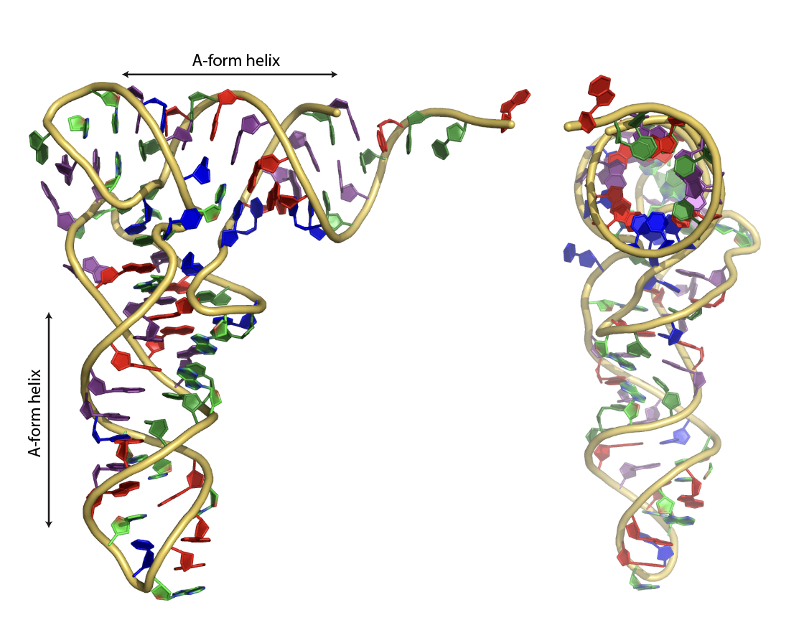
tRNA: RNA likes A
tRNA
tRNA

Slide 15
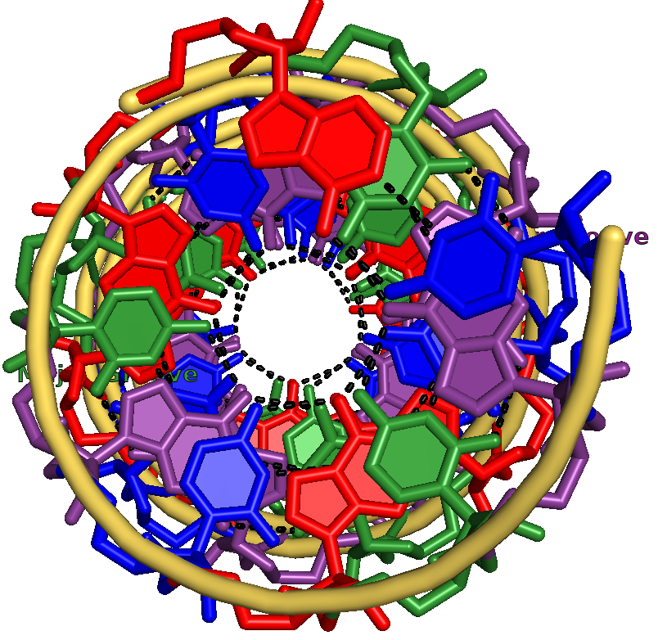
tRNA: RNA likes A
tRNA
tRNA
idea A-form helix

Slide 16
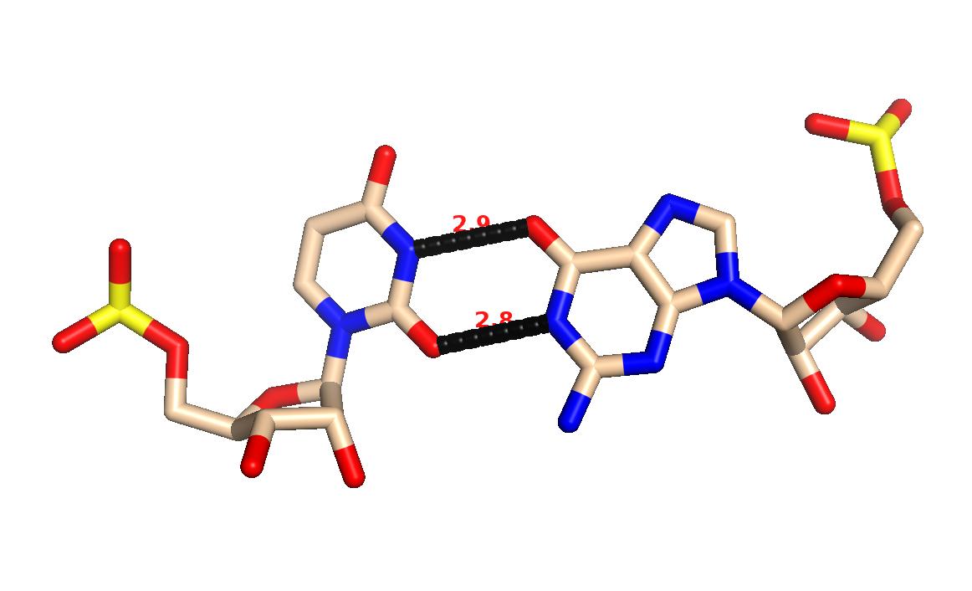
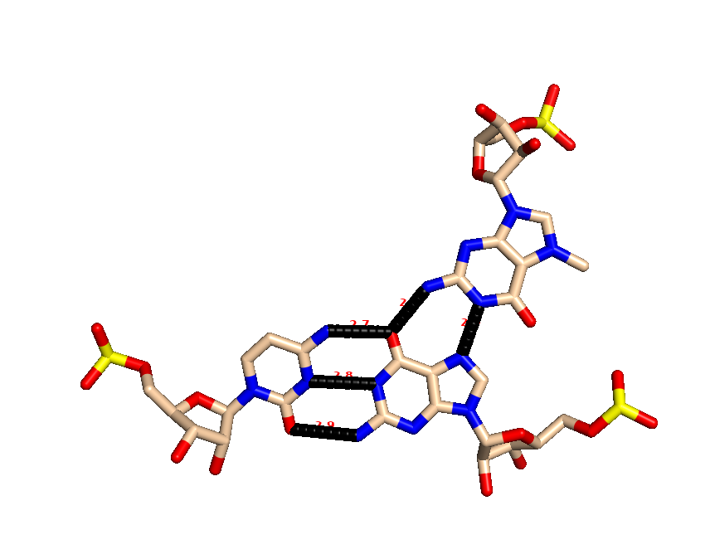
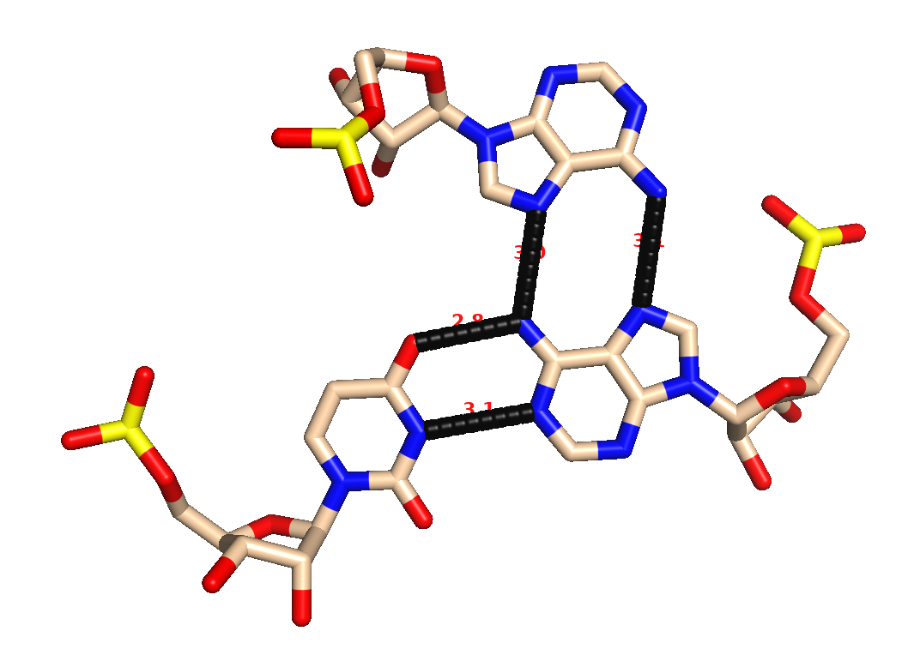
GU Wobble
Base Triples in tRNA

Slide 17
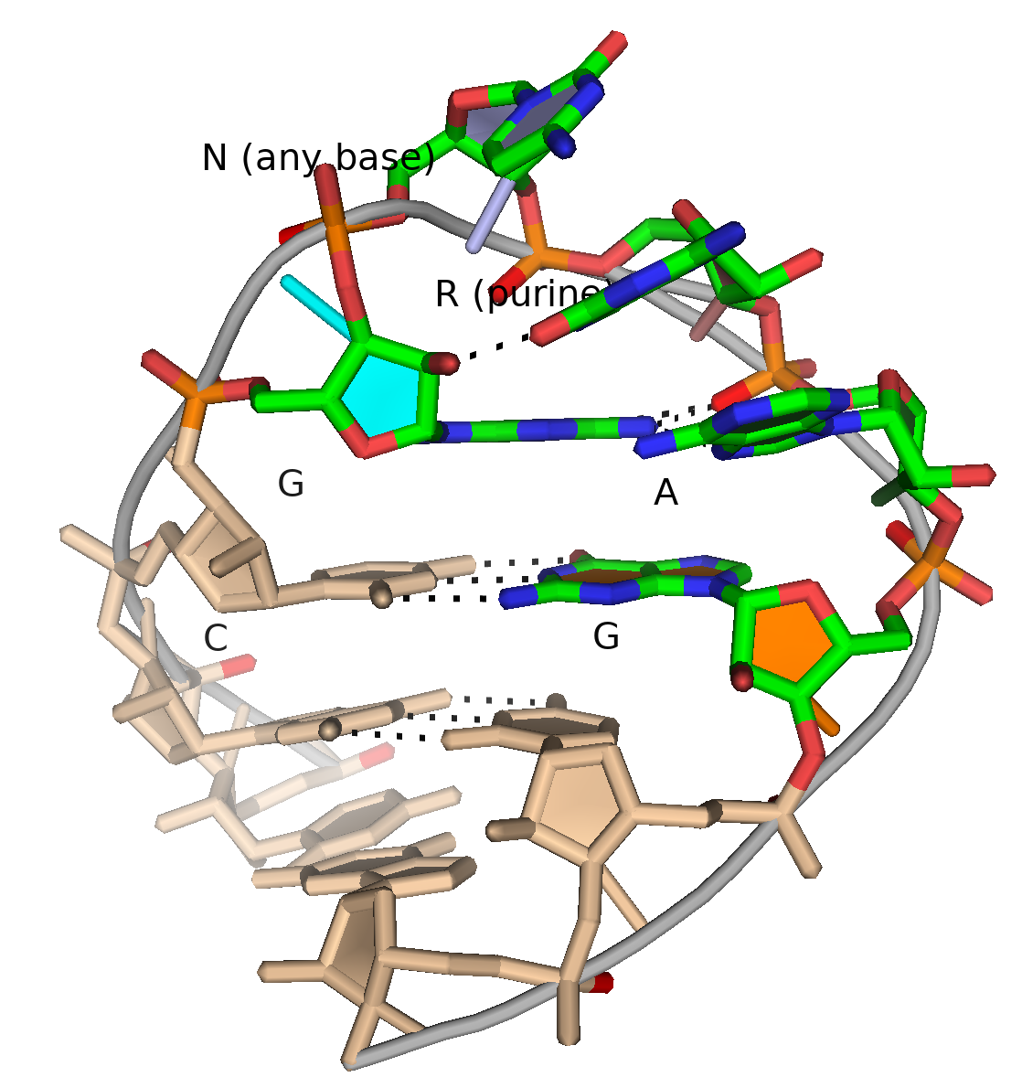
GNRA tetraloop
G
G

Slide 19
GNRA tetraloop

Slide 20
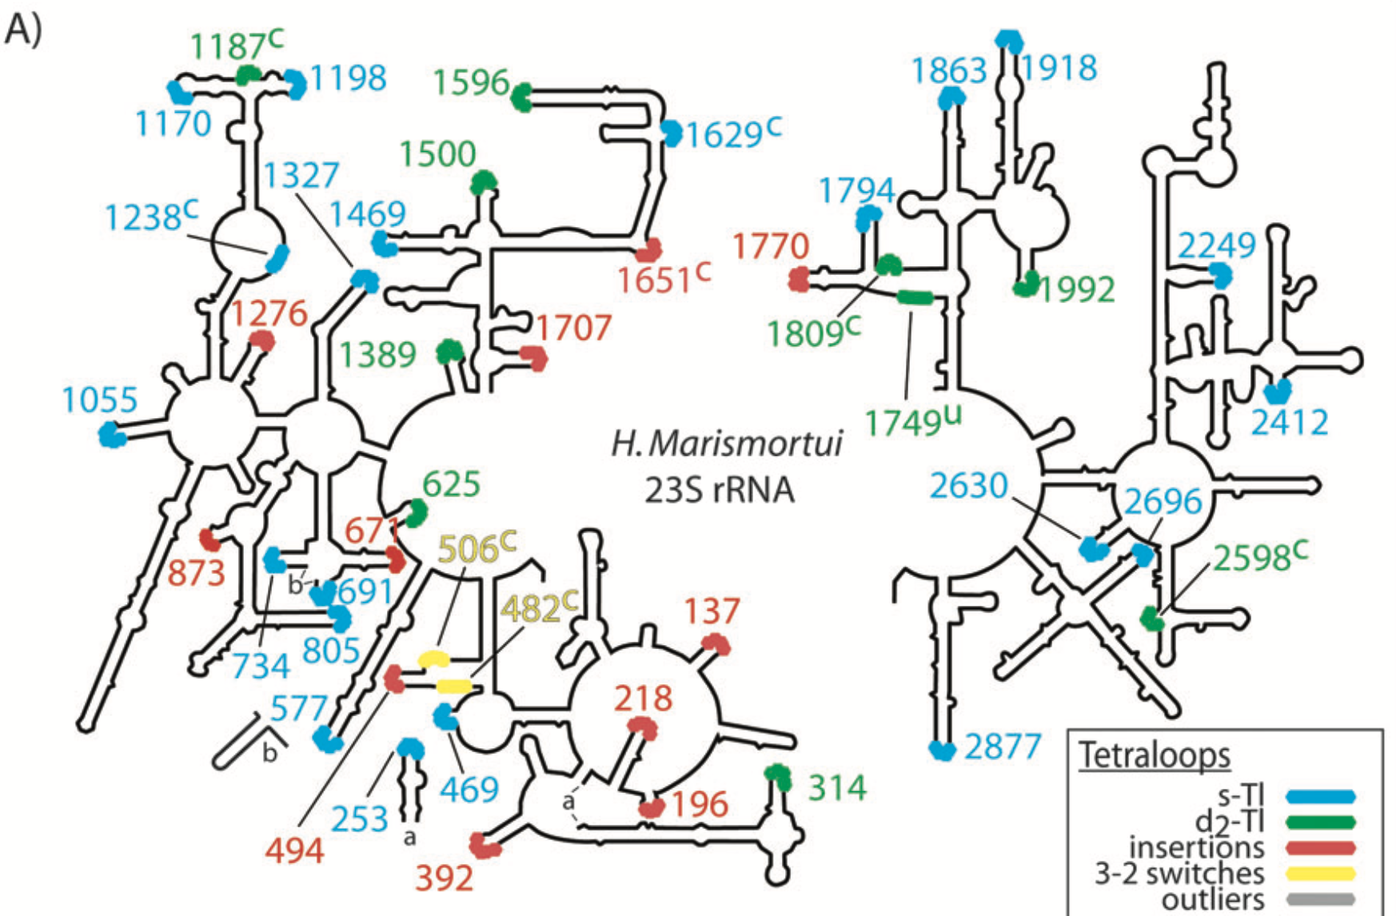

Slide 21
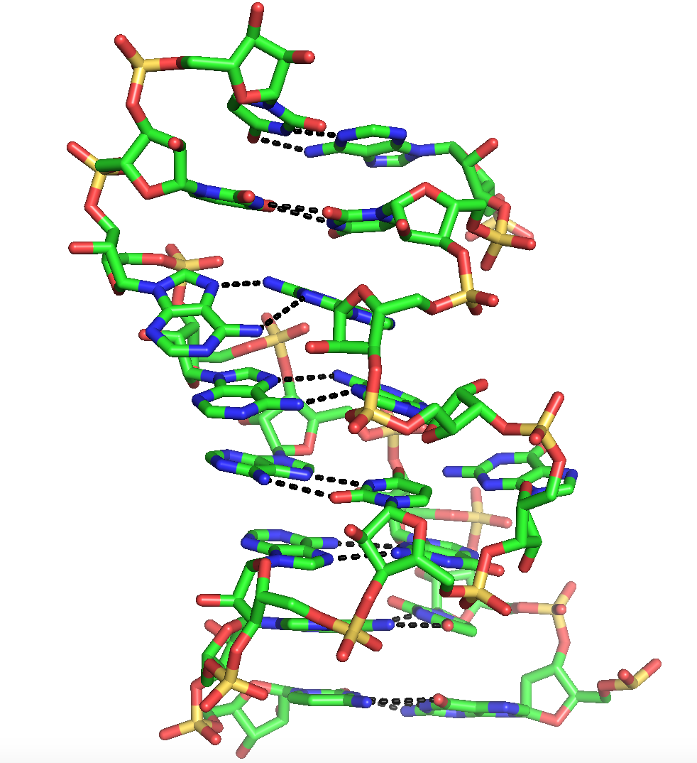
Helix 26a of the Ribosome

Slide 23
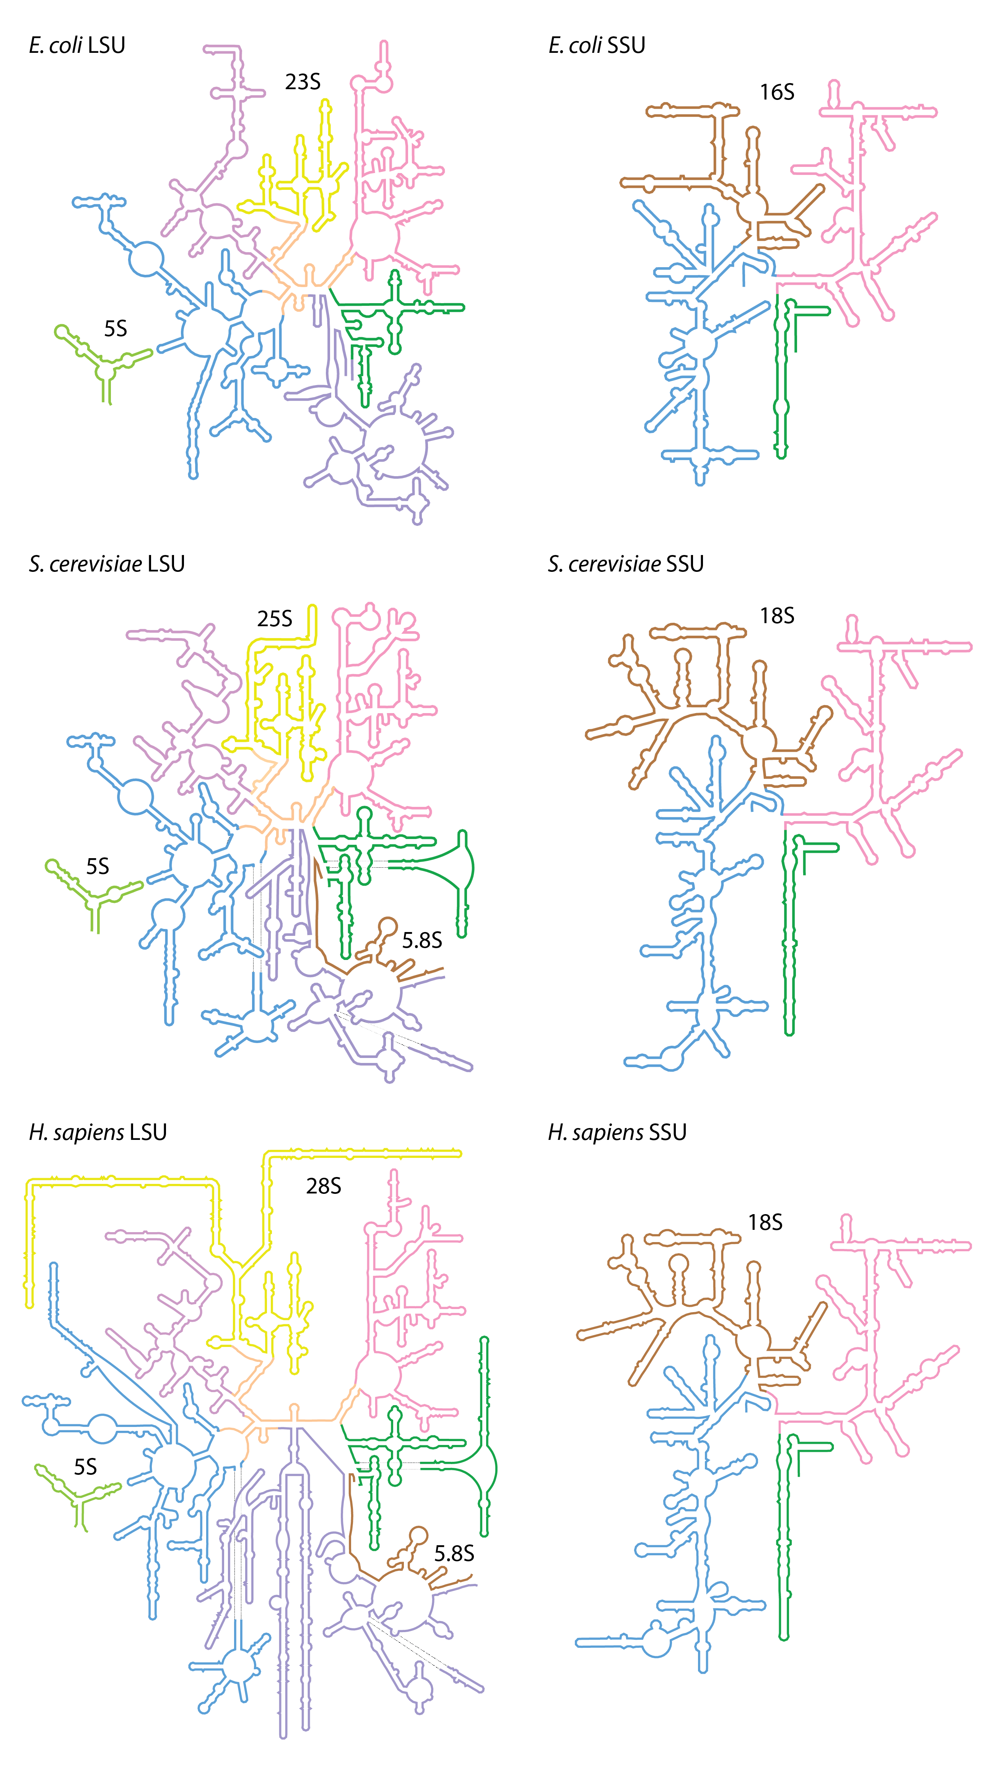

Slide 24
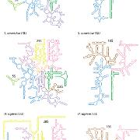
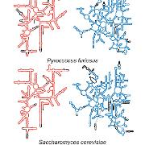
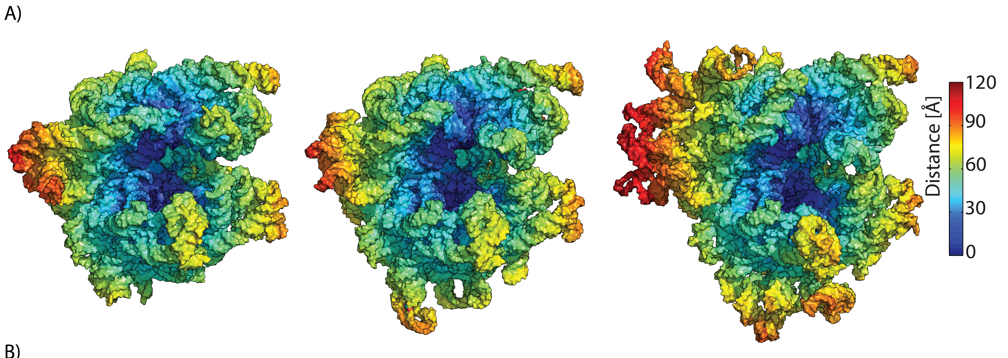
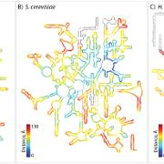
E coli P furiosus S. cerevisiae

Slide 25
Ribozymes
The vast majority of catalysis in biology is conducted by proteins (enzymes).
But some catalysis is performed by RNA (ribozymes which are actually RNPs)
two kinds of reactions:
Peptidyl transfer in the ribosome
RNA cutting and pasting in the splicosome, RNAse P, etc

Slide 26
The ribosome

Slide 27
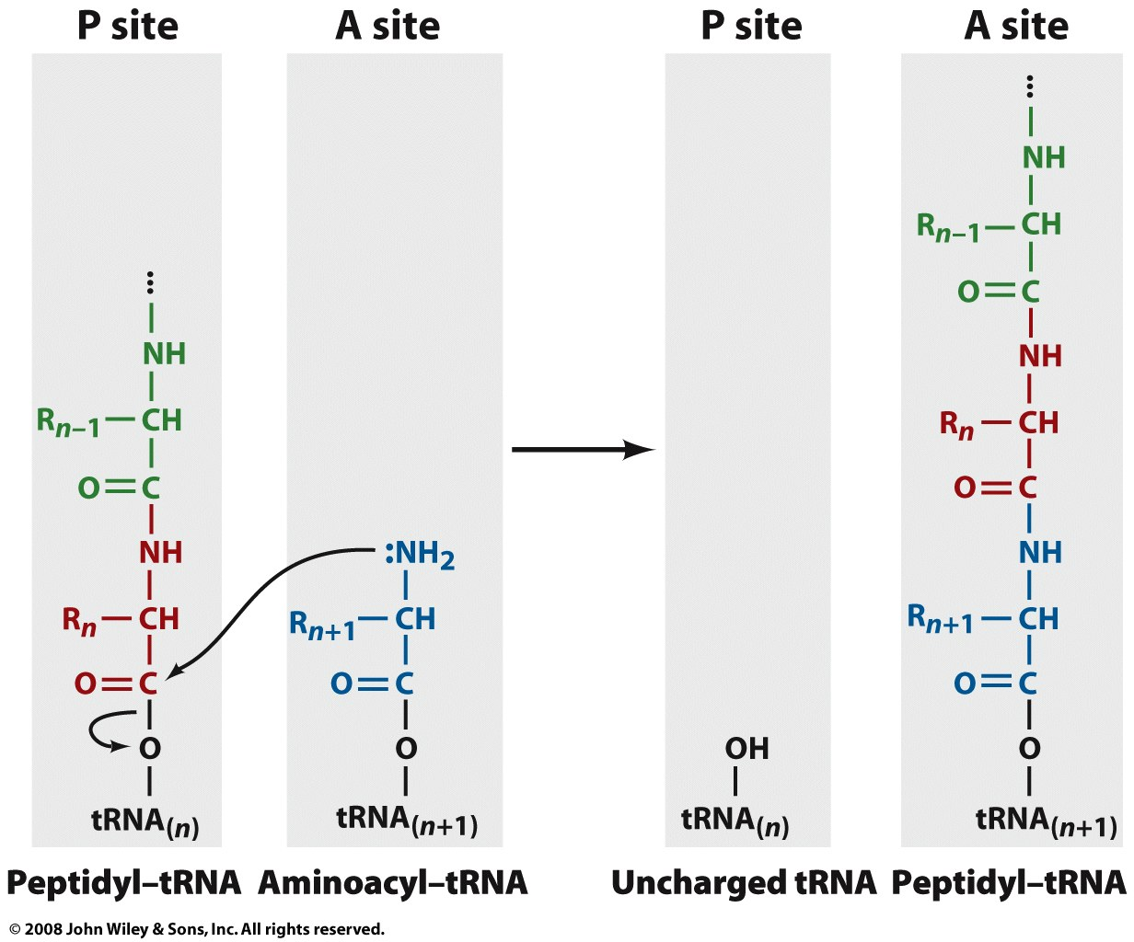
The Ribosome: The peptidyl transfer reaction

Slide 28
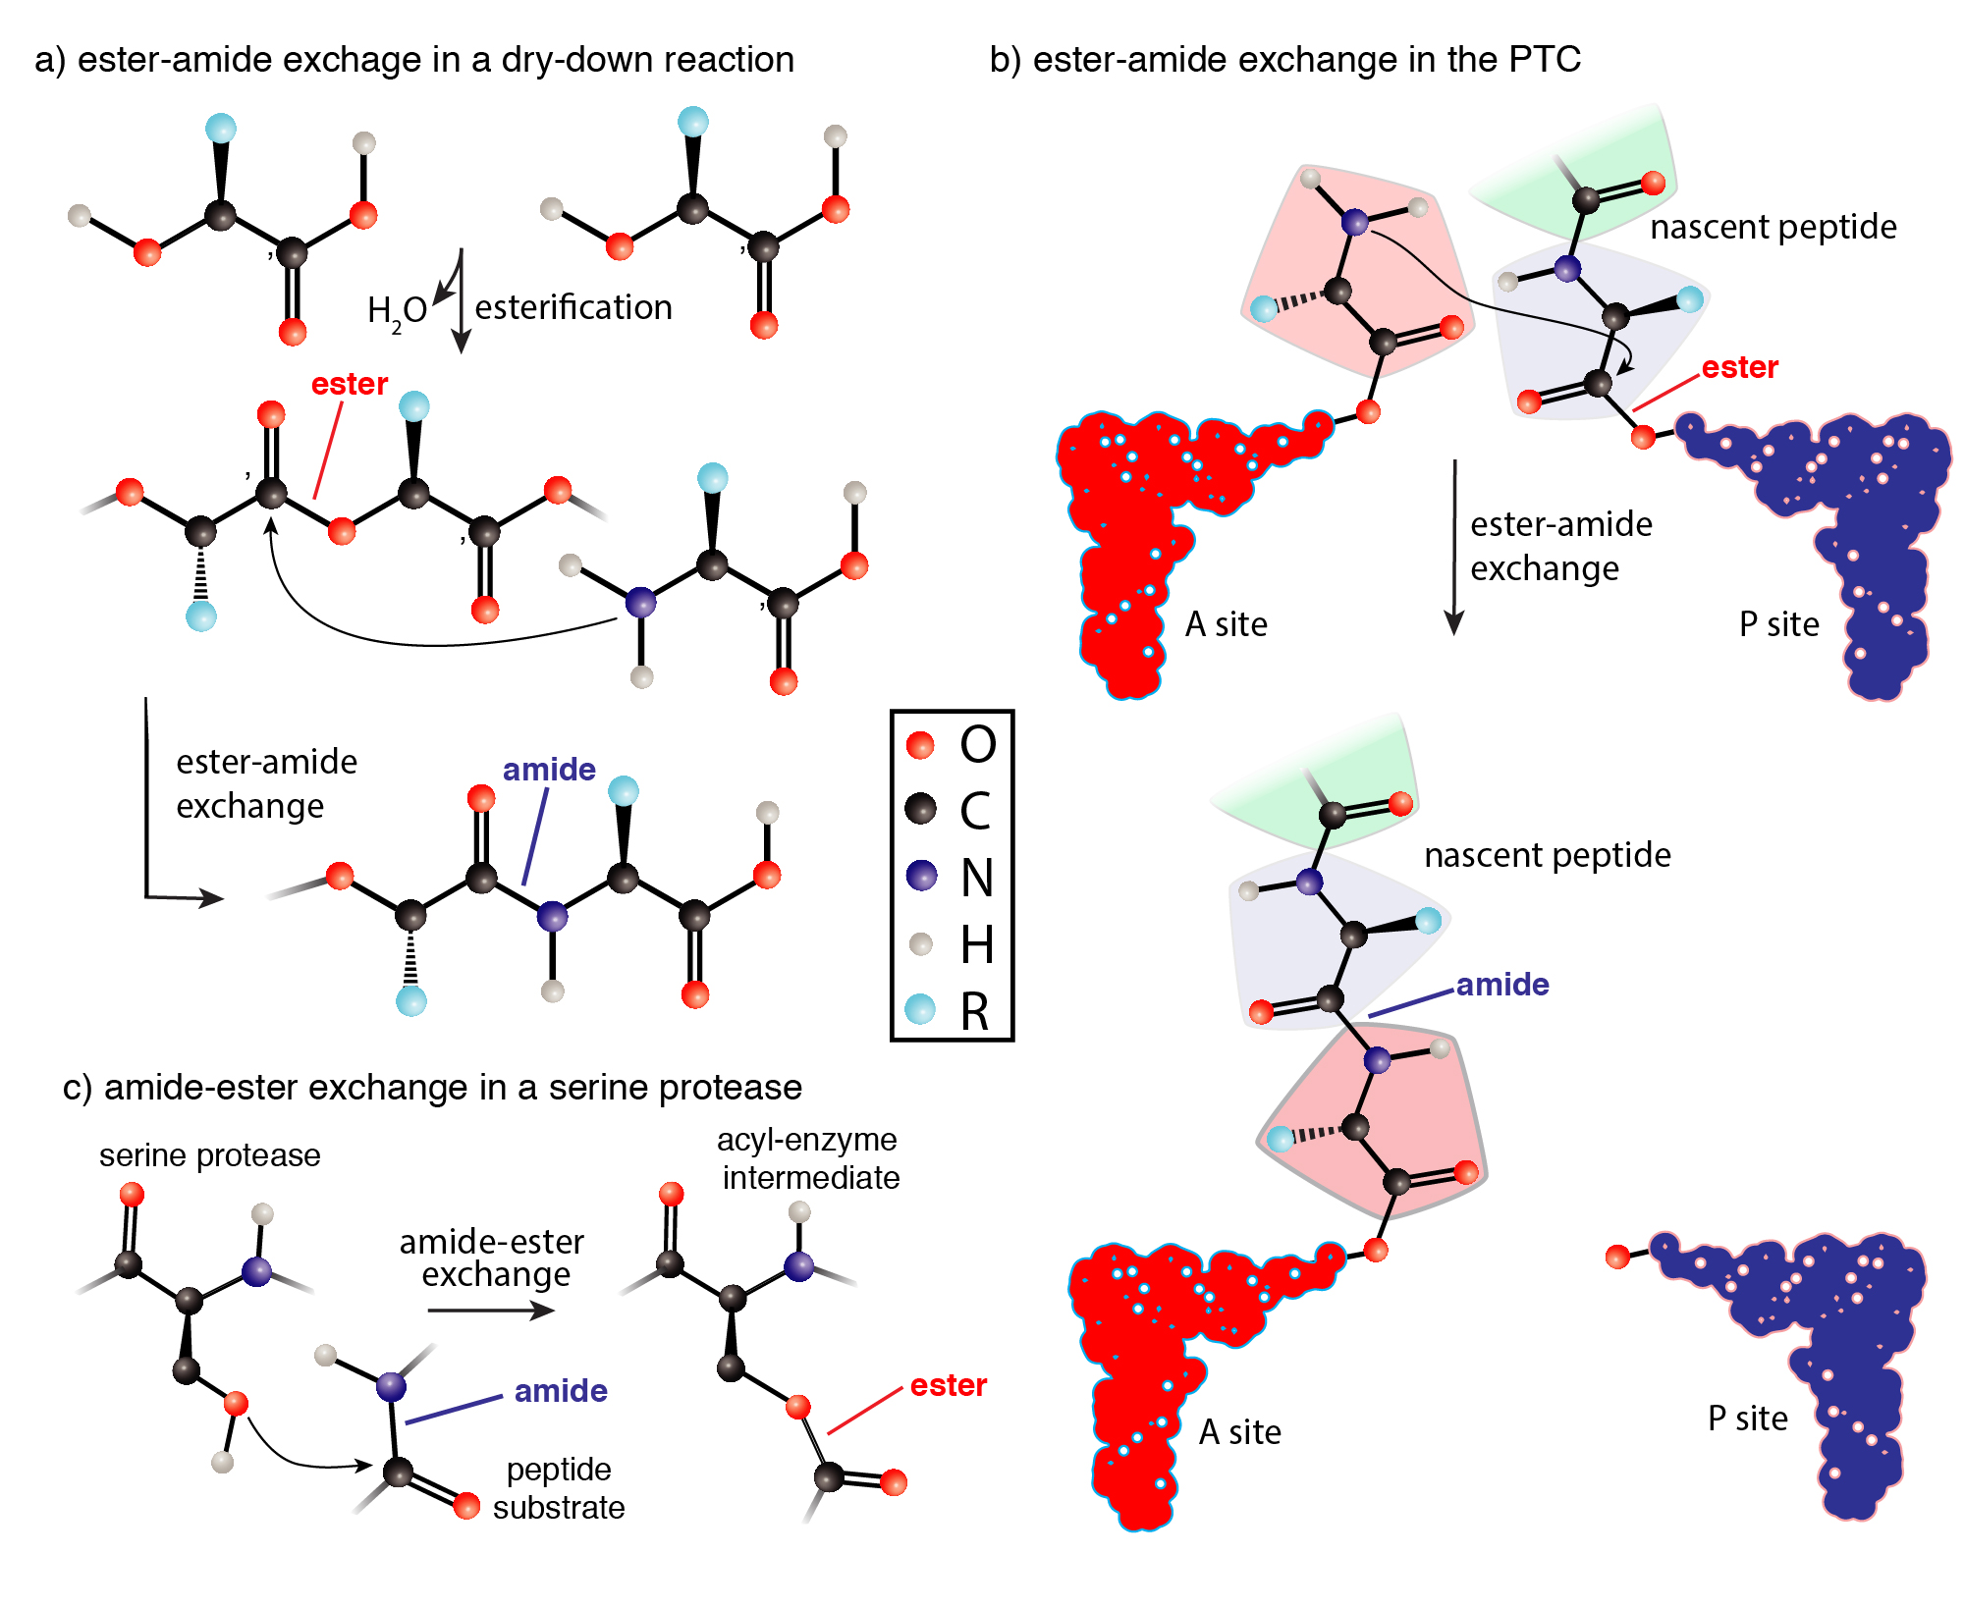
Notes:
Translation outrageously complex, produces coded protein by very simple chemistry

Slide 29
Splicing

Slide 30
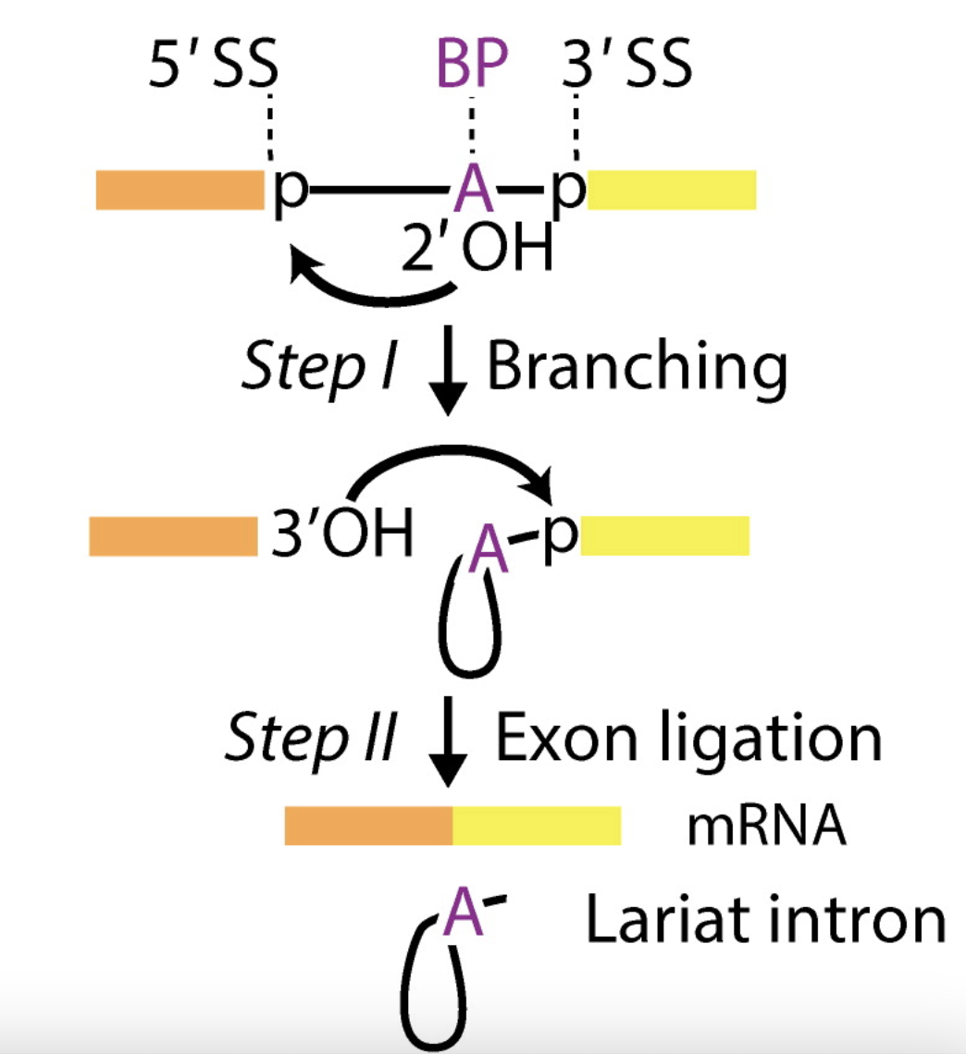
Exons of eukaryotic genes are interleaved by introns that are removed (spliced) from pre-mRNAs to form mature mRNAs.
A human has around 22,000 protein-coding genes. A gene has 8 introns on average.
The length of intron is around 1000 nucleotides on average.
exon
exon
Image from RNA Splicing by the Spliceosome, Annual Review of Biochemistry (2020)

