Slide 2
Transcription
In bacteria and archaea, transcription of genes with related functions is co-regulated in response to environmental or cellular conditions (operon model). Transcription and translation are coordinated in time and space.
In eukarya, transcription of each gene is independent and involves complex regulatory networks with multiple enhancers, silencers, and chromatin modifications. Transcription takes place in the nucleus and transclation takes place in cytosol.

Slide 3
The lac operon in bacteria
The lac operon ensures that the enzymes needed to transport lactose into the cell and break it down into glucose and galactose are produced only when lactose is available and glucose is scarce.

Slide 4
The lac operon in bacteria
Structural Genes:
lacZ: Encodes β-galactosidase, which breaks down lactose into glucose and galactose.
lacY: Encodes lactose permease, which transports lactose into the cell.
lacA: Encodes thiogalactoside transacetylase, whose role in lactose metabolism is less clear.
Regulatory Elements:
Promoter (P): Binding site for RNA polymerase to initiate transcription.
Operator (O): Binding site for the lac repressor protein.
lacI (Regulatory Gene): Encodes the lac repressor, which binds to the operator to block transcription in the absence of lactose.
Effector Molecules:
Allolactose (an isomer of lactose): Inducer that binds to the repressor, preventing it from binding to the operator.
cAMP: Levels increase when glucose is low, activating CAP (catabolite activator protein) to enhance transcription.

Slide 5
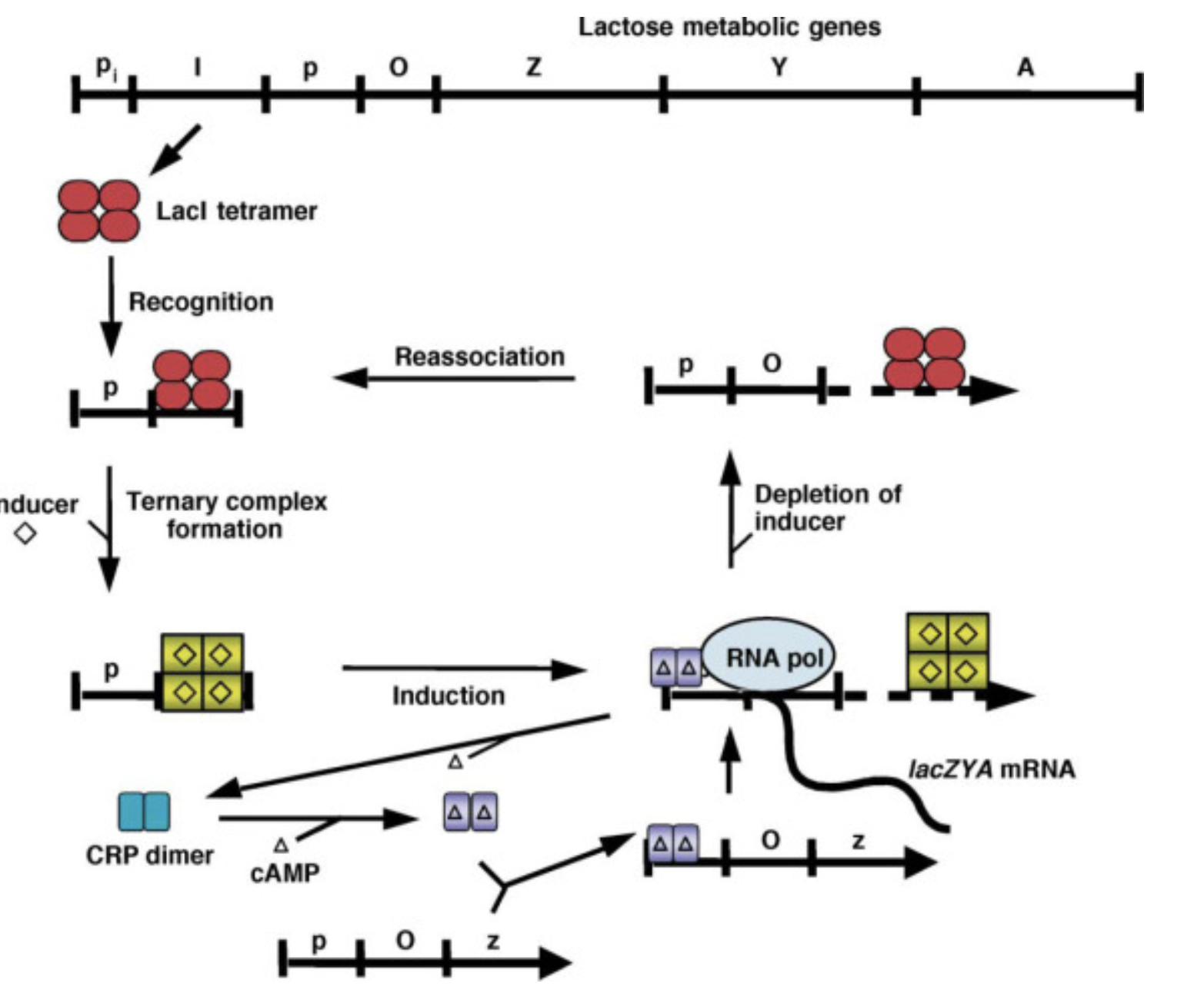
The lac operon, indicating positions of the promoter (Pi) for the tetrameric lactose repressor (lacI gene, “I”), the promoter (P) for the metabolic enzymes, the operator LacO (O site for LacI binding), and the metabolic enzyme genes (lacZYA, “Z,” “Y,” and “A”).
The cartoon of the functional cycle represents LacI tetramer binding to operator, association with inducer (⋄, a sugar), dissociation from operator (induction), RNA polymerase (RNA pol) binding and transcription, and subsequent reassociation with the operator when sugar levels diminish.
Shown at the bottom is the dimeric structure of CRP, its association with cAMP (triangle), and binding within the promoter region to facilitate RNA polymerase binding and transcription. CRP dissociates from the promoter when glucose levels increase and cAMP levels fall.
lacI: Encodes the lac repressor, binds to the operator to block transcription.
P: Binding site for RNA polymerase to initiate transcription.
O: Binding site for the lac repressor protein.

Slide 6
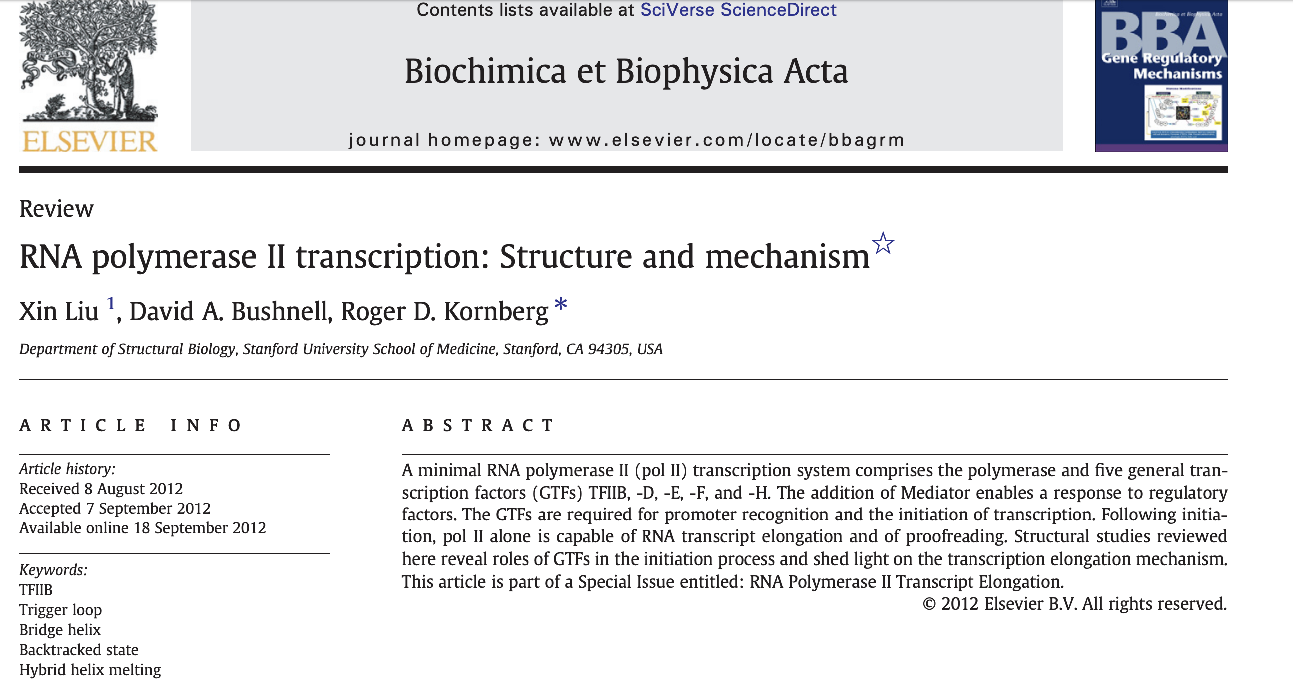

Slide 7
Overview of RNA Metabolism
Eukaryotes
Transcribed from DNA
  Transcription is tightly regulated in order to control the concentration of each protein.
Ribozymes
  Being mainly single stranded, many RNA molecules can fold into compact structures with specific functions.
  Some RNA molecules can act as catalysts (ribozymes), often using metal ions as cofactors such as the group I introns.
Processing of mRNAs
  Splicing - elimination of introns; joining of exons
  Poly-adenylation of the 3’ end
  Capping the 5’ end

Slide 8
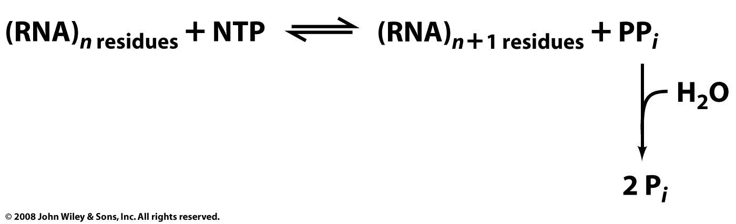
Overview of RNA polymerases
RNA polymerase (RNAP) is an enzyme that produces RNA using DNA as a template. RNAPs are essential to modern life and are found in all living systems.
RNAPs are nucleotidyl transferases that initiate synthesis de novo (do not required primers, unlike DNA polymerases, RNAPs can initiate a new RNA strand without a primer). RNAPs add ribonucleotides to the 3' hydroxyl group of RNA molecules. The reactions are driven by release of PPi..
fastest

Slide 9
Overview of RNA polymerases
RNA polymerase (RNAP) is an enzyme that produces RNA using DNA as a template. RNAPs are essential to modern life and are found in all living systems.
RNAPs are nucleotidyl transferases that initiate synthesis de novo (do not required primers, unlike DNA polymerases, RNAPs can initiate a new RNA strand without a primer). RNAPs add ribonucleotides to the 3' hydroxyl group of RNA molecules. The reactions are driven by release of PPi..
Fastest, elongation at 60 nt/sec.
elongation at 30 nt/sec.

Slide 10
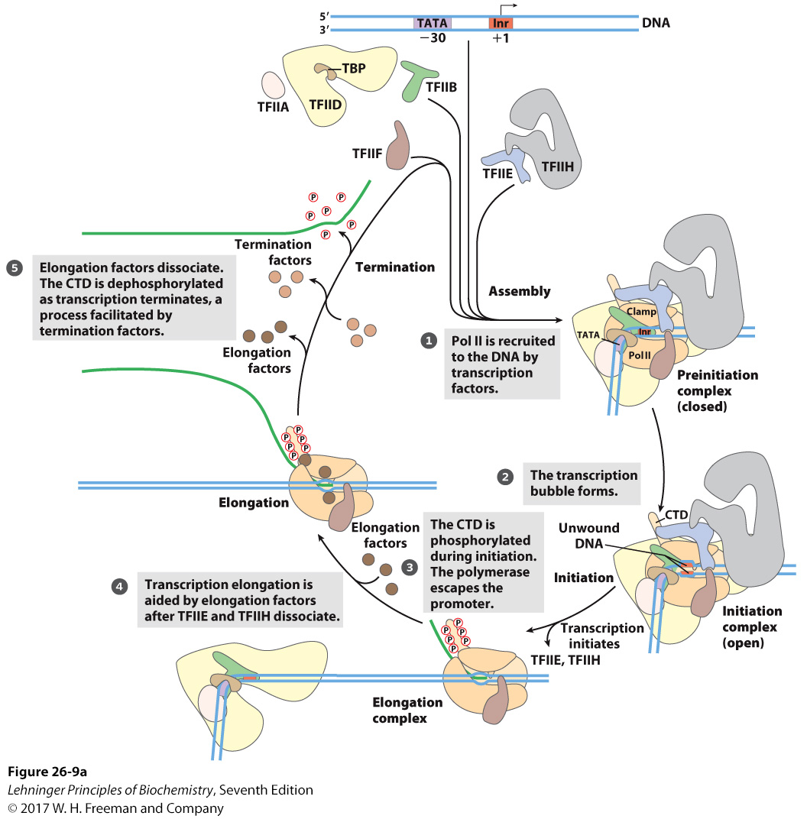
Transcription Using RNA Pol II
CDT: 52 repeats of
Tyr-Ser-Pro-Thr-Ser-Pro-Ser
Notes:
FIGURE 26–9a Transcription at RNA polymerase II promoters. (a) The sequential assembly of TBP (often with TFIIA), TFIIB, TFIIF plus Pol II, TFIIE, and TFIIH results in a closed complex. Within the complex, the DNA is unwound at the Inr region by the helicase activity of TFIIH and perhaps of TFIIE, creating an open complex. The carboxyl-terminal domain of the largest Pol II subunit is phosphorylated by TFIIH, and the polymerase then escapes the promoter and begins transcription. Elongation is accompanied by the release of many transcription factors and is also enhanced by elongation factors (see Table 26–2). After termination, Pol II is released, dephosphorylated, and recycled.

Slide 11
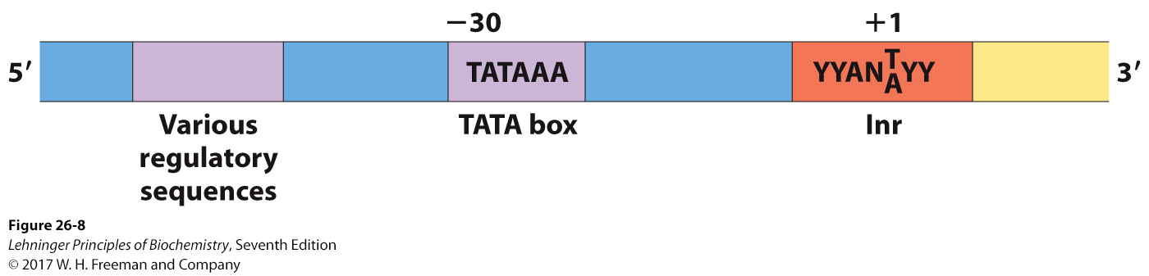
Features of Promoters Recognized by Eukaryotic RNA Polymerase II
Consensus sequence TATA(A/T)A(A/T)(A/G) ~−30
Inr sequence (Initiator) ~+1
Specific regulatory sequences farther upstream
Notes:
FIGURE 26–8 Some common sequences in promoters recognized by eukaryotic RNA polymerase II. The TATA box is the major assembly point for the proteins of the preinitiation complexes of Pol II. The DNA is unwound at the initiator sequence (Inr), and the transcription start site is usually within or very near this sequence. In the Inr consensus sequence shown here, N represents any nucleotide; Y, a pyrimidine nucleotide. Many additional sequences serve as binding sites for a wide variety of proteins that affect the activity of Pol II. These sequences are important in regulating Pol II promoters and differ greatly in type and number, and in general the eukaryotic promoter is much more complex than suggested here (see Fig. 15–25). Many of the sequences are located within a few hundred base pairs of the TATA box on the 5’ side; others may be thousands of base pairs away. The sequence elements summarized here are more variable among the Pol II promoters of eukaryotes than among the E. coli promoters (see Fig. 26–5). The majority of Pol II promoters lack a TATA box or a consensus Inr element or both. Additional sequences around the TATA box and downstream (to the right as drawn) of Inr may be recognized by one or more transcription factors.

Slide 12
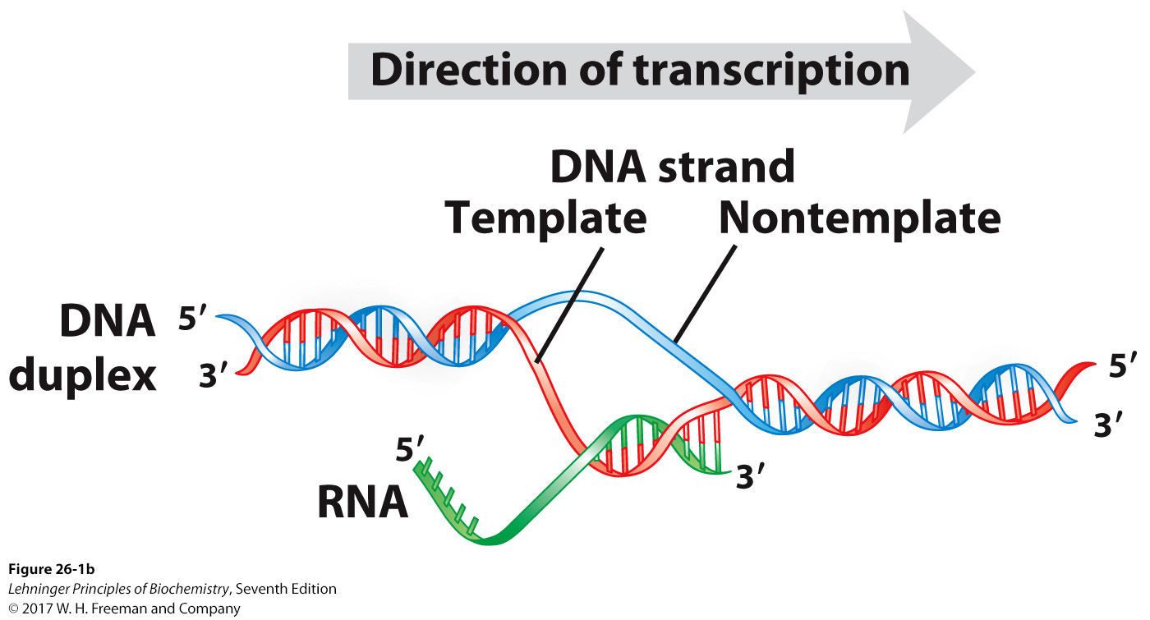
Overview of RNA polymerases
Transcription “Bubble”
Notes:
MECHANISM FIGURE 26–1b Transcription by RNA polymerase in E. coli. For synthesis of an RNA strand complementary to one of two DNA strands in a double helix, the DNA is transiently unwound. (b) About 17 bp of DNA are unwound at any given time. RNA polymerase and the transcription bubble move from left to right along the DNA as shown, facilitating RNA synthesis. The DNA is unwound ahead and rewound behind as RNA is transcribed. As the DNA is rewound, the RNA-DNA hybrid is displaced and the RNA strand is extruded.

Slide 13
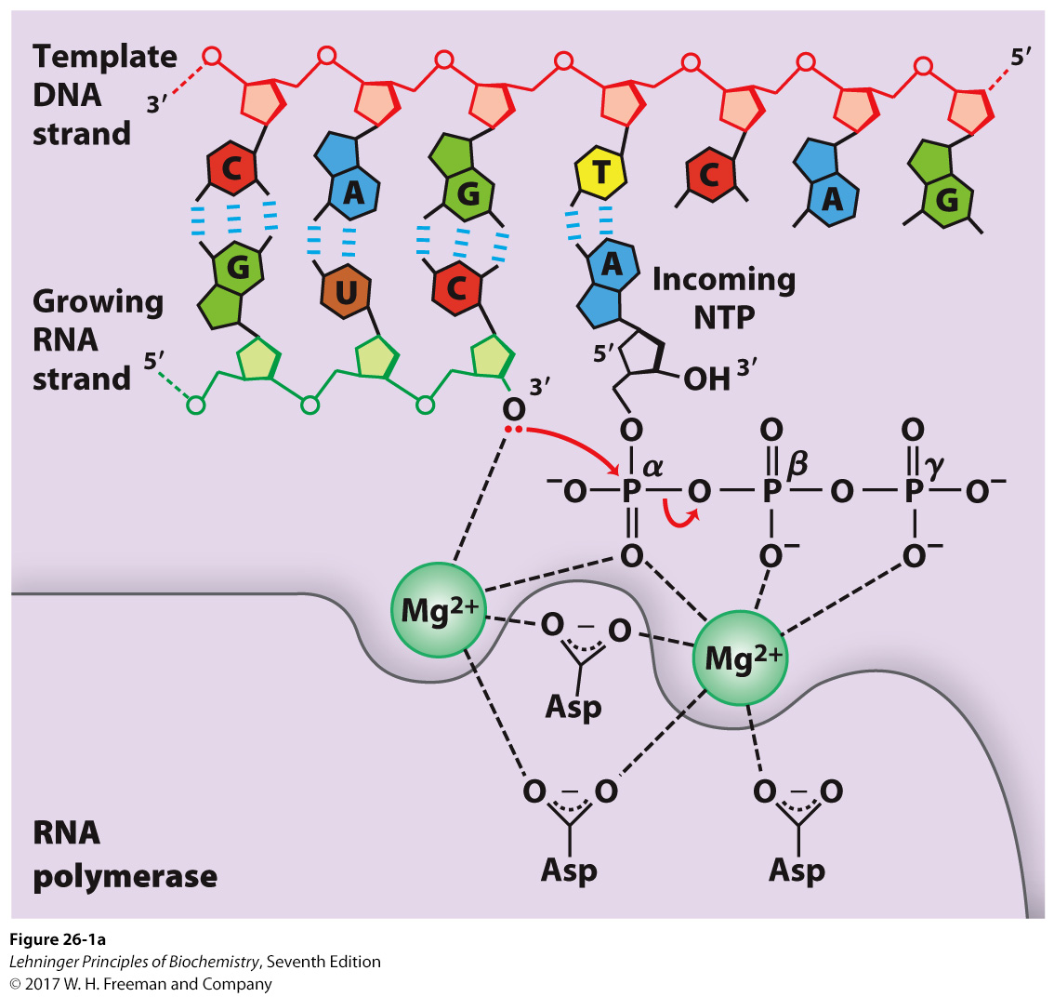
Overview of RNA polymerases
This image is out of proportion. Magnesium appears gigantic (actual ionic radius = 0.67 Å, it not bigger than a purine). Mg coordination is not correct. Phosphates are all different sizes. And RNA and NTP are missing their 2’ hydroxyl groups.
Notes:
MECHANISM FIGURE 26–1a Transcription by RNA polymerase in E. coli. For synthesis of an RNA strand complementary to one of two DNA strands in a double helix, the DNA is transiently unwound. (a) Catalytic mechanism of RNA synthesis by RNA polymerase. Note that this is essentially the same mechanism used by DNA polymerases (see Fig. 25–5a). The reaction involves two Mg²⁺ ions, coordinated to the phosphate groups of the incoming nucleoside triphosphates (NTPs) and to three Asp residues, which are highly conserved in the RNA polymerases of all species. One Mg²⁺ ion facilitates attack by the 3’-hydroxyl group on the α phosphate of the NTP; the other Mg²⁺ ion facilitates displacement of the pyrophosphate, and both metal ions stabilize the pentacovalent transition state.

Slide 14
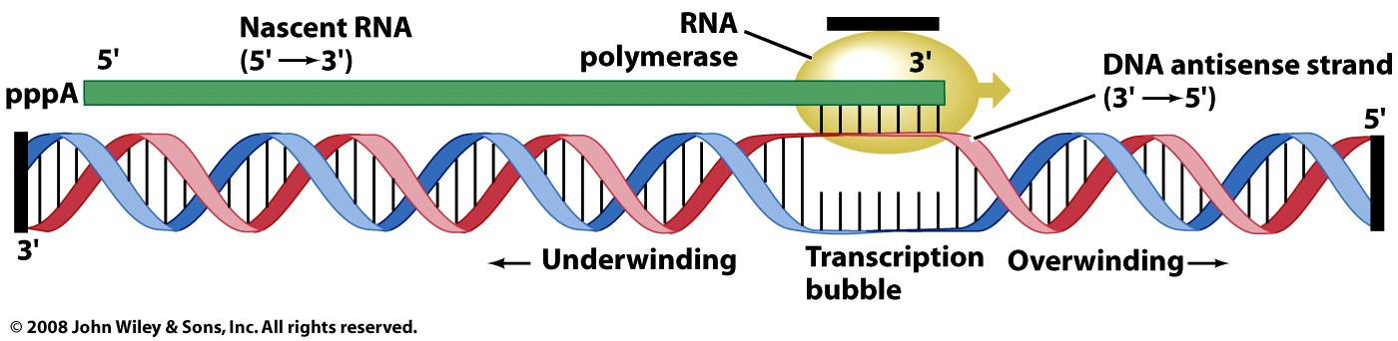
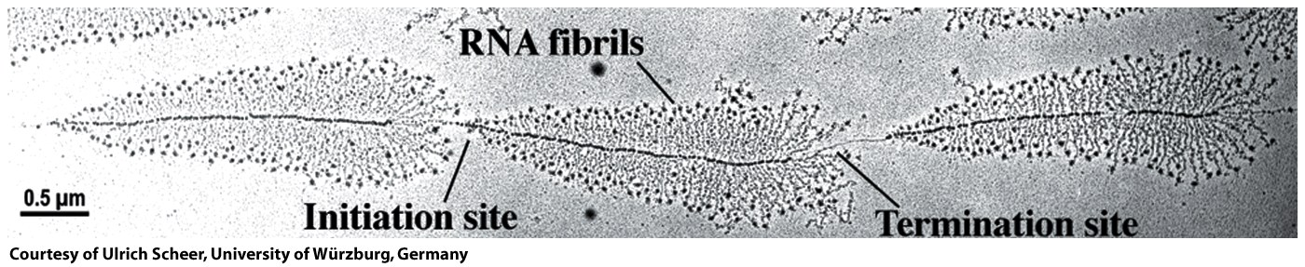
Topology issues during elongation.
The RNA Pol generates positive supercoils ahead, negative supercoils behind, relieved by topoisomerases.
Figure 26-7

Slide 15
Transcription Factors
Transcription factors bind to specific DNA sequences and regulate transcription of specific genes. Transcription factors activate and/or repress wide repertoires of genes in a combinatorial fashion. Some transcription factors are at the ends of signal transduction pathways that change TFs (subcellular localization, phosphorylation state, etc). Modifications to transcription factors in the cytosol can cause them to translocate to the nucleus where they can interact with enhancers.

Slide 16
Assembly of RNA Polymerase II at Promoter
Initiated by binding of TATA-binding protein (TBP) to the promoter
  TBP is part of multisubunit complex TFIID.
    TBP bends of the DNA by nearly 90 deg, wrapping it around pol II.
    TBP is required for transcription of genes lacking a TATA box,
    TBP is required for transcription by polymerases I and III as
    Other proteins include TFIIB, TFIIA, TFIIF, TFIIE and TFIIH.

Slide 17
Assembly of RNA Polymerase II at Promoter
Initiated by binding of TATA-binding protein (TBP) to the promoter
Helicase activity in TFIIH unwinds DNA at the promoter.
Kinase activity in TFIIH phosphorylates the polymerase at the CTD (carboxy-terminal domain), changing the conformation and enabling RNA Pol II to transcribe.

Slide 18
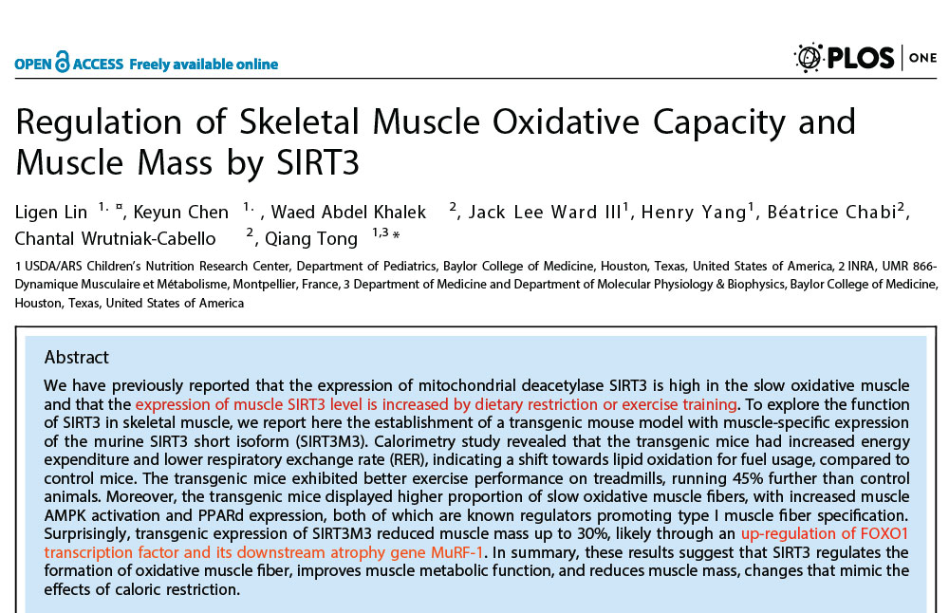
Go the CRC: Change your Gene Expression:
SIRTs regulate metabolism at the transcriptional level and more directly control the activity of metabolic enzymes.

Slide 19
Steps in transcription
Eukaryotic Initiation
Eukaryotes use six General Transcription Factors (GTFs) to form a PreInitiation Complex (PIC). Transcription Factor IID (TF IID) contains TATA Box binding Protein (TBP). TBP binds to the TATA box but also to TATA-less promoters.

Slide 20
Steps in transcription
Promoter clearance
After initiation the RNAP has a tendency to release truncated RNA transcripts (abortive initiation). RNAP II clears the promoter and leaves behind some of the GTFs including TFIID (a second RNAP II complex can reinitiate more quickly than the first).

Slide 21
Steps in transcription
Elongation
RNA polymerase traverses the DNA template (antisense) strand, and following the rules of Watson-Crick complementarity with the antisense strand, creates an RNA copy of the sense (coding) strand. Polymerization is processive (without dissociation). Transcripts can be thousands or even millions of nucleotides. The rate of polymerization is around 50 nucleotides/second, slower than replication. The error rate of transcription is around 1 in 4000. RNA polymerase traverses the template strand from 3' → 5'. Polymerization occurs in the 5' → 3' direction. The resulting RNA transcript is a copy of the sense (coding, non-template) strand, except that thymines are replaced with uracils, and deoxyriboses are replaced by riboses. A second RNAP can quickly reinitiate from the same site.
The C-Terminal Domain (CTD) of RpbI is phosphorylated and binds to a six protein complex called Elongator.

Slide 22
Steps in transcription
Termination. Eukaryotes lack specific transcription termination sites. The 3’ ends of the transcription product are heterogeneous, but are cleaned up by processing before translation (3’ poly A tails are added).

Slide 23
Elongation and Termination
After 60-70nt, TFIIE is released followed by TFIIH.
Elongation factors bound to RNA Pol II enhance processivity and coordinate posttranslational modifications.
  Some elongation factors are bound to the phosphorylated CTD.
For termination, Pol II is dephosphorylated.
Regulation is complex

Slide 24
TABLE 26-2 | Proteins Required for Initiation of Transcription at the RNA Polymerase II (Pol II) Promoters of Eukaryotes
Transcription protein |  | Number of different subunits | Subunit(s) M_{r}ª | Function(s)
Initiation
Pol II |  | 12 | 7,000–220,000 | Catalyzes RNA synthesis
TBP (TATA-binding protein) |  | 1 | 38,000 | Specifically recognizes the TATA box
TFIIA |  | 2 | 13,000, 42,000 | Stabilizes binding of TFIIB and TBP to the promoter
TFIIB |  | 1 | 35,000 | Binds to TBP; recruits Pol II–TFIIF complex
TFIID^{b} |  | 13–14 | 14,000–213,000 | Required for initiation at promoters lacking a TATA box
TFIIE |  | 2 | 33,000, 50,000 | Recruits TFIIH; has ATPase and helicase activities
TFIIF |  | 2–3 | 29,000–58,000 | Binds tightly to Pol II; binds to TFIIB and prevents binding of Pol II to nonspecific DNA sequences
TFIIH |  | 10 | 35,000–89,000 | Unwinds DNA at promoter (helicase activity); phosphorylates Pol II (within the CTD); recruits nucleotide-excision repair proteins
Elongation^{c}
ELL^{d} |  | 1 | 80,000
pTEFb |  | 2 | 43,000, 124,000 | Phosphorylates Pol II (within the CTD)
SII (TFIIS) |  | 1 | 38,000
Elongin (SIII) |  | 3 | 15,000, 18,000, 110,000
ªMr reflects the subunits present in the complexes of human cells. Some components differ somewhat in size in yeast. ^{b}The presence of multiple copies of some TFIID subunits brings the total subunit composition of the complex to 21–22. ^{c}The function of all elongation factors is to suppress the pausing or arrest of transcription by the Pol II–TFIIF complex. ^{d}Name derived from eleven-nineteen lysine-rich leukemia. The gene for ELL is the site of chromosomal recombination events frequently associated with acute myeloid leukemia.

