Slide 1
Amino Acids
An amino acid contains
an amine group,
a carboxylic acid group,
a side-chain (or R-group),
all attached to a common chiral carbon atom (Cα),
with L stereochemistry
There are twenty proteinogenic* amino acids, which are encoded by the genetic code, which is universal throughout the tree of life. Amino acids are distinguished by their sidechains.
Selenocysteine is encoded (by UGA, normally a stop) and is said to be the 21st proteinogenic amino acid but is rare (in only 25 proteins in humans).
Pyrrolysine is encoded (by UAG, normally a stop) and is said to be the 22nd amino acid but is very rare (only found in some bacteria).

Slide 2
Amino Acids Differ Only in the R Groups
(aka Sidechains)
alanine Ala A
arginine Arg R
asparagine Asn N
aspartic acid Asp D
cysteine Cys C
glutamic acid Glu E
glutamine Gln Q
glycine Gly G
histidine His H
isoleucine Ile I
leucine Leu L
lysine Lys K
methionine Met M
phenylalanine Phe F
proline Pro P
serine Ser S
threonine Thr T
tryptophan Trp W
tyrosine Tyr Y
valine Val V

Slide 3
Amino Acids are Chiral
Always draw proteinogenic amino acids like this.
(i) N to C (left to right)
(ii) R group up and out (or down and back)
Proteinogenic amino acids are L (not D).
[glycine (R=H) is not chiral]
Notes:
FIGURE 3-2 General structure of an amino acid. This structure is common to all but one of the α-amino acids. (Proline, a cyclic amino acid, is the exception.) The R group, or side-chain (red), attached to the α carbon (blue) is different in each amino acid.

Slide 4
Notes:
Glycine

Slide 5
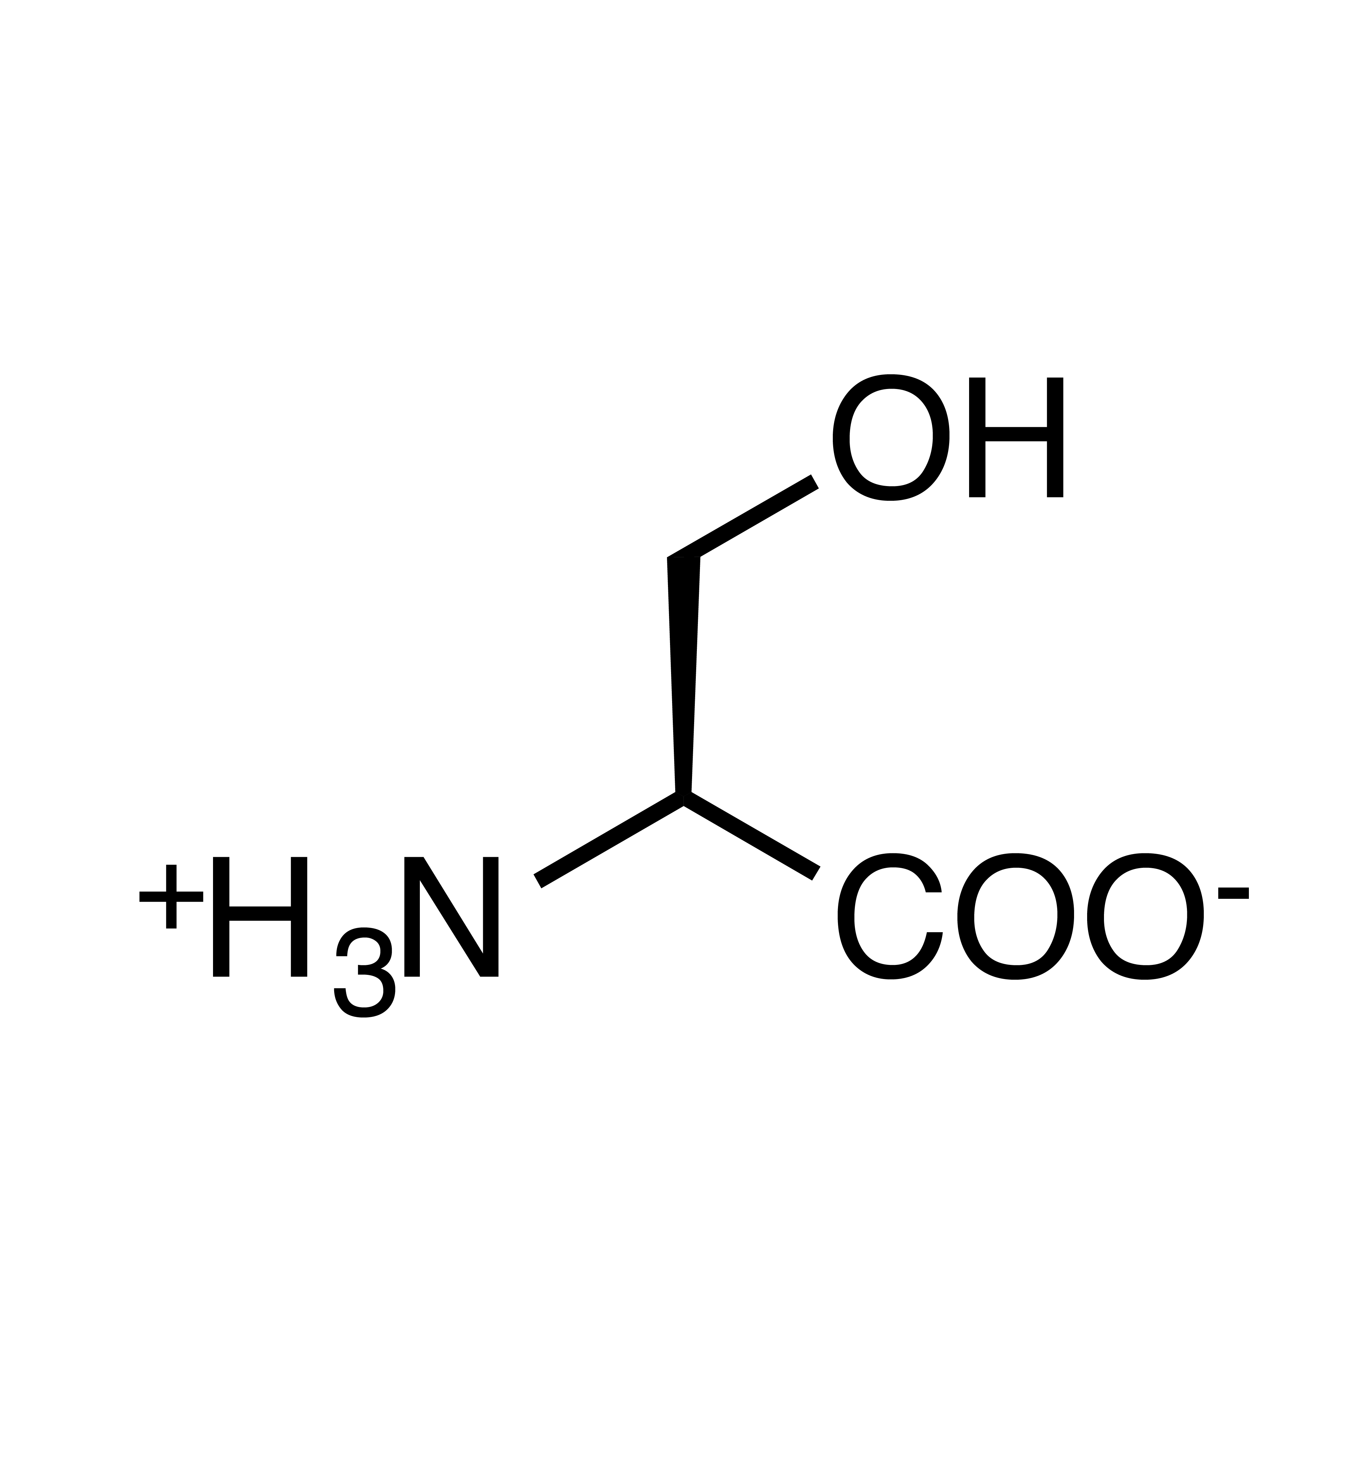
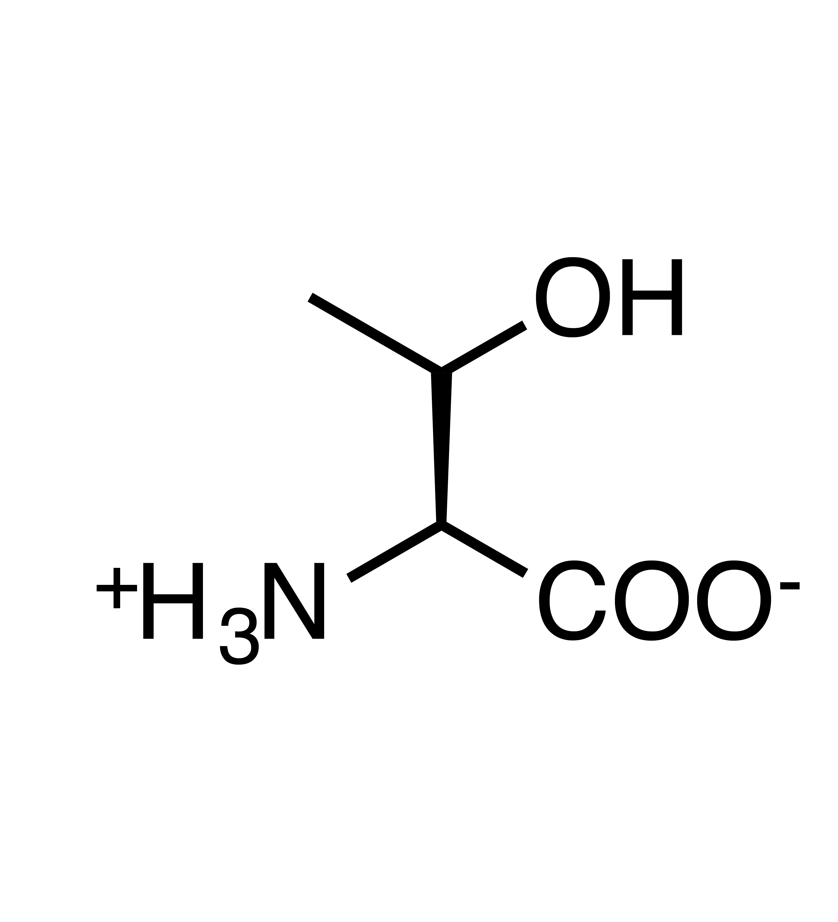
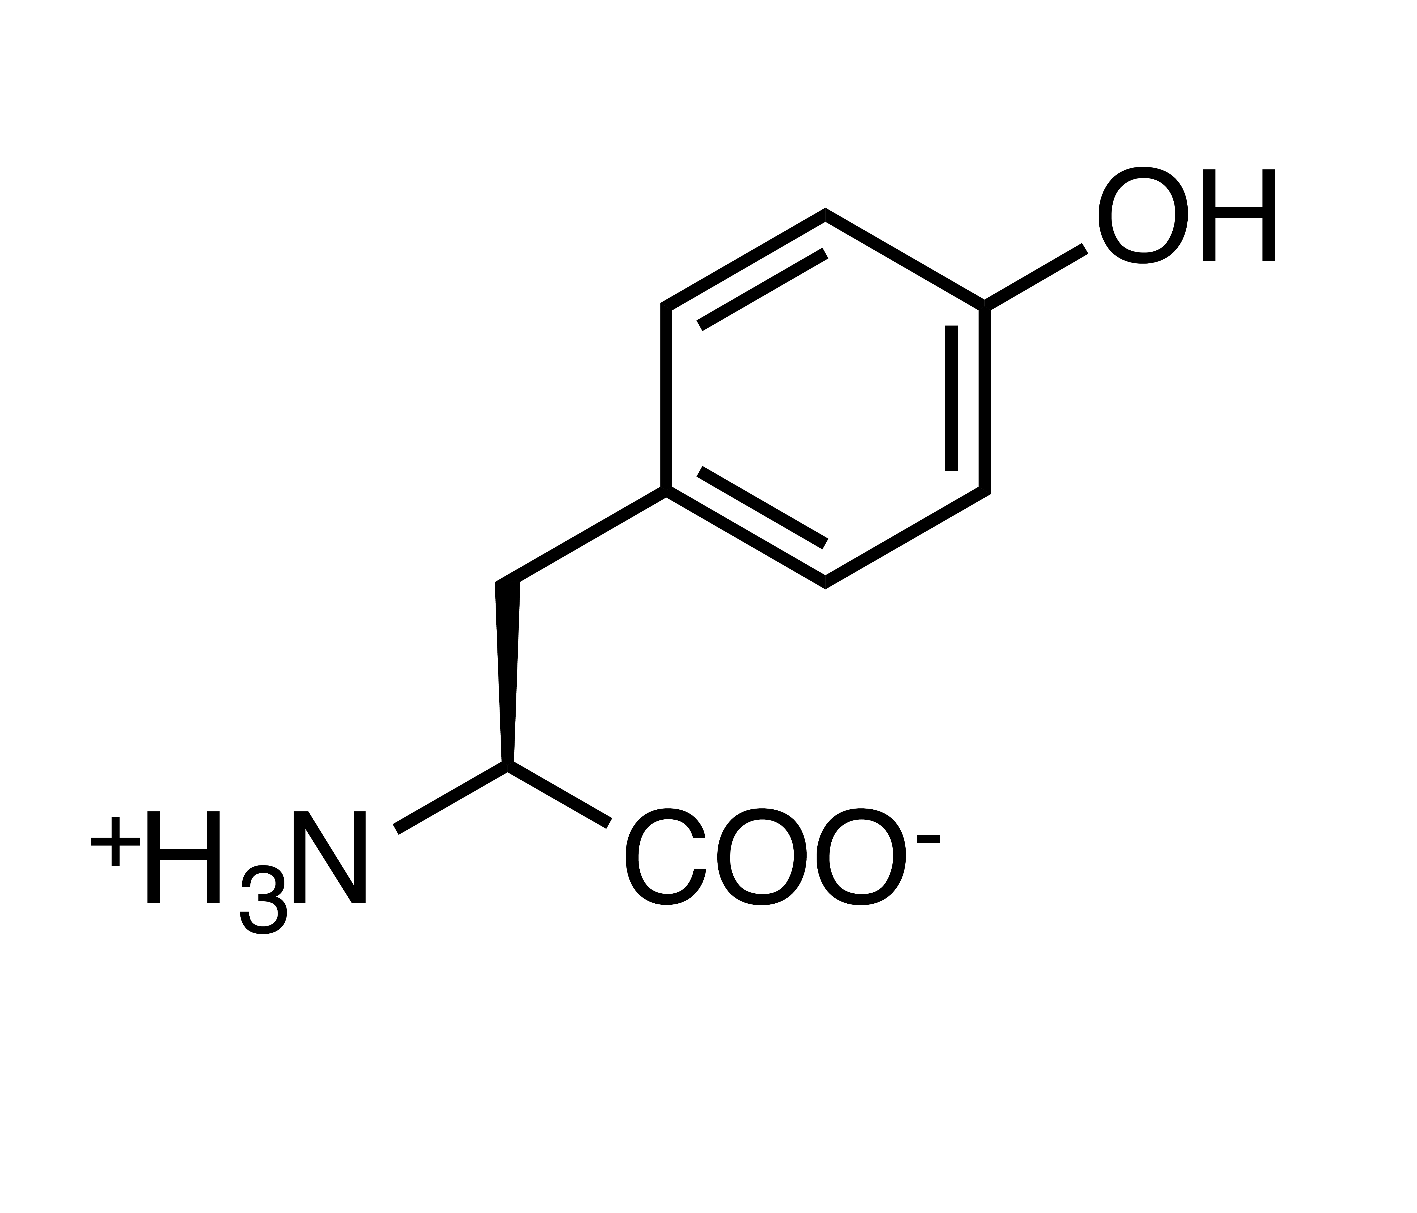
Notes:
Serine, Threonine, Tyrosine

Slide 6
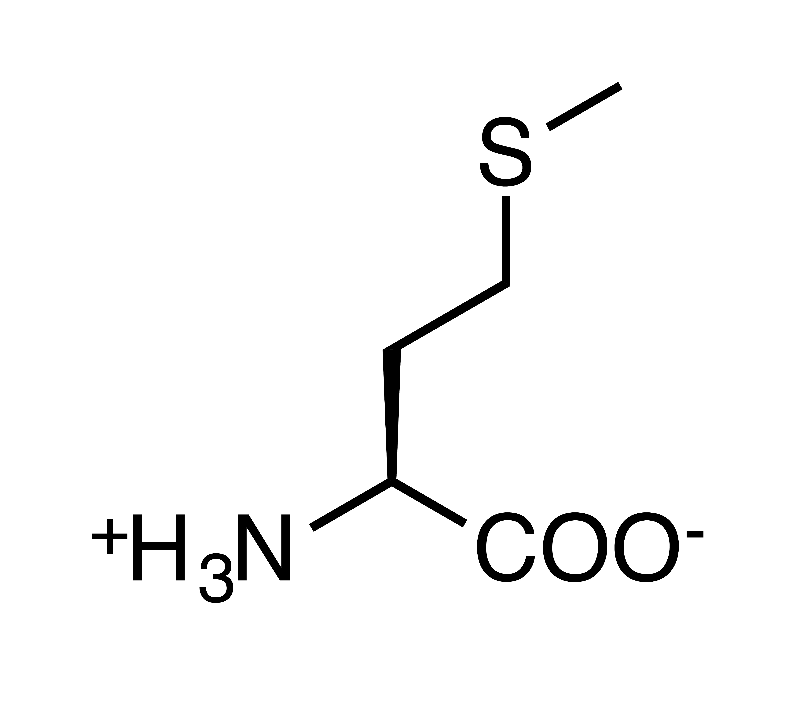
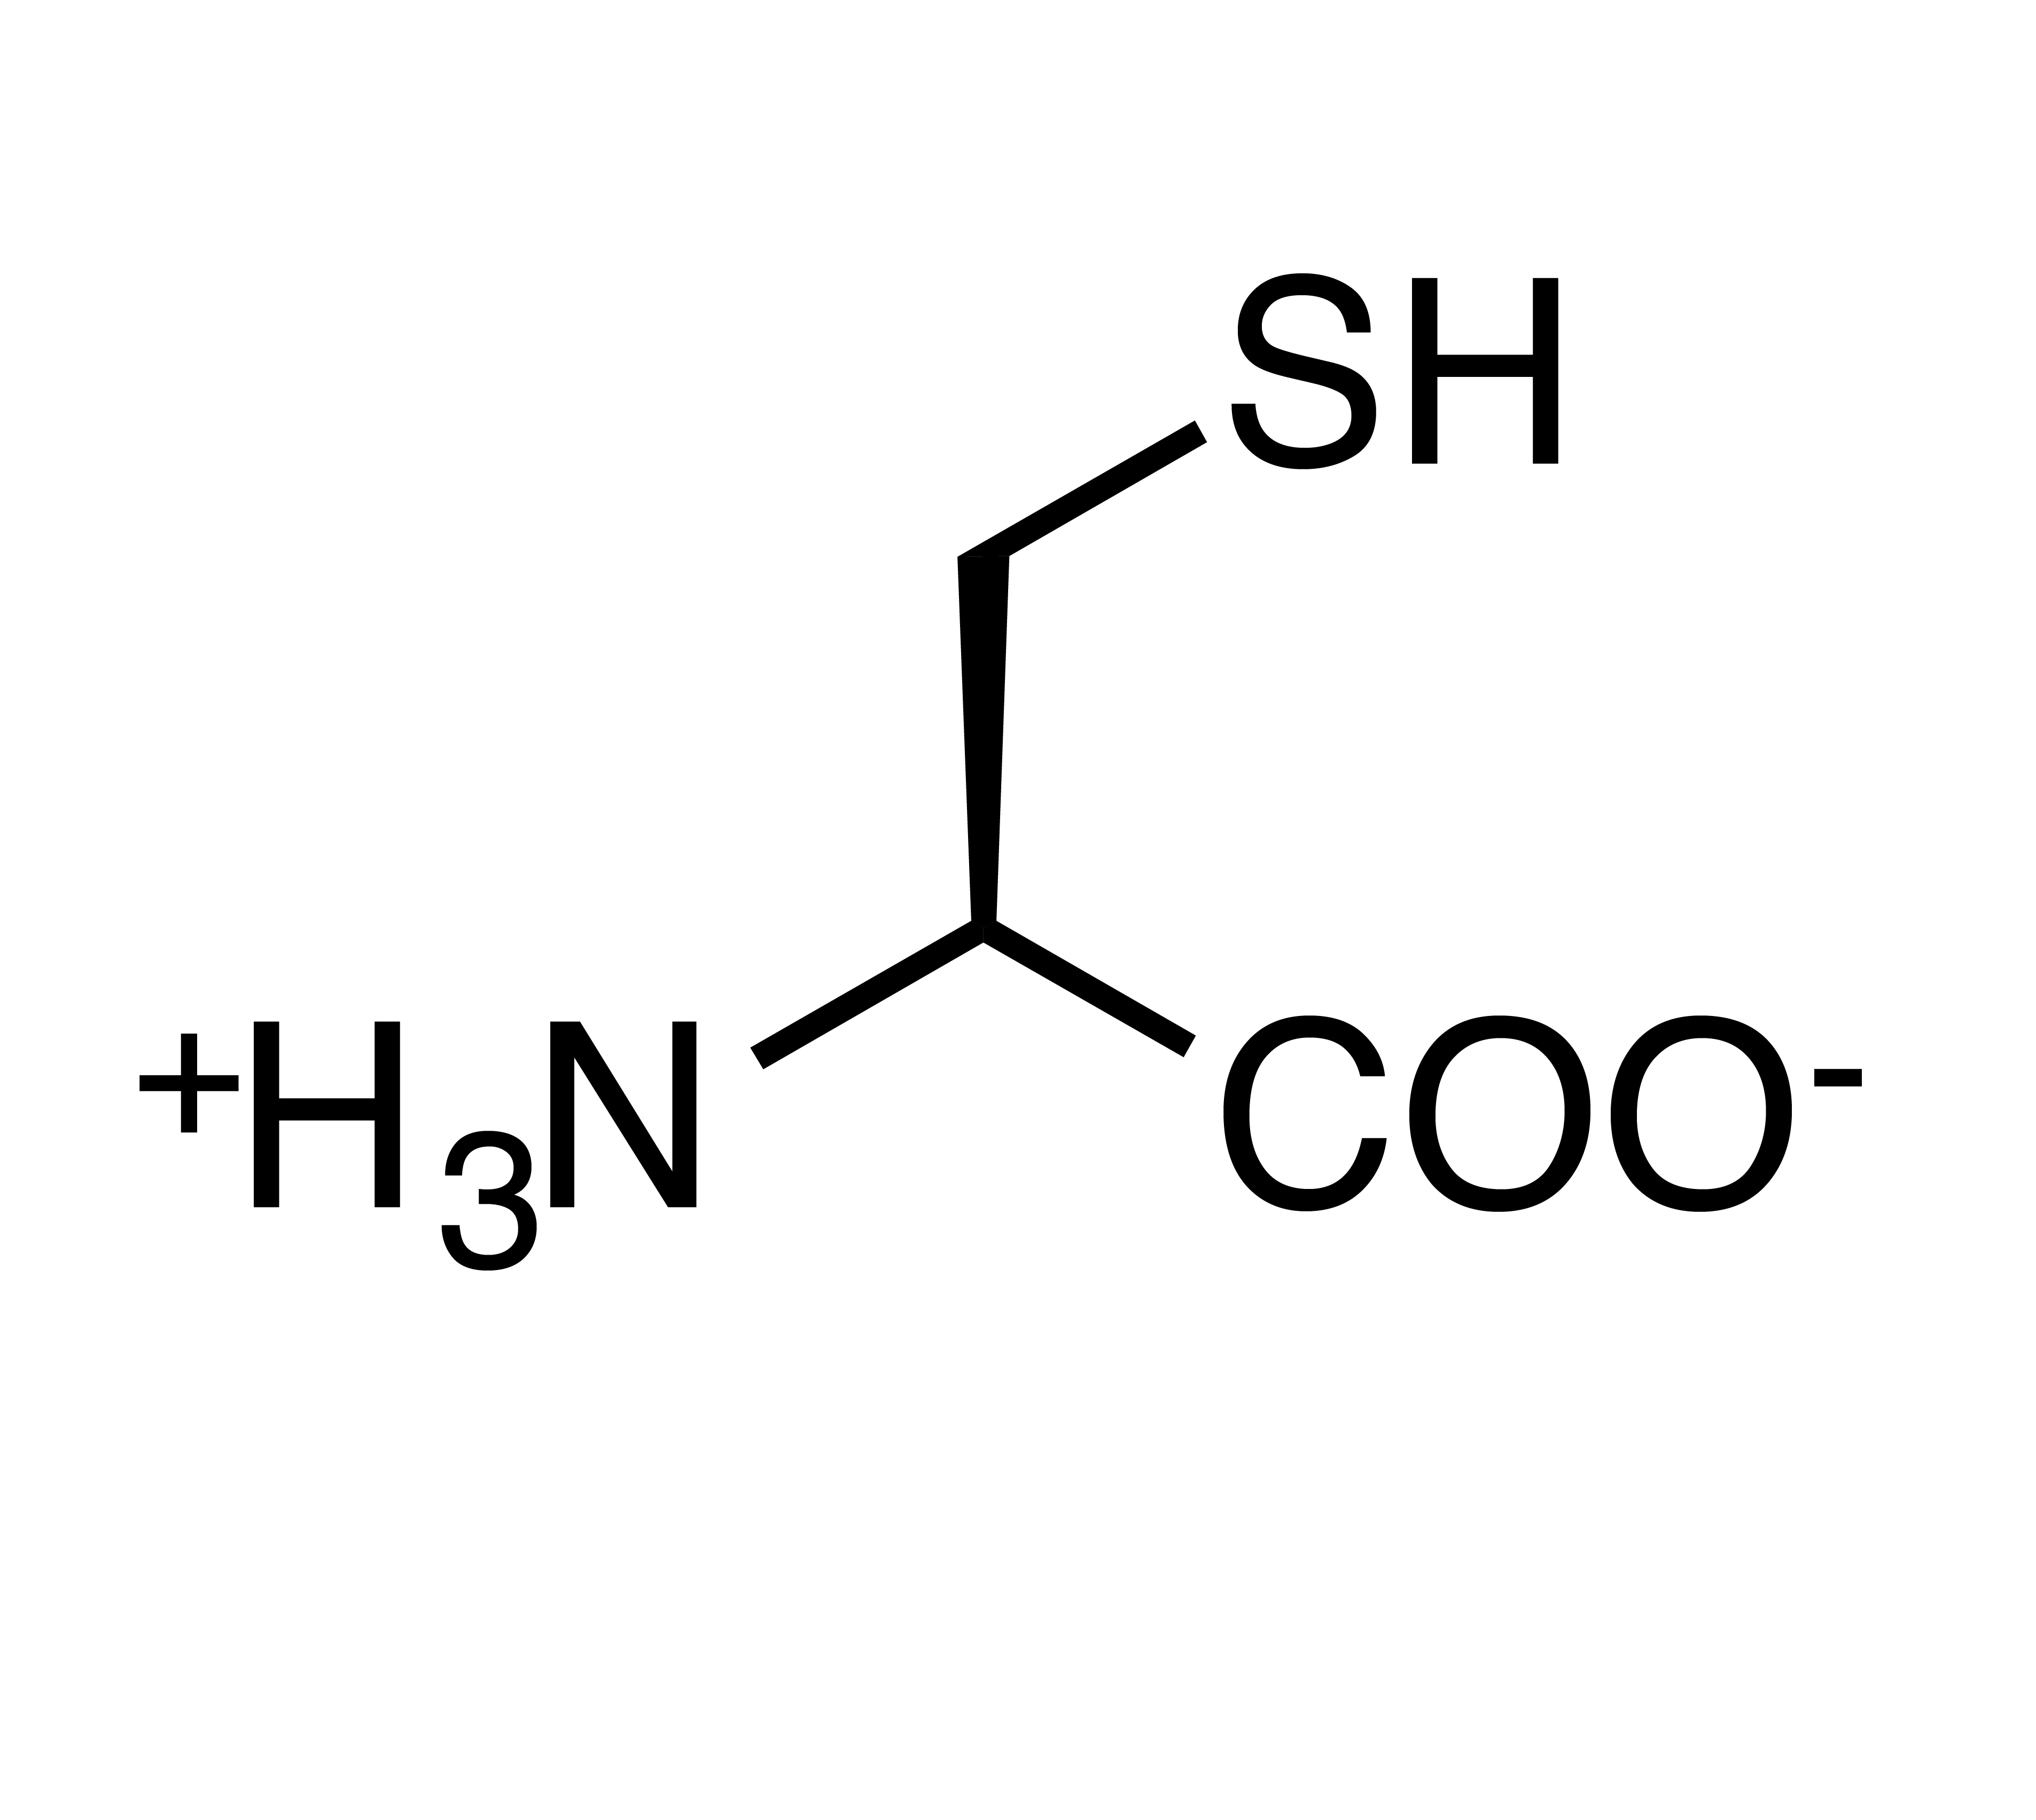

Slide 7
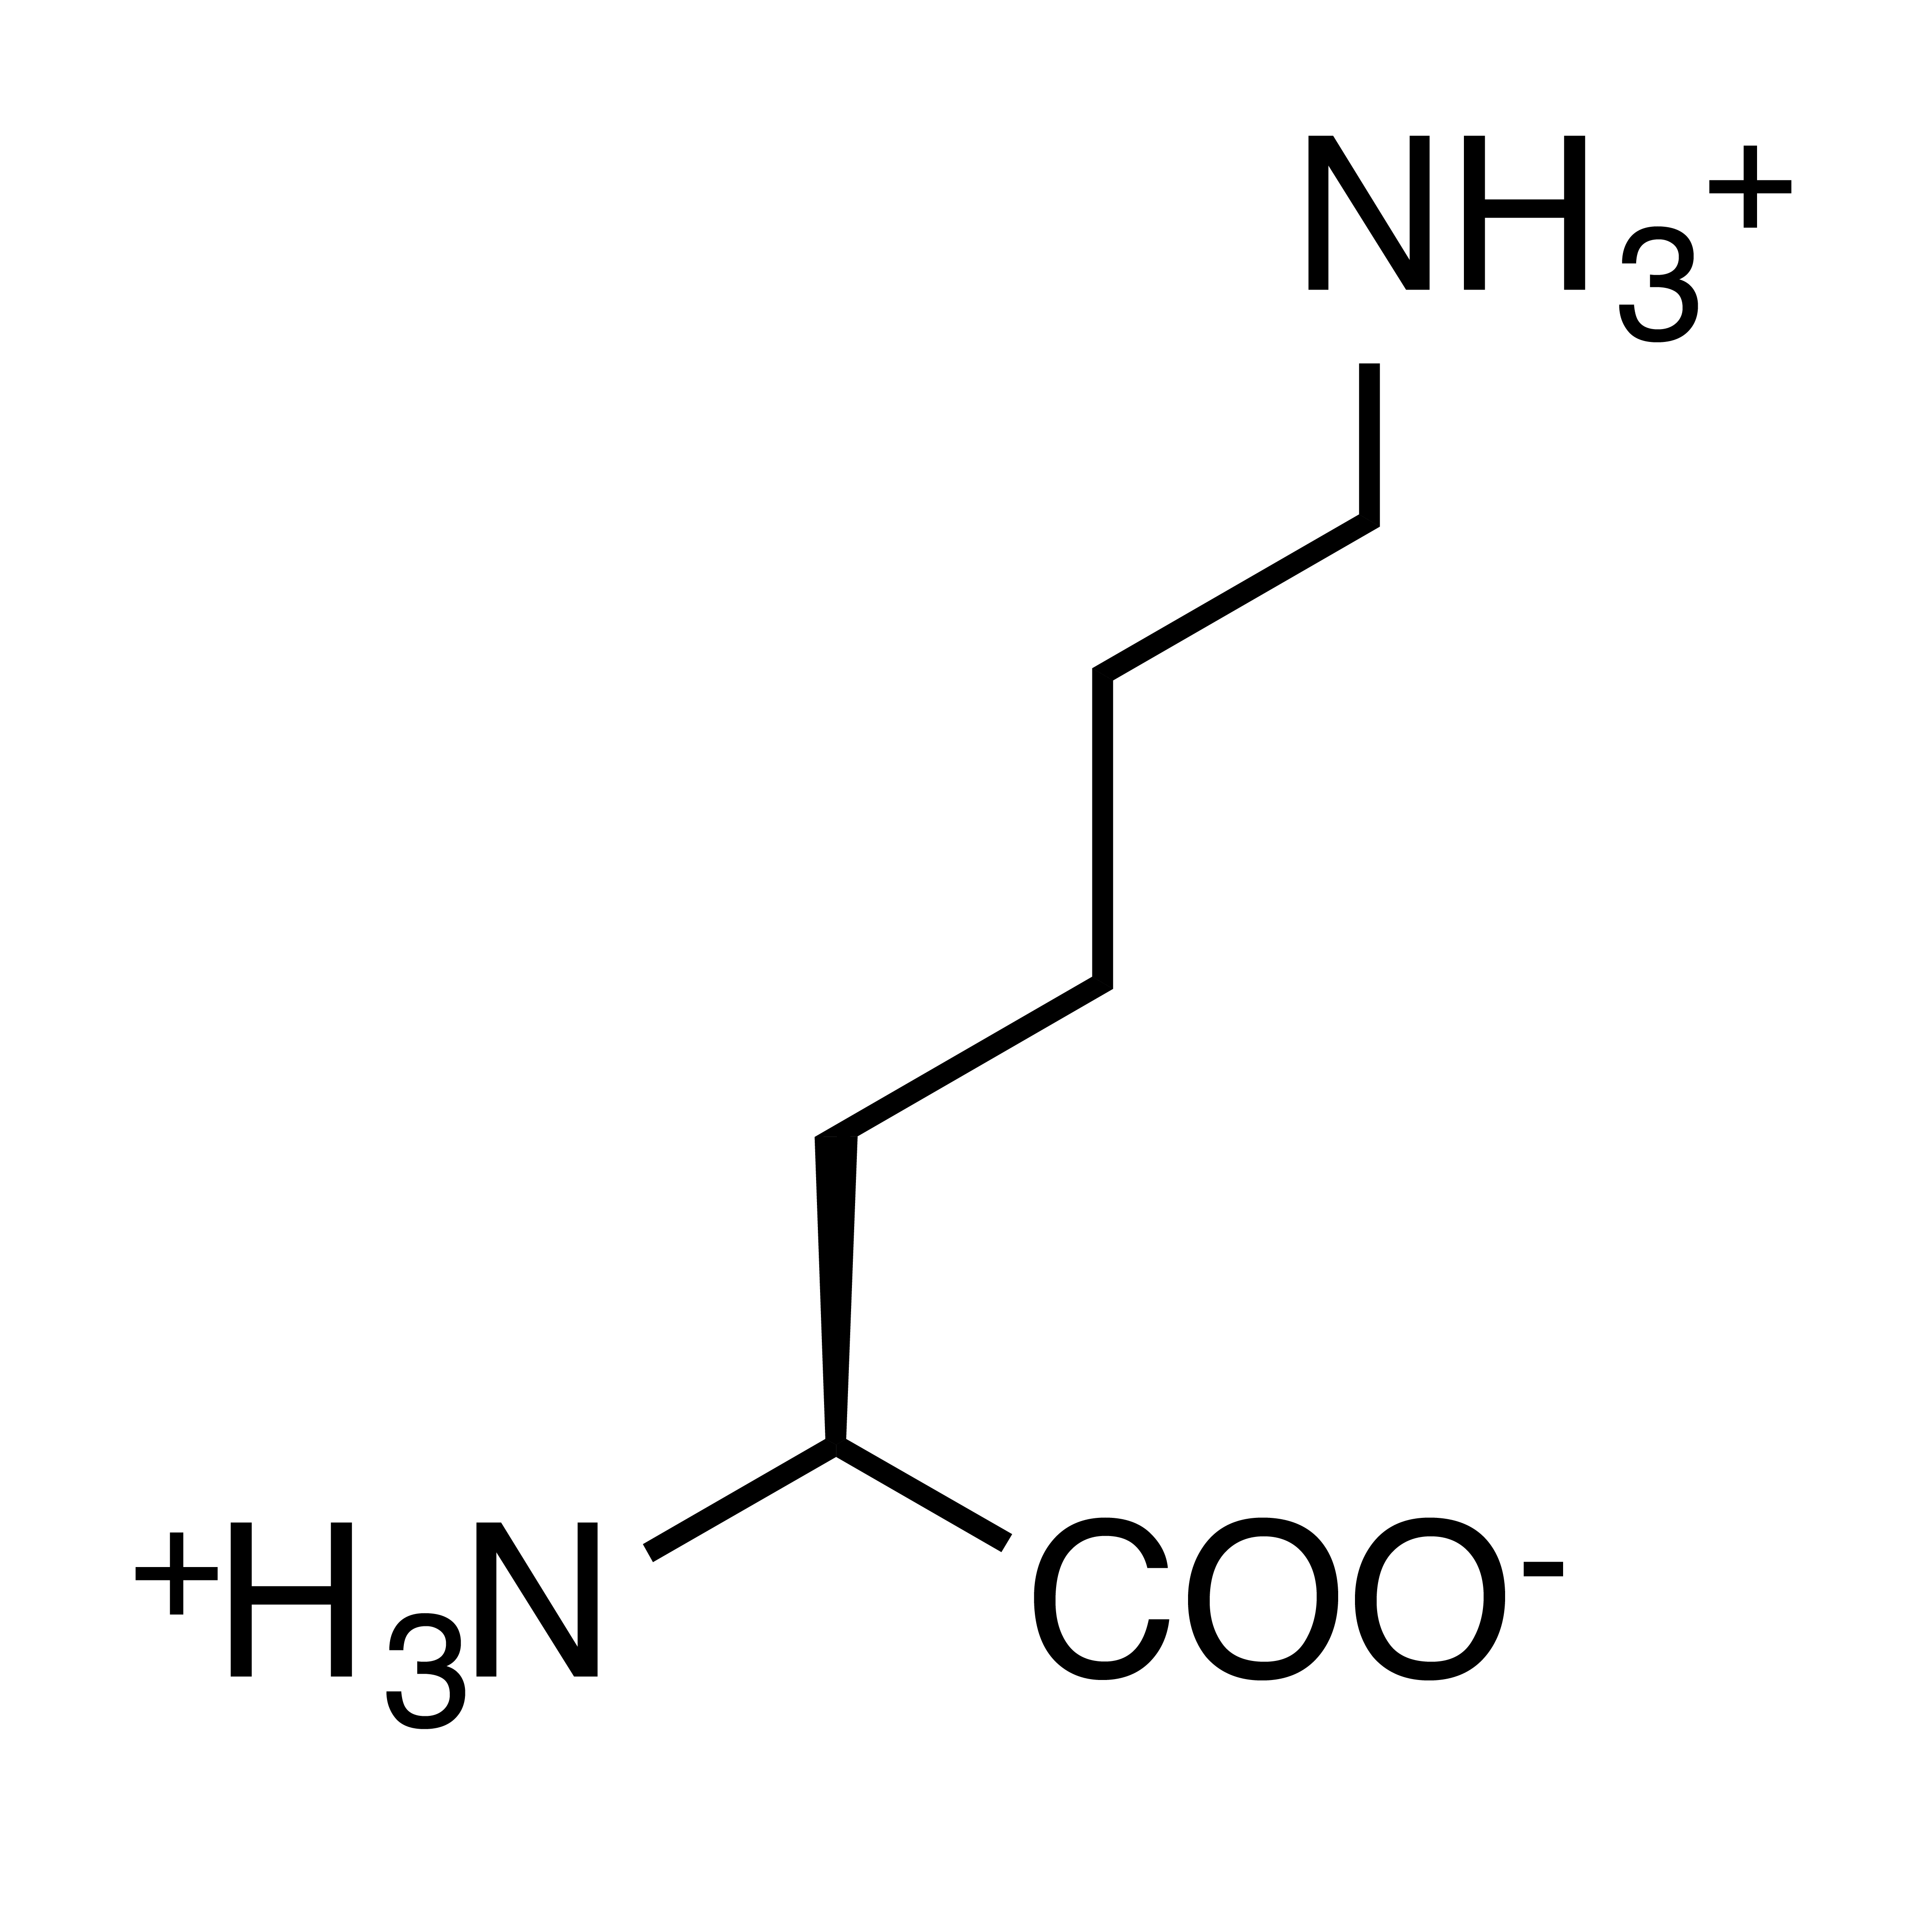
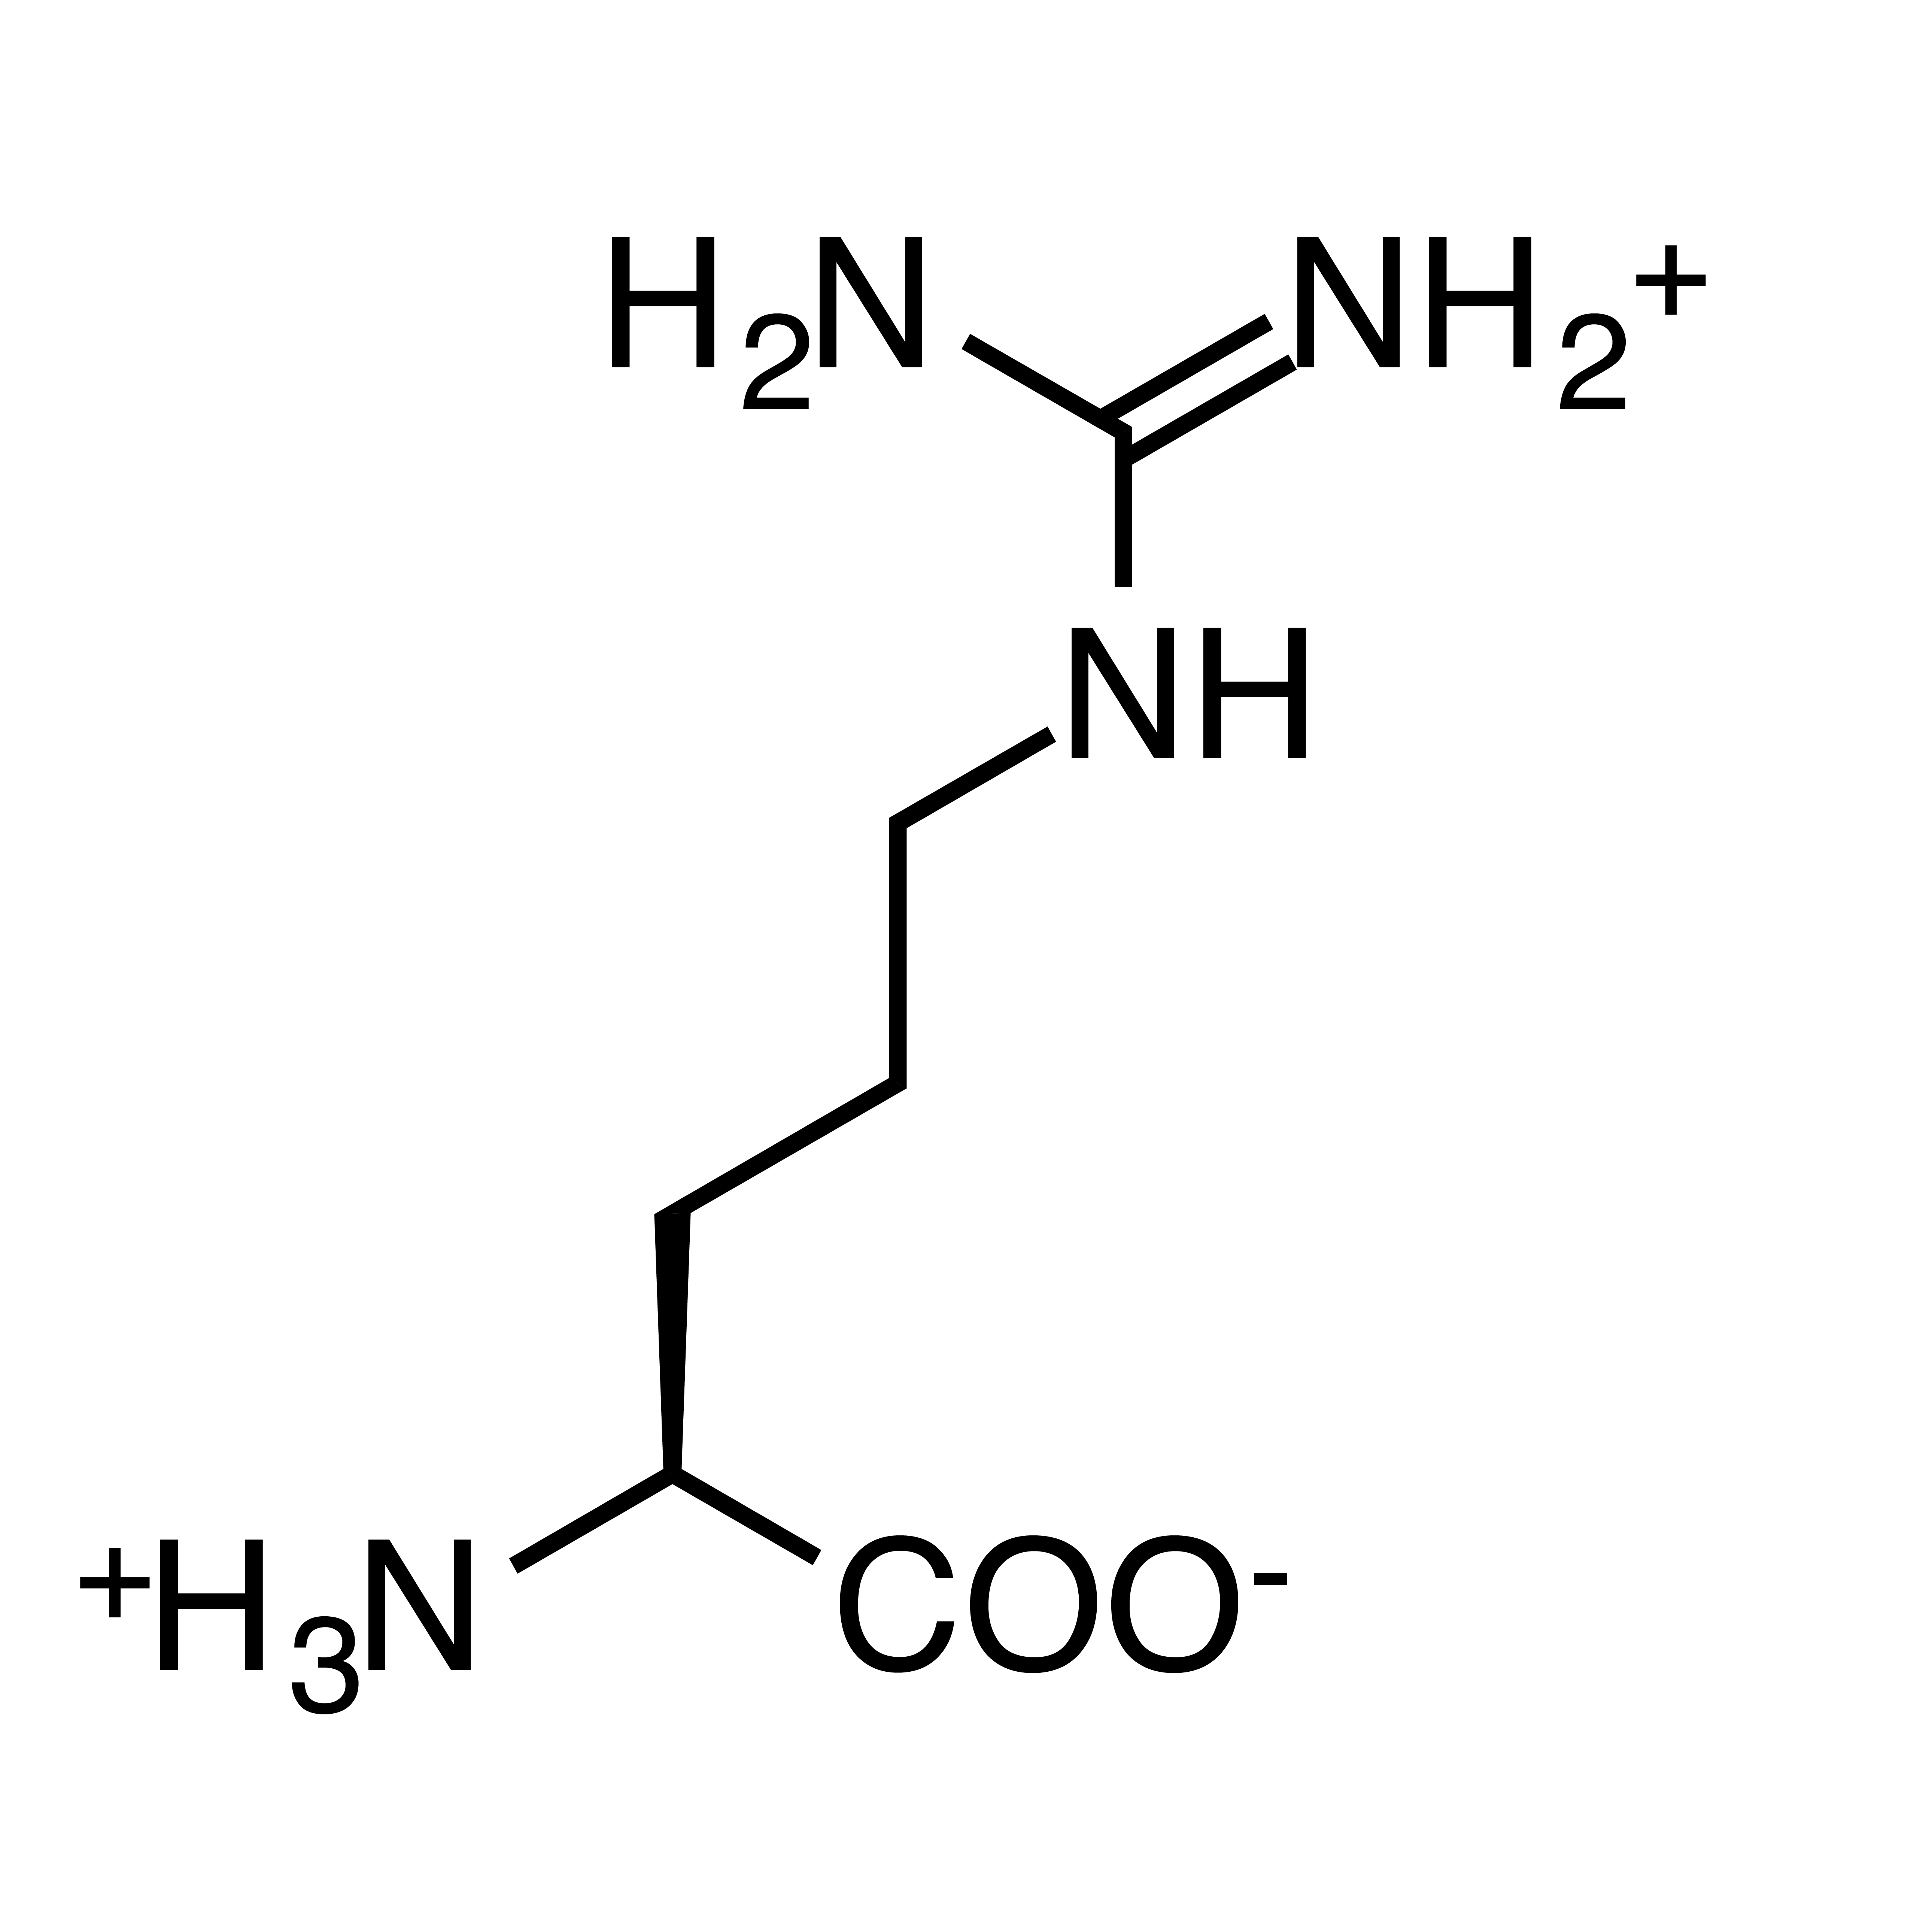

Slide 8
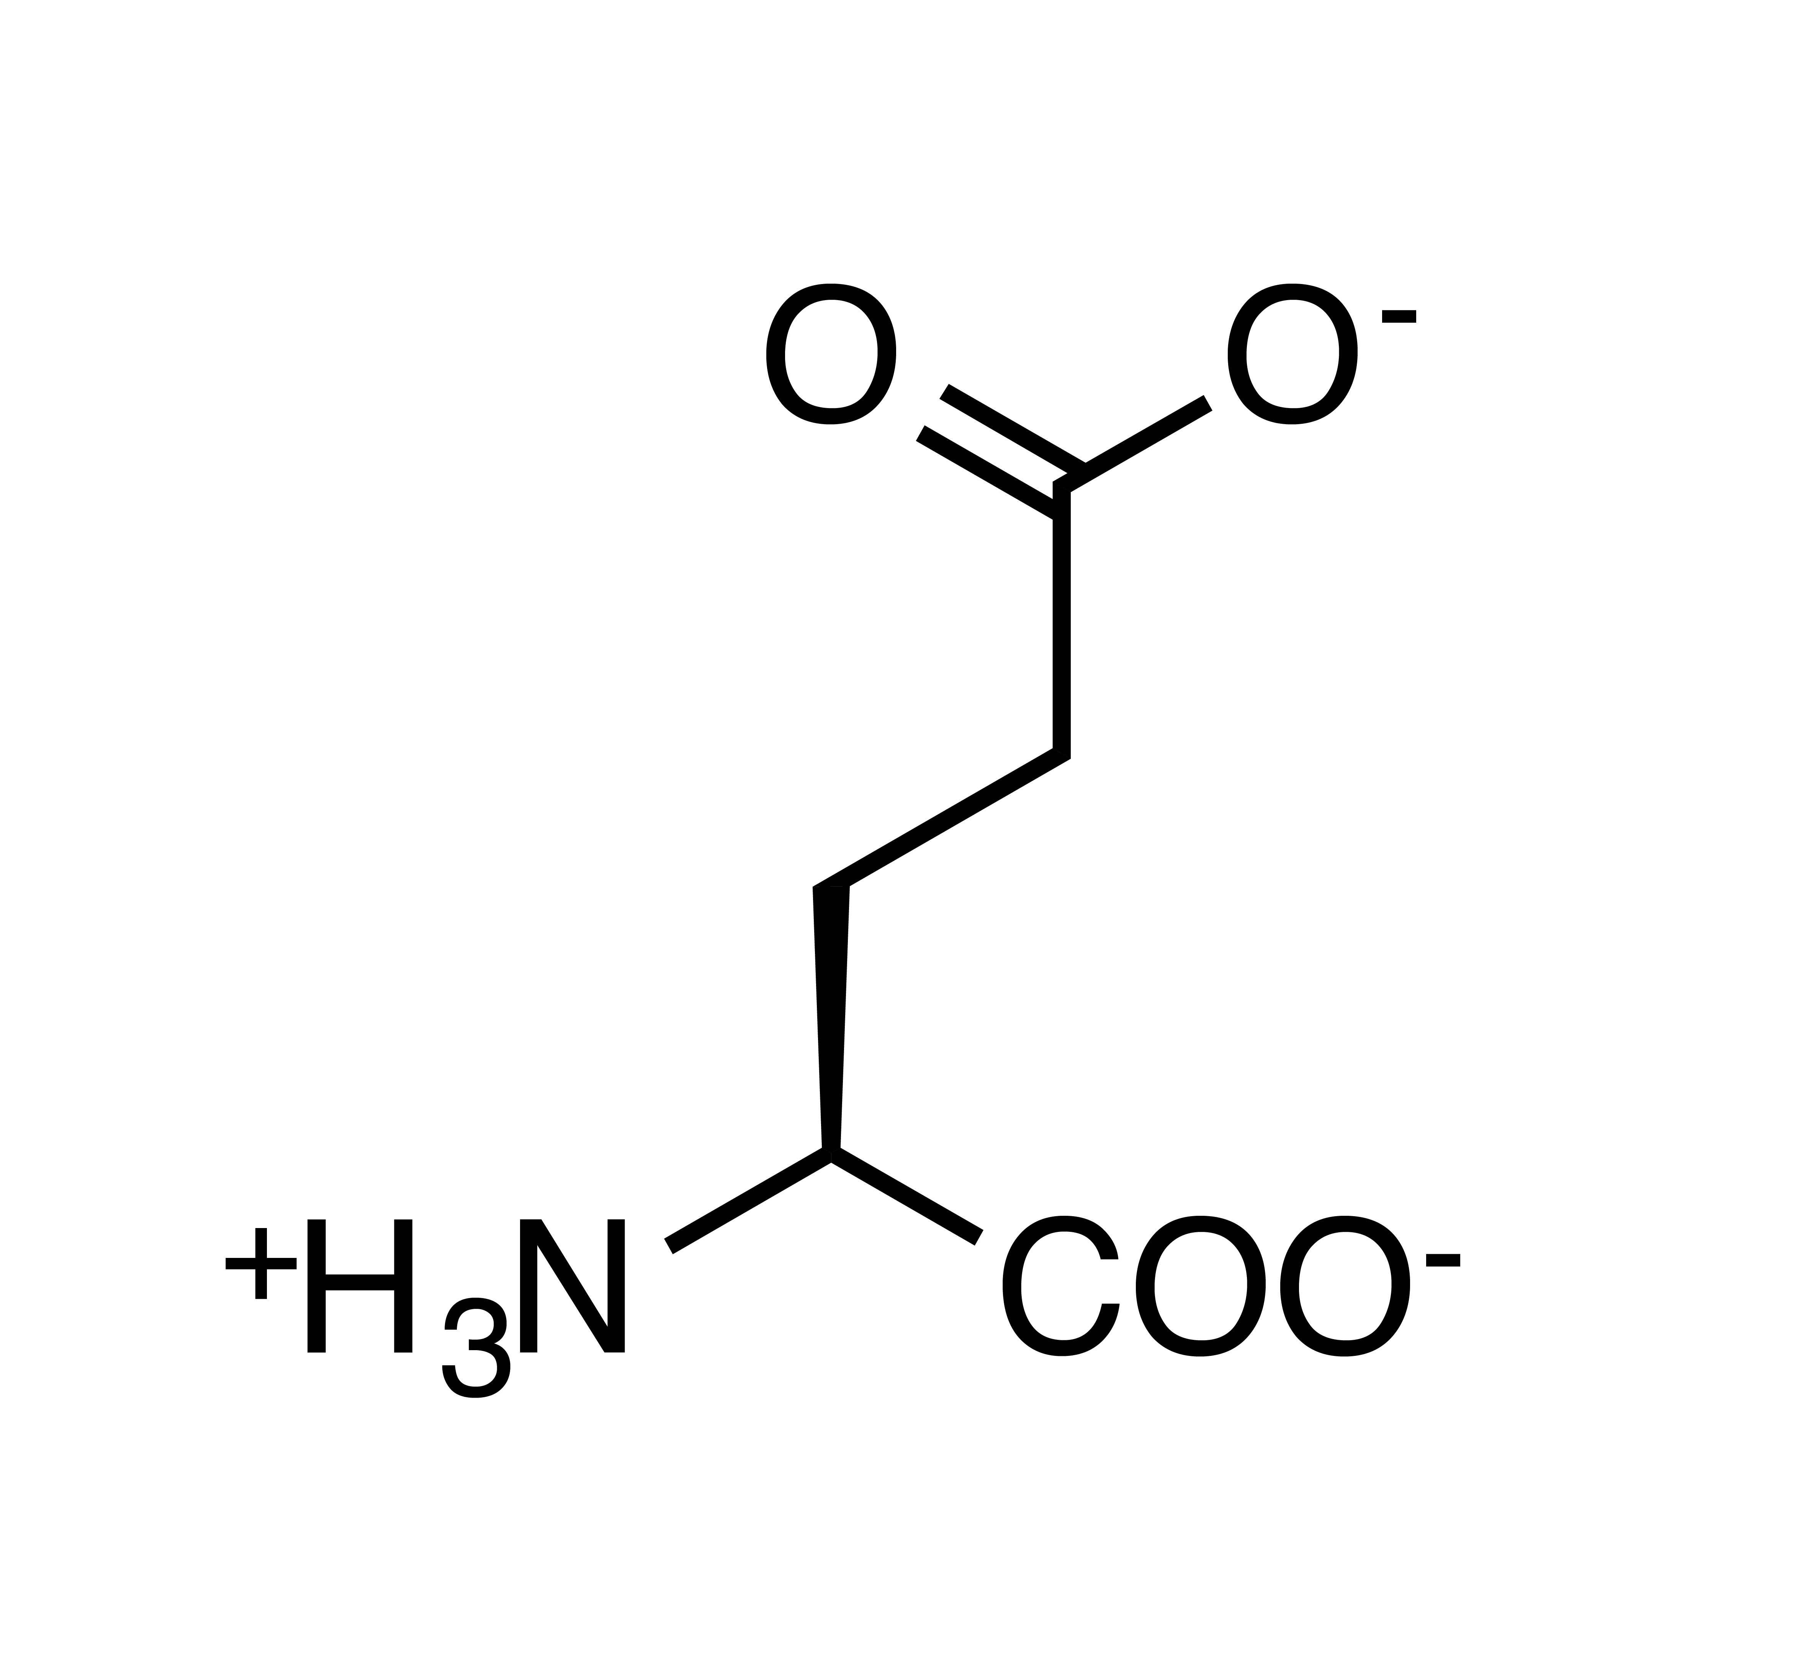
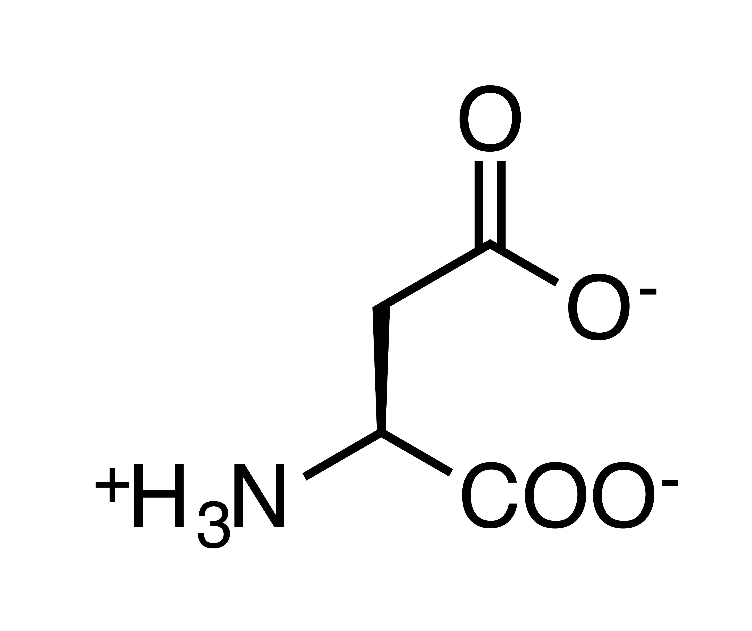

Slide 9
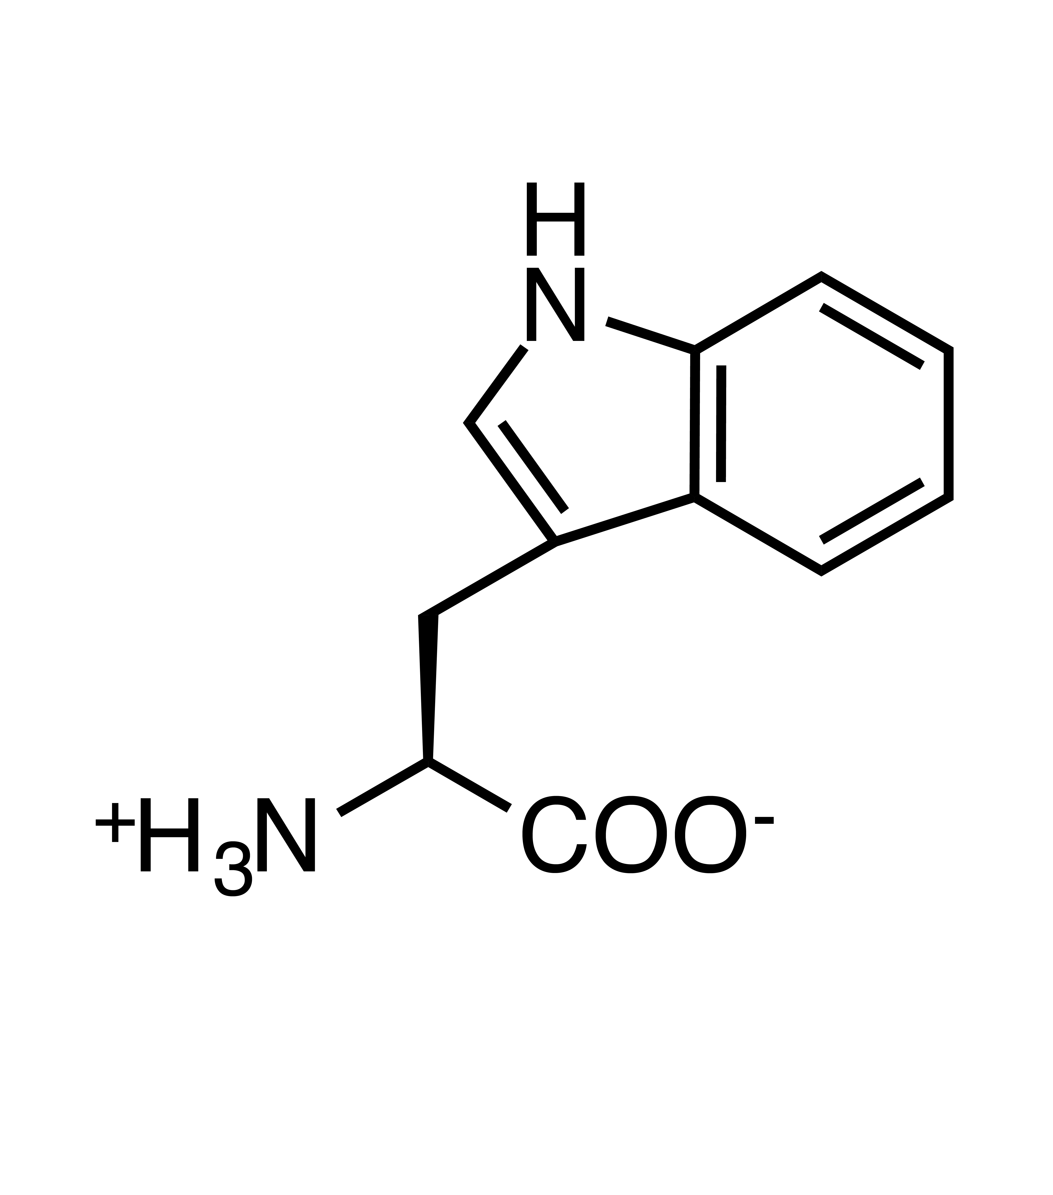
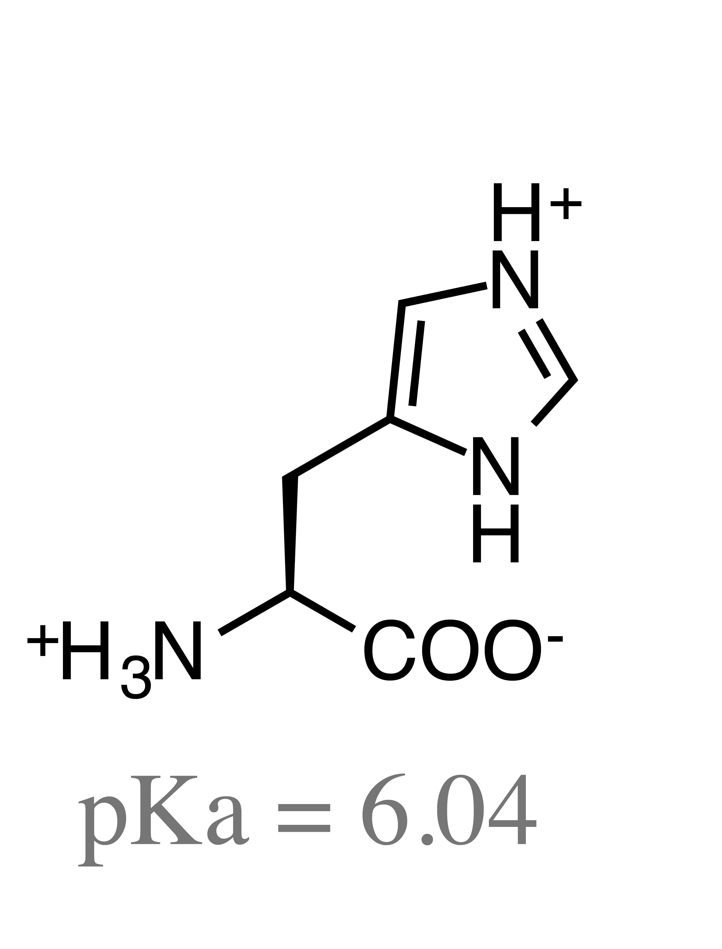
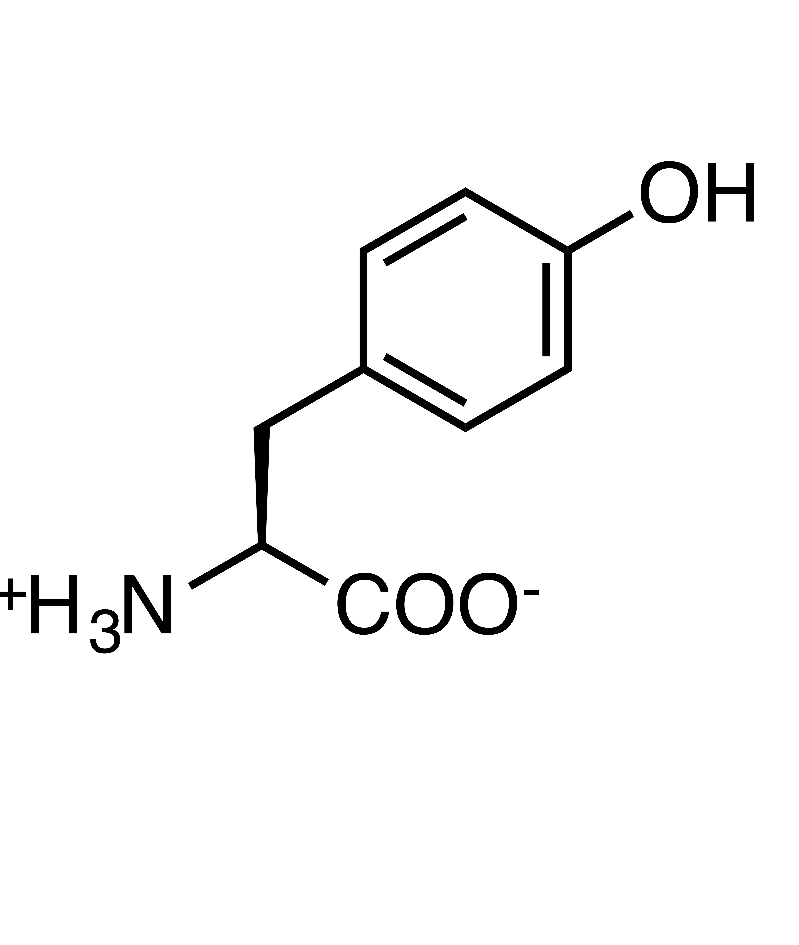
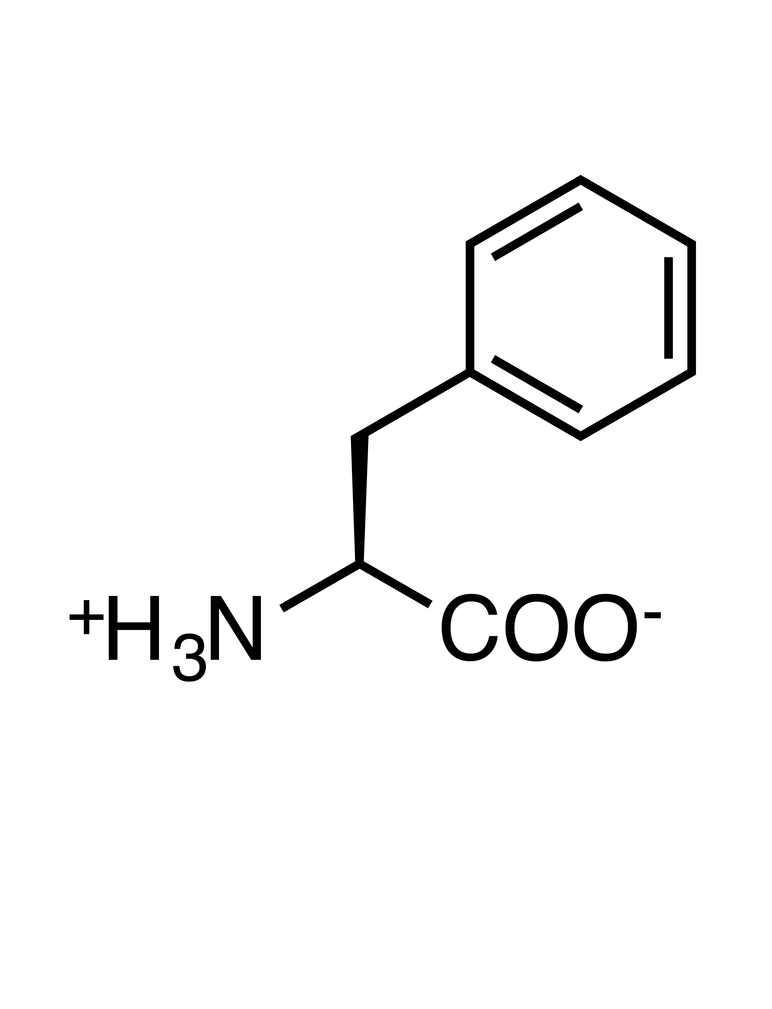

Slide 10
Histidine (protonation state)
pH < pK_{a}
pH > pK_{a}
pKa=6.05

Slide 11
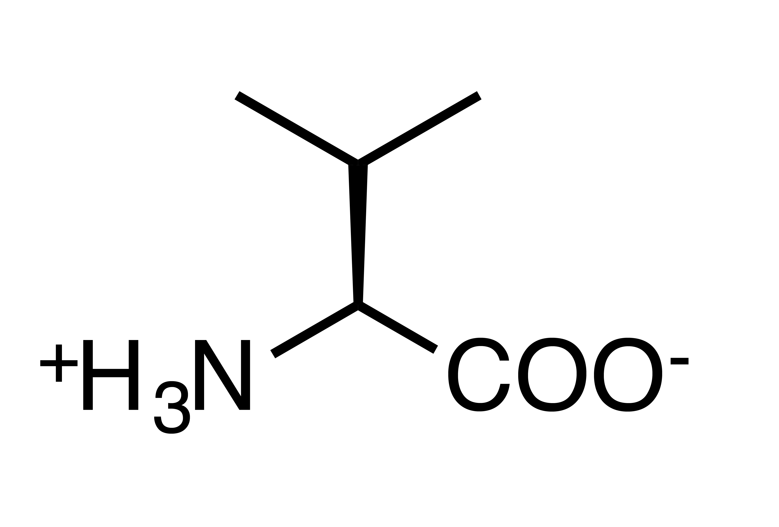
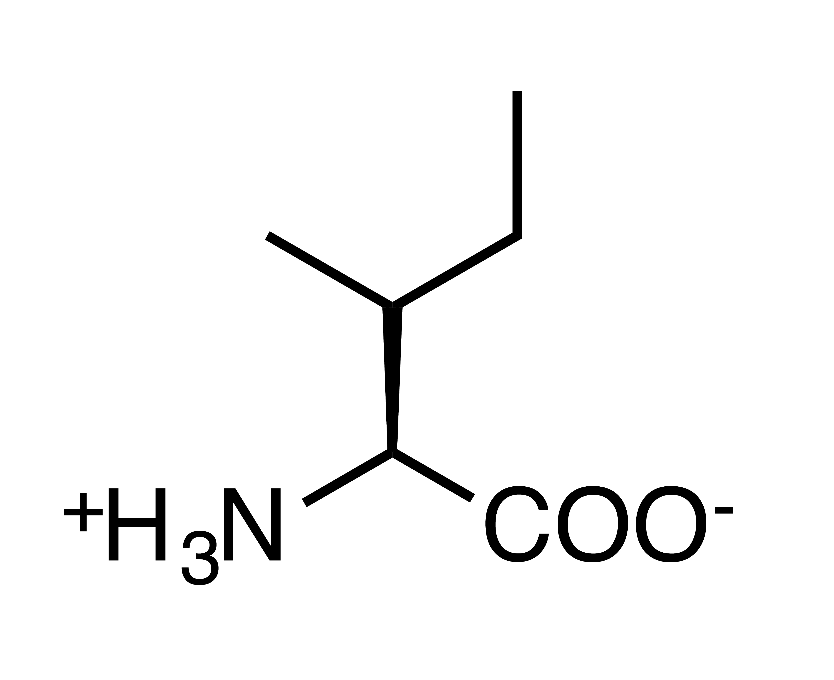
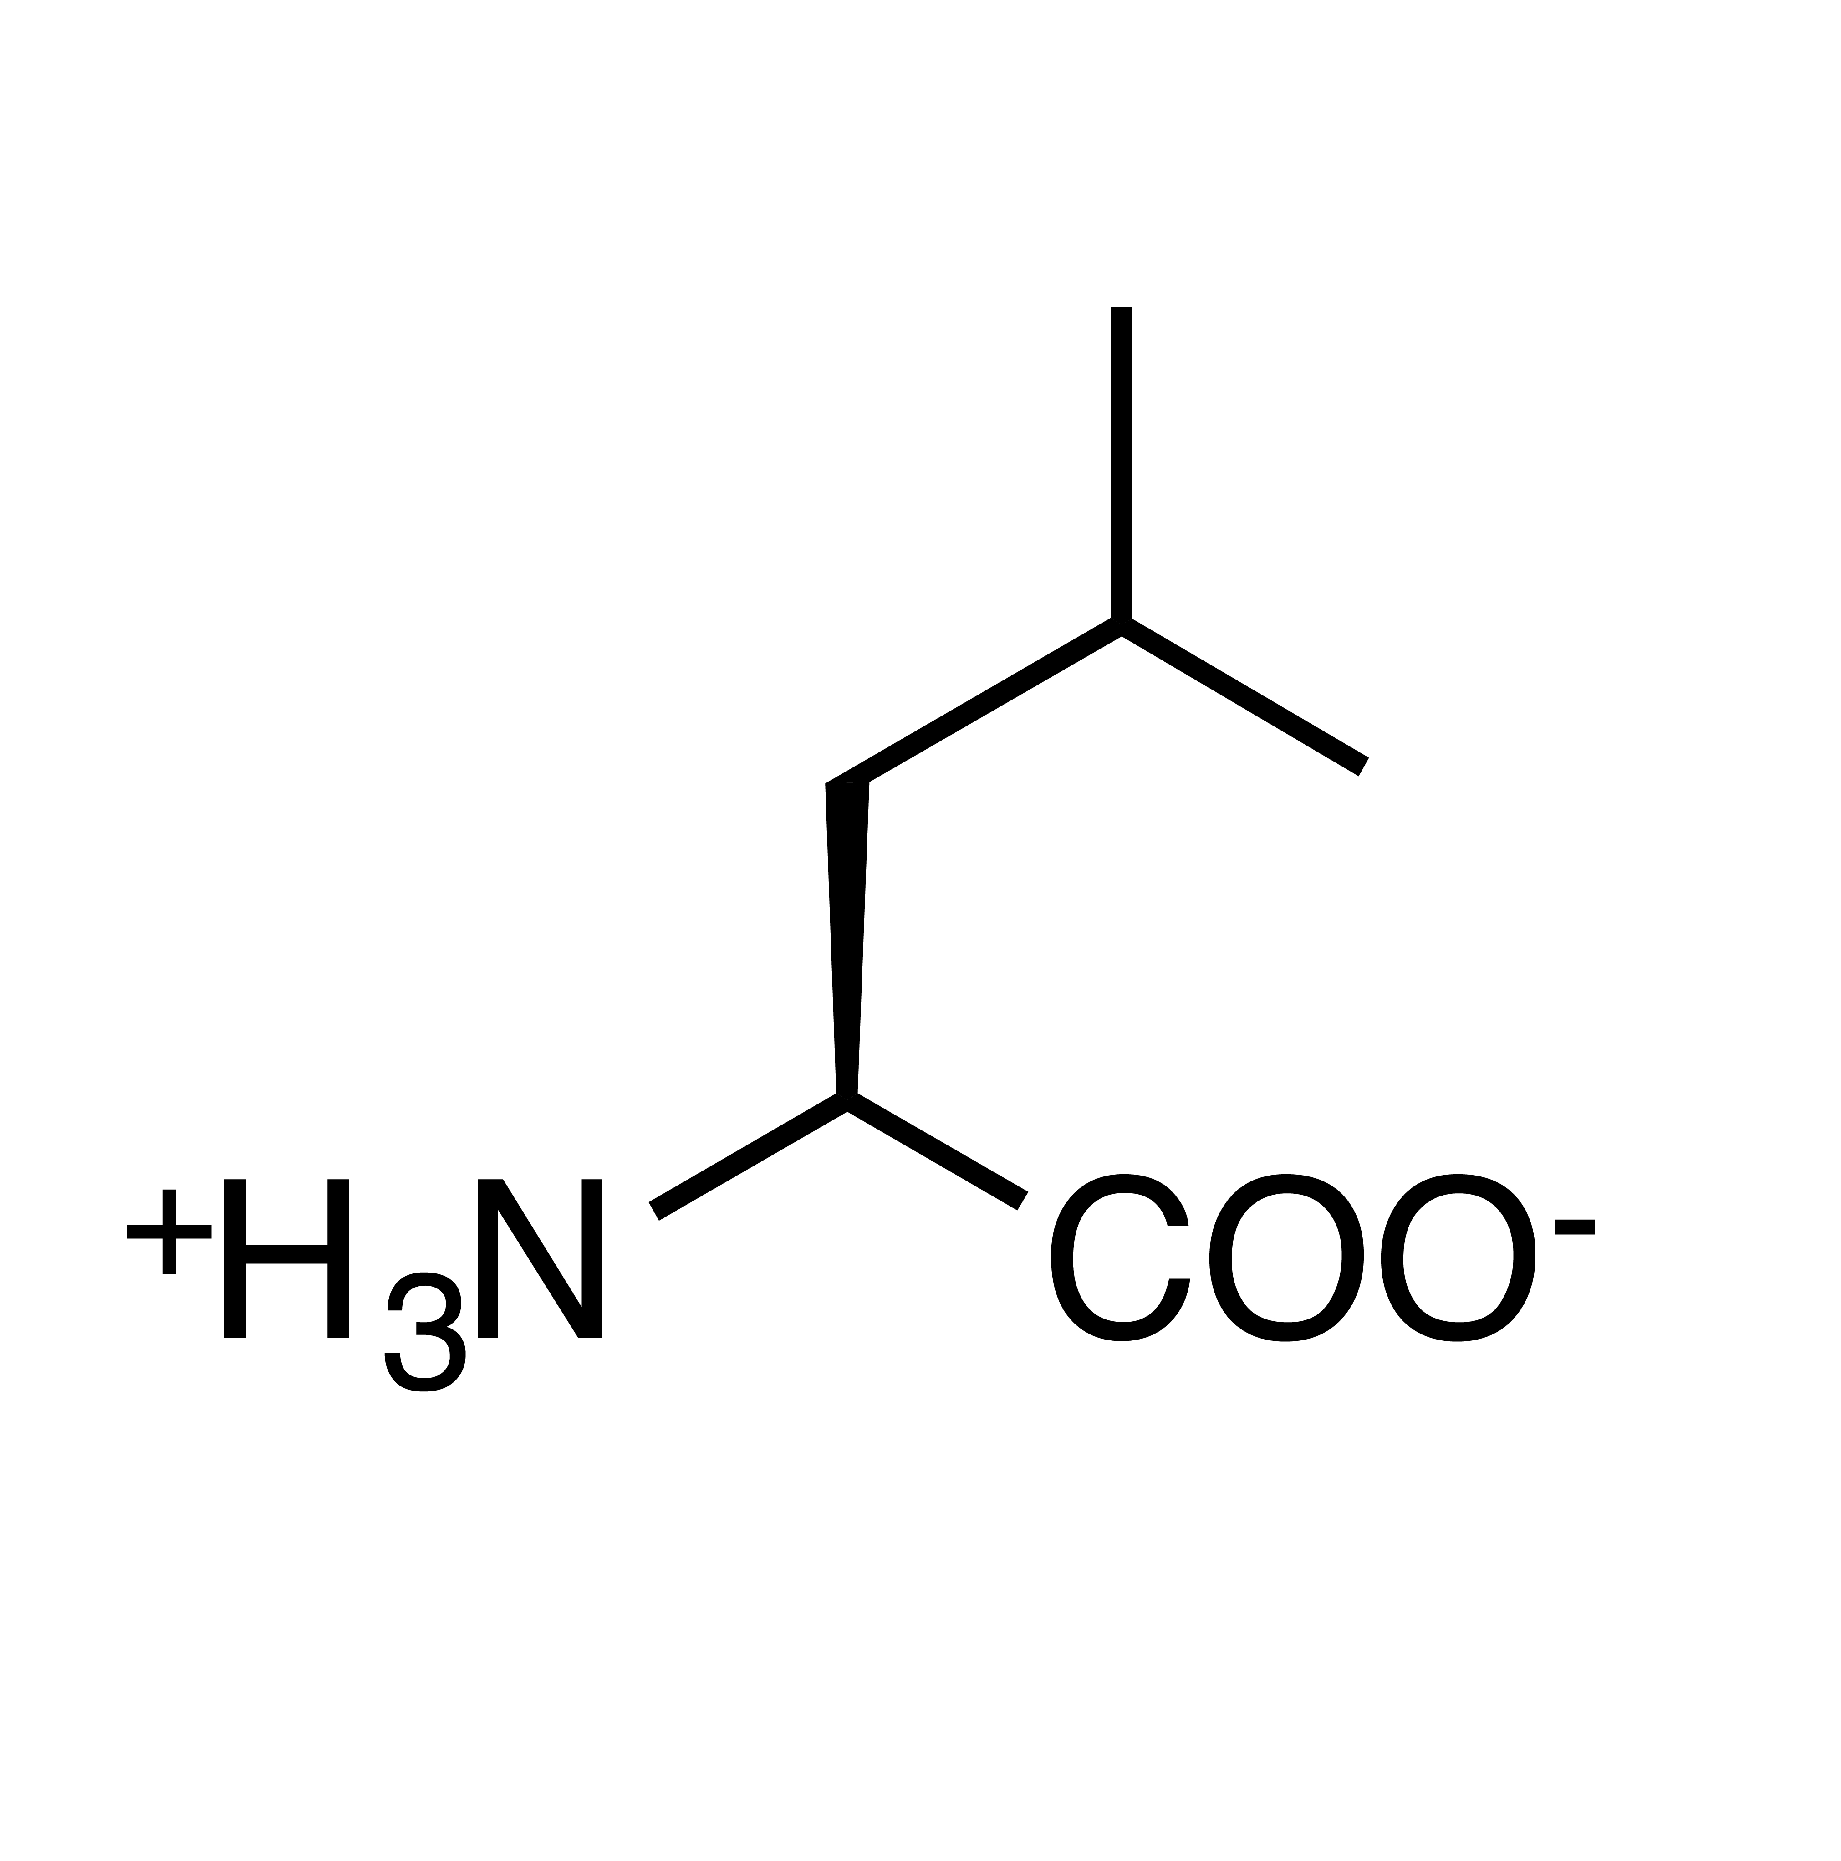
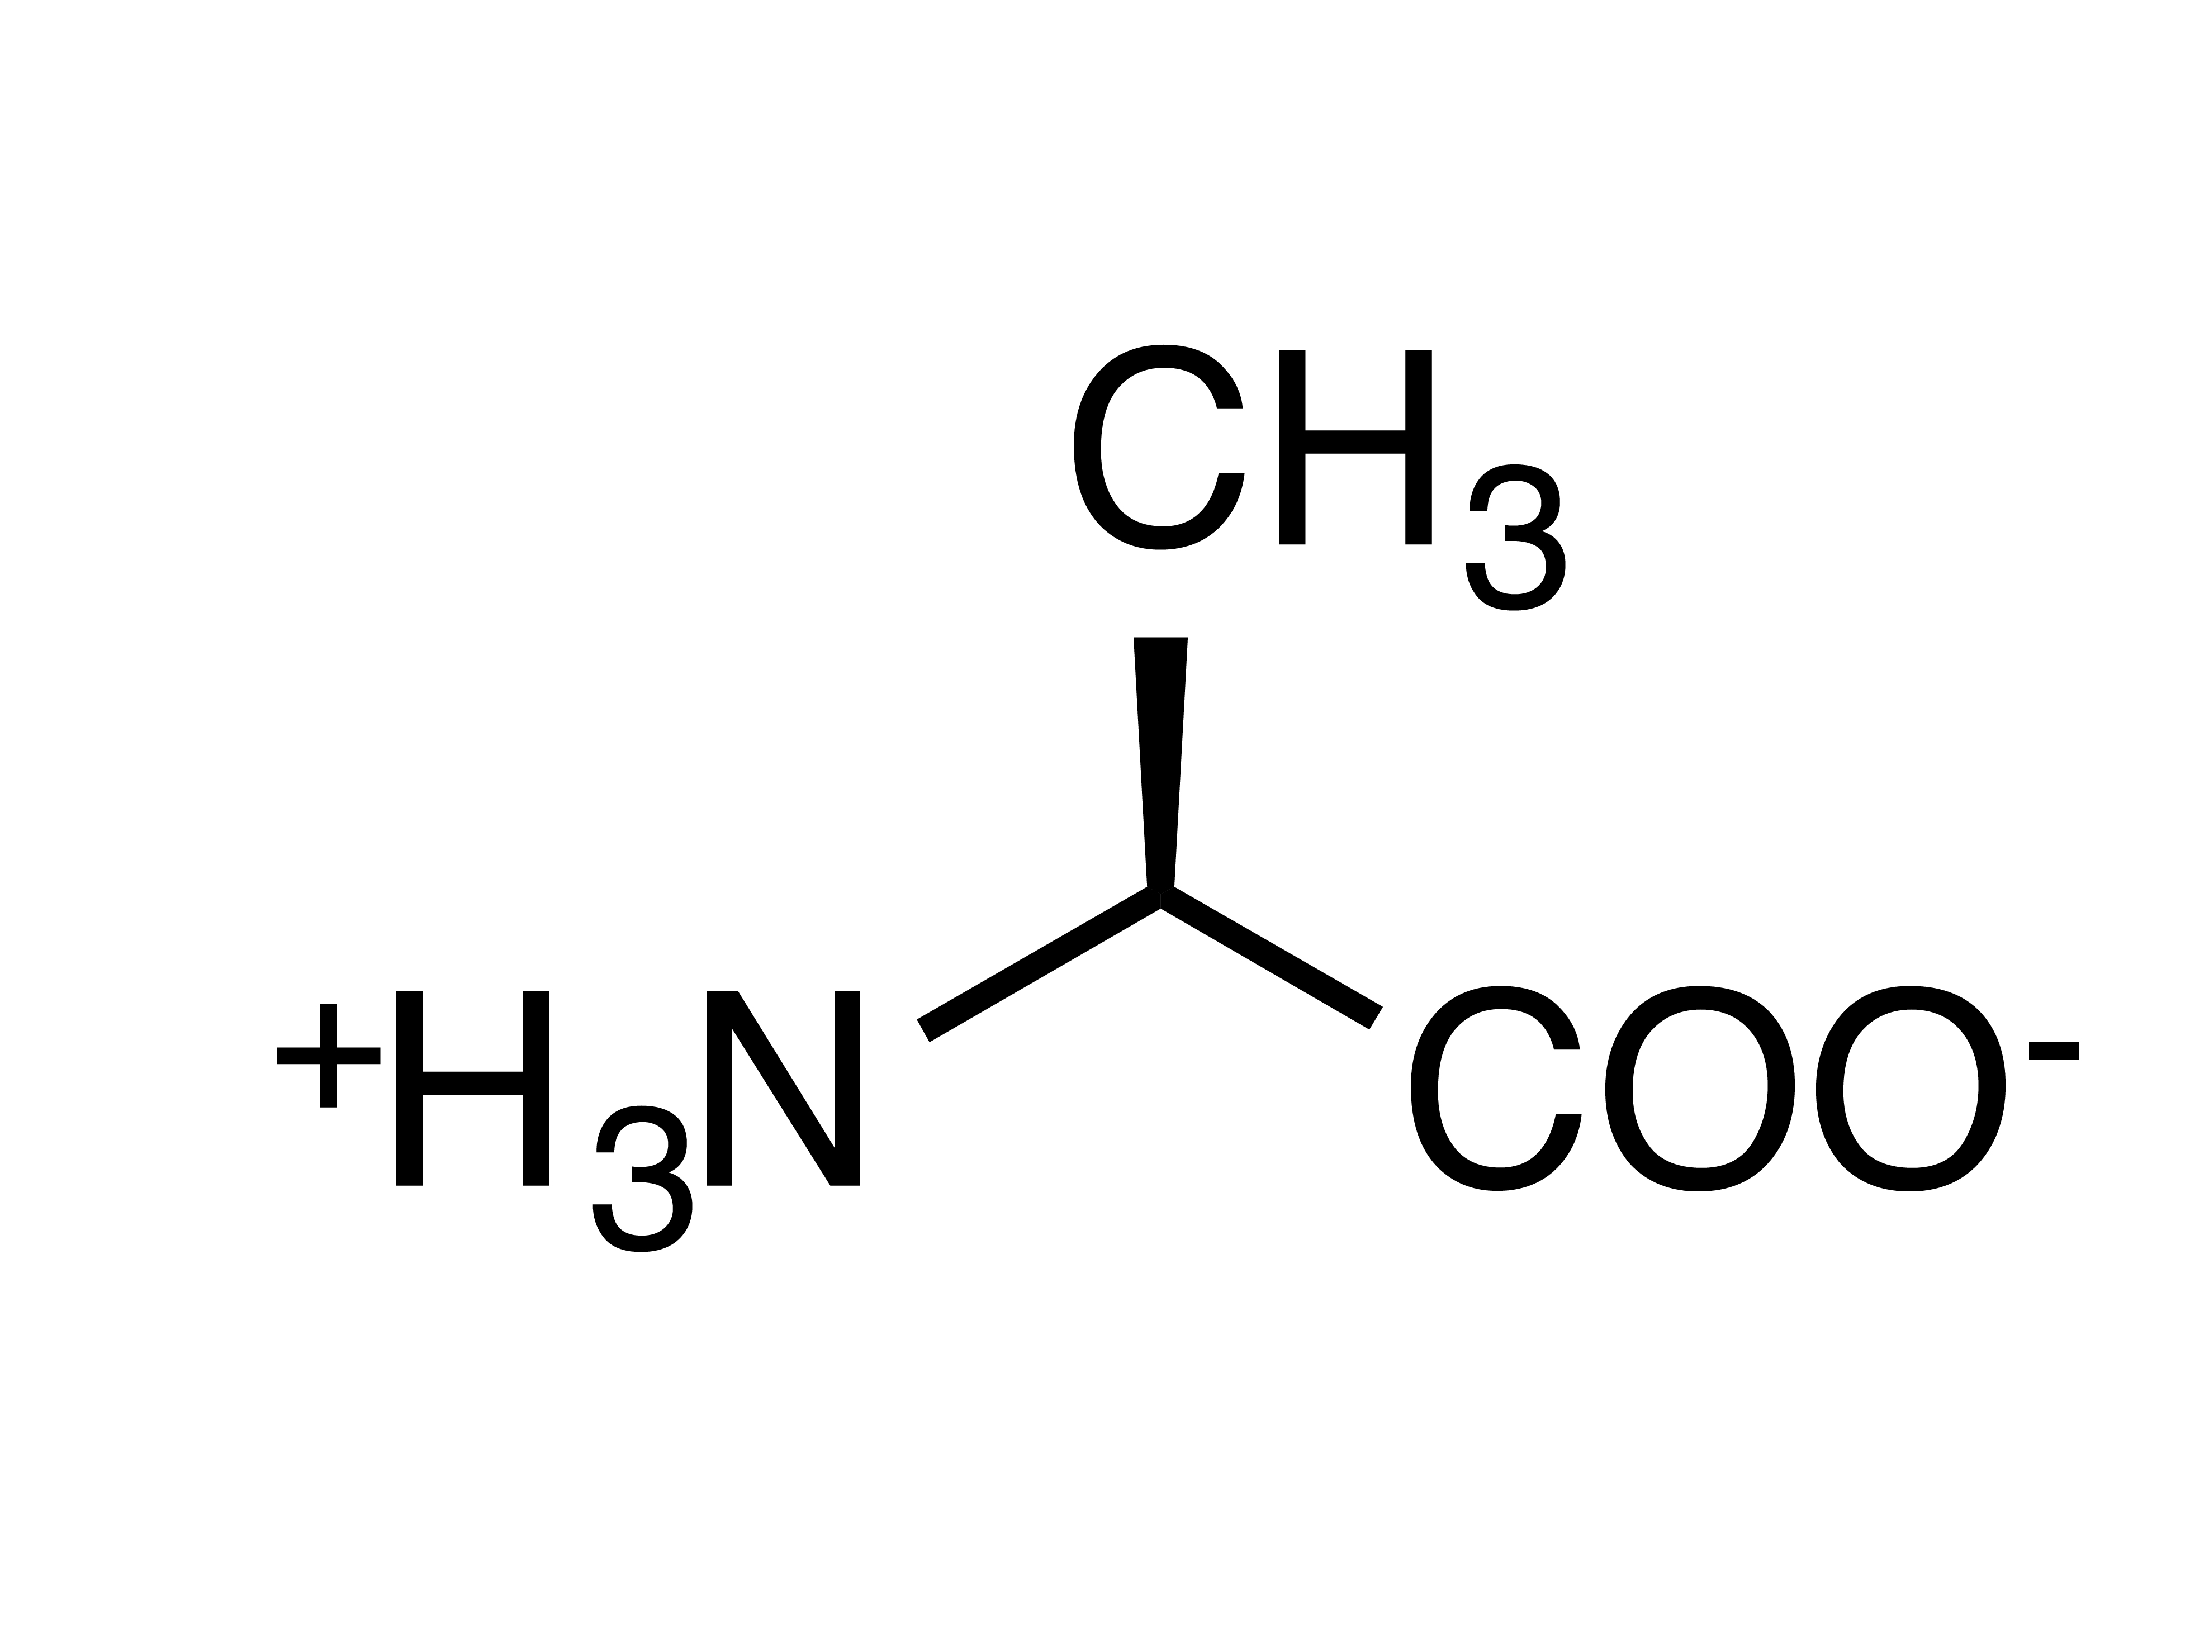

Slide 12
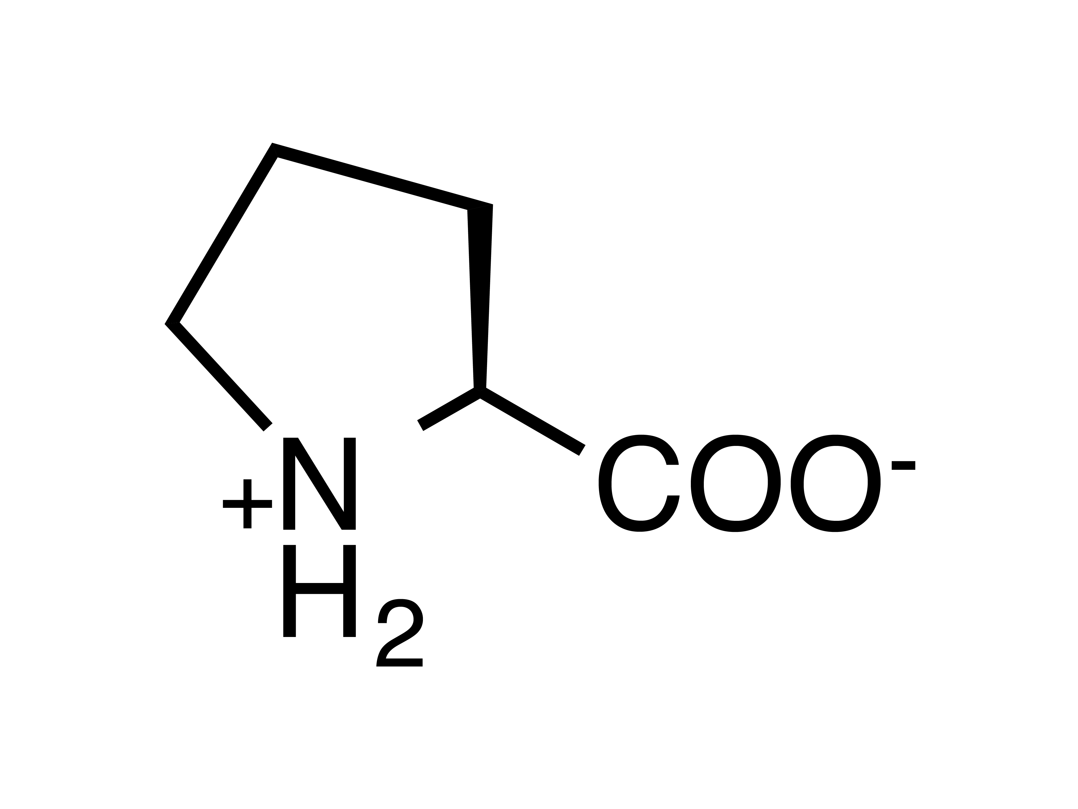

Slide 13
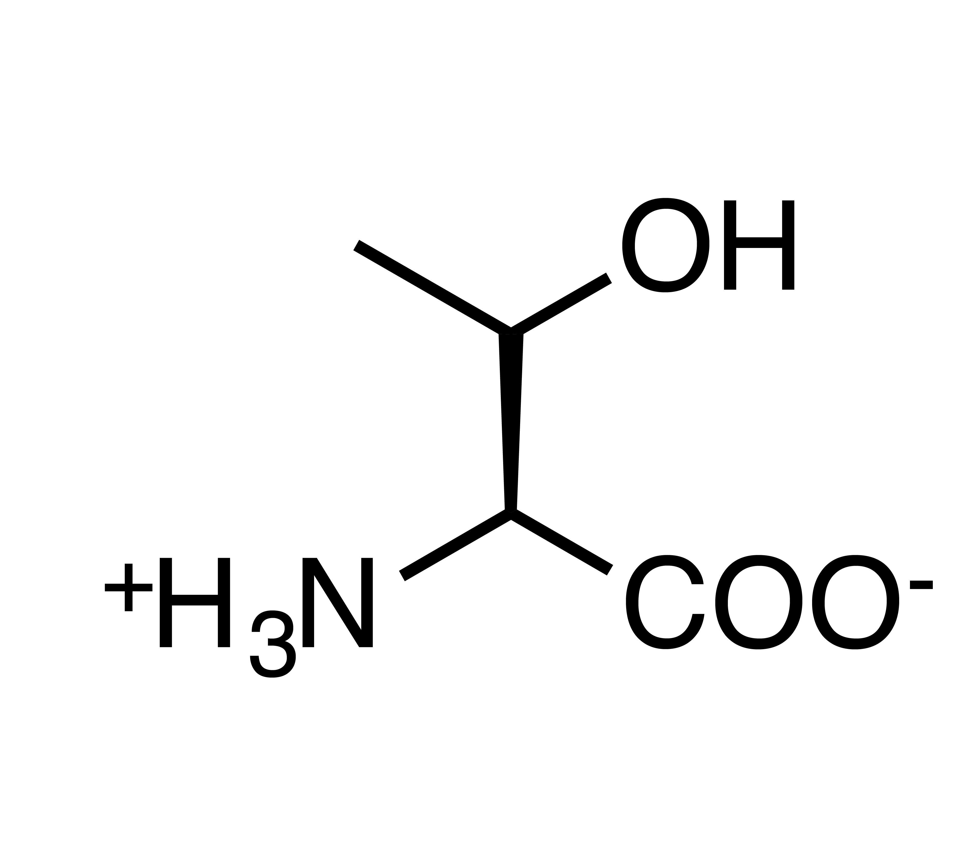
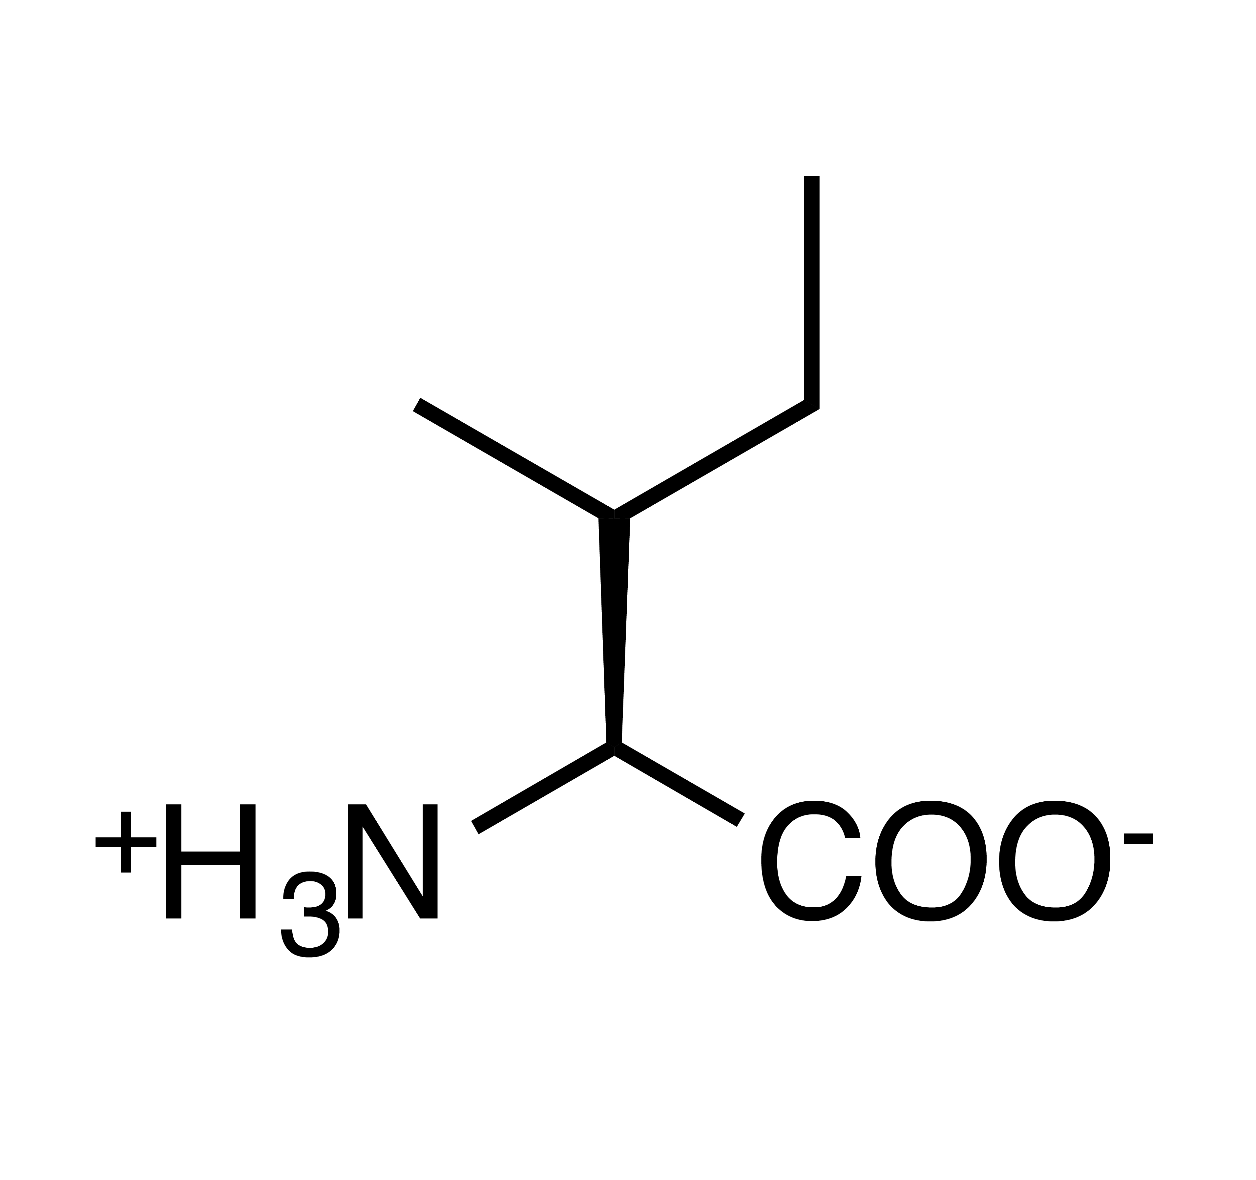
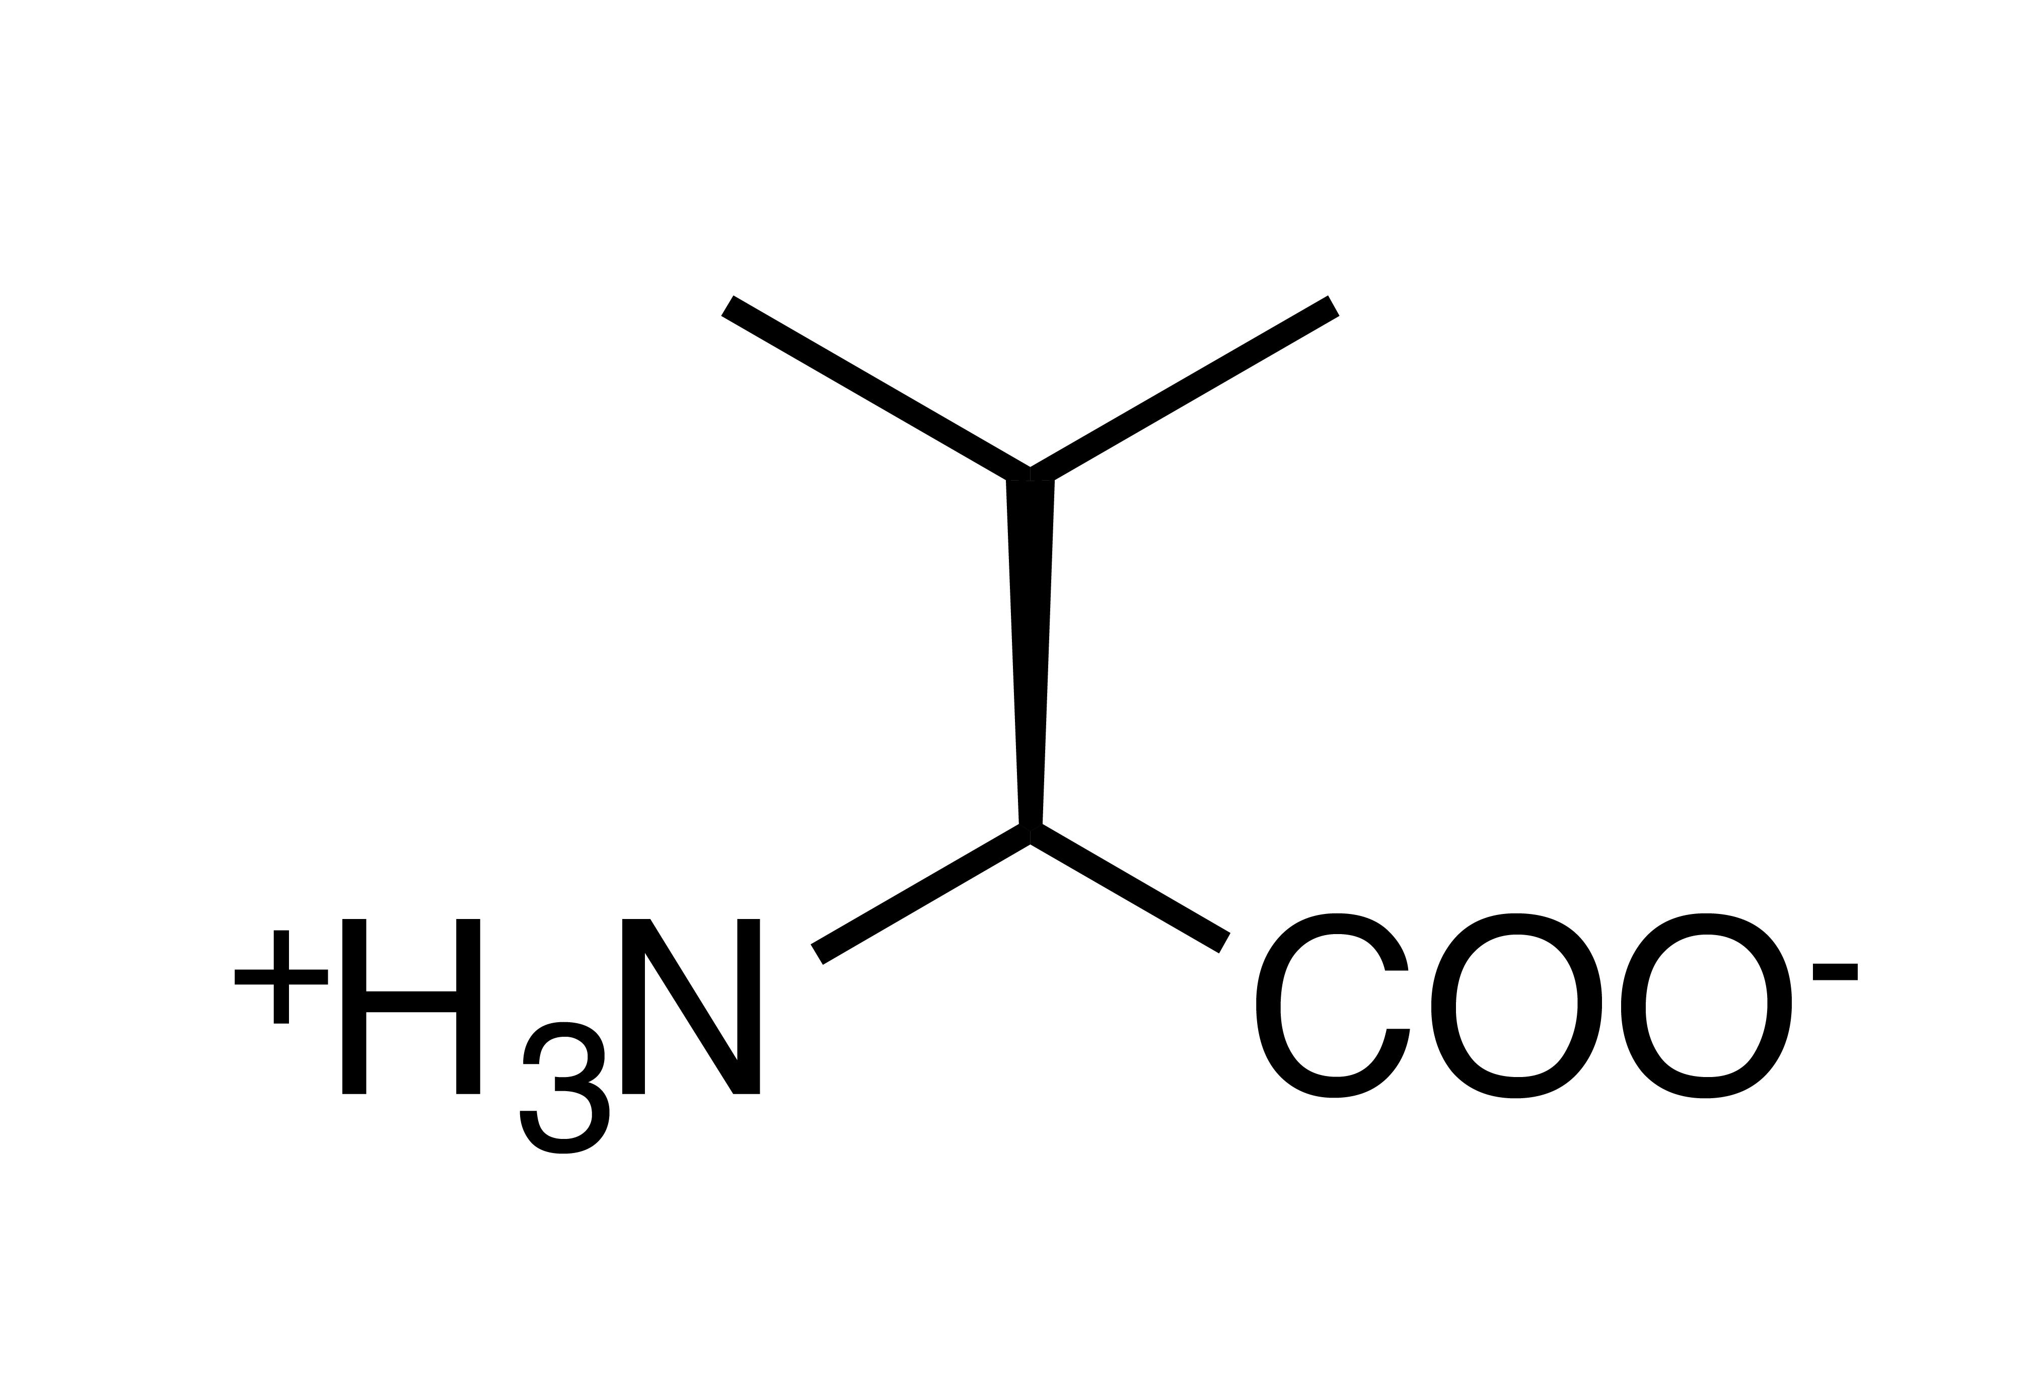

Slide 14
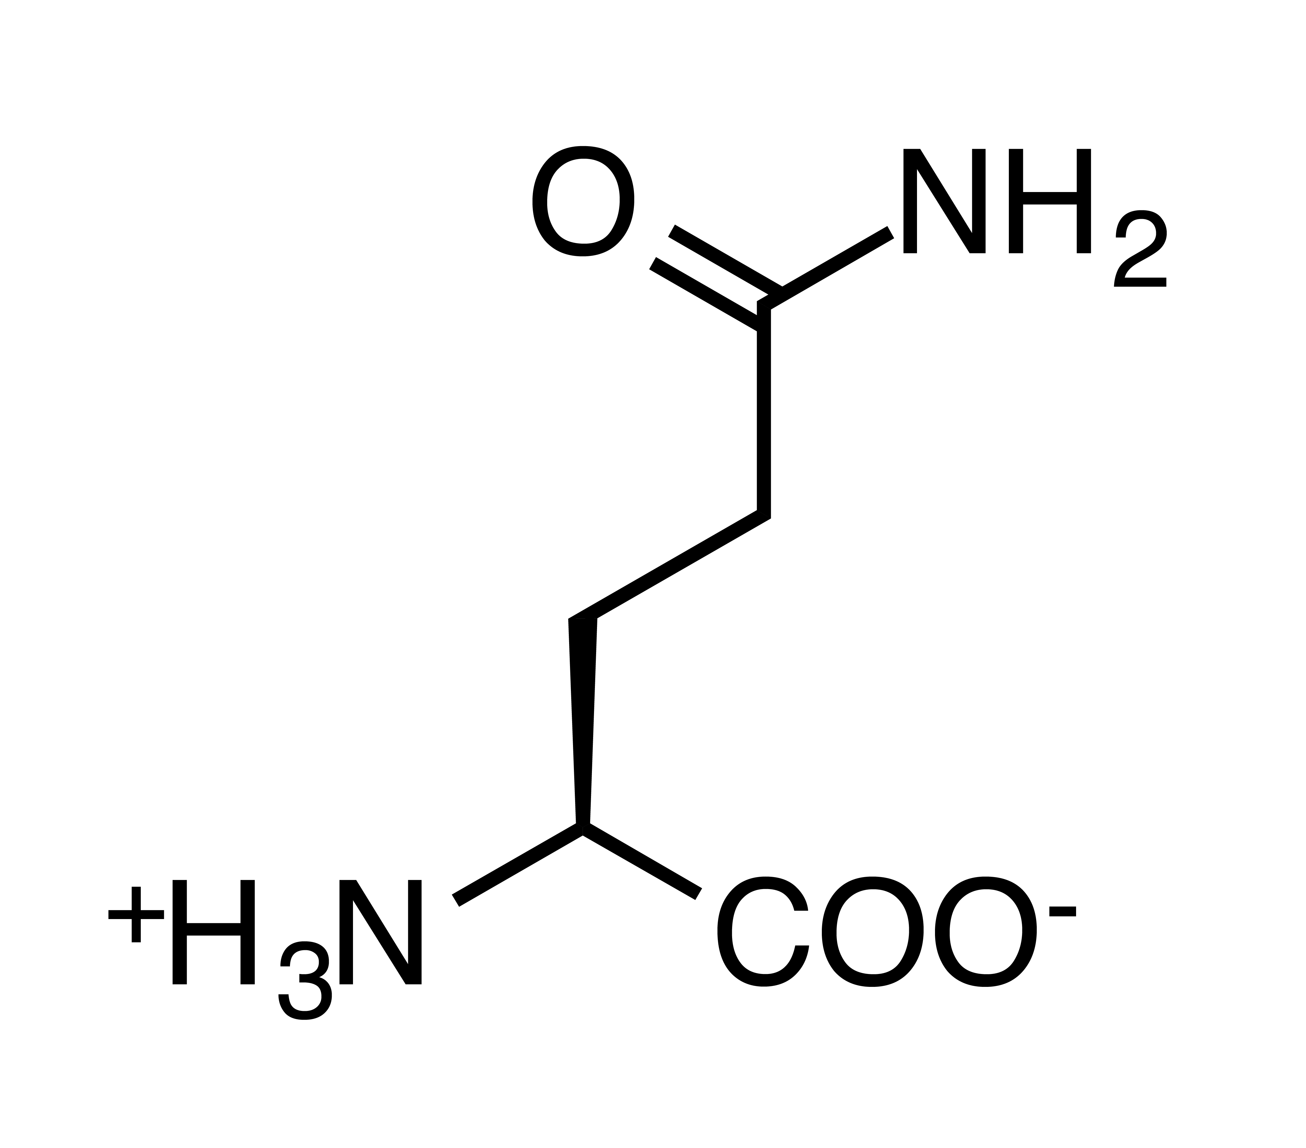
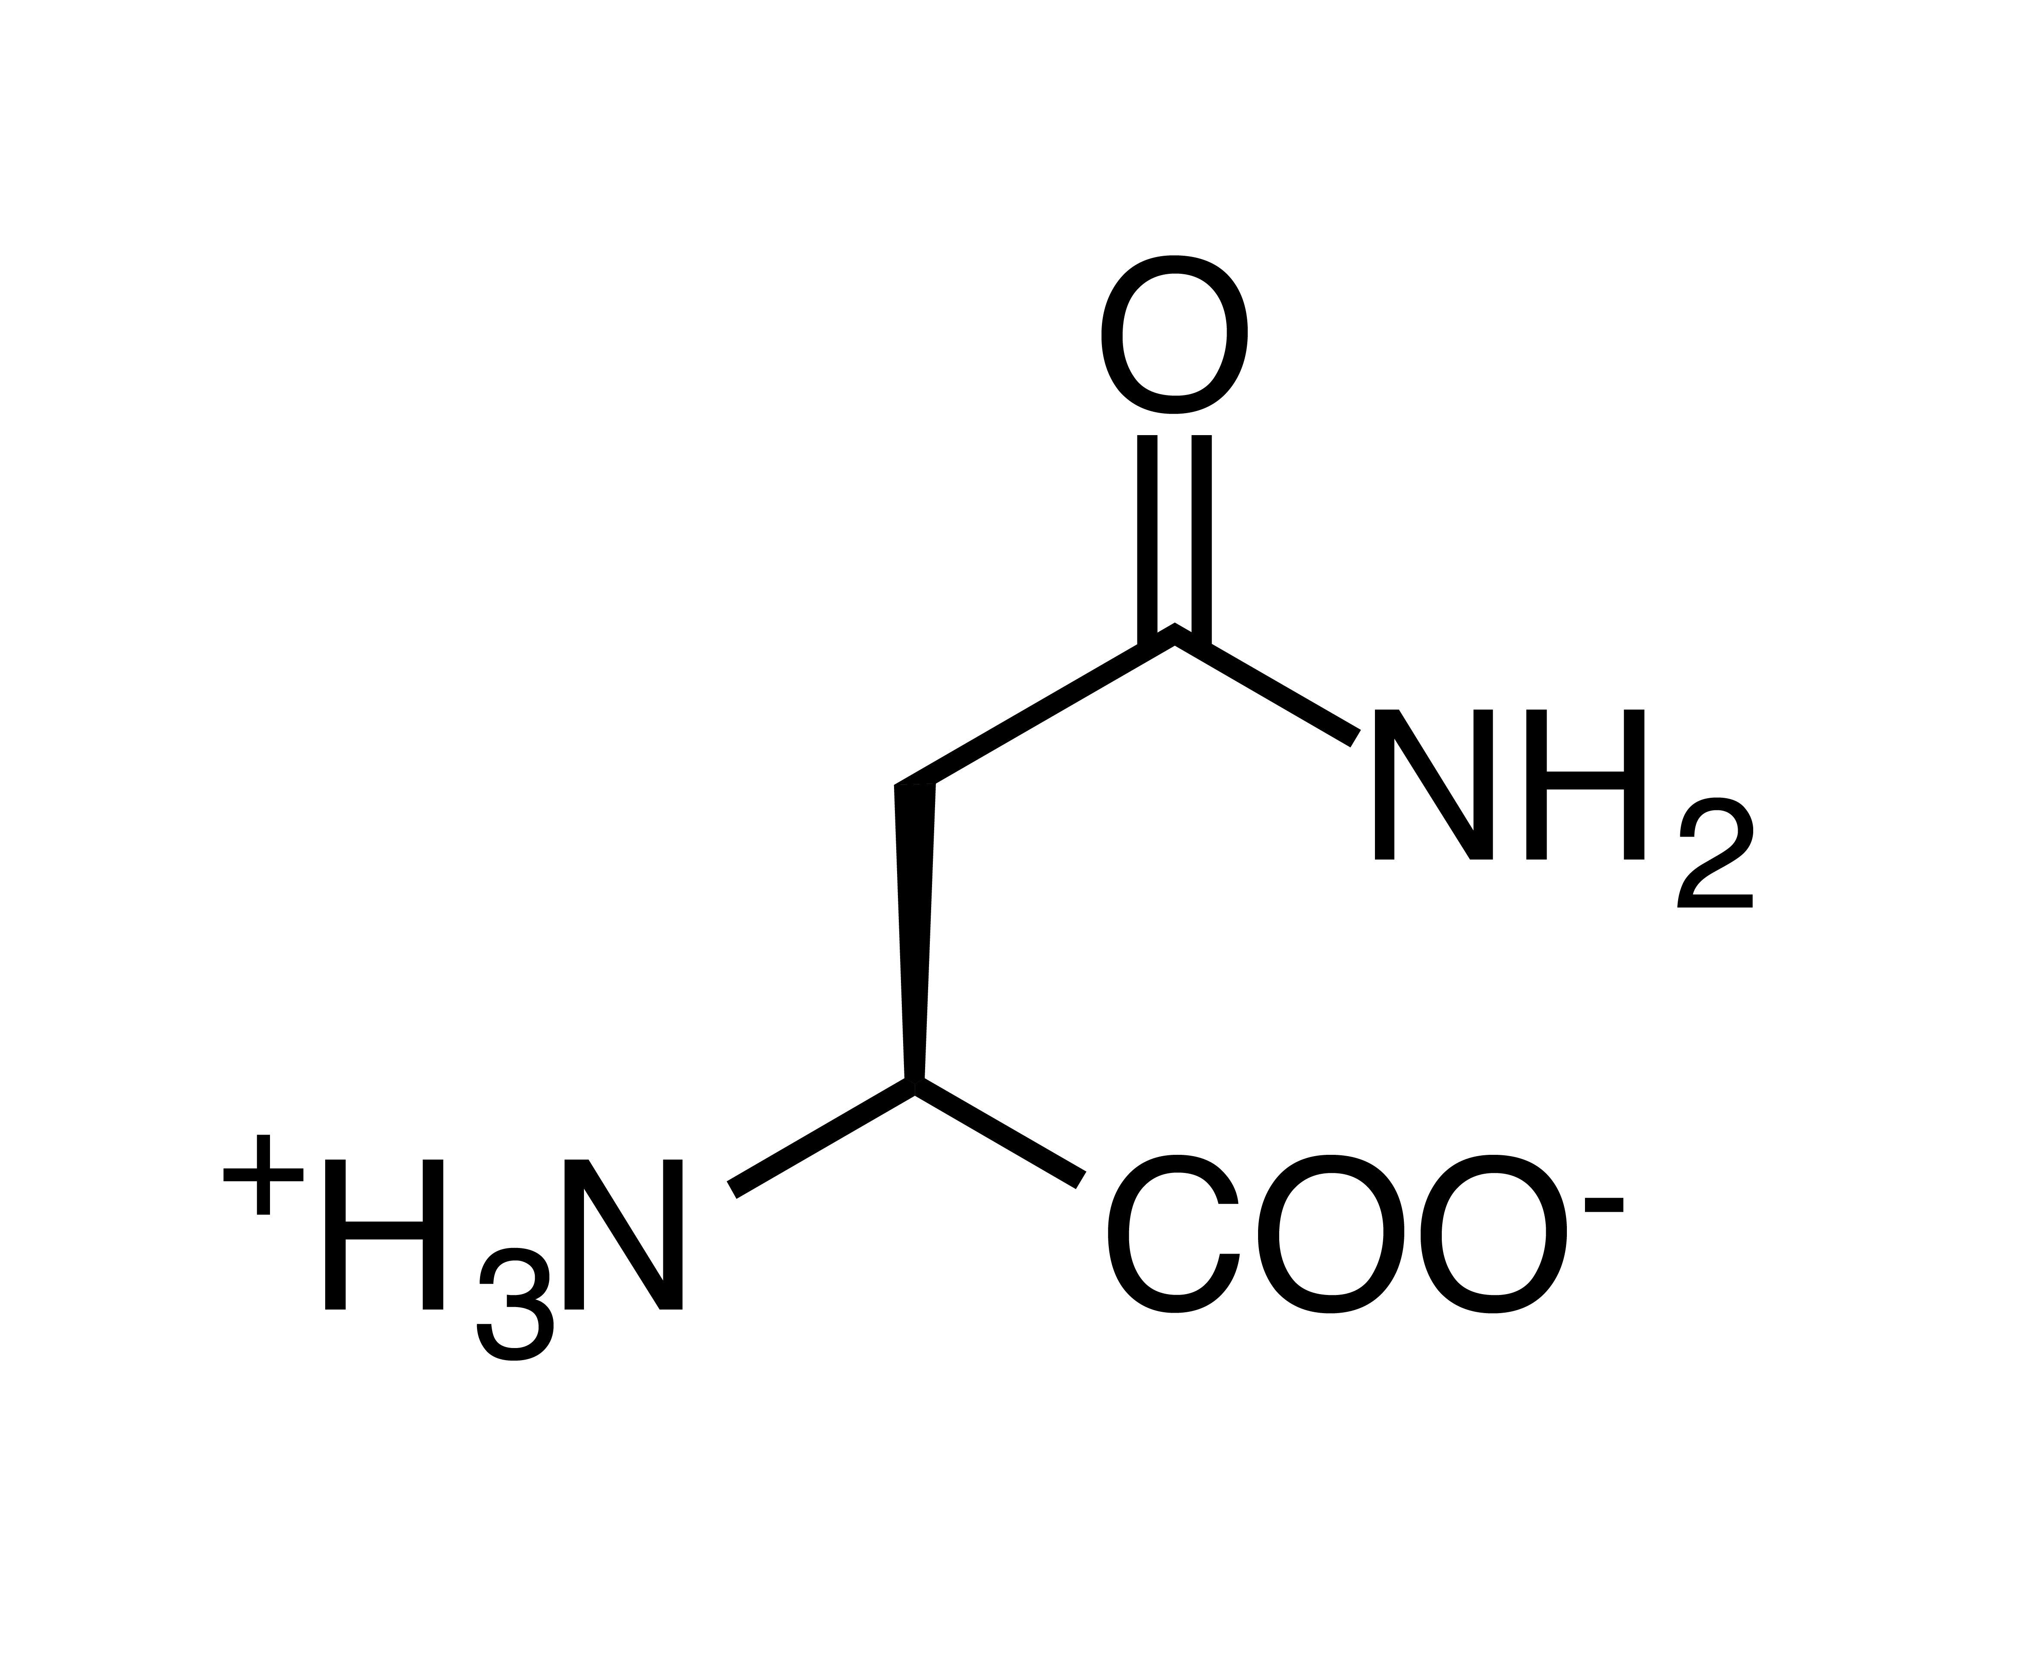

Slide 15
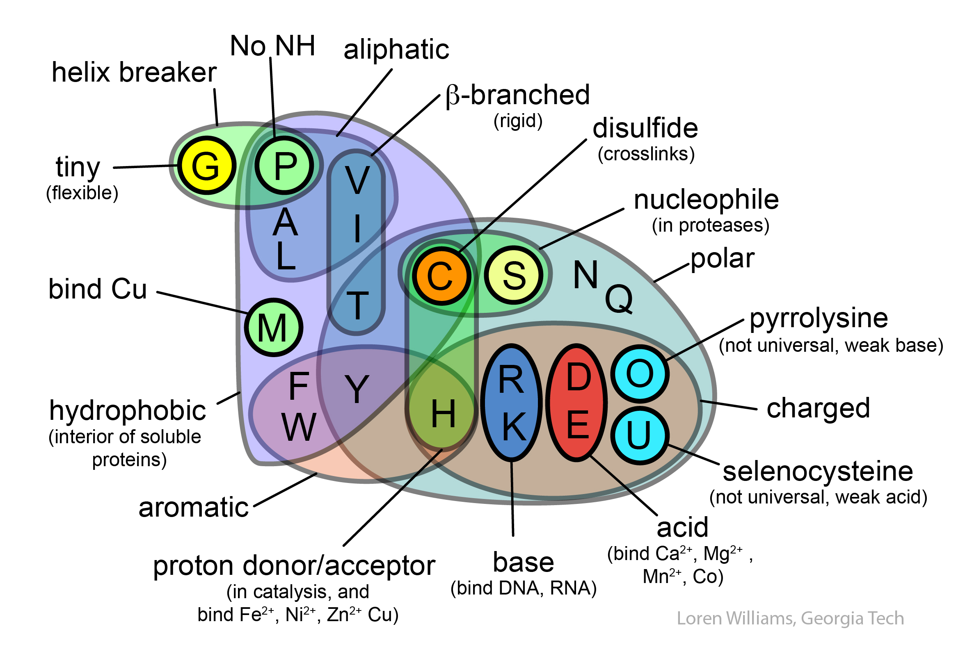

Slide 16
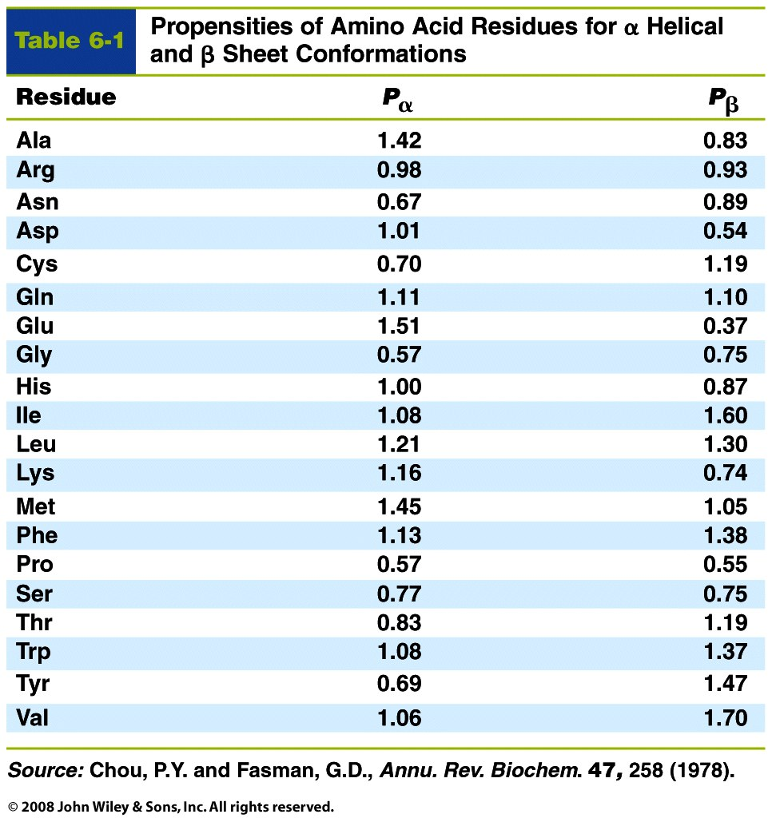
Table 6-1

Slide 17
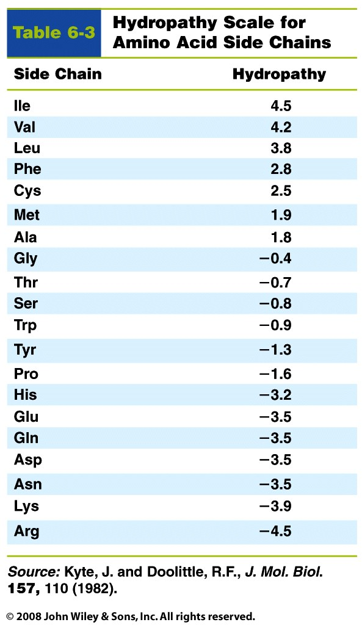
Table 6-3

Slide 18
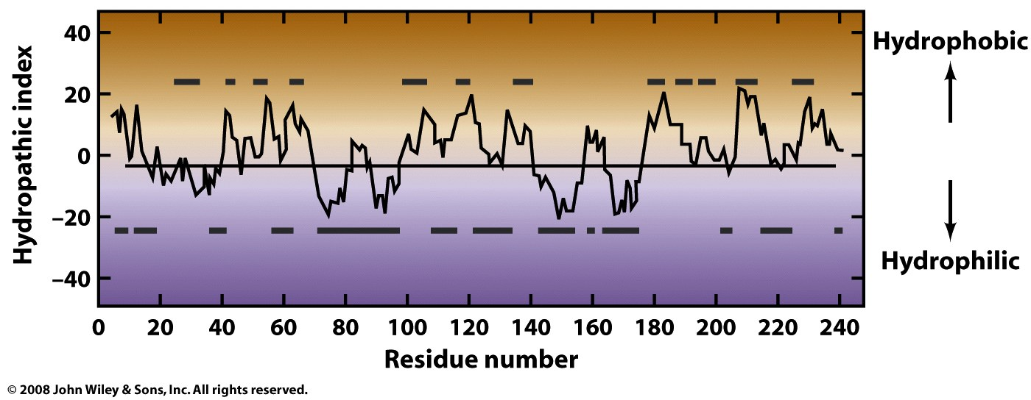
Figure 6-35

Slide 19
Never draw amino acids like this

Slide 20
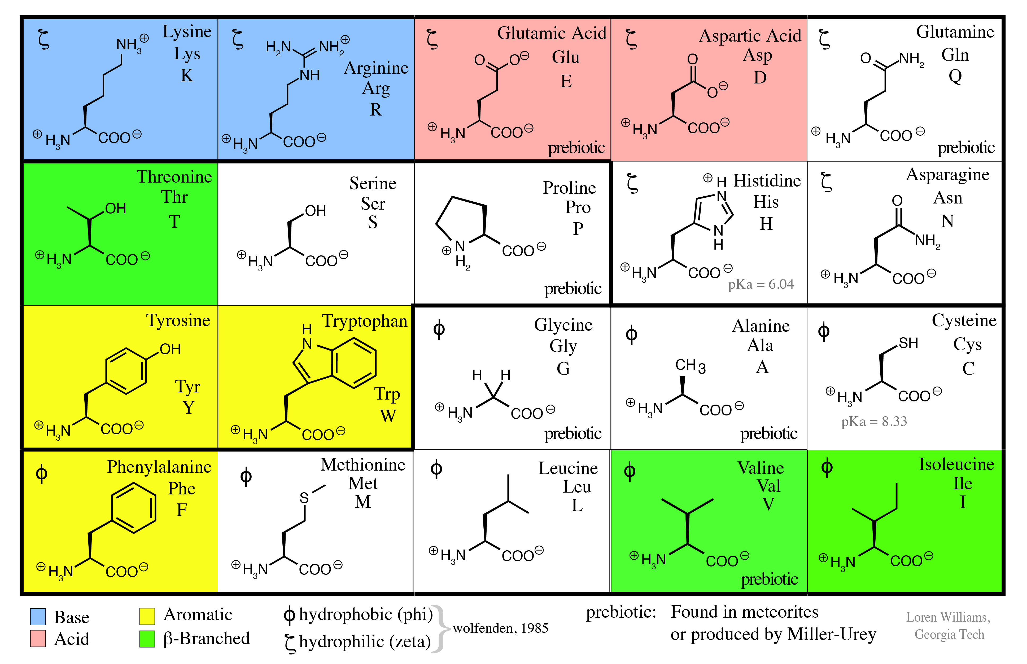
draw amino acids like this

