Slide 1
Annotated Timeline
of
Molecular Biology Techniques
and Advances
that are important
in 2024
Revised 1/9/2024

Slide 2

1950’S
Notes:
Buddy Holly

Slide 3
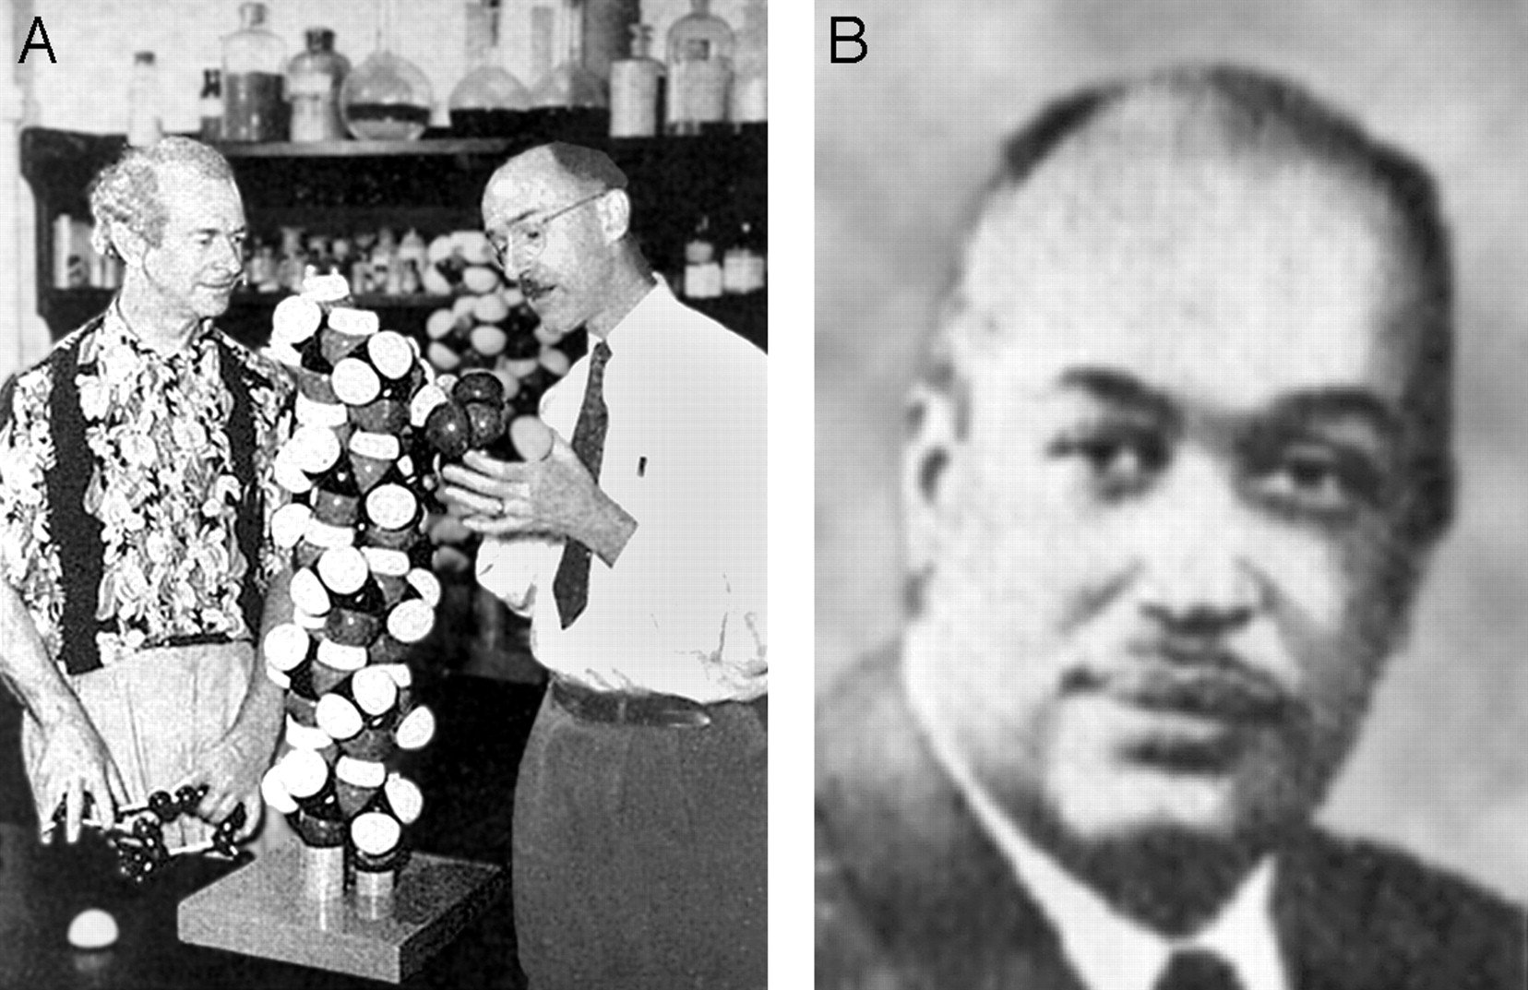
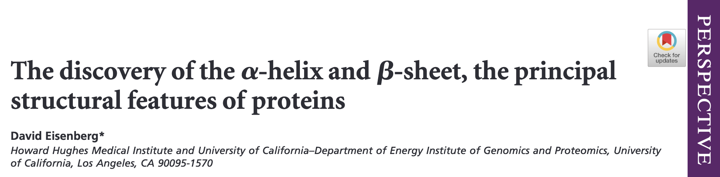
α-helix (also β-sheet)
Pauling, L., Corey, R. B. & Branson, H. R. (1951) Proc. Natl. Acad. Sci. USA 37, 205–211.
Pinus Pauling and Robert Corey (A) and Herman Branson (B). Robert Corey provided Pauling with the fundamental information he needed. Herman Branson was a physicist from Howard University on leave at the California Institute of Technology, who found all helices consistent with the rules of structural chemistry that he and Corey had determined. The wooden helix between Pauling and Corey has a scale of 1 inch per Å, an enlargement of 254,000,000 times. Eisenberg, 2003)
PNAS

Slide 4
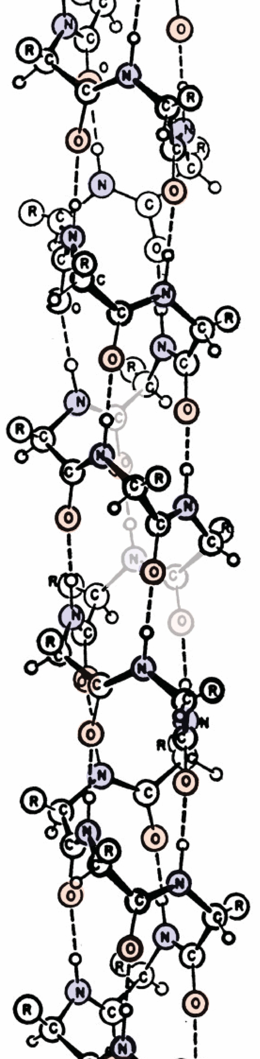

Slide 5
Watson Crick
Wilkins Stokes Wilson

Slide 6
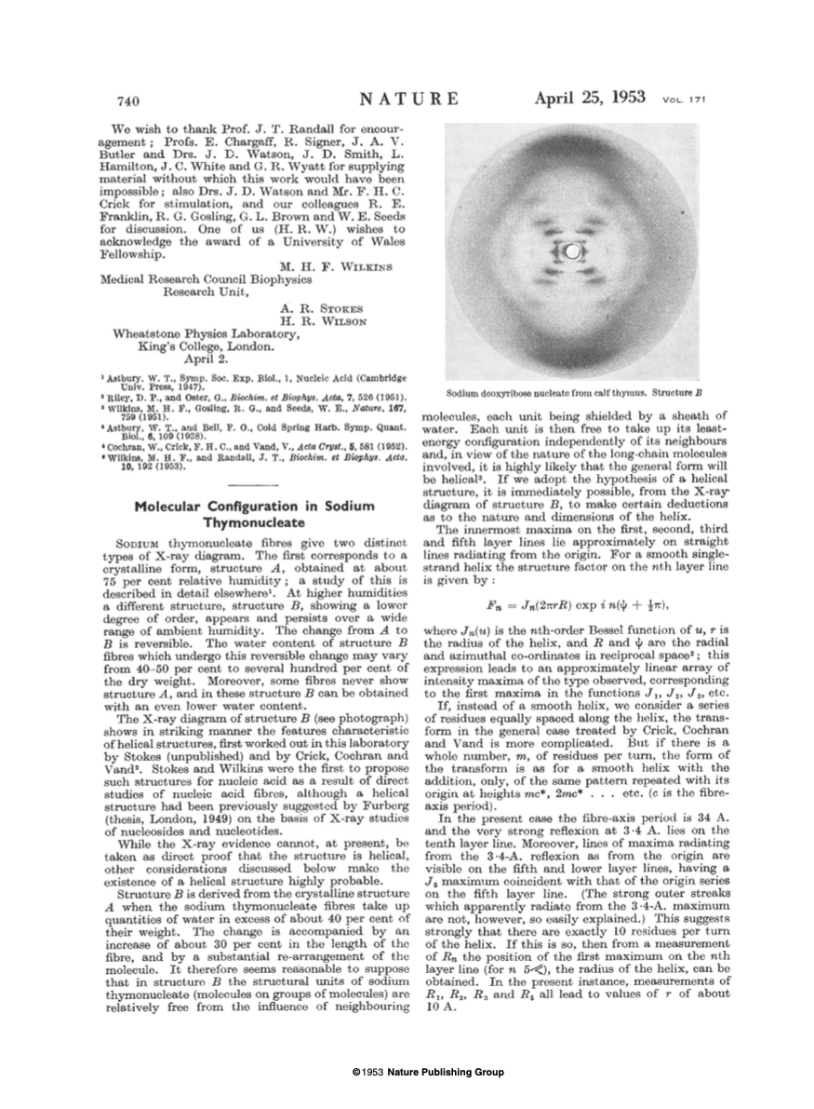
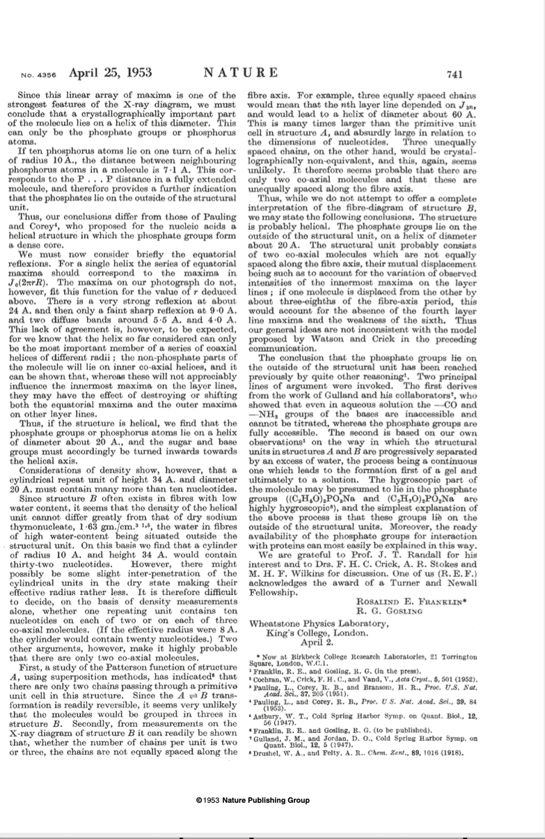
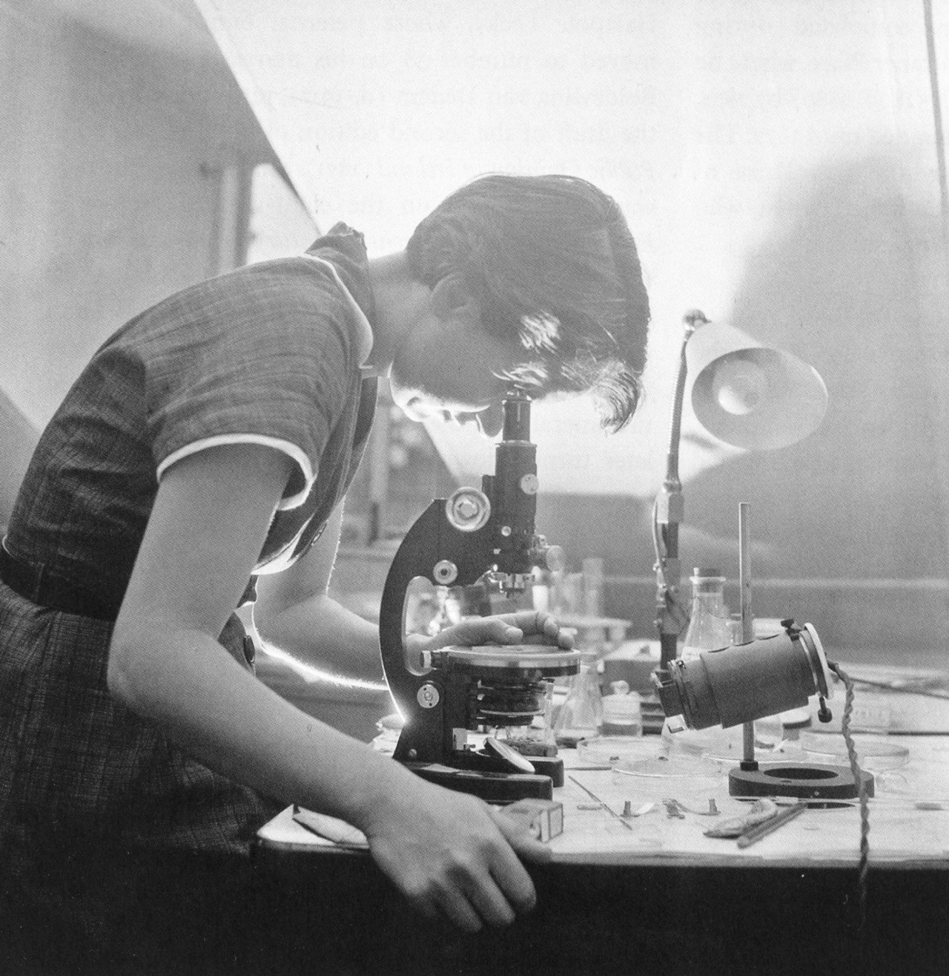
Franklin and Gosling

Slide 7
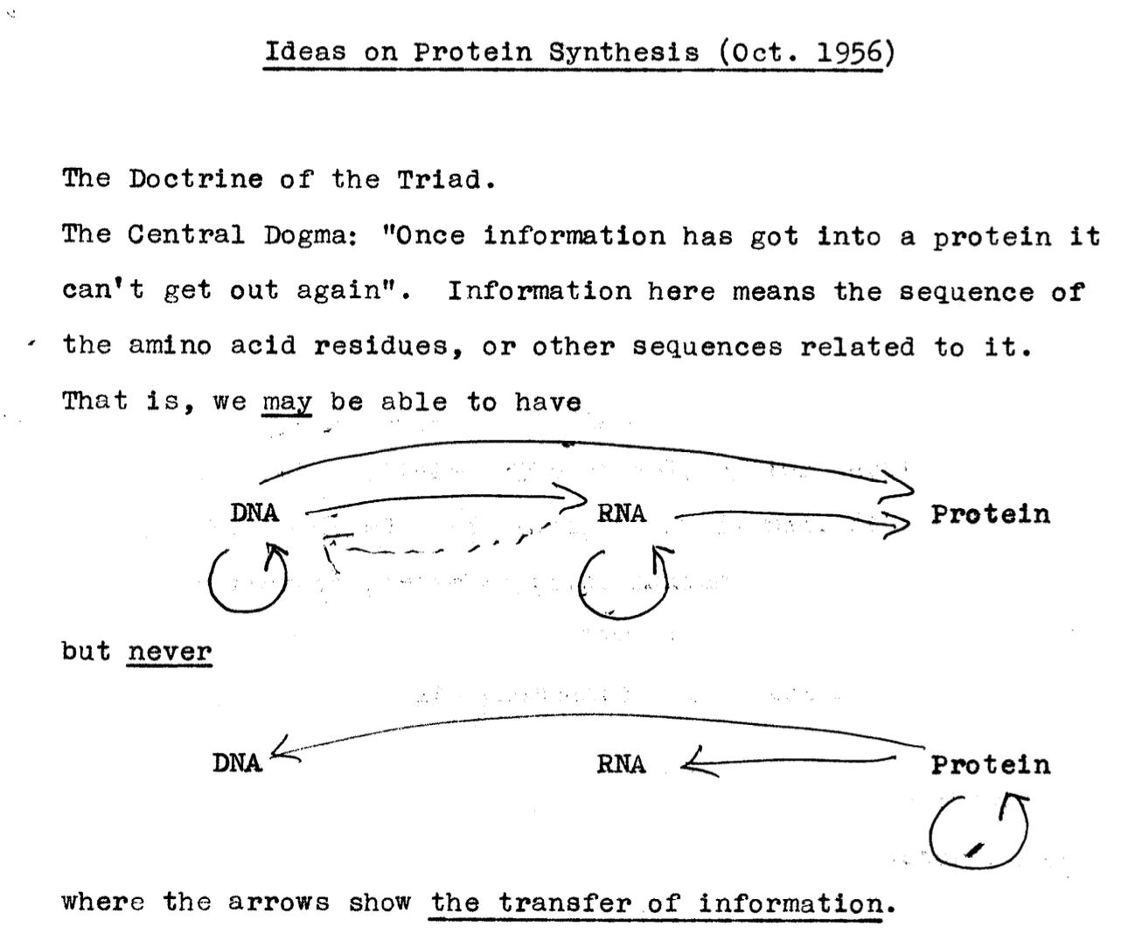

Slide 8
Notes:
Central Dogma
The arrows represent information flow in form of sequence

Slide 9

1960’S
Notes:
Beatles

Slide 10
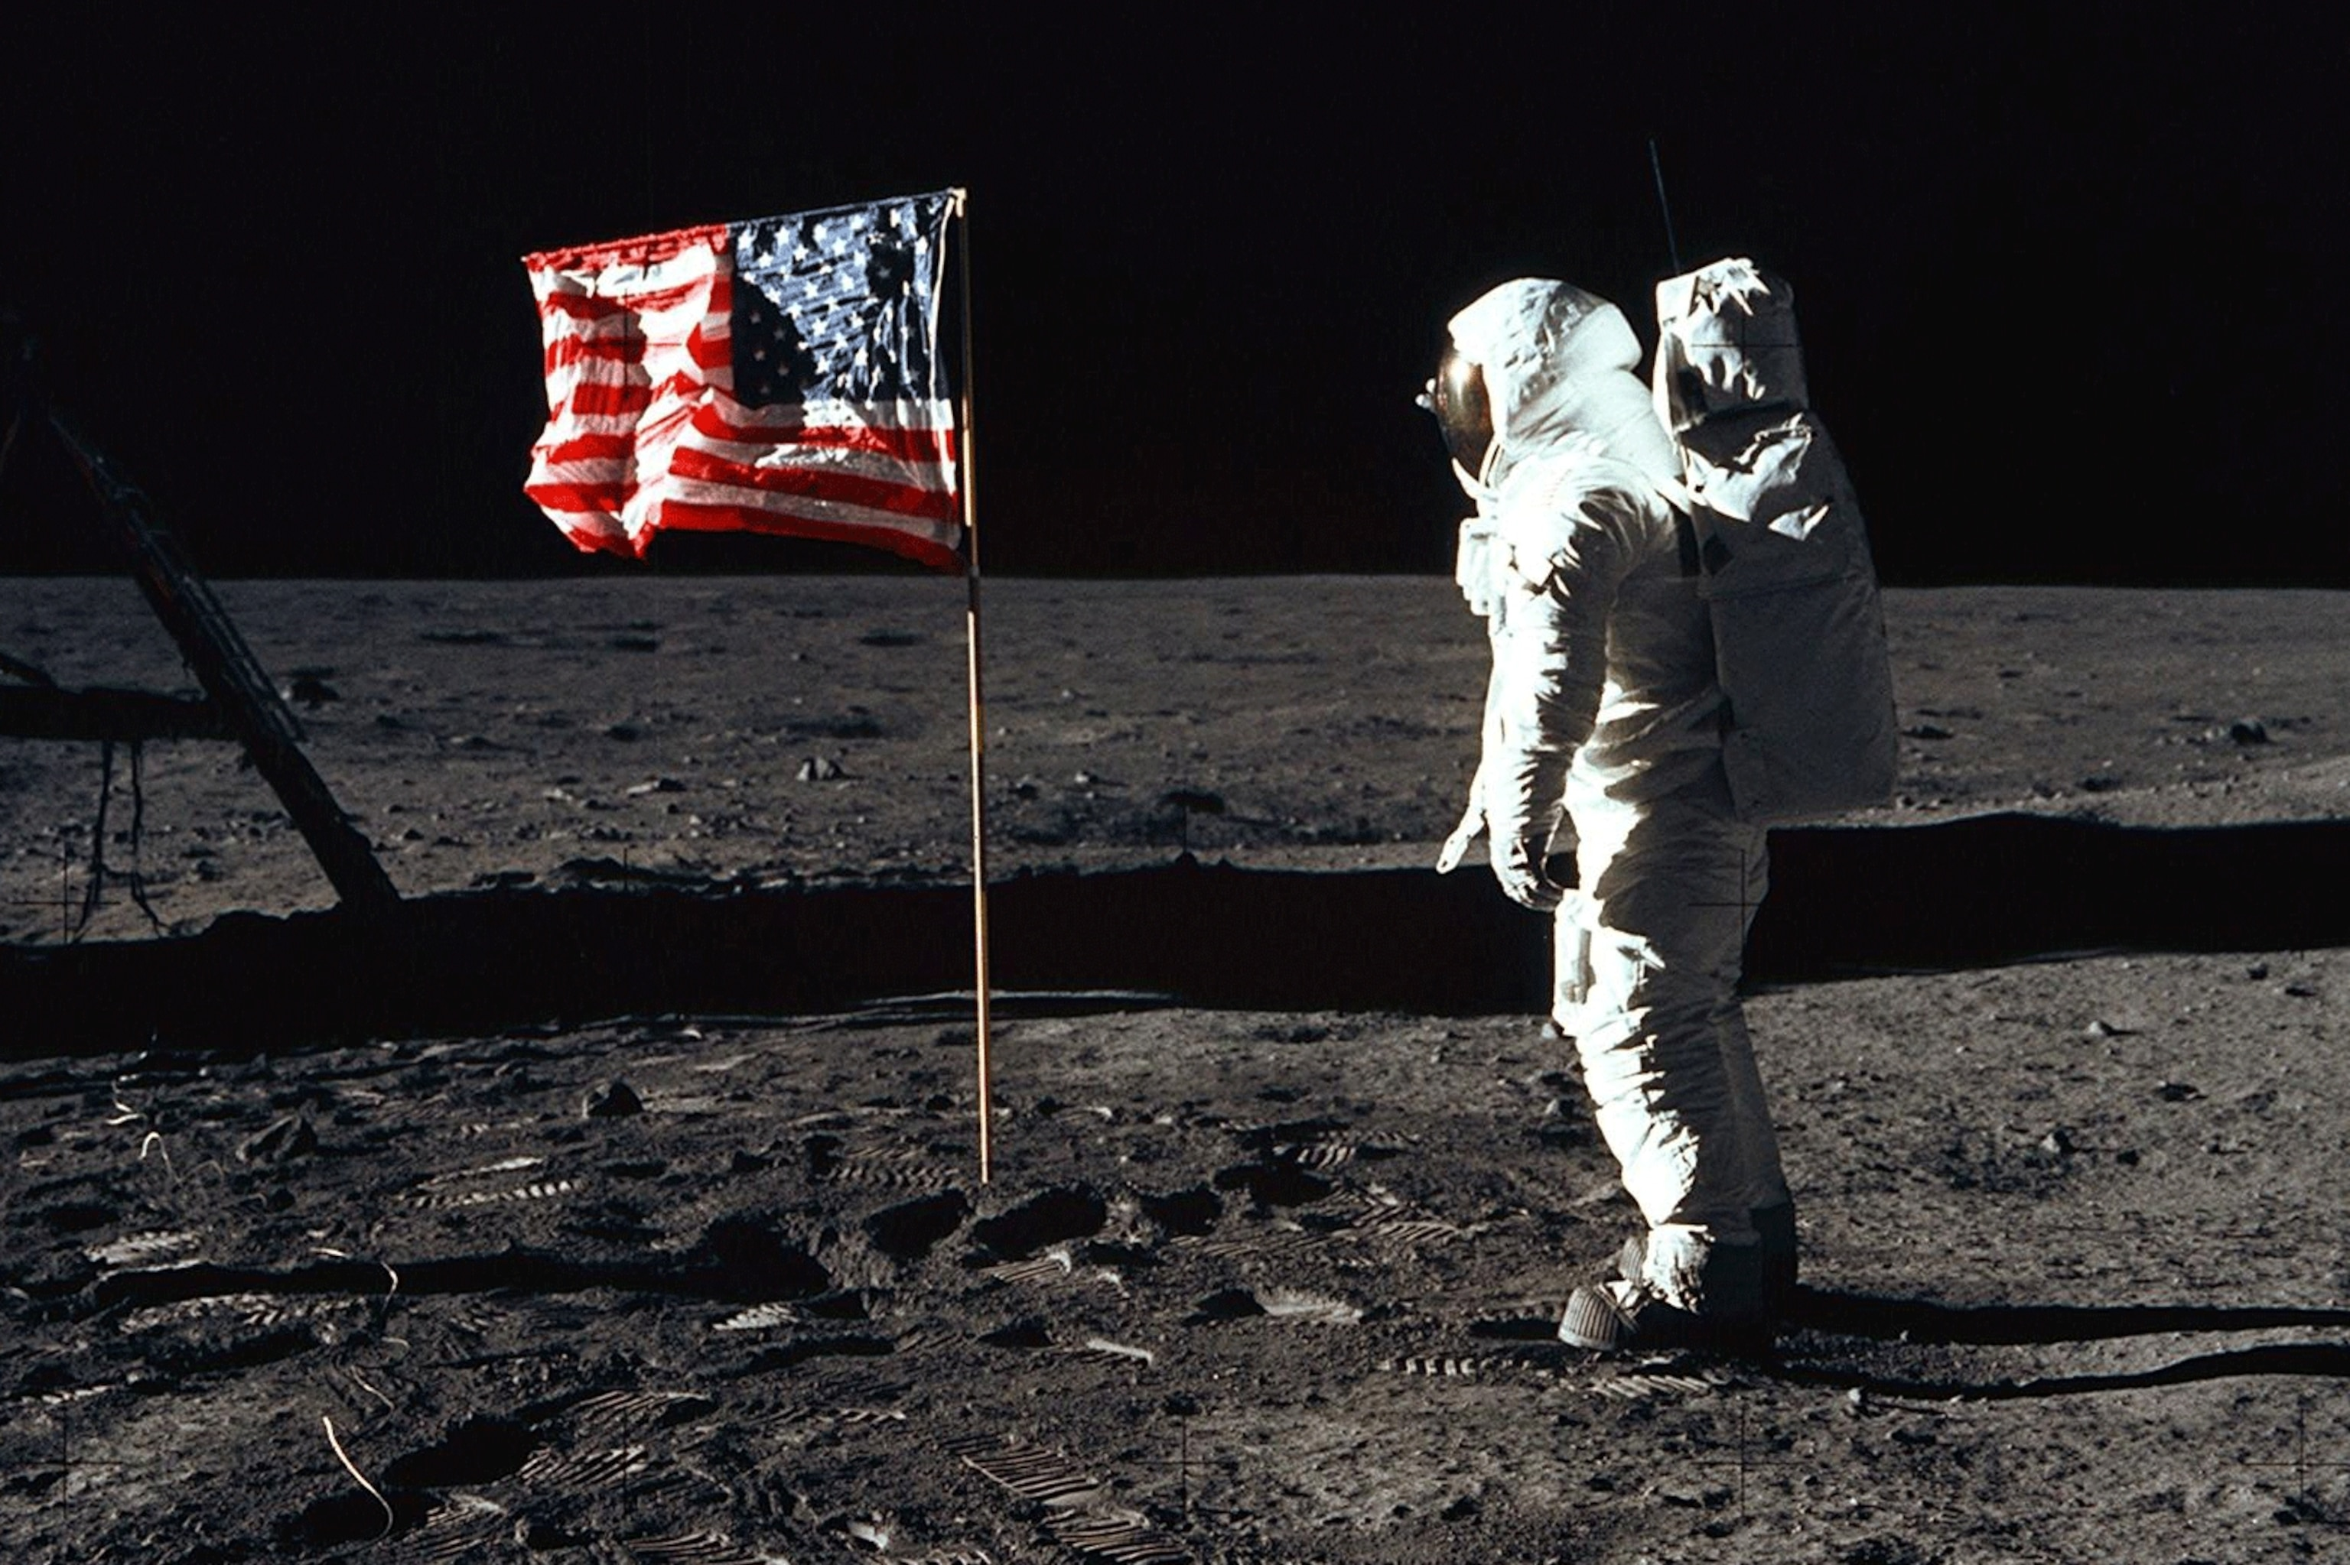

Slide 11
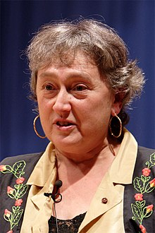
1961: Messenger RNA (mRNA) Discovery
François Jacob and Jacques Monod, along with Sydney Brenner and others, discovered mRNA. mRNA serves as a temporary copy of genetic information from DNA, which is then translated to form proteins.
1967: Endosymbiotic Theory by Lynn Margulis
Lynn Margulis proposed the endosymbiotic theory, suggesting that mitochondria and chloroplasts originated from symbiotic bacteria. "On the Origin of Mitosing Cells", appeared in 1967 after being rejected by ~fifteen journals.

Slide 12


1970’S
Notes:
Pink Floyd, Stevie Wonder

Slide 13
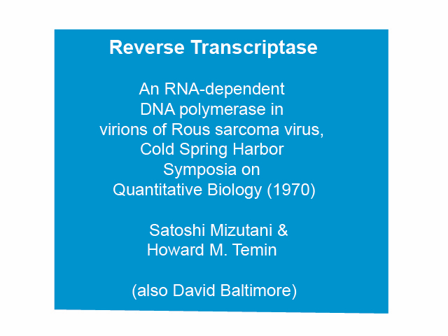

Slide 14
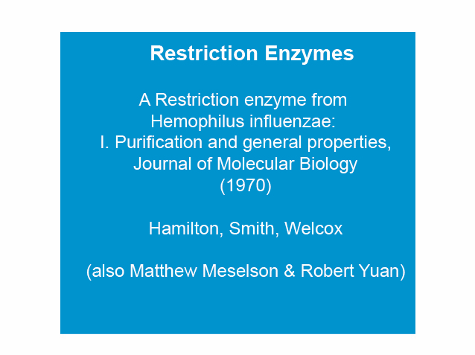
Notes:
The is enabling technology for molecular biology.

Slide 15

Founded in 1974 by Don Comb

Slide 16
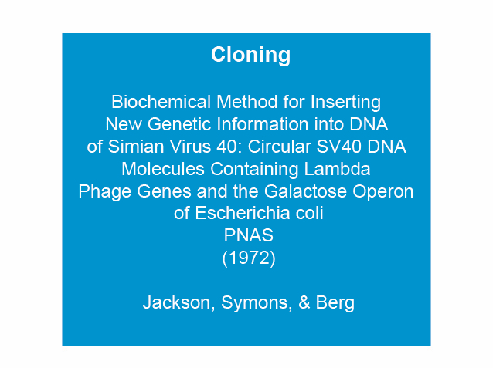

Slide 17
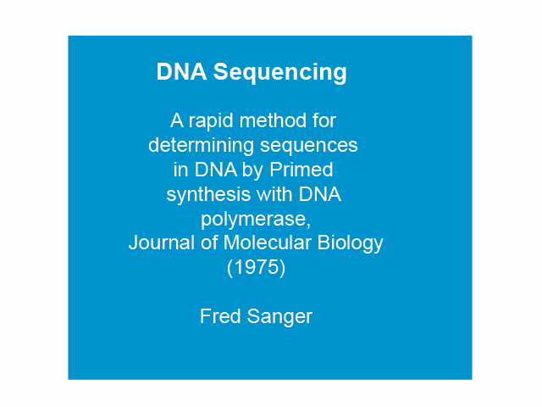

Slide 18
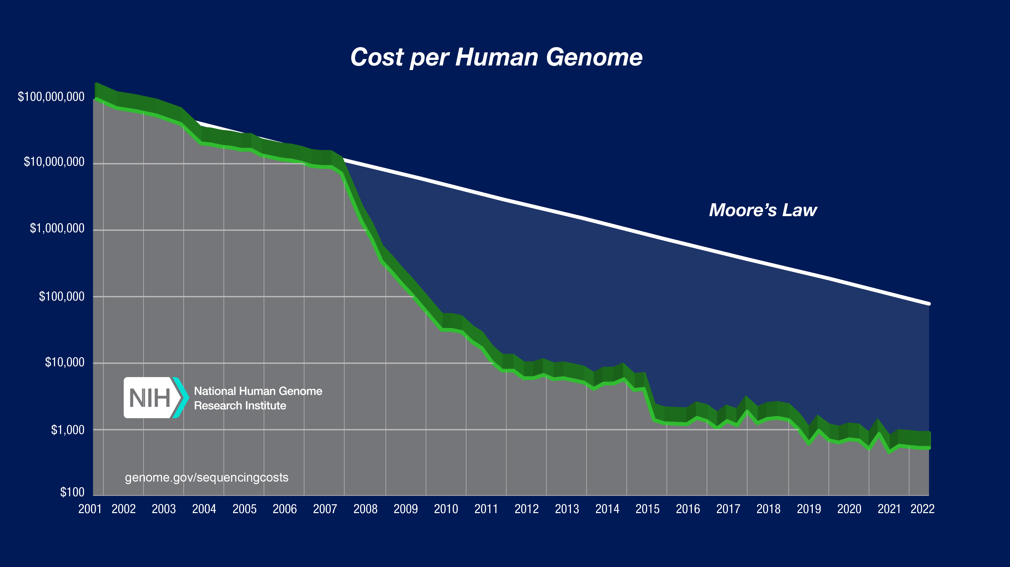
https://www.genome.gov/sites/default/files/inline-images/2022_Sequencing_cost_per_Human_Genome.jpg
The cost of sequencing a human genome from 2001 to 2019

Slide 19
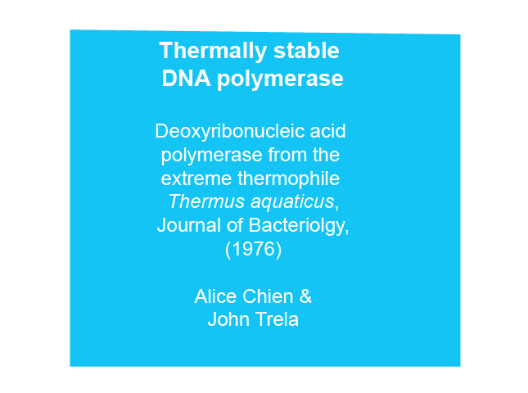
Notes:
TAQ

Slide 20


Slide 21


Slide 22
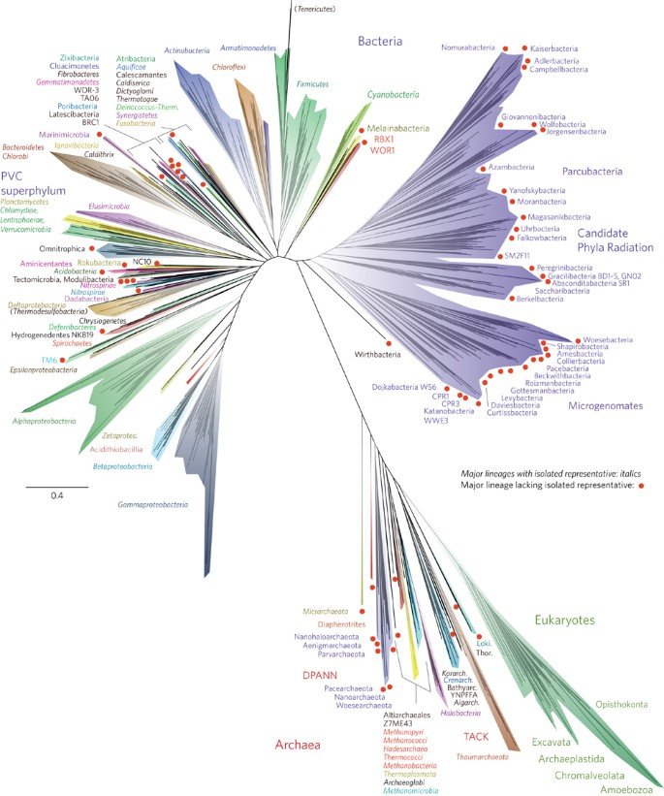

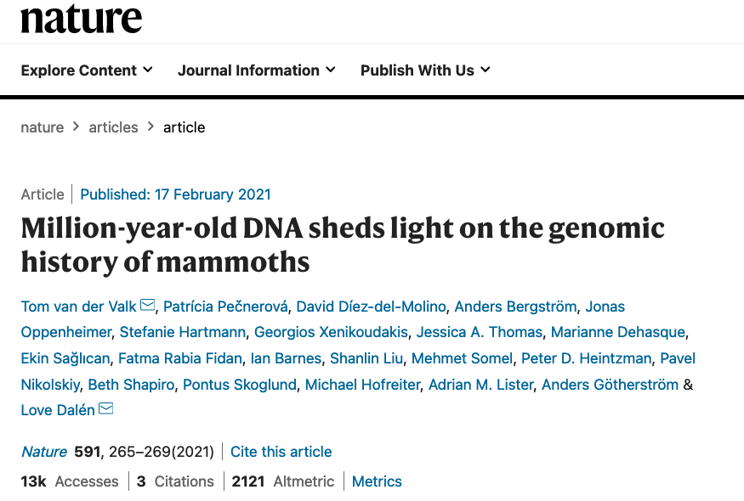

Slide 23
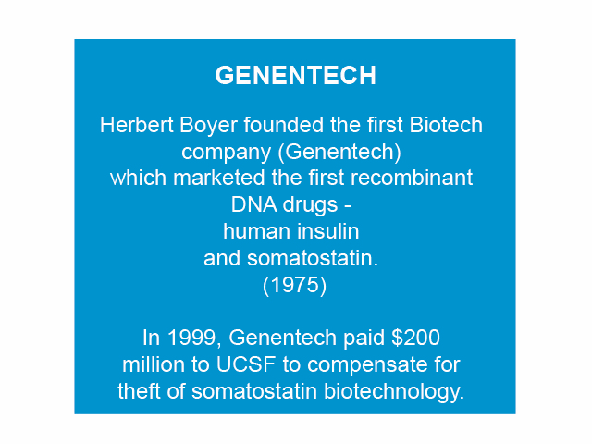

Slide 24
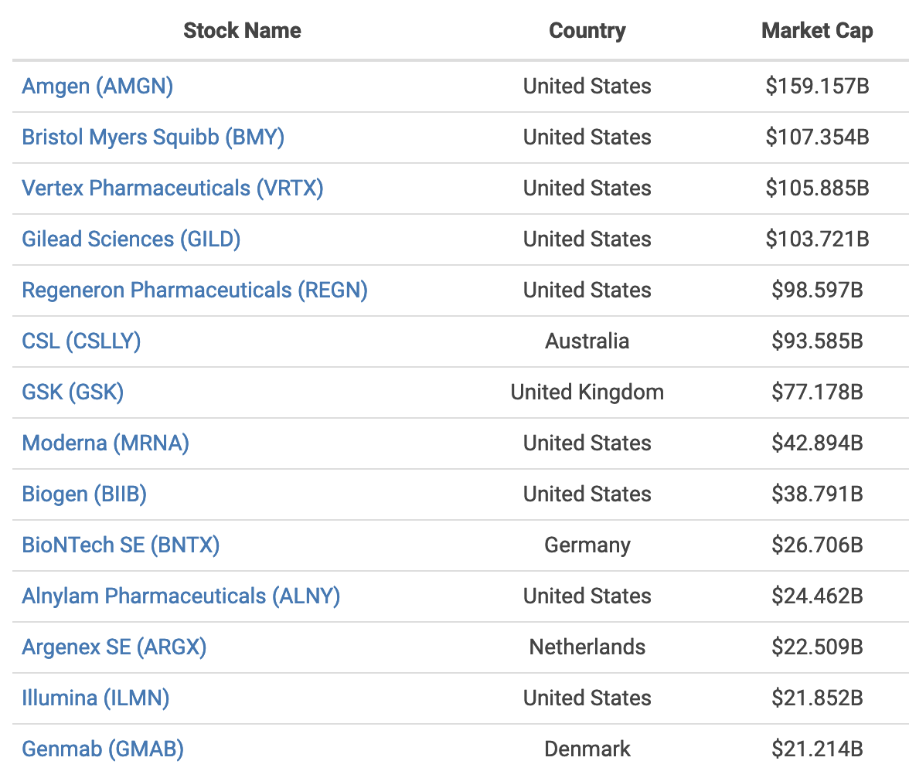

Slide 25
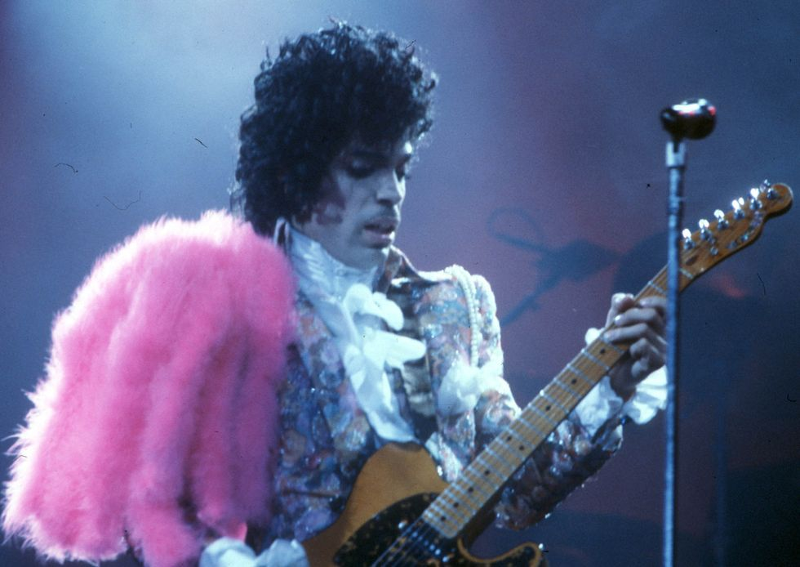

1980’S
Notes:
Prince and Michael Jackson

Slide 26
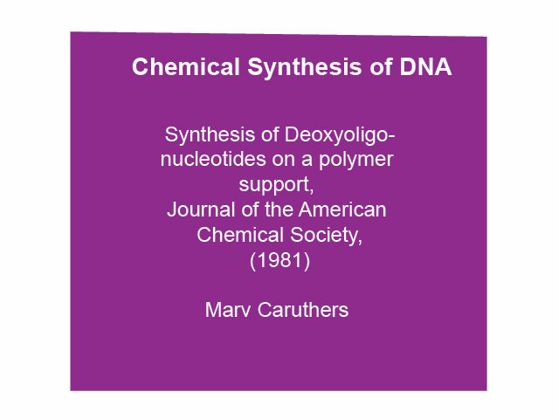

Slide 27
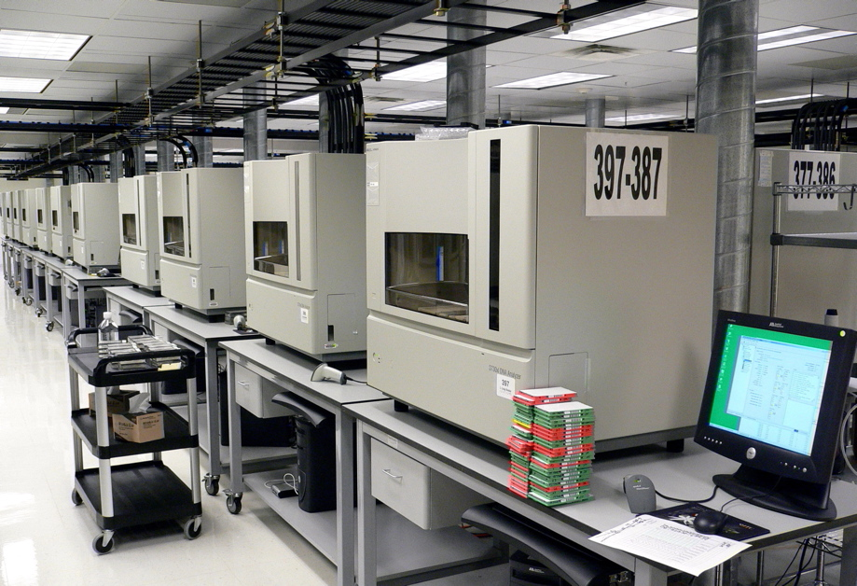

Slide 28
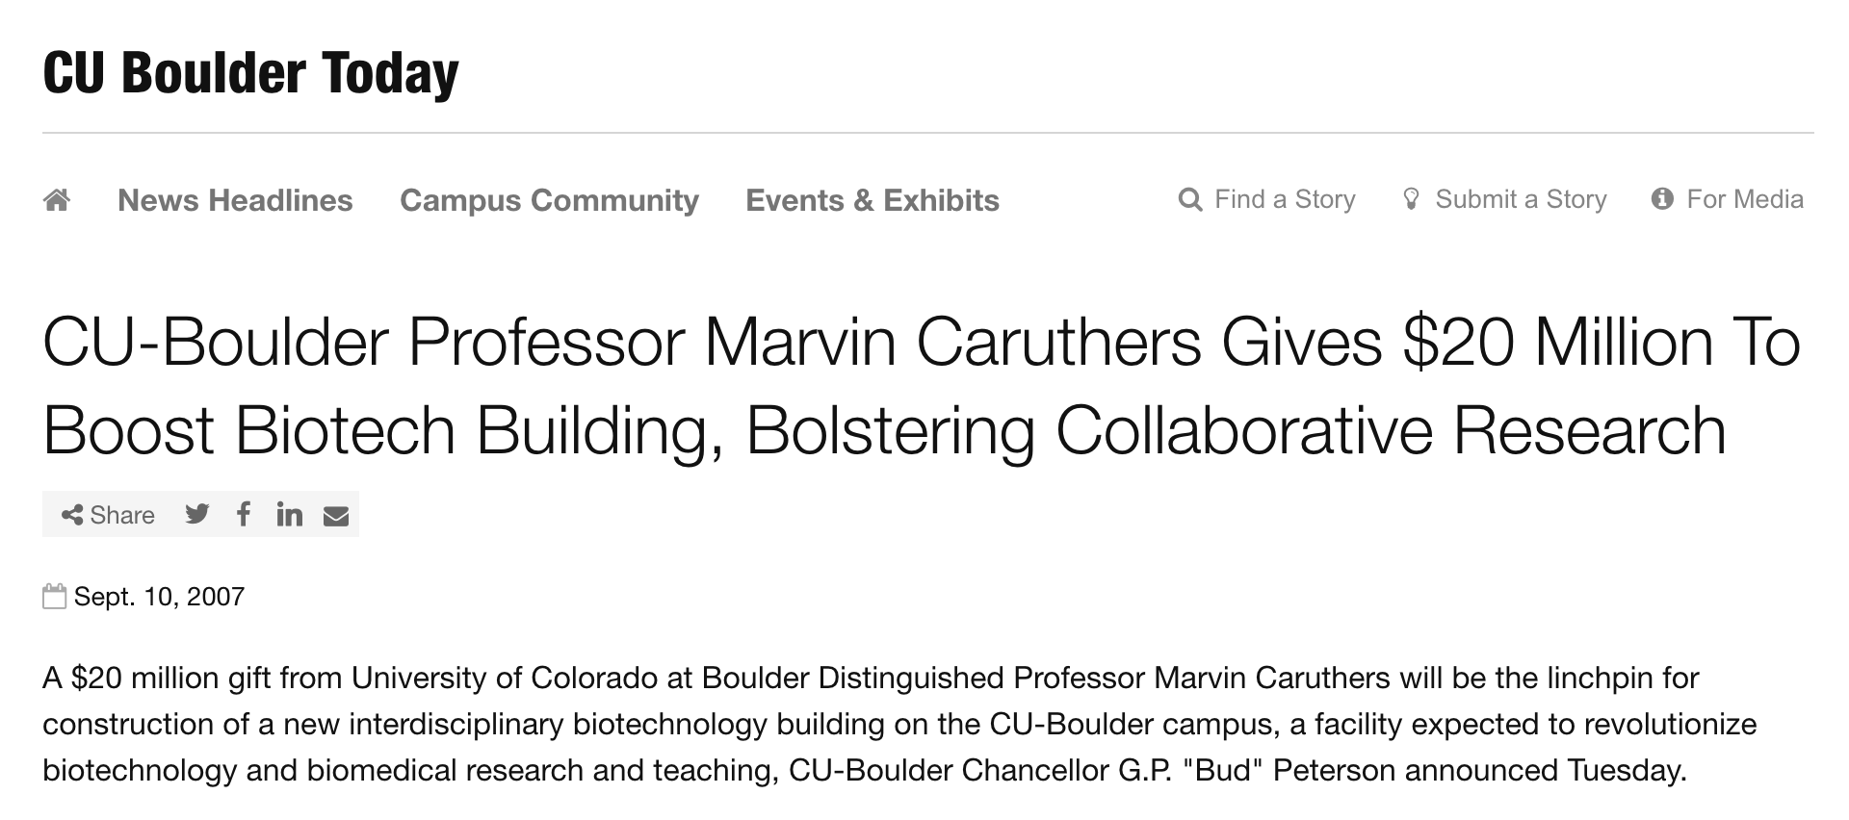

Slide 29
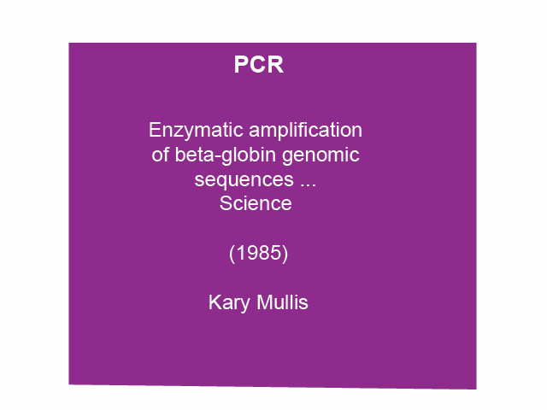

Slide 30
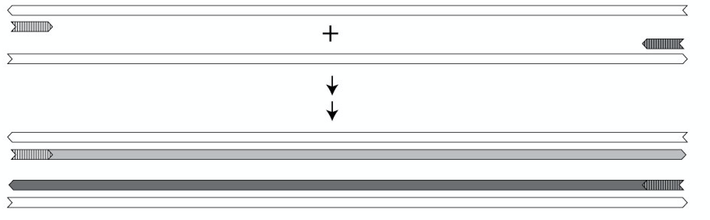
Notes:
Selecting and amplifying

Slide 31
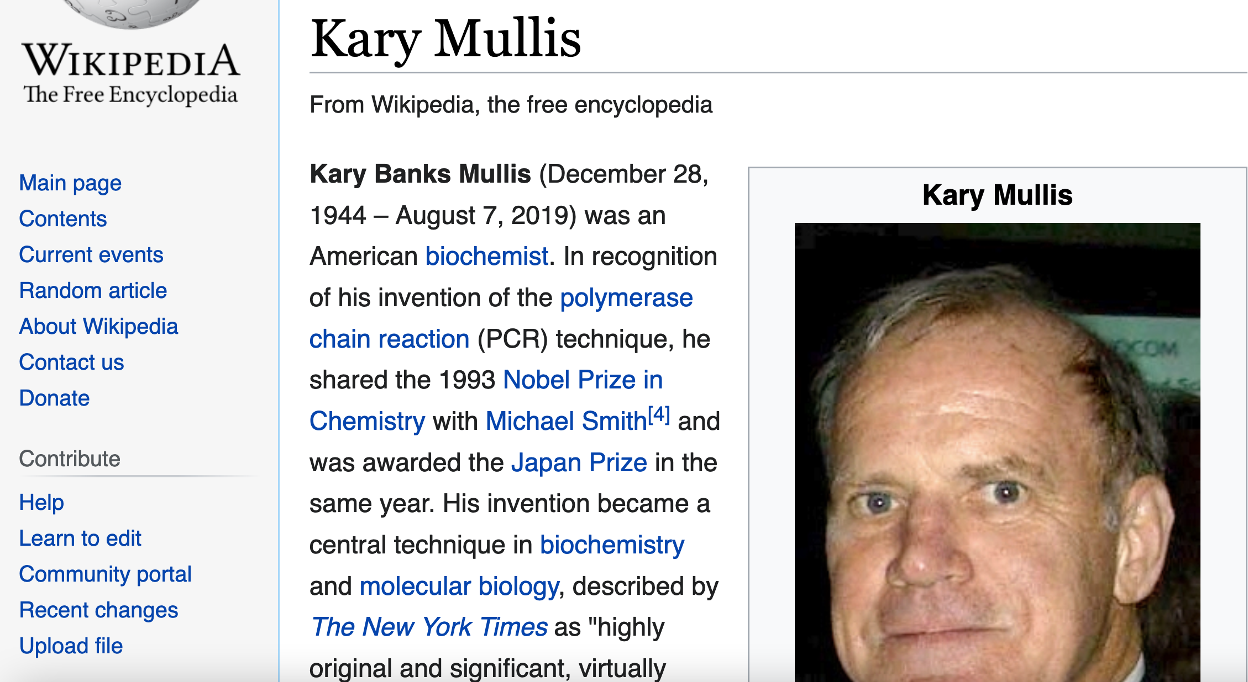

Slide 32
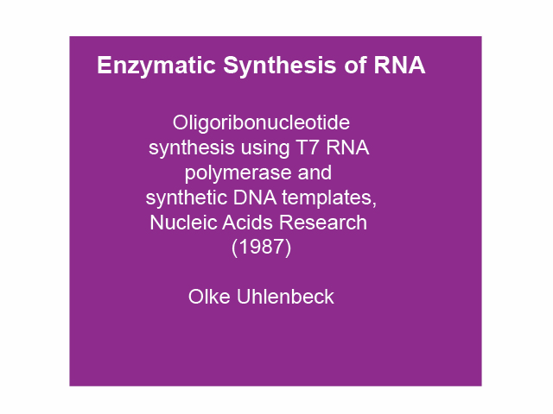

Slide 33

Olke

Slide 34
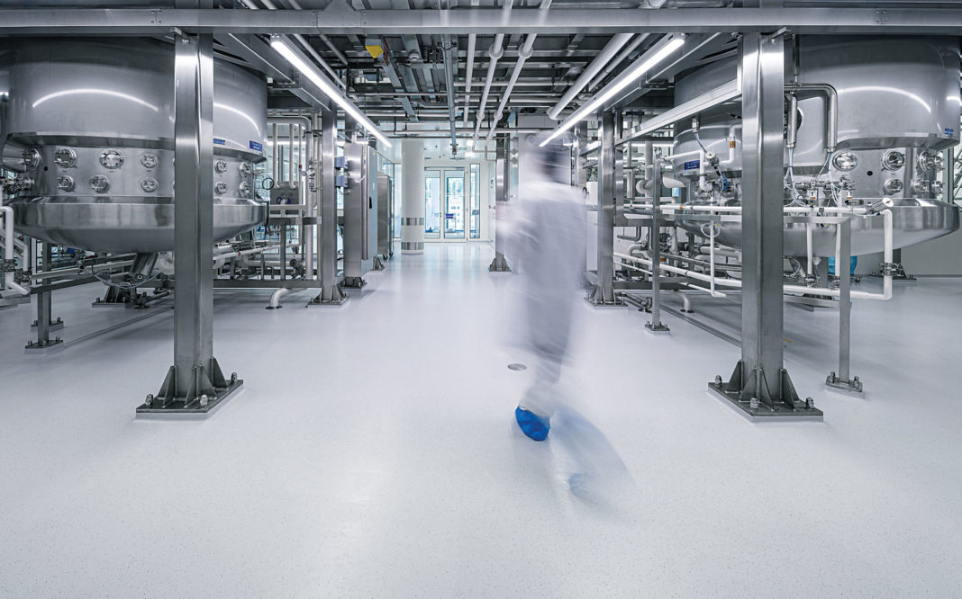
Moderna and Lonza have entered a 10-year strategic collaboration to facilitate the large-scale manufacture of Moderna’s mRNA vaccine (mRNA-1273) and additional future Moderna products at Lonza’s facilities in the United States and Switzerland. This image shows a large-scale manufacturing facility at Lonza’s Ibex dedicated facility in Visp, Switzerland. [Lonza]

Slide 35

1990’S
Notes:
Nirvana

Slide 36
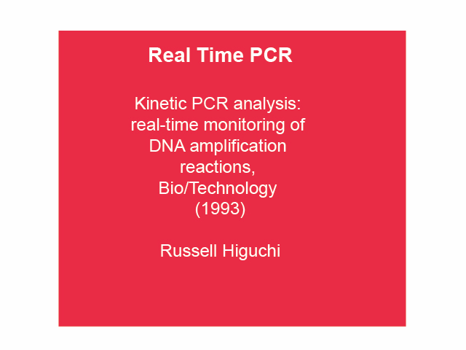

Slide 37
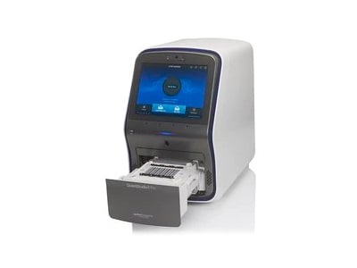

Slide 38
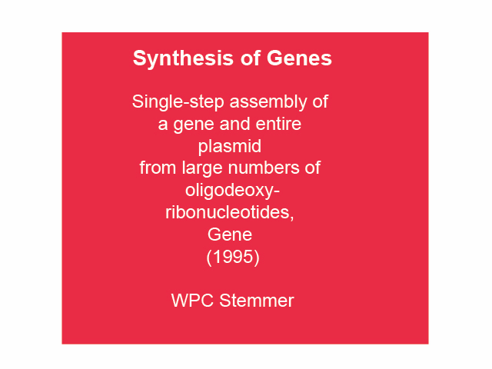

Slide 39
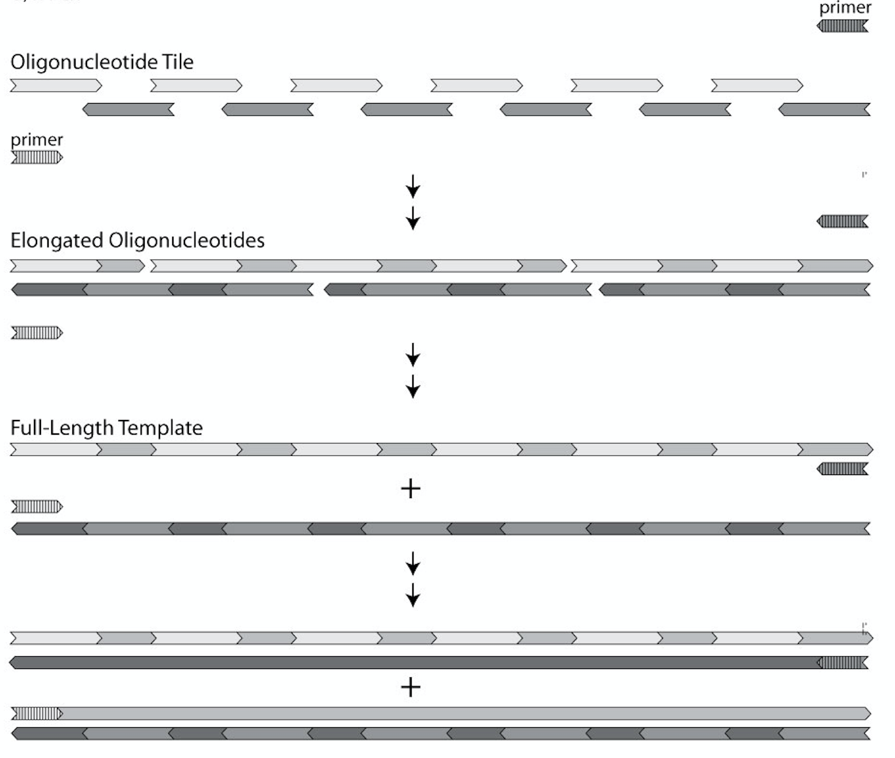

Slide 40


2000’S
Notes:
Radiohead and Pink

Slide 41
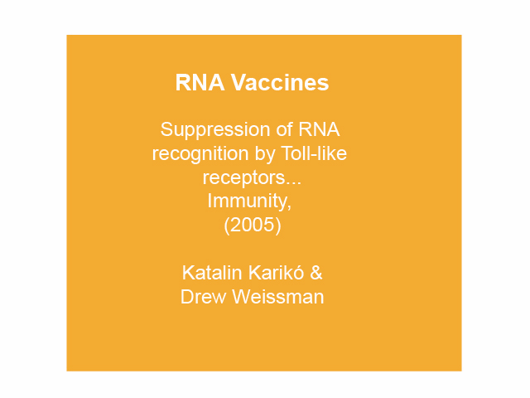

Slide 42
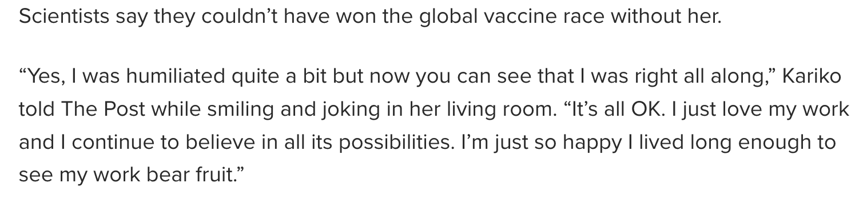
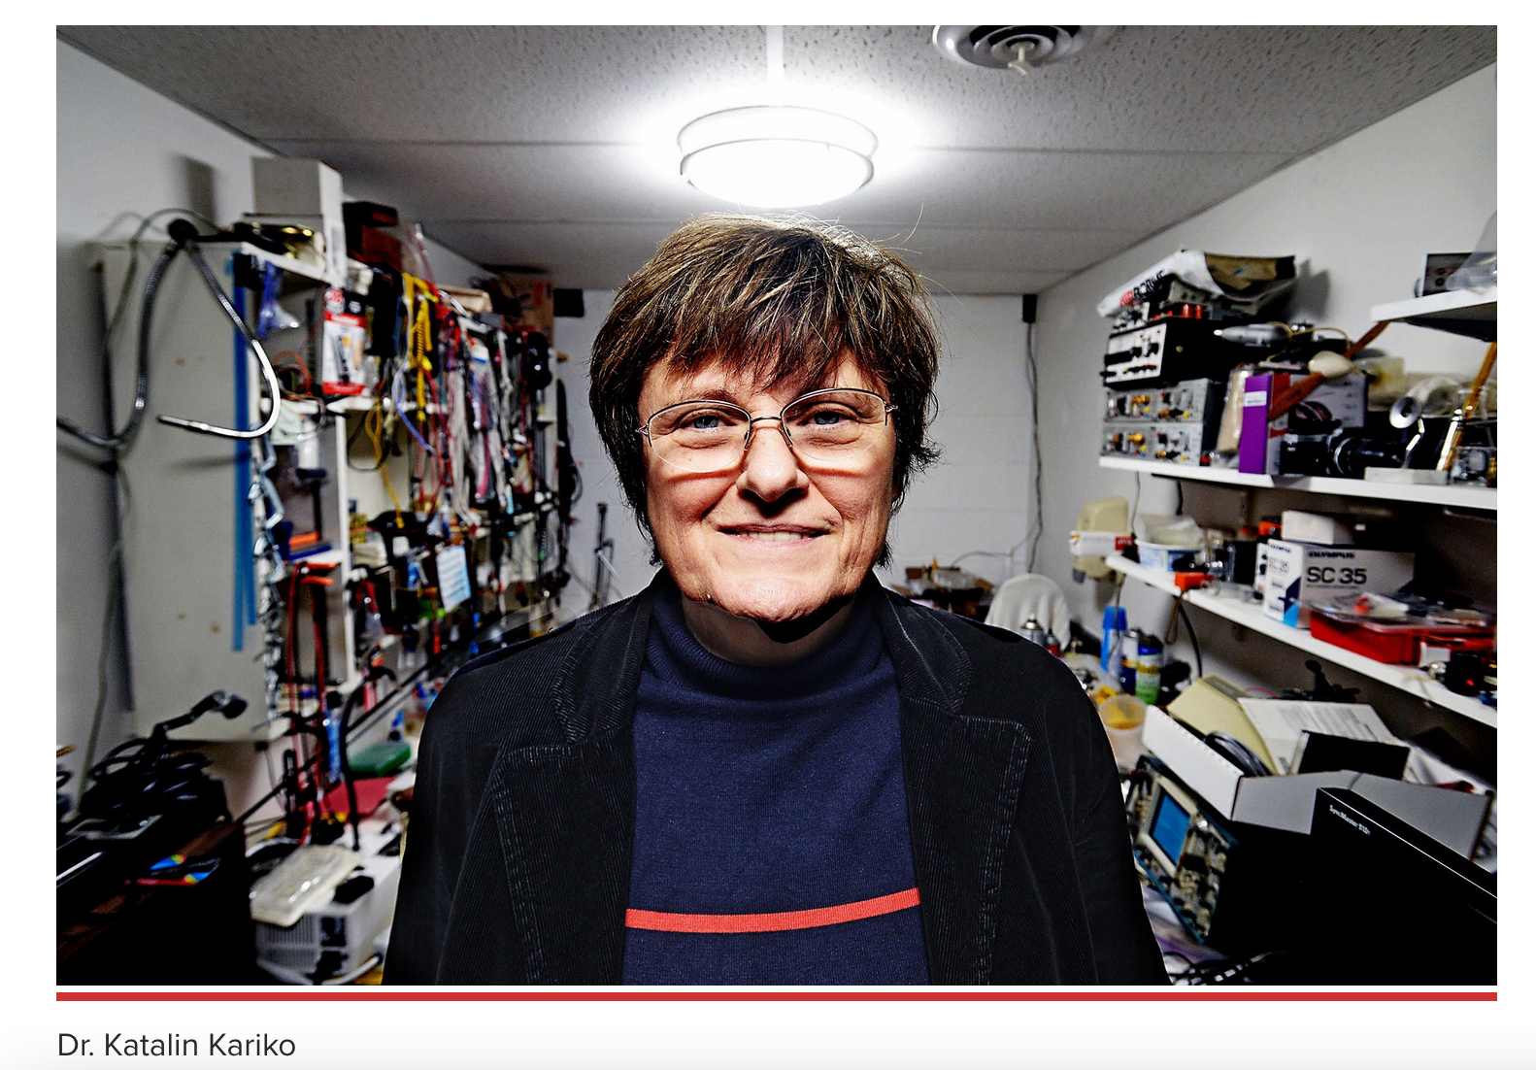

Slide 43


Slide 44

2010’S
Notes:
Artic Monkeys

Slide 45
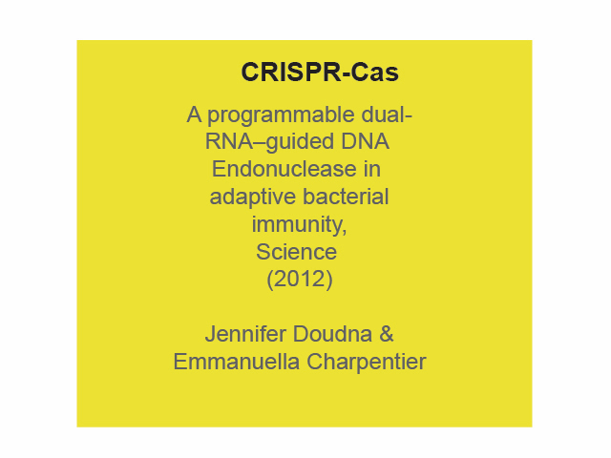

Slide 46
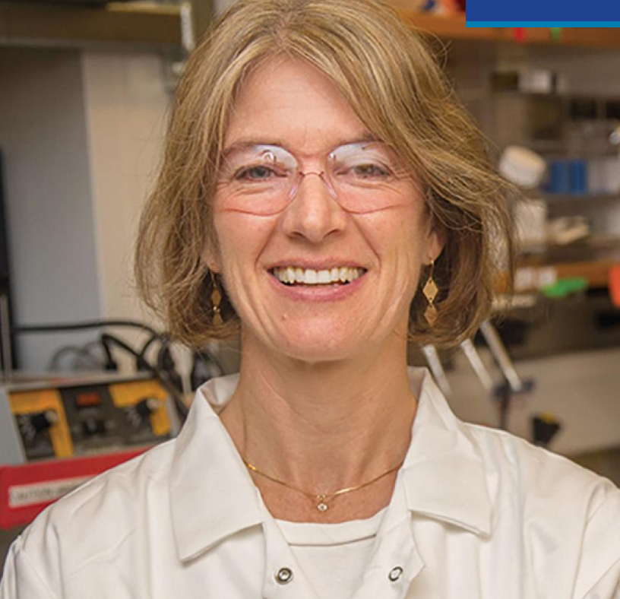

Slide 47


Slide 48

2020’S
Notes:
Taylor Swift

Slide 49
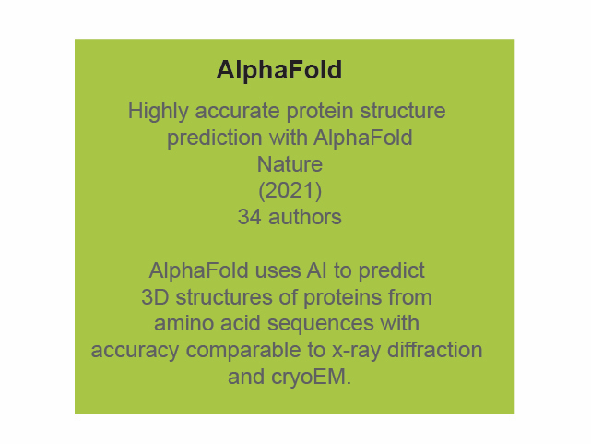

Slide 50
