Slide 1
α-helix

Slide 2
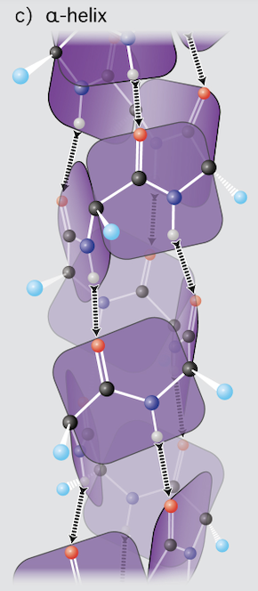

Slide 3
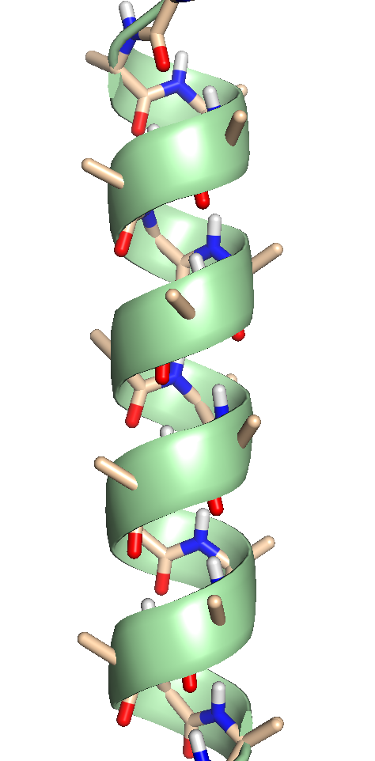
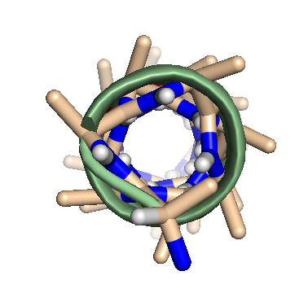
α-helix
right-handed

Slide 4
α-helix
most prevalent secondary structural element
most uniform secondary structure in conformation
most predictable secondary structure from sequence
right-handed

Slide 5
α-helix
right-handed
the NH of i+4 donates to O of i
69 H -> O 65, 68 H-> O 64, 67 H -> O 63
100°/aa

Slide 6
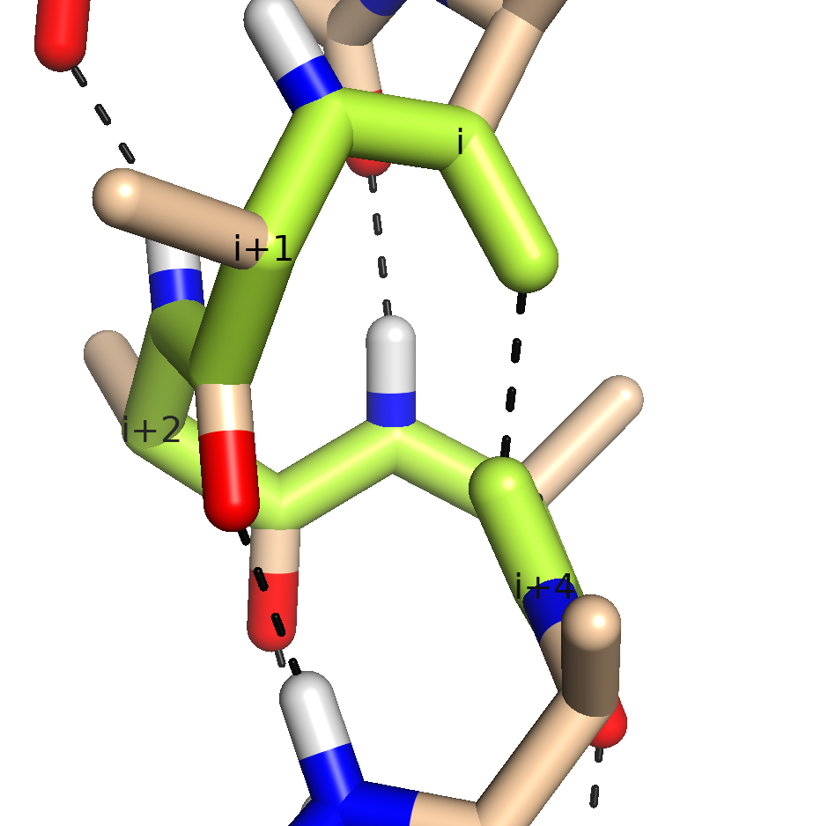
α-helix
most prevalent secondary structural element
most uniform secondary structure in conformation
most predictable secondary structure from sequence
right-handed
the NH of i+4 donates to O of I
13 atoms in the HB ring

Slide 7
α-helix
most prevalent secondary structural element
most uniform secondary structure in conformation
most predictable secondary structure from sequence
right-handed
the NH of i+4 donates to O of i
69 H -> O 65, 68 H-> O 64, 67 H -> O 63
100°/aa
φ = -50° to -90°, ϕ = -30 to -60°
3.6 aa per turn
1.5 Å/aa, 5.4 Å/turn (1.5 Å/aa x 3.6 aa/turn)
Amino-acids have 'propensities' for being in α-helices. Methionine, alanine, leucine, uncharged glutamate, and lysine ("MALEK" in the amino-acid 1-letter codes) have high helix-forming propensities. Proline and glycine have low helix-forming propensities.

Slide 8
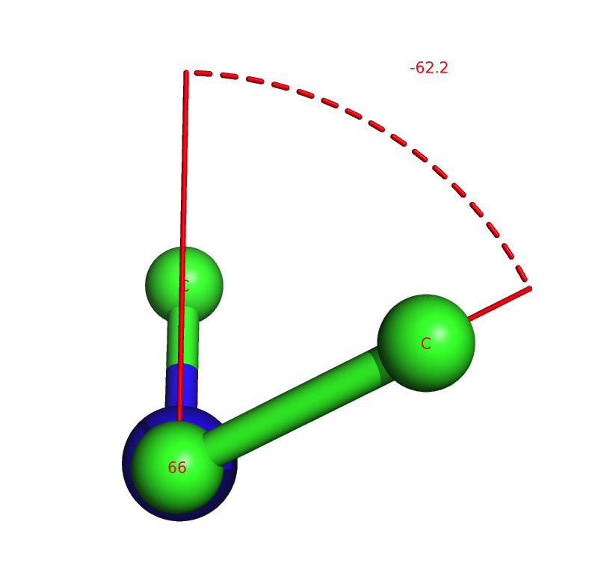
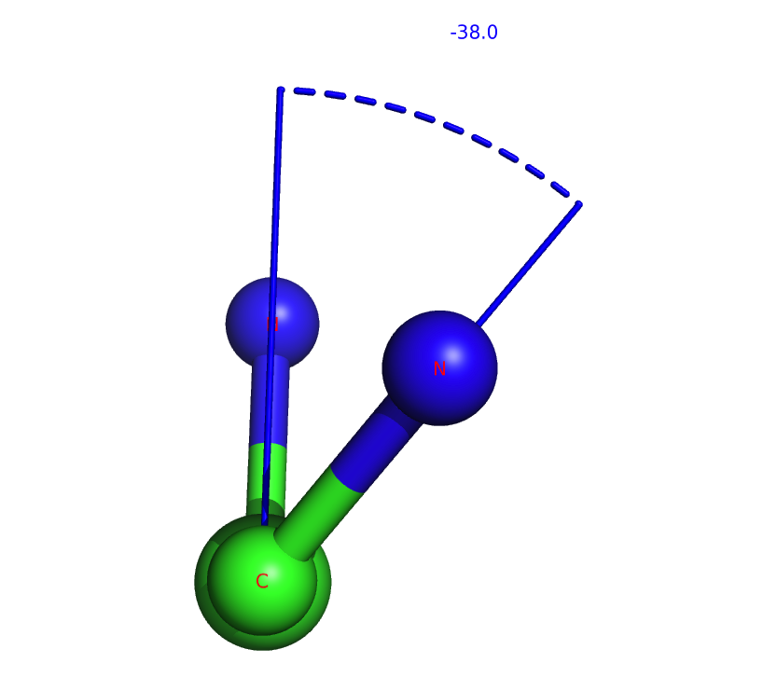
α-helix
φ = ~ -60°, ϕ = ~ -50°
angle φ in an α-helix
angle ϕ in an α-helix

Slide 9
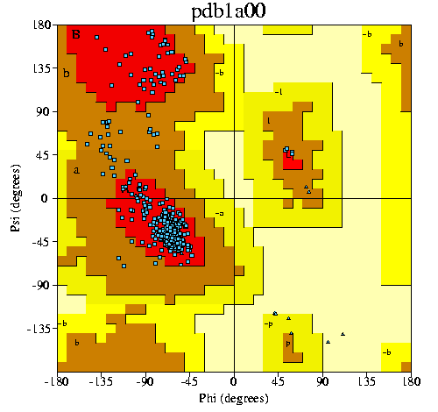
α-helix

Slide 10
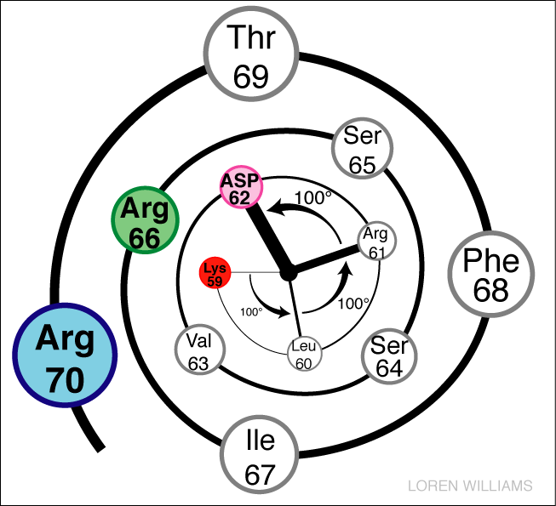
Helical Wheel
Amphipath
hydrophobic
hydrophilic

Slide 11
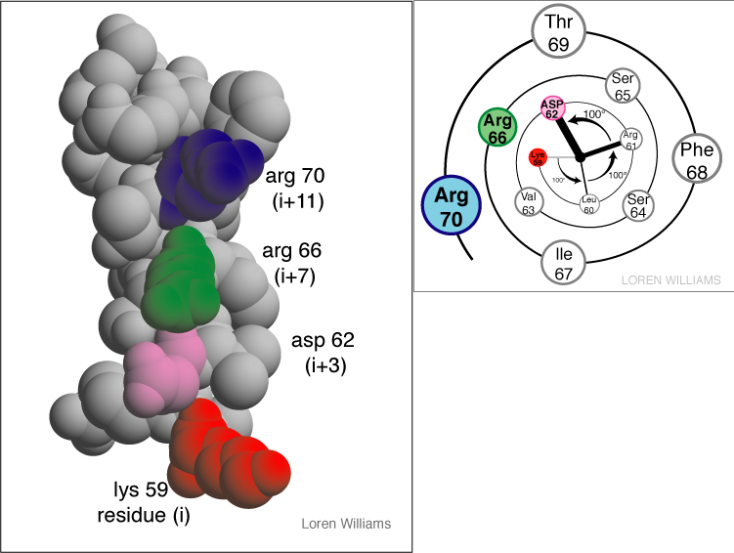

Slide 12
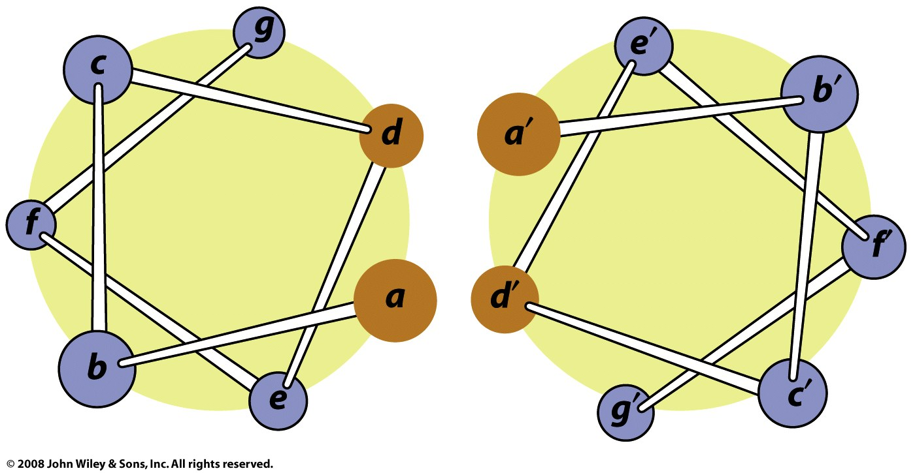
Coiled-coils: two α-helices form a "supercoil" with a heptad sequence repeat of seven aa's (a-b-c-d-e-f-g-a-b-c-d-e-f-g...). The a and d aa's are hydrophobic (d usually leucine). The e and g residues (the e and g aa's have opposing charges.

Slide 13
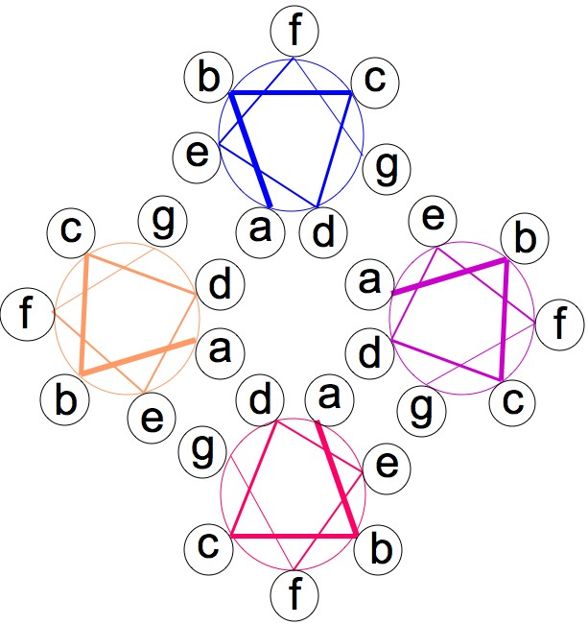
A pair of coiled-coils can form a four-helix bundle

