Slide 1
β-sheet

Slide 2
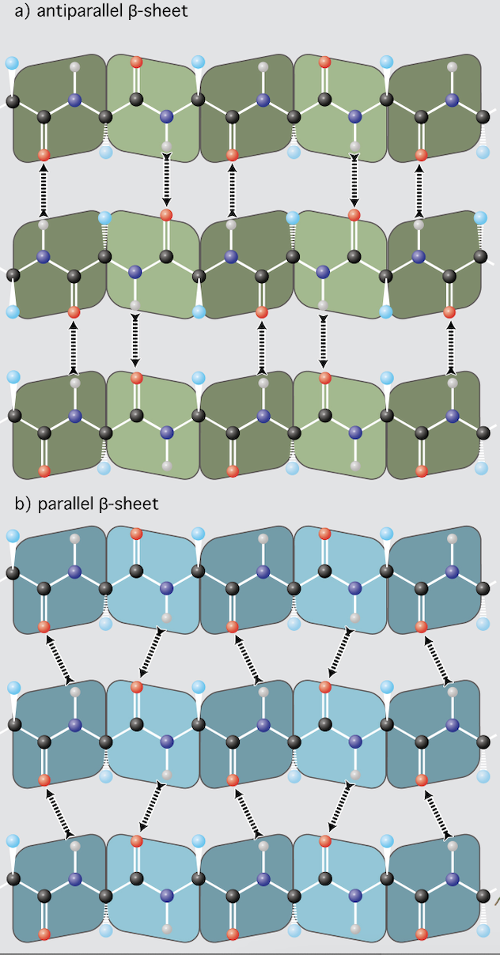

Slide 3
β strand: a single continuous stretch of amino acids involved in backbone hydrogen bonds another strand
β sheet is an assembly of at least two β strands.
Backbone N-H groups of one strand form hydrogen bonds with backbone C=O groups of adjacent strands.
Sicechain disposition: Successive side chains are above, then below the plane of the sheet.
Parallel and Antiparallel: Antiparallel sheets have the strongest inter-strand H-honds, which are linear, which is their preferred geometry.
φ = -110° to -140°
ϕ = +110° to +135°

Slide 4
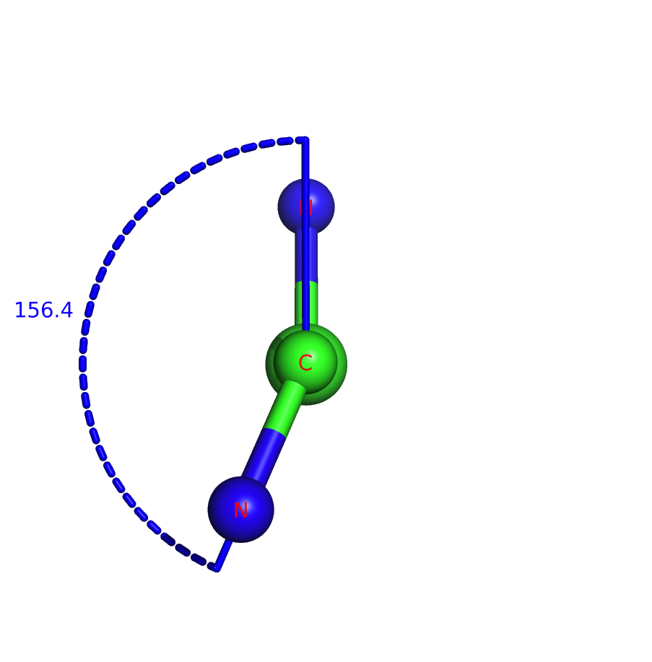
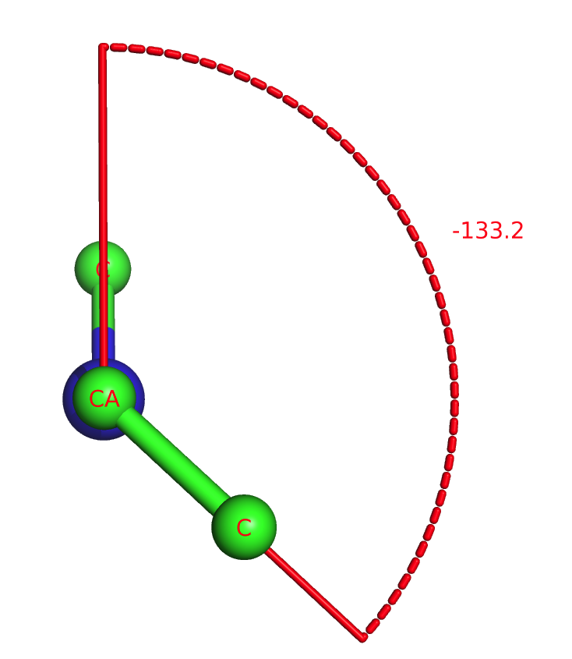
angle φ in an β-sheet
angle ϕ in an β-sheet
φ = -110 to -140 and ϕ = +110 to +135

Slide 5
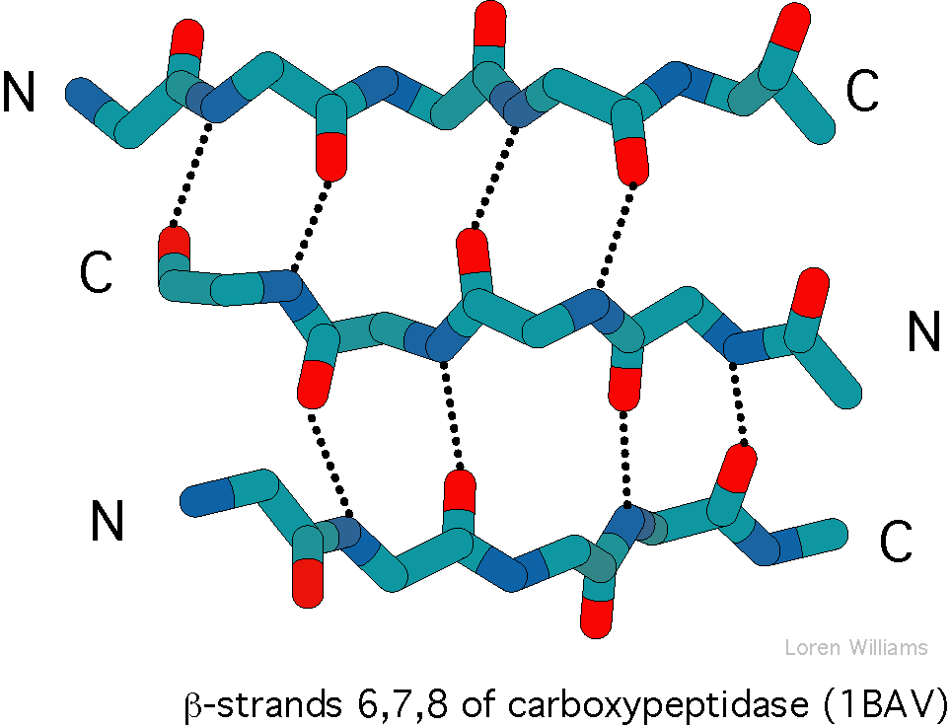
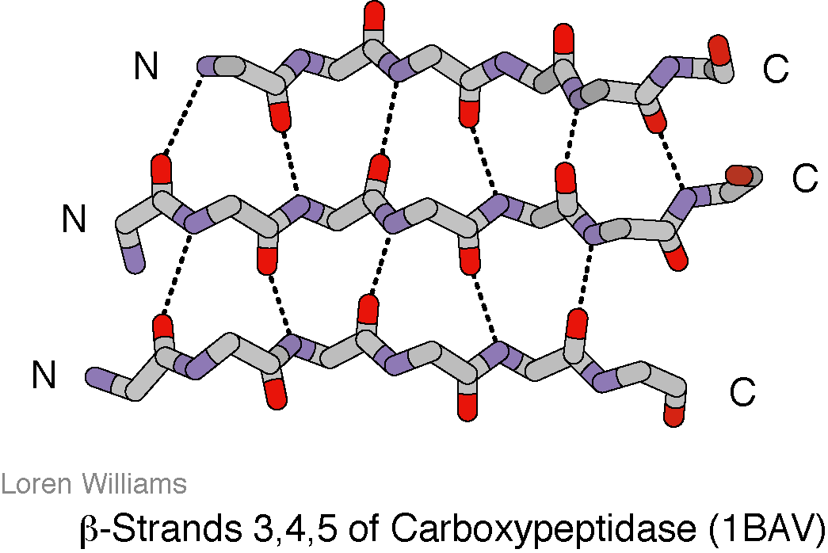
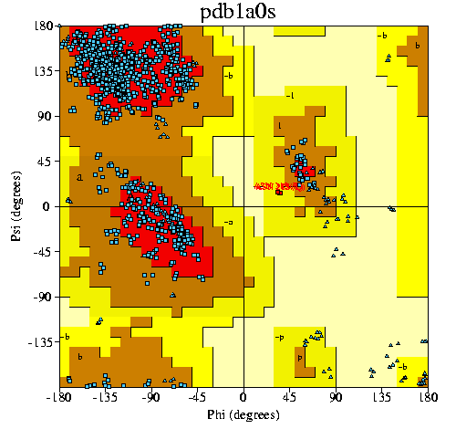
β-sheet
β-sheet
φ = -110° to -140°
ϕ = +110° to +135°
Antiparallel sheets are more extended: with larger |φ| and larger ϕ.

