Slide 1
β-turn

Slide 2
The β-turn
(1__ - 2 PRO -3 GLY - __ )
a simple protein structural motif
generally found on protein surfaces
turns the backbone around by 180 degrees to fold back on itself
links two anti-parallel two beta strands
that are adjacent in primary structure,
that are adjacent in secondary structure
is a short loop of two to five amino acids
frequently contains glycine at position 3, (small H side chain allows extreme phi-psi).
frequently contains proline at position 2, (P forces the backbone into the appropriate conformation)

Slide 3
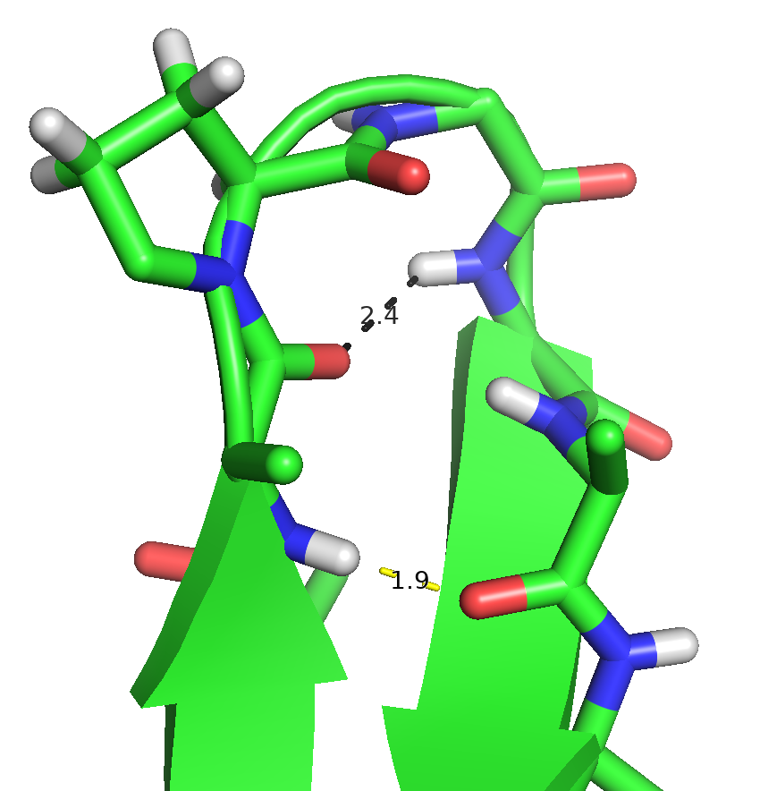

Slide 4
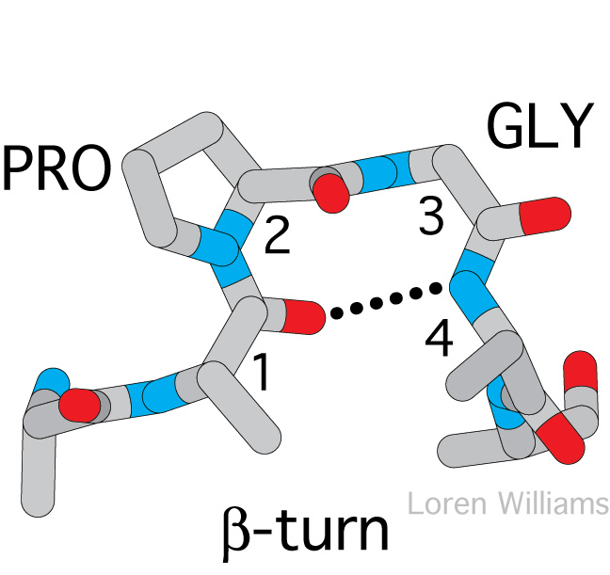

Slide 5
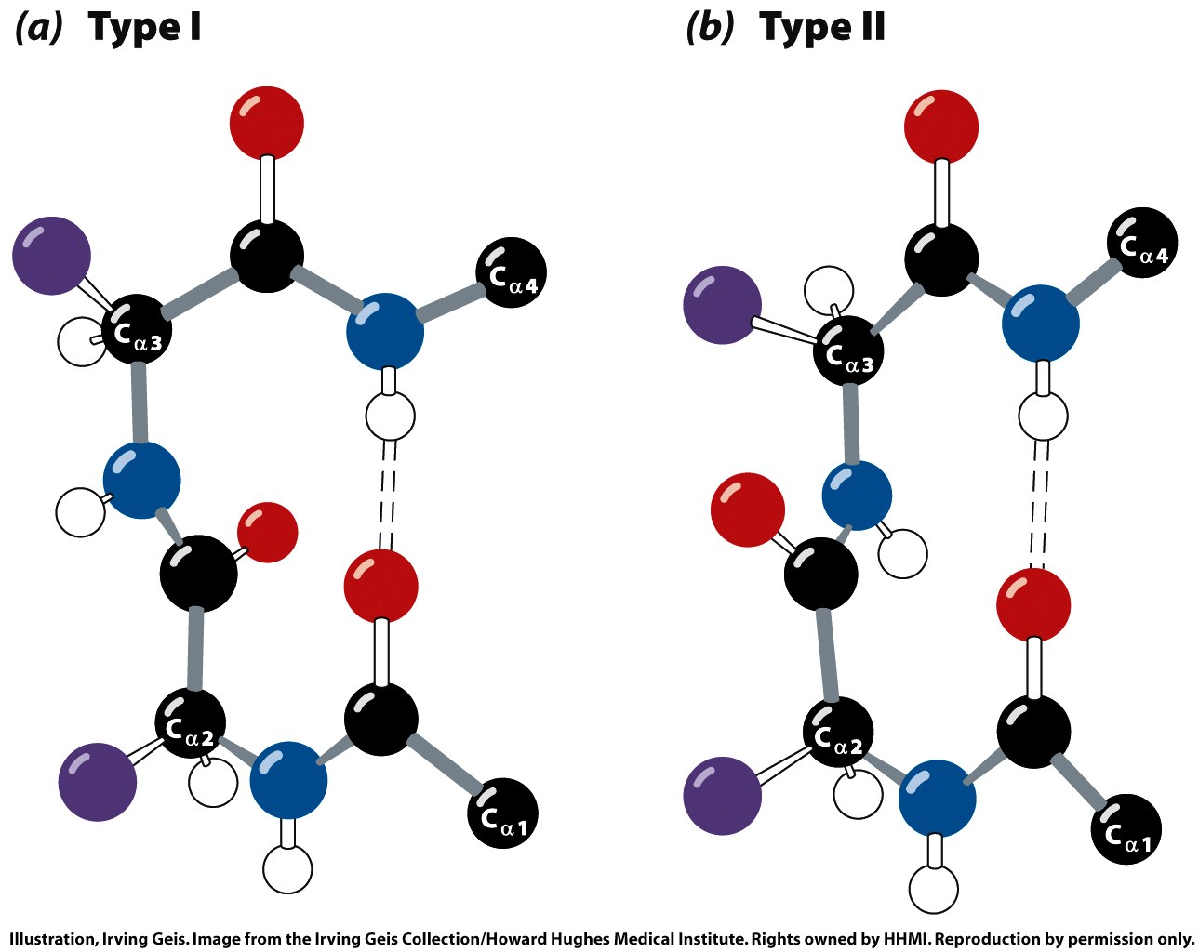
Figure 6-14

