Slide 1
Fibrous Proteins

Slide 2
α-keratin

Slide 3
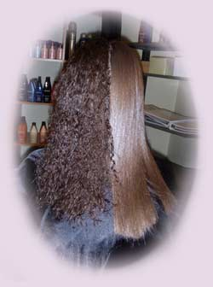
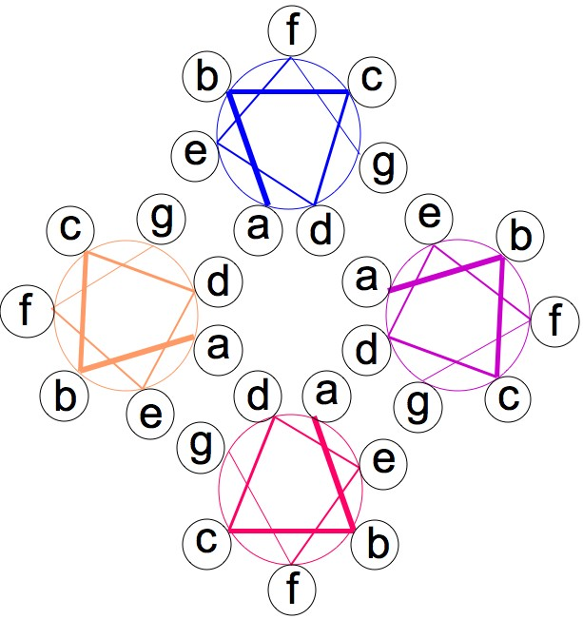
coiled-coil
fibrous structural protein
in skin, hair and nails
high frequence of cysteine that forms disulfide bridges to confer strength, form, rigidity.

Slide 4
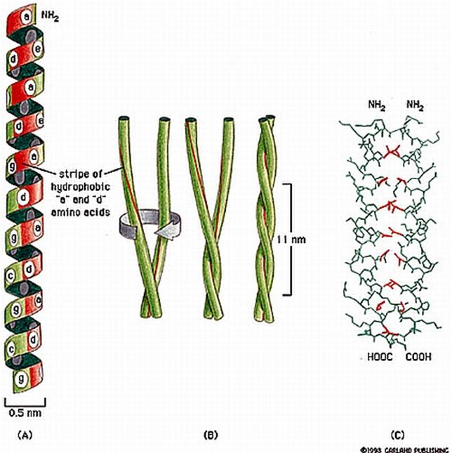

Slide 5
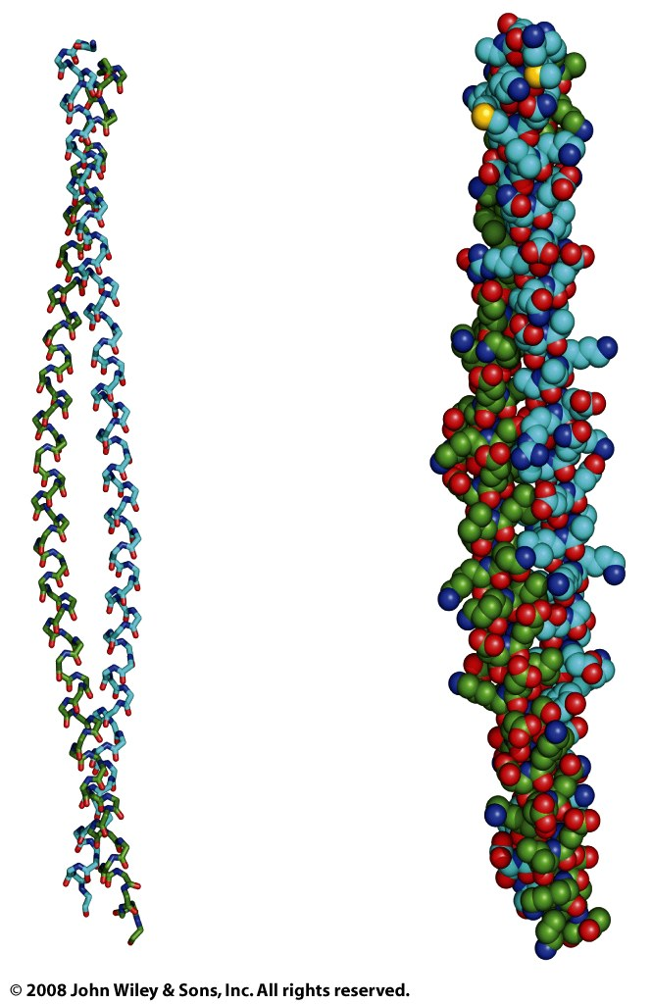
Figure 6-15b

Slide 6
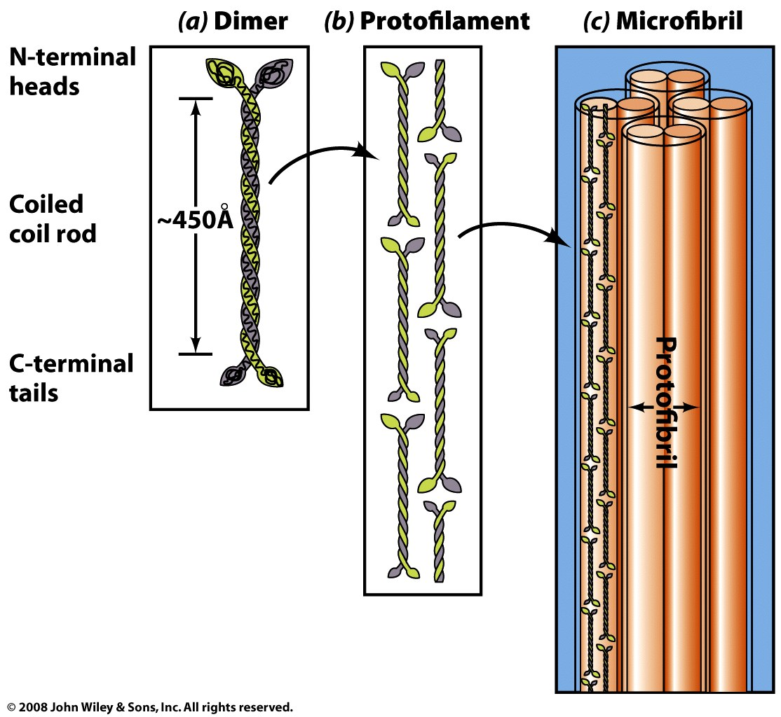
α-keratins: Hair, horns, claws, nails, hooves…

Slide 7
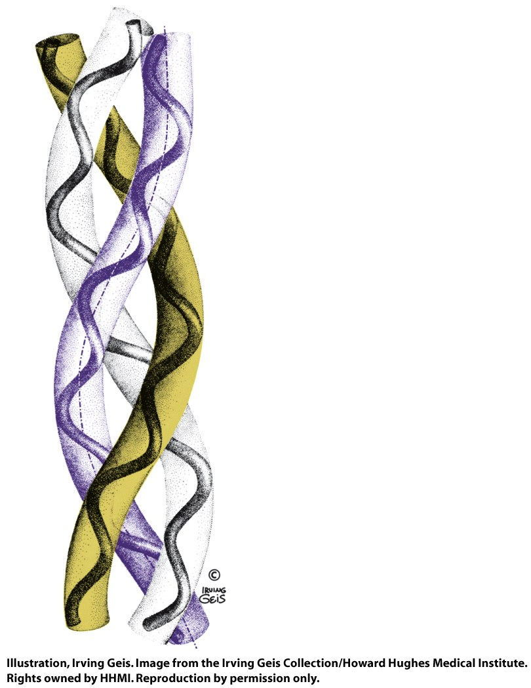
Collagen

Slide 8
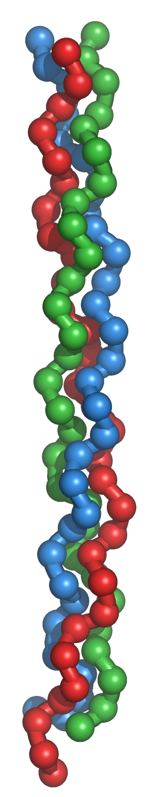
Collagen
protein found in connective tissue of vertebrates
tendons, ligaments, skin, corneas, cartilage, bones, blood vessels, etc.
is the matrix of bone on which mineral constituents are precipitated
is the most abundant protein in mammals
right-handed triple helix
each triple helix is wound together with the two other triple helices to form a right handed fiber
amino acid sequence is repeating Gly-X-Y, where X is often proline and Y is proline or hydroxyproline
every third residue lies near the center of the triple helix and can only be glycine
the number of amino acid in a chain averages around 1,000
Collagen has many modified amino acid sidechains (hydroxyproline and hydroxylysine)
Hydroxyproline helps to stabilize the triple helix via hydrogen bonds.
Hydroxylysine provides attachment sites for polysaccharides
Hydroxylation of proline requires ascorbic acid (vitamin C). Deficiency of vitamin C reduces hydroxyproline production, leading to weakened collagen fibers and the condition known as scurvy.

Slide 9
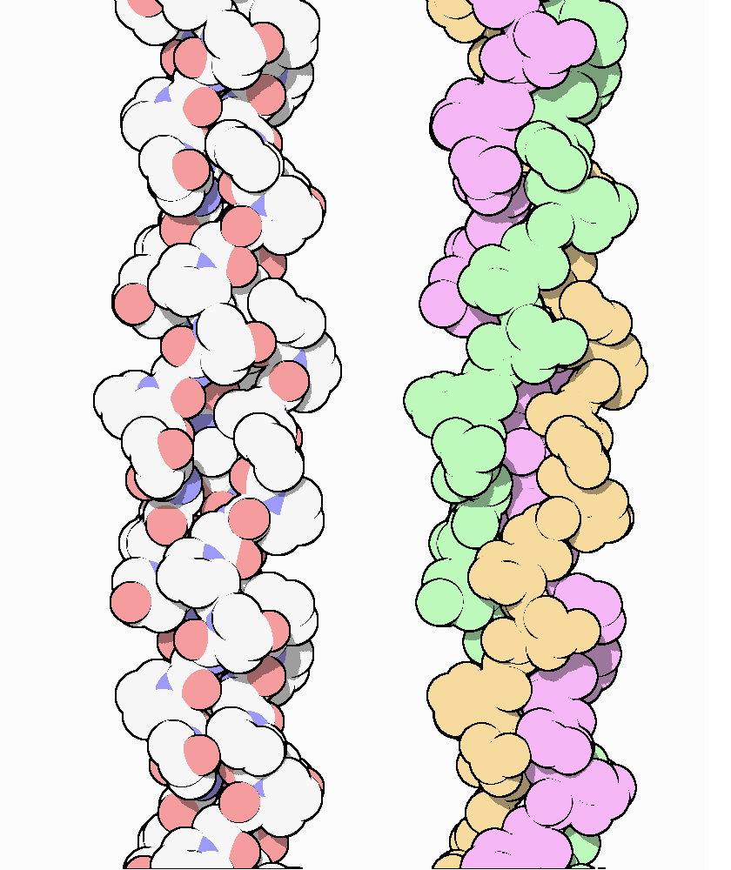
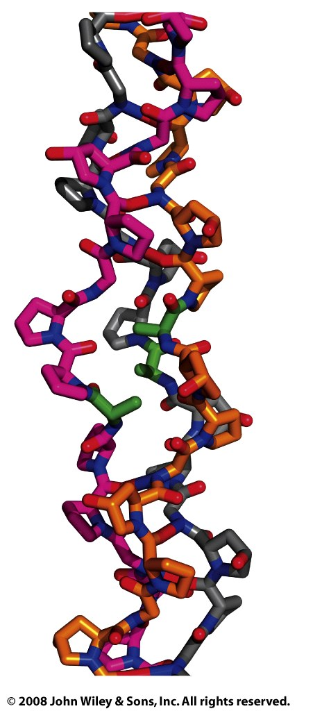

Slide 10
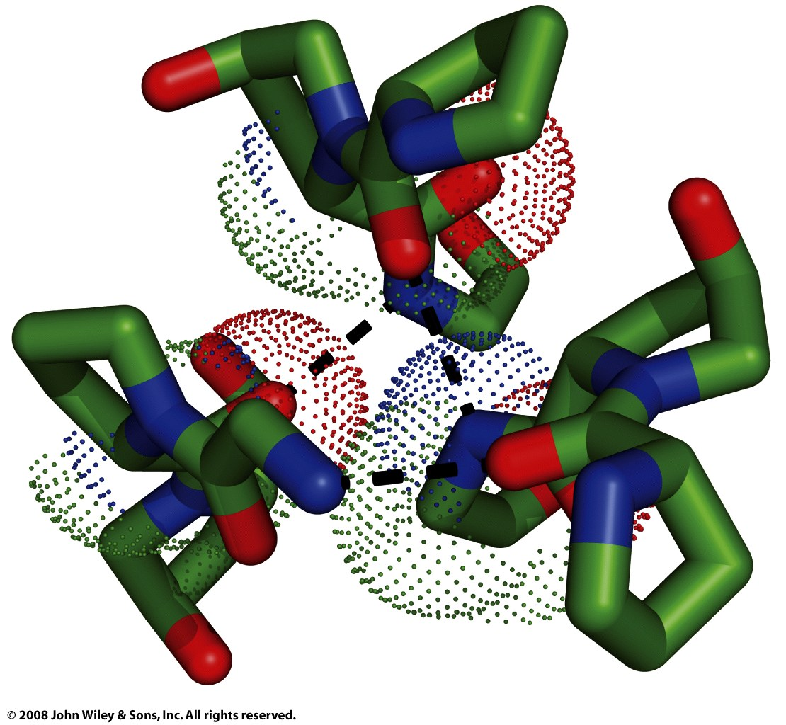
Figure 6-18b

Slide 11
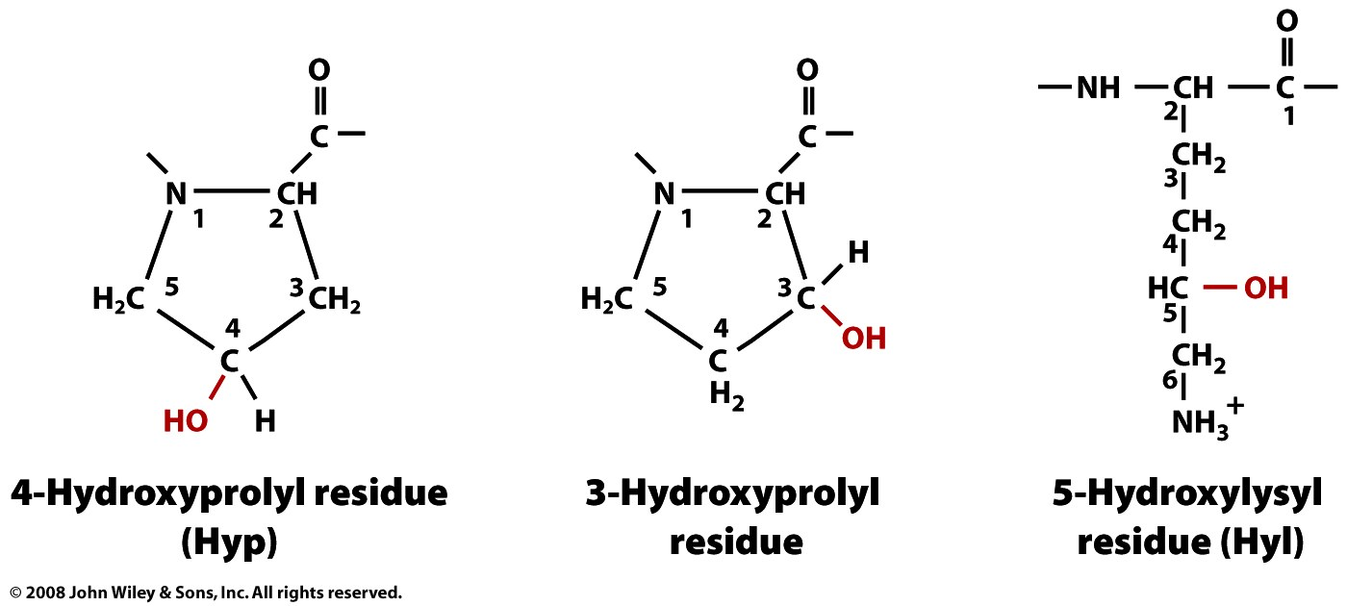
Page 137

