Slide 1
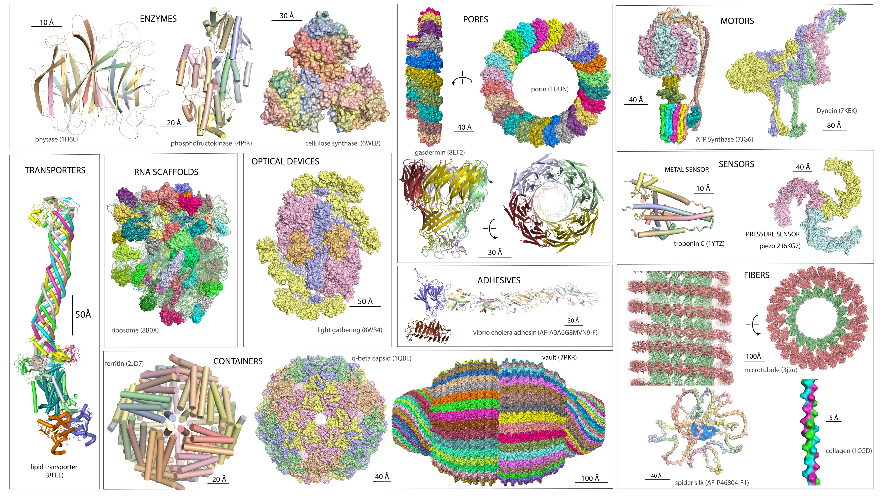

Slide 2
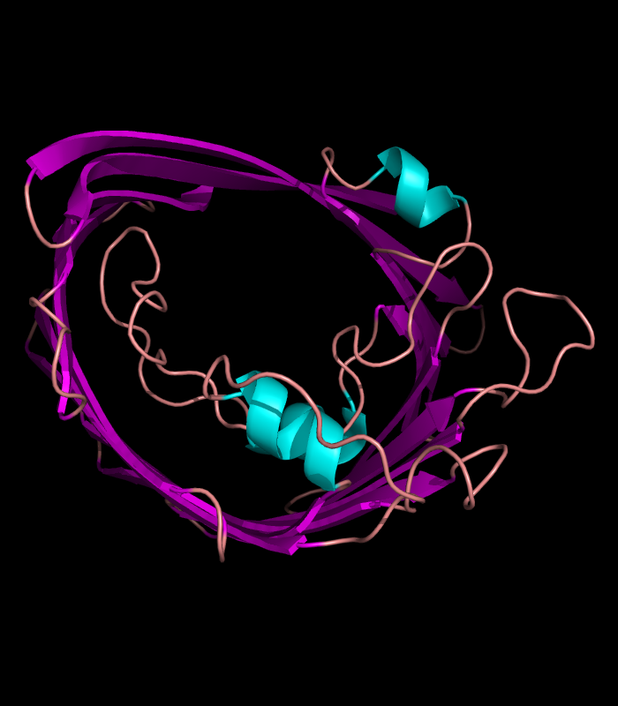
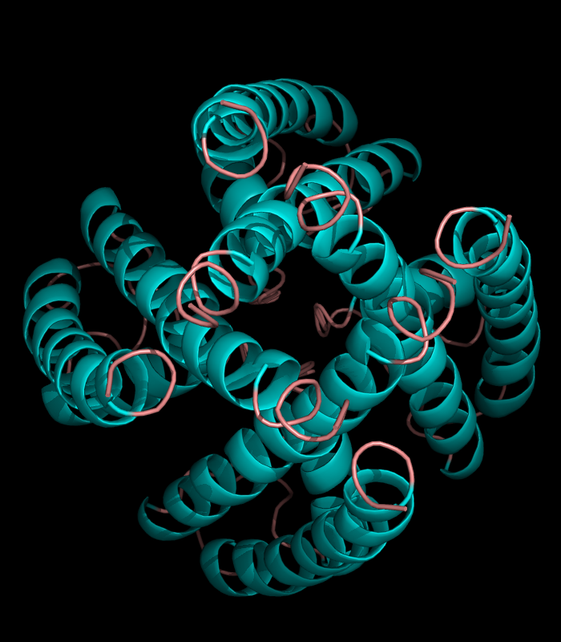
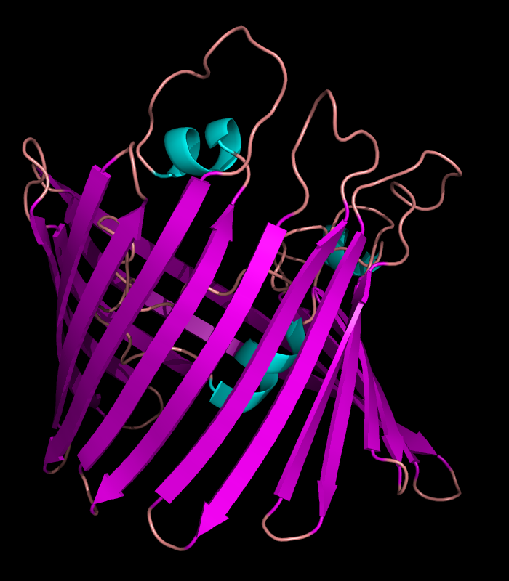
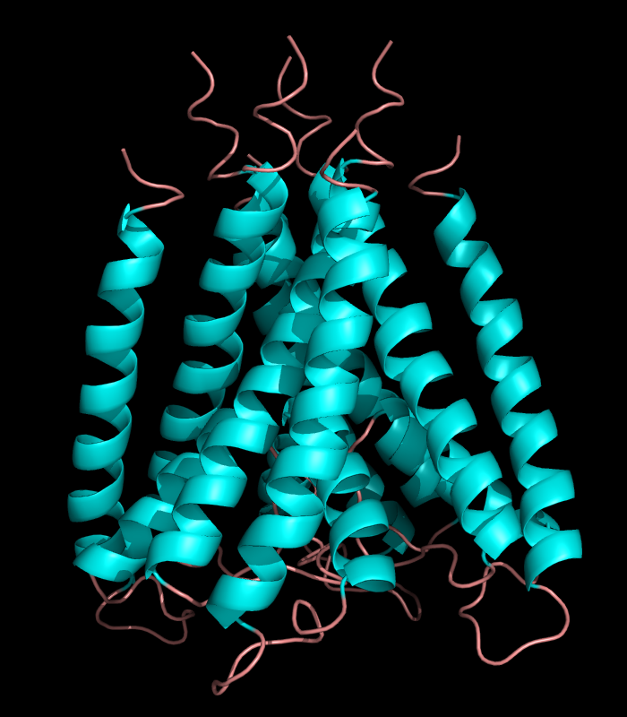

Slide 3
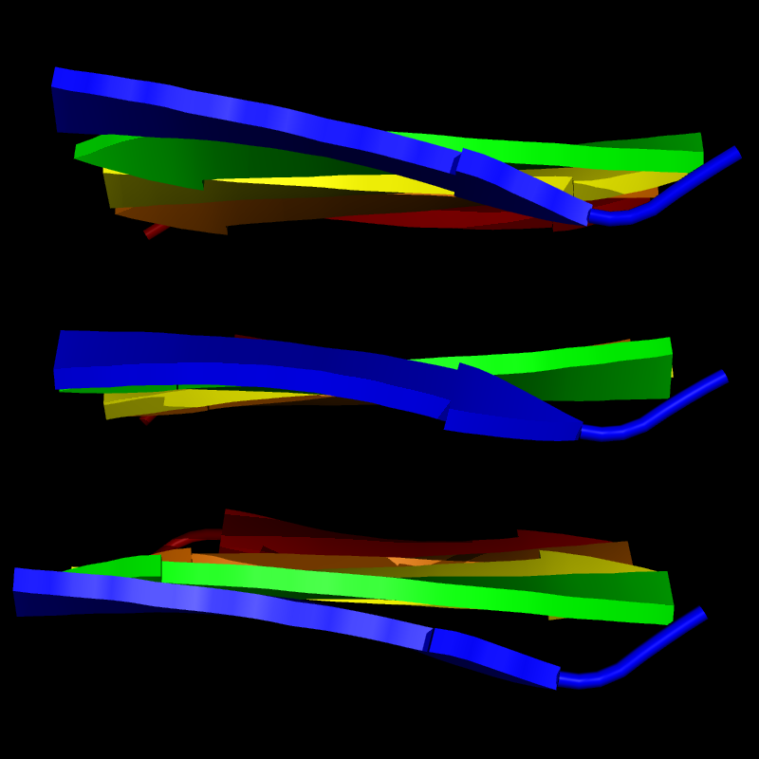
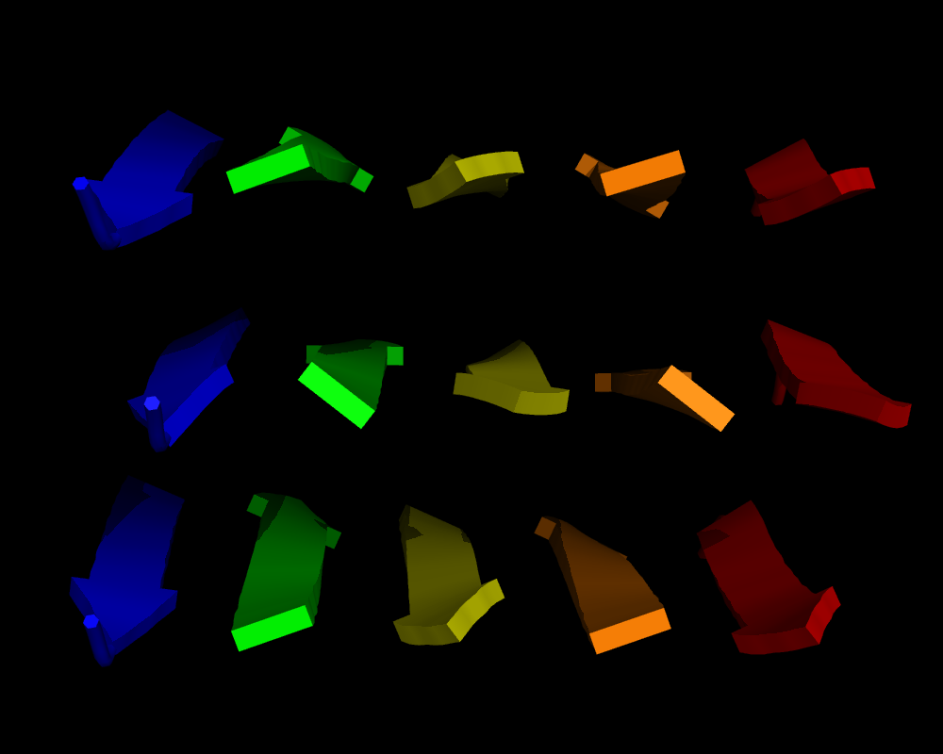

Slide 4
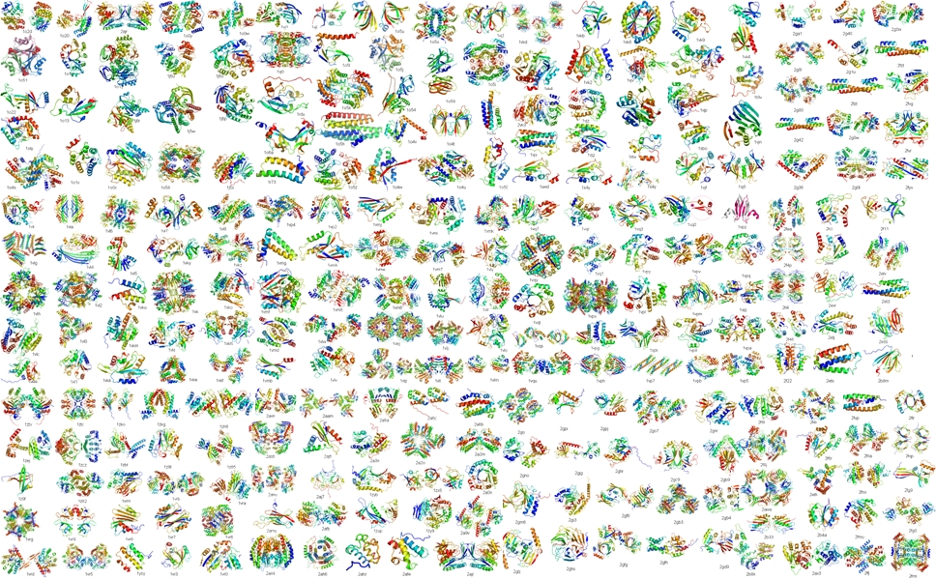

Slide 5
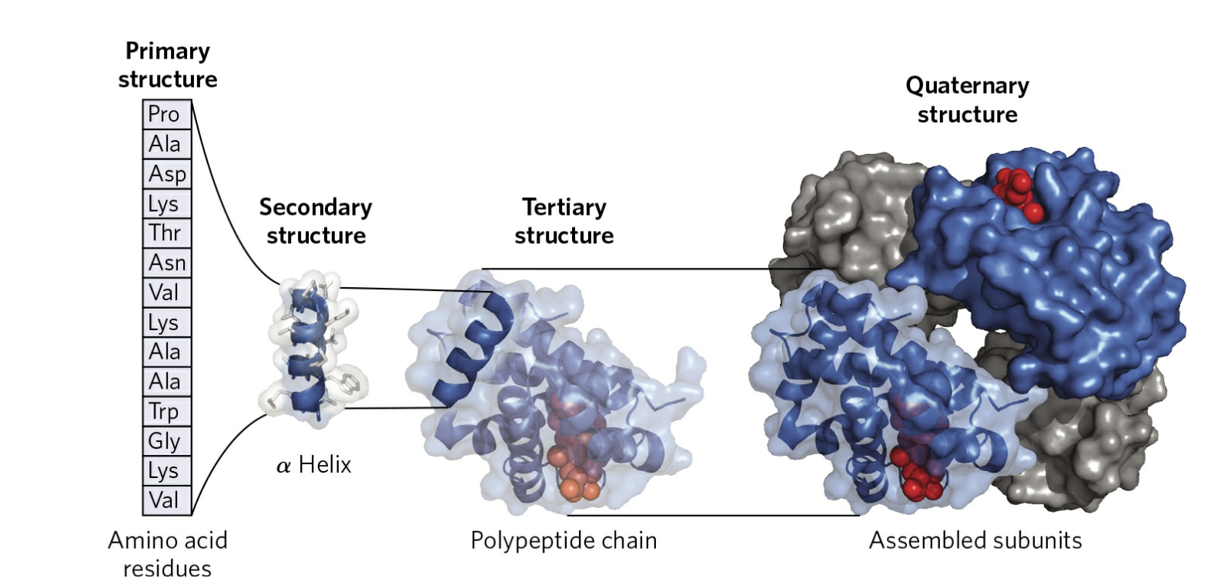
Levels of Protein Structure
Levels of structure in proteins. The primary structure consists of a sequence of amino acids linked together by peptide bonds and includes any disulfide bonds. The resulting polypeptide can be arranged into units of secondary structure, such as an α helix. The helix is a part of the tertiary structure of the folded polypeptide, which is itself one of the subunits that make up the quaternary structure of the multisubunit protein, in this case hemoglobin.

Slide 6
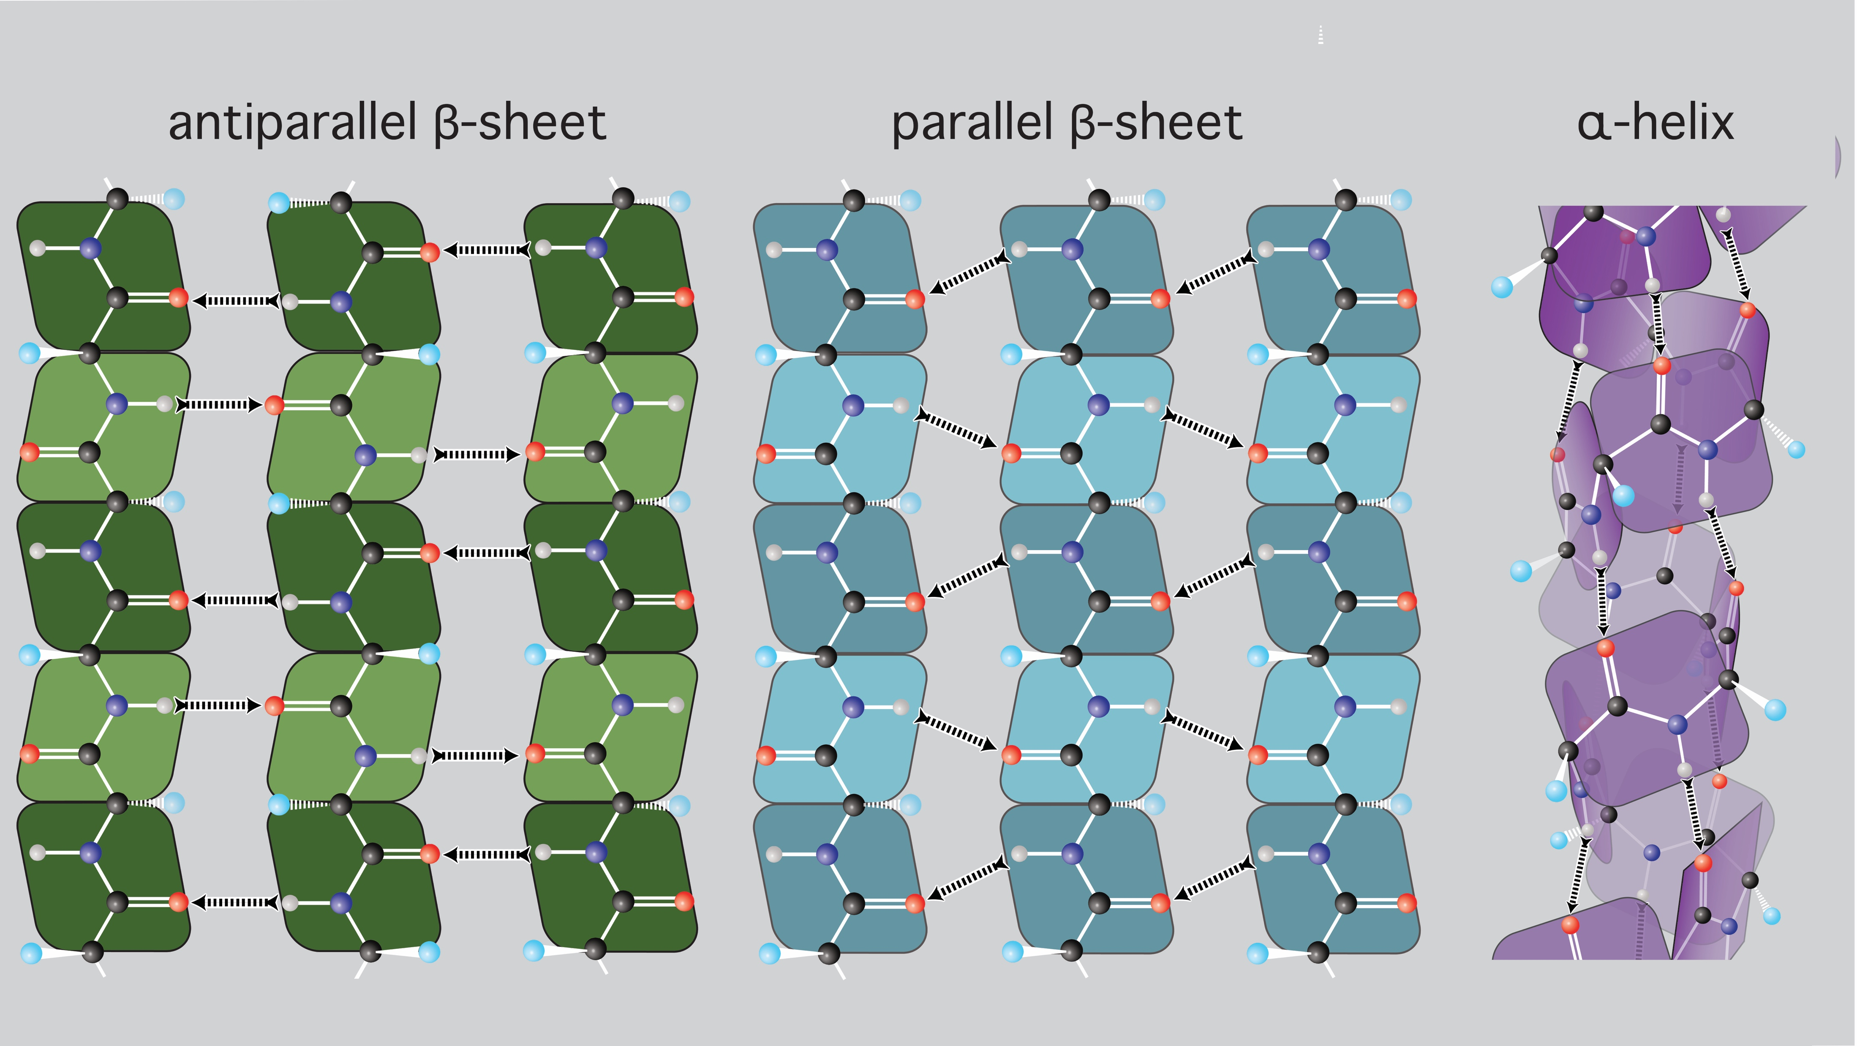
secondary structures: parallel/antiparallel β-sheet, α-helix, β-turn

Slide 7
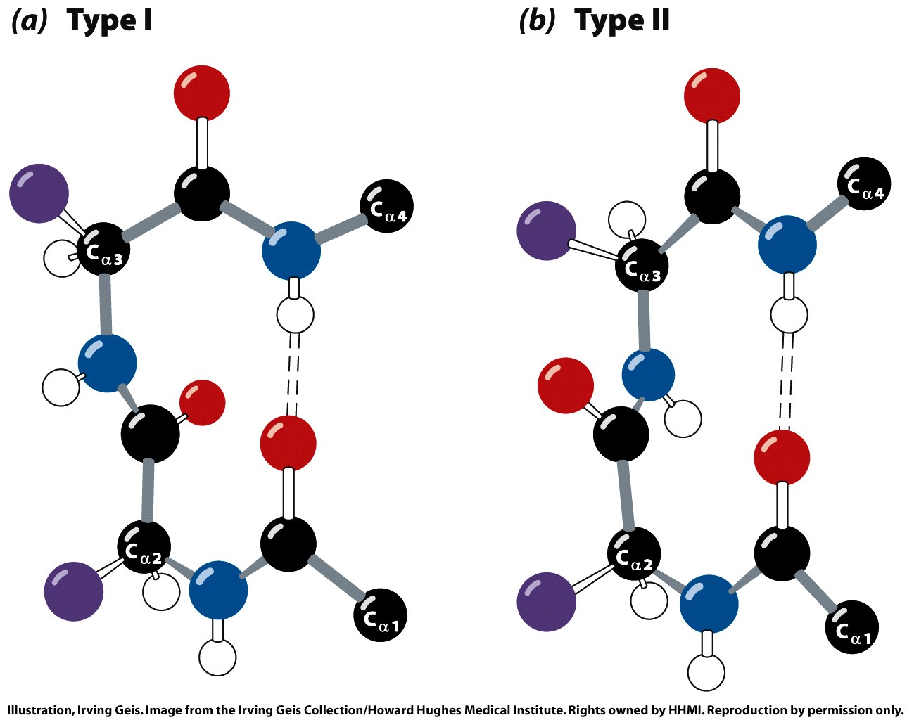
secondary structures: parallel/antiparallel β-sheet, α-helix, β-turn
Structures of β turns. Type I and type II β turns are most
common, distinguished by the ϕ and ψ angles taken up by the peptide backbone in the turn. Type I turns occur more than twice as frequently as type II. Although many amino acid residues are accommodated in these turns, some biases are evident.
Pro is the most common residue at position 2 in type I turns, appearing in about 16% of them. Pro is also the most common residue at position 2 in type II turns, appearing about 23% of the time. The most prominent bias is the presence of Gly at position 3 in more than 75% of type II turns. Note the hydrogen bond between the peptide groups of the first and fourth residues of the bends. (Individual amino acid residues are framed by large blue circles. Not all H atoms are shown in these depictions.)

Slide 8
secondary structures in porin: antiparallel β-sheet, α-helix, β-turn

