Slide 1
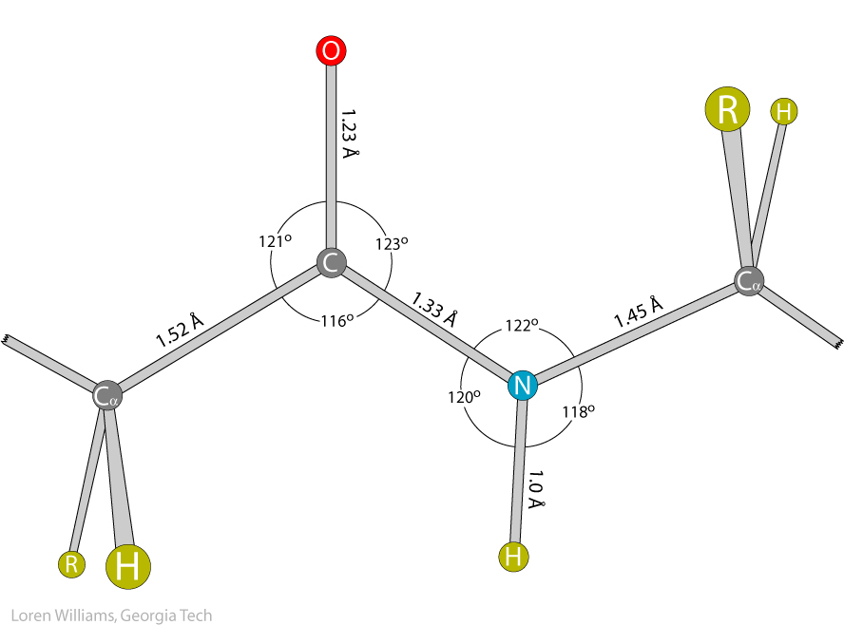

Slide 2
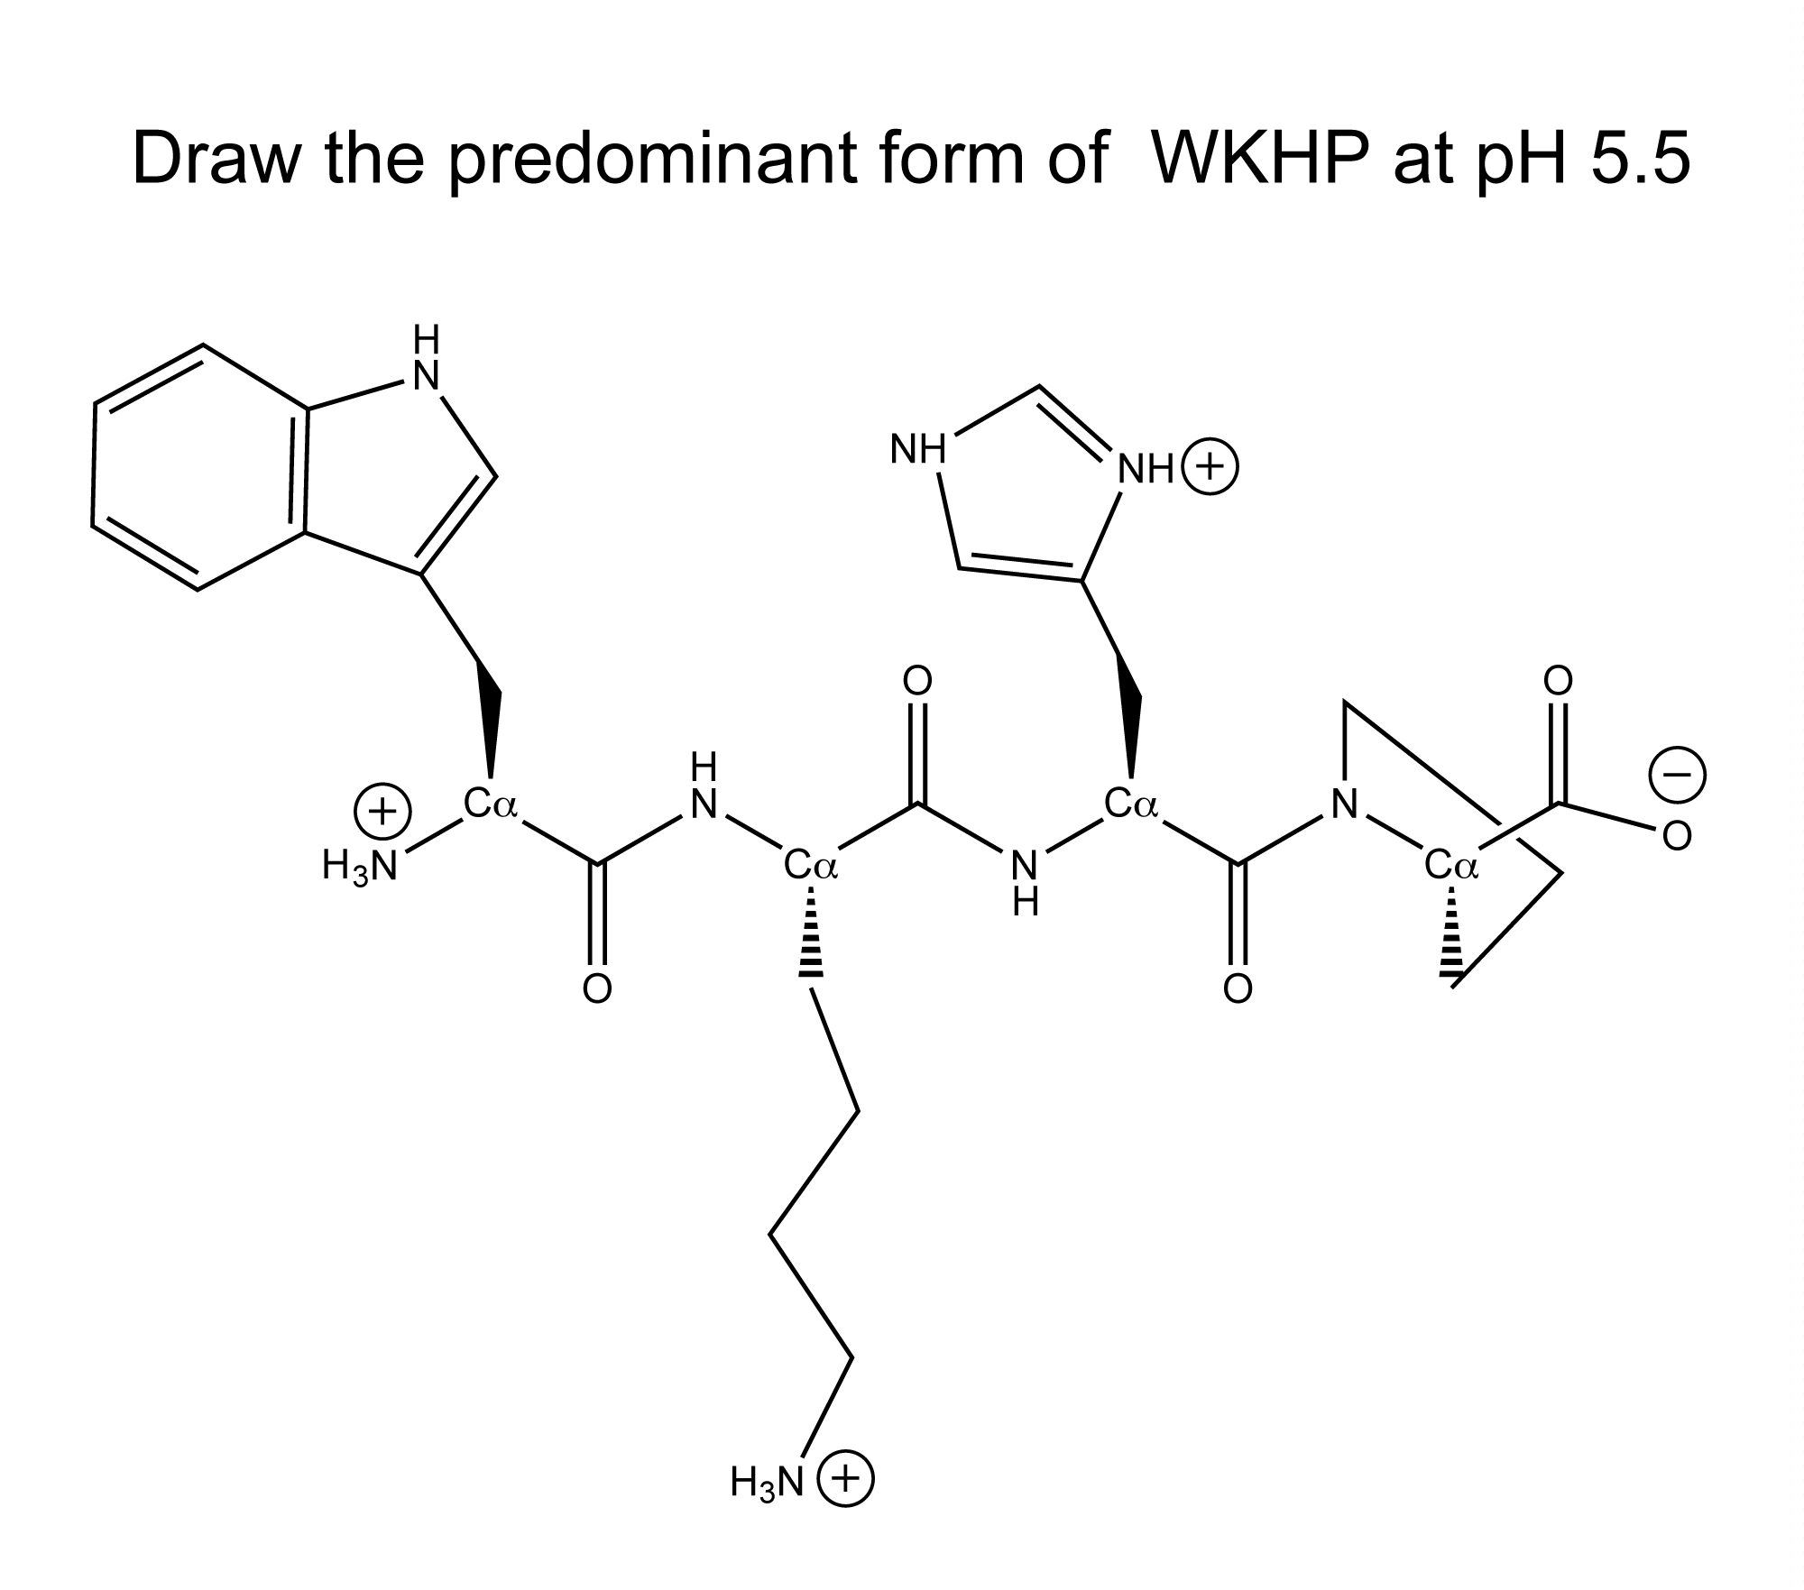

Slide 3
This is how I want you to draw peptides
N to C (---->)
correct stereochemistry at Cα
correct ionization states (His,Cys)
draw all H, except those bonded to C
no chemical mistakes

Slide 4
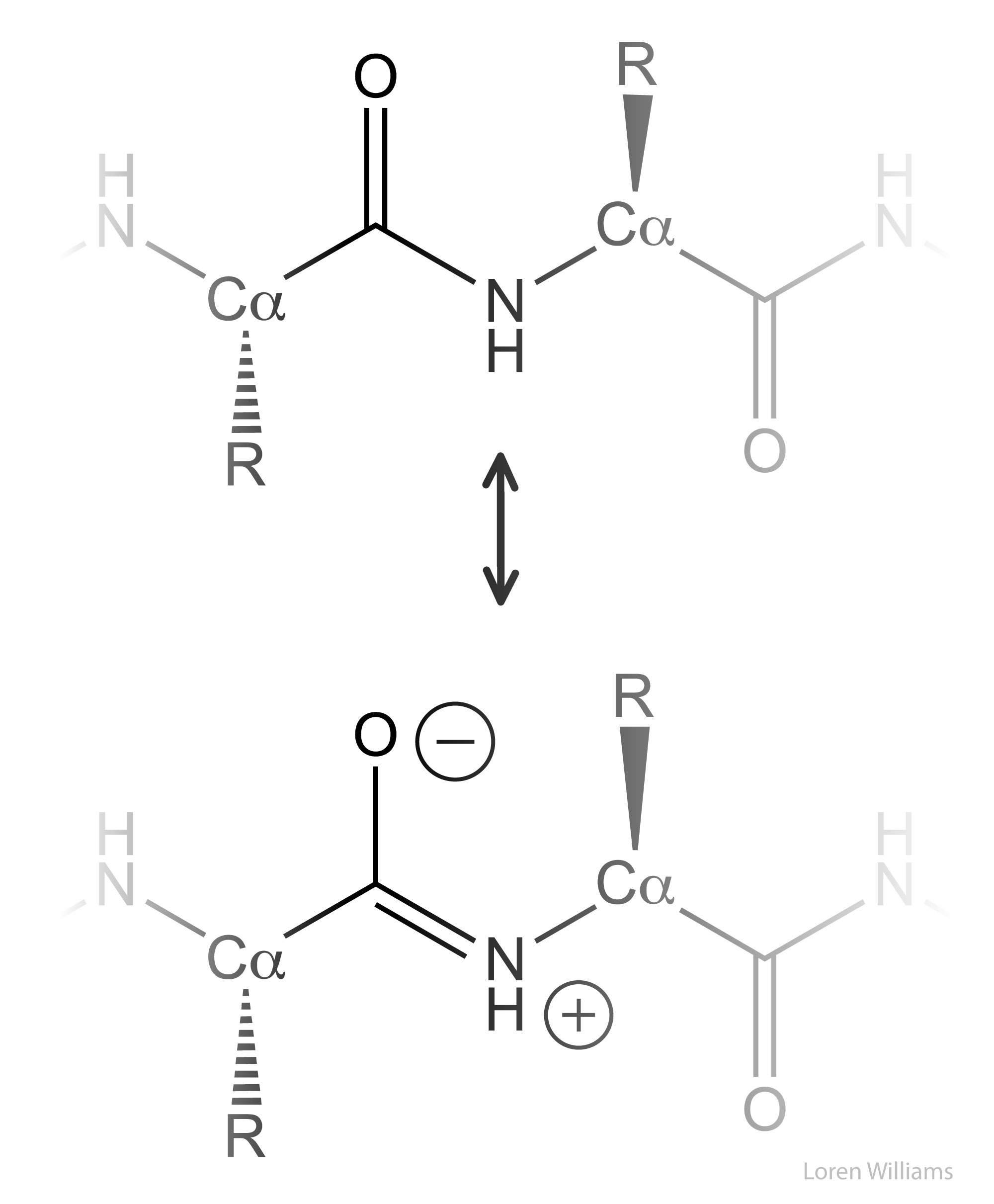
The Peptide Bond: Resonance
Page 127

Slide 6
