Slide 1
Protein Folding
& Misfolding

Slide 2
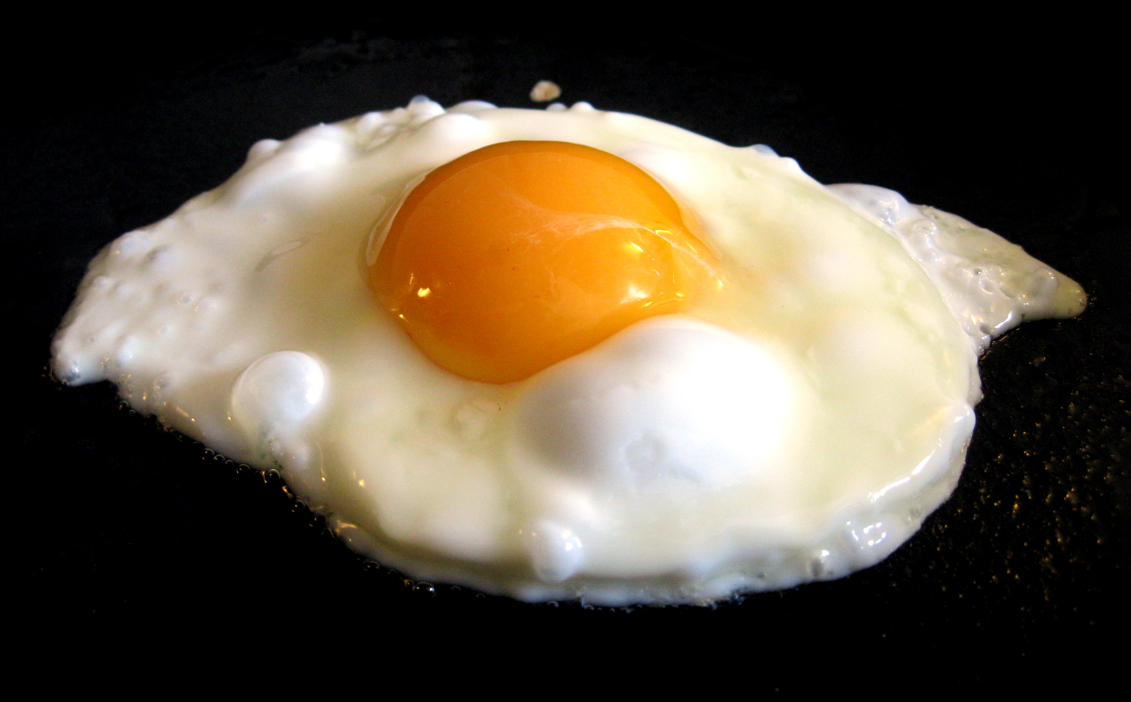

Slide 3
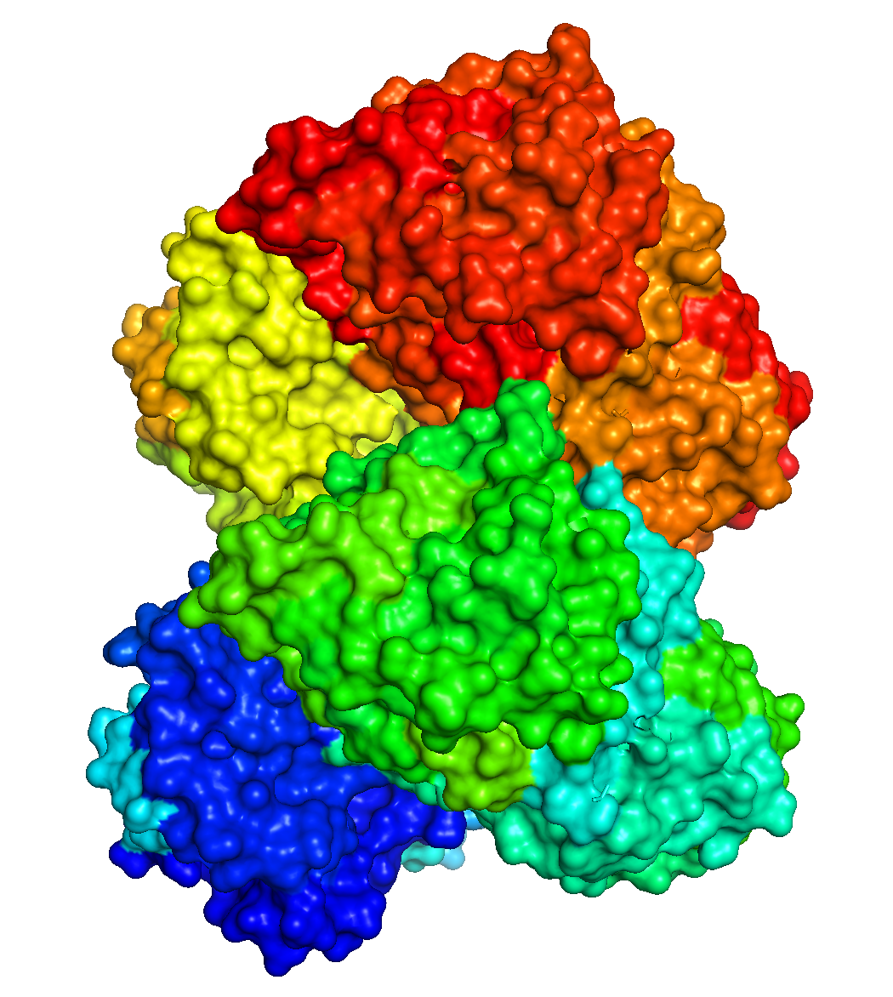
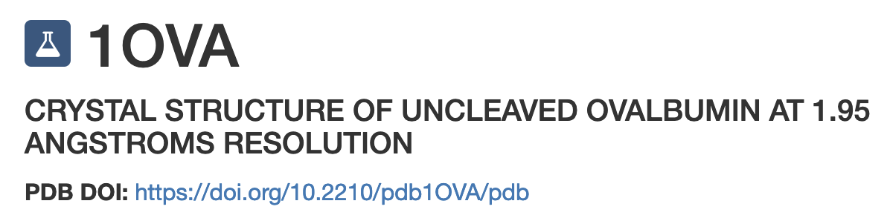

Slide 4
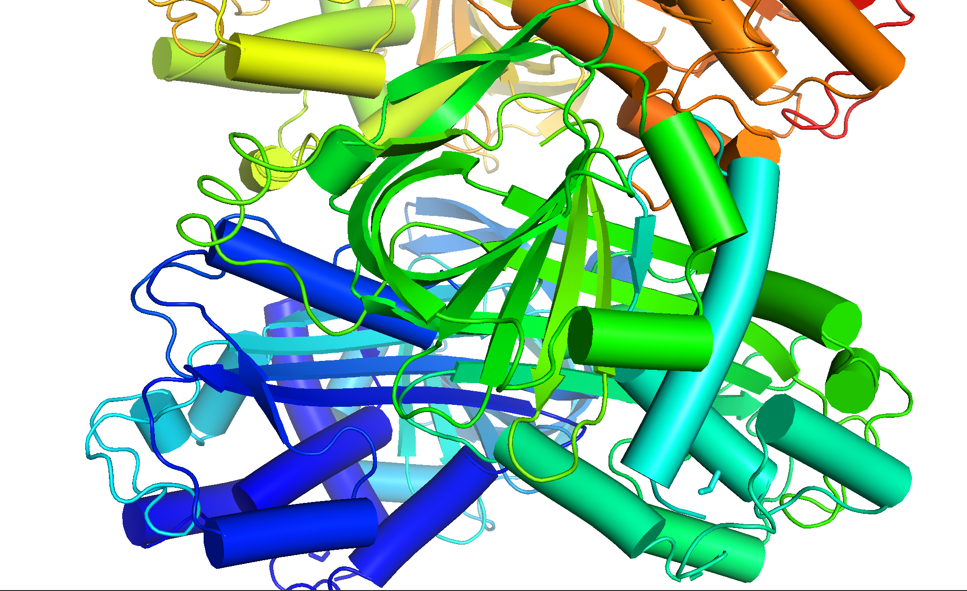

Slide 5
What happens when you hard boil an egg?
When egg is heated (does not have to be too hot, ~65 deg C), ovalbumin denatures, meaning the native globular structure unfolds. Quaternary, tertiary and (some secondary structure) falls apart.
When it unfolds, hydrophobic regions of ovalbumin, (which are buried in the native state), are exposed, leading to non-native intra-protein protein-protein interactions (aggregation).
As unfolded ovalbumin molecules aggregate, they form intramolecular β-sheets. Exposed edges of β-sheets nucleate formation of additional b-sheets.
When you boil an egg you are converting α-helix and loops to β-sheet, which is the thermodynamic ground state (at high concentration).

Slide 6
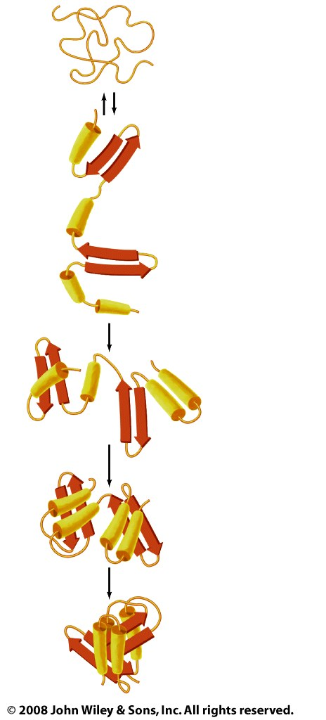
In the old days we were taught Anfinsen’s Dogma,
(aka the thermodynamic hypothesis)
the Native State
is unique,
is the functional state,
is the thermodynamic ground state,
is kinetically accessible (no knots etc.),
is determined only by the protein's amino acid sequence.
Anfinsen’s Dogma does not explain what happens when you boil an egg.
Anfinsen’s Dogma ignores the backbone – the backbone is a primary determinant of the native state, the sequence is a second order perturbation.
Figure 6-40

Slide 7
Most proteins are in marginally stable folded states in a tenuous balance between native and non-native states.

Slide 8
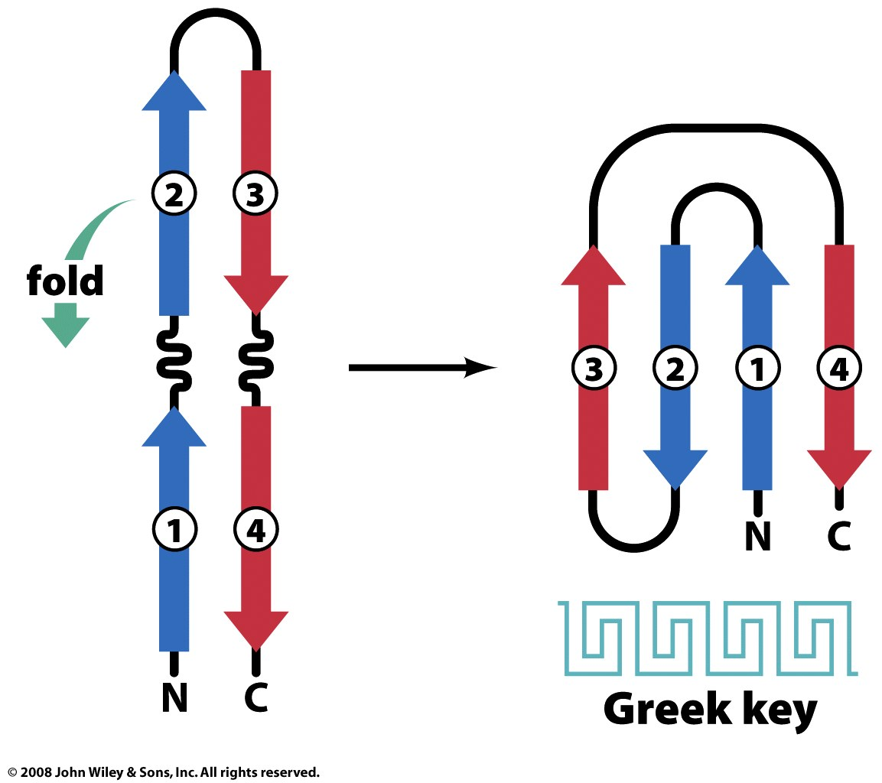
What does it mean to be
kinetically accessible

Slide 9
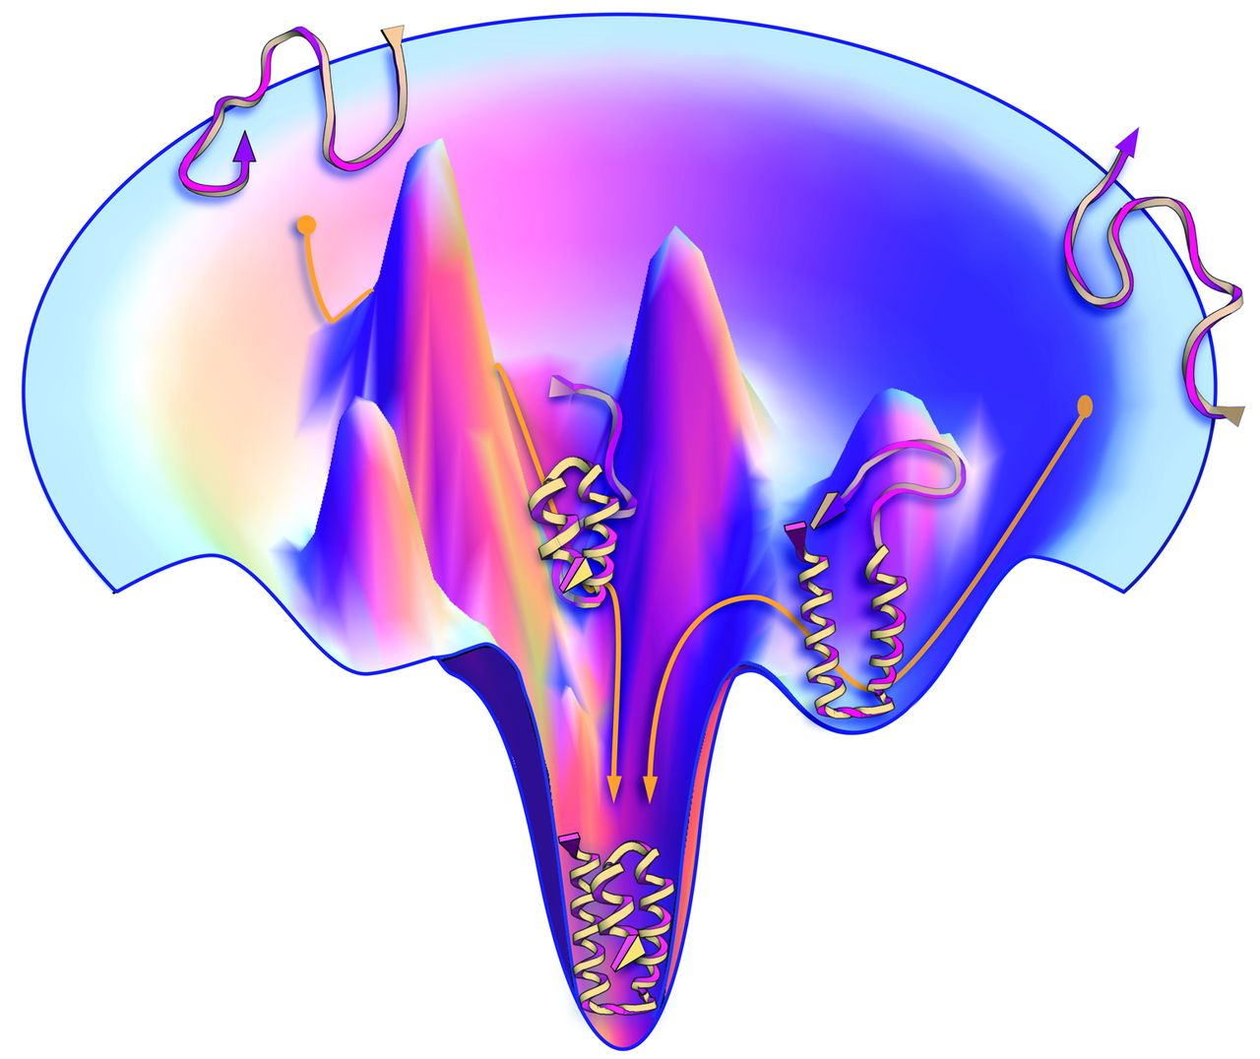
The Protein-Folding Problem, 50 Years On
Ken A. Dill and Justin L. MacCallum
Science, 23 Nov 2012
Vol 338, Issue 6110
pp. 1042-1046
DOI: 10.1126/science.1219021
Proteins have a funnel-shaped energy landscape with many high-energy, unfolded structures and only a few low-energy, folded structures. Folding occurs via alternative microscopic trajectories.

Slide 10
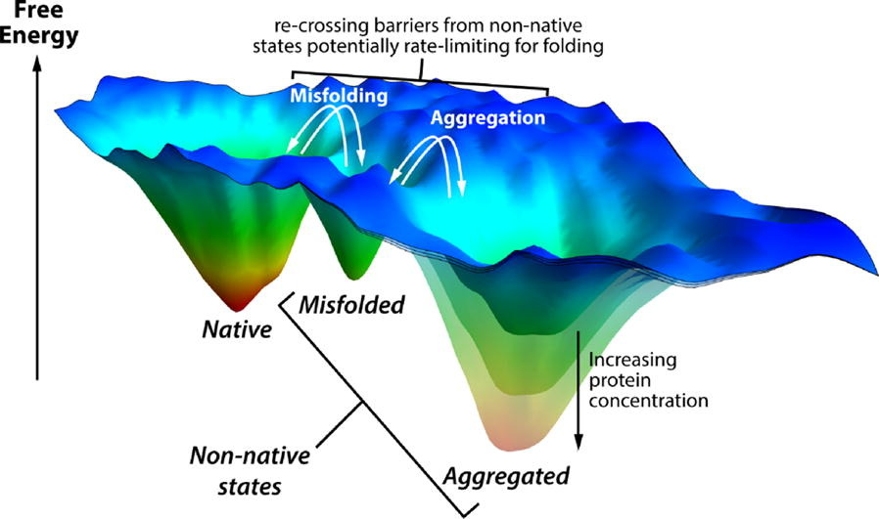
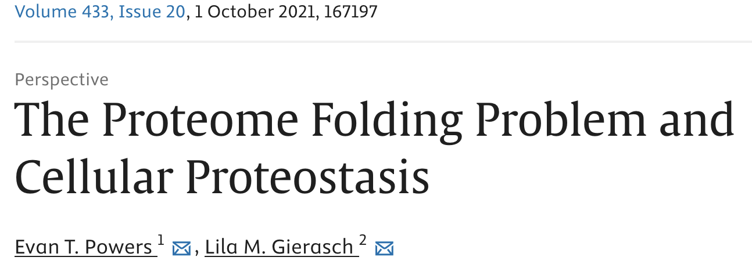

Slide 11
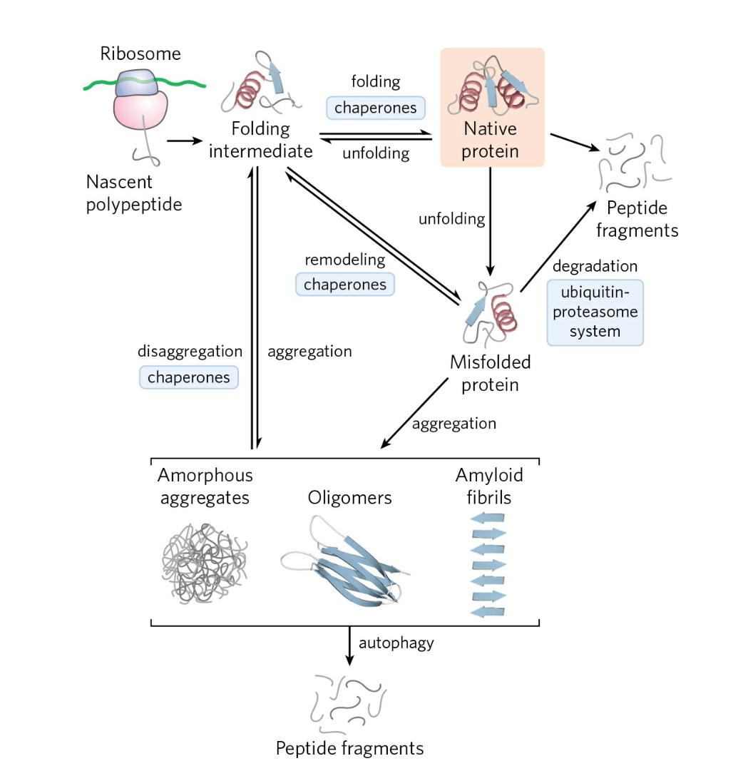
LEHNINGER FIGURE 4-25
Proteostasis. Dynamic maintainence of a functional proteome
1) Proteins are synthesized by the ribosome.
Protein folding* initiates within the exit tunnel of the ribosome (not shown here). The exit tunnel is a chaperone for α-helices (no room for β-sheets).
2) Chaperones (and chaperonins) can refold proteins that are partially and transiently unfolded or misfolded.
2) Some proteins irreversibly unfold or misfold
a) These proteins are sequestered and degraded in the proteasome,
b) Or cause disease (mad cow, etc)
* Some proteins are intrinsically disordered (do not fold).
[See F. U. Hartl et al., Nature 475:324, 2011, Fig.
6.]

Slide 12
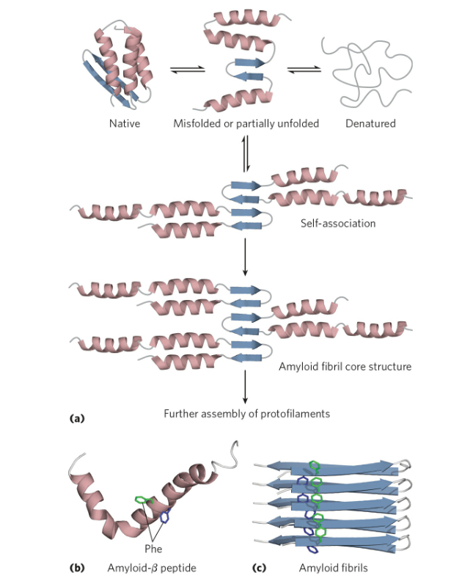
LEHNINGER FIGURE 4-32
Formation of disease-causing amyloid fibrils. (a) Protein molecules whose normal structure includes regions of β sheet undergo partial folding. Before folding is complete, the β-sheet regions of one polypeptide associate with the same region in another polypeptide, forming the nucleus of an
amyloid. Additional protein molecules associate with the
amyloid and extend it to form a fibril.

Slide 13
Crystal
Bubble
Amyloid
Nucleation -> Growth
https://www.google.com/search?client=firefox-b-1-d&sca_esv=40ad471a4e6b196f&sca_upv=1&sxsrf=ACQVn0_s7WOsmcN6ZSJkKQ8wlCnvR2RCbg:1707830065258&q=coke+mento&tbm=vid&source=lnms&sa=X&ved=2ahUKEwirlYHjsqiEAxV3IUQIHRH_BqkQ0pQJegQICRAB&biw=973&bih=512&dpr=2.4#fpstate=ive&vld=cid:6252bb40,vid:ZwyMcV9emmc,st:0

Slide 14
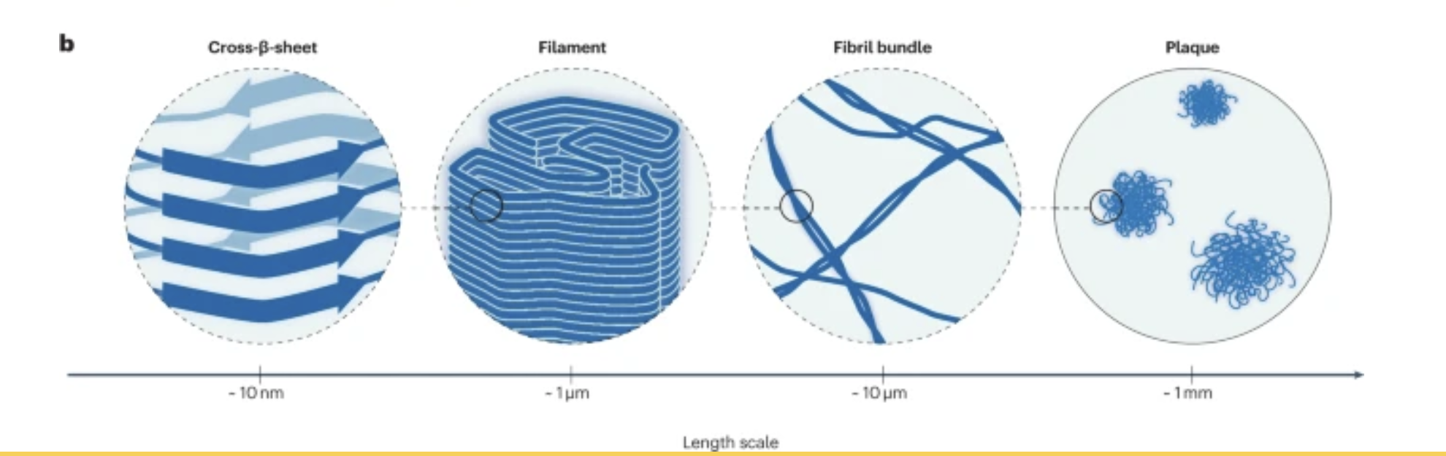
Amyloid fibrils are involved in human disorders including Alzheimer and Parkinson diseases, type 2 diabetes and systemic amyloidosis^{3,4,5,6}. In these diseases, peptides and proteins transition from dilute solution states to aberrant (misfolded) solid structures called amyloid fibrils.

Slide 15
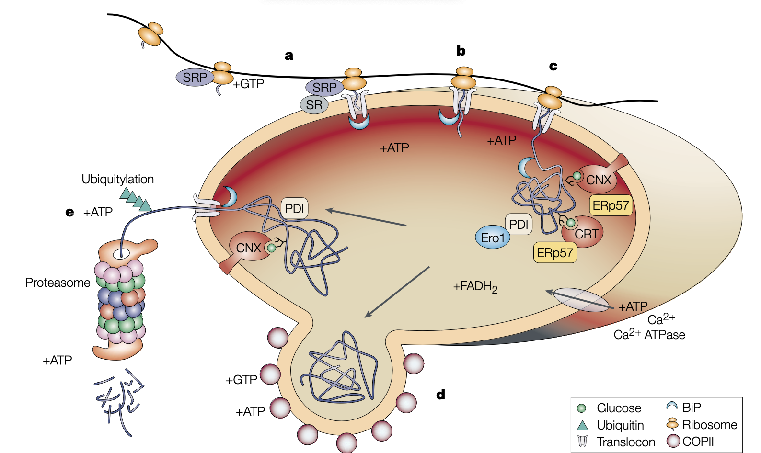
a) Proteins that are destined for synthesis in the endoplasmic reticulum are recognized, through signal peptides, by the signal recognition particle (SRP), which associates with the ribosome. The complex diffuses too the translocon, where the SRP docks with the SRP receptor (SR). a) Passage of the growing peptide through the translocon is coupled with the ATPase activity of binding Ig protein (BiP). c | BiP functions as a chaperone to fold substrates, as do the lectins calnexin
(CNX) and calreticulin (CRT). Disulphide-bond formation is regulated by the activity of Ero1 through the protein disulphide isomerase
(PDI) — the function of Ero1 depends on FADH2. The bonds that are formed are modified by the activity of ERp57, which gains access to its folding substrate through its association with CXN or CRT. d) Properly folded proteins exit the ER through coat protein (COP)II-coated vesicles. e) Misfolded proteins can associate with BiP, CNX and PDI for retrotranslocation, ATP-dependent ubiquitylation and digestion by the proteasome, another ATP-dependent process. ATP is required for the Ca2+ ATPase to maintain a calcium gradient.
NATURE REVIEWS | MOLECUL AR CELL BIOLOGY VOLUME 3 | JUNE 2002

Slide 16
Things you can do to a native protein
Denature (no bonds broken)
Oxidize/reduce (break/form disulfides)

Slide 17
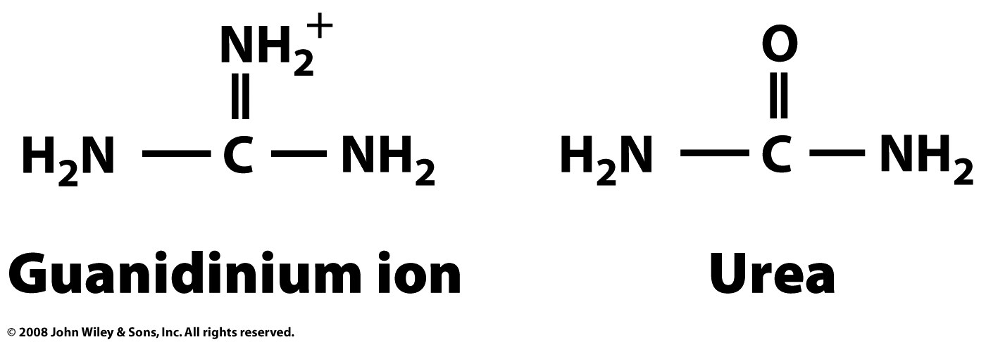
Denaturants
Heat, pH, Guanidinium, Urea

Slide 18
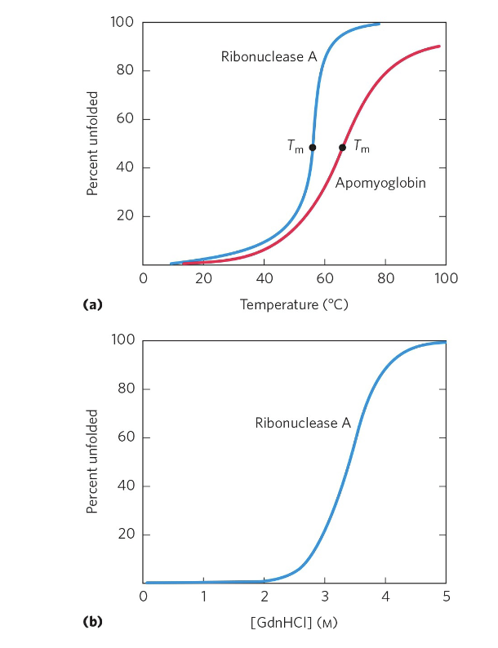
LEHNINGER, FIGURE 4-26 Protein denaturation (unfolding). Proteins can be
Denatured by increasing temperature or by addition of chemical denaturants (guanidinium hydrochloride; GdnHCl, urea is also a good denaturant). The transition from folded state to unfolded state is cooperative (note sigmoidal curve).
Denaturation does not disrupt disulfide bonds. That is a redox effect.
The midpoint of the temperature range over which denaturation occurs is called the melting temperature, or Tm
(a) Data from R.A. Sendak et al., Biochemistry 35:12,978, 1996; I. Nishii et al., J. Mol.
Biol. 250:223, 1995. (b) Data from W. A. Houry et al., Biochemistry
35:10,125, 1996.]

Slide 19
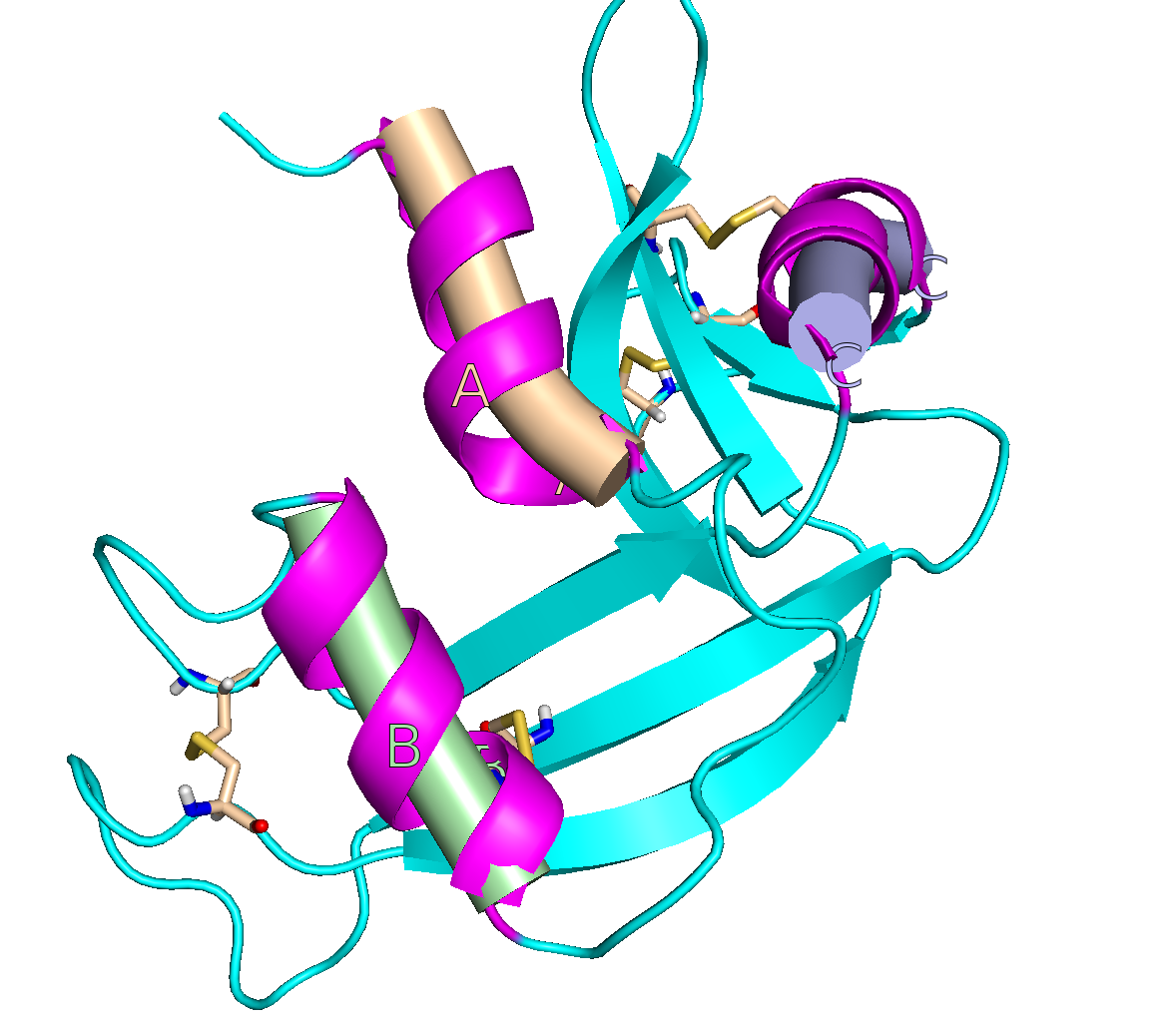

Slide 20
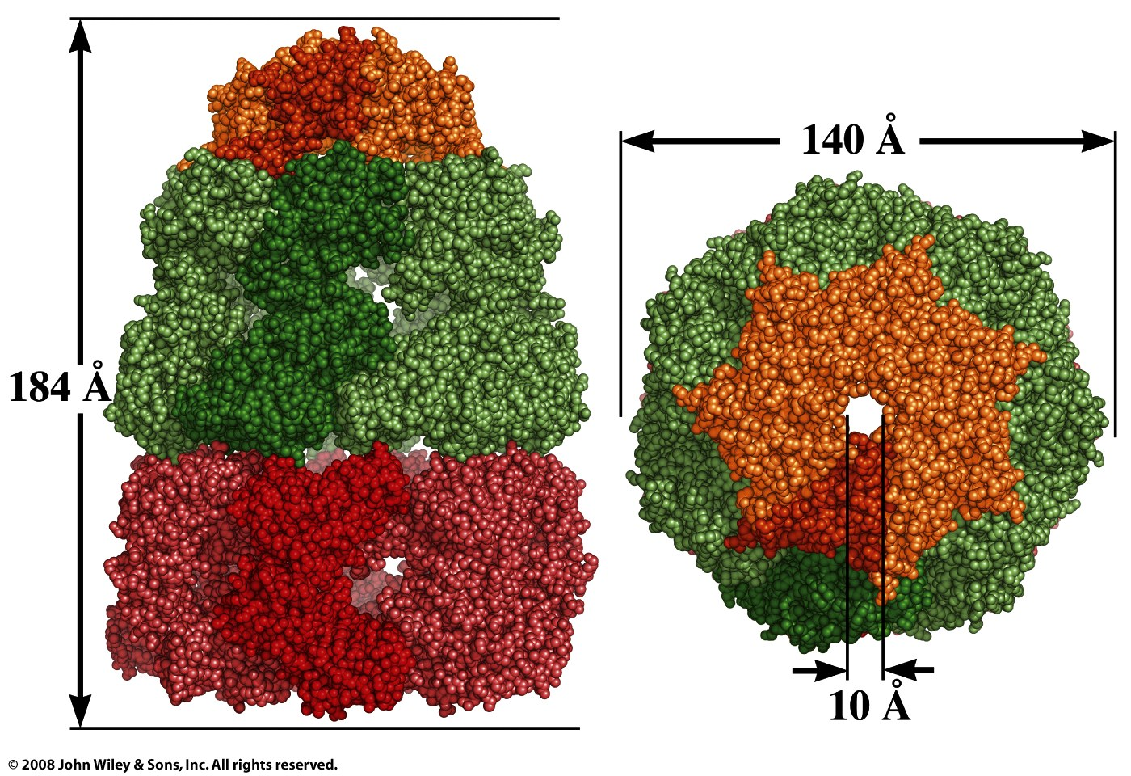
GroEL (Chaperone)
Figure 6-43a,b

Slide 21
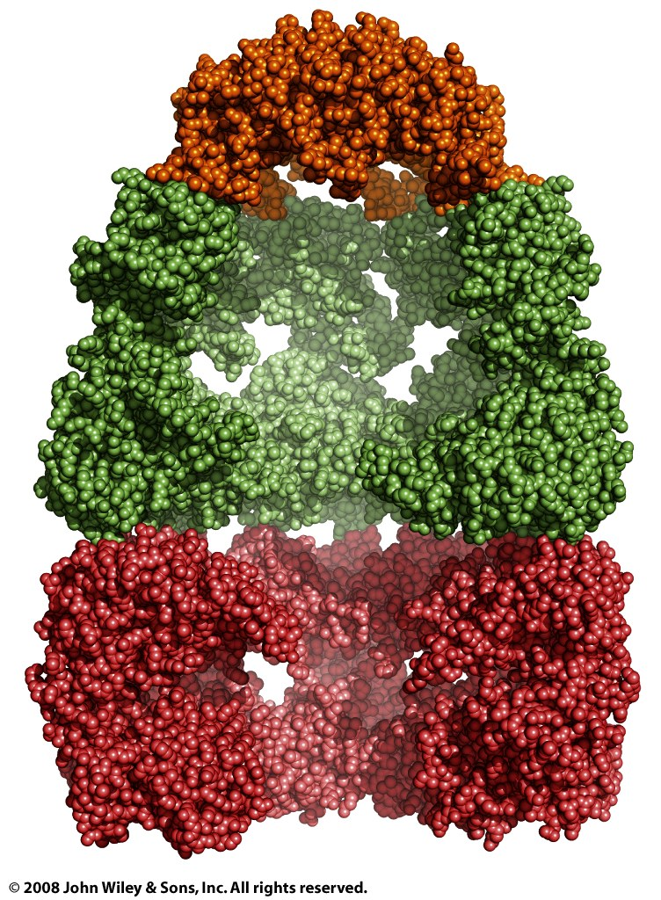
Figure 6-43c

Slide 22
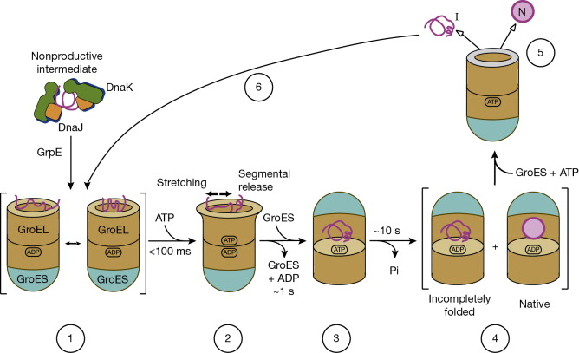
Figure 6-44

Slide 23
SUMMARY
The maintenance of the steady-state collection of active cellular proteins —called proteostasis— involves an elaborate set of pathways and processes that synthesize, fold, refold, and degrade polypeptide chains.
Protein folding in cells is generally hierarchical. Initially, regions of secondary structure may form, followed by folding into motifs and domains. Large ensembles of folding intermediates are rapidly brought to a single native conformation.
The native structure and the function of most proteins can be destroyed by denaturation, Some denatured proteins can renature spontaneously to form biologically active proteins, others form fibrils.
For many proteins, folding is facilitated by Hsp70 chaperones and by chaperonins.
Disulfide-bond formation and the cis-trans isomerization of Pro peptide bonds are catalyzed by specific enzymes.
Protein misfolding is the molecular basis of a wide range of human diseases, including the amyloidoses

Slide 24
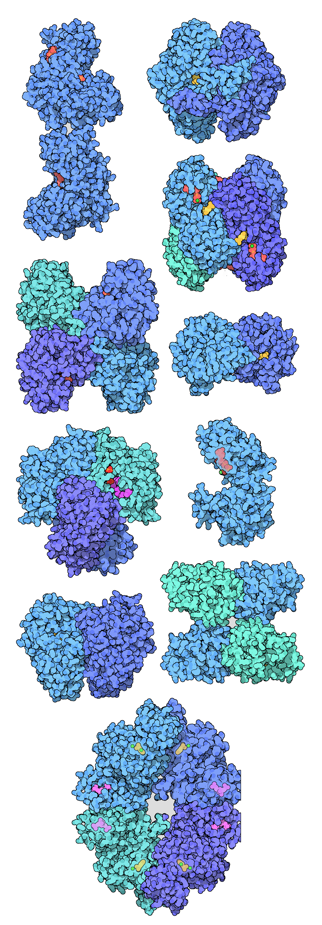
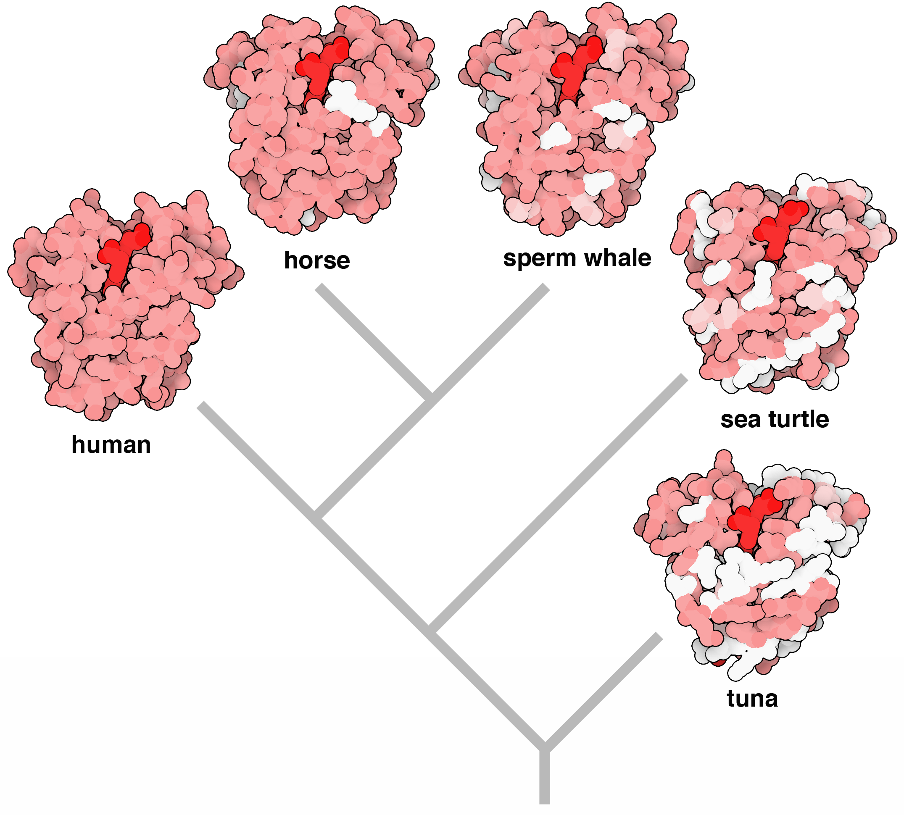
Most proteins are in marginally stable folded states in a tenuous balance between folded and unfolded states and misfolded state.
Sequences of myoglobin from five different animals are compared to create a phylogenetic tree. Each molecule is colored to show differences from the human protein. From the PDB Gallery.
Glycolytic enzymes from the PDB Gallery.

