Slide 1
Topology

Slide 2
Protein Topology
a reduced representation,
shows the ordering of secondary elements,
and (if possible) their relative positions and orientations (often not possible).
Allows characterization, comparison and grouping of protein structures.

Slide 3
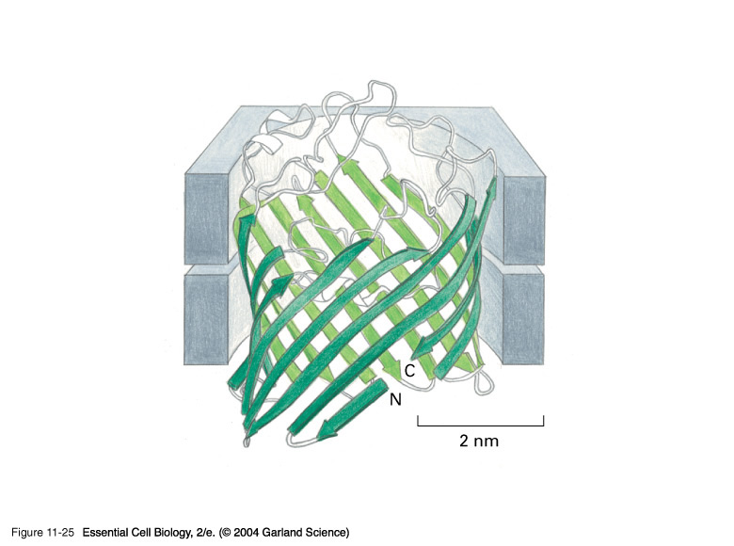
Porin
membrane
Hydrophilic Inside
Hydrophobic Outside

Slide 4
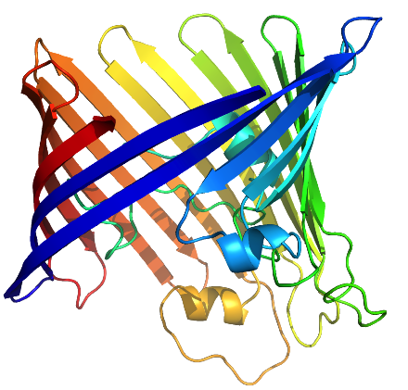
Porin
16 β-strands
3 α-helices

Slide 5
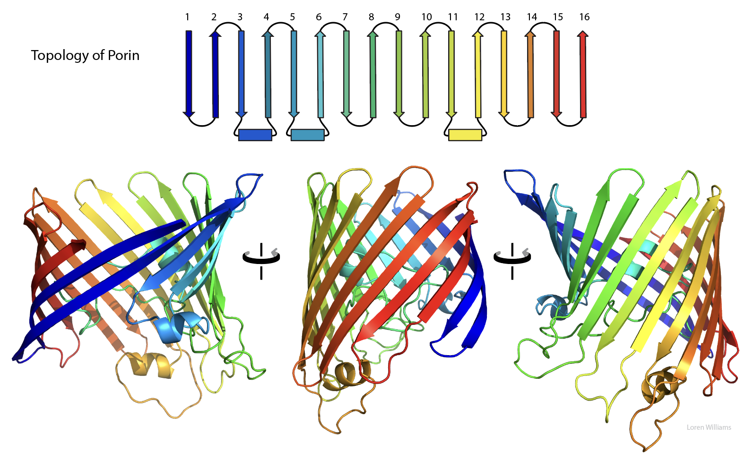

Slide 6
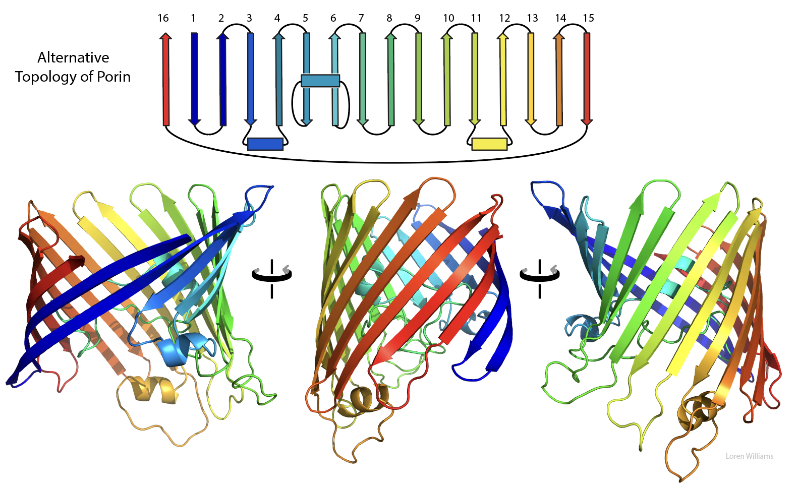

Slide 7
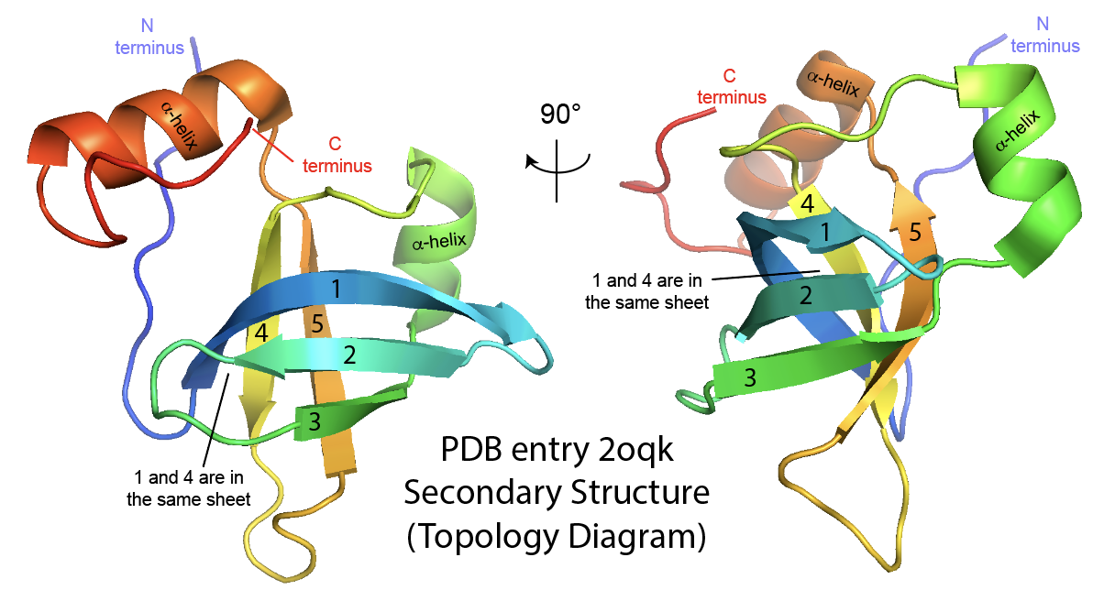

Slide 8
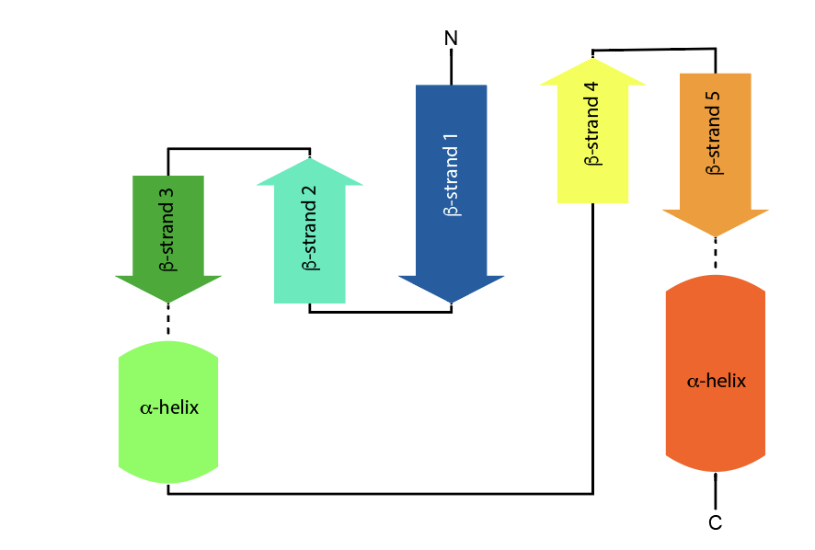

Slide 9
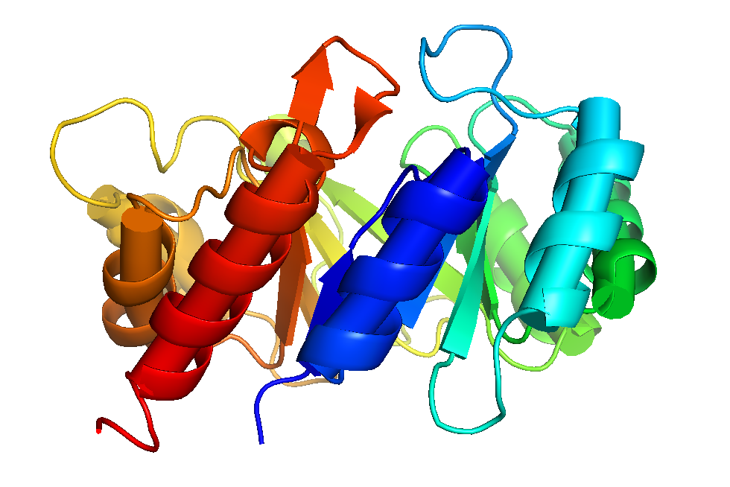
TIM Barrel (Triosphosphate Isomerase)
AKA α/β barrel
Always 8 parallel β-strands (8 staves never 7 or 9)
10% of all enzymes are TIM Barrels
A relatively big domain (200-250 amino acids)
a C-terminal end and an N-terminal end of the barrel
the loops at the C-terminal end of the barrel contain the active site

Slide 10
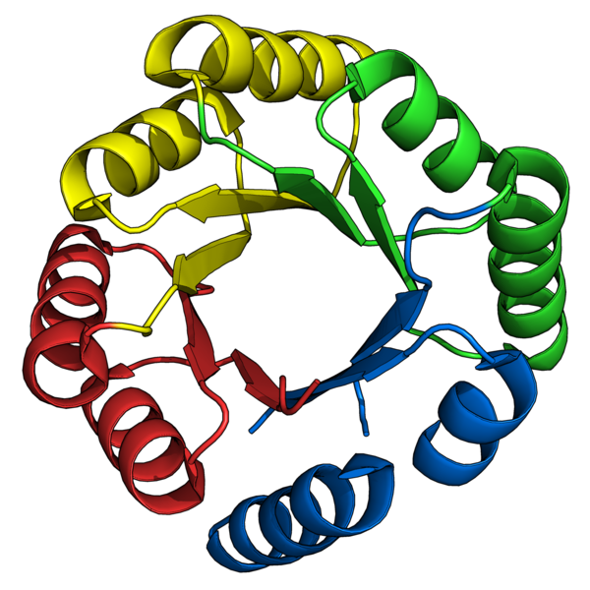
Perfect TIM Barrel
Made by a protein designer

Slide 11
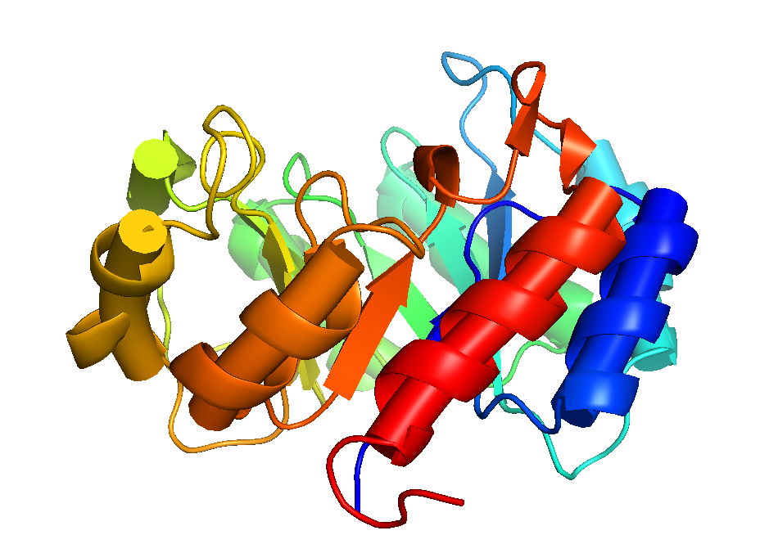
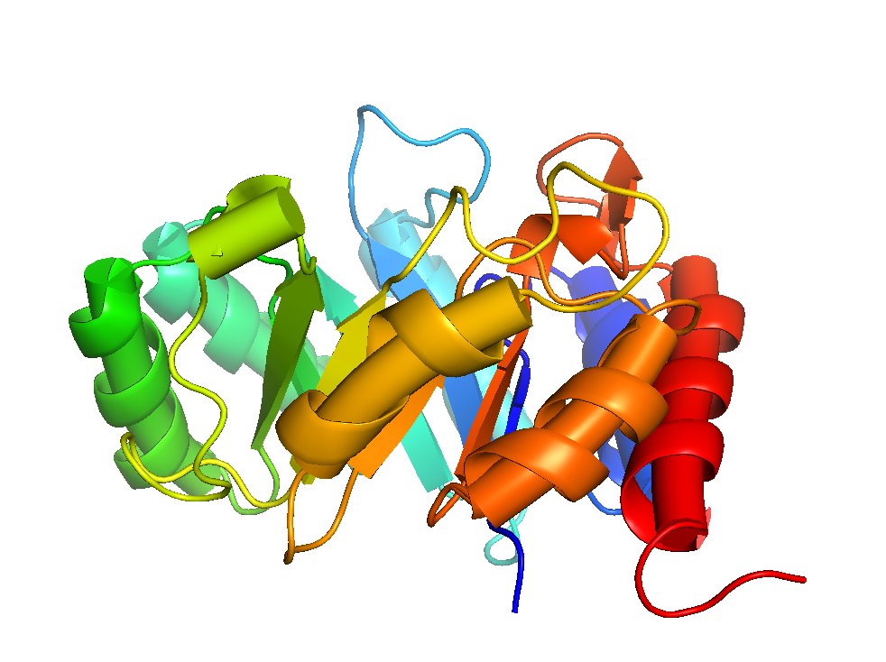
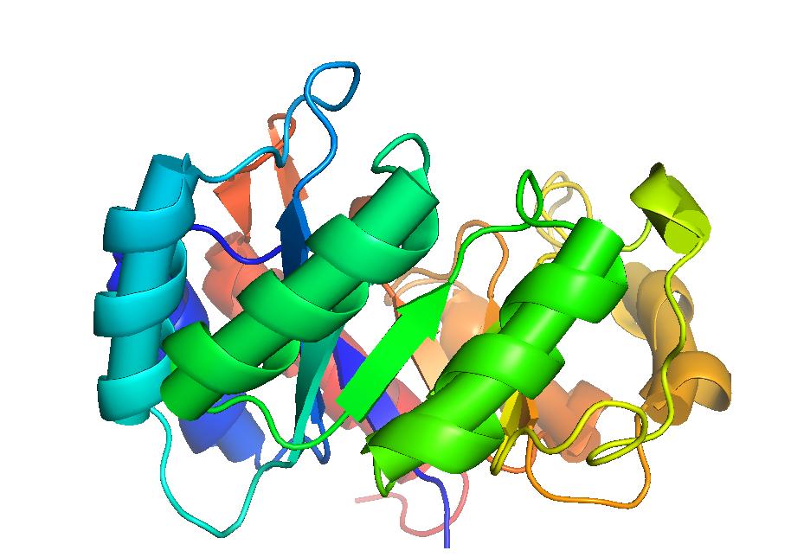
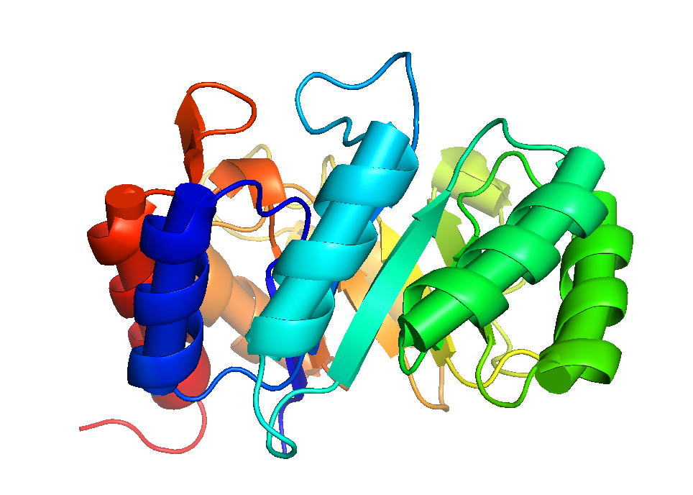
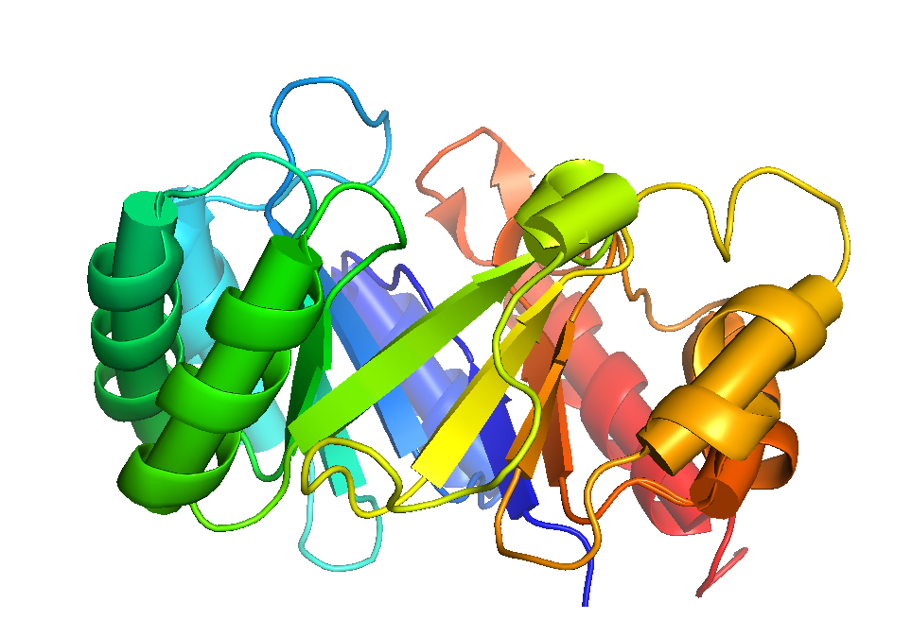

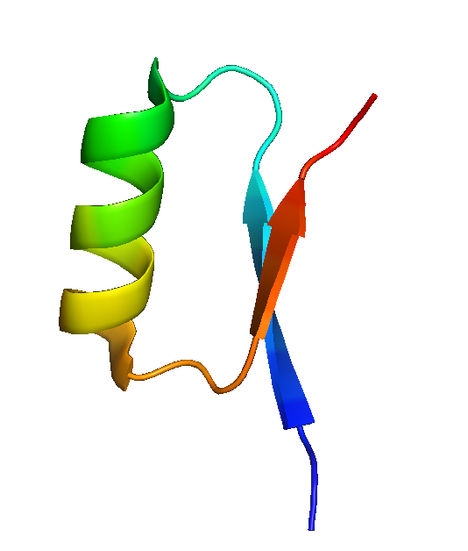
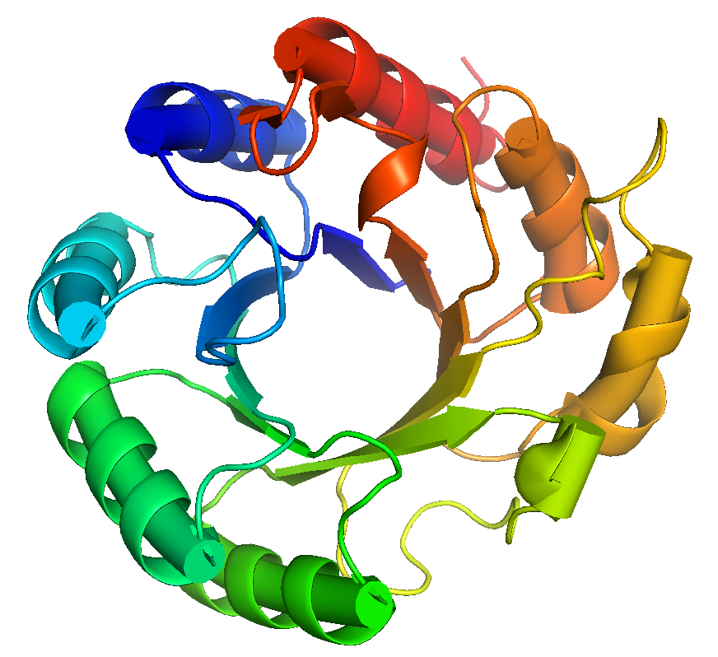
60°
60°
60°
60°
60°
8x β/α/β motif

Slide 12
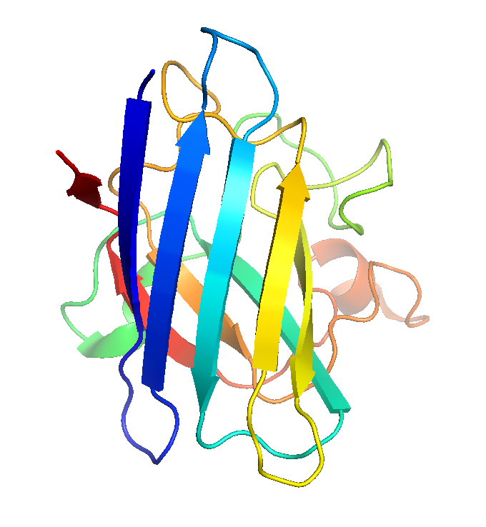
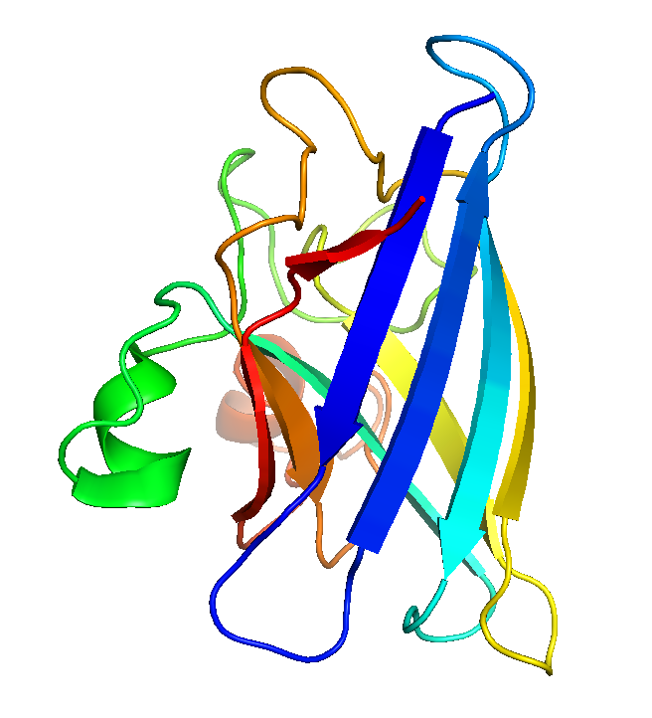
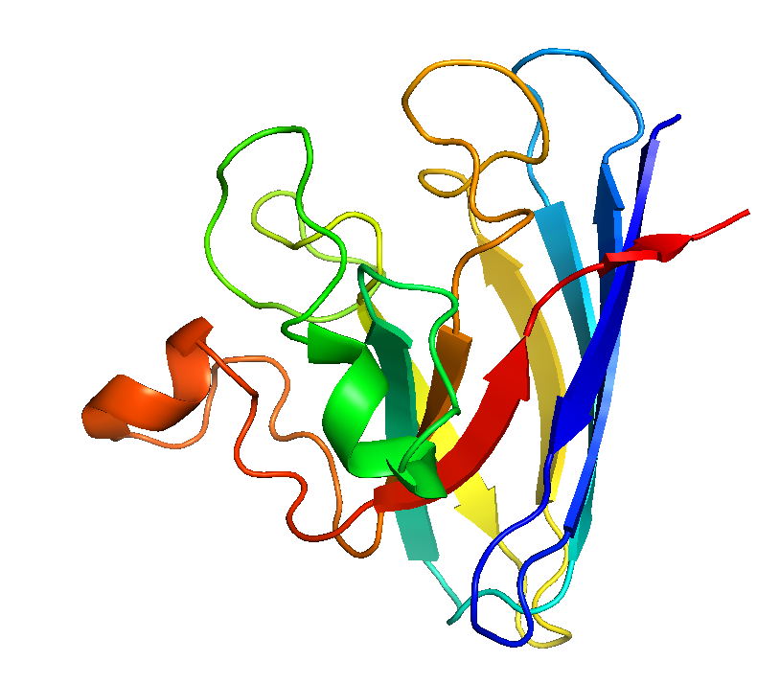
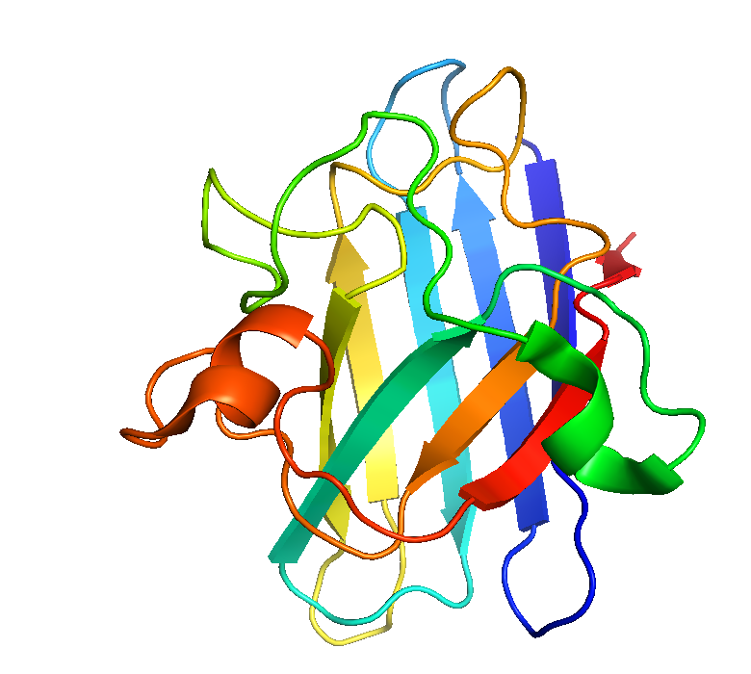
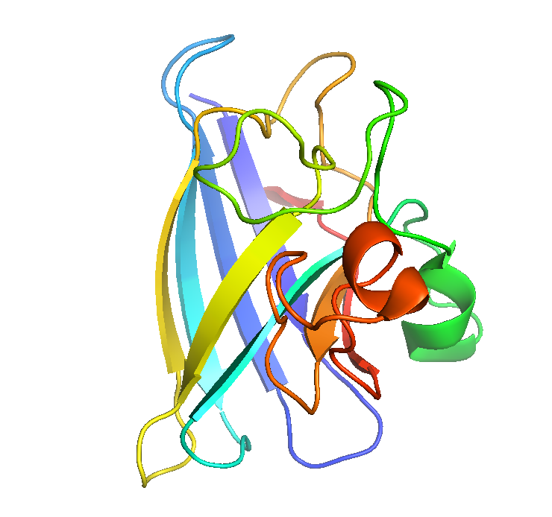
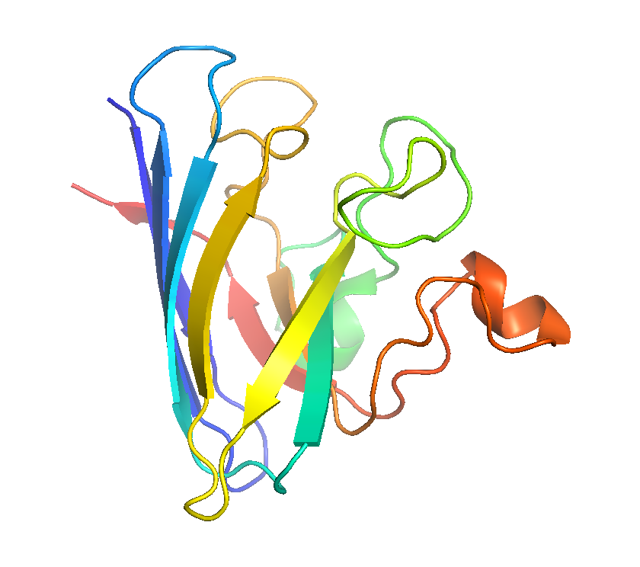
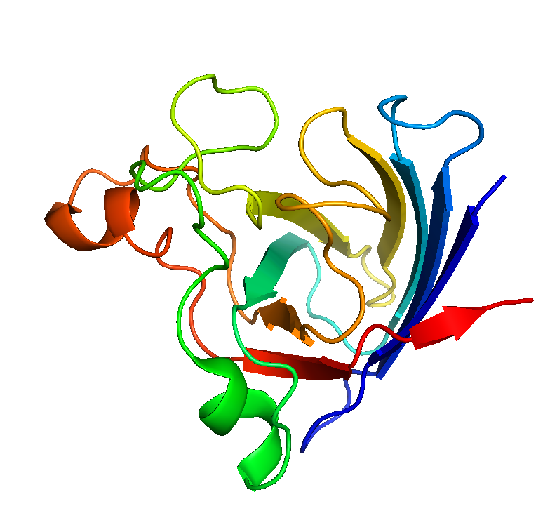
60°
60°
60°
60°
60°
SOD1
Draw the Secondary Structure

