Slide 1
Serine Proteases
Almost one-third of all proteases contain a Ser nucleophile in the active site.
Distinguished by catalytic triad: Asp−His−Ser
  There are some strange catalytic triads and dyads; Ser−His−Glu, Ser−Lys/His, His−Ser−His, and N-terminal Ser
Four clans
  chymotrypsin/trypsin (most abundant, found in bacteria, archaea, eukarya, viruses),
  subtilisin,
  carboxypeptidase Y,
  Clp
Chymotrypsin-like proteases
  digestion, hemostasis, apoptosis, signal transduction, production, immune response
Perform posttranslational proteolysis, removing
  The N-terminal methionine
  N-terminal signal or targeting peptide,
  activation peptide to unmask the latent activity,

Slide 2
Serine Proteases
Cascades of sequential activation of serine proteases are seen in
  blood coagulation,
  complement fixation,
  fibrinolysis,
  development,
  matrix remodeling,
  differentiation,
  wound healing

Slide 3
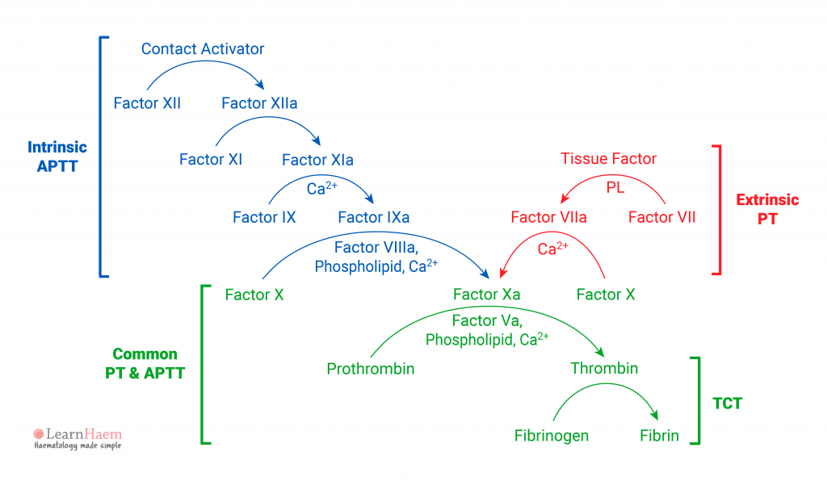

Slide 4
Trypsin Regulation
Inactive zymogens of trypsin, chymotrypsin, and carboxypeptidases are synthesized and secreted by the pancreas.
Trypsinogen is converted to its active form, trypsin, by the protease enteropeptidase (in the small intestine). Enteropeptidase cleaves 15 AAs from the N-terminus of trypsinogen to release trypsin.
Trypsin catalyzes the conversion of additional trypsinogen to trypsin.
Trypsin also catalyzes the conversion chymotrypsinogen, the procarboxypeptidases, and proelastase to active forms.

Slide 5
Trypsin Mechanism
There are many elementary steps in the mechanism
(i.e., there are many intermediates, many transition states and many rate constants)
Trypins demonstrates the following “elements of enzymatic catalysis”
acid & base catalysis (yes)
covalent intermediate (yes)
proximity and orientation (yes)
preferential binding to and stabilization of the transition state (yes)
metal ions (no)

Slide 6
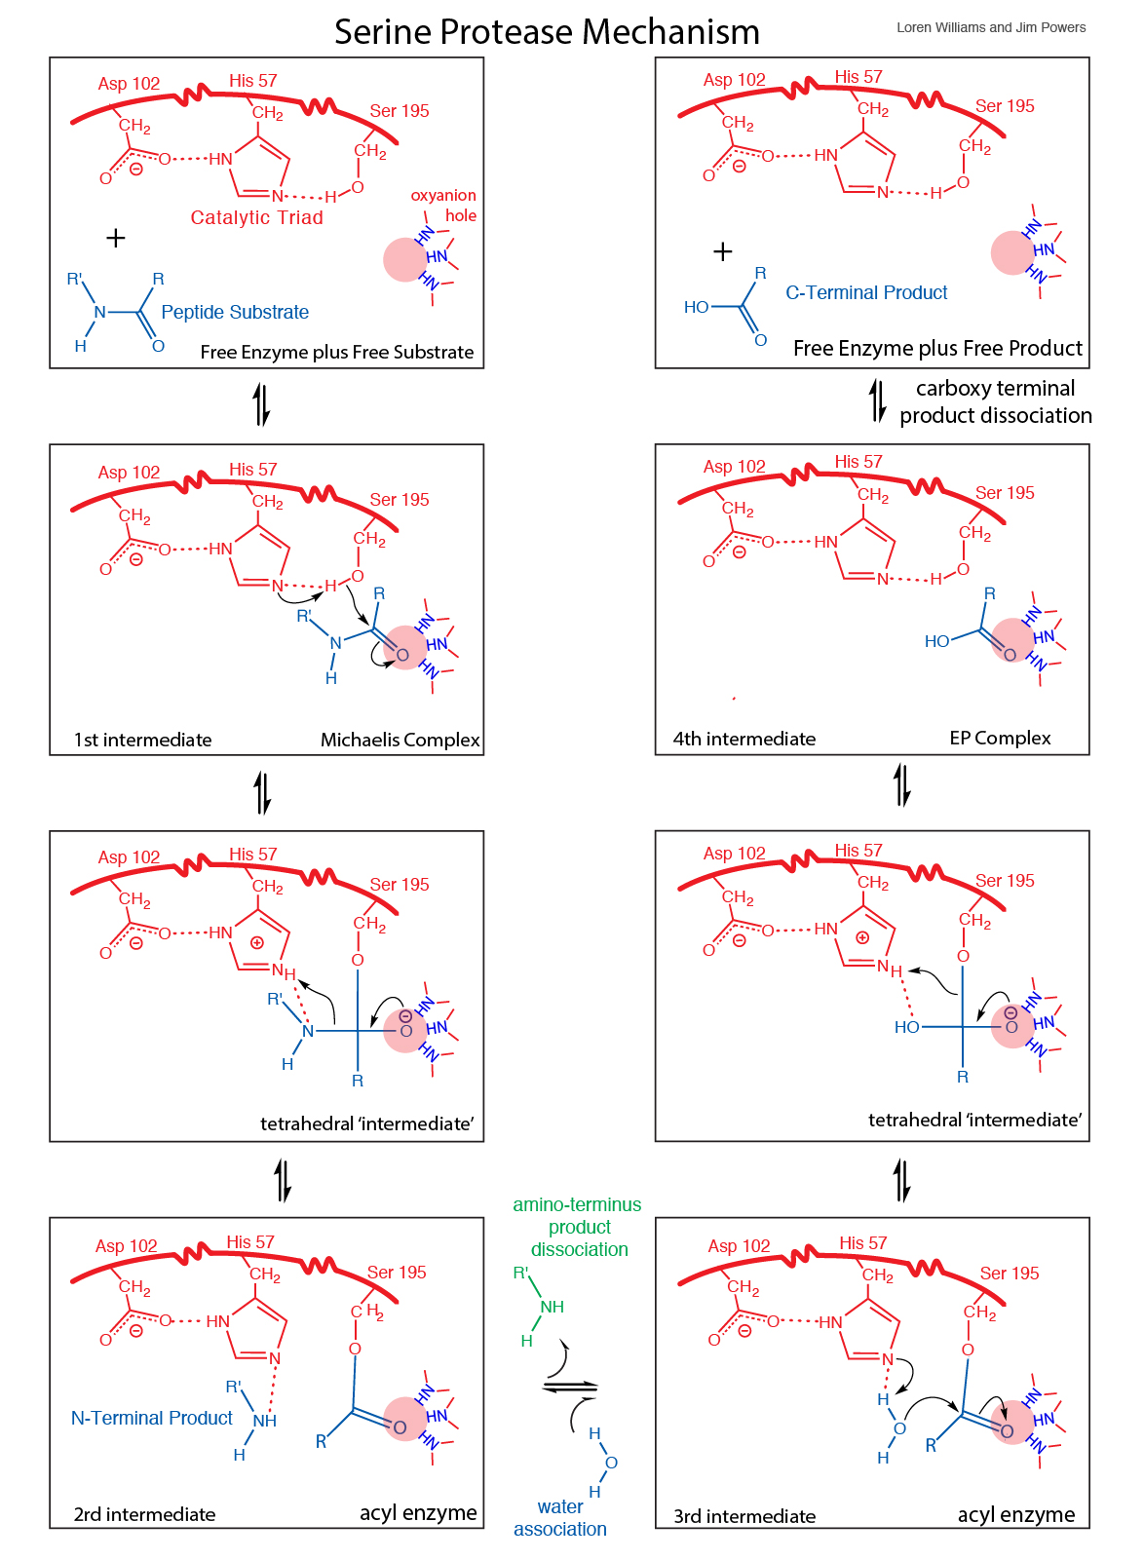

Slide 7
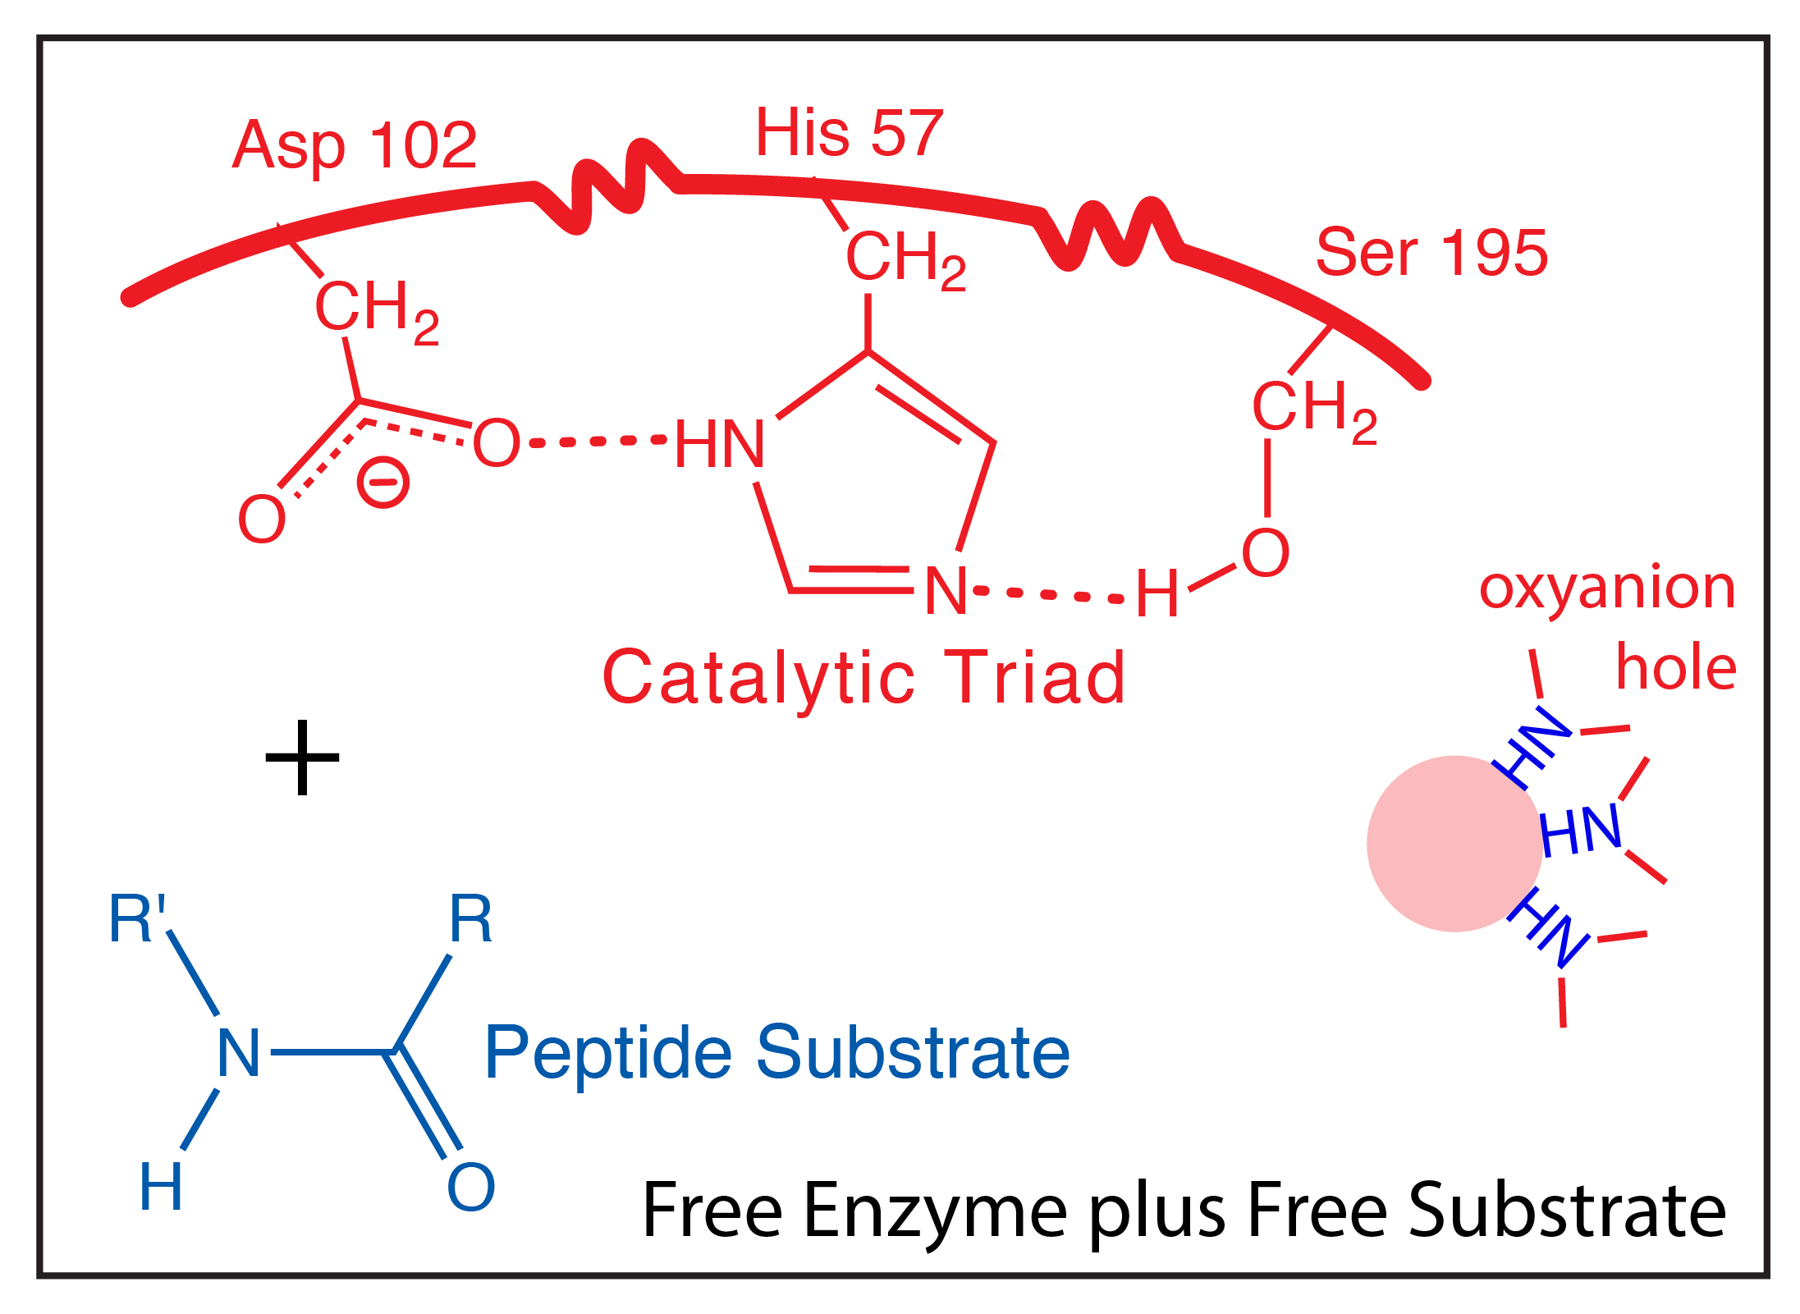
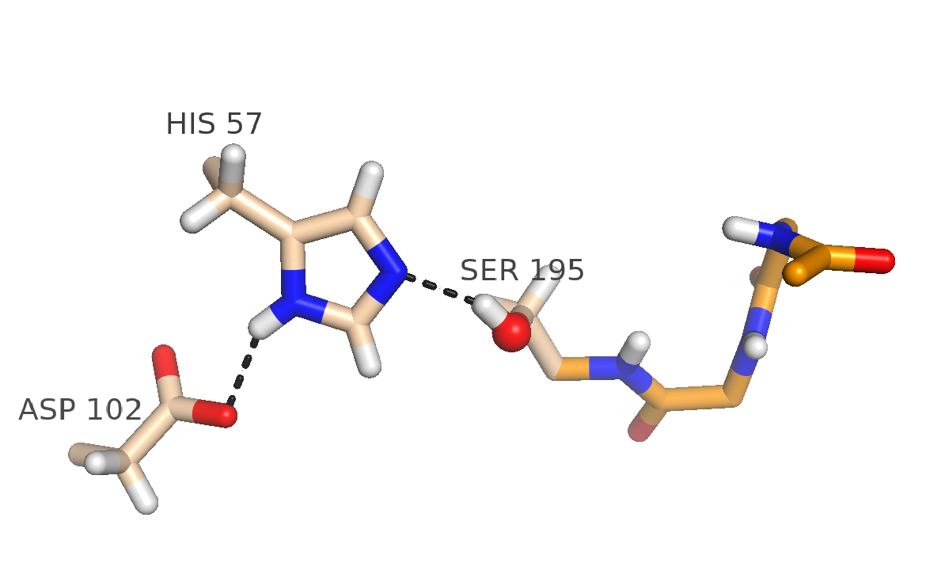

Slide 8
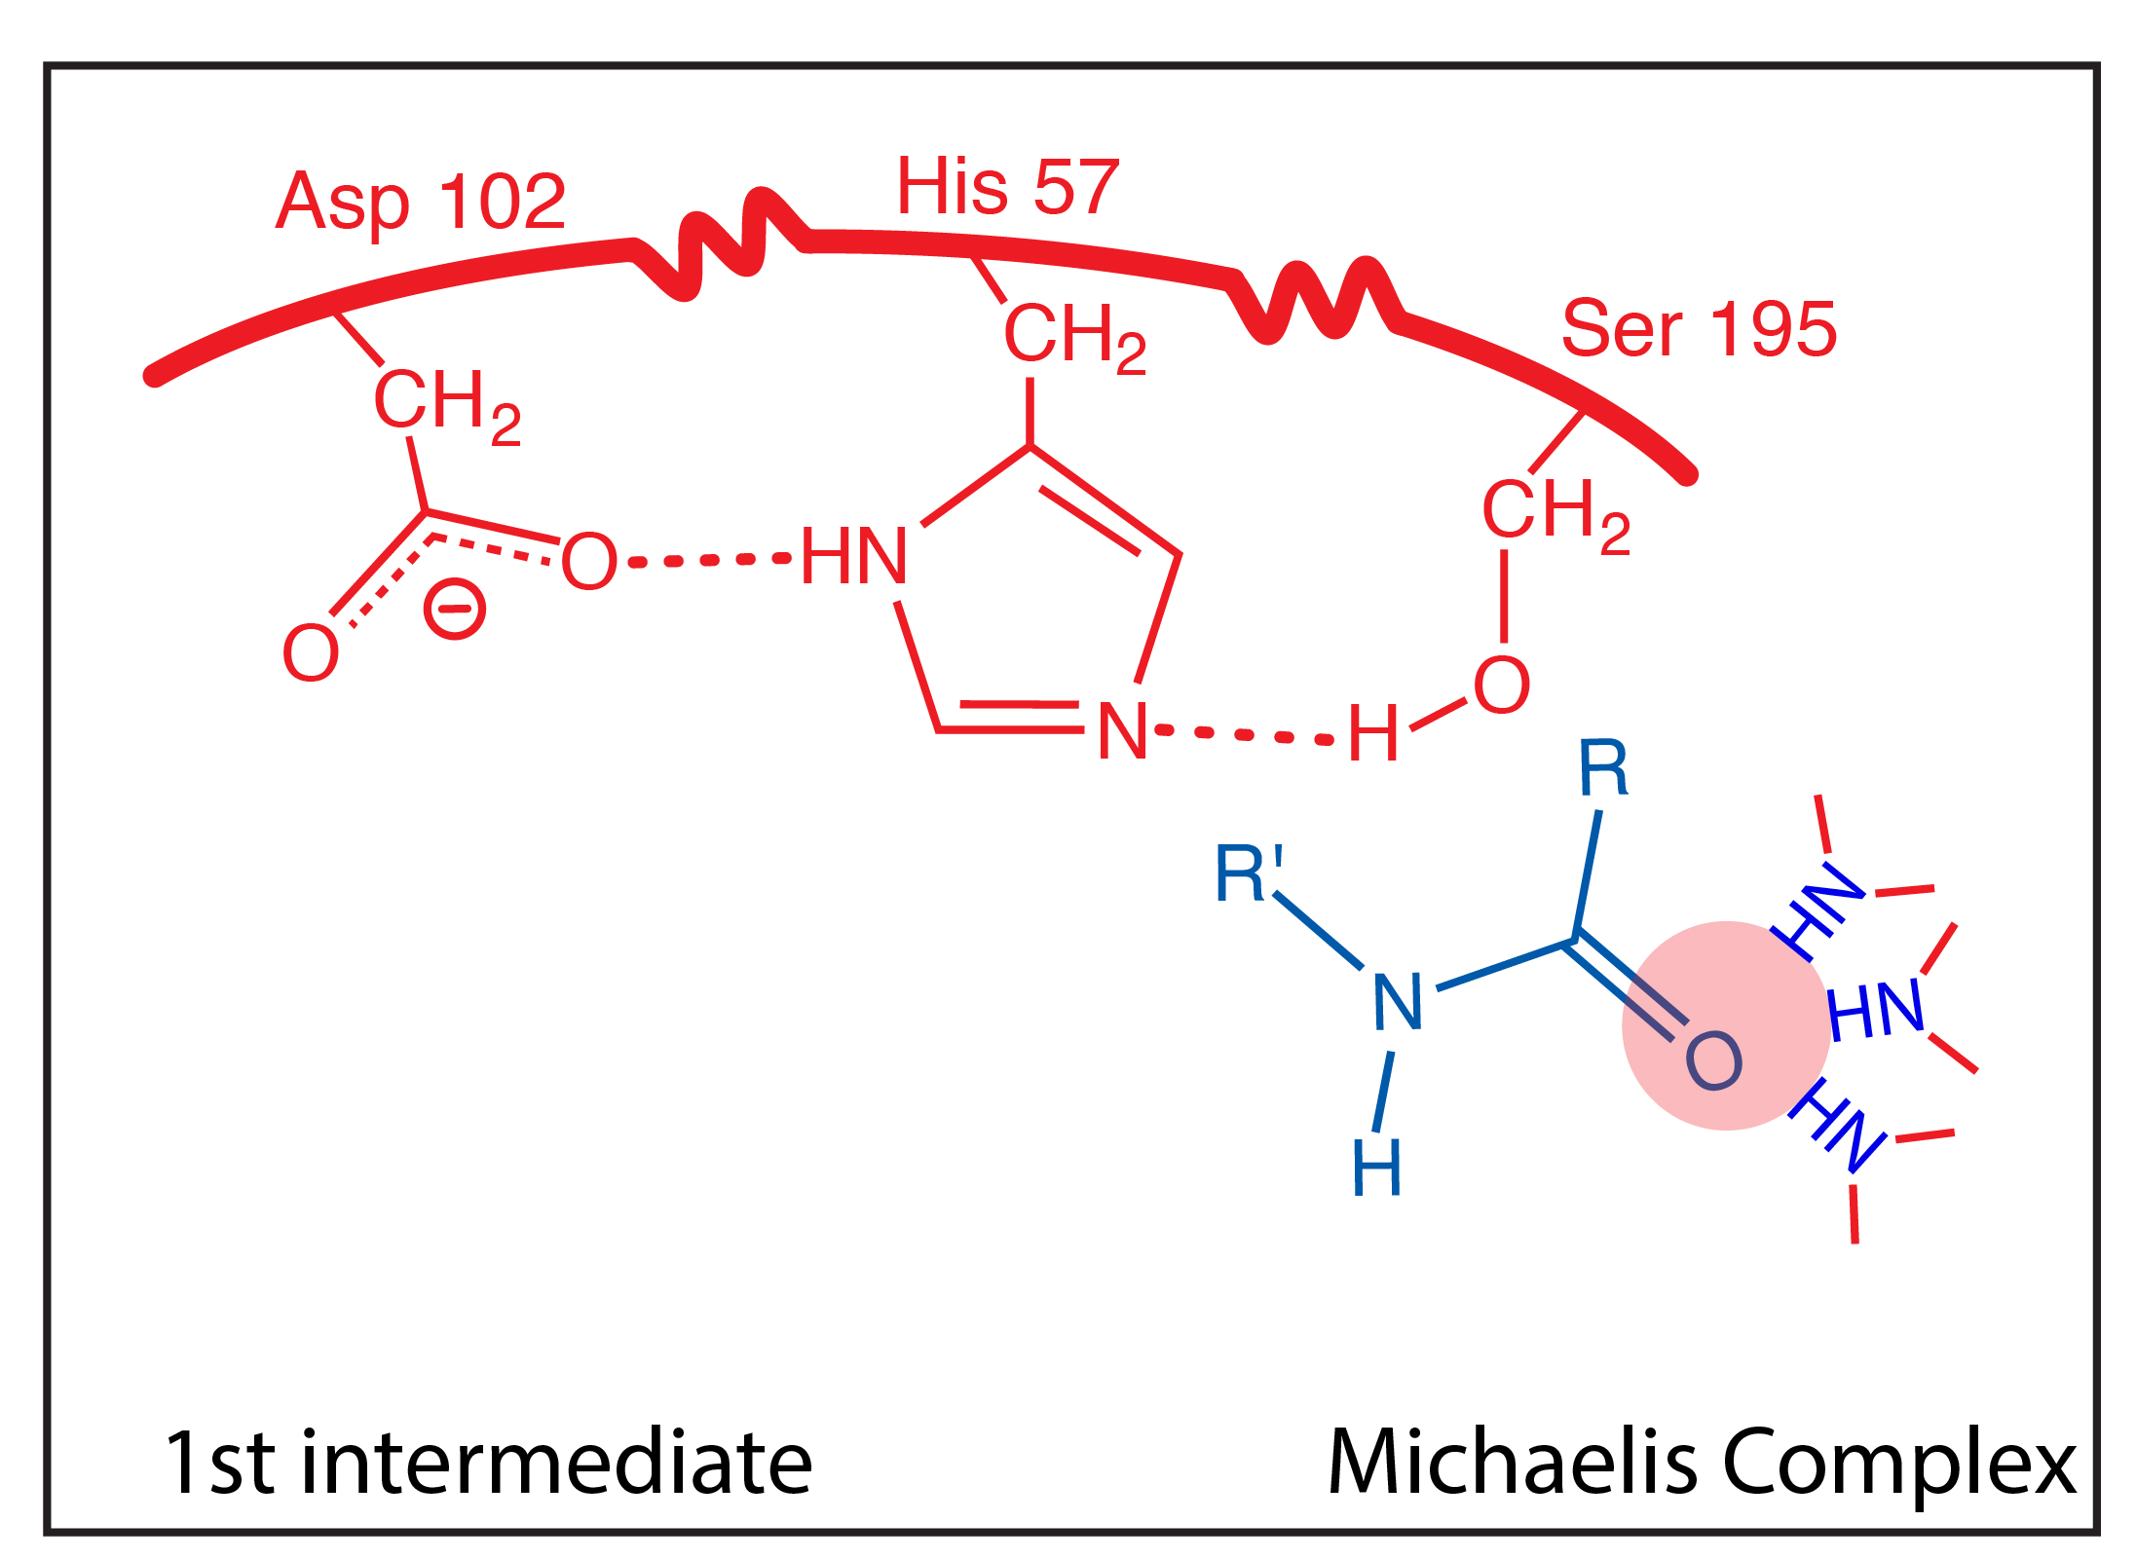
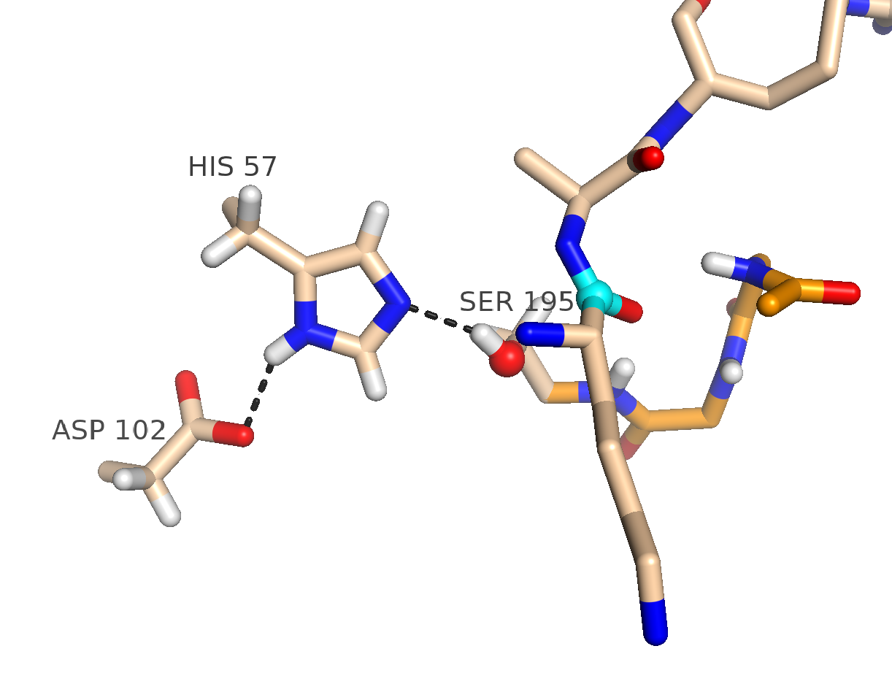

Slide 9
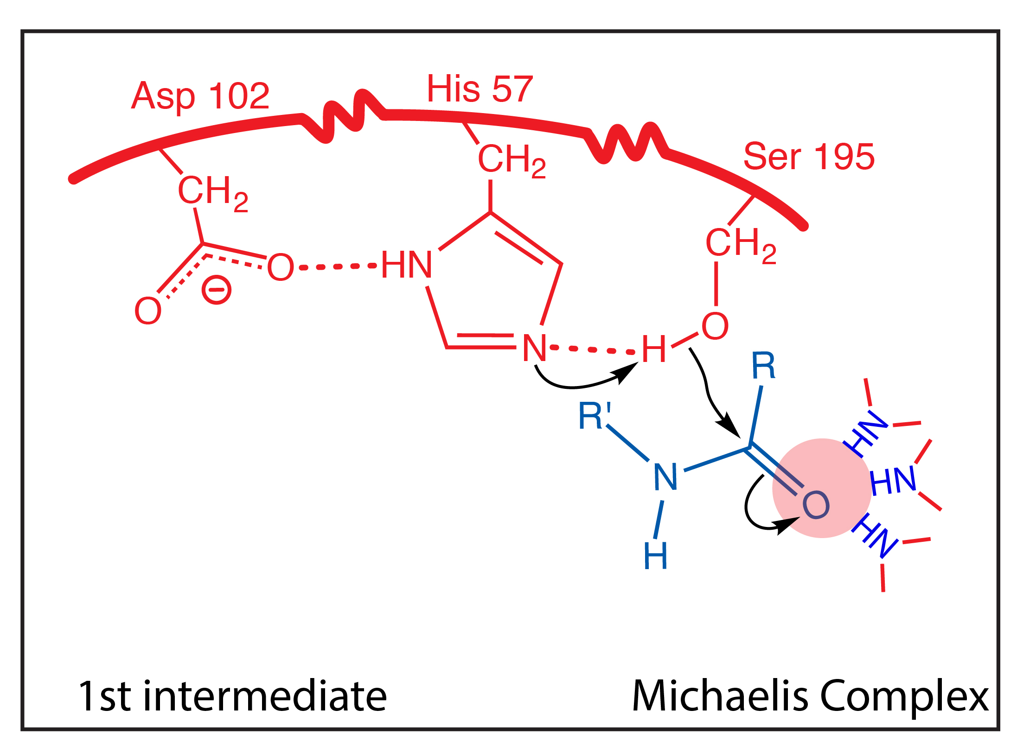
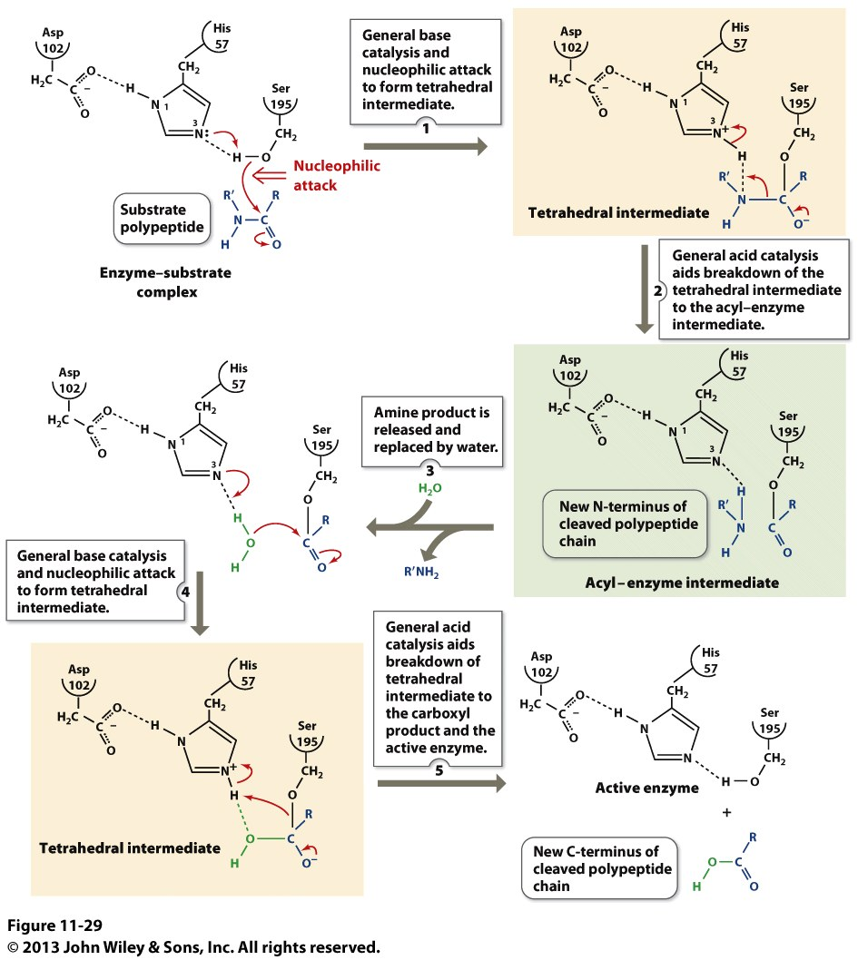

Slide 10
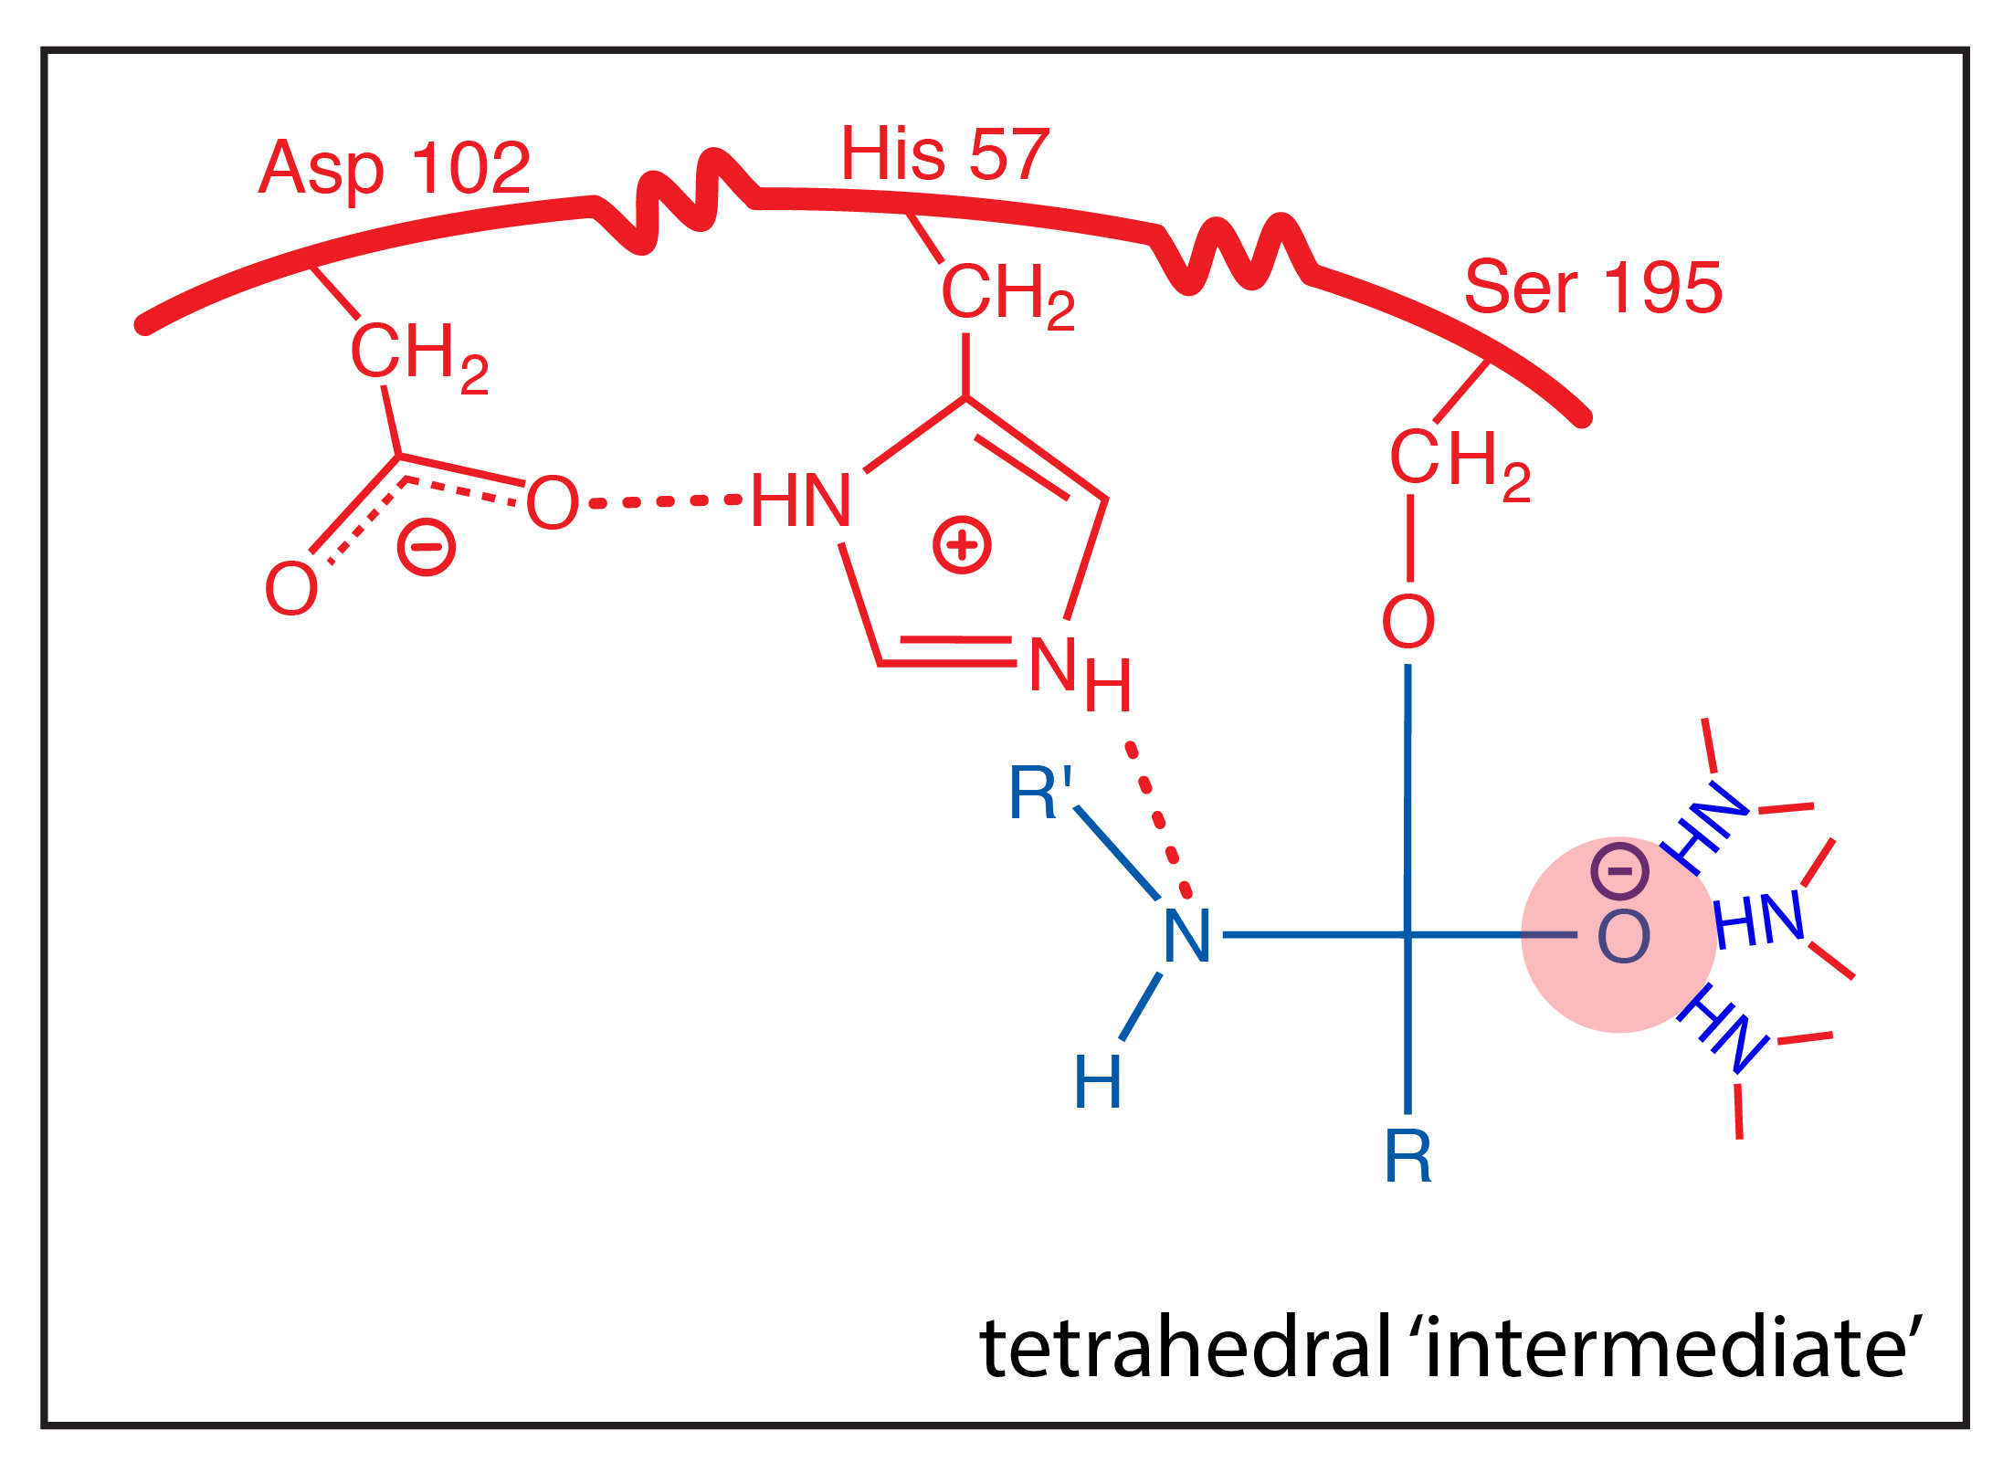
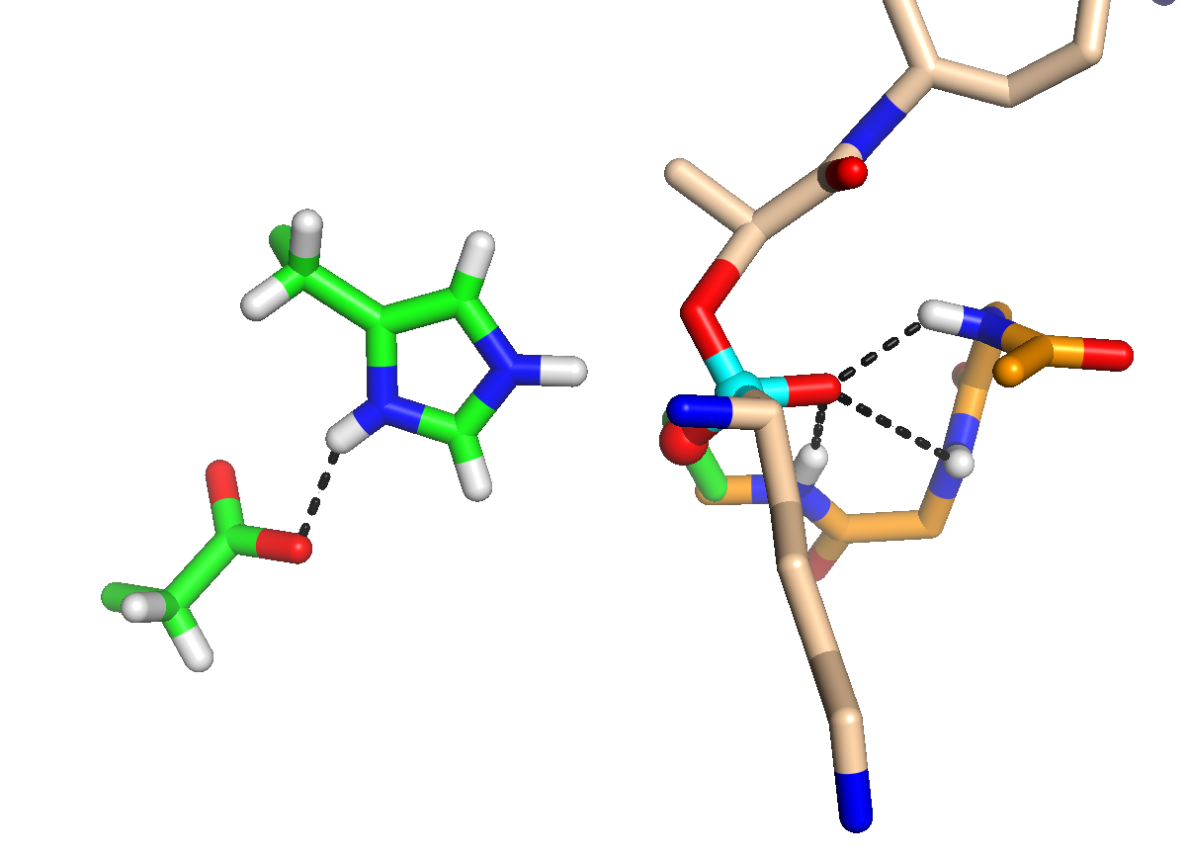
Covalent bond formed between enzyme and substrate
Covalent catalysis: intermediate resembles transition state.

Slide 11
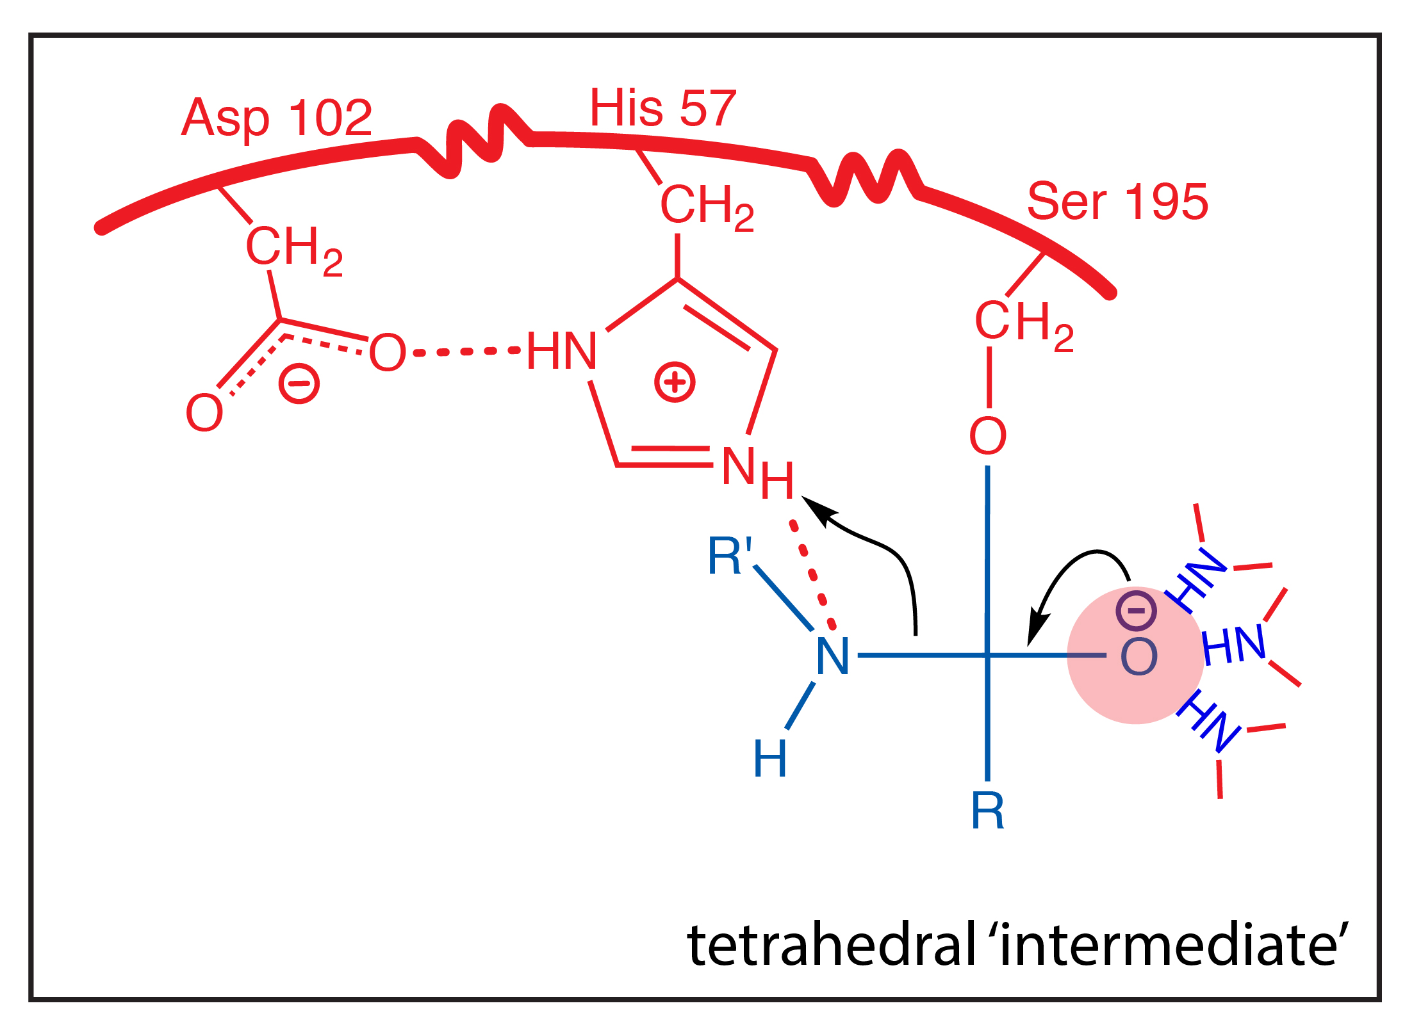

Slide 12
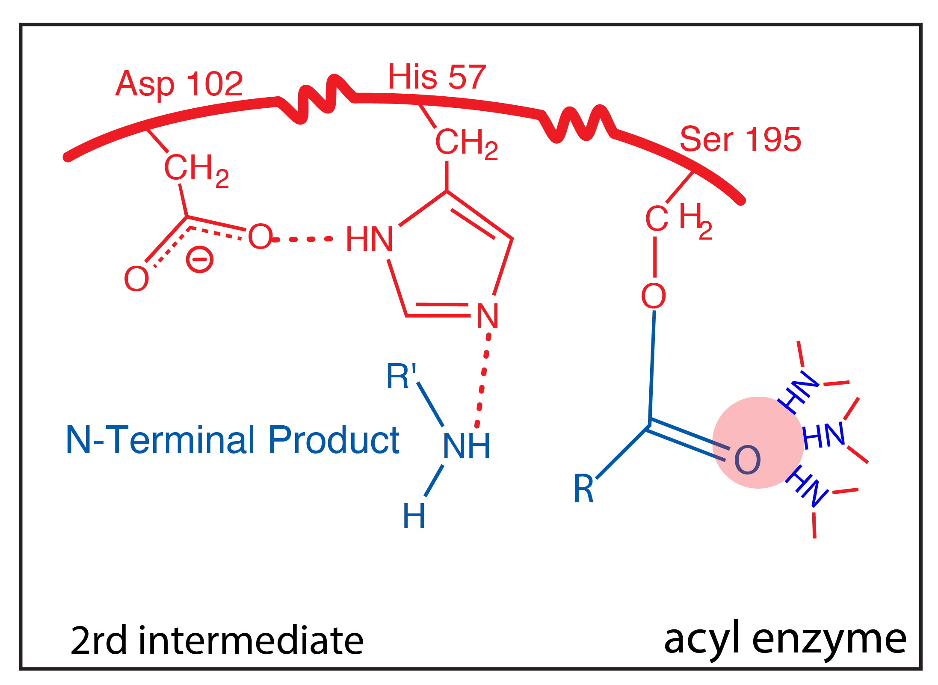

Slide 13
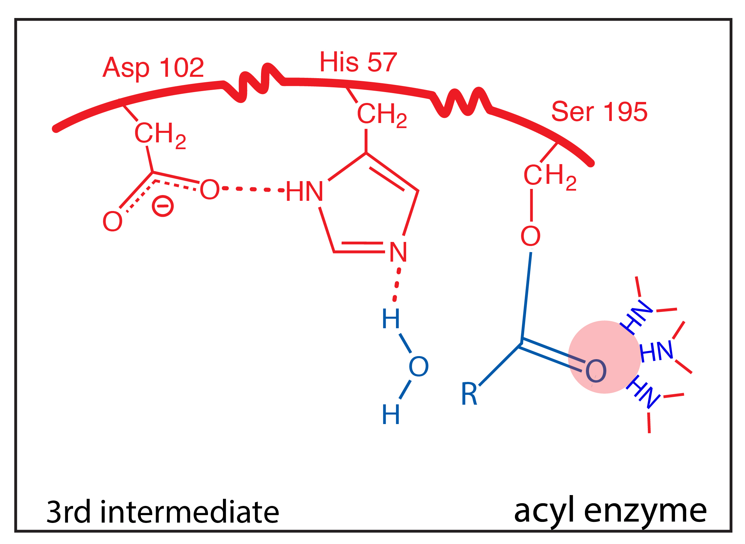

Slide 14
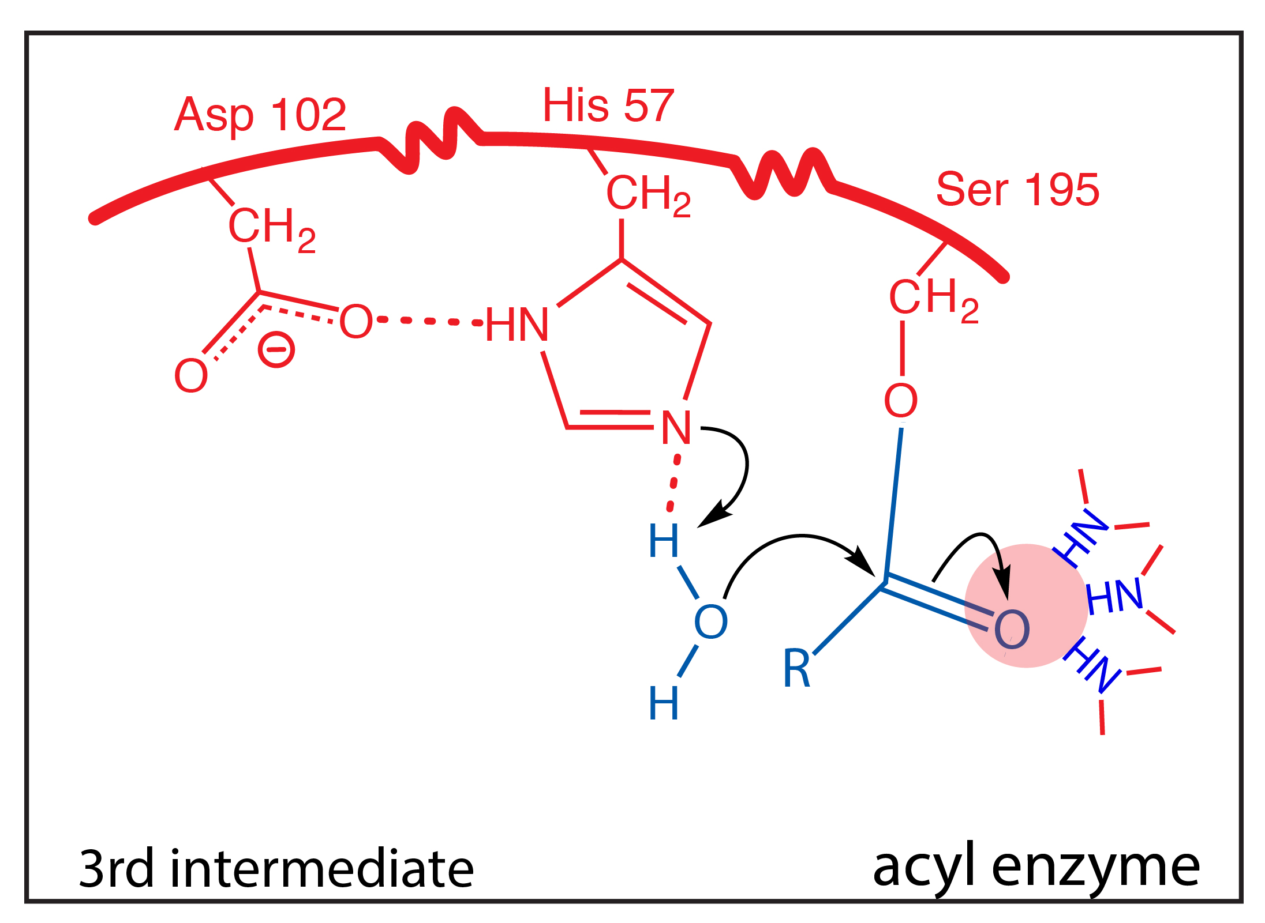

Slide 15
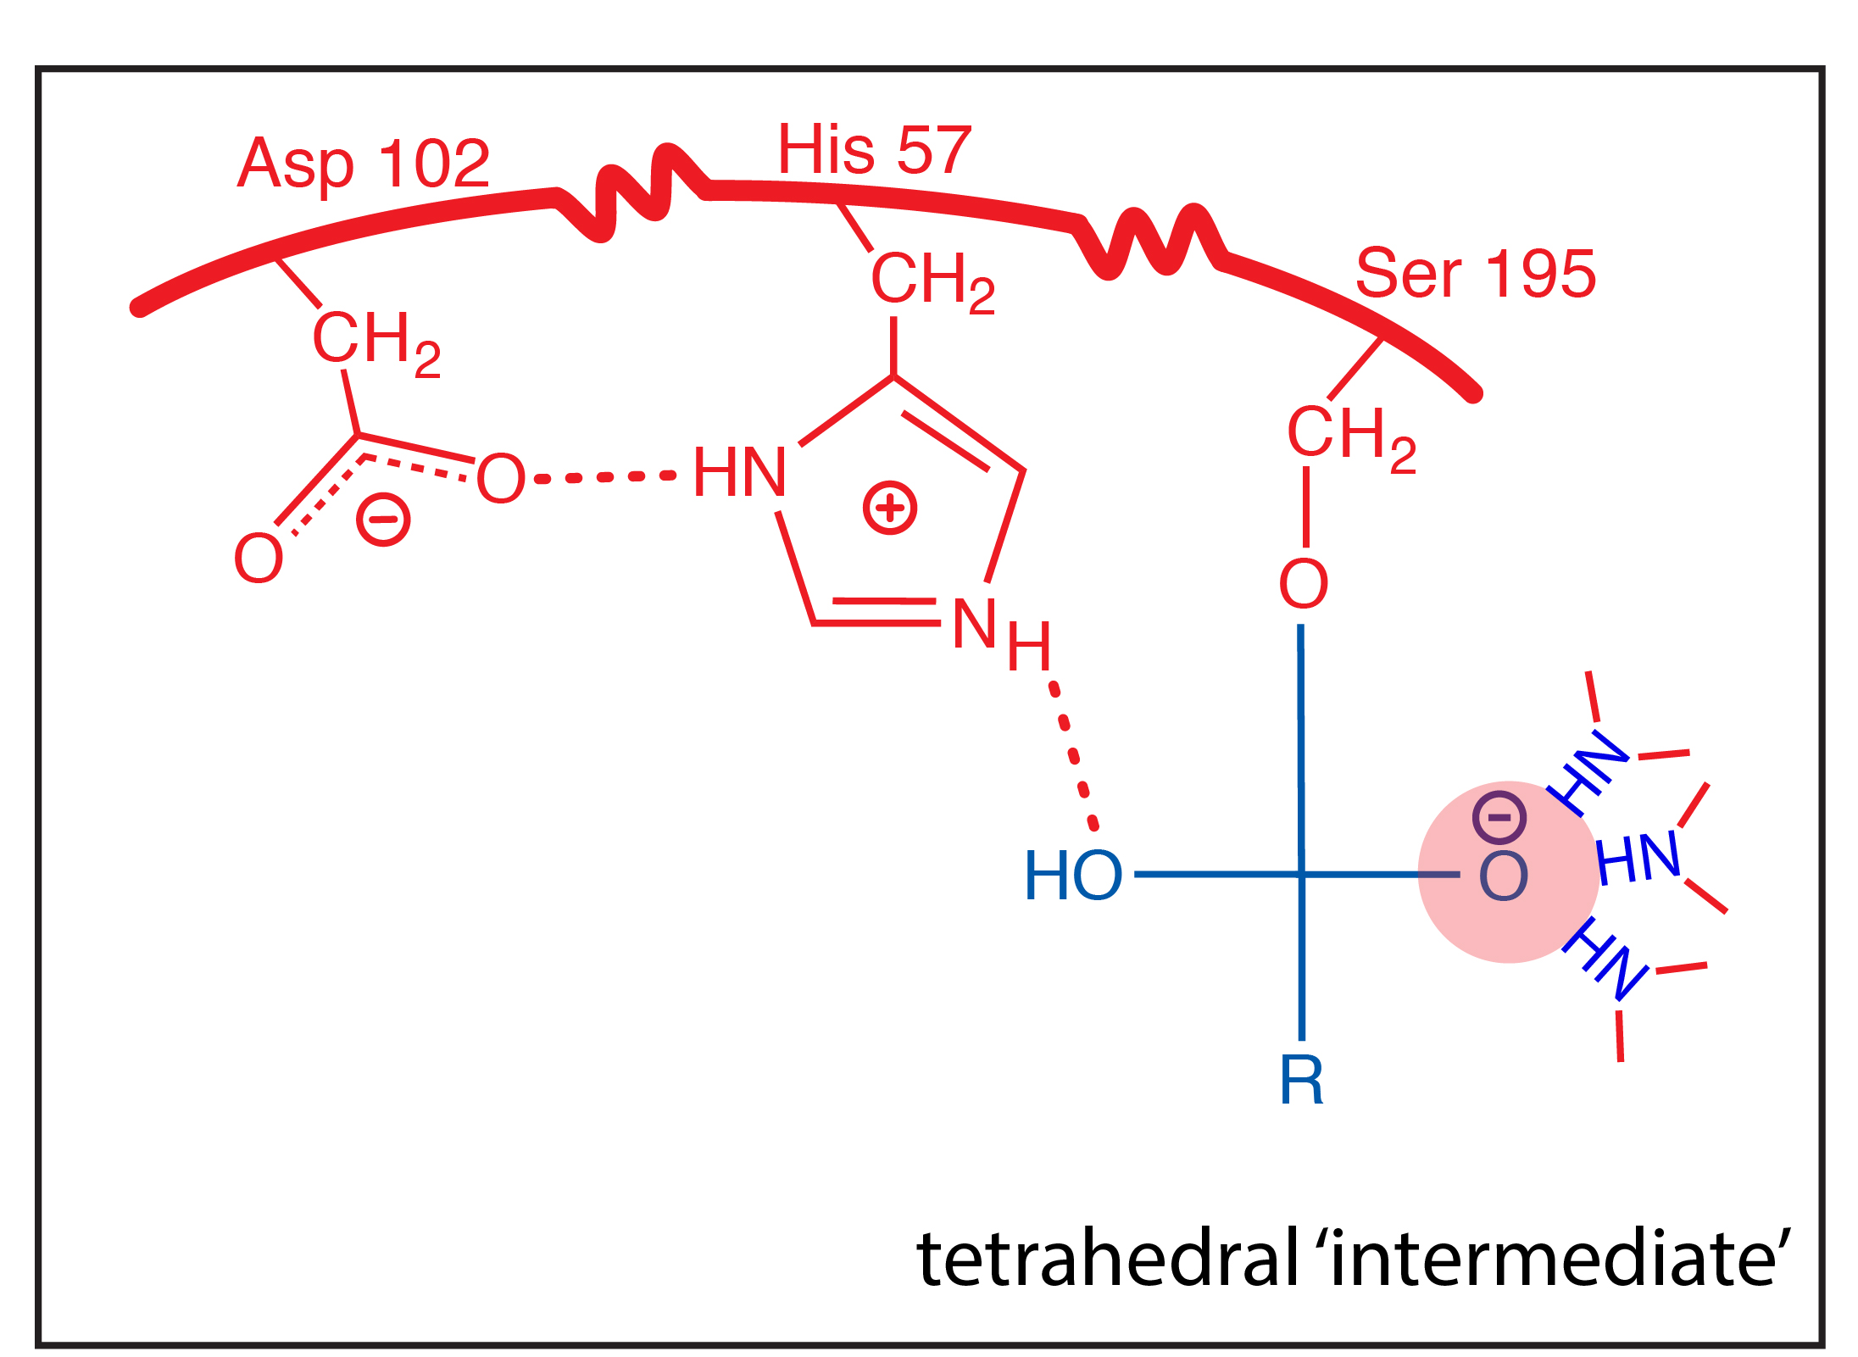

Slide 16
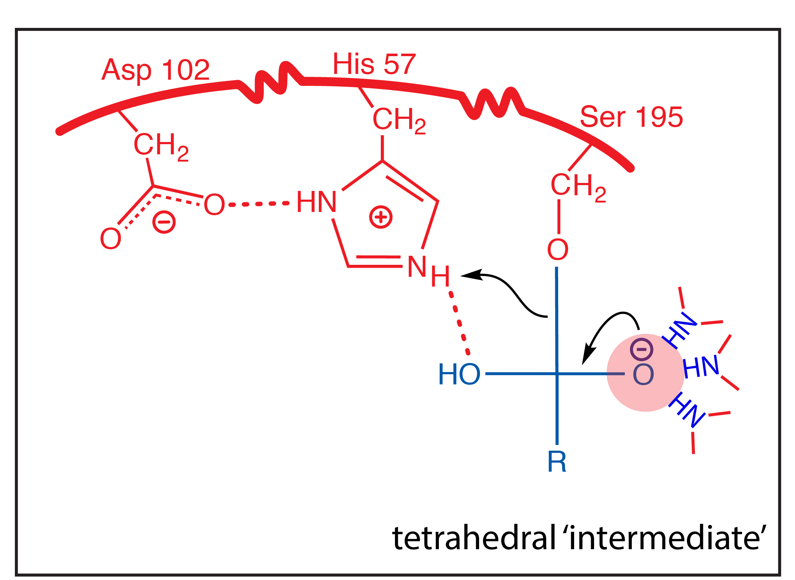

Slide 17
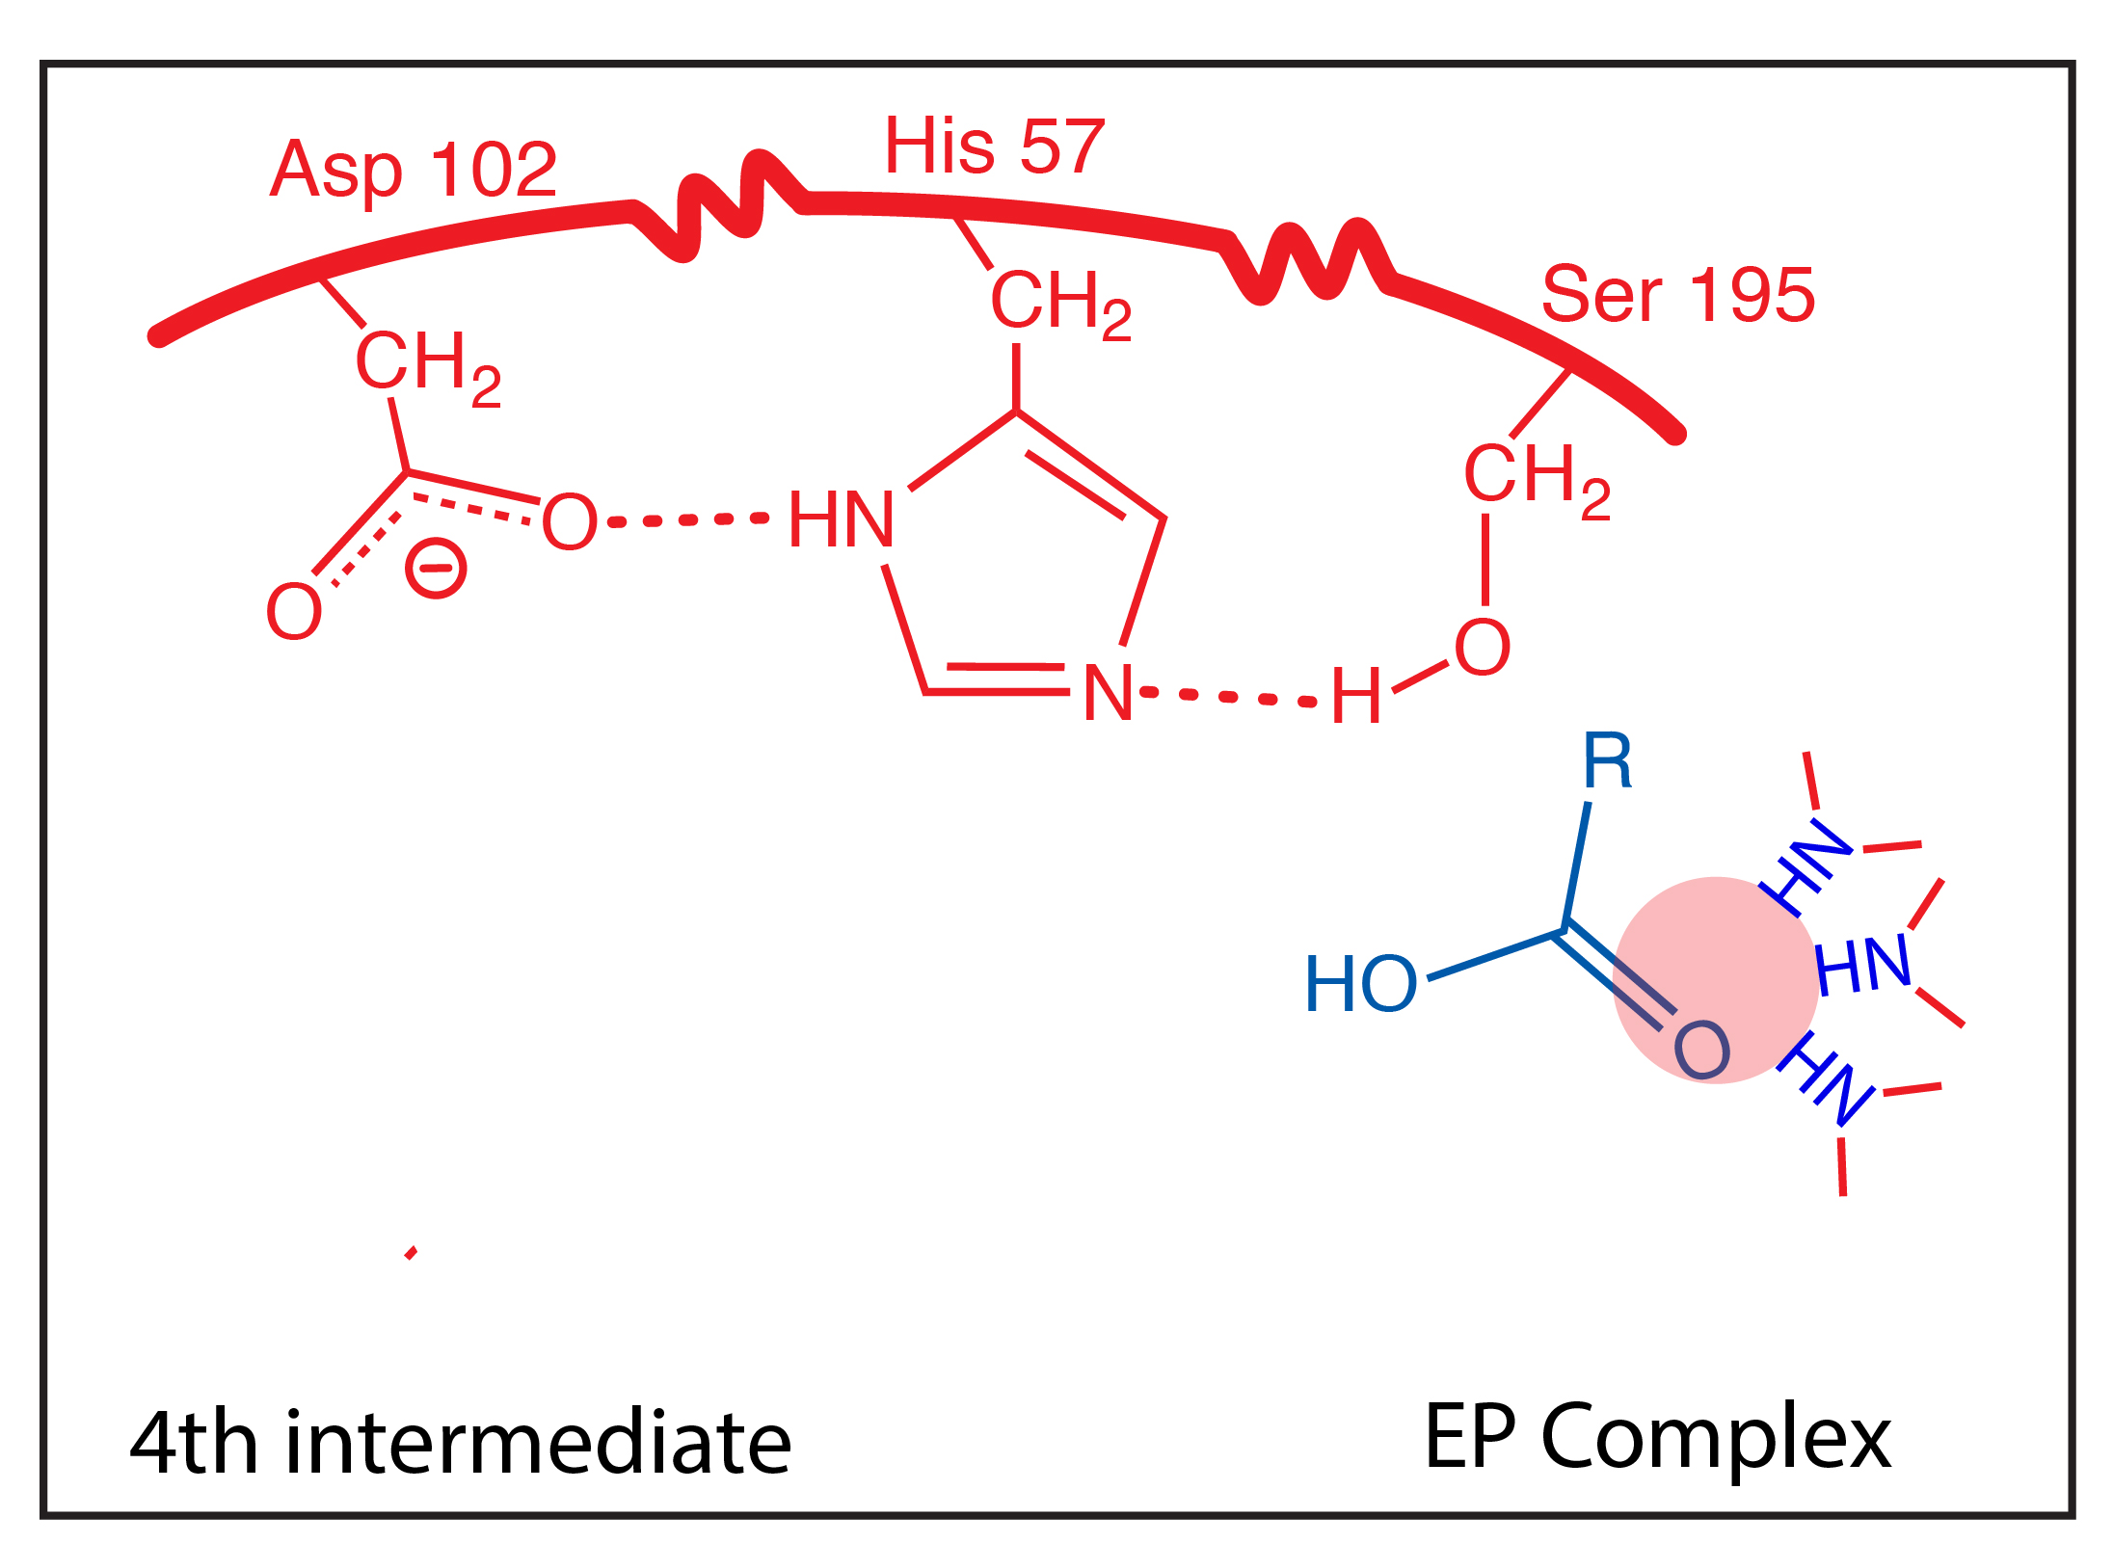

Slide 18
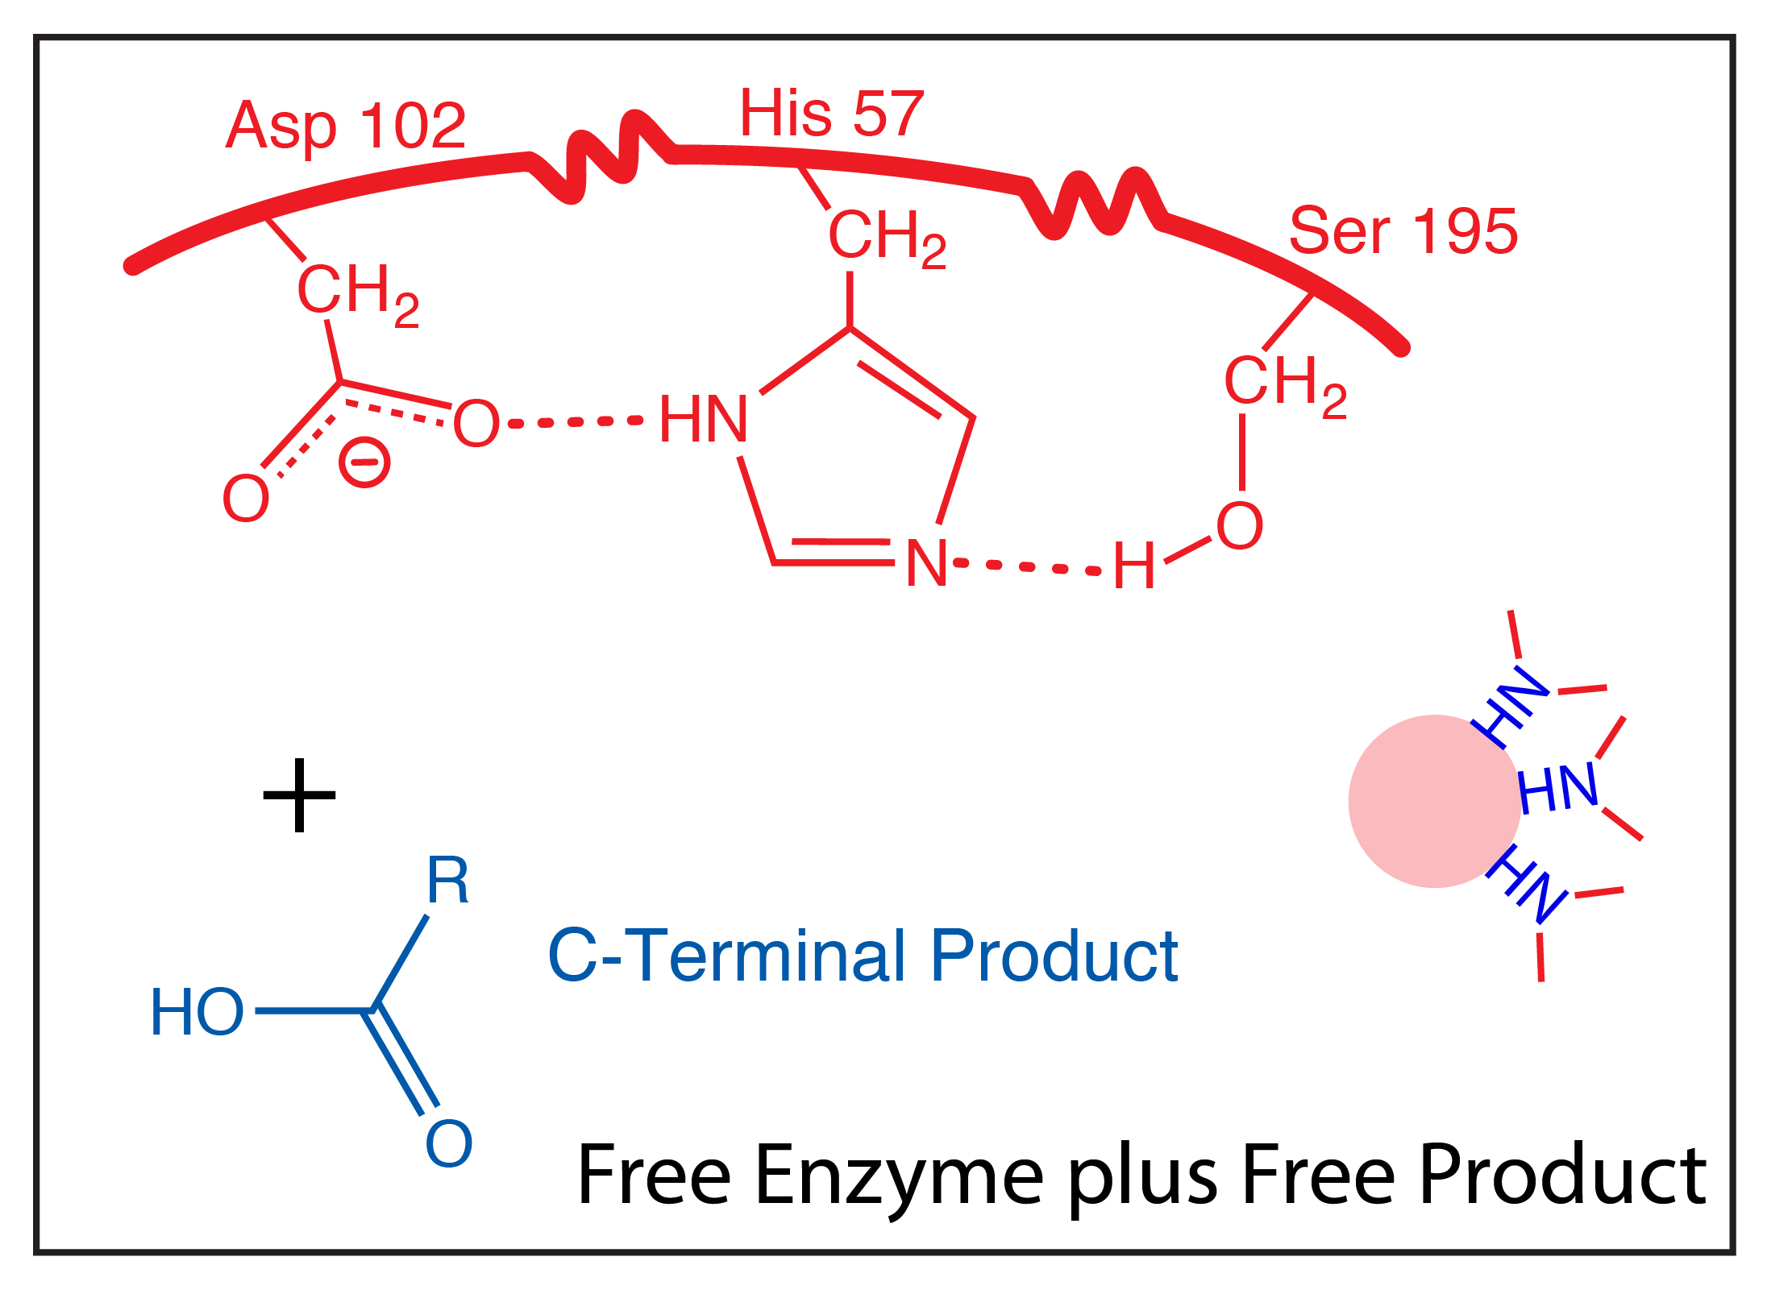

Slide 20
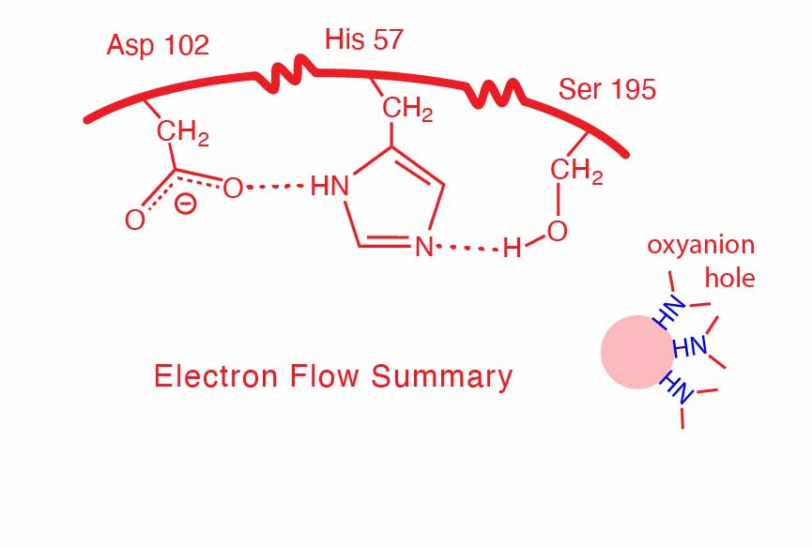

Slide 21
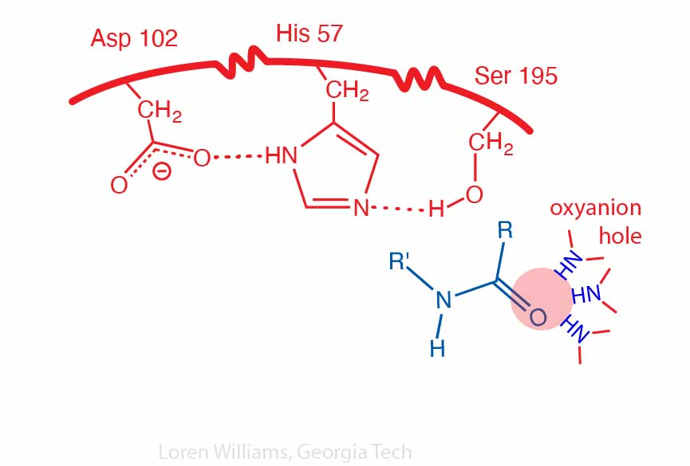

Slide 22
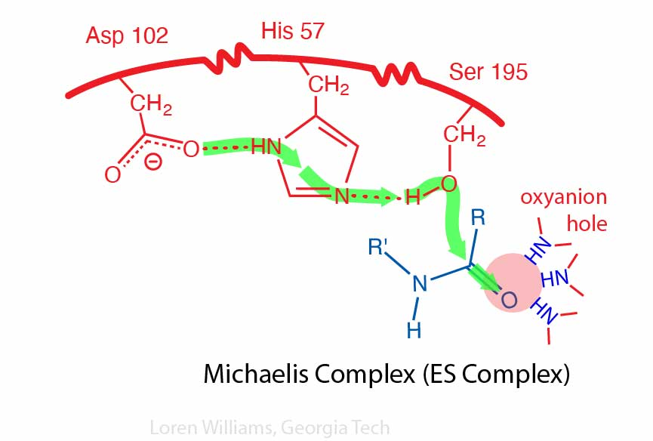

Slide 23
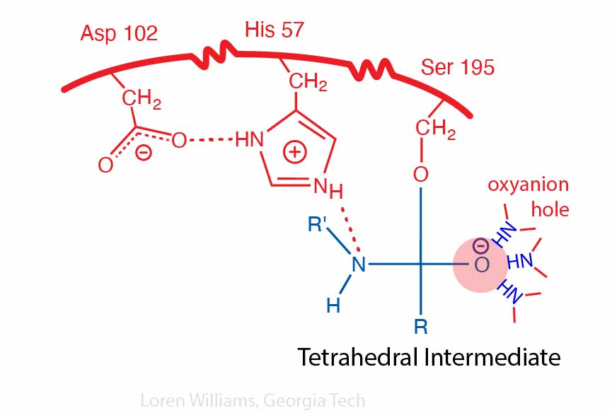

Slide 24
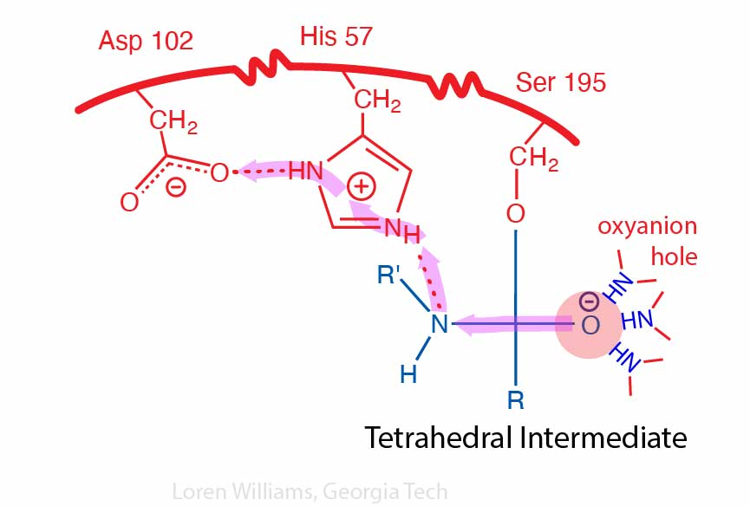

Slide 25
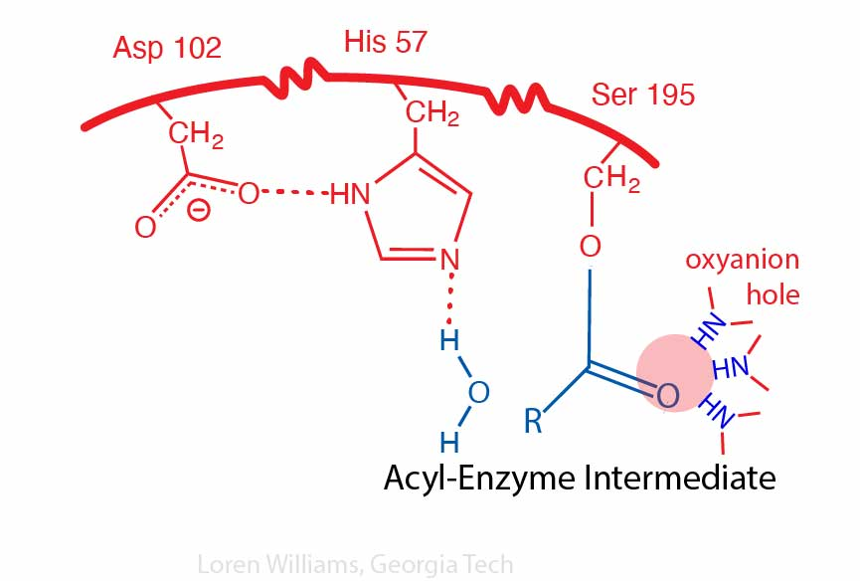

Slide 26
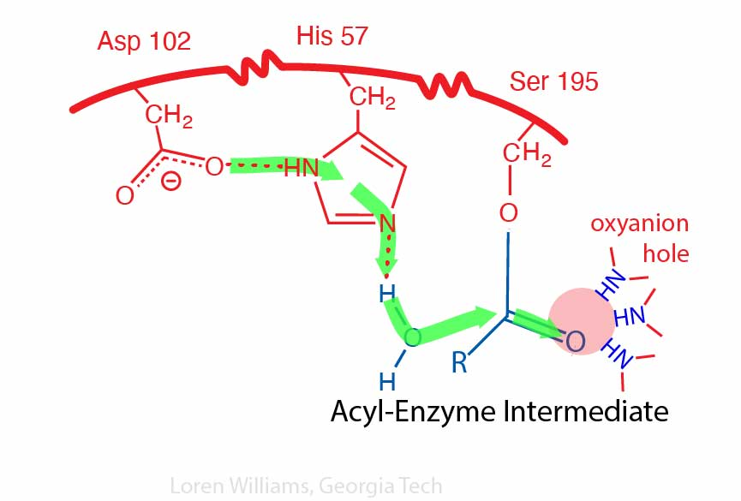

Slide 27
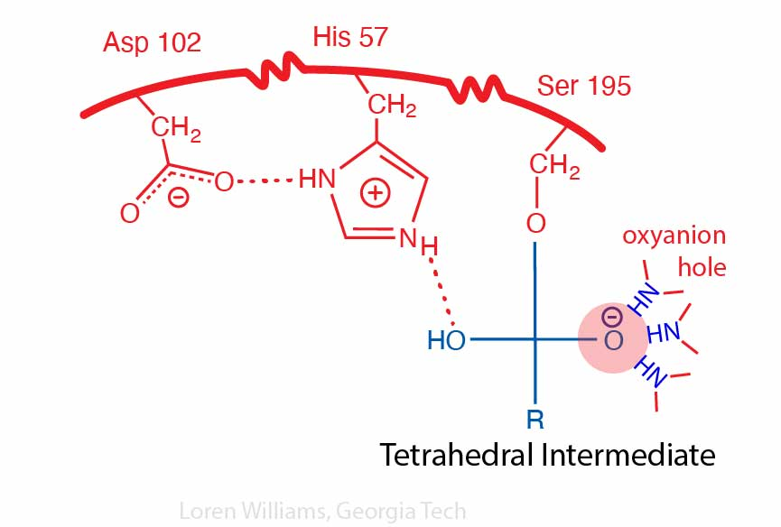

Slide 28
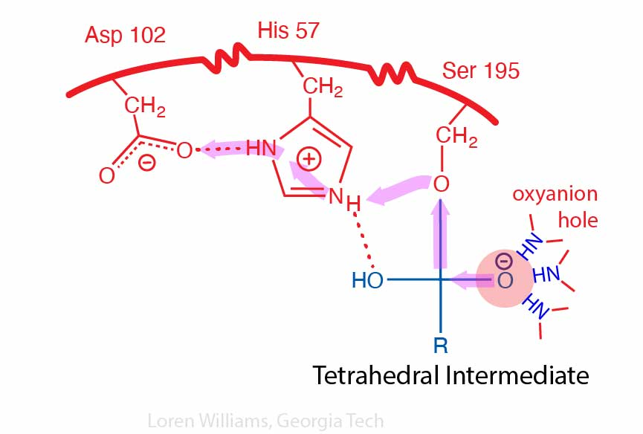

Slide 29
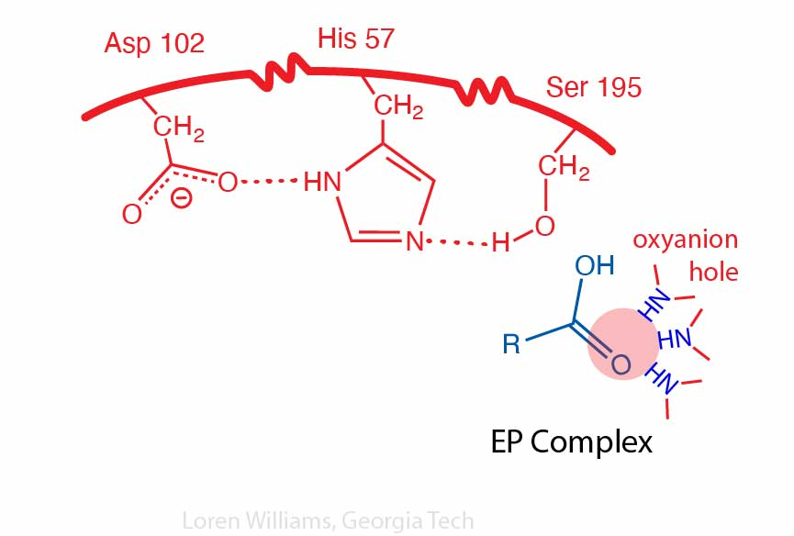

Slide 32
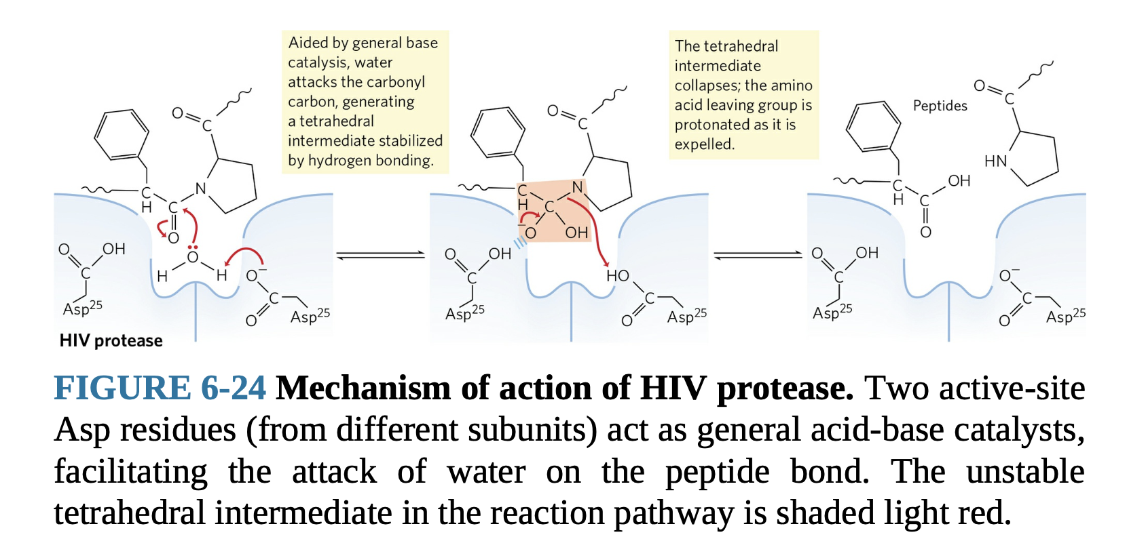
For comparison:
A protease with a different mechanism

Slide 33
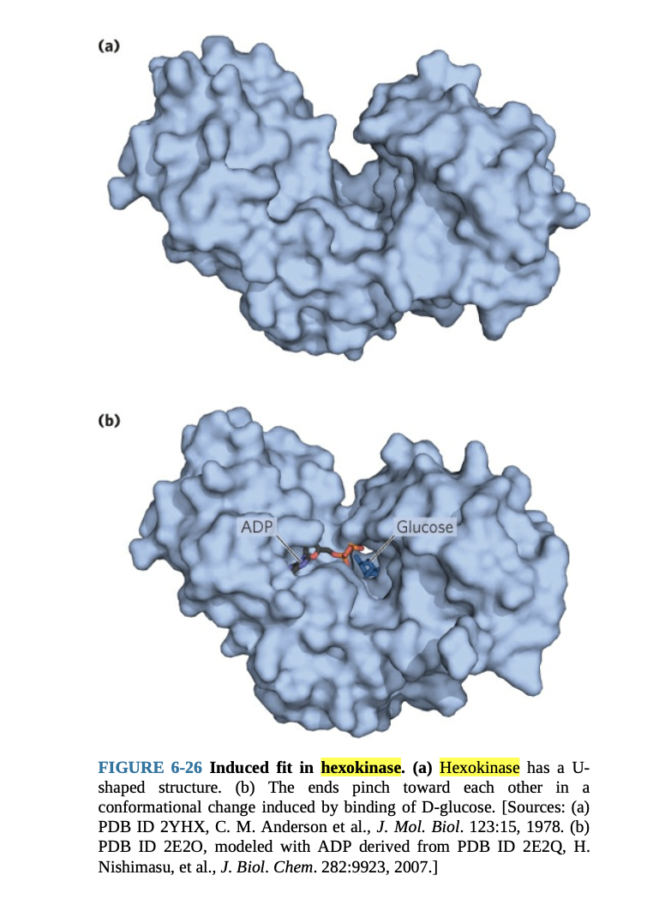
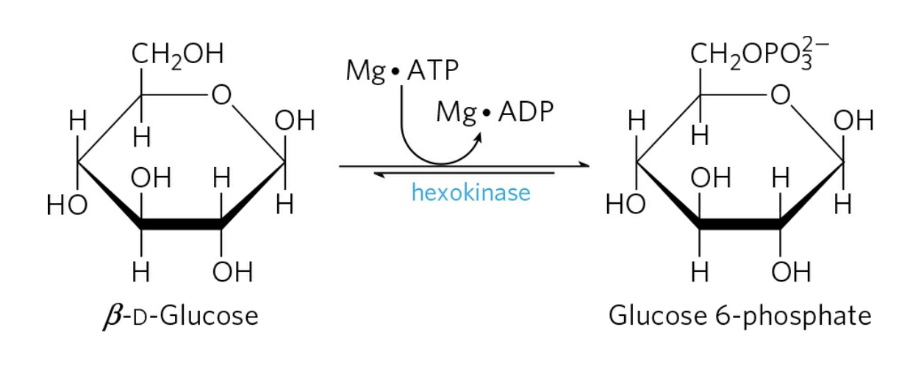
For comparison:
An enzyme that uses induced fit

